Slide 1
Statistics of Grain Size Distributions
Sean Donegan
27-750 Texture, Microstructure, and Anisotropy
Monday, April 28, 2014

Slide 2
Outline
Why grain size distributions?
Statistical considerations of distributions
  The log-normal distribution
  PDFs and CDFs
Theoretical approaches to grain size distributions
  Hillert distribution
  Mullins distribution
Analysis of real microstructures
  Visualizations
    Histograms
    eCDFs
    Probability plots
  Sampling
  Extreme value theory

Slide 3
Why grain size distributions?
Grain size has a measurable effect on material properties
σ_{y} = yield stress
C = constant
D = ‘grain size’
Hall-Petch:
.
ε = strain rate
n = creep exponent
D = ‘grain size’
Creep:
Real grain sizes exhibit dispersion, which leads to a grain size distribution
So why only one ‘grain size’ in the phenomenological relationships?

Slide 4
Why grain size distributions?
Answer: no one likes to deal with statistics
Another answer: it’s hard
Kurzydlowski attempted to incorporate grain dispersion into Hall-Petch by defining a constant size of grains (CSG) polycrystal
Berbenni extended Kurzydlowski by defining a size-dependant constitutive equation for elasto-viscoplastic behavior
Both these approaches assume log-normal distributions of grains; but are grain size distributions really log-normal?

Slide 5
Log-normal distribution
The log-normal distribution describes a random variable whose natural logarithm follows the normal distribution. The cumulative distribution function (CDF) of a log-normal distribution is:
The probability density function (PDF) of a log-normal distribution is:

Slide 6
PDFs and CDFs
The PDF of a random variable defines the probability of that variable taking a particular value (think ‘bell curve’ e.g. normal distribution)
The integral of a PDF along its domain must equal 1 (i.e., if discrete, all probabilities sum to 1)
The CDF of a random variable defines the probability that a value of the variable will be found <= x (think ‘s-curve’)
The CDF can be defined as the integral of the PDF up to x

Slide 7
Theoretical approaches: Hillert
Hillert derived a limiting grain size distribution based on a presumed growth equation
Assume grain boundary velocity is proportional to the local curvature:
V = velocity
M = mobility
P = pressure
σ = grain boundary energy
ρ = radii of curvature

Slide 8
Theoretical approaches: Hillert
The rate of change should be equivalent to the integral of the velocity around the grain boundary surface
This allows us to rewrite the velocity as a rate of change for the grain size:
R = circle/sphere equivalent radius
R_{cr} = critical radius

Slide 9
Theoretical approaches: Hillert
By the n-6 rule, the rate of change for grain size in 2D becomes:
n = number of sides
But where does n-6 come from? Originally derived by von Neumann for soap froths, extended by Mullins

Slide 10
n-6 rule
Consider a plane curve r(θ,t)
red = r(θ,t)
blue = polar vector
green = (directed) tangent
k = Mσ

Slide 11
n-6 rule
Consider a network of r_{N}(θ,t) curves where all vertices terminate at angles of 2π/3; number the sides and vertices of a given curve in the following manner:

Slide 12
Theoretical approaches: Hillert
Now determine the average number of sides:

Slide 13
Theoretical approaches: Hillert
Finally, after some calculus, arrive at the growth equation:
u = R/R_{cr}
γ = 2αMσ(dt/dR_{cr}²)
τ = lnR_{cr}²
M Hillert, Acta Metall., vol. 13 pp. 227-238 (1965)

Slide 14
Theoretical approaches: Hillert
The goal is now to arrive at a PDF for the limiting grain size distribution. After some (more) calculus:
Is it a PDF?
YES!
M Hillert, Acta Metall., vol. 13 pp. 227-238 (1965)

Slide 15
Theoretical approaches: Mullins
Mullins derived a more general form for the limiting grain size distribution that can extend up to ∞ (as opposed to just 2)
The distribution requires a function of the number of sides of a grain (s(x)) and a function G(x) that is conceptually describes whether grains of a particular size will grow or shrink:
x = R/<R>
d = dimensionality
P = PDF
NB: the integration need not be taken to ∞!
W.W. Mullins, Acta Mater., vol. 46 pp. 6219-6226 (1998)

Slide 16
Theoretical approaches: Mullins
Inverting G(x) yields an expression for the PDF:
Not all G(x) necessarily yield a true PDF!
If s(x) is defined (in 2D) as a linear function of the number of sides, then Mullins is degenerate to Hillert!
There is no (closed-form) analytical solution in 3D since we lack a well-defined n-6 rule in higher dimensions
W.W. Mullins, Acta Mater., vol. 46 pp. 6219-6226 (1998)

Slide 17
Are they log-normal?
Answer: not really… (they fail the standard tests)
They are not really close to real grain size distributions (or simulations) either!
So where do we go from here?

Slide 18
Visualizing grain size
Histograms provide a way to visualize the PDF
A histogram discretizes the data by separating it into bins (x axis). The y axis is then the total number of data points that fall in each bin

Slide 19
Visualizing grain size
Empirical CDFs (eCDF) provide a way to visualize the CDF
The eCDF is a step function that jumps by 1/x for each of the x data points
red = actual data
blue = sampled from ideal normal

Slide 20
Visualizing grain size
Probability plots compare empirical data to a theoretical distribution
Probability plots may have different types of axes (quantiles or probabilities)
The shape of the curve on a probability plot determines the shape of the underlying distribution

Slide 21
Sampling
Actual problem: how does one sample data points from a given PDF?
One answer: inverse transform sampling
Inverse transform sampling requires knowing the quantile function, which is the inverse of the CDF:
Unfortunately, not all CDFs can be expressed in terms of elementary functions, and thus cannot be inverted (not even the normal distribution); this is the case for the general Mullins, but not for the Hillert

Slide 22
Numerical CDFs

Slide 23
Numerical CDFs

Slide 24
Numerical CDFs
Construct a numerical CDF by computing the cumulative sum of the areas:
A grain size can now be sampled by finding a random (real) number, Q, on the interval [0,1], and comparing it to the set P:

Slide 25
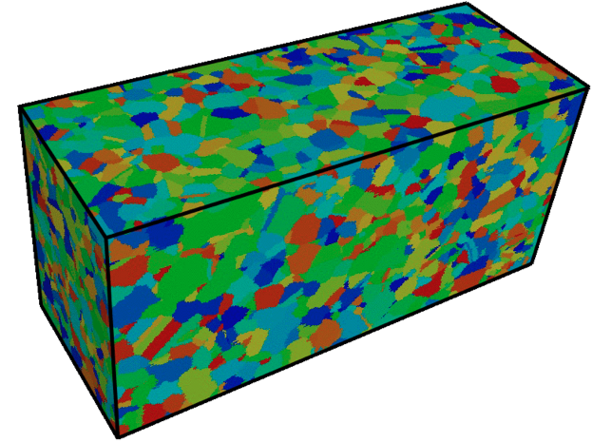
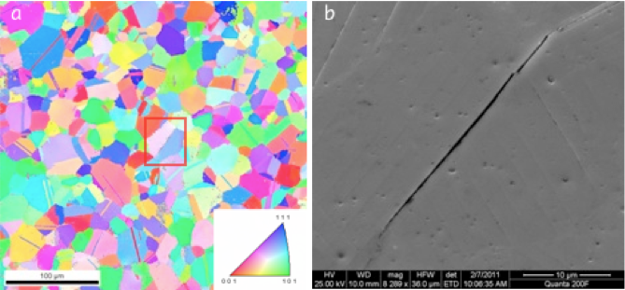
Extreme value theory
In some material systems, large grains (“as-large-as”, or ALA) play an important role in failure, since they often serve as the nucleation site for fatigue cracks

Slide 26
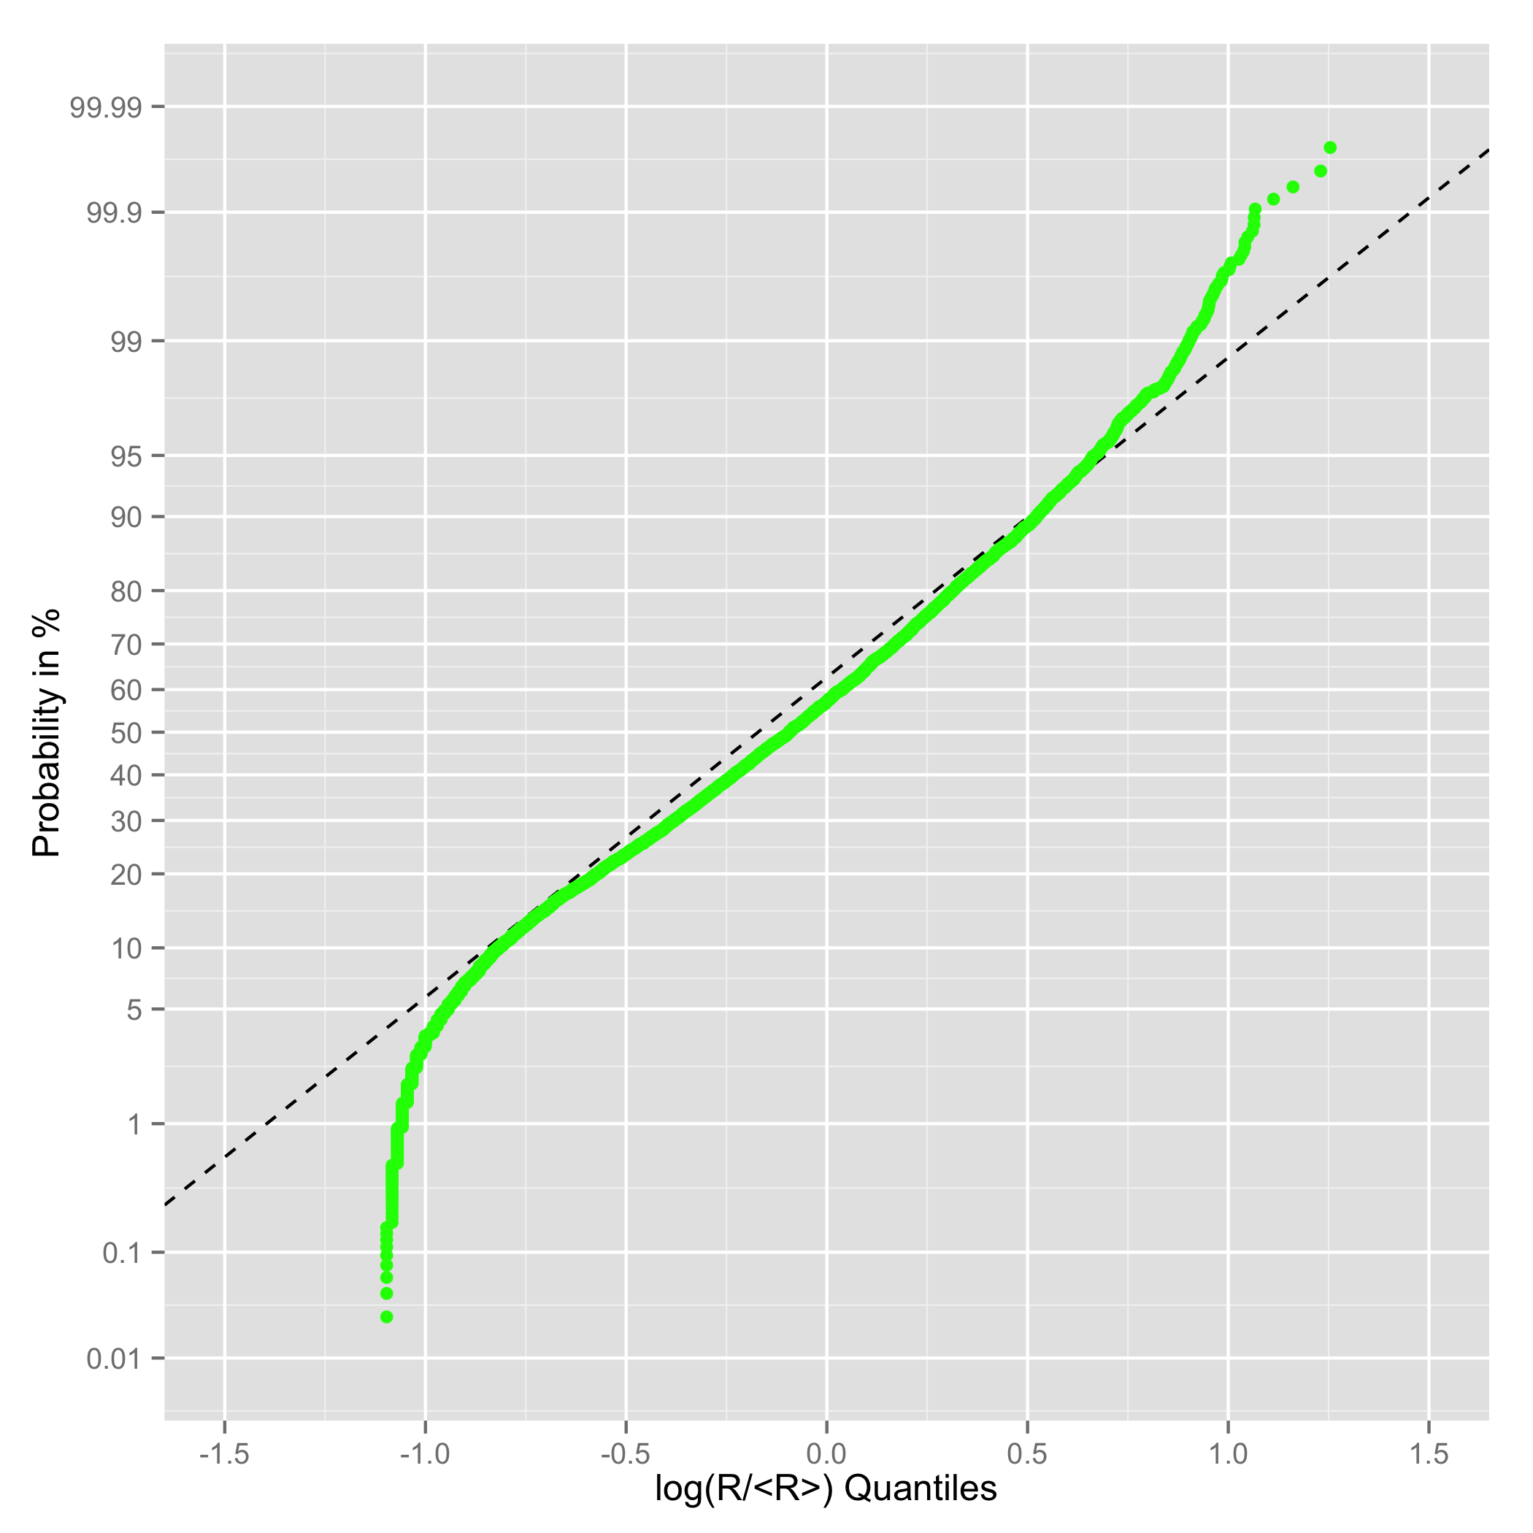
Extreme value theory
IN100

Slide 27
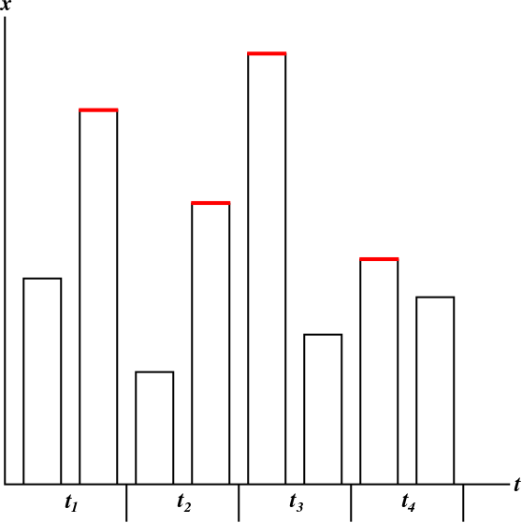
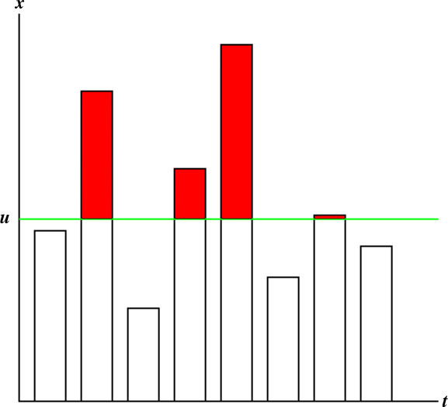
Extreme value theory
Fisher-Tippett-Gnedenko Theorem: The maximum of a random variable converges in distribution to either the Gumbel, Fréchet, or Weibull distribution.
Pickands-Balkema-de Haan Theorem: For some unknown distribution of a random variable, the distribution of values beyond some threshold, u, converges in distribution to the generalized Pareto distribution (GPD).

Slide 28
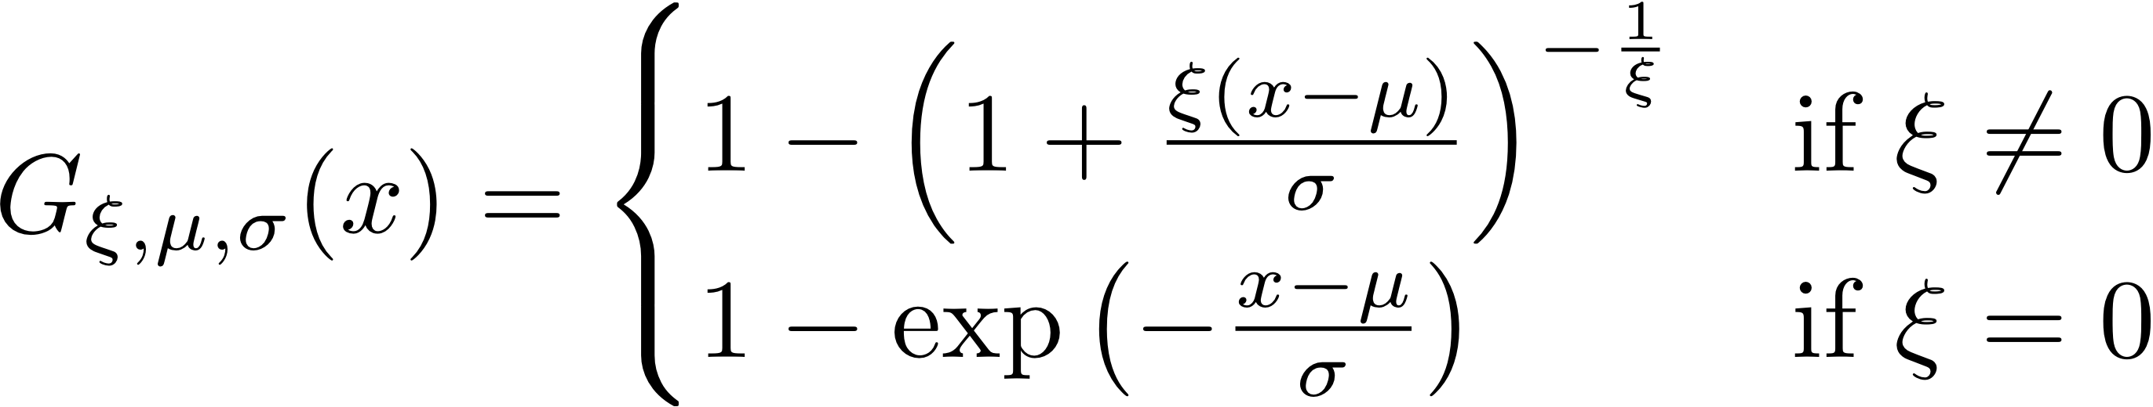
Extreme value theory
density
ξ = shape parameter
σ = scale parameter
μ = location parameter
ξ+
x

Slide 29
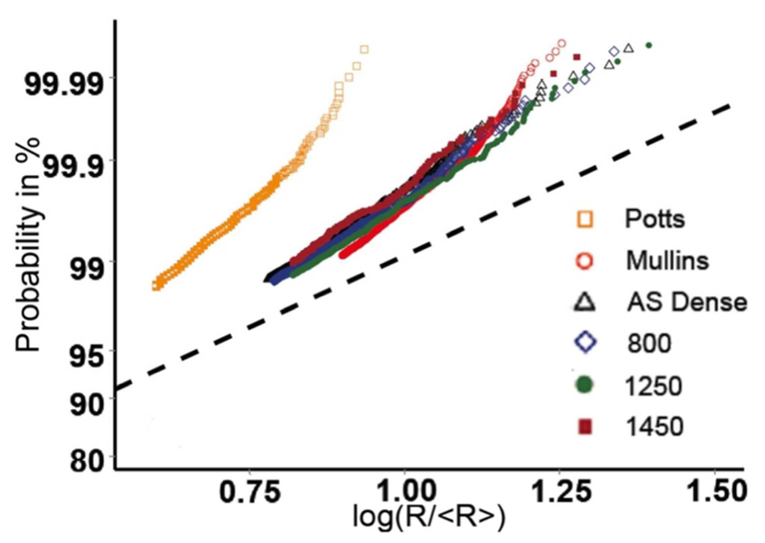
Extreme value theory
The tails of different grain size distributions can be quantitatively compared (given suitable normalization)

Slide 30
Extreme value theory
The shapes of the upper tails of grain size distributions appears correlated to grain growth kinetics: upper tails become longer (more akin to log-normal) as the microstructure stagnates
Analytical approaches to plane curve evolution indicate that the limiting (self-similar) size distribution is uniquely determined by the initial tail distribution
“Analytical approaches” means application of mean curvature flow to a collection of disjoint plane curves

