Slide 1


X-ray Texture Measurement
Pole Figures
High Energy Diffraction Microscopy
27-731 (normally, 27-750)
Texture, Microstructure & Anisotropy
A.D. Rollett
Last revised: 20th Jan. ‘20

Slide 2
Objectives
Definition and explanation of the pole figure.
Provide information on how to measure x-ray pole figures.
Explain the stereographic and equal area projections.
Explain the defocussing correction.
Explain how pole figures of single orientations relate to stereographic projections.
Explain how to compute a pole figure based on the orientation matrix.
Spherical angle grid, area element and normalization of pole figure data.
Define and explain the inverse pole figure.
Computation of an inverse pole figure
Description of High Energy Diffraction Microscopy: near-field and far-field variants.

Slide 3
In Class Questions: 1
How is an x-ray pole figure measured?
Why does it not provide complete orientation information for a polycrystalline sample?
How can one construct a pole figure for a single orientation?
Why does a pole figure for a single orientation provide the complete orientation (by contrast to the single crystal case)?
Why does an experimental pole figure not correspond to a theoretical one at the edges?

Slide 4
In Class Questions: 2
How does the stereographic projection work?
How does the equal area projection work?
Given an orientation (e.g. the orientation matrix), how do you calculate the positions of the poles in a pole figure?
How do you compute an inverse pole figure?
How does one normalize the data for a pole figure to obtain “multiples of a random density (MRD)”?

Slide 5
Pole Figure: Definition
A pole figure (in the context of texture) is a map of a selected set of crystal plane normals plotted with respect to the sample frame. Think of the rows (not columns) in the orientation matrix, which define the coordinates of each crystal axis with respect to the sample frame.
This definition refers to plane normals because of the standard use of x-ray diffraction to measure pole figures; crystal directions can equally well be treated.
Since each plane normal is plotted by itself, there is no information in the resulting plot about directions lying in that plane. Therefore pole figures represent a projection of the texture information.
Each chosen crystal direction is generally specified as a low-index plane normal, e.g. {100}, {110}, {001}.
Crystal symmetry is generally assumed to apply such that all equivalent plane normals sharing the same Miller indices are shown. For cubic materials, obviously, plane normals and directions are coincident but this is not the case for lower symmetry Bravais lattices.
Since unit vectors representing directions with respect to a common origin live on a sphere, it is natural to transform the coordinates to spherical angles such as azimuth (longitude) and declination (co-latitude). This makes it more clear that, for each crystallite, its 3-parameter orientation (e.g. Euler angles) is reduced (projected) to only two (2) parameters.
Only the upper hemisphere is plotted, by convention. The resulting diagram is often called a stereogram, although this implies something about the choice of projection (see later slides).
If only a few distinct orientations are displayed, multiple poles can be plotted on the same diagram as a discrete pole figure.
When many crystallites are included in the dataset, which have variable orientation, it is impracticable to have more than one pole. Also it is necessary to bin the data and convert points to densities. For display purposes, contour plots are the easiest way to understand the result.

Slide 6
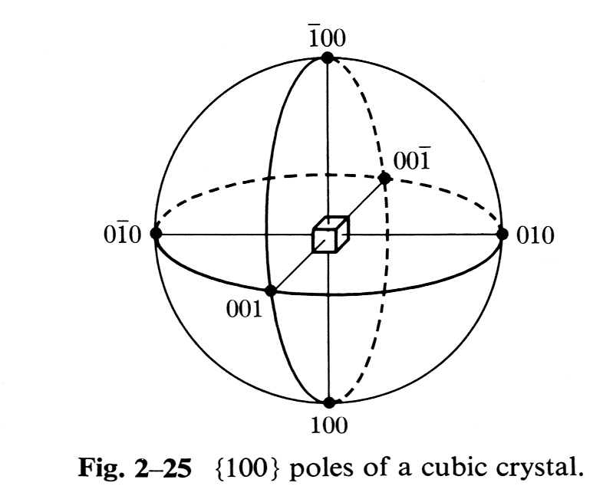
Crystal Directions on the Sphere
Uses the inclination of the normal to the crystallographic plane: the points are the intersection of each crystal direction with a (unit radius) sphere.
This is an orthographic projection to illustrate the physical directions, not a stereographic projection.

Slide 7
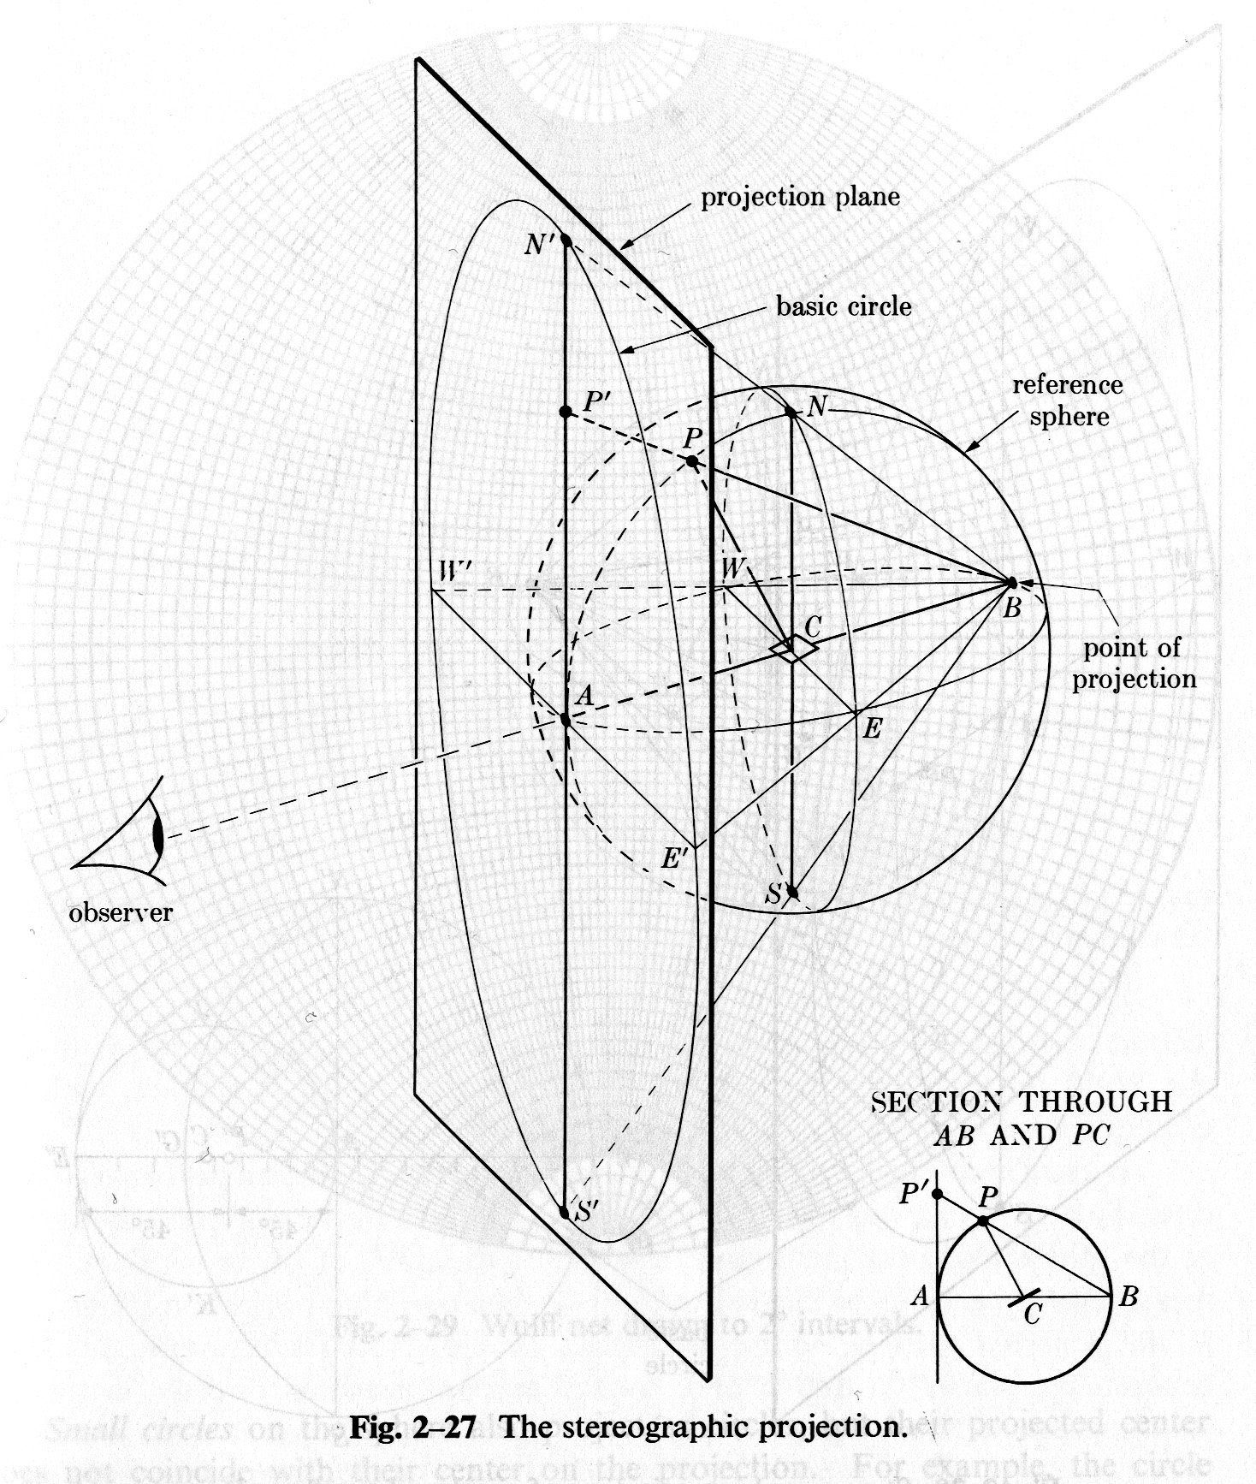
Projection from Sphere to Plane
The measured pole figure exists on the surface of a (hemi-)sphere. To make figures for publication one must project the information onto a flat page. This is a traditional problem in cartography. We exploit just two of the many possible projection methods.
Projection of spherical information onto a flat surface
  Equal area projection, or,
  Schmid projection
  Equiangular projection, or,
  Wulff projection,
  more common in crystallography
[Cullity]

Slide 8
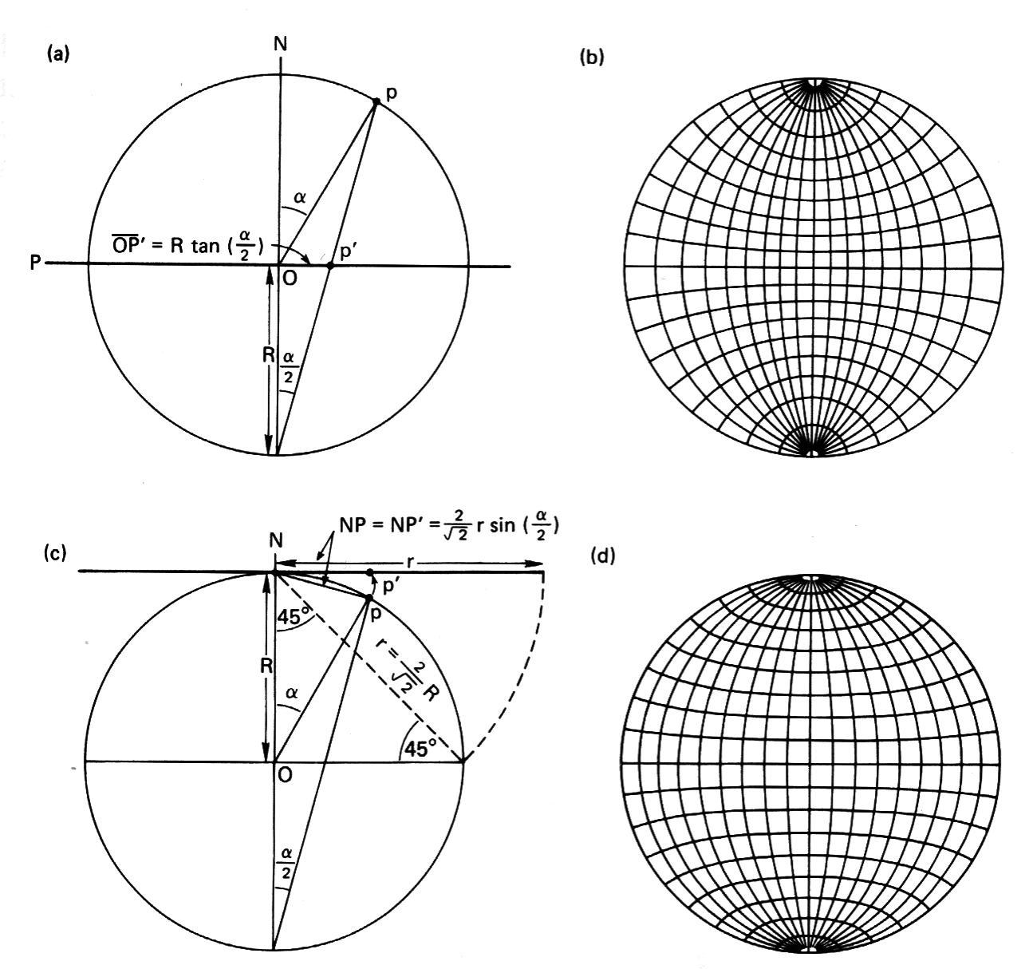
Stereographic vs. Equal Area Projection
Stereographic
Equal Area
* Many texts, e.g. Cullity, show the plane touching the sphere at N: this changes the magnification factor for the projection, but not its geometry.
[Kocks]

Slide 9
Stereographic Projections
Connect a line from the South pole to the point on the surface of the sphere. The intersection of the line with the equatorial plane defines the project point. The equatorial plane is the projection plane. The radius from the origin (center) of the sphere, r, where R is the radius of the sphere, and α is the angle from the North Pole vector to the point to be projected (co-latitude), is given by:
r = R tan(α/2)
Given spherical coordinates (α,ψ), where the longitude is ψ (as before), the Cartesian coordinates on the projection are therefore:
(x,y) = r(cosψ, sinψ) = R tan(α/2)(cosψ, sinψ)
To obtain the spherical angles from [uvw], we calculate the co-latitude and longitude angles as:
cosα = w
tanψ = v/u
!Careful: Use ATAN2(v,u), and remember the difference between atan2(x,y) in excel, and atan2(y,x) in fortran and c++!

Slide 10
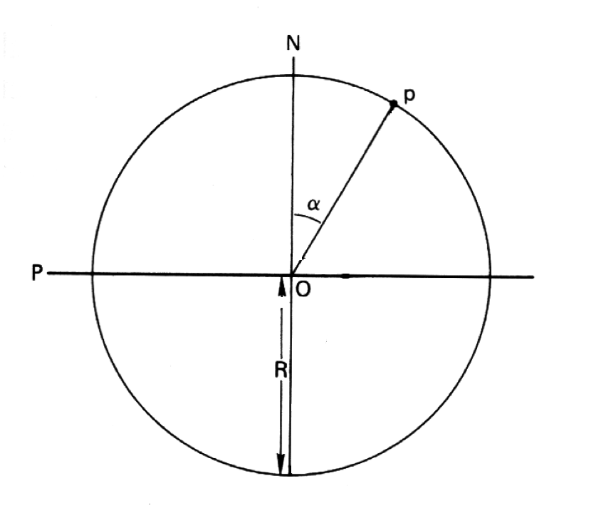
Stereographic Projection – Step 1
North pole
Point “p” to be projected, whose co-latitude = α
Equator
Vertical cross-section of sphere through a point to be projected onto equatorial plane
South pole

Slide 11
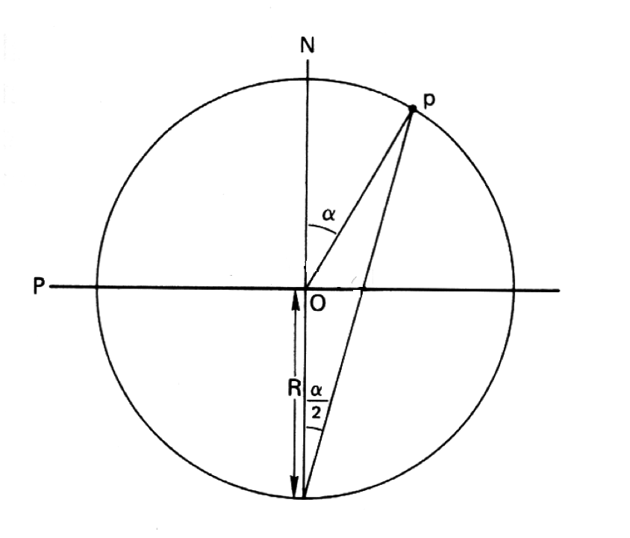
Stereographic Projection – Step 2
North pole
Point to be projected
Equator
Connect point “p” to the South Pole
South pole

Slide 12
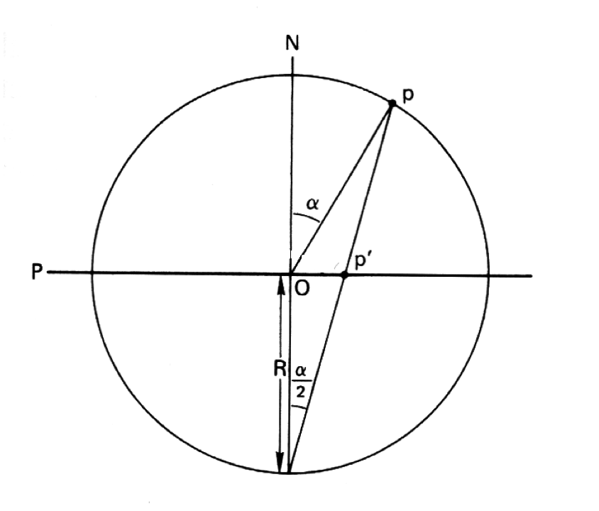
Stereographic Projection – Step 3
North pole
Point to be projected
Equator
Identify projected point p’ on the equatorial plane
South pole

Slide 13
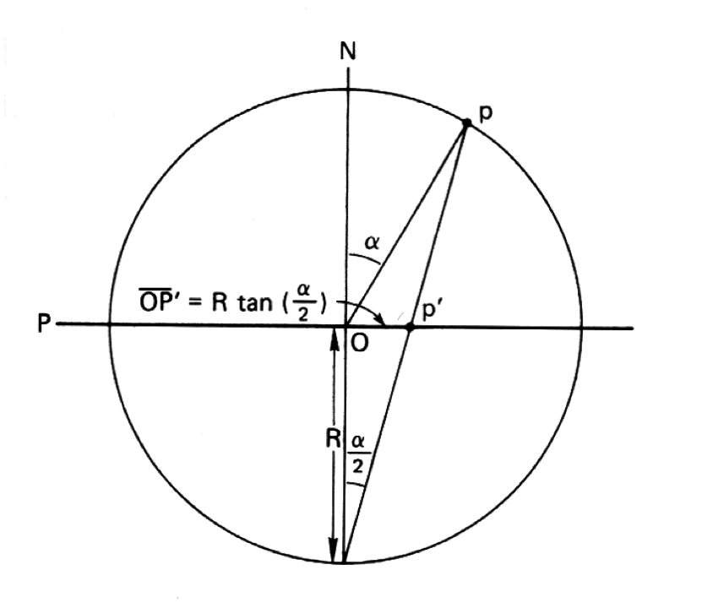
Stereographic Projection – Step 4
North pole
Point to be projected
Equator
Compute radius of projected point p’ on the equatorial plane
South pole

Slide 14
Stereographic Projection – Step 5
p’ = Rtan(α/2)[cos(φ),sin(φ)]
Longitude of the projected point = φ
p’
Radius = R tan(α/2)
φ
O

Slide 15
Texture Component → Pole Figure
To calculate where a texture component shows up in a pole figure, there are various operations that must be performed.
The key concept is that of thinking of the pole figure as a set of crystal plane normals (e.g. {100}, or {111}) in the reference configuration (“cube component”) and applying the orientation as a transformation to that pole (or set of poles) to find its position with respect to the sample frame.
Step 1: write the crystallographic pole (plane normal) of interest as a unit vector;
e.g. (111) = 1/√3(1,1,1) = h. In general, you will repeat this for all symmetrically equivalent poles (so for cubics, one would also calculate {-1,1,1}, {1,-1,1} etc.). In the future, we will use a set of symmetry operators to obtain all the symmetry related copies of a given pole.
Step 2: apply the inverse transformation (passive rotation), g⁻¹, to obtain the coordinates of the pole (Miller indices, normalized, crystal axes) in the pole figure (direction in sample axes):
h’ = g⁻¹h
(pre-multiply the vector by, e.g. the transpose of the orientation matrix, g, that represents the orientation; Rodrigues vectors or unit quaternions can also be used).
Step 3: convert the rotated pole into spherical angles (to help visualize the result, and to simplify Step 4) where Θ is the co-latitude and φ is the longitude:
Θ = cos⁻¹(h’_{z}), φ = tan⁻¹(h’_{y}/h’_{x}).
Remember - use ATAN2(h’_{y},h’_{x}) in your program or spreadsheet and be careful about the order of the arguments!
Step 4: project the pole onto a point, p, in the plane (stereographic or equal-area):
p_{x} = tan(Θ/2) cosφ; p_{y} = tan(Θ/2) sinφ. [corrected sine and cosine for p_{y} and p_{x} components 25 i 08]
The previous slide explains where this formula comes from.
Note: why do we use the inverse transformation (passive rotation)?! One way to understand this is to recall that the orientation is, by convention (in materials science), written as an axis transformation from sample axes to crystal axes. To construct a pole figure, we need to transform a known crystal direction (i.e. the plane normal) to the sample frame so that we know its coefficients in the latter system.

Slide 16
Texture Component → Pole Figure: pseudo code
Repeat these steps for each crystallographically equivalent pole, where the sphere (and projection circle) have unit radius -
Step 1: write the crystallographic pole (plane normal) of interest as a unit vector; e.g. h = 1/√3(1,1,1)
Step 2: transform pole to sample ref. frame:
h’ = g⁻¹h
Step 3: convert the transformed pole into spherical angles:
Θ = cos⁻¹(h’_{z}), φ = tan⁻¹(h’_{y}/h’_{x})
Step 4: stereographic projection of the pole onto a point:
p_{x} = tan(Θ/2) cosφ; p_{y} = tan(Θ/2) sinφ.

Slide 17
Matlab help
Matrix multiplication in Matlab can be accomplished several different ways.
For matrices of the same dimensions, one can simply use “*”, as in “A * B”, where A and B are, say, 3x3 matrices. There is a function mmult(A,B) that accomplishes the same multiplication.
To get the inverse of a transformation/rotation matrix, =A⁻¹ or (in Matlab) “A^-1”, one only needs the transpose. The transpose of a matrix can be written as “A’” where the apostrophe signifies transpose.
To left multiply a vector by a 3x3 matrix (matrix on the left, vector on the right) one needs a column vector. However, if one enters a vector as h=[1,1,1], for example, the result (“h”) is a row vector. The fix is to use the transpose of the vector, thus: “hnew = A * h’”.

Slide 18
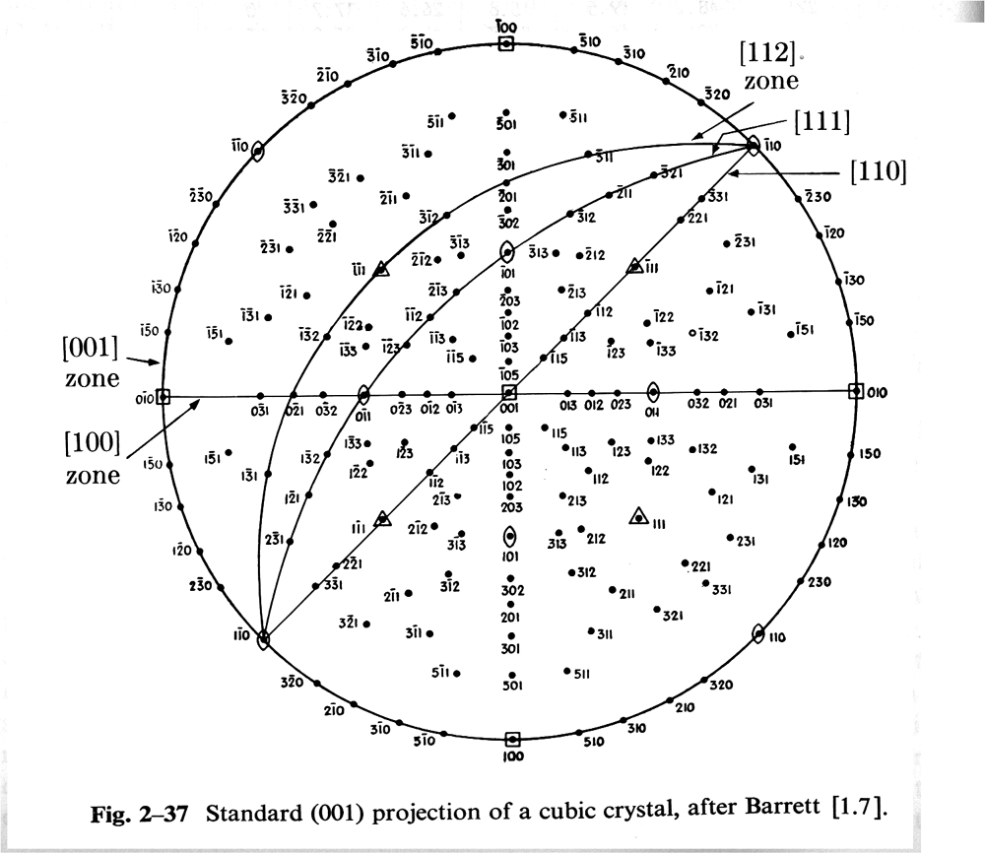
Standard (001) Projection

Slide 19
Equal Area Projection
Connect a line from the North Pole to the point to be projected. Rotate that line onto the plane tangent to the North Pole (which is the projection plane). The radius, r, of the projected point from the North Pole, where R is the radius of the sphere, and α is the angle from the North Pole vector (co-latitude) to the point to be projected, is given by:
r = 2R sin(α/2)
Given spherical coordinates (α,ψ), where the longitude is ψ (as before), the Cartesian coordinates on the projection are therefore:
(x,y) = r(cosψ, sinψ) = 2R sin(α/2)(cosψ, sinψ)
Concept Params. Euler Normalize Vol.Frac. Cartesian Polar Components

Slide 20
Standard Stereographic Projections
Pole figures are familiar diagrams. Standard Stereographic projections provide maps of low index directions and planes.
PFs of single crystals can be derived from SSTs by deleting all except one Miller index.
Construct {100}, {110} and {111} PFs for cube component.

Slide 21
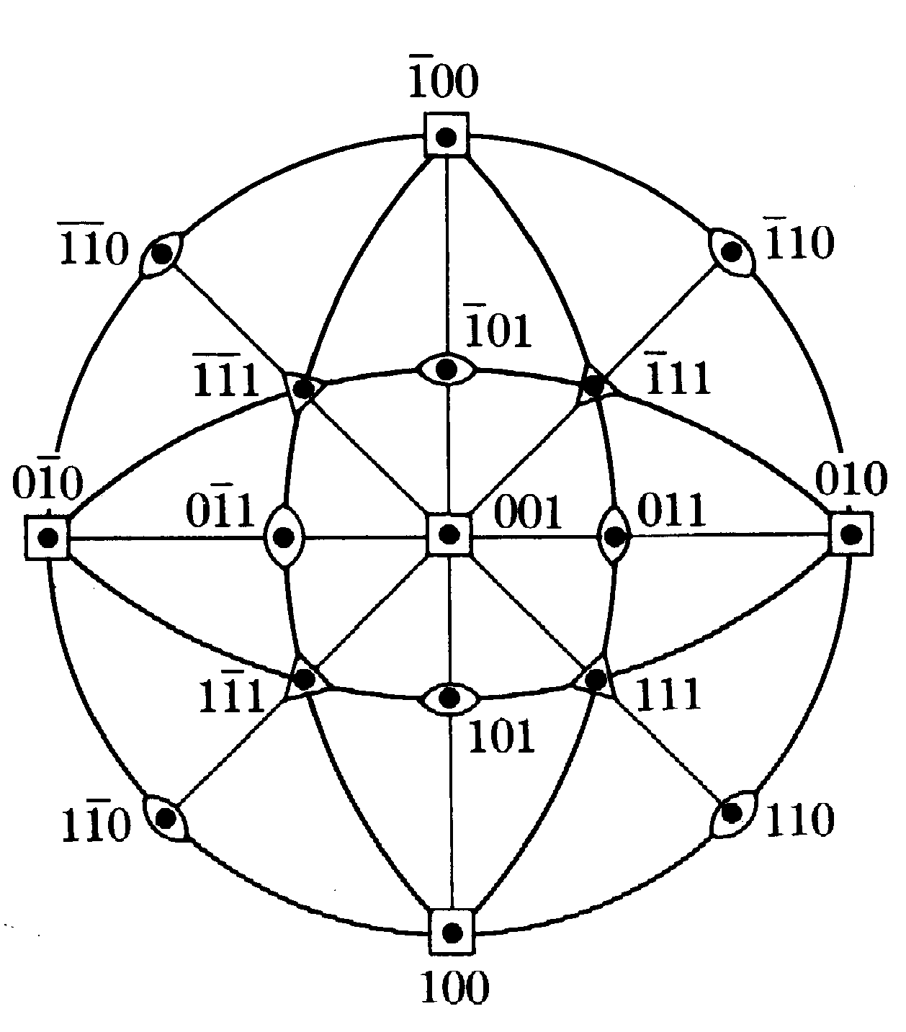
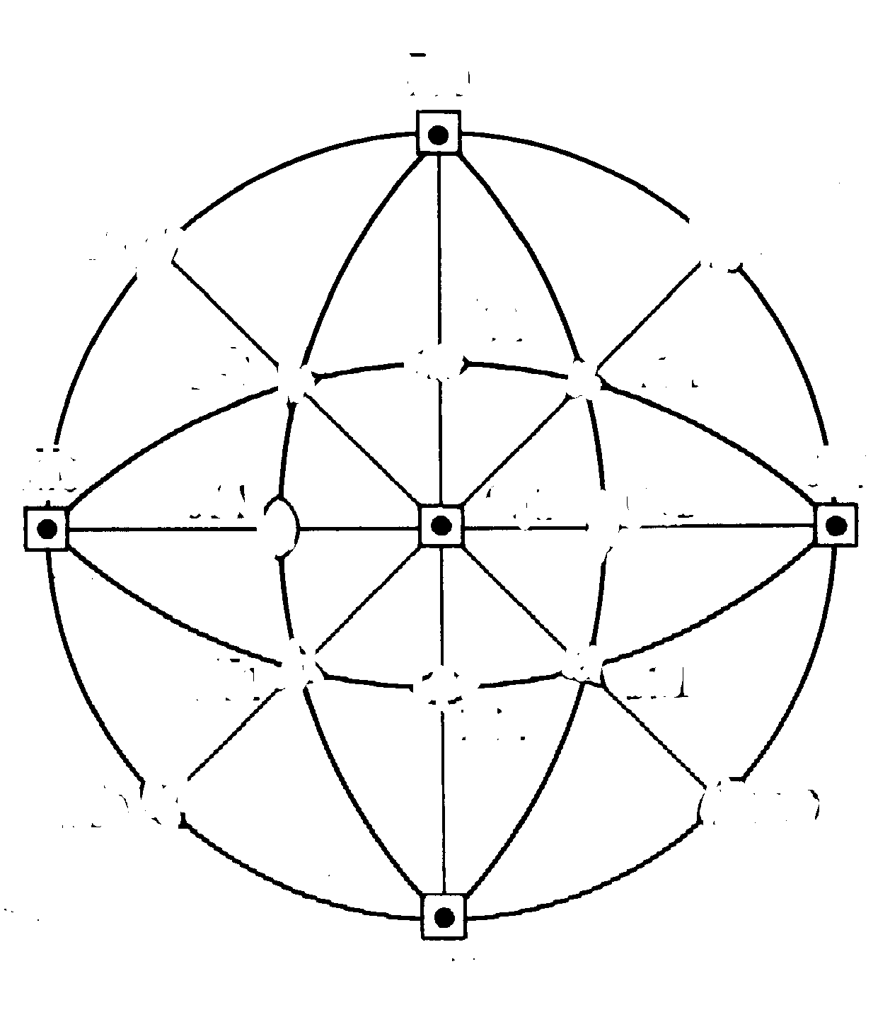
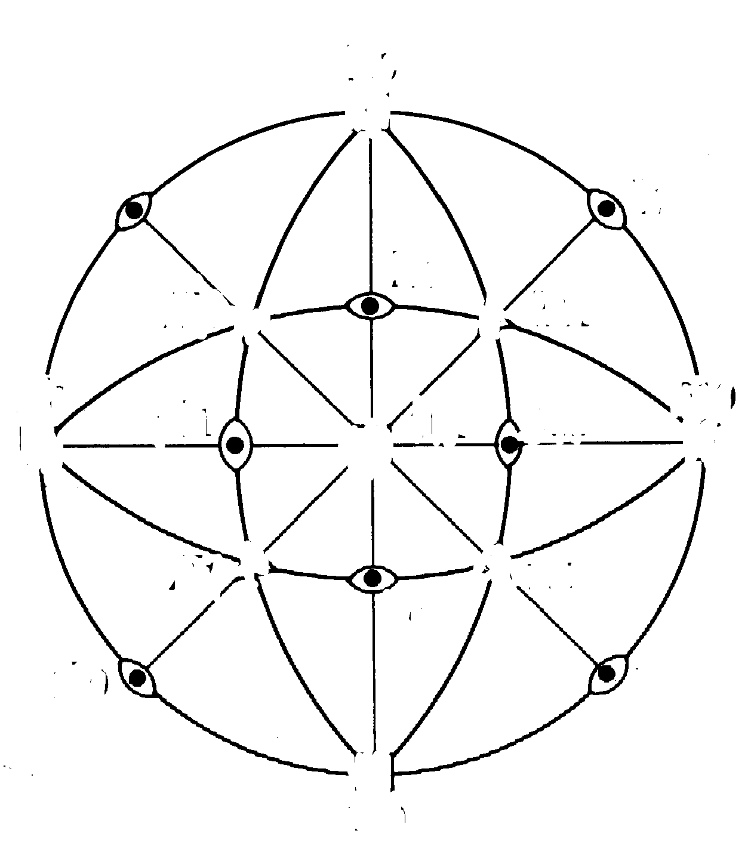
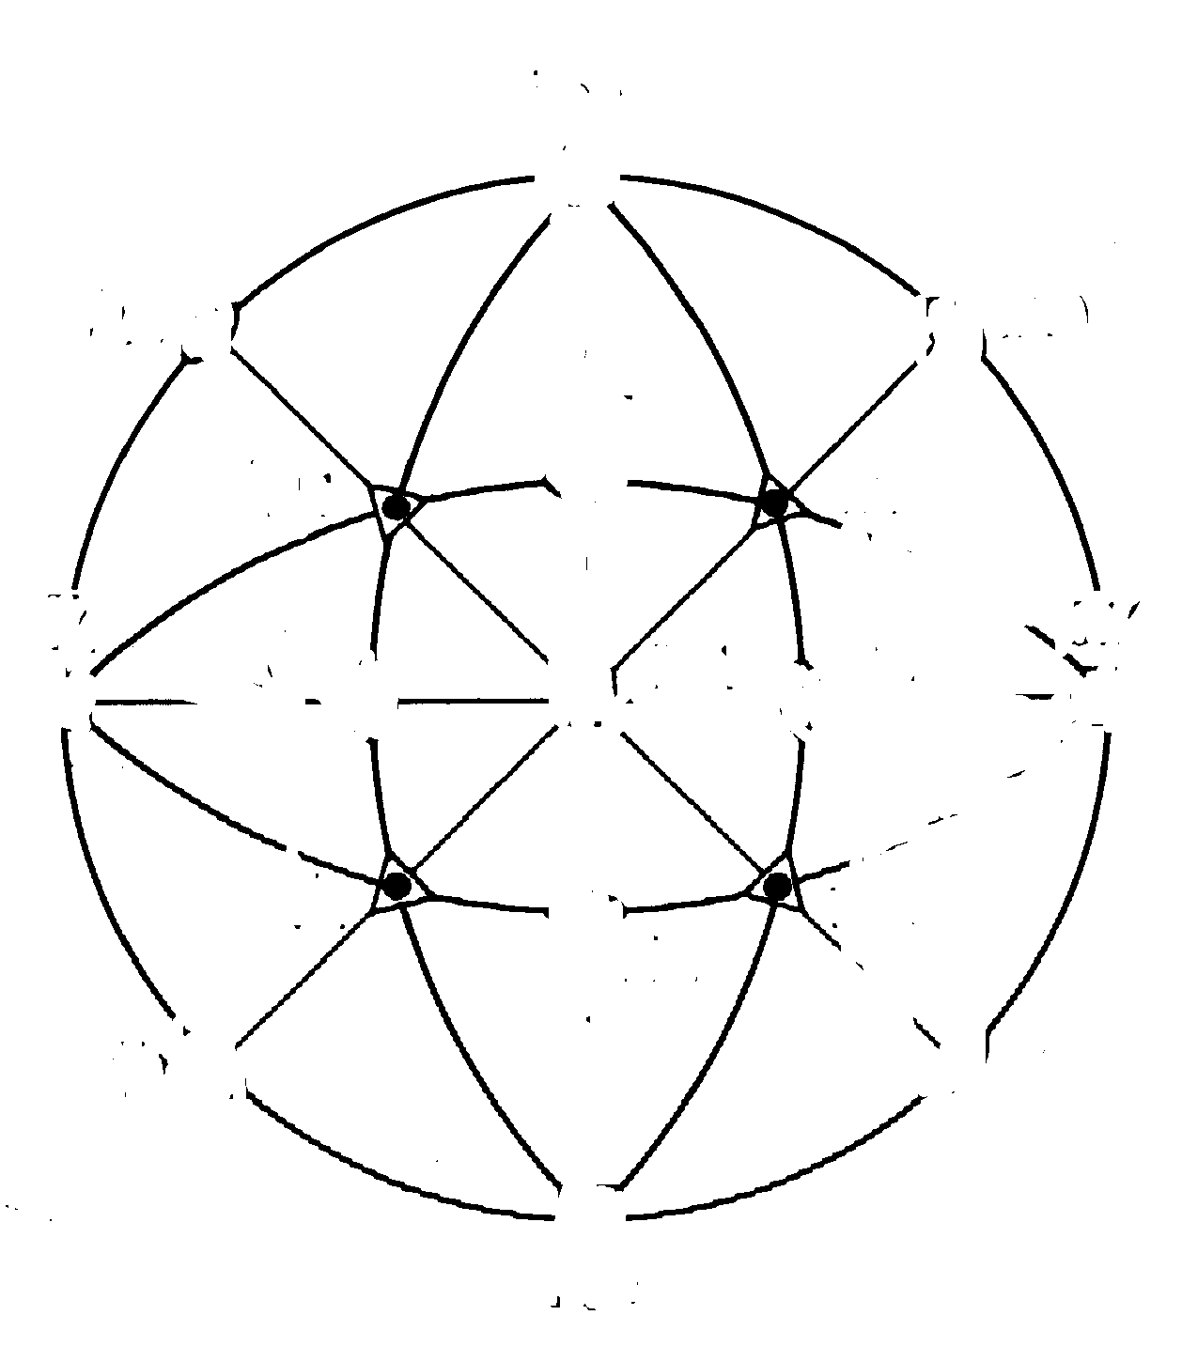
Cube Component = {001}<100>
{100}
{111}
{110}
Think of the θ-2θ setting as acting as a filter on the standard stereographic projection,

Slide 22
How to Measure Texture
X-ray diffraction; pole figures; measures average texture at a surface (µms penetration); projection (2 angles).
Neutron diffraction; type of data depends on neutron source; measures average texture in bulk (cms penetration in most materials) ; projection (2 angles).
Electron [back scatter] diffraction; easiest [to automate] in scanning electron microscopy (SEM); local surface texture (nms penetration in most materials); complete orientation (3 angles).
Optical microscopy: optical activity (plane of polarization); limited information (one angle).

Slide 23
Texture: Quantitative Description
Three (3) parameters needed to describe the orientation [of a crystal relative to the embedding body or its environment].
Most common: 3 [rotation] Euler angles.
Most experimental methods [X-ray and neutron pole figures included] do not measure all 3 angles, so orientation distribution must be calculated.
Best mathematical representation for graphing, illustrating symmetry: Rodrigues-Frank vectors.
Best mathematical representation for calculations: quaternions.

Slide 24
X-ray Pole Figures
X-ray pole figures are the most common source of texture information; cheapest, easiest to perform. They have the advantage of providing an average texture over a reasonably large surface area (~1mm²), compared to EBSD. For a grain size finer than about 100 µm, this means that thousands of grains are included in the measurement, which ensures statistical viability.
Pole figure:= variation in diffracted intensity with respect to direction in the specimen.
Representation:= map in projection of diffracted intensity.
Each PF is equivalent to a geographic map of a hemisphere (North pole in the center).
Map of the density of a specific crystal direction w.r.t. sample reference frame. More concretely, it is the frequency of occurrence of a given crystal plane normal per unit spherical area. Think of a (spherical) pin cushion with each pin representing the normal to {hkl}.

Slide 25
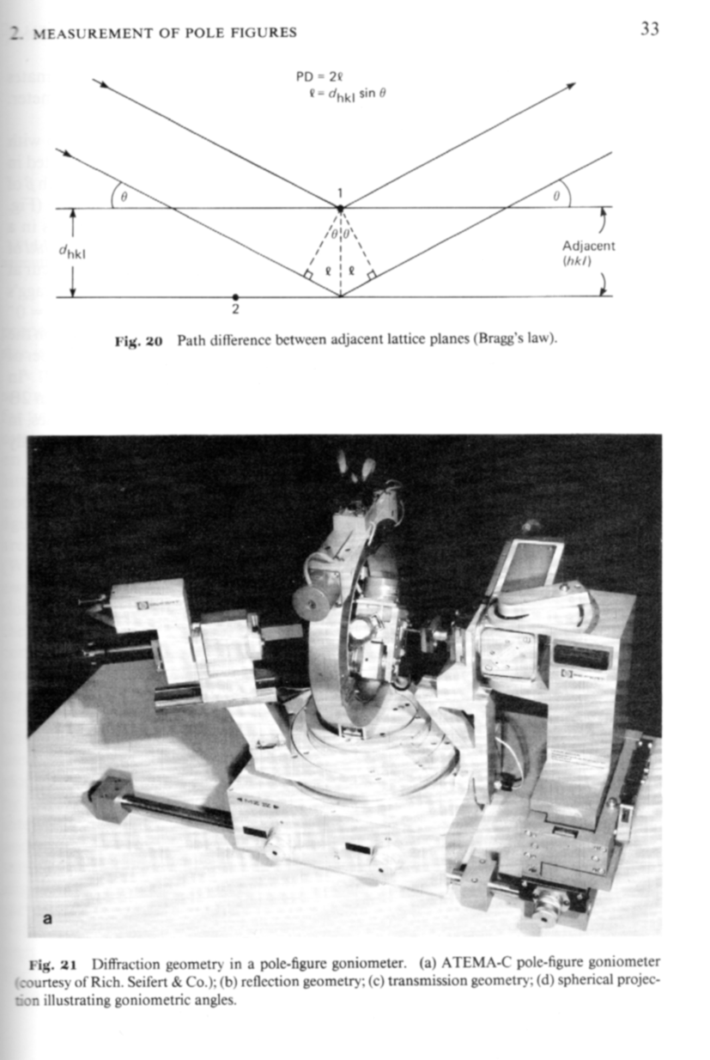
PF apparatus
From Wenk’s chapter in Kocks book.
Fig. 20: showing path difference between adjacent planes leading to destructive or constructive interference. The path length condition for constructive interference is the basis for the Bragg equation:
2 d sinθ = n λ
Fig. 21: pole figure goniometer for use with x-ray sources.
[Kocks]

Slide 26
Pole Figure measurement
PF measured with 5-axis goniometer.
2 axes used to set Bragg angle (choose a specific crystallographic plane with θ/2θ), which determines the Miller indices associated with the PF. These settings remain constant during the measurement of a given pole figure.
Third axis tilts specimen plane w.r.t. the focusing plane (co-latitude angle in the PF, i.e. distance from North Pole). Although this angle can be as large as 90°, no diffracted intensity will be measured with the plane of the beams parallel to the surface: this limits the maximum tilt angle at which PFs can be measured in reflection to about 80°.
Fourth axis spins the specimen about its normal (longitude angle in the PF).
Fifth axis (optional) oscillates the Specimen under the beam in order to maximize the number of grains included in the measurement.
For texture calculation, at least 2 PFs required and 3 are preferable even for materials with high crystal symmetry.
N.B. deviations of relative intensities in a standard θ/2θ scan from powder file indicate texture but only on a qualitative basis.

Slide 27
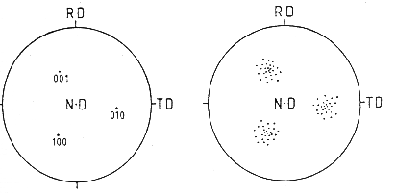
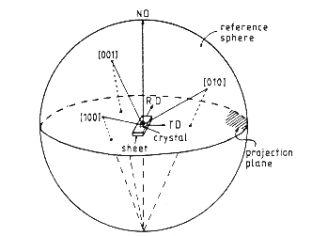
Pole Figure Example
If the goniometer is set for {100} reflections, then all directions in the sample that are parallel to <100> directions will exhibit diffraction.
[Bunge]
Note the convention with the RD pointing up, TD to the right, and ND out of the plane. This is an unfortunate convention because it is a left-handed set of axes!

Slide 28
Practical Aspects
Typical to measure three PFs for the 3 lowest values of Miller indices (smallest available angles of Bragg peaks).
Why?
  Small Bragg angles correspond to normals coincident with symmetry elements of the crystal, which means fewer symmetry-related poles, and, consequently, greater dynamic range of intensity (peak to valley).
  A single PF does not uniquely determine orientation(s), texture components because only the plane normal is measured, but not directions in the plane (2 out of 3 parameters).
  Multiple PFs required for calculation of Orientation Distribution
  The lowest index reflections have the smallest Bragg angles and are therefore the easiest to measure, with the highest intensities.

Slide 29
Corrections to Measured Data
Random texture [=uniform dispersion of orientations] means same intensity in all directions.
Background count must be subtracted, just as in conventional x-ray diffraction analysis.
X-ray beam becomes defocused at large tilt angles (> ~60°); measured intensity even from a sample with random texture decreases towards edge of PF because less of the diffracted beam intersects with, or is captured by the detector.
Defocusing correction required to increase the intensity towards the edge of the PF. (Despite the uncertainty associated with this correction, it is better to measure in reflection out to as large a tilt as possible, in preference to trying to combine reflection and transmission figures.)
After these corrections have been applied, the dataset must be normalized in order that the average intensity is equal to unity (similar to, although not the same as, making sure that a probability distribution has unit area under the curve).
Units: multiples of a random density (MRD). To be explained …

Slide 30
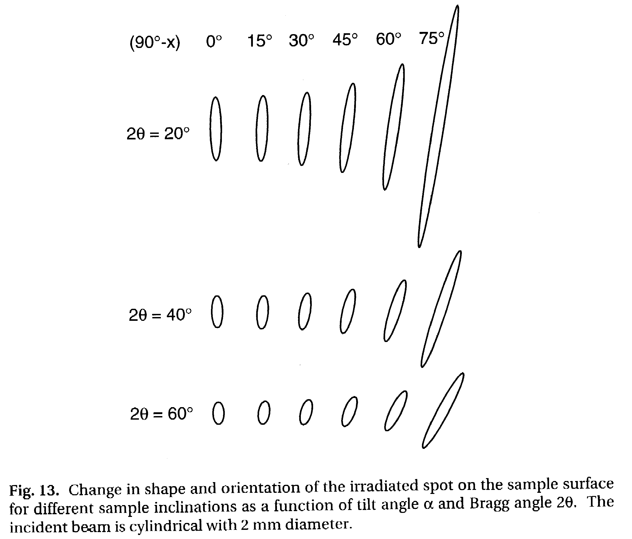
Defocussing
The combination of the θ−2θ setting and the tilt of the specimen face out of the focusing plane spreads out the beam on the specimen surface.
Above a certain spread, not all the diffracted beam enters the detector.
Therefore, at large tilt angles, the intensity decreases for purely geometrical reasons.
This loss of intensity must be compensated for, using the defocussing correction.
[Kocks]

Slide 31
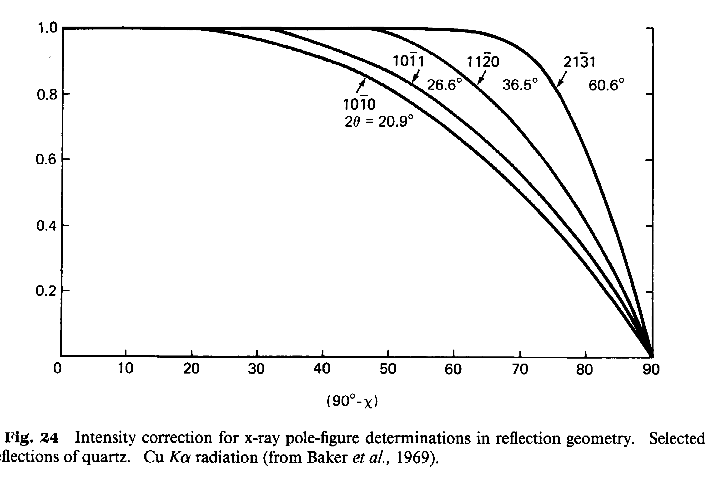
Defocusing Correction
No defocusing correction needed at small tilts, χ, because all the diffracted beam enters the detector. The correction becomes more important with decreasing 2θ and narrower receiving slit.
Best procedure involves measuring the intensity from a reference sample with random texture.
If such a reference sample is not available, one may have to correct the available defocusing curves in order to optimize the correction. This will be explained again in the context of using mtex or popLA.
[Kocks]

Slide 32
popLA and the
Defocussing Correction
Values for correcting background
Values for correcting data
0
5
10
15
20
25
30
35
40
45
50
55
60
65
70
75
80
85
90
100.00
100.00
100.00
100.00
100.00
100.00
100.00
100.00
100.00
100.00
99.00
96.00
92.00
83.00
72.00
54.00
32.00
13.00
.00
demo (from Cu1S40, smoothed a bit: UFK)
111
1000.00
999.
999.
999.
999.
999.
999.
999.
999.
999.
982.94
939.04
870.59
759.37
650.83
505.65
344.92
163.37
2.19
0
5
10
15
20
25
30
35
40
45
50
55
60
65
70
75
80
85
90
Tilt
Angles
Tilt
Angles
At each tilt angle, the data is multiplied by 1000/value
If you change the DFB file, always plot the curves to check them visually!

Slide 33
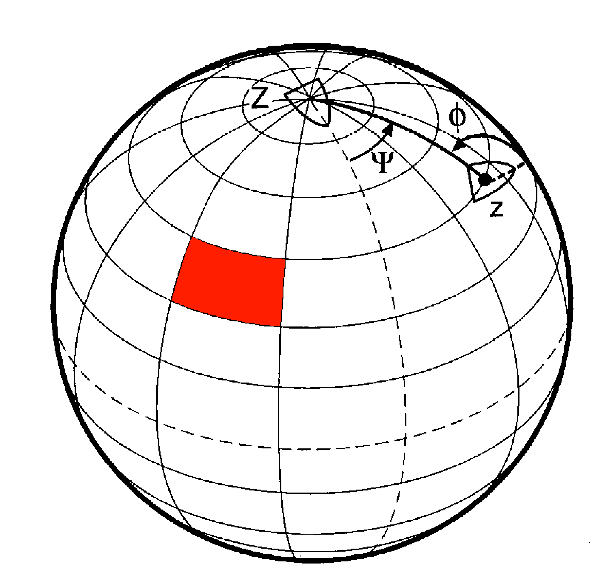
Area Element, Volume Element
If many data points (individual poles) are measured, a discrete plot is too crowded. The points can be binned and then a contour plot generated.
The simplest grid has equal increments in each of the two spherical angles, Θ and ψ. These are co-latitude and longitude.
Spherical coordinates result in an area element, dA, whose magnitude depends on the declination (or co-latitude):
dA = sinΘ dΘ dψ
[Kocks]
Θ
dA
dθ
dψ
In practice, a diffracted intensity is measured at the center of each cell in the grid. Therefore each value is associated with a different area.
Concept Params. Euler Normalize Vol.Frac. Cartesian Polar Components

Slide 34
Normalization
Normalization is the operation that ensures that “random” is equivalent to an intensity of one.
This is achieved by integrating the un-normalized intensity, f’(θ,ψ), over the full area of the pole figure, and dividing each value by the result, taking account of the solid area. Thus, the normalized intensity,
f(θ,ψ), must satisfy the following equation, where the 2π accounts for the area of a hemisphere:
Note that in popLA files, intensity levels are represented by i4 integers, so the random level = 100. Also, in .EPF data sets, the outer few rings (typically, Θ > 80°) are empty because they are unmeasurable; therefore the integration for normalization excludes these empty outer rings.

Slide 35
Inverse Pole Figure: Definition
An inverse pole figure (in the context of texture) is a map of a selected set of sample directions plotted with respect to the crystal frame. Think of the columns (not rows) in the orientation matrix, which define the coordinates of each sample axis with respect to the crystal frame.
In general, only the 1, 2 & 3 (RD, TD, ND) directions are plotted.
The sample directions are generally notated with Miller indices, e.g. [100], [010], [001].
Sample symmetry is ignored because these 3 sample directions are (almost) never equivalent.
Since unit vectors representing directions with respect to a common origin live on a sphere, it is natural to transform the coordinates to spherical angles such as azimuth (longitude) and declination (co-latitude). This makes it more clear that, for each crystallite, its 3-parameter orientation (e.g. Euler angles) is reduced (projected) to only two (2) parameters.
Only the upper hemisphere is plotted, by convention. The resulting diagram is often called a stereogram, although this implies something about the choice of projection (see later slides).
If only a few distinct orientations are displayed, multiple poles can be plotted on the same diagram as a discrete inverse pole figure.
When many crystallites are included in the dataset it is necessary to bin the data and convert points to densities. For display purposes, contour plots are the easiest way to understand the result.
Because orientations are reduced (projected) to a single direction, the space required to display a unique result depends on the crystal symmetry. For cubics, only the Standard Stereographic Triangle (SST) is needed. See the Kocks book for lower symmetry cases.

Slide 36
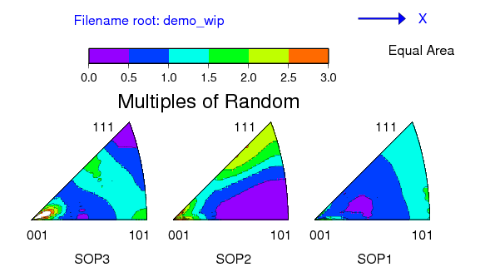
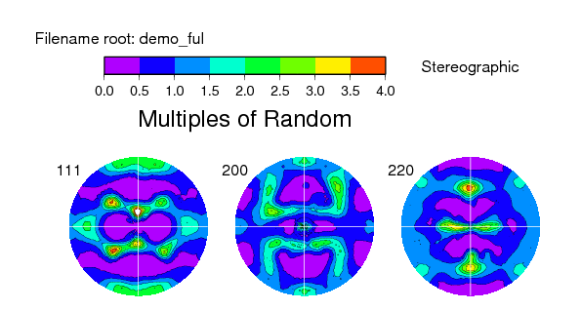
Inverse Pole Figures
The figure above shows an example of a set of Inverse Pole Figures, derived from a sample of rolled copper (“DEMO” as found in the demonstration dataset for popLA). From left to right, we see the distribution of the ND, TD and RD, respectively, with respect to the crystal reference frame. The cubic crystal symmetry of copper means that we only need one unit triangle to represent the distribution. Thus the Standard Stereographic Triangle (SST) is the fundamental zone for inverse pole figures for cubic materials. The (experimental) pole figures for this dataset are shown to the right.

Slide 37
Inverse Pole Figure - Procedure
To calculate where a sample direction appears in an inverse pole figure, there are various operations that must be performed.
The key concept is that of thinking of the inverse pole figure as a set of sample directions (e.g. RD, or ND) in the reference configuration and applying the orientation as a transformation to that direction (here one only needs to deal with a single direction, in contrast to the Pole Figure case) to find its position with respect to the sample frame.
Step 1: write the sample direction of interest as a unit vector; e.g. ND≡[001] = h.
Step 2: apply the transformation (passive rotation), g (not g⁻¹, or g^{T}), to obtain the coordinates of the sample direction in the inverse pole figure (in crystal axes):
h’ = gh
(pre-multiply the vector by, e.g. the orientation matrix, g, that represents the orientation; Rodrigues vectors or quaternions can also be used).
Step 3: convert the rotated direction into spherical angles (to help visualize the result, and to simplify Step 4) where Θ is the co-latitude and φ is the longitude:
Θ = cos⁻¹(h’_{z}), φ = tan⁻¹(h’_{y}/h’_{x}).
Remember - use ATAN2(h’_{y} , h’_{x}) in your program or spreadsheet and be careful about the order of the arguments!
Step 4: project the direction onto a point, p, in the plane (stereographic or equal-area):
p_{x} = tan(Θ/2) cosφ; p_{y} = tan(Θ/2) sinφ.
The previous slide explains where this formula comes from. The axes of the inverse pole figure are x=100 and y=010. (Caution - this is simple and obvious for cubics. For low symmetry crystals, these are Cartesian x and y, which may or may not correspond to the a and b crystal axes. The location of Cartesian x and y for hexagonal systems requires particular care!)
Note: why do we use the transformation (passive rotation)?! One way to understand this is to recall that the orientation is, by convention (in materials science), written as an axis transformation from sample axes to crystal axes. For the inverse pole figure, we are transforming a sample direction into crystal axes so we can use the orientation matrix directly.

Slide 38
Summary: Pole Figures
The pole figure is explained as a plot in which poles of crystal planes are projected (stereographic or equal area) onto a circular plot with the sample axes as the reference frame. If data is taken from an experiment or a large number of poles are binned, contour plots are displayed.
A method to compute the positions of poles in such a figure is described, based on transforming the coefficients of a crystal plane normal to the sample frame.
The typical reflection mode for measuring pole figures with x-ray diffraction is described, along with the need for a defocussing correction and normalization to obtain units of multiples of a random density (MRD).
The inverse pole figure is described in which sample directions are plotted in the crystal frame (also as a stereographic or equal area projection), along with the calculation method.

Slide 39
High Energy Diffraction Microscopy
HEDM will be discussed in a guest lecture by Rachel Lim

Slide 40

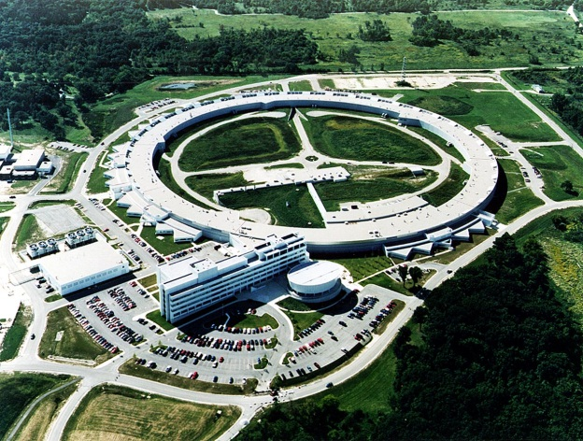

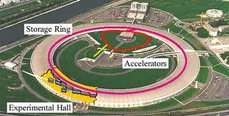
High Energy X-Rays from Synchrotrons
Extensive use of Synchrotron-based radiation for materials characterization
The high energy x-rays are uniquely able to penetrate high-Z, fully dense materials
Enables both absorption and
diffraction experiments.
“Near field” HEDM maps provide
both spatial and crystallographic
orientation information
Spring 8, Japan
ESRF, Grenoble, France
Adv. Photon Src., Chicago

Slide 41
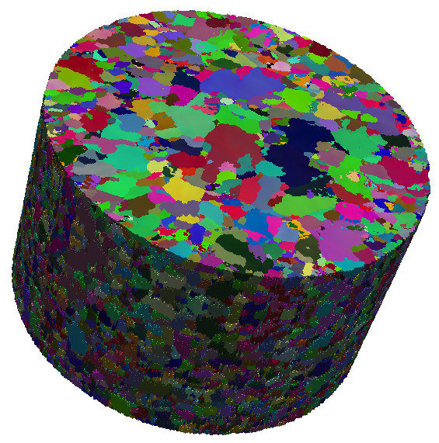
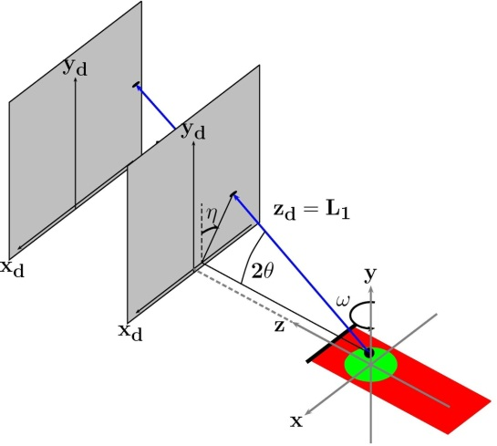
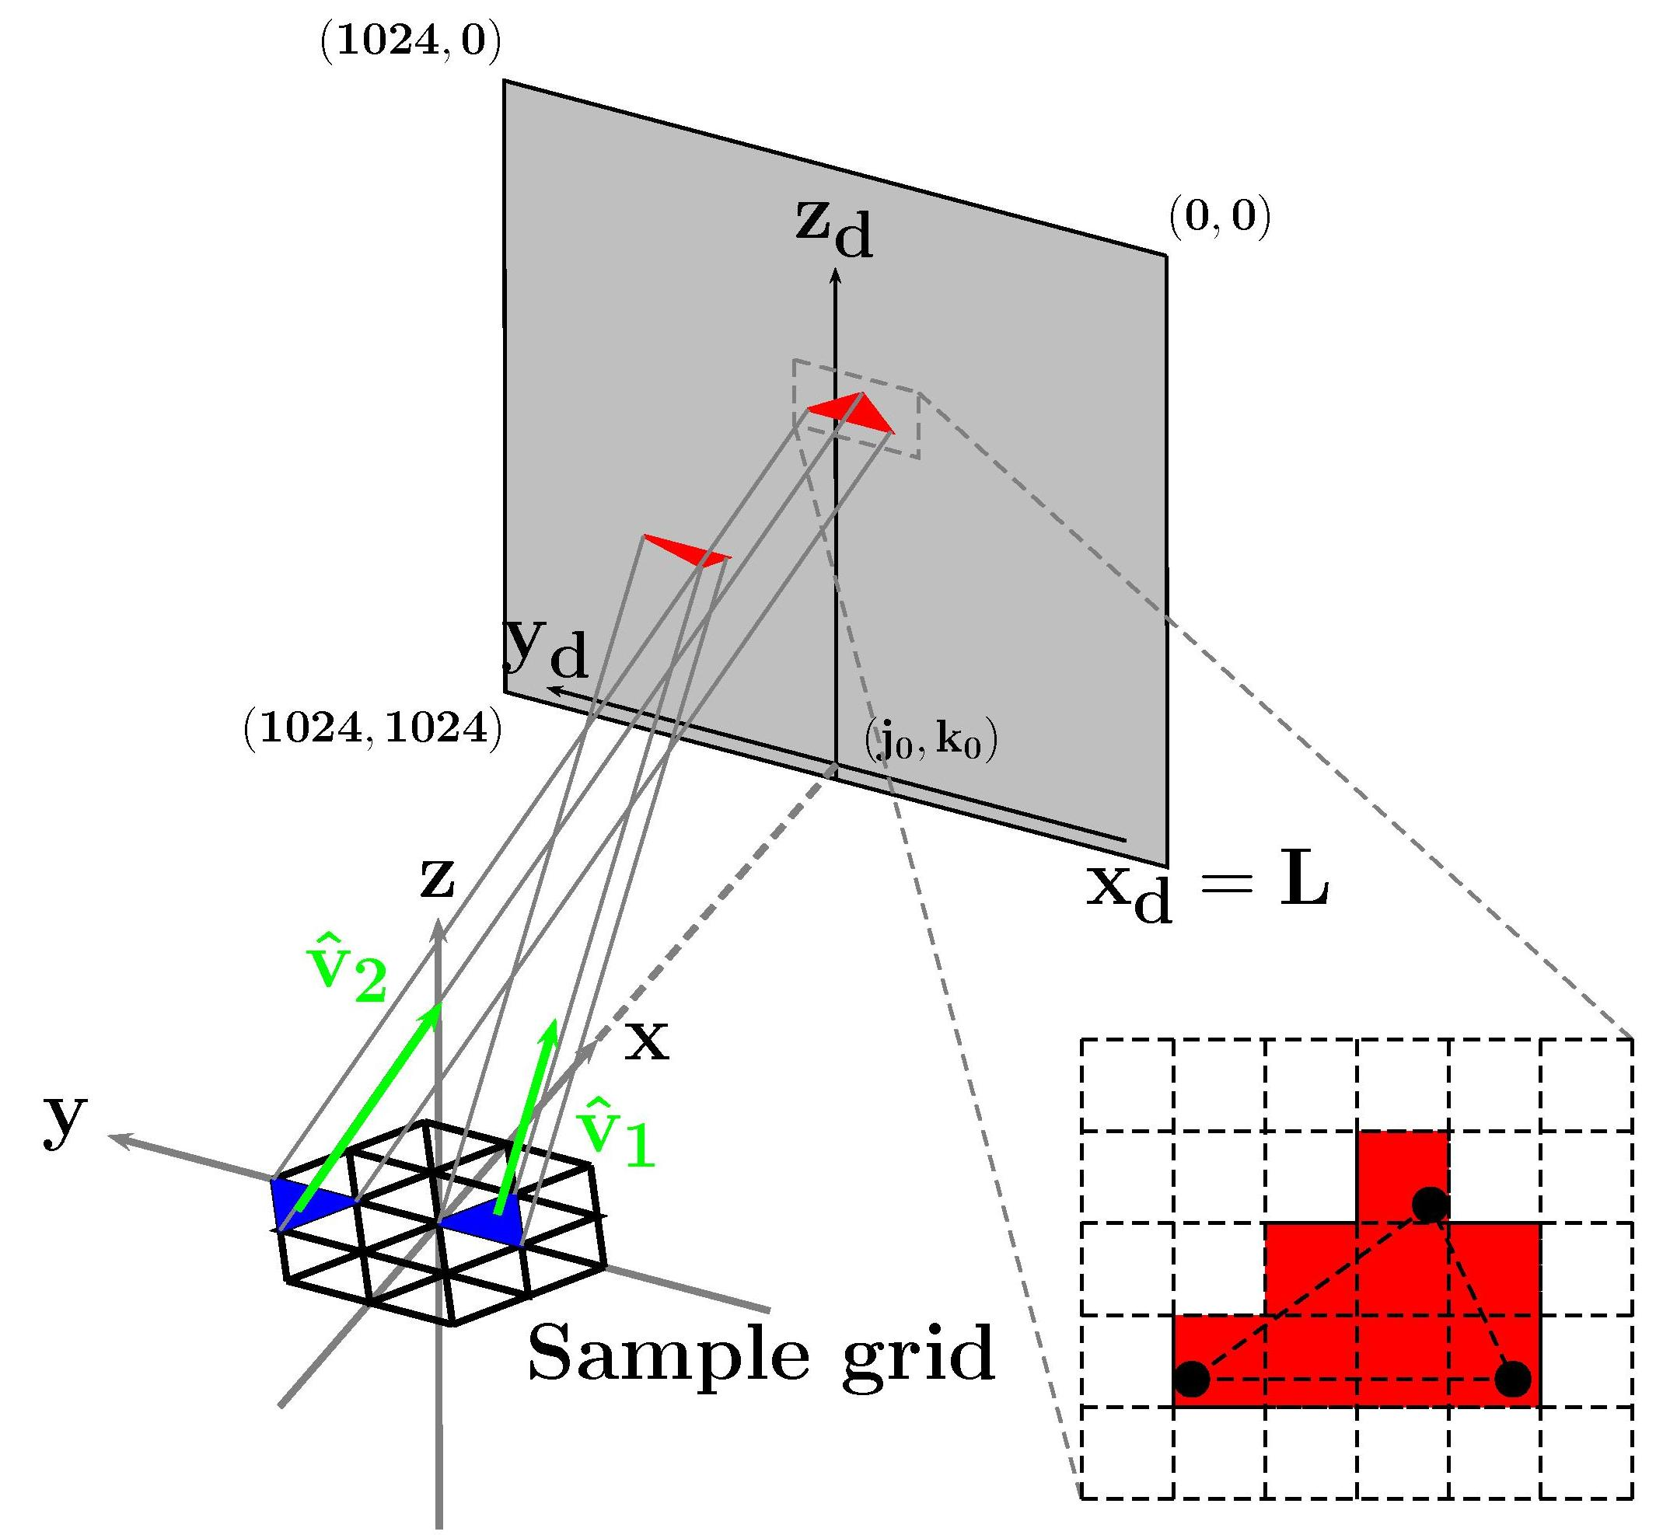
3D Orientation Mapping: High Energy X-ray Diffraction Microscopy (nf-HEDM)
Advanced Photon Source Measurements
1-ID high brilliance, high energy x-rays
Millimeter samples probed with micron spatial, < 0.1 deg orientation resolution
Tera-byte data sets
> 3 x 10⁶ Bragg peaks
10³ core parallel processing: 2D images to 3D orientation maps
3D copper microstructure
0.4 mm³
Colors represent crystal lattice orientations
HEDM measurement schematic
Computational reconstruction
Image diffracted beams
360 images/layer
~100 successive cross-sections
Optimizes orientations in > 10⁷ voxels (volume elements)
Poulsen, Springer 2004
Suter et al., Rev. Sci. Instruments, 2006
Li and Suter, J Appl. Cryst. 2013; LLNL-CODE-657639

Slide 42
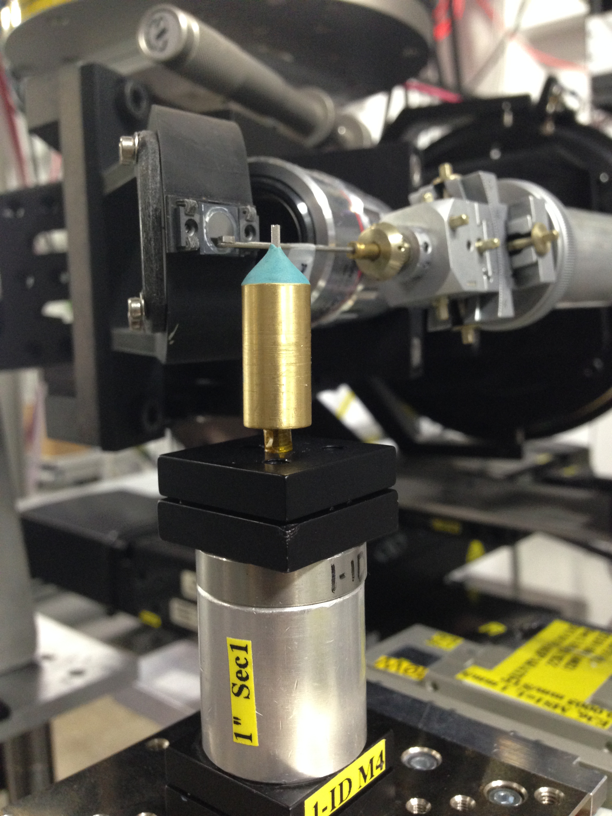
Experimental Setup
Setup:
High Energy X-Rays
  Energy: 51.996 keV
  Line Focused Beam
Samples:
→ Ti6Al4V
    As-received
    Stress relieved at 650 C
    Annealed at 850 C
→TiFe Alloy
→AlSi10Mg
→316L Stainless Steel
Multi-modal Measurements:
Data Collection
  Near-field HEDM
  Far-field HEDM
  Tomography
APS Beamline 1-ID E

Slide 43

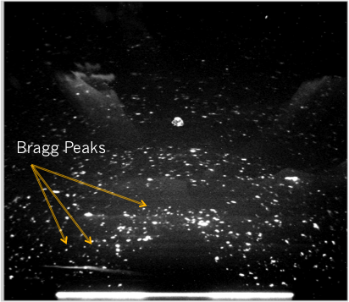
nf-HEDM: Orientation Reconstruction
Confidence:
0
0
Experiment
500
500
Simulation
1000
1000
1500
1500
2000
2000
500
0
500
1000
1500
2000
0
1000
1500
2000
Forward Modeling Method: Li et al., Journal Appl. Cryst. 46 (2013) 512-524.
Laplacian segmentation: Lind et al. (2014) Proc. ICIP.

Slide 44
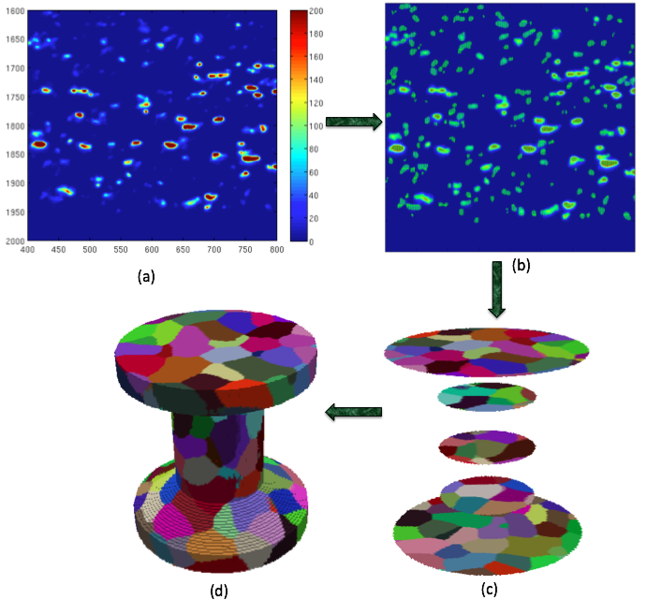
3D microstructure reconstruction from nf-HEDM experiment
Background subtraction and cleaning up tails around the “real intensity”
Reconstruction of 2D orientation fields, which are then stacked together to obtain a 3D volume

Slide 45
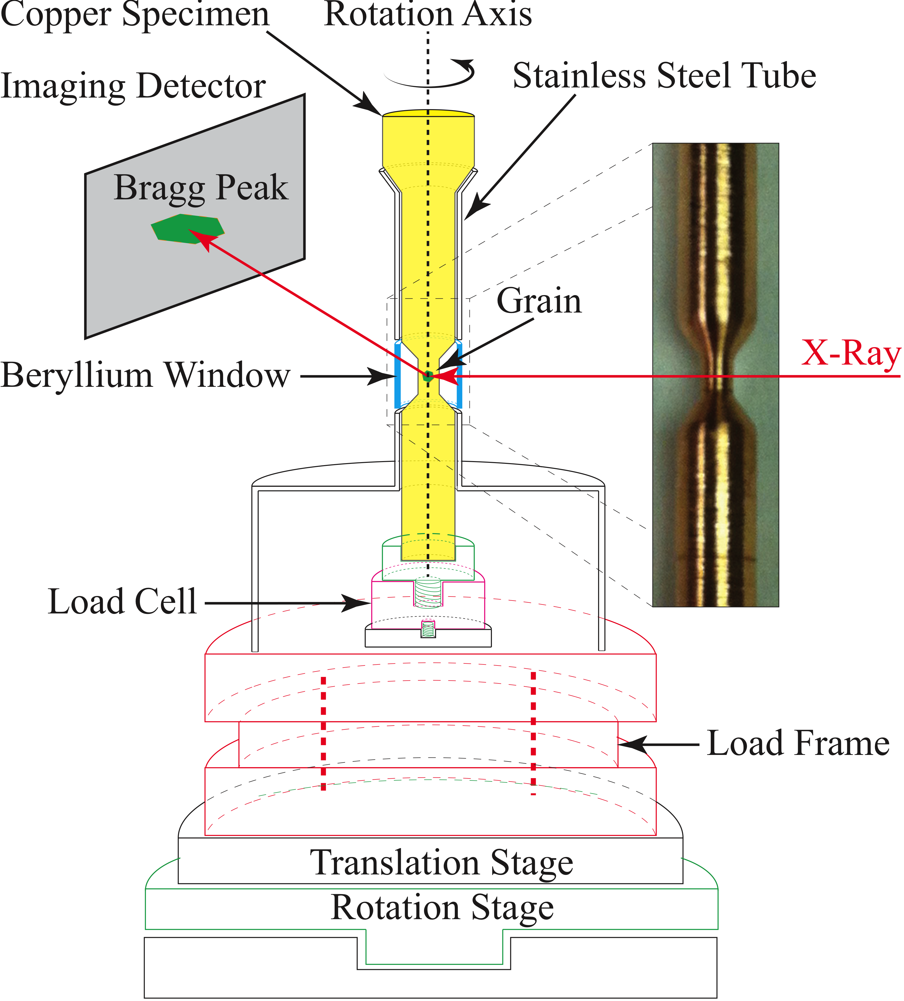
Detector Images:
Experimental Setup
0%
12%
Pokharel, R et al. International Journal of Plasticity 67, (2015) 217-234

Slide 46
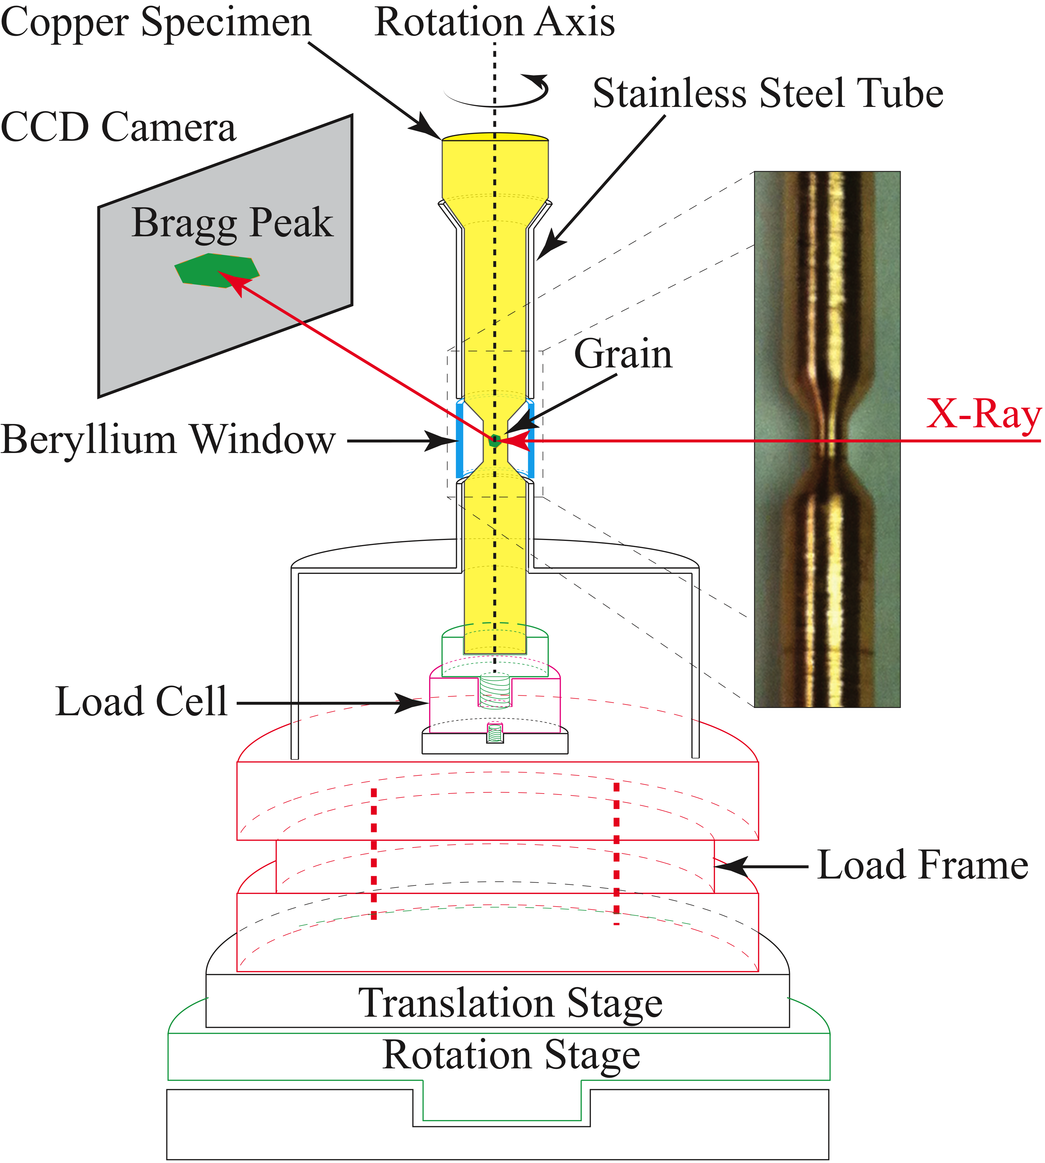
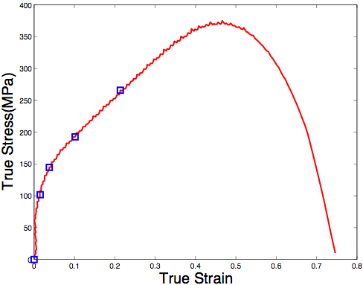
In-situ uniaxial tensile deformation (3D)
Sample:
Cu: 99.995% pure
Initial diameter: 1mm
Initial length: 1mm
Heat treated at 550° C for 1 hr
# of measured states: 5
0%-21%
tensile strain

Slide 48
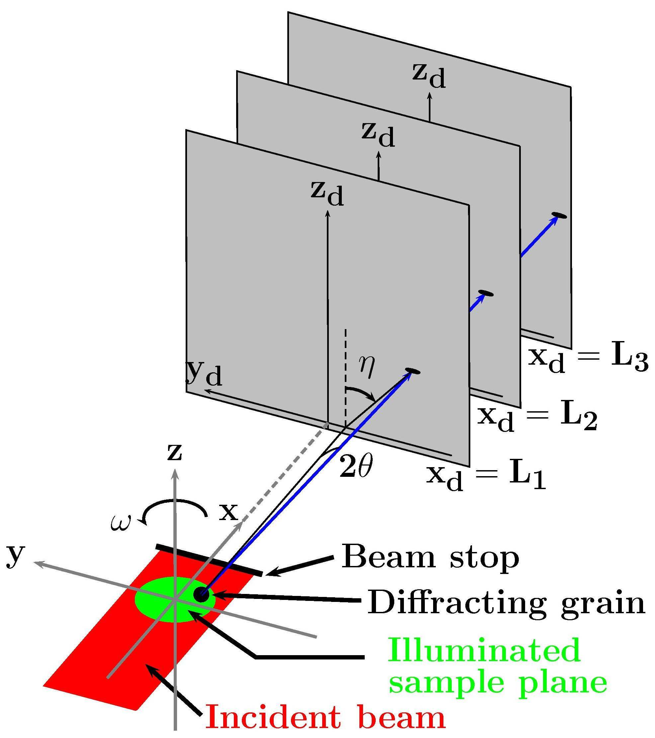
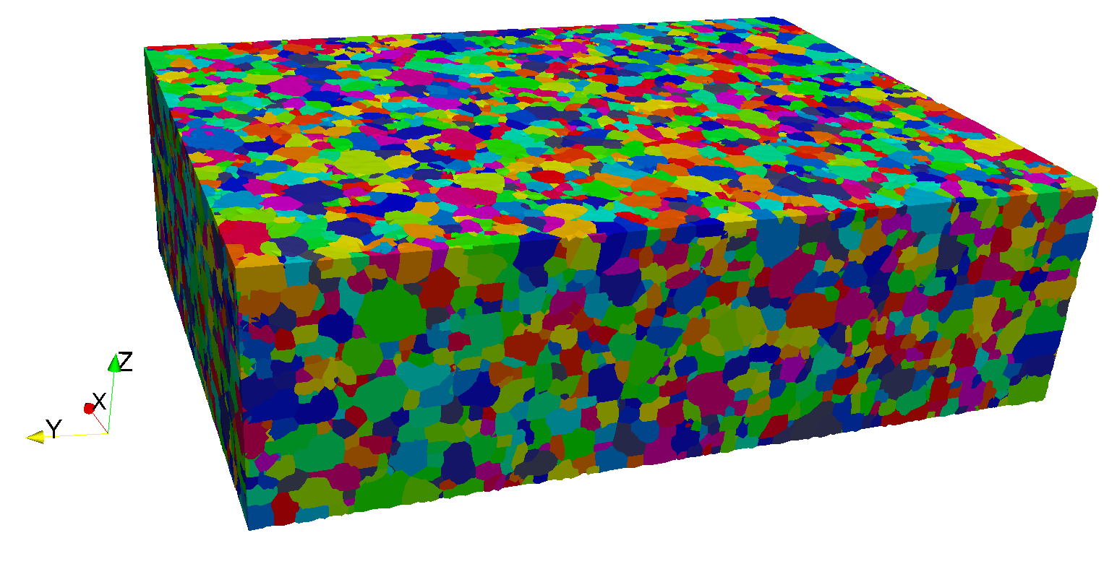
Near Field High Energy X-Ray Diffraction Microscopy (nf-HEDM)
Non-destructive
High energy (> 50keV) x-rays
Specimen cross sectional diameter up to 1.3 mm.
Typical beam height 4 μm
Collection of diffractograms by a near-field detector
Reconstruction: Software simulates the experiment
Suter, R. M. et al. (2006). Review of Scientific Instruments, 77(12):123905.
Suter, R. M. et al. (2008) Journal of Engineering Materials and Technology, 130(2):021007.
Li S.F., Suter R.M. (2013). Journal of Applied Crystallography, 46: 512-24.
Notes:
Since the mechanical response of polycrystals relies heavily on the microstructural features, it is crucial to measure the grain morphology and orientation distributions accurately and efficiently. In this thesis work, one of the non-destructive synchrotron based techniques, high-energy X-ray diffraction microscopy (HEDM) is used as a tool of characterization.
Braggs condition
HEDM is a non-destructive 3D microstructure mapping method, in which monochromatic high energy x-rays from a synchrotron source, in this case the Advanced Photon Source (APS) at Argonne National Laboratory are used to characterize bulk samples [7,8]. The HEDM experiment involves collection of diffractograms by a near-field detector, which means that the detector is only about a centimeter away from the specimen; hence it is referred to as near-field HEDM, Fig. 2.1.
The sample, sitting on a rotation stage, is probed by a monochromatic ∼1.2 mm width and ∼ 4μm height X-ray beam [9]. The grains satisfying the Bragg’s condition, nλ = 2dhkl sin θ, where n is an integer and dhkl is the spacing between atomic planes, diffract the beam, and the diffraction data is collected on the CCD detector. The position of a diffraction spot not only depends on its point of origination in the specimen, but also on the diffraction vector. Initially a calibration specimen (such as a well characterized gold) is used to optimize the geometrical parameters such as the specimen-to-detector distance. Then, diffractograms are repeatedly collected from each layer of the specimen as the sample is rotated about the vertical axis in typically one-degree increments through 180 of rotation, with two or three different stand-off distances for the detector at each rotation position. For each material, the cross sectional sample size is limited by the attenuation depth and the operation energy. Typical HEDM measurements are performed at 50-100keV. Reconstruction of the 3D orientation map relies on a forward modeling algorithm [7,9]. The reconstruction software IceNine [10] simulates the experiment by including the beam, sample and detector. The parameters obtained from the calibration specimen are used in the fit algorithm after the raw diffraction images are reduced. The process involves creating a sample grid, and simulating the diffraction for any voxel in crystallographic orientation space. The simulated diffraction is compared to the actual data and a best fit is selected. Nf-HEDM is capable of mapping grain structures and orientations non-destructively, however the technique does not have strain resolution. For lattice strain measurements and phase segmentations, far-field HEDM (ff-HEDM) technique can be used [11]. Combining the ff-HEDM strain and phase measurements and the nf-HEDM grain structure and orientation measurements ensures the robust characterization of microstructural features.

Slide 49
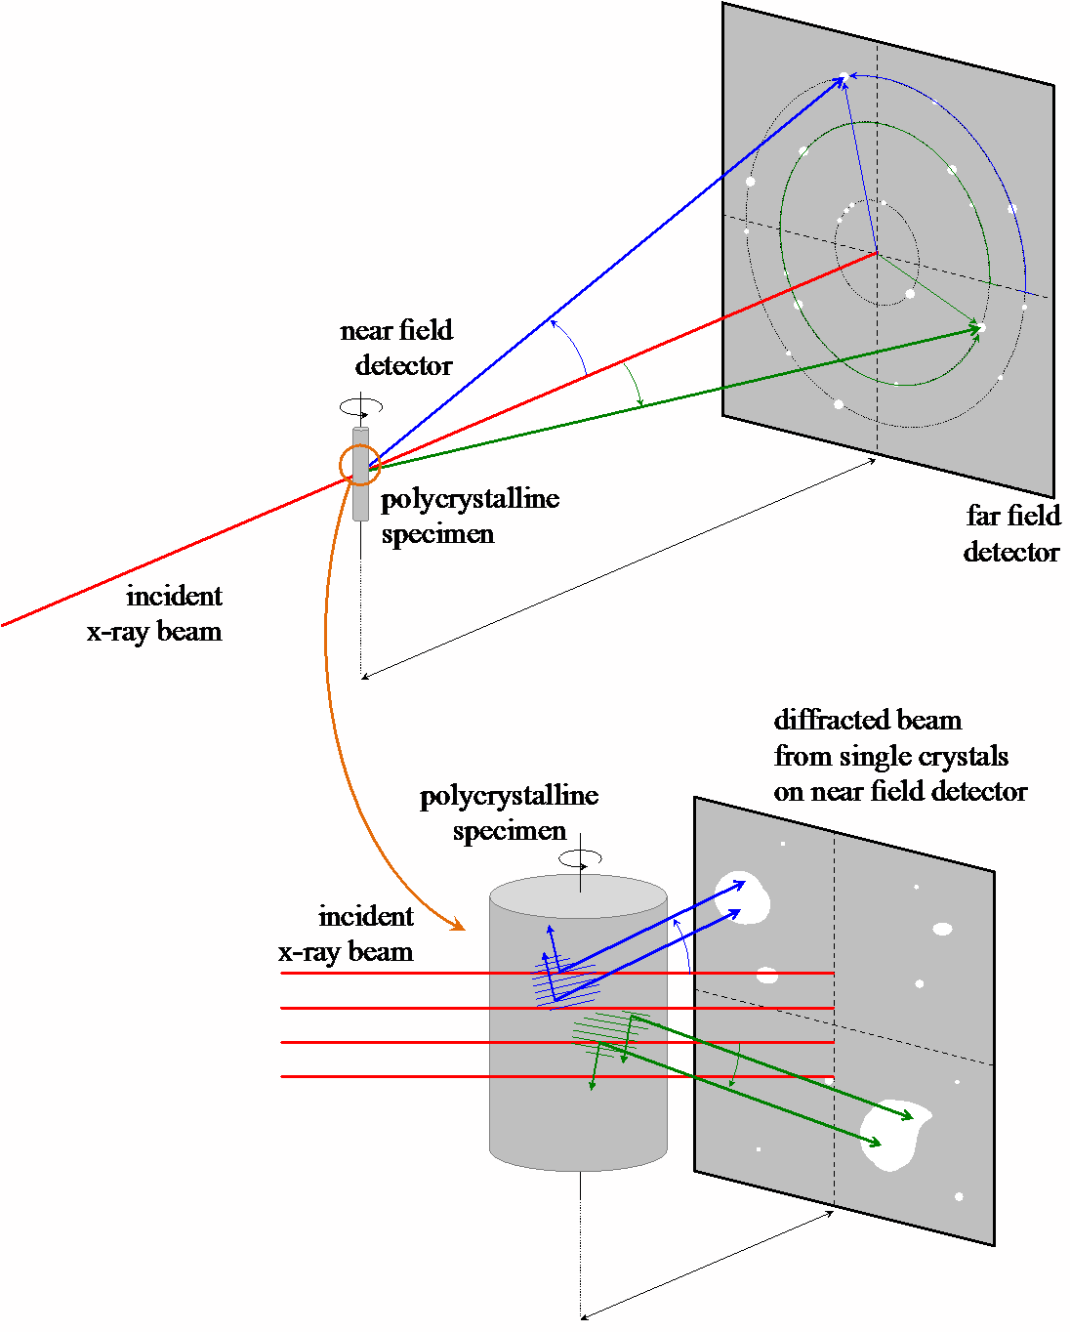
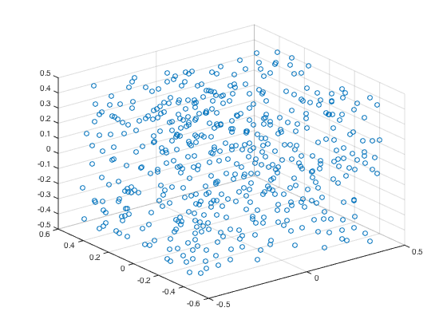
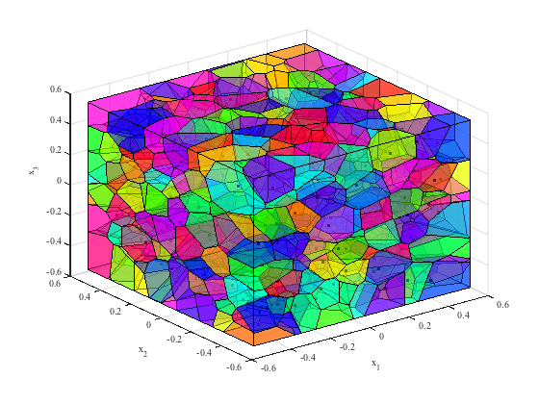
Far-field HEDM
Schematic of far field and near field data collection performed on polycrystalline specimens for grain mapping techniques.
D. Dale, Cornell Univ.
http://news.chess.cornell.edu/articles/2014/Koker_Fontes140813.html

Slide 50
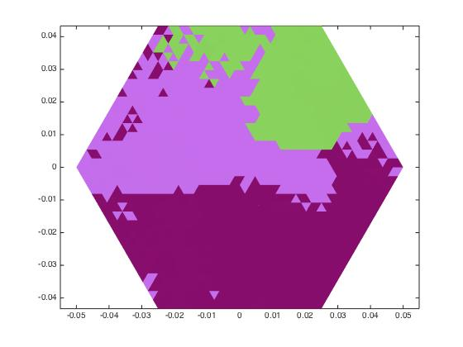
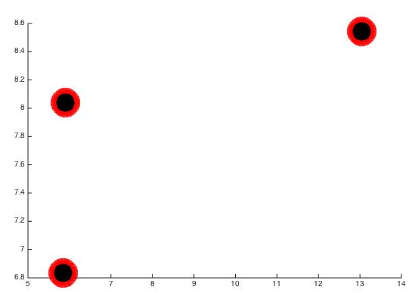
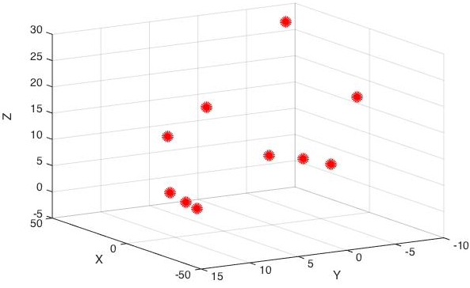
Nf and Ff High Energy X-ray Diffraction Microscopy of Au
As a calibration sample, low deformation Au
Single layer Nf-Grain structure reconstruction on the left, Ff-Center of mass reconstruction on the right (note that the axis scales are different)
Far-field COM, 35 µm box beam

Slide 51
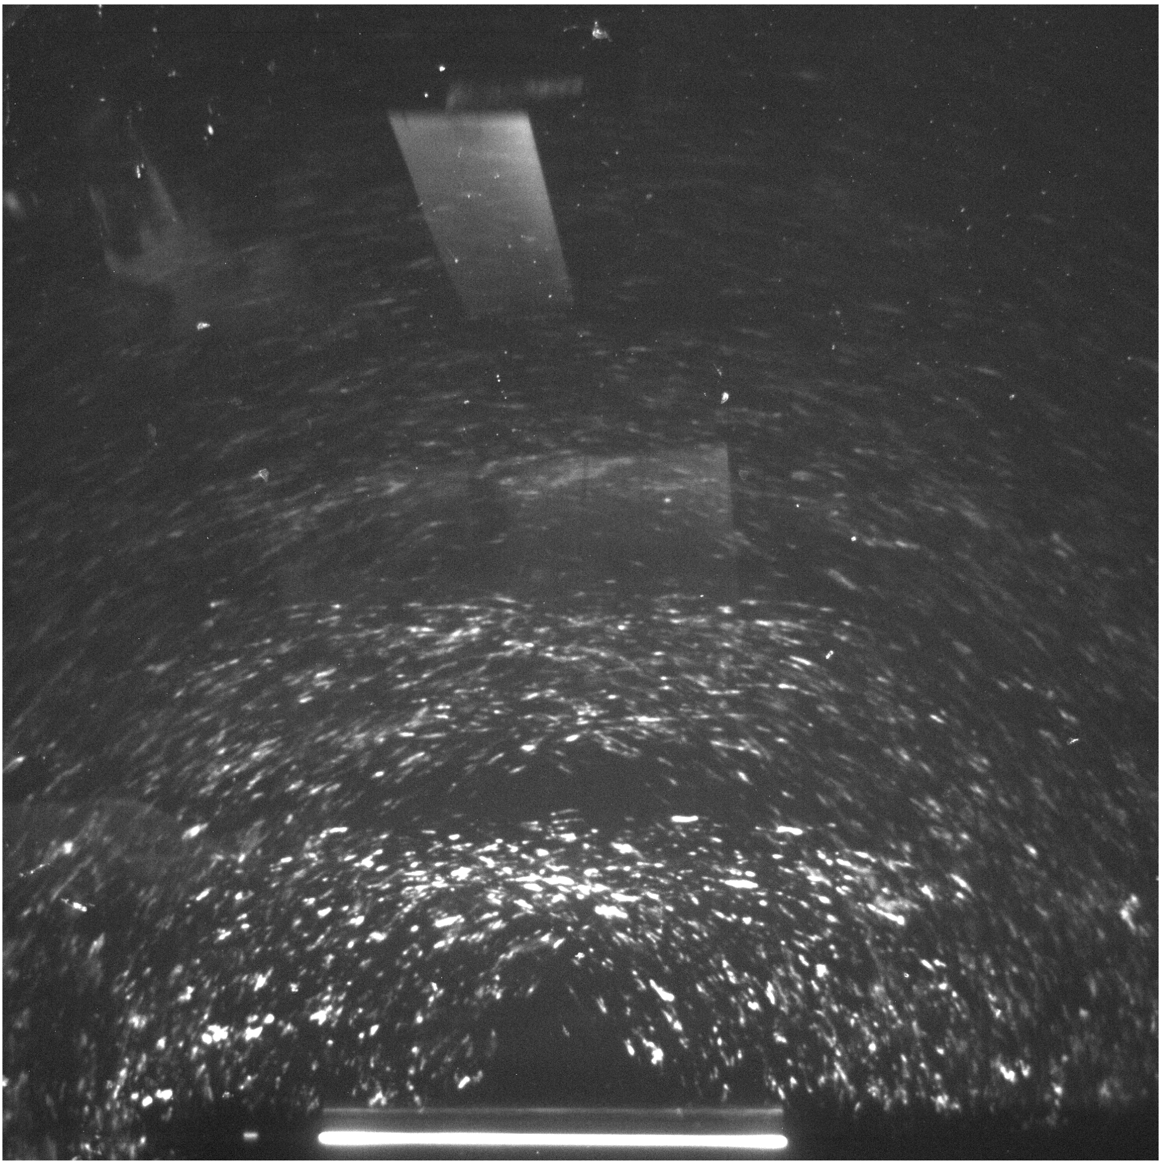
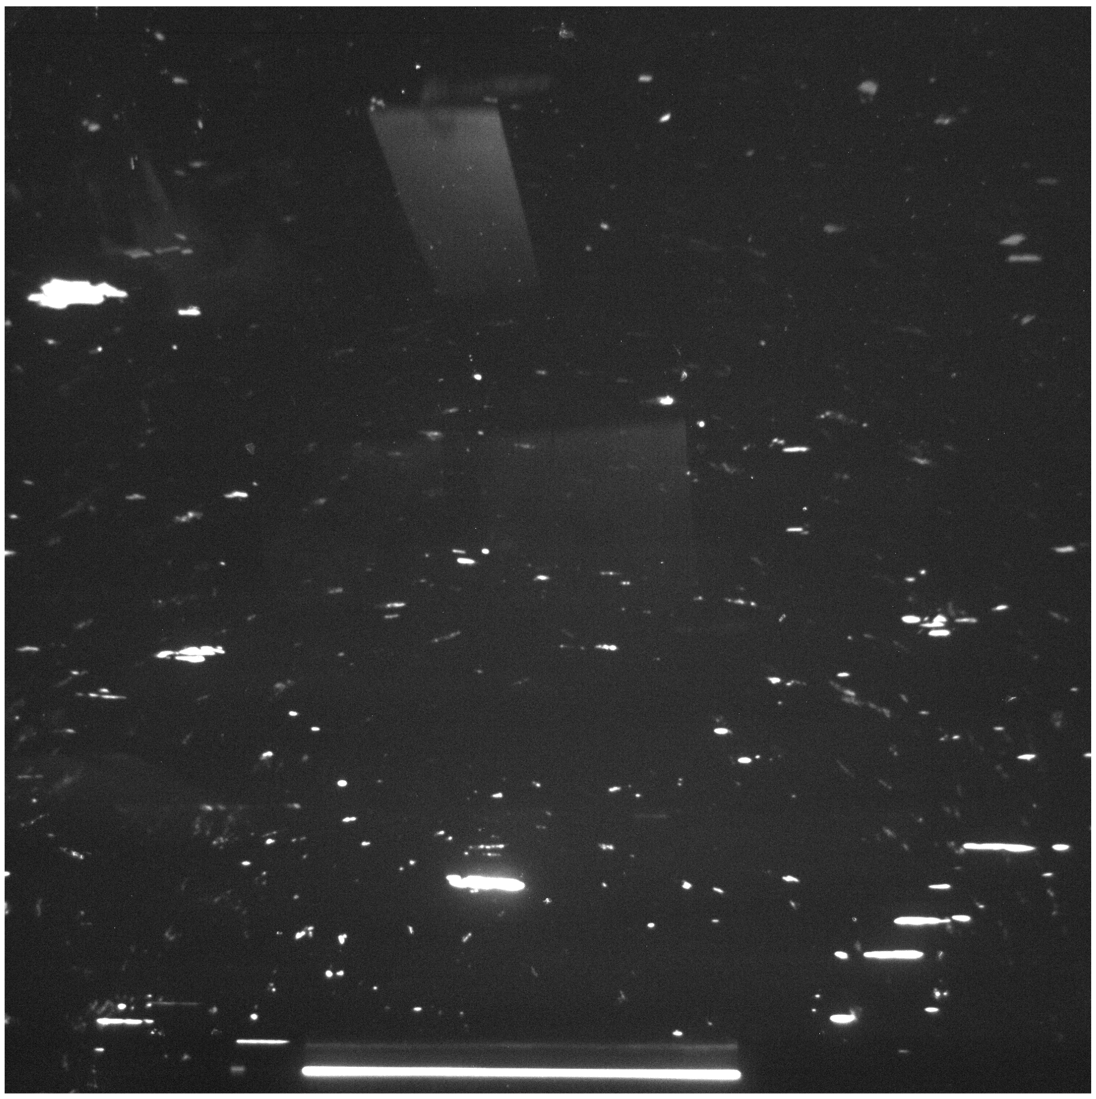
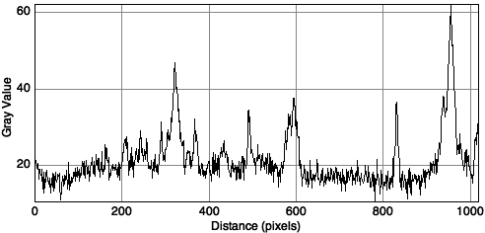
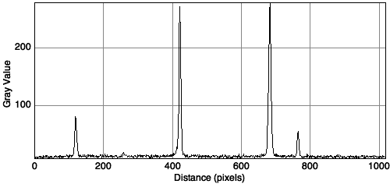
Near-field Raw Detector Images
As-received 316L SS
Heat treated at 1060 °C 316L SS
Diffractions from beam block, corrected for in background subtraction
Notes:
Large dynamic range in intensity in the as-received state. Small grains, dual-phase.

Slide 52
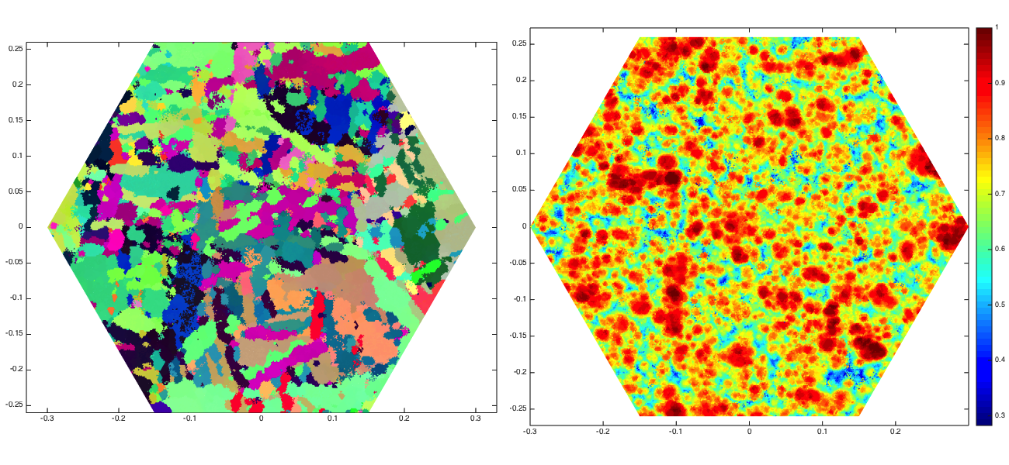
Nf-High Energy X-ray Diffraction Microscopy of AM Ti-6Al-4V
Microstructure/property relationship investigation, experimental part: Near-field and far-field high energy X-ray diffraction microscopy (HEDM)
As-Received Alpha Reconstruction
High power low velocity 3D printed Ti-6V-4Al (4x melt pool of nominal settings)
1 layer nf-HEDM hcp phase reconstruction
Grain structure on the left, confidence index on the right

Slide 53
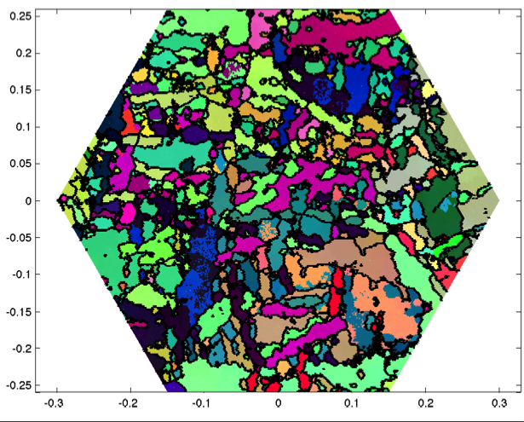
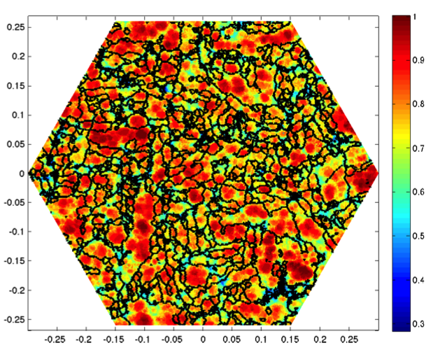
Nf-High Energy X-ray Diffraction Microscopy of AM Ti-6Al-4V
Microstructure/property relationship investigation, experimental part: Near-field and far-field high energy X-ray diffraction microscopy (HEDM)
As-Received Alpha Reconstruction
High power low velocity Ti64 (4x melt pool of nominal settings)
1 layer nf-HEDM hcp phase reconstruction
Grain structure on the left, confidence index on the right

Slide 54
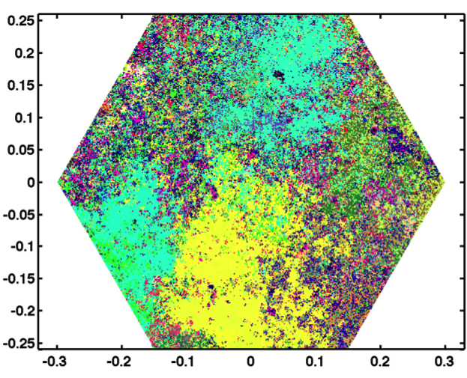
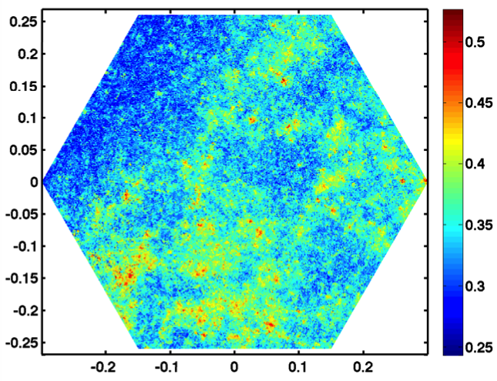
Nf-High Energy X-ray Diffraction Microscopy of AM Ti6Al4V
Microstructure/property relationship investigation, experimental part: Near-field and far-field high energy X-ray diffraction microscopy (HEDM)
As-Received Beta Reconstruction
Low confidence as a result of prior beta grains sharing Bragg peaks with the alpha phase – to be quantified
High power low velocity Ti64 (4x melt pool of nominal settings)
1 layer nf-HEDM bcc phase reconstruction
Grain structure on the left, confidence index on the right

Slide 55
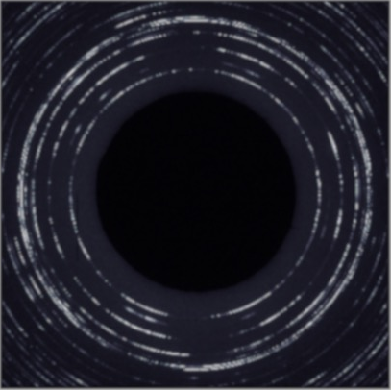
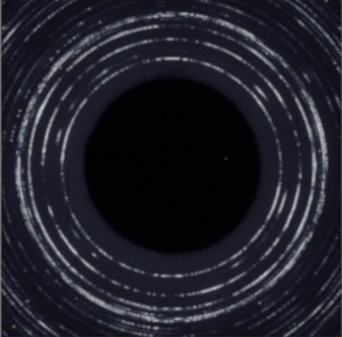




Ff-High Energy X-ray Diffraction Microscopy of AM Ti Alloys
Microstructure/property relationship investigation, experimental part: Near-field and far-field high energy X-ray diffraction microscopy (HEDM)
Nominal settings, Ti64 | As received | Stress-relieved | Annealed
High power low velocity Ti64 | As received | Stress-relieved | Annealed

Slide 56

Reference Frames
Unfortunately, it is necessary to take account of differences in reference frame when comparing different sources of data, just as with EBSD

Slide 57
Supplemental Slides
The following slides contain revision material about Miller indices from the first two lectures.

Slide 58
Kernel Average Misorientation (KAM)
• KAM is defined as average misorientation angle between each point (orange box), and its specified number of nearest neighbors (shown by purple arrows)
• Misorientation angles greater than a chosen threshold (y, say, = 5°) are excluded.
• Using of a threshold value eliminates any contribution from high angle boundaries.
∆g = {O_{c}}g_{B}g_{A}⁻¹{O_{c}}
neighbor
neighbor
neighbor
neighbor
Why is KAM important?
Calculate local orientation variation
Closely related to GNDs.
Analyze local strain, surface distortion
Measure stored energy

Slide 59

Miller Indices
Cubic system: directions, [uvw], are equivalent to planes, (hkl).
Miller indices for a plane specify reciprocals of intercepts on each axis.

Slide 60
Miller <-> vectors
Miller indices [integer representation of direction cosines] can be converted to a unit vector, n: {similar for [uvw]}.

Slide 61

Miller indices of a pole
Miller indices are a convenient way to represent a direction or a plane normal in a crystal, based on integer multiples of the repeat distance parallel to each axis of the unit cell of the crystal lattice. This is simple to understand for cubic systems with equiaxed Cartesian coordinate systems but is more complicated for systems with lower crystal symmetry. Directions are simply defined by the set of multiples of lattice repeats in each direction. Plane normals are defined in terms of reciprocal intercepts on each axis of the unit cell. In cubic materials only, plane normals are parallel to directions with the same Miller indices.
When a plane is written with parentheses, (hkl), this indicates a particular plane normal: by contrast when it is written with curly braces, {hkl}, this denotes a the family of planes related by the crystal symmetry. Similarly a direction written as [uvw] with square brackets indicates a particular direction whereas writing within angle brackets , <uvw> indicates the family of directions related by the crystal symmetry.

Slide 62
Miller Index Definition of Texture Component
The commonest method for specifying a texture component is the plane-direction.
Specify the crystallographic plane normal that is parallel to the specimen normal (e.g. the ND) and a crystallographic direction that is parallel to the long direction (e.g. the RD).
(hkl) // ND, [uvw] // RD, or (hkl)[uvw]

Slide 63
Direction Cosines
Definition of direction cosines:
The components of a unit vector are equal to the cosines of the angle between the vector and each (orthogonal, Cartesian) reference axis.
We can use axis transformations to describe vectors in different reference frames (room, specimen, crystal, slip system….)

Slide 64
Euler Angles, Animated
e’₃=
e₃=Z_{sample}=ND
[001]
z_{crystal}=e”’₃=
e”₃
[010]
φ₁
y_{crystal}=e”’₂
e”₂
φ₂
e’₂
e₂=Y_{sample}=TD
x_{crystal}=e”’₁
[100]
Φ
e’₁
=e”₁
e₁=X_{sample}=RD

