Slide 1
Vectors, Matrices, Rotations, Axis Transformations
Texture, Microstructure & Anisotropy
A.D. Rollett
Most of the material in these slides originated in lecture notes by Prof. Brent Adams (now emeritus at BYU). Last revised: 9 Nov. ‘11

Slide 2
Notation
X point
x₁,x₂,x₃ coordinates of a point
u vector
o origin
base vector (3 dirn.)
ν₁ coefficient of a vector
Kronecker delta
e_{ijk} permutation tensor
a_{ij,}Λ_{ij} rotation matrix (passive) or, axis transformation
g_{ij} rotation matrix (active*)
u (u_{i}) vector (row or column)
||u|| L2 norm of a vector
A (A_{ij}) general second rank tensor (matrix)
λ eigenvalue
v eigenvector
I Identity matrix
A^{T} transpose of matrix
n, r rotation axis
θ rotation angle
tr trace (of a matrix)
ℜ³ 3D Euclidean space
* in most texture books, g denotes an axis transformation, or passive rotation!

Slide 3
Points, vectors, tensors, dyadics
Material points of the crystalline sample, of which x and y are examples, occupy a subset of the three-dimensional Euclidean point space, ℜ³, which consists of the set of all ordered triplets of real numbers, {x₁,x₂,x₃}. The term point is reserved for elements of ℜ³. The numbers x₁,x₂,x₃ describe the location of the point x by its Cartesian coordinates.
Cartesian; from René Descartes, a French mathematician, 1596 to 1650.

Slide 4
VECTORS
The difference between any two points defines a vector according to the relation . As such denotes the directed line segment with its origin at x and its terminus at y. Since it possesses both a direction and a length the vector is an appropriate representation for physical quantities such as force, momentum, displacement, etc.

Slide 5
Parallelogram Law
Two vectors u and v compound (addition) according to the parallelogram law. If u and v are taken to be the adjacent sides of a parallelogram (i.e., emanating from a common origin), then a new vector, w, is defined by the diagonal of the parallelogram which emanates from the same origin. The usefulness of the parallelogram law lies in the fact that many physical quantities compound in this way.

Slide 6
Coordinate Frame
It is convenient to introduce a rectangular Cartesian coordinate frame for consisting of the base vectors , , and and a point o called the origin. These base vectors have unit length, they emanate from the common origin o, and they are orthogonal to each another. By virtue of the parallelogram law any vector can be expressed as a vector sum of these three base vectors according to the expressions

Slide 7
Coordinate Frame, contd.
where are real numbers called the components of in the specified coordinate system. In the previous equation, the standard shorthand notation has been introduced. This is known as the summation convention. Repeated indices in the same term indicate that summation over the repeated index, from 1 to 3, is required. This notation will be used throughout the text whenever the meaning is clear.

Slide 8
Magnitude of a vector
The magnitude, v, of is related to its components through the parallelogram law:
You will also encounter this quantity as the “L2 Norm” in matrix-vector algebra:

Slide 9
Scalar Product (Dot product)
The scalar product u•v of the two vectors and whose directions are separated by the angle θ is the scalar quantity where u and v are the magnitudes of u and v respectively. Thus, u•v is the product of the projected length of one of the two vectors with the length of the other. Evidently the scalar product is commutative, since:

Slide 10
Cartesian coordinates
There are many instances where the scalar product has significance in physical theory. Note that if and are perpendicular then =0, if they are parallel then =uv , and if they are antiparallel =-uv. Also, the Cartesian coordinates of a point x, with respect to the chosen base vectors and coordinate origin, are defined by the scalar product

Slide 11
For the base vectors themselves the following relationships exist The symbol is called the Kronecker delta. Notice that the components of the Kronecker delta can be arranged into a 3x3 matrix, I, where the first index denotes the row and the second index denotes the column. I is called the unit matrix; it has value 1 along the diagonal and zero in the off-diagonal terms.

Slide 12
Vector Product (Cross Product)
The vector product of vectors and is the vector normal to the plane containing and , and oriented in the sense of a right-handed screw rotating from to . The magnitude of is given by uv sinθ, which corresponds to the area of the parallelogram bounded by and . A convenient expression for in terms of components employs the alternating symbol, e or ε.

Slide 13
Permutation tensor, e_{ijk}
Related to the vector and scalar products is the triple scalar product which expresses the volume of the parallelipiped bounded on three sides by the vectors , and . In component form it is given by

Slide 14
Handed-ness of Base Vectors
With regard to the set of orthonormal base vectors, these are usually selected in such a manner that . Such a coordinate basis is termed right handed. If on the other hand , then the basis is left handed.

Slide 15
CHANGES OF THE COORDINATE SYSTEM
Many different choices are possible for the orthonormal base vectors and origin of the Cartesian coordinate system. A vector is an example of an entity which is independent of the choice of coordinate system. Its direction and magnitude must not change (and are, in fact, invariants), although its components will change with this choice.

Slide 16
New Axes
Consider a new orthonormal system consisting of right-handed base vectors with the same origin, o, associated with and The vector is clearly expressed equally well in either coordinate system: Note - same vector, different values of the components. We need to find a relationship between the two sets of components for the vector.
^
^
e₃
e’₃
^
e’₂
^
e₂
^
^
e₁
e’₁

Slide 17
Direction Cosines
The two systems are related by the nine direction cosines, , which fix the cosine of the angle between the i^{th} primed and the j^{th} unprimed base vectors: Equivalently, represent the components of in according to the expression

Slide 18
Direction Cosines, contd.
That the set of direction cosines are not independent is evident from the following construction: Thus, there are six relationships (i takes values from 1 to 3, and j takes values from 1 to 3) between the nine direction cosines, and therefore only three are independent.

Slide 19
Orthogonal Matrices
Note that the direction cosines can be arranged into a 3x3 matrix, Λ, and therefore the relation above is equivalent to the expression where Λ ^{T} denotes the transpose of Λ. This relationship identifies Λ as an orthogonal matrix, which has the properties

Slide 20
Relationships
When both coordinate systems are right-handed, det(Λ)=+1 and Λ is a proper orthogonal matrix. The orthogonality of Λ also insures that, in addition to the relation above, the following holds: Combining these relations leads to the following inter-relationships between components of vectors in the two coordinate systems:

Slide 21
Transformation Law
These relations are called the laws of transformation for the components of vectors. They are a consequence of, and equivalent to, the parallelogram law for addition of vectors. That such is the case is evident when one considers the scalar product expressed in two coordinate systems:

Slide 22
Invariants
Thus, the transformation law as expressed preserves the lengths and the angles between vectors. Any function of the components of vectors which remains unchanged upon changing the coordinate system is called an invariant of the vectors from which the components are obtained. The derivations illustrate the fact that the scalar product, is an invariant of the vectors u and v. Other examples of invariants include the vector product of two vectors and the triple scalar product of three vectors. Note that the transformation law for vectors also applies to the components of points when they are referred to a common origin.

Slide 23
Rotation Matrices
Since an orthogonal matrix merely rotates a vector but does not change its length, the determinant is one, det(Λ)=1.

Slide 24
Orthogonality
A rotation matrix, Λ, is an orthogonal matrix, however, because each row is mutually orthogonal to the other two.
Equally, each column is orthogonal to the other two, which is apparent from the fact that each row/column contains the direction cosines of the new/old axes in terms of the old/new axes and we are working with [mutually perpendicular] Cartesian axes.

Slide 25
Vector realization of rotation
The convenient way to think about a rotation is to draw a plane that is normal to the rotation axis. Then project the vector to be rotated onto this plane, and onto the rotation axis itself.
Then one computes the vector product of the rotation axis and the vector to construct a set of 3 orthogonal vectors that can be used to construct the new, rotated vector.

Slide 26
Vector realization of rotation
One of the vectors does not change during the rotation. The other two can be used to construct the new vector.
Note that this equation does not require any specific coordinate system; we will see similar equations for the action of matrices, Rodrigues vectors and (unit) quaternions

Slide 27
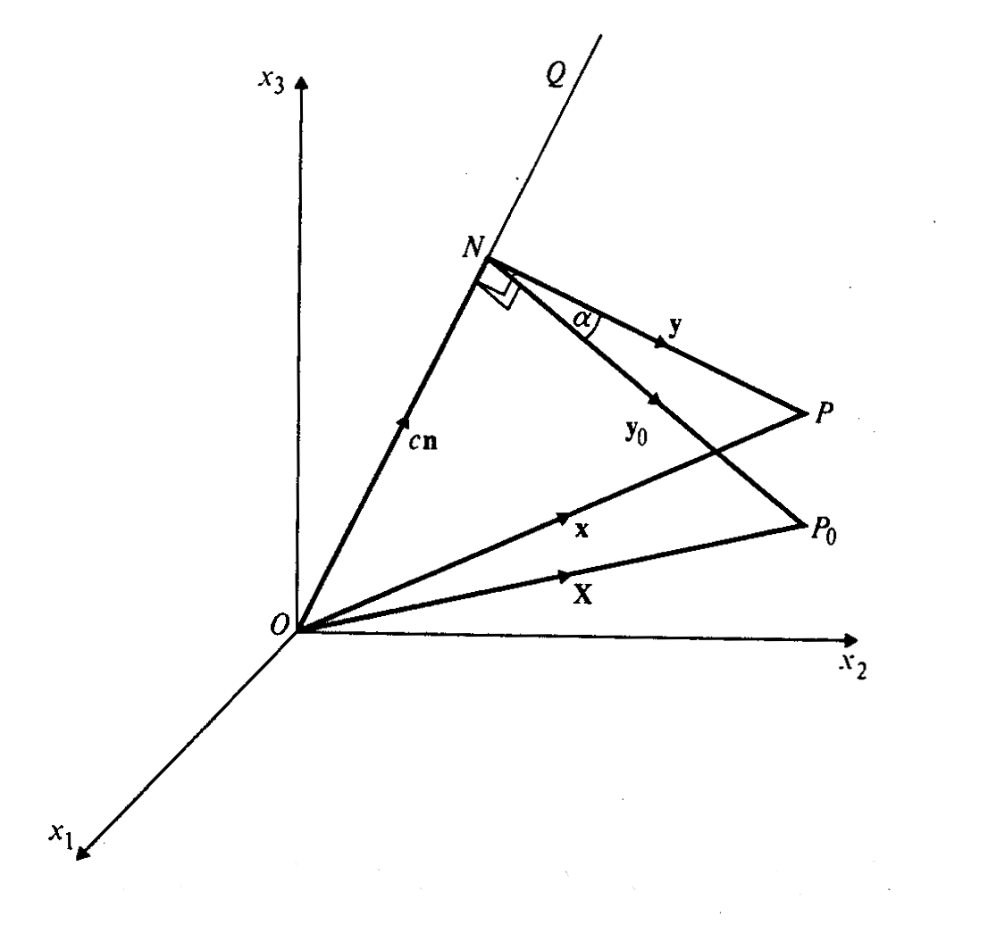
Rotations (Active): Axis- Angle Pair
A rotation is commonly written as ( ,θ) or as (n,ω). The figure illustrates the effect of a rotation about an arbitrary axis, OQ (equivalent to and n) through an angle α (equivalent to θ and ω).
(This is an active rotation: a passive rotation ≡ axis transformation)

Slide 28
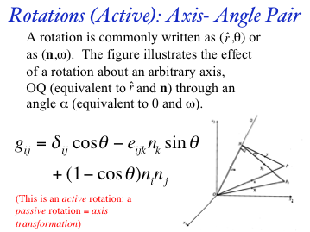
Axis Transformation from Axis-Angle Pair
The rotation can be converted to a matrix (passive rotation) by the following expression, where δ is the Kronecker delta and ε is the permutation tensor; note the change of sign on the off-diagonal terms.
Compare with active rotation matrix!

Slide 29
Rotation Matrix for Axis Transformation from Axis-Angle Pair
This form of the rotation matrix is a passive rotation, appropriate to axis transformations

Slide 30
Eigenvector of a Rotation
A rotation has a single (real) eigenvector which is the rotation axis. Since an eigenvector must remain unchanged by the action of the transformation, only the rotation axis is unmoved and must therefore be the eigenvector, which we will call v. Note that this is a different situation from other second rank tensors which may have more than one real eigenvector, e.g. a strain tensor.

Slide 31
Characteristic Equation
An eigenvector corresponds to a solution of the characteristic equation of the matrix a, where λ is a scalar:
av = λv
(a - λI)v = 0
det(a - λI) = 0

Slide 32
Rotation: physical meaning
Characteristic equation is a cubic and so three eigenvalues exist, for each of which there is a corresponding eigenvector.
Consider however, the physical meaning of a rotation and its inverse. An inverse rotation carries vectors back to where they started out and so the only feature to distinguish it from the forward rotation is the change in sign. The inverse rotation, a⁻¹ must therefore share the same eigenvector since the rotation axis is the same (but the angle is opposite).

Slide 33
Forward vs. Reverse Rotation
Therefore we can write:
a v = a⁻¹ v = v,
and subtract the first two quantities.
(a – a⁻¹) v = 0.
The resultant matrix, (a – a⁻¹) clearly has zero determinant (required for non-trivial solution of a set of homogeneous equations).

Slide 34
Eigenvalue = +1
To prove that (a - I)v = 0 (λ = 1): Multiply by a^{T}: a^{T}(a - I)v = 0 (a^{T}a - a^{T})v = 0 (I - a^{T})v = 0.
Add the first and last equations: (a - I)v + (I - a^{T})v = 0 (a - a^{T})v = 0.
If a^{T}a≠I, then the last step would not be valid.
The last result was already demonstrated.
Orthogonal matrix property

Slide 35
Rotation Axis from Matrix
One can extract the rotation axis, n, (the only real eigenvector, same as v in previous slides, associated with the eigenvalue whose value is +1) in terms of the matrix coefficients for (a - a^{T})v = 0, with a suitable normalization to obtain a unit vector:
Note the order (very important) of the coefficients in each subtraction; again, if the matrix represents an active rotation, then the sign is inverted.

Slide 36
Rotation Axis from Matrix, contd.
(a – a⁻¹) =
Given this form of the difference matrix, based on a⁻¹ = a^{T}, the only non-zero vector that will satisfy (a – a⁻¹) n = 0 is:

Slide 37
Rotation Angle from Matrix
Another useful relation gives us the magnitude of the rotation, θ, in terms of the trace of the matrix, a_{ii}:
, therefore, cos θ = 0.5 (trace(a) – 1).
- In numerical calculations, it can happen that tr(a)-1 is either slightly greater than 1 or slightly less than -1. Provided that there is no logical error, it is reasonable to truncate the value to +1 or -1 and then apply ACOS.
- Note that if you try to construct a rotation of greater than 180° (which is perfectly possible using the formulas given), what will happen when you extract the axis-angle is that the angle will still be in the range 0-180° but you will recover the negative of the axis that you started with. This is a limitation of the rotation matrix (which the quaternion does not share).

Slide 38
(Small) Rotation Angle from Matrix
What this shows is that for small angles, it is safer to use a sine-based formula to extract the angle (be careful to include only a₁₂-a₂₁, but not a₂₁-a₁₂). However, this is strictly limited to angles less than 90° because the range of ASIN is -π/2 to +π/2, in contrast to ACOS, which is 0 to π, and the formula below uses the squares of the coefficients, which means that we lose the sign of the (sine of the) angle. Thus, if you try to use it generally, it can easily happen that the angle returned by ASIN is, in fact, π-θ because the positive and the negative versions of the axis will return the same value.

Slide 39
Rotation Angle = 180°
A special case is when the rotation, θ, is equal to 180° (=π). The matrix then takes the special form:
In this special case, the axis is obtained thus:
However, numerically, the standard procedure is surprisingly robust and, apparently, only fails when the angle is exactly 180°.

Slide 40
Trace of the (mis)orientation matrix
Thus the cosine, v, of the rotation angle, v=cosθ, expressed in terms of the Euler angles:

Slide 41
Is a Rotation a Tensor? (yes!)
Recall the definition of a tensor as a quantity that transforms according to this convention, where Λ is an axis transformation, and a is a rotation:
a’ = Λ^{T} a Λ
Since this is a perfectly valid method of transforming a rotation from one set of axes to another, it follows that an active rotation can be regarded as a tensor. (Think of transforming the axes on which the rotation axis is described.)

Slide 42
Matrix, Miller Indices
In the following, we recapitulate some results obtained in the discussion of texture components (where now it should be clearer what their mathematical basis actually is).
The general Rotation Matrix, a, can be represented as in the following:
Where the Rows are the direction cosines for [100], [010], and [001] in the sample coordinate system (pole figure).
[100] direction
[010] direction
[001] direction

Slide 43
Matrix, Miller Indices
The columns represent components of three other unit vectors:
Where the Columns are the direction cosines (i.e. hkl or uvw) for the RD, TD and Normal directions in the crystal coordinate system.
[uvw]≡RD
TD
ND≡(hkl)

Slide 44
Compare Matrices
[uvw]
(hkl)
[uvw]
(hkl)

Slide 45
Summary
The rules for working with vectors and matrices, i.e. mathematics, especially with respect to rotations and transformations of axes, has been reviewed.

Slide 46
Supplemental Slides
[none]

