Slide 1


Rodrigues vectors,
unit Quaternions
27-750
Texture, Microstructure & Anisotropy
A.D. (Tony) Rollett, S. R. Wilson
Last revised: 26th Jan. 2015

Slide 2
Objectives
Briefly describe rotations/orientations
Introduce Rodrigues-Frank vectors
Introduce unit quaternions
Learn how to manipulate and use quaternions as rotation operators
Discuss conversions between Euler angles, rotation matrices, RF vectors, and quaternions

Slide 3
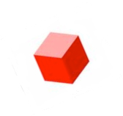
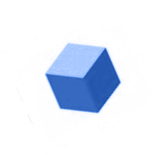
Why do we need to learn about orientations and rotations?
g_{A}
g_{B}
g_{S}
Orientation distributions: Define single-grain orientations relative sample reference frame, and take symmetry into account.

Slide 4
Why do we need to learn about orientations and rotations?
Δg_{AB} = g_{B}g_{A}⁻¹
g_{A}
g_{B}
g_{S}
Misorientation distributions: Compare orientations on either side of grain boundaries to determine boundary character.
MISORIENTATION : The rotation required to transform from the coordinate system of grain A to grain B

Slide 5
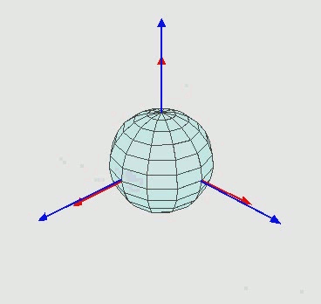
Review: Euler angles
Euler angles:
ANY rotation can be written as the composition of, at most, 3 very simple rotations.
R(φ₁,Φ,φ₂) = R(φ₂)R(Φ)R(φ₁)
Once the Euler angles are known, rotation matrices for any rotation are therefore straight-forward to compute.
Note the order in which the rotation sequence is written (for passive rotations): the 1st is on the right, and the last is on the left.
z-x-z rotation sequence
Movie credit: Wikipedia

Slide 6
Review: Euler angles
Difficulties with Euler angles:
Non-intuitive, difficult to visualize.
There are 12 different possible axis-angle sequences. The “standard” sequence varies from field to field, and even within fields.
We use the Bunge convention, as noted on the movie.
Every rotation sequence contains at least one artificial singularity, where Euler angles do not make sense, and which can lead to numerical instability in nearby regions.
Operations involving rotation matrices derived from Euler angles are not nearly as efficient as quaternions.
z-x-z rotation sequence
Movie credit: Wikipedia

Slide 7

Passive rotations
We want to be able to quantify transformations between coordinate systems
“Passive” rotations:
Given the coordinates (v_{x},v_{y},v_{z}) of vector v in the black coordinate system, what are its coordinates (v_{x},v_{y},v_{z}) in the red system?
Unit sphere

Slide 8
Active rotations
We want to be able to quantify transformations between coordinate systems
“Active” rotations:
Given the coordinates (v_{x},v_{y},v_{z}) of vector v in the black coordinate system, what are the coordinates (w_{x},w_{y},w_{z}) of the rotated vector w in the (same) black system?
Unit sphere
Passive / Active : “only a minus sign” difference, but it is very important

Slide 9
Basics, reviewed
We also need to describe how to quantify and represent the rotation that relates any two orientations
An orientation may be represented by the rotation required to transform from a specified reference orientation (sample axes)
Unit sphere
We need to be able to quantitatively represent and manipulate 3D rotations in order to deal with orientations

Slide 10
How to relate two orthonormal bases?
First pick a direction represented by a unit normal r
Two numbers related to the black system are needed to determine r
Unit sphere
(i.e. r_{x} and r_{y}, or latitude and longitude, or azimuthal and polar angles)

Slide 11
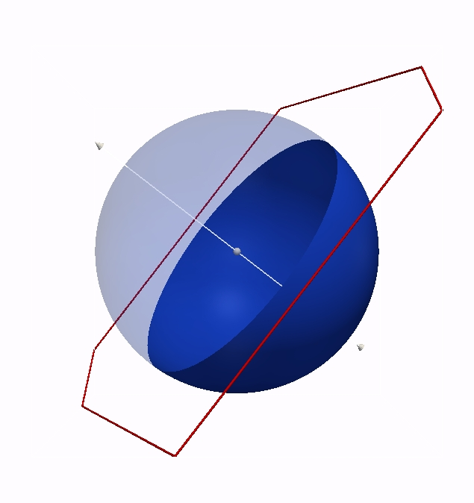
How to relate two orthonormal bases?
To specify an orthonormal basis, one more number is needed (such as an angle in the plane perpendicular to r)
Three numbers are required to describe a transformation from the black basis to the red basis
Unit sphere
. . .the “right hand rule” and orthogonality determine the position of third basis vector.

Slide 12
Rodrigues vectors
Any rotation may therefore be characterized by an axis r and a rotation angle α about this axis
R(r, α )
“axis-angle” representation
The RF representation instead scales r by the tangent of α/2
BEWARE: Rodrigues vectors do NOT obey the parallelogram rule (because rotations are NOT commutative!) See slide 16…
Note semi-angle

Slide 13
Rodrigues vectors
Rodrigues vectors were popularized by Frank [“Orientation mapping.” Metall. Trans. 19A: 403-408 (1988)], hence the term Rodrigues-Frank space for the set of vectors.
Most useful for representation of misorientations, i.e. grain boundary character; also useful for orientations (texture components).
Application to misorientations is popular because the Rodrigues vector is so closely linked to the rotation axis, which is meaningful for the crystallography of grain boundaries.

Slide 14
Axis-Angle from Matrix
The rotation axis, r, is obtained from the skew-symmetric part of the matrix:
Another useful relation gives us the magnitude of the rotation, θ, in terms of the trace of the matrix, a_{ii}:
, therefore,
cos θ = 0.5 (trace(a) – 1).
See the slides on Rotation_matrices for what to do when you have small angles, or if you want to use the full range of 0-360° and deal with switching the sign of the rotation axis. Also, be careful that the argument to arc-cosine is in the range -1 to +1 : round-off in the computer can result in a value outside this range.

Slide 15
Conversions: matrix→RF vector
Conversion from rotation (misorientation) matrix, due to Morawiec, with ∆g_{AB}=g_{B}g_{A}⁻¹:

Slide 16
Conversion from Bunge Euler Angles
tan(α/2) = √{(1/[cos(Φ/2) cos{(φ₁ + φ₂)/2}]² – 1}
ρ₁ = tan(Φ/2) [cos{(φ₁ - φ₂)/2}/cos{(φ₁ + φ₂)/2}]
ρ₂ = tan(Φ/2) [sin{(φ₁ - φ₂)/2}/[cos{(φ₁ + φ₂)/2}]
ρ₃ = tan{(φ₁ + φ₂)/2}
P. Neumann (1991). “Representation of orientations of symmetrical
objects by Rodrigues vectors.”
Textures and Microstructures 14-18: 53-58.
Conversion from Rodrigues to Bunge Euler angles:
sum = atan(R₃) ; diff = atan ( R₂/R₁ )
φ₁ = sum + diff; Φ = 2. * atan(R2 * cos(sum) / sin(diff) ); φ₂ = sum - diff

Slide 17

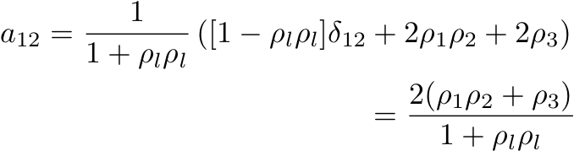
Conversion Rodrigues vector to axis transformation matrix
Due to Morawiec:
Example for the 12 entry:
NB. Morawiec’s Eq. on p.22 has a minus sign in front of the last term; this will give an active rotation matrix, rather than the passive rotation matrix seen here.

Slide 18
Combining Rotations as RF vectors
Two Rodrigues vectors combine to form a third, ρ_{C}, as follows, where ρ_{B} follows after ρ_{A}. Note that this is not the parallelogram law for vectors!
ρ_{C} = (ρ_{A}, ρ_{B}) =
{ρ_{A} + ρ_{B} - ρ_{A} x ρ_{B}}/{1 - ρ_{A}•ρ_{B}}
addition
vector product
scalar product

Slide 19
Combining Rotations as RF vectors: component form

Slide 20
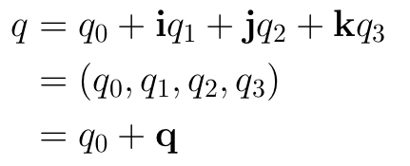

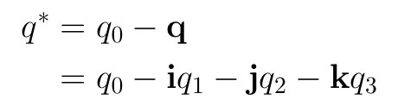
Quaternions: Yet another representation of rotations
What is a quaternion?
A quaternion is first of all an ordered set of four real numbers q₀, q₁, q₂, and q₄.
Here, i, j, k are the familiar unit vectors that correspond to the x-, y-, and z-axes, resp.
Scalar part
Vector part
Addition of two quaternions and multiplication of a quaternion by a real number are as would be expected of normal four-component vectors.
Magnitude of a quaternion:
Conjugate of a quaternion:

Slide 21




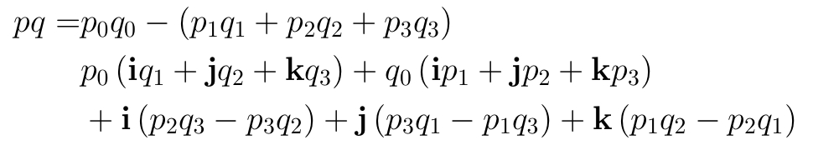
Multiplication of two quaternions
However, quaternion multiplication is ingeniously defined in such a way so as to reproduce rotation composition.
Multiplication of the basis quaternions is defined as follows:
[1] Quaternion multiplication is non-commutative (pq≠qp).
[2] There are similarities to complex numbers (which correspond to rotations in 2D).
[3] The first rotation is on the left (“p”, below) and the second (“q”) is on the right (contrast with matrix multiplication).
From these rules it can be shown that the product of two arbitrary quaternions p,q is given by:
Using more compact notation:
again, note the + in front of the vector product
Scalar part
Vector part
On a New Species of Imaginary Quantities Connected with a Theory of Quaternions,
by William Rowan Hamilton, Proceedings of the Royal Irish Academy, 2 (1844), 424–434.

Slide 22


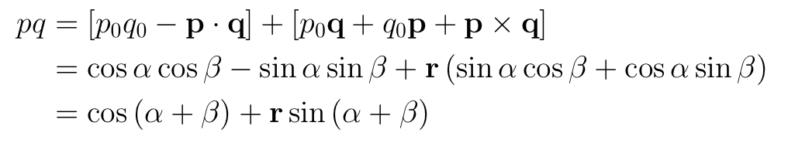
Unit quaternions as rotations
We state without proof that a rotation of α degrees about the (normalized) axis r may be represented by the following unit quaternion:
It is easy to see that this is a unit quaternion, i.e. that
Note the similarity to Rodrigues vectors.
For two rotations q and p that share a single axis r, note what happens when q (2nd) and p (1st) are composed or multiplied together:

Slide 23
Quaternions as symmetry operators
Here we recapitulate what we have studied elsewhere, namely the application of crystal and sample symmetry to orientations.
With matrices, recall that a) each successive rotation left-multiplies its predecessor, and b) an orientation, g, describes a transformation from sample to crystal. Therefore a crystal symmetry operator goes on the left whereas a sample symmetry operator goes on the right.
For quaternions there exists an exactly equivalent scheme, based on the definitions given already. For simplicity we show two separate compositions, one for sample symmetry, one for crystal.

Slide 24

Multiplication of a quaternion
and a 3-D vector
It is useful to define the multiplication of vectors and quaternions as well. Vectors have three components, and quaternions have four. How to proceed?
Every vector v corresponds to a “pure” quaternion whose 0th component is zero.
…and proceed as with two quaternions:
Note that in general that the product of a quaternion and a vector can result in a non-pure quaternion with non-zero scalar component.

Slide 25


Rotation of a vector
by a unit quaternion
Although the quantity qv may not be a vector, it can be shown that the triple products q*vq and qvq* are.
In fact, these vectors are the images of v by passive and active rotations corresponding to quaternion q.
Passive rotation
Active rotation

Slide 26

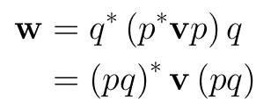

Rotation of a vector by a unit quaternion
Expanding these expressions yields
Passive rotation
Active rotation
Moreover, the composition of two rotations (one rotation following another) is equivalent to quaternion multiplication.
Remember that, within the system of passive rotations, applying the upper expression to a vector in sample space transforms it into crystal space (used for inverse pole figures); changing the sign in front of the vector product reverses the direction of the transformation (used in pole figures).
since

Slide 27
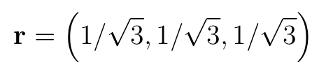
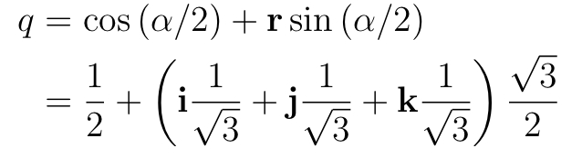

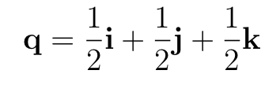
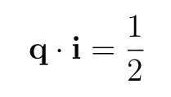
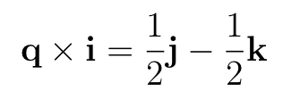
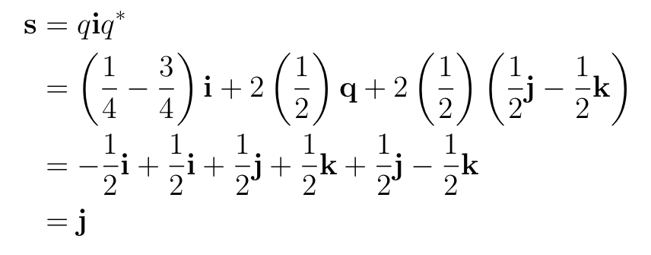
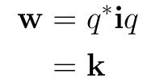
Example: Rotation of a Vector by Quaternion-Vector Multiplication
Consider rotating the vector i by an angle of α = 2π/3 about the <111> direction.
Rotation axis:
k
j
For an active rotation:
i
For a passive rotation:

Slide 28
Conversions: matrix→quaternion
Formulae, due to Morawiec:
Note: passive rotation/ axis transformation (axis changes sign for for active rotation)
Note the coordination of choice of sign!

Slide 29
Conversions: matrix→quaternion
Formulae, from Rowenhorst et al.:
For the meaning of “P”, read the complete paper from the reference at the top.
In our case, P = +1

Slide 30
References
Frank, F. (1988). “Orientation mapping,” Metallurgical Transactions 19A: 403-408.
P. Neumann (1991). “Representation of orientations of symmetrical objects by Rodrigues vectors.” Textures and Microstructures 14-18: 53-58.
Takahashi Y, Miyazawa K, Mori M, Ishida Y. (1986). “Quaternion representation of the orientation relationship and its application to grain boundary problems.” JIMIS-4, pp. 345-52. Minakami, Japan: Trans. Japan Inst. Metals. (1st reference to quaternions to describe grain boundaries).
A. Sutton and R. Balluffi (1996), Interfaces in Crystalline Materials, Oxford.
V. Randle & O. Engler (2000). Texture Analysis: Macrotexture, Microtexture & Orientation Mapping. Amsterdam, Holland, Gordon & Breach.
S. Altmann (2005 - reissue by Dover), Rotations, Quaternions and Double Groups, Oxford.
A. Morawiec (2003), Orientations and Rotations, Springer (Europe).
“On a New Species of Imaginary Quantities Connected with a Theory of Quaternions”, by William Rowan Hamilton, Proceedings of the Royal Irish Academy, 2 (1844), 424–434.
“Des lois géométriques qui régissent les déplacements d’un système solide dans l’espace et de la variation des coordonnées provenant de ces déplacements considérées indépendamment des causes qui peuvent les produire”, M. Olinde Rodrigues, Journal des Mathématiques Pures et Appliquées, 5 380-440.

