Slide 1
Rodrigues vectors and unit Quaternions
27-750 Texture, Microstructure & Anisotropy
A.D. (Tony) Rollett, Seth R. Wilson*
*Iowa State Univ.
Last revised: 21st Mar. 2014

Slide 2
Objectives
Briefly describe rotations/orientations
Introduce Rodrigues-Frank vectors
Introduce quaternions
Learn how to manipulate and use quaternions as rotation operators
Discuss conversions between Euler angles, rotation matrices, RF vectors, and (unit) quaternions

Slide 3
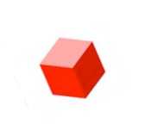
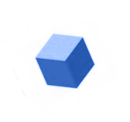
Why do we need to learn about orientations and rotations?
g_{A}
g_{B}
g_{S}
Orientation distributions: Define single-grain orientations relative sample reference frame, and take symmetry into account (both sample and crystal).

Slide 4
Why do we need to learn about orientations and rotations?
Δg_{AB} = g_{B}g_{A}⁻¹
g_{A}
g_{B}
g_{S}
Misorientation distributions: Compare orientations on either side of grain boundaries to determine boundary character.
MISORIENTATION : The rotation required to transform from the coordinate system of grain A to grain B

Slide 5
Review: Euler angles
Euler angles:
ANY rotation can be written as the composition of at most 3 very simple rotations.
R(φ₁,Φ,φ₂) = R(φ₂)R(Φ)R(φ₁)
Once the Euler angles are known, rotation matrices for any rotation are therefore straight-forward to compute.
z-x-z rotation sequence
Movie credit: Wikipedia

Slide 6
Review: Euler angles
Difficulties with Euler angles:
Non-intuitive, difficult to visualize.
There are 12 different possible axis-angle sequences. The “standard” sequence varies from field to field, and even within fields.
Every rotation sequence contains at least one artificial singularity, where Euler angles do not make sense, and which can lead to numerical instability in nearby regions.
Operations involving rotation matricies derived from Euler angles are not nearly as efficient as quaternions.
z-x-z rotation sequence
Movie credit: Wikipedia

Slide 7
Passive rotations
We want to be able to quantify transformations between coordinate systems
“Passive” rotations:
Given the coordinates (v_{x},v_{y},v_{z}) of vector v in the black coordinate system, what are its coordinates (v_{x},v_{y},v_{z}) in the red system?
Unit sphere

Slide 8
Active rotations
We want to be able to quantify transformations between coordinate systems
“Active” rotations:
Given the coordinates (v_{x},v_{y},v_{z}) of vector v in the black coordinate system, what are the coordinates (w_{x},w_{y},w_{z}) of the rotated vector w in the black system?
Unit sphere
Passive / Active : “only a minus sign” difference, but it is very important

Slide 9
Basics, reviewed
We also need to describe how to quantify and represent the rotation that relates any two orientations
An orientation may be represented by the rotation required to transform from a specified reference orientation (sample axes)
Unit sphere
We need to be able to quantitatively represent and manipulate 3D rotations in order to deal with orientations

Slide 10
How to relate two orthonormal bases?
First pick a direction represented by a unit normal r
Two numbers related to the black system are needed to determine r
Unit sphere
(i.e. r_{x} and r_{y}, or latitude and longitude, or azimuthal and polar angles)

Slide 11
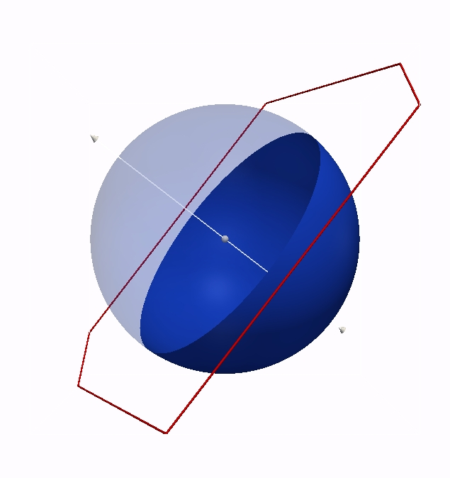
How to relate two orthonormal bases?
To specify an orthonormal basis, one more number is needed (such as an angle in the plane perpendicular to r)
Three numbers are required to describe a transformation from the black basis to the red basis
Unit sphere
. . .the “right hand rule” and orthogonality determine the position of third basis vector.

Slide 12
Rodrigues vectors
Any rotation may therefore be characterized by an axis r and a rotation angle α about this axis
R(r, α )
“axis-angle” representation
The RF representation instead scales r by the tangent of α/2
BEWARE: Rodrigues vectors do NOT obey the parallelogram rule (because rotations are NOT commutative!) See slide 16…
Note semi-angle

Slide 13
Rodrigues vectors
Rodrigues vectors were popularized by Frank [“Orientation mapping.” Metall. Trans. 19A: 403-408 (1988)], hence the term Rodrigues-Frank space for the set of vectors.
Most useful for representation of misorientations, i.e. grain boundary character; also useful for orientations (texture components).
Application to misorientations is popular because the Rodrigues vector is so closely linked to the rotation axis, which is meaningful for the crystallography of grain boundaries.

Slide 14
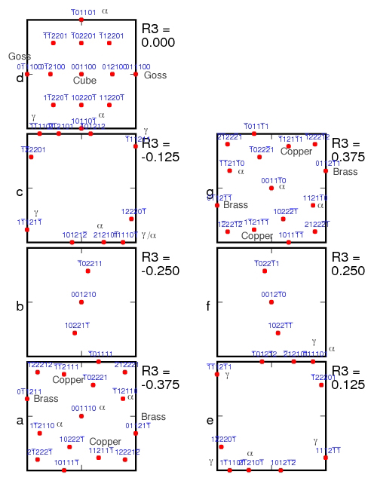
Miller Index Map in RF-space
Cubic crystal symmetry; no sample symmetry
The map shows the location of texture components, identified as (hkl)[uvw], up to order 2.
Note that many of the low index points lie on the boundary of the cubic-triclinic fundamental zone.
If the component has a name, or belongs to a fiber, that is noted next to the point.
Generated by RFpoints_HKLUVW_1Jun07.f

Slide 15
Transformation Matrix from Axis-Angle Pair
Written out as a complete 3x3 matrix:
Note the “+” sign before the third term (with permutation tensor), signifying a passive rotation.

Slide 16
Axis-Angle from Matrix
The rotation axis, r, is obtained from the skew-symmetric part of the matrix:
Another useful relation gives us the magnitude of the rotation, θ, in terms of the trace of the matrix, a_{ii}:
, therefore, cos θ = 0.5 (trace(a) – 1). See the slides on Rotation_matrices for what to do when you have small angles, or if you want to use the full range of 0-360° and deal with switching the sign of the rotation axis. Also, be careful that the argument to arc-cosine is in the range -1 to +1 : round-off in the computer can result in a value outside this range.

Slide 17
Symmetry Operator examples
Diad on z: [uvw] = [001], θ = 180° - substitute the values of uvw and angle into the formula
4-fold on x: [uvw] = [100] θ = 90°

Slide 18
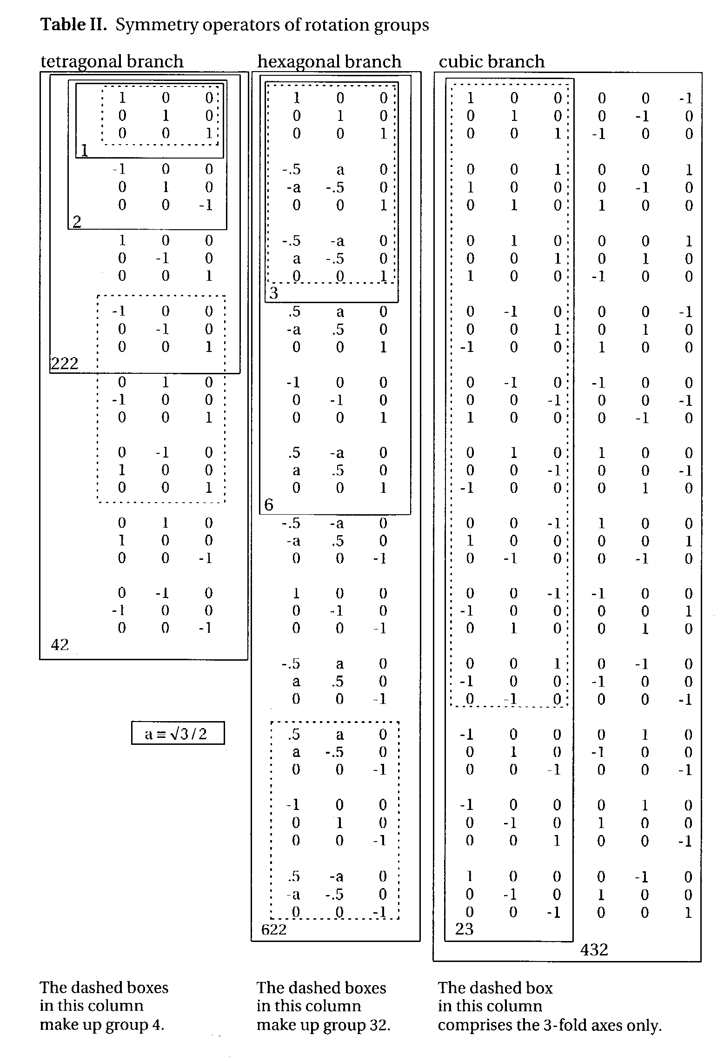
Matrix representation of the rotation point groups
-
What is a group? A group is a set of objects that form a closed set: if you combine any two of them together, the result is simply a different member of that same group of objects. Rotations in a given point group form closed sets - try it for yourself!
Note: the 3rd matrix in the 1st column (x-diad) is missing a “-” on the 33 element; this is corrected in this slide. Also, in the 2nd from the bottom, last column: the 33 element should be +1, not -1. In some versions of the book, in the last matrix (bottom right corner) the 33 element is incorrectly given as -1; here the +1 is correct.
Kocks, Tomé, Wenk: Ch. 1 Table II
The 4 operators enclosed in orange boxes are also the 222 point group, appropriate to orthorhombic symmetry
Notes:
Complicated slide with much data. Illustrates the different matrices used. Note that the coefficients for the 6-fold rotation axes do not have unit values.

Slide 19
Cubic Crystal Symmetry Operators
The numerical values of these symmetry operators can be found at: http://neon.materials.cmu.edu/texture_subroutines: quat.cubic.symm etc.

Slide 20
(432) in unit quaternions
quat.symm.cubic file with 24 proper rotations in quaternion form
24
0 0 0 1
1 0 0 0
0 1 0 0
0 0 1 0
0.707107 0 0 0.707107
0 0.707107 0 0.707107
0 0 0.707107 0.707107
-0.707107 0 0 0.707107
0 -0.707107 0 0.707107
0 0 -0.707107 0.707107
0.707107 0.707107 0 0
-0.707107 0.707107 0 0
0 0.707107 0.707107 0
0 -0.707107 0.707107 0
0.707107 0 0.707107 0
-0.707107 0 0.707107 0
0.5 0.5 0.5 0.5
-0.5 -0.5 -0.5 0.5
0.5 -0.5 0.5 0.5
-0.5 0.5 -0.5 0.5
-0.5 0.5 0.5 0.5
0.5 -0.5 -0.5 0.5
-0.5 -0.5 0.5 0.5
0.5 0.5 -0.5 0.5
Cubic point group; proper rotations expressed as quaternions; the first four lines/elements/operators are equivalent to (222) and represent orthorhombic symmetry; the next 12 lines are 90° rotations about <100> or 180° rotations about <110>; the last 8 lines are 120° rotations.

Slide 21
Conversions: matrix→RF vector
Conversion from rotation (misorientation) matrix, due to Morawiec, with ∆g_{AB}=g_{B}g_{A}⁻¹:

Slide 22
Conversion from Bunge Euler Angles
tan(α/2) = √{(1/[cos(Φ/2) cos{(φ₁ + φ₂)/2}]² – 1}
ρ₁ = tan(Φ/2) [cos{(φ₁ - φ₂)/2}/cos{(φ₁ + φ₂)/2}]
ρ₂ = tan(Φ/2) [sin{(φ₁ - φ₂)/2}/[cos{(φ₁ + φ₂)/2}]
ρ₃ = tan{(φ₁ + φ₂)/2}
P. Neumann (1991). “Representation of orientations of symmetrical objects by Rodrigues vectors.” Textures and Microstructures 14-18: 53-58.
Conversion from Rodrigues to Bunge Euler angles:
sum = atan(R₃) ; diff = atan ( R₂/R₁ ) φ₁ = sum + diff; Φ = 2. * atan(R2 * cos(sum) / sin(diff) ); φ₂ = sum - diff

Slide 23
Conversion Rodrigues vector to axis transformation matrix
Due to Morawiec:
Example for the 12 entry:
NB Morawiec’s Eq on p22 has a minus sign in front of the last term; this will give an active rotation matrix, rather than the passive rotation matrix seen here.

Slide 24
Combining Rotations as RF vectors
Two Rodrigues vectors combine to form a third, ρ_{C}, as follows, where ρ_{B} follows after ρ_{A}. Note that this is not the parallelogram law for vectors! ρ_{C} = (ρ_{A}, ρ_{B}) = {ρ_{A} + ρ_{B} - ρ_{A} x ρ_{B}}/{1 - ρ_{A}•ρ_{B}}
addition
vector product
scalar product

Slide 25
Combining Rotations as RF vectors: component form

Slide 26
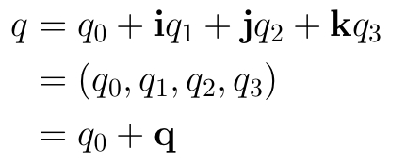
Quaternions: Yet another representation of rotations
What is a quaternion?
A quaternion is first of all an ordered set of four real numbers q₀, q₁, q₂, and q₃, (sometimes q₁, q₂ q₃, and q₄) .
Here, i, j, k are the familiar unit vectors that correspond to the x-, y-, and z-axes, resp.
Scalar part
Vector part
Addition of two quaternions and multiplication of a quaternion by a real number are as would be expected of normal four-component vectors.
Magnitude of a quaternion:
Conjugate of a quaternion:
On a New Species of Imaginary Quantities Connected with a Theory of Quaternions, by William Rowan Hamilton, Proceedings of the Royal Irish Academy, 2 (1844), 424–434.

Slide 27
Multiplication of two quaternions
However, quaternion multiplication is ingeniously defined in such a way so as to reproduce rotation composition.
Multiplication of the basis quaternions is defined as follows:
[1] Quaternion multiplication is non-commutative (pq≠qp).
[2] There are similarities to complex numbers (which correspond to rotations in 2D).
From these rules it can be shown that the product of two arbitrary quaternions p,q is given by:
Using more compact notation:
Scalar part
Vector part
On a New Species of Imaginary Quantities Connected with a Theory of Quaternions, by William Rowan Hamilton, Proceedings of the Royal Irish Academy, 2 (1844), 424–434.

Slide 28
Unit quaternions as rotations
We state without proof that a rotation of α degrees about the (normalized) axis r may be represented by the following unit quaternion:
It is easy to see that this is a unit quaternion, i.e. that
Note the similarity to Rodrigues vectors, except with a different scaling.
For two rotations q and p that share a single axis r, note what happens when q and p are multiplied:

Slide 29
Multiplication of a quaternion
and a 3-D vector
It is useful to define the multiplication of vectors and quaternions as well. Vectors have three components, and quaternions have four. How to proceed?
Every vector v corresponds to a “pure” quaternion whose 0th component is zero.
…and proceed as with two quaternions:
Note that in general that the product of a quaternion and a vector can result in a non-pure quaternion with non-zero scalar component.

Slide 30
Rotation of a vector
by a unit quaternion
Although the quantity qv may not be a vector, it can be shown that the triple products q*vq and qvq* are.
In fact, these vectors are the images of v by passive and active rotations corresponding to quaternion q.
Passive rotation
Active rotation

Slide 31
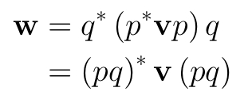
Rotation of a vector by a unit quaternion
Expanding these expressions yields
Passive rotation
Active rotation
Moreover, the composition of two rotations (one rotation following another) is equivalent to quaternion multiplication.
since

Slide 32
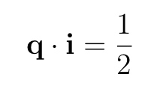
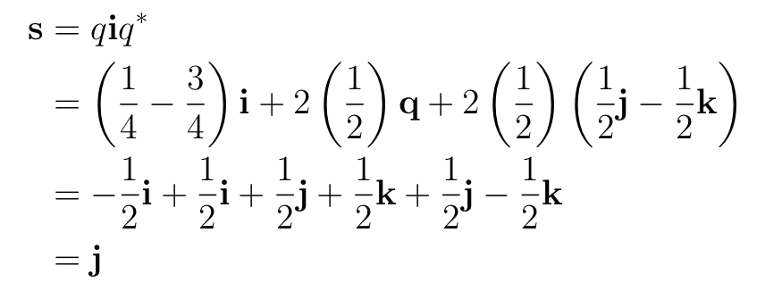
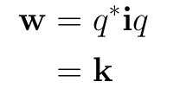
Example: Rotation of a Vector by Quaternion-Vector Multiplication
Consider rotating the vector i by an angle of α = 2π/3 about the <111> direction.
Rotation axis:
k
j
For an active rotation:
i
For a passive rotation:

Slide 33
Positive vs Negative Rotations
One curious feature of quaternions that is not obvious from the definition is that they allow positive and negative rotations to be distinguished. This is more commonly described in terms of requiring a rotation of 4π to retrieve the same quaternion as you started out with but for visualization, it is more helpful to think in terms of a difference in the sign of rotation.

Slide 34
Positive vs Negative Rotations
Let’s start with considering a positive rotation of θ about an arbitrary axis, r. From the point of view of the result one obtains the same thing if one rotates backwards by the complementary angle, θ - 2π (also about r). Expressed in terms of quaternions, however, the representation is different! Setting r = [u,v,w] again,
q(r,θ) = q(u sinθ/2, v sinθ/2, w sinθ/2, cosθ/2)
θ
θ - 2π

Slide 35
Positive vs Negative Rotations
q(r,θ−2π) = q(u sin(θ−2π)/2, v sin(θ−2π)/2, w sin(θ−2π)/2, cos(θ−2π)/2) = q(-u sinθ/2, -v sinθ/2, -w sinθ/2, -cosθ/2)= -q(r,θ)
θ
θ - 2π

Slide 36
Positive vs Negative Rotations
The result, then is that the quaternion representing the negative rotation is the negative of the original (positive) rotation. This has some significance for treating dynamic problems and rotation: angular momentum, for example, depends on the sense of rotation. For static rotations, however, the positive and negative quaternions are equivalent or, more to the point, physically indistinguishable, q ≡ -q.
Caution! By “negative rotation” we mean the position arrived at by rotating in the opposite direction. This is not the same as taking the same axis but rotating in the opposite sense.

Slide 37
Conversions: matrix→quaternion
Formulae, due to Morawiec:
Note: passive rotation/ axis transformation (axis changes sign for for active rotation)
Note the coordination of choice of sign!

Slide 38
Bunge angles → quaternion
[q₁, q₂, q₃, q₄] = [sinΦ/2 cos{(φ₁ - φ₂)/2 }, sinΦ/2 sin{(φ₁ - φ₂)/2}, cosΦ/2 sin{φ₁ + φ₂)/2}, cosΦ/2 cos{(φ₁ + φ₂)/2} ]
Note the occurrence of sums and differences of the 1st and 3rd Euler angles (that eliminate the degeneracy at the origin of Euler space)!

Slide 39
References
Frank, F.C. (1988). “Orientation mapping,” Metallurgical Transactions 19A: 403-408.
P. Neumann (1991). “Representation of orientations of symmetrical objects by Rodrigues vectors.” Textures and Microstructures 14-18: 53-58.
Takahashi Y, Miyazawa K, Mori M, Ishida Y. (1986). “Quaternion representation of the orientation relationship and its application to grain boundary problems.” JIMIS-4, pp. 345-52. Minakami, Japan: Trans. Japan Inst. Metals. (1st reference to quaternions to describe grain boundaries).
A. Sutton and R. Balluffi (1996), Interfaces in Crystalline Materials, Oxford.
V. Randle & O. Engler (2000). Texture Analysis: Macrotexture, Microtexture & Orientation Mapping. Amsterdam, Holland, Gordon & Breach.
S. Altmann (2005 - reissue by Dover), Rotations, Quaternions and Double Groups, Oxford.
A. Morawiec (2003), Orientations and Rotations, Springer (Europe).
William Rowan Hamilton (1844), “On a New Species of Imaginary Quantities Connected with a Theory of Quaternions”, Proceedings of the Royal Irish Academy, 2: 424–434.
M. Olinde Rodrigues (1840), “Des lois géométriques qui régissent les déplacements d’un système solide dans l’espace et de la variation des coordonnées provenant de ces déplacements considérées indépendamment des causes qui peuvent les produire”, Journal des Mathématiques Pures et Appliquées, 5: 380-440.

