Slide 1
Plastic Anisotropy: Relaxed Constraints, Theoretical Textures
Texture, Microstructure & Anisotropy
A.D. Rollett
Last revised: 29th Apr. 2014

Slide 2
Objective
The objective of this lecture is to complete the description of plastic anisotropy.
Vectorization of stress and strain
Definition of Taylor factor
Comparison of single with multiple slip
Description of Relaxed Constraints

Slide 3
References
Kocks, Tomé & Wenk: Texture & Anisotropy (Cambridge); chapter 8, 1996. Detailed analysis of plastic deformation and texture development.
Reid: Deformation Geometry for Materials Scientists, 1973. Older text with many nice worked examples. Be careful of his examples of calculation of Taylor factor because, like Bunge & others, he does not use von Mises equivalent stress/strain to obtain a scalar value from a multiaxial stress/strain state.
Hosford: The Mechanics of Crystals and Textured Polycrystals, 1993 (Oxford). Written from the perspective of a mechanical metallurgist with decades of experimental and analytical experience in the area.
Khan & Huang: Continuum Theory of Plasticity. Written from the perspective of continuum mechanics.
De Souza Neto, Peric & Owen: Computational Methods for Plasticity, 2008 (Wiley). Written from the perspective of continuum mechanics.

Slide 4
Vectorization of stress, strain
The lack of dependence on hydrostatic stress and volume constancy permits a different vectorization to be used (cf. matrix notation for anisotropic elasticity). The following set of basis tensors provides a systematic approach. The first tensor, b⁽¹⁾ represents deviatoric tension on Z, second plane strain compression in the Z plane, and the second row are the three simple shears in the {XYZ} system. The first two tensors provide a basis for the π-plane.

Slide 5
Vectorization: 2
The components of the vectorized stresses and strains are then contractions (projections) with the basis tensors: σ_{λ} = σ:b^{(λ)}, ε_{λ} = ε:b^{(λ)}
There is, in fact, a 6th eigentensor that separates out the hydrostatic components of stress and strain

Slide 6
Vectorization: 3
This preserves work conjugacy, i.e. σ:ε = Σ_{λ}σ_{λ}ε_{λ}. The Lequeu vectorization scheme was almost the same as this but with the first two components interchanged. It is also useful to see the vector forms in terms of the regular tensor components.

Slide 7
Maximum work, summary
The sum of the shears for the actual set of active systems is less than any hypothetical set (Taylor’s hypothesis). This also shows that we have obtained an upper bound on the stress required to deform the crystal because we have approached the solution for the work rate from above: any hypothetical solution results in a larger work rate than the actual solution.

Slide 8
Taylor factor, M
We can take ratios of stresses, or strains to define the Taylor factor, M; if a simple choice of deformation axes is made, such as uniaxial tension, then the indices can be dropped to obtain the typical form of the equation, σ = <M>τ_{crss}. For the polycrystal, the arithmetic mean of the Taylor factors is typically used to represent the ratio between the macroscopic flow stress and the critical resolved shear stress. This relies on the assumption that weak (low Taylor factor) grains cannot deform much until the harder ones are also deforming plastically, and that the harder (high Taylor factor) grains are made to deform by a combination of stress concentration and work hardening around them.

Slide 9
Taylor factor, multiaxial stress
For multiaxial stress states, one may use the effective stress, e.g. the von Mises stress (defined in terms of the stress deviator tensor, S=σ-(σ_{ii}/3), and also known as effective stress). Note that the equation below provides the most self-consistent approach for calculating the Taylor factor for multi-axial deformation.

Slide 10
Taylor factor, multiaxial strain
Similarly for the strain increment (where dε_{p} is the plastic strain increment which has zero trace, i.e. dε_{ii}=0).
Compare with single slip: Schmid factor = cosφcosλ = τ/σ

Slide 11
Uniaxial compression/tension
So, for axisymmetric straining paths, the orientation dependence within a Standard Stereographic Triangle (SST) is as follows. The velocity gradient has the form:
The von Mises equivalent strain for such a tensile strain is always 2δ.

Slide 12
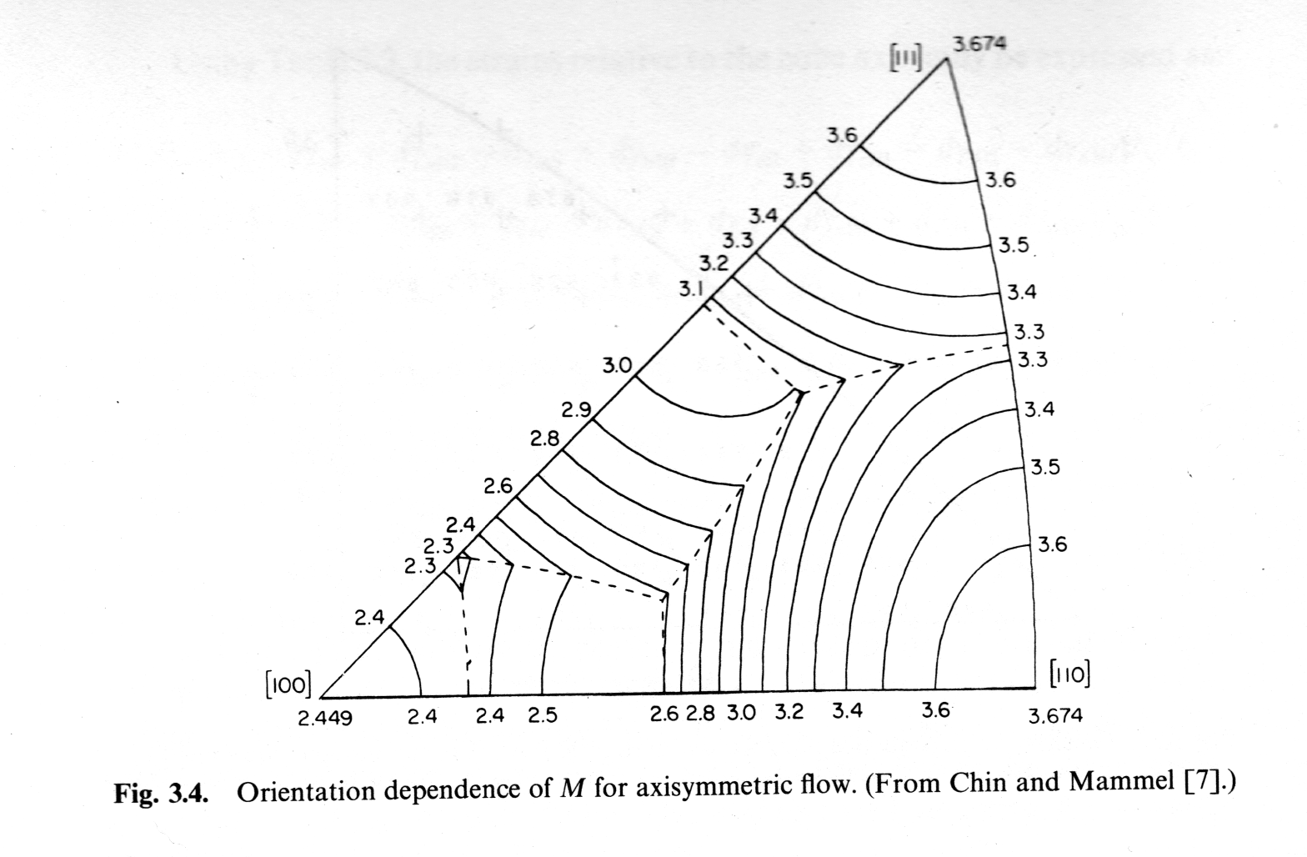
Taylor factor(orientation)
Hosford: mechanics of xtals...

Slide 13
Texture hardening
Note that the Taylor factor is largest at both the 111 and 110 positions and a minimum at the 100 position. Thus a cubic material with a perfect <111> or <110> fiber will be 1.5 times as strong in tension or compression as the same material with a <100> fiber texture. This is not as dramatic a strengthening as can be achieved by other means, e.g. precipitation hardening, but it is significant. Also, it can be achieved without sacrificing other properties.

Slide 14
Uniaxial deformation: single slip
Recall the standard picture of the single crystal under tensile load. In this case, we can define angles between the tensile direction and the slip plane normal, φ, and also between the tensile direction and the slip direction, λ. Given an applied tensile stress (force over area) on the crystal, we can calculate the shear stress resolved onto the particular slip system as τ=σcosφcosλ. This simple formula (think of using only the direction cosine for the slip plane and direction that corresponds to the tensile axis) then allows us to rationalize the variation of stress with testing angle (crystal orientation) with Schmid's Law concerning the existence of a critical resolved shear stress.

Slide 15
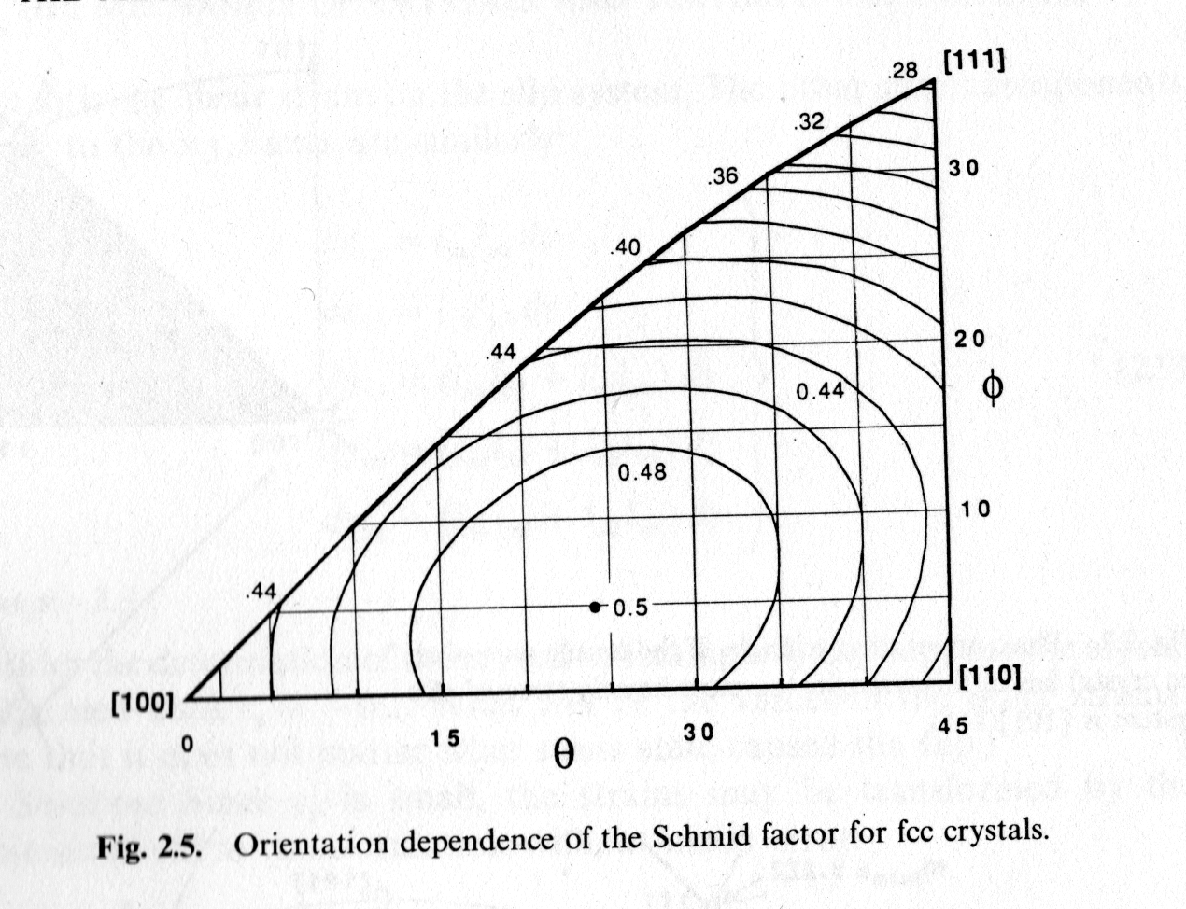
Single slip: Schmid factors
Re-write the relationship in terms of (unit) vectors that describe the slip plane, n, and slip direction, b: index notation and tensor notation are used interchangeably.

Slide 16
Single: multiple comparison
It is interesting to consider the difference between multiple slip and single slip stress levels because of its relevance to deviations from the Taylor model. Hosford presents an analysis of the ratio between the stress required for multiple slip and the stress for single slip under axisymmetric deformation conditions (in {111}<110> slip).

Slide 17
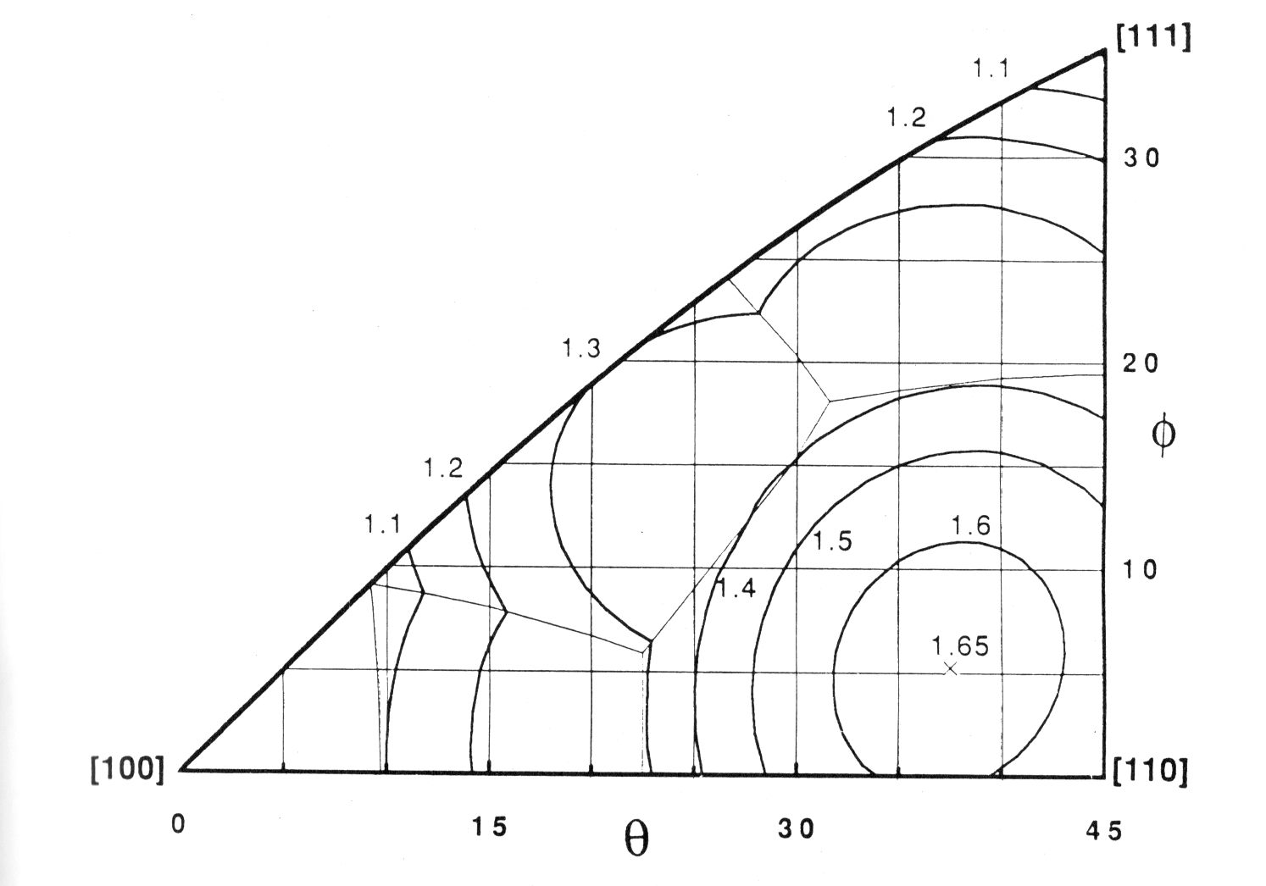
Single: Multiple comparison
Max. difference (=1.65) between single & multiple slip
Figure 6.2 from Ch. 6 of Hosford, showing the ratio of the Taylor factor to the reciprocal Schmid factor, M/(1/m), for axisymmetric flow with {111}<110> slip. Orientations near 110 exhibit the largest ratios and might therefore be expected to deviate most readily from the Taylor model.

Slide 18
Single: Multiple comparison
The result expressed as a ratio of the Taylor factor to the reciprocal Schmid factor is that orientations near 100 or 111 exhibit negligible differences whereas orientations near 110 exhibit the largest differences. This suggests that the latter orientations are the ones that would be expected to deviate most readily from the Taylor model. In wire drawing of bcc metals, this is observed*: the grains tend to deform in plane strain into flat ribbons. The flat ribbons then curl around each other in order to maintain compatibility.
*W. F. Hosford, Trans. Met. Soc. AIME, 230 (1964), pp. 12.

Slide 19
Plane Strain Compression
So, for plane strain straining paths, the velocity gradient has the form:
The von Mises equivalent strain for such a tensile strain is always 2/√3δ = 1.155δ. Note that this value leads to different results for the Taylor factor, compared to examples in, e.g., Reid and in Bunge (but is consistent with the definitions in the LApp code).

Slide 20
Relaxed Constraints
An important modification of the Taylor model is the Relaxed Constraints (RC) model. It is important because it improves the agreement between experimental and calculated textures. The model is based on the development of large aspect ratios in grain shape with increasing strain. It makes the assumption that certain components of shear strain generate displacements in volumes that are small enough that they can be neglected. Thus any shear strain developed parallel to the short direction in an elongated grain (e.g. in rolling) produces a negligible volume of overlapping material with a neighboring grain.

Slide 21
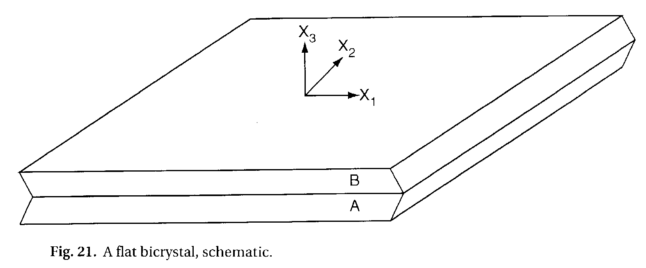
Relaxed Constraints, contd.
In the case of rolling, both the ε₁₃ and the ε₂₃ shears produce negligible compatibility problems at the periphery of the grain. Thus the RC model is a relaxation of the strict enforcement of compatibility inherent in the Taylor model.

Slide 22
Relaxed Constraints, contd.
Full constraints vs. Relaxed constraints

Slide 23
RC model (rate sensitive)
With only 3 boundary conditions on the strain rate, the same equation must be satisfied but over fewer components.
Note: the Bishop-Hill maximum work method can still be applied to find the operative stress state: one uses the 3-fold vertices instead of the 6- and 8-fold vertices of the single crystal yield surface.

Slide 24
Relaxed Constraints
Despite the crude nature of the RC model, experience shows that it results in superior prediction of texture development in both rolling and torsion.
It is only an approximation! Better models, such as the self-consistent model (and finite-element models) account for grain shape more accurately.

Slide 25
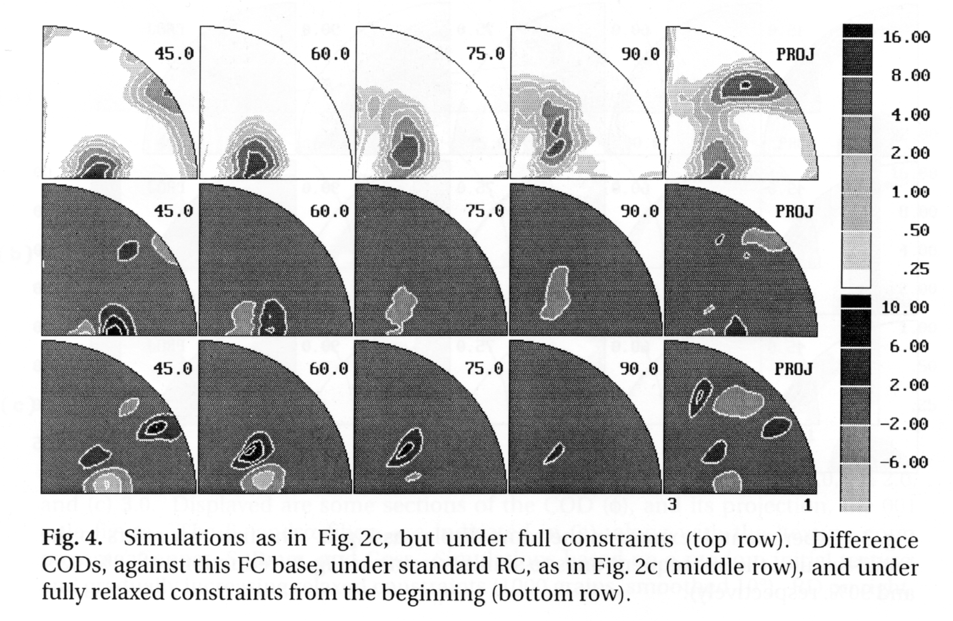
Effect of RC on texture development
In (fcc) rolling, the stable orientation approaches the Copper instead of the Taylor/Dillamore position.

Slide 26
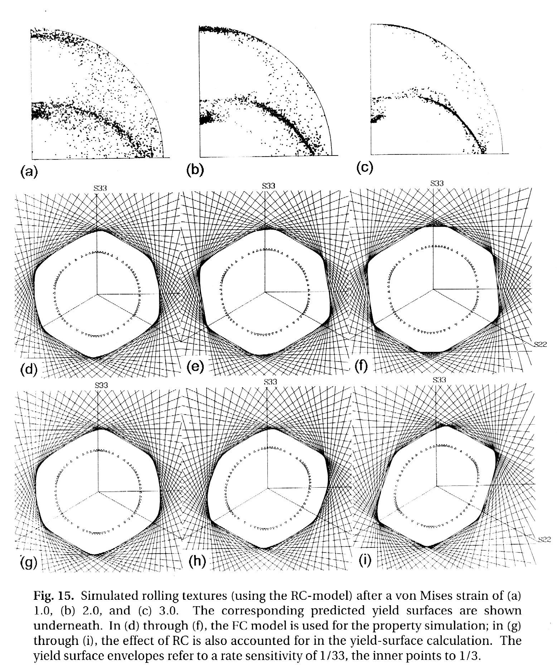
Y.S. for textured polycrystal
Kocks: Ch.10 Note sharp vertices for strong textures at large strains.
FC
Yield surfaces based on highly elongated grains and the RC model
RC

Slide 27
Summary
Vectorization of stress, strain tensors.
Definition, explanation of the Taylor factor.
Comparison of single and multiple slip.
Relaxed Constraints model with mixed boundary conditions, allowing for the effect of grain shape on anisotropy.

