Slide 1


Polycrystal Plasticity -
Self-Consistent Model
27-731 (normally, 27-750)
Texture, Microstructure & Anisotropy
A.D. Rollett, J.V. Gordon
  Lecture notes originally by:
  Carlos Tomé (LANL, retired)
  Hamid Garmestani (GaTech),
  Gilberto Branco (FAMU/FSU)
Last revised: 2nd March, 2022

Slide 2
Objective
The objective of this lecture is to explain how we can use Eshelby's theory of interaction between an inclusion and its surrounding matrix to model anisotropic deformation.
Further, to show how to calculate the stresses and distribution of slips in each grain of a polycrystal using the Viscoplastic Selfconsistent code, VPSC.
Requirements:
A basic understanding of how polycrystal plasticity works based on multiple slip in each grain.

Slide 3
Questions & Answers
What does “self-consistent” mean? This refers to the design of the algorithm that ensures that the polycrystal ensemble satisfies the boundary conditions of the imposed strain rate (velocity gradient), perhaps combined with certain stress boundary conditions.
What does “visco-plastic” mean? This refers to the use of a strain-rate sensitive yield function at the single slip system scale, i.e., the shear (slip) rate is proportional to the RSS/CRSS raised to a power. The exponent is typically in the range 10 to 50.
What improvement does VPSC offer over the Taylor model? The VPSC model allows each grain to deviate from the polycrystal average in a fashion that is consistent (that word again!) with the Eshelby-Kröner inclusion model. The stiffer the interaction, the smaller the deviation (in strain rate).
For which materials is VPSC most useful? The larger the anisotropy of the single crystal yield surface (think hexagonal versus cubic), the larger the potential deviation of an individual grain from the polycrystal (homogeneous medium).

Slide 4
References
Key Paper: Lebensohn RA and Tome CN (1993) "A Self-Consistent Anisotropic Approach for the Simulation of Plastic-Deformation and Texture Development of Polycrystals - Application to Zirconium Alloys" Acta Metall. Mater. 41 2611-2624.
Eshelby, JD, “The Determination of the Elastic Field of an Ellipsoidal Inclusion and Related Problems”, Proceedings of the Royal Society of London Series A - Mathematical Physical and Engineering Sciences, A241, 376–396 (1957).
Taylor G (1938) "Plastic strain in metals", J. Inst. Metals (U.K.) 62 307 ;
Bishop J and Hill R (1951), Phil. Mag. 42 1298;
Van Houtte P (1988), Textures and Microstructures 8 & 9 313-350;
Kocks, Tomé & Wenk: Texture & Anisotropy (Cambridge); chapter 8, 1996. Detailed analysis of plastic deformation and texture development.
Reid: Deformation Geometry for Materials Scientists, 1973. Older text with many nice worked examples. Be careful of his examples of calculation of Taylor factor because, like Bunge & others, he does not use von Mises equivalent stress/strain to obtain a scalar value from a multiaxial stress/strain state.
Hosford: The Mechanics of Crystals and Textured Polycrystals, Oxford, 1993. Written from the perspective of a mechanical metallurgist with decades of experimental and analytical experience in the area.
Khan & Huang: Continuum Theory of Plasticity, Wiley-Interscience, 1995. Written from the perspective of continuum mechanics.
Gurtin: An Introduction to Continuum Mechanics, Academic Press, 1981.

Slide 5
Background, Concepts
The original Taylor model is a pure strain-based boundary condition on the grains. Commonly known as the “full constraints” (FC) model.
Mecking developed a “relaxed constraints” (RC) model. This was mainly directed at rolling (plane strain compression) that develops strongly flattened grains such that two shear components could be non-zero with only a small penalty in compatibility. Adoption of the RC model resulted in improved agreement between simulated and measured textures.
The essential idea behind the (viscoplastic) self-consistent (VPSC) model is to compute the stress in each grain as if it were an inclusion embedded in an otherwise homogeneous medium. The “medium” is simply the averaged polycrystal in terms of plastic stiffness.
A later variant is known as the elasto-viscoplastic self-consistent model (ESCP) in which the effects of elastic anisotropy are included.

Slide 6

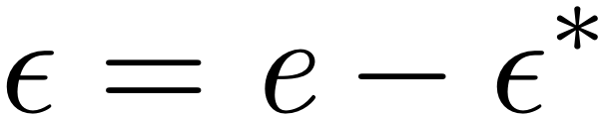
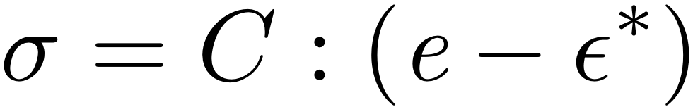
Eigenstrains and Eigenstresses
Transforming region
Remove
region
Thermal Expansion
Eigenstrains result!
Non-transforming
matrix
Apply surface
tractions
Replace
region
and remove
surface tractions
Eigenstresses result!
Notes:
First we start with a transforming region (or inclusion) inside a non-transforming matrix. If we allow the inclusion to undergo some kind of transformation which can be a phase transformation, thermal expansion, or any other volume changing transformation where no stress is applied free of the matrix. For this explanation we will assume it is a volume expansion. The resulting strains are called eigenstrains. Now, if we apply surface tractions to counteract the volume change caused by the eigenstrains so that the inclusion returns to it’s original size, we can replace the region inside the non-transforming matrix easily/nicely. Finally we remove the surface tractions and the matrix will constrain the expansion of the inclusion – the inclusion will not return to it’s free expansion volume. This will cause stresses inside of the body. Because these stresses were formed by eigenstrains, they are called eigenstresses.
Not sure if I should use this or not:
It is important to not that these eigenstrains are result from a transformation but not when a stress is applied. These types of strains are called elastic strains. How to include the equations?

Slide 7
Self-Consistent Model
Following slides contain information about a more sophisticated model (than the Taylor model) for crystal plasticity, called the self-consistent model.
It is based on a finding a mean-field approximation to the environment of each individual grain.
This provides the basis for the popular code VPSC made available by Tomé and Lebensohn (Lebensohn, R. A. and C. N. Tome (1993). "A Self-Consistent Anisotropic Approach for the Simulation of Plastic-Deformation and Texture Development of Polycrystals - Application to Zirconium Alloys." Acta Metallurgica et Materialia 41 2611-2624).

Slide 8
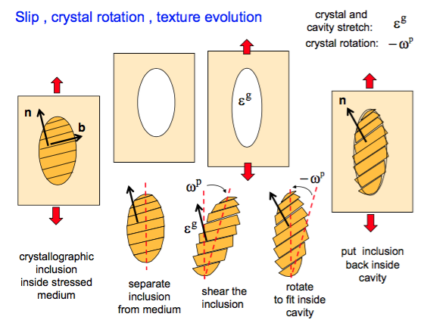
VPSC: Inclusion

Slide 9
Eshelby Theory
Eshelby analyzed the situation of an ellipsoidal inclusion within an infinite matrix that has undergone some eigenstrain. A thermoelastic potential may be defined for inclusions in a matrix with thermal eigen-strains and used to compute the resultant thermal stresses. The potential is employed to determine the displacement at all locations within the solid. Eshelby used this formulation to compute surface integrals at the inclusion surface, which he later simplified to what are known today as Eshelby tensors. These Eshelby tensors transform the local thermoelastic eigenstrain tensors to local total strain tensors.
One of the most significant conclusions from Eshelby’s approach is the finding that the surface integrals are independent of location within the inclusion itself, and thus, the stress and strain states are constant. For spherical symmetry, the 3 independent tensors are computed as shown on the right.

Slide 10
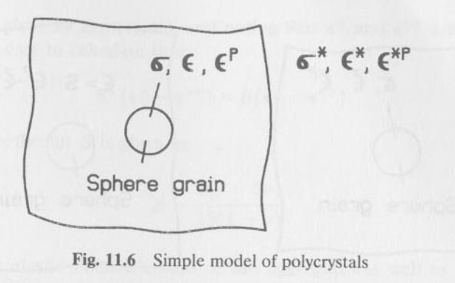
Kröner, Budiansky and Wu’s Model
Taylor Model
- compatibility across grain boundary
- violation of the equilibrium between the grains
Budiansky and Wu’s Model
- Self-consistent model
- Ensures both compatibility and equilibrium conditions on grain boundaries
- Based on the Eshelby inclusion model

Slide 11
Kröner, Budiansky and Wu’s Model
The model:
Khan & Huang
Sphere (single crystal grain) embedded in a homogeneous polycrystal matrix.
The grain and the matrix are elastically isotropic.
Can be described by an elastic stiffness tensor C, which has an inverse C⁻¹.
The matrix is considered to be of infinite extent.
The overall quantities and are considered to be the average values of the local quantities and over all randomly distributed single crystal grains.

Slide 12
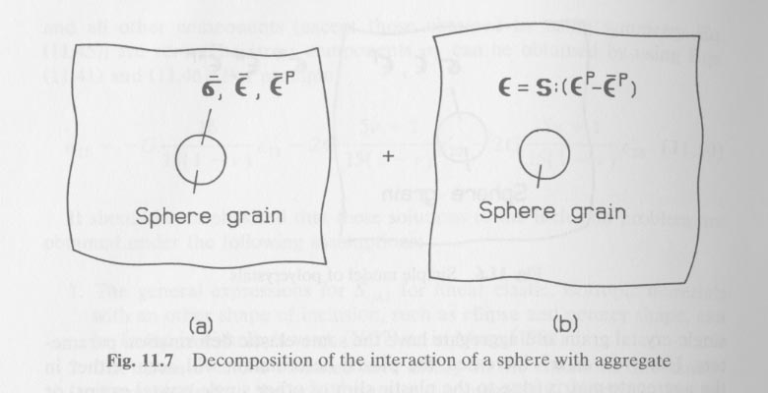
Kröner, Budiansky and Wu’s Model
The initial problem can be solved by the following approach
1 – split the proposed scheme into two others as follows, where the overbar indicates the polycrystal ave. and S is an Eshelby tensor
Khan & Huang

Slide 13
Kröner, Budiansky and Wu’s Model
1.a – The aggregate and grain are subject to the overall quantities and . In this case the total strain is given by the sum of the elastic and plastic strains:
Khan & Huang

Slide 14
Kröner, Budiansky and Wu’s Model
1.b – The sphere
has a stress-free transformation strain, ε’, which originates in the difference in plastic response of the individual grain from the matrix as a whole. This transformation strain is an eigenstrain;
has the same elastic property as the aggregate;
is small when compared with the aggregate (the aggregate is considered to extend to infinity).
Notes:
Consider the “stress-free transformation strain” to be the same as an EIGENSTRAIN. Where this comes from is the difference in plastic behavior between the grain itself and the matrix.

Slide 15
Kröner, Budiansky and Wu’s Model
The strain inside the sphere due to the elastic interaction between the grain and the aggregate caused by is given by
Where,
S is the Eshelby tensor (not a compliance tensor) for a spherical inclusion in an isotropic elastic matrix

Slide 16
Kröner, Budiansky and Wu’s Model
Then the actual strain inside the sphere is given by the sum of the two representations (1a and 1b) as follows
Given that,
where
The fraction 𝛽 was shown earlier as S₁₂₁₂
This leads to

Slide 17
Kröner, Budiansky and Wu’s Model
From the previous equation, it follows that the stress inside the sphere is given by

Slide 18
Kröner, Budiansky and Wu’s Model
In incremental form
where

Slide 19
ViscoPlastic-SelfConsistent code (VPSC)
VPSC is based on the Taylor model (uniform plastic strain across a polycrystal) but modified to allow for interactions between each grain and the polycrystal in which it is embedded.
There is no microstructure in VPSC: it works with just a set (list) of orientations. Therefore, there is no local interaction between a grain and some set of neighbor grains, only with the homogeneous effective medium (HEM).
The modification allows the deformation of each grain to deviate from that of the polycrystal. The constraint on each grain is computed with Eshelby theory (for inclusions).
Compared to any full-field (FE or FFT) computation with crystal plasticity, VPSC is an order of magnitude more efficient. For example, it is very useful for fitting Voce hardening parameters to experimental data. It is also very efficient for determining constitutive parameters such as CRSS values that evolve with strain for fitting to experimental texture data.

Slide 20
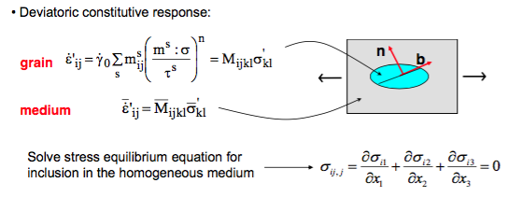


VPSC
Each grain is a visco-plastic anisotropic ellipsoidal inclusion embedded in a visco-plastic anisotropic Homogeneous Effective Medium (HEM).
Eshelby result: Stress and strain rate are uniform inside the inclusion but differ from macroscopic (average) values
Connection between stress in inclusion/grain versus average stress
Avg stress= Macroscopic stress → Self consistent
Source: Carlos Tome, EFRC Summer School 2012

Slide 21
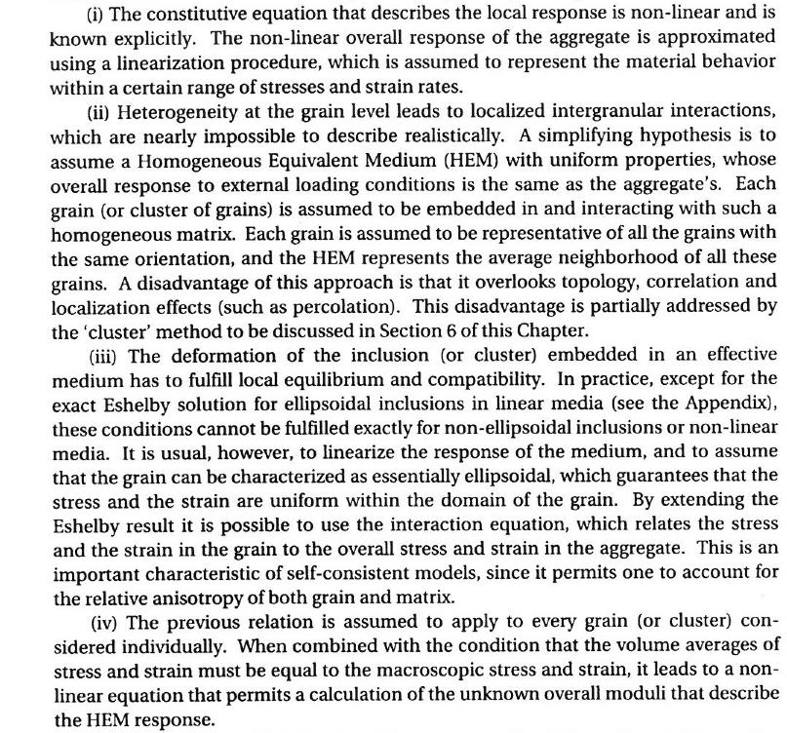
Assumptions for VPSC
Kocks,
Tomé,
Wenk:
Ch. 8

Slide 22
FULL CONSTRAINTS (FC) POLYCRYSTAL MODEL
Also known as Taylor model. Based on enforcing strain continuity over stress equilibrium. Represents an absolute upper bound for macroscopic stress.
Imposes the same velocity gradient (plastic strain and plastic spin) to all the grains
grain strain rate
impose
solve non-linear equation (typically n=20) for the stress in each grain
calculate shear rates in every slip system
update hardening and grain orientation incrementally
Source: Carlos Tome, EFRC Summer School 2012

Slide 23
VISCO-PLASTIC SELF-CONSISTENT (VPSC) POLYCRYSTAL MODEL ^{[1]}
Each grain is a visco-plastic anisotropic ellipsoidal inclusion embedded in a visco-plastic anisotropic Homogeneous Effective Medium (HEM).
Deviatoric constitutive response:
n
grain
b
Homog. medium
Solve stress equilibrium equation for inclusion in the homogeneous medium
Eshelby result: stress and strain-rate are uniform inside the inclusion
…but different from the macroscopic stress and strain rate !
[1] R.A. Lebensohn & C.N. Tomé, Acta Materialia 41 (1993) 2611
Source: Carlos Tome, EFRC Summer School 2012

Slide 24
VPSC model → interaction equation
Solving stress equilibrium equation for the VP inclusion embedded in the VP medium leads to the interaction equation
affine
M is the compliance of the medium and relates stress with strain rate
M large: the medium is very compliant → stress continuity → Sachs
M small: the medium is very stiff → strain continuity → Taylor
Intermediate cases: secant, affine, tangent (different choices in vpsc7.in)
Source: Carlos Tome, EFRC Summer School 2012

Slide 25
Visco-Plastic Self-Consistent Polycrystal Model
The interaction equation can be written as a localization equation that relates stress in the inclusion with average stress
B: localization tensor
Assumption for having a polycrystal model: treat each grain as an inclusion inside the effective macroscopic medium.
The condition that the average stress over all grains has to be equal to the macroscopic stress …
…leads to a self-consistent equation for the plastic moduli of the aggregate:
Source: Carlos Tome, EFRC Summer School 2012

Slide 26
Hardening of slip modes inside VPSC
An ‘extended Voce’ law is used in VPSC to describe the hardening of slip and twin systems vs accumulated shear in grain Γ
400
If latent hardening parameters h are considered the CRSS is incrementally updated as:
300
[MPa]
200
σ
ND
AA5182 measured
100
AA5182 predicted
0
0.0
-0.1
-0.2
-0.3
-0.4
-0.5
else:
ε
ND
Source: Carlos Tome, EFRC Summer School 2012

Slide 27
Running the code VPSC: input & output
INPUT:
Parameters of the run and names of datafiles (file VPSC7.IN)
  INITIAL TEXTURE (discrete orientation file)
  ACTIVE SLIP AND TWIN SYSTEMS (hardening parameters)
  MACROSCOPIC VELOCITY GRADIENT (strain history)
OUTPUT:
Parameters of the run and input data (file RUN_LOG.OUT)
  FINAL TEXTURE (discrete orientation file → TEX_PH1.OUT)
  STRESS-STRAIN RESPONSE (hardening → STR_STR.OUT)
  STATISTICS (system activity, twin fractions → ACT_PH1.OUT)
Source: Carlos Tome, EFRC Summer School 2012

Slide 28
Running VPSC → control file VPSC7.IN
. . . . . .
0 grain shape and orient ctrl (ishape=0 to 4)
1.0 1.0 1.0 initial ellipsoid ratios (dummy if ishape=4)
0.0 0.0 0.0 init Eul ang ellips axes (dummy if ishape=3,4)
* name and path of texture file (filetext)
example1\rand500.tex
* name and path of single crystal file (filecrys)
example1\fcc.sx
. . . . . . .
. . . . . . .
*MODELING CONDITIONS FOR THE RUN
0 ihardlaw (0:Voce, 1:MTS, 2:composite grain)
1 iratesens (0:rate insensitive, 1:rate sensitive)
0 interaction (0:FC,1:affine,2:secant,3:neff=10,4:tangent,5:SO)
1 1 1 iupdate: update orient, grain shape, hardening
. . . . . .
*NUMBER OF PROCESSES
1
*IVGVAR AND PATH\NAME OF FILE FOR EACH PROCESS
0
example1\tension.3
Source: Carlos Tome, EFRC Summer School 2012

Slide 29
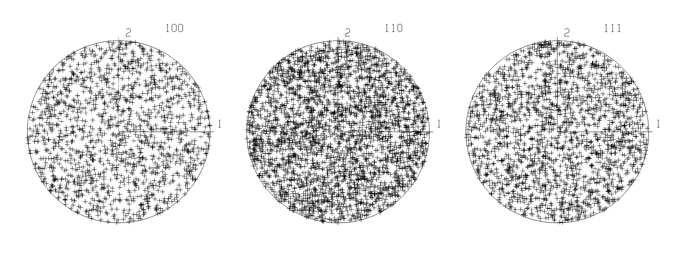
Running VPSC7 → TEXTURE file
RAND500.TEX → a file containing 500 randomly generated orientations
dummy
dummy
random texture generated by RANDTEXT.FOR (23/01/97)
B 500
102.74 119.56 33.65 1.000000
219.06 36.21 70.51 1.000000
166.66 28.59 45.80 1.000000
149.74 86.13 38.68 1.000000
. . . . . . .
. . . . . . .
Source: Carlos Tome, EFRC Summer School 2012

Slide 30
Running VPSC7 → PROCESS file
TENSION.3 → 50 steps of 2% axial strain along direction 3
50 3 0.02 298. nsteps ictrl eqincr temp
* boundary conditions
1 1 1 iudot | flag for vel.grad.
1 1 1 | (0:unkn-1:known)
1 1 1 |
-0.5 0. 0. udot | vel.grad
0. -0.5 0. |
0. 0. 1.0 |
0 0 0 iscau | flag for Cauchy
0 0 | (0:unkn-1:known)
0 |
0. 0. 0. scauchy | Cauchy stress
0. 0. |
0. |
Source: Carlos Tome, EFRC Summer School 2012

Slide 31
Running VPSC7 → SINGLE CRYSTAL FILE
FCC.SX → slip systems and hardening parameters for FCC
*Material: AUSTENITIC STEEL
cubic crysym
1. 1. 1. 90. 90. 90. unit cell axes and angles
Elastic stiffness (single crystal [GPa])
205.0 138.0 138.0 000.0 000.0 000.0
….
*Info about slip & twinning modes in this file:
2 nmodesx (total # of modes listed in file)
1 nmodes (# of modes to be used in the calculation)
1 mode(i) (label of the modes to be used)
<111>{110} SLIP
1 12 20 1 modex,nsmx,nrsx,iopsysx
0.000 0 0.000 0.000 twshx,isectw,thres1,thres2
1.0 0.0 0.0 0.0 0. 0. tau0,tau1,thet0,thet1 ,hpfac,gndfac
1.0 1.0 hlat(nmodes)
1 1 1 0 1 -1
1 1 1 1 0 -1
1 1 1 1 -1 0
………. ………
Source: Carlos Tome, EFRC Summer School 2012

Slide 32
EXAMPLE 1: TENSION & COMPRESSION of FCC
Simulate axial tension and compression of an initially random FCC aggregate.
Deformation by slip in the <110> direction and on {111} crystallographic planes. The CRSS = τ^{s} = constant = 1
The Voce hardening is rigid perfectly plastic:
The imposed velocity gradient is symmetric and equal to the strain rate tensor:
Source: Carlos Tome, EFRC Summer School 2012

Slide 33
EXAMPLE 1: TENSION & COMPRESSION of FCC → TEXTURE
Predicted textures after 100% axial tension and compression using different grain-matrix interaction and compression (INTERACTION=0,1,2,3,4)
TENSION
COMPRESSION
Source: Carlos Tome, EFRC Summer School 2012

Slide 34
EXAMPLE 1: TENSION & COMPRESSION of FCC → STRESS
Stress (Taylor factor) evolution and Average Number of Active Systems per Grain using different grain-matrix interaction assumptions.
TAYLOR (FC):
upper bound and more than 6 active systems
TANGENT:
lower bound, about 4 active systems in tension and 3 in compression.
In general: Self-Consistent leads to plane strain deformation of individual grains
Source: Carlos Tome, EFRC Summer School 2012

Slide 35
EXAMPLE 2: ROLLING of FCC
Simulate plane strain deformation of an initially random FCC aggregate.
Deformation by slip in the <110> direction and on {111} crystallographic planes, up to E33=100% (63% reduction).
The Voce hardening is linearly increasing:
The imposed velocity gradient is plane strain (EXAMPLE 2a):
We also run plane strain with superimposed shear (EXAMPLE 2b):
Source: Carlos Tome, EFRC Summer School 2012

Slide 36
EXAMPLE 2: ROLLING of FCC → PROCESS FILE
File VPSC7.INa enforces rolling followed by a yield locus calculation and a Lankford and Young modulus calculation.
. . . . . .
. . . . . .
*NUMBER OF PROCESSES
3
*IVGVAR AND PATH\NAME OF FILE OR STRESS SUBSPACE OR ANG INCREM
0 ivgvar=0 will run a monotonic strain path
example2\rolling
2 ivgvar=2 will calculate PCYS at the end
1 2 --> section of stress space
3 ivgvar=3 will calculate Lankford coefficients at the end
10 --> angular increment for tensile probing
Source: Carlos Tome, EFRC Summer School 2012

Slide 37
EXAMPLE 2: ROLLING of FCC → FINAL TEXTURE
The superimposed shear breaks the orthotropic symmetry of the rolling texture
Source: Carlos Tome, EFRC Summer School 2012

Slide 38
EXAMPLE 2: ROLLING of FCC → CHARACTERIZATION
The superimposed shear alters the final texture. As a consequence,
the yield locus,
the in-plane anisotropy (Lankford),
the directional Young modulus,
the final rolling components,
are different.
Plane strain
Plane strain + shear
Source: Carlos Tome, EFRC Summer School 2012

Slide 39
EXAMPLE 5: TORSION of FCC → fixed ends
Simulate torsion (simple shear) of an initially random FCC aggregate.
Deformation by slip in the <110> direction and on {111} crystallographic planes, up to ε₁₂ = 2.0
The Voce hardening is linearly increasing:
Case 5a: the imposed velocity gradient is fixed-end mode
the hoop and radial stress components are imposed to zero
3
1
2
Source: Carlos Tome, EFRC Summer School 2012

Slide 40
EXAMPLE 5: TORSION of FCC → process sequence
The sequence of processes enforced through VPSC7.IN are:
1- 40 steps of
2- calculation of intermediate yield surface, projection
3- 40 steps of
4- calculation of the final yield surface, projection
*NUMBER OF PROCESSES
4
*IVGVAR AND PATH\NAME OF FILE; STRESS SUBSP OR ANG INCR
0
example5\torsion.a
2 ivgvar=2 will calculate PCYS at the end
1 5 --> section of stress space
0
example5\torsion.a
2 ivgvar=2 will calculate PCYS at the end
1 5 --> section of stress space
Source: Carlos Tome, EFRC Summer School 2012

Slide 41
EXAMPLE 5: TORSION of FCC → free ends
Simulate torsion (simple shear) of an initially random FCC aggregate.
Deformation by slip in the <110> direction and on {111} crystallographic planes, up to
The Voce hardening is linearly increasing:
Case 5b: the imposed velocity gradient is free-end mode
the hoop and radial stress components are imposed as zero
3
1
2
Source: Carlos Tome, EFRC Summer School 2012

Slide 42
EXAMPLE 5: TORSION of FCC → FINAL TEXTURE
Textures are typical of shear.
A slight rotation of the texture between fix-end and free-end is responsible for the rotation of the yield locus and the associated change in length.
Source: Carlos Tome, EFRC Summer School 2012

Slide 43
EXAMPLE 5: TORSION of FCC → CHARACTERIZATION
Fixed-end torsion
FIXED END:
Axial strain is zero → strain rate perpendicular to the yield surface AND vertical.
FREE END:
Axial stress is zero → strain rate perpendicular to the yield surface AND stress vector vertical.
Free-end torsion
Source: Carlos Tome, EFRC Summer School 2012

Slide 44
Plotting Results from VPSC: packages and installation
Suggestion: use MTEX, which is available as an open source package within MATLAB. MATLAB is freely available for academic use for members of CMU.
Step 1: install MATLAB
Step 2: search on “github mtex” to find the webpage. Download it as a zip file. Unpack the zip.
Step 3: open MATLAB and add the path to the MTEX folder.

Slide 45
Specific Directions for M1 Macs
Here are the directions from the Apple developer website for how to get TF up and running on an M1 mac. It suggests that you use miniconda rather than anaconda, so there might be some complications there. I was running into issues on my intel Mac because python was being compiled on an older version of clang. I would run this line "python -c "import platform; print(platform.mac_ver())"" to see which version of clang python was compiled on the first line needs to be either 11 or 12; I can't totally remember. My version that doesn't work is 10.13 so I think anything higher than that will work because that's when M1 was introduced. I doubt ARM64 compiled python versions would be on any clang from before that, so hopefully, this works for you without too much trouble.
Courtesy of Gregory Wong, CMU, Feb. 2022

Slide 46
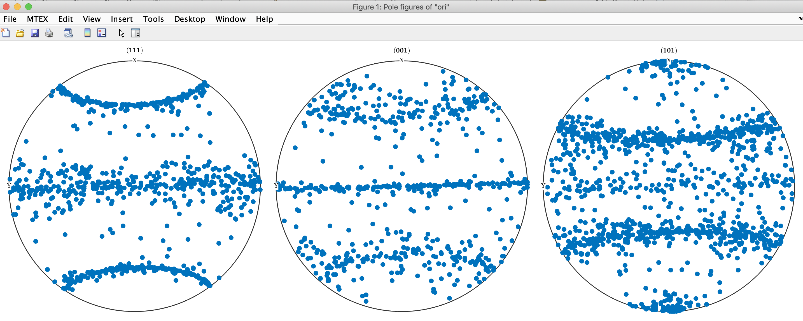
Plotting Results : Using MTEX
Step 1: edit the file TEX_PH1-compression1.OUT, where the name depends on what you have in the VPSC control file, vpsc7.in. You can always do this by hand but a python/bash script would be worth implementing to automate it.
  Each texture output has 4 header lines. Insert “#” at the beginning of each of those lines. Add a 5th line that reads “ phi1 Phi phi2 weight” so that MTEX can read in appropriate headers for each of the 4 columns of data.
Go to https://mtex-toolbox.github.io/OrientationImport.html to find an example of how to import lists of orientations.
  For fcc metals such as Al, use cs = crystalSymmetry.load(‘Al-Aluminum.cif’) to load the correct crystal symmetry
  Add Folder to the MATLAB path where you have the VPSC results (with the edited TEX list).
  fname = fullfile(‘~/code/CarlosTome-self-consistent/vpsc7d_noexe/Al_Rollett ','TEX_PH1-compression1-headers.txt’); note the different path name to the data
  plotPDF(ori,Miller({1,1,1},{0,0,1},{1,0,1},cs)); note the different set of Miller indices to specify which poles to plot

Slide 47
Plotting Results: MTEX, odf
https://mtex-toolbox.github.io/ODFTutorial.html
This command should work to compute the odf from the list of orientations:
odf = calcDensity(ori)
Assuming that you succeed in computing the odf, many different kinds of plot are possible.
See https://mtex-toolbox.github.io/orientation.calcDensity.html for more detail of options (kernel width, e.g.)
pf = calcPoleFigure(odf,Miller({1,1,1},{0,0,1},{1,0,1},cs))

Slide 48
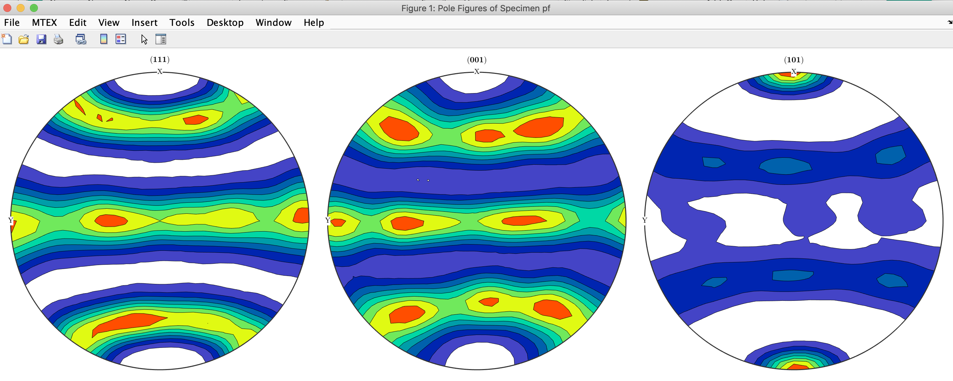
Pole Figures
https://mtex-toolbox.github.io/PoleFigure.plot.html
plot(pf,'contourf')

