Slide 1


Transformation texture and Orientation relationship
Vahid Tari, Ben Anglin, S. Mandal, and A.D. Rollett
27-750
Texture, Microstructure & Anisotropy
Last revised 28th Apr. 2016

Slide 2
Objective
Understand orientation relationships
Phase transformation and variant selection in steel alloys
Phase transformation and variant selection in Titanium alloys
Construct misorientation matrices from given orientation relationship
Forward and backward texture prediction
Notes:
Frequency of occurrence of any particular OR usually far exceeds the probability of obtaining by taking the two crystals and joining in arbitrary way -> reduce the interface energy, and hence the activation energy for nucleation -> the properties of interfaces depend on the relative dispositions of the crystals that they connect.

Slide 3
Orientation Relationships
Orientation Relationship (OR): Relation between specific planes and directions of two crystals on either side of boundary.
During most phase transformations, some favored orientation relationship exists between the parent and the product phases which allows the best fit at the interface between the two crystals.
Why important? Phase transformations; morphology of precipitates; nucleation mechanisms; interfaces; high temperature orientation determination; thin film orientation prediction.
Notes:
Frequency of occurrence of any particular OR usually far exceeds the probability of obtaining by taking the two crystals and joining in arbitrary way -> reduce the interface energy, and hence the activation energy for nucleation -> the properties of interfaces depend on the relative dispositions of the crystals that they connect.

Slide 4
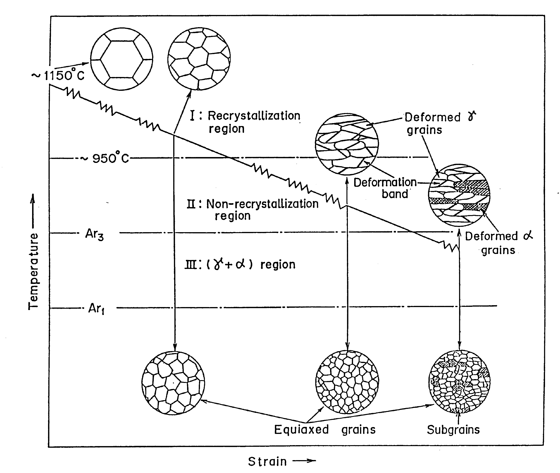
Why transformation texture and OR are important?
Ray and Jonas, International Materials Reviews 1990 Vol. 35 NO.1

Slide 5
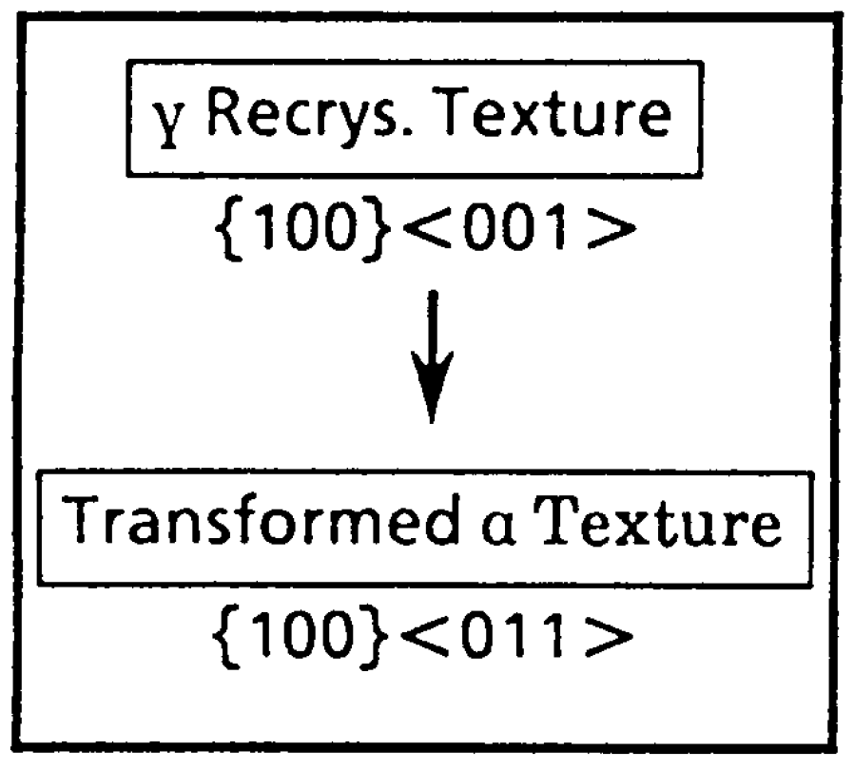
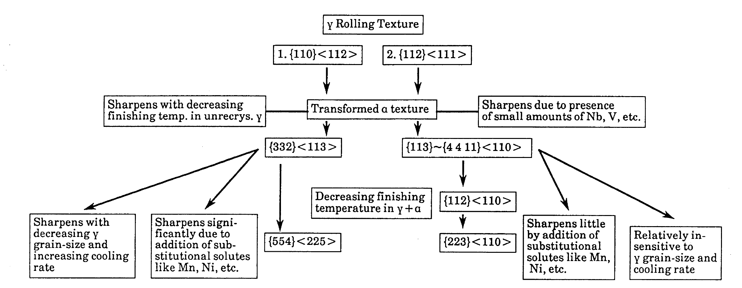
Ray and Jonas, International Materials Reviews 1990 Vol. 35 NO.1

Slide 6
Orientation relationship (OR)
Notation:
(hkl)_{α}//(h’k’l’)_{β} [uvw]_{α}//[u’v’w’]_{β}
The (hkl) plane of the α crystal lies parallel to the (h’k’l’) plane of the β crystal
Similarly for the [uvw] and [u’v’w’] directions of the two crystals
[uvw] and [u’v’w’] must lie in the (hkl) and (h’k’l’) planes, respectively
The orientation relationship holds regardless of the coherency of the boundary
Notes:
Frequency of occurrence of any particular OR usually far exceeds the probability of obtaining by taking the two crystals and joining in arbitrary way -> reduce the interface energy, and hence the activation energy for nucleation -> the properties of interfaces depend on the relative dispositions of the crystals that they connect.

Slide 7
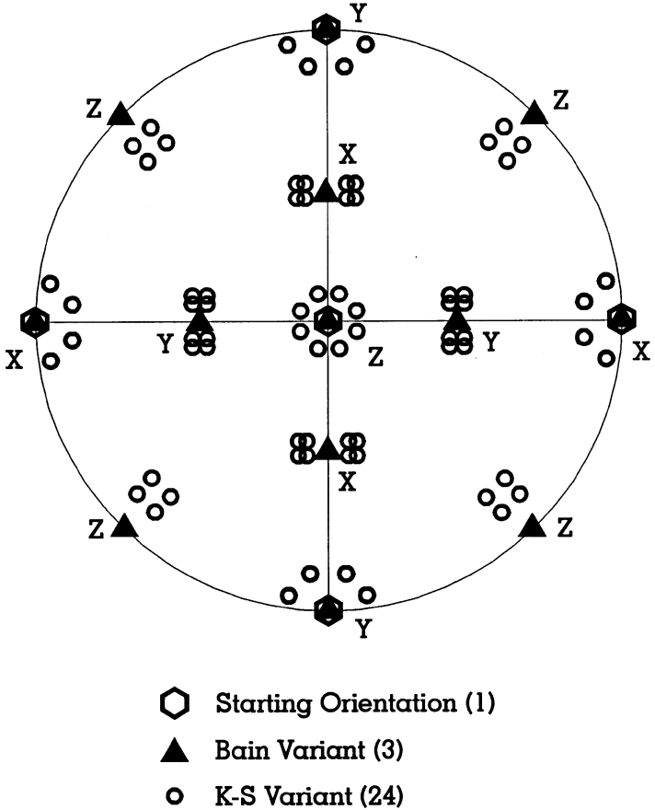
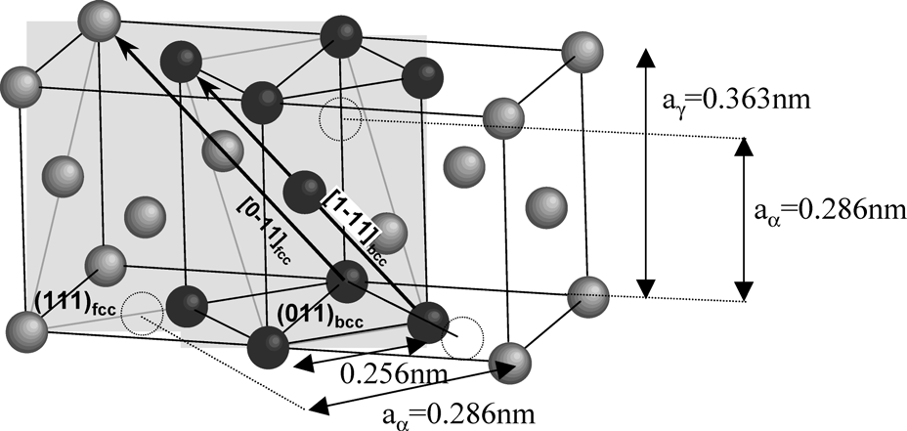
OR Variants
Variants of a given OR are specific alignment of planes and directions. These exist because of crystal symmetry
In the K-S OR, there are 4 {111}_{γ} planes, each plane parallel to a {110}_{α} plane. A {111}_{γ} plane contains 3 ⟨110⟩_{γ} directions and each ⟨110⟩_{γ} direction is parallel to 2 ⟨111⟩_{α} directions [1]. Hence 24 K-S variants.
[1] Verbeken, Barbe, Raabe, ISIJ Int, 2009 (49) 10, 1601-1609
Butron-Guillen, Da Costa Viana, Jonas, Met Trans A, 1997 (28A) 1755-1768
Notes:
Frequency of occurrence of any particular OR usually far exceeds the probability of obtaining by taking the two crystals and joining in arbitrary way -> reduce the interface energy, and hence the activation energy for nucleation -> the properties of interfaces depend on the relative dispositions of the crystals that they connect.

Slide 8
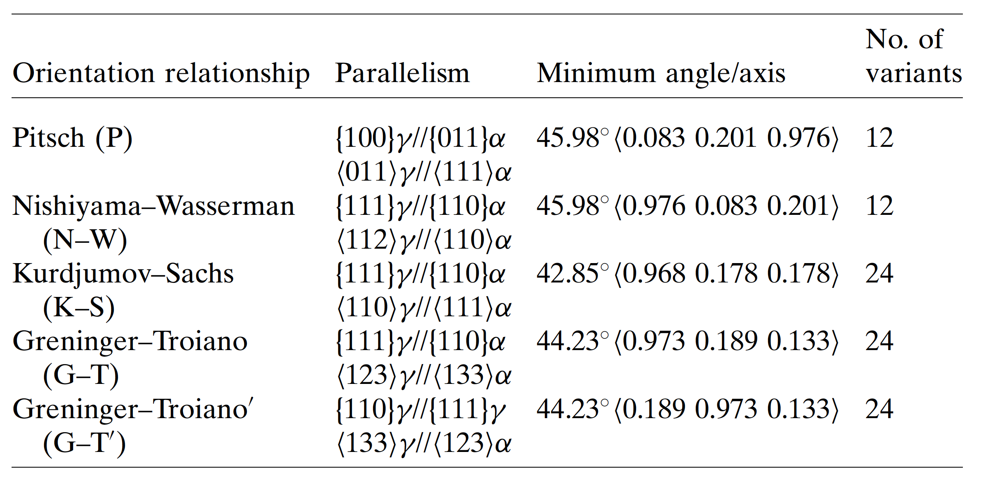
Orientation relationships in Steel

Slide 9
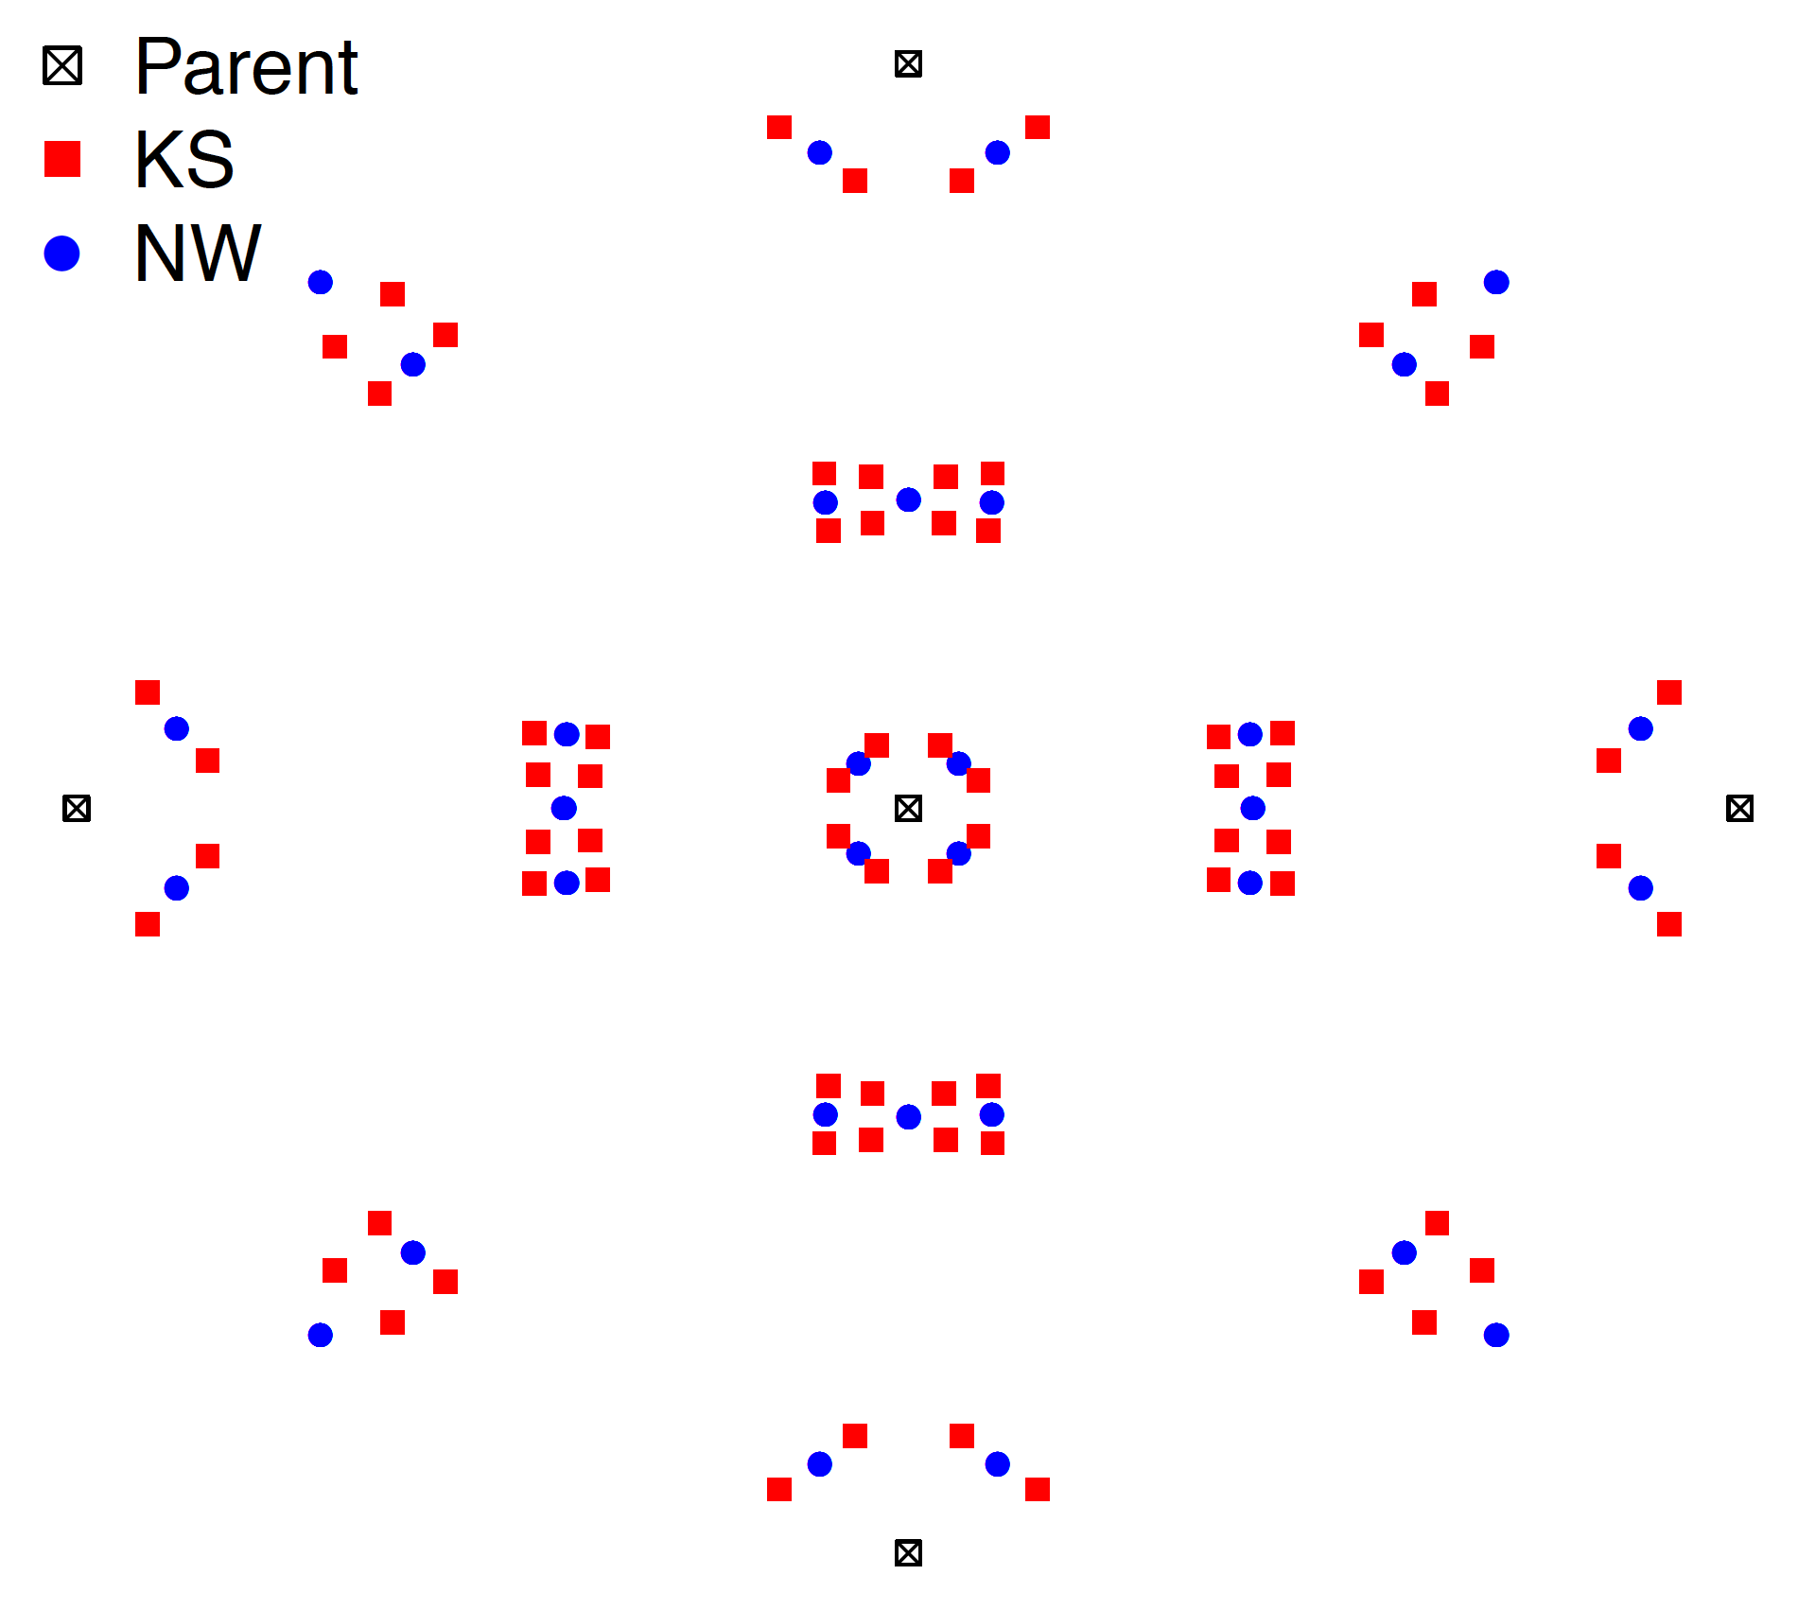
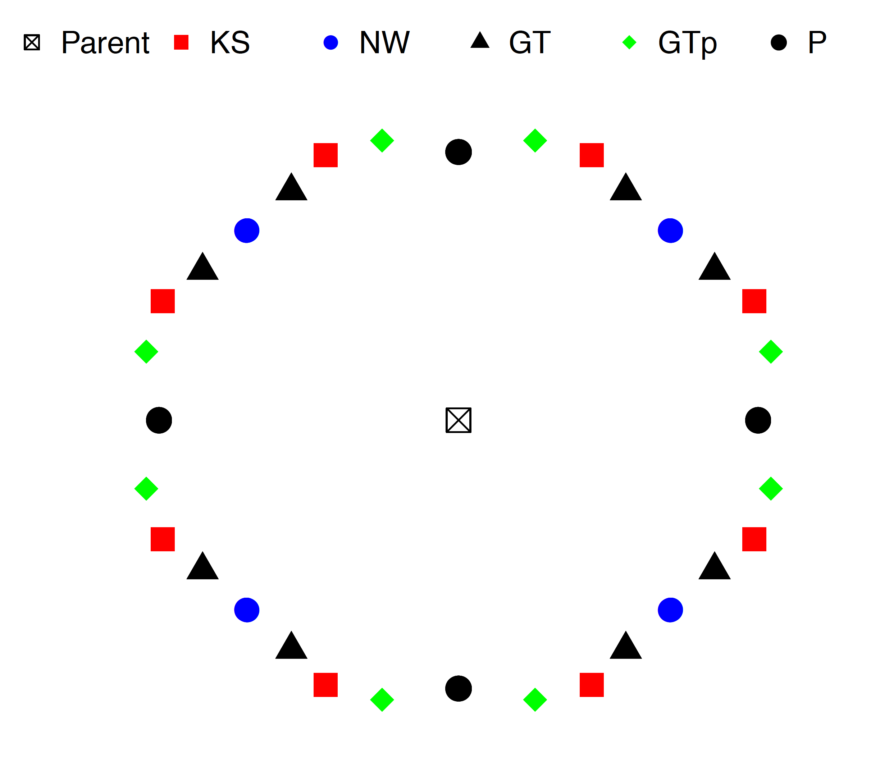
Stereographic Projection of ORs
010
100
{100}

Slide 10
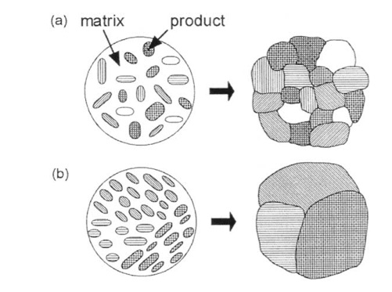
Variants Selection
Variants selection: Few of the theoretically predicted variants dominant. Some variants may be preferred over others depending on the transformation mechanism.
Knowledge about variants selection important to understand microstructure evolution.
Fig: Evolution of microstructure during diffusional phase transformation (a) without variant selection (each nucleus with a different variant becomes a different grain, resulting in a fine structure). (b) with variant selection (neighboring nuclei having the same variants coalesce to form larger grains). (Furuhara and Maki, 2001)

Slide 11
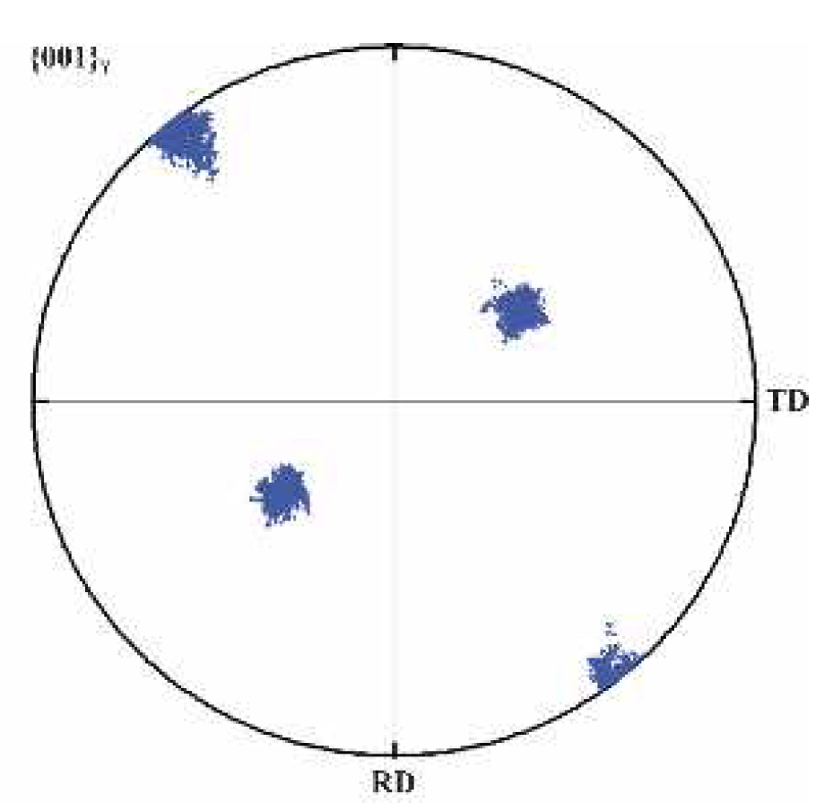
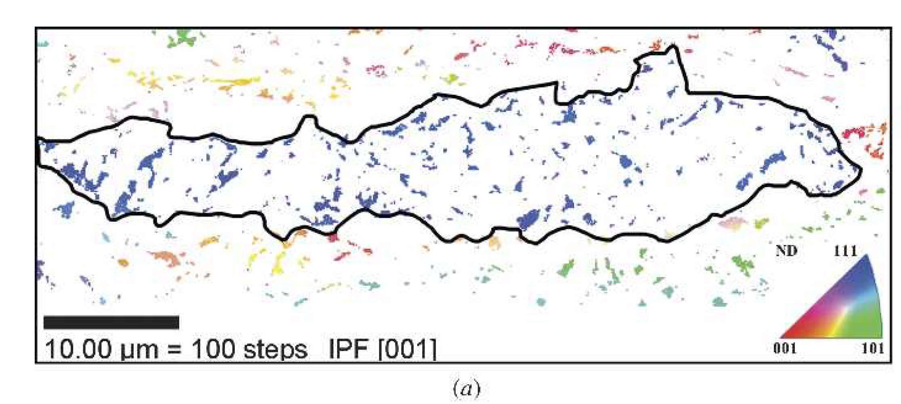
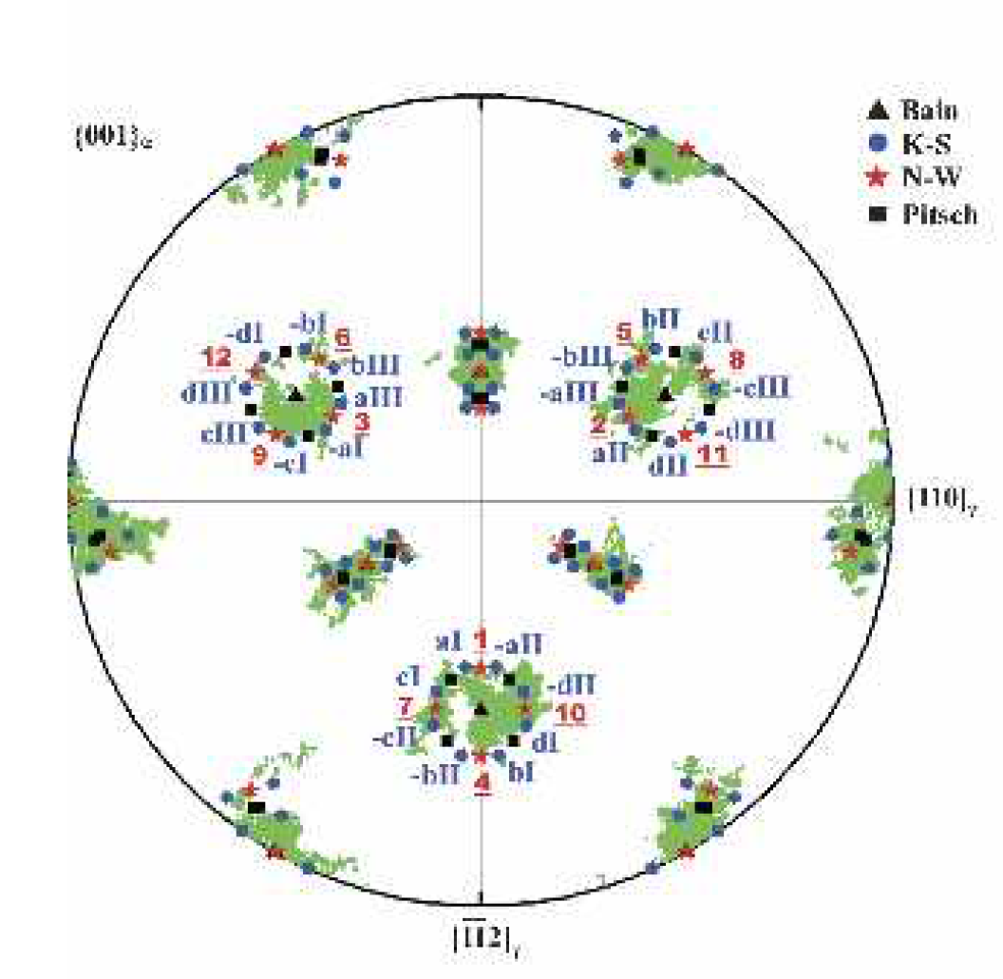
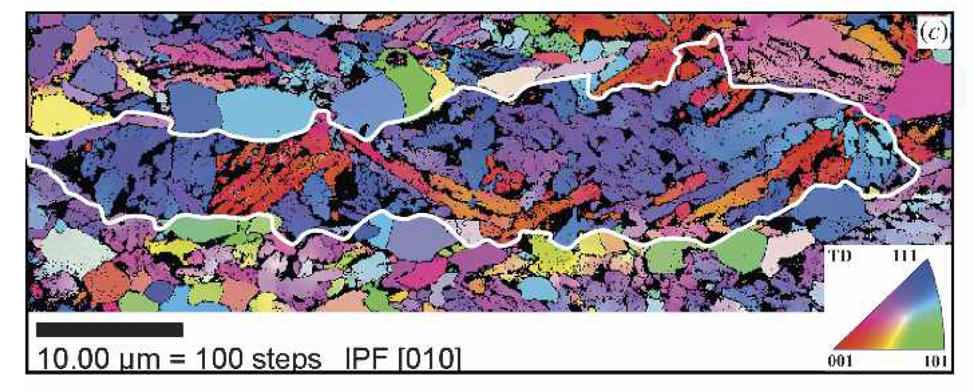
Variant selection during phase transformation in steel
Youliang He, John J Jonas, Stéphane Godet, Metallurgical and Materials Transactions A, Vol. 37A, 2006,2641

Slide 12
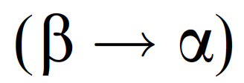
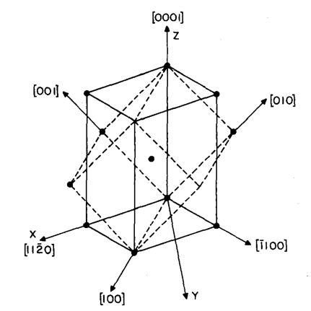
OR (Burgers) in Titanium Alloys
Phase transformation
BCC
HCP
Predominant OR observed for body-centered cubic to hexagonal transformation in Ti alloys
Burgers OR
(0 0 0 1)_{HCP} ||{0 1 1}_{BCC}
[1 1 -2 0]_{HCP}||⟨1 1 1⟩_{BCC}
Fig: Geometrical representation of the Burgers OR with dashed lines showing the BCC crystal and continuous lines showing the HCP crystal (Menon et al.,1986)

Slide 13
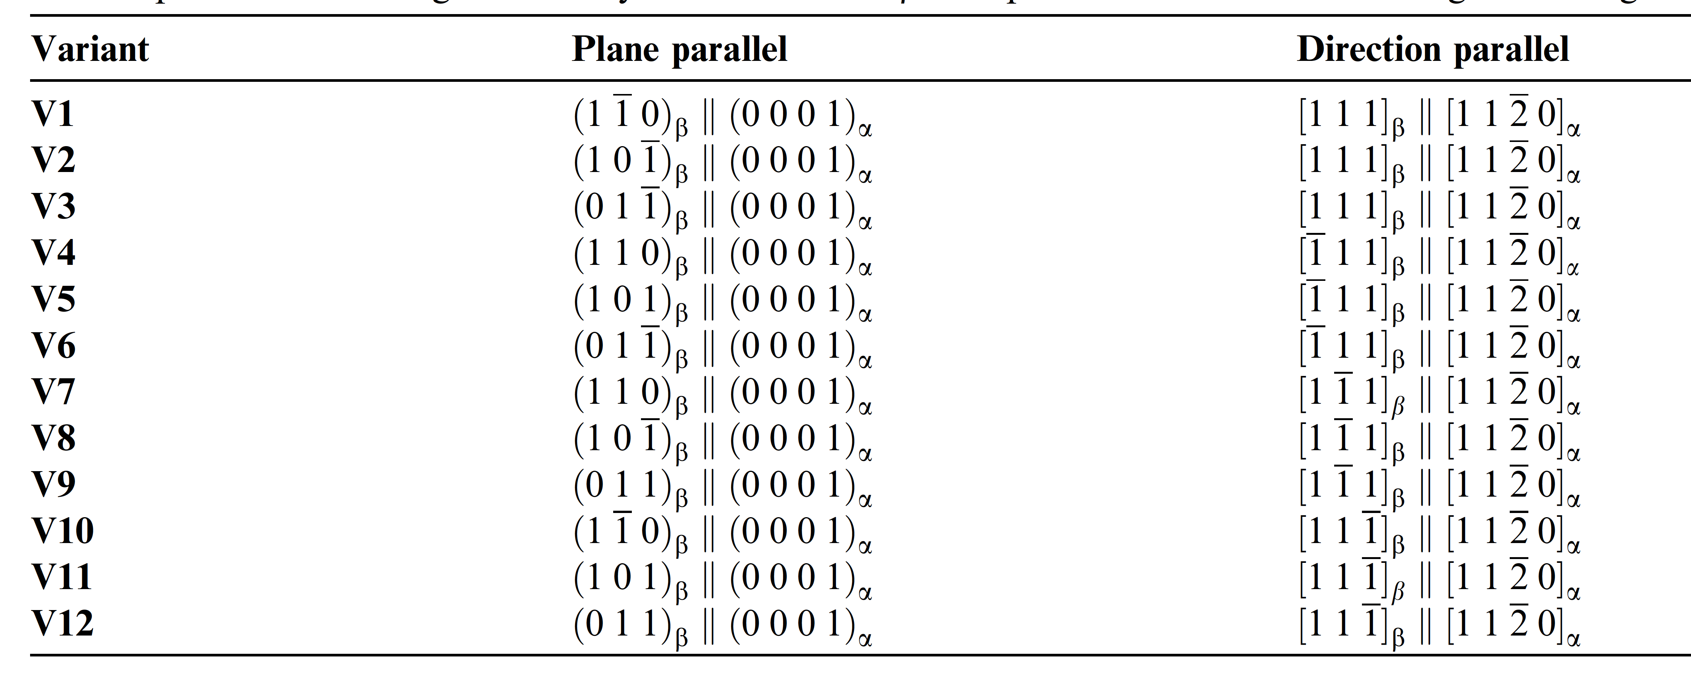
Burgers OR Variants
Variants: Each crystallographic orientation relationship predicts different numbers of product orientations originating from a single crystallographic orientation of the parent phase.
Number of variants is determined by the OR that the product phase have with the parent phase.
# variants for Burger’s OR=12

Slide 14
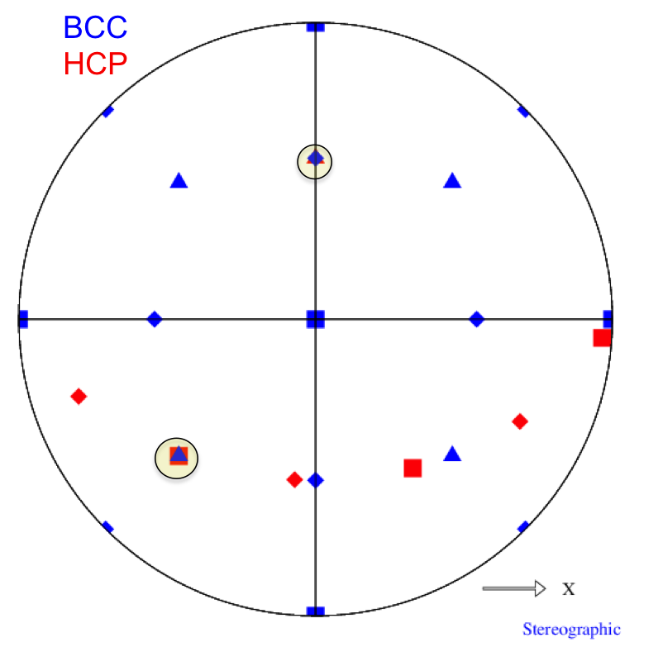
Stereographic Projection of Burgers OR
Stereographic projection for one of the variants of the Burgers OR with a parent BCC orientation of {0,0,0}. Constructed using in-house scripts OR stereogram and DrawPF. Available from AD Rollett.
Plane alignment
Hexagonal
(low T)
BCC (high T)
111
0001
Direction alignment
100
11-20
110
10-10

Slide 15
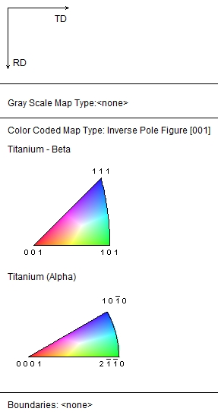
An example
Fig: IPF map of an EBSD dataset. (Provided by IISc)
Fig: Pole figures generated using TSL software for this data.

Slide 16
Variants Selection in Ti
[-1 1 -1]
[-1 1 1]
[ 1 1 -1]
[ 1 1 1]
MEAN
← Directions
(110)
(1-10)
(011)
(01-1)
(101)
(-101)
← Planes
Fig: Relative frequency of variants for the EBSD dataset (Provided by IISC).
Notes:
[1 1 -1] direction strong

Slide 17
Creating Misorientation Matrix for OR
Assume: (hkl) // (h’k’l’) // ND
and [uvw] // [u’v’w’] // RD
1.) Construct orientation matrix for phase α.
2.) Construct orientation matrix for phase β.
3.) Compute misorientation matrix from the α phase to the β phase. Note the importance of the sense of the transformation; for grain boundaries we invoke switching symmetry but you must not apply this to phase transformations!
Notes:
Frequency of occurrence of any particular OR usually far exceeds the probability of obtaining by taking the two crystals and joining in arbitrary way -> reduce the interface energy, and hence the activation energy for nucleation -> the properties of interfaces depend on the relative dispositions of the crystals that they connect.

Slide 18
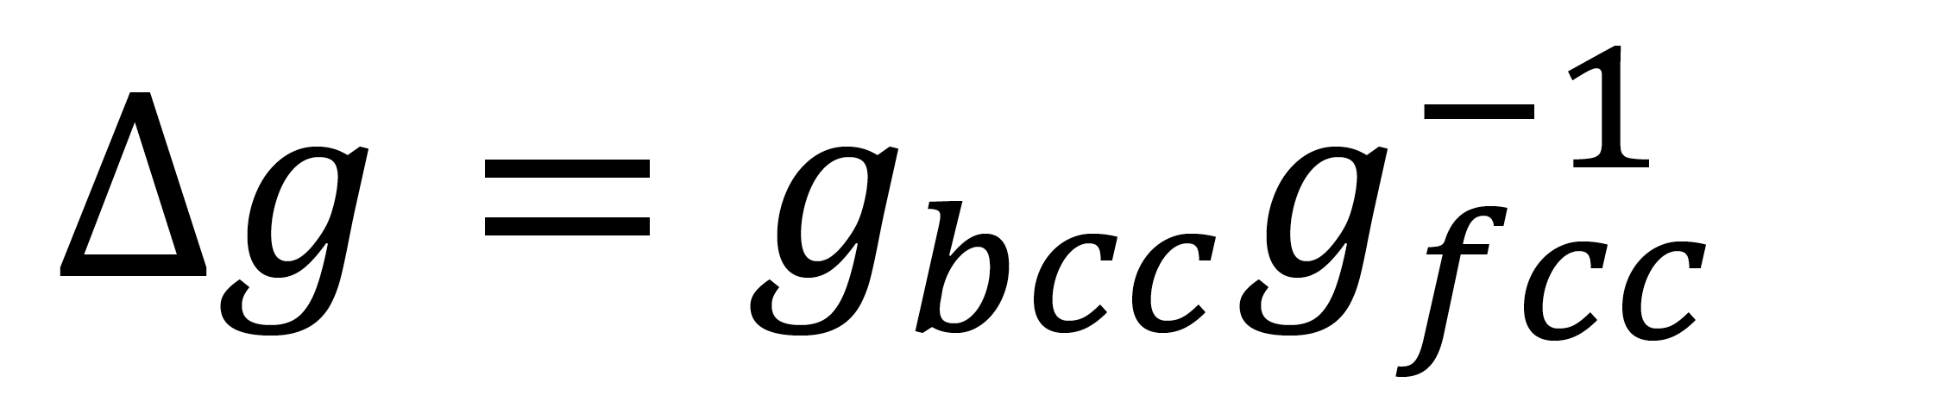
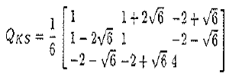
Creating Misorientation Matrix for OR
Consider the K-S orientation relationship:
(111)_{fcc}||(-110)_{bcc}
[1-10]_{fcc}||[111]_{bcc}
1) Construct orientation matrix for phase fcc.
2) Construct orientation matrix for phase bcc.
3) Compute misorientation matrix from one phase to the other; here we pass from fcc (high temperature) to bcc (low temperature).
Notes:
Frequency of occurrence of any particular OR usually far exceeds the probability of obtaining by taking the two crystals and joining in arbitrary way -> reduce the interface energy, and hence the activation energy for nucleation -> the properties of interfaces depend on the relative dispositions of the crystals that they connect.

Slide 19
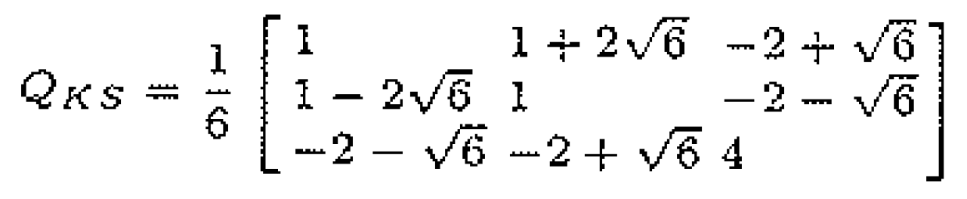
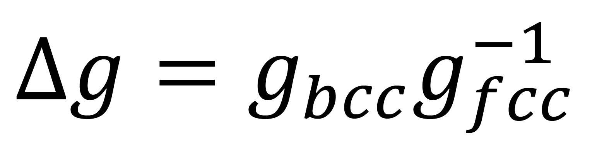
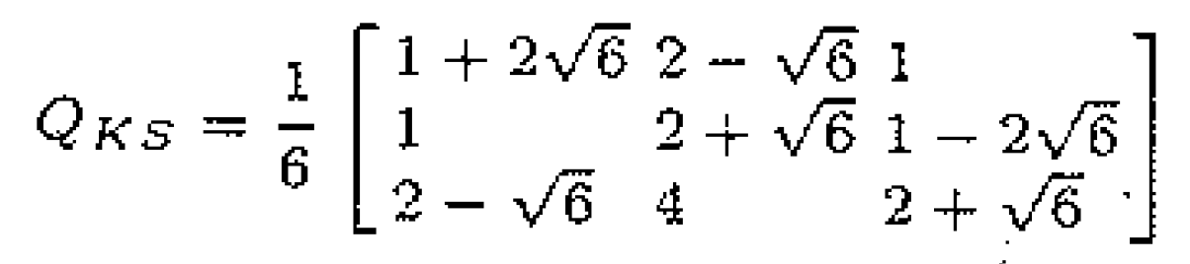
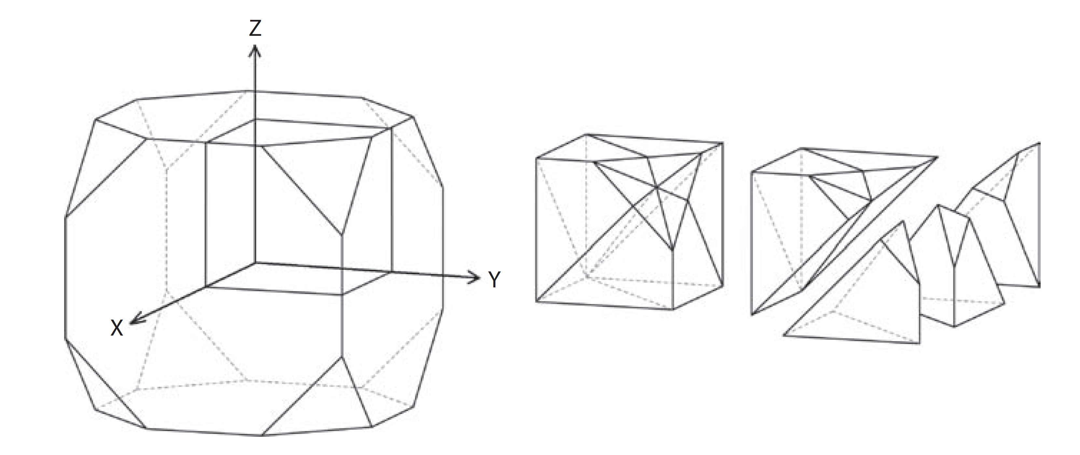
Minimum misorientation angle and axis associated with ORs

Slide 20
Minimum misorientation angle and axis associated with ORs

Slide 21
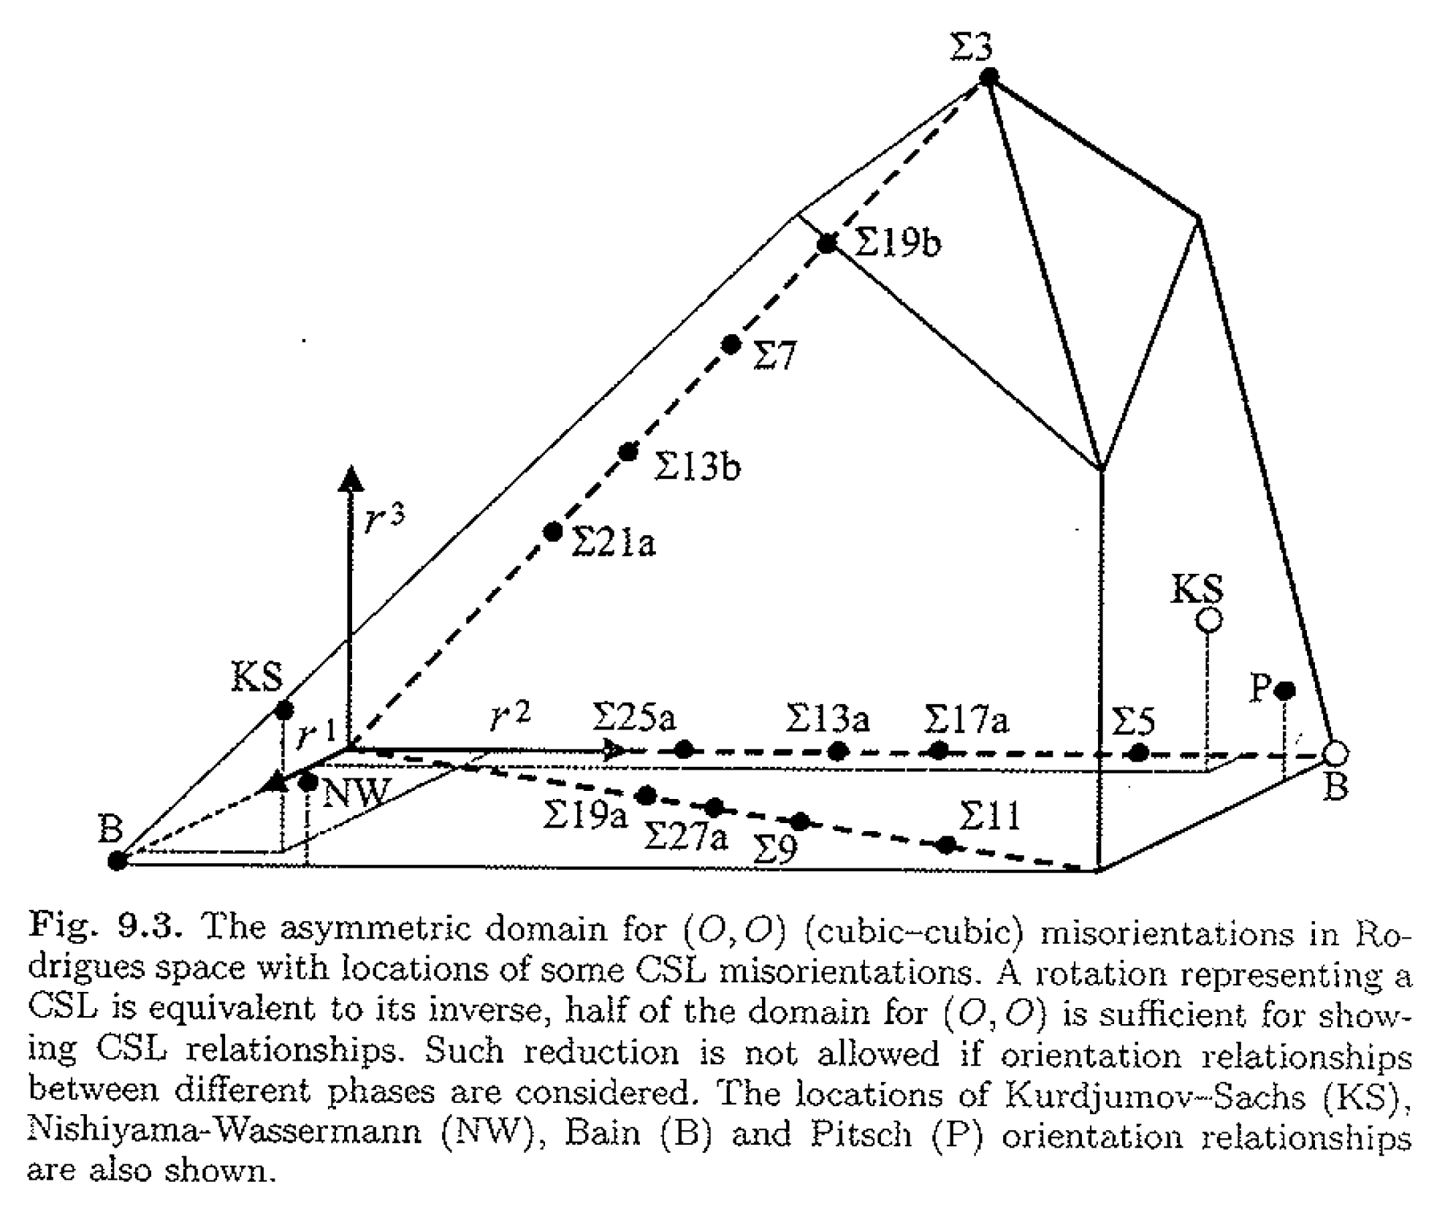
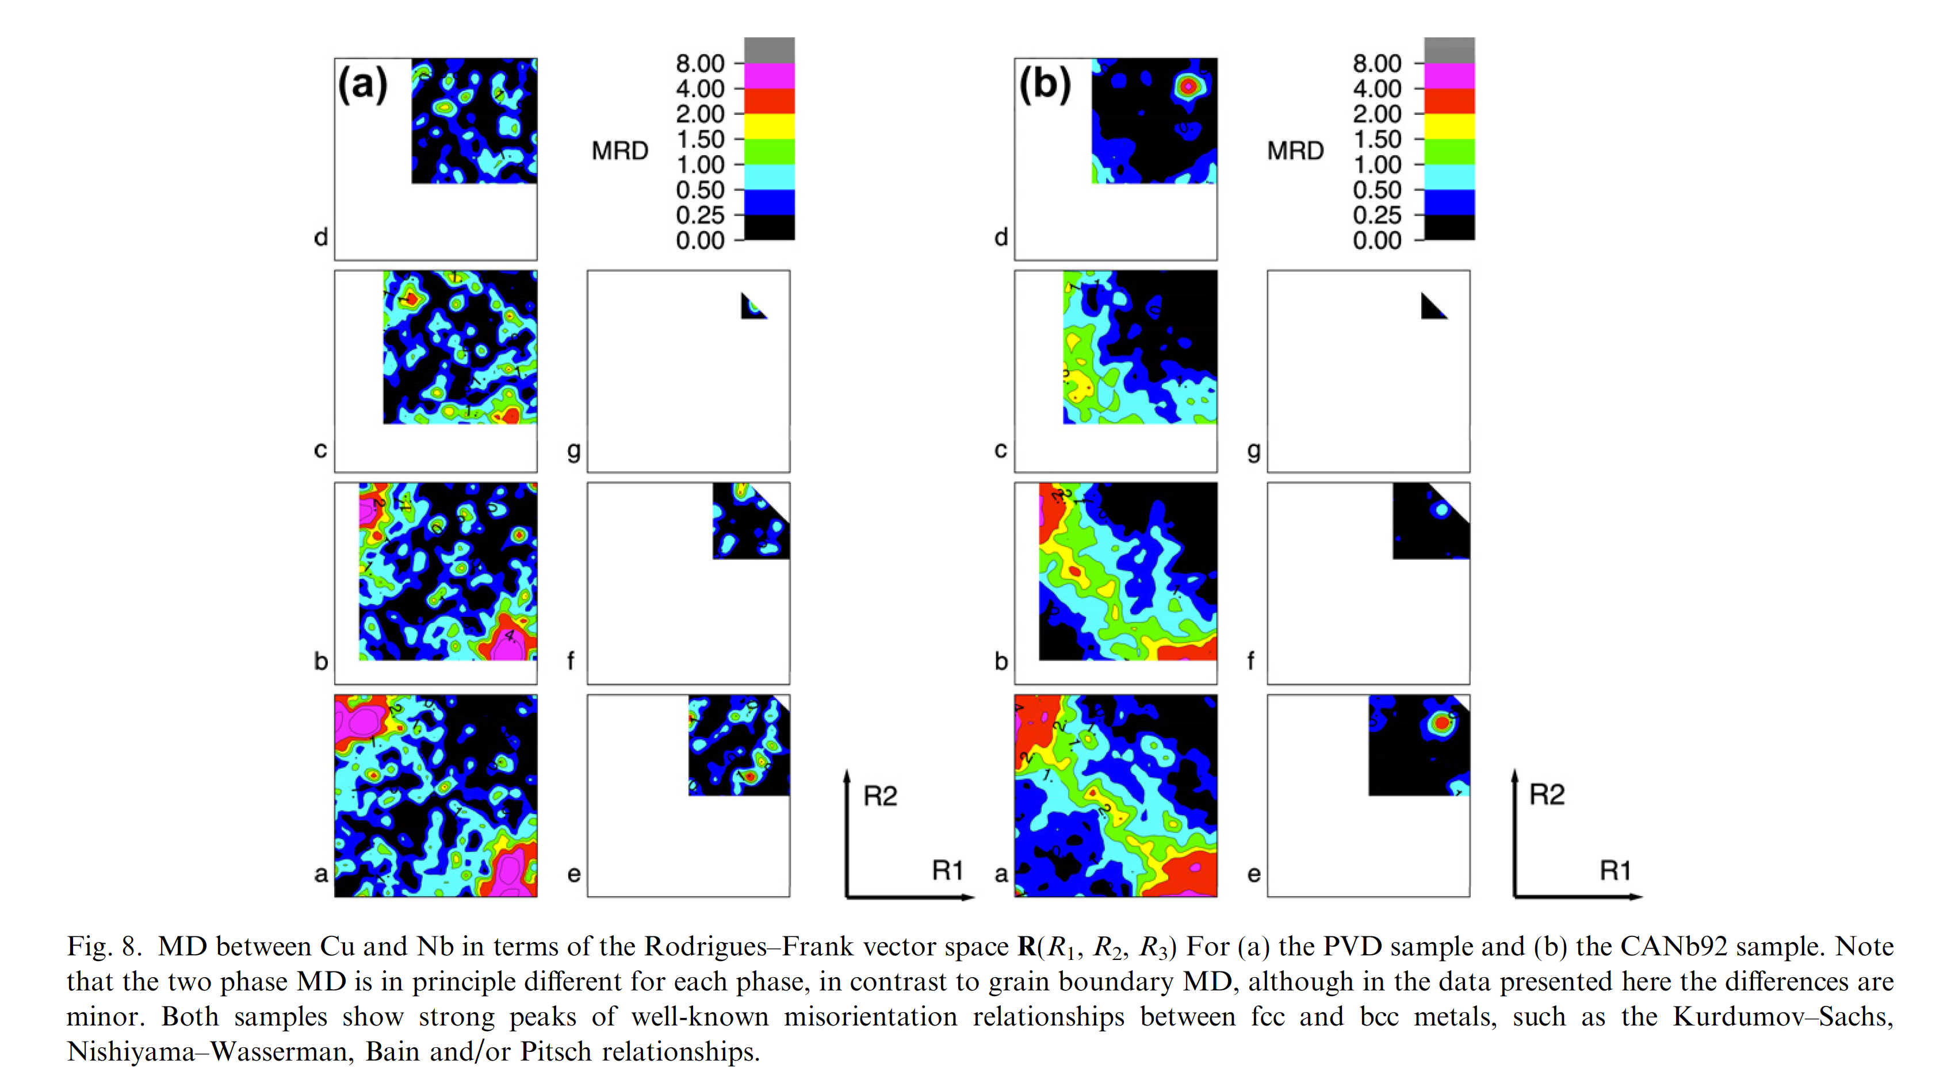
ORs in Rodrigues space
Orientations and Rotations, Adam Morawiec ,2003
S.-B. Lee et al. / Acta Materialia 60 (2012) 1747–1761

Slide 22
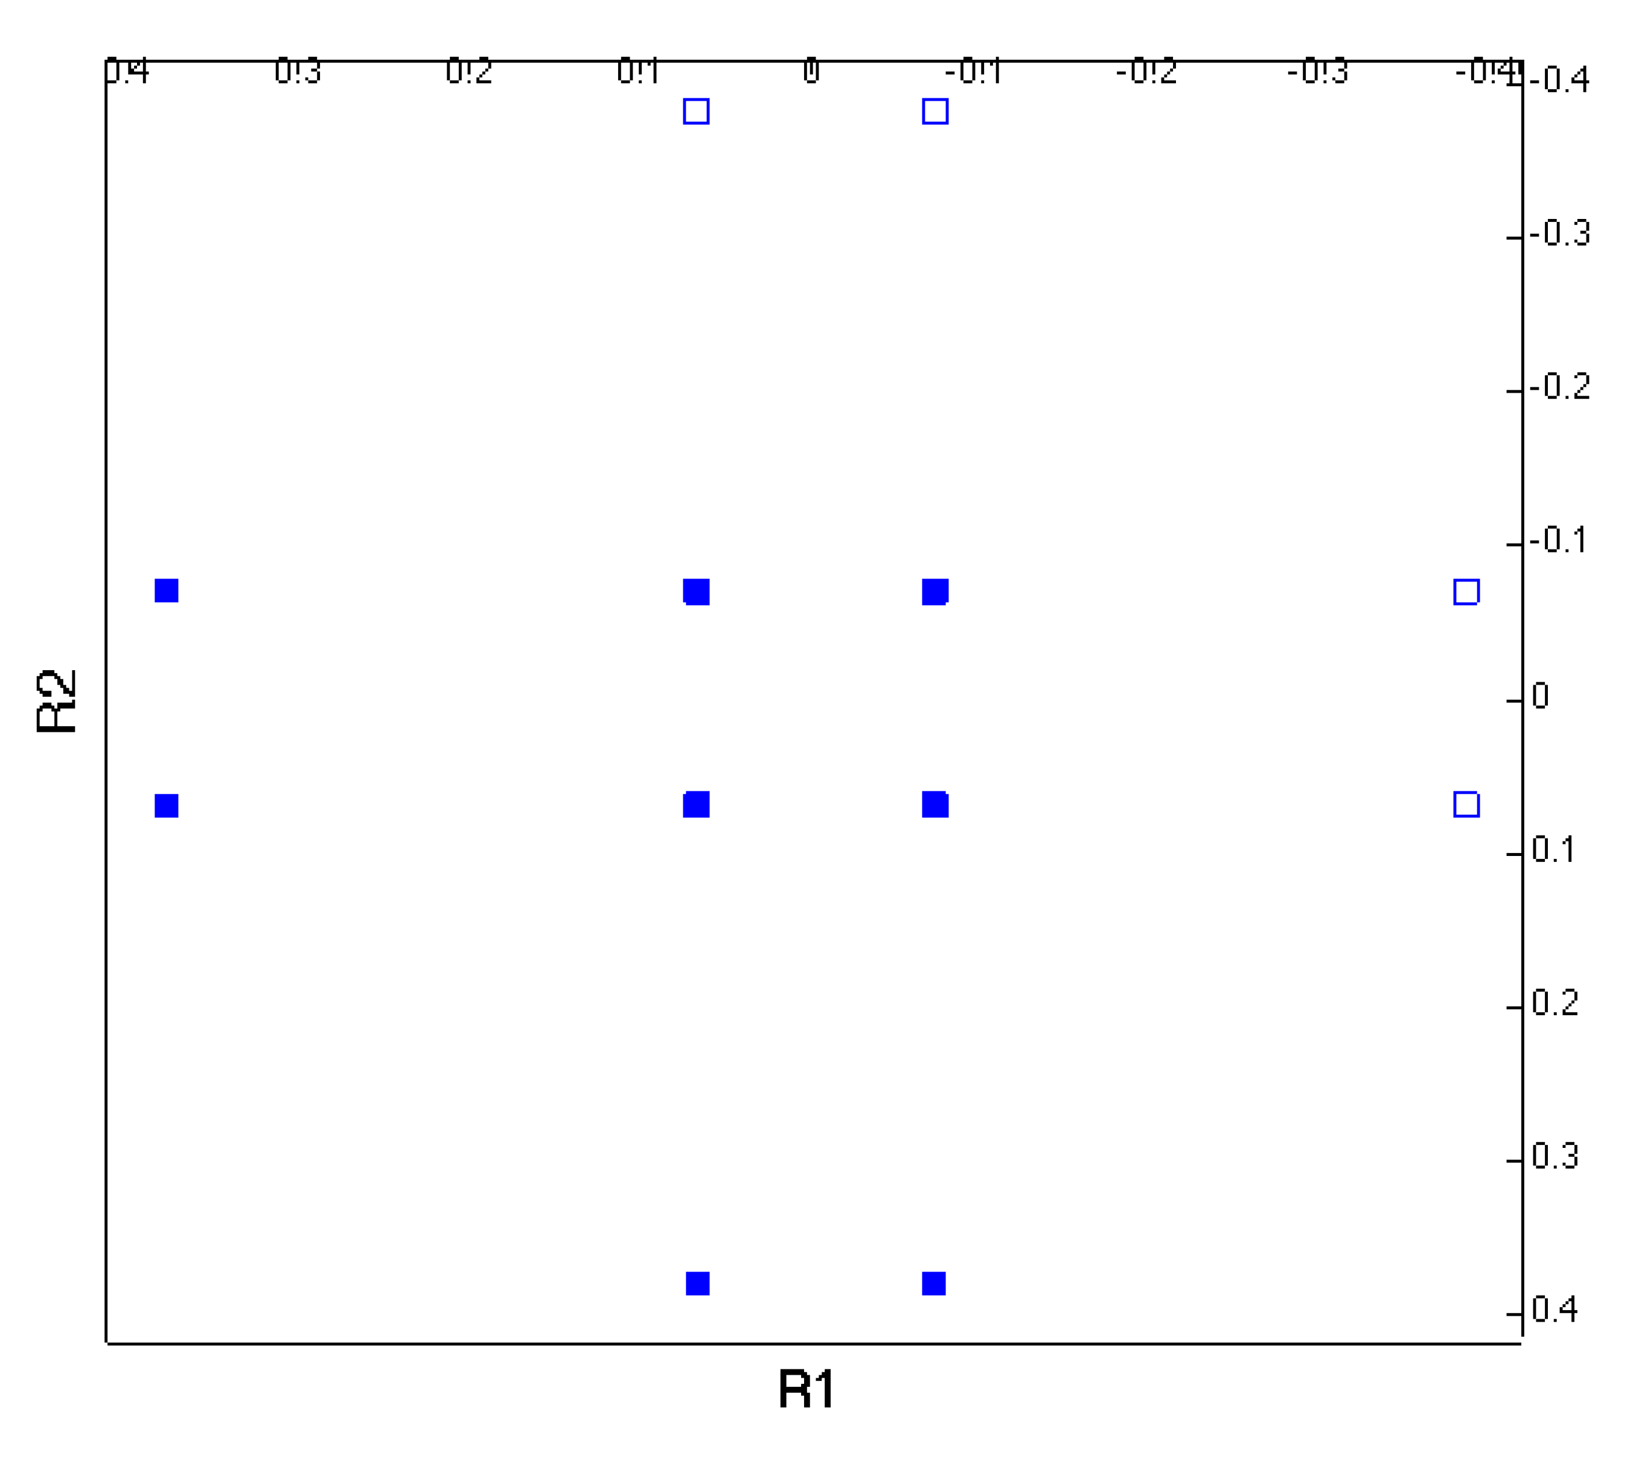
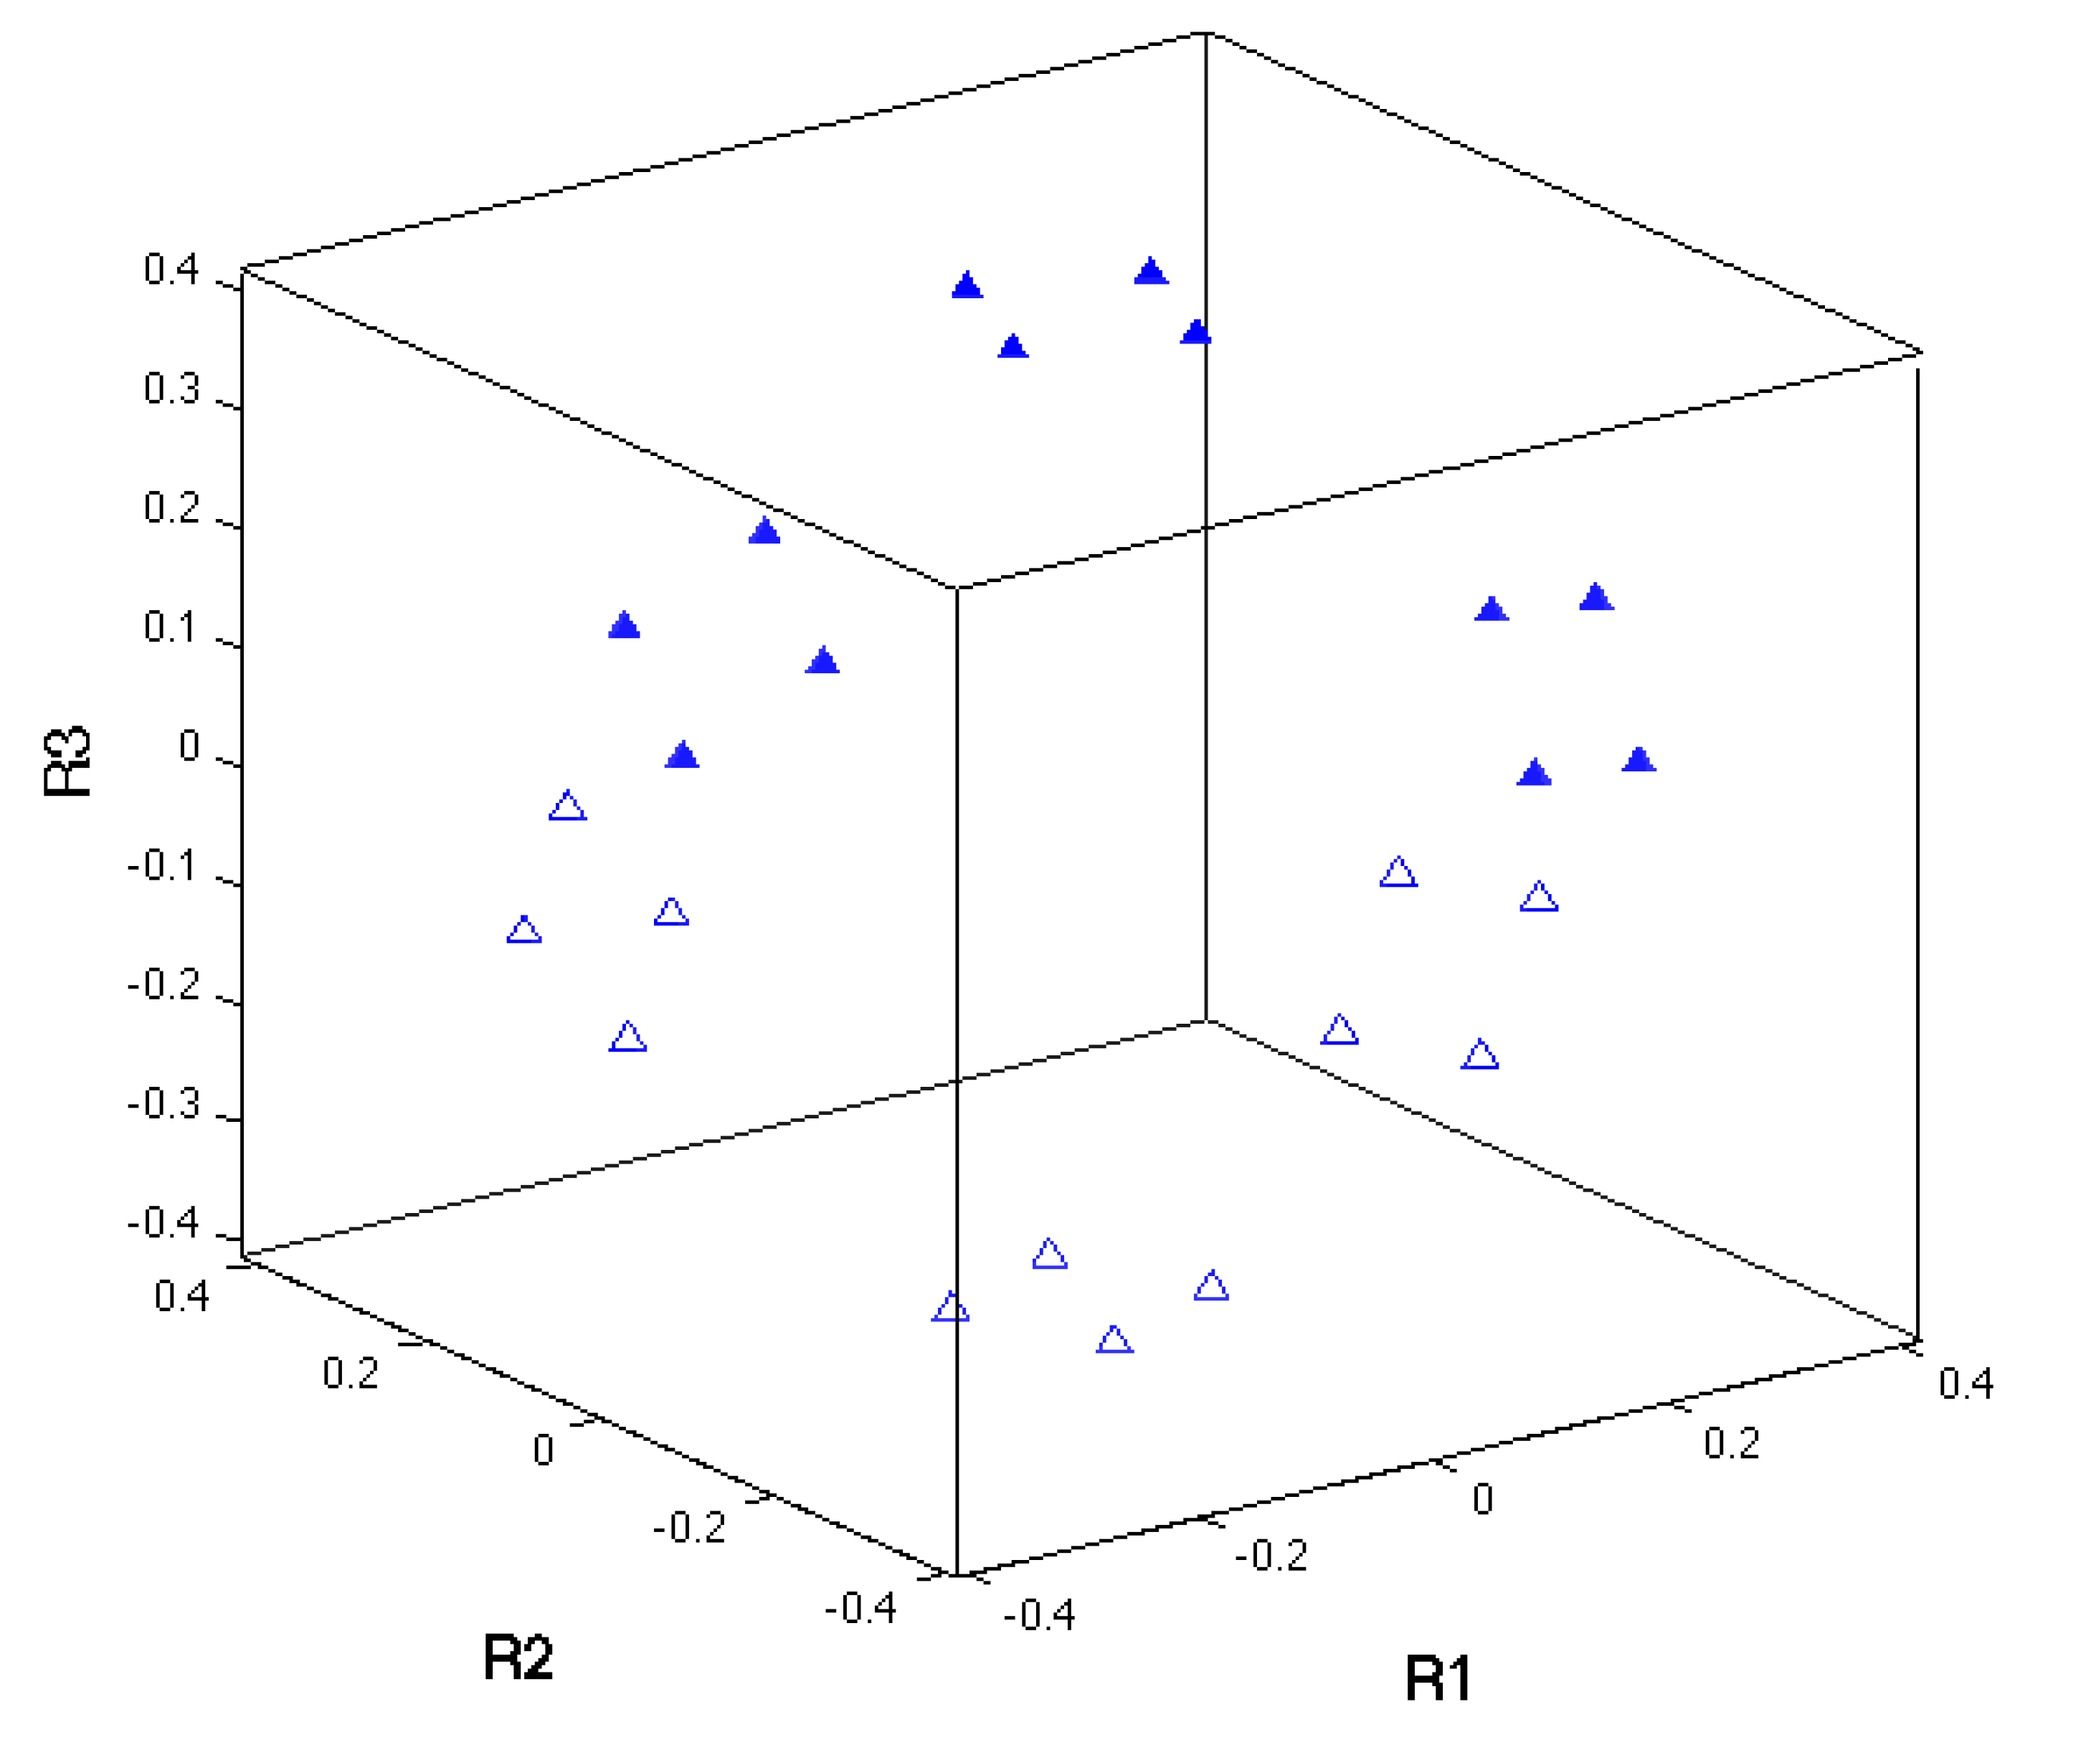
KS Orientation relationship in Rodrigues Space

Slide 23
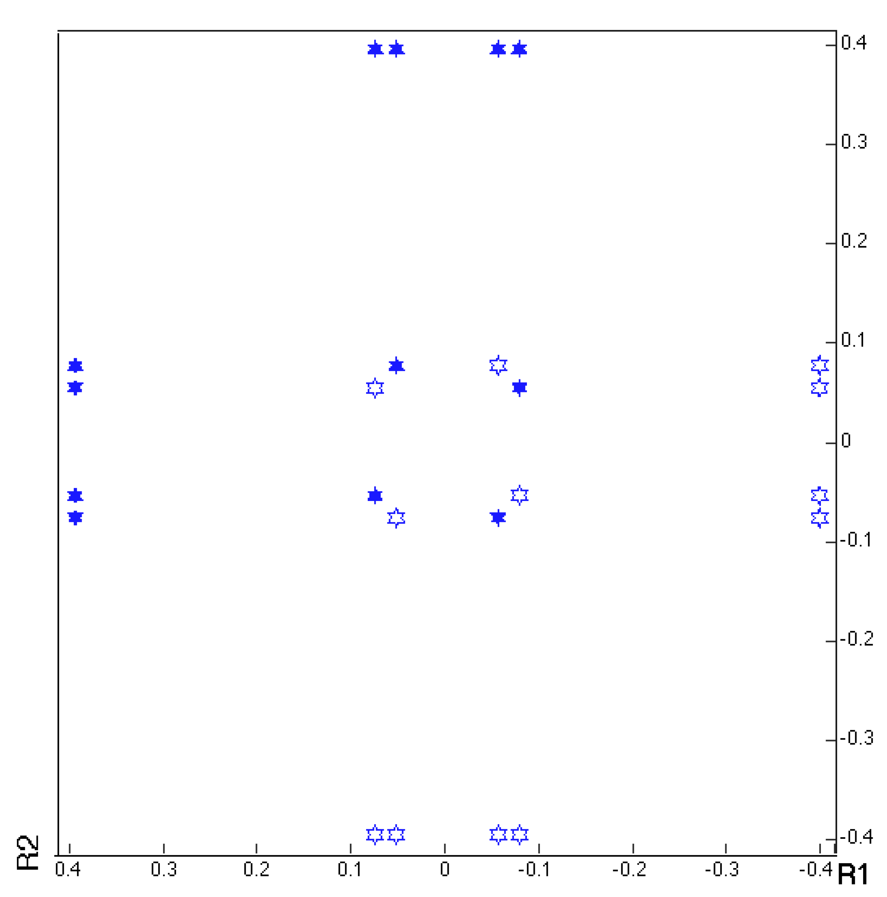
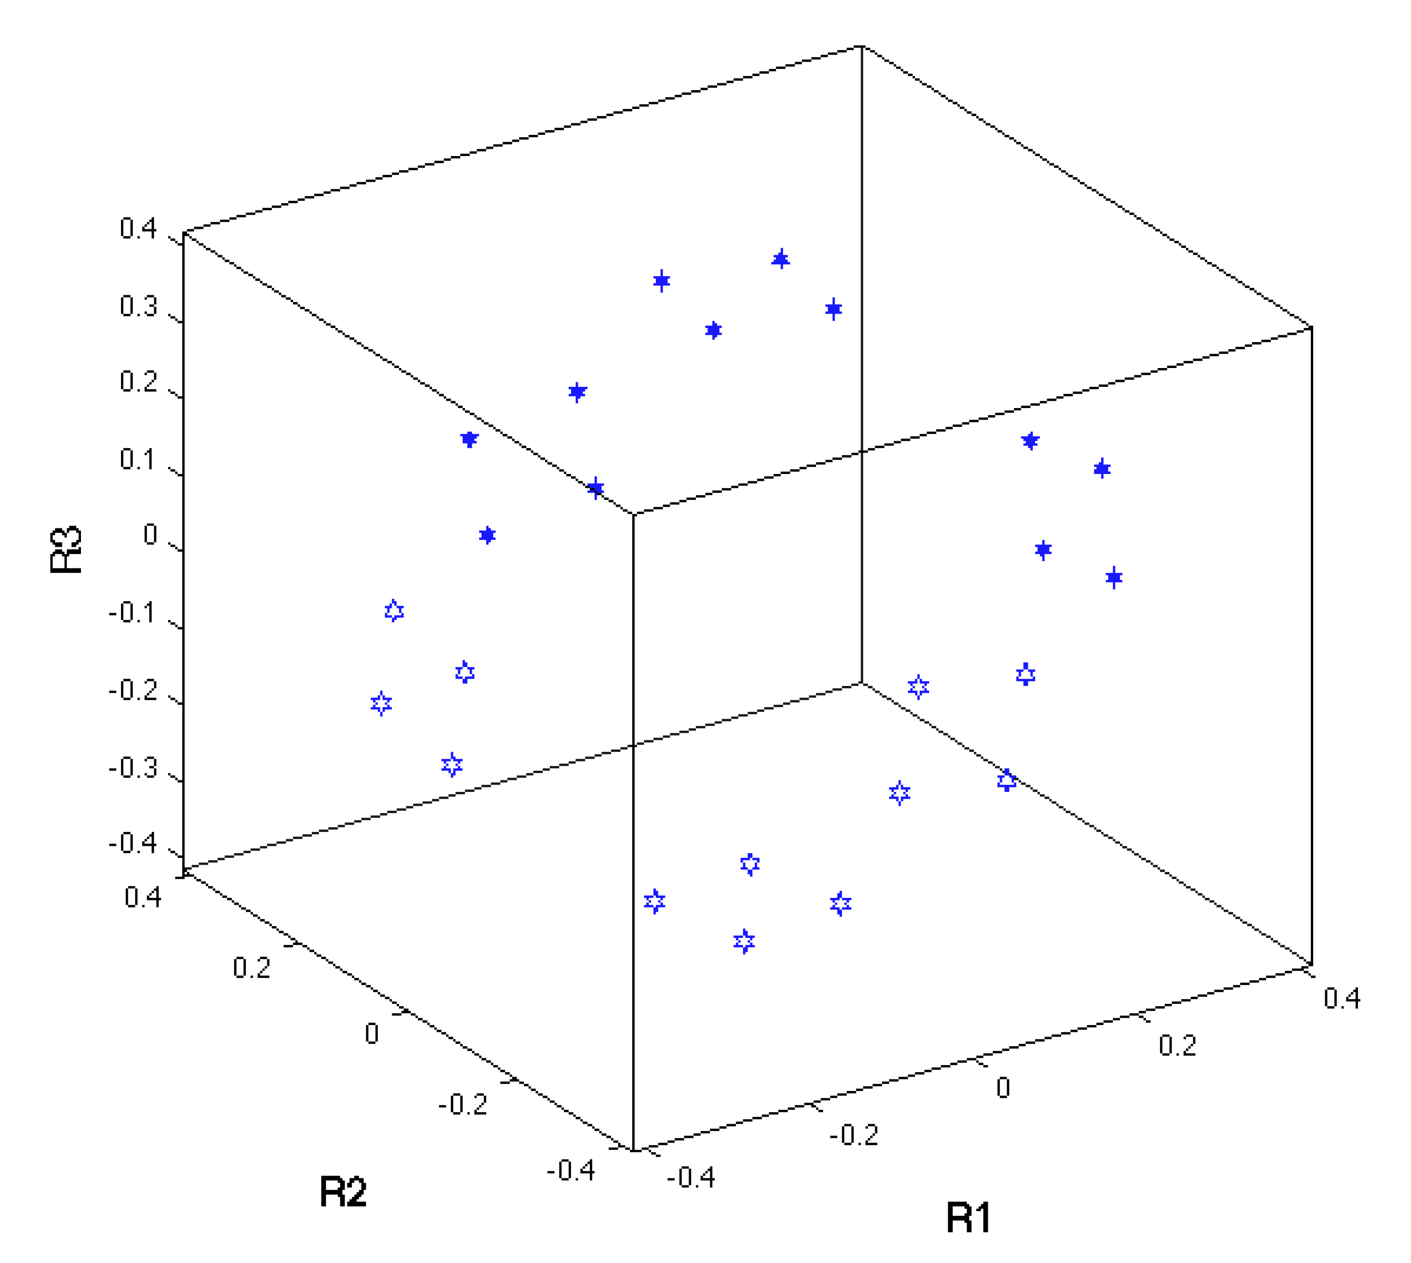
GT Orientation relationship in Rodrigues Space

Slide 24
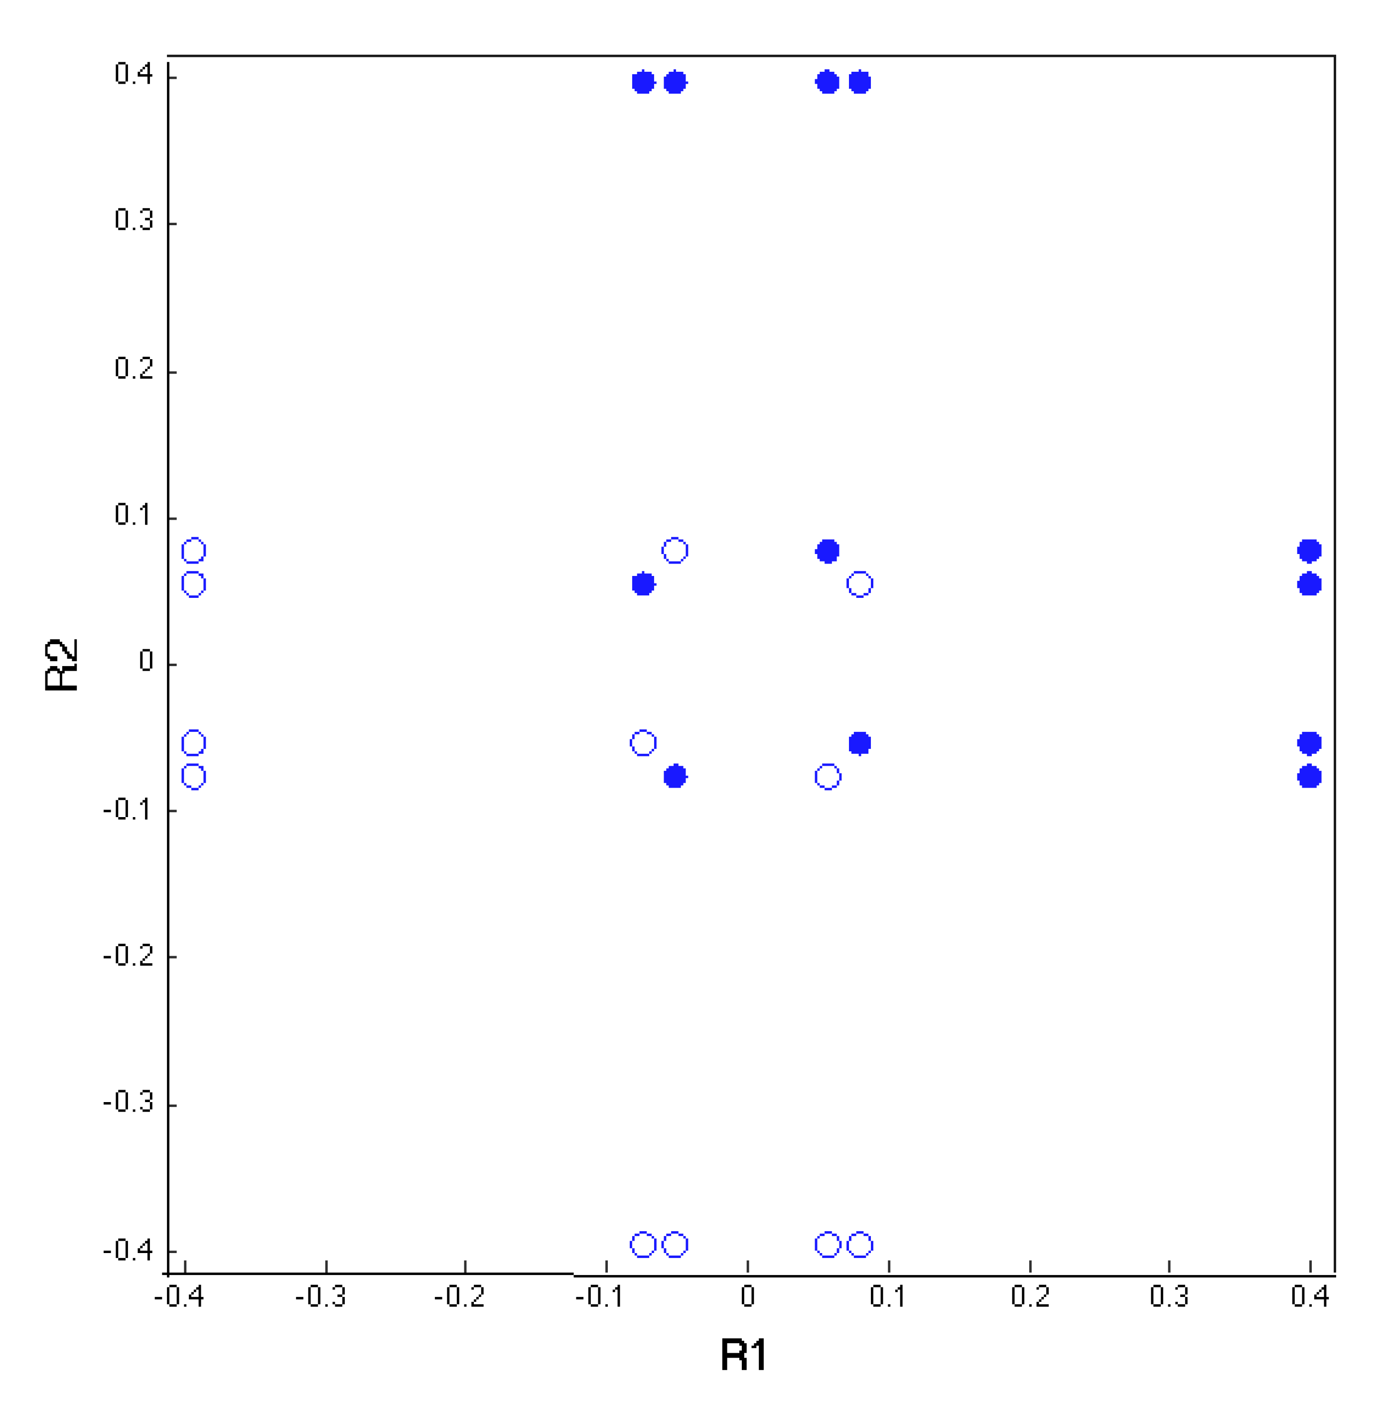
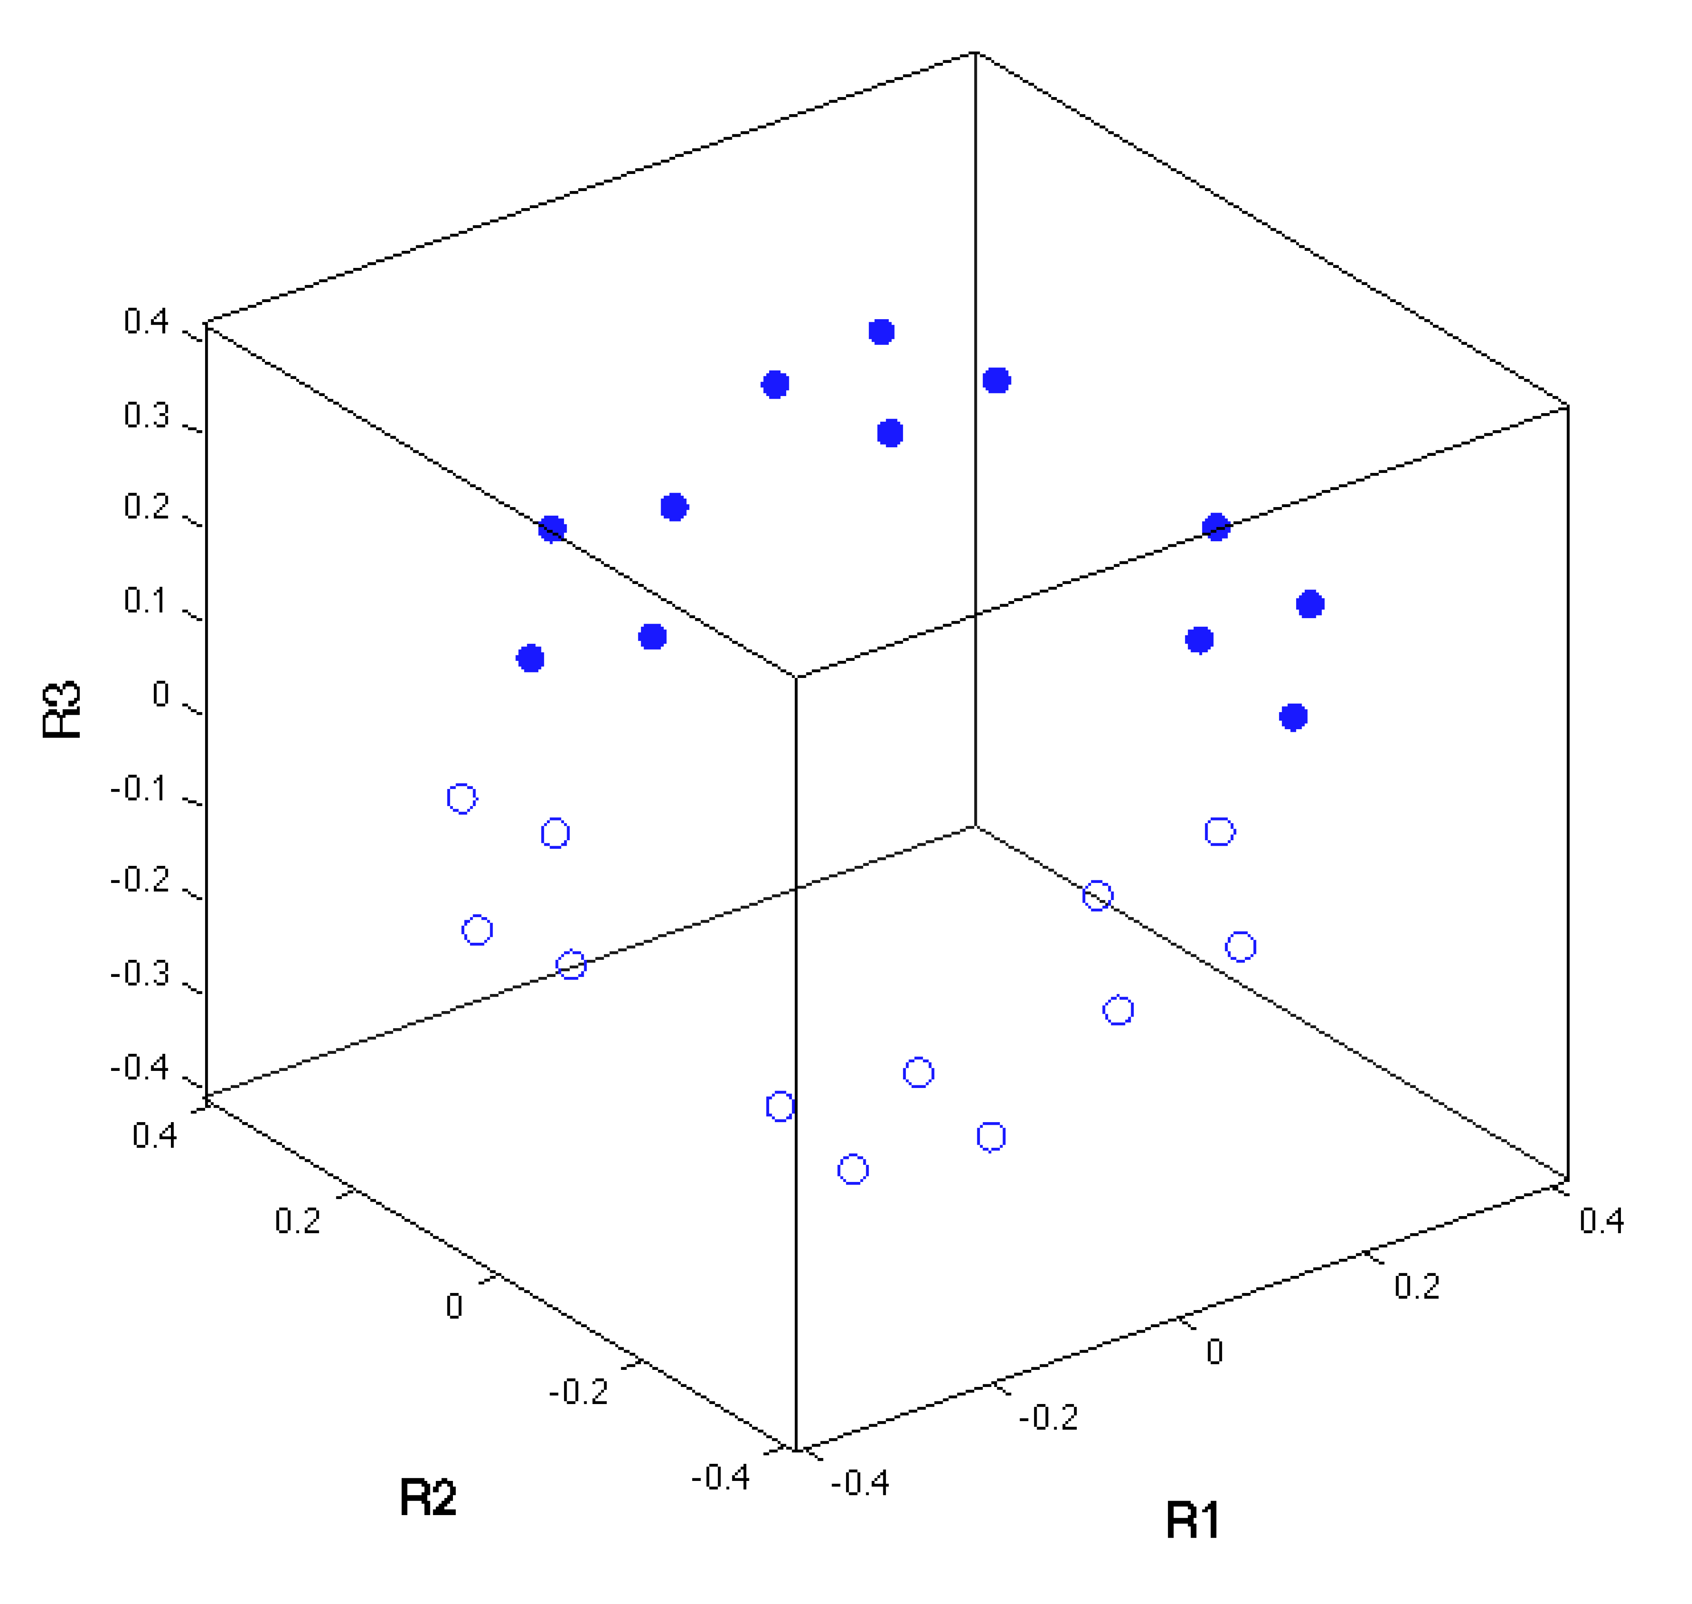
GT’ Orientation relationship in Rodrigues Space

Slide 25
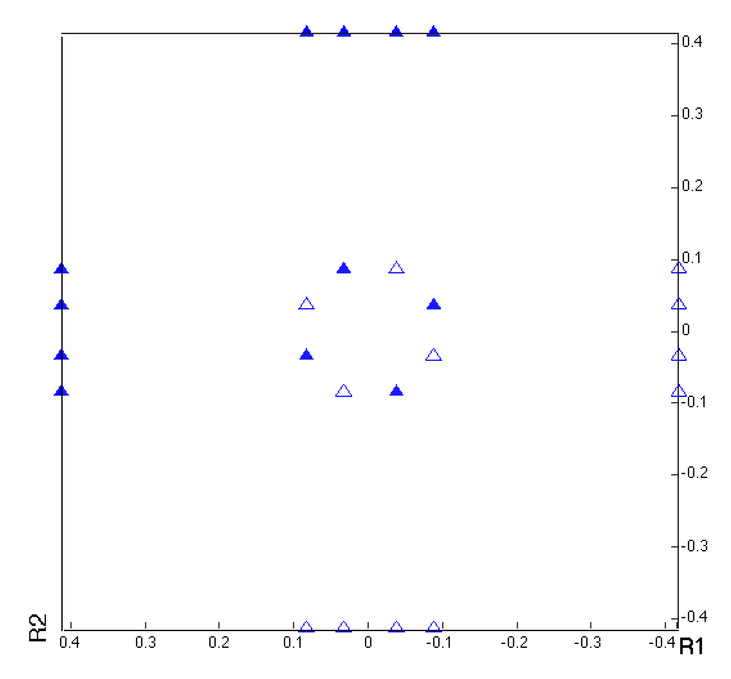
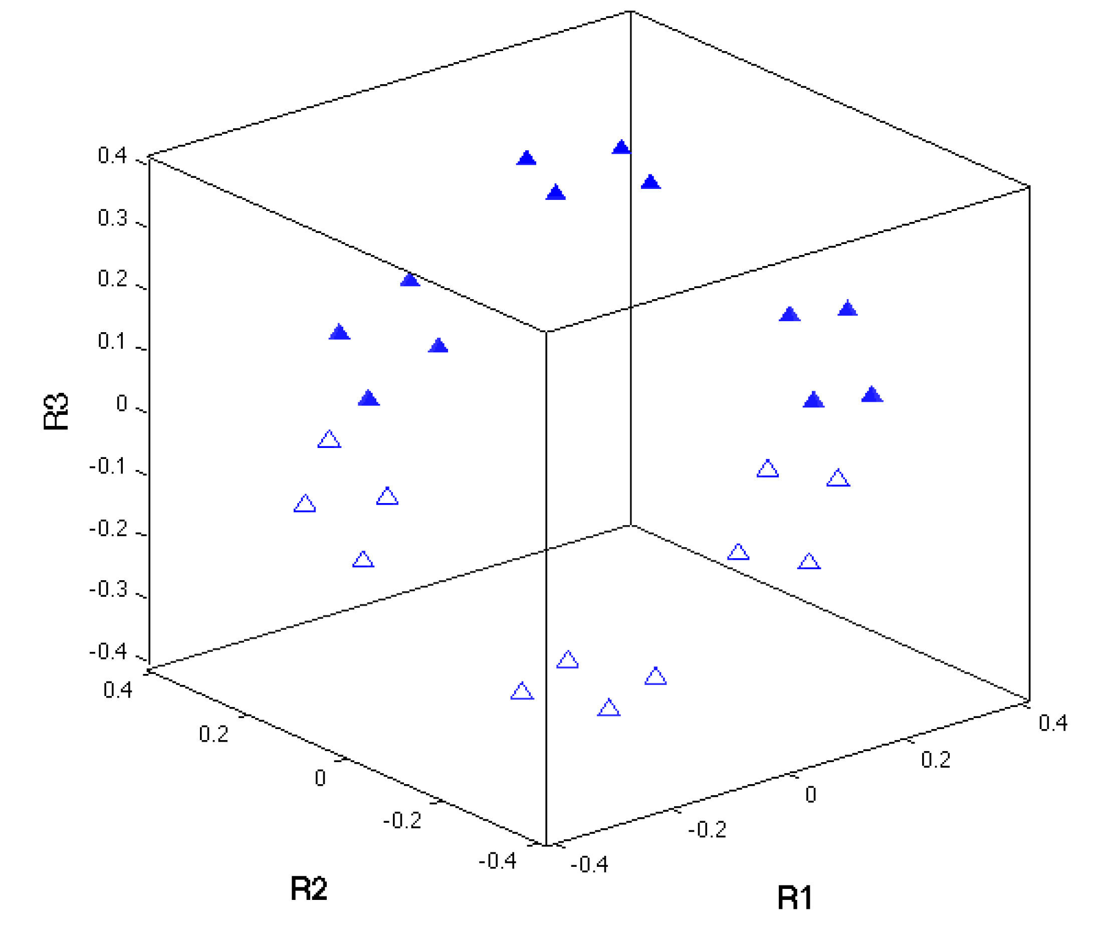
NW Orientation relationship in Rodrigues Space

Slide 26
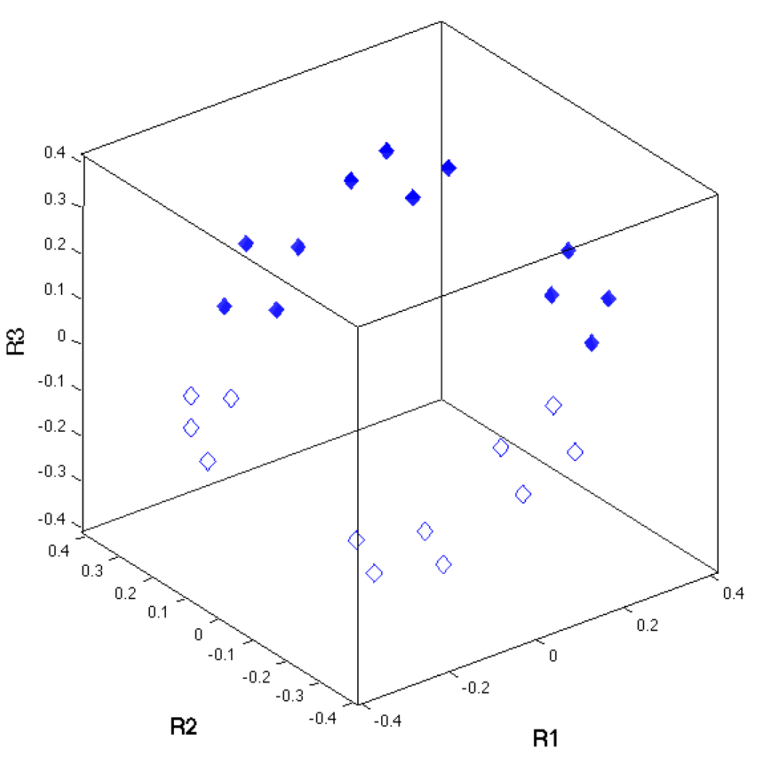
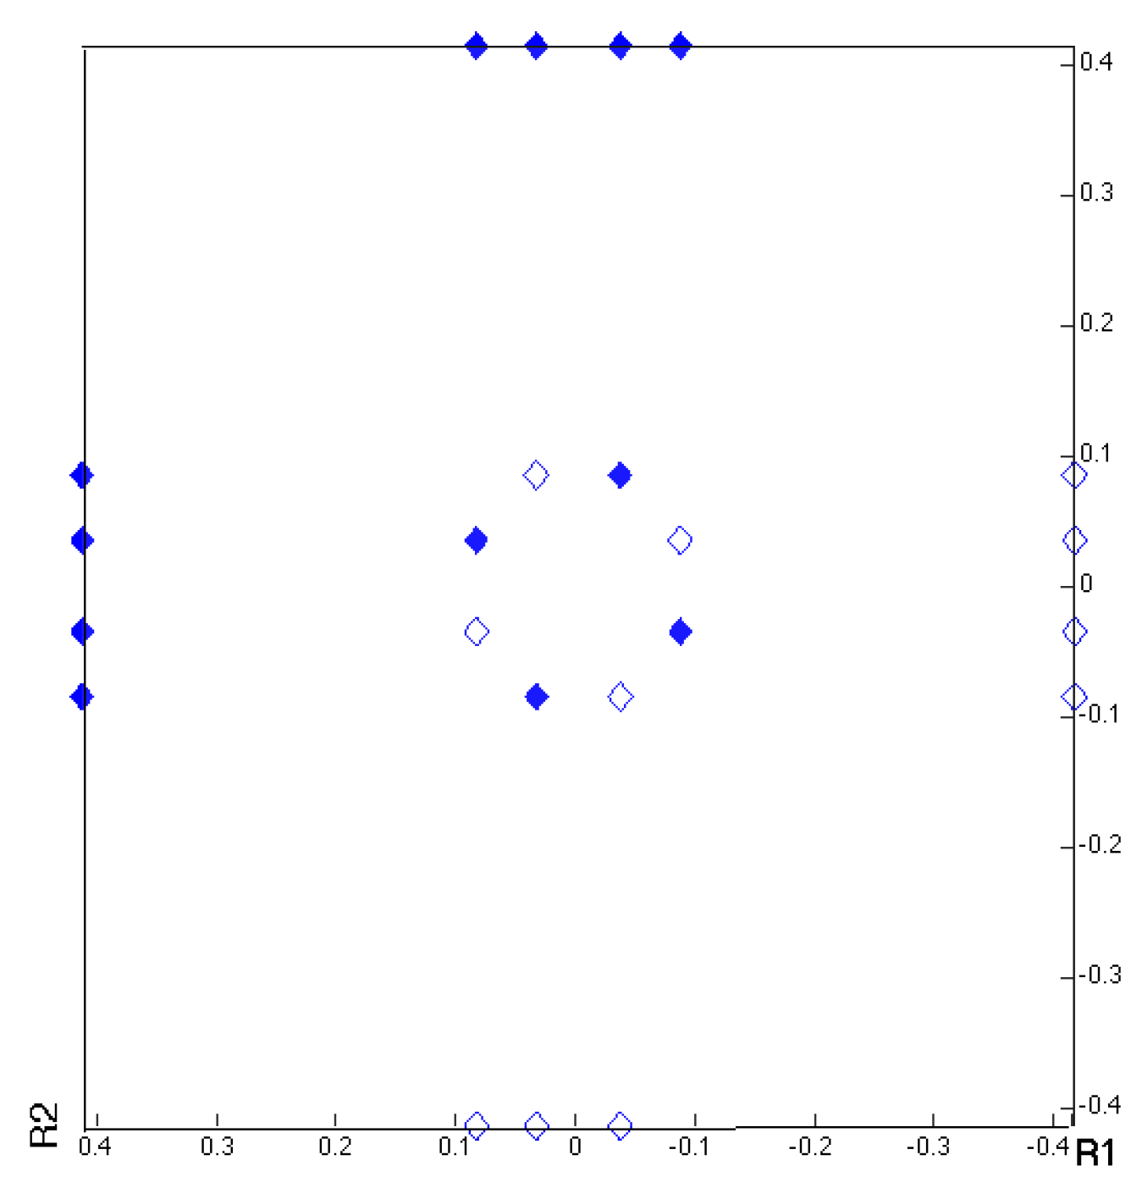
Pitsch Orientation relationship in Rodrigues Space
Note that the ~45° angle means that the points lie almost on the surfaces of the Rodrigues space for cubic (mis)orientations

Slide 27
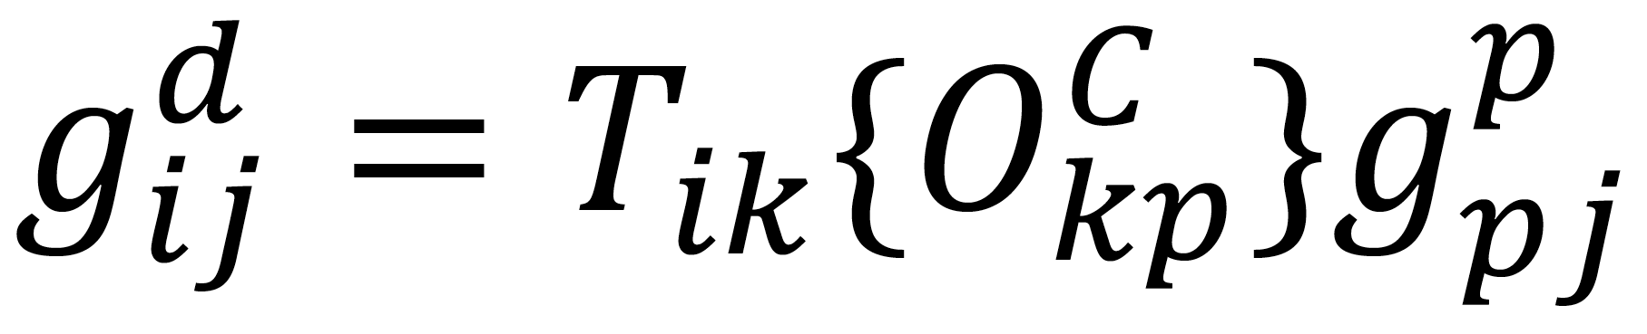
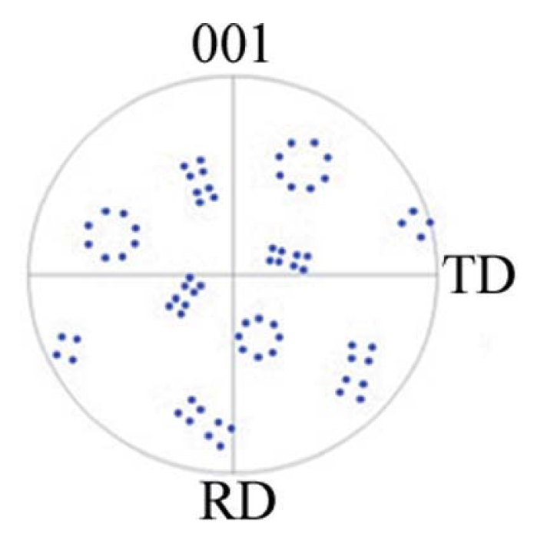
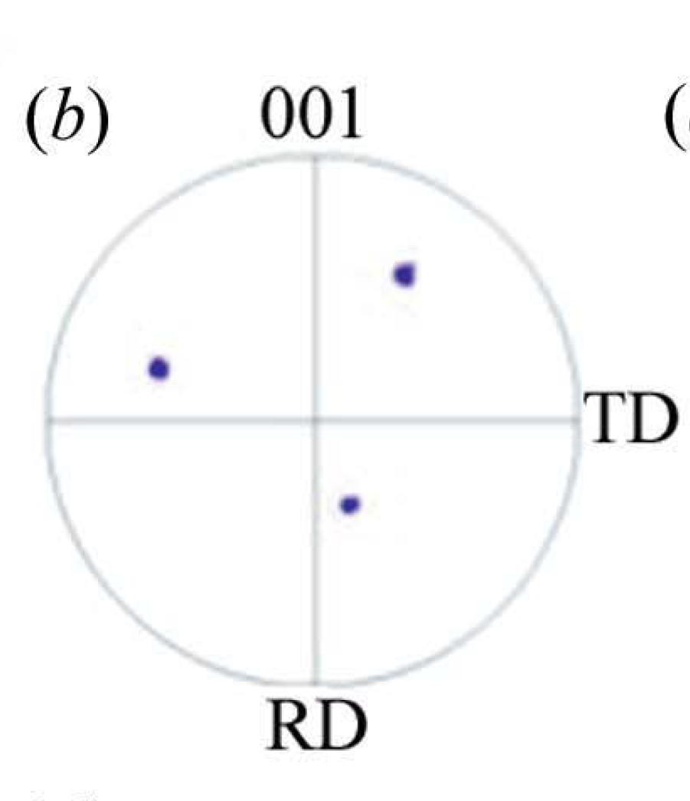
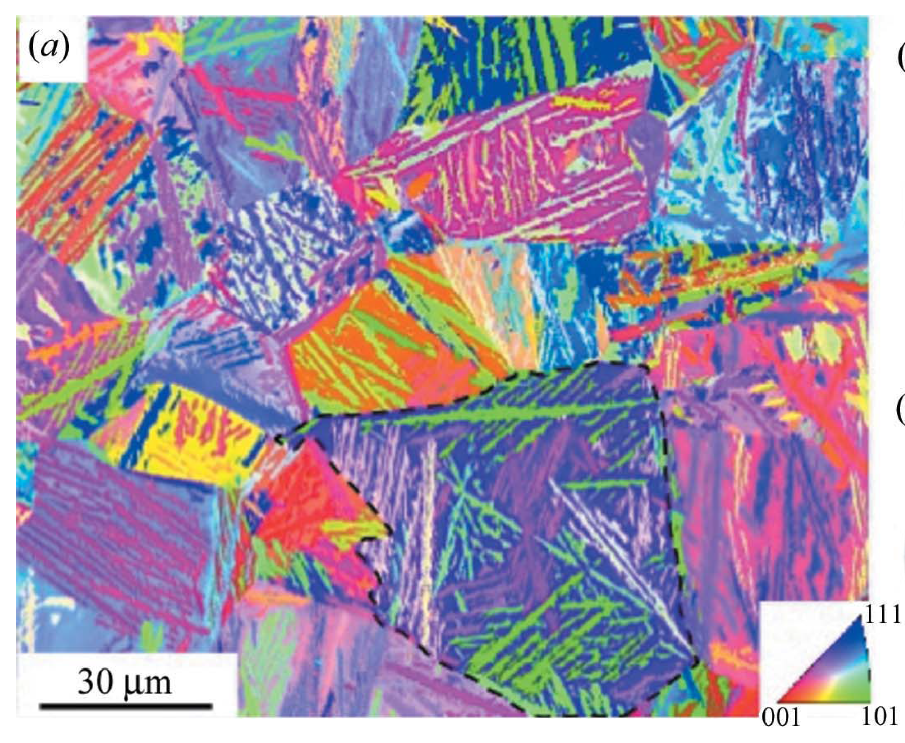
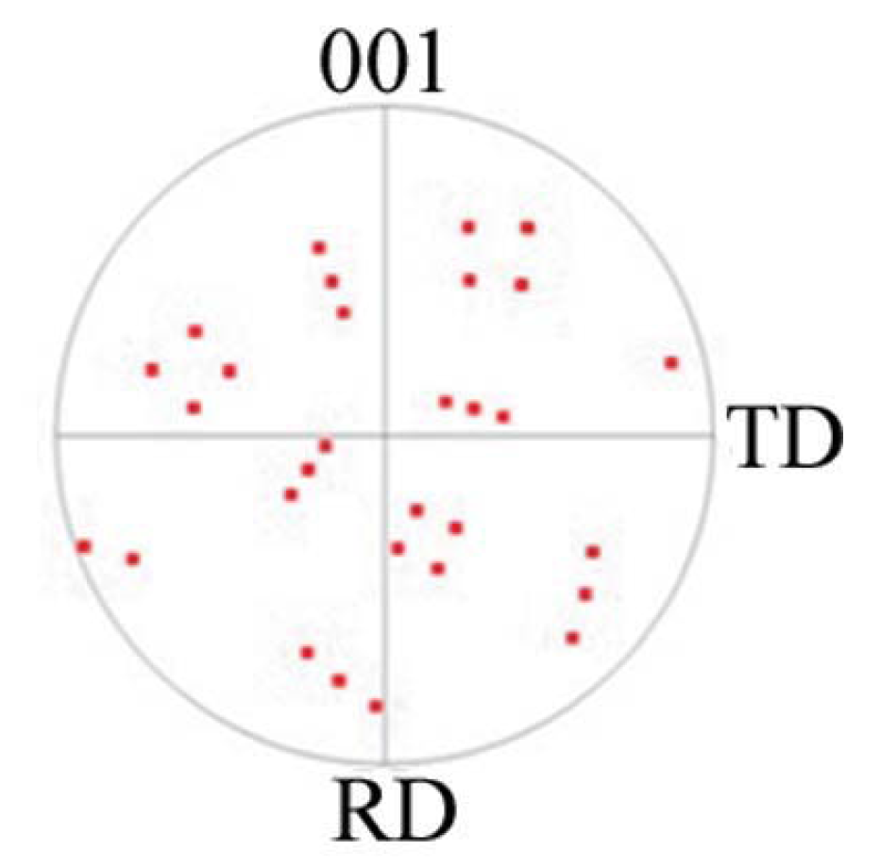
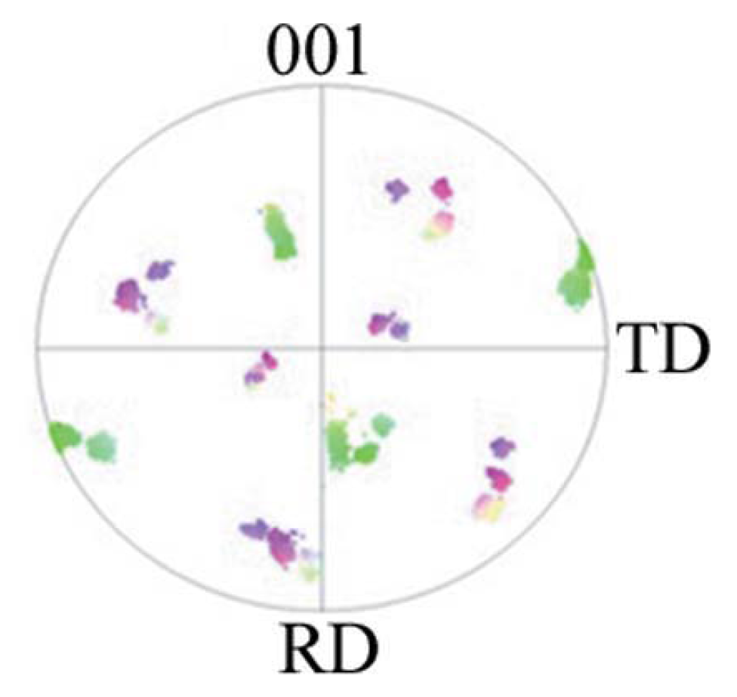
Forward Texture Prediction
Phase transformation
Parent (FCC)
Daughter
(BCC)
KS
Tari et al. (2013) J Appl. Cryst., 46 210-215.
NW

Slide 28
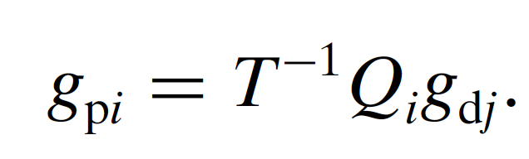
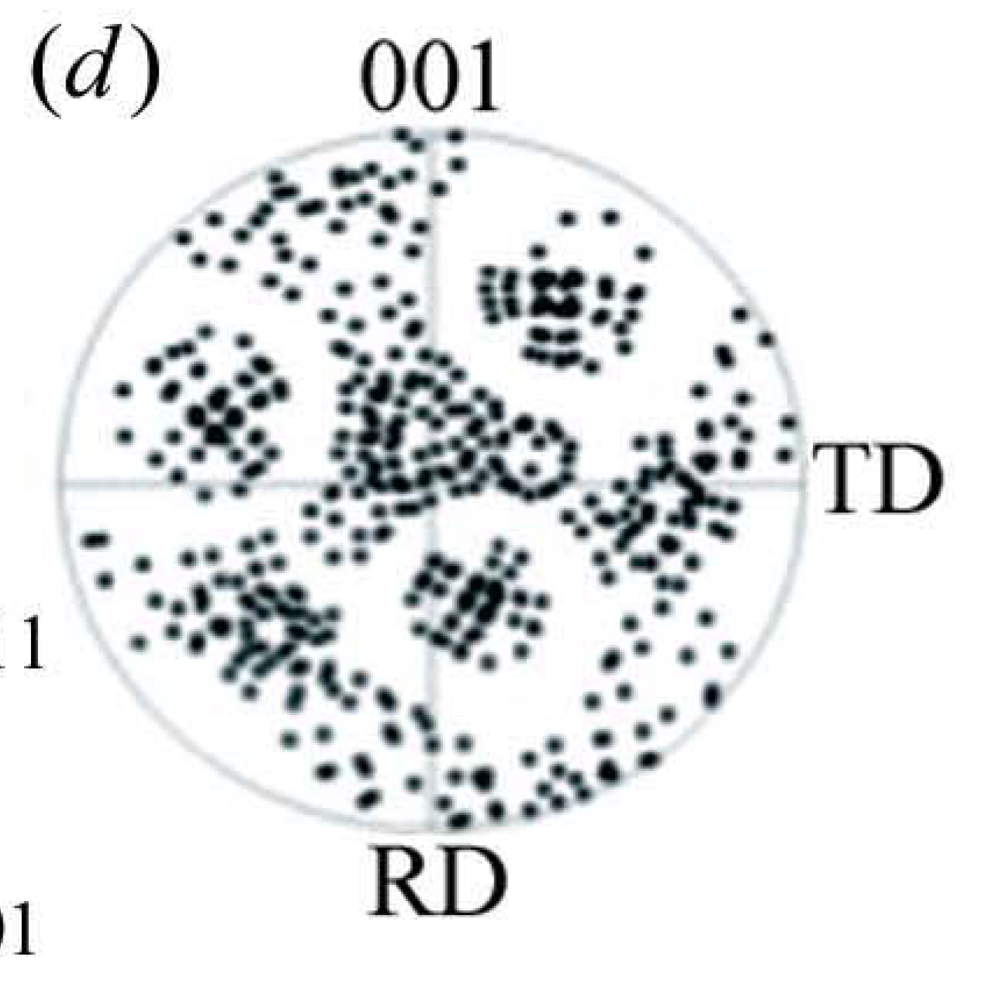
Backward Texture Calculation
Daughter
(BCC)
Parent (FCC)
v1
g_{dj}= BCC variants orientation
Q_{i}= symmetry operator
T= OR matrix
g_{pi}= FCC variants orientation
v6
v2
v5
p1
p2
v4
v3
p3
Tari et al. (2013) J Appl. Cryst., 46 210-215.

Slide 29
Backward Texture prediction
α₁ α₂ α₃ α₄ α_{n}
BCC variants
Vγ_{1_1}
Vγ_{1_i}
Vγ_{1_n}
Vγ_{2_1}
Vγ_{2_i}
Vγ_{2_n}
Vγ_{3_1}
Vγ_{3_i}
Vγ_{3_n}
Vγ_{4_1}
Vγ_{4_i}
Vγ_{4_n}
Vγ_{n_1}
Vγ_{n_i}
Vγ_{n_n}
FCC possible variants
Tari et al. (2013) J Appl. Cryst., 46 210-215.

Slide 30
Backward Texture prediction
α₁ α₂ α₃ α₄ α_{n}
BCC variants
Vγ_{1_1}
Vγ_{1_i}
Vγ_{1_n}
Vγ_{2_1}
Vγ_{2_k}
Vγ_{2_i}
Vγ_{2_n}
Vγ_{3_1}
Vγ_{3_i}
Vγ_{3_n}
Vγ_{4_1}
Vγ_{4_i}
Vγ_{2_ j}
Vγ_{4_n}
SMMA_γ_{1_1}
FCC possible variants
SMMA_γ_{2_i}
SMMA_γ_{2_n}
Tari et al. (2013) J Appl. Cryst., 46 210-215.

Slide 31
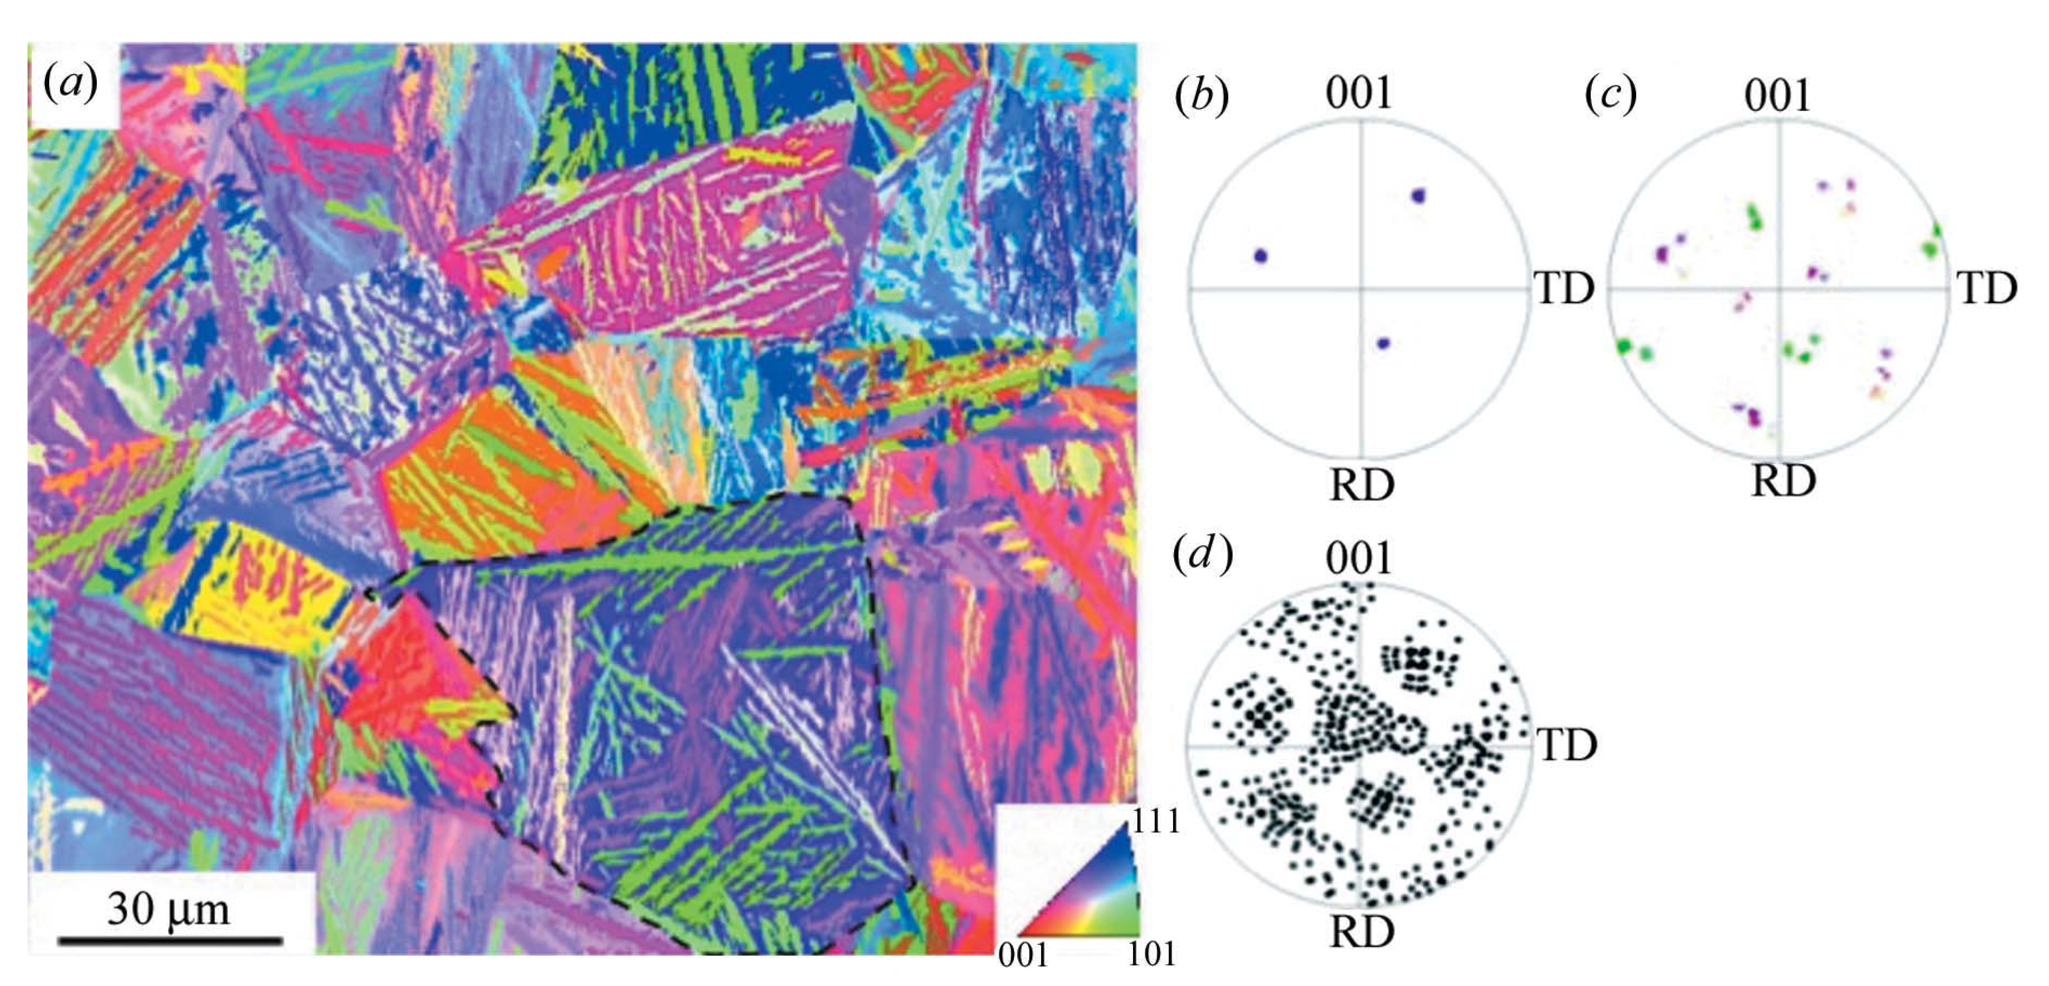
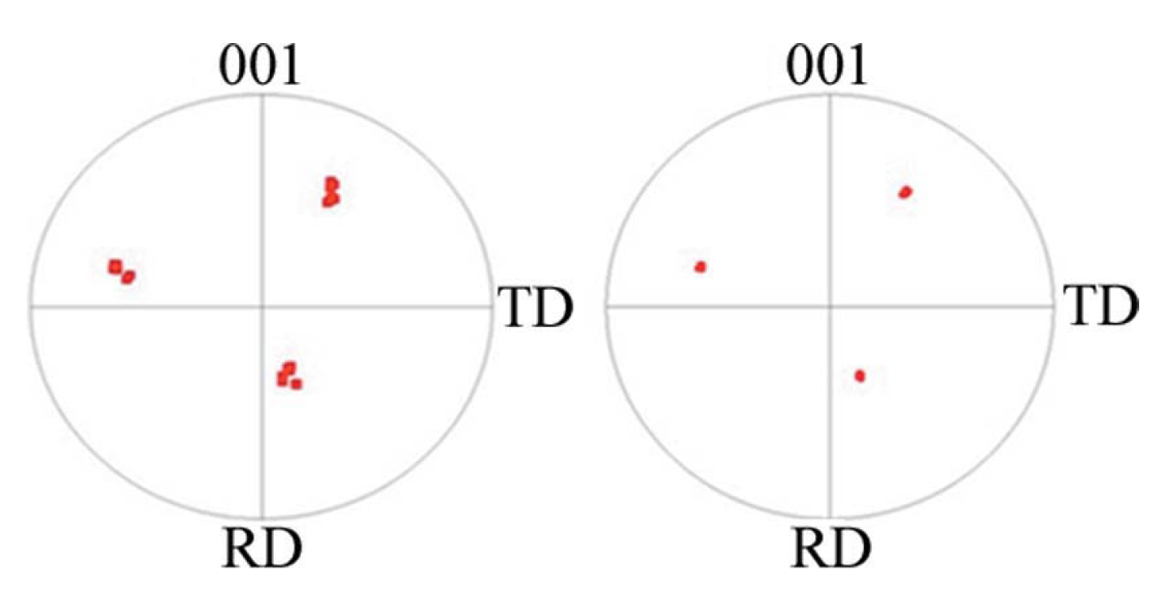
Backward Texture prediction
Austenite
Bainite
KS
NW

Slide 32
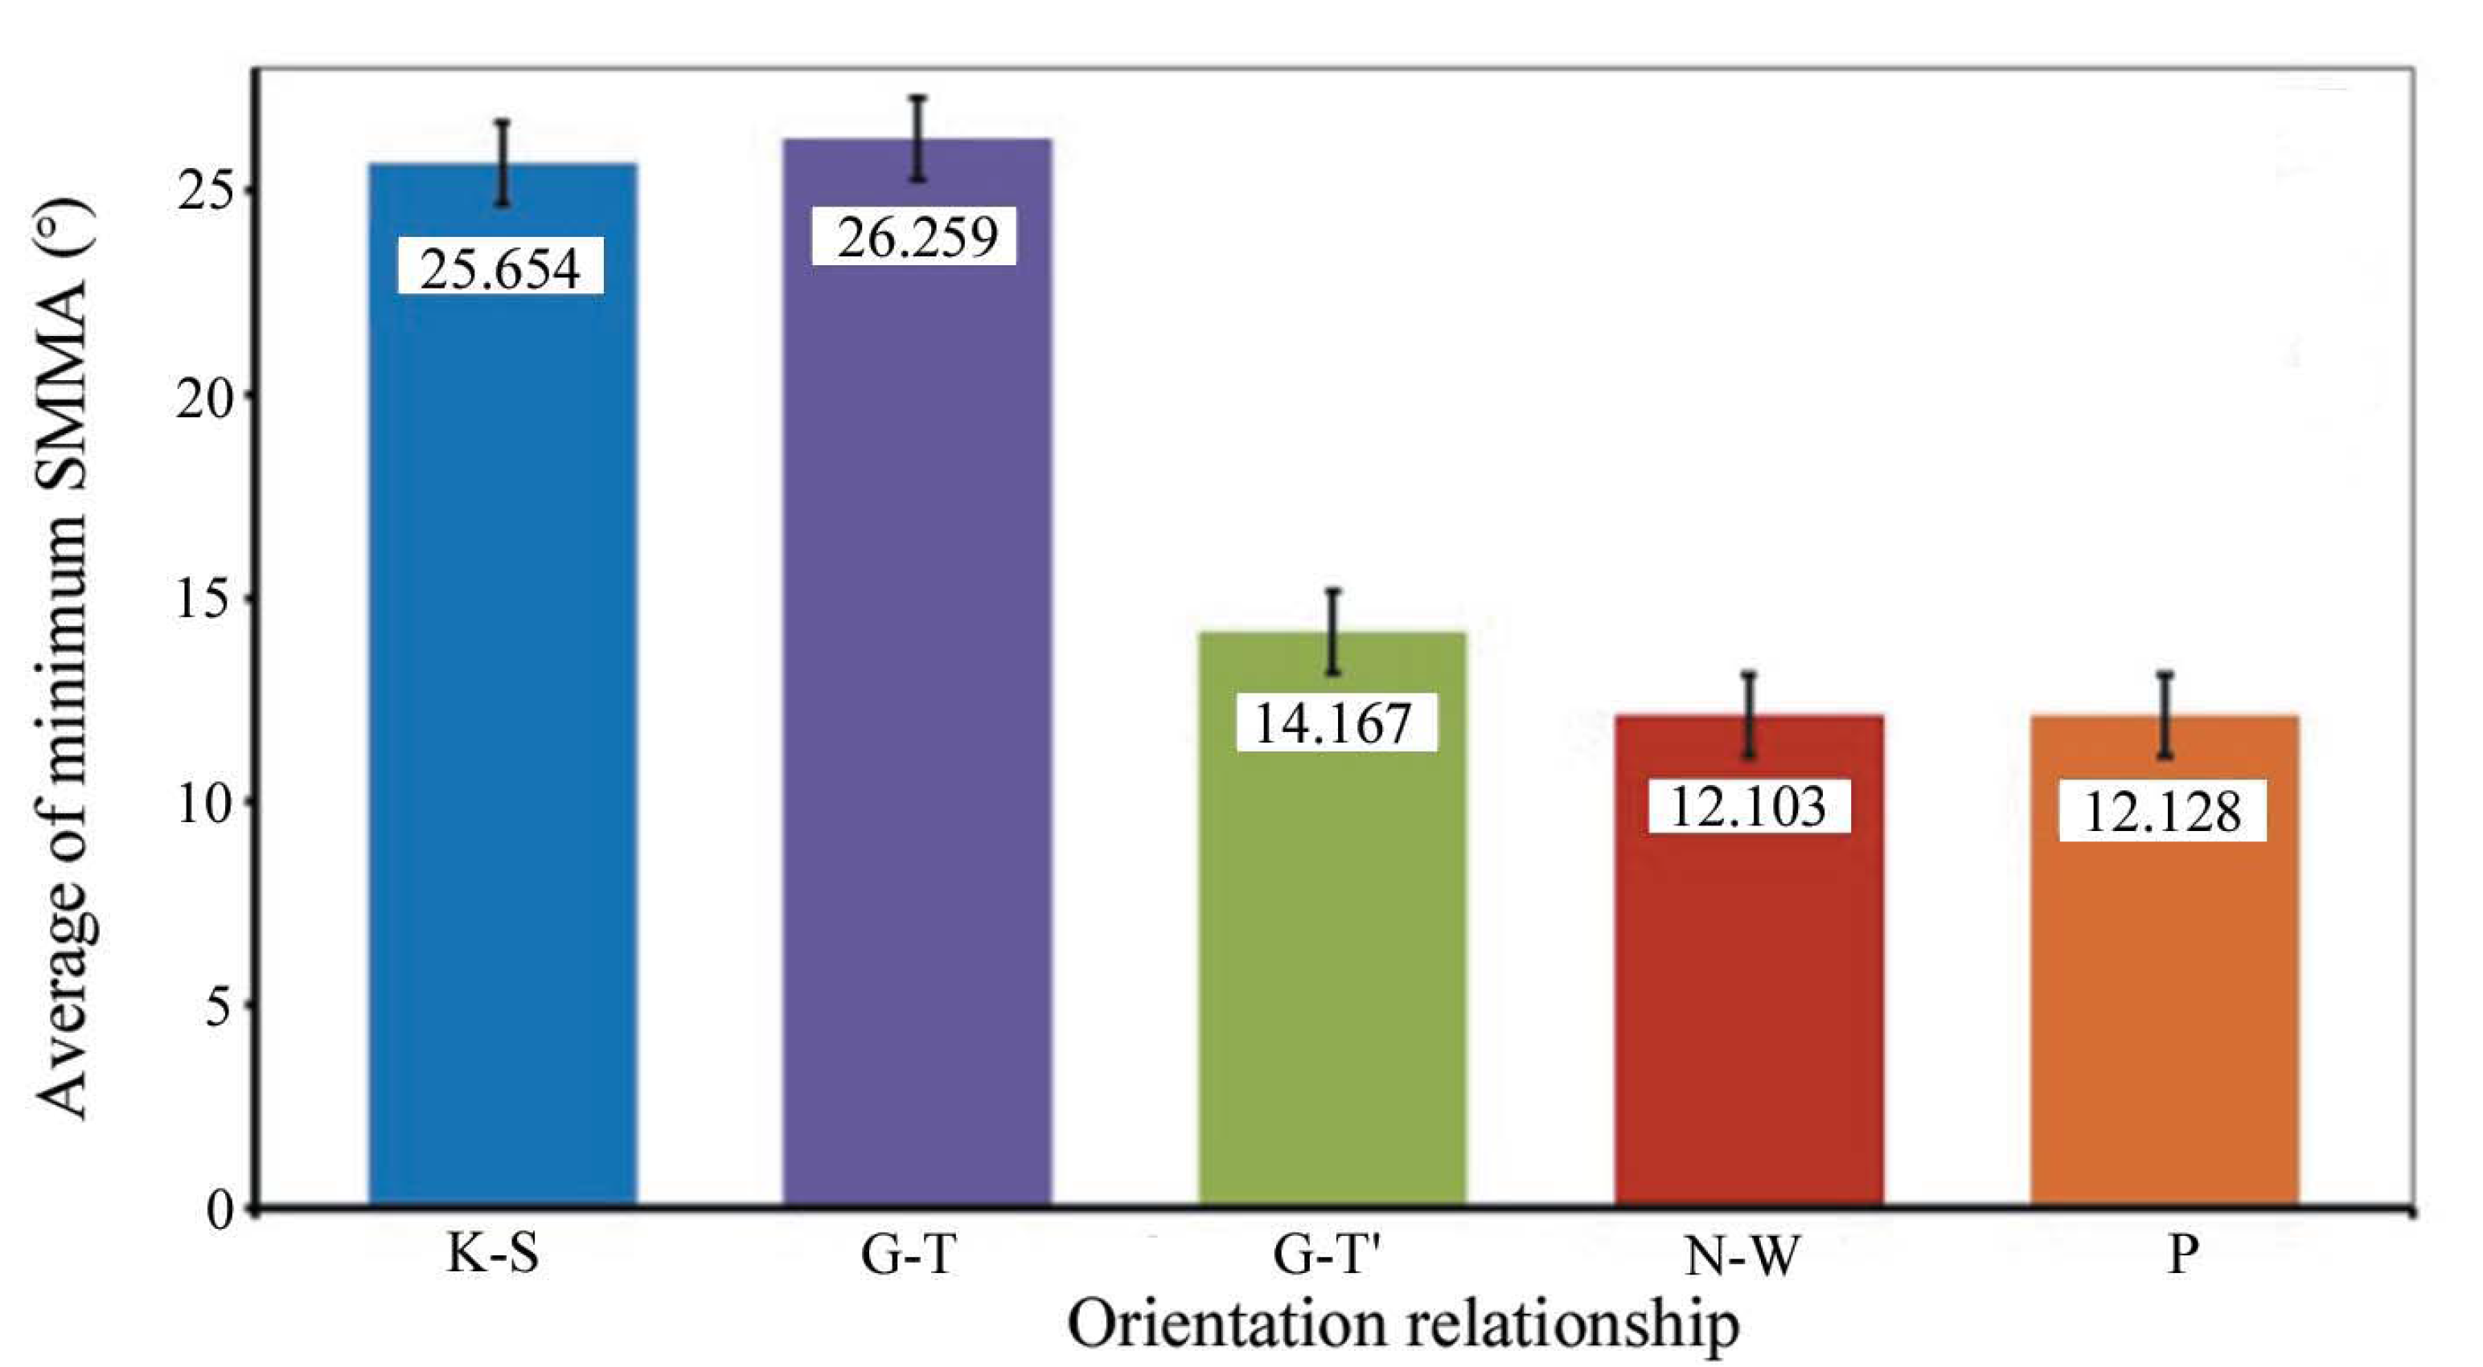
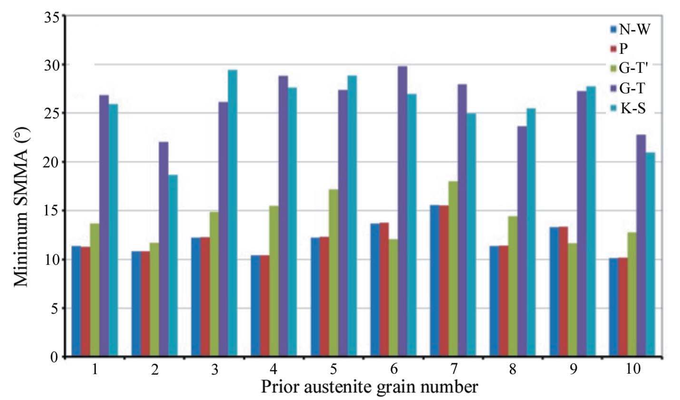
Backward Texture prediction
Tari et al. (2013) J Appl. Cryst., 46 210-215.

Slide 33
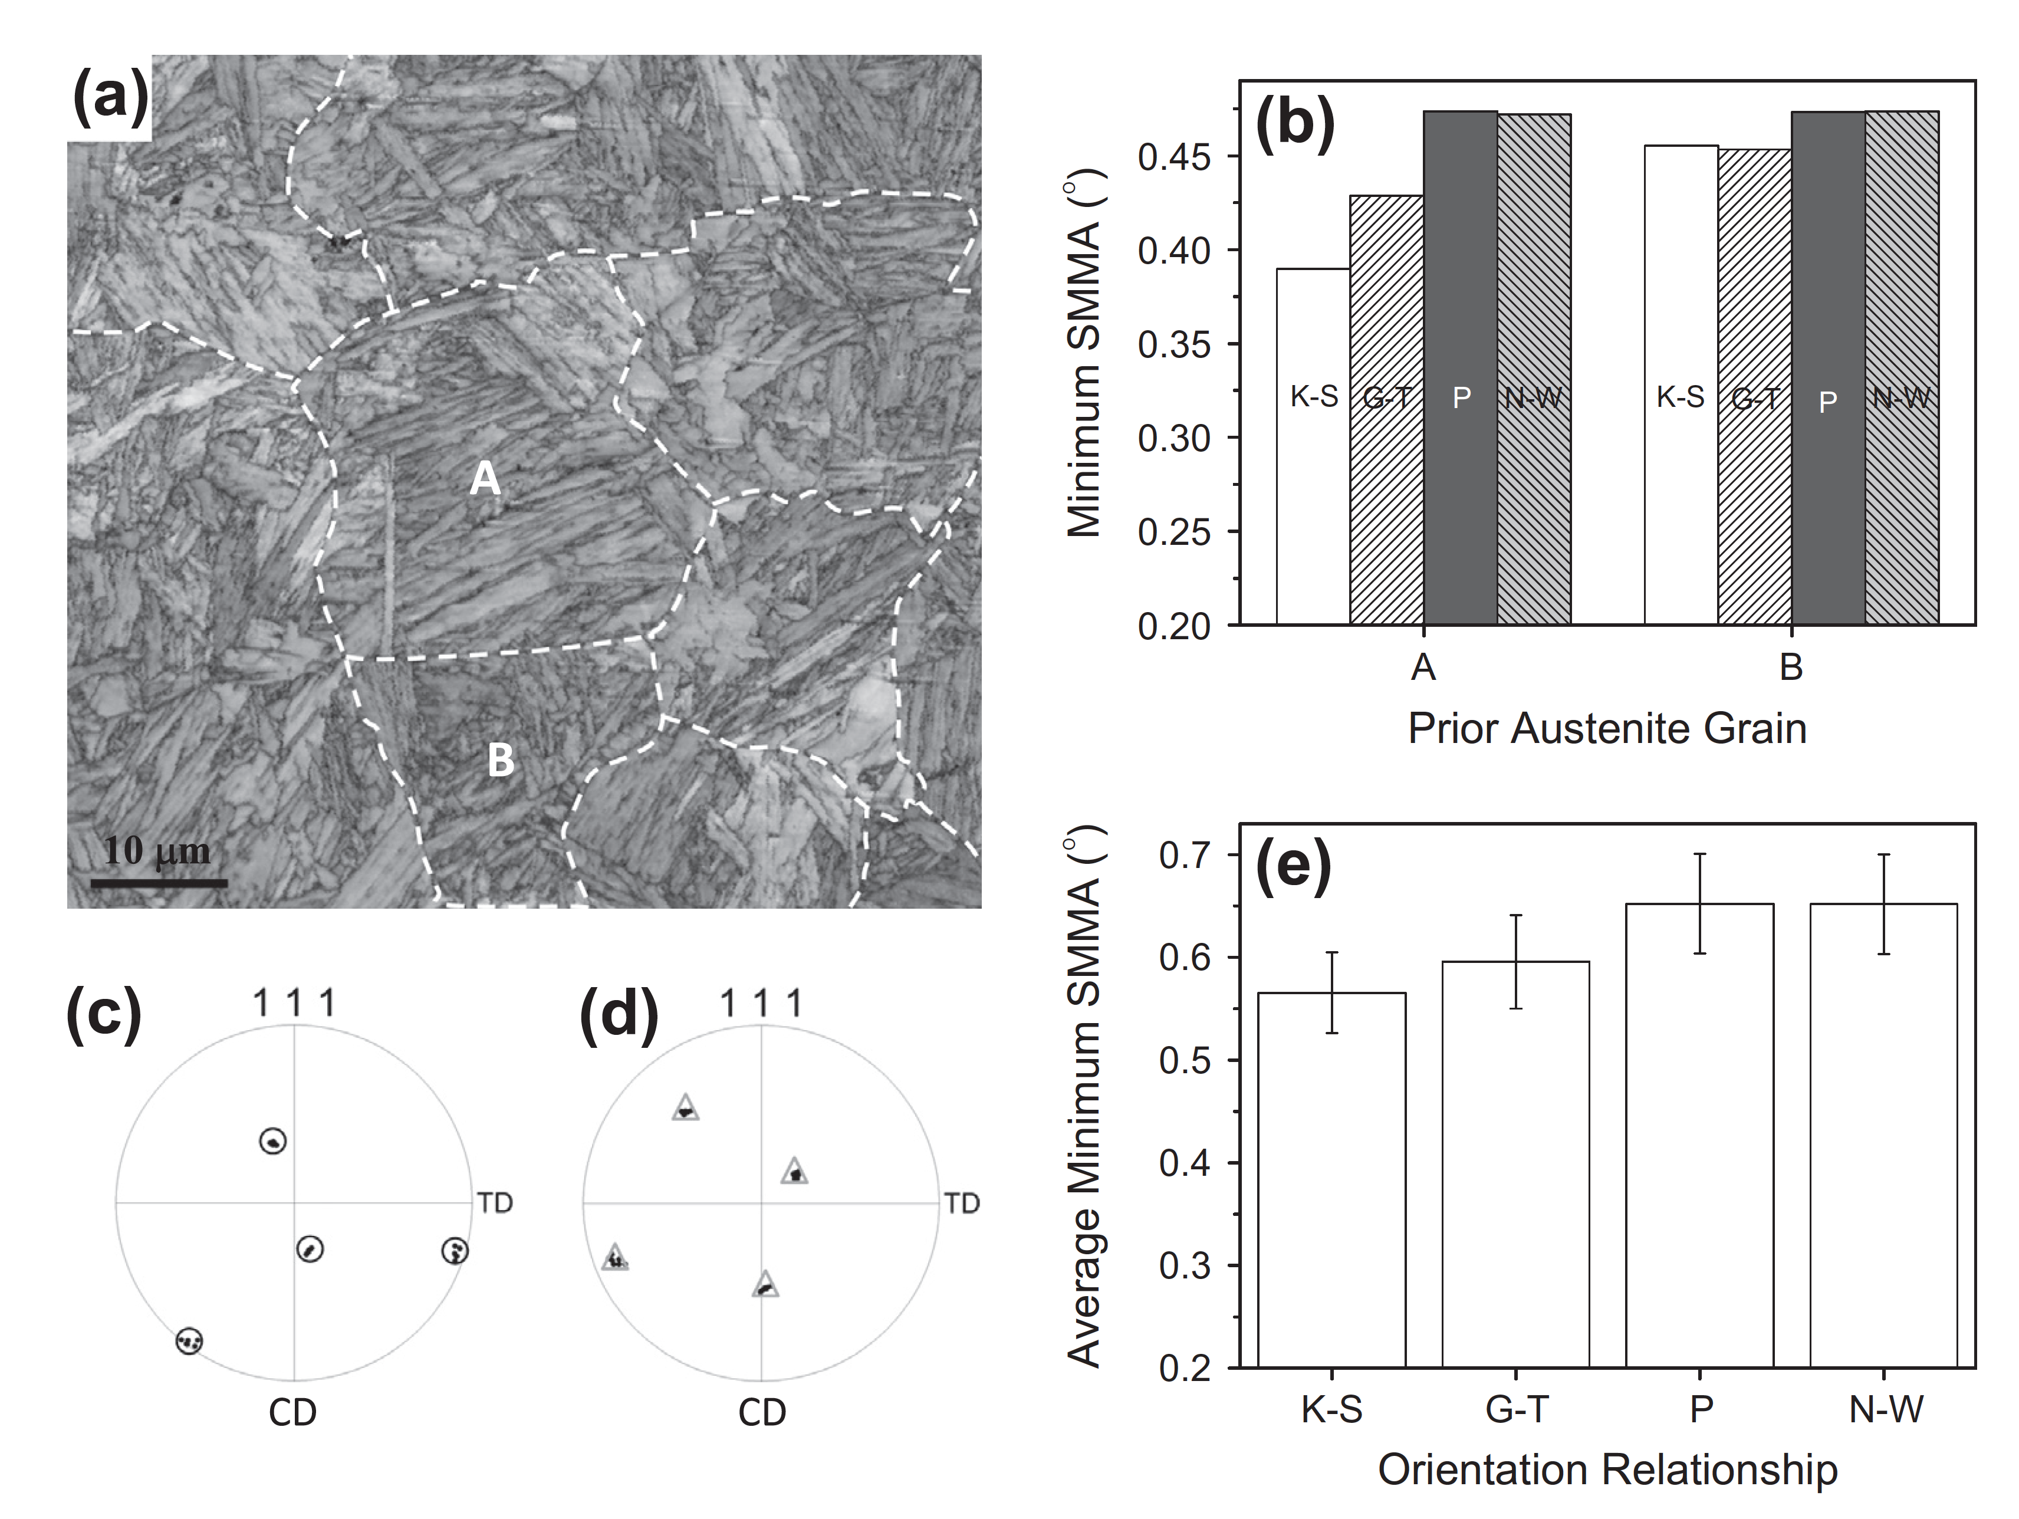
Backward Texture prediction
0.04C–1.52Mn–0.2Si–0.22Mo–0.08Ti–0.033Al (in wt.%)
Beladi et al. (2014) Acta Materialia 63 86–98

Slide 34
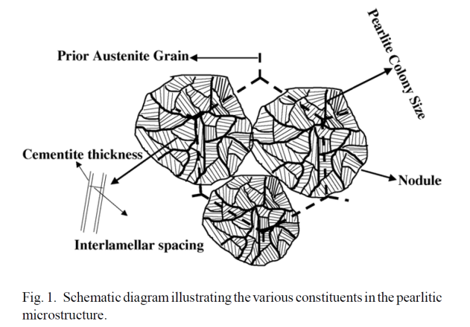
Orientation Relationships in Pearlite Microstructures
Pearlite is a lamellar structure comprised of BCC α-ferrite and orthorhombic¹ cementite (Fe3C). A schematic of the pearlitic lamellar structure is shown below, with many different length scales represented: prior austenite grain size, pearlite colony size, interlamellar spacing, and cementite thickness. If a high enough microstructural resolution is used, all length scales should be visible in the vpFFT simulations. This may make a case for the use of multiple SVEs rather than RVEs for this microstructure. (Something to be decided later.) Additionally, because of the sharp and (usually) straight ferrite and cementite interface, there likely exists an orientation relationship (OR) between the two phases. In fact, three ORs have been reported in the literature². Two of these ORs occur with a higher frequency than the third, and these two occur with the same frequency. The three ORs are Bagaryatsky³, Isaichev⁴, and Pitsch-Petch^{5,6} and are described on the lower right. The Isaichev OR is the least frequently observed OR.
Bagaryatsky: [100]c//[1͞10]f
[010]c//[111]f
(001)c//(͞1͞12)f
Isaichev: [010]c//[111]f
(101)c//(11͞2)f
Pitsch-Petch: [100]c 2.6 deg from [͞31͞1]f
[010]c 2.6 deg from [131]f
(001)c//[21͞5]f
¹I.G. Wood et al., J Applied Crystallography, 37 (2004) 82-90
²M.A. Mangan, G.J. Shiflet, Met Trans A, 30A (1999) 2767-81
³Y.A. Bagaryatsky, Dokl Akad Nauk SSSR, 73 (1950)1161-64
⁴I.V. Isaichev, Z Tekhn Fiz, 17 (1947) 835-38
⁵W. Pitsch, Acta Cryst, 10 (1962) 79-80
⁶N.J. Petch, Acta Cryst, 6 (1953) 96
A.M. Elwazri et al.,
Mat Sci and Eng A,
404 (2005) 91-98

Slide 35
Further Literature Review of Cementite ORs
Why do different ORs exist for ferrite and cementite in pearlite?
In a large review paper on using electron backscatter diffraction for the study of phase transformations in 2002¹, a section pertaining to pearlite was presented. It cited a 1999 paper² which found that the Pitsch-Petch orientation relationship occurs when the pearlite colony nucleates first with cementite. The Bagaryatsky orientation relationship was observed when the pearlite colony nucleated with ferrite. This was observed in both hypereutectoid or hypoeutectoid alloys. All results of ORs were confirmed using EBSD.
A 2009 review paper³ on predicting orientation relationships using an edge-to-edge matching method to minimize the misfit at an interface stated that using a “selected area electron diffraction” is insufficient resolution to differentiate between the Isaichev and Bagaryatsky ORs. Higher resolution measurements using convergent beam Kikuchi line diffraction patterns never observed the Bagaryatsky OR. They go as far as to say the Pitsch-Petch OR also does not exist, but it is really four distinct ORs which vary less than 6º from Pitsch-Petch. Additionally, the Bagaryatsky and Isaichev OR vary by about 3.5º.
However, in a 2008 PhD thesis⁴ the Bagaryatsky OR was observed using EBSD, which has a angular resolution of about 1-2 degrees.
With the small difference between ORs and EBSD confirmation of the Bagaryatsky, I still believe that the Bagaryatsky OR (along with the Pitsch-Petch OR) is still valid and occur about 50/50.
¹Gourges-Lorenzen, A.F., Int. Materials Reviews, 52 (2002) no. 2
²Mangan, Shiflet, Met Trans A, 30A (1999) 2767-2781
³Zhang, M.X., Kelly, P.M., Progress in Materials Science, 54 (2009) 1101-1170
⁴Nikolussi, M., PhD Thesis, 2008

Slide 36

Pearlite: Hypothesis and Experiments
Hypothesis: Pearlite colonies containing the Bagaryatsky OR will deform more than those containing the Pitsch-Petch OR.
Concise background relating to hypothesis:
Orientation Relationships
Slip Systems of Pearlite
Bagaryatsky: [100]c//[1͞10]f
[010]c//[111]f
Habit Planes → (001)c//(͞1͞12)f
Pitsch-Petch: [100]c 2.6 deg from [͞31͞1]f
[010]c 2.6 deg from [131]f
Habit Planes → (001)c//[21͞5]f
Ferrite: <111>{110}
<111>{112}
Cementite: <100>{001}
<100>{011}
<111>{110}
Isotropic Elevated Yield Stress
Bagaryatsky OR
With the slip plane in ferrite aligned to the habit plane, long distance between obstacles on this slip plane
Pitsch-Petch OR
With the slip plane in ferrite misaligned to the habit plane, short distance between obstacles on the {112} slip planes. In fact, {1-21} is perpendicular to {125}
{112}
{125}
{1-21}

Slide 37

Pearlite: Hypothesis and Experiments
Hypothesis: Pearlite colonies containing the Bagaryatsky OR will deform more than those containing the Pitsch-Petch OR.
Concise background relating to hypothesis:
Orientation Relationships
Slip Systems of Pearlite
Bagaryatsky: [100]c//[1͞10]f
[010]c//[111]f
Habit Planes → (001)c//(͞1͞12)f
Pitsch-Petch: [100]c 2.6 deg from [͞31͞1]f
[010]c 2.6 deg from [131]f
Habit Planes → (001)c//[21͞5]f
Ferrite: <111>{110}
<111>{112}
Cementite: <100>{001}
<100>{011}
<111>{110}
Isotropic Elevated Yield Stress
Bagaryatsky OR
With the slip plane in ferrite aligned to the habit plane, long distance between obstacles on this slip plane
Pitsch-Petch OR
With the slip plane in ferrite misaligned to the habit plane, short distance between obstacles on the {112} slip planes. In fact, {1-21} is perpendicular to {125}
{112}
{125}
{1-21}

Slide 38
Pearlite: Varying Fractions of the ORs
Testing of this hypothesis is to be performed using the viscoplastic FFT simulations. I am building seven (7) different microstructures from a single parent ferrite grain microstructure. These seven microstructures are:
1.) 0_B-100_PP – 100% of all parent ferrite grains spawn cementite lamellae with the Pitsch-Petch OR
2.) 25_B-75_PP – 75% of all parent ferrite grains spawn cementite lamellae with the Pitsch-Petch OR, the other 25% of all parent ferrite grains spawn cementite lamellae with the Bagaryatsky OR
3.) 50_B-50_PP – 50% of all parent ferrite grains spawn cementite lamellae with the Pitsch-Petch OR, the other 50% of all parent ferrite grains spawn cementite lamellae with the Bagaryatsky OR
4.) 75_B-25_PP – 25% of all parent ferrite grains spawn cementite lamellae with the Pitsch-Petch OR, the other 75% of all parent ferrite grains spawn cementite lamellae with the Bagaryatsky OR
5.) 100_B-0_PP – 100% of all parent ferrite grains spawn cementite lamellae with the Bagaryatsky OR
6.) Polycrystalline – this microstructure is the parent ferrite grains with a number of ferrite grains switched phase switched to cementite (from ferrite) to match the 16% volume fraction of cementite in pearlite
7.) Ferrite only – this microstructure is simply the parent ferrite grains
Recall that there is no true length scale involved in the FFT simulations. So the simulations are not informed as to the length to the nearest boundary which will impede slip on a given slip system. That is to say, these tests will simply test if the introduction of different ORs in the microstructure play a role in the deformation behavior of pearlite. Additionally, comparison of the lamellar microstructure to the polycrystalline sample accentuates the role of the different ORs compared to a simple incorporation of cementite in to the system.
ORs are assigned in the order in which the parent grains are randomly selected making the assignment of OR to each grain random. Additionally, the axis along which the OR is place (the (-1-12) in the case of Bagaryatsky) is also done with a random symmetry operator (belonging to the cubic set).

Slide 39
while inserted_twins < desired_number_of_twins AND unfilled_grains?
Randomly select grainID
Get grain orientation g_{i}
while room for twin within grainID
What is the habit plane normal, v_{c}, in crystal reference frame?
Choose random crystal symmetry operator for crystal class of parent grain O_{c}^{(n)}
Apply crystal symmetry v_{c}’ = O_{c}^{(n)} v_{c}
Find direction in sample space v_{s} = g₁^{T} v_{c}’
Construct grain geometry of twin/lamella within parent grain
Define rotation from parent orientation to twin/lamella orientation, Δg, by orientation relationship
Assign lamella twin/orientation g_{t} by
g_{t} = Δg O_{c}^{(n)} g_{i}
More twins to insert within grain?
done
All grains filled with twins?
More twins to insert overall?
done

Slide 40





Pearlite: Varying Fractions of the ORs
Grain Structure Images
Ferrite Only
Polycrystalline
Colored by grain number
Polycrystalline – Distribution of Cementite Phase
Colored by phase – red = cementite

Slide 41




Pearlite: Varying Fractions of the ORs
Grain Structure Images (Cont’d)
0_B-100_PP
25_B-75_PP
50_B-50_PP
Colored by grain number
dark red = cementite grains
75_B-25_PP
100_B-0_PP

Slide 42
Pearlite: Varying Fractions of the ORs
Grain Structures
Structure | Vol. Frac. Cementite | No. of Twins Inserted
0_B-100_PP | 0.124 | 381
25_B-75_PP | 0.126 | 378
50_B-50_PP | 0.123 | 373
75_B-25_PP | 0.125 | 377
100_B-0_PP | 0.124 | 380
Polycrystalline | 0.125 | 0
Ferrite Only | 0.000 | 0
Fe-C Equilibrium Phase Diagram | 0.1105 | ——
Recall that the Fe-C equilibrium phase diagram predicts the weight fraction of cementite be about 11%. The table on the right displays the measured volume fraction (for simplicity, assumed to be equivalent to weight fraction) of the cementite in each microstructure.
The number of twins inserted in to the 51 parent ferrite grains are also listed.
0_B-100_PP
25_B-75_PP
50_B-50_PP
75_B-25_PP
100_B-0_PP
Ferrite Only
Polycrystalline

Slide 43

Pearlite: Varying Fractions of the ORs
Stress Strain Curves
These are the overall stress-strain curves for the tested microstructures. The variation in stress response in the pearlitic microstructures no longer increases with increasing Pitsch-Petch orientation relationship.
Notice the lowest stresses are found in microstructures without cementite. Introduction of cementite just as a second phase (polycrystalline) only slightly increases by 200 MPa.
The restriction of cementite to a lamellar structure additionally increases stress values. On average, this is an increase of 350 MPa for the 100_B-0_PP microstructure.
The average difference between the 100_B-0_PP and 25_B-75_PP curves is 80 MPa.

Slide 44

Pearlite: Varying Fractions of the ORs
Stress Strain Curves
To test the likelihood of the orientation playing a dominating role on the deformation behavior, I took the original 50_B-50_PP grain structure and assigned orientations to all grains at random. I did this 10 times.
The results to the right show the range of stress response possible for various orientations given this grain structure. The average difference between the highest and lowest stress-strain curves is ~40 MPa.
Therefore, it seems reasonable that some differences in response for the microstructures is due to the structure itself. (i.e. the spatial orientations of the lamellae, which is somewhat controlled by the parent ferrite orientation)

Slide 45






Texture Development
0% Strain – Cementite
TD
0_B-100_PP
RD
75_B-25_PP
25_B-75_PP
100_B-0_PP
50_B-50_PP

Slide 46





Texture Development
100% Strain – Cementite
TD
0_B-100_PP
RD
75_B-25_PP
25_B-75_PP
100_B-0_PP
50_B-50_PP

Slide 47





Texture Development
100% Strain – Ferrite
TD
0_B-100_PP
RD
75_B-25_PP
25_B-75_PP
100_B-0_PP
50_B-50_PP

Slide 48





Partitioning by OR
Non-random ferrite orientations
0_B-100_PP
25_B-75_PP
50_B-50_PP
No matter the fraction of the OR present, grains (ferrite and cementite) associated with the Pitsch-Petch OR contain a higher stress value on average than those associated with the Bagaryatsky. This agrees with the hypothesis.
For 0_B-100_PP and 100_B-0_PP the partitioned values match the overall curve (obviously).
75_B-25_PP
100_B-0_PP

Slide 49


Partitioning by Phase
Non-random ferrite orientations
Ferrite
Cementite
It is interesting to see that regardless of the OR fraction, the stress values in ferrite do not vary much. However, the cementite stress values seem quite dependent on the OR. While the overall response of the pearlite agrees with the hypothesis, my reasoning seems wrong. I reasoned that in the Bagaryatsky OR the ferrite slip-plane is highly aligned with the interface plane allowing for dislocations to move longer distances prior to encounter obstacles. Currently, I do not have reasoning as to why cementite, instead of ferrite, is sensitive to the OR.

Slide 50
Microstructure of Martensite
The microstructural characteristics of martensite are:
- the product (martensite) phase has a well defined crystallographic relationship with the parent (matrix).
- martensite forms as platelets within grains.
- each platelet is accompanied by a shape change
- the shape change appears to be a simple shear parallel to a habit plane (the common, coherent plane between the phases) and a uniaxial expansion (dilatation) normal to the habit plane. The habit plane in plain-carbon steels is close to {225}, for example (see P&E fig. 6.11).
- successive sets of platelets form, each generation forming between pairs of the previous set.
- the transformation rarely goes to completion.

Slide 51

Microstructures
Martensite formation
rarely goes to
completion because
of the strain associated
with the product
that leads to back
stresses in the
parent phase.

Slide 52

Shear strain in martensite formation
The change in shape that occurs during martensite formation is important to understanding its morphology.
In most cases there is a large shear strain. This shear strain is, however, opposed by the surrounding material.
A typical feature of martensitic transformations is that each colony of martensite laths/plates consists of a stack in which different variants alternate. This allows large shears to be accommodated with minimal macroscopic shear. The reason for this morphology is that the volume of matrix affected by the sheared material is minimized by this alternating pattern of laths.

Slide 53

Atomic model - the Bain Model
For the case of fcc Fe transforming to body-centered tetragonal (bct) ferrite
(Fe-C martensite), there is a basic model known as the Bain model.
The essential point of the Bain model is that it accounts for the structural transformation with a minimum of atomic motion.
Start with two fcc unit cells: contract by 20% in the z direction, and expand by 12% along the x and y directions.
Orientation relationships in the Bain model are:
(111)_{γ} <=> (011)_{α’}
[101]_{γ} <=> [111]_{α’}
[110]_{γ} <=> [100]_{α’}
[112]_{γ} <=> [011]_{α’}
NB The fcc lattice can be obtained from the bcc lattice by expanding in the vertical direction by a factor of √2.

Slide 54
Crystallography, contd.
Although the Bain model explains several basic aspects of martensite formation, additional features must be added for complete explanations (not discussed in detail here).
The missing component of the transformation strain is a rotation and an additional twinning shear that changes the character of the strain so as to account for the experimental observation of an invariant [undistorted] plane. This is explained in figs. 6.8 and 6.9 and the accompanying text.
A rather better explanation can be found in Physical Metallurgy by P. Haasen, pp 337-343. The best approach to the problem puts it into the form of an eigenvalue equation, with transformation matrices to describe each of the 3 component steps of the transformation.

Slide 55
Role of Dislocations
Dislocations play an important, albeit hard to define role in martensitic transformations.
Dislocations in the parent phase (austenite) clearly provide sites for heterogeneous nucleation.
Dislocation mechanisms are thought to be important for propagation/growth of martensite platelets or laths. Unfortunately, the transformation strain (and invariant plane) does not correspond to simple lattice dislocations in the fcc phase. Instead, more complex models of interfacial dislocations are required.

Slide 56
Cu-Nb laminate composites
The next few slides provide information about Cu-Nb composites made by either physical vapor deposition (PVD), or by accumulative roll bonding (ARB). This was the subject of a long-term research program at the Los Alamos National Laboratory.
Interestingly, the PVD composites exhibited the K-S OR with habit plane being the same as the coincident planes. The ARB composites, however, exhibited the same K-S OR but with variable habit plane.

Slide 57

Application where OR is important – Accumulated Roll Bonding
Radiation damages bulk crystalline materials
Nanocomposites with high content of certain interfaces are radiation tolerant
After 33keV He⁺ bombardment to ~7dpa
In layered Cu-Nb composites, Kurdjumov-Sachs interface plays an important role, can act as “super sink” to store radiation induced damages, trapping and recombining defects at the interface
    Point defect formation energies are order of magnitude lower and rates of Frenkel pair annihilation significantly higher at interfaces than neighboring crystalline layers
      Heal damage by trapping and recombining defects before clustering can take place
A. Misra, M. J. Demkowicz, X. Zhang, R. G. Hoagland, JOM 60, 62 (2007)
Notes:
- dpa=displacements per atom, a measure of radiation-induced damage. 1dpa means that every atom was displaced on average once from its original location by a collision with an energetic particle. 7dpa means that every atoms has been displaced on average 7 times.
57

Slide 58





HIPD Results – ARB
Lee et al. (2012) Acta materialia 60 1747
HIPD = Heterophase Interphase Plane Distribution
Cu: FCC
Nb: BCC
770 nm as-rolled, EBSD
Samples scanned at Los Alamos.
Notes:
PF-fix sample, which direction specified crystal normals heading
IPF-which crystal planes (directions) are perpendicular to sample direction

Slide 59



HICD Results - ARB (KS)
Minimum axis-angle pair, 42.85° <0.968 0.178 0.178>
001 standard stereographic projection
010
44.88 (max MRD)
-110
110
011
-111
111
-100
-101
001
101
100
45.68 (max MRD)
-1-11
1-11
0-11
-1-10
1-10
Acta Mater. 59 (2011) 7744; Demkowicz & Thilly; 7° tilt away from ideal {112}//{112} lowers interface energy from 820 down to 690mJ/m⁻²
0-10
770 nm as-rolled, EBSD

Slide 60
Ex Situ Thermal stability Study of ARB Cu-Nb (18nm)
Used drop furnace – each sample held for 1 hr at temperature in vacuum (10⁻⁷ Torr) and then furnace cooled
Compare to conventional K-S ({111}Cu//{110}Nb) interface, {112} K-S is high energy interface, is it thermally stable?
Does the interface deviate from {112} K-S stable?
Is a triple junction stable?
Is a very thin layer stable?

Slide 61


{112} K-S interface is thermally stable
Interfaces that deviate from {112} K-S thermally unstable

Slide 62

Widmanstätten morphology
Widmanstätten’s name is associated with platy precipitates that possess a definite crystallographic relationship with their parent phase.
Examples:
- ferrite in austenite (iron-rich meteors!)
- γ’ precipitates in Al-Ag (see fig. 3.42)
- hcp Ti in bcc Ti (two-phase Ti alloys, slow cooled)
- θ’ precipitates in Al-Cu
The latter example is based on the orientation relationship (001)_{θ’}//{001}_{Al}, [100]_{θ’}//<100>_{Al}. See fig. 3.41 for a diagram of the tetragonal structure of θ’ whose a-b plane, i.e. (001), aligns with the (100) plane of the parent Al.

Slide 63
The Basics
Orientation relationships describe the specific orientation between two crystals
This is usually done for phase boundaries, but can describe grain boundaries as well.
Can you think of a special grain boundary that has a well-known orientation relationship?
(111)_{α}//(111)_{β}
[011]_{α}//[110]_{β}
The Σ3 CSL boundary has this OR. What is the habit plane if this is a coherent Σ3? Answer: {111}
Notes:
Frequency of occurrence of any particular OR usually far exceeds the probability of obtaining by taking the two crystals and joining in arbitrary way -> reduce the interface energy, and hence the activation energy for nucleation -> the properties of interfaces depend on the relative dispositions of the crystals that they connect.

Slide 64
Some common ORs
Bagaryatsky OR
[1 0 0]_{cem} ||[0 -1 1]_{fer}
[0 0 1]_{cem}||[-1 -1 2]_{fer}
Between cementite and ferrite phases in Pearlite.
Kurdjumov-Sachs OR
{111}_{FCC}||{0 1 1}_{BCC}
<101>_{FCC}||⟨1 1 1⟩_{BCC}
Between austenite and ferrite phases in Iron; Cu-Zn.
Burgers OR
(0 0 0 1)_{HCP} ||{0 1 1}_{BCC}
[1 1 -2 0]_{HCP}||⟨1 1 1⟩_{BCC}
Between alpha and beta phases in Ti, Zr.
Potter OR
(0 1 -1 1)_{HCP} ||{-1 0 1}_{BCC}
[2 -1 -1 0]_{HCP}||⟨1 -1 1⟩_{BCC}
Between alpha and beta phases in Mg-Al aloys.
*Slide courtesy of S Mandal

Slide 65

Complex semi-coherent interfaces
It can often happen that an orientation relationship exists despite the lack of an exact match.
Such is the case for the relationship between bcc and fcc iron (ferrite and austenite).
Note limited atomic match for the NW relationship
*Slide courtesy of AD Rollett

Slide 66
Creating Coordinate Transformation Matrix for OR
Let’s say you are given an orientation relationship and you want to know the rotation and change in volume between the two crystals. The coordinate transformation matrix, J, contains both pieces of information.
Given: (hkl)_{α}//(h’k’l’)_{β}, [uvw]_{α}//[u’v’w’]_{β}
First, define which phase is the parent phase and which is the derivative phase (e.g. α→β)
Define:
Where did [rst]_{α} and [r’s’t’]_{β} come from?
Can either be specified in OR or found by cross product of normal vector, n, for (hkl) and direction vector, b, for [uvw]. (See earlier lectures for defining orientation matrix from (hkl)[uvw].)
**k, m, and g relate the length of the lattice vectors of the two crystals.
Notes:
Frequency of occurrence of any particular OR usually far exceeds the probability of obtaining by taking the two crystals and joining in arbitrary way -> reduce the interface energy, and hence the activation energy for nucleation -> the properties of interfaces depend on the relative dispositions of the crystals that they connect.

Slide 67
Creating Coordinate Transformation Matrix for OR
Recall from previous lectors, each column represents the components of a basis vector of α in β, in [uvw], [rst], (hkl) order.
To find J for α→β:
β
α
Notes:
Frequency of occurrence of any particular OR usually far exceeds the probability of obtaining by taking the two crystals and joining in arbitrary way -> reduce the interface energy, and hence the activation energy for nucleation -> the properties of interfaces depend on the relative dispositions of the crystals that they connect.

Slide 68
Coordinate Transformation Matrix for OR to Strain and Rotation Matrices
Within the transformation matrix are stretch, P, and rotation, U, matrices. When multiplied together these matrices recover the transformation matrix. J=UP
To find the stretch and rotation matrices use a polar decomposition†.
, denotes the conjugate transpose of
and
Per usual, transform rotation matrix, U, to other notations for other uses
**Use MATLAB (function “poldec”) or some other computation package to make this calculation easier**
†See, e.g., An Introduction to Continuum Mechanics, M. Gurtin
Notes:
Frequency of occurrence of any particular OR usually far exceeds the probability of obtaining by taking the two crystals and joining in arbitrary way -> reduce the interface energy, and hence the activation energy for nucleation -> the properties of interfaces depend on the relative dispositions of the crystals that they connect.

Slide 69
Coordinate Transformation Matrix for OR to Strain and Rotation Matrices (Example)
Given the Kurdjumov-Sachs OR for ferrite, α, and austenite, γ, below, find the rotation matrix.
Notes:
Frequency of occurrence of any particular OR usually far exceeds the probability of obtaining by taking the two crystals and joining in arbitrary way -> reduce the interface energy, and hence the activation energy for nucleation -> the properties of interfaces depend on the relative dispositions of the crystals that they connect.

Slide 70
Coordinate Transformation Matrix for OR to Strain and Rotation Matrices (Example)
Given:
Polar Decomposition
Rotation
Stretch
Strain = P – 1
Notes:
Frequency of occurrence of any particular OR usually far exceeds the probability of obtaining by taking the two crystals and joining in arbitrary way -> reduce the interface energy, and hence the activation energy for nucleation -> the properties of interfaces depend on the relative dispositions of the crystals that they connect.

Slide 71
Summary
Specific OR exists between product and parent phases for most of the transformations
Well defined ORs also occur for thin film deposition
Construction of misorientation matrix given an OR is straight-forward given parallel (hkl)[uvw]
Some variants of an OR may be preferred over others depending on mechanism

