Slide 1


Effect of Symmetry on the Orientation Distribution
27-731 (normally, 27-750)
Texture, Microstructure & Anisotropy
A.D. Rollett
Last revised: 4th January 2020

Slide 2
Objectives
How to convert Euler angles to an orientation matrix, and back.
How to convert an orientation matrix to Miller indices, and back.
Review of symmetry for both crystals and materials processing.
Explain symmetry operators, their matrix representation, and how to use them to find all the symmetrically equivalent descriptions of a given texture component.
To illustrate the effect of crystal and sample symmetry on the Euler space required for unique representation of orientations.
To point out that sample symmetry is statistical rather than physical. Also that orientations related by sample symmetry are, in general, physically distinct.
To explain why Euler space is generally represented with each angle in the range 0-90°, instead of the most general case of 0-360° for φ₁ and φ₂, and 0-180° for Φ.
To point out the special circumstance of cubic crystal symmetry, combined with orthorhombic sample symmetry, and the presence of 3 equivalent points in the 90x90x90° “box” or “reduced space”.
To explain the concept of “fundamental zone”.
Part 1 of the lecture deals with orientation matrices, Euler angles and Miller indices.
Part 2 provides a qualitative description of symmetry and its effects.
Part 3 provides the quantitative description of how to express symmetry operations as rotation matrices and apply them to orientations.

Slide 3
In Class Questions: 1
What is a fundamental zone?
What is the difference between “crystal symmetry” and “sample symmetry”?
Which kind of symmetry is physical in nature, and which one is statistical?
Which point group is applicable to cubic metals? Hexagonal metals? Tetragonal tin?
List the common types of sample symmetry.

Slide 4
In Class Questions: 2
What limits on the Euler angles are appropriate to cubic-monoclinic symmetry?
Give an example of a symmetry operator in the hexagonal group 622.
Explain how to start with a set of Euler angles, apply symmetry and obtain a new set of Euler angles for the symmetrically equivalent orientation.
If we apply the symmetry of a given point group, by what factor is the volume of the resulting sub-space decreased, compared to the original orientation volume?
Based on a matrix representation of orientations, do we left-multiply or right-multiply to apply a sample symmetry operator?

Slide 5
In Class Questions: 3
How can we test our scheme to calculate symmetry-related orientations to make sure that we apply crystal and sample symmetry correctly?
If we change the sample symmetry to monoclinic, how large a space should we use in Euler angle space?
If we change the crystal symmetry to hexagonal, how does this change the range of Euler angles required? Can you explain why the 3rd Euler angle only needs to have the range 0-60°?
Draw a stereographic projection and add ovals to represent diads, triangles to represent triads and squares to represent tetrads until you have a diagram of the O(432) point group.

Slide 6
Part 1: Miller indices ↔︎Matrix↔︎Euler angles
In this section, we find out how to convert from one representation of orientation (texture component) to another.

Slide 7
Form matrix from Miller Indices
Basic idea: we can construct the complete rotation matrix from two known, easy to determine columns of the matrix. Knowing that we have columns rather than rows is a consequence of the sense of rotation, which is equivalent to the direction in which the axis transformation is carried out.
Obj/notation AxisTransformation Matrix EulerAngles Components

Slide 8
Bunge Euler angles to Matrix
Basic idea: construct the complete orientation matrix from individual, easy to understand rotations that are based on the three different Euler angles. Demonstrate the equivalence between the rotation matrix constructed from these rotations, and the matrix derived from direction cosines. “Rotation” in this context means “transformation of axes”.
Rotation 1 (φ₁): rotate axes (anticlockwise)
about the (sample) 3 [ND] axis; Z₁.
Rotation 2 (Φ): rotate axes (anticlockwise)
about the (rotated) 1 axis [100] axis; X.
Rotation 3 (φ₂): rotate axes (anticlockwise)
about the (crystal) 3 [001] axis; Z₂.
Obj/notation AxisTransformation Matrix EulerAngles Components

Slide 9
Bunge Euler angles to Matrix, contd.
Each individual rotation is a 2-D rotation about X or Z
Combine the 3 rotations via matrix multiplication; 1st on the right, last on the left:
A=Z₂XZ₁
Obj/notation AxisTransformation Matrix EulerAngles Components

Slide 10
Matrix with Bunge Angles
When you multiply everything out …
A = Z₂XZ₁ =
[uvw]
(hkl)
Obj/notation AxisTransformation Matrix EulerAngles Components

Slide 11
Compare Matrices
[uvw]
(hkl)
[uvw]
(hkl)
≡
Basic idea: the complete orientation matrix that describes an orientation must be numerically the same, coefficient by coefficient, regardless of whether it is constructed from the Euler angles, or from the Miller indices. Therefore we can equate the two matrix descriptions, entry by entry.
Obj/notation AxisTransformation Matrix EulerAngles Components

Slide 12
Miller indices from Euler angle matrix
Compare the matrix formed from the Miller indices with the Euler angle matrix. Extract indices from the 1st and 3rd columns
n, n’ = arbitrary factors to make integers from real numbers
Obj/notation AxisTransformation Matrix EulerAngles Components

Slide 13
Euler angles from Orientation Matrix
Notes: the range of inverse cosine (ACOS) is 0-π, which is sufficient for Φ;
from this, sin(Φ) can be obtained. The range of inverse tangent is 0-2π, so numerically one must use the ATAN2(y,x) function) to calculate φ₁ and φ₂. Caution: in Excel, one has ATAN2(x,y), which is the reverse order of arguments compared to the usual ATAN2(y,x) in Fortran, C (use ‘double atan2 ( double y, double x ); ‘) etc.!
Also, if the second Euler angle is too close to zero, or 180°, then the standard formulae fail because sine(Φ) approaches zero (see next slide). The formulae to the right deal with this special case, where the 1st and 3rd angles are linearly dependent; distributing the rotation between them is arbitrary.
Corrected -a₃₂ in formula for φ₁ 18th Feb. 05; corrected a33=1 case 13th Jan08; added a33~-1 13iv14; corrected Φ=π 7 ii 17

Slide 14
Special Case: Φ = 0
A = Z₂IZ₁ =
Set φ₁ = φ₂
I is the Identity matrix
Obj/notation AxisTransformation Matrix EulerAngles Components

Slide 15
Special Case: Φ = 180°, cosΦ=-1
A = Z₂XZ₁ =
Set φ₁ = −φ₂
Obj/notation AxisTransformation Matrix EulerAngles Components

Slide 16
Part 2: Crystal and Sample Symmetry
This section provides a qualitative description of symmetry and its effects

Slide 17
Crystal vs. Sample Symmetry
An understanding of the role of symmetry is essential in texture.
Two separate and distinct forms of symmetry are relevant:
  CRYSTAL symmetry
  SAMPLE symmetry
Crystal symmetry is always present (even if, in principle, heavily defected crystals may exhibit lower symmetry) and must always be accounted for. Sample symmetry is only present on a statistical basis, i.e. only a polycrystal can exhibit sample symmetry for the texture as a whole.
Typical usage lists the combination crystal-sample symmetry in that order, e.g. cubic-orthorhombic.

Slide 18
Take-Home Message
The essential points of this lecture are:
Crystal symmetry means that a crystal can be rotated in various ways that leave it unchanged (physically indistinguishable). In orientation space, the equivalent result is that any given orientation is related to exactly as many other orientations as there are symmetry operators (understandable in terms of group theory).
Because there are multiple equivalent points, we usually divide up the full orientation space (e.g. 360°x180°x360° in Euler space) and use only a small portion of it (e.g. 90°x90°x90°).
Sample symmetry has the same sort of effect as crystal symmetry, even though it is a statistical symmetry (and orientations related by a sample symmetry element are physically distinguishable and do have a misorientation between them. Sample symmetry is evident in pole figures whereas crystal symmetry is evident in inverse pole figures.
Unfortunately, Euler space (spherical angles) means that the dividing planes have odd shapes and so for the common cubic-orthorhombic combination, we have 3 copies of the fundamental zone in the range 0-90° for each angle. Rodrigues space is far simpler in this respect because symmetry operators always lead to flat dividing planes.

Slide 19
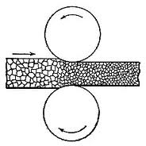
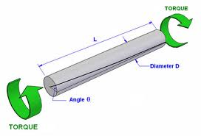
Deformation vs. Sample Symmetry
Note that the texture of a material is a consequence of its thermomechanical history (and therefore offers clues about that history).
The (statistical) sample symmetry is directly related to the symmetry of the preceding deformation.
In general, the sample symmetry reflects the lowest symmetry deformation that was imposed on the material.
Rolling is a plane strain deformation, with orthorhombic symmetry. We call it “plane strain” because (in the ideal case) all the strain occurs in one plane, the RD-ND plane with zero strain in the TD (parallel to the axes of the rolls). Torsion is a simple shear, with monoclinic symmetry. Wire drawing is an axi-symmetric deformation with cylindrical symmetry. Upsetting or uniaxial compression is also an axi-symmetric deformation with cylindrical symmetry.
Rolling:
anvilfire.com
torsion:
ejsong.com

Slide 20
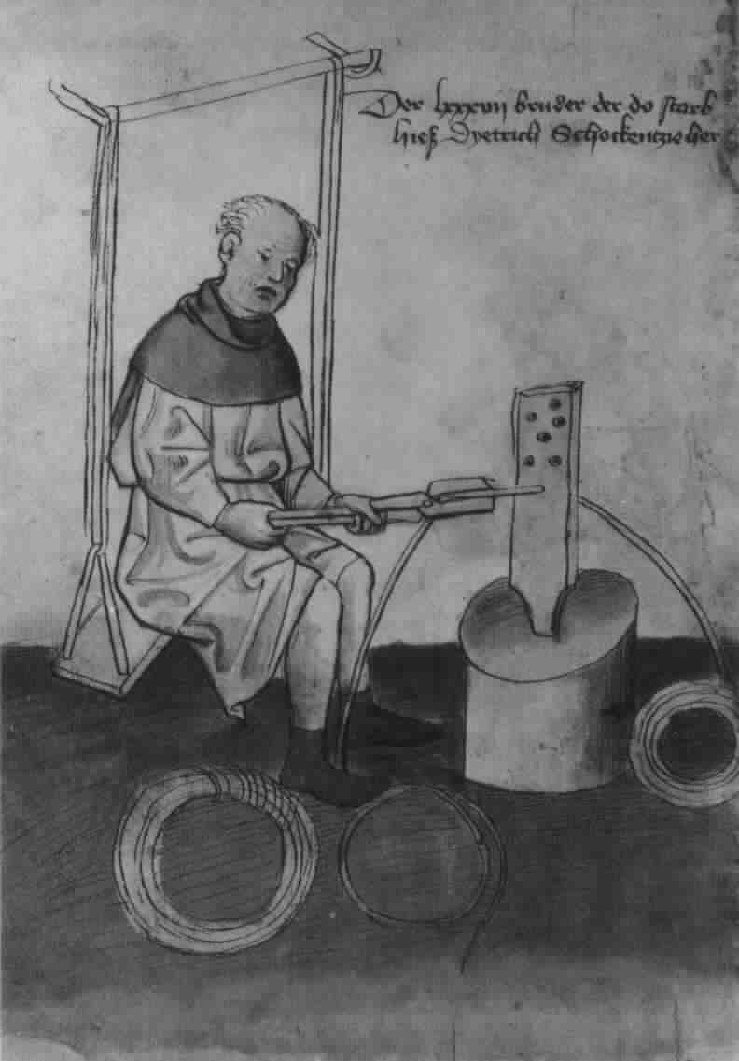
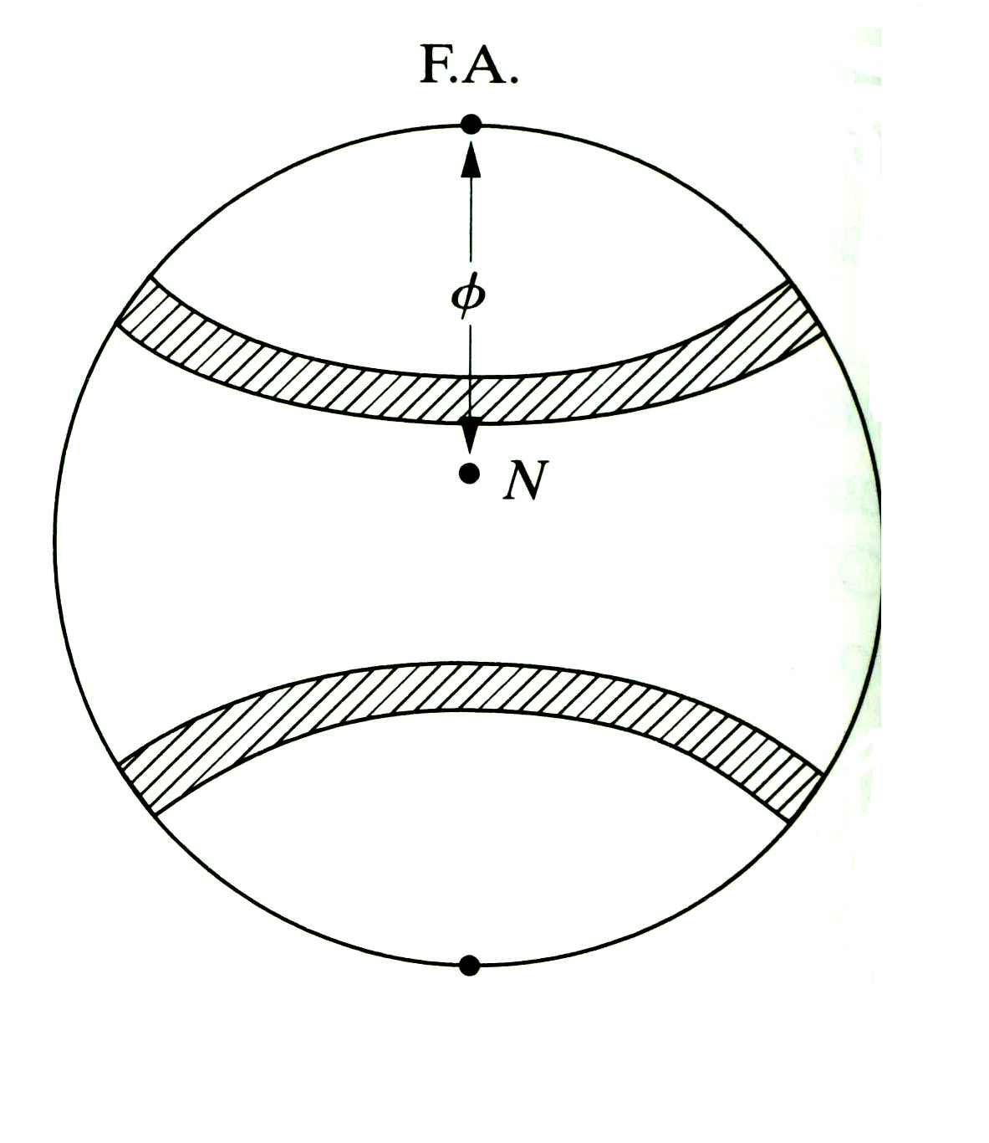
Pole Figure for Wire Texture
(111) pole figure showing a maximum intensity at a specific angle from a particular direction in the sample and showing an infinite rotational symmetry (C∞).
F.A.=Fiber Axis (parallel to the length of the wire)
A particular crystal direction in all crystals is aligned with this fiber axis (i.e. a particular sample direction).
For a cubic material, this combination would be classed as cubic-cylindrical.
{111}
forth-armoury.com
In this case, <100> // F.A.

Slide 21
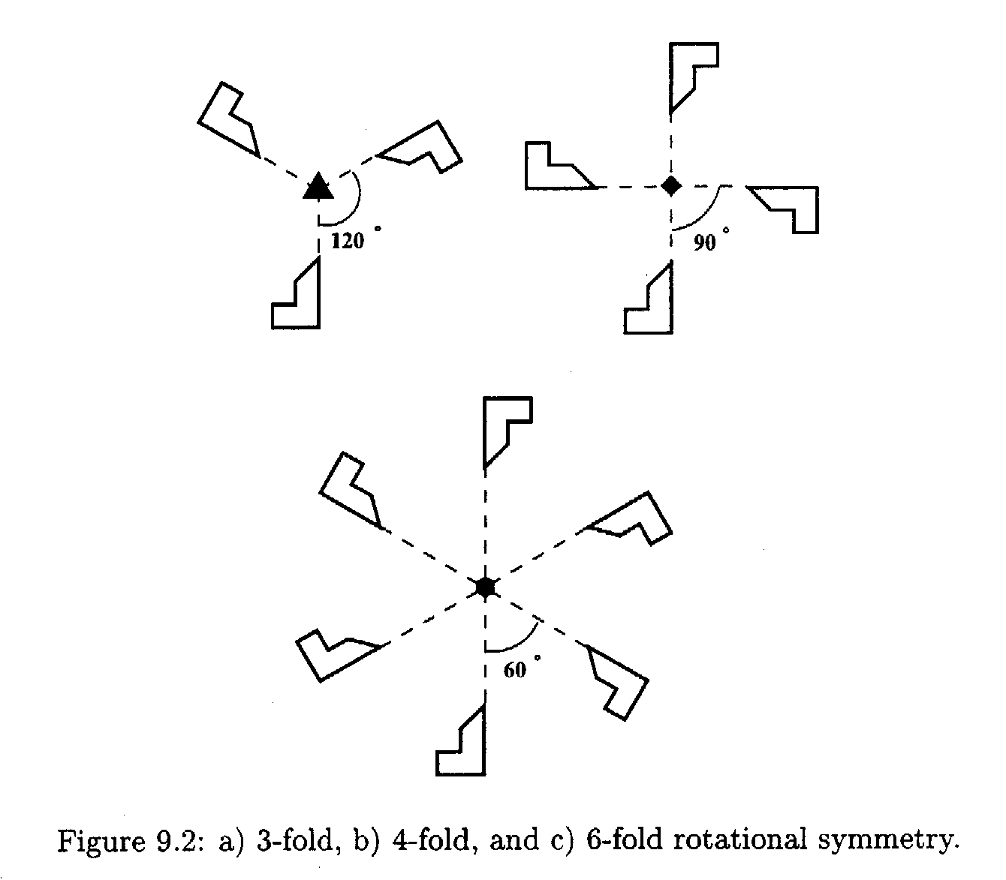
Effect of Symmetry
Illustration of 3-fold, 4-fold, 6-fold rotational symmetry
The essential point about applying a symmetry operation is that, once it has been done, you cannot tell that anything has changed. In other words, the rotated or reflected object is physically indistinguishable from what you started with.
Note the symbols used to denote the different rotational symmetry elements.
Notes:
Point = rotation superimposes the object on itself
Order of the rotation axis is the number of times you can do this in a complete turn (2π)

Slide 22
Effect of Symmetry: Example
[001]
[010]
[010]
[100]
[100]
[001]
Note how one can re-label the axes but leave the physical object (crystal) unchanged.
Which symmetry operator was applied (from O(432))?

Slide 23
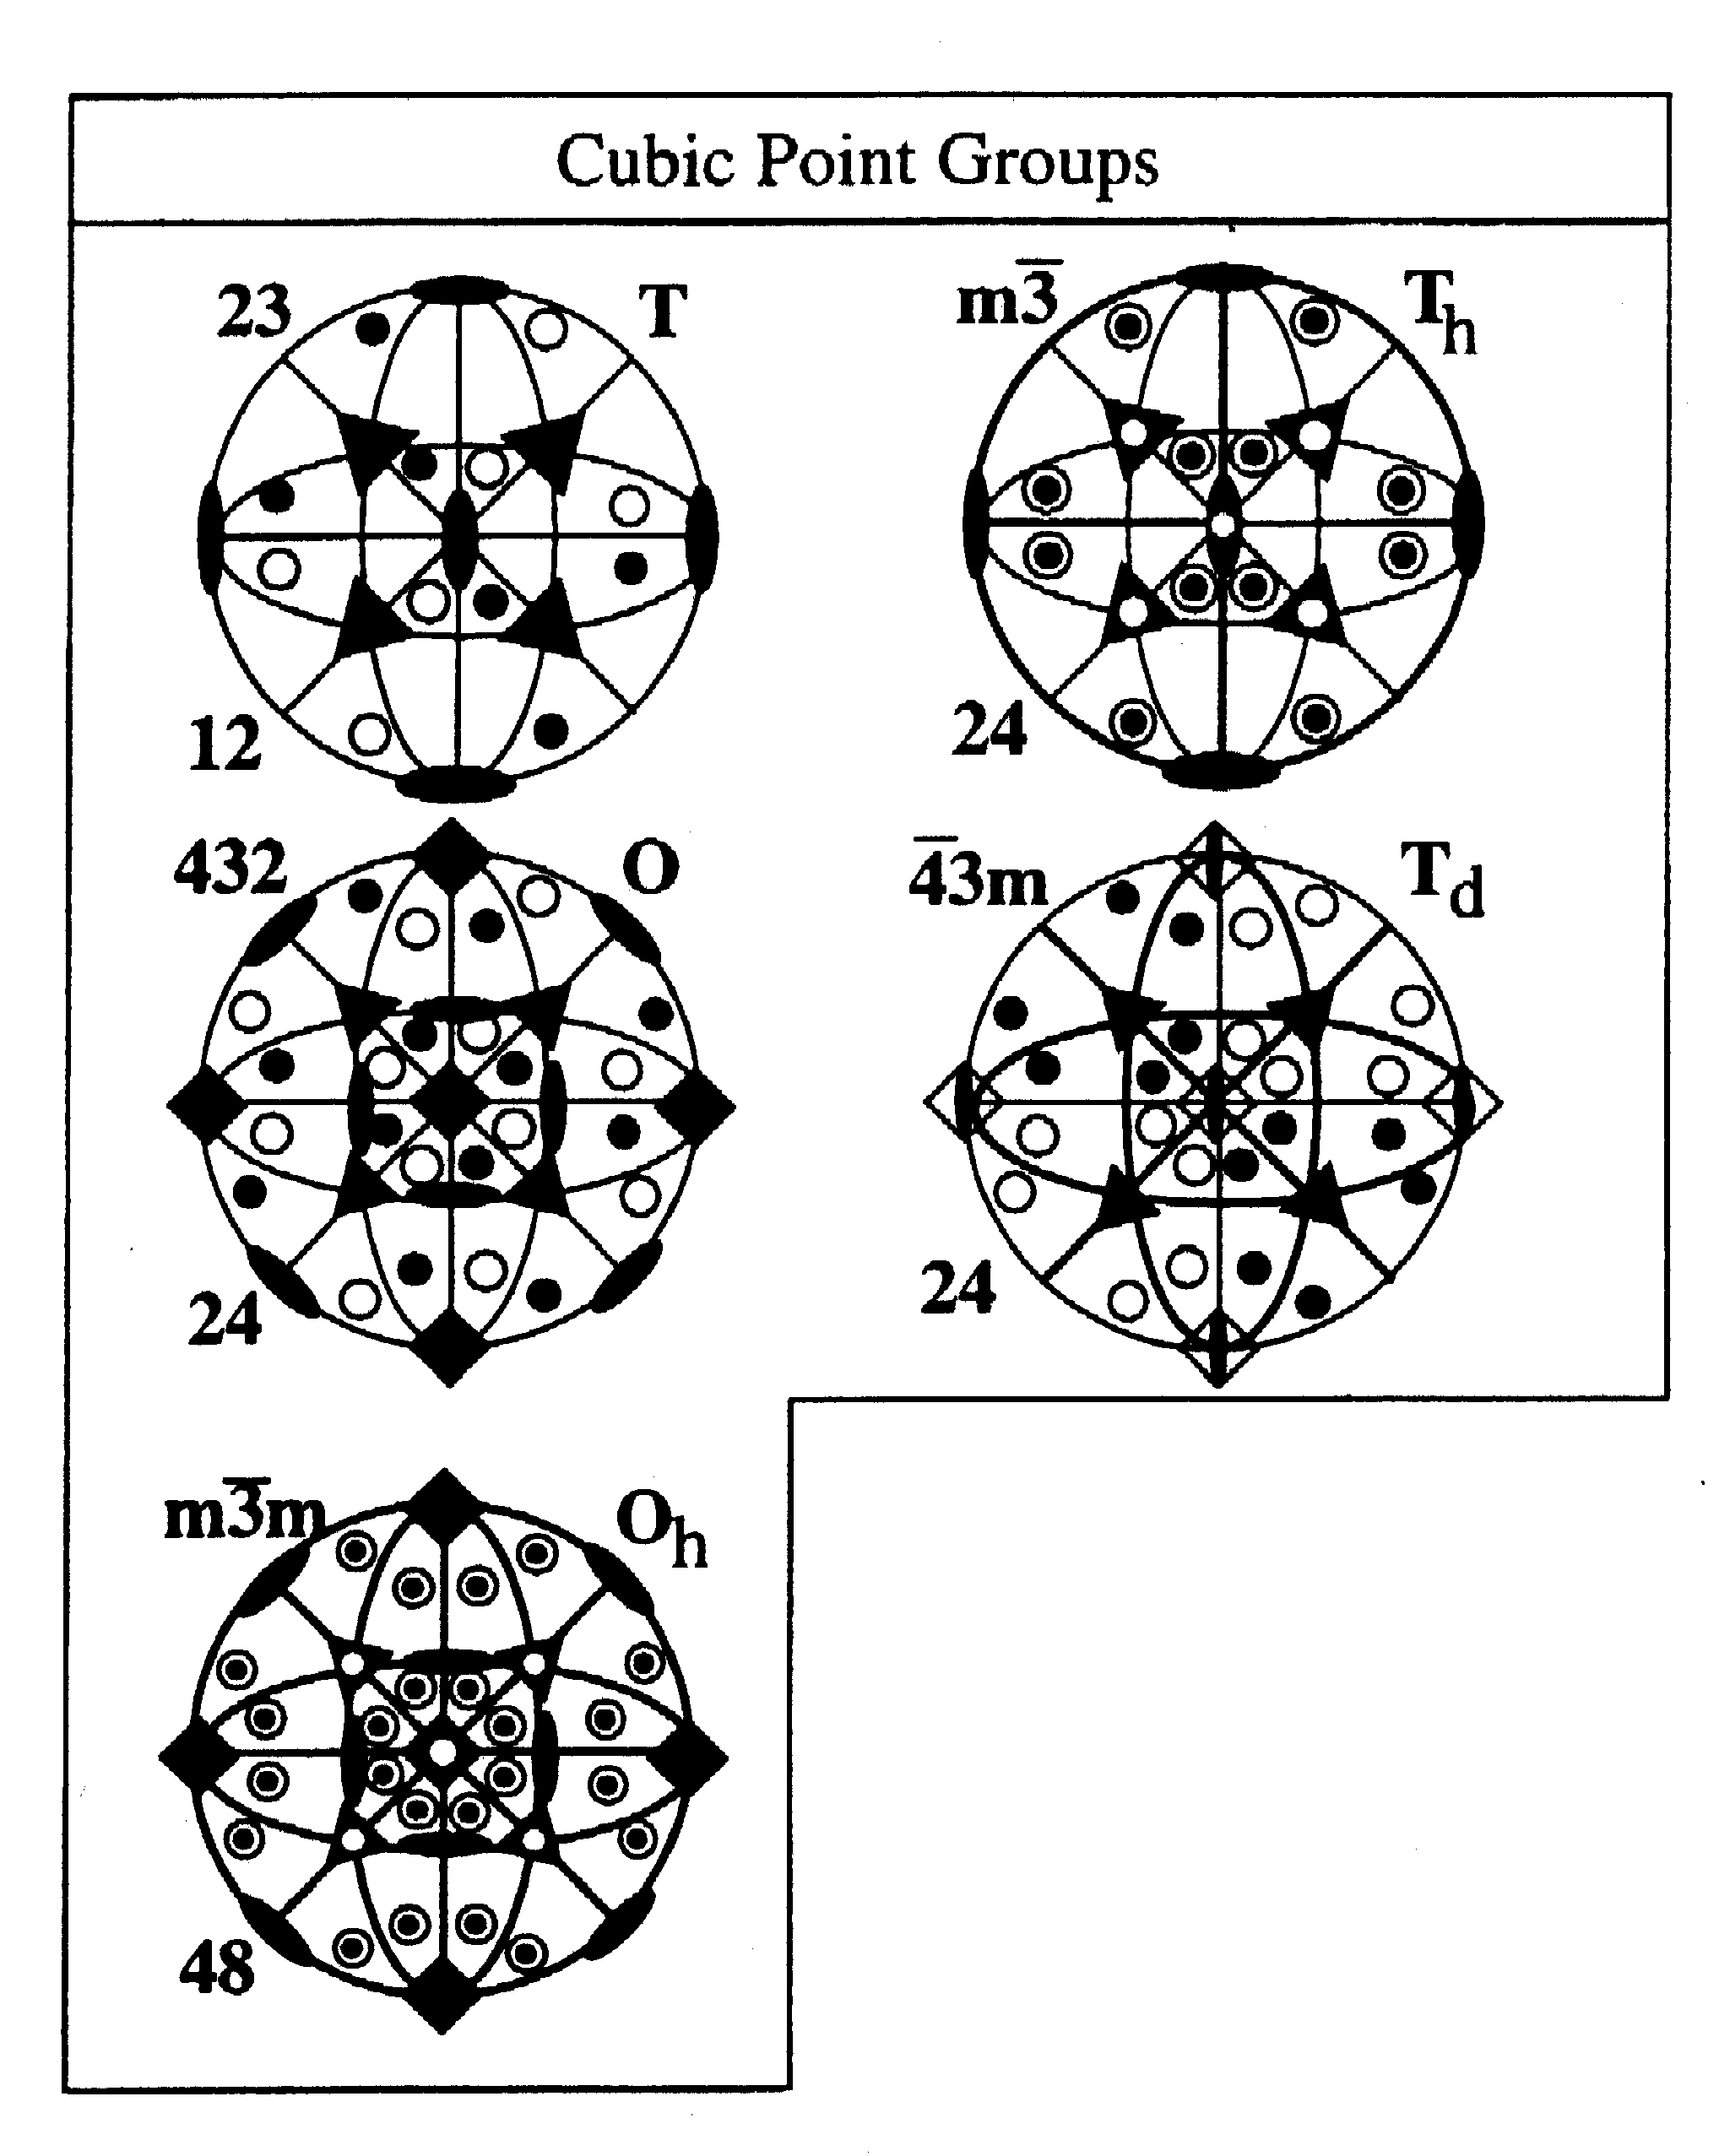
Stereographic projections
of symmetry elements
and general poles in the
cubic point groups
with Hermann-Mauguin
and Schoenflies
designations.
Note the presence of
four triad symmetry
elements in all these
groups on <111>.
Cubic metals mostly
fall under .
Groups: mathematical concept, very useful for symmetry

Slide 24
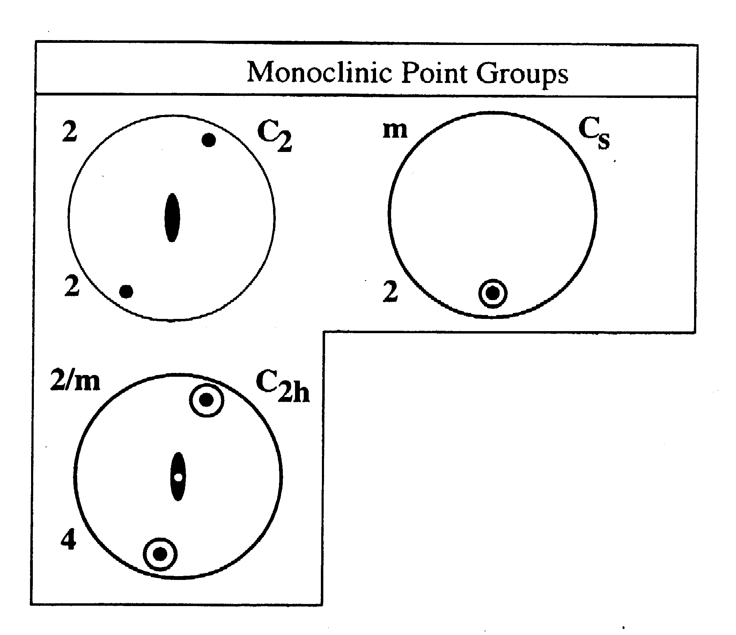
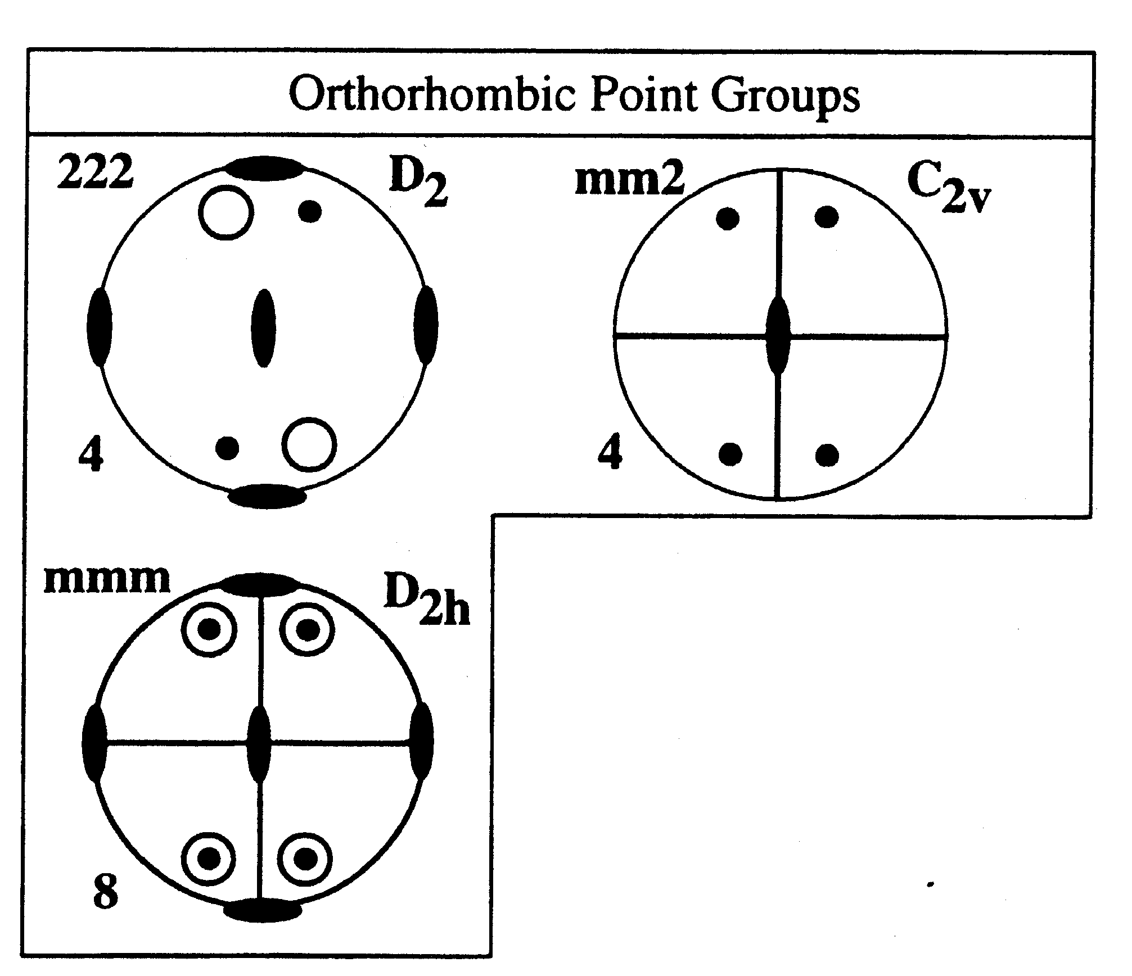
Sample Symmetry
Torsion, shear:
Monoclinic, 2.
Rolling, plane strain
compression, mmm.
Otherwise,
triclinic.
Axisymmetric: C∞

Slide 25
Fundamental Zone
The fundamental zone (or asymmetric unit) is the portion or subset of orientation space within which each orientation (or misorientation, when we later discuss grain boundaries) is described by a single, unique point.
The fundamental zone is the minimum amount of orientation space required to describe all orientations.
Example: the standard stereographic triangle (SST) for directions in cubic crystals.
The size of the fundamental zone depends on the amount of symmetry present in both crystal and sample space. More symmetry ⇒ smaller fundamental zone.
Note that in Euler space, the 90x90x90° region typically used for cubic [crystal]+orthorhombic [sample] symmetry is not a fundamental zone because it contains 3 copies of the actual zone!

Slide 26
Symmetry Issues
Crystal symmetry operates in a frame attached to the crystal axes.
Based on the definition of Euler angles, crystal symmetry elements produce relations between the second & third angles.
Sample symmetry operates in a frame attached to the sample axes.
Sample symmetry produces relations between the first & second angles.
The combination of crystal and sample symmetry is written as crystal-sample, e.g. cubic-orthorhombic, or hexagonal-triclinic.

Slide 27
Choice of Section Size
Quad, Diad symmetry elements are easy to incorporate, but Triads are inconvenient.
Four-fold rotation elements (and mirrors in the orthorhombic group) are used to limit the third, φ₂, (first, φ₁) angle range to 0-90°.
Second angle, Φ, has range 0-90° (diffraction adds a center of symmetry).

Slide 28
Section Sizes
Crystal - Sample
Cubic-Orthorhombic:
0≤φ₁ ≤90°, 0≤Φ ≤90°, 0≤φ₂ ≤90°
Cubic-Monoclinic:
0≤φ₁ ≤180°, 0≤Φ ≤90°, 0≤φ₂ ≤90°
Cubic-Triclinic:
0≤φ₁ ≤360°, 0≤Φ ≤90°, 0≤φ₂ ≤90°
But, these limits do not delineate a fundamental zone.

Slide 29
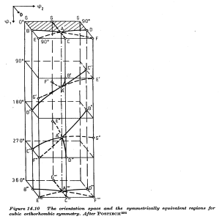
Points related by triad symmetry element on
<111>
(triclinic sample symmetry)
φ₂
Φ
φ₁
Take a point, e.g. “B”; operate on it with the 3-fold rotation axis (blue triad); the set of points related by the triad are B, B’, B’’, with B’’’ being the same point as B. The point is, that as you operate on a point (orientation) with a symmetry operation, in general all the Euler angles change.
[Bunge]

Slide 30
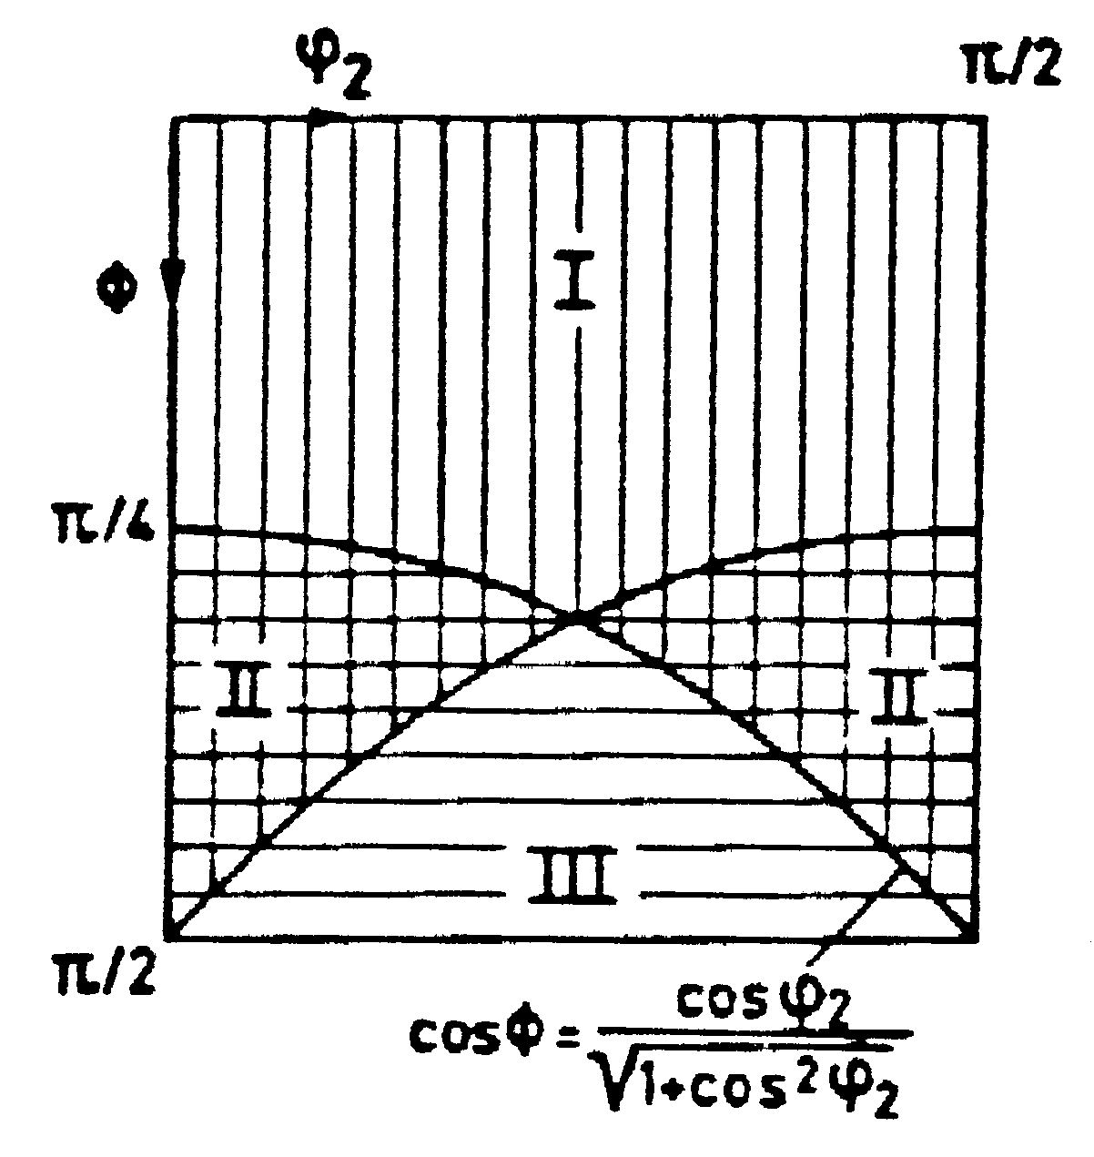
Effect of 3-fold axis
section
in φ₁ cuts
through
more than
one subspace
Regions I, II and III are
related by the triad crystal symmetry element,
i.e. 120° about <111>, combined with sample symmetry.
[Bunge]
Angles measured in radians
Notes:
Shows the 3 related regions in the box: also the way in which COD sections at constant phi-2 expose different parts of the 3 subregions

Slide 31
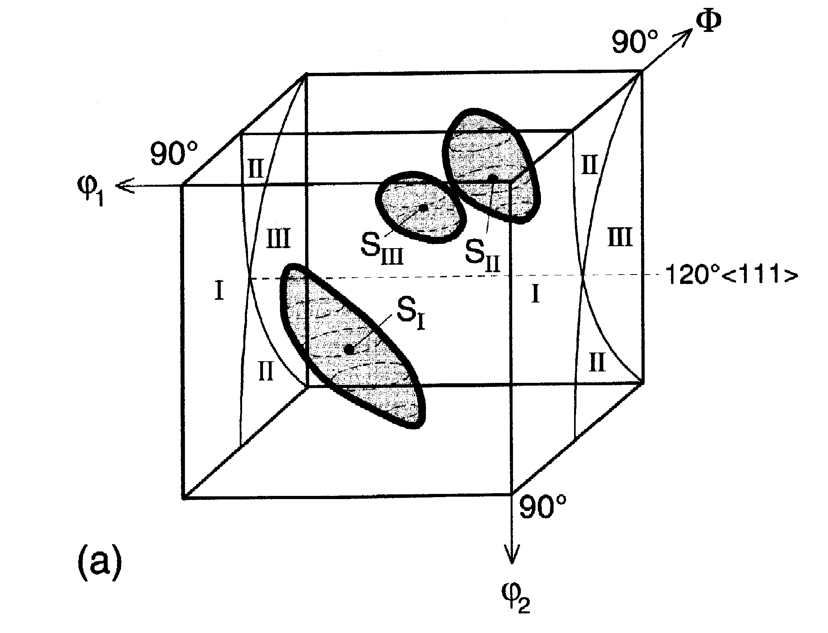
Example of 3-fold symmetry
The “S” component,
{123}<634>
has angles {59, 37, 63}
also {27,58,18},{53,74,34}
and occurs in three
related locations
in Euler space. 10° scatter
shown about component; shape is not spherical because the volume element size varies as sin(Φ).
Regions I, II and III are
related by the triad crystal symmetry element,
i.e. 120° about <111>, combined with sample symmetry.
[Randle & Engler, fig. 5.7]
Notes:
Effect of the triad; also showing the distortion at low cap-Phi

Slide 32
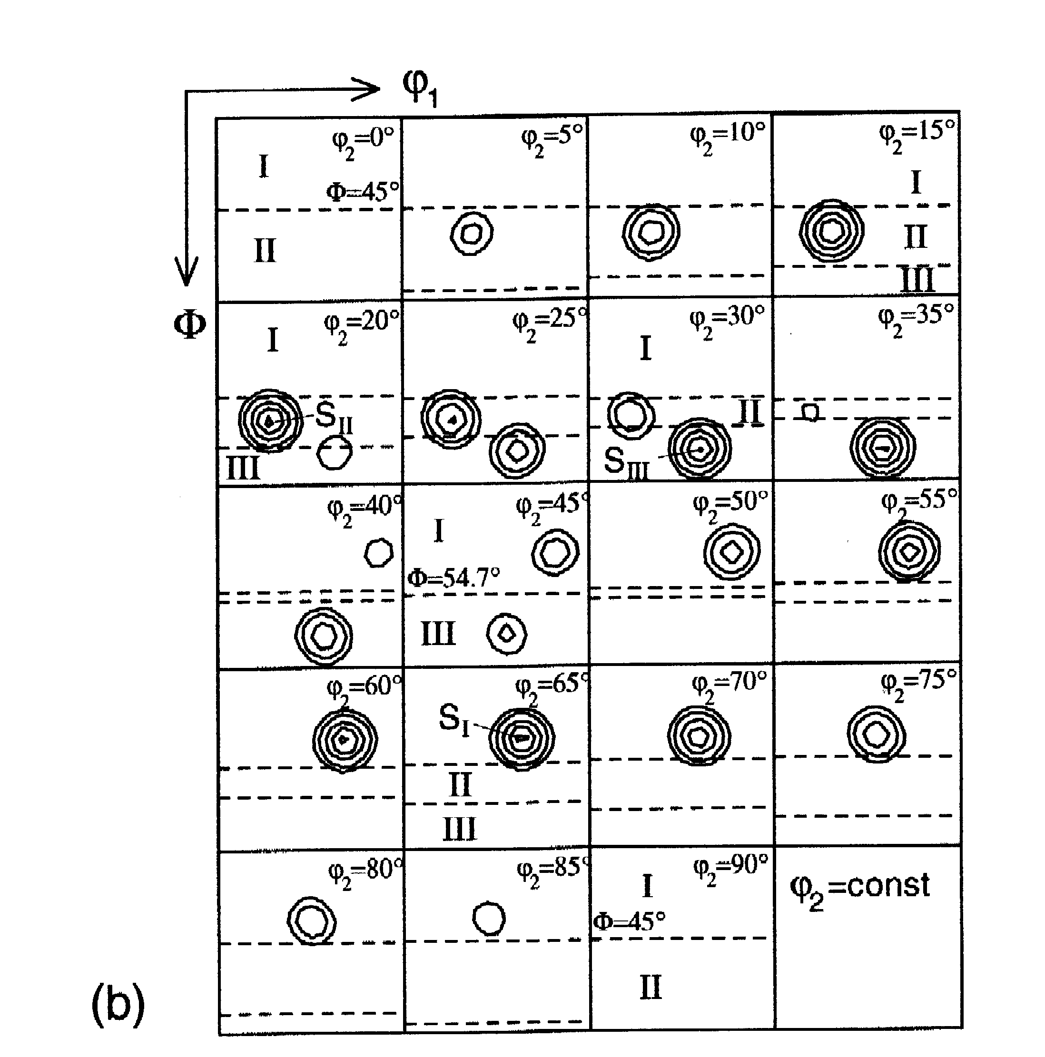
S component in φ₂ sections
Regions I, II and III are
related by the triad
symmetry element,
i.e. 120° about <111>.
10° scatter
shown about the S component, so that each of the 3 equivalent positions is cross-sectioned in multiple sections.
[Randle & Engler, fig. 5.7]
Notes:
Just one component, with a spread!

Slide 33
Orthorhombic Sample Symmetry (mmm) Relationships in Euler Space
φ₁=0°
90°
diad
180°
270°
360°
Φ
‘mirror’
‘mirror’
Φ = 180°
2-fold screw axis changes φ₂ by π
Note: this slide illustrates how the set of 3 diads (+ identity) in sample space operate on a given point. The relationship labeled as ‘mirror’ is really a diad that acts like a 2-fold screw axis in Euler space.
Notes:
Note the way in which points are related to one another by symmetry elements: note that the section angle also changes!

Slide 34
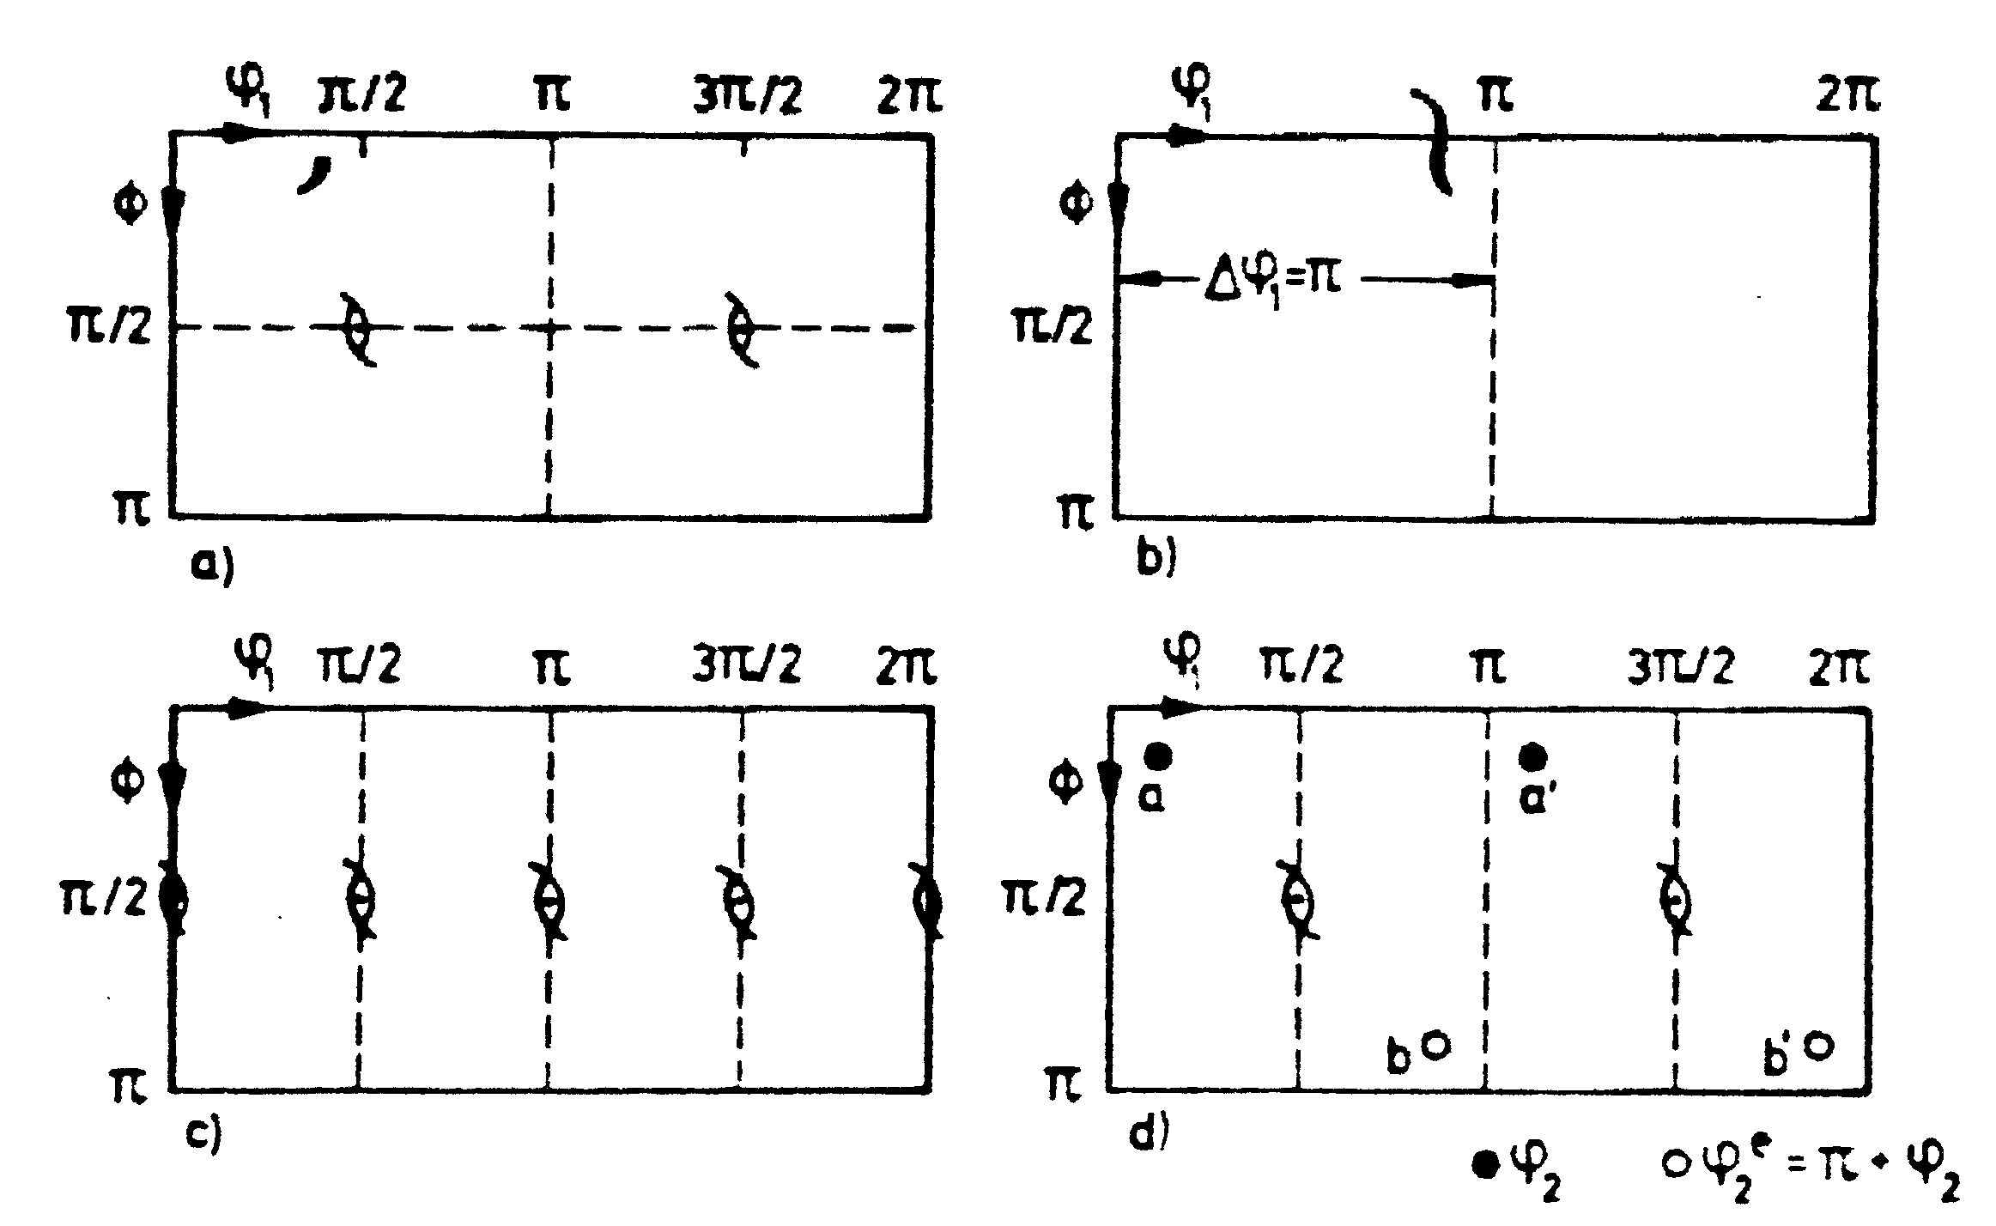
Sample symmetry, detail
Tables for Texture Analysis of Cubic Crystals, Springer Verlag, 1978
Notes:
from the Texture Tables, showing the representation with screw diads.

Slide 35
Crystal Symmetry Relationships (432) in Euler Space
3-fold axis
90°
180°
270°
360°
φ₂=0°
Φ
4-fold axis
Other 4-fold, 2-fold axis:
act on φ₁ also
Φ = 180°
Note: points related by triad (3-fold) have different φ₁ values
Notes:
Several types of symmetry element illustrated, including the triad. Different shading of the points indicates different depths in phi-1

Slide 36
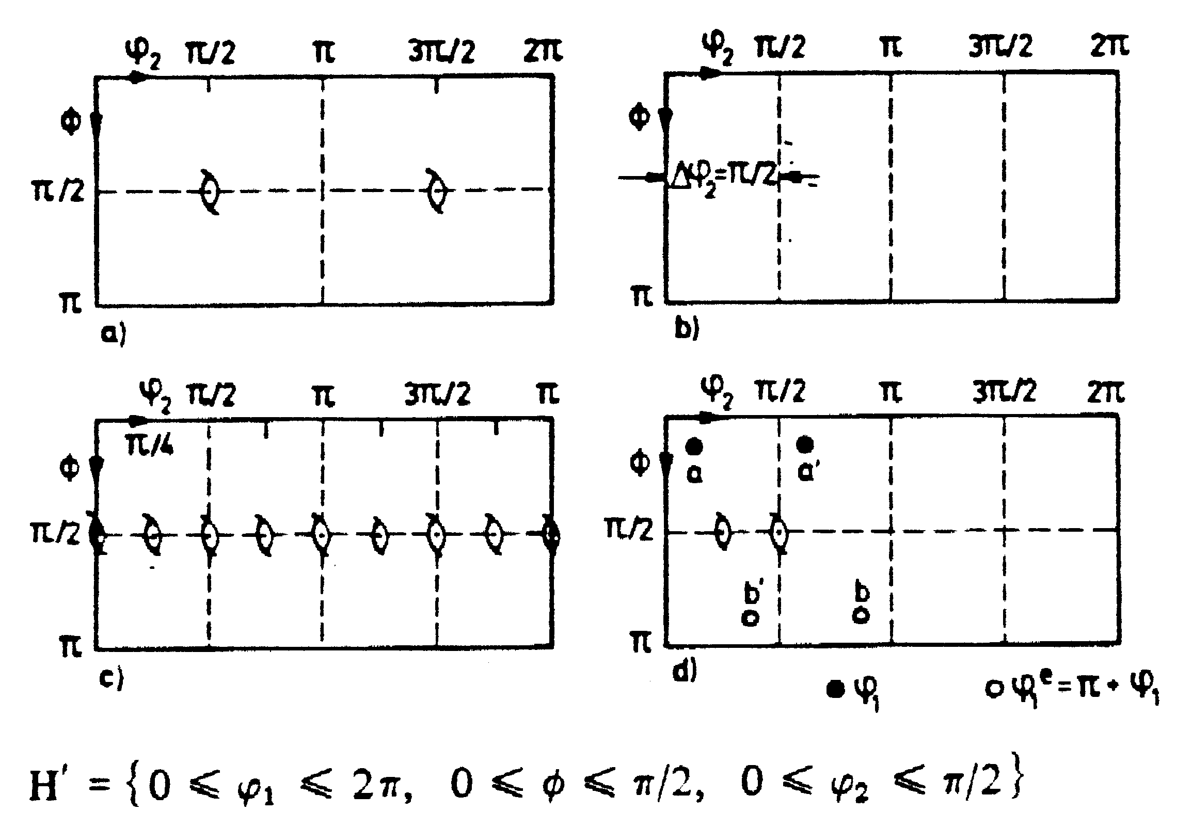
Crystal symmetry: detail
Tables for Texture Analysis of Cubic Crystals, Springer Verlag, 1978
Notes:
This Texture Tables picture shows the situation for crystal symmetry. “H” indicates the sub-space

Slide 37
How many equivalent points?
For cubic-orthorhombic crystal+sample symmetry, we use a range 90°x90°x90° for the three angles, giving a volume of 90^{°2} (or π²/4 in radians).
In the (reduced) space there are 3 equivalent points for each orientation (texture component). Both sample and crystal symmetries must be combined together to find these sets.
If we look within the full orientation space then there are as many equivalent points as there are symmetry elements. Thus for cubic crystal symmetry there are 24 equivalent points; for hexagonal 12 etc.
Fewer (e.g. Copper) or more (e.g. cube) equivalent points for each component are found in the reduced space if the the component coincides with one of the symmetry elements.

Slide 38
Volume of Orientation Space
O(432) has 24 operators (i.e. order=24); O(222) has 4 operators (i.e. order=4): why not divide the volume of Euler space (8π², or, 360°x180°x360°) by 24x4=96 to get π²/12 (or, 90°x30°x90°)?
Answer: we leave out a triad axis (because of the awkward shapes that it would give us), so we divide by 8x4=32 to get π²/4 (90°x90°x90°).
This is an illustration of group theory in action. Each set of symmetry operators divides up the orientation space by a factor equal to the number of elements in the group.
The reason is, essentially, a question of counting: each point in one zone has exactly one point in another zone related by a given operator.
Notes:
Careful again: later we see that it is not this simple.

Slide 39
Group theory approach
Again, this is an illustration of group theory in action. Each set of symmetry operators divides up the orientation space by a factor equal to the number of elements in the group.
Crystal symmetry:
a combination of 4- and 2-fold crystal axes (2x4=8 elements) reduce the range of Φ from π to π/2, and φ₂ from 2π to π/2.
Sample symmetry:
the 2-fold sample axes (4 elements in the group) reduce the range of φ₁ from 2π to π/2.
Volume of {0 ≤ φ₁, Φ, φ₂ ≤ π/2} is π²/4.
The reason is, essentially, a question of counting: each point in one zone has exactly one point in another zone related by a given operator.

Slide 40
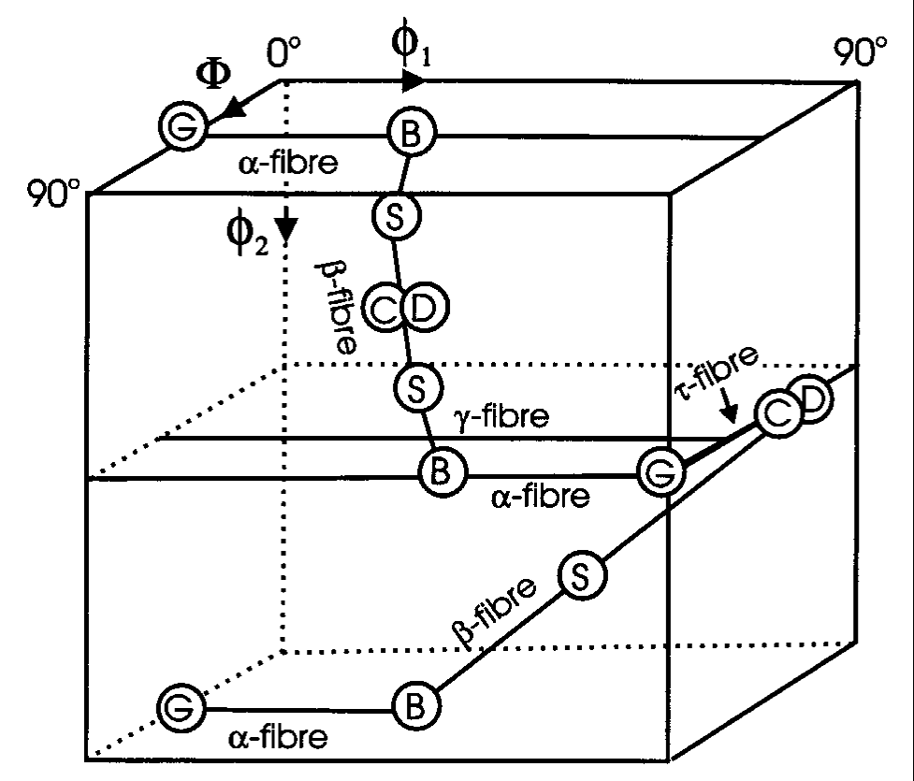
Special Points, Partial Fibers
No. of points in the 90x90x90° space
Copper: 2
Brass: 3
S: 3
Goss: 3
Cube: 8
Dillamore:2
Why this variation?
Points that fall on the edge may appear more, or fewer times than the standard count of 3.
Humphreys & Hatherly
Notes:
Discuss what happens when a point lies on the edge of the box and therefore coincides with a symmetry element

Slide 41
Sample Symmetry Relationships in Euler Space: special points
φ₁=0°
90°
diad
180°
270°
360°
Φ
diad
diad
Φ = 90°
Cube lies on the corners
Copper, Brass, Goss lie on an edge, so that they coincide with a symmetry element
Notes:
Brass lies on the edge with phi-2 = 0 or 90, therefore subject to crystal symmetry; also Goss. Copper lies on phi1=90 edge, therefore subject to lower sample symmetry. Even though phe1 and phi2 both limited to 0-90°, they do not have equivalent symmetries.

Slide 42
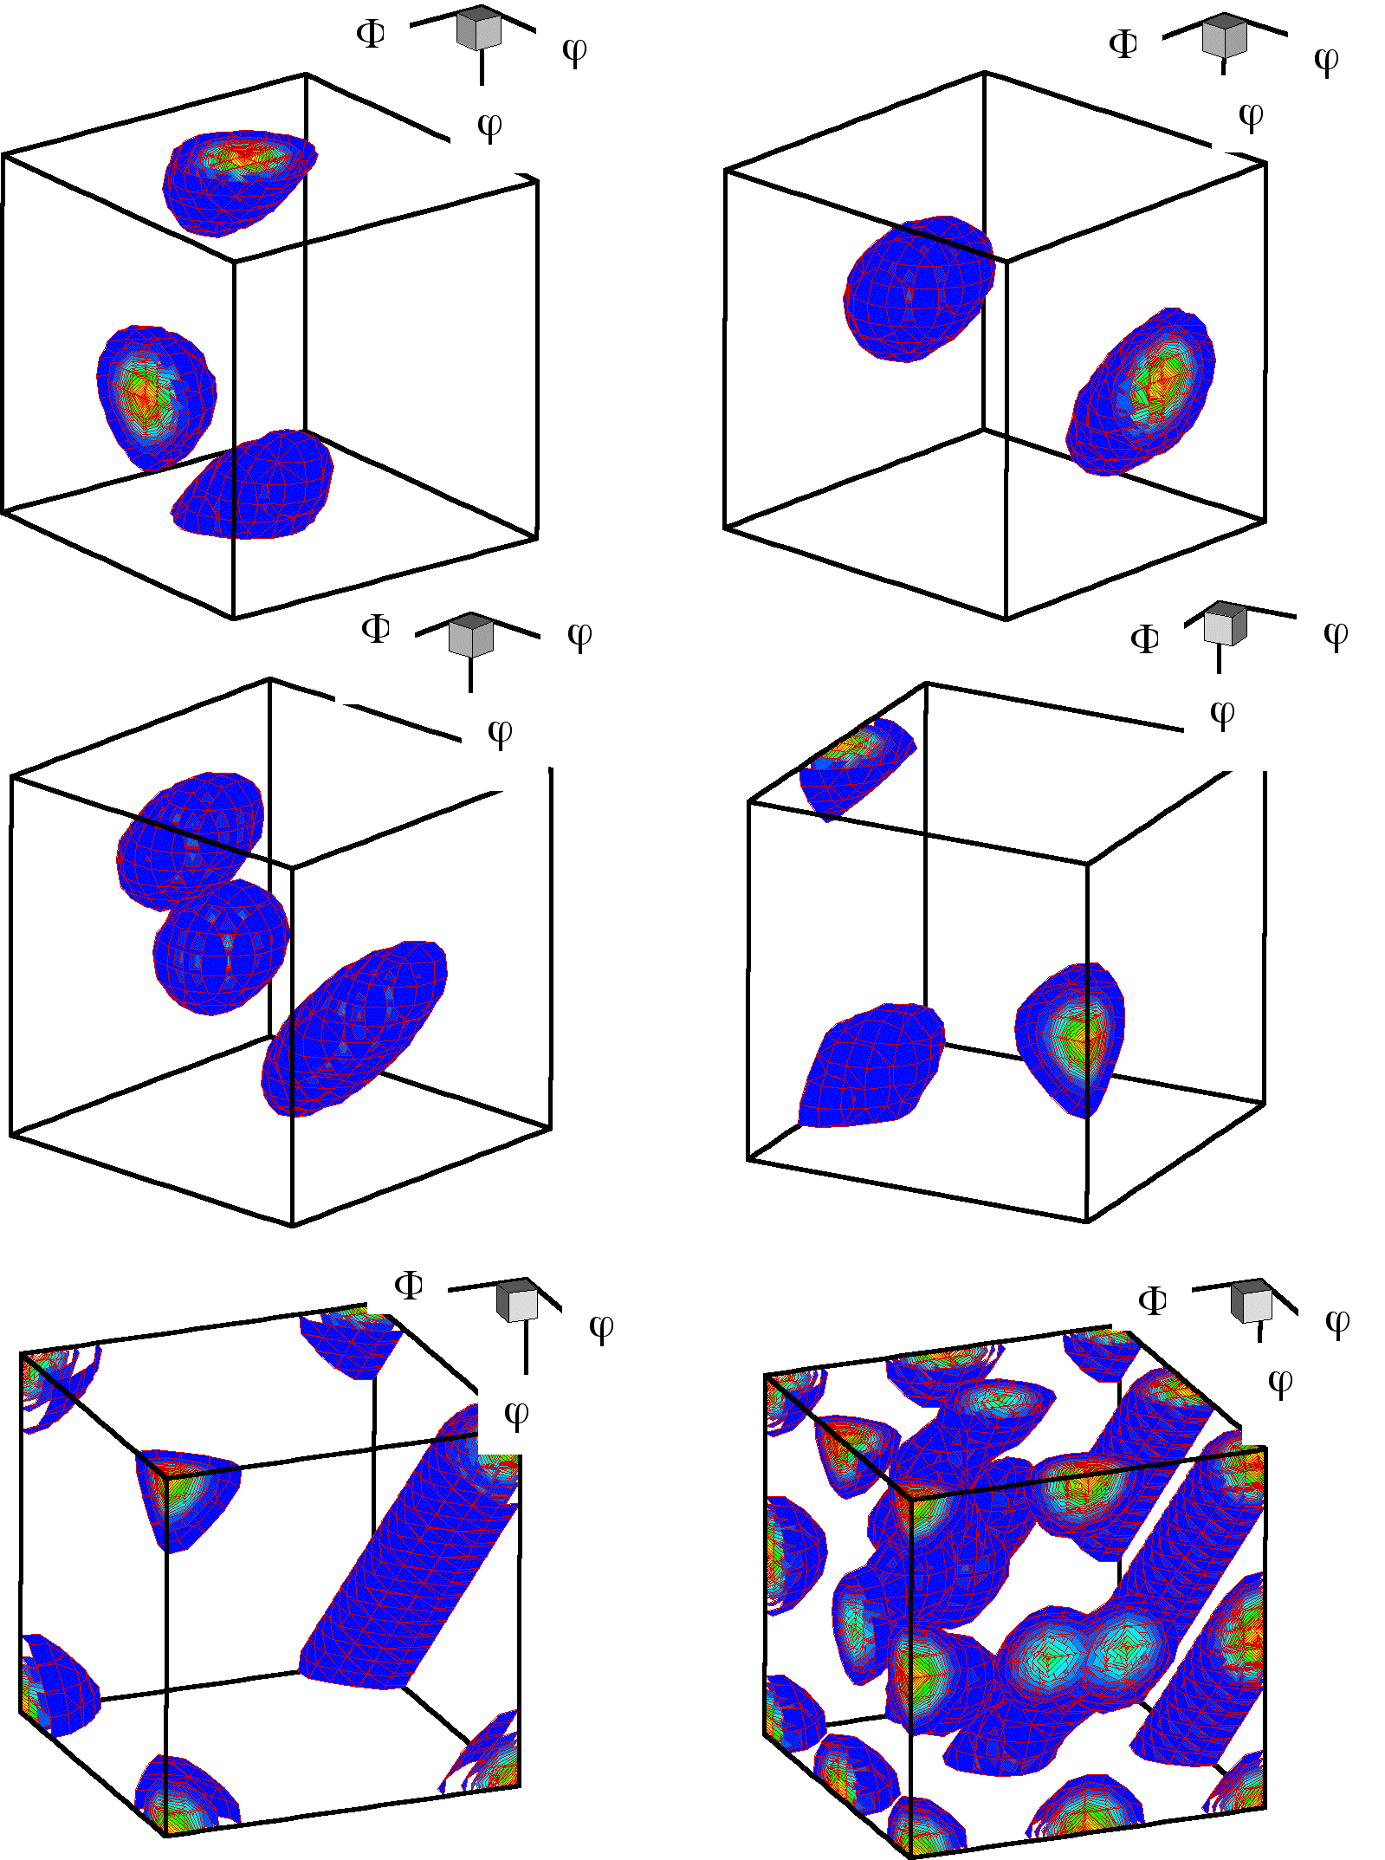
3D Views
a) Brass b) Copper c) S d) Goss e) Cube
f) combined texture
1: {35, 45, 90}, Brass,
2: {55, 90, 45}, Brass
3: {90, 35, 45}, Copper,
4: {39, 66, 27}, Copper
5: {59, 37, 63}, S,
6: {27, 58, 18}, S,
7: {53, 75, 34}, S
8: {90, 90, 45}, Goss
9: {0, 0, 0}, cube* 10: {45, 0, 0}, rotated cube
* Note that the cube exists as a line between (0,0,90) and (90,0,0) because of the linear dependence of the 1st and 3rd angles when the 2nd angle = 0.
Figure courtesy of Jae-hyung Cho

Slide 43
Special Points: Explanations
Points coincident with symmetry axes may also have equivalent points, often on the edge. Cube: should be a single point, but each corner is equivalent and visible.
Goss, Brass: a single point becomes 3 because it is on the φ₂=0 plane.
Copper: 2 points because one point remains in the interior but another occurs on a face; also the Dillamore orientation.
Note for later about volume fractions: although the volumes enclosed by the 12° capture (misorientation) distance shown in the figure vary with the 2nd euler angle, to first order it is the symmetry planes that control the volume fractions. So S, for example, has 3 complete “blobs” whereas Goss has only 3 x ¼ and so will contain only ~1/4 of the volume fraction of S, based on a random (uniform) texture.
Notes:
repeat

Slide 44
[Kocks, Tomé, Wenk]

Slide 45
Meaning of “Variants”
The existence of variants of a given texture component is a consequence of (statistical) sample symmetry.
If one permutes the Miller indices for a given component (for cubics, one can change the sign and order, but not the set of digits), then different values of the Euler angles are found for each permutation.
If a pole figure is plotted of all the variants, one observes a number of physically distinct orientations, which are related to each other by symmetry operators (diads, typically) fixed in the sample frame of reference.
Each physically distinct orientation is a “variant”. The number of variants listed depends on the choice of size of Euler space (typically 90x90x90°) and the alignment of the component with respect to the sample symmetry.

Slide 46
Part 3: Quantitative Treatment of Symmetry
In section, we describe the methods for describing symmetry operations as rotation matrices and how to apply them to texture components, also expressed as matrices.
Notation:
orientation: g
(crystal) symmetry operator: O_{C}
(sample) symmetry operator: O_{S}

Slide 47
Rotations: definitions
Rotational symmetry elements exist whenever you can rotate a physical object and result is indistinguishable from what you started out with.
Rotations can be expressed in a simple mathematical form as unimodular matrices (or, orthogonal matrices), often with elements that are usually either one or zero (but not always!). Each row and each column has unit length.
When represented as matrices, the inverse of a rotation is equal to the transpose of the matrix.
Rotations are transformations of the first kind; determinant = +1.
Reflections (not needed here) are transformations of the second kind; determinant = -1.
Crystal symmetry also can involve translations but these are not included in this treatment.
Notes:
objective is to relate the physical characteristics of rotation axes to a convenient mathematical form

Slide 48
Rotation Matrix
from Axis-Angle Pair
Written out as a complete 3x3 matrix:

Slide 49
Symmetry Operator examples
Diad on z: [uvw] = [001], θ = 180° - substitute the values of uvw and angle into the formula
4-fold on x:
[uvw] = [100]
θ = 90°

Slide 50
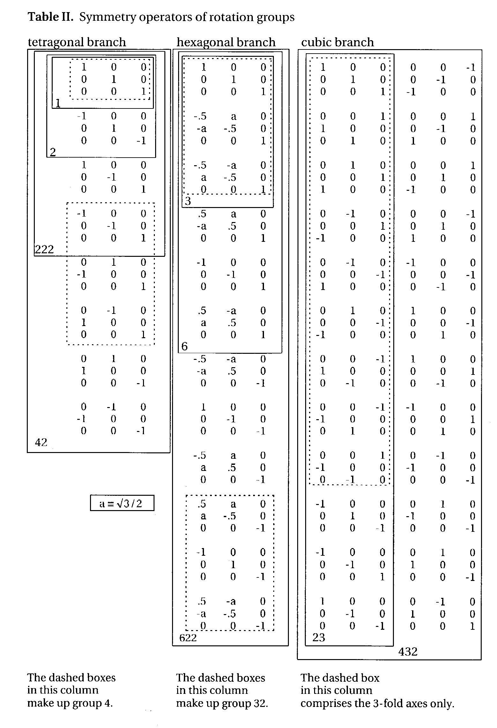
Matrix
representation of the
rotation point groups
-
What is a group? A group is a set of objects that form a closed set: if you combine any two of them together, the result is simply a different member of that same group of objects. Rotations in a given point group form closed sets - try it for yourself!
Note: the 3rd matrix in the 1st column (x-diad) is missing a “-” on the 33 element; this is corrected in this slide. Also, in the 2nd from the bottom, last column: the 33 element should be +1, not -1. In some versions of the book, in the last matrix (bottom right corner) the 33 element is incorrectly given as -1; here the +1 is correct.
Kocks, Tomé, Wenk:
Ch. 1 Table II
The 4 operators enclosed in orange boxes are also the 222 point group, appropriate to orthorhombic symmetry
Notes:
Complicated slide with much data. Illustrates the different matrices used. Note that the coefficients for the 6-fold rotation axes do not have unit values.

Slide 51
Nomenclature for rotation elements
In general, the notation identifies the axis about which the rotation is performed.
Thus a 2-fold axis (180° rotation) about the z-axis is known as a z-diad, or C_{2z}, or L₀₀₁²
Triad (120° rotation) about [111] as a 111-triad, or,
120°-<111>, or, L₁₁₁³ etc.
A point group is written as O(432),
for example, where the entry
in the parentheses indicates
the symmetry.
Notes:
The various symmetry elements have many different names

Slide 52
How to use a symmetry operator?
Convert Miller indices that represent an orientation or texture component to a (orientation) matrix.
Perform matrix multiplication with the symmetry operator, O_{c}, and the orientation matrix, g, to obtain the new orientation (matrix), g’. Be careful to get the order correct! For the standard coordinate/axis transformation used here, the crystal symmetry operator always left-multiplies (pre-multiplies) the orientation. Since the orientation matrix converts from sample to crystal axes, you can think of applying crystal symmetry after transforming a quantity into the crystal frame.
g’ = O_{C} g
Convert the matrix back to Miller indices.
The two sets of indices represent (for crystal symmetry) indistinguishable objects.
Notes:
We use matrix multiplication to operate on an orientation, I.e. applying the symmetry operator produces a NEW orientation that is physically equivalent to the old one.

Slide 53
Example
g’ = O_{C} g
g
Goss: (011)[100]:
=
O_{C}
g
Pre-multiply by z-diad:
which is (0-11)[-100]
g’
Sample symmetry: right multiply (post-multiply) the matrix.
Notes:
Rotate the Goss component by a 2 fold axis on Z.

Slide 54
Crystal symmetry
O(432) acting on the
(231)[3-46] S component
Euler angles: (52.9, 74.5, 33.7)
Note that all 24 variants are present
Homework exercise: you can make this same plot by using, e.g., Matlab to compute the matrix of each symmetrically equivalent orientation and then converting each new matrix to Euler angles; then use “scatter3” to plot in 3D.
Notes:
Plotted with Kaleidagraph – label indicates the phi-1 value (depth/height)

Slide 55
Order of Matrices
Assume that we are using the standard axis transformation (passive rotation) definition of orientation (as found, e.g. in Bunge’s book).
Order depends on whether crystal or sample symmetry elements are applied.
For an operator in the crystal system, O_{xtal}, the operator pre-multiplies the orientation matrix.
Think of the sequence as first transform into crystal coordinates, then apply crystal symmetry once you are in crystal coordinates.
For a sample operator, O_{sample}, post-multiply the orientation matrix.
Notes:
This is critical! It matters very much about the order in which you perform the matrix multiplication. Think of applying the symmetry in the appropriate axis system: to apply crystal you must have transformed your entity into the xtal system.

Slide 56
Symmetry Relationships
Note that the result of applying any available operator is equivalent to (physically indistinguishable in the case of crystal symmetry) from the starting configuration (not mathematically equal to!).
Also, if you apply a sample symmetry operator, the result is generally physically different from the starting position. Why?! Because the sample symmetry is only a statistical symmetry, not an exact, physical symmetry. Two orientations related via a sample symmetry are physically distinct (by contrast to crystal symmetry).
Do not confuse this with the standard expression for the transformation of a second rank tensor: T’ = OTO^{T}
NB: if one writes an orientation as an active rotation (as in continuum mechanics), then the order of application of symmetry operators is reversed: premultiply by sample, and postmultiply by crystal symmetry!
Notes:
This is useful later on - orientations related by symmetry are not mathematically identical (unlike a physical quantity such as a stress or a strain).

Slide 57
Symmetry: How-to
How to find all the symmetrically equivalent points?
Convert the component of interest to matrix notation.
Make a list of all the symmetry operators in matrix form (24 for cubic crystal symmetry or 12 for hexagonal crystal symmetry, and 4 for orthorhombic sample symmetry). This is the same list of operators shown as 3x3 matrices in the Table quoted from the Kocks book, slide 35 in this set.
Crystal symmetry: identity (1), plus 90/180/270° about <100> (9), plus 180° about <110> (6), plus 120/240° about <111> (8).
Sample symmetry: identity, plus 180° about RD/TD/ND (4).
Loop through each symmetry operator in turn, with separate loops for sample and crystal symmetry.
For each result, convert the matrix to Euler angles.
How can you be sure that you have applied the operators correctly? Answer: make a pole figure of the set of symmetrically related orientations. Crystal symmetry related points must plot on top of one another whereas sample symmetry related points give rise to (in general) multiple sets of points, related by the sample symmetry that should be evident in the pole figure.

Slide 58
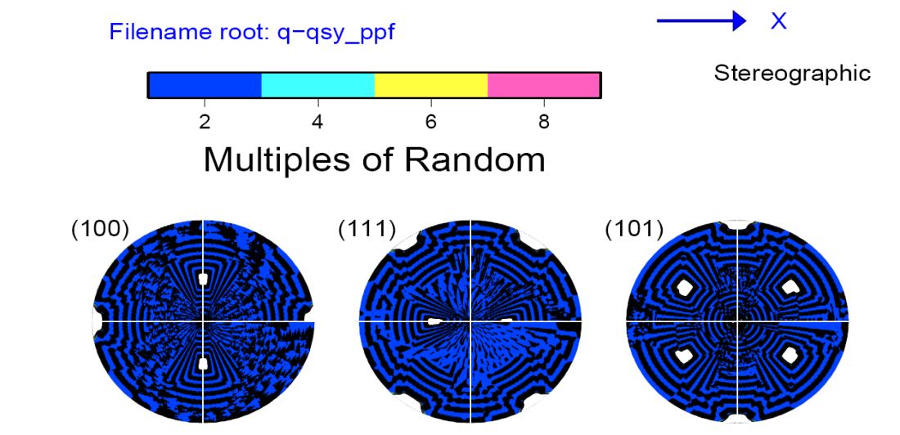
Crystal Symmetry Correctly Applied
If you start with the Goss orientation and apply crystal symmetry by left-multiplying, you should obtain pole figures like this. The application of crystal symmetry did not produce any new orientations as far as the pole figure is concerned. Note that x (//RD) points right in this example.
Plots courtesy of Vahid Tari, 2011

Slide 59
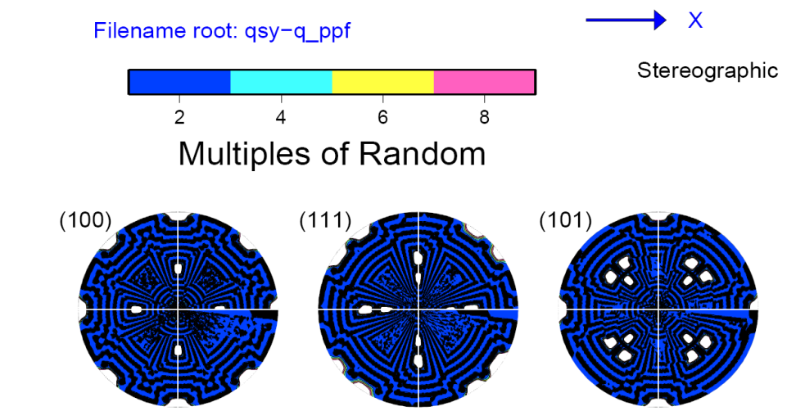
Crystal Symmetry Incorrectly Applied
If you start with the Goss orientation and apply crystal symmetry by right-multiplying, you should obtain pole figures like this. The application of crystal symmetry does produce new orientations in the pole figures but this incorrect. The result of applying crystal symmetry must be indistinguishable from the initial state. Note that x points right in this example.
Plots courtesy of Vahid Tari, 2011

Slide 60
Texture Component Variants
Variants of a given texture component share Miller indices that are the same except for whatever variations are allowed by crystal symmetry. This results in orientations that are usually, but not invariably, different i.e. have finite misorientations between them.
To obtain a set of variants, one applies the appropriate set of sample symmetry operators to a single orientation that defines the component, e.g. from a pair of Miller indices for hkl//ND, uvw//RD. For orthorhombic sample symmetry, for example, {O_{sample}} = O(222) which has four operators, so there are a maximum of four variants.
As a consequence of the way that each component aligns with the sample symmetry operators, the cube and Goss components have only one variant, the copper and brass have two, whereas the S component has all four variants.

Slide 61
Summary
Symmetry operators have been explained in terms of rotation matrices, with examples of how to construct them from the axis-angle descriptions.
The effect of symmetry on the range of Euler angles needed, and the shape of the plotting region.
The particular effect of symmetry on certain named texture components found in rolled fcc metals has been described.
In later lectures, we will see how to perform the same operations but with or on Rodrigues vectors and quaternions.

Slide 62
Supplemental Slides
The following slides provide:
Details of the range of Euler angles, and the shape of the plotting space required for CODs (crystallite orientation distributions) or SODs (sample orientation distributions) as a function of the crystal symmetry;
Additional information about the details of how symmetry elements relate different locations in Euler space.

Slide 63
Axis Transformation from Axis-Angle Pair
• Since crystal symmetry operators are closely linked to low index directions, it is helpful to convert axis-angle descriptions to matrices and vice versa.
• The rotation can be converted to a matrix, g, (passive rotation) by the following expression, where δ is the Kronecker delta, θ is the rotation angle, r is the rotation axis, and ε is the permutation tensor.
Compare with active rotation matrix!

Slide 64
Geometry of {hkl}<uvw>
Sample to Crystal (primed)
Miller index
notation of
texture component
specifies direction
cosines of crystal
directions // to
sample axes. Form the second axis from the cross-product of the 3rd and 1st axes.
^
^
e’₃
e₃ // (hkl)
[001]
[010]
^
e’₂
^
^
e₂ // t
^
e₁ // [uvw]
^
t = hkl x uvw
e’₁
[100]
Obj/notation AxisTransformation Matrix EulerAngles Components

Slide 65
Matrix, Miller Indices
The general Rotation Matrix, a, can be represented as in the following:
Here the Rows are the direction cosines for the 3 crystal axes, [100], [010], and [001] expressed in the sample coordinate system (pole figure).
[100]_{xtal} direction
[010]_{xtal} direction
[001]_{xtal} direction
Obj/notation AxisTransformation Matrix EulerAngles Components

Slide 66
Matrix, Miller Indices
The columns represent components of three other unit vectors:
[uvw]≡RD
TD
ND≡(hkl)
Here the Columns are the direction cosines (i.e. hkl or uvw) for the sample axes, RD, TD and Normal directions expressed in the crystal coordinate system. Compare to inverse pole figures.
Obj/notation AxisTransformation Matrix EulerAngles Components

Slide 67
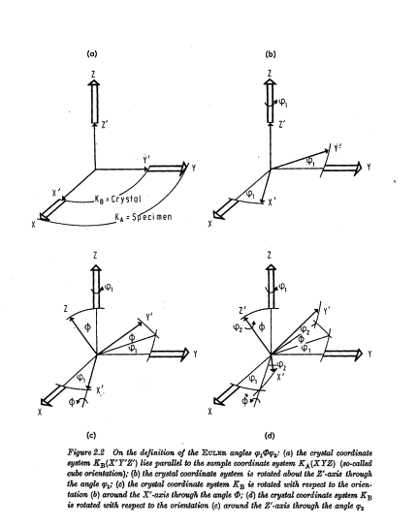
Sample Symmetry Element e.g. diad on ND
(associated with φ₁)
Crystal Symmetry Element
e.g. rotation on [001]
(associated with φ₂)
[Bunge]

Slide 68
[Kocks]
These are simple cases: see detailed charts at the end of this set of slides

Slide 69
Other symmetry operators
Symmetry operators of the second kind: these operators include the inversion center and mirrors; determinant = -1.
The inversion (= center of symmetry) simply reverses any vector so that (x,y,z)->(-x,-y,-z).
Mirrors operate through a mirror axis. Thus an x-mirror is a mirror in the plane x=0 and has the effect (x,y,z)->(-x,y,z).
Notes:
Distinguish between operators that preserve a right handed set of axes, and those, like mirrors, that do not.

Slide 70
Examples of symmetry operators
Diad on z:
(1st kind)
Mirror on x:
(2nd kind)
Inversion
Center:
(2nd kind)

Slide 71
How many equivalent points?
Each symmetry operator relates a pair of points in orientation (Euler) space.
Therefore each operator divides the available space by a factor of the order of the rotation axis. In fact, the order of group is significant. If there are four symmetry operators in the group, then the size of orientation space is decreased by four.
This suggests that the orientation space is smaller than the general space by a factor equal to the number of general poles.
Notes:
Careful! this is a qualitative argument. To correctly deduce the new volume after decreasing the angular range, one must re-integrate over the new range.

Slide 72
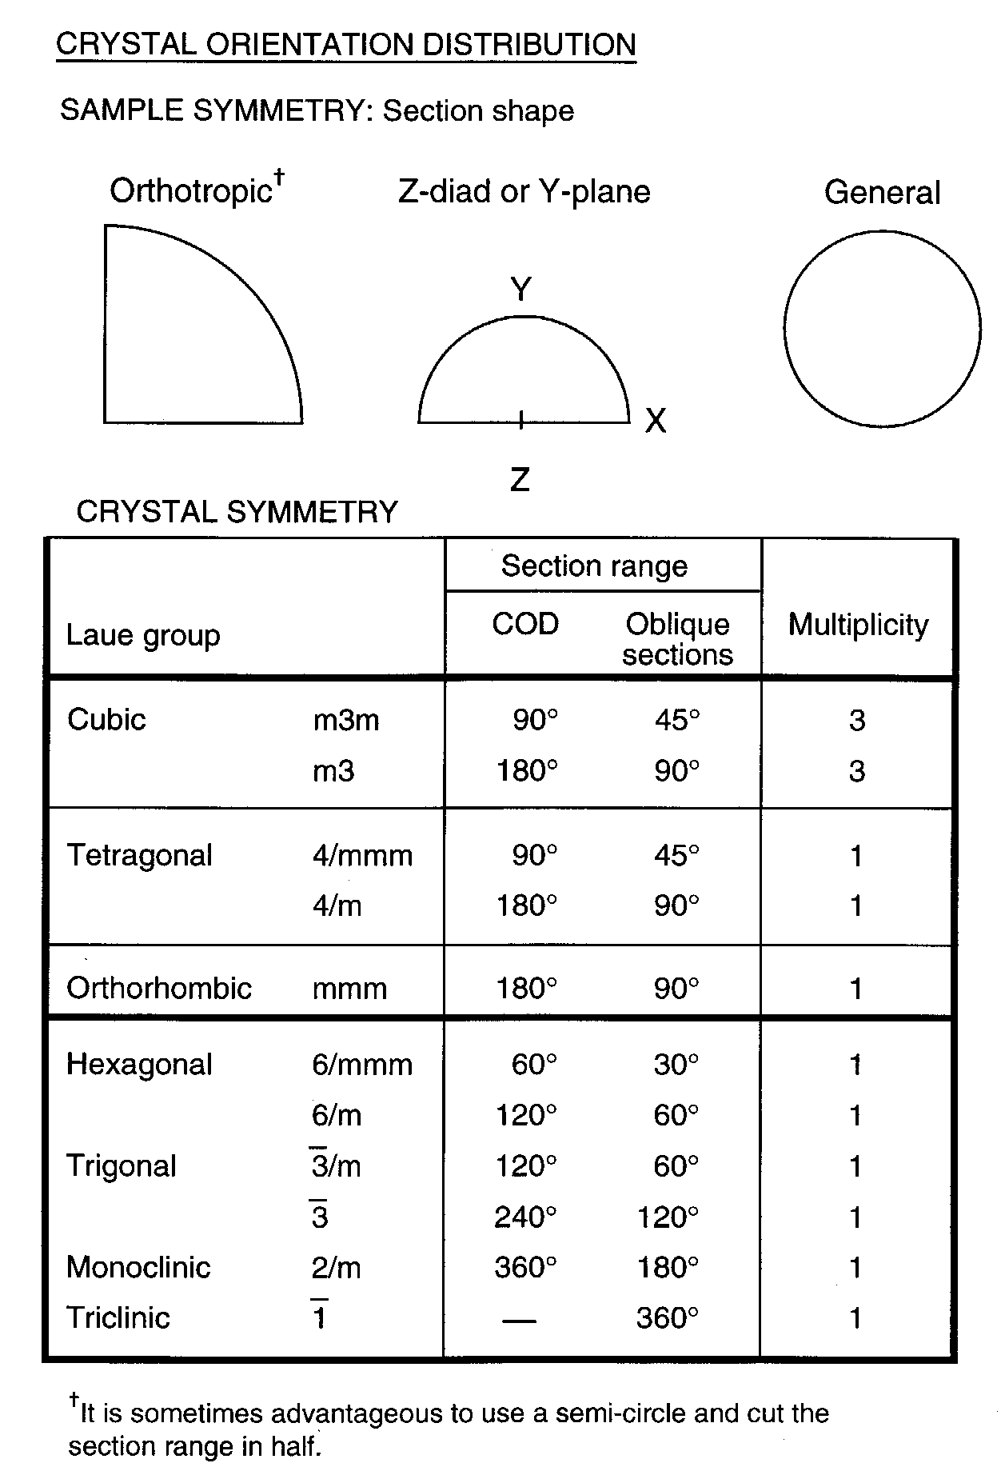
Crystallite Orientation Distribution
Sections at constant
values of the third angle
Kocks, Tomé, Wenk:
Ch. 2 fig. 36
Notes:
Take some time over this slide. This table shows the size of the space used in each case, and the number of physically equivalent points within that space: only the cube for COD has more than one point. Can define fundamental zone here.

Slide 73
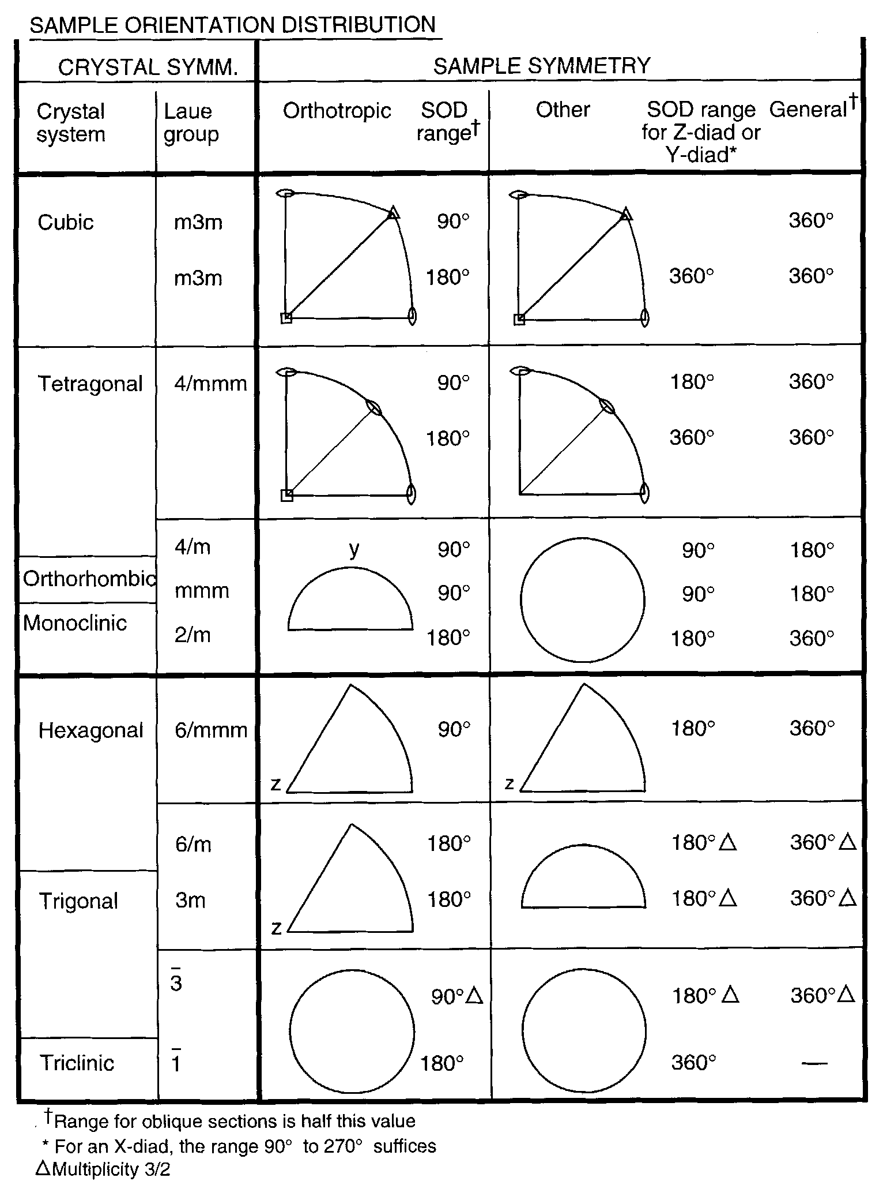
Sample Orientation Distribution
Sections at constant
values of the
first angle
Kocks, Tomé, Wenk:
Ch. 2 fig. 37
Notes:
Another busy slide: note the difference between cubic and tetragonal: the latter must go out to 90° tilt. 60° sector is enough for hexagonal.

Slide 74
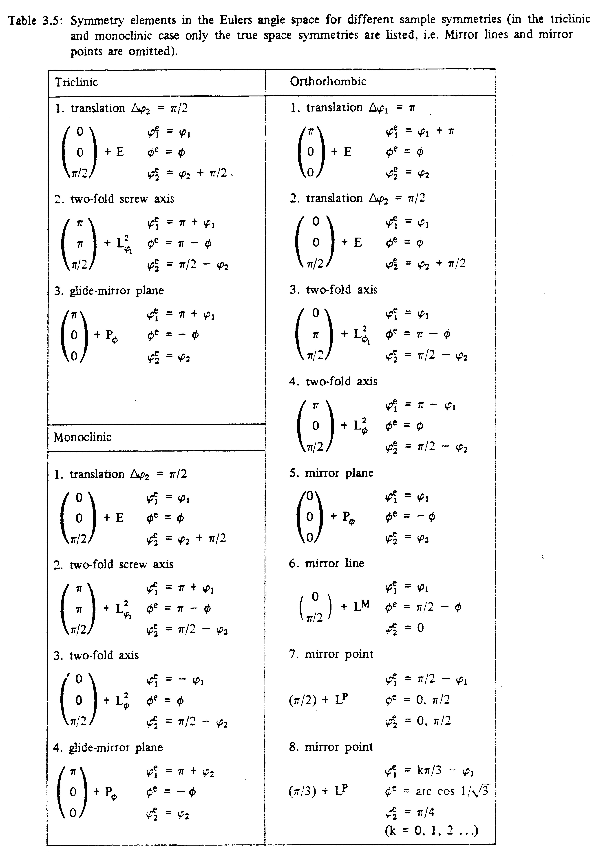
Tables for Texture Analysis of Cubic Crystals, Springer Verlag, 1978

Slide 75
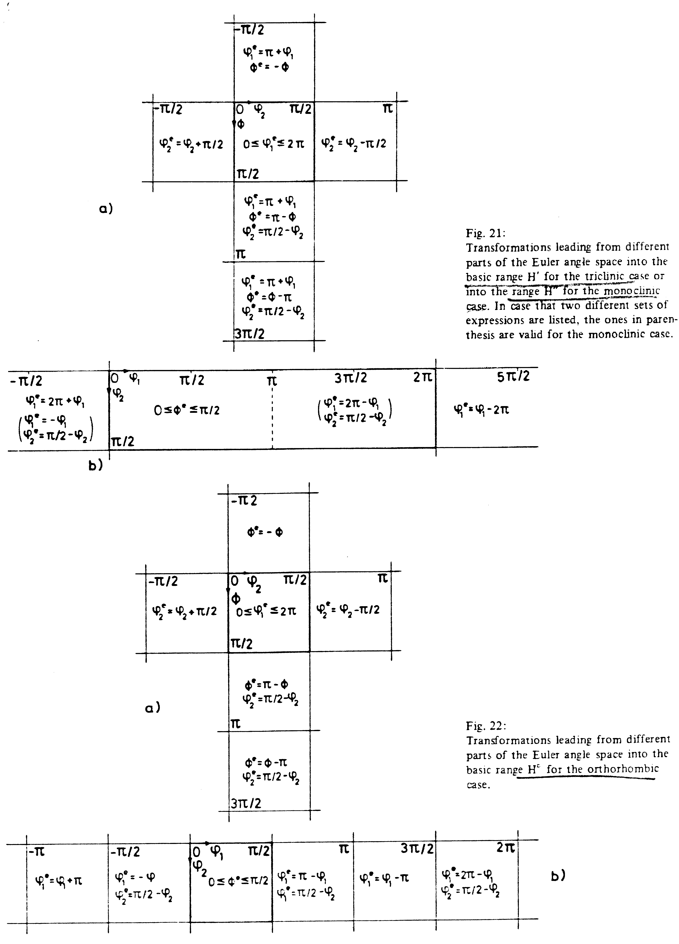
Tables for Texture Analysis of Cubic Crystals, Springer Verlag, 1978

Slide 76
Determinant of a matrix
Multiply each set of three coefficients taken along a diagonal: top left to bottom right are positive, bottom left to top right negative.
|a| = a₁₁a₂₂a₃₃+a₁₂a₂₃a₃₁+a₁₃a₂₁a₃₂- a₁₃a₂₂a₃₁-a₁₂a₂₁a₃₃-a₁₁a₃₂a₂₃
=ε_{i1i2}…_{in}a_{i11}a_{i22}…a_{iNN}
+
-
Notes:
review

Slide 77
Symmetry and Properties
For later: when you use a material property (of a single crystal, for example) to connect two physical quantities, then applying symmetry means that the result is unchanged. In this case there is an equality. This equality allows us to decrease the number of independent coefficients required to describe an anisotropic property (Nye).

Slide 78
Anisotropy
Given an orientation distribution, f(g), one can write the following for any tensor property or quantity, t, where the range of integration is over the fundamental zone of physically distinguishable orientations, SO(3)/G.
“SO(3)” means all possible proper rotations in 3D space (but not reflections); “G” means the set (group) of symmetry operators, e.g. (432) for the proper rotations in the cubic system; SO(3)/G means the space of rotations divided by the symmetry group.

Slide 79
Homework
This describes the part of the homework that deals with learning how to apply symmetry operators to components and find all the symmetrically related positions in Euler space.
  A. Write the symmetry operators for the cubic crystal symmetry (point group 432) as matrices into a file (or as an array in a python/Matlab script). It is sensible to put three numbers on a line, so that the appearance of the numbers is similar to the way in which a 3x3 matrix is written in a book. You can simply copy what was given in the slides (taken from the Kocks book). Python/ Matlab examples, with the ID of the operator written as the 3rd index: e(:,:,1)=[1 0 0; 0 1 0; 0 0 1]; e(:,:,2)=[1 0 0;0 -1 0;0 0 -1]; etc.
  [Alternatively, you can work out what each matrix is based on the actual symmetry operator. This is more work but will show you more of what is behind them.]
  B. Write the symmetry operators for the orthorhombic sample symmetry (point group 222) as matrices into a separate file (or as an array in a python/Matlab script).
  C. Write a computer code that reads in the two sets of symmetry operators (cubic crystal, asks for an orientation specified as (six) Miller indices, (h,k,l)[u,v,w], and calculates each new orientation, which should be written out as Euler angles (meaning, convert the result, which is a matrix, back to Euler angles). Note that the identity operator is always include as the first symmetry operator. So, even if you apply no symmetry, in terms of loops in your program, you go at least once through each loop where the first time through is applying the identity operator (ones on the diagonal, zeros elsewhere).
  D. List all the equivalent points for {123}<63-4> for triclinic (meaning, no sample symmetry). In each listing, identify the points that fall into the 90x90x90 region typically used for plotting.
  E. List all the equivalent points for {123}<63-4> for monoclinic (use only the ND-diad operator, i.e. 180° about the sample z-axis). In each listing, identify the points that fall into the 90x90x90 region typically used for plotting.
  F. List all the equivalent points for {123}<63-4> for orthorhombic sample symmetries (use all 3 diads in addition to the identity). In each listing, identify the points that fall into the 90x90x90 region typically used for plotting.
  G. Repeat F) above for the Copper component, (112)[11-1].
  H. How many different points do you find for each of the three sample symmetries?
  I. How many points fall within the 90x90x90 region that we typically use for plotting orientation distributions?
Students may code the problem in any convenient language (Excel, C++, Pascal….) but are strongly encouraged to do the exercises in python (or Matlab): be very careful of the order in which you apply the symmetry operators!

