Slide 1


Misorientations and
Grain Boundaries
27-750, Advanced Characterization & Microstructural Analysis
A.D. Rollett, P.N. Kalu
Last revised: 9th June, 2009

Slide 2
Objectives
Introduce grain boundaries as a microstructural feature of particular interest.
Describe misorientation, why it applies to grain boundaries and orientation distance, and how to calculate it, with examples.
Define the Misorientation Distribution Function (MDF): the MDF can be used, for example, to quantify how many grain boundaries of a certain type are present in a sample, where “type” is specified by the misorientation.

Slide 3
References
A. Sutton and R. Balluffi, Interfaces in Crystalline Materials, Oxford, 1996.
V. Randle & O. Engler (2000). Texture Analysis: Macrotexture, Microtexture & Orientation Mapping. Amsterdam, Holland, Gordon & Breach.
Frank, F. (1988). “Orientation mapping.” Metallurgical Transactions 19A: 403-408.
H. Grimmer, Acta Cryst., A30, 685 (1974)
V. Randle & O. Engler (2000). Texture Analysis: Macrotexture, Microtexture & Orientation Mapping. Amsterdam, Holland, Gordon & Breach.
S. Altmann (2005 - reissue by Dover), Rotations, Quaternions and Double Groups, Oxford.
A. Morawiec (2003), Orientations and Rotations, Springer (Europe).

Slide 4
Misorientation
Definition of misorientation†: given two orientations (grains, crystals), the misorientation is the rotation required to transform tensor quantities (vectors, stress, strain) from one set of crystal axes to the other set [passive rotation].
Alternate [active rotation*]: given two orientations (grains, crystals), the misorientation is the rotation required to rotate one set of crystal axes into coincidence with the other crystal (based on a fixed reference frame).
* For the active rotation description, the natural choice of reference frame is the set of sample axes. Expressing the misorientation in terms of sample axes, however, will mean that the associated misorientation axis is unrelated to directions in either crystal. In order for the misorientation axis to relate to crystal directions, one must adopt one of the crystals as the reference frame. Confused?! Study the slides and examples that follow!
† In some texts, the word disorientation (as opposed to misorientation) means the smallest physically possible rotation that will connect two orientations. The idea that there is any choice of rotation angle arises because of crystal symmetry: by re-labeling axes (in either crystal), the net rotation changes.

Slide 5
Why are grain boundaries interesting?
Grain boundaries vary a great deal in their characteristics (energy, mobility, chemistry).
Many properties of a material - and also processes of microstructural evolution - depend on the nature of the grain boundaries.
Materials can be made to have good or bad corrosion properties, mechanical properties (creep) depending on the type of grain boundaries present.
Some grain boundaries exhibit good atomic fit and are therefore resistant to sliding, show low diffusion rates, low energy, etc.

Slide 6
What is a Grain Boundary?
Boundary between two grains.
Regular atomic packing disrupted at the boundary.
In most crystalline solids, a grain boundary is very thin (one/two atoms).
Disorder (broken bonds) unavoidable for geometrical reasons; therefore large excess free energy (0.1 - 1 J.m⁻²).

Slide 7
Degrees of (Geometric) Freedom
Grain boundaries have 5 degrees of freedom in terms of their macroscopic geometry: either 3 parameters to specify a rotation between the lattices plus 2 parameters to specify the boundary plane; or 2 parameters for each boundary plane on each side of the boundary (total of 4) plus a twist angle (1 parameter) between the lattices.
In addition to the macroscopic degrees of freedom, grain boundaries have 3 degrees of microscopic freedom (not considered here). The lattices can be translated in the plane of the boundary, and they can move towards/away from each other along the boundary normal.
If the orientation of a boundary with respect to sample axes matters (e.g. because of an applied stress, or magnetic field), then an additional 2 parameters must be specified.

Slide 8
Boundary Type
There are several ways of describing grain boundaries.
A traditional method (in materials science) uses the tilt-twist description.
A twist boundary is one in which one crystal has been twisted about an axis perpendicular to the boundary plane, relative to the other crystal.
A tilt boundary is one in which one crystal has been twisted about an axis that lies in the boundary plane, relative to the other crystal.
More general boundaries have a combination of tilt and twist.
The approach specifies all five degrees of freedom.
Contrast with more recent (EBSD inspired) method that describes only the misorientation between the two crystals.

Slide 9
Tilt versus Twist Boundary Types
Tilt boundary is a rotation about an axis in the boundary plane.
Twist boundary is a rotation about an axis perpendicular to the plane.
Grain A
Grain B
Tilt Boundary
Grain Boundary
Grain A
Grain B
Twist Boundary
NB: the tilt or twist angle is not necessarily the same as the misorientation angle (although for low angle boundaries, it typically is so).

Slide 10
How to construct a grain boundary
There are many ways to put together a grain boundary.
There is always a common crystallographic axis between the two grains: one can therefore think of turning one piece of crystal relative to the other about this common axis. This is the misorientation concept. A further decision is required in order to determine the boundary plane.
Alternatively, one can think of cutting a particular facet on each of the two grains, and then rotating one of them to match up with the other. This leads to the tilt/twist concept.

Slide 11
Differences in Orientation
Preparation for the math of misorientations: the difference in orientation between two grains is a rotation, just as an orientation is the rotation that describes a texture component.
Convention: we use different methods (Rodrigues vectors) to describe g.b. misorientation than for texture (but we could use Euler angles for everything, for example).

Slide 12
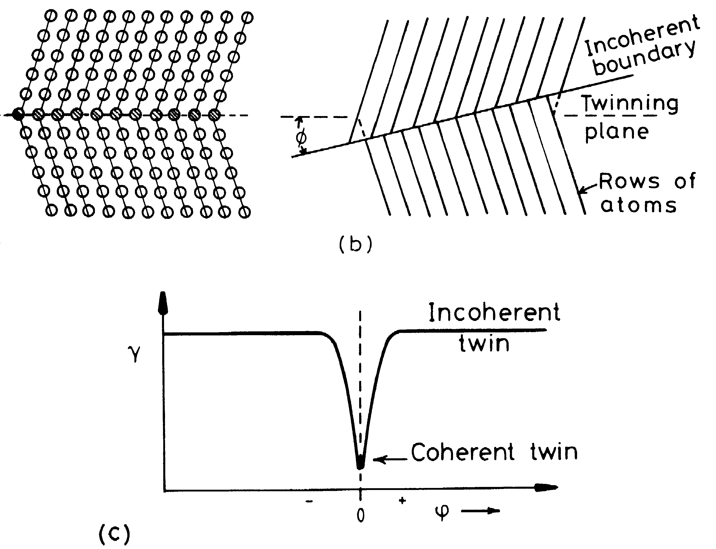
Example: Twin Boundary
<111> rotation axis,
common to both crystals
θ=60°
Porter & Easterling fig. 3.12/p123

Slide 13
Rotations at a Grain Boundary
z
g_{B}
In terms of orientations:
rotate back from position A
to the reference position.
Then rotate to position B.
Compound (“compose”)
the two rotations to arrive
at the net rotation between
the two grains.
y
g_{A}⁻¹
reference
position:
(001)[100]
x
Net rotation = g_{B}g_{A}⁻¹
NB: these are passive rotations

Slide 14
Alternate Diagram
g_{B}
TJ_{ACB}
g_{D}
g_{B}g_{A}⁻¹
g_{C}
g_{A}
TJ_{ABC}

Slide 15
Representations of Misorientation
What is different from Texture Components?
Miller indices not useful (except for axis).
Euler angles can be used but untypical.
Reference frame is usually the crystal lattice, not the sample frame.
Application of symmetry is different (no sample symmetry!)

Slide 16
Grain Boundaries vs. Texture
Why use the crystal lattice as a frame? Grain boundary structure is closely related to the rotation axis, i.e. the common crystallographic axis between the two grains.
The crystal symmetry applies to both sides of the grain boundary; in order to put the misorientation into the fundamental zone (or asymmetric unit) two sets of 24 operators (for cubic symmetry) with the switching symmetry must be used. However only one set of 24 symmetry operators are needed to find the minimum rotation angle.
“Switching symmetry” is explained on a later slide.

Slide 17
Disorientation
Thanks to the crystal symmetry, no two cubic lattices can be different by more than ~62.8°.
Combining two orientations can lead to a rotation angle as high as 180°: applying crystal symmetry operators decreases the required rotation angle.
Disorientation:= (is defined as) the minimum rotation angle between two lattices with the misorientation axis located in the Standard Stereographic Triangle.

Slide 18
Grain Boundary Representation
Axis-angle representation: axis is the common crystal axis (but it is also possible to describe the axis in the sample frame); angle is the rotation angle, θ.
3x3 Rotation matrix, ∆g=g_{B}g_{A}^{T}.
Rodrigues vector: 3 component vector whose direction is the axis direction and whose length = tan(θ /2).

Slide 19
How to Choose the
Misorientation Angle: matrix
If the rotation angle is the only criterion, then only one set of 24 operators (cubic) need be applied: sample versus crystal frame is indifferent because the angle (from the trace of a rotation matrix) is invariant under axis transformation.
Note: taking absolute value of the misorientation angle accounts for switching symmetry

Slide 20
How to Choose the
Misorientation Angle: quaternions
This algorithm is valid only for cubic-cubic misorientations and for obtaining only the angle (not the axis).
Arrange q₄ ≥ q₃ ≥ q₂ ≥ q₁ ≥ 0.
Choose the maximum value of the fourth component, q₄’, from three variants as follows:
[i] (q₁,q₂,q₃,q₄)
[ii] (q₁-q₂, q₁+q₂, q₃-q₄, q₃+q₄)/√2
[iii] (q₁-q₂+q₃-q₄, q₁+q₂-q₃-q₄, -q₁+q₂+q₃-q₄, q₁+q₂+q₃+q₄)/2
Reference: Sutton & Balluffi, section 1.3.3.4; see also H. Grimmer, Acta Cryst., A30, 685 (1974) for more detail.

Slide 21
Rotation Axis, Angle
g_{B}
g_{D}
∆g=g_{B}g_{A}⁻¹≡ g_{A}g_{B}⁻¹
g_{C}
g_{A}
Switching symmetry:
A to B is indistinguishable
from B to A
rotation axis,
common to both crystals

Slide 22
Switching Symmetry
What do we mean by switching symmetry?
The idea is that going from grain A to grain B makes no difference to the physical nature of the boundary. Therefore we consider the two descriptions to be physically equivalent.
The mathematical descriptions are different, however. Therefore we have to describe the set of equivalent misorientations as the union of the forward and backward sets.
Also, collapsing the descriptions into a fundamental zone with only one unique descriptor of each misorientation requires care with the shape and symmetry elements used.

Slide 23
Crystal vs Sample Frame
Components of
the rotation axis
are always
(1/√3,1/√3,1/√3) in
the crystal frame:
in the sample frame
the components
depend on the
orientations of
the grains.
z
g_{B}
y
g_{A}⁻¹
reference
position:
(001)[100]
θ=60°
x

Slide 24
Worked Example
In this example, we take a pair of orientations that were chosen to have a 60°<111> misorientation between them (rotation axis expressed in crystal coordinates). In fact the pair of orientations are the two sample symmetry related Copper components, which are twin related.
We calculate the 3x3 Rotation matrix for each orientation, g_{A} and g_{B}, and then form the misorientation matrix, ∆g=g_{B}g_{A}⁻¹.
From the misorientation matrix, we calculate the angle,
= cos⁻¹(trace(∆g)-1)/2), and the rotation axis.
In order to find the smallest possible misorientation angle, we have to apply crystal symmetry operators, O, to the misorientation matrix, O∆g, and recalculate the angle and axis.
First, let’s examine the result….

Slide 25
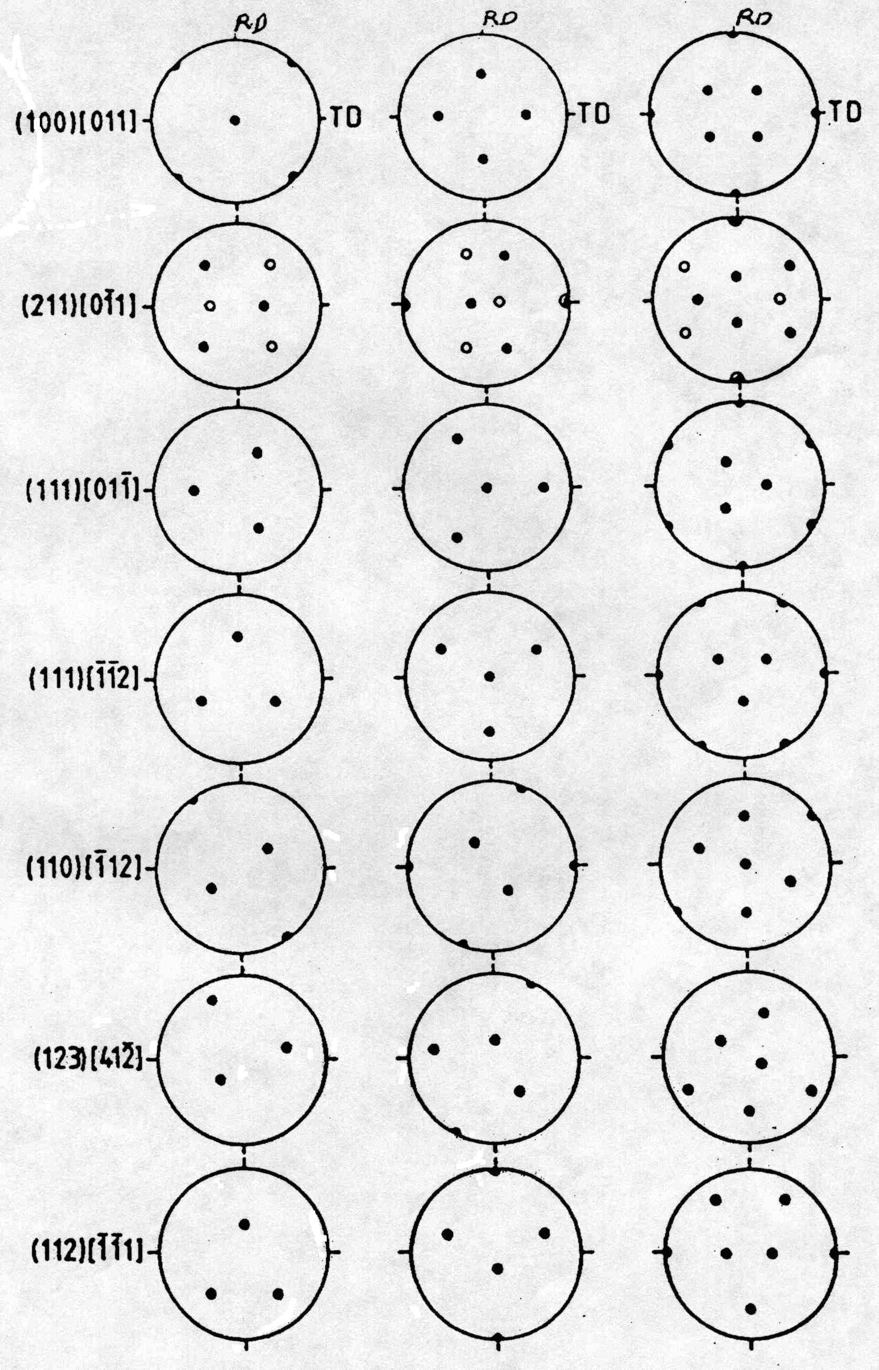
Worked Example
angles.. 90. 35.2599983 45.
angles.. 270. 35.2599983 45.
1st Grain: Euler angles: 90. 35.2599983 45.
2nd Grain: Euler angles: 270. 35.2599983 45.
1st matrix:
[ -0.577 0.707 0.408 ]
[ -0.577 -0.707 0.408 ]
[ 0.577 0.000 0.817 ]
2nd matrix:
[ 0.577 -0.707 0.408 ]
[ 0.577 0.707 0.408 ]
[ -0.577 0.000 0.817 ]
Product matrix for gA X gB^-1:
[ -0.667 0.333 0.667 ]
[ 0.333 -0.667 0.667 ]
[ 0.667 0.667 0.333 ]
MISORI: angle= 60. axis= 1 1 -1
{100} pole figures
+
Note that the misorientation axis is // 1 1 -1, which is also the sample-1 (X) axis

Slide 26
Detail Output
Symmetry operator number 5
Product matrix for gA X gB^-1:
[ -0.667 -0.667 -0.333 ]
[ 0.333 -0.667 0.667 ]
[ -0.667 0.333 0.667 ]
Trace = -0.666738987
angle = 146.446442
Symmetry operator number 6
Product matrix for gA X gB^-1:
[ 0.667 0.667 0.333 ]
[ 0.333 -0.667 0.667 ]
[ 0.667 -0.333 -0.667 ]
Trace = -0.666738987
angle = 146.446442
Symmetry operator number 7
Product matrix for gA X gB^-1:
[ 0.667 -0.333 -0.667 ]
[ 0.333 -0.667 0.667 ]
[ -0.667 -0.667 -0.333 ]
Trace = -0.333477974
angle = 131.815872
Symmetry operator number 8
Product matrix for gA X gB^-1:
[ 0.667 -0.333 -0.667 ]
[ -0.333 0.667 -0.667 ]
[ 0.667 0.667 0.333 ]
Trace = 1.66695571
angle = 70.5199966
Symmetry operator number 9
Product matrix for gA X gB^-1:
[ 0.333 -0.667 0.667 ]
[ 0.667 -0.333 -0.667 ]
[ 0.667 0.667 0.333 ]
Trace = 0.333477855
angle = 109.46682
Symmetry operator number 10
Product matrix for gA X gB^-1:
[ -0.333 0.667 -0.667 ]
[ -0.667 0.333 0.667 ]
[ 0.667 0.667 0.333 ]
Trace = 0.333477855
angle = 109.46682
Symmetry operator number 11
Product matrix for gA X gB^-1:
[ -0.333 0.667 -0.667 ]
[ 0.667 0.667 0.333 ]
[ 0.667 -0.333 -0.667 ]
Trace = -0.333261013
angle = 131.807526
Symmetry operator number 12
Product matrix for gA X gB^-1:
[ 0.667 0.667 0.333 ]
[ 0.667 -0.333 -0.667 ]
[ -0.333 0.667 -0.667 ]
Trace = -0.333261073
angle = 131.807526
Symmetry operator number 13
Product matrix for gA X gB^-1:
[ -0.333 0.667 -0.667 ]
[ -0.667 -0.667 -0.333 ]
[ -0.667 0.333 0.667 ]
Trace = -0.333261013
angle = 131.807526
Symmetry operator number 14
Product matrix for gA X gB^-1:
[ -0.667 -0.667 -0.333 ]
[ -0.667 0.333 0.667 ]
[ -0.333 0.667 -0.667 ]
Trace = -1.
angle = 180.
Symmetry operator number 15
Product matrix for gA X gB^-1:
[ 0.333 -0.667 0.667 ]
[ -0.667 -0.667 -0.333 ]
[ 0.667 -0.333 -0.667 ]
Trace = -1.
angle = 180.
Symmetry operator number 16
Product matrix for gA X gB^-1:
[ -0.667 -0.667 -0.333 ]
[ 0.667 -0.333 -0.667 ]
[ 0.333 -0.667 0.667 ]
Trace = -0.333260953
angle = 131.807526
Symmetry operator number 17
Product matrix for gA X gB^-1:
[ 0.333 -0.667 0.667 ]
[ 0.667 0.667 0.333 ]
[ -0.667 0.333 0.667 ]
Trace = 1.66652203
angle = 70.533165
Symmetry operator number 18
Product matrix for gA X gB^-1:
[ 0.667 0.667 0.333 ]
[ -0.667 0.333 0.667 ]
[ 0.333 -0.667 0.667 ]
Trace = 1.66652203
angle = 70.533165
Symmetry operator number 19
Product matrix for gA X gB^-1:
[ 0.333 -0.667 0.667 ]
[ -0.667 0.333 0.667 ]
[ -0.667 -0.667 -0.333 ]
Trace = 0.333044171
angle = 109.480003
Symmetry operator number 20
Product matrix for gA X gB^-1:
[ 0.667 -0.333 -0.667 ]
[ 0.667 0.667 0.333 ]
[ 0.333 -0.667 0.667 ]
Trace = 2.
angle = 60.
Symmetry operator number 21
Product matrix for gA X gB^-1:
[ 0.667 0.667 0.333 ]
[ -0.333 0.667 -0.667 ]
[ -0.667 0.333 0.667 ]
Trace = 2.
angle = 60.
Symmetry operator number 22
Product matrix for gA X gB^-1:
[ 0.667 -0.333 -0.667 ]
[ -0.667 -0.667 -0.333 ]
[ -0.333 0.667 -0.667 ]
Trace = -0.666522205
angle = 146.435211
Symmetry operator number 23
Product matrix for gA X gB^-1:
[ -0.667 -0.667 -0.333 ]
[ -0.333 0.667 -0.667 ]
[ 0.667 -0.333 -0.667 ]
Trace = -0.666522026
angle = 146.435196
Symmetry operator number 24
Product matrix for gA X gB^-1:
[ -0.333 0.667 -0.667 ]
[ 0.667 -0.333 -0.667 ]
[ -0.667 -0.667 -0.333 ]
Trace = -0.999999881
angle = 179.980209
MISORI: angle= 60. axis= 1 1
MISORI: angle= 60. axis= 1 1 -1-1
1st matrix:
[ -0.691 0.596 0.408 ]
[ -0.446 -0.797 0.408 ]
[ 0.569 0.100 0.817 ]
2nd matrix:
[ 0.691 -0.596 0.408 ]
[ 0.446 0.797 0.408 ]
[ -0.569 -0.100 0.817 ]
Symmetry operator number 1
Product matrix for gA X gB^-1:
[ -0.667 0.333 0.667 ]
[ 0.333 -0.667 0.667 ]
[ 0.667 0.667 0.333 ]
Trace = -1.
angle = 180.
Symmetry operator number 2
Product matrix for gA X gB^-1:
[ -0.667 0.333 0.667 ]
[ -0.667 -0.667 -0.333 ]
[ 0.333 -0.667 0.667 ]
Trace = -0.666738808
angle = 146.446426
Symmetry operator number 3
Product matrix for gA X gB^-1:
[ -0.667 0.333 0.667 ]
[ -0.333 0.667 -0.667 ]
[ -0.667 -0.667 -0.333 ]
Trace = -0.333477736
angle = 131.815857
Symmetry operator number 4
Product matrix for gA X gB^-1:
[ -0.667 0.333 0.667 ]
[ 0.667 0.667 0.333 ]
[ -0.333 0.667 -0.667 ]
Trace = -0.666738927
angle = 146.446442
This set of tables shows each successive result as a different symmetry operator is applied to ∆g. Note how the angle and the axis varies in each case!

Slide 27
Basics
Passive Rotations
Materials Science
g describes an axis transformation from sample to crystal axes
Active Rotations
Solid mechanics
g describes a rotation of a crystal from ref. position to its orientation.
Passive Rotations (Axis Transformations) Active (Vector) Rotations

Slide 28
Objective
To make clear how it is possible to express a misorientation in more than (physically) equivalent fashion.
To allow researchers to apply symmetry correctly; mistakes are easy to make!
It is essential to know how a rotation/orientation/texture component is expressed in order to know how to apply symmetry operations.

Slide 29
Matrices
g = Z₂XZ₁ =
g = g_{φ1/001}g_{Φ100}g_{φ2/001} =
Passive Rotations (Axis Transformations) Active (Vector) Rotations

Slide 30
Worked example: active rotations
So what happens when we express orientations as active rotations in the sample reference frame?
The result is similar (same minimum rotation angle) but the axis is different!
The rotation axis is the sample [100] axis, which happens to be parallel to a crystal <111> direction.
{100} pole figures
60° rotation
about RD

Slide 31
Active rotations example
Symmetry operator number 1
Product matrix for gB X gA^-1:
[ -1.000 0.000 0.000 ]
[ 0.000 -1.000 0.000 ]
[ 0.000 0.000 1.000 ]
Trace = -1.
angle = 180.
Symmetry operator number 2
Product matrix for gB X gA^-1:
[ -0.333 0.000 0.943 ]
[ 0.816 -0.500 0.289 ]
[ 0.471 0.866 0.167 ]
Trace = -0.666738927
angle = 146.446442
Symmetry operator number 3
Product matrix for gB X gA^-1:
[ 0.333 0.817 0.471 ]
[ 0.817 0.000 -0.577 ]
[ -0.471 0.577 -0.667 ]
Trace = -0.333477914
angle = 131.815872
…………..
angles.. 90. 35.2599983 45.
angles.. 270. 35.2599983 45.
1st Grain: Euler angles: 90. 35.2599983 45.
2nd Grain: Euler angles: 270. 35.2599983 45.
1st matrix:
[ -0.577 0.707 0.408 ]
[ -0.577 -0.707 0.408 ]
[ 0.577 0.000 0.817 ]
2nd matrix:
[ 0.577 -0.707 0.408 ]
[ 0.577 0.707 0.408 ]
[ -0.577 0.000 0.817 ]
MISORInv: angle= 60. axis= 1 0 0
Note that the misorientation axis is still // 1 1 -1, but now the calculation identifies 1 0 0 as the axis, which is the sample-1 (X) axis.

Slide 32
Active rotations
What is stranger, at first sight, is that, as you rotate the two orientations together in the sample frame, the misorientation axis moves with them, if expressed in the reference frame (active rotations).
On the other hand, if one uses passive rotations, so that the result is in crystal coordinates, then the misorientation axis remains unchanged.

Slide 33
Active rotations example
Symmetry operator number 1
Product matrix for gB X gA^-1:
[ -1.000 0.000 0.000 ]
[ 0.000 -1.000 0.000 ]
[ 0.000 0.000 1.000 ]
Trace = -1.
angle = 180.
Symmetry operator number 2
Product matrix for gB X gA^-1:
[ -0.478 0.004 0.878 ]
[ 0.820 -0.355 0.448 ]
[ 0.314 0.935 0.167 ]
Trace = -0.666738808
angle = 146.446426
Symmetry operator number 3
Product matrix for gB X gA^-1:
[ 0.044 0.824 0.564 ]
[ 0.824 0.289 -0.487 ]
[ -0.564 0.487 -0.667 ]
Trace = -0.333477765
angle = 131.815857
…………..
Add 10° to the first Euler angle so that both crystals move together:
angles.. 100. 35.2599983 45.
angles.. 280. 35.2599983 45.
1st Grain: Euler angles: 90. 35.2599983 45.
2nd Grain: Euler angles: 270. 35.2599983 45.
1st matrix:
[ -0.577 0.707 0.408 ]
[ -0.577 -0.707 0.408 ]
[ 0.577 0.000 0.817 ]
2nd matrix:
[ 0.577 -0.707 0.408 ]
[ 0.577 0.707 0.408 ]
[ -0.577 0.000 0.817 ]
MISORInv: angle= 60. axis= 6 1 0
Note the change in the misorientation axis from 100 to 610 because it is expressed in the sample frame!

Slide 34
Texture+Symmetry
Symmetry Operators:
O_{sample} ≡ O_{s}
O_{crystal} ≡ O_{c}
Note that the crystal symmetry post-multiplies, and the sample symmetry pre-multiplies.
Note the reversal in order of application of symmetry operators!
Passive Rotations (Axis Transformations) Active (Vector) Rotations

Slide 35
Groups:
Sample+Crystal Symmetry
O_{c}∈O(432);
proper rotations of the cubic point group.
O_{s}∈O(222);
proper rotations of the orthorhombic point group.
Think of applying the symmetry operator in the appropriate frame: thus for active rotations, apply symmetry to the crystal before you rotate it.
Passive Rotations (Axis Transformations) Active (Vector) Rotations

Slide 36
Misorientations
Misorientations:
∆g=g_{B}g_{A}⁻¹;
transform from crystal axes of grain A back to the reference axes, and then transform to the axes of grain B.
Misorientations:
∆g=g_{B}g_{A}⁻¹;
the net rotation from A to B is: rotate first back from the position of grain A and then rotate to the position of grain B.
Passive Rotations (Axis Transformations) Active (Vector) Rotations

Slide 37
Notation
In some texts, misorientation formed from axis transformations is written with a tilde.
Standard A->B transformation is expressed in crystal axes.
You must verify from the context which type of misorientation is discussed in a text!
Standard A->B rotation is expressed in sample axes.
Passive Rotations (Axis Transformations) Active (Vector) Rotations

Slide 38
Misorientation+Symmetry
∆g=
(O_{c} g_{B})(O_{c} g_{A})⁻¹
= O_{c}g_{B}g_{A}⁻¹O_{c}⁻¹.
Note the presence of symmetry operators pre- & post-multiplying the basic misorientation
∆g=g_{B}g_{A}⁻¹;
(g_{B}O_{c})(g_{A}O_{c})⁻¹
= g_{B}O_{c}O_{c}⁻¹g_{A}⁻¹
= g_{B} O_{c} g_{A}⁻¹.
Note the reduction to a single symmetry operator because the symmetry operators belong to the same group!
Passive Rotations (Axis Transformations) Active (Vector) Rotations

Slide 39
Switching Symmetry
g_{B}
∆g=g_{B}g_{A}⁻¹≡ g_{A}g_{B}⁻¹
Switching symmetry:
A to B is indistinguishable
from B to A because there is no difference in grain
boundary structure
g_{A}

Slide 40
Switching Symmetry, v2
If we write down the set of possible misorientations, recognizing the equivalence of forward and backward rotations, we get:
{∆g}={∆g_{AB}}U{∆g_{BA}} =
{(O_{c} g_{B})(O_{c} g_{A})⁻¹}U(O_{c} g_{A})(O_{c} g_{B})⁻¹}
= {O_{c}g_{B}g_{A}⁻¹O_{c}⁻¹}U{O_{c}g_{A}g_{B}⁻¹O_{c}}.
Equivalently in the sample frame:
{∆g}={g_{B}g_{A}⁻¹}U{g_{A}g_{B}⁻¹}=
{(g_{B}O_{c})(g_{A}O_{c})⁻¹}U
{(g_{A}O_{c})(g_{B}O_{c})⁻¹}
= {g_{B}O_{c}O_{c}⁻¹g_{A}⁻¹}U{g_{A}O_{c}O_{c}⁻¹g_{B}⁻¹}
= {g_{B}O_{c}g_{A}⁻¹}U{g_{A}O_{c}g_{B}⁻¹}.
Passive Rotations (Axis Transformations) Active (Vector) Rotations

Slide 41
Symmetry: how many equivalent representations of misorientation?
Axis transformations:
24 independent operators present on either side of the misorientation. Two equivalents from switching symmetry.
Number of equivalents=
24x24x2=1152.
Active rotations:
Only 24 independent operators present “inside” the misorientation. 2 from switching symmetry.
Number of equivalents=
24x2=48.
Passive Rotations (Axis Transformations) Active (Vector) Rotations

Slide 42
Passive <-> Active
Just as is the case for rotations, and texture components,
g_{passive}(θ,n) = g^{T}_{active}(θ,n),
so too for misorientations,

Slide 43
Disorientation Choice?
Disorientation to be chosen to make the description of misorientation unique and thus within the Fundamental Zone (irreducible zone, etc.).
Must work in the crystal frame in order for the rotation axis to be described in crystallographic axes.
Active rotations: write the misorientation as follows in order to express in crystal frame:
∆g=(g_{B}O_{c}) ⁻¹(g_{A}O_{c}) =O_{c}g_{B}⁻¹g_{A}O_{c}⁻¹.

Slide 44
Disorientation Choice, contd.
Rotation angle to be minimized, and,
place the axis in the standard stereographic triangle.
Use the full list of 1152 equivalent representations to find minimum angle, and:
u ≥ v ≥ w ≥ 0,
where [uvw] is the rotation axis associated with the rotation.
Algorithm: see next slide

Slide 45
Pseudo-code for Disorientation
! Work in crystal (local) frame
Calculate misorientation as g_{B}g_{A}⁻¹
For each ith crystal symmetry operator, calculate O_{i}g_{B}g_{A}⁻¹
For each jth crystal symmetry operator, calculate O_{i}g_{B}g_{A}⁻¹O_{j}
Test the axis for whether it lies in the FZ; repeat for inverse rotation
If if does, test angle for whether it is lower than the previous minimum
If new min. angle found, retain the result (with indices i & j)
endif
endif
enddo
enddo
Note that it is essential to test the axis in the outer loop and the angle in the inner loop, because it is often the case that the same (minimum ) angle will be found for multiple rotation axes.
The “inverse rotation” can be easily obtained by negating the fourth (cosine) component of the quaternion.

Slide 46
(432) in quaternions
quat.symm.cubic file with 24 proper rotations in quaternion form
24
0 0 0 1
1 0 0 0
0 1 0 0
0 0 1 0
0.707107 0 0 0.707107
0 0.707107 0 0.707107
0 0 0.707107 0.707107
-0.707107 0 0 0.707107
0 -0.707107 0 0.707107
0 0 -0.707107 0.707107
0.707107 0.707107 0 0
-0.707107 0.707107 0 0
0 0.707107 0.707107 0
0 -0.707107 0.707107 0
0.707107 0 0.707107 0
-0.707107 0 0.707107 0
0.5 0.5 0.5 0.5
-0.5 -0.5 -0.5 0.5
0.5 -0.5 0.5 0.5
-0.5 0.5 -0.5 0.5
-0.5 0.5 0.5 0.5
0.5 -0.5 -0.5 0.5
-0.5 -0.5 0.5 0.5
0.5 0.5 -0.5 0.5
Cubic point group;
proper rotations expressed as quaternions;
the first four lines/elements/operators are equivalent to (222) and represent orthorhombic symmetry

Slide 47
Conversions for Axis
Matrix representation, a, to axis, [uvw]=v:
Rodrigues
vector:
Quaternion:
N.B. the axis is assumed to be from an axis transformation

Slide 48
ID of symmetry operator(s)
For calculations (numerical) on grain boundary character, it is critical to retain the identity of each symmetry operator use to place a given grain boundary in the FZ.
That is, given O_{c} ∈O(432)=O_{i}{O₁,O₂,…,O₂₄}
one must retain the value of index “i” for subsequent use, e.g. in determining tilt/twist character.

Slide 49
Successive misorientations
There are problems where one needs to calculate the effect of two successive misorientations, taking into account variants. By “variants” we mean that the second misorientation (twin) can occur on any of the systems related by crystal symmetry. For example, if twinning occurs on more than one system, then the second twin can be physically contained within the first twin but still make a boundary with the original matrix. So, the problem is, how do we calculate the matrix-twin₂ misorientation, taking account of crystal symmetry and the possibility of (crystal) symmetry-related variants?
Matrix-twin₁
Matrix-twin₂
Matrix
twin₁
g’
g
twin₂
g’’
twin₁
g’
Matrix
twin₁-twin₂
g

Slide 50
Successive Twins
The key to this problem is to recognize that (a) the order of the two twins/misorientations does not matter, and (b) that one must insert an additional (crystal) symmetry element between the two twins/misorientations. In effect one treats each twin/misorientation (T) as a rotation (or orientation). The same procedure can be used for phase transformations, although one must be careful about the difference between going from phase 1 to phase 2, versus 2 to 1. We obtain a set of physically equivalent orientations, {g”}, starting from a matrix orientation, g, thus:
{g”} = (O_{c} T₂) O_{c}(O_{c} T₁)g = O_{c}T₂ O_{c} T₁ g.
Note the presence of symmetry operators pre-multiplying, as well the additional symmetry operator in between the two misorientations. This additional symmetry operator is applied in a manner that is equivalent to sample symmetry.
Curiously, the order in which the twins/misorientations are applied does not make any difference, for the three types of twins considered here (for Ti). The overall misorientation for matrix→twin₁→twin₂ is the same as matrix→twin₂→twin₁. The reason for this not very obvious result is the fact that the rotation axes coincide with mirror planes in the crystal symmetry. Accordingly, this is not a general result.
Thanks to Nathalie Bozzolo (Univ. Metz) for pointing out this problem.
For a (much) more detailed analysis of twin chains, see papers by Cayron.

Slide 51
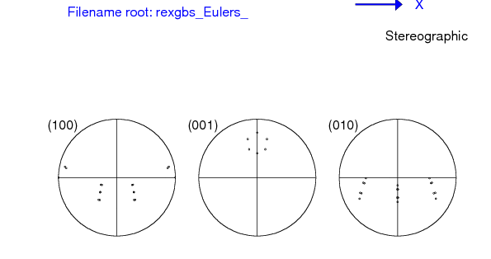
Successive twins: simple example
First let’s illustrate how this works with the first misorientation as 60° about 100, and the second as 15°, also about 100. We use hexagonal crystal symmetry so that we can view the 0001 pole figure and easily interpret the results. What we expect to see is that the second misorientation (twin, if you like) “decorates” the first twin, by producing additional, small changes in position relative to the first one. In this example, the two symmetry operators that are normally used to apply crystal symmetry to calculate disorientation have been omitted. If only the first misorientation of 60° had been applied, there would be only one pole in the 0001 pole figure ( at the center of the ring of six poles that you see).
{∆g} = T₂ O_{c} T₁

Slide 52
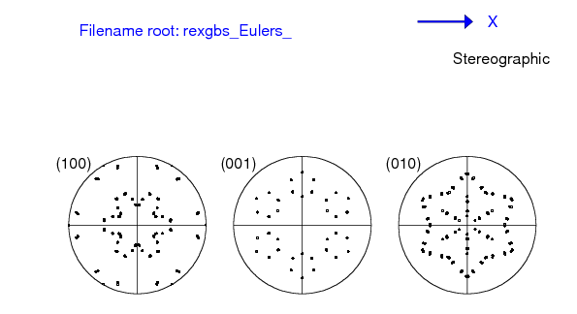
Successive twins: simple example
Now let’s add all the symmetry operators so that we see all the possible variants. Now there are six rings of six poles in the 0001 pole figure. Remember: pole figures of pairs of successive twins vary with the order in which the twins are applied, even though the misorientations remain the same.
{∆g} =
(O_{c} T₂) O_{c}(O_{c} T₁)
= O_{c}T₂ O_{c} T₁O_{c}
= O_{c}T₂ O_{c} T₁ O_{c}.

Slide 53

Successive twins: Zr, CT-TT2
This illustrates the result for a hexagonal system (Zr) with the two twins,
a) tensile twins (twin₂)
(TT2 type ; close to sigma11a ; 35.1°<10-10> )
b) inside compressive twins (twin₁)
(CT type; close to sigma7b ; 64.6°<10-10> )
The results are illustrated first as pole figures, in order to make sure that the calculations are performed correctly.

Slide 54

Successive twins: Zr, CT-TT2
Now we add all the symmetry operators so that we see the full effect. Note that the two twins share the same axis and that the two angles add up to almost exactly 100°, so there are many near coincidences in the pole positions.

Slide 55
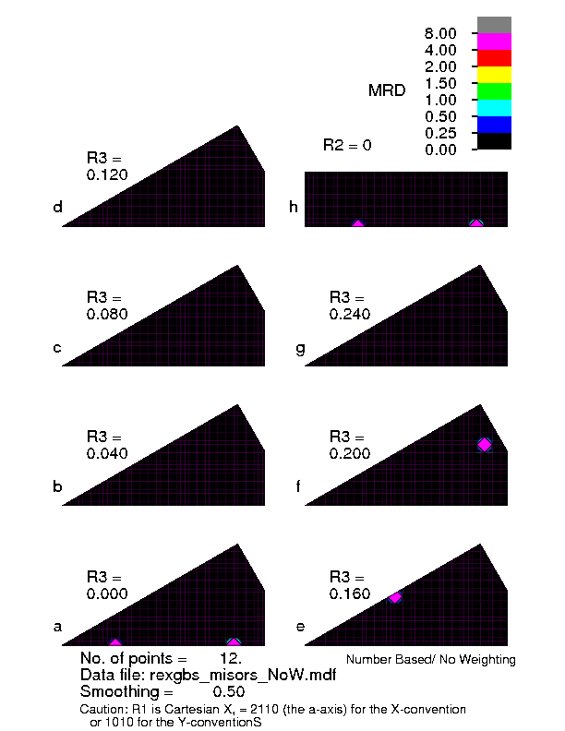
Successive twins: Zr, CT-TT2
Now we plot the misorientations that result from this pair.
These are the misorientations between the matrix and the second twin. The combination produces new misorientations, relative to the two twins.
Add chains of CT, TT1 …; add the second cut for R1=0

Slide 56
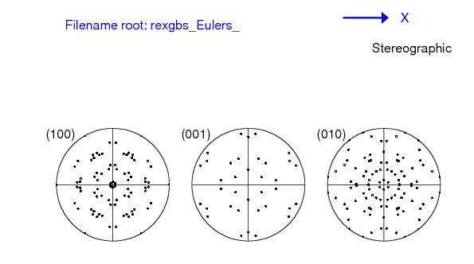
Successive twins: Zr, TT2-CT
The twin chain TT2 then CT produces a slightly different result in terms of pole figures. The misorientations, however, are the same.

Slide 57

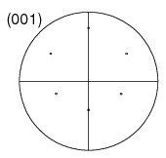
Order of twins, PFs, ∆g
We can understand the reason for the pole figures depending on the order of the twins, but not the misorientation as follows. Pole figures show us what is going on with respect to the sample frame. Given that two rotations do not commute, it is not surprising that the net result is different: see below for 60° about 100, followed by 15° about each of the equivalent 100 axes in the intermediate frame. The other figure shows 15° followed by 60°, again for all equivalent 100 axes in the intermediate frame.
1st rotation = 60° [100]
1st rotation = 15° [100]

Slide 58
Order of twins, PFs, ∆g, contd.
In order to understand why, in this particular case, the order of the twins does not matter, consider the fact that the twin/rotation axis is coincident with one of the 2-fold symmetry operators in the hexagonal point group.
The consequence of this is that, although the forward twin is obviously different from the negative twin, the set of twin variants produced by the twin is the same, regardless of whether rotates in the positive or negative sense.
In mathematical terms, this means the following (note the “=“, meaning that the sets are the same):
{O_{c} T₂} = {O_{c} T₂⁻¹}
Recall also the physical equivalence between the forward (positive) and the backward (negative) misorientation across a boundary:
∆g ≡ ∆g⁻¹

Slide 59
Order of twins, PFs, ∆g, contd.
∆g = O_{c}T₂ O_{c} T₁ O_{c} ≡ O_{c}T₁⁻¹ O_{c} T₂⁻¹O_{c}
What we want is the set of transformations that represent the boundary:
{∆g}={∆g₁₂}U{∆g₂₁}
Using the equality noted above:
{∆g} = {O_{c}T₂ O_{c} T₁ O_{c}} U {O_{c}T₁⁻¹ O_{c} T₂⁻¹O_{c}}
= {O_{c}T₂ O_{c} T₁ O_{c}} U {O_{c}T₁ O_{c} T₂ O_{c}}
This demonstrates (Q.E.D.) that the order of the twins does not matter, provided that the twins both coincide with a crystal symmetry element such that the forward and backward rotations (with all their variants) yield the same set of results.

Slide 60
Calculation with rexgbs
The results shown in many of the slides in this set were calculated with rexgbs.f. This is a program written in fortran-77 that computes the disorientation for a given input pair of orientations (or a single misorientation).
Crystal symmetry: as of Sep 08, cubic, hexagonal or orthorhombic are possible.
Input: the program can either read direct input from the terminal, or from texin, which is has to be a list of Euler angles in popLA .WTS format. There are 4 header lines and then each line has a triple of Euler angles [in degrees] and a weight [not needed for rexgbs]. Direct input can be in Euler angles (degrees or radians), (HKL)[UVW] pairs, Rodrigues vectors, quaternions, or axis-angle. In most cases, either a single misorientation can be entered, or a pair of orientations.
The program is available on my website under the neon.materials.cmu.edu/rollett/texture_subroutines directory.

Slide 61
rexgbs output
Output: rexgbs_output.txt contains the standard output from the program (similar to what you see on the screen). Each combination of grains (orientations) leads to a unique disorientation, printed in terms of axis-angle and quaternion.
Output: rexgbs_misors.mdf contains the same output as above but listed as quaternions so that the disorientations can be plotted with RF_misor (latest is RF_misor_27Aug08.f).
Output: rexgbs_Eulers.wts contains the same information as above, except that it is formatted as a popLA .WTS file (4 header lines, then sets of 3 Euler angles with a weight of 1) so that it can be processed with wts2pop to examine and plot textures. The special feature of this output is that it includes all the variants of the final orientation, including the effect of an intermediate symmetry operator when requested. This permits twin chains to be treated, as discussed in the preceding slides.
Output: rexgbs_misors_forward.mdf contains the same information as the file above, but formatted such as to be suitable as input for RF_misor. As of Sep 08, this does not give different results from rexgbs_misors.mdf when plotted in the fundamental zone (of misorientations).

Slide 62
Summary
Grain boundaries require 3 parameters to describe the lattice relationship because it is a rotation (misorientation).
Misorientation is calculated from the product (or composition) of one orientation and the inverse of the other.
Almost invariably, misorientations between two crystals are described in terms of the local, crystal frame so that the misorientation axis is in crystal coordinates.
To find the minimum misorientation angle, one need only apply one set of 24 symmetry operators for cubic crystals. However, to find the full disorientation between two cubic crystals, one must apply the symmetry operators twice (24x24) and reverse the order of the two crystals (switching symmetry).

Slide 63
Summary
Differences between orientation and misorientation? There are some differences: misorientation always involves two orientations and therefore (in principle) two sets of symmetry operators (as well as switching symmetry for grain boundaries).
{∆g} = (O_{c} g_{B})(O_{c} g_{A})⁻¹ = O_{c}g_{B}g_{A}⁻¹O_{c}⁻¹.
Orientation involves only one orientation, although one can think of it as being calculated in the same way as misorientation, just with one of the orientations set to be the identity (matrix), I.
So, leaving out sample symmetry and starting with the same formula, the set of equivalent orientations for grain B is:
{g_{B}} = (O_{c} g_{B})(O_{c} I)⁻¹ = O_{c}g_{B}I = O_{c}g_{B}.

Slide 64
Summary, contd.
Misorientation distributions are defined in a similar way to orientation distributions, except that, for grain boundaries, they refer to area fractions rather than volume fractions. The same parameters can be used for misorientations as for orientations (but the fundamental zone is different, in general - to be discussed later).
In addition to the misorientation, boundaries require an additional two parameters to describe the plane.
Rodrigues vectors are particularly useful for representing grain boundary crystallography; axis-angle and quaternions also useful - to be discussed later.

Slide 65
Supplemental Slides
[none]

