Slide 1

27-750, Texture, Microstructure & Anisotropy:
popLA Demonstration
A.D. Rollett, Carnegie Mellon Univ.
Last revised: 27th April 2014

Slide 2
Objective
The objective of this lecture is to introduce students to the preferred orientation package from Los Alamos (popLA) so that they can analyze pole figure data, produce an orientation distribution and calculate basic properties.
Some familiarity with pole figures and orientation distributions is assumed.

Slide 3
Questions, Practical Exercises
What is a standard sequence of operations to obtain an Orientation Distribution (OD) from a set of experimentally measured pole figures?
What is the most important check on the quality of the OD calculation?
How do you detect problems with defocussing, and what practical steps can you take to correct them?
Why is the alignment of the specimen in an x-ray goniometer important for subsequent texture analysis?
Why is it helpful to rotate (in-plane) pole figures before analysis?
What properties can you calculate with popLA? (This is not covered in this lecture – you need to explore the package!).

Slide 4
Outline
popLA, at the moment, is a DOS-based package. (Work is in progress to write a new GUI for XP.) The basic sequence of steps to use the program for analyzing a pole figure data set are as follows.
  Process the raw PF data (subtract background, apply de-focussing correction, normalize)
  Use the series expansion method (fitting of generalized spherical harmonics) to preform a preliminary OD analysis of the data
  Use the re-normalized result from above as input to a WIMV analysis (calculation of a discrete OD)
  Plot the results
  Calculate volume fractions of texture components of interest
  Calculate inverse pole figures, non-measured pole figures
  Calculate sets of individual orientations weighted by their fit to the OD

Slide 5
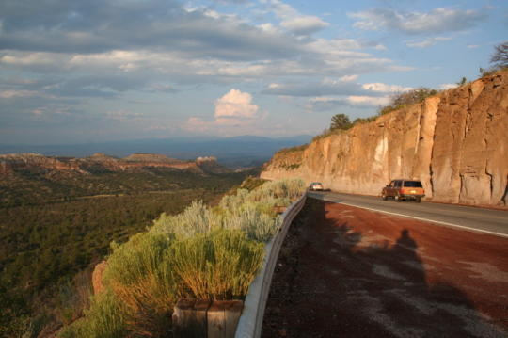

POPLA
Preferred Orientation Package-Los Alamos
A.D. (Tony) Rollett
with thanks to Carl Necker, Los Alamos National Laboratory, and Raul Bolmaro, Rosario Univ., Argentina
adapted from ICOTOM 15 Workshop, 2008

Slide 6
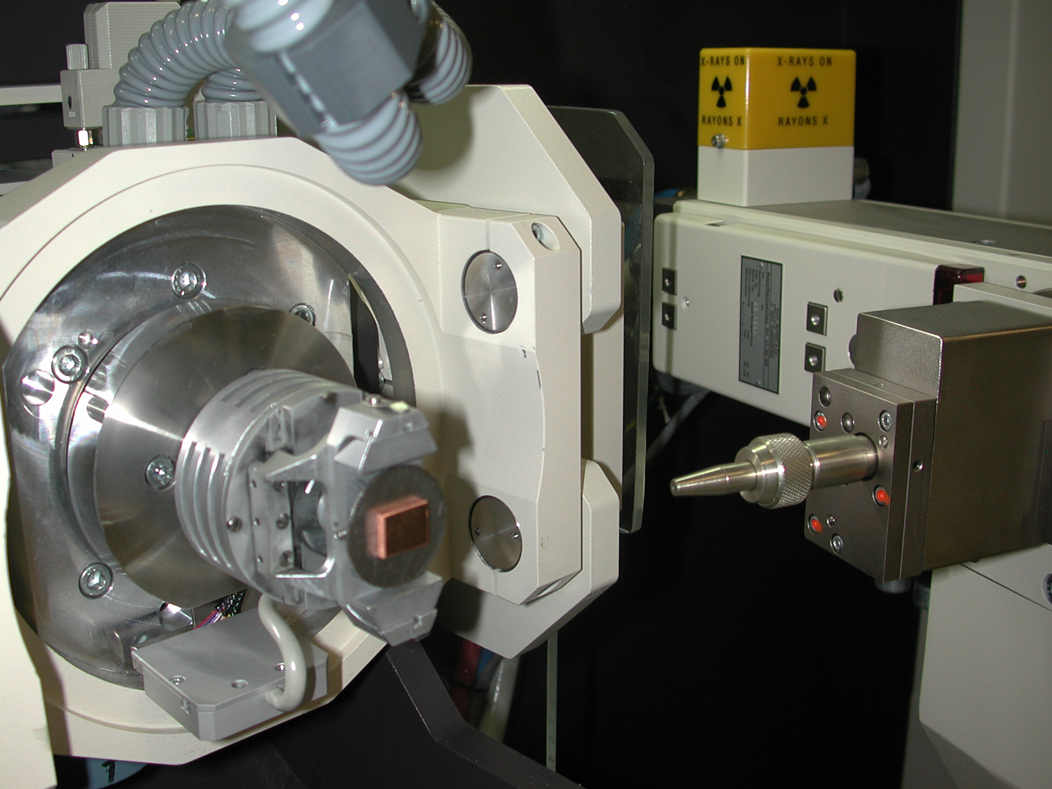
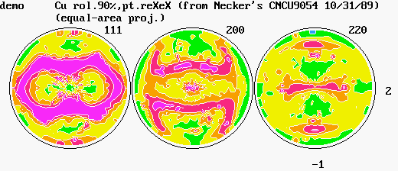
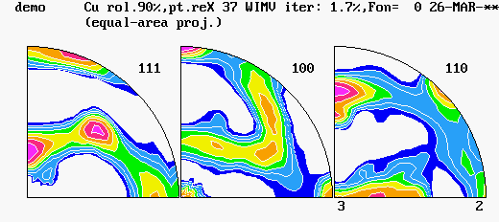
What can PopLA do for you?
Preferred Orientation Package Los Alamos

Slide 7
What is happening with PopLA?
C:/x/popla.bat
1980s to Present: DOS based coherent set of programs
works on many PC systems (started on IBM 286 DOS machine)
Microsoft’s advent of Windows XP and Vista
finding some issues, particularly with DOS screen capture
Non-Windows based format not as user friendly to the Windows based world
LANL contract with University of Rosario, Rosario Argentina
create a Windows based interface to run popLA
user friendly interface
remove programs that were driven by ‘slow’ computer speeds
improve functionality

Slide 8
Workshop Outline
Historical information
Things to keep in mind before using PopLA
Review classic PopLA with typical data processing scenario
Introduce the New and Improved PopLA
A look under the hood – how the critical programs work
Supplementary tools to be used in concert with PopLA
What can you do to help improve PopLA?

Slide 9
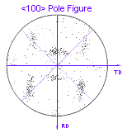


PopLa Nucleation and Growth
Los Alamos thinking….
+
Automate the process of
evaluating and presenting
texture
(IBM 286!)

Slide 10
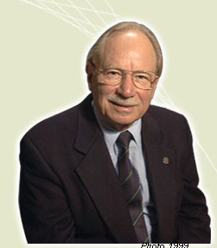
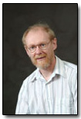
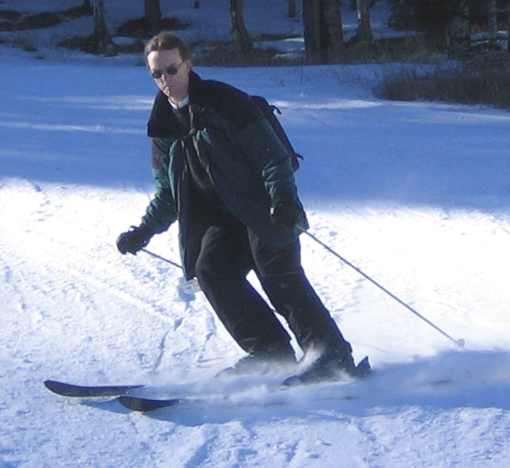
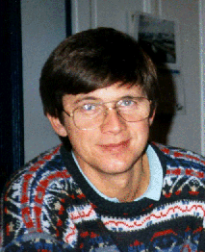
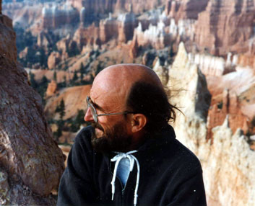
PopLA Brains Trust
Fred Kocks
John Kallend
Tony Rollett
Raul Bolmaro
Carl Necker
Carlos Tome
Tayfur Ozturk
Stuart Wright
Gilles Canova
Rudy Wenk

Slide 11
PopLA History
Time stamp on many of the critical programs: 1988-1989
Kocks, Canova, Tome, Rollett, Wright, Computer Code LA-CC-88-6
(Los Alamos, NM: Los Alamos National Laboratory, 1988)
Kocks, Kallend, Wenk, Rollett, Wright, Computer Code LA-CC-89-18
(Los Alamos, NM: Los Alamos National Laboratory, 1989)
Minor changes through the early 1990s
Otherwise: unchanged

Slide 12
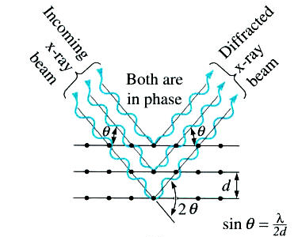
Before using PopLA….
Bragg’s Law
typical 5-axis goniometer
Proper goniometer alignment required!
Keep peaks from shifting!
PopLA is only as good as your measurements! (Garbage in, garbage out)

Slide 13
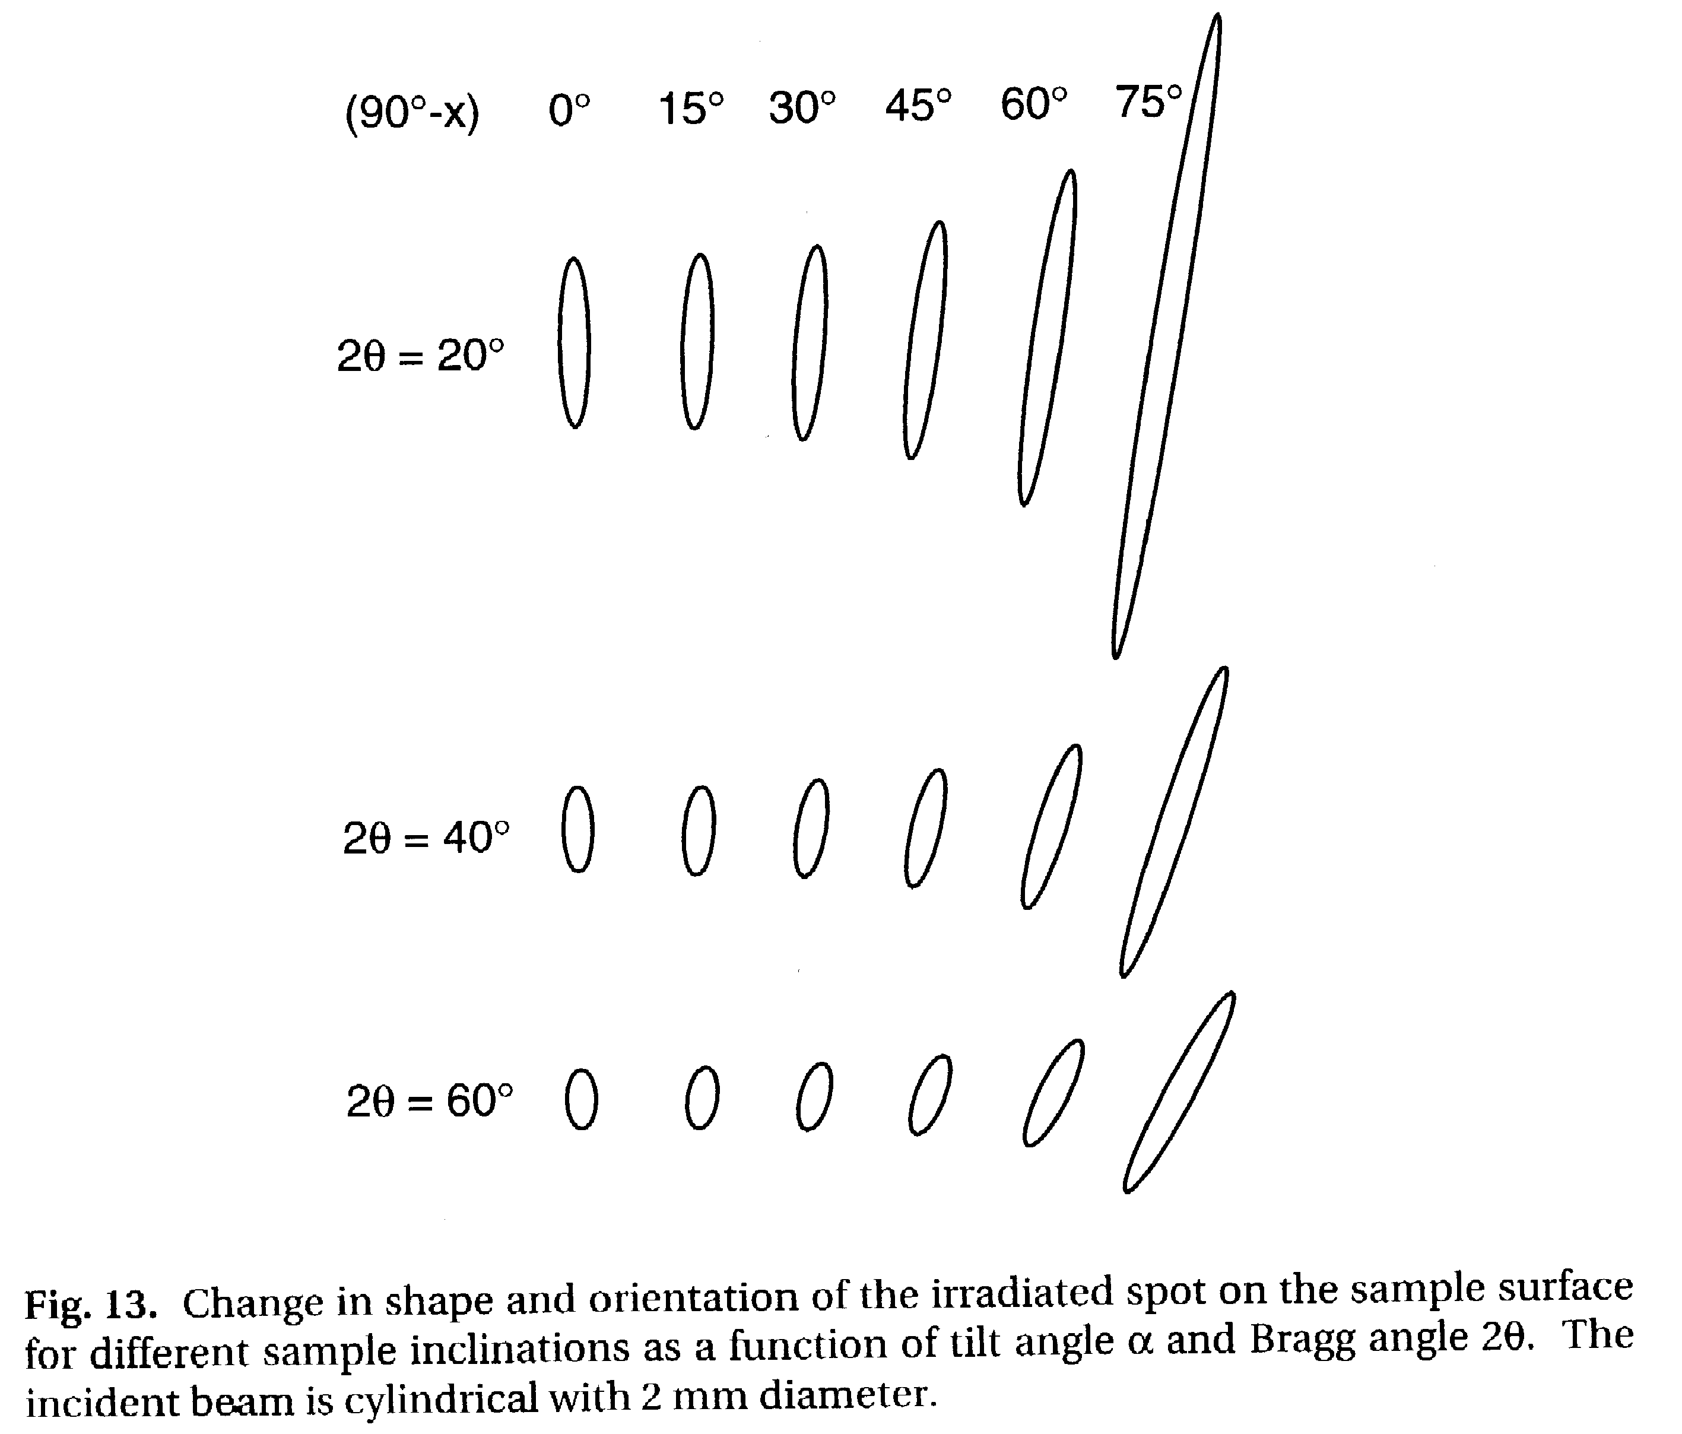
Geometric Defocussing
The combination of the θ−2θ setting and the tilt of the specimen spreads out the beam on the specimen surface.
Above a certain spread, not all the diffracted beam enters the detector.
Therefore, at large tilt angles, the intensity decreases for purely geometrical reasons.
Tilting of a random sample will result in a
reduction of peak height and broadening of peak width; this can lead to overlap of peaks and cross-talk between pole figures.

Slide 14
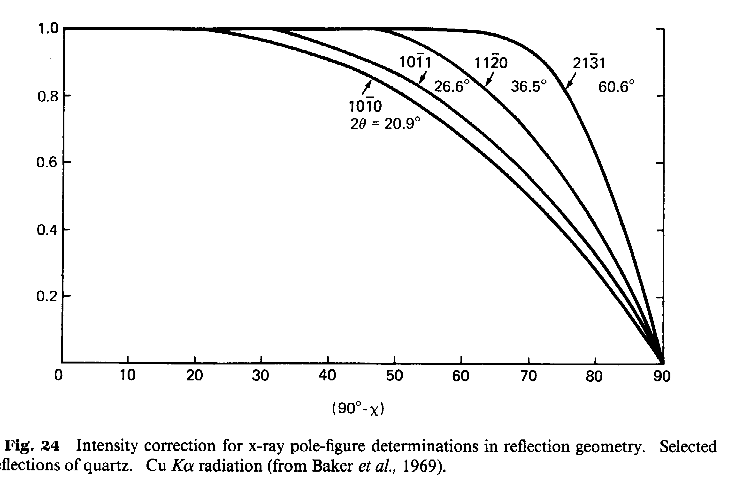
Importance of Defocussing Corrections
Defocusing correction more important with decreasing 2θ and narrower receiving slit.
Best procedure involves measuring the intensity from a reference sample with random texture.
If such a reference sample is not available, one may have to correct the available defocusing curves in order to optimize the correction.
An important point to be aware of is that the exact shape of each defocussing curve depends on the material and the machine. The material influence is primarily through the diffraction angles (correction is more important for small angles). The machine influence is primarily through the slit widths (acceptance angle at the detector, e.g.).

Slide 15
Coordinate Systems and Rotations
1=RD
Mark samples with orientations
Record connection between
sample nomenclature and
orientation with goniometer
reference frame.
3=ND
2=TD
popLA assumes a counter-clockwise data
sequence in files thus UNRAW inverts the
spin (RAW-EPF) since ‘our’ goniometer
spins clockwise. Check the sense of rotation on your own system!
Keeping track of these orientations is critical when dealing
with non-symmetric textures as well as when you write your own
programs to convert goniometer specific data into popLA format.

Slide 16
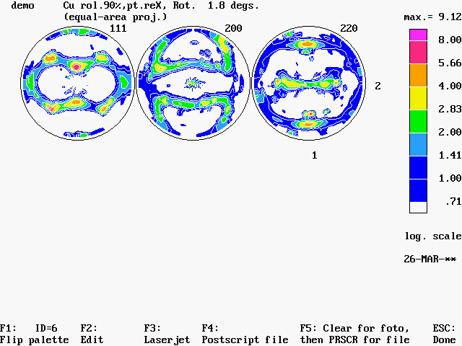
Instrument vs. Material Frames
2=Y_{instrument}
It can easily happen that the sample is mounted in the instrument (x-ray goniometer, for example) in such a way that the natural material axes are not aligned with the instrument axes.
1=X_{material}
1=X_{instrument}
2=Y_{instrument}
2 = Y_{material}
How can you tell that the instrument and material (sample) axes are not aligned? Generally the pole figures tell you immediately, especially if any plane rolling has occurred during the lifetime of the material.
1=X_{material}
1=X_{instrument}
2 = Y_{material}

Slide 17
Instrument vs. Material Frames, contd.
2=Y_{instrument}
So, what can you/ should you do about this issue?
Answer: if you expect the texture to reveal the inherent material axes (that are a consequence of its thermomechanical history), then make the measurement and perform the rotations on the pole figures (in the X-Y plane: page 2, #4).
1=X_{material}
1=X_{instrument}
2 = Y_{material}
2=Y_{instrument}
Caution: if the mis-match between Materials and Instrument axes is more complicated than just in the X-Y plane, you will have to first compute the OD, then re-calculate complete pole figures, then you can use the popLA tool that permits out-of-plane rotations (page 2, #5). Alternatively, you can generate a Weighted List of orientations and rotate all the rotations in that list. This tool does not exist in popLA at this point so you will have to write your own program.
1=X_{material}
1=X_{instrument}
2 = Y_{material}

Slide 18
Data Formatting
IT MUST BE PERFECT!
First line is (a26) to include an 8 character name (a limitation) and date?
Second line:
Fortran (a5,4f5.1,5i2,2i5,2a5)
(hkl,DR,RM,DAZ,AZM,IW,JW,IPER,IAVG,IBG,stuff)
Third line+:
(1x,18i4) if i>9999 then all data in the pole figure is scaled – IAVG<100
(1x,19i4) every fourth line if background is measured for each ring
(in which case IBG=0)
end of pole figure data block is marked with a blank line before others are appended.
cnu5258p 3-7-03 approx.75%rolled
111 5. 80. 5. 360. 1 1 2 1 3 100 1
29 29 29 29 29 29 29 29 29 29 29 29 29 29 29 29 29 29
29 29 29 29 29 29 29 29 29 29 29 29 29 29 29 29 29 29
29 29 29 29 29 29 29 29 29 29 29 29 29 29 29 29 29 29
29 29 29 29 29 29 29 29 29 29 29 29 29 29 29 29 29 29
25 23 19 14 33 24 26 21 28 31 38 34 27 31 30 34 31 42
35 25 31 37 37 34 38 33 45 32 26 19 28 32 29 31 28 20
20 30 29 26 21 25 23 21 22 29 23 30 18 23 25 27 22 26
15 22 32 28 17 23 13 32 15 16 14 22 22 19 23 23 23 32
27 23 26 26 34 36 33 38 29 39 27 30 35 42 44 46 38 48

Slide 19
Home Page
popLA: preferred orientation package - Los Alamos (Page 1)
U.F. Kocks, J.S. Kallend, H.R. Wenk, A.D. Rollett, S.I. Wright (April 1995)
0. QUIT
1. Get specimen DIRECTORY and VIEW a file
2. MASSAGE data files: correct,rotate,tilt,symmetrize,smooth,compare
3. WIMV: make spec.SOD; calculate PFs and inverse PFs; make matrices
4. HARMONIC analysis: COMPLETE rim (.FUL), get Roe Coeff.file (.HCF)
5. CONVERSIONS, permutations, transformations, paring
6. DISPLAYS and plots
7. Derive PROPERTIES from .SOD or .HCF files, make WEIGHTS file for simul.
8. DOS (temporary: type EXIT to return)_
Please type a number from 0 to 8 -->

Slide 20
Graphics page
DISPLAYS AND PLOTS (popLA page 6)
0. Quit
1. Return to Page 1
------ POLAR REPRESENTATION (Wenk and Kocks) ---------
DENSITY PLOTS:
2. POD: colors or gray-shades on VGA
(with possibility to capture into .PCX file or such)
or (with less resolution) direct to hp-LASERJET or PS-file
CONTOUR PLOTS:
3. OD sections from density files (Wenk program): very slow!
4. single PF from density file (Wenk program, slow)
5. single PF from density file (Kallend program, need PP.EXE or hp-plotter)
DISCRETE ORIENTATION PLOTS:
6. PFs, points or contours (Tome/Wenk program)
7. DIORPLOT: all OD sections and projections, compatible with POD
------ SQUARE SECTIONS (Kallend): cub/hex/tetr.cry.,ort/mono samples
8. Colors on screen (fast, but limited options).
9. Contours on hp-Laserjet (needs PP.EXE) or hp-plotter
Please type a number from 0 to 9 -->

Slide 21
Demo.raw
POD

Slide 22
Home Page
popLA: preferred orientation package - Los Alamos (Page 1)
U.F. Kocks, J.S. Kallend, H.R. Wenk, A.D. Rollett, S.I. Wright (April 1995)
0. QUIT
1. Get specimen DIRECTORY and VIEW a file
2. MASSAGE data files: correct,rotate,tilt,symmetrize,smooth,compare
3. WIMV: make spec.SOD; calculate PFs and inverse PFs; make matrices
4. HARMONIC analysis: COMPLETE rim (.FUL), get Roe Coeff.file (.HCF)
5. CONVERSIONS, permutations, transformations, paring
6. DISPLAYS and plots
7. Derive PROPERTIES from .SOD or .HCF files, make WEIGHTS file for simul.
8. DOS (temporary: type EXIT to return)_
Please type a number from 0 to 8 -->

Slide 23
“Massage” page
UNRAW
MASSAGE DATA FILES (mostly PFs) (popLA page 2)
0. Quit
1. Return to Page 1
2. Make THEORETICAL defocussing & background file: .DFB (R. Bolmaro)
3. DIGEST Raw Data (.RAW), with exper.or theor. .DFB: make .EPF
4. ROTATE PFs or adjust for grid offsets: make .RPF or .JWC
5. TILT PFs around right axis: make .TPF (T. Ozturk)
6. SYMMETRIZE PFs: make .QPF or .SPF or .FPF
7. EXPAND PFs back to full circle (needed for WIMV & harm.): .FPF
8. SMOOTH PFs or ODs with Gaussian Filter (quad, semi, or full): make .MPF
9. Take DIFFERENCE between 2 files (PFs or ODs): make .DIF

Slide 24
Convert Raw -> EPF
UNRAW
DEMO RAW 17,447 10-0-93 8 ¦ Volume in drive C has no label
olume
Directory of C:\x\demo16FB ¦ :50a DEMO.RAW
1 file(s) 17,447 bytes
0 dir(s) 2,147,155,968 bytes free
Note: If your data are on a SCINTAG .RR file: use DA5READ to make .RAW
If they are on a PHILIPS .RAW file, use UNPHIL to make our .RAW
If they are on an Aachen pole figure file, use AC2LA to make .EPF
If they are on a RIGAKU .PFG file: use RIG2LA to make our .RAW
(but you must have a PWD subdirectory into which it puts it:
compliments of RIGAKU/USA.)
(BREAK now to do any of the above..., else RETURN)
Press any key to continue . . .
Empirical Defocussing Correction
Note: the sample is assumed to have rotated counter-clockwise
Data will be sequenced clockwise in .EPF
Enter name of raw data file (ext .RAW assumed) demo
Enter name of correction file (ext .DFB assumed)demo

Slide 25
…. output
demo Cu rol.90%,pt.reXeX (from Necker'
(hkl)=(111) Background= 195 Using correction curve 1
...correcting raw data
...extrapolating outer ring
...normalizing. Normalization factor= .088
...writing corrected data to demo .EPF
demo Cu rol.90%,pt.reXeX (from Necker'
(hkl)=(200) Background= 248 Using correction curve 2
...correcting raw data
...extrapolating outer ring
WARNING! Extrapolation gives negative intensities. Values set to 1
...normalizing. Normalization factor= .134
...writing corrected data to demo .EPF
demo Cu rol.90%,pt.reXeX (from Necker'
(hkl)=(220) Background= 433 Using correction curve 3
...correcting raw data
...extrapolating outer ring
...normalizing. Normalization factor= .167
...writing corrected data to demo .EPF
Stop - Program terminated.
Press any key to continue . . .

Slide 26
Home Page
popLA: preferred orientation package - Los Alamos (Page 1)
U.F. Kocks, J.S. Kallend, H.R. Wenk, A.D. Rollett, S.I. Wright (April 1995)
0. QUIT
1. Get specimen DIRECTORY and VIEW a file
2. MASSAGE data files: correct,rotate,tilt,symmetrize,smooth,compare
3. WIMV: make spec.SOD; calculate PFs and inverse PFs; make matrices
4. HARMONIC analysis: COMPLETE rim (.FUL), get Roe Coeff.file (.HCF)
5. CONVERSIONS, permutations, transformations, paring
6. DISPLAYS and plots
7. Derive PROPERTIES from .SOD or .HCF files, make WEIGHTS file for simul.
8. DOS (temporary: type EXIT to return)_
Please type a number from 0 to 8 -->

Slide 27
Graphics page
DISPLAYS AND PLOTS (popLA page 6)
0. Quit
1. Return to Page 1
------ POLAR REPRESENTATION (Wenk and Kocks) ---------
DENSITY PLOTS:
2. POD: colors or gray-shades on VGA
(with possibility to capture into .PCX file or such)
or (with less resolution) direct to hp-LASERJET or PS-file
CONTOUR PLOTS:
3. OD sections from density files (Wenk program): very slow!
4. single PF from density file (Wenk program, slow)
5. single PF from density file (Kallend program, need PP.EXE or hp-plotter)
DISCRETE ORIENTATION PLOTS:
6. PFs, points or contours (Tome/Wenk program)
7. DIORPLOT: all OD sections and projections, compatible with POD
------ SQUARE SECTIONS (Kallend): cub/hex/tetr.cry.,ort/mono samples
8. Colors on screen (fast, but limited options).
9. Contours on hp-Laserjet (needs PP.EXE) or hp-plotter
Please type a number from 0 to 9 -->

Slide 28
POD input
quadrants or (circles): 1,2,3-6,7-12 1-2,3-11 (8)
semi-circles: : 1,2,3-12 1-2,3-11
Enter the number of plots on page (<=12) --> 3
Enter name of data file # 1 --> demo.epf
Scanning data set identified by:
demo Cu rol.90%,pt.reX DFB=demo
(111)
0 to start with this data set
n to skip n data sets --> 0
Scanning data set identified by:
demo Cu rol.90%,pt.reX DFB=demo
(200)
Scanning data set identified by:
demo Cu rol.90%,pt.reX DFB=demo
(220)
Absolute MAXIMUM of all plots in file = 1299.
Absolute MINIMUM of all plots in file = 0.
Now you will determine the intensity scale to be used,
on the basis of 8 major contours.
(Some choices will later put 2 intervals each.)
Choose highest contour value <default=max.>
<e.g.: 200,400,800,1600,3200> --> 0

Slide 29
POD input, contd.
demo Cu rol.90%,pt.reX DFB=demo
(220)
Absolute MAXIMUM of all plots in file = 1299.
Absolute MINIMUM of all plots in file = 0.
Now you will determine the intensity scale to be used,
on the basis of 8 major contours.
(Some choices will later put 2 intervals each.)
Choose highest contour value <default=max.>
<e.g.: 200,400,800,1600,3200> --> 800
-- How many major contours below intensity 1.0 ?
<e.g.: 3, 3, 1, 3, 2>
<default to specify lowest value next> --> 1
MAJOR CONTOURS will be at (times random):
8.00
5.66
4.00
2.83
2.00
1.41
1.00
.71
HIGH resolution. Contours: Y
0: OK; 1: try again --> 0

Slide 30
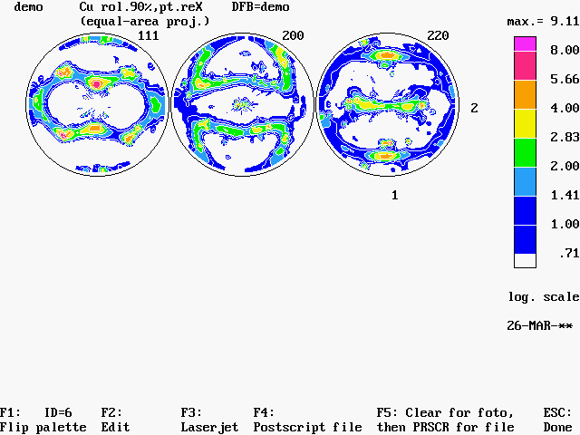
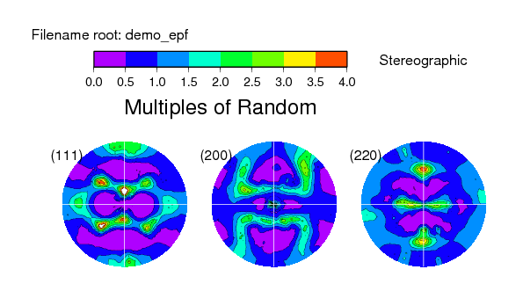
Demo.epf
Plot with popLA:
Plot with GMT:

Slide 31
Home Page
popLA: preferred orientation package - Los Alamos (Page 1)
U.F. Kocks, J.S. Kallend, H.R. Wenk, A.D. Rollett, S.I. Wright (April 1995)
0. QUIT
1. Get specimen DIRECTORY and VIEW a file
2. MASSAGE data files: correct,rotate,tilt,symmetrize,smooth,compare
3. WIMV: make spec.SOD; calculate PFs and inverse PFs; make matrices
4. HARMONIC analysis: COMPLETE rim (.FUL), get Roe Coeff.file (.HCF)
5. CONVERSIONS, permutations, transformations, paring
6. DISPLAYS and plots
7. Derive PROPERTIES from .SOD or .HCF files, make WEIGHTS file for simul.
8. DOS (temporary: type EXIT to return)_
Please type a number from 0 to 8 -->

Slide 32
“Massage” page
ROTATE
MASSAGE DATA FILES (mostly PFs) (popLA page 2)
0. Quit
1. Return to Page 1
2. Make THEORETICAL defocussing & background file: .DFB (R. Bolmaro)
3. DIGEST Raw Data (.RAW), with exper.or theor. .DFB: make .EPF
4. ROTATE PFs or adjust for grid offsets: make .RPF or .JWC
5. TILT PFs around right axis: make .TPF (T. Ozturk)
6. SYMMETRIZE PFs: make .QPF or .SPF or .FPF
7. EXPAND PFs back to full circle (needed for WIMV & harm.): .FPF
8. SMOOTH PFs or ODs with Gaussian Filter (quad, semi, or full): make .MPF
9. Take DIFFERENCE between 2 files (PFs or ODs): make .DIF

Slide 33
Rotate output
Directory of C:\x\demo16FB ¦ :59a DEMO.EPF
1 file(s) 17,607 bytes
0 dir(s) 2,147,155,968 bytes free
ROTATE POLE FIGURES AND/OR CHANGE GRID
Program by John Kallend
1. Symmetry analysis and rotation about center
2. Change grid azimuth offset (JW)
3. Change grid polar and azimuth offset (IW,JW)
4. Invert spin
Enter 1, 2, 3, or 4 --> 1
Input file (with .ext, default .EPF): demo
111 demo Cu rol.90%,pt.reX DFB=demo
200 demo Cu rol.90%,pt.reX DFB=demo
220 demo Cu rol.90%,pt.reX DFB=demo
SUGGESTED ROTATION 1.8 DEGREES
Is this ok? Y
ROTATE

Slide 34
Rotated PFs: demo.rpf
This step required to bring material axes in line with Instrument axes, as discussed previously.
1.8 degrees

Slide 35
HARMONIC ANALYSIS (popLA page 4)
0. Quit
1. Return to Page 1
Find harmonic coefficients .HCF, completed PFs (.FUL) for:
2. Cubic crystal system
3. Hexagonal, tetragonal or orthorhombic crystal system
4. Compute SOD or COD from harmonic coefficients (slow!)
5. Recalculate pole figures .HPF
6. Inverse pole figures .HIP
7. List harmonic coefficients to screen or printer
Note: To convert Aachen-format Bunge coeffs. to Kallend's binary
Roe coeff.file .HCF: use AC2Wlmn (outside this menu) -
Also need FAKTOR.CtW (J. Hirsch)
8. Establish coefficients for a given TRANSFORMATION
9. Apply TRANSFORMATION to given coefficients
Please type a number from 0 to 9 -->

Slide 36
Harmonic analysis: input
Harmonic Pole Figure Analysis (Cubic)
Enter name of data file (default .epf): demo
1demo Cu rol.90%,pt.reX
3 Pole figures read in.
How many iterations on missing parts? 9
CUBIC ODF ANALYSIS FOR demo
Sample symmetry:
0. Orthorhombic
1. Mirror perpendicular to Z
Enter 0 or 1==> 0
Error output to:
1. printer
2. screen
Enter 1 or 2 ==> 2
CUBAN2

Slide 37
Harmonic output
200 Reflection. Trunc. error = .36 Normalization = .10E+01
220 Reflection. Trunc. error = .39 Normalization = .10E+01
Severity = 1.712. Generated to l = 22
ERROR ESTIMATES: 1. Polefigures
L MEAN 111 200 220
0 .228E-06 .225E-06 .233E-06 .225E-06
2 .204E-02 .155E-02 .247E-02 .198E-02
4 .245E-02 .255E-02 .301E-02 .155E-02
6 .146E-02 .201E-02 .114E-02 .101E-02
8 .162E-02 .111E-02 .149E-02 .210E-02
10 .127E-02 .113E-02 .716E-03 .174E-02
12 .622E-03 .869E-03 .181E-03 .610E-03
14 .124E-02 .120E-02 .111E-02 .139E-02
16 .706E-03 .145E-03 .539E-03 .109E-02
18 .545E-03 .786E-03 .306E-03 .424E-03
20 .572E-03 .556E-03 .355E-03 .740E-03
22 .764E-03 .665E-04 .591E-03 .118E-02
ALL .113E+00 .106E+00 .103E+00 .127E+00
2. Estimated avg. error in ODF .38
RE-ESTIMATING MISSING PARTS OF POLEFIGURES
Writing harmonic coefficients to demo .HCF
Print out Wlmn coefficients ? Y

Slide 38
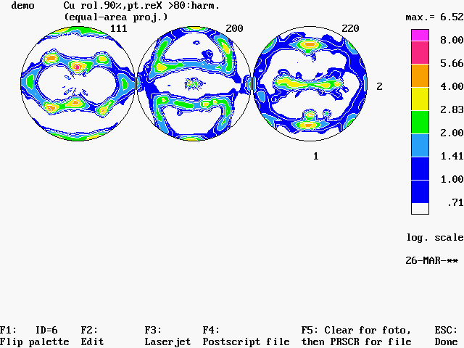
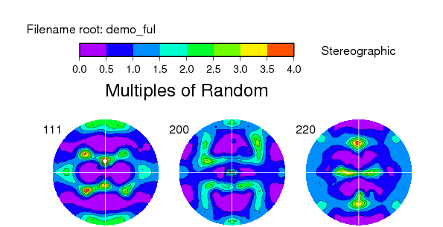
From Harmonic analysis: demo.ful
Plot with popLA:
Plot with GMT:

Slide 39
Home Page
popLA: preferred orientation package - Los Alamos (Page 1)
U.F. Kocks, J.S. Kallend, H.R. Wenk, A.D. Rollett, S.I. Wright (April 1995)
0. QUIT
1. Get specimen DIRECTORY and VIEW a file
2. MASSAGE data files: correct,rotate,tilt,symmetrize,smooth,compare
3. WIMV: make spec.SOD; calculate PFs and inverse PFs; make matrices
4. HARMONIC analysis: COMPLETE rim (.FUL), get Roe Coeff.file (.HCF)
5. CONVERSIONS, permutations, transformations, paring
6. DISPLAYS and plots
7. Derive PROPERTIES from .SOD or .HCF files, make WEIGHTS file for simul.
8. DOS (temporary: type EXIT to return)_
Please type a number from 0 to 8 -->

Slide 40
WIMV page
The 3
WIMV
options
WIMV Analysis (popLA page 3)
0. Quit
1. Return to Page 1
WIMV: make .SOD and recalc. pole figures .WPF -- for:
2. cubic, tetra-,hexagonal crystals; sample diad: up to 3 PFs, 13 poles
3. trigonal cry.,gen'l.sample sym.,or higher: up to 7 PFs, 25 poles
4. orthorhombic crystals; sample Z-diad: up to 7 PFs, 25 poles
**or: orthorh./gen'l./7/25 **requires 386, DOS 5, and 4MB memory**
Recalculate POLE FIGURES (even non-measured ones): make .APF -
5. using .WIM matrix for the desired PFs (up to 3, 13 poles)
6. using .BWM or .WM3 matrix for the desired PFs (up to 7, 25 poles)
7. Calculate INVERSE pole figures from .SOD: .WIP
(So far assumes tetragonal crystal symmetry)
8. Make WIMV pointer matrix for new crystal structure and set of PFs
9. Make WIMV pointer matrix for any INVERSE pole figures: make .WMI
Please type a number from 0 to 9 -->
WIMV
BWIMV
WIMV386
SOD2PF
OSOD2PF
SOD2INV
*
INVGEN
*WIMVGEN/BWIMVGEN/WGEN386

Slide 41
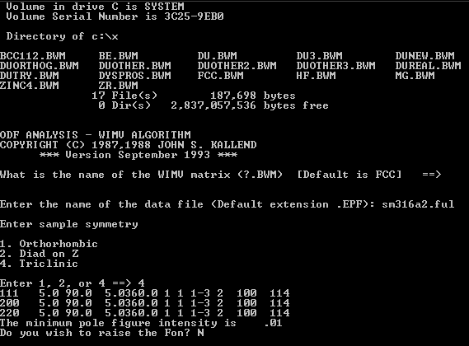
BWIMV input

Slide 42
WIMV input
ODF ANALYSIS - WIMV ALGORITHM
COPYRIGHT (C) 1987,1988 JOHN S. KALLEND
*** Version September 1993 ***
Enter the name of the wimv matrix (?.WIM)
[Default is CUBIC] ==>CUBIC
Name of data file (default extension .epf): demo.ful
Sample Symmetry is:
0. Orthorhombic
1. Diad on Z
Enter 0 or 1 ==> 0
demo Cu rol.90%,pt.reX
111 5.0 90.0 5.0360.0 1 1 2-1 3 100 72
200 5.0 90.0 5.0360.0 1 1 2-1 3 100 72
220 5.0 90.0 5.0360.0 1 1 2-1 3 100 72
The minimum pole figure intensity is .01
Do you wish to raise the Fon? N
Note: the “FON” is the name for the uniform (“random”) background level; “raising the FON” means that the program will try to maximize this level. In practice, this makes little difference to the outcome.

Slide 43
WIMV output
Iteration 2 in progress
Sharpening may cause larger error in iteration 3
Texture Strength (m.r.d.): 2.0
(= square-root of "Texture Index")
Iteration 2 estimated OD error (%) = 36.1
Iteration 3 in progress
Texture Strength (m.r.d.): 2.1
Iteration 3 estimated OD error (%) = 30.5
Iteration 4 in progress
Texture Strength (m.r.d.): 2.2
Iteration 4 estimated OD error (%) = 13.2
Iteration 5 in progress
Texture Strength (m.r.d.): 2.2
Iteration 5 estimated OD error (%) = 10.4
Iteration 6 in progress
Texture Strength (m.r.d.): 2.2
Iteration 6 estimated OD error (%) = 8.5
Continue? Y

Slide 44
WIMV output, contd.
Continue? Y
Iteration 35 in progress
Texture Strength (m.r.d.): 2.5
Iteration 35 estimated OD error (%) = 1.8
Continue? Y
Iteration 36 in progress
Texture Strength (m.r.d.): 2.5
Iteration 36 estimated OD error (%) = 1.7
Continue? Y
Iteration 37 in progress
Texture Strength (m.r.d.): 2.5
Iteration 37 estimated OD error (%) = 1.7
Continue? n
Normalization factor: .99
In output file, angles increase from 0 in nomenclature of
1. Kocks (need this one for WEIGHTS)
2. Roe/Matthies
3. Bunge (rotates plot +90 deg.)
Enter 1,2, or 3 ==> 1

Slide 45
WIMV: demo.wpf

Slide 46
“Massage” page
QUAD4
MASSAGE DATA FILES (mostly PFs) (popLA page 2)
0. Quit
1. Return to Page 1
2. Make THEORETICAL defocussing & background file: .DFB (R. Bolmaro)
3. DIGEST Raw Data (.RAW), with exper.or theor. .DFB: make .EPF
4. ROTATE PFs or adjust for grid offsets: make .RPF or .JWC
5. TILT PFs around right axis: make .TPF (T. Ozturk)
6. SYMMETRIZE PFs: make .QPF or .SPF or .FPF
7. EXPAND PFs back to full circle (needed for WIMV & harm.): .FPF
8. SMOOTH PFs or ODs with Gaussian Filter (quad, semi, or full): make .MPF
9. Take DIFFERENCE between 2 files (PFs or ODs): make .DIF

Slide 47
Expand WPF
DEMO QPF 4,890 10-0-93 11 ¦ Volume in drive C has no label
olume
Directory of C:\x\demo16FB ¦ :32a DEMO.QPF
1 file(s) 4,890 bytes
0 dir(s) 2,147,155,968 bytes free
File not found
Directory of C:\x\demo16FB ¦ Volume in drive C has no label
olume
2,147,155,968 bytes free
Make full pole figure from quadrant or semi
Program by John Kallend
Enter name of data file (with extension) : demo.wpf

Slide 48
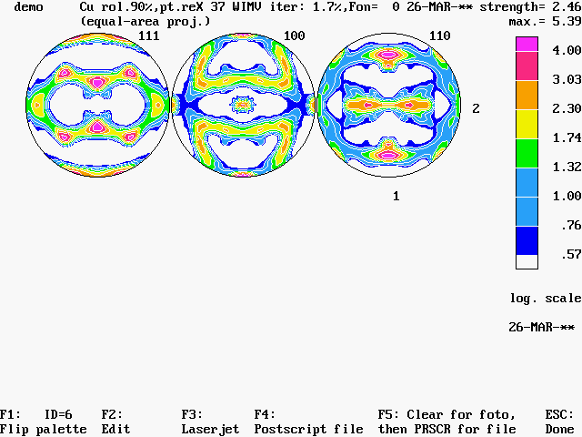

Expand: demo.fpf
Plot with popLA:
Plot with GMT:

Slide 49
Combine exptl, WIMV pole figures for comparison
********************************************************
To return to program, type EXIT (from SAME subdirectory)
********************************************************
Microsoft(R) Windows 98
(C)Copyright Microsoft Corp 1981-1999.
C:\x\demo>copy demo.ful+demo.fpf demo.cmb

Slide 50
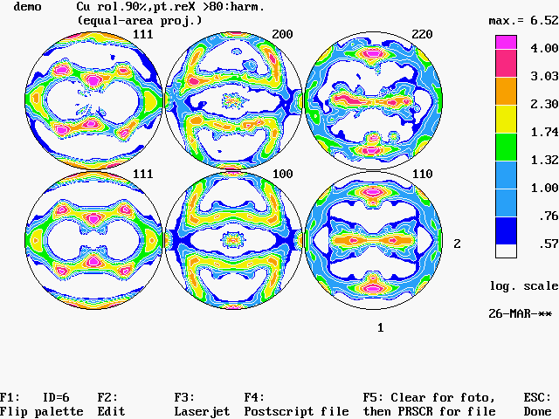
Exptl: top row;
WIMV: bottom row

Slide 51
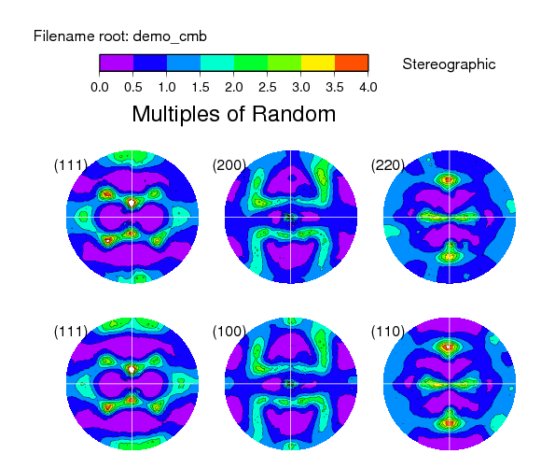
Exptl: top row;
WIMV: bottom row

Slide 52
Plot Inv. PFs
quadrants or (circles): 1,2,3-6,7-12 1-2,3-11 (8)
semi-circles: : 1,2,3-12 1-2,3-11
Enter the number of plots on page (<=12) --> 3
Enter name of data file # 1 --> demo.wip
Scanning data set identified by:
demo Cu rol.90%,pt.reXcalculated from SOD 8-OCT-93 strength= .00
SOP3 PROJ
0 to start with this data set
n to skip n data sets --> 0
Scanning data set identified by:
demo Cu rol.90%,pt.reXcalculated from SOD 8-OCT-93 strength= .00
SOP2 PROJ
Scanning data set identified by:
demo Cu rol.90%,pt.reXcalculated from SOD 8-OCT-93 strength= .00
SOP1 PROJ
THE FILE CONSISTS OF SOD SECTIONS:
0 Plot default (full or quarter circles)
1 Plot cubic inverse pole figures
2 Plot tetragonal inverse pole figures
3 Plot hexagonal inverse pole figures
4 Plot trigonal inverse pole figures
1
SOD2INV

Slide 53
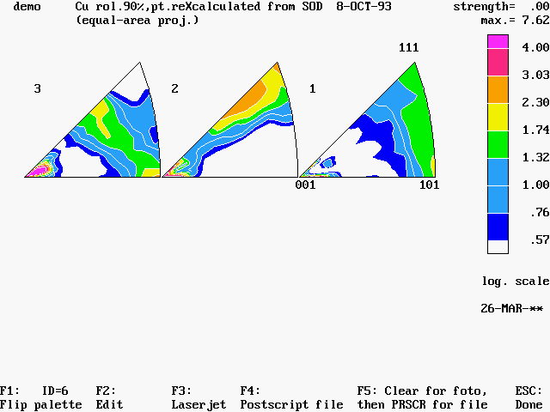
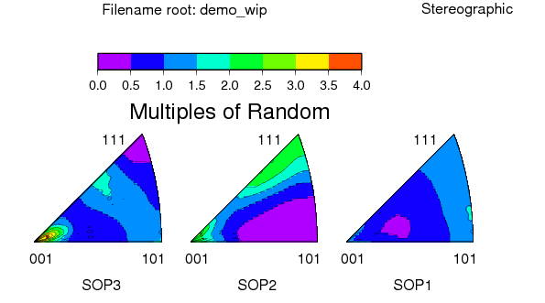
Demo.wip
Plot with GMT:
Plot with popLA:

Slide 54
Home Page
popLA: preferred orientation package - Los Alamos (Page 1)
U.F. Kocks, J.S. Kallend, H.R. Wenk, A.D. Rollett, S.I. Wright (April 1995)
0. QUIT
1. Get specimen DIRECTORY and VIEW a file
2. MASSAGE data files: correct,rotate,tilt,symmetrize,smooth,compare
3. WIMV: make spec.SOD; calculate PFs and inverse PFs; make matrices
4. HARMONIC analysis: COMPLETE rim (.FUL), get Roe Coeff.file (.HCF)
5. CONVERSIONS, permutations, transformations, paring
6. DISPLAYS and plots
7. Derive PROPERTIES from .SOD or .HCF files, make WEIGHTS file for simul.
8. DOS (temporary: type EXIT to return)_
Please type a number from 0 to 8 -->

Slide 55
Conversions page 5
CONVERSIONS of SODs, HCFs, and discrete angles files (popLA page 5)
0. QUIT
1. RETURN to Page 1
--- ORIENTATION DENSITY FILES ---
2. Permute axes in .SOD
3. Make .COD from .SOD file (or .CHD from .SHD)
4. Make OBLIQUE sections from .SOD file: .SON,.CON, or .SHN,.CHN from .SHD
(Note: no projections; use the one from end of .COD or .SOD)
5. Pare to SUBSET for display: make .SOS or .COS (or .SHS,.CHS)
--- DISCRETE ORIENTATION FILES ---
6. Convert generic MILLER INDICES to any Euler angles
7. DIOR: Add crystal and sample symmetries, permute axes, change
angle convention, or make DENSITY file from DISCRETE grain file
SOD2COD
PARE

Slide 56
POD input
demo Cu rol.90%,pt.reX 37 WIMV iter: 1.7%,Fon= 0 2
SODK Psi= 90.0
Scanning data set identified by:
demo Cu rol.90%,pt.reX 37 WIMV iter: 1.7%,Fon= 0 2
SOP3 Psi=PROJ
THE FILE CONSISTS OF SOD SECTIONS:
0 Plot default (full or quarter circles)
1 Plot cubic inverse pole figures
2 Plot tetragonal inverse pole figures
3 Plot hexagonal inverse pole figures
4 Plot trigonal inverse pole figures
0
Absolute MAXIMUM of all plots in file = 8358.
Absolute MINIMUM of all plots in file = 0.
Now you will determine the intensity scale to be used,
on the basis of 8 major contours.
(Some choices will later put 2 intervals each.)
Choose highest contour value <default=max.>
<e.g.: 200,400,800,1600,3200> --> 1600
-- How many major contours below intensity 1.0 ?
<e.g.: 3, 3, 1, 3, 2>
<default to specify lowest value next> --> 2

Slide 57
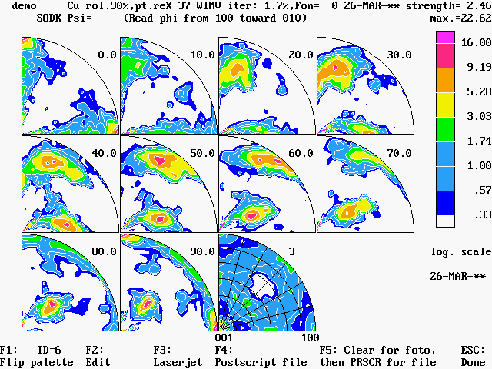
Demo.sos

Slide 58
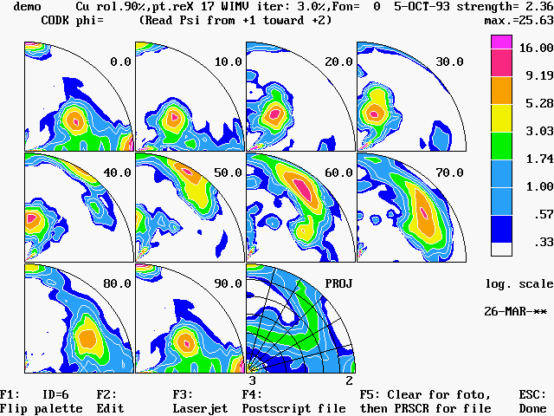
Demo.cos

Slide 59
Conventional Cartesian plots
The conventional plotting approach is to use Cartesian (square) plots, as you find in most papers and books.
We illustrate plotting using the programs smoothsod[.f90] (for smoothing orientation distributions with a Gaussian filter, and sodcon[.f] for contour plotting. The latter has options to plot with line contours, or solid colour. It can also plot ODs for hexagonal materials where one generally wants to limit the third angle to the range 0-60° because of crystal symmetry. These are available in texture_subroutines on my website. The latter program must be compiled with the package of routines called psplot.txt, which you can find at www.nova.edu/ocean/psplot.html .

Slide 60
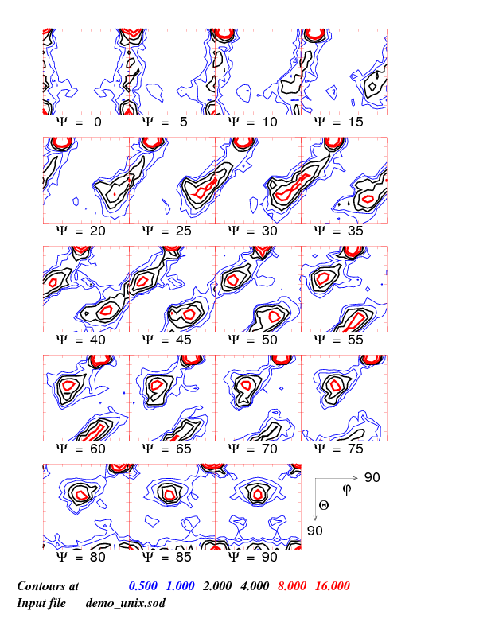
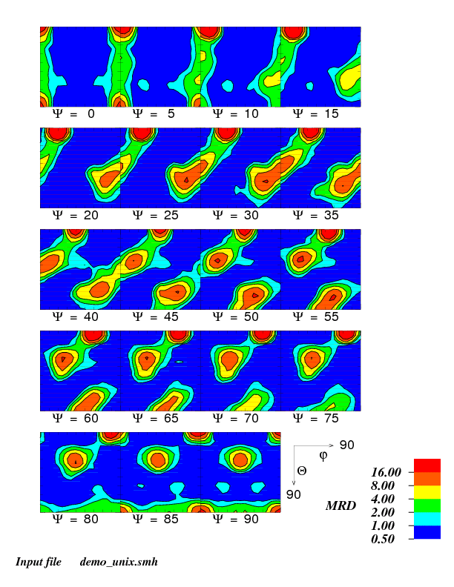
DEMO.SOD
unsmoothed
Smoothed (5°)

Slide 61
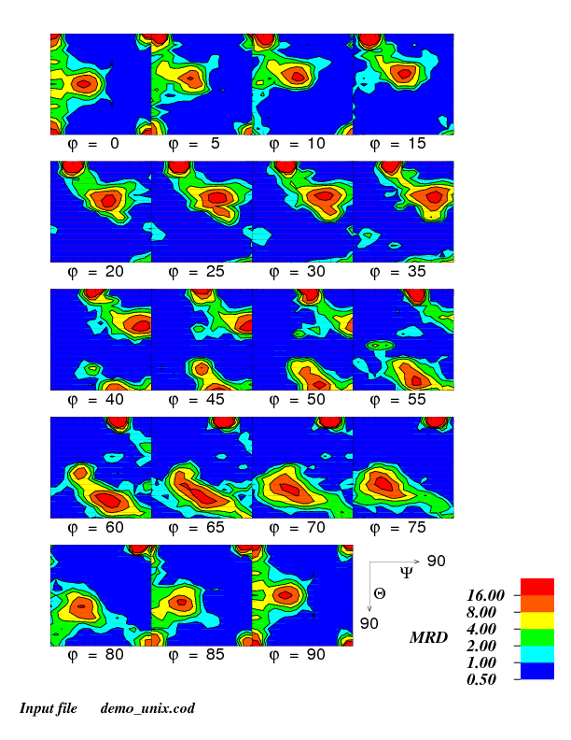
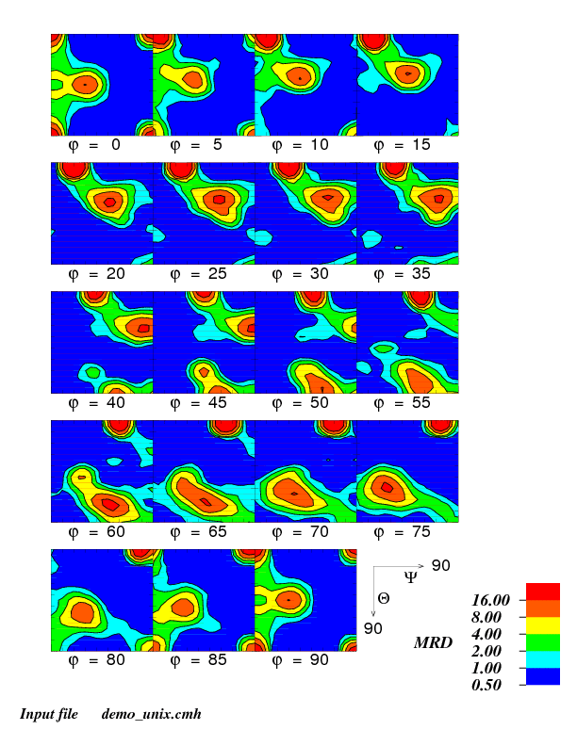
DEMO.COD
unsmoothed
Smoothed (5°)

Slide 62
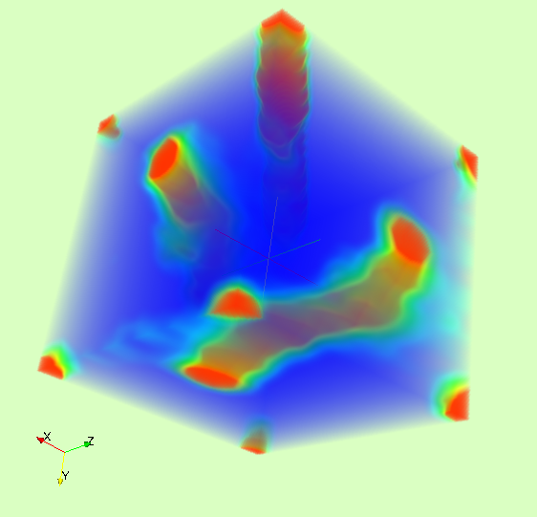
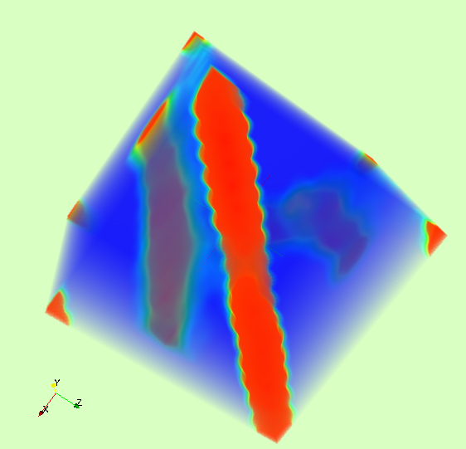
3D view (Paraview)
See neon.materials.cmu.edu/texture_subroutines for programs
x = φ₁ , y = Φ , z = φ₂
Use SOD2vtk.f to get a VTK file for 3D viewing

Slide 63
PROPERTIES (popLA page 7)
0. Quit
1. Return to Page 1
2. Assign WEIGHTS to discrete grains file from .SOD
_ (Need Kocks style Euler angles in both .SOD and TEXfile -
_ can convert the latter in DIOR, p.5,#7)
3. Average ELASTIC properties (Reuss, Voigt, Hill, self-consistent)
(Program by C. Tome) Input ELTEX.DAT, ELMOD.DAT; out ELOUT?.DAT
4. SIMULATION of polycrystal PLASTICITY from weighted grains file -
LApp code: with rate sensitivity and grain shape effects,
for all crystal and sample symmetries (not much twinning):
calculate current yield surface, Lankford coefficients;
predict texture development, Taylor factors,
stress/strain curves for all straining paths. Up to 1152 grains.
SHEET properties directly from harmonic coefficients (Kallend)
(only for orthotropic plane strain, cubic metals):
5. Yield locus section (11,22) for any angle in plane (Bishop-Hill)
6. Lankford coefficients (Hosford-Backofen model)
Please type a number from 0 to 6 -->
LANK

Slide 64
Lankford output
Plastic anisotropy calculations for FCC, BCC metals
from harmonic coefficients.
Program by John Kallend (C)1969
What is the specimen name (.HCF Assumed)? demo
Plasticity data for demo Cu rol.90%,pt.reX
RESTRICTED (R) or PENCIL (P) glide ?
Enter P or R: ==> r
Parameters calculated:
M = Taylor Factor
R = Lankford parameter
qmin = width/length strain
beta = ratio of plane strain strengths Mez=o/Mey=o
Restricted glide
Angle M R qmin Beta
0 3.16 .87 .46 1.00
15 3.13 .82 .45 .99
30 3.10 1.19 .54 1.02
45 3.04 1.62 .62 1.03
60 2.99 1.31 .57 1.03
75 3.01 .89 .47 .99
90 3.05 .82 .45 .96
Press any key to continue . . .

Slide 65
PROPERTIES (popLA page 7)
0. Quit
1. Return to Page 1
2. Assign WEIGHTS to discrete grains file from .SOD
_ (Need Kocks style Euler angles in both .SOD and TEXfile -
_ can convert the latter in DIOR, p.5,#7)
3. Average ELASTIC properties (Reuss, Voigt, Hill, self-consistent)
(Program by C. Tome) Input ELTEX.DAT, ELMOD.DAT; out ELOUT?.DAT
4. SIMULATION of polycrystal PLASTICITY from weighted grains file -
LApp code: with rate sensitivity and grain shape effects,
for all crystal and sample symmetries (not much twinning):
calculate current yield surface, Lankford coefficients;
predict texture development, Taylor factors,
stress/strain curves for all straining paths. Up to 1152 grains.
SHEET properties directly from harmonic coefficients (Kallend)
(only for orthotropic plane strain, cubic metals):
5. Yield locus section (11,22) for any angle in plane (Bishop-Hill)
6. Lankford coefficients (Hosford-Backofen model)
Please type a number from 0 to 6 -->
WEIGHTS

Slide 66
WEIGHTS
What does WEIGHTS do?
Think of WEIGHTS as doing a merge between the texture-being-sampled (i.e. the SOD file made from the popLA analysis or from binning of oim2wts output) and the random-set-of-orientations-to-be-fitted, so that the list used as input to VPSC is long enough to be representative (via the weighting) but short enough to give reasonable run times. Thus WEIGHTS asks 1st for the texture-being-sampled and 2nd for the list-to-be-fitted. Using a long list of randomly chosen orientations, e.g. random200k.wts, for the 2nd input gives you the freedom to pick a larger or smaller set of orientations to be fitted.
In general, use SOD datasets with no sample symmetry (1st Euler angle 0-360°).

Slide 67
Making a .WTS file
Directory of C:\x\demo16FB ¦ Volume in drive C has no label
olume
2,147,155,968 bytes free
*******************************************************************
For discrete grains files, use the following (in c:\x):
filename min.cry.sym min.sam.sym use #grains:
-------- ----------- ----------- -----------
texRAN any any any(1000)
texRAN.WTS tetragonal Z-diad all(1000)
texISO.wts tetragonal any/Z-diad/ortho. 1024/512/256
texCUB.wts cubic any/Z-diad/ortho. 3072/1536/768
...here, average triplets, so final # is 1024/512/256
texREG.wts tetragonal diad on Z or Y 3456 (/3=1152 for cubic)
orthotropic 1728 (/3=576 for cubic)
fiber which stays 192 (/3=64 for cubic)
*******************************************************************
Intensity file (w/ext:.SOP or .S?D, default=.SOD): demo.sod

Slide 68
WTS, contd.
Discard grains below a certain weight? Which? 0.
.1
texran :use any portion (only file when less than tetr.cry.sym.)
Evm F11 F12 F13 F21 F22 F23 F31 F32 F33
0.000 1.000 0.000 0.000 0.000 1.000 0.000 0.000 0.000 1.000
Kocks:Psi Theta phi weight (up to 6 state parameters, f8.2) XYZ= 1 2
Is this a file of triplets to be averaged<1>? 0
How many orientations total? 1500
Do you wish to bring grains from outside the irreducible area
into it, by applying 360/PHImax-fold crystal Z-axis?
(Use 0 with TEXLAT.WTS, TEXISO.WTS, TEXCUB.WTS)-> 1
Writing file
demo .wts
681 grains written
Volume fraction .01 discarded
You may wish to rerun with different limit on weights...
For grain-shape effect, you must manually adjust F in .WTS file!
(Also, you may wish to record vol.fraction discarded in 1st line.)
• Modern versions of WEIGHTS have options to read and write Bunge angles, to adjust the format of the output for use as VPSC input, and to read hexagonal textures.

Slide 69
FAQs: POD and PODIN
A frequent problem with using popLA for the first time concerns the main graphics program, POD. This program expects to see a file called PODIN. This file merely serves to record what parameters were used the last time that POD was run.
The file is available from Rollett’s popLA page:
neon.materials.cmu.edu/rollett/popLA
Even if you have the file present in your \X directory, you will still need to copy it into whatever directory you are working in
(copy C:\X\PODIN .).
Note that the main issue with POD under XP is that “PrintScreen” no longer works. An alternative approach to graphics is to use postscript-based graphics. Programs (scripts) exist to plot pole figure information with GMT [Generic Mapping Tools, http://gmt.soest.hawaii.edu/ ]. The script is called “Draw_Stereograms” and can be found in texture_subroutines in a folder called “plotting with GMT” on my website. There is also a small conversion program called “pf2GMT.f” that converts data files to GMT format, for Draw_stereograms to use as input.
Another alternative is to use DOSBox, which is a DOS emulator freely available just type “DOSBox” into Google and follow the link(s). As of 15-Apr-2012, this works very nicely under OS X 10.6. I used “Boxer” and I drop the popLA folder onto Boxer which launches it as running on the C: drive, just as it needs to be. This also works for the Phillips conversion program to convert data from Phillips/Panalytical systems into popLA format. Very important supplemental instructions can be found at this URL (many thanks to Carl Necker):
http://www.mmnt.net/db/0/0/ftp.lanl.gov/public/ctn
In particular, make sure that you use popLA2.bat, in place of the older batch file (popla.bat). Also make sure that you execute autoexec.bat (which you may have to copy from autoexec.pop) before you try to run popLA.

Slide 70
FAQ: Standard Sequence
Q: A reasonable question is “what sequence of steps should I use to analyze a set of pole figures?”
A: The following page lists a sequence of steps that will work under most circumstances. For details on how to execute each step, see the main body of this lecture. Above all, be careful to check your results by plotting them as you go along. The main check is that the recalculated pole figures from WIMV must resemble the input pole figures (as .EPF, i.e. corrected and normalized).

Slide 71
FAQ: Standard Sequence: 2
Apply defocussing correction, background subtraction and normalization (RAW to EPF).
Apply in-plane rotation to maximize orthorhombic sample symmetry and/or align the texture with the reference frame (EPF to RPF).
Apply the harmonic analysis so as to improve the normalization (RPF to FUL).
Apply the WIMV analysis to calculate an Orientation Distribution (FUL to SOD + WPF); do not use any sample symmetry (triclinic).
Plot the WPF pole figures and compare with the EPF pole figures. Do not proceed unless good agreement is evident.
Calculate a set of weighted orientations based on the calculated texture (SOD to WTS). Use random20k.wts or random200k.wts as the input list of randomized orientations.
In order to use the WTS file as input to VPSC, the 4th line must be edited so that the first character specifies the type of Euler angles (e.g. K for Kocks, B for Bunge, R for Roe), with a blank space and then the number of grains/orientations. This requires manual editing of the file in order to count the number of lines, which is the total number of lines, minus 4 (for the 4 header lines).

Slide 72
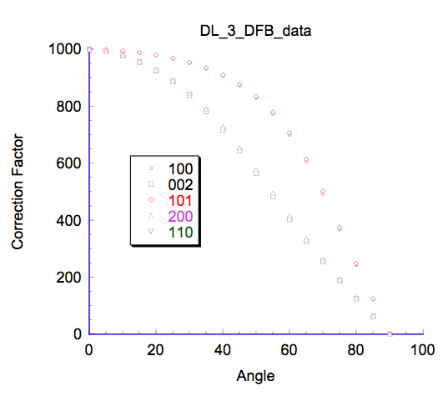
FAQs: DFB files
DFB files contain data on defocussing (and background) corrections. An example of how the values vary with angle is shown on the right of the slide.
An important point to be aware of is that the exact shape of each defocussing curve depends on the material and the machine. The material influence is primarily through the diffraction angles (correction is more important for small angles). The machine influence is primarily through the slit widths (acceptance angle at the detector, e.g.).
The best way to obtain a defocussing curve for your particular material is to measure pole figures on a randomly oriented sample of that same material.
Whenever you change material, or diffractometer, you can expect your defocussing corrections (and therefore DFB file) to change.

Slide 73
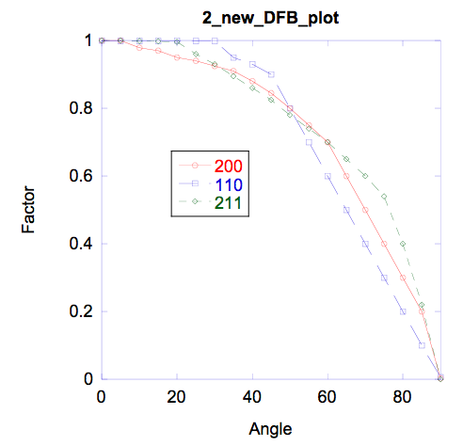
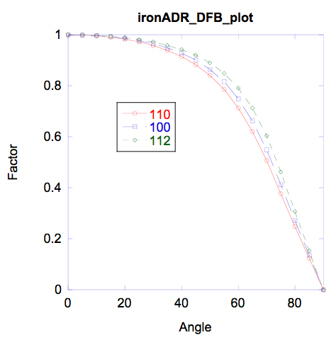
FAQs: DFB files #2
To illustrate the effect of varying the defocussing, we analyze a data set for a steel sample with two different defocussing corrections and examine the impact on the quality of the OD calculation. The source of the 1st DFB is unknown and the curves cross in a rather unlikely fashion; the 2nd was generated with MAKEDFB (option #2 on page 2) using the theta values appropriate to Fe, Cu-Ka radiation, a slit width of 0.1° and a peak width of 1°.

Slide 74
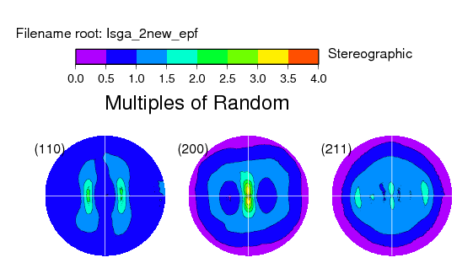
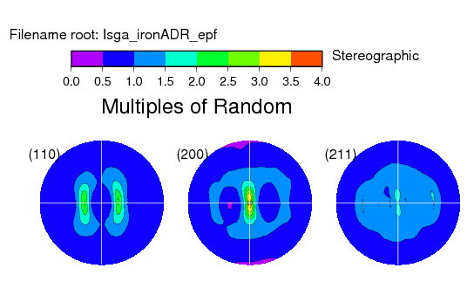
FAQs: DFB files #3
Now we show the corrected . EPF files.
Note the more uniform intensity going out to the edges of the PFs in the second set.

Slide 75
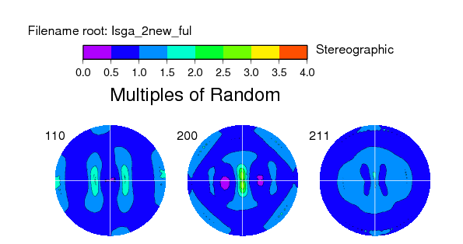

FAQs: DFB files #4
And the .FUL files from performing a harmonic analysis:
Note that the harmonic analysis produces rather similar results because of the renormalization of the PFs.

Slide 76
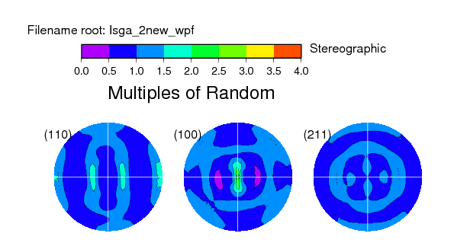

FAQs: DFB files #5
And, finally, the .WPF files (from applying the WIMV analysis, no sample symmetry):
Note that using an incorrect defocussing correction will be most likely to give problems if you use the WIMV analysis directly on .EPF files. First applying the harmonic analysis and then using the .FUL dataset as input to WIMV is much more likely to be correctly normalized.

Slide 77
FAQs: conversion from X’Pert format data files
Please find the description in Converting_XPert_to_POPLA_format_KB.doc
that is posted on the course website.
As mentioned elsewhere, we recommend using DosBox (aka Boxer) to run DOS programs such as popLA and PhilConv.exe.
Note that the program provided by Phillips (now PanAlytical) produces a popLA *.raw file that has minor but significant errors on the second line of each file. These must be corrected before processing the data with popLA.

Slide 78
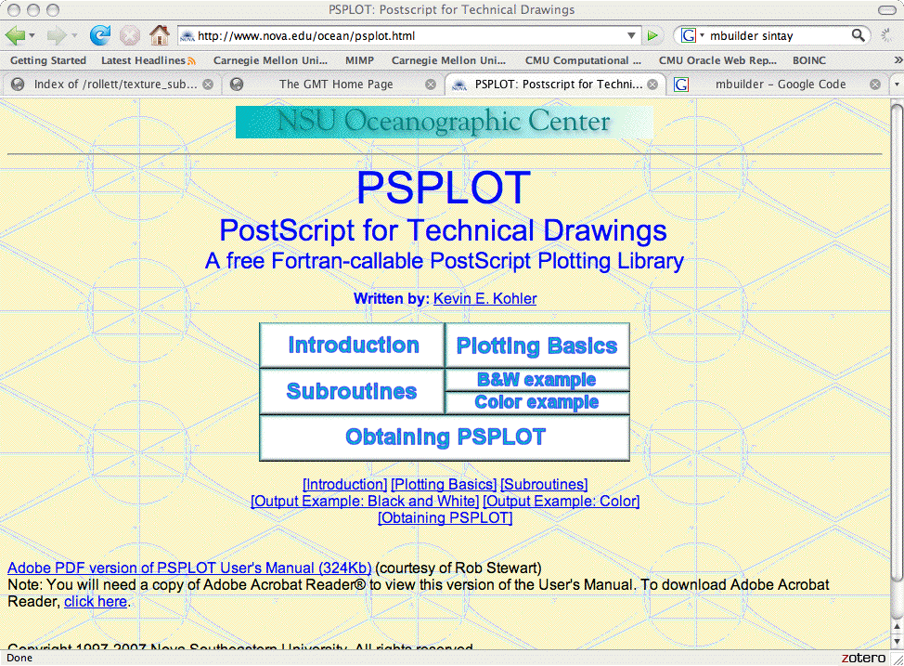
PSPLOT package
http://www.nova.edu/ocean/psplot.html
PSPLOT is an open source (Fortran) set of subroutines that allow you to make postscript files containing a plot.
The program sodcon.f (which draws square ODf plots with either line contour plots or solid color) calls subroutines from this package. You can either include the whole set of subroutines with your code (inefficient) or build a psplot library (more involved, more efficient).

Slide 79
DEMO.SOD
unsmoothed
Smoothed (5°)

Slide 80
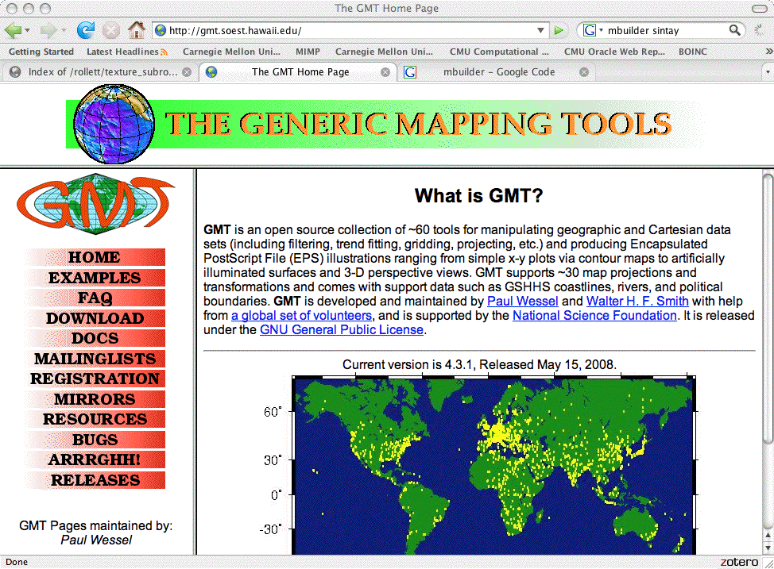
GMT package
http://gmt.soest.hawaii.edu/
GMT is an open source collection of ~60 tools for manipulating geographic and Cartesian data sets; makes postscript (EPS) files.
The shell script Draw_Stereograms calls programs from this package. It has the capability of drawing pole figures, inverse pole figures, and grain boundary character information. You convert from popLA format to GMT format by running pf2GMT, which works on any kind of popLA-style pole figure data.

Slide 81
GMT plot:
Demo.wip
Plot with GMT:
./pf2GMT demo.wip
[ program digests the inverse PF data, converts to GMT format with {longitude,latitude,intensity}, giving 3 (typically) files with names demo_wip1.gpf, demo_wip2.gpf, demo_wip3.gpf ]
./Draw_Stereograms 3 demo_wip IP \
( wysiwyg/gray/polar/rainbow low-contour high-contour step stereo/equal/ortho CUBIC/HEX/ORT )
Note that the script uses clipping to obtain only the SST (standard stereographic triangle).

Slide 82
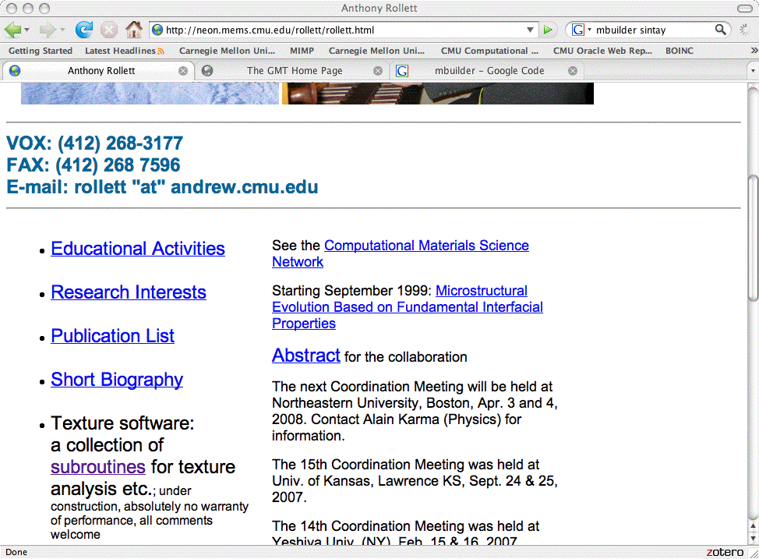
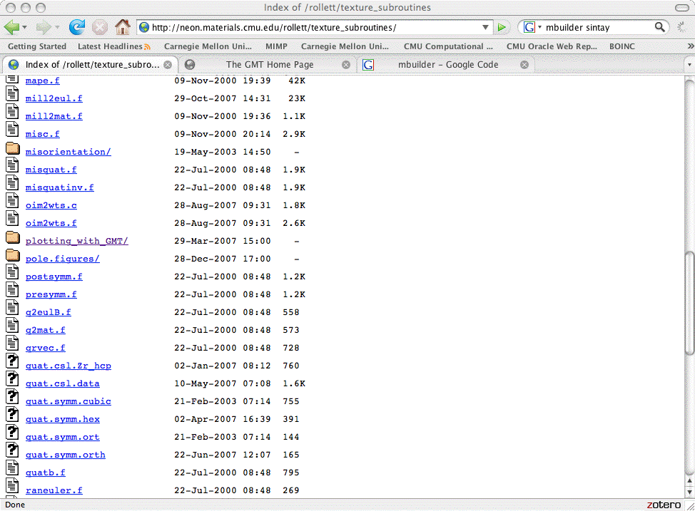
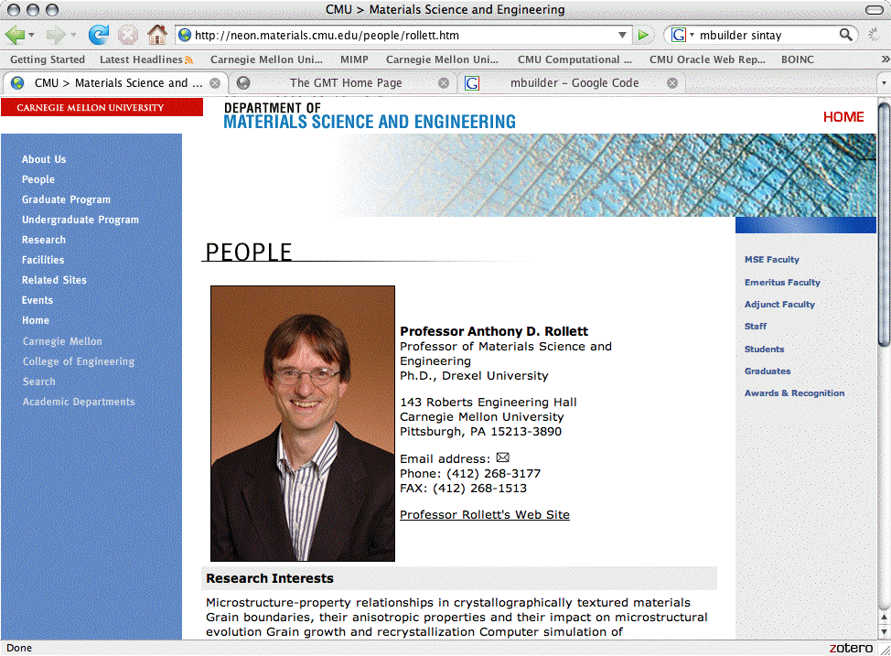
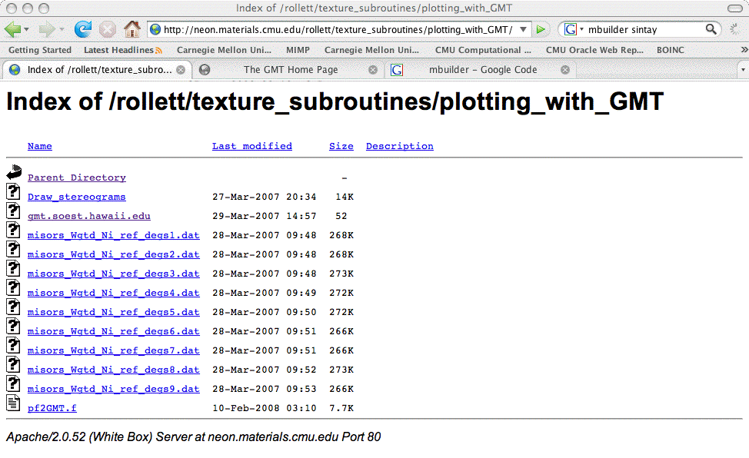
Sources of codes, scripts

Slide 83
Issues with Open Source Graphics
The script(s) to use GMT for pole figures can be found at neon.materials.cmu.edu/rollett/texture_subroutines.
GMT is best suited to Unix systems; on Windows the advice is to run it in a Unix window (Cygwin). Installation of GMT on a Mac requires prior installation of Developer Tools (including X11) - this is easy; then you must generate a script and run it - mildly scary when doing it for the first time. Also available from port (http://www.macports.org/); once “port” is installed, you can get GMT via “sudo port install gmt”. As of June 2012, one can also install it via fink (similar to port, similar to apt-get). As of 2014, you can download a “DMG” installer for Macs, which makes installation very much easier. Once you have it installed, a long list of programs become available for the various processing steps - Draw_stereograms automates this for you.
The main reason to use GMT is that it handles spherical data very gracefully; does not require a regular grid, knows every standard projection, can smooth data, and allows annotation.
PSPLOT is a simpler package because it is only a set of subroutines. As with most such packages, the authors like you to register as a user so that they that you are using it, and so that they can get the credit for the use. Significantly more effort is required, however, to write the Fortran code to make use of the capability and generate plots. Paul Lee (Ph.D., CMU/MSE, 1999) is credited with writing the original version of SODCON.

Slide 84
Summary
Basic sequence demonstrated that takes you from RAW pole figures, as measured on an x-ray goniometer to an Orientation Distribution.
Many more functions available.

