Slide 1
Plastic Anisotropy: Yield Surfaces
27-750
Texture, Microstructure & Anisotropy
A.D. Rollett
Last revised: 23rd Feb. ‘16

Slide 2
Objective
The objective of this lecture is to introduce you to the topic of yield surfaces.
Yield surfaces are useful at both the single crystal level (material properties) and at the polycrystal level (anisotropy of textured materials).

Slide 3
Outline
What is a yield surface (Y.S.)?
2D Y.S.
Crystallographic slip
Vertices
Strain Direction, normality
π-plane
Symmetry
Rate sensitivity

Slide 4
Questions: 1
How does one define a yield surface [demarcation between elastic and plastic response in stress space]?
What are two examples of yield functions commonly used in solid mechanics of materials [Tresca and von Mises]?
What is the “normality rule” [strain direction is perpendicular to the yield surface]?
How do we construct the yield surface for a single slip system [use the geometry of slip]?
Why does the normality rule hold exactly for single slip [again, use the geometry of slip]?
How do we construct the yield surface for a polycrystal [calculate the average Taylor factor for the set of orientations, for each strain direction in the relevant stress space]?

Slide 5
Questions: 2
Which yield surface (YS) is the Cauchy plane YS [two principal stresses]?
Which is the “pi-plane YS” [stresses in the plane perpendicular to the mean/hydrostatic stress direction]?
What is a YS vertex [location where the strain direction changes sharply, most noticeable on single xtal yield surfaces]?
What effect does rate sensitivity have on the yield surface of single and poly-crystals [a finite rate sensitivity serves to round off the vertices present in single xtal YSs and thus also rounds off polycrystal YSs]?
What effect does sample symmetry have on (polycrystal) yield surfaces [sample symmetry ensures that certain components of strain must be zero if the corresponding stress component is zero]?

Slide 6
Questions: 3
What is the “r-value” or “Lankford parameter” [the r-value is the ratio of the two transverse strain components that are measured during a tensile strain test]?
How does the r-value relate to a yield surface, or how can we compute the r-value based on a knowledge of the yield surface [the r-value depends on the ratio of two components of normal strain, so it is determined by the strain direction at the point on the yield surface that corresponds to the loading direction]?
In the pi-plane, what shape corresponds to an isotropic material, and what shape corresponds to a random cubic polycrystal [isotropic is a circle, and a random polycrystal lies between the von Mises circle and Tresca]?

Slide 7
Bibliography
Kocks, U. F., C. Tomé, H.-R. Wenk, Eds. (1998). Texture and Anisotropy, Cambridge University Press, Cambridge, UK.
W. Hosford (1993), The Mechanics of Crystals and Textured Polycrystals, Oxford Univ. Press.
W. Backofen 1972), Deformation Processing, Addison-Wesley Longman, ISBN 0201003880.
Reid, C. N. (1973), Deformation Geometry for Materials Scientists. Oxford, UK, Pergamon.
Khan and Huang (1999), Continuum Theory of Plasticity, ISBN: 0-471-31043-3, Wiley.
Nye, J. F. (1957). Physical Properties of Crystals. Oxford, Clarendon Press.
T. Courtney, Mechanical Behavior of Materials, McGraw-Hill, 0-07-013265-8, 620.11292 C86M.

Slide 8
Yield Surface definition
A Yield Surface is a map in stress space, in which an inner envelope is drawn to demarcate non-yielded regions from yielded (flowing) regions. The most important feature of single crystal yield surfaces is that crystallographic slip (single system) defines a straight line in stress space and that the straining direction is perpendicular (normal) to that line.

Slide 9
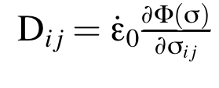
Plastic potential→Yield Surface
One can define a plastic potential, Φ, whose differential with respect to the stress deviator provides the strain rate. By definition, the strain rate is normal to the iso-potential surface.
Provided that the critical resolved shear stress (also in the sense of the rate-sensitive reference stress) is not dependent on the current stress state, then the plastic potential and the yield surface (defined by τ_{crss}) are equivalent. If the yield depends on the hydrostatic stress, for example, then the two may not correspond exactly.
Notes:
$ D_{ij} = \dot{ \epsilon}_0 \frac{ \partial \Phi(\sigma) } { \partial \sigma_{ij} }

Slide 10
Yield surfaces: introduction
The best way to learn about yield surfaces is think of them as a graphical construction.
A yield surface is the boundary between elastic and plastic flow.
Example: tensile stress
σ=0
elastic
plastic
σ
σ= σ_{yield}

Slide 11
2D yield surfaces
Yield surfaces can be defined in two dimensions.
Consider a combination of (independent) yield on two different axes.
plastic
The material is elastic if σ₁ < σ_{1y} and
σ₂ < σ_{2y}
σ₂
σ= σ_{2y}
plastic
elastic
0
σ₁
σ= σ_{1y}

Slide 12
2D yield surfaces, contd.
The Tresca yield criterion is familiar from mechanics of materials:
The material is elastic if the difference between the 2 principal stresses is less than a critical value, σ_{k} , which is a maximum shear stress.
plastic
σ₂
σ= σ_{k}
plastic
elastic
0
σ₁
σ= σ_{k}

Slide 13
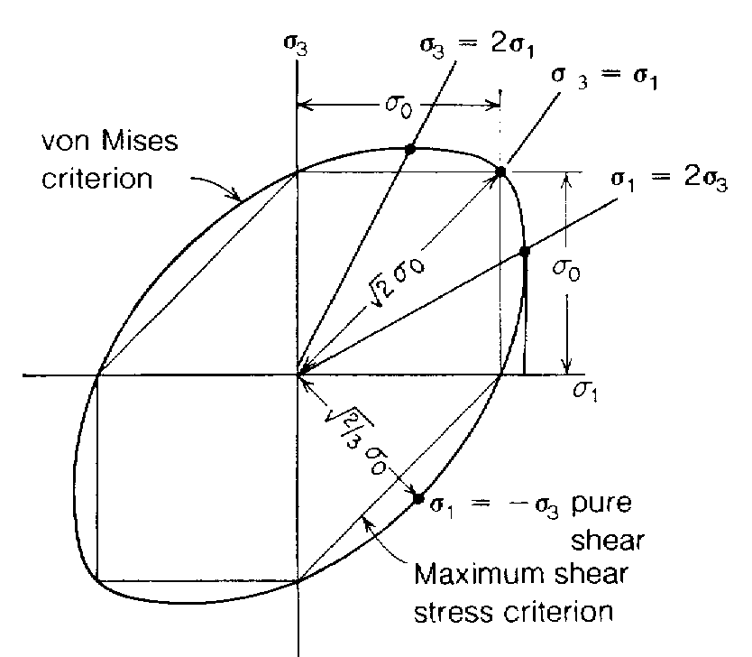
2D yield surfaces, contd.
Graphical representations of yield surfaces are generally simplified to the envelope of the demarcation line between elastic and plastic. Thus it appears as a polygonal or curved object that is closed and convex (hence the term convex hull is applied).
This plot shows both the Tresca and the von Mises criteria.
plastic
elastic
σ= σ_{yield}

Slide 14
Crystallographic slip: a single system
Now that we understand the concept of a yield surface we can apply it to crystallographic slip.
The result of slip on a single system is strain in a single direction, which appears as a straight line on the Y.S.
[Kocks]

Slide 15
A single slip system
Yield criterion for single slip: b_{i}σ_{ij}n_{j} ≥ τ_{crss}
In 2D this becomes (σ₁≡σ₁₁: b₁σ₁n₁+ b₂σ₂n₂ ≥ τ_{crss}
σ₂
The second equation defines a straight line connecting the intercepts
plastic
τ_{crss}/b₂n₂
elastic
0
σ₁
τ_{crss}/b₁n₁

Slide 16
A single slip system: strain direction
Now we can ask, what is the straining direction?
The strain increment is given by: dε = Σ_{s} dγ^{(s)}b^{(s)}n^{(s)} which in our 2D case becomes: dε₁ = dγ b₁n₁; dε₂ = dγ b₂n₂
This defines a vector that is perpendicular to the line for yield! σ₂ = (constant - b₁σ₁n₁)/(b₂n₂)

Slide 17
Single system: normality
• We can draw the straining direction in the same space as the stress. • The fact that the strain is perpendicular to the yield surface is a demonstration of the normality rule for crystallographic slip.
σ₂
dε = dγ (b₁n₁ , b₂n₂)
τ_{crss}/b₂n₂
plastic
elastic
0
σ₁
τ_{crss}/b₁n₁

Slide 18
Drucker’s Postulate
We have demonstrated that the physics of crystallographic slip guarantees normality of plastic flow.
Drucker (d. 2001) showed that plastic solids in general must obey the normality rule. This in turn means that the yield surface must be convex. Crystallographic slip also guarantees convexity of polycrystal yield surfaces.
Details on Drucker’s Postulate in supplemental slides.

Slide 19
Vertices on the Y.S.
Based on the normality rule, we can now examine what happens at the corners, or vertices, of a Y.S.
The single slip conditions on either side of a vertex define limits on the straining direction: at the vertex, the straining direction can lie anywhere in between these limits.
Thus, we speak of a cone of normals at a vertex.

Slide 20
Cone of normals
dε_{a}
Vertex
dε_{b}
[Kocks]
Cone of normals: the straining direction can lie
anywhere within the cone

Slide 21
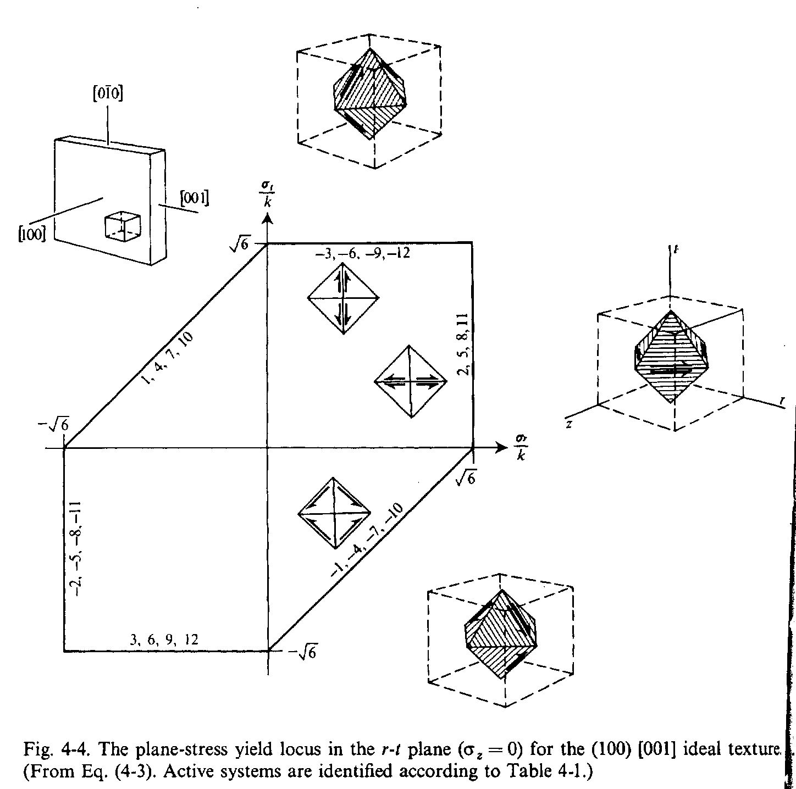
Single crystal Y.S.
8-fold vertex
Cube component: (001)[100]
Backofen Deformation Processing
The 8-fold vertex identified is one of the 28 Bishop & Hill stress states

Slide 22
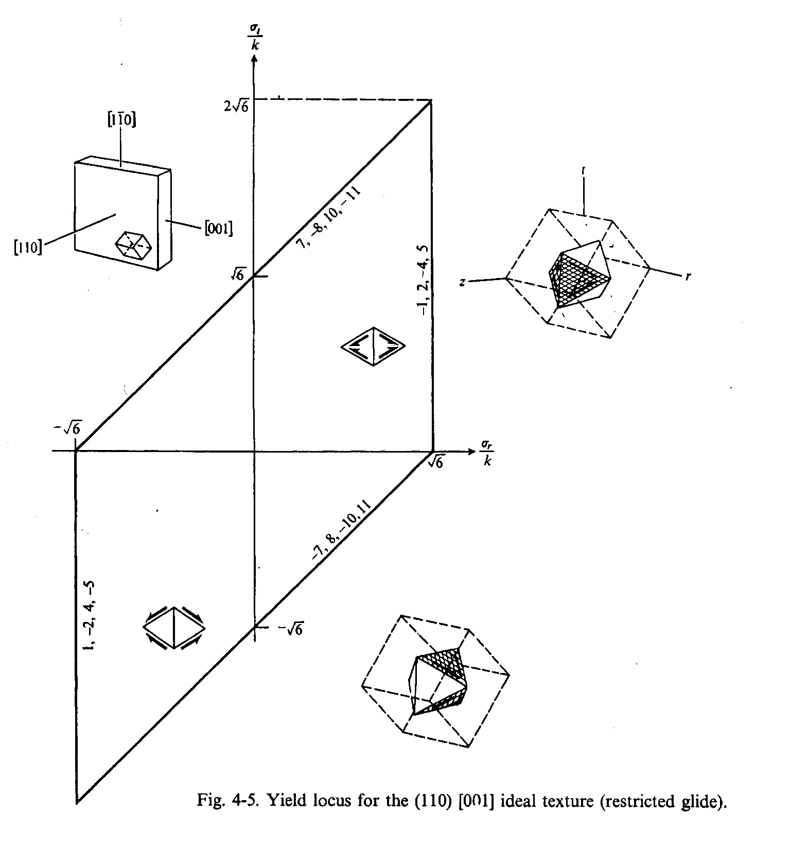
Single crystal Y.S.: 2
8-fold vertex
Goss component: (110)[001]
From the thesis work of Prof. Piehler
Backofen: Deformation Processing

Slide 23
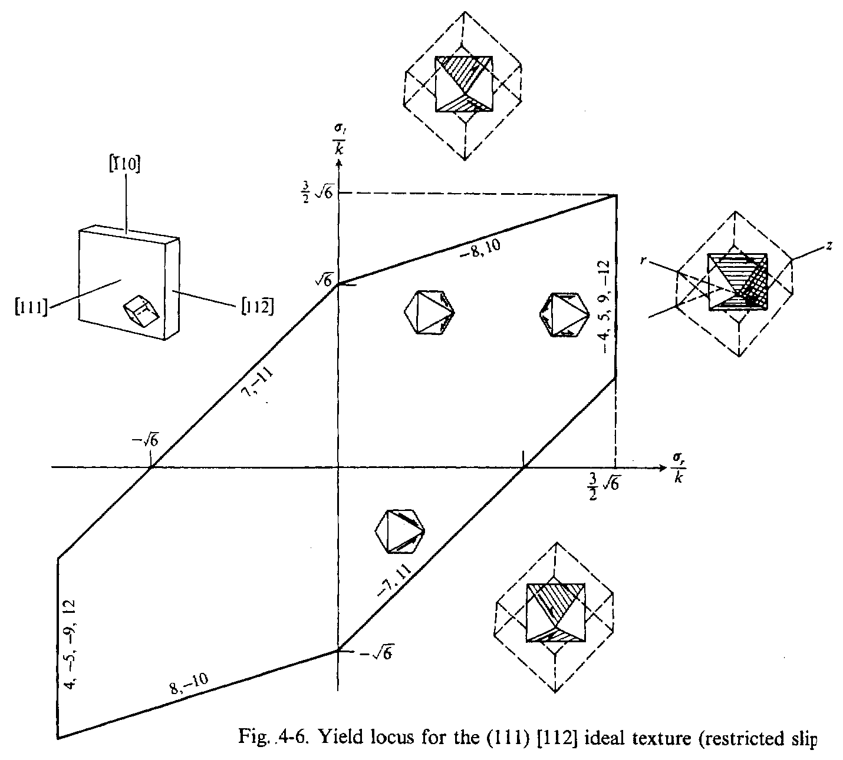
Single crystal Y.S.: 3
6-fold vertex
Copper: (111)[112]
Backofen: Deformation Processing

Slide 24
Polycrystal Yield Surfaces
As discussed in the notes about how to use LApp, the method of calculation of a polycrystal Y.S. is simple. Each point on the Y.S. corresponds to a particular straining direction: the stress state of the polycrystal is the average of the stresses in the individual grains.

Slide 25
Polycrystal Y.S. construction
2 methods commonly used:
(a) locus of yield points in stress space
(b) convex hull of tangents
Yield point loci is straightforward: simply plot the stress in 2D (or higher) space.

Slide 26
Tangent construction
(1) Draw a line from the origin parallel to the applied strain direction.
(2) Locate the distance from the origin by the average Taylor factor.
(3) Draw a perpendicular to the radius.
(4) Repeat for all strain directions of interest.
(5) The yield surface is the inner envelope of the tangent lines.

Slide 27
Tangent construction: 2
dε
σ₂
<M>
σ₁
[Kocks]

Slide 28
The “pi-plane” Y.S.
A particularly useful yield surface is the so-called π-plane, i.e. the projection down the line corresponding to pure hydrostatic stress (all 3 principal stresses equal). For an isotropic material, the π-plane has 120° rotational symmetry with mirrors such that only a 60° sector is required (as the fundamental zone). For the von Mises criterion, the π-plane Y.S. is a circle.

Slide 29
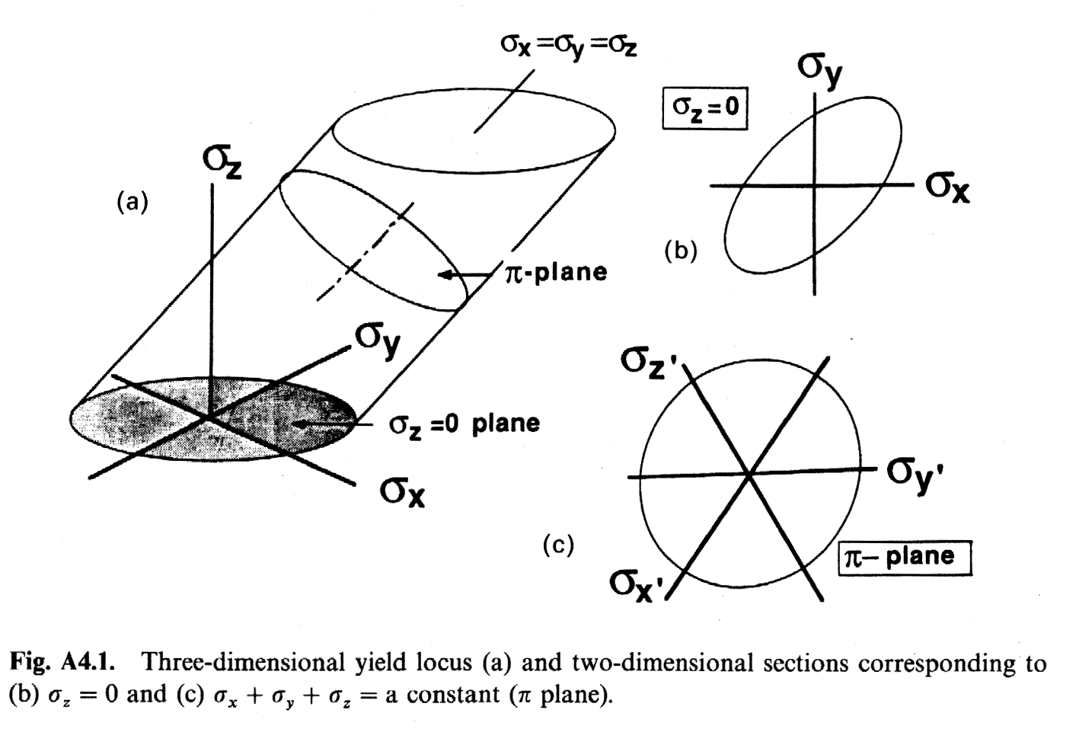
Principal Stress <-> π-plane
Hosford: mechanics of crystals...

Slide 30
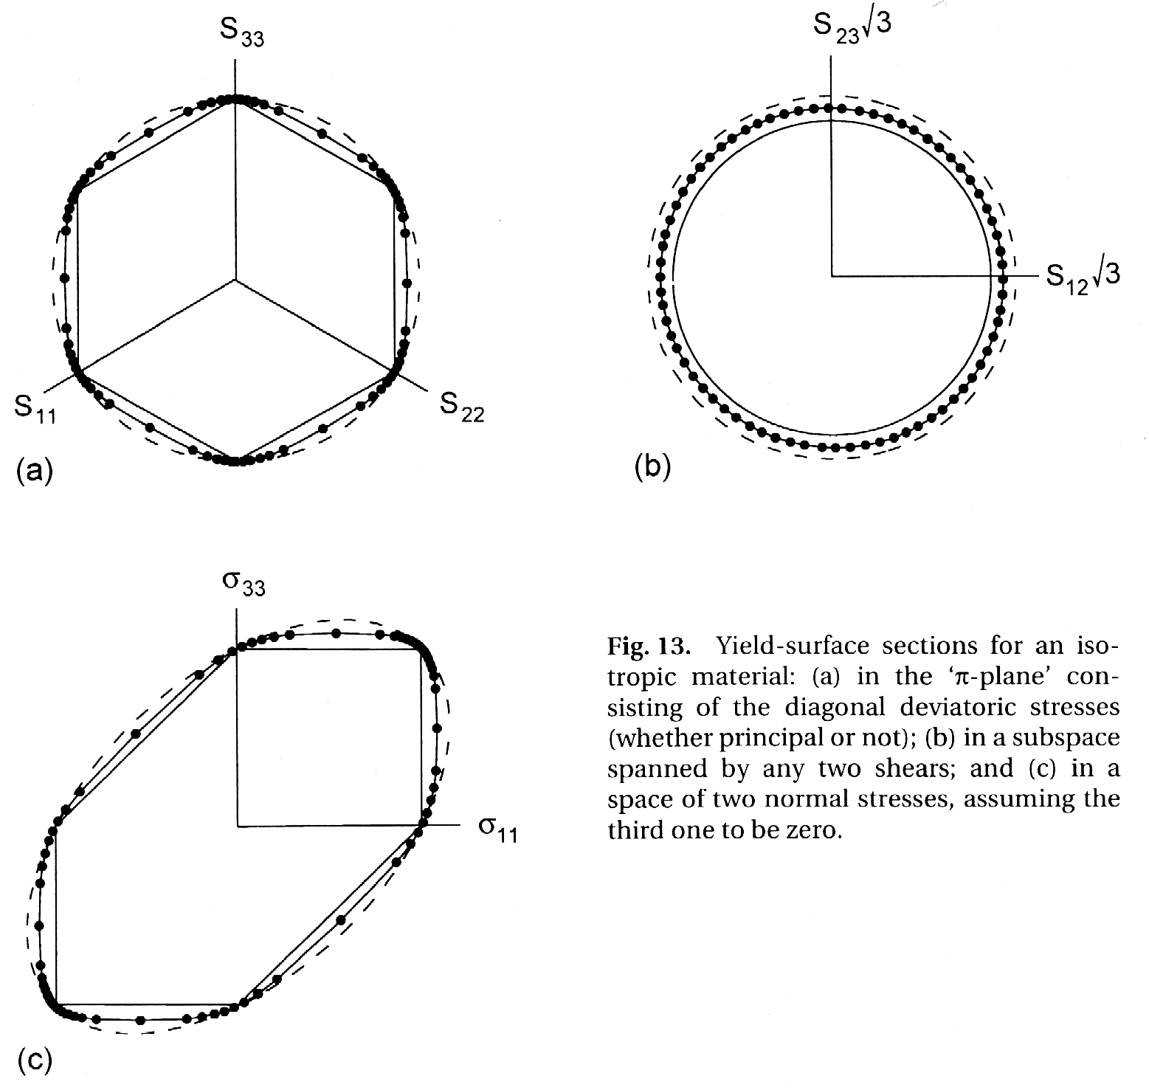
Isotropic material
Note that an isotropic material has a Y.S. in between the Tresca and the von Mises surfaces
[Kocks]

Slide 31
Y.S. for textured polycrystal
Kocks: Ch.10 Note sharp vertices for strong textures at large strains.
[Kocks]

Slide 32
Symmetry & the Y.S.
We can write the relationship between strain (rate, D) and stress (deviator, S) as a general non-linear relation D = F(S)

Slide 33
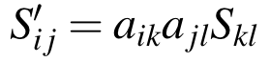
Effect on stimulus (stress)
The non-linearity of the property (plastic flow) means that care is needed in applying symmetry because we are concerned not with the coefficients of a linear property tensor but with the existence of non-zero coefficients in a response (to a stimulus). That is to say, we cannot apply the symmetry element directly to the property because the non-linearity means that (potentially) an infinity of higher order terms exist. The action of a symmetry operator, however, means that we can examine the following special case. If the field takes a certain form in terms of its coefficients then the symmetry operator leaves it unchanged and we can write: S = OSO^{T}
Note that the application of symmetry operators to a second rank tensor, such as deviatoric stress, is exactly equivalent to the standard tensor transformation rule:

Slide 34
Response(Field)
Then we can insert this into the relation between the response and the field: ODO^{T} = F(OSO^{T}) =F(S) = D The resulting identity between the strain and the result of the symmetry operator on the strain then requires similar constraints on the coefficients of the strain tensor.

Slide 35
Example: mirror on Y
Kocks (p343) quotes an analysis for the action of a mirror plane (note the use of the second kind of symmetry operator here) perpendicular to sample Y to show that the subspace {π, σ₃₁} is closed. That is, any combination of σ_{ii} and σ₃₁ will only generate strain rate components in the same subspace, i.e. D_{ii} and D₃₁. The negation of the 12 and 23 components means that if these stress components are zero, then the stress deviator tensor is equal to the stress deviator under the action of the symmetry element. Then the resulting strain must also be identical to that obtained without the symmetry operator and the corresponding 12 and 23 components of D must also be zero. That is, two stresses related by this mirror must have σ₁₂ and σ₂₃ zero, which means in turn that the two related strain states must also have those components zero.

Slide 36
Mirror on Y: 2
Consider the equation above: any stress state for which σ₁₂ and σ₂₃ are zero will satisfy the following relation for the action of the symmetry element (in this case a mirror on Y): OSO^{T} = S

Slide 37
Mirror on Y: 2
Provided the stress obeys this relation, then the relation ODO^{T} = D also holds. Based on the second equation quoted from Kocks, we can see that only strain states for which D₁₂ and D₂₃ = 0 will satisfy this equation.

Slide 38
Symmetry: summary
Thus we have demonstrated with an example that stress states that obey a symmetry element generate straining directions that also obey the symmetry element. More importantly, the yield surface for stress states obeying the symmetry element are closed in the sense that they do not lead to straining components outside that same space.

Slide 39
Rate sensitive yield
The rate at which dislocations move under the influence of a shear stress (on their glide plane) is dependent on the magnitude of the shear stress. Turning the statement around, one can say that the flow stress is dependent on the rate at which dislocations move which, through the Orowan equation, given below, means that the "critical" resolved shear stress is dependent on the strain rate. The first figure below illustrates this phenomenon and also makes the point that the rate dependence is strongly non-linear in most cases. Although the precise form of the strain rate sensitivity is complicated if the complete range of strain rate must be described, in the vicinity of the macroscopically observable yield stress, it can be easily described by a power-law relationship, where n is the strain rate sensitivity exponent. Here is the Orowan equation:

Slide 40
Shear strain rate
The crss (τ_{crss}) becomes a reference stress (as opposed to a limiting stress). For the purposes of simulating texture, the shear rate on each system is normalized to a reference strain rate and the sign of the slip rate is treated separately from the magnitude.
Notes:
$$\dot{ \gamma } = \left( \frac{\tau}{ \tau_{crss} } \right) ^n = \left( \frac{b_i \sigma_{ij} n_j}{ \tau_{crss} } \right) ^n = \left( \frac{m_{ij} \sigma_{ij} }{ \tau_{crss} } \right) ^n

Slide 41
Sign dependence
Note that, in principle, both the critical resolved shear stress and the strain rate exponent, n, can be different on each slip system. This is, for example, a way to model latent hardening, i.e. by varying the crss on each system as a function of the slip history of the material.
Notes:
$$\dot{ \gamma } = \left| \frac{b_i \sigma_{ij} n_j}{ \tau_{crss} } \right| ^n sgn (b_i \sigma_{ij} n_j)

Slide 42
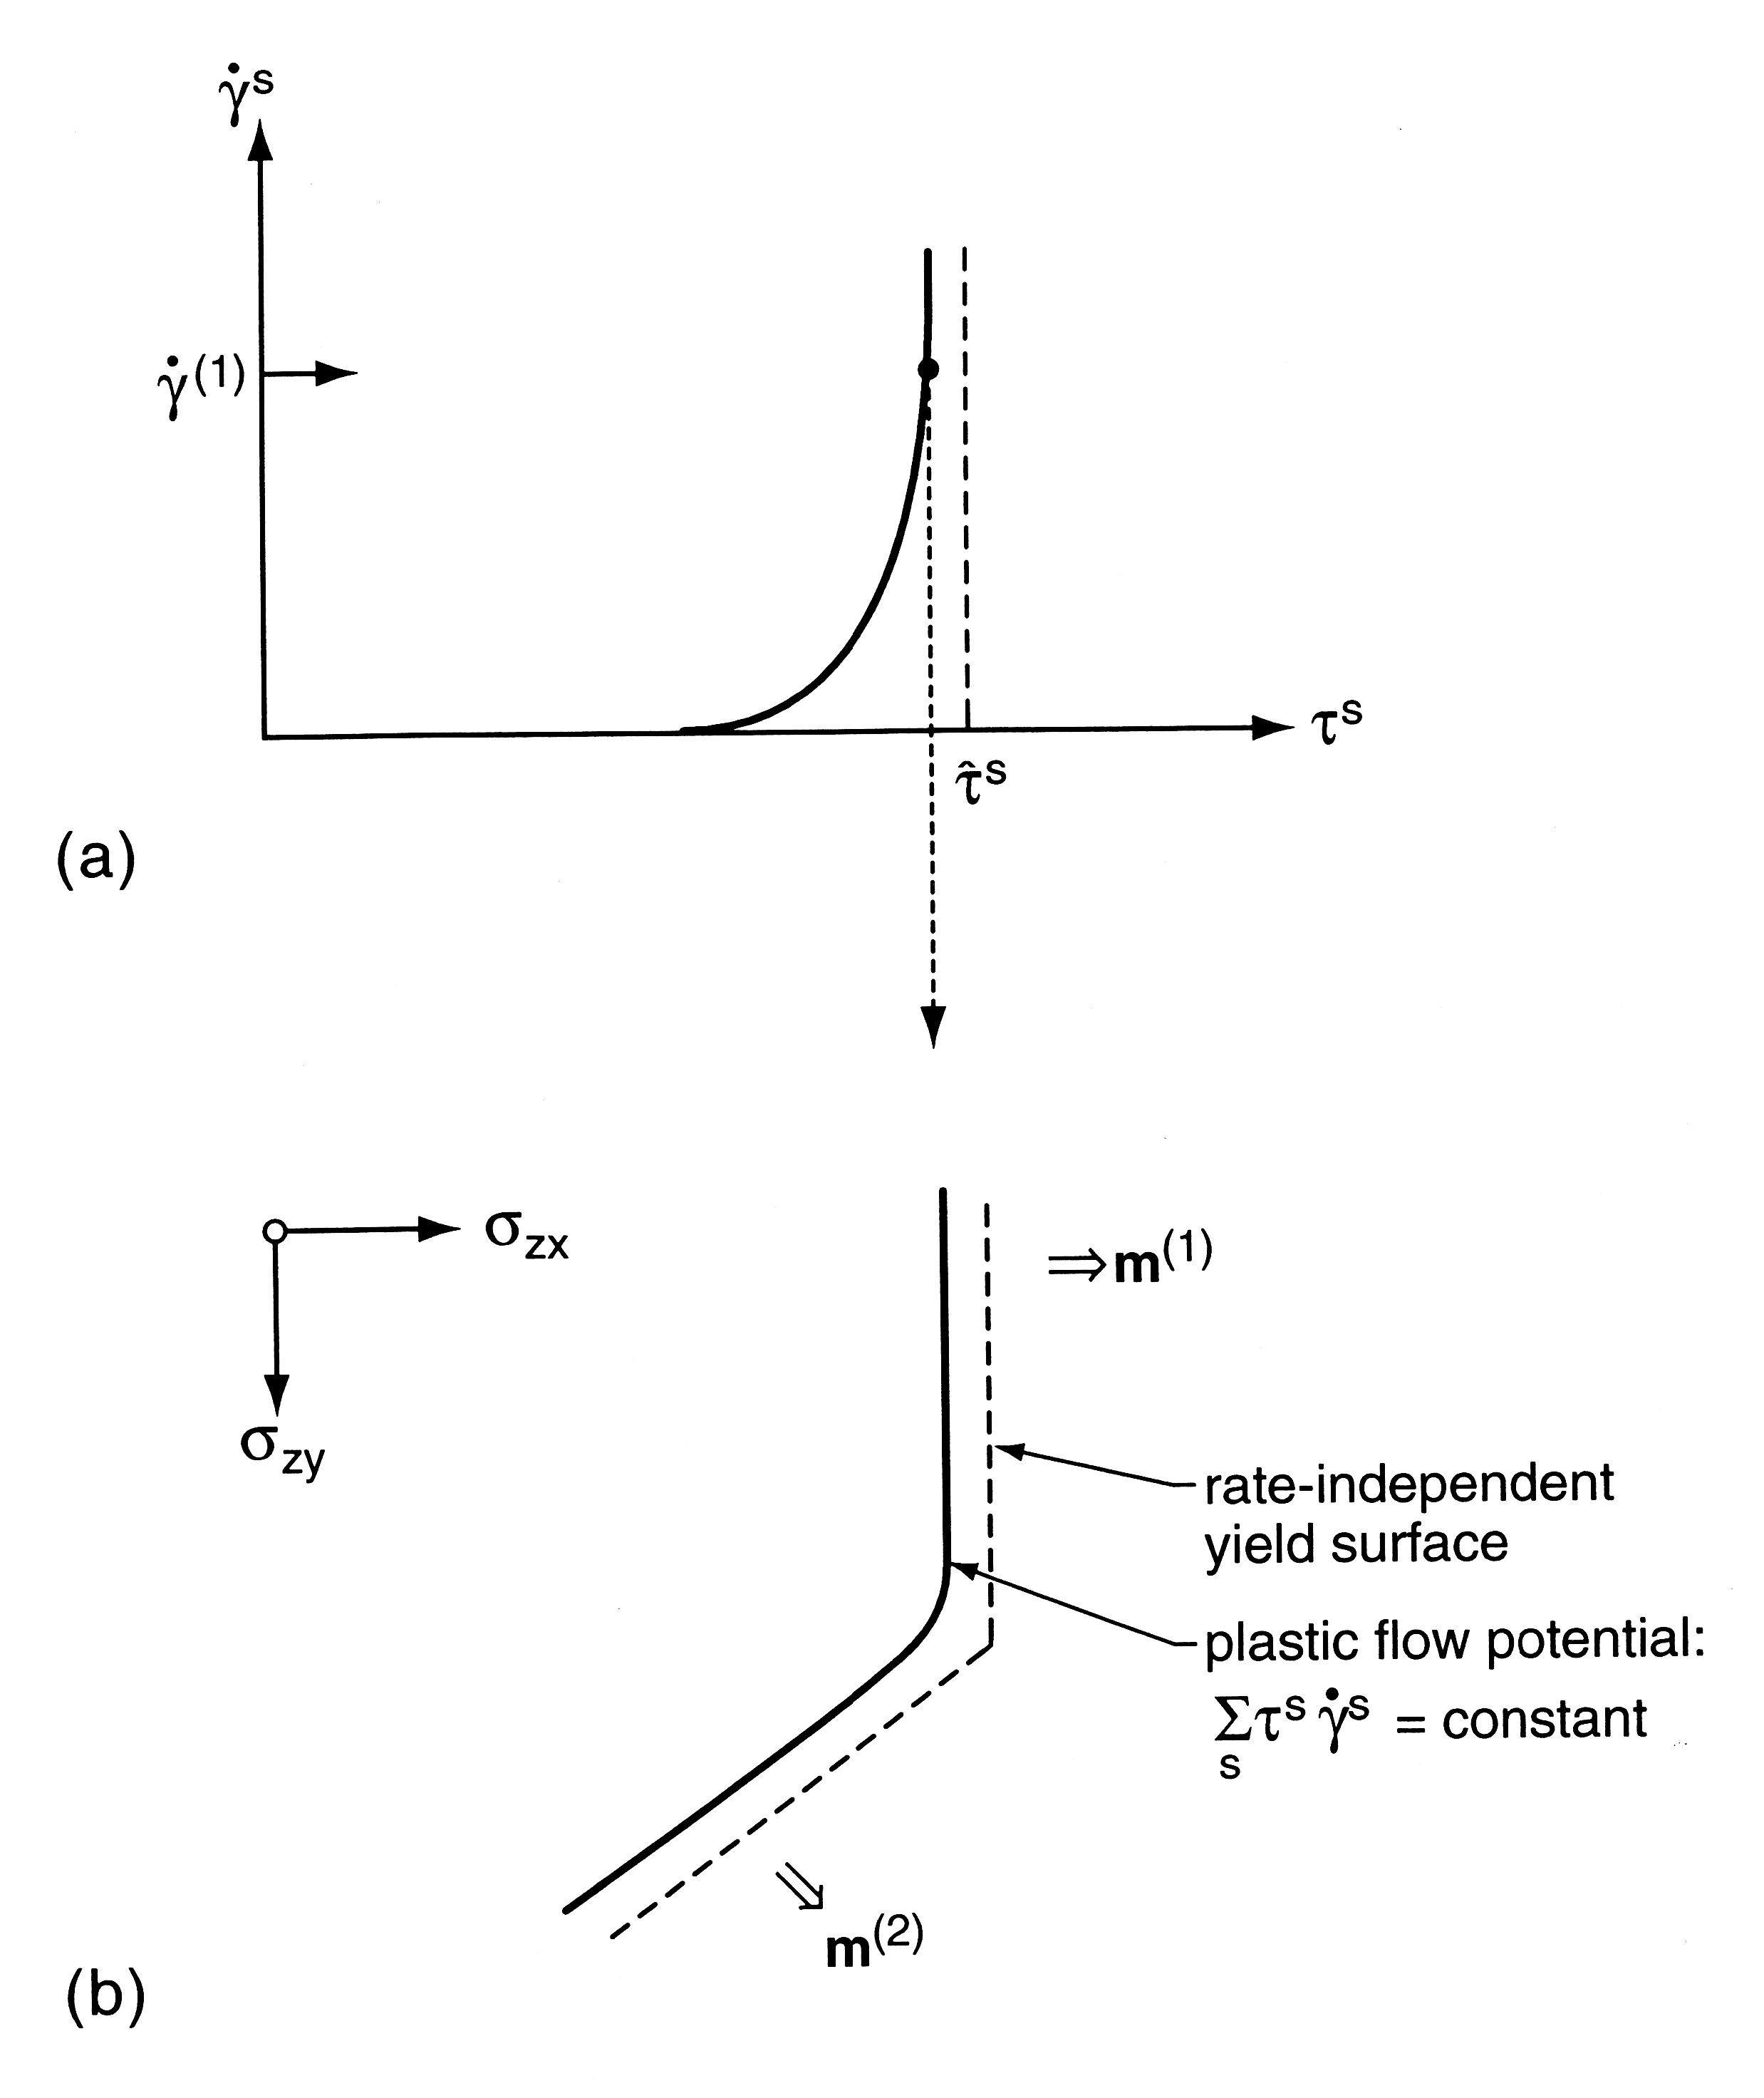
Effect on single crystal Y.S.
Note the “rounding-off” of the yield surface as a consequence of rate-sensitive yield
[Kocks]

Slide 43
Rate sensitivity: summary
The impact of strain rate sensitivity on the single crystal yield surface (SCYS) is then easy to recognize. The consequence of the normalization of the strain rate is such that if more than one slip system operates, the resolved shear stress on each system is less than the reference crss. Thus the second diagram, above, shows that, in the vicinity of a vertex in the SCYS, the yield surface is rounded off. The greater the rate sensitivity, or the smaller the value of n, the greater the degree of rounding. In most polycrystal plasticity simulations, the value of n chosen to be small enough, e.g. n=30, that the non-linear solvers operate efficiently, but large enough that the texture development is not affected. Experience with the LApp model indicates that anisotropy and texture development are significantly affected only when small values of the rate sensitivity exponent are used, n≤5.

Slide 44
Plastic Strain Ratio (r-value)
Large r_{m} and small ∆r required for deep drawing
σ₁
Rolling Direction
0°
σ₂
45°
90°
L_{i}
W_{i}

Slide 45
R-value & the Y.S.
The r-value is a differential property of the polycrystal yield surface, i.e. it measures the slope of the surface.
Why? The Lankford parameter is a ratio of strain components: r = ε_{width}/ε_{thickness}
ε_{width}
r = slope
ε_{thickness}

Slide 46
A π-plane Y.S.: fcc rolling texture at a strain of 3
ND
Note: the Taylor factors for loading in the RD and the TD are nearly equal but the slopes are very different!
TD
S₁₁
RD
dε₂₂ ~ dε₃₃
r ~ 1
dε₁₁ ~ 0
r ~ 0
[Kocks]

Slide 47
How to obtain r at other angles?
Consider the stress system in a tensile test in the plane of a sheet.
Mohr’s circle shows that a shear stress component is required in addition to the two principal stresses.
Therefore a third dimension must be added to be standard σ₁₁-σ₂₂ yield surface.

Slide 48
Stress system in tensile tests
For a test at an arbitrary angle to the rolling direction:
Note: the corresponding strain tensor may have all non-zero components.

Slide 49
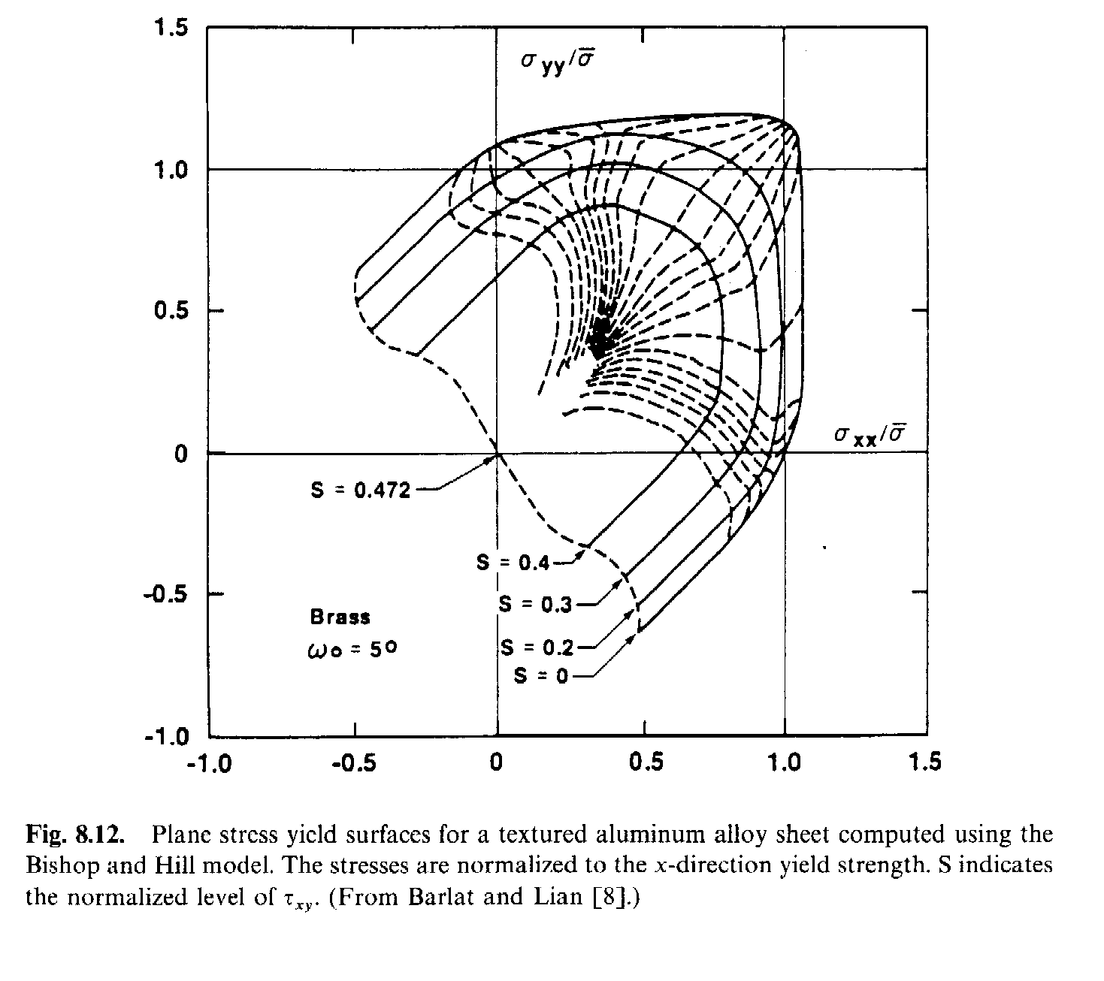
3D Y.S. for r-values
Think of an r-value scan as going “up-and-over” the 3D yield surface.
Hosford: Mechanics of Crystals...

Slide 50
Summary
Yield surfaces are an extremely useful concept for quantifying the anisotropy of materials.
Graphical representations of the Y.S. aid in visualization of anisotropy.
Crystallographic slip guarantees normality.
Certain types of anisotropy require special calculations, e.g. r-value.

Slide 51
Supplemental Slides

Slide 52
Drucker’s Postulate
The material is said to be stable in the sense of Drucker if the work done by the tractions, ∆t_{i}, through the displacements, ∆u_{i}, is positive or zero for all ∆t_{i}:

Slide 53
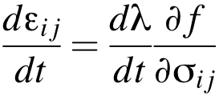
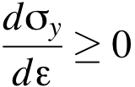
Drucker, contd.
This statement is somewhat analogous (but not equivalent) to the second law of thermodynamics. A stable material is strongly dissipative. It can be shown that, for a plastic material to be stable in this sense, it must satisfy the following conditions:
The yield surface, f(σ_{ij}), must be convex;
The plastic strain rate must be normal to the yield surface;
The rate of strain hardening must be positive or zero.

