Slide 1


Understanding the TSL EBSD Data Collection System
27-750
Texture, Microstructure & Anisotropy
A.D. Rollett
With thanks to: Harry Chien, Lisa Chan,
Bassem El-Dasher, Gregory Rohrer,
Stefan Zaefferer (Max-Planck, Düsseldorf)
Last revised: 7th Feb. ‘16

Slide 2
Overview
Understanding the diffraction patterns
  Source of diffraction
  SEM setup per required data
  The makeup of a pattern
Setting up the data collection system
  Environment variables
  Phase and reflectors
Capturing patterns
  Choosing video settings
  Background subtraction
Image Processing
  Detecting bands: Hough transform
  Enhancing the transform: Butterfly mask
  Selecting appropriate Hough settings
  Origin of Image Quality (I.Q.)

Slide 3
Overview (cont’d)
Indexing captured patterns
  Identifying detected bands: Triplet method
  Determining solution: Voting scheme
  Origin of Confidence Index (C.I.)
  Identifying a solution in multi-phase materials
Calibration
  Physical meaning
  Method and need for tuning
Scanning
  Choosing appropriate parameters
General reference on orientation mapping: “Orientation Mapping” by Anthony D Rollett & Katayun Barmak; uploaded to Box as CH11-Orientation_Mapping-final_proofs.pdf.

Slide 4
Questions (1)
Why do we need to position the specimen at the eucentric point?
Why does the specimen need to be tilted at a steep angle of incidence (70°) to the electron beam?
Why is it so important to avoid contact between a specimen and the phosphor screen?
What is the function of the phosphor screen?
What is the characteristic appearance of a diffraction pattern in EBSD?
Why is specimen surface preparation so important?
What are reflectors and how do you choose them?
What is the Hough Transform?
What does “binning” refer to (in connection with Hough Transforms)?
What is a “sharpening mask”?
What does “frame averaging” do for acquisition?

Slide 5
Questions (2)
What does background subtraction do?
What is image quality?
What are the coordinates of the image after the Hough transform has been applied?
Why is the Hough transform effective for detecting lines?
What are interzonal angles (in the context of an EBSD diffraction pattern)?
What is the “confidence index” and how is it calculated?
Why is it important to have a flat surface for the specimen?

Slide 6
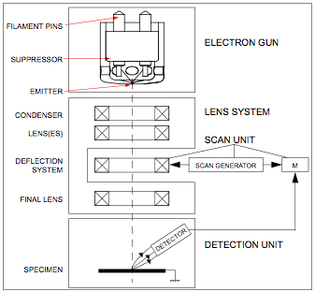
SEM Schematic Overview
All students using this system need to know how to use SEM. It is recommended that all users take SEM courses offered by the MSE department

Slide 7
Sample Size effect
1.5 inch
1.25 inch
All the samples needs to be prepared (polished) before EBSD data collection. As most samples are mounted before polishing, it is recommended to use smaller size mount (1.25 inch preferred)
It is difficult to work with large mounted samples (with 1.5 inch) in OIM as the edge of the mount may touch either the camera or the SEM emitter after tilting
It is critically important that the specimen does NOT touch the phosphor screen because this is easily damaged

Slide 8
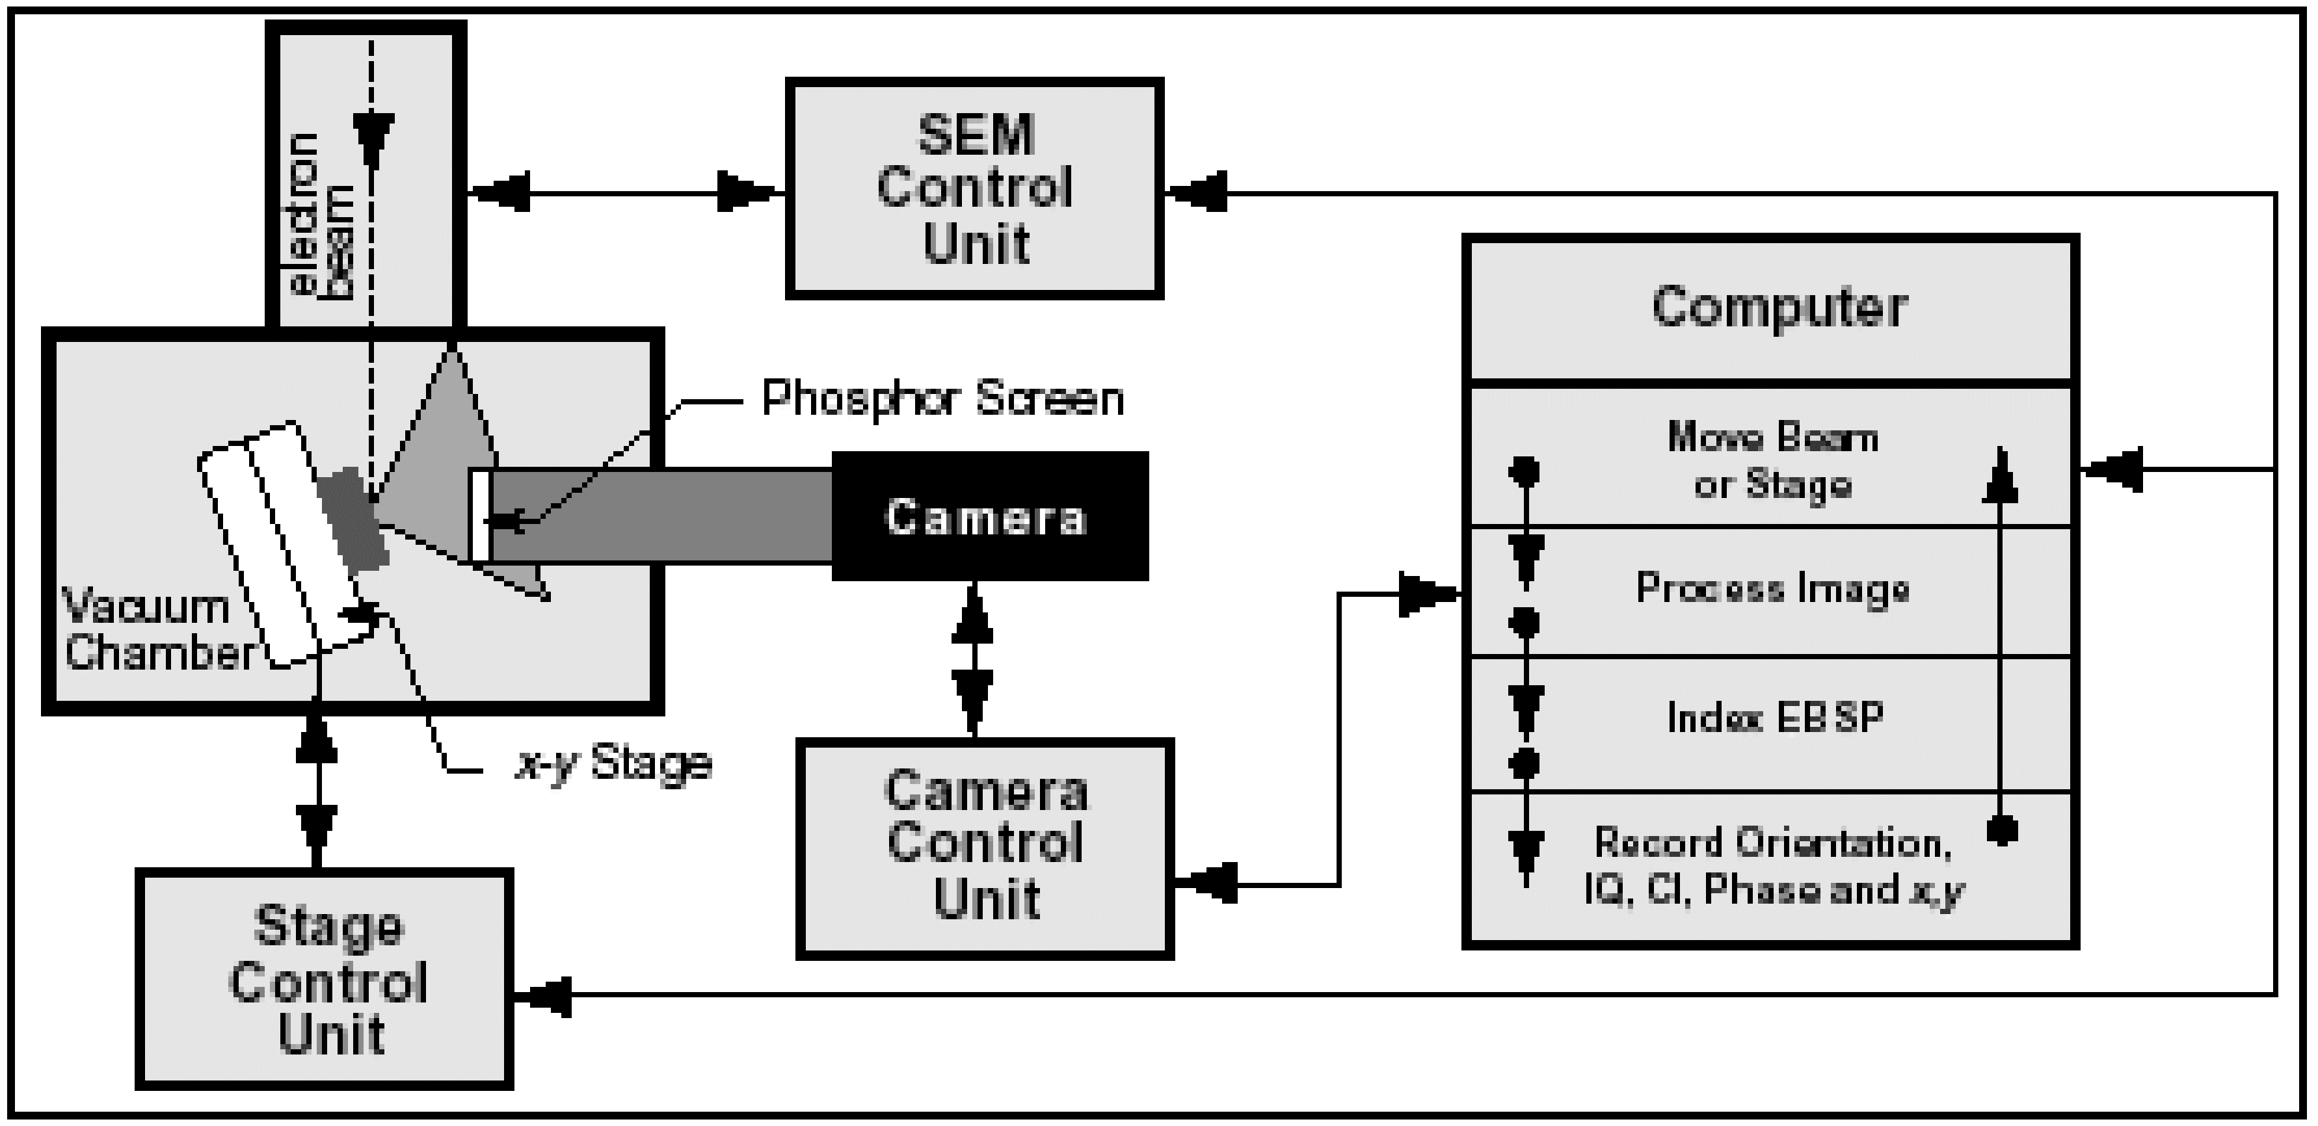
Diffraction Pattern-Observation Events
OIM computer asks Microscope Control Computer to place a fixed electron beam on a spot on the sample
A cone of diffracted electrons is intercepted by a specifically placed phosphor screen
Incident electrons excite the phosphor, producing photons
A Charge Coupled Device (CCD) Camera detects and amplifies the photons and sends the signal to the OIM computer for indexing

Slide 9
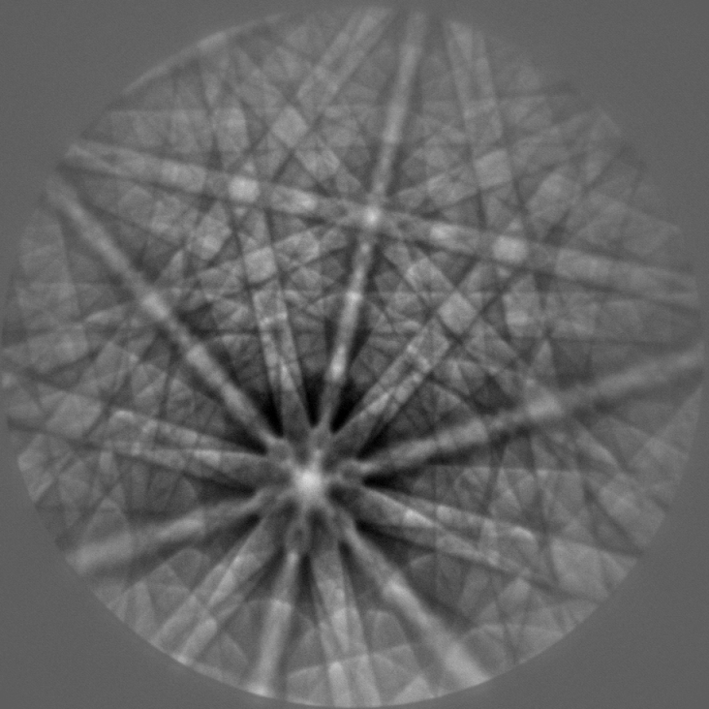
Electron backscatter diffraction (EBSD)
incoherent incoming wave field (produced by inelastic scattering)
coherent outgoing wave field (backscatter diffraction)
A typical EBSD pattern (Niobium, 15 kV)
sample
detector (with directional sensitivity)

Slide 10
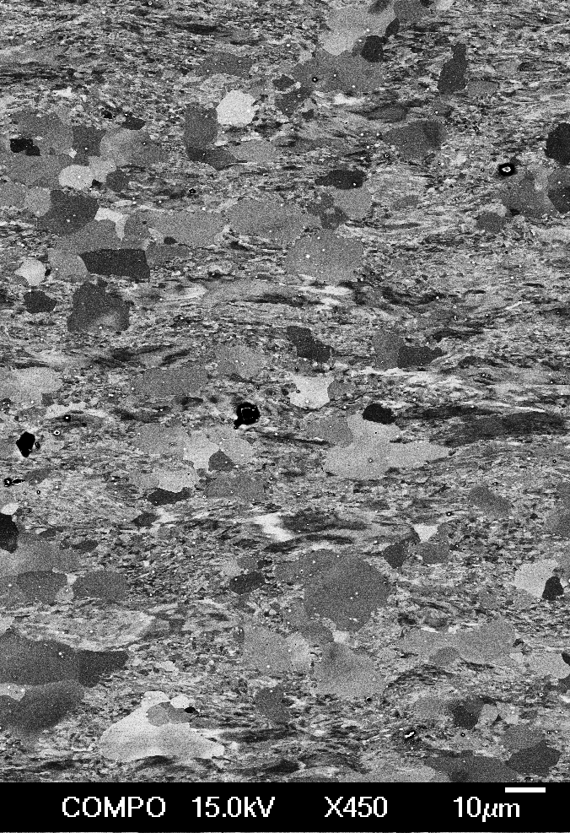

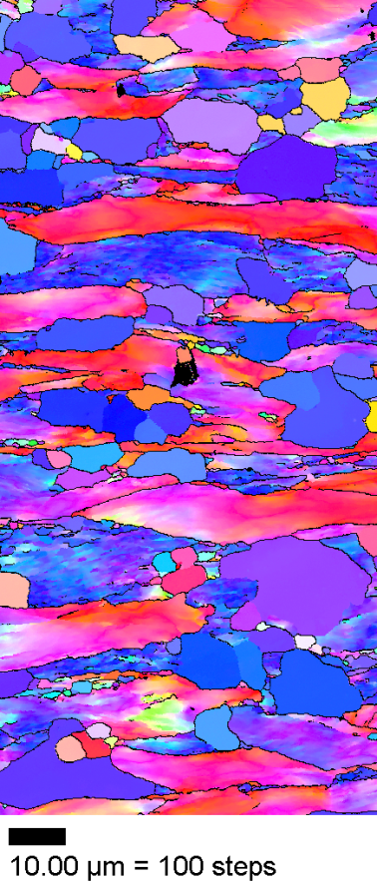
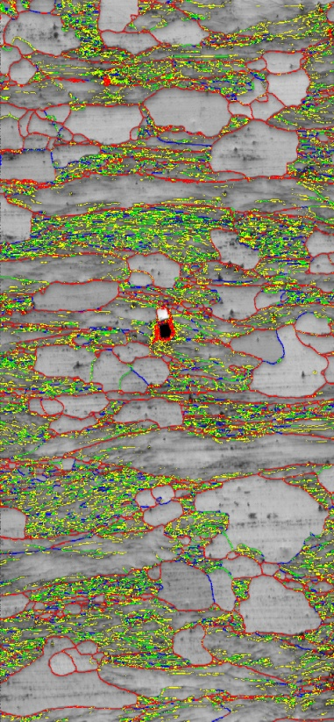
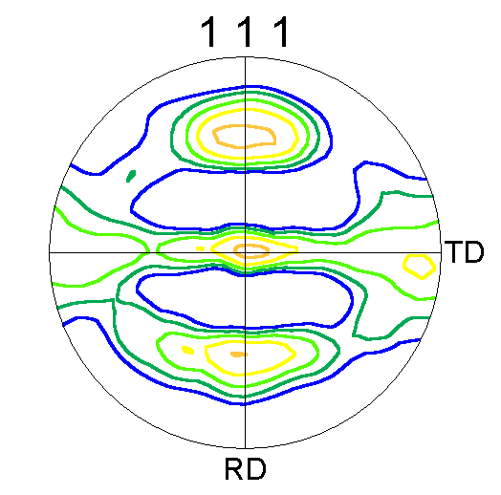
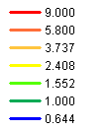
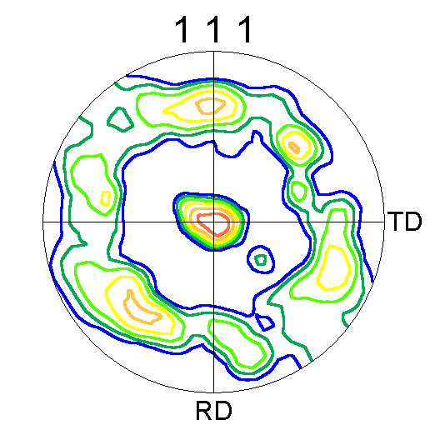
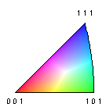

EBSD-based orientation microscopy
e⁻
deformed
recrystallised grains
BSEI of a partially recrystallised IF steel
inverse pole figure map
grain boundary character
pole figures
By nature a “quantitative” technique!
Spatial resolution: lateral ~ 20 … 80 nm, depth ~ 10 nm
Angular resolution: conventional 0.5°, special > 0.01°
Measured area: µm² … cm²
10

Slide 11
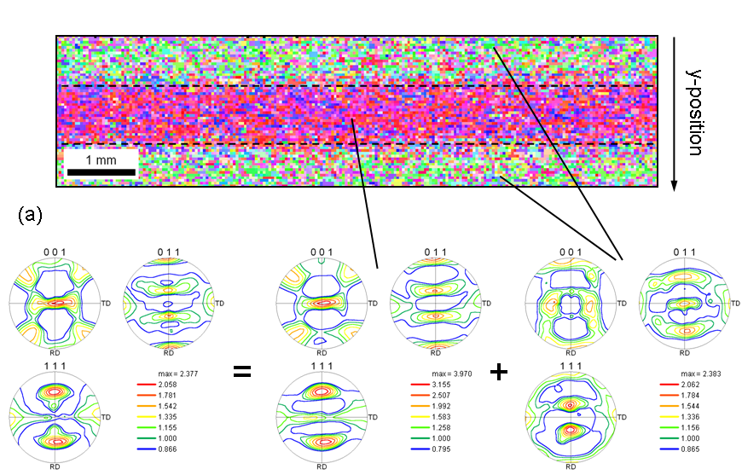
Measurement of macroscopic textures using EBSD
Advantages:
  direct measure of orientation distribution
  no corrections for absorption, defocussing etc. required
  no peak overlaps in multiphase materials
Texture field in a hot-rolled Si-steel
Challenges:
  statistical representativeness
  spatial resolution on highly deformed or sub-µ material

Slide 12
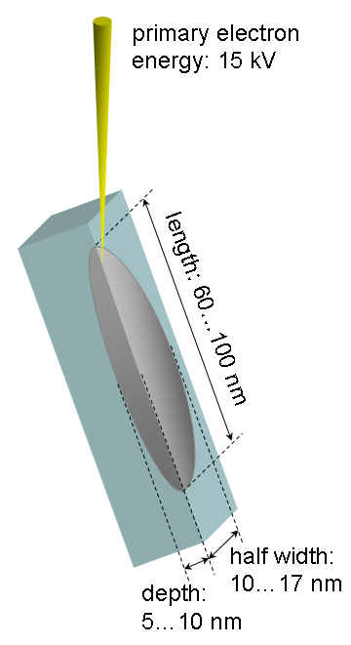
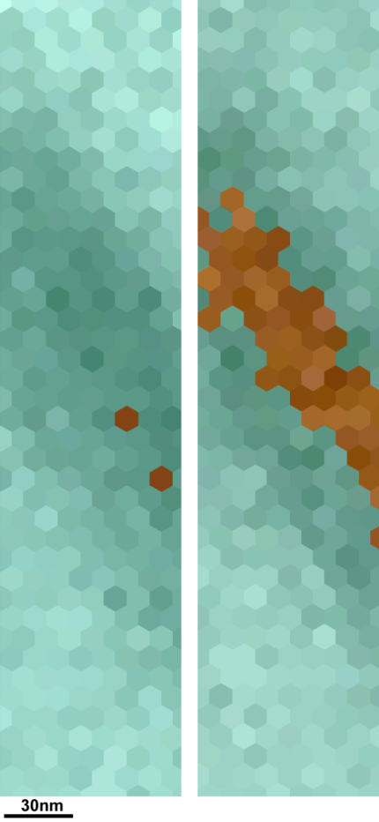
Spatial resolution of EBSD
50nm
15kV
7.5kV
D. Steinmetz, S. Zaefferer (2010), Mat. Sci. Tech. 26, 640

Slide 13
A word on spatial resolution of SEM and TEM
15 keV
200 keV
20·10³ nm³
2·10³ nm³
30 nm
75 nm
75 nm
EBSD-based orientation microscopy
5 nm
TEM-based orientation microscopy
10 nm
see, e.g., Zaefferer, Ultramic. (2007)
Notes:
13

Slide 14
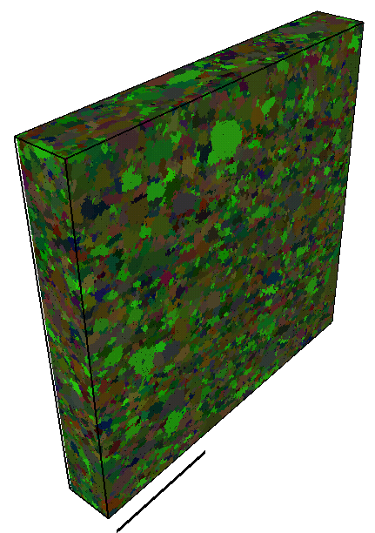
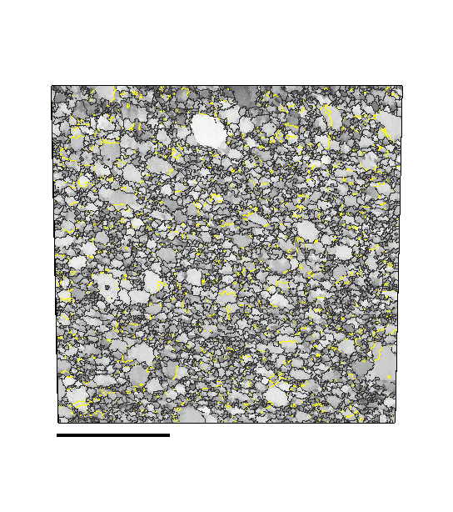
An example data set
All Euler colouring
Cu-Zr HPT-deformed & annealed
420 x 420 x 60 voxels; approx. 40,000 grains
Step Size 50 nm
Courtesy A. Khorashadizadeh, MPIE
Advanced Engineering Materials 13 237 (2011)
8 µm

Slide 15
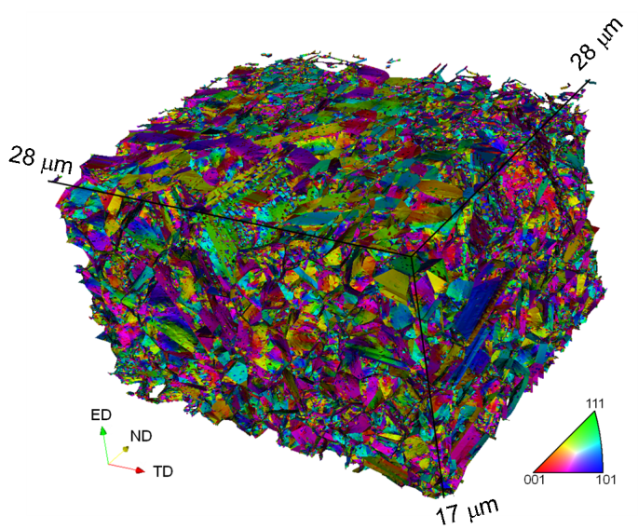
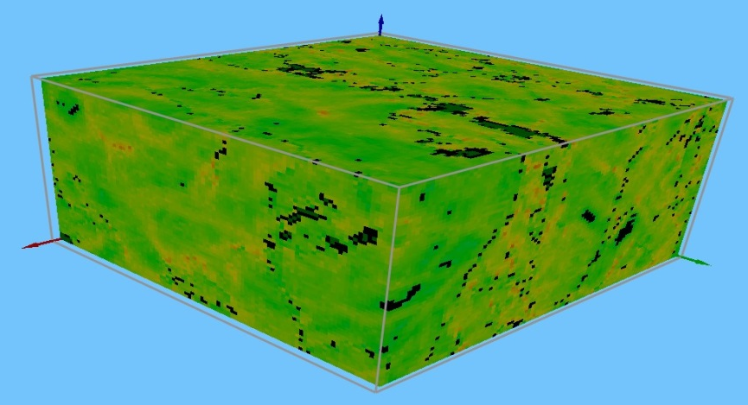
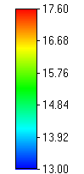
Applications of 3D orientation microscopy
3D morphology
5-parameter grain boundary characterization
Calculation of GND densities using the Nye-tensor approach
Coupling with modelling
Total GND density (log 1/m²)
Interfaces colored according to their miller indices

Slide 16
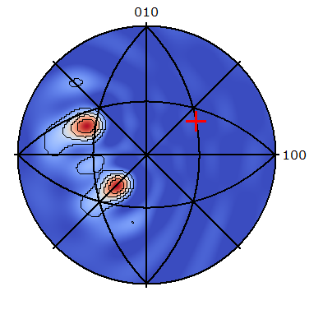
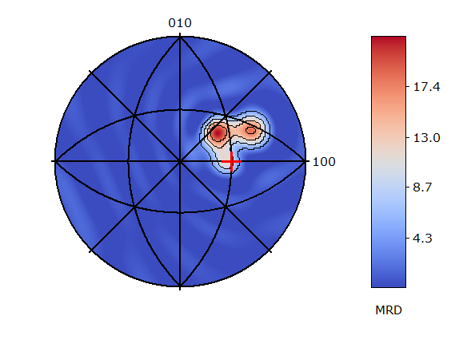
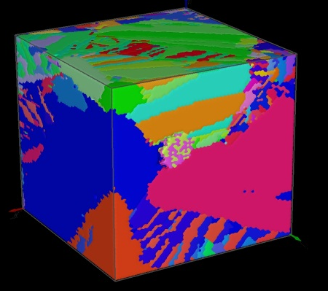
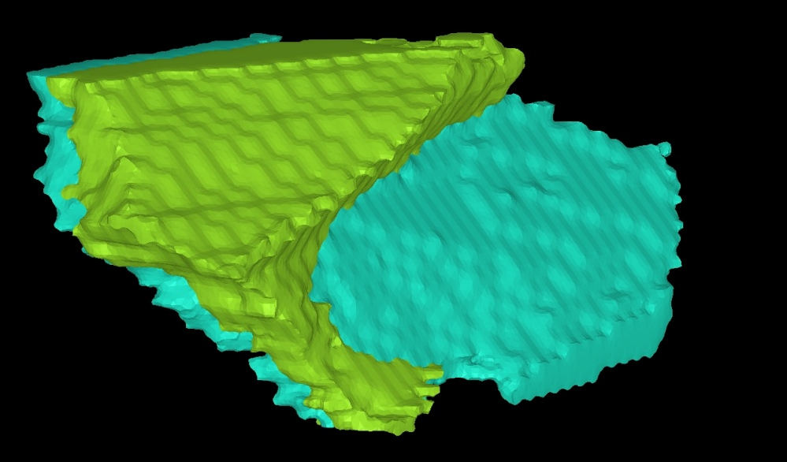
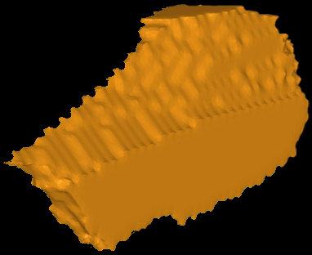

Grain Boundaries
57° <110>
3D EBSD: serial sectioning & reconstruction with software QUBE
(Konijnenberg, Bruker Nano)
53°<323>
(hkl)_{gb}
<uvw>
Tilt boundary
Twist boundary
ω
[uvw]
1 μm
Grain boundary normal vectors
(hkl)_{gb}
  5 rotational parameters: ω (1), <uvw> (2), (hkl)_{gb} (2)

Slide 17
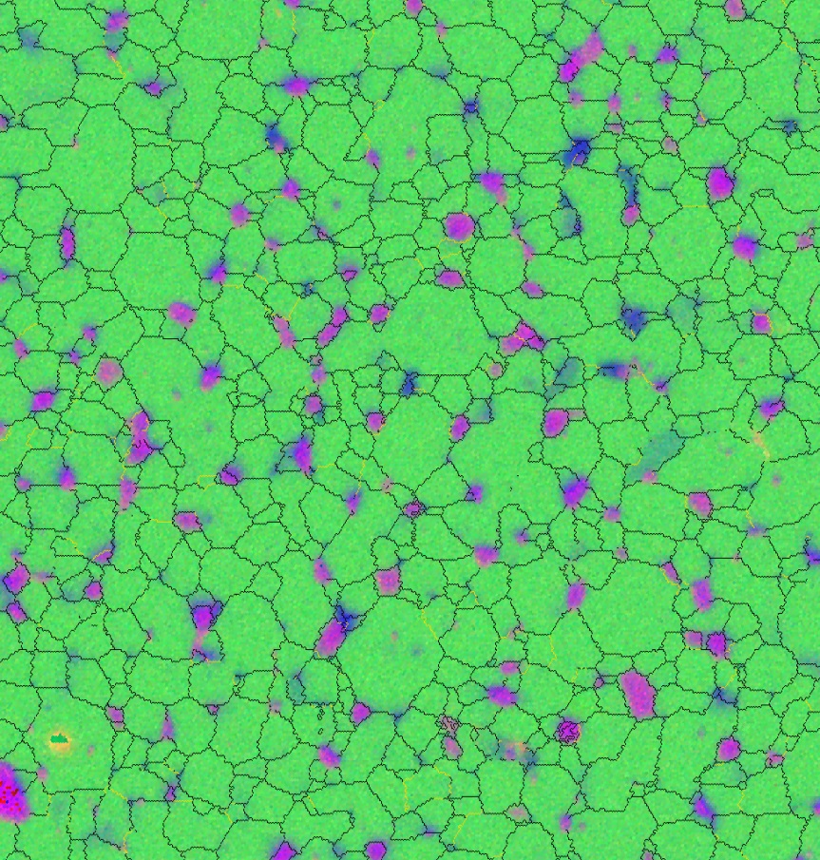
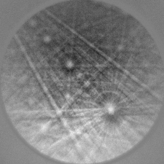
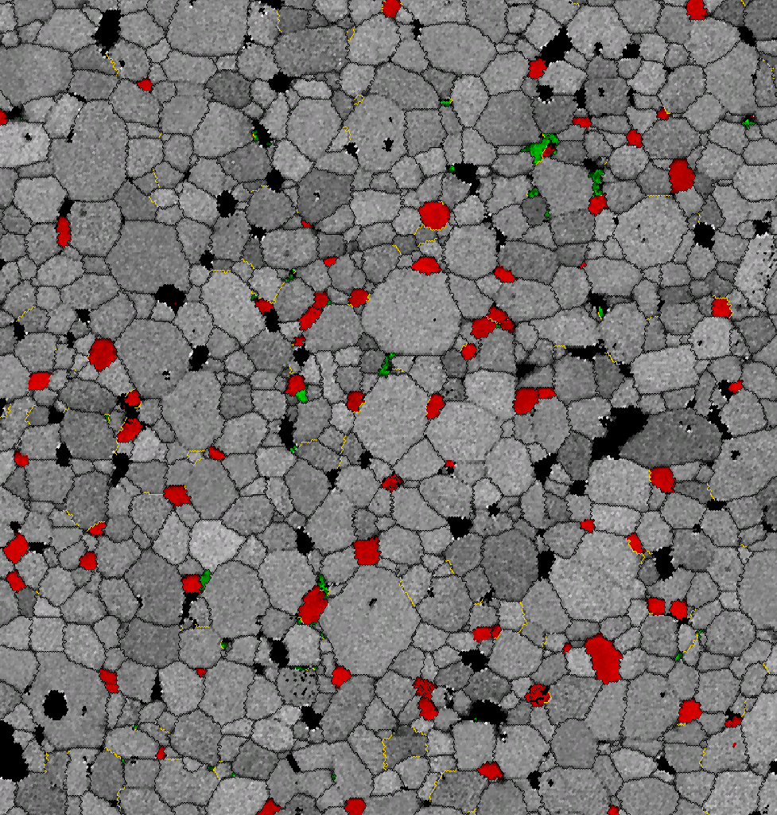
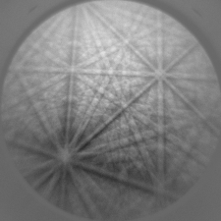
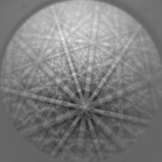
Phase and structure determination
FeNdB(-O )Material, Courtesy of T. Woodcock, IfW Dresden
Phases:
Nd2O3 – Red
NdO – Green
FeNdB - Gray
Unknown
cubic
EDS Counts:
O-Red
Fe-Green
Nd-Blue
trigonal

Slide 18
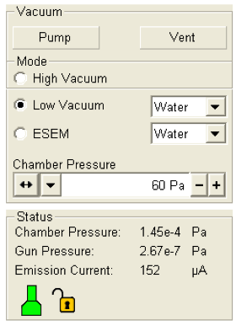
Vacuum System
The Quanta FEG has 3 operating vacuum modes to deal with different sample types:
  High Vacuum
  Low Vacuum
  ESEM (Environmental SEM)
Low Vacuum and ESEM can use water vapours from a built-in water reservoir which is supplied by the user and connected to a gas inlet provided.
Observation of outgassing or highly charging materials can be made using one of these modes without the need to metal coat the sample.

Slide 19
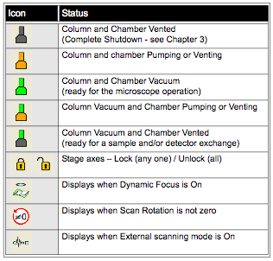
Vacuum Status
Green: PUMPED to the desired vacuum mode
Orange: TRANSITION between two vacuum modes (pumping / venting / purging)
Grey: VENTED for sample or detector exchange

Slide 20
The Tool Bar
Surface Positioning detector
(automatically detect working
Distance)
Image Refreshing rate
Turtle: lower refresh rate (higher resolution)
Rabbit: Higher refresh rate (lower resolution)
Automatic Contrast and Brightness (short key F9)

Slide 21
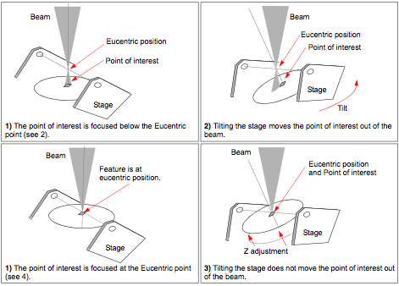
Eucentric Position
Note that eucentric position only occurs when the working distance is 10.

Slide 22
Diffraction Patterns-Source
Electron Backscatter Diffraction Patterns (EBSPs) are observed when a fixed, focused electron beam is positioned on a tilted specimen
Tilting is used to reduce the path length of the backscattered electrons
To obtain sufficient backscattered electrons, the specimen is tilted between 55-75º, where 70º is considered ideal because it maximizes the yield of backscattered electrons in the direction of the scintillation screen
The backscattered electrons escape from 30-40 nm underneath the surface, hence there is a diffracting volume
Note that
and
e⁻ beam
20-35º
δz
δy
δx

Slide 23
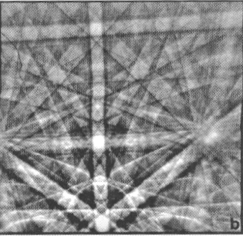
Diffraction Patterns-Anatomy of a Pattern
There are two distinct features:
  Bands
  Poles
• Bands are intersections of diffraction cones that correspond to a family of crystallographic planes
• The small Bragg angles mean that the lines of intersection of the cones with the scintillation screen are effectively straight lines
Band widths are proportional to the inverse interplanar spacing
Intersection of multiple bands (planes) correspond to a pole of those planes (vector)
Note that while the bands are bright, they are surrounded by thin dark lines on either side
X
X
X
X

Slide 24
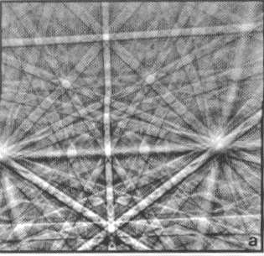
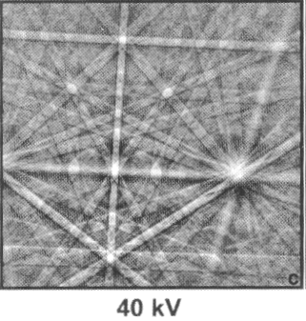
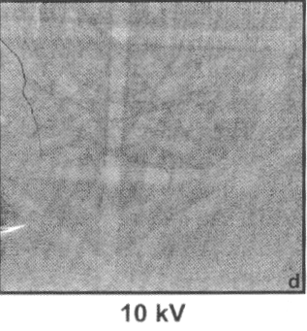
Diffraction Pattern-SEM Settings
Increasing the Accelerating Voltage increases the energy of the electrons Increases the diffraction pattern intensity
Higher Accelerating Voltage also produces narrower diffraction bands (a vs. b) and is necessary for adequate diffraction from coated samples (c vs. d)
Larger spot sizes (beam current) may be used to increase diffraction pattern intensity
High resolution datasets and non-conductive materials require lower voltage and spot size settings
For insulators (most ceramics), consider using a low-vacuum “environmental” SEM.

Slide 25
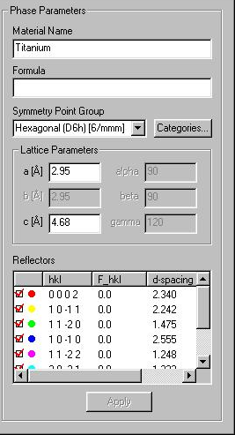
System setup-Material data
In order for the system to index diffraction patterns, three material characteristics need to be known:
  Symmetry
  Lattice parameters
  Reflectors
“Reflector” means a particular set of lattice planes (“hkl” values)
Information for most materials exist in TSL .mat files
“Custom” material files can be generated using the ICDD powder diffraction data files; try searching http://www.crystallography.net/new.html to find information. For example, the MTEX software reads CIF files to determine crystal structure and symmetry.
Symmetry and Lattice parameters can be readily input from the ICDD data
Reflectors with the highest intensity should be used (4-5 reflectors for high symmetry; up to 12 reflectors for low symmetry)

Slide 26
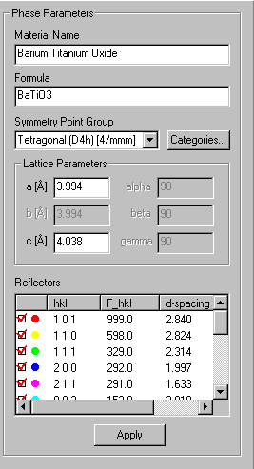
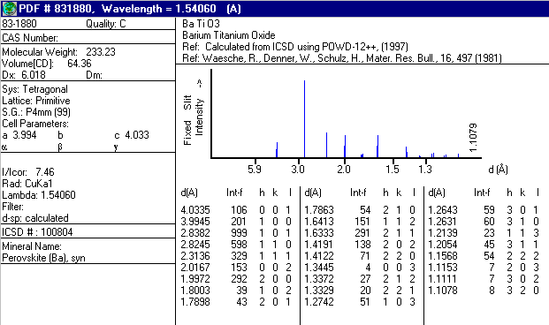
System setup-Material data
Enter appropriate material parameters
Reflectors should be chosen based on:
  Intensity (higher intensity is better)
  The number per zone

Slide 27
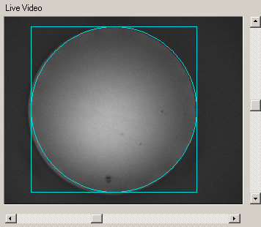
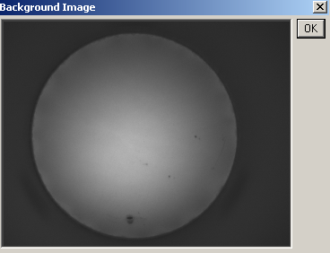
Pattern capture-Background
Live signal
Averaged signal
The background is the fixed variation in the captured frames due to the spatial variation in intensity of the backscattered electrons
Removal is done by averaging 8 frames (SEM in TV scan mode)
Note the variation of intensity in the images. The brightest point (marked with X) should be close to the center of the captured circle.
The location of this bright spot can be used to indicate how appropriate the Working Distance is. A low bright spot = WD is too large and vice versa

Slide 28
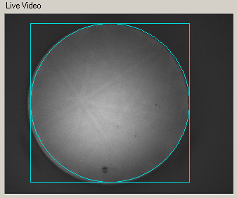
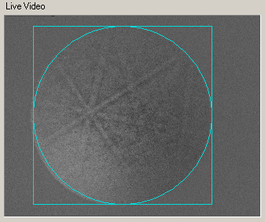


Pattern capture-Background Subtraction
Without subtraction
With subtraction
The background subtraction step is critical as it “brings out” the bands in the pattern
The “Balance” slider can be used to aid band detection. Usually a slightly lower setting improves indexing even though it may not appear better to the human eye

Slide 29
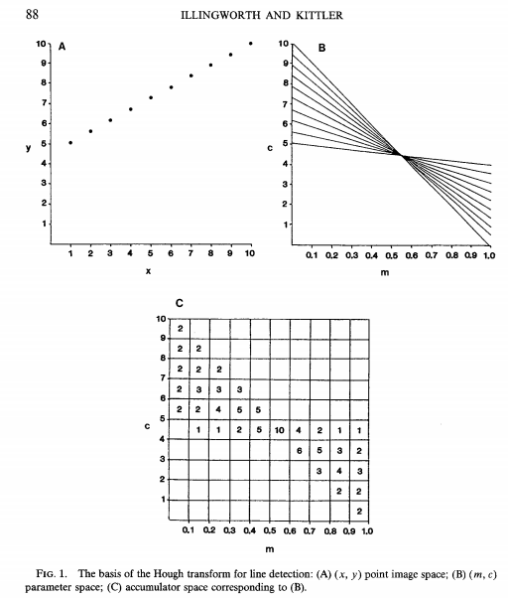
Hough: Accumulator Diagram (1)
The most basic idea behind the Hough transform is to take each point in the image and “spread it out” along the line defined by the transform in Hough space (angle vs. radius).
See: Illingworth and Kittler Computer Vision, Graphics and Image Processing, 44, 87-116 (1988); Duda & Hart (1972), “Use of Hough transform to detect lines and curves in picture”, Communications of the ACM, 15 11-15.

Slide 30
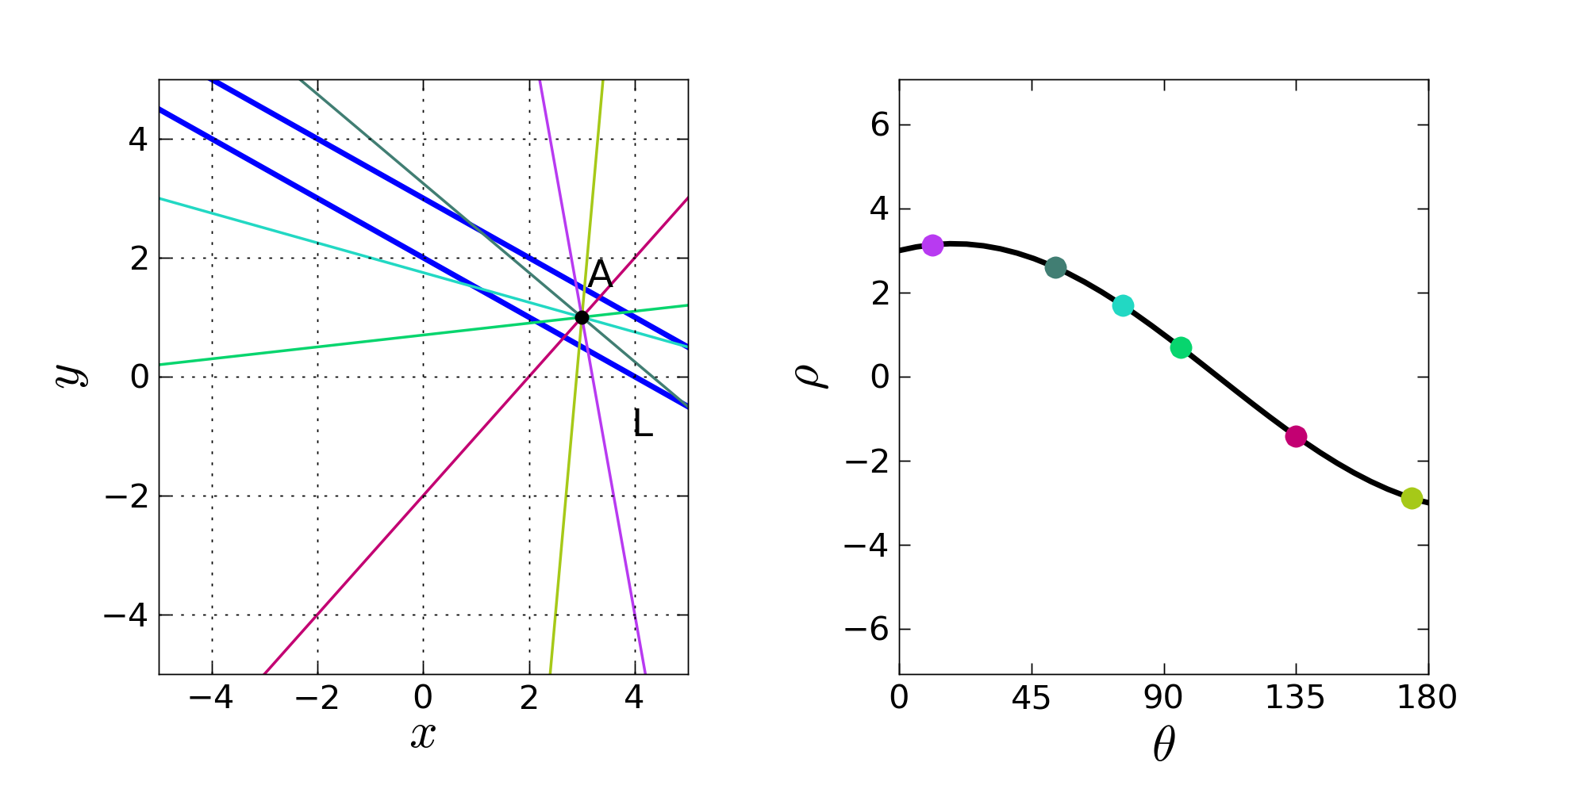
Hough: Accumulator Diagram (2)
The following is quoted (12 iv 14) from: http://www.ebsd-image.org/documentation/reference/ops/hough/op/houghtransform.html
“Effectively, this transformation converts each pixel of the image space into a sinusoidal curve in the Hough space. The calculated ρ value is rounded to the closest pixel ρ_{j}. The intensity of the pixels (θ_{j}, ρ_{j}) that are part of the sinusoidal curve are augmented by the intensity of the corresponding pixel (x_{i},y_{i}) in the image space. The accumulation of these intensities give rise to peaks in the Hough space which corresponds to the θ and ρ coordinates of the bands in the image space.”

Slide 31
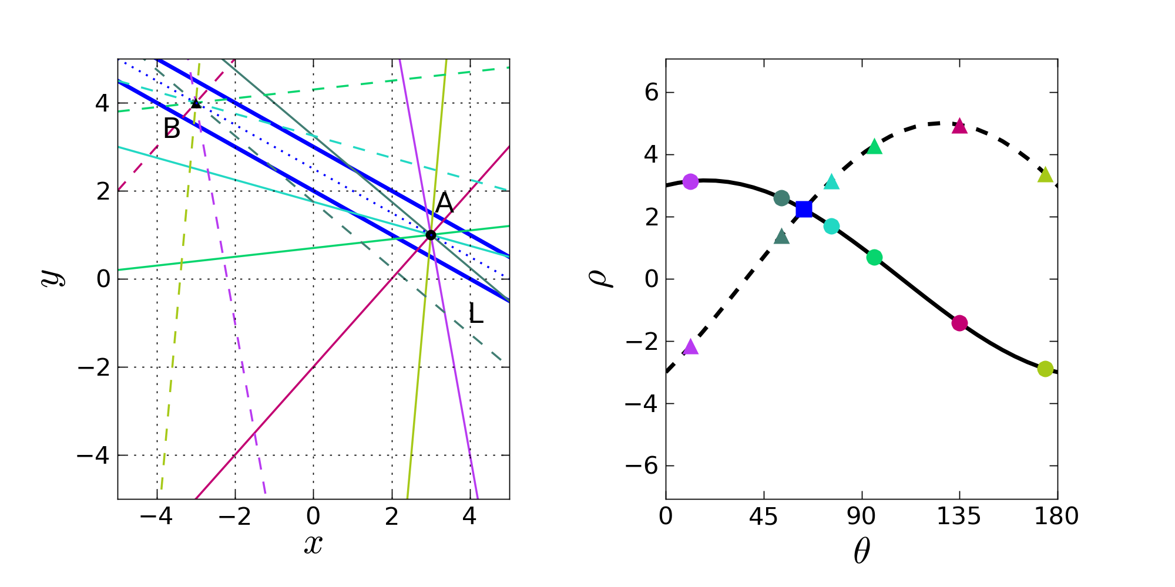
Hough: Accumulator Diagram (3)
The following is quoted from: http://www.ebsd-image.org/documentation/reference/ops/hough/op/houghtransform.html
Additional Refs:
• Krieger Lassen (1994). Automated determination of crystal orientations from electron backscattering patterns. (Unpublished doctoral dissertation). The Technical University of Denmark.
• Tao & Eades (2005). Errors, artifacts, and improvements in ebsd processing and mapping. Microscopy Microanalysis, 11 79-87.
“From the definition of the Hough transform, each pixel in the image space is transformed into a sinusoidal curve in the Hough space. The curve represents all the possible uni-dimensional lines that can pass through that pixel in the image space. A few lines are drawn in the figure above with their corresponding position in Hough space represented by circle markers. Only a small fraction of the lines are fully contained in the band, the rest of the lines cross it, but most of their pixels are outside the band.
If this geometrical construction is repeated for another pixel, B, of the band L, the same result is obtained. In the figure above, the lines passing by B and their equivalent representation in Hough space using triangular marker. All the lines or curves related to pixel B are drawn as dashed lines.
The lines inside of band L and passing by pixel B are the same lines that are also passing by pixel A. In Hough space, these lines end up having the same coordinates θ and ρ, forming a peak. The intersection of the sinusoidal curves therefore corresponds to the lines that are fully inscribed inside the band in the image space. The intensity at this intersection is higher than the background because of two interlinked reasons: a) the sinusoidal curve of the pixels in the band have a higher intensity that the one of the pixels outside of it; and b) the intensity of many sinusoidal curves is added at this intersection.”

Slide 32
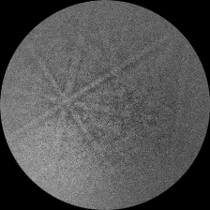
Detecting Patterns-Hough Transform
A modified Hough Transform is used, and transforms the pattern so that it has a reference frame that is akin to polar coordinates
Lines in the captured pattern with points (x_{i},y_{i}) are transformed into the length of the orthogonal vector, ρ and an angle θ
The average grayscale of the line (x_{i},y_{i}) in Cartesian space is then assigned to the point (ρ,θ) in Hough space
Cartesian space
Transformed (Hough) space
y
ρ=n
II
I
I
II
ρ
ρ=0
θ
O
III
IV
O
x
III
IV
ρ=-n
θ=0
θ=π/2
θ=π
I: 0≤ρ≤n ; 0≤θ≤π/2
III: -n≤ρ<0 ; 0≤θ≤π/2
II: 0≤ρ≤n ; π/2<θ≤π
IV: -n≤ρ<0 ; π/2<θ≤π
2n = Hough bin size

Slide 33

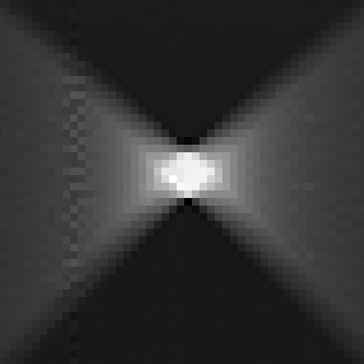
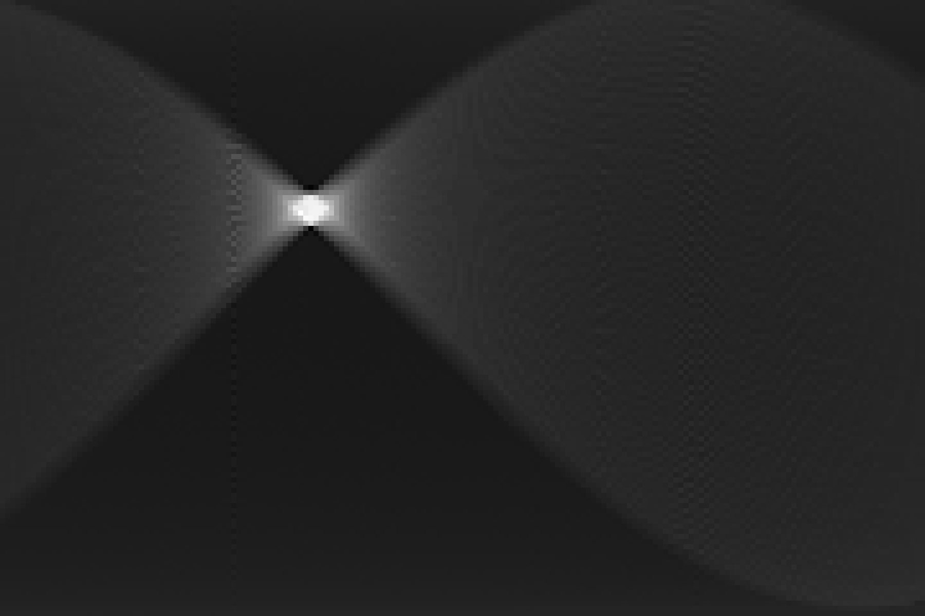
Detecting Patterns-The Hough of one band
Cartesian space
Transformed (Hough) space
Since the patterns are composed of bands, and not lines, the observed peaks in Hough space are a collection of points and not just one discrete point
Lines that intersect the band in Cartesian space are on average higher than those that do not intersect the band at all

Slide 34
Setting up binning/mask
Due to the shape of a band in Hough space, a multiplicative mask can be used to intensify the band grayscale
Three mask sizes are available: 5 x 5, 9 x 9, 13 x 13. These numbers refer to the pixel size of the mask
A 5 x 5 block of pixels is processed at a time
The grayscale value of each pixel is multiplied by the corresponding mask value
The total value is added to the grayscale value at the center of the mask
Note that the sum of the mask elements = zero
5 x 5 mask

Slide 35
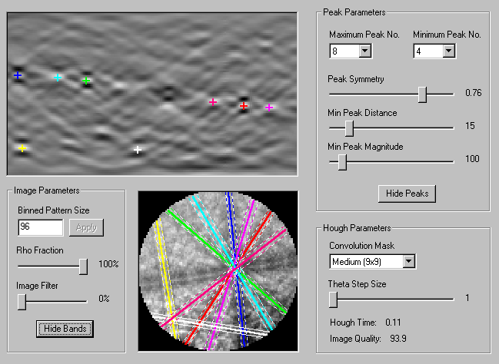

Detecting Patterns-Hough Parameters
More peaks | Less peaks
Use with low symmetry | Use with cubic materials
Increases the number of solutions | Decreases the number of solution
Symmetry 0
Symmetry 1
Smaller distance | Larger distance
Closely spaced bands | Sparsely distributed bands
Smaller mag. | Larger mag.
Band intensity is low | Band intensity is high
Binned Pattern Size=Hough resolution in ρ
Smaller size | Larger size
Use with broad bands | Use with narrower bands
Use for faster speed | Use with low symmetry materials
I.Q.=Average grayscale value of detected Hough peaks

Slide 36
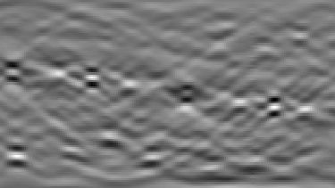

Indexing Patterns-Identifying Bands
Procedure:
  Generate a lookup table from given lattice parameters and chosen reflectors (planes) that contains the inter-planar angles
  Generate a list of all triplets (sets of three bands) from the detected bands in Hough space
  Example (cubic): 100^111 = 54.7°; 111^110 = 35.3°; 100^110 = 45°
  Calculate the inter-planar angles for each triplet set
  Since there is often more than one possible solution for each triplet, a method that uses all the bands needs to be implemented

Slide 37

Indexing Patterns-Settings
Tolerance = How much angular deviation a plane is allowed while being a candidate
Lower Tolerance | Larger Tolerance
Use if many bands are tightly bunched | Use with poorer patterns
Higher speed (eliminates possible solutions) | Lower speed (more possible solutions)
Band widths: check if the theoretical width of bands should be considered during indexing
If multi-phase indexing is being used, a “best” solution for each phase will be calculated. These values assign a weight to each possible factor:
Votes: based on total votes for the solution/largest number of votes for all phases
CI: ratio of CI/largest CI for all phases
Fit: fit for the solution/best (smallest) fit between all phases
The indexing solution of the phase with the largest Rank value is chosen as the solution for the pattern

Slide 38

Indexing Patterns-Voting Scheme
Consider an example where there exist:
  Only 10 band triplets (i.e. 5 detected bands)
  Many possible solutions to consider, where each possible solution assigns an hkl to each band. Only 11 solutions are shown for illustration
Triplets are illustrated as 3 colored lines
If a solution yields inter-planar angles
within tolerance, a vote or an “x” is
marked in the solution column
The solution chosen is that with most
number of votes
Confidence index (CI) is calculated as
Once the solution is chosen, it is compared
to the Hough and the angular deviation is
calculated as the fit
Solution #
Band triplets
# votes
S1 (solution w/most votes)
S2 (solution w/ 2ndmost votes)

Slide 39
Scanning
The selection of scanning parameters depends on some factors:
  Time allotted
  Desired area of coverage (scan size)
  Desired detail (step size)
To determine if the scan settings are acceptable time-wise you must:
  Start the scan
  Use a watch and note how many patterns are solved per minute (n)
  Divide the total number of points by n to get the total time
To decide if the step size is appropriate for your SEM settings, use the following rough guide:

Slide 40
Supplemental

Slide 41

Cubics: interplanar angles

