Slide 1


OD Calculation from
Pole Figure Data
27-750
Texture, Microstructure & Anisotropy
A.D. Rollett
Last revised: 2nd Feb. ‘14

Slide 2
Notation
p Intensity in pole figure
α, β angles in pole fig.
Ψ,Θ,φ Euler angles (Roe/Kocks)
Γ integration variable
Y_{lmn} Spherical harmonic function
P Associated Legendre polynomial
Q Coefficient on Legendre polynomial
l,m,n integer indices for polynomials
Z_{lmn} Jacobi polynomials
W Coefficient on Jacobi polynomial
ξ, η polar coordinates pole (hkl) in crystal coordinates
odd part of the orientation distribution function
even part of the orientation distribution function

Slide 3
Notation: 2
I = no. pole figures
M = multiplicity
N = normalization
y = connectivity matrix between pole figures and orientation distribution space
f = intensity in the orientation distribution
p = pole figure intensity
m = pole figure index

Slide 4
Objectives
To explain what is being done in popLA, Beartex, and other software packages when pole figures are used to calculate Orientation Distributions
To explain how the two main methods of solving the “fundamental equation of texture” that relates intensity in a pole figure, p, to intensity in the OD, f.

Slide 5
In-Class Questions
Does the WIMV method fit a function to pole figure data, or calculate a discrete set of OD intensity values that are compatible with the input? Answer: discrete ODs.
Why is it necessary to iterate with the harmonic method with typical reflection-method pole figures? Answer: because the pole figures are incomplete and iteration is required to fill in the missing parts of the data.
What is the significance of the “order” in harmonic fitting? Answer: the higher the order, the higher the frequency that is used. In general there is a practical limit around l=32.
What is a “WIMV matrix”? Answer: this is a set of relationships between intensities at a point in a pole figure and the corresponding set of points in orientation space, all of which contribute to the intensity at that point in the pole figure.
What is the “texture strength”? This is the root-mean-square value of the OD.

Slide 6
Methods
Two main methods for reconstructing an orientation distribution function based on pole figure data.
Standard harmonic method fits coefficients of spherical harmonic functions to the data.
Second method calculates the OD directly in discrete representation via an iterative process (e.g. WIMV method).

Slide 7
History
Original proposals for harmonics method:
Pursey & Cox (1954), Phil. Mag. 45 295-302;
also Viglin (1960), Fiz. Tverd. Tela 2 2463-2476.
Complete methods worked out by Bunge and Roe: “Zur Darstellung Allgemeiner Texturen”, Bunge (1965), Z. Metall., 56 872-874; “Description of crystallite orientation in polycrystalline materials. III. General solution to pole figure inversion”, Roe (1965): J. Appl. Phys., 36 2024-2031.
WIMV method:
Matthies & Vinel (1982): Phys. Stat. Solid. (b), 112 K111-114.
MTex method: “A novel pole figure inversion method: specification of the MTEX algorithm”, Hielscher & Schaeben (2008): J. Appl. Cryst. 41 1024–1037.

Slide 8
Harmonics
Spherical harmonics, Y_{lmn}:
An infinite series of orthogonal functions that can be used to describe data (intensities) that depend on (two) spherical angles (but not radius). Analogous to Fourier series. Legendre polynomials are a special case of spherical harmonics. Used to fit pole figure (PF) data (intensities). Also used extensively in quantum mechanics. See http://en.wikipedia.org/wiki/Spherical_harmonics.
Generalized spherical harmonics:
An infinite series of orthogonal functions that can be used to describe data that depend on (three) Euler angles (like spherical angles plus an extra longitude angle). Used to fit Orientation Distribution data (intensities).
Orthogonal functions:
Two functions, f and g, are orthogonal when their inner product is zero (analogous to the dot product between two vectors being zero when they are orthogonal/perpendicular). See http://en.wikipedia.org/wiki/Orthogonal_functions.

Slide 9
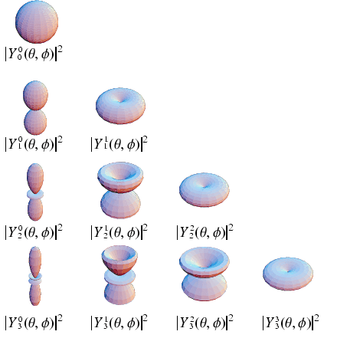
Series Expansion Method
akbar.marlboro.edu
The harmonic method is a
two-step method.
First step: fitting coefficients
to the available PF data, where
p is the intensity at an
angular position; α, β, are the declination and azimuthal angles, Q are the coefficients, P are the associated Legendre polynomials and l and m are integers that determine the shape of the function.
Useful URLs:
  geodynamics.usc.edu/~becker/teaching-sh.html
  http://commons.wikimedia.org/wiki/Spherical_harmonic

Slide 10
Pole Figure (spherical) angles
TD
β
: azimuth
declination:
α
RD
ND
You can also think of these angles as longitude ( = azimuth) and co-latitude ( = declination, i.e. 90° minus the geographical latitude)

Slide 11
coefficients to be determined
Notes:
p: intensity in the pole figure
P: associated Legendre polynomial
l: order of the spherical harmonic function
l,m: govern shape of spherical function
Q: can be complex, typically real

Slide 12

Coefficients of Sph. Harmonics
The functions are orthogonal, which allows integration to find the coefficients. Notice how the equation for the Q values is now explicit and based on the intensity values in the pole figures!
“Orthogonal” has a precise mathematical meaning, similar to orthogonality or perpendicularity of vectors. To test whether two functions are orthogonal, integrate the inner product of the two functions over the range in which they are valid. This is a very useful property because, to some extent, sets of such functions can be treated as independent units, just like the unit vectors used to define Cartesian axes. In this case we must integrate over the applicable ranges of the angles.

Slide 13
Orientation Distribution Expansion
The expressions in Roe angles are similar, but some of the notation, and the names change.
Notes:
Z_{lmn} are Jacobi polynomials
Objective: find values of coefficients, W, that fit
the pole figure data (Q coefficients).

Slide 14
Fundamental Equation
If, and only if (hkl) = (001), then integrate directly over 3rd angle, φ:
For a general pole, there is a complicated
relationship between the integrating parameter,
Γ, and the Euler angles.

Slide 15
Solution Method
coefficients to
be determined
• Obtained by inserting the PF and OD equations
the Fundamental Equation relating PF and OD.
• ξ and η are the polar coordinates of the pole (hkl)
in crystal coordinates.
• Given several PF data sets (sets of Q) this gives
a system of linear simultaneous equations, solvable for W.

Slide 16
Order of Sph. Harm. Functions
Simplifications: cubic crystal symmetry requires that W_{2mn}=0, thus Q_{2m}=0.
All independent coefficients can be determined up to l=22 from 2 PFs.
Sample (statistical) symmetry further reduces the number of independent coefficients.
Given W, other, non-measured PFs can be calculated, also Inverse Pole Figures.

Slide 17
Incomplete Pole Figures
Lack of data (from the standard reflection method for measuring PFs) at the edges of PFs requires an iterative procedure. The reason is that the integration (summation) described before only applies (directly) if the PFs are complete.
1: estimate PF intensities at edge by extrapolation;
2: make estimate of W coefficients;
3: re-calculate the edge intensities;
4: replace negative values in the OD by zero;
5: iterate until criterion satisfied.

Slide 18
Series Expansion Advantages
Set of coefficients (for each generalized spherical harmonic) is a compact representation of texture.
Rapid calculation of anisotropic properties possible; this is particularly true of elastic anisotropy where one only needs coefficients up to l=4.
Automatic smoothing of OD from truncation at finite order (equivalent to limiting frequency range in Fourier analysis).

Slide 19
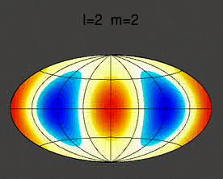
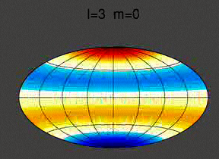
Ghosts
Distribution of poles on a sphere, as in a PF, is centro-symmetric.
Sph. Harmonic Functions are centrosymmetric for l=even but antisymmetric for l=odd. Therefore the Q=0 when l=odd.
Coefficients W for l=odd can take a range of values provided that PF intensity=0 (i.e. the intensity can vary on either side of zero in the OD).

Slide 20
Ghosts, contd.
Need the odd part of the OD to obtain correct peaks and to avoid negative values in the OD (which is a probability density).
Can use zero values in PF to find zero values in the OD: from these, the odd part can be estimated, Bunge & Esling, J. de Physique Lett. 40, 627(1979).

Slide 21
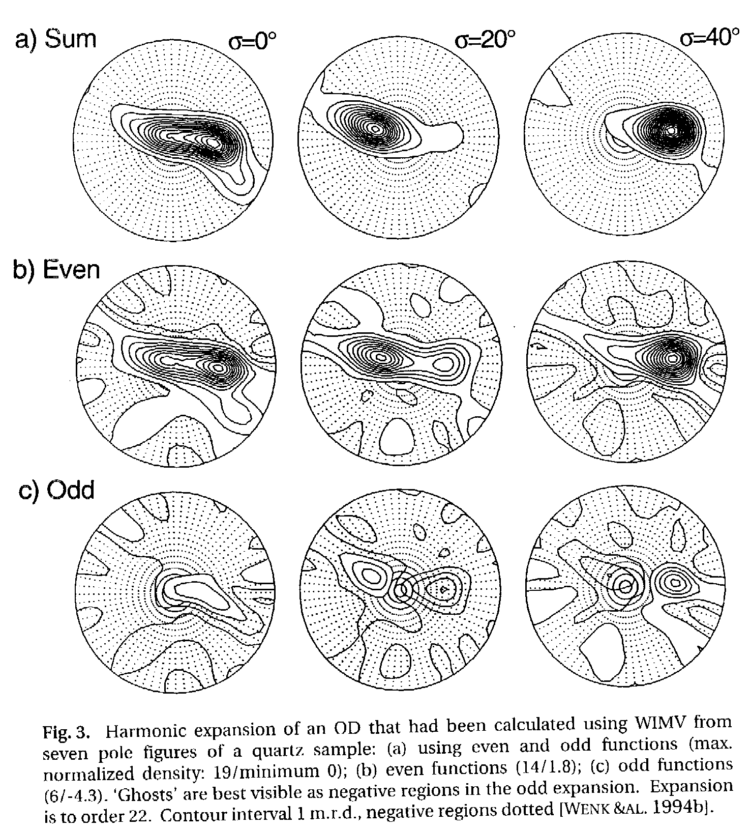
Example of ghosts
Quartz sample;
7 pole figures;
WIMV calculation;
harmonic expansions
If only the even part
is calculated, ghost
peaks appear - fig (b)
[Kocks Tomé Wenk]

Slide 22
Discrete Methods: History
Williams (1968): J. Appl. Phys., 39, 4329.
Ruer & Baro (1977): Adv. X-ray Analysis, 20, 187-200.
Matthies & Vinel (1982): Phys. Stat. Solid. (b), 112, K111-114.
The idea behind the discrete methods was to construct intensity values for a discrete form of the Orientation Distribution (OD) directly from pole figure data, with no function being fitted.

Slide 23
Discrete Methods
Establish a grid of cells in both PF and OD space; e.g. 5°x5° and 5°x5°x5°.
Calculate a correspondence or pointer matrix between the two spaces, i.e. y(g). Each cell in a pole figure is connected to multiple cells in orientation space (via the equation above). More specifically, the intensity in each pole figure cell is the summation of the intensities in the associated OD cells.
Corrections needed for cell size, shape.

Slide 24
Initial Estimate of OD
Initial Estimate of the Orientation Distribution:
I = no. pole figures;
M = multiplicity;
N = normalization;
f = intensity in the orientation distribution;
p = pole figure intensity;
m = pole figure index

Slide 25
Iteration on OD values
Iteration to Refine the Orientation Distribution:
Note: the correction is squared in the second iteration (in the WIMV program), provided that the intensity is to be increased. This sharpens the distribution.

Slide 26
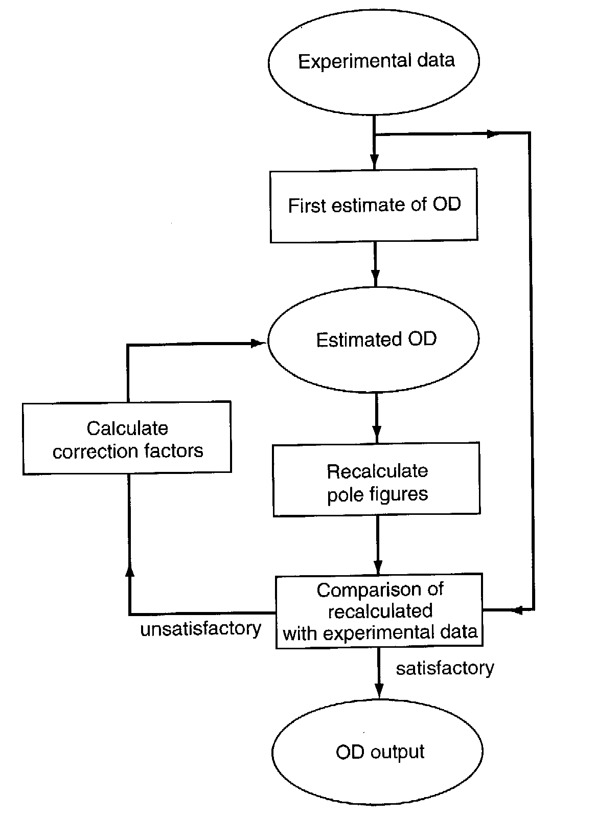
Flow Chart
[Kocks Tomé Wenk, Ch. 4]

Slide 27
“RP” Error
RP: RMS value of relative error (∆P/P)
- not defined for f=0.
Note: this definition of the RP error, which is output by the WIMV code (part of popLA) in each iteration, was updated to reflect the actual code, Sept. 2011.

Slide 28
Discrete Method: Advantages
Ghost problem automatically avoided by requirement of f >0 in the solution.
Zero range in PFs (i.e. an intensity value = 0) automatically leads to zero range in the OD.
Much more efficient for lower symmetry crystal classes: useful results obtainable for only three measured PFs.

Slide 29
Discrete Method: Disadvantages
Susceptible to noise (filtering possible).
Normalization of PF data is critical (harmonic analysis helps with this).
Depending on OD resolution, large set of numbers required for representation (~5,000 points for 5x5x5 grid in Euler space), although the speed and memory capacity of modern PCs have eliminated this problem.
Pointer matrix is also large, e.g. 5.10⁵ points required for OD ↔ {111}, {200} & {220} PFs.

Slide 30
MTex method
From the 2008 paper, the method uses advanced numerical analysis to find a best-fit ODF from pole figure data.
“…is the approximation by finite linear combinations of radially symmetric functions, i.e. by functions of the form:”
Ψ is a non-negative radially symmetric function and g₁,..., g_{M} is a set of nodes in the domain of rotations.

Slide 31
Texture index, strength
Second moment of the OD provides a scalar measure of the randomness, or lack of it in the texture:
Texture Index = <f²>
Texture Strength = √<f²>
Random: texture index & strength = 1.0
Any non-random OD has texture strength > 1.
If textures are represented with lists of discrete orientations (e.g. as in *.WTS files) then weaker textures require longer lists.
One can also compute the entropy of an OD as S=-Σf(g)ln(f(g)). There is an apparent problem about what to do with zero values. However, in the case of p(x_{i}) = 0 for some i, the value of the corresponding entropy term [0 log(0)] is taken to be 0, which is consistent with the well-known limit: limit{p → 0⁺} pln(p) = 0. Strong textures will exhibit large entropies and a perfectly uniform (random) texture will have an entropy of zero.
Some methods of pole figure reduction are based on entropy maximization.

Slide 32
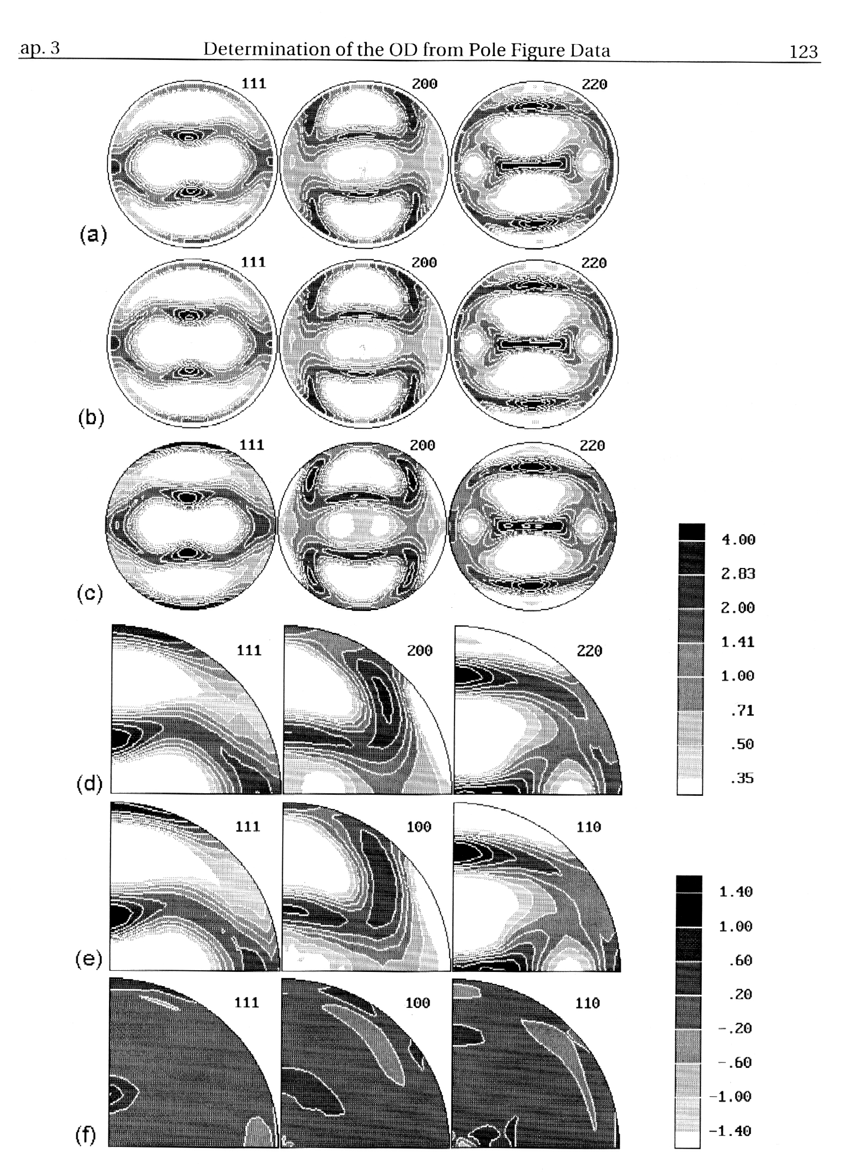
Example: Rolled Cu
a) Experimental
b) Rotated
c) Edge Completed
(Harmonic analyis)
d) Symmetrized
e) Recalculated (WIMV)
f) Difference PFs

Slide 33
Summary
The two main methods of calculating an Orientation Distribution from Pole Figure data have been reviewed.
Series expansion method is akin to the Fourier transform: it uses orthogonal functions in the 3 Euler angles (generalized spherical harmonics) and fits values of the coefficients in order to fit the pole figure data available.
Discrete methods calculate values on a regular grid in orientation space, based on a comparison of recalculated pole figures and measured pole figures. The WIMV method, e.g., uses ratios of calculated and measured pole figure data to update the values in the OD on each iteration.

