Slide 1
Typical Textures, part 2 FCC Torsion, BCC textures
A. D. Rollett
27-750 Texture, Microstructure & Anisotropy
Last revised: 26th Apr. ‘14

Slide 2
Objectives
Part 1 of the slides covers shear (torsion) and rolling textures; part 2 covers some aspects of textures in BCC metals.

Slide 3
Shear Texture
Shear strain means that displacements are tangential to the direction in which they increase.
Shear direction=1, Shear Plane ⊥ 2-axis
ε₁₂= tanθ
Note the definition of strain, ε_{ij}, as the derivative of the displacement u_{i} with respect to coordinate x_{j}.
2 = Torsion Axis = {hkl}
θ
1 = Shear Direction = <uvw>

Slide 4
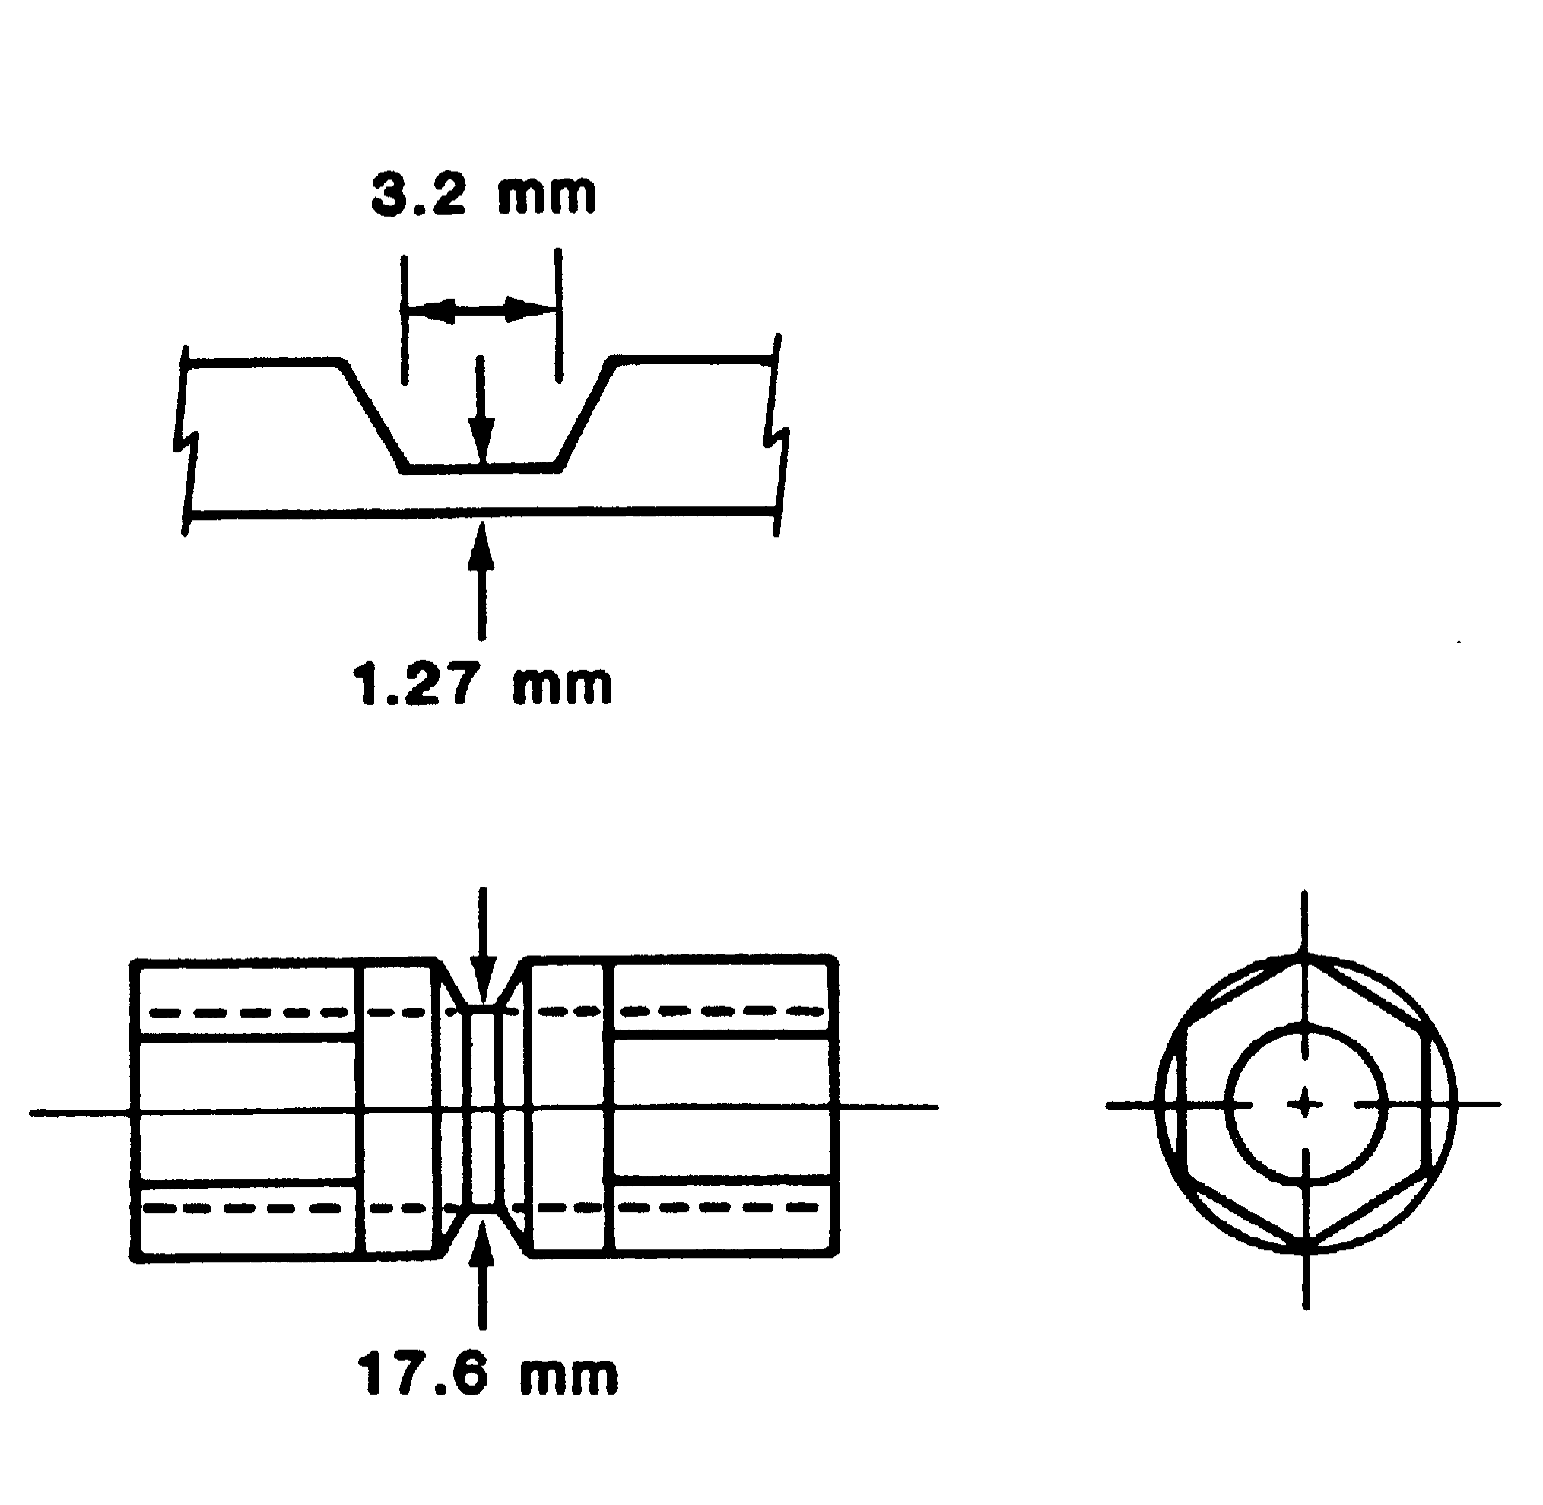
Torsion Textures: twisting of a hollow cylinder specimen
(a)
Sense of shear:
Torsion Axis
(c)
(b)

Slide 5
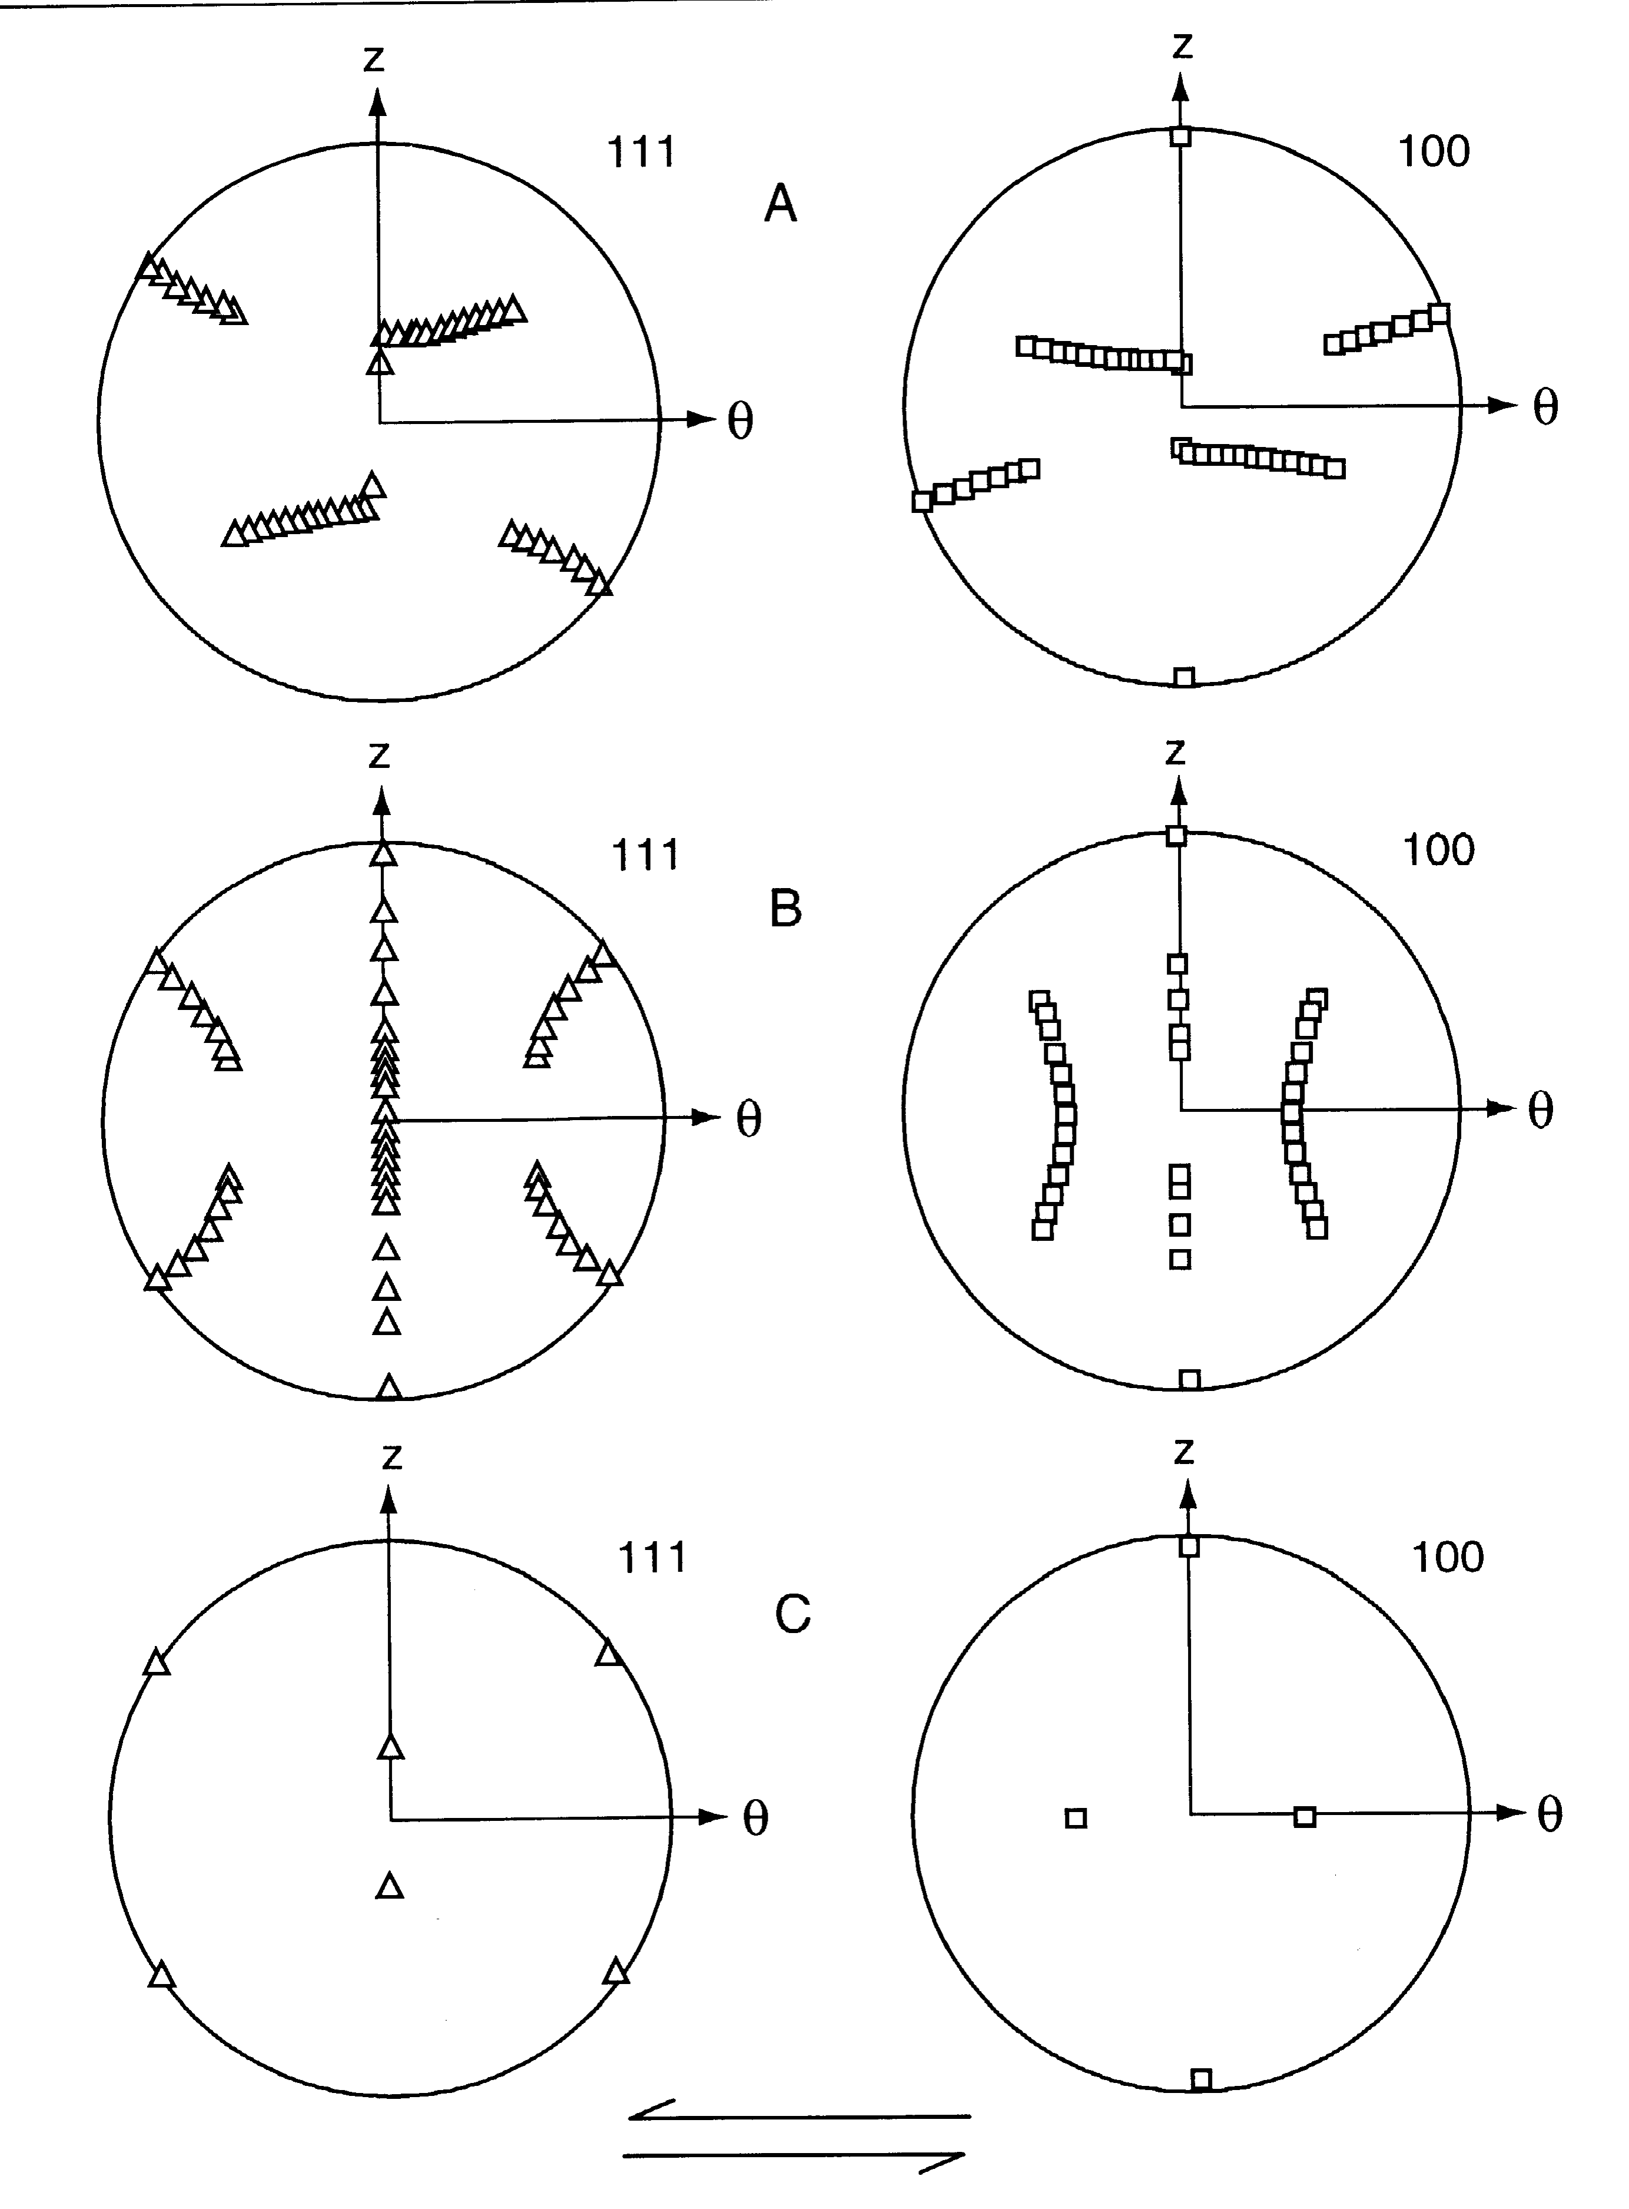
Shear Textures: idealized texture components for FCC metals
Torsion Axis
A partial fiber {111}<uvw>
B partial fiber {hkl}<110>
C component: {001}<110>
Shear direction

Slide 6
Shear Texture Components
Why study shear textures? Shear strain is common near the surface of rolled parts, for example.
Partial Fibers: A/D {111}<uvw>…<110> B {hkl}<110> … {112} Components C {001}<110> D {112}<111> E {011}<111> F {110}<001>

Slide 7
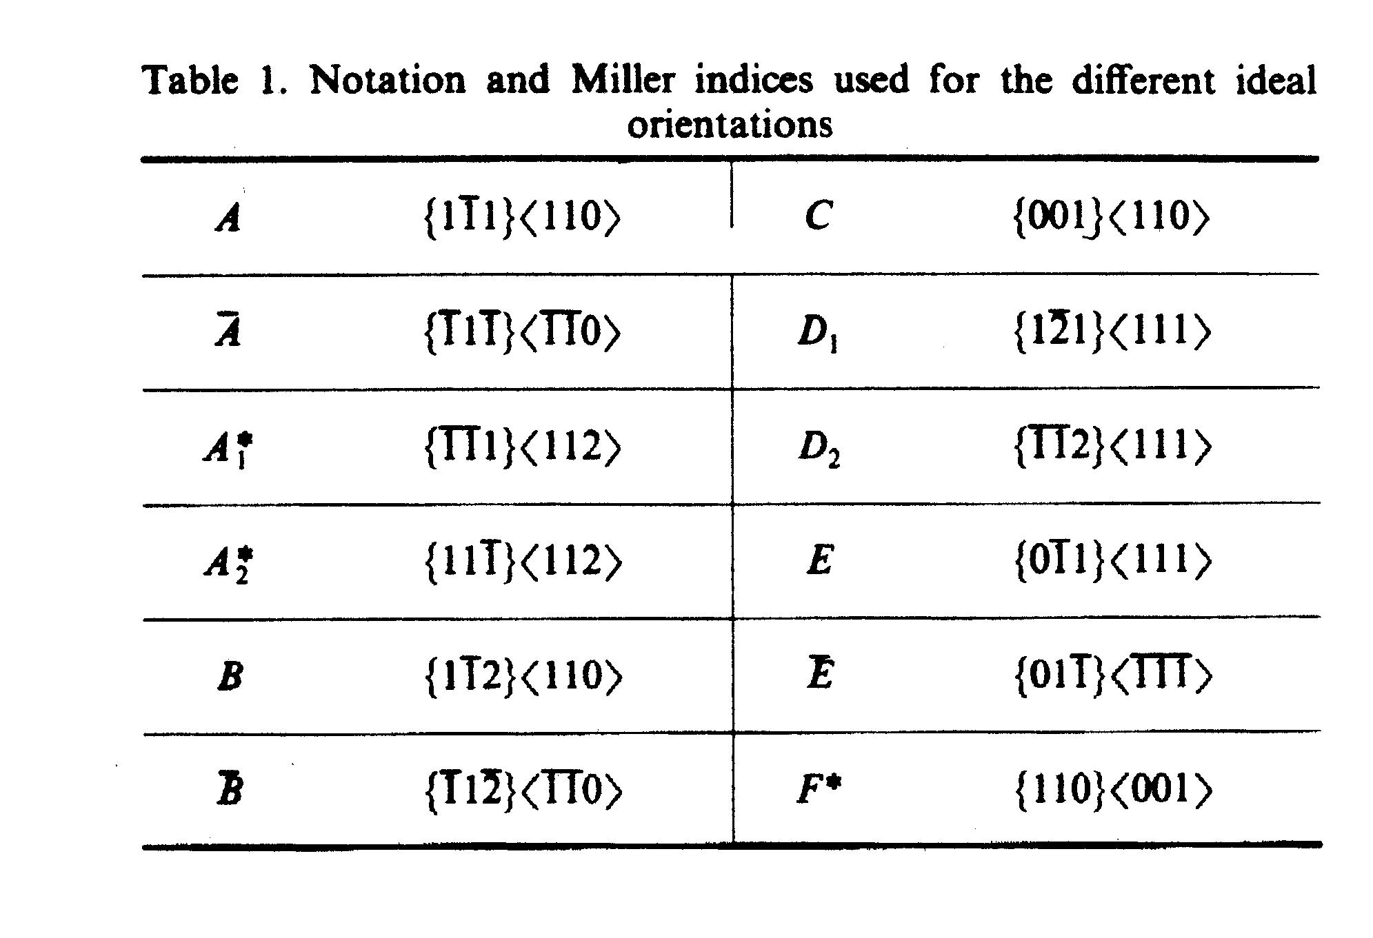
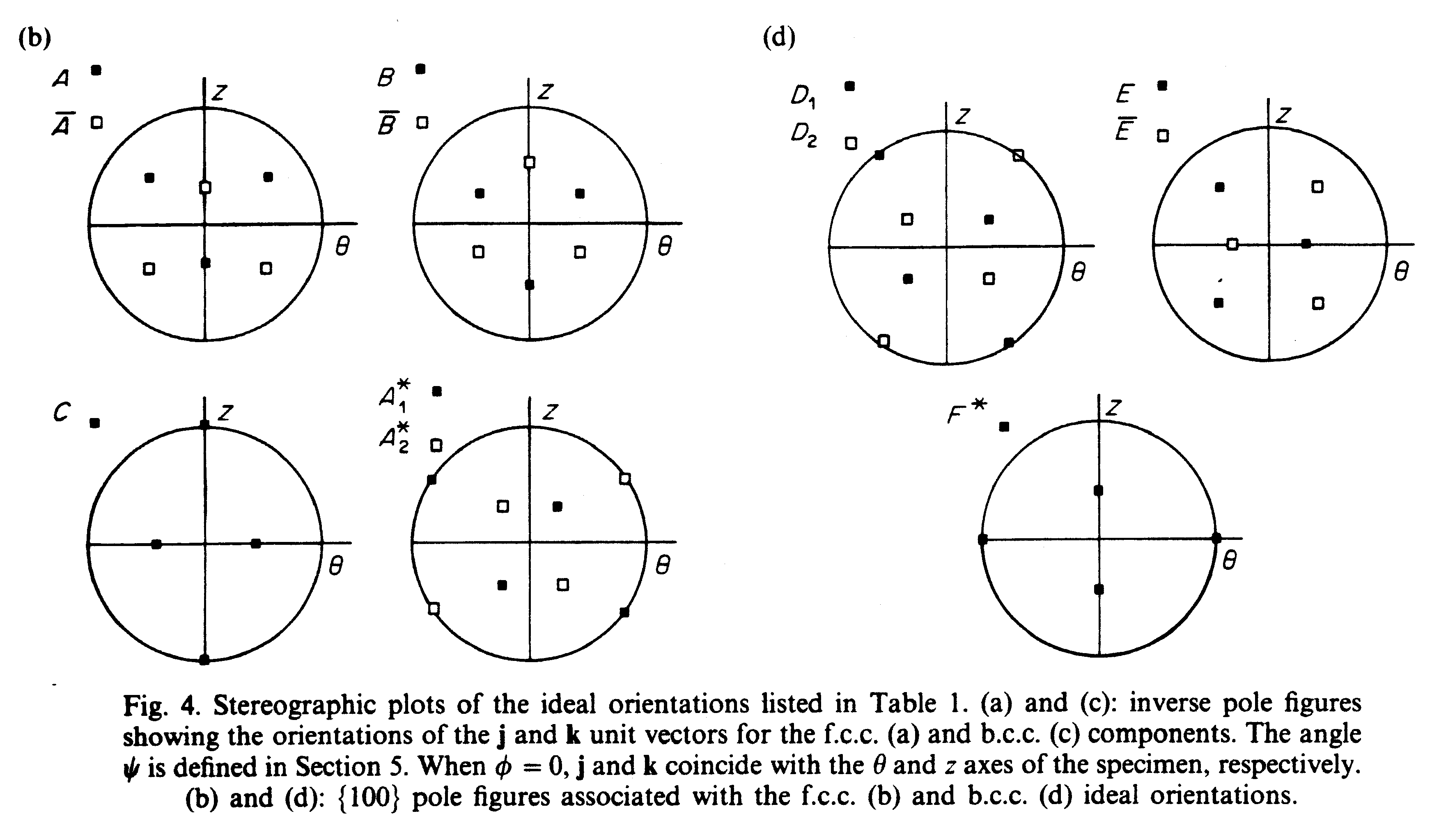
{100} Pole figures Montheillet et al., Acta metall., 33, 705, 1985
FCC
BCC

Slide 8
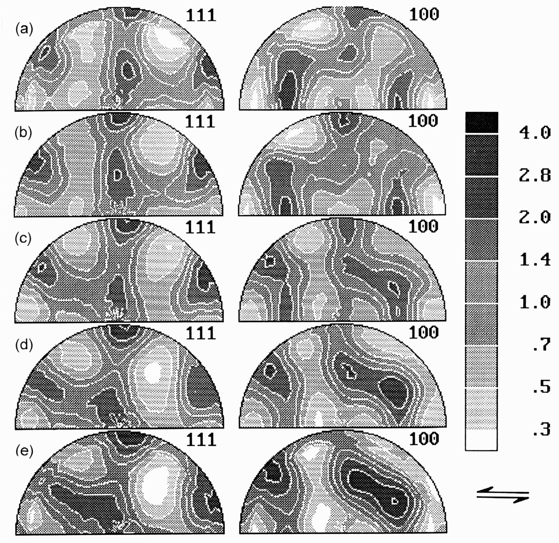
FCC Torsion Textures
Plots of {111} and {200} pole figures (equal area projection; torsion axis vertical) for the following materials deformed in torsion; the shear direction points to the left in these figures.
a) Nickel at γ=3.6
b) Copper at γ=3.5
c) Silver at γ=3.5
d) Cu-30Zn at γ=3.5
e) Ni-60Co at γ=3.2
Note that the partial "A" fiber is present in Ni and Cu, but is absent in the other materials. Silver, brass and Ni-60Co show instead a "D" fiber which is similar to the A fiber but rotated approximately 90° about the torsion axis. The B fiber is present to varying degrees in all the materials.
Kocks, Ch. 5

Slide 9
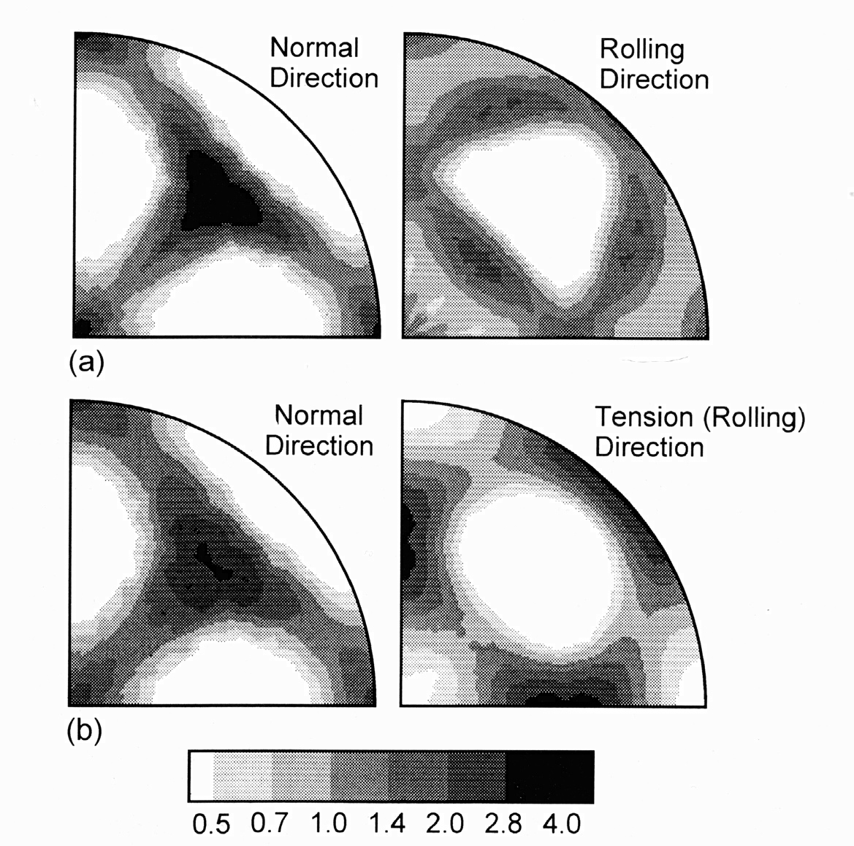
BCC uniaxial textures
92% rolled Ta Tensile test in original RD to strain of 0.6: <110> fiber
(a) Normal and rolling direction inverse pole figures (equal area projection) of 92% rolled Ta and (b) Prior normal and rolling direction inverse pole figures for (a) tested in tension to a strain of 0.6 (tensile direction coincident to prior rolling direction).
Kocks, Ch. 5

Slide 10
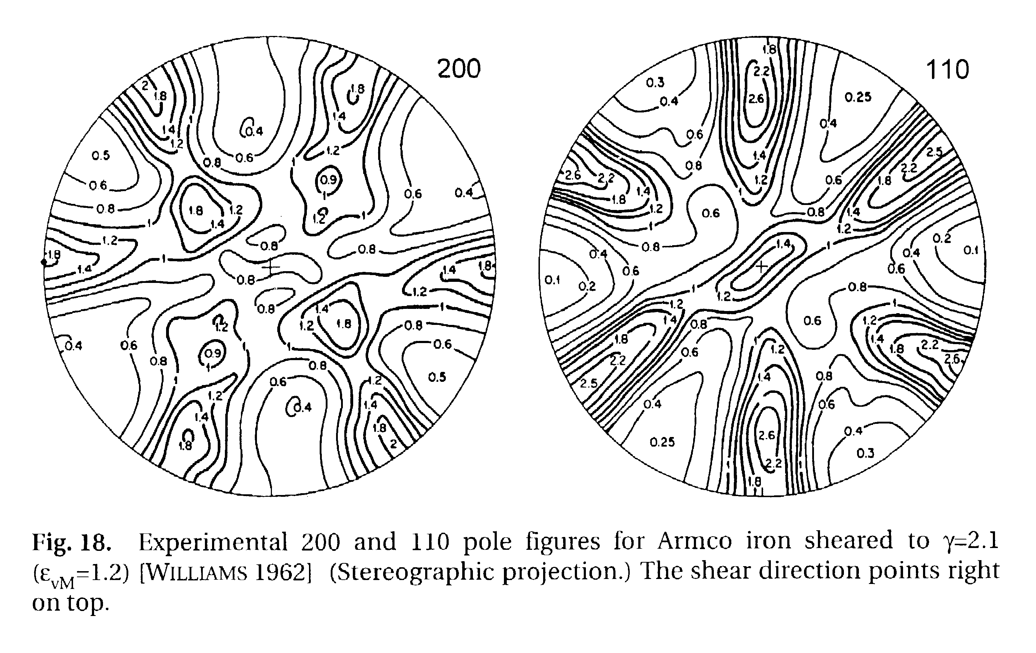
BCC torsion textures: Fe
Ideal |{100} pole figures

Slide 11
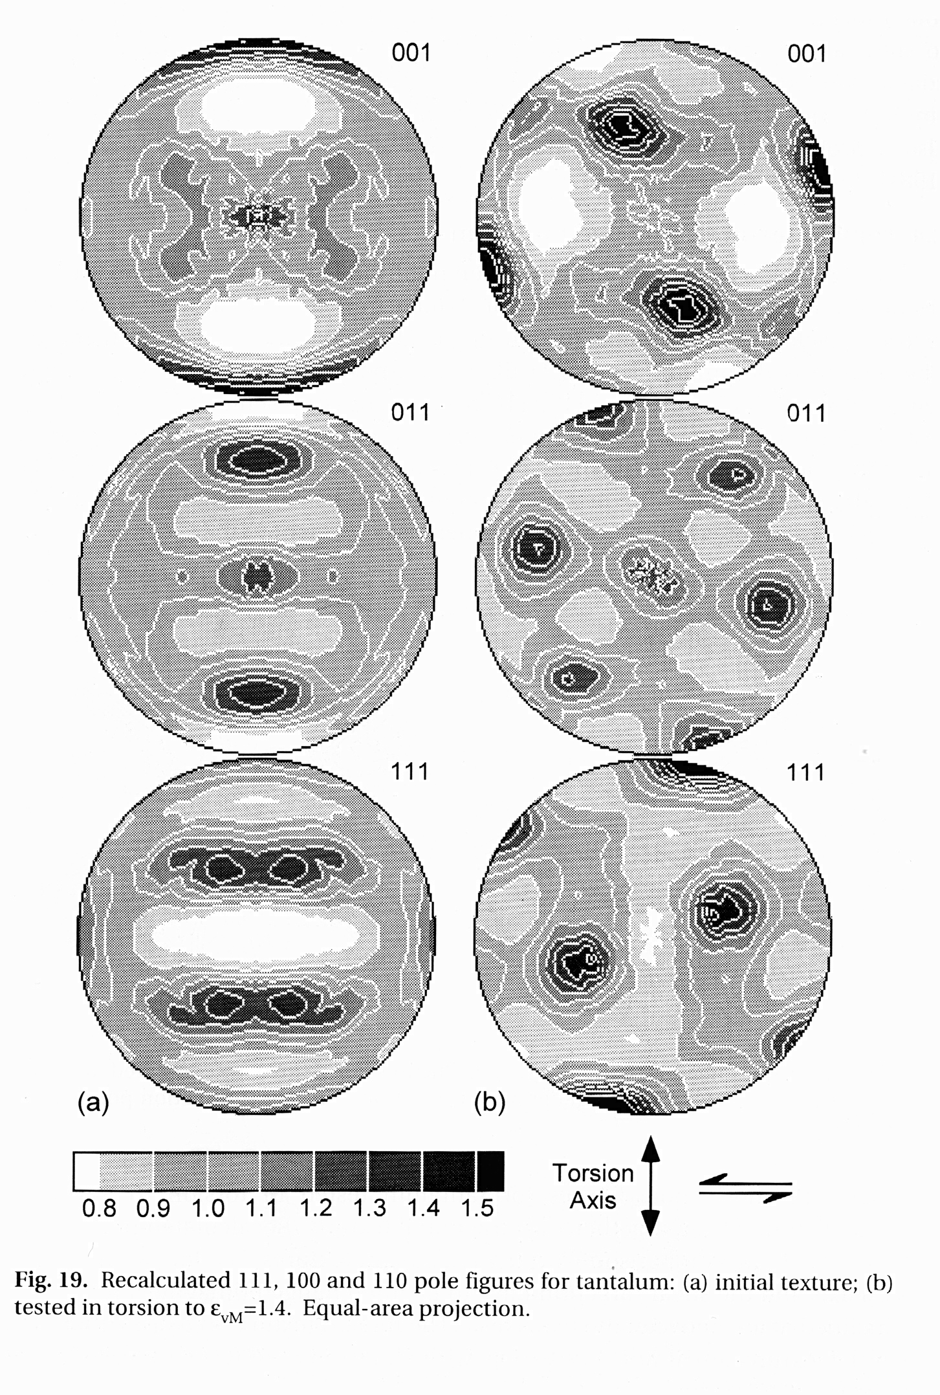
BCC torsion textures: Ta
(a) initial texture from swaged rod;
(b) torsion texture
Ideal |{100} pole figures
Kocks, Ch. 5

Slide 12
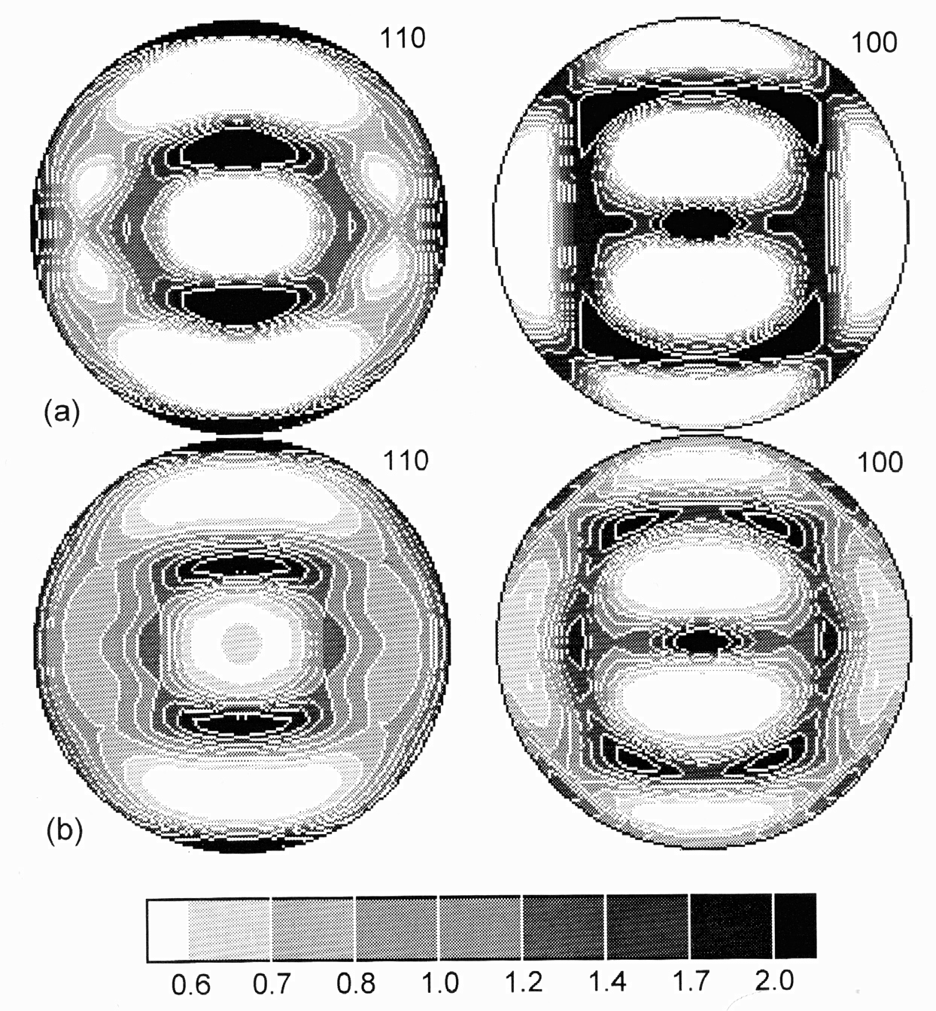
Rolling Textures BCC
{110} and {100} pole figures (equal area projection; rolling direction vertical) for (a) low-carbon steel cold rolled to a reduction in thickness of 80% (approximate equivalent strain of 2); (b) tantalum, unidirectionally rolled at room temperature to a reduction in thickness of 91%.
Kocks, Ch. 5

Slide 13
{100} Pole figure for certain components of rolled BCC metals
Note how very different components tend to overlap in a pole figure.
Kocks, Ch. 5
Notes:
Pole figures are evidently less than ideal for distinguishing particular components!

Slide 14
BCC fibers: the φ₂ = 45° section
φ₁
Φ
ε, <110>||TD
γ, <111>||ND
α,
<110>||RD
Goss

Slide 15
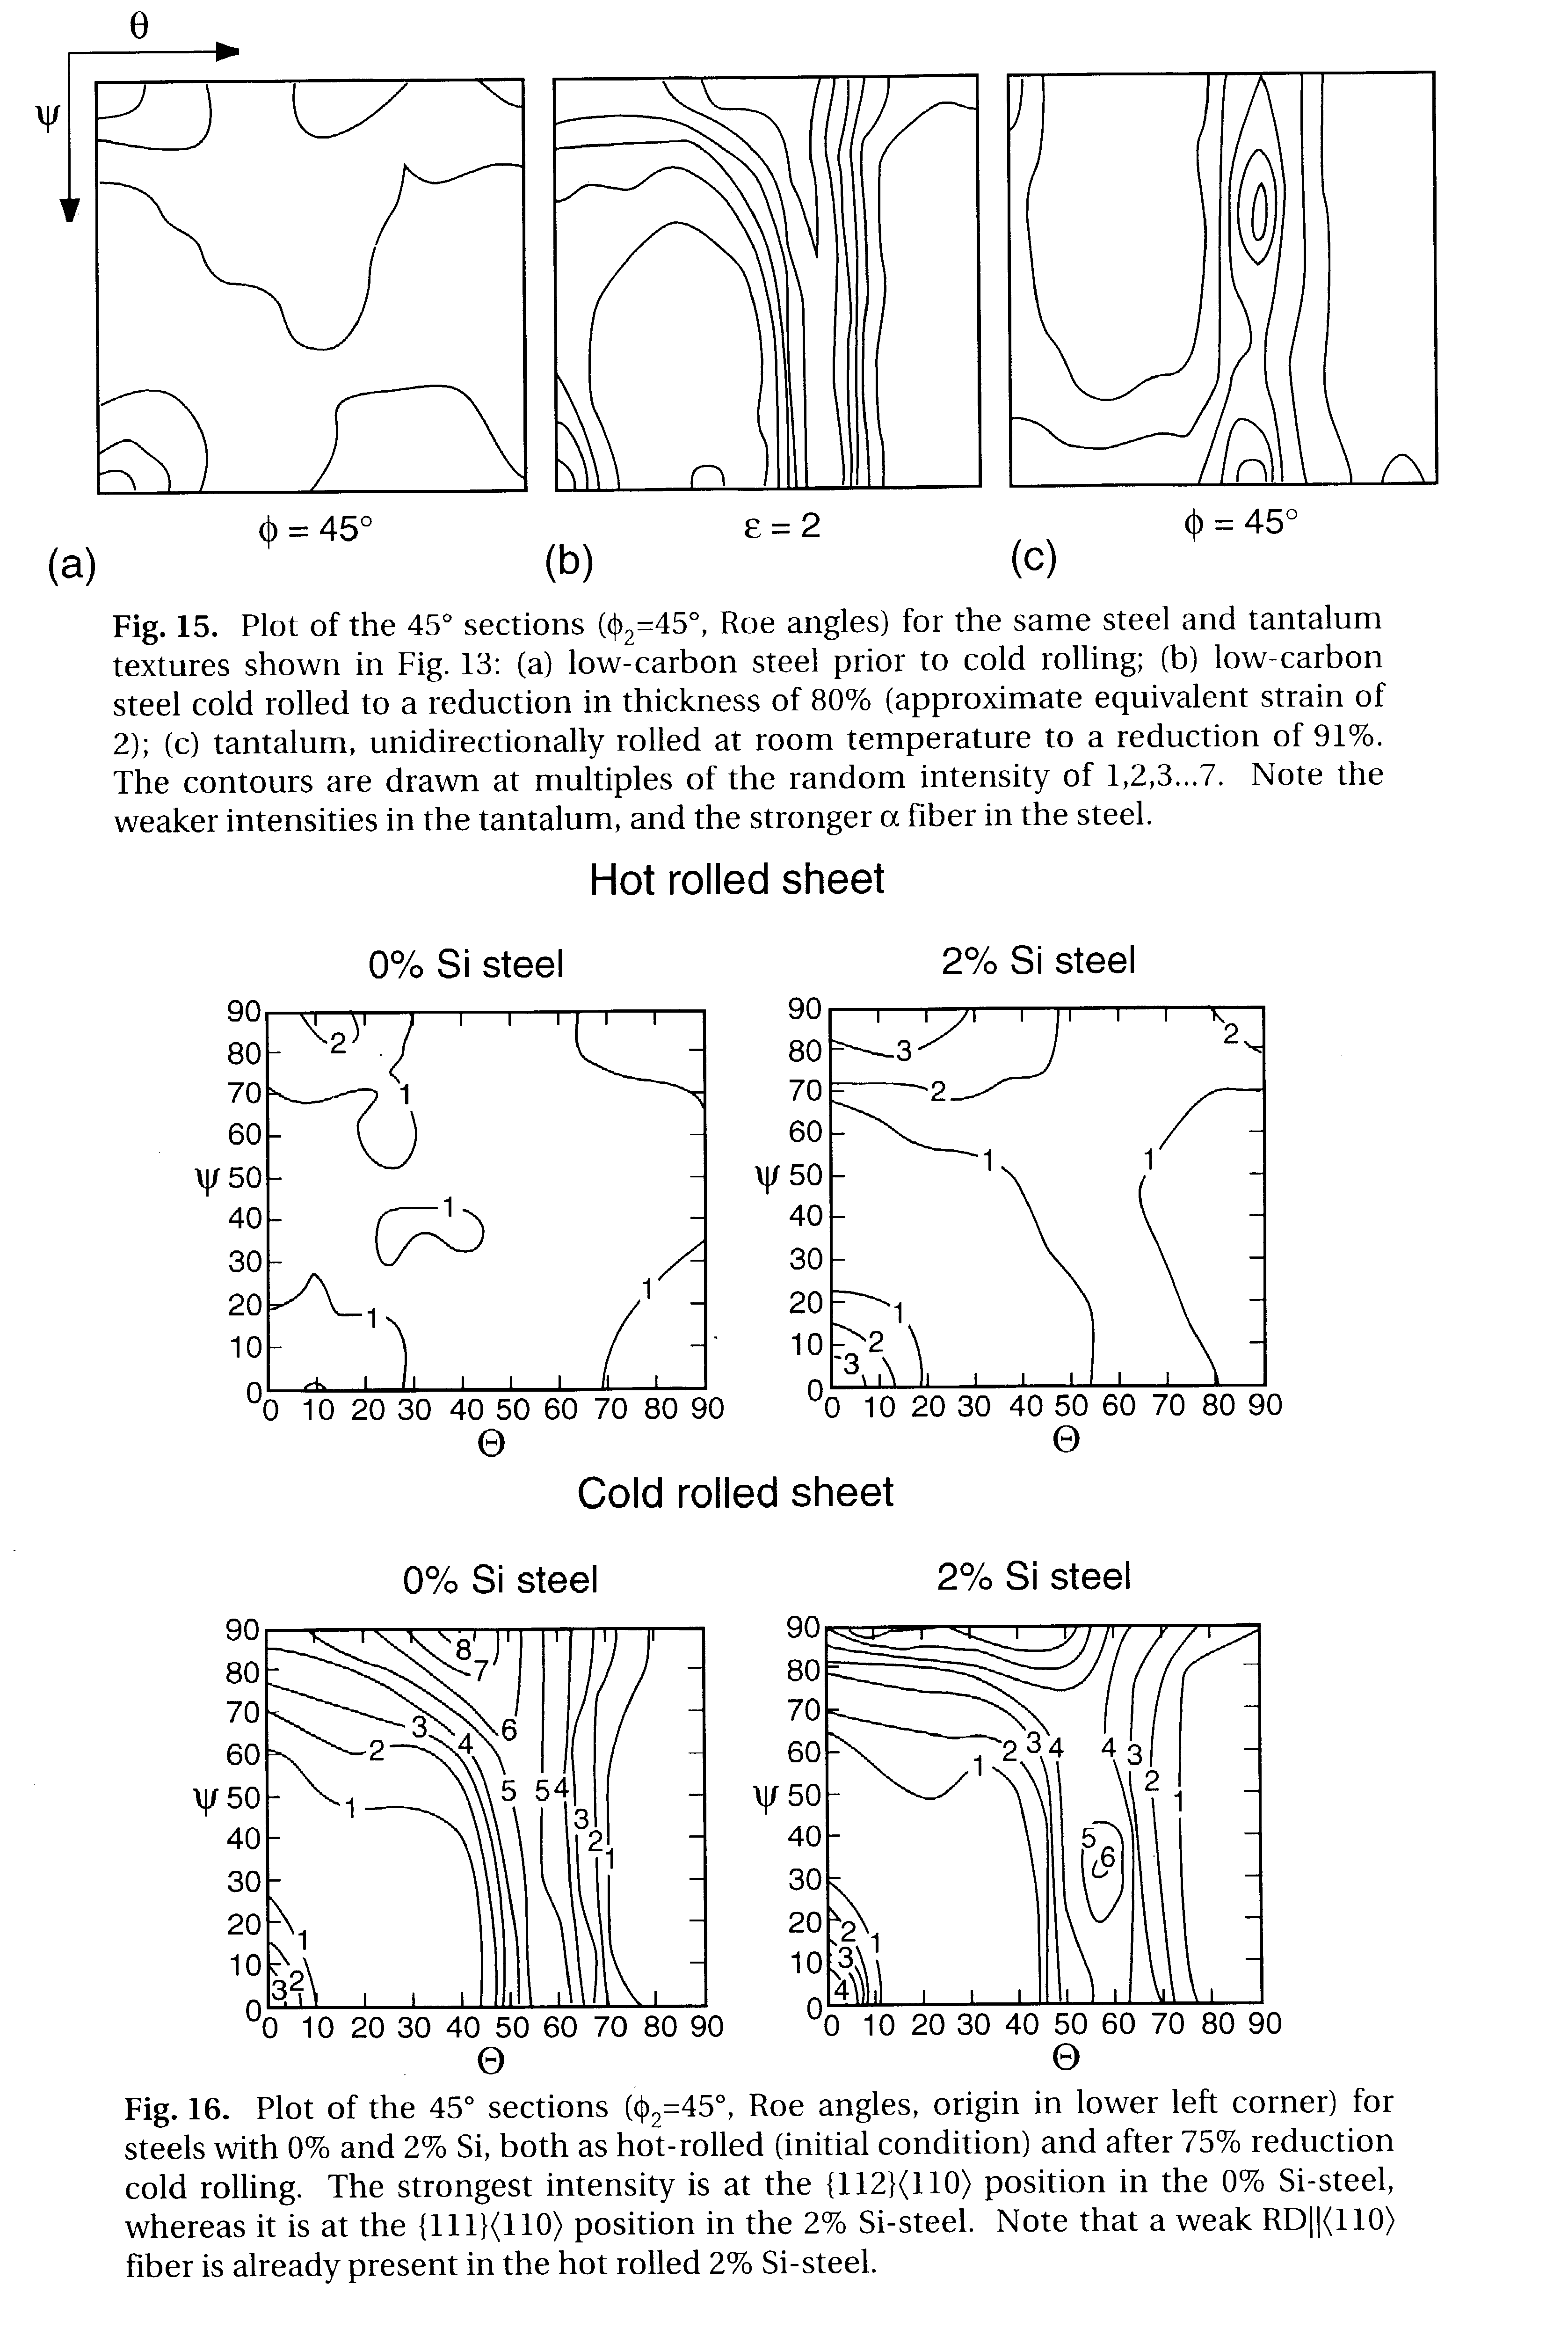
Ta,Fe rolling textures
Note: Euler angles are Roe angles: axes transposed with Θ horiz., ψ vertical.

Slide 16
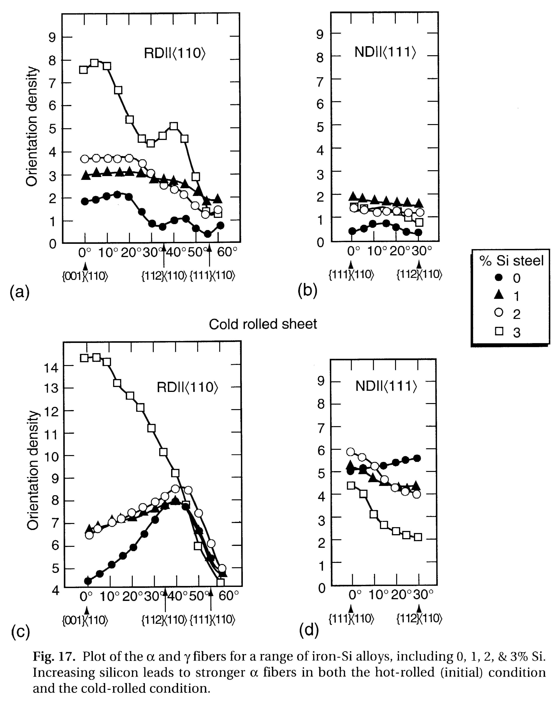
Fe,Fe-Si rolling fiber plots
Note the marked alloy dependence in the alpha fiber; smaller variations in the gamma fiber.

Slide 17
Summary: part 2
Typical textures illustrated for shear textures and for bcc metals.
Pole figures are recognizable for standard deformation histories but orientation distributions provide much more detailed information.

