Slide 1
Thermomechanical Processing Textures, part 3
A. D. Rollett
27-750 Texture, Microstructure & Anisotropy
Updated 26th Apr. 2014

Slide 2
Objective
Part 3 of the notes on typical textures covers solidification textures and textures in hexagonal metals and composites.

Slide 3
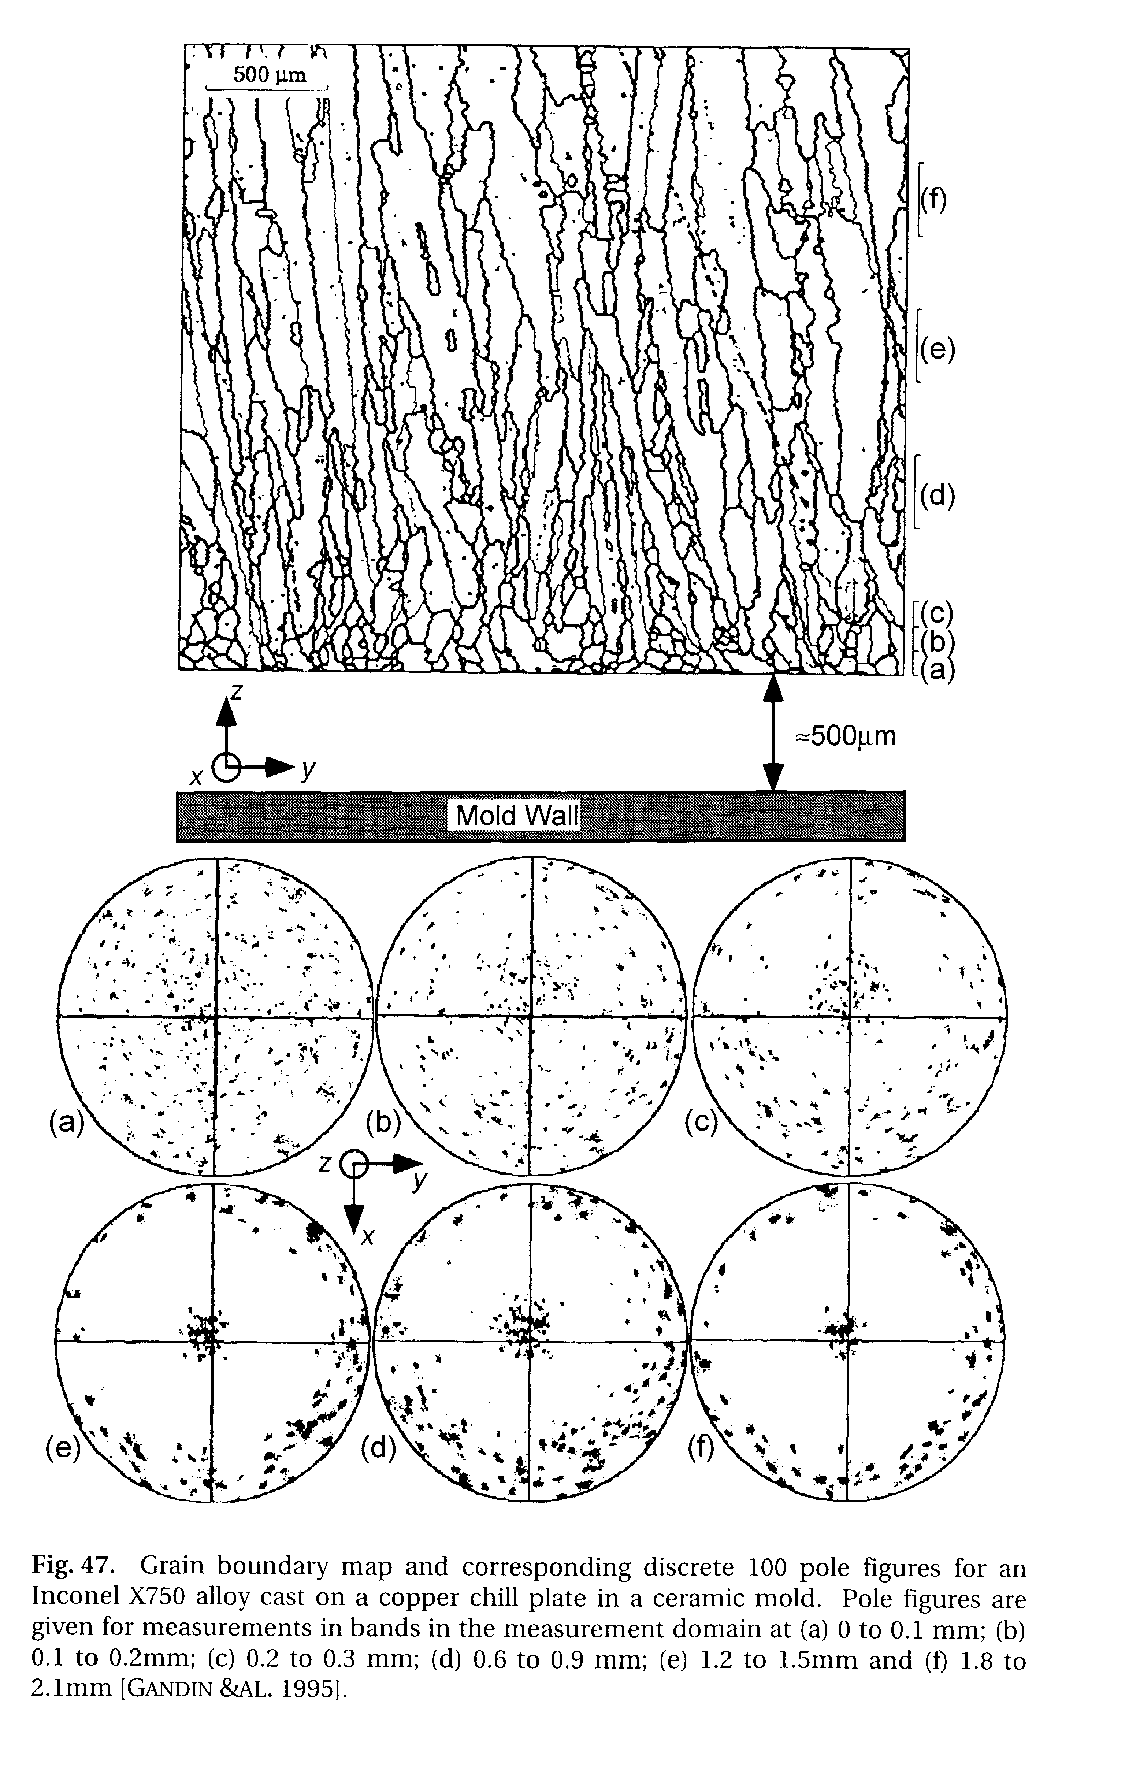
Solidification texture: <100> growth directions

Slide 4
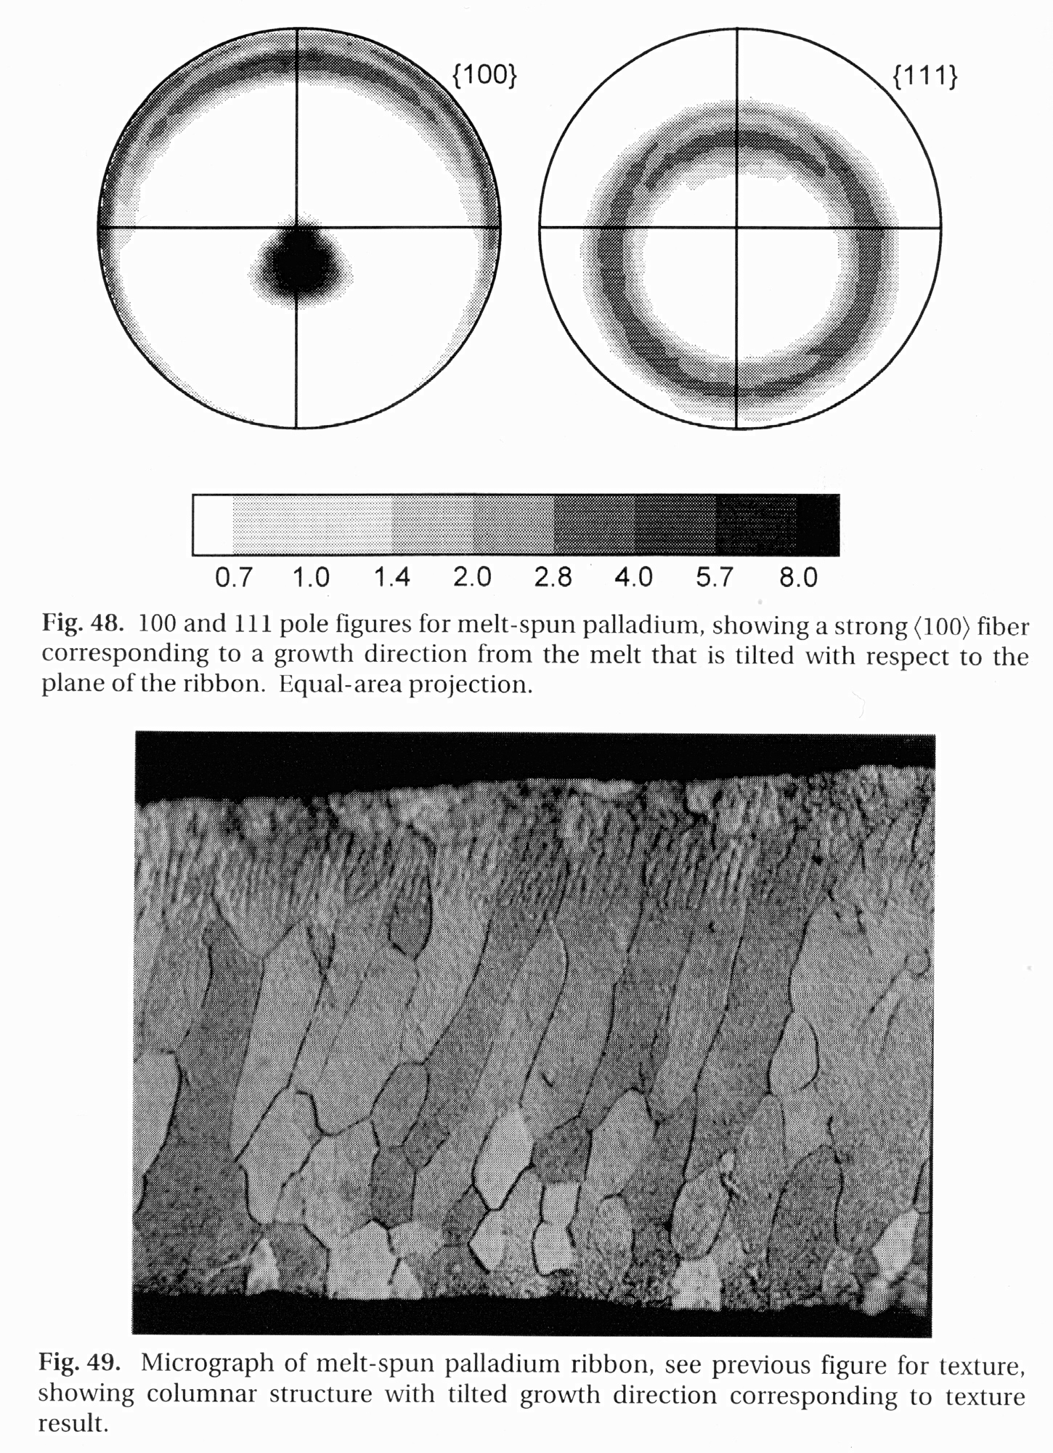
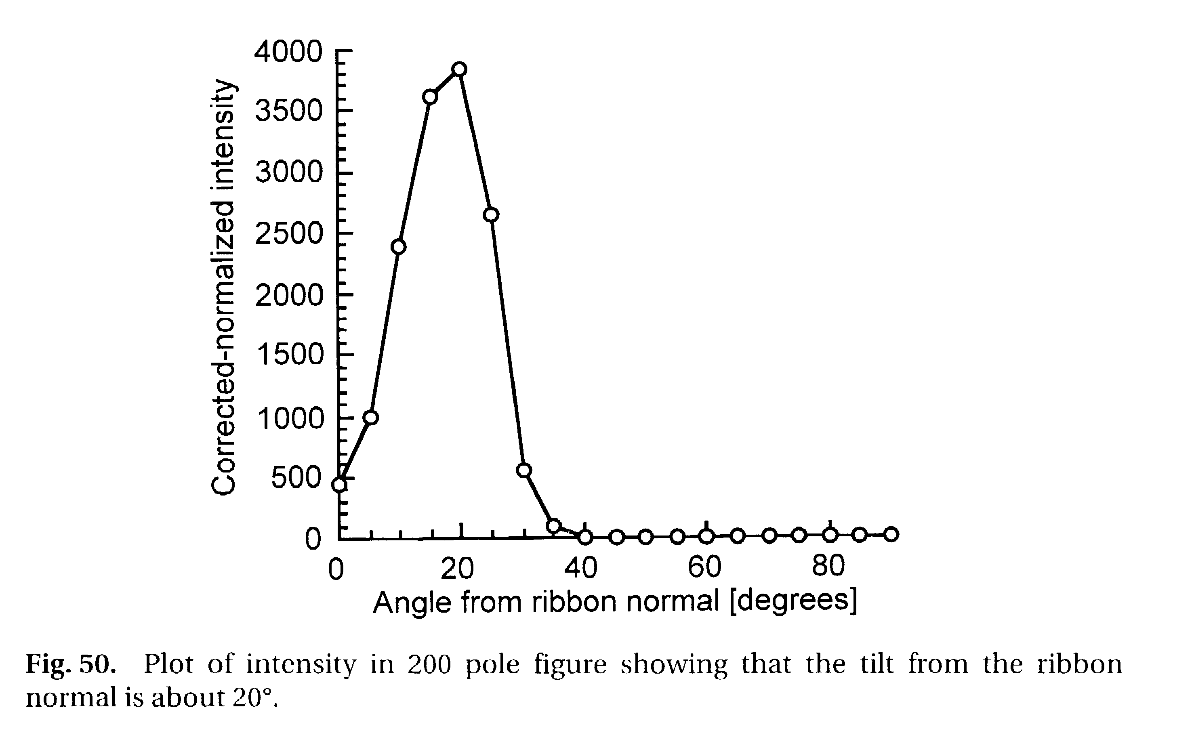
Melt-spun Palladium columnar structures

Slide 5
Hexagonal Metals
Common to show the (0001) pole figure: provides most information needed.
Easy slip on the basal plane means that compression generally aligns the basal plane normal with the compression axis.
Tension typically aligns basal plane normals perpendicular to the axis.

Slide 6
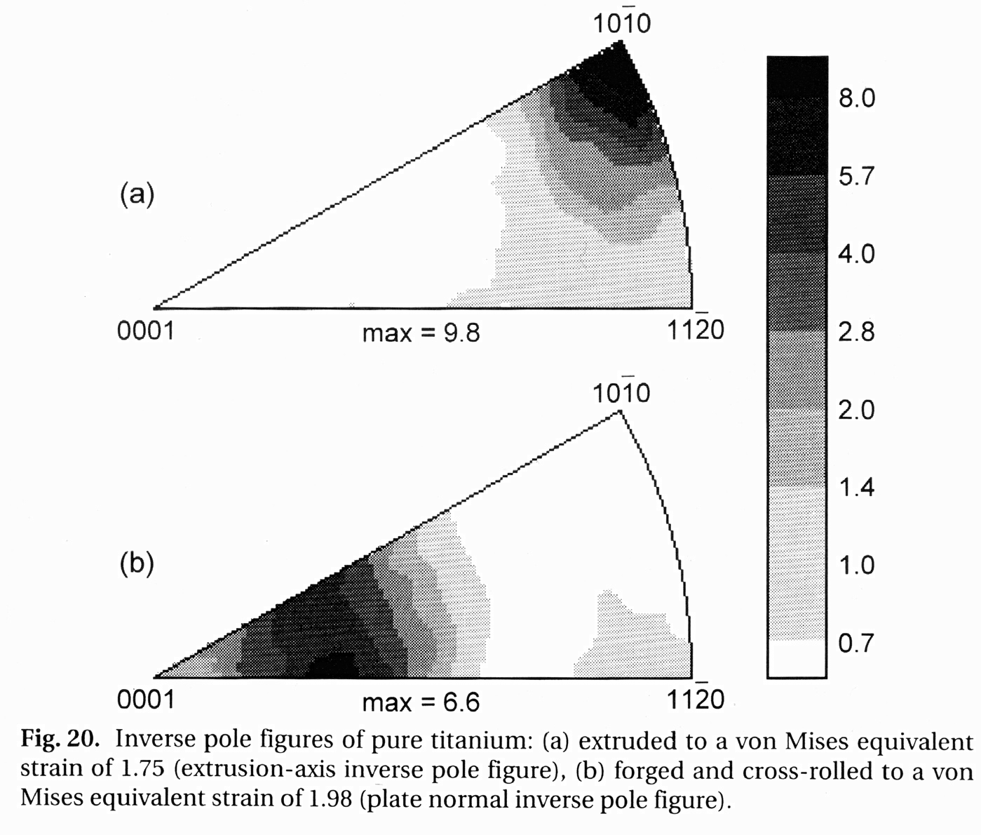
Uniaxial textures in Ti
tension
compression
Compression: 25° from 0001,
~ <11-24>

Slide 7
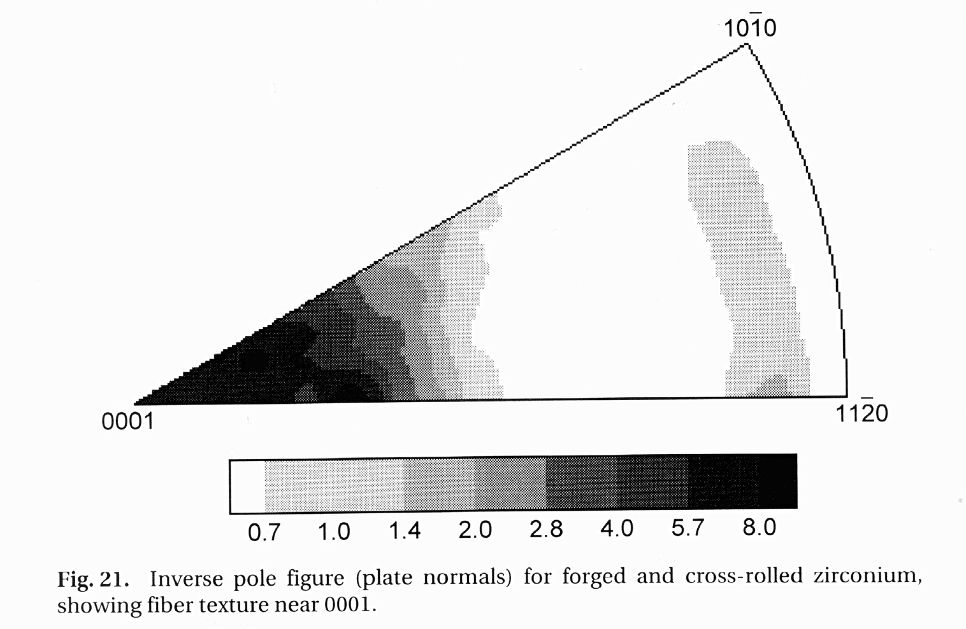
Zr: compression Ti: compression

Slide 8
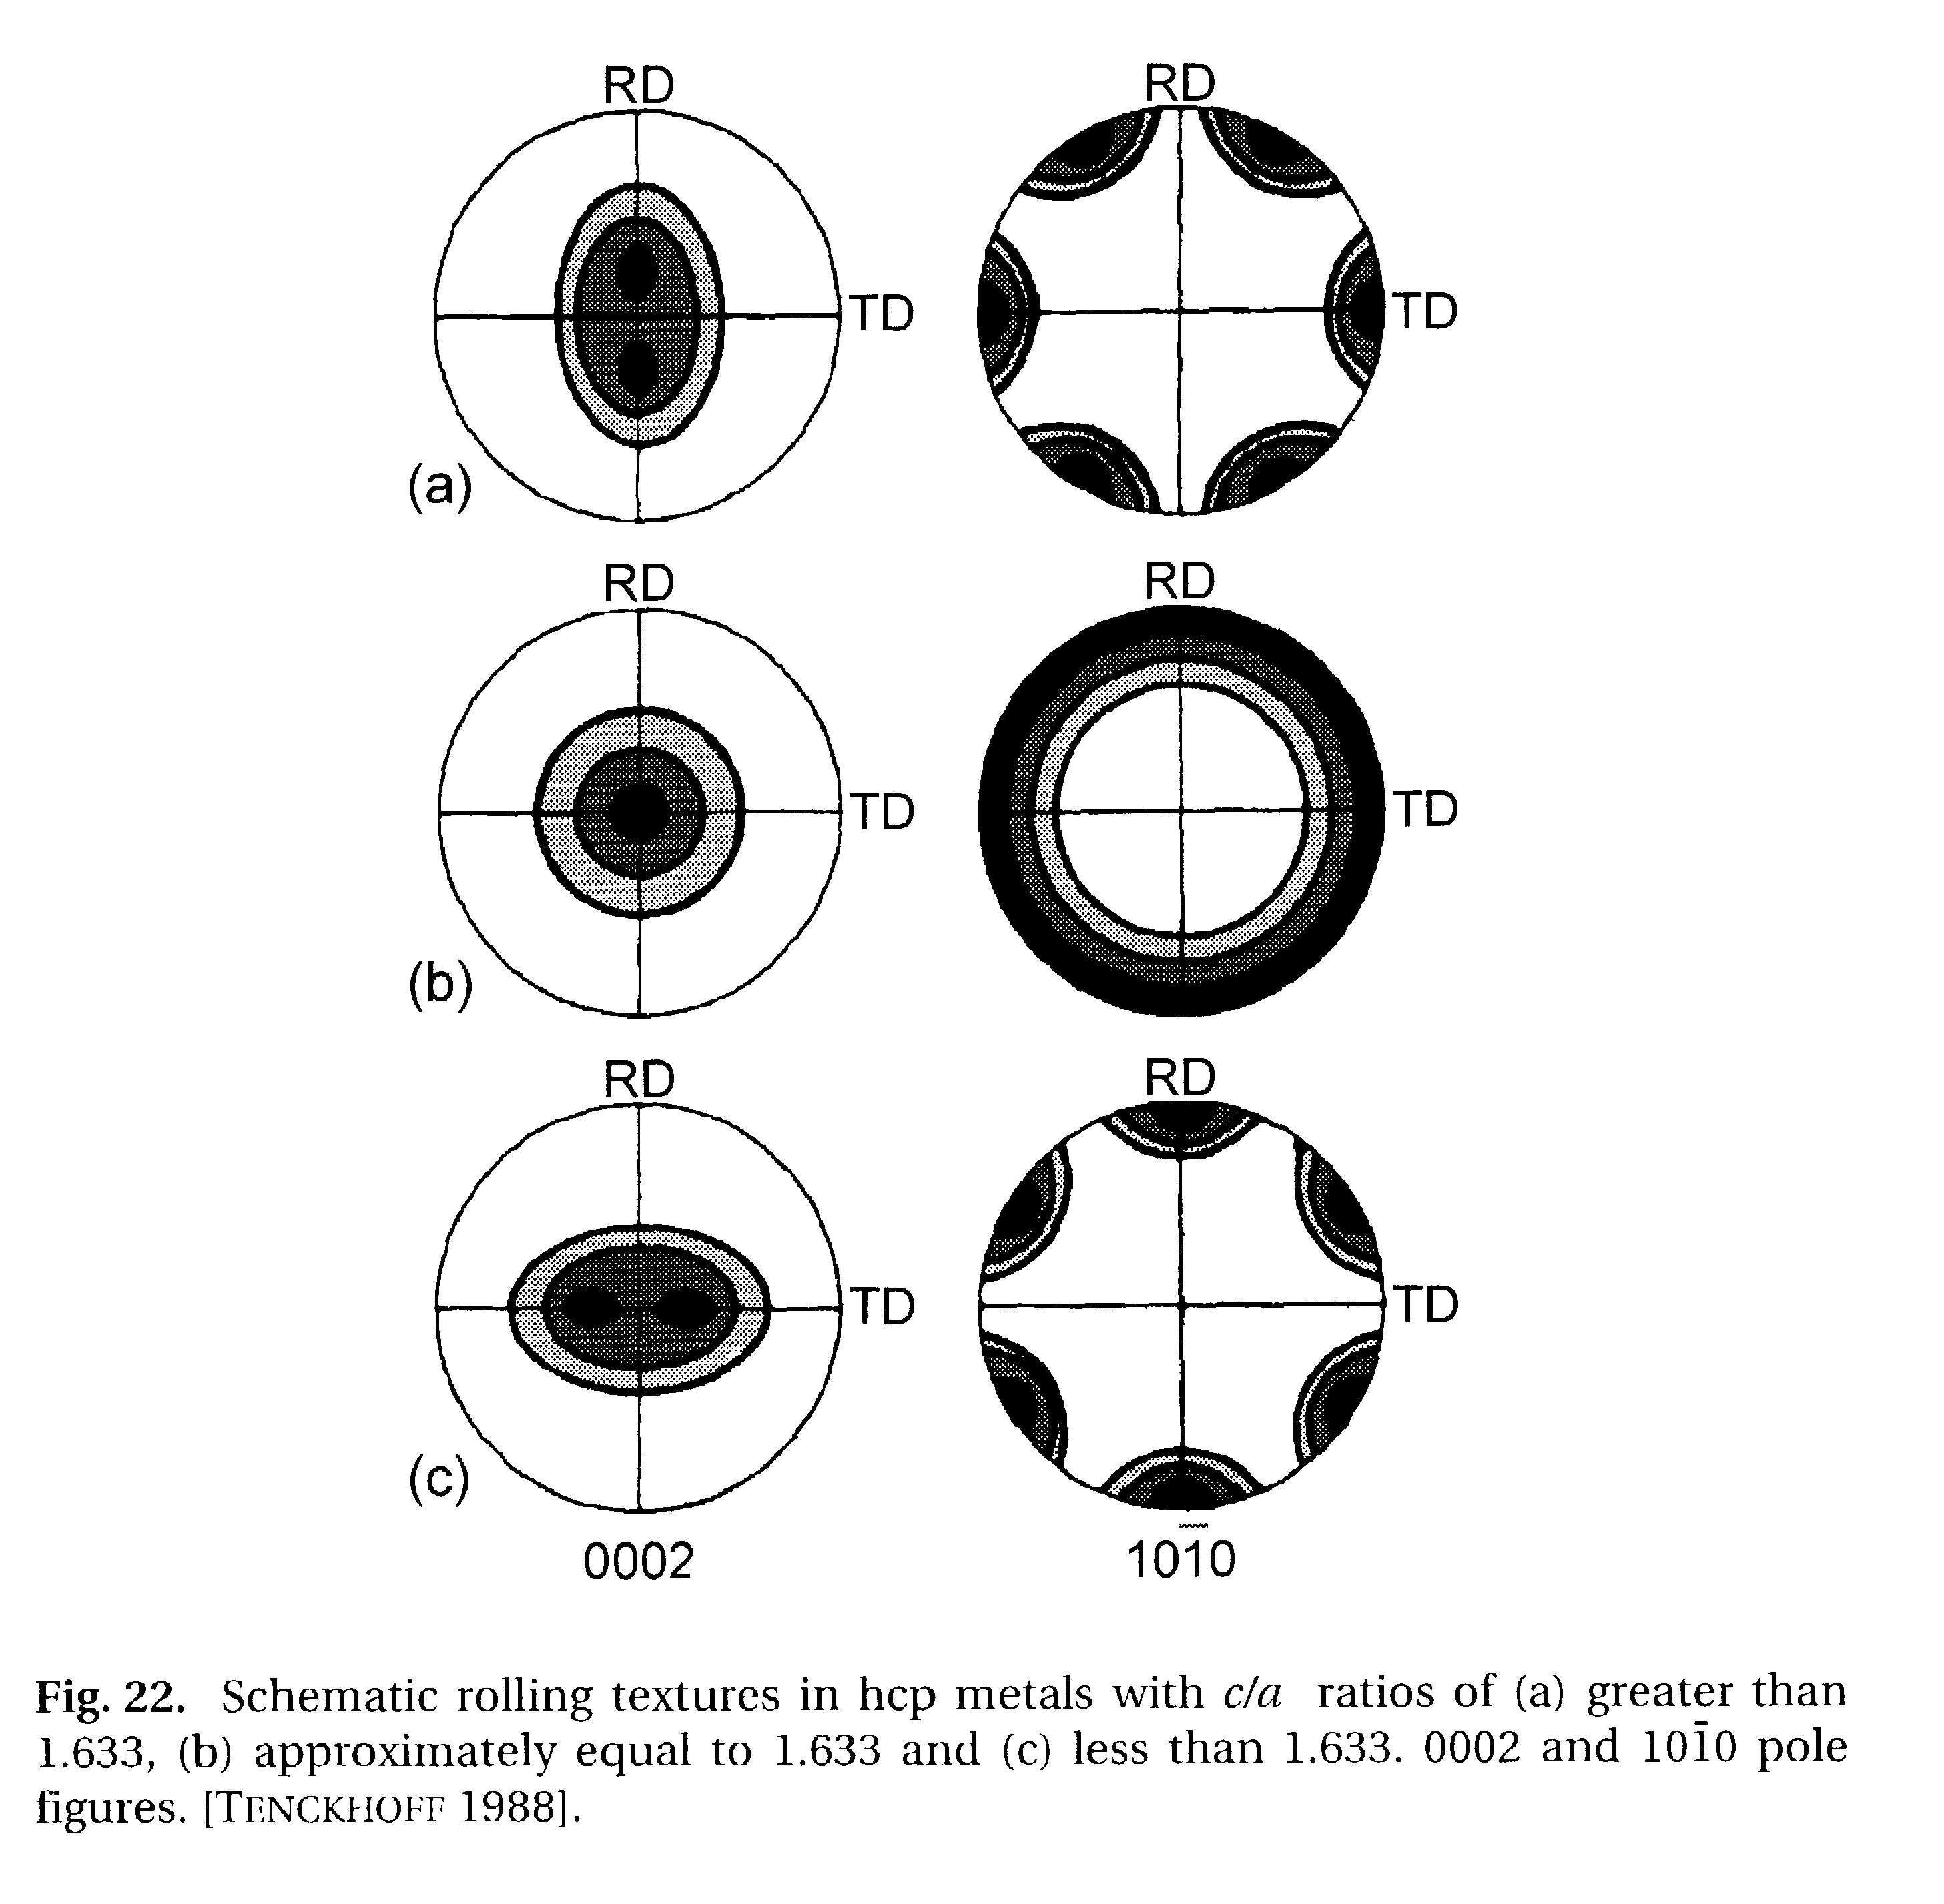
hcp Rolling Textures; schematic
c/a > 1.633: RD split in 0001
c/a < 1.633:
TD split in 0001
Kocks, Ch. 5

Slide 9
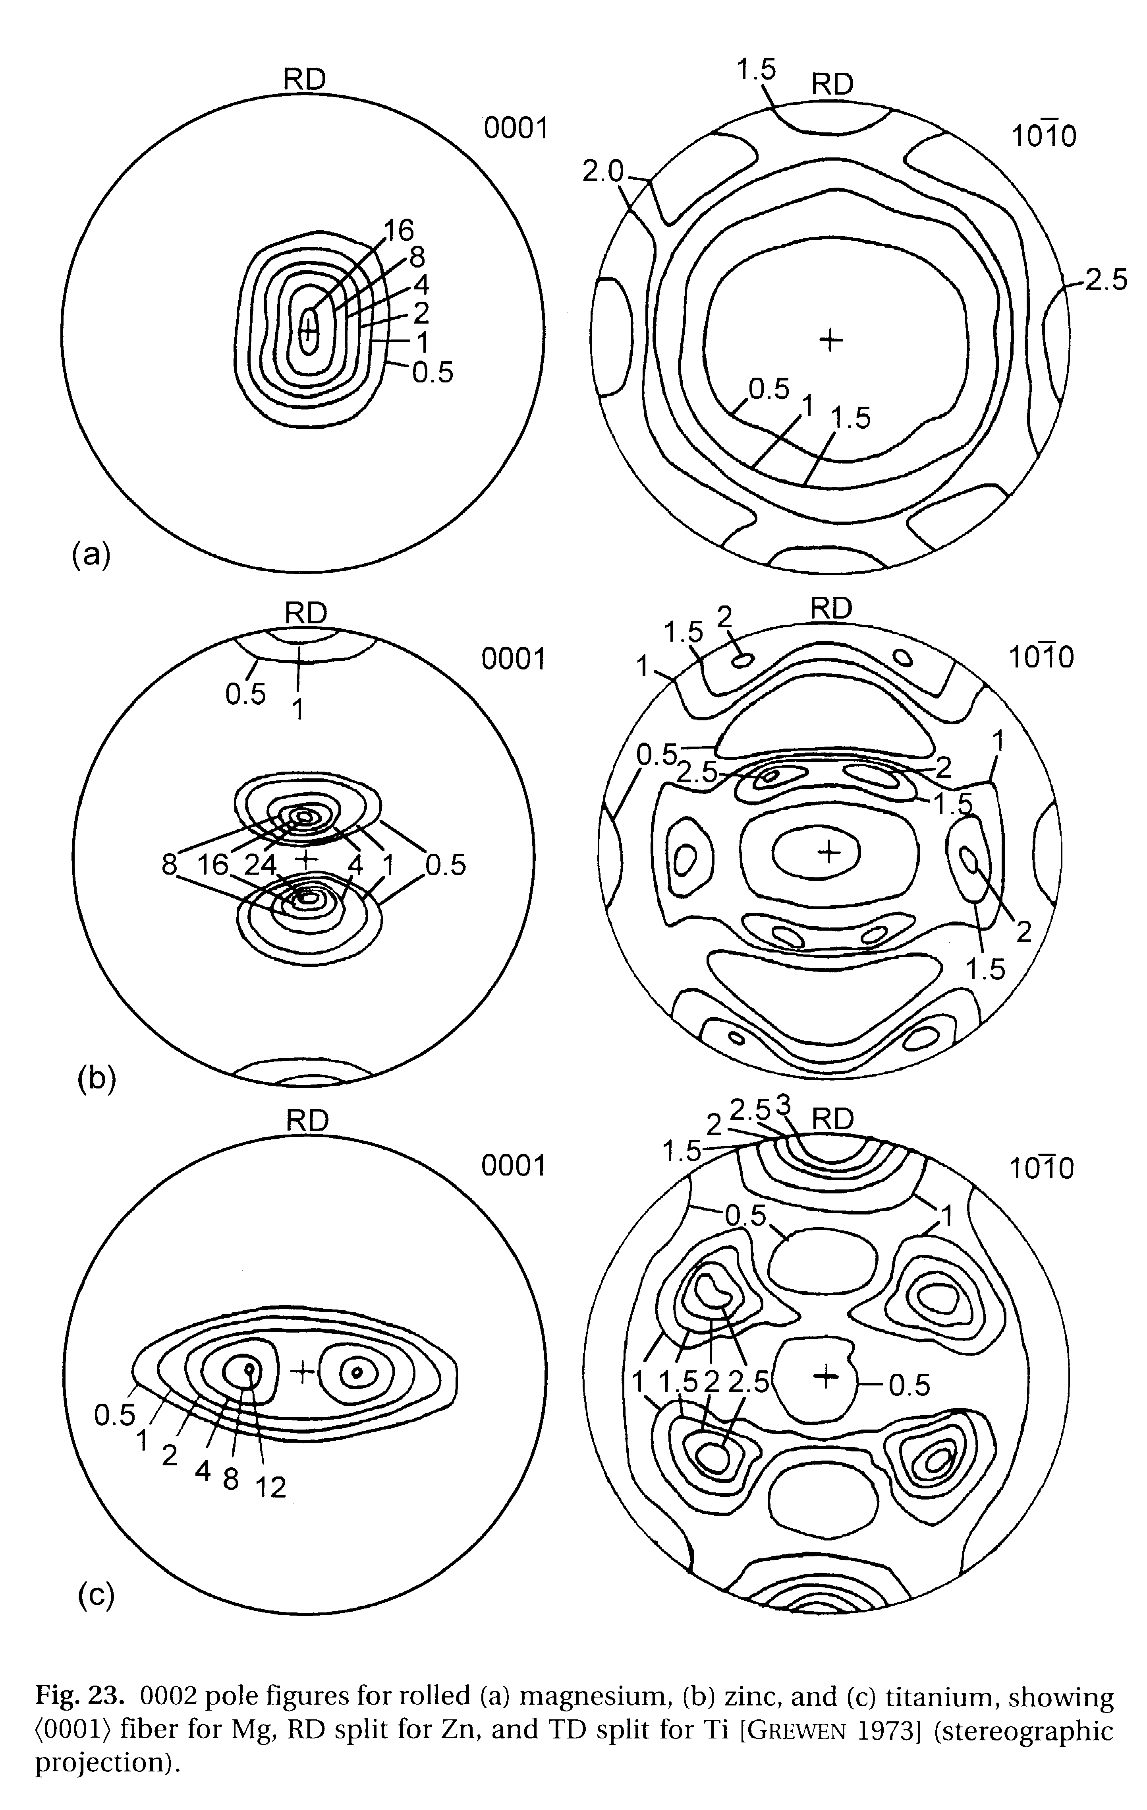
hcp Rolling Textures: exptl.
Kocks, Ch. 5

Slide 10
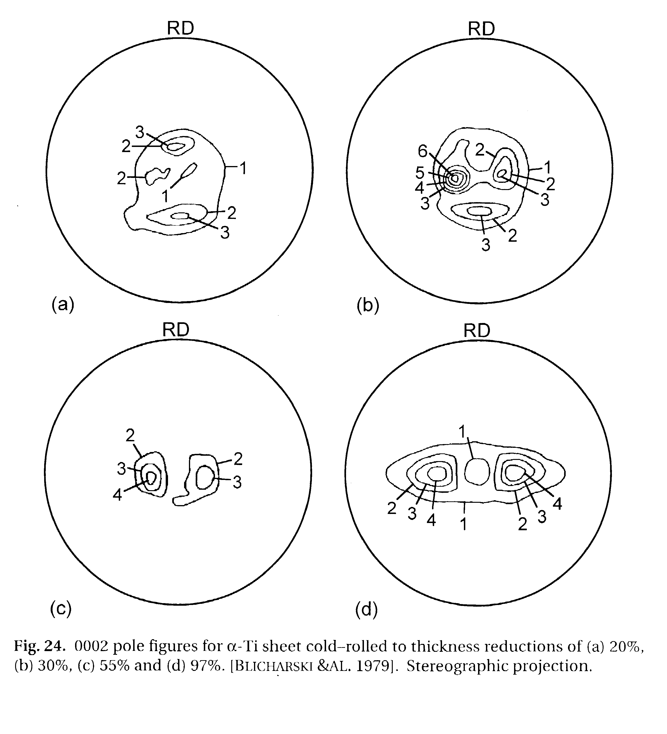
hcp: Rolling: strain dependence
20%
30%
55%
97%
Kocks, Ch. 5

Slide 11
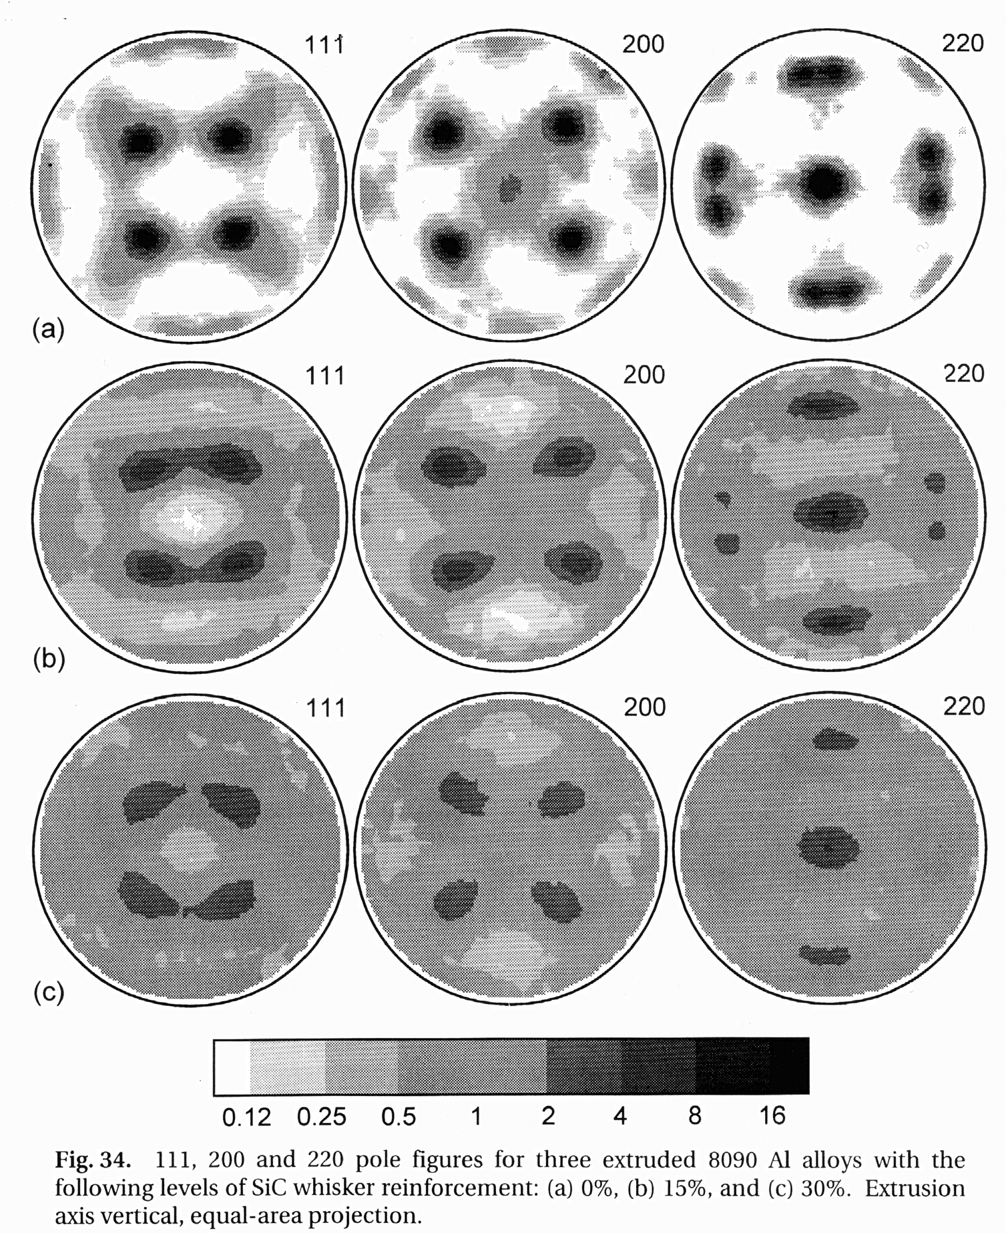
Al-SiC composites
• Reinforcement tends to randomize texture
Kocks, Ch. 5

Slide 12
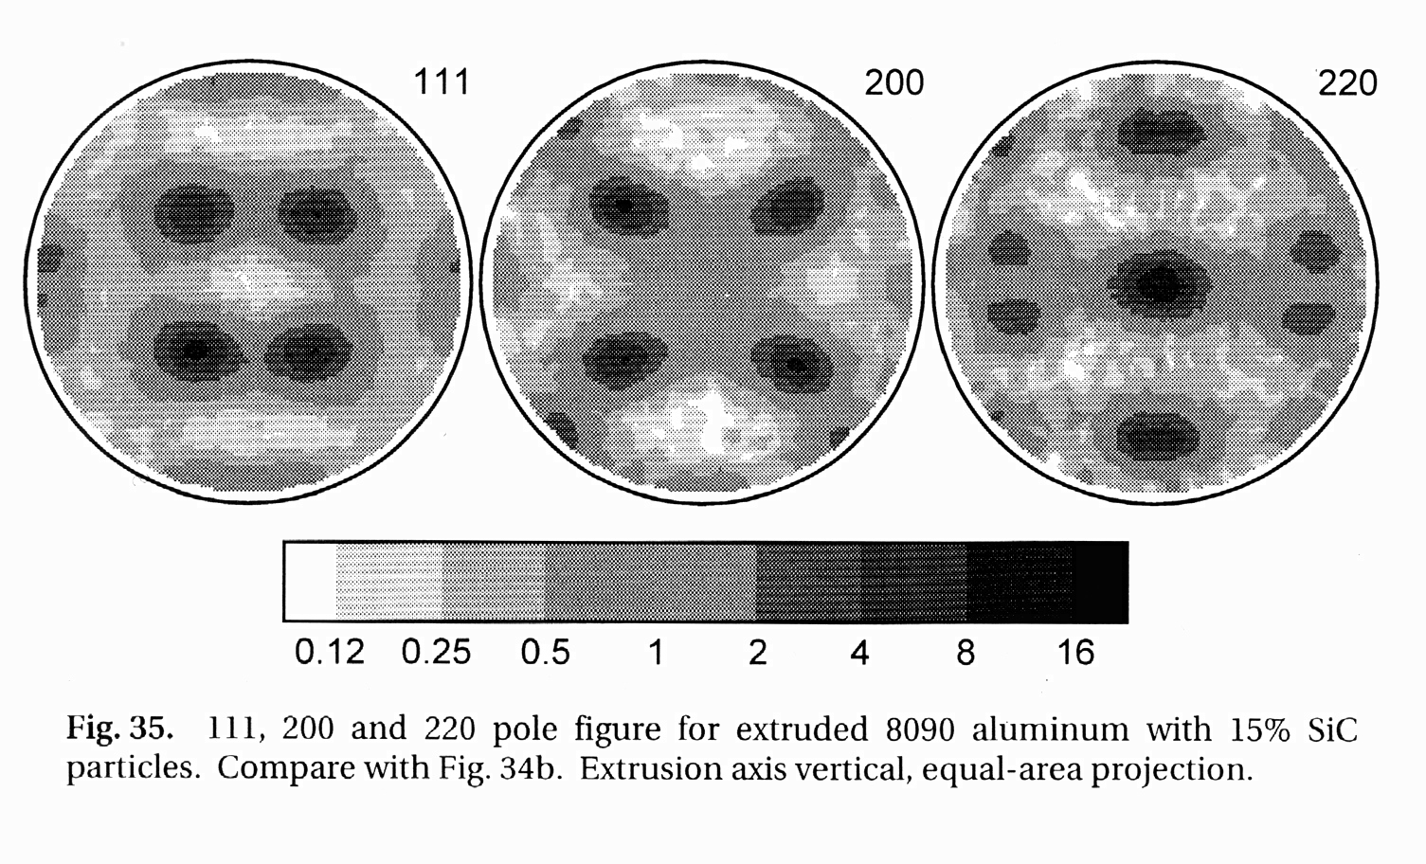
Al-SiC: Fibers vs. particles:
• Randomization from particles less than for fibers
Kocks, Ch. 5

Slide 13
Summary: part 3
Typical textures illustrated for solidification, metal matrix composites and for deformed hexagonal metals.
Solidification textures can be strong but are often ignored in processing histories!
Significant alloy dependence observed in hexagonal metals.
Composites generally have weaker textures than equivalently deformed single phase metals.

