Slide 1


Textures in Thermomechanical Processing (TMP) of Metals
A. D. Rollett
27-750
Texture, Microstructure & Anisotropy
Last revised: 26th Apr. 2016

Slide 2
Objectives
Introduce you to experimentally observed textures in a wide range of materials.
Develop a taxonomy of textures based on deformation type.
Prepare you for relating observed textures to theoretical (numerical) models of texture development, especially the Taylor model.
See chapter 5 in Kocks, Tomé & Wenk.
Some slides courtesy of Prof. P. Kalu (FAMU) and Prof. D. Waryoba (Penn State Dubois)

Slide 3
Taxonomy
Note that solidification often introduces texture where the microstructure is columnar because it is usually dendritic and the preferred growth direction is <100>. Equi-axed microstructures are nearly random.
Deformation history more significant than alloy.
Crystal structure determines texture through slip (and twinning) characteristics.
Alloy (and temperature) can affect textures through planarity of slip.
Annealing (recrystallization) sometimes produces a drastic change in texture, especially in pure fcc metals.

Slide 4
Why does deformation result in texture development?
Qualitative discussion:
Deformation means that a body changes its shape, which is quantified by the plastic strain, ε_{p}.
Plastic strain is accommodated in crystalline materials by dislocation motion, or by re-alignment of long chain molecules in polymers.

Slide 5
Dislocation glide ⇒ grain reorientation
Dislocation motion at low (homologous) temperatures occurs by glide of loops on crystallographic planes in crystallographic directions: restricted glide.
Restricted glide throughout the volume is equivalent to uniform shear.
In general, shear requires lattice rotation in order to maintain grain alignment: compatibility is required, which is the basis for the Taylor model.

Slide 6
Re-orientation → Preferred orientation
Reorientations experienced by grains depend on the type of strain (compression versus rolling, e.g.) and the type of slip (e.g. {111}<110> in fcc).
In general, some orientations are unstable (f(g) decreases) and some are stable (f(g) increases) with respect to the deformation imposed, hence texture development.

Slide 7
The Taylor model
The Taylor model has one basic assumption: the change in shape (micro-strain) of each grain is identical to the body’s change in shape (macro-strain).
Named for G.I. Taylor, English physicist, mid-20th century; first to provide a quantitative explanation of texture development.

Slide 8
The Taylor model
The Taylor model has one basic assumption: the change in shape (micro-strain) of each grain is identical to the body’s change in shape (macro-strain).
Named for G.I. Taylor, English physicist, mid-20th century; first to provide a quantitative explanation of texture development.
This was discussed in the lecture on multiple slip (L11).
Taylor G (1938) "Plastic strain in metals", J. Inst. Metals (U.K.) 62 307

Slide 9
Single slip models ineffective
Elementary approach to single crystal deformation emphasizes slip on a single deformation system.
Polycrystal texture development requires multiple slip systems (5 or more, as dictated by von Mises).
Cannot use simple rules, e.g., alignment of slip plane with compression plane!

Slide 10
Deformation systems (typical)
Fcc metals
(low temperature):
{111}<110>
Bcc metals:
{110}<111>,
{112}<111>,
{123}<111>,
pencil glide
Hexagonal metals:
{1010}<1210>; prismatic
{0001}<1210>; basal
{1012}<1011>_{twin};
{1011}<1123>;
pyramidal, or c+a
{2112}<2113>_{twin}.

Slide 11
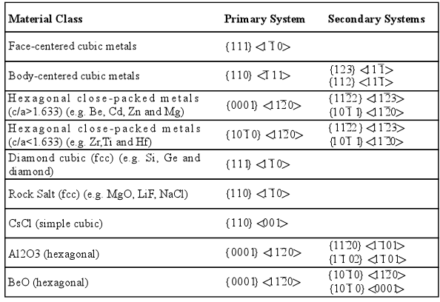
Deformation systems (typical)
In deformed materials, texture or preferred orientation exists due to the anisotropy of slip. While slip in bcc metals generally occurs in the <111> type direction, it may be restricted to {110} planes or it may involve other planes. In general, texture development in bcc metals appears to involve <111>{112} as well as <111>{110}, but this may reflect easy cross-slip between different {110} planes, not actual {112} slip planes.
(T. H. Courtney, Mechanical Behavior of Materials, McGraw-Hill, New York, 1990.)

Slide 12
Strain Measures
Strain commonly defined as a scalar measure of (plastic, irreversible) deformation: logarithmic strain:=
ε = ln {l_{new}/l_{old}}
Rolling strain: typical: reduction in thickness:= r = 100% x h_{new}/h_{old}
better to use von Mises equivalent strain:
ε_{vM} = 2/√3 ln {l_{old}/l_{new}}

Slide 13
Deformation Modes: sample symmetry
Tension, Wire Drawing, Extrusion C∞
Compression, Upsetting C∞
Torsion, Shear 2
Plane Strain Compression, Rolling mmm
Deformation modes of uniaxial type generate fiber textures, i.e. a single common crystal axis parallel to the deformation axis
Shear gives monoclinic symmetry
Plane strain gives orthorhombic symmetry

Slide 14
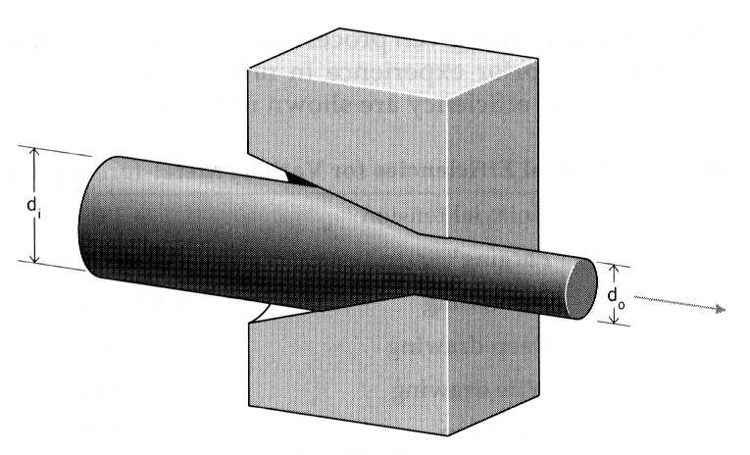
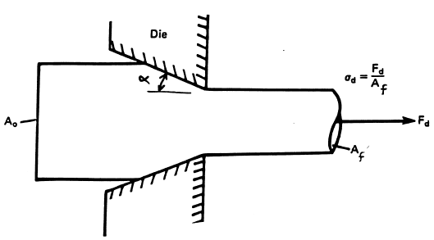
Axisymmetric deformation: Extrusion, Drawing
α is the "die angle"; smaller angles give more uniform deformation but higher friction forces

Slide 15
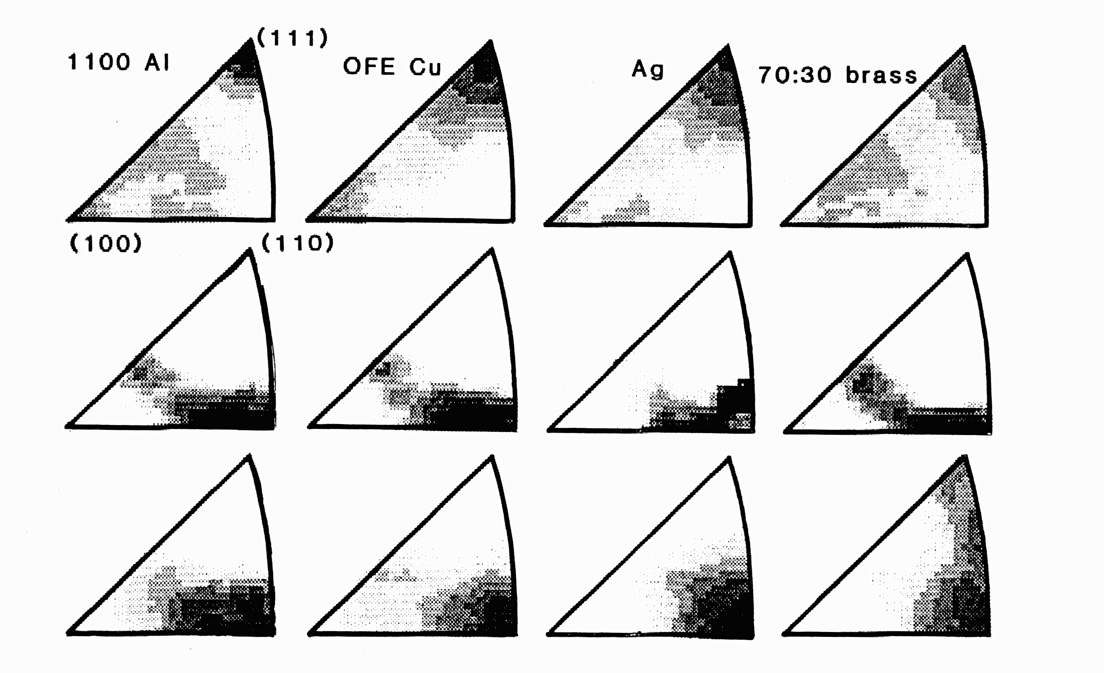
Uniaxial Strain
Inverse
Pole
Figures
(FCC)
C∞
tension
compression
See Ch. 5 in Kocks, Tomé & Wenk

Slide 16
Uniaxial Modes - C∞
Deformation mode/ fcc/ bcc/ hcp (Ti)
Wire drawing, <111> <110> <10-10>
Round extrusion. & <100>
Upsetting, <110> <111> <0001>
Uniaxial compression. &<100>
Note exchange of types between fcc & bcc

Slide 17
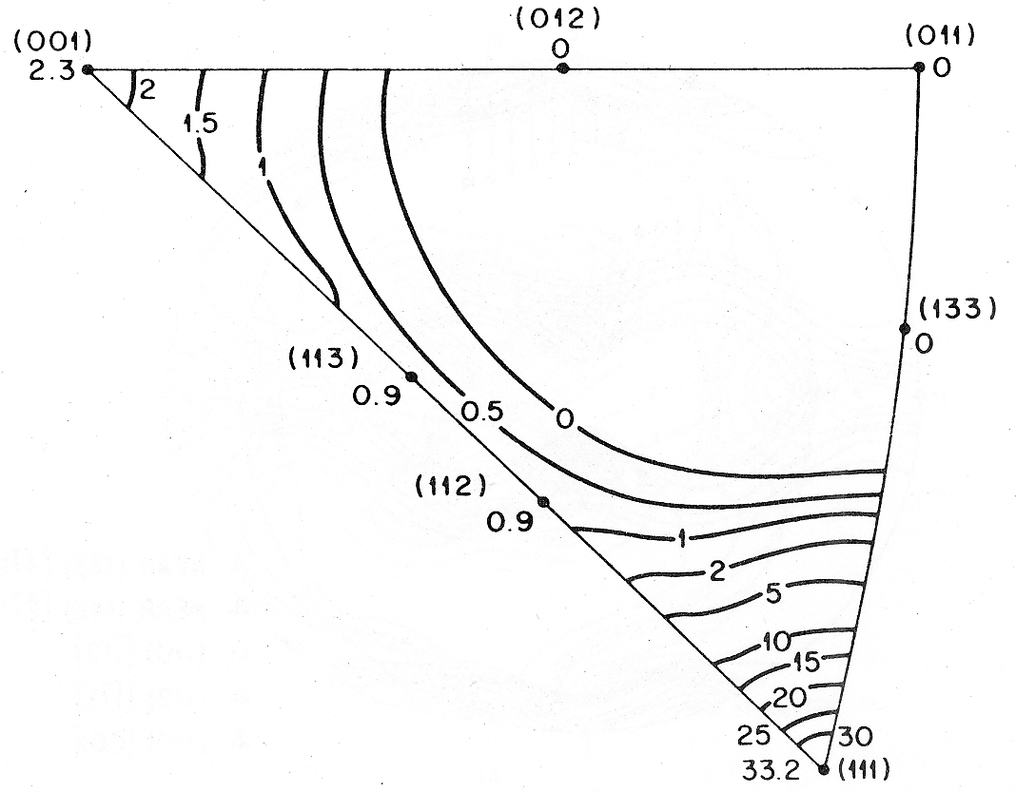
Axisymmetric deformation
In fcc metals, axisymmetric deformation (e.g. wire drawing) produces fiber texture: <111> + <100> duplex, parallel to the wire.
McHargue et al., 1959
Schmid and Wassermann (1963): 60% <111> + 40% <100>
Ahlborn and Wassermann (1963): 66% <111> + 34% <100>
}
Electrolytic Copper

Slide 18
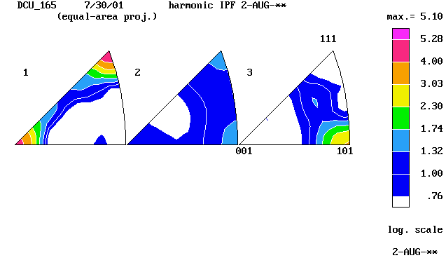
Axisymmetric deformation
Axisymmetric deformation ~ higher order symmetry, C∞
Texture can be represented by an inverse pole figure (IPF).
In IPF, contour lines show the frequency with which the various directions, <uvw>, in the crystal coincide with the specimen axis under consideration
DD
TD
ND
DD – Drawing direction corresponds to RD in rolling

Slide 19
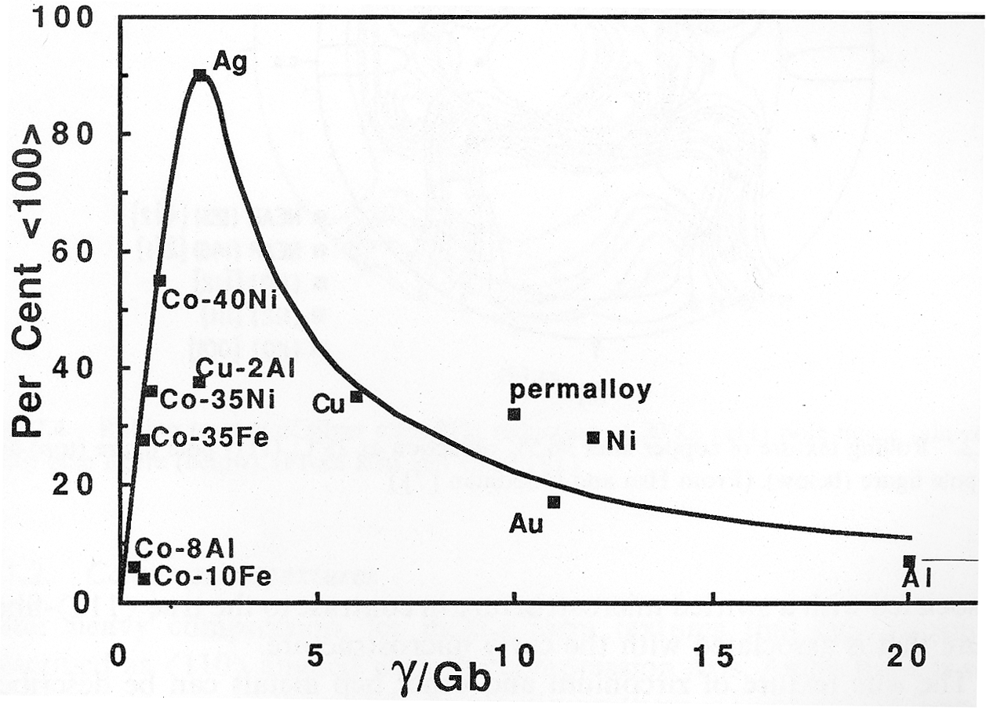
Axisymmetric deformation
The relative proportions of the two components are determined by the stacking fault energy and vary in a complex manner.
English & Chin (1965) Acta metall.

Slide 20
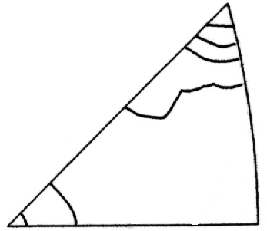
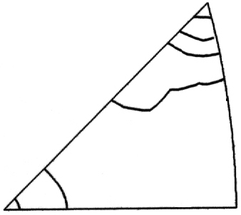
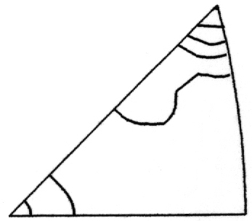
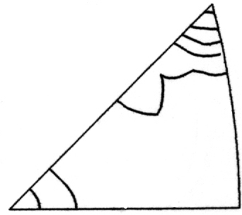
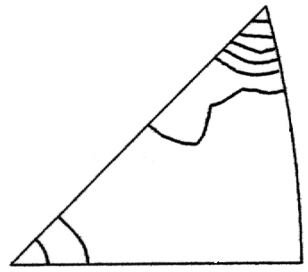
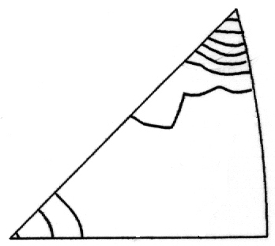
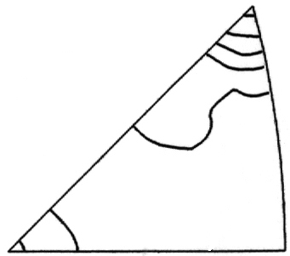
Effect of deformation strain
111
111
111
111
Max = 4.1
Max = 4.5
Max = 5.0
Max = 5.4
001
101
001
101
001
101
001
101
ε = 0.0
ε = 0.45
ε = 1.29
ε = 2.31
111
111
111
Max = 6.9
Max = 7.7
Max = 5.3
001
101
001
101
001
101
ε = 2.80
ε = 3.10
ε = 3.56
X-ray IPFs showing the effect of strain on the texture of OFHC copper wire
D. R. Waryoba, Ph. D. Dissertation, FSU, 2003

Slide 21
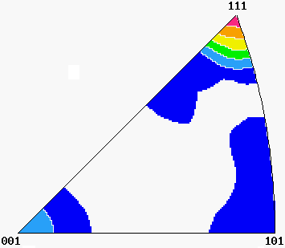
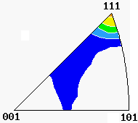
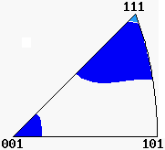
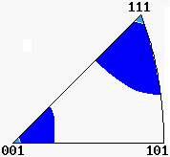
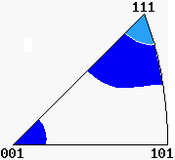
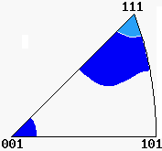
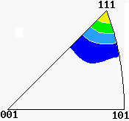
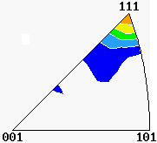

Effect of Temperature
Max. = 6.85
Max. = 5.29
Max. = 2.06
Max. = 2.10
RT
180°C
250°C
300°C
Max. = 2.48
Max. = 2.44
Max. = 4.65
Max. = 5.97
450°C
500°C
600°C
750°C
X-ray IPFs showing the effect of annealing temperature on the texture of OFHC copper wire, initially drawn to true strain of 2.31. The strong <111> fiber first decreases with annealing temperature but then increases again.
D. R. Waryoba and P. N. Kalu, TMS 2003,San Diego, CA

Slide 22
Uniaxial Compression: various fcc metals
Initial
texture
theoretical
texture
exptl.
texture
[Kocks Ch. 5: Inverse Pole Figures]

Slide 23
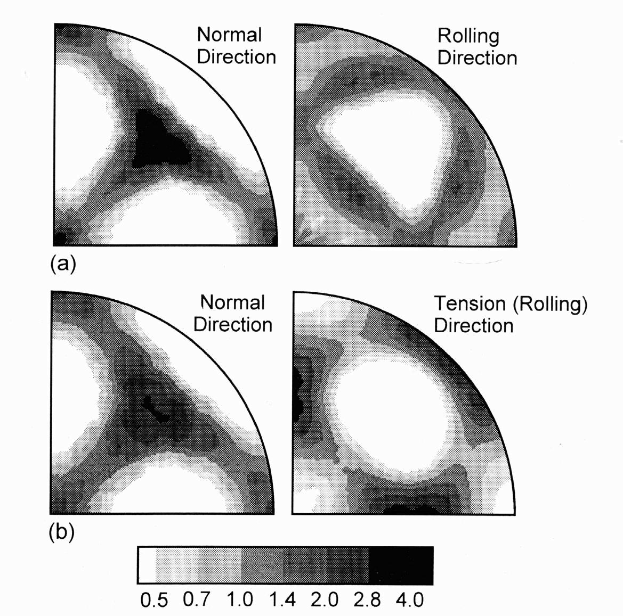
BCC uniaxial textures
92% rolled Ta
Tensile test in
original RD to
strain of 0.6:
<110> fiber
(a) Normal and rolling direction inverse pole figures (equal area projection) of 92% rolled Ta and (b) Prior normal and rolling direction inverse pole figures for (a) tested in tension to a strain of 0.6 (tensile direction coincident to prior rolling direction).
Kocks, Ch. 5

Slide 24
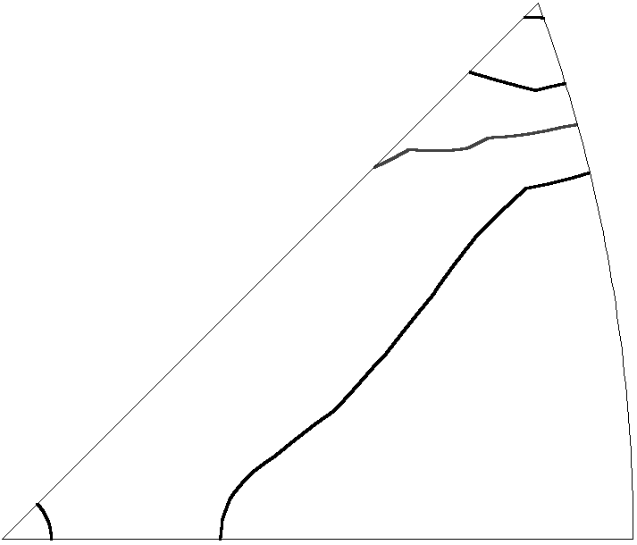
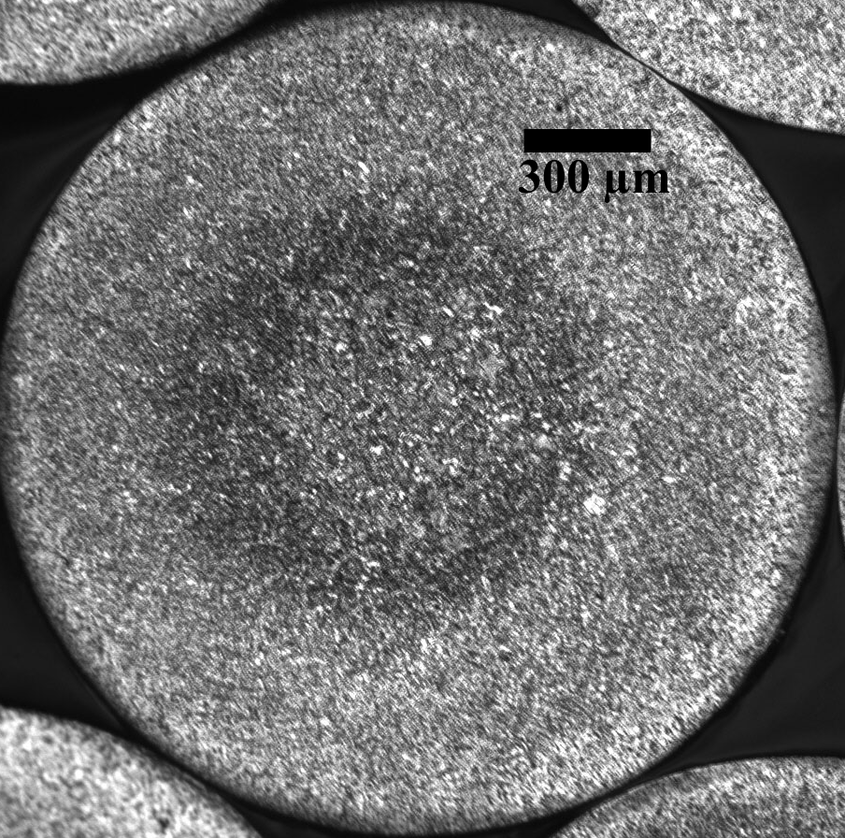
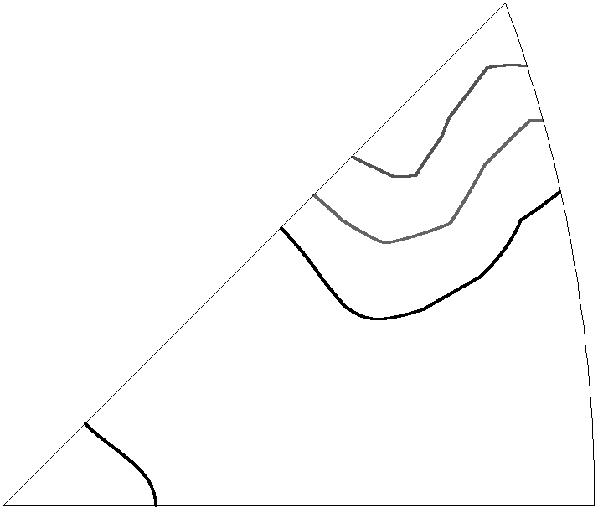
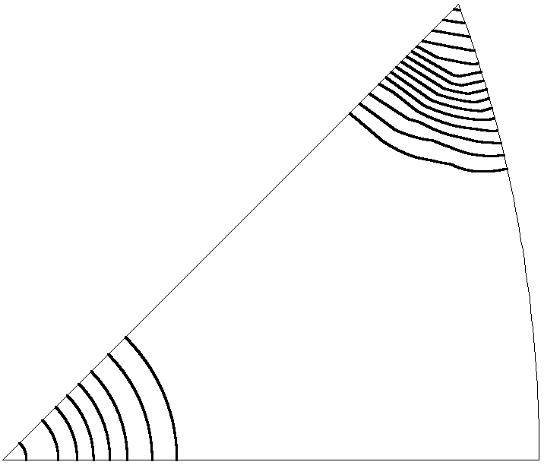
Texture inhomogeneity in Drawn Wires
Max = 4.2
III
II
I
Max = 3.5
Max = 15.7
OIM IPFs representing outer region, mid region, and inner core of the OFHC Cu wire drawn to true strain of 2.31 (contours are at 1, 2, 3 … times random)
D. R. Waryoba and P. N. Kalu, TMS 2005, San Francisco, CA

Slide 25
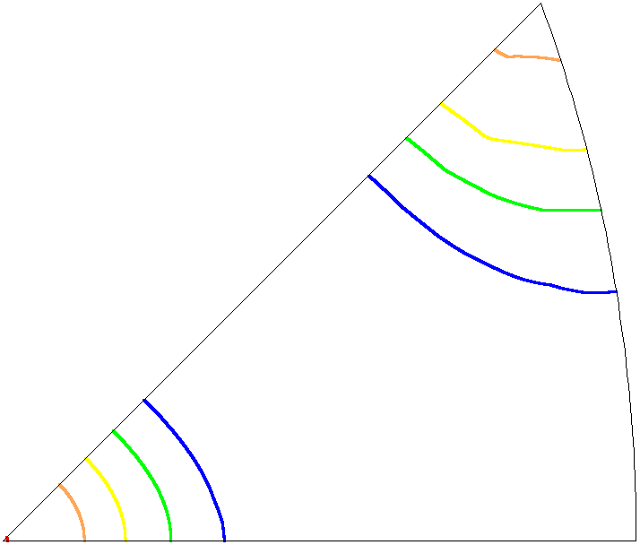
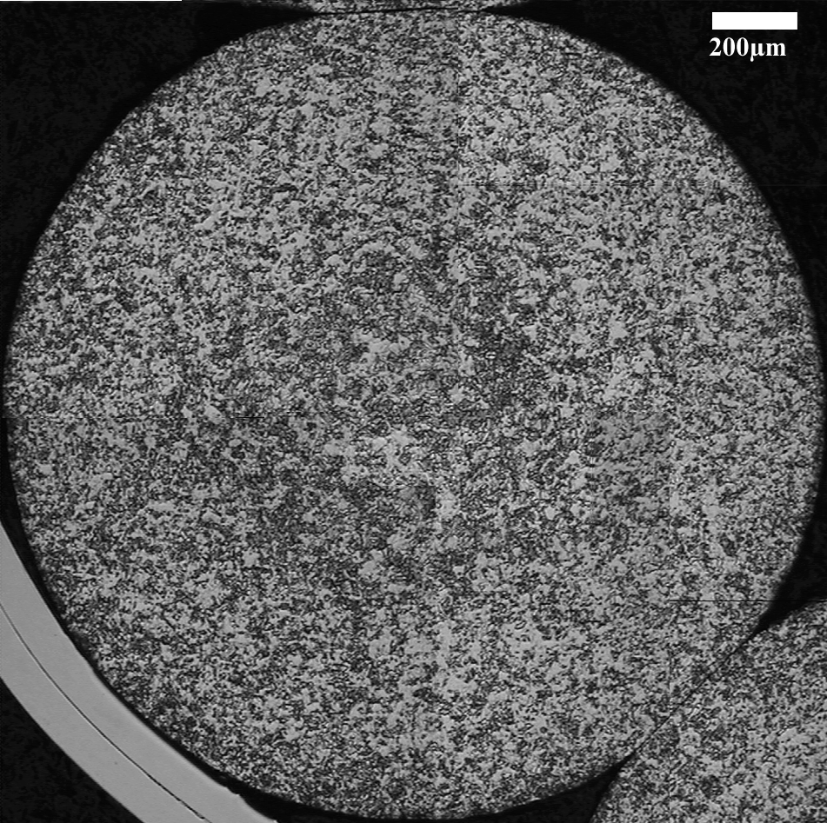
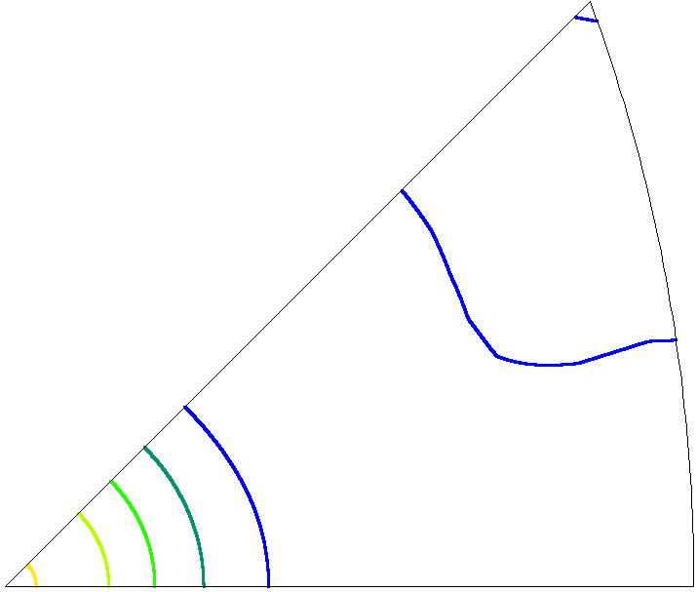
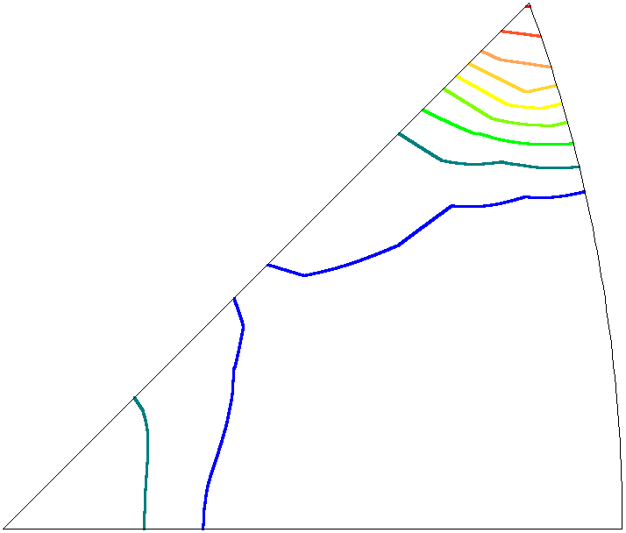
Texture inhomogeneity in Drawn Wires
10 min
Max = 5.1
Max = 5.3
Max = 9.2
OIM IPFs representing outer region, mid region, and inner core of the OFHC Cu wire drawn to true strain of 2.31 and annealed at 250°C for 10 min (contours are at 1, 2, 3 … times random)
D. R. Waryoba and P. N. Kalu, TMS 2005, San Francisco, CA

Slide 26
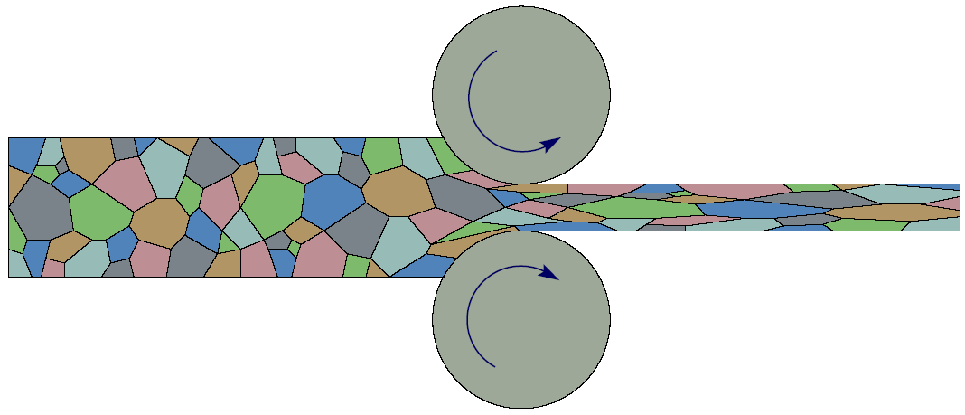
Rolling = Plane Strain
ND
RD
Rolling ~ plane strain deformation means extension or compression in a pair of directions with zero strain in the third direction: a multiaxial strain.

Slide 27
Plane strain (rolling)
Plane strain means extension/compression in
a pair of directions with zero strain in the
third direction: a multiaxial strain.
tension
1
3
compression

Slide 28
Typical rolling texture in FCC Materials
Type | Component | {hkl}<uvw> | Euler Angles (Bunge)
 |  |  | ϕ₁ | θ | ϕ₂
Deformation | Bs | {011}<211> | 35 | 45 | 0
 | S | {123}<634> | 55 | 35 | 65
 | Cu | {112}<111> | 90 | 30 | 45
 | Shear₁ | {001}<110> | 0 | 0 | 45
 | Shear₂ | {111}<110> | 0 | 55 | 45
 | Shear₃ | {112}<110> | 0 | 35 | 45
Recrystallization | Goss | {011}<001> | 0 | 45 | 0
 | Cube | {001}<100> | 0 | 0 | 0
 | RC_{RD1} | {013}<100> | 0 | 20 | 0
 | RC_{RD2} | {023}<100> | 0 | 35 | 0
 | RC_{ND1} | {001}<310> | 20 | 0 | 0
 | RC_{ND2} | {001}<320> | 35 | 0 | 0
 | P | {011}<122> | 70 | 45 | 0
 | Q | {013}<231> | 55 | 20 | 0
 | R | {124}<211> | 55 | 75 | 25

Slide 29
fcc/ bcc/ hcp (Ti)
Shear:
A:{111}<uvw> E:{110}<001> ?
B:{hkl}<110> D:{112}<110>
C: {001}<110>
Rolling: Partial Fibers:
beta, alpha gamma, alpha {0001}
split to +/-TD

Slide 30
Fcc rolling textures
The next set of slides summarizes rolling textures in fcc metals. This topic was also presented as an example in the discussion of Orientation Distributions and their graphical representation.

Slide 31
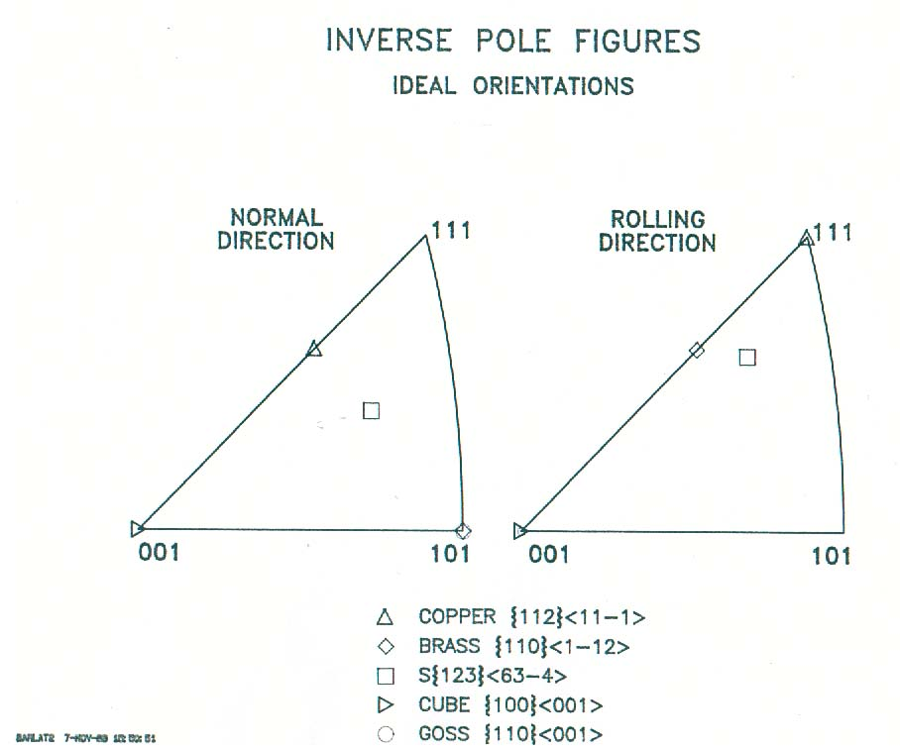

Slide 32
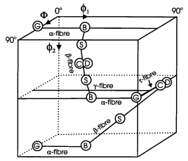
Cartesian Euler Space
φ₁
Φ
φ₂

Slide 33
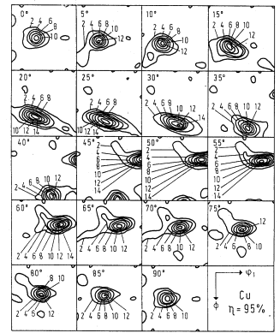
Sections
φ₂ = 5°
φ₂ = 15°
φ₂ = 0°
φ₂ = 10°
Φ
φ₁
φ₂

Slide 34
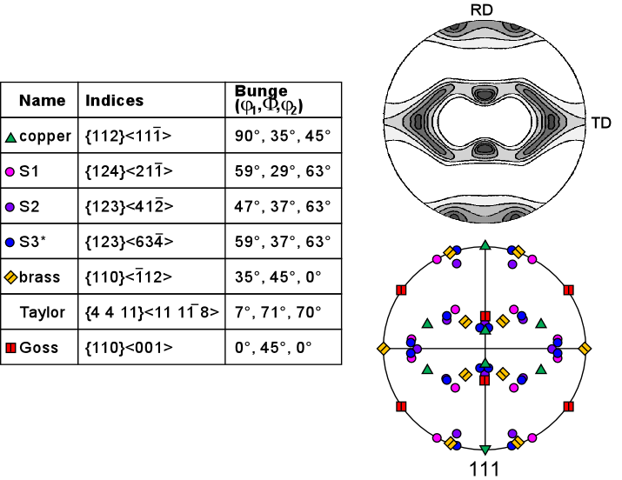
PF Representation
Note how very different components
tend to overlap in a pole figure.

Slide 35
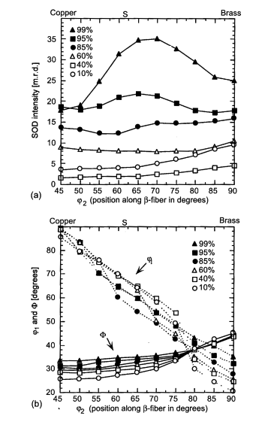
Fiber Plots:
various rolling
reductions:
(a) intensity versus
position along
the fiber
(b) angular position
of intensity maximum
versus position along
the fiber
Kocks, Ch. 2
β-fiber

Slide 36
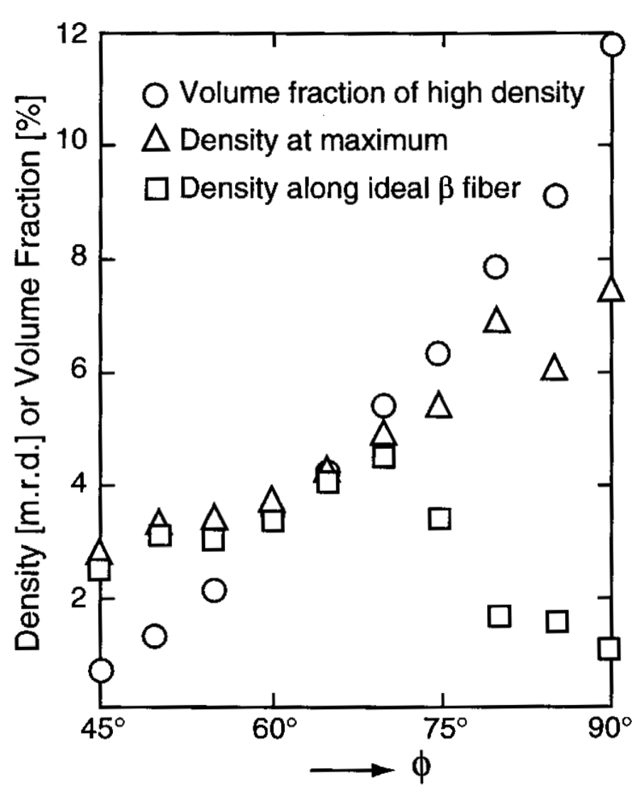
Volume fraction vs. density (intensity)
• Volume fraction
associated with
region around
the fiber in a given
section.
• V_{f} increases faster
than density with
increasing Φ.
• Location of max.
density not at nominal
location.
Kocks, Tomé, Wenk: Ch. 2

Slide 37
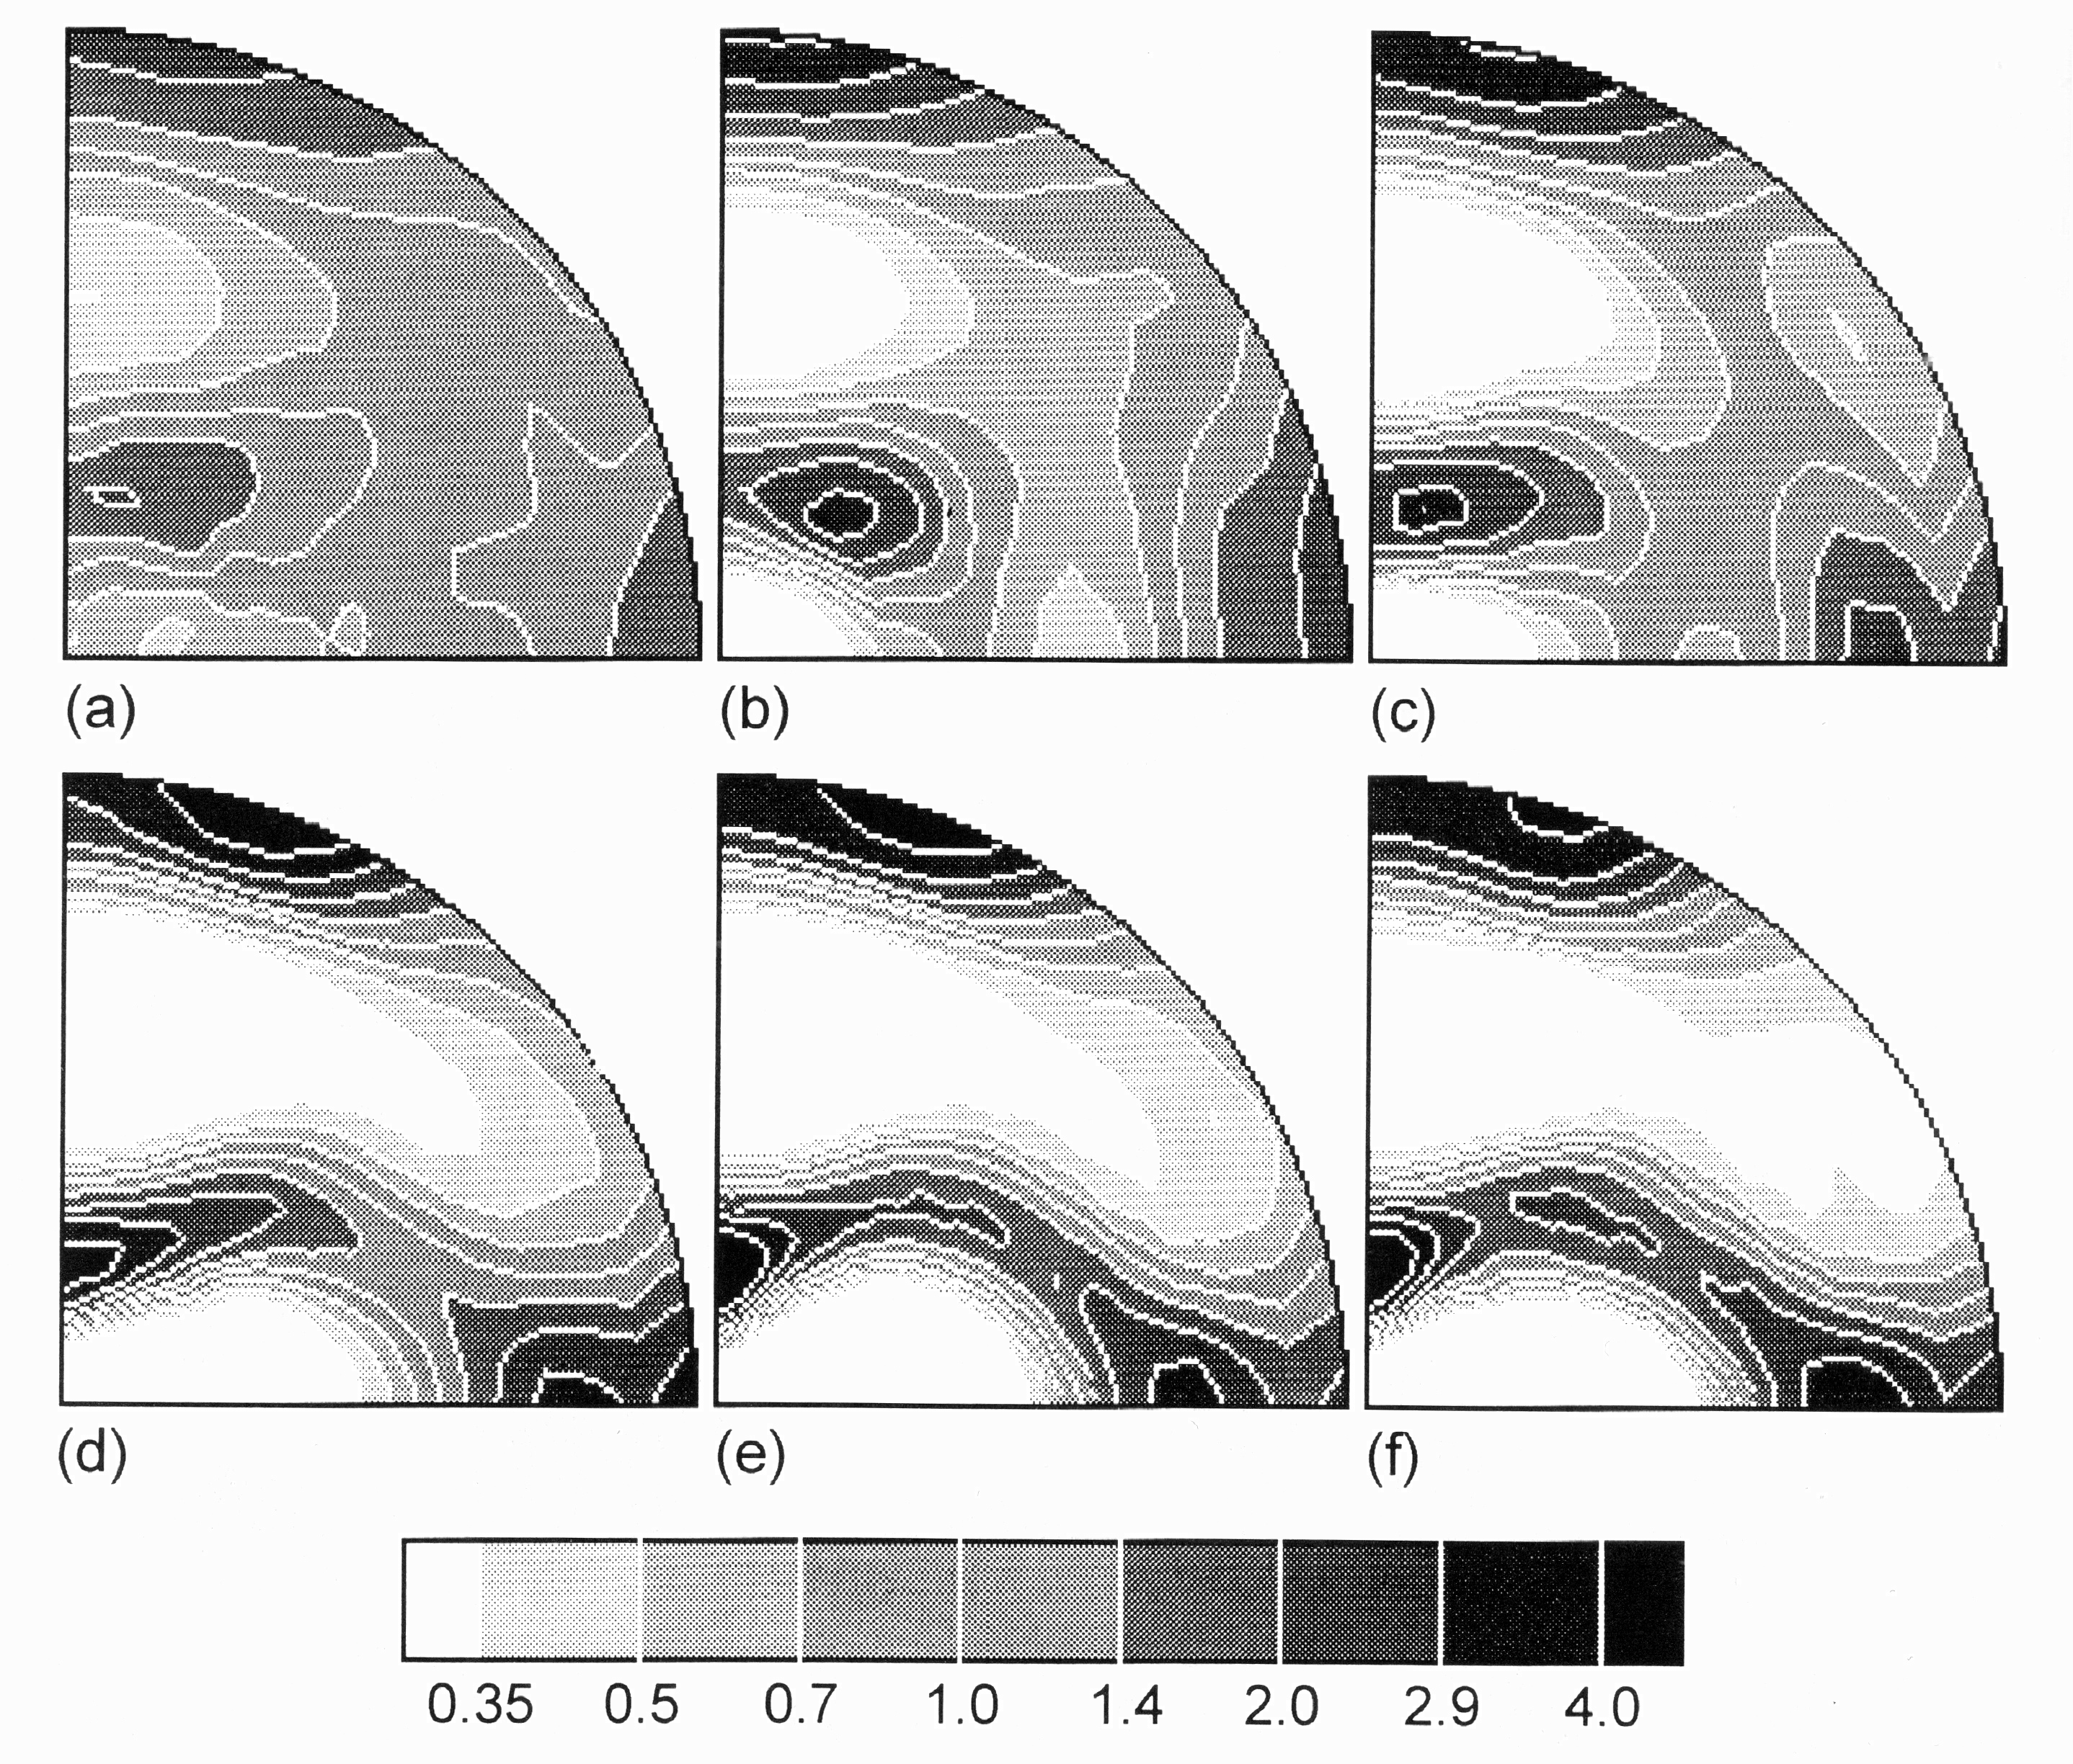
Rolling fcc Cu:
Effect of Strain
{111} Pole Figures,
RD vertical
von Mises strains= initial, 0.5, 1.0, 2.0, 2.7, 3.5

Slide 38
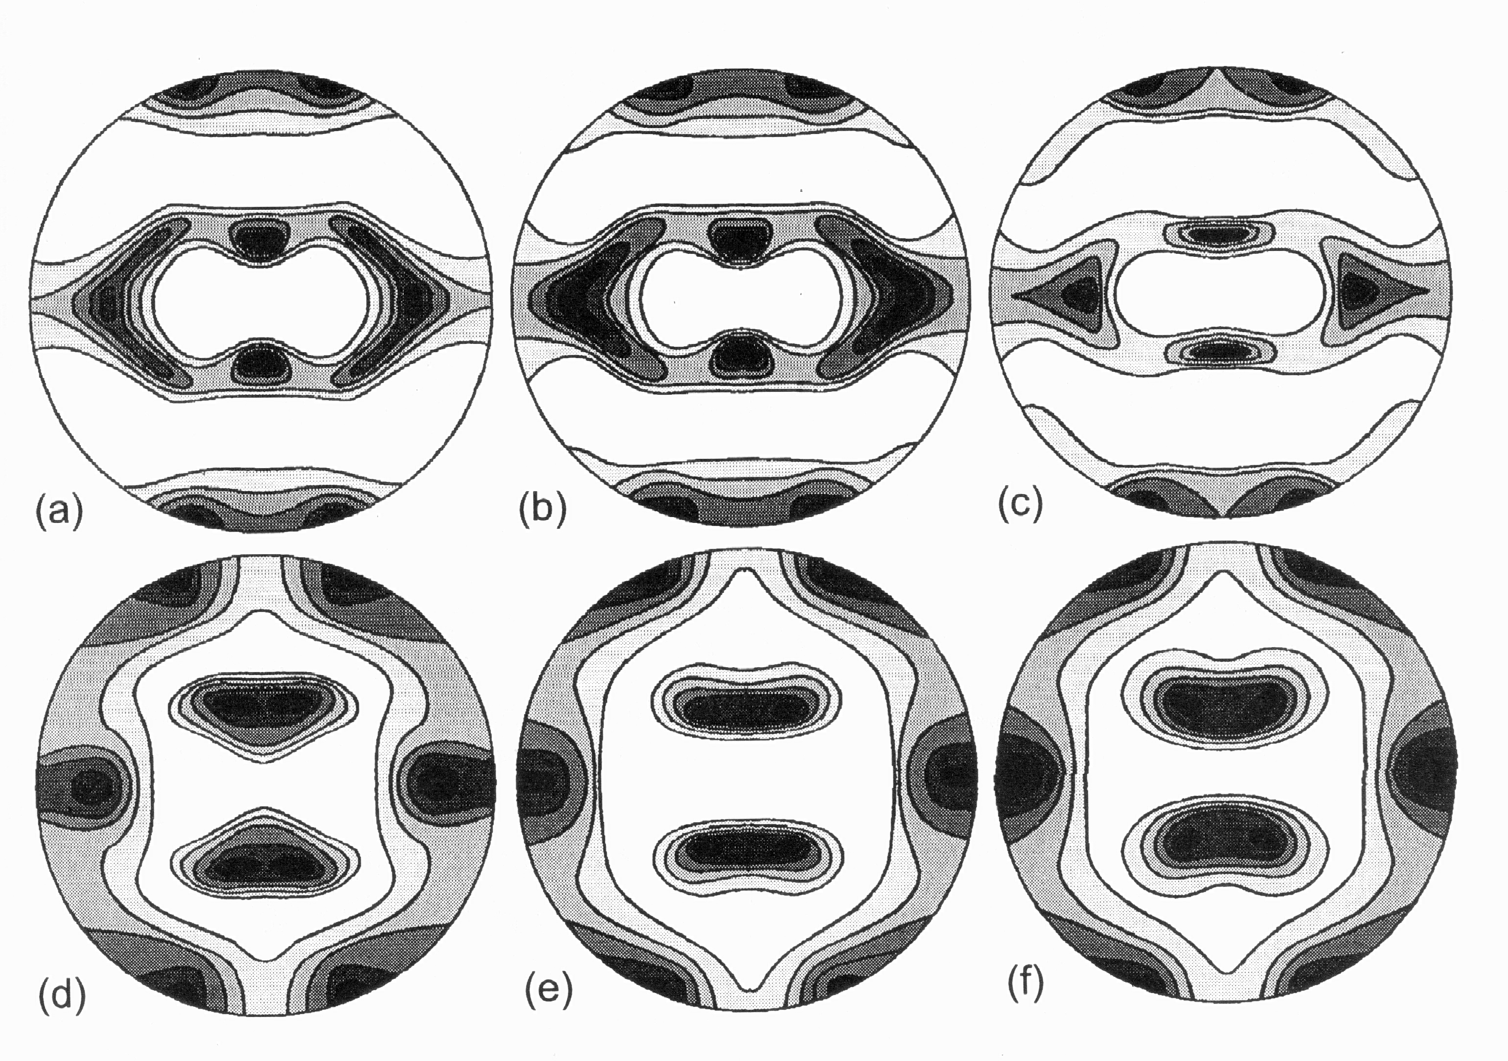
Effect of Alloying: Cu-Zn (brass); the texture transition
Copper
component
Brass
Zn content: (a) 0%, (b) 2.5%, (c) 5%, (d) 10%, (e) 20% and (f) 30% [Stephens PhD, U Arizona, 1968]

Slide 39
Alloy, Precipitation Effects
copper
brass
copper
brass
Hirsch & Lücke, 1988 , Acta metall. 36, 2863
Engler et al., 1989, Acta metall. 37, 2743

Slide 40
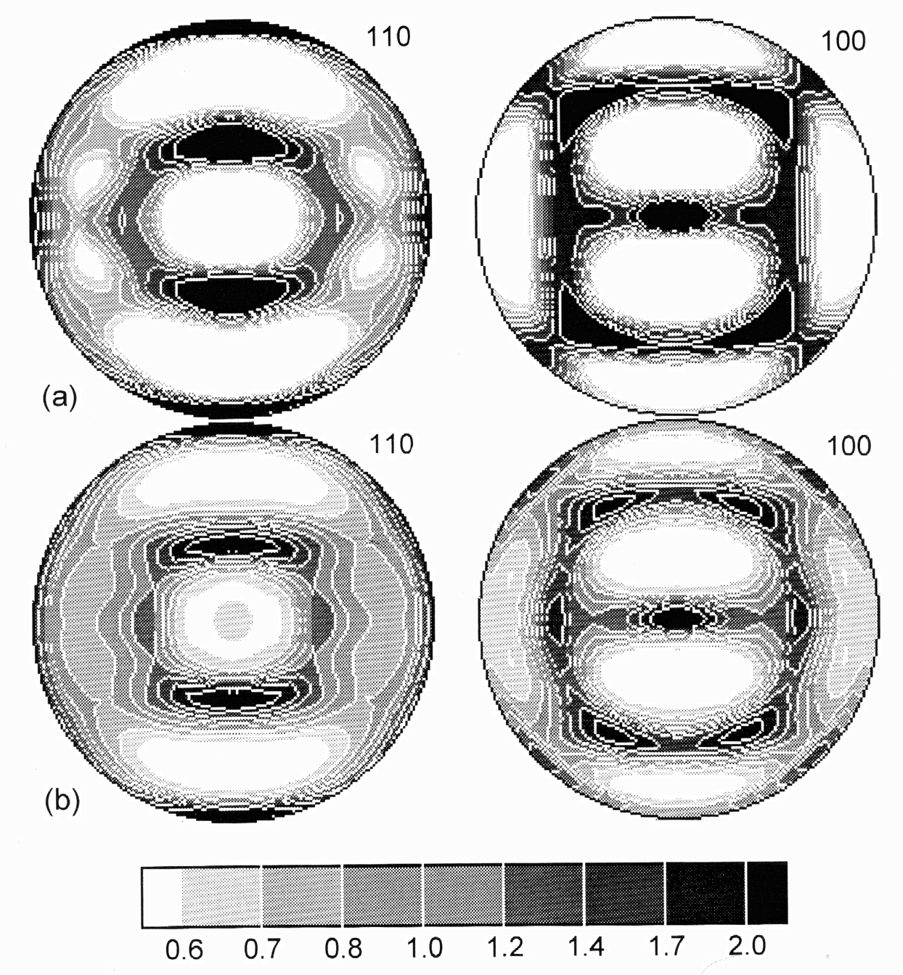
Rolling Textures BCC
{110} and {100} pole figures (equal area projection; rolling direction vertical) for (a) low-carbon steel cold rolled to a reduction in thickness of 80% (approximate equivalent strain of 2); (b) tantalum, unidirectionally rolled at room temperature to a reduction in thickness of 91%.
Kocks, Ch. 5

Slide 41
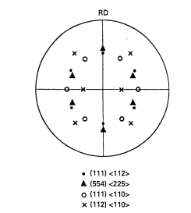
{100} Pole figure for certain components of rolled BCC metals
Note how very different components
tend to overlap in a pole figure.
Kocks, Ch. 5
Notes:
Pole figures are evidently less than ideal for distinguishing particular components!

Slide 42
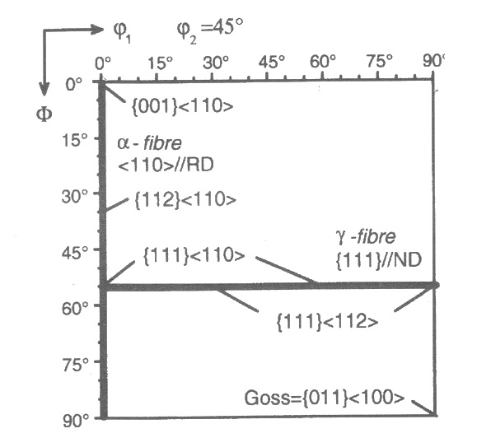
BCC fibers: the φ₂ = 45° section
φ₁
ε,
<110>||TD
α,
<110>||RD
γ, <111>||ND
Φ
Goss

Slide 43
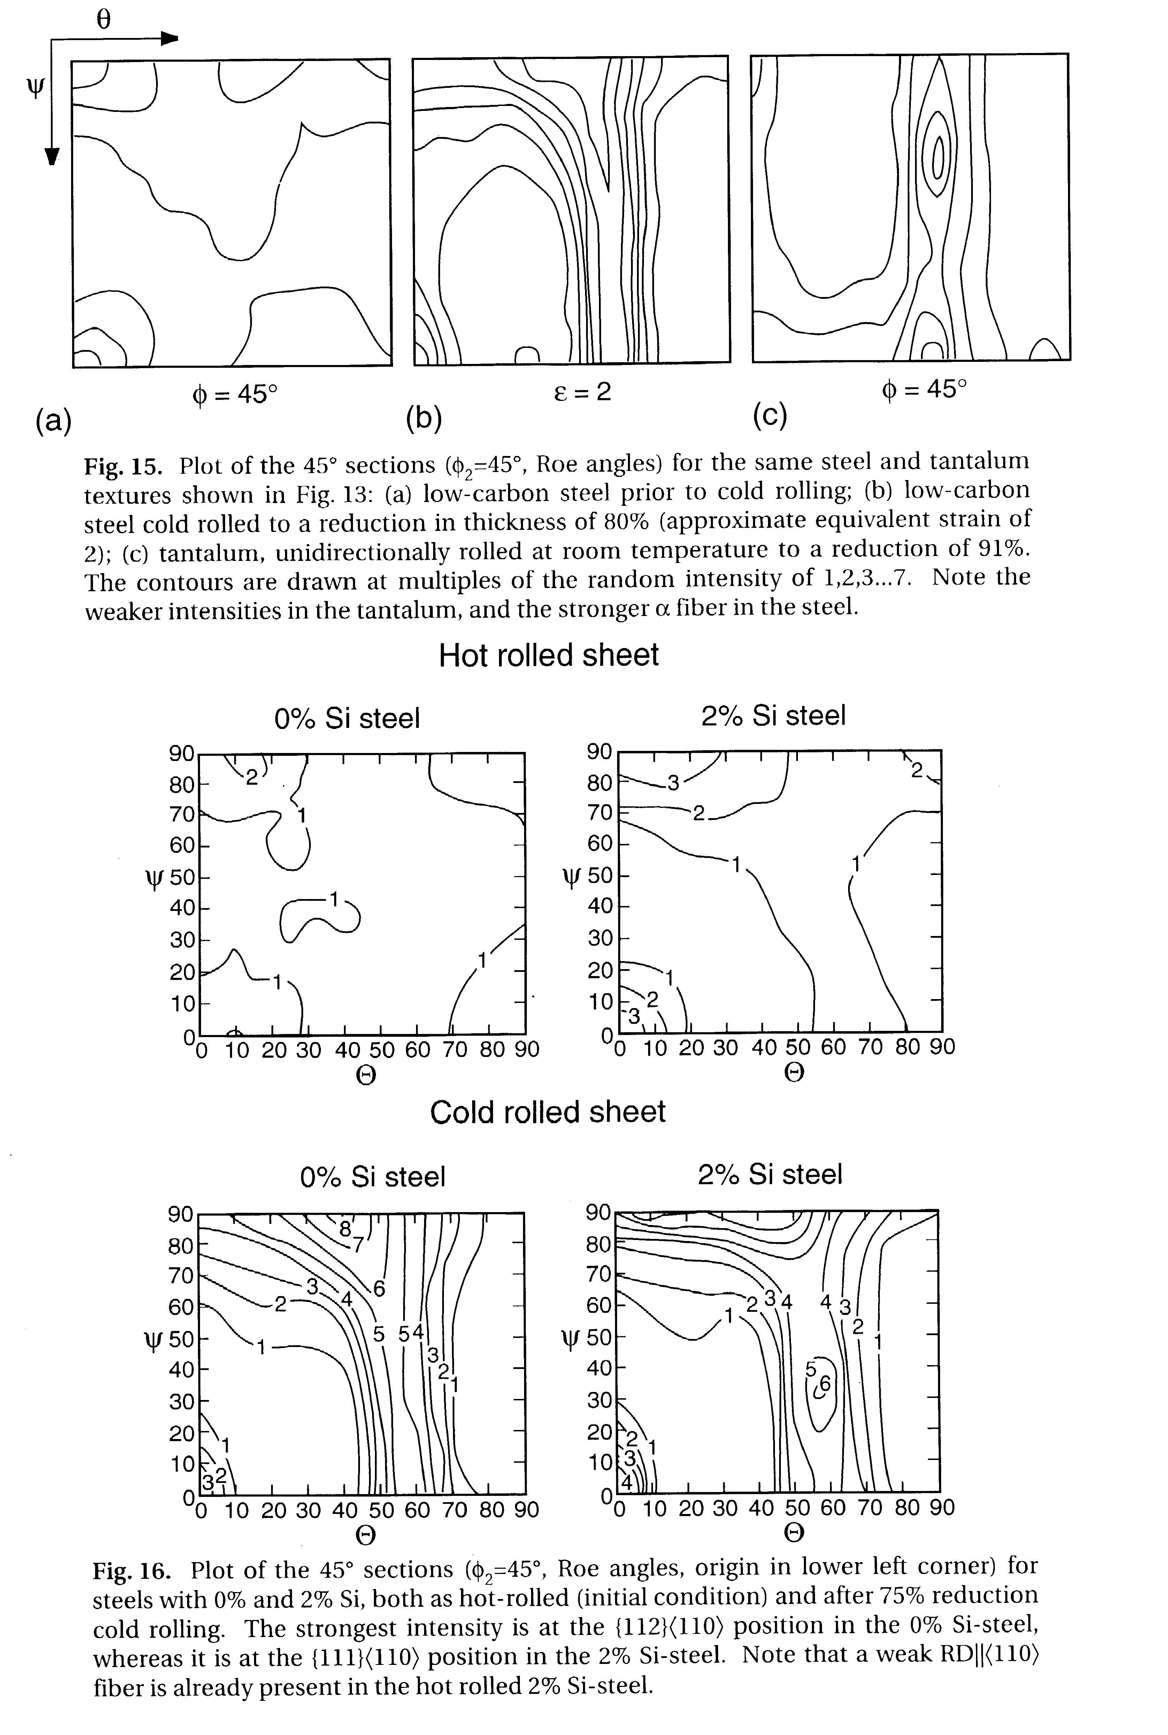
Ta, Fe rolling textures
Note: Euler angles
are Roe angles:
axes transposed
with Θ horiz.,
ψ vertical.

Slide 44
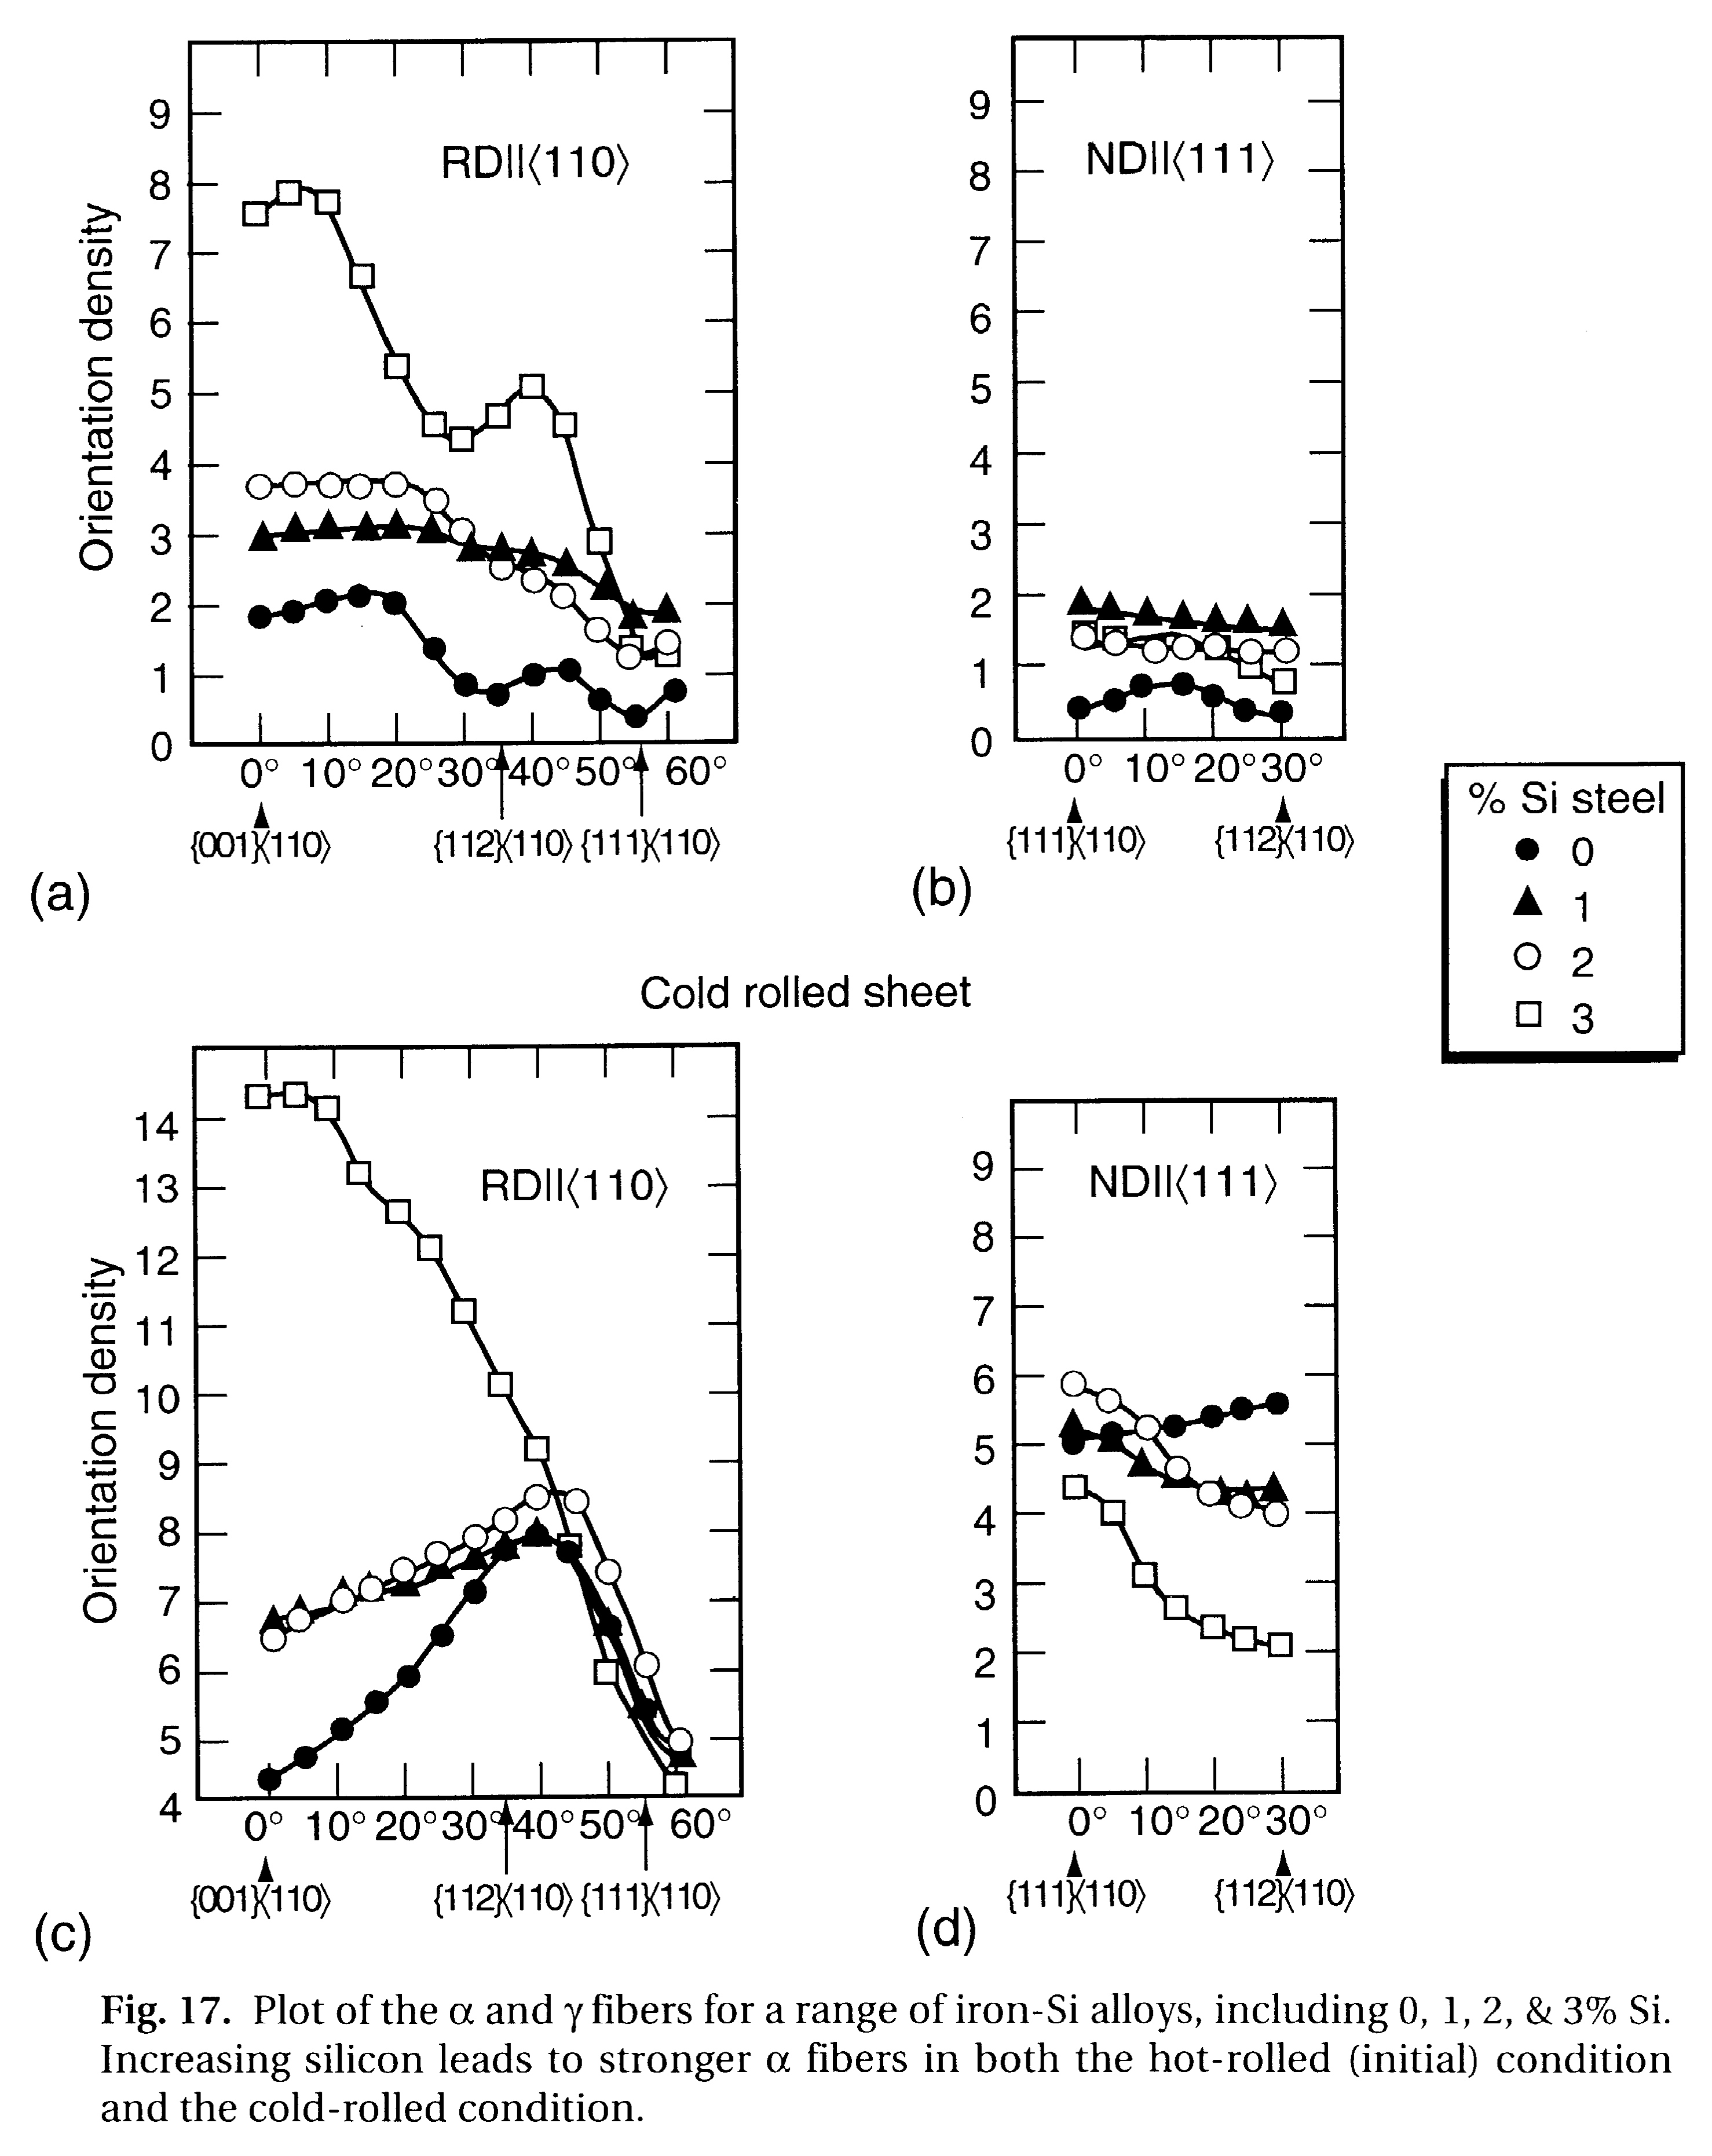
Fe, Fe-Si rolling fiber plots
Note the marked
alloy dependence
in the alpha fiber;
smaller variations
in the gamma fiber.

Slide 45
Summary: part 1
Typical textures illustrated for FCC & BCC metals as a function of alloy type (stacking fault energy) and deformation character (strain type).
Pole figures are recognizable for standard deformation histories but orientation distributions provide much more detailed information. Inverse pole figures are also useful, especially for uniaxial textures.
Measure strain using von Mises equivalent strain.
Plane strain (rolling) textures concentrate on characteristic lines ("partial fibers") in orientation space.
Uniaxial textures align certain crystal axes with the deformation axis.

Slide 46
Part 2: shear/ torsion textures
This section covers shear (torsion) textures

Slide 47
Shear Texture
Shear strain means that displacements are tangential to the direction in which they increase.
Shear direction=1, Shear Plane ⊥ 2-axis
The matrix shows the velocity gradient; the strain (rate) is the symmetrized version of L.
ε₁₂=
tanθ
Note the definition of strain, ε_{ij}, as the derivative of the displacement u_{i} with respect to coordinate x_{j}.
2 =
Torsion
Axis
= {hkl}
θ
1 = Shear Direction = <uvw>

Slide 48
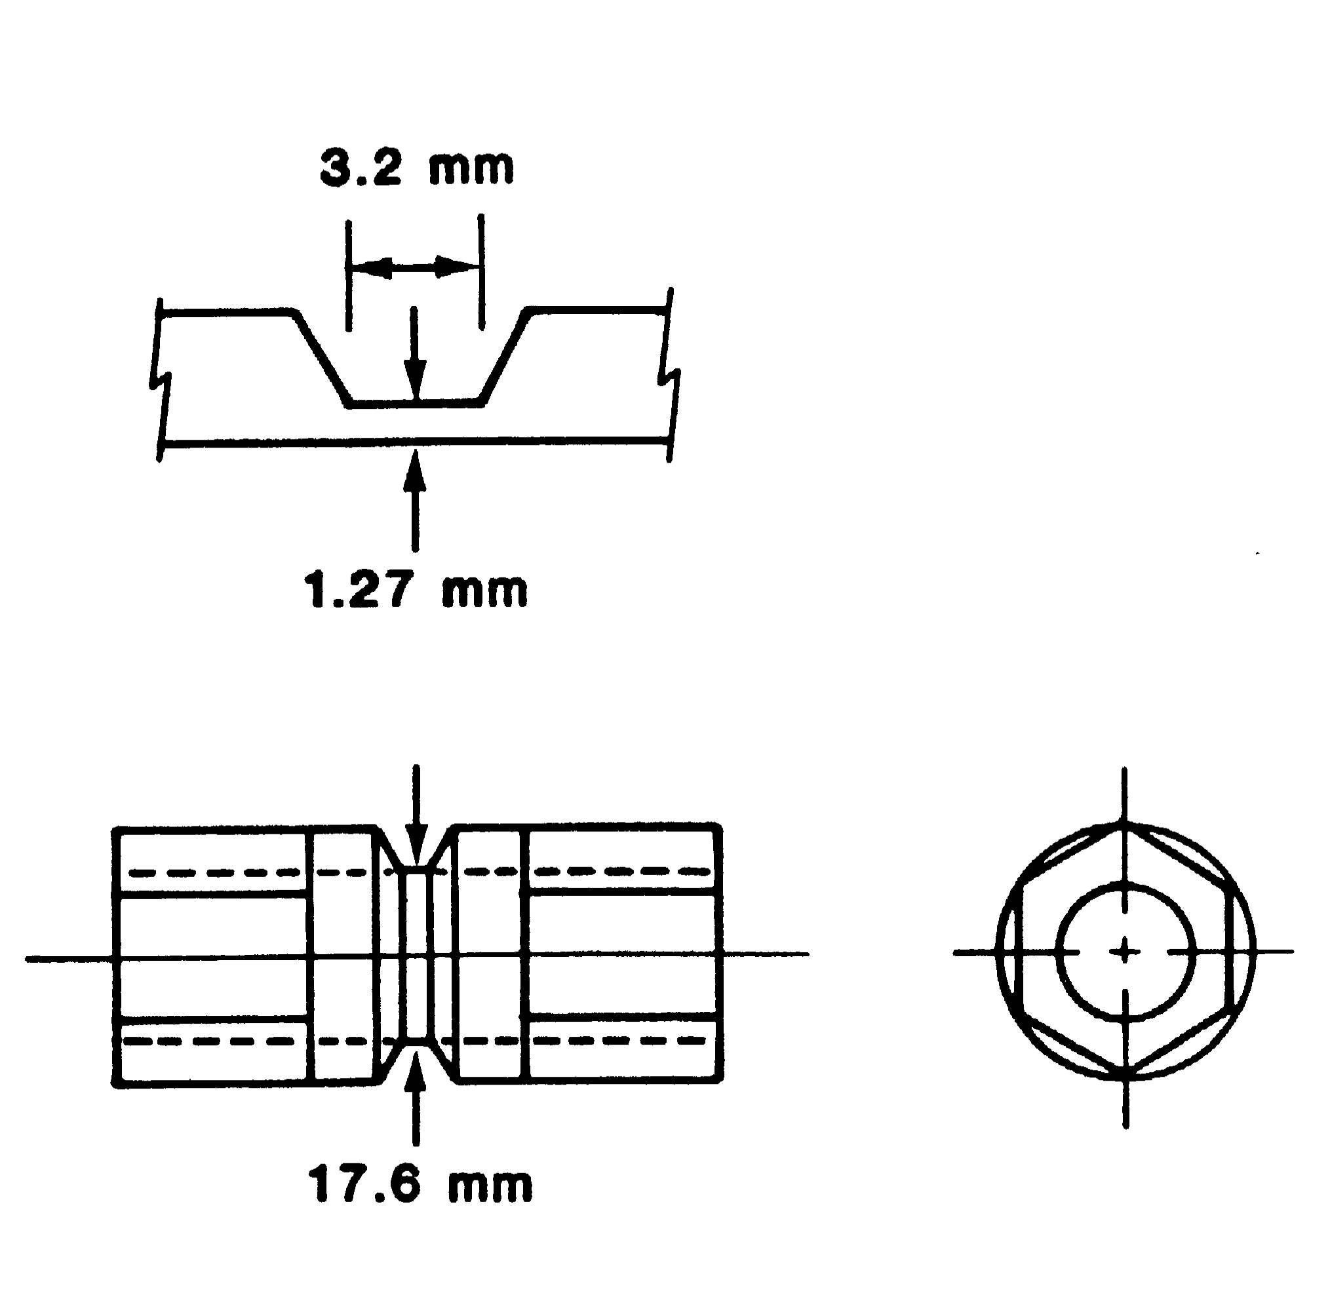
Torsion Textures: twisting of a hollow cylinder specimen
(a)
Sense of shear:
Torsion Axis
(c)
(b)

Slide 49
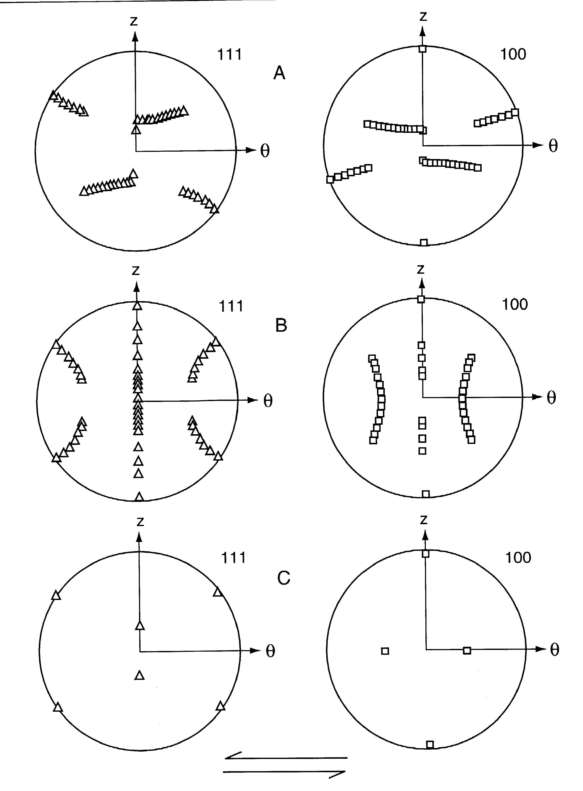
Shear Textures: idealized texture components for FCC metals
Torsion Axis
A partial fiber {111}<uvw>
B partial fiber {hkl}<110>
C component: {001}<110>
Canova et al. (1982), 'Texture Development Prediction for Deformation in Torsion and Tension at Large Strains', J. Metals 35 A21-A21; Canova et al. (1984), 'Theory of Torsion Texture Development', Acta metall. 32 211
Shear direction

Slide 50
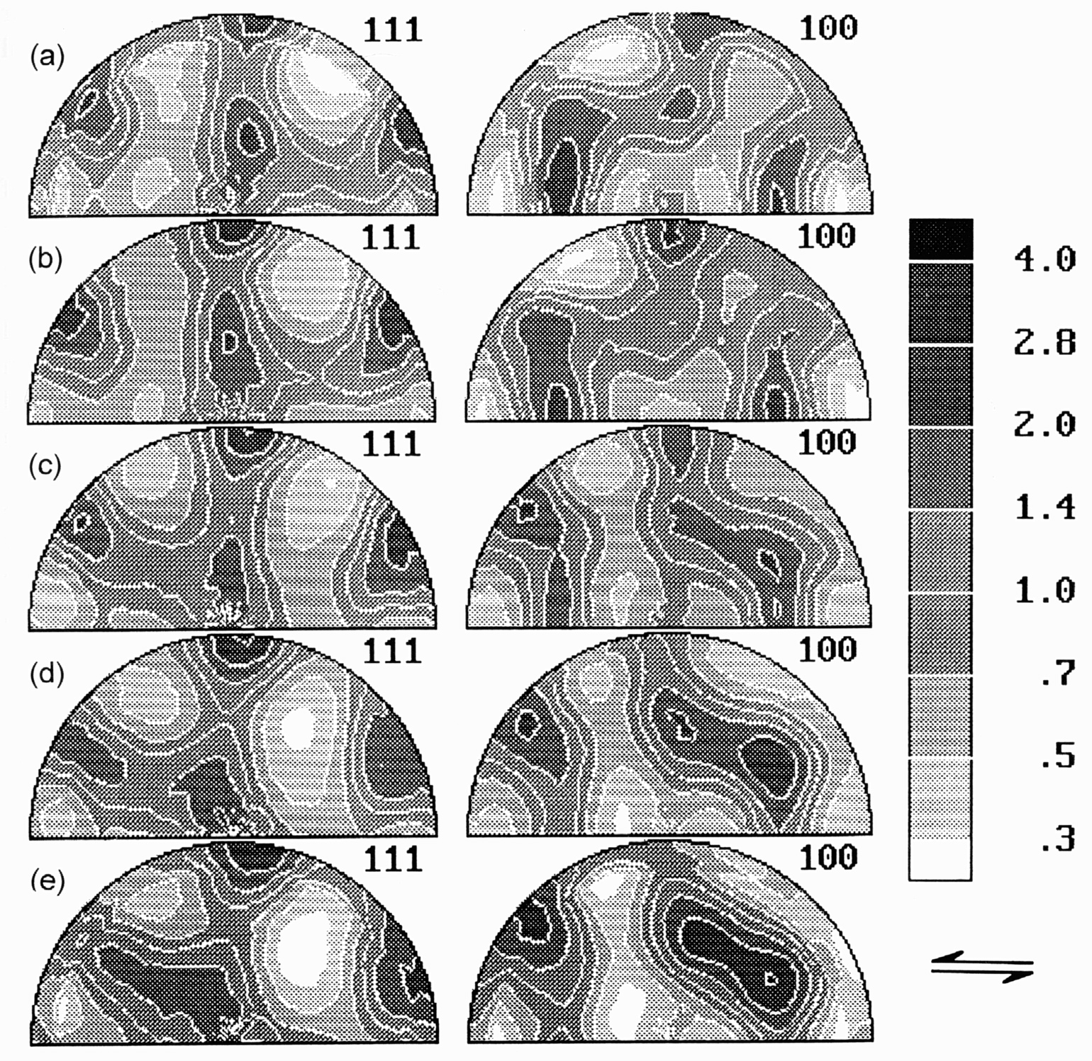
FCC Torsion Textures
  Plots of {111} and {200} pole figures (equal area projection; torsion axis vertical) for the following materials deformed in torsion; the shear direction points to the left in these figures.
  a) Nickel at γ=3.6
  b) Copper at γ=3.5
  c) Silver at γ=3.5
  d) Cu-30Zn at γ=3.5
  e) Ni-60Co at γ=3.2
Note that the partial "A" fiber is present in Ni and Cu, but is absent in the other materials. Silver, brass and Ni-60Co show instead a "D" fiber which is similar to the A fiber but rotated approximately 90° about the torsion axis. The B fiber is present to varying degrees in all the materials.
Kocks, Ch. 5

Slide 51
Shear Texture Components
Why study shear textures? Shear strain is common near the surface of rolled parts, for example.
Partial Fibers: A/D {111}<uvw>…<110>
B {hkl}<110> … {112}
Components C {001}<110>
D {112}<111>
E {011}<111>
F {110}<001>

Slide 52
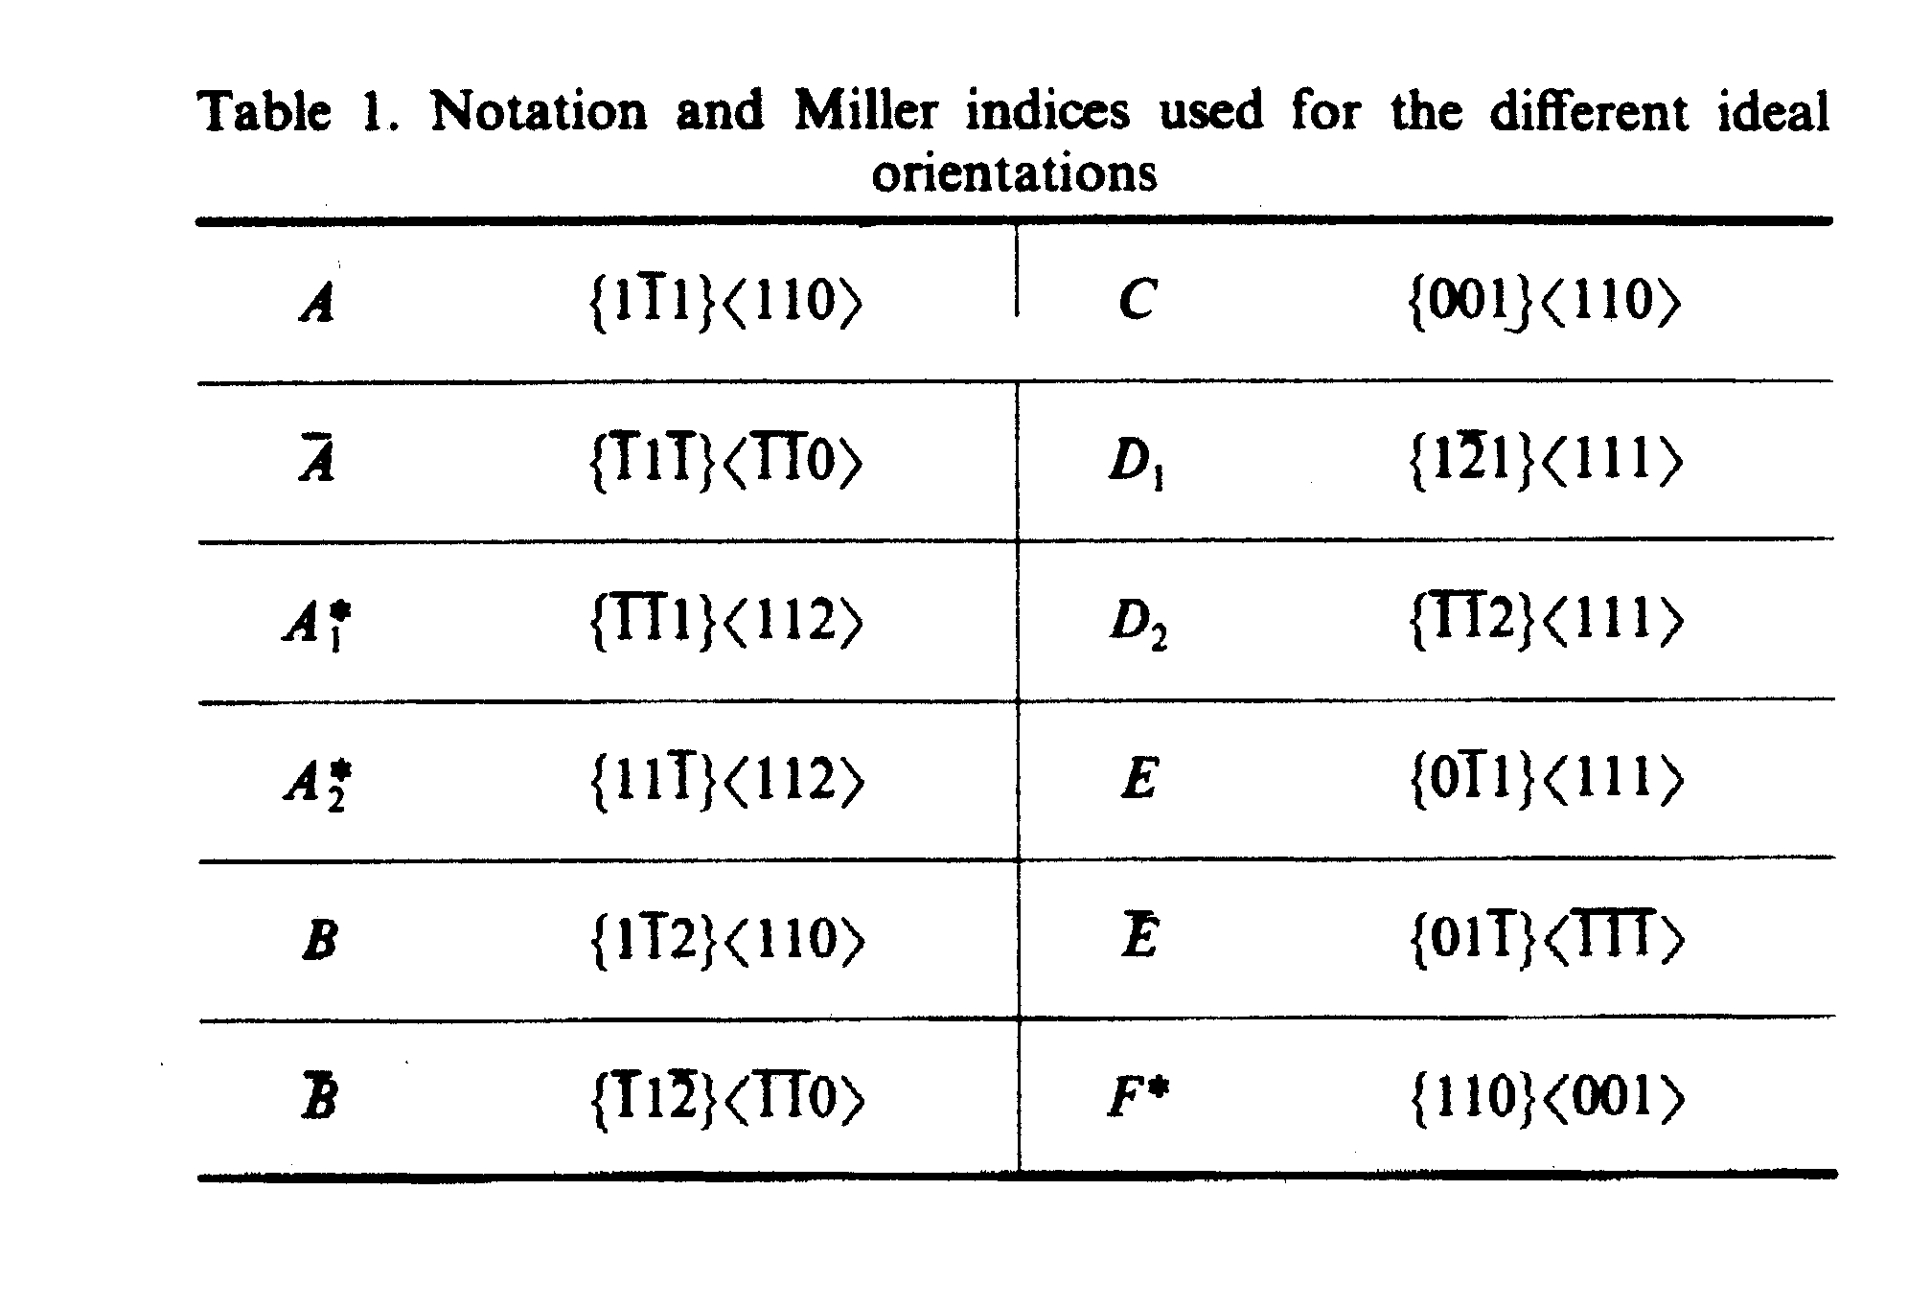
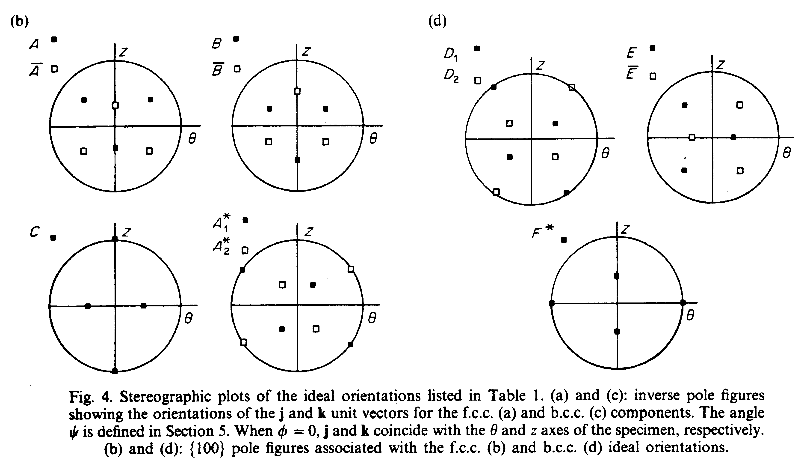
FCC vs. BCC
{100} Pole figures
FCC
BCC
Montheillet et al. (1985), Acta metall., 33 705

Slide 53

BCC torsion textures: Fe
Ideal |{100}
pole figures

Slide 54

BCC torsion textures: Ta
(a) initial texture
from swaged rod;
(b) torsion texture
Ideal |{100}
pole figures
Kocks, Ch. 5

Slide 55
Hexagonal Metals
Common to show the (0001) pole figure: provides most information needed.
Easy slip on the basal plane means that compression generally aligns the basal plane normal with the compression axis.
Tension typically aligns basal plane normals perpendicular to the axis.

Slide 56
Deformation systems, hexagonal
Acta mater. 49 (2001) 3085–3096

Slide 57

Uniaxial textures in Ti
tension
compression
Compression:
25° from 0001,
~ <11-24>
Kocks, Ch. 5

Slide 58

Zr: compression
Ti: compression
Kocks, Ch. 5

Slide 59

Hexagonal Rolling Textures; schematic
c/a > 1.633:
RD split in 0001
c/a < 1.633:
TD split in 0001
Kocks, Ch. 5

Slide 60

Hexagonal Rolling Textures: exptl.
Kocks, Ch. 5

Slide 61

Hexagonal Rolling: strain dependence
20%
30%
55%
97%
Kocks, Ch. 5

Slide 62
Hexagonal: clock rolling
Note the strong anisotropy caused by texture
Tomé et al. (2001) Acta mater. 49 3085–3096

