Slide 1


Abnormal Grain Growth
27-750
Texture, Microstructure & Anisotropy
A.D. Rollett
Contributors: E.A. Holm¹, D.J. Srolovitz¹⁰, Y. Arita², L. Chan⁶, S.D. Sintay³, T. Bennett⁹, S. Wilson¹, S. Wang¹, M. Miodownik⁵, C. Roberts⁷, S.L. Semiatin⁸, K.-J. Ko⁴, W. Frazier¹, S. Dillon¹¹, M.P. Harmer¹², G.S. Rohrer¹, S. Bojarski¹
¹Carnegie Mellon University, ²Nippon Steel, ³Los Alamos Natl. Lab., ⁴Seoul National Univ., ⁵University College, London, ⁶Tescan, ⁷Cartech Inc., ⁸Air Force Research Lab., ⁹Univ. Ghent, ¹⁰U. Penn., ¹¹UIUC, ¹²Lehigh
Last revised: 21st April 2016

Slide 2
Outline
Review of possible causes of Abnormal Grain Growth (AGG)
Variation in stored energy (from plastic deformation)
Particle and pore pinning
Complexion transitions
AGG theory based on energy & mobility
Coarsening of subgrain structures (giving rise to recrystallization nuclei)
Appendix: computer codes: MMSP, MEV, SPPARKS

Slide 3
Possible Causes of AGG
Abnormal grains maintain high mobility on their perimeters:
Example 1 – the GBs acquire impurities and transition from one structure to a different one, aka they undergo a complexion transition.
Requires propagation of the complexion transition from one GB to another. See work by Dillon, Harmer, Rohrer, Frazier et al.
Example 2 – in a subgrain network, a highly misoriented (compared to the matrix) subgrain has high angle, mobile boundaries. See papers by Holm, Wang.
Matrix pinned from faceting of majority of grain boundaries: abnormal grains escape by de-facetting. However, it do the abnormal grains maintain a majority of defacetted boundaries? See work by Henry, Yoon et al.
Matrix pinned with second phase particles: abnormal grains escape how? Or, how do they maintain high mobility?
A possible explanation of AGG in the presence of pinning particles is where the matrix is stabilized at a size below the Zener-Smith limit because all the particles are on the boundaries, then a grain that can get away will grow abnormally. Roberts, Holm, Hoffman et al.
Matrix grains have a non-trivial stored energy (but nucleation of recrystallization somehow not possible, e.g. insufficient strain): abnormal grains have lower stored energy. Antonione, Bennett, et al.
Special case: AGG in grain-oriented electrical steels has been ascribed to wetting of matrix grains by low angle boundaries in Goss grains. Hwang et al.

Slide 4
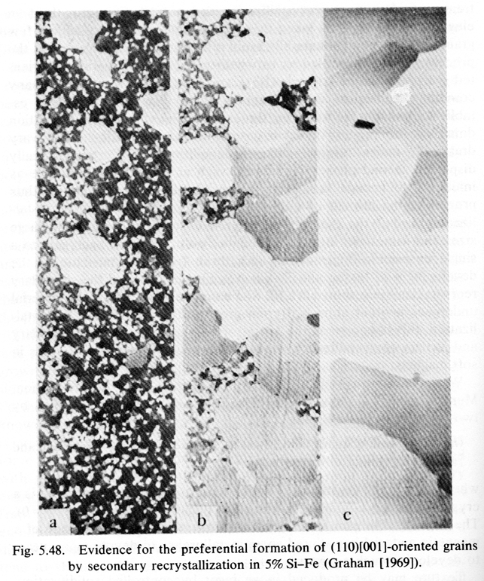
Abnormal grain growth microstructure
Abnormal grain growth is dramatically obvious in Fe-3Si steels.
The {110}<001> grains are much larger than the matrix grains.
Pinning of the matrix grains can be achieved with either MnS or AlN particles
time →
[Graham 1969]
Goss, N. P. (1935). "New development in electrical strip steels characterized by fine grain structure approaching the properties of a single crystal." Transactions of the Metallurgical Society of AIME 23: 511-544

Slide 5
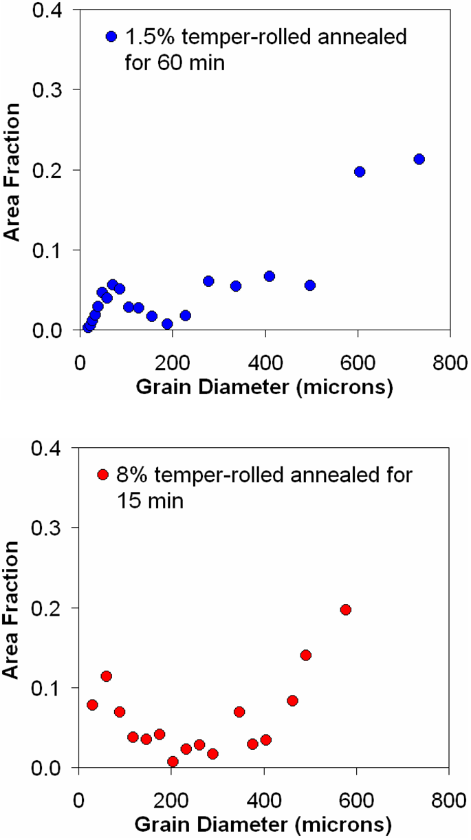
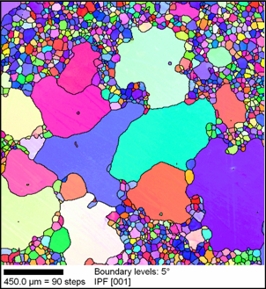
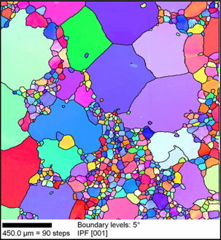
AGG: Definition
AGG has occurred when a minority of grains grow much larger than the majority (“matrix”).
AGG has occurred when the grain size distribution is clearly bi-modal.
Definition above works best when the upper set is a minority by number (and then area-weighting helps).
In this material, AGG is a consequence of non-uniform stored energy from the low strain.
1.5% temper-rolled material annealed for 60 min. at 787C in air.
Bimodal feature typical of AGG
8% temper-rolled material annealed for 15 min. at 787C in air.
[Bennett 2011]

Slide 6
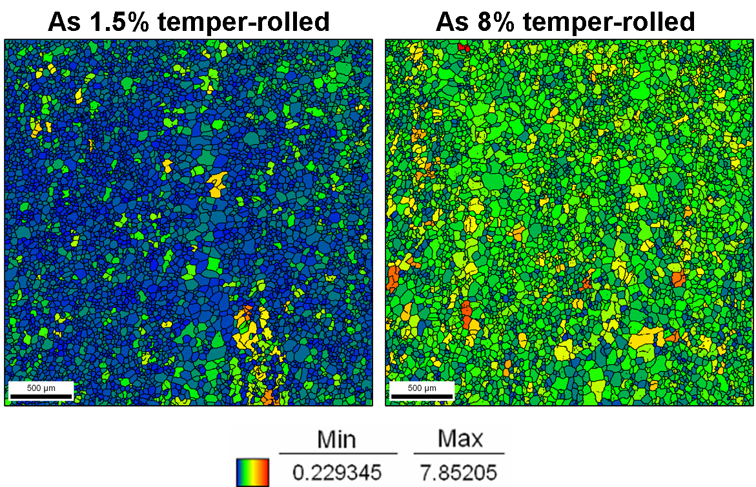
As-deformed Fe-1%Si
Intergranular variations in GOS greater in 8% temper-rolled material.
Maps shaded according to GOS.
AGG is a local phenomenon.
AGG occurs more readily in 8% material because of greater local intergranular orientation gradients.
Grains that grow abnormally already exist in the as-deformed material.
Density of abnormally large grains will be higher in the 8% material.
Presence of several same-stored-energy regions in 1.5% material leads to lower density of abnormally large grains.
[Bennett 2011]

Slide 7
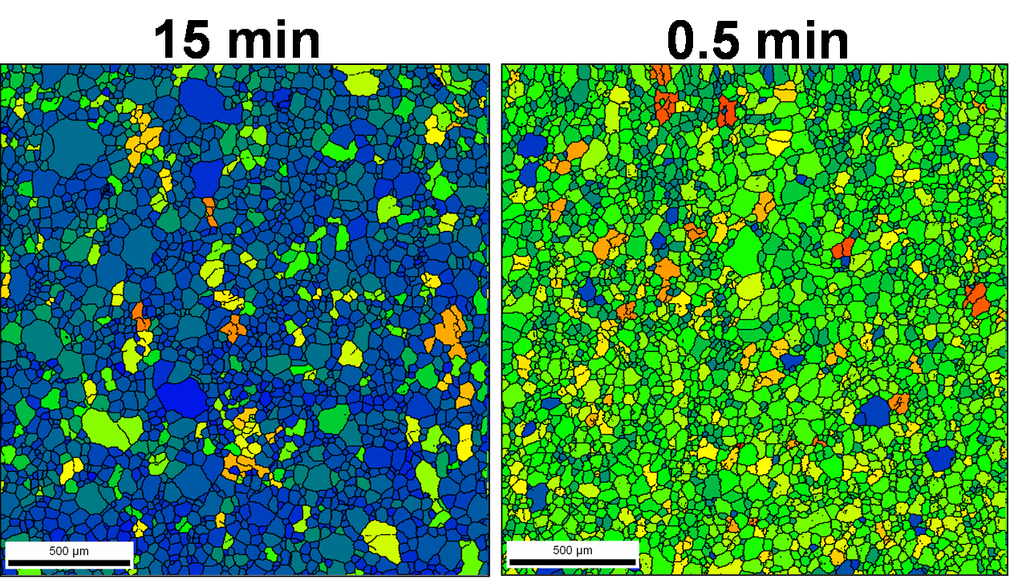
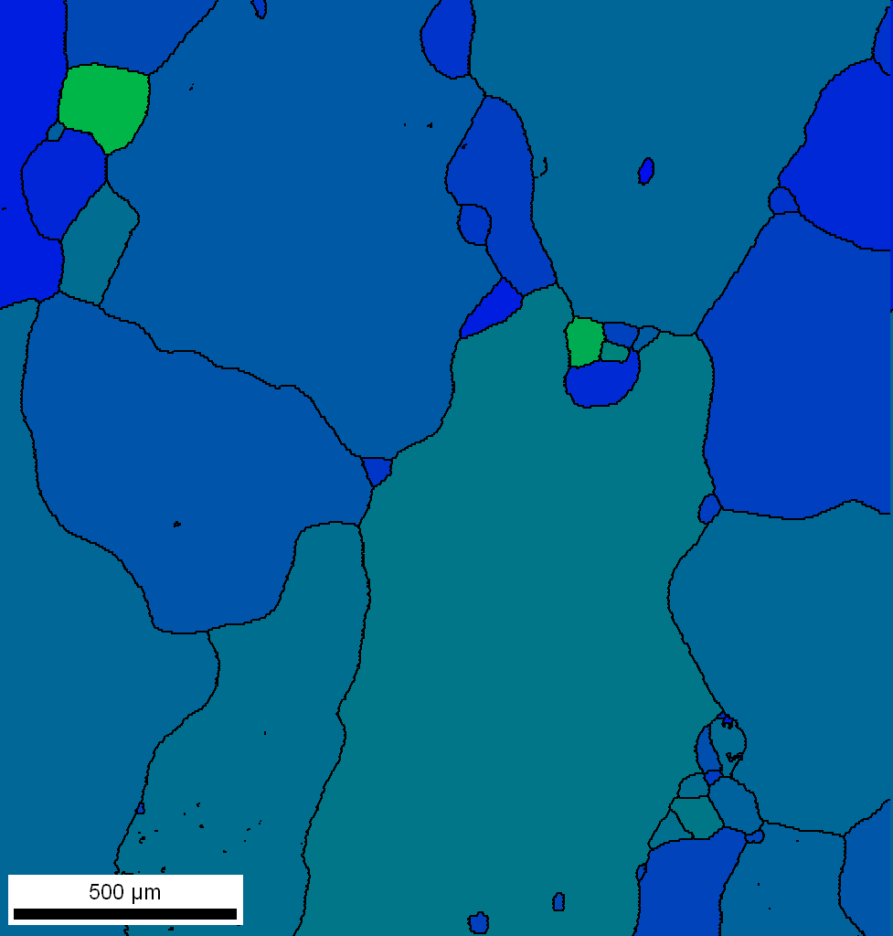
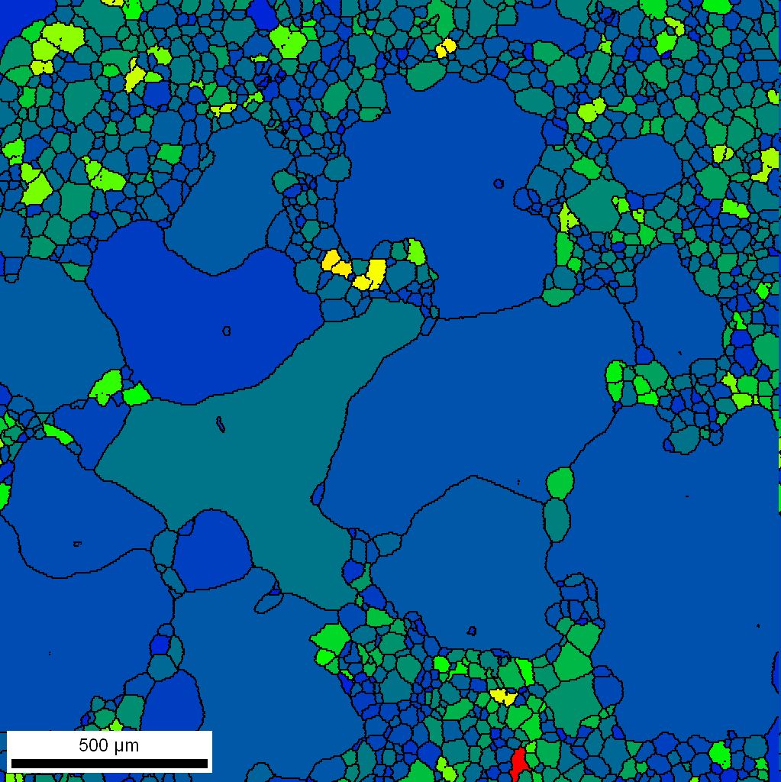
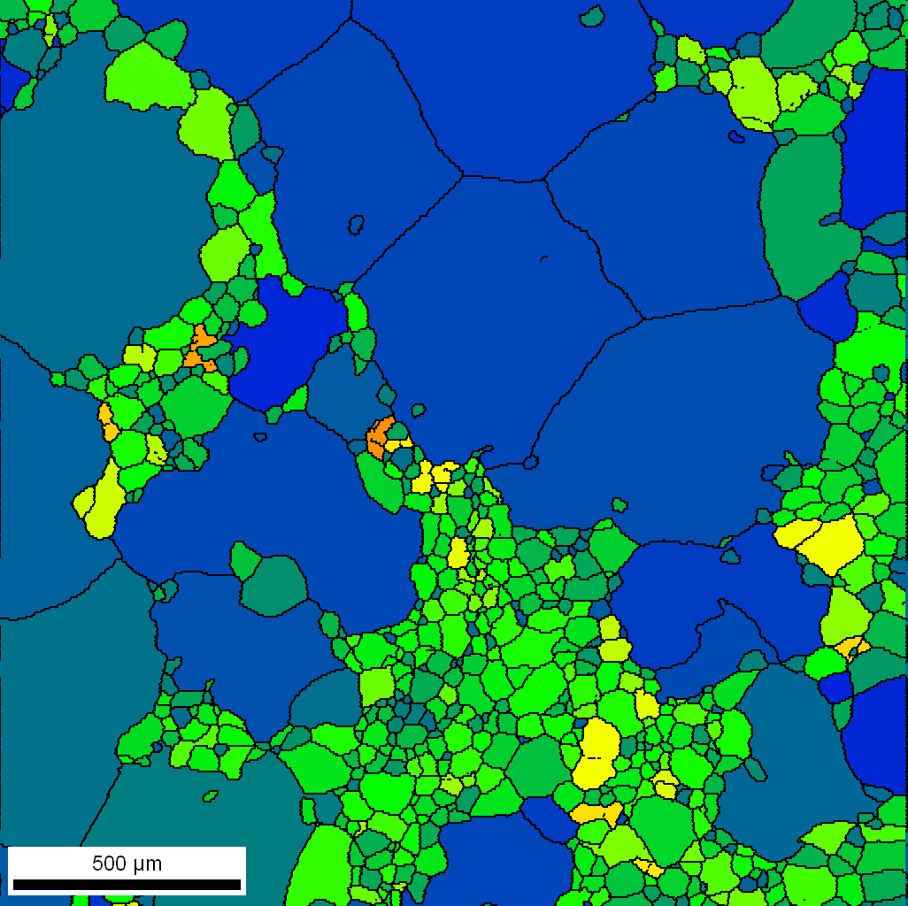
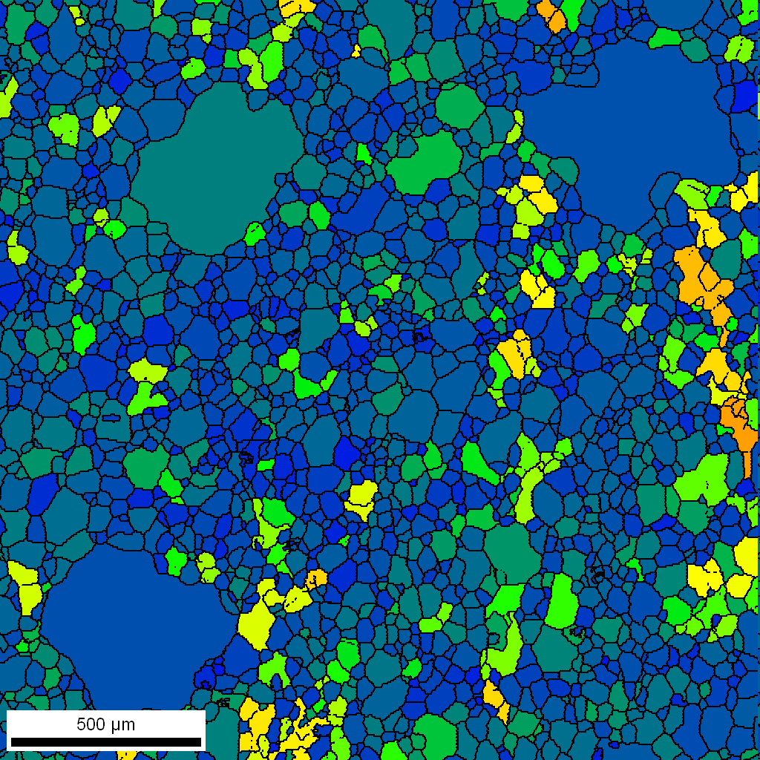
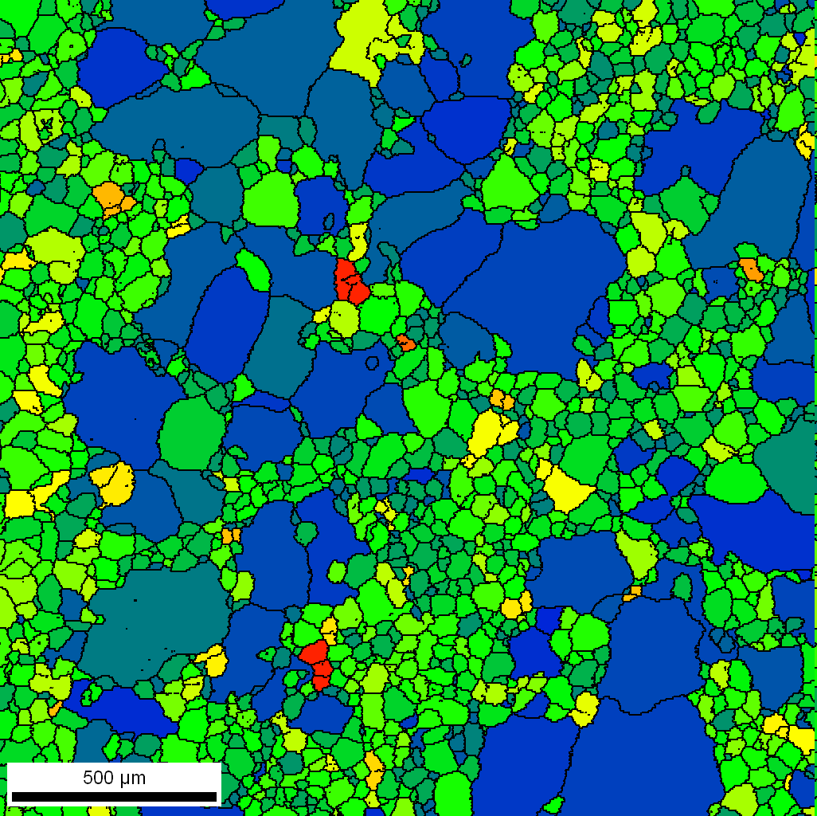
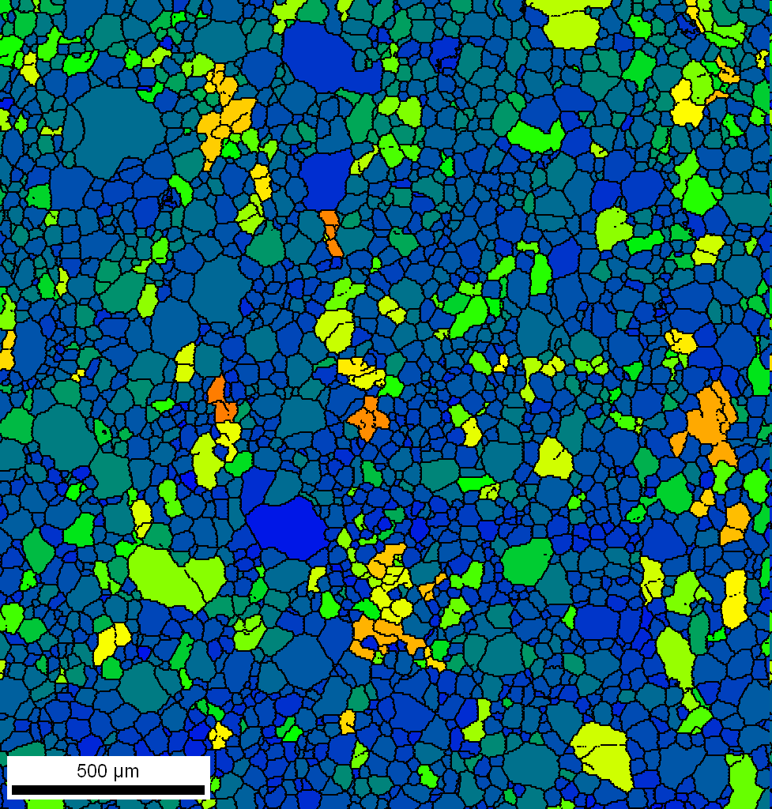
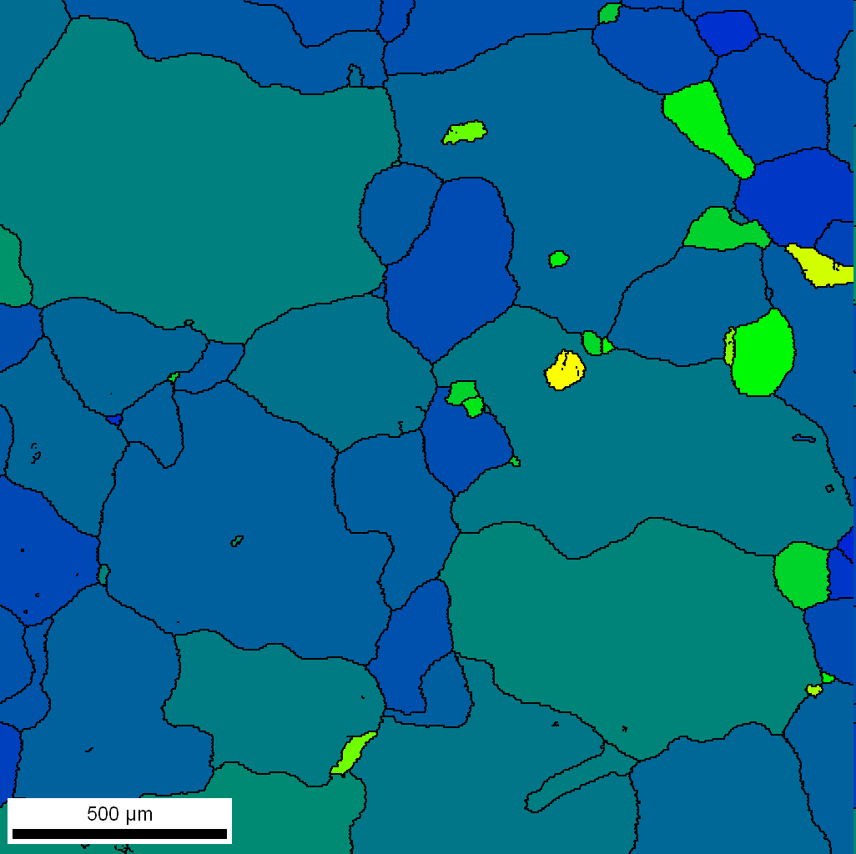
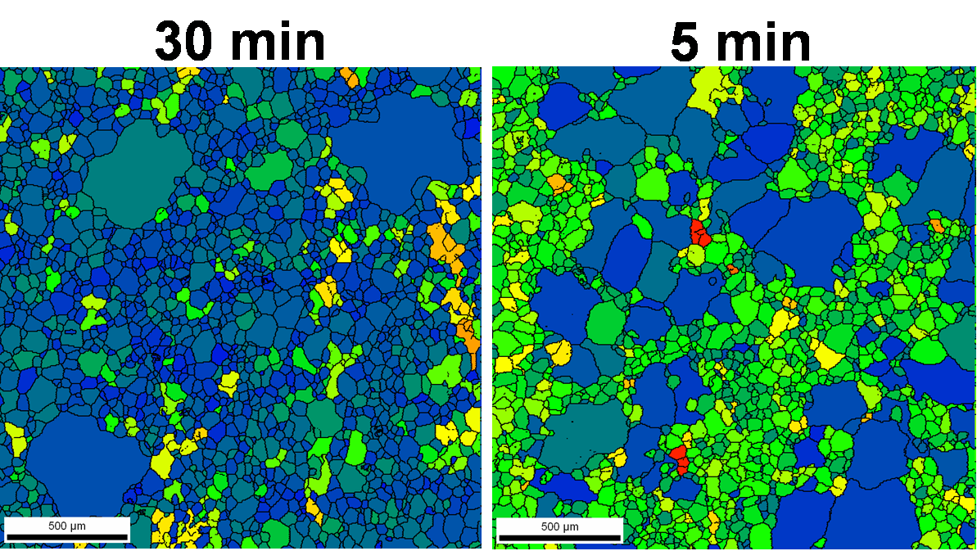
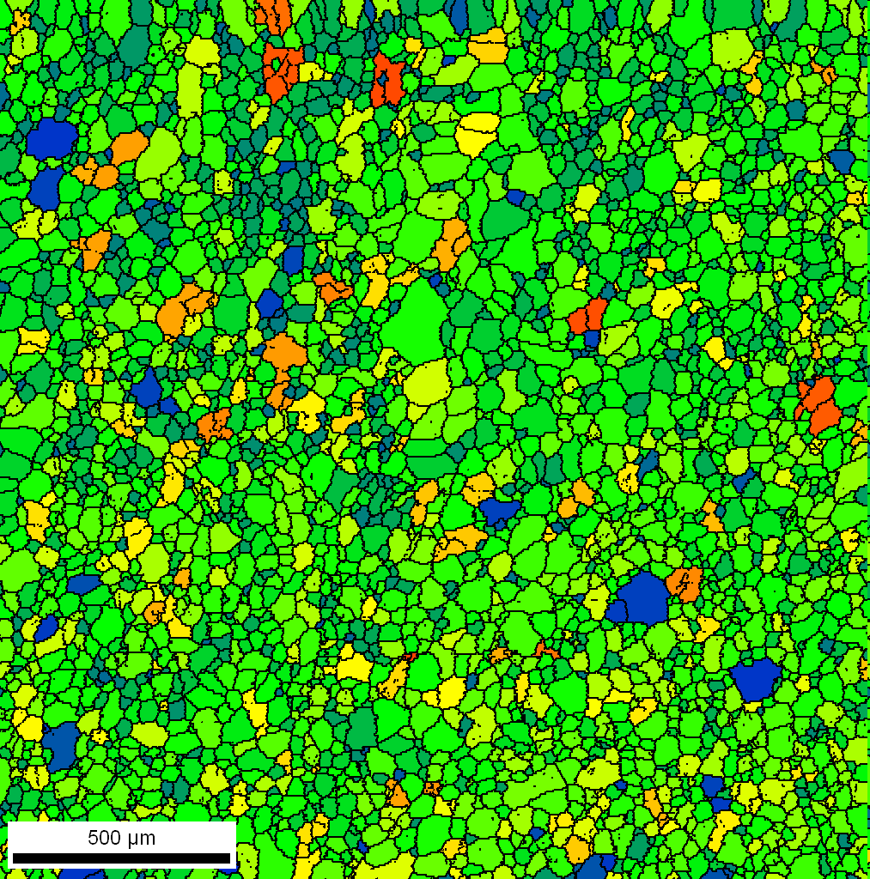
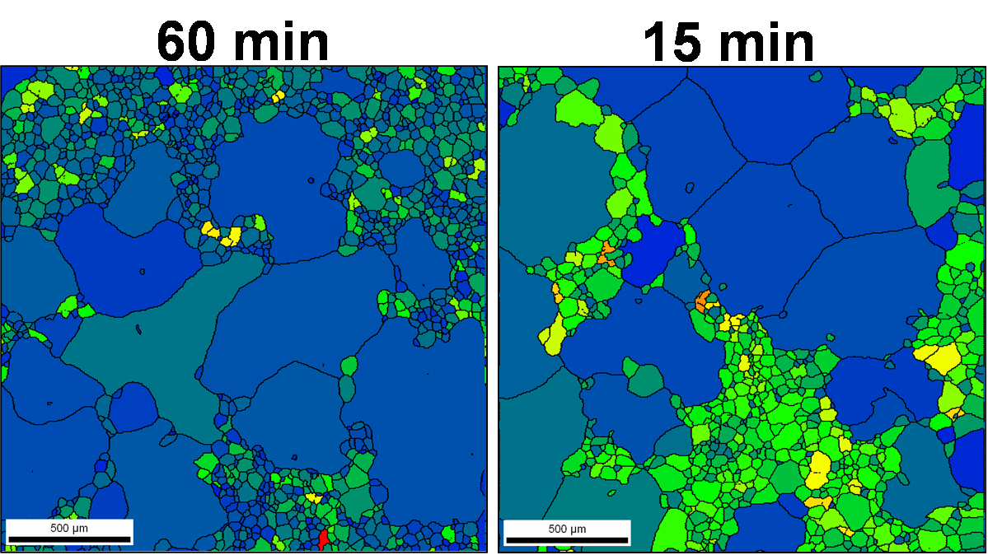
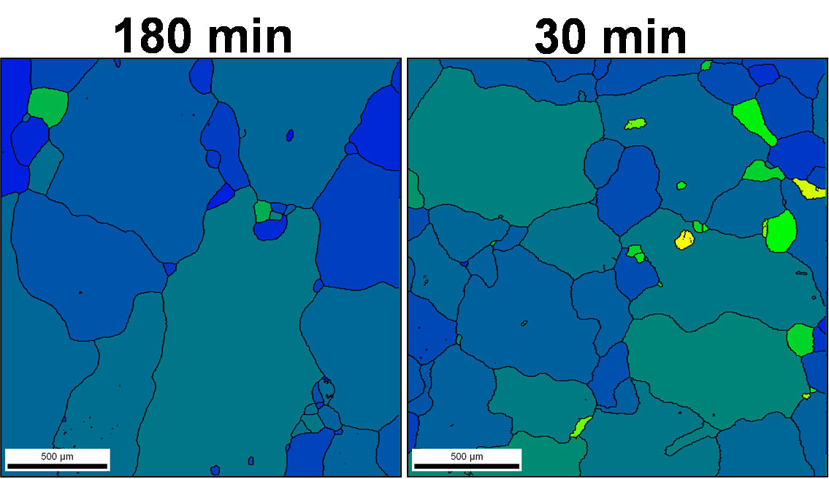

Orientation Spread, Fe-1%Si
1.5% and 8% temper-rolled Fe-1%Si, annealed in air at 787C for various times.
1.5% temper-rolled
8% temper-rolled
60 min.
0.5 min.
15 min.
15 min.
180 min.
30 min.
30 min.
5 min.
[Bennett 2011]
AGG proceeds by low GOS, soft grains, consuming their high GOS, deformed neighbors.
Overall GOS decreases with annealing time.

Slide 8
Pinning & AGG
Calvet J and Renon C (1960) “Discontinuous grain growth in Al-Cu alloys” Mémoires Scientifiques Revue de Métallurgie 57 3
Still to be explained is the role of particles in AGG. Why is it that the phenomenon is so often (but not always) associated with annealing in the proximity of a solvus?

Slide 9
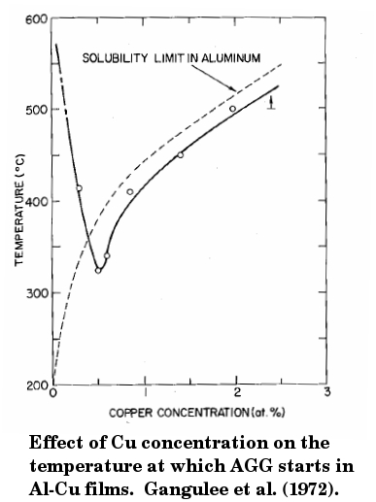
Background
Pinned microstructures
In pinned microstructures, the onset of AGG has been strongly correlated to the solution solvus.
Traditional explanation:
- Second-phase particles begin dissolving
- The pinning force is decreased due to smaller particle size
- Select boundaries are then able to break free.
However, simulations have shown that AGG can occur:
. . . in particle-pinned microstructures without particle dissolution (Roberts et al.)
. . . in solute-pinned microstructures without particles (Kim et al.)
Gangulee, A. & D'Heurle, F. M. (1972), 'Anomalous Large Grains in Alloyed Aluminum Thin-Films. 1. Secondary Grain-Growth in Aluminum-Copper Films', Thin Solid Films, 12 399.

Slide 10
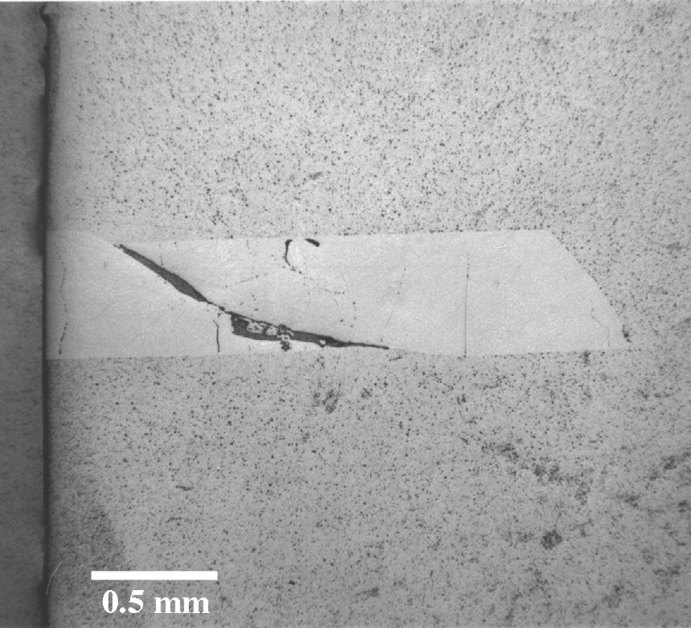
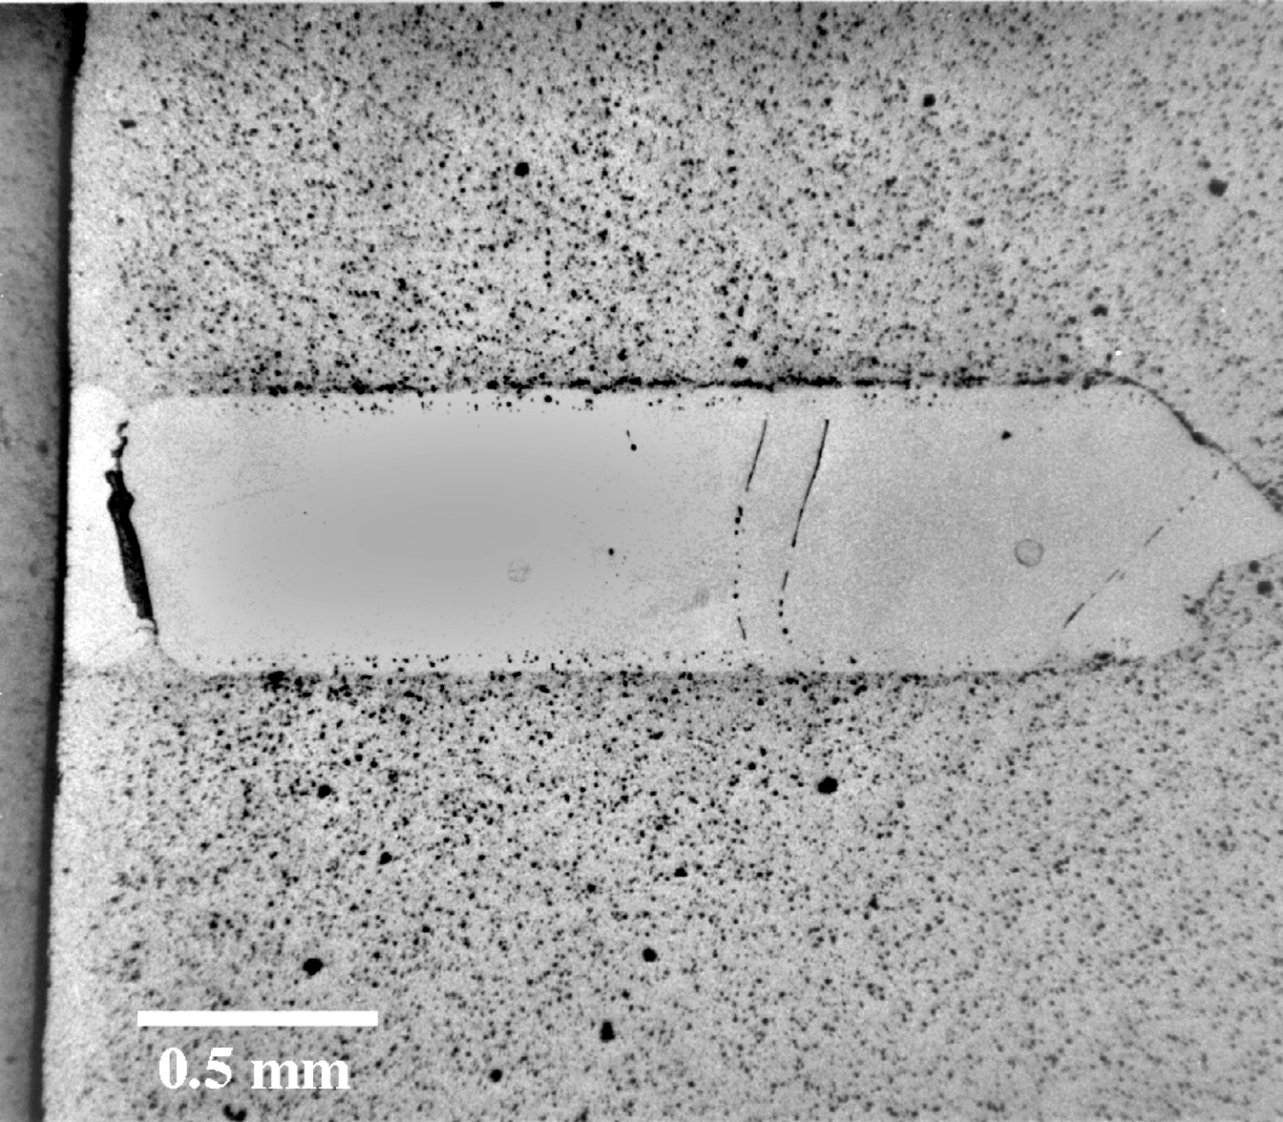
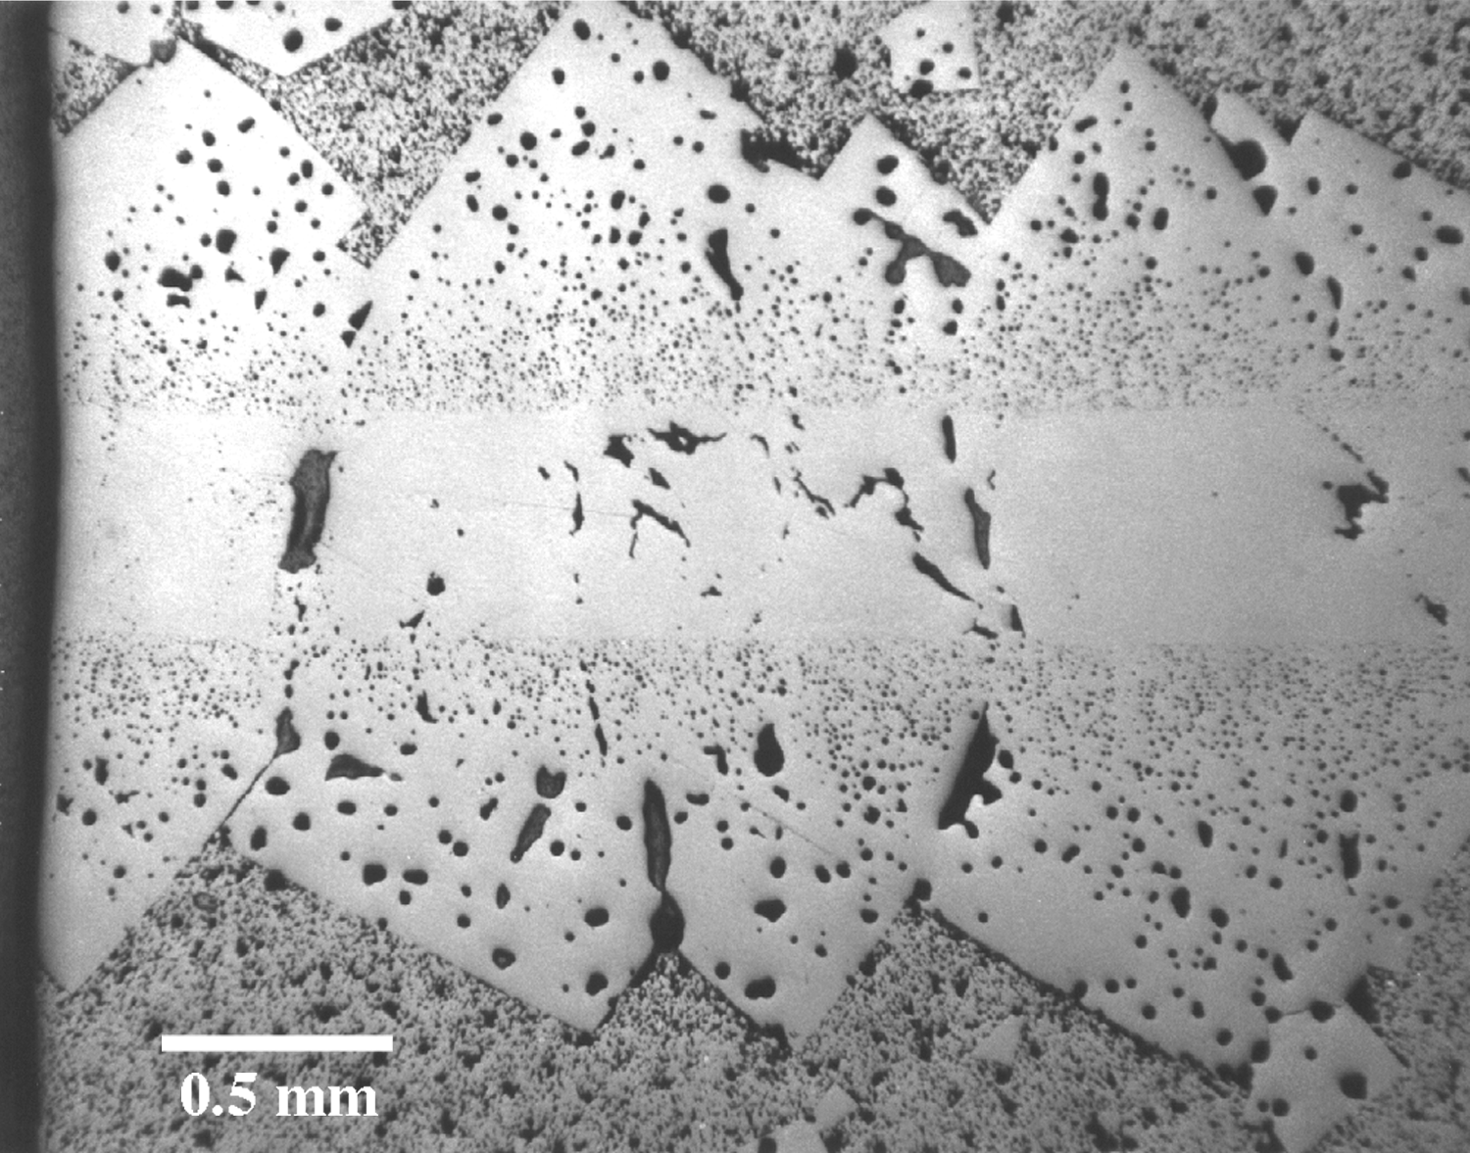
Crystal Growth in
Pb(Mg_{1/3}Nb_{2/3})O₃ -PbTiO₃ [PMN-PT]
0% PbO
1% PbO
5% PbO
Polycrystal
<111>
PMN-35PT Seed
Grown Crystal
{111} seeds PMN-35PT + xPbO 1150°C 10hrs
*Courtesy E. Gorzkowski (PhD thesis 2005), M. Harmer, Lehigh Univ.;
J. Amer. Ceramic Society, 89, 2286-2294

Slide 11
Role of Particle Pinning
Well dispersed second phase particles (including voids) are well known to be efficient at stabilizing grain networks.
Smith-Zener analysis provides the basic theory but is based on randomly placed particles, with respect to the boundaries.
Particle pinning investigated in Waspaloy*: 2 key observations were that (a) the density of particles on boundaries was higher than random, and (b) AGG occurred.
Zener, C. (1948). Private communication to C.S. Smith. Trans. Metall. Soc. AIME 175: 15.
Roberts, C. G. 2007, 'Grain Growth and the Zener Pinning Phenomenon: A Computational and Experimental Investigation', .PhD thesis, Carnegie Mellon Univ. 2007
D.A. Porter and K.E. Easterling, Phase Transformations in Metals and Alloys, (1981) Van Nostrand Reinhold Co: New York.
P.A. Manohar, M.Ferry and T. Chandra, ISIJ Intl., 38 (1998), 913.

Slide 12
Notation
r particle radius
R grain size (or domain size)
R_{max} maximum (limiting) grain size (or domain size)
f or v_{f} volume fraction (of particles)
γ grain boundary energy (or domain wall energy)
θ angle made by boundary at pinning point
P_{drag} drag force
∆E Energy trap
∆U Change in energy of system
N_{V} Number density of voids
N_{A} Voids per unit area of domain wall

Slide 13
Smith-Zener: Basics
Why do particles have a pinning effect?
Answer: once a boundary has intersected with a particle, a certain amount of boundary area is removed from the system. In order for the boundary to move off the particle, the “missing area” must be re-created. This restoration of boundary area requires an energy increase. Through the principle of virtual work, this requires a force.
E

Slide 14
Analogy to Pinning Effect
Remember how to blow bubbles?
You take a ring on the end of a stick, dip the ring into a soap solution to get a film inside the ring, and then blow bubbles out of the ring.
The soap+water film “sticks” to the ring for the same reason as a grain boundary (or domain boundary) sticks to a particle: it is simply trying to minimize its surface area.

Slide 15
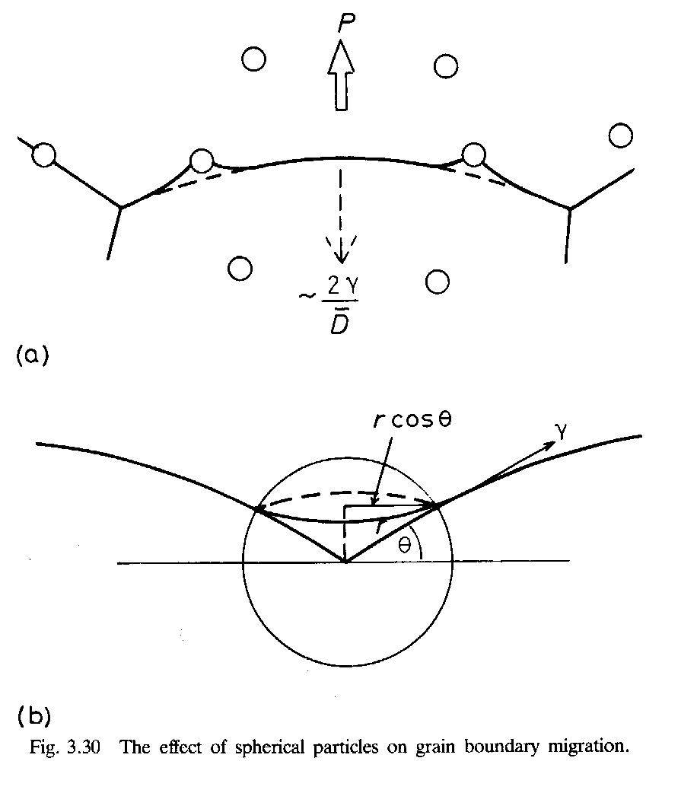
Boundary-particle interaction
The drag effect of the particles can be quantified by considering a force balance at the (immovable) particle surface.
Length of boundary attached to a particle
= 2πr cos θ.
Force per unit length exerted by boundary on particle = γ sin θ.
Total force =
length * force.length⁻¹.
For θ=45°, the reaction force on the boundary is at a maximum.
Maximum force = πγr
grain growth pressure

Slide 16
Drag pressure
To find the point at which grain growth stagnates, we have to equate the driving force (pressure, really) to the drag pressure.
We cannot equate a per-particle force to a pressure, so we must make an assumption about the fraction of boundary area that intersects with particles.
Smith-Zener assumption was that the boundaries can be assumed to intersect randomly with the particles (not always true, but a good place to start!).
Stereology (again!): the fraction of particles with radius r and volume fraction f that intersect unit area of a random oriented section plane is 3f/2πr².
Multiply the maximum force per particle by the number per unit area of boundary to obtain the drag pressure:
P_{drag} = πγr * 3f/2πr² = 3fγ/2r

Slide 17
Stagnation of grain growth
The point at which grain growth will stop is (approximately) determined by a balance between the driving force (pressure) for grain growth, γ/D, and the drag force (pressure).
3fγ/2r_{particle} = γ/R_{stagnation} = γ/R_{max}
⇔ R_{max} ≤ 2r/3f, or,
D_{max} ≤ 4r/3f (Smith-Zener Equation)
Note that Underwood gives a more precise analysis and arrives at a larger limiting grain size (in fact, double the above estimate),
R_{max} ≤ 4r/3f
which illustrates the approximate nature of the derivation given.

Slide 18
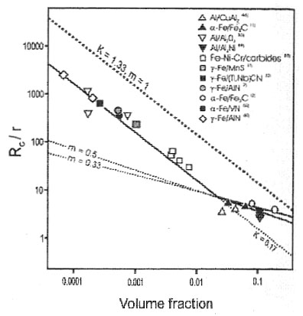
Grain Size Control
Upper right panel illustrates the physics of boundary-particle interaction: D_{pinned} ~ d_{ppt}/V_{f}
Lower right panel shows summary of experimental data, together with only available parallel calculations w/Monte Carlo in 3D
Investigating the significant range of particle volume fraction drives us into the petascale; linear sizes of the required mesh indicated on graph
Monte Carlo method (Potts) offers only practical algorithm
Previous parallel results: Miodonwik
10⁵
10⁴
10³
10²
Experimental review: Manohar et al. ISIJ 1998

Slide 19
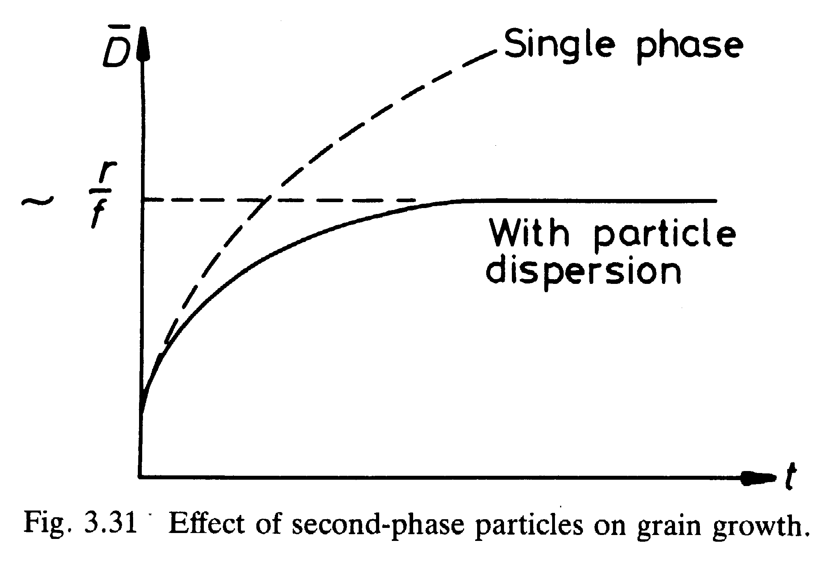
Grain growth kinetics
The effect of the presence of fine particles is to slow down,and eventually stop grain growth.
D²-D₀²∝t
Porter &
Easterling

Slide 20
Pinning: technological impact
The technological impact of particle pinning is considerable.
Most commercial structural materials, especially for elevated temperature service, rely on fine second phase particles to maintain a fine grain size.
Limitations: particle dispersions are less effective when not stable, or not fully stable.
A common observation: abnormal grain growth frequently occurs in materials annealed close to a solvus, where a particle dispersion is barely stable.
Pinning of GBs by pores is equally effective. However, pores can also coarsen via diffusion along GBs. Therefore grain growth in ceramics is normally limited by pinning at pores, which in turn is limited by pore densification and/or coarsening. If, however, GBs escape from the pinning effect then abnormal grain growth can occur. This tends to leave pores behind in the matrix, which becomes a signature of AGG (in ceramics at least).

Slide 21
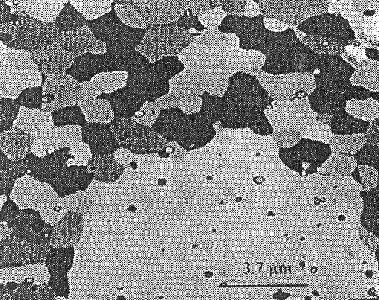
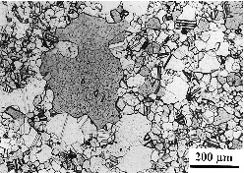
Particles and AGG
AGG is often observed in particle-containing systems
  Near the particle solvus ⇒ local dissolution?
  Far from the particle solvus ⇒ inhomogeneous particle distribution?
  In both cases, theories center around how disruptions in the Zener-pinned structure cause AGG.
Large-scale simulations of pinned systems - with no disruptions - showed AGG at
very long times (Roberts - CMU).
How do static particles affect the growth of abnormal grains?
Notes:
Top: AGG in Al-Cu from Calvet and Renon, Mem Sci Rev Met, 1960. Near the ppt solvus.
Bottom: AGG in RENE 88 from Yoon and Henry, Met Trans A, 2001. Pinning carbide particles remain at the AGG temperature.

Slide 22
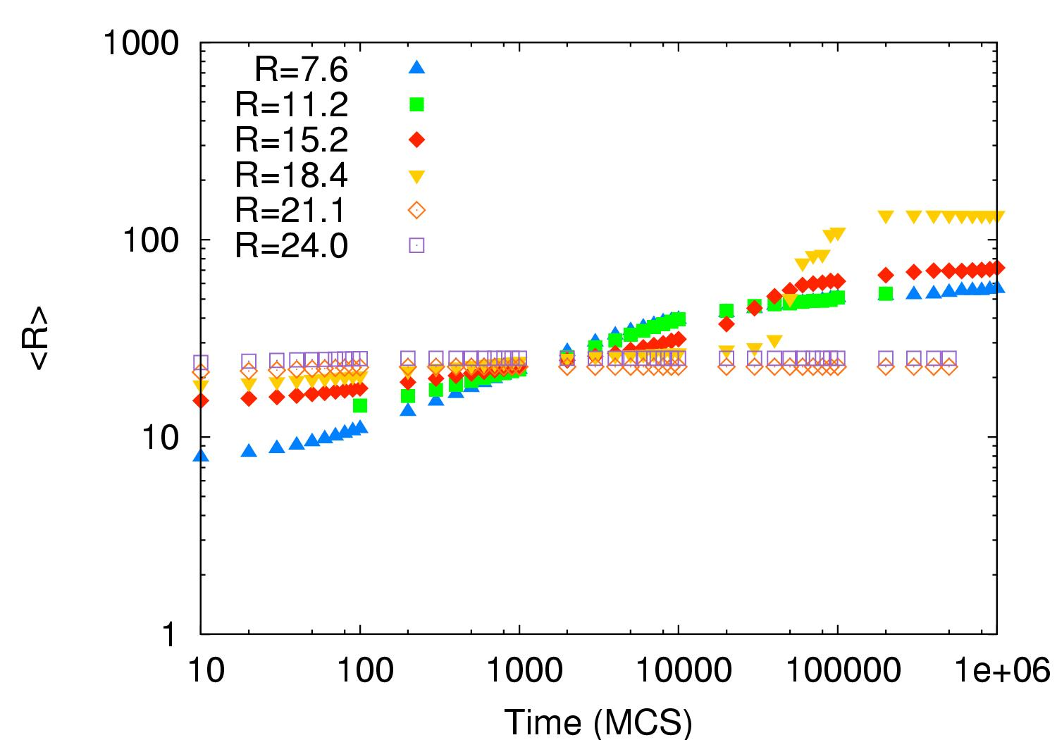
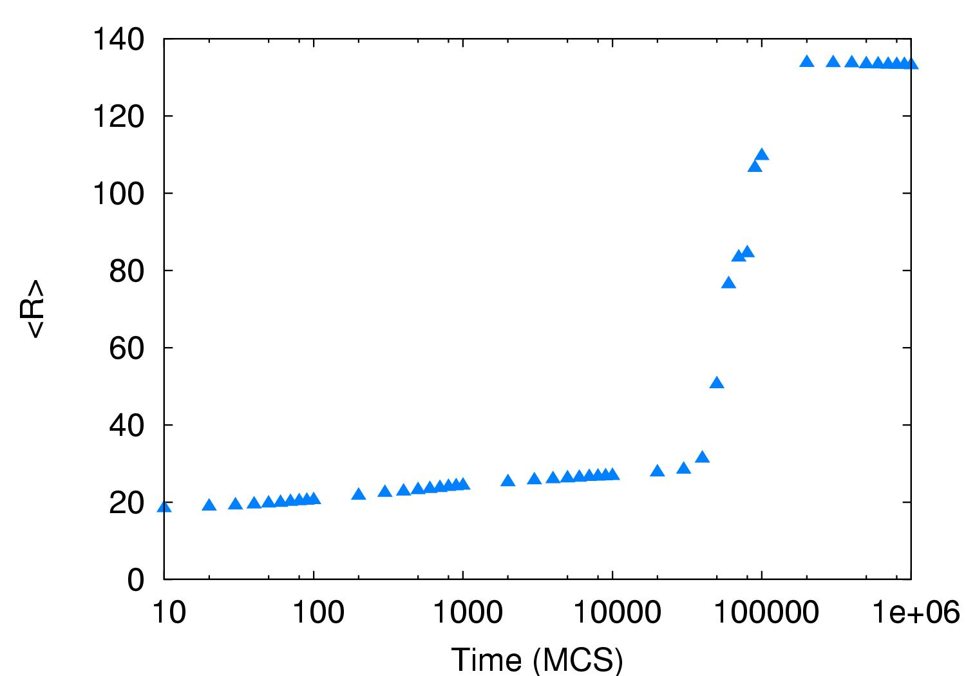
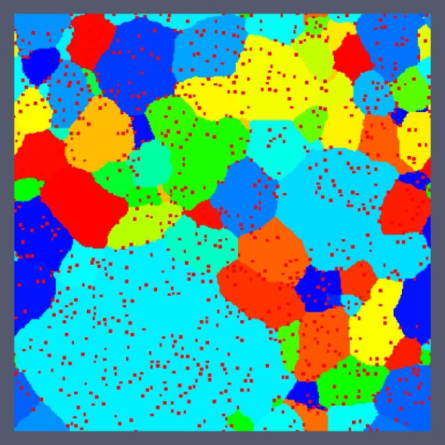
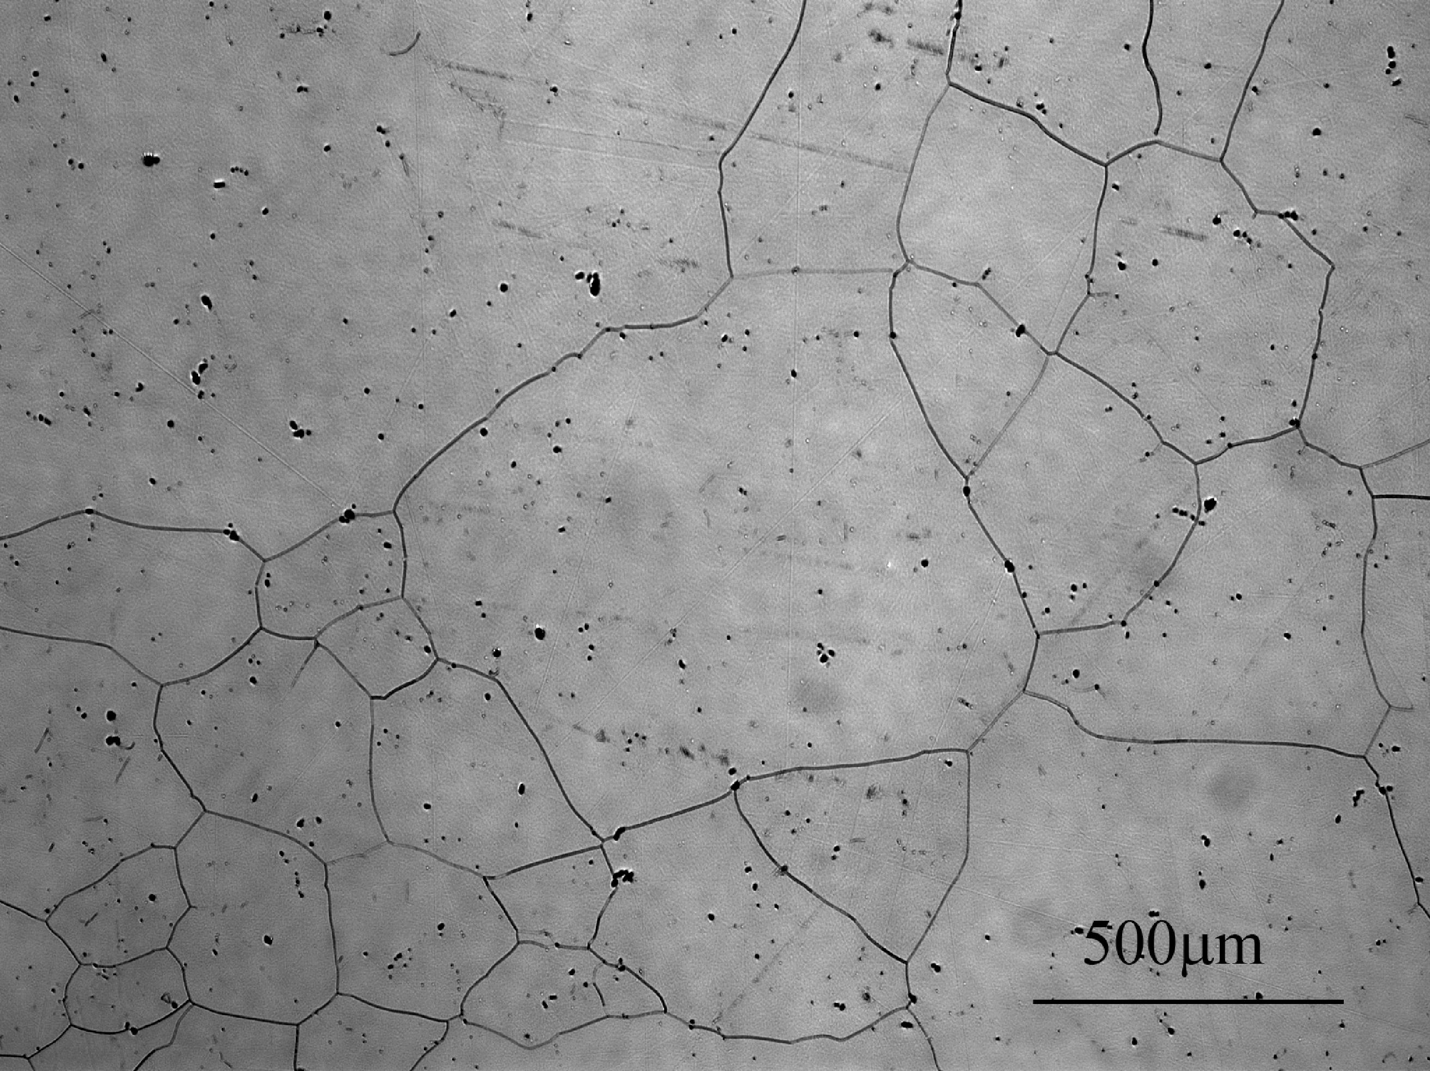
Comparison of Expt. with Simulation
A transition from NGG to AGG was observed in both the simulations and experiment
Initiation of AGG was caused by grain size advantage and/or non-random particle distributions on grain boundaries. More specifically, if the grain size is smaller than the Smith-Zener limit, but the structure is pinned by the larger-than-random density of particles on boundaries (to match expts.), then it is possible for a large grain to escape and become “abnormal”.
Simulation: isotropic GB properties; temperature = 1.5; particles size = 27 voxels; volume fraction of particles = 6%, 70% of particles were located on boundaries; image taken at 100,000 MCS.
Roberts (2007), PhD thesis, CMU
Notes:
In the end, the MC model successfully simulates abnormal grain growth as was observed in the nickel alloy!!
Both analyses (exp & sim) reach an identical conclusion: AGG is not texture-induced.

Slide 23
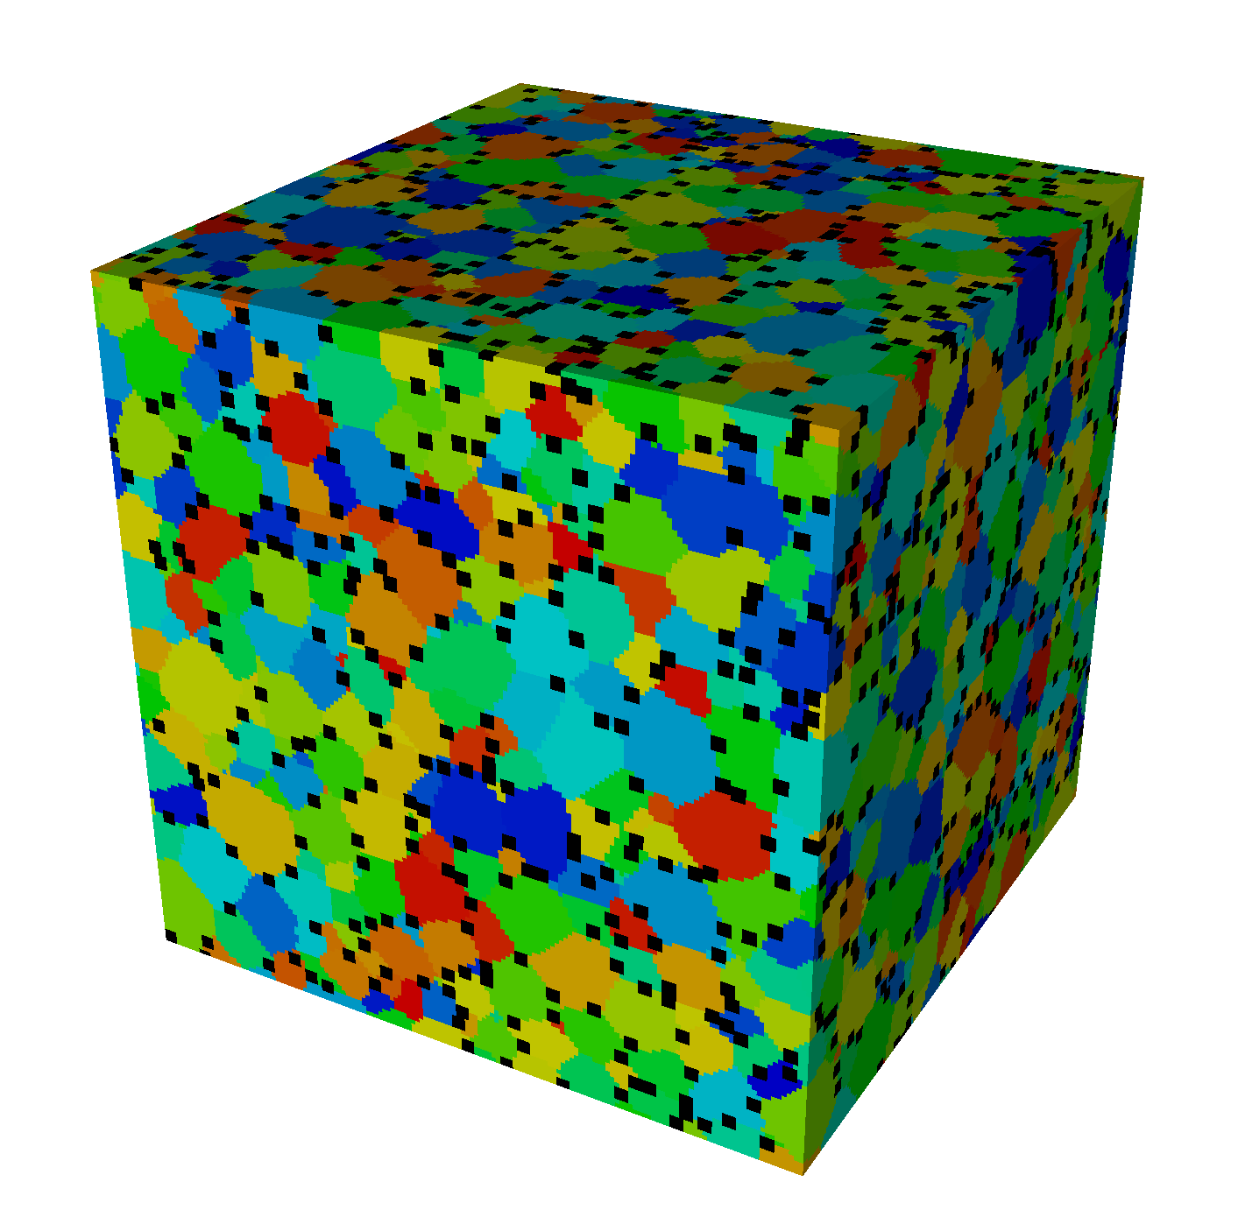
Simulation parameters, take 2
Begin with an equiaxed polycrystalline microstructure
  Boundary properties are uniform and isotropic, random grain texture
  Note that there AGG is never observed in the absence of particles
Deposit particles at random on the grain boundaries
  At sufficiently high particle fractions, the system will be pinned
  Note that this is a stronger pinning situation than Zener pinning because of the non-random spatial correlation of particles and boundaries
Allow grains to evolve via normal grain growth physics

Slide 24
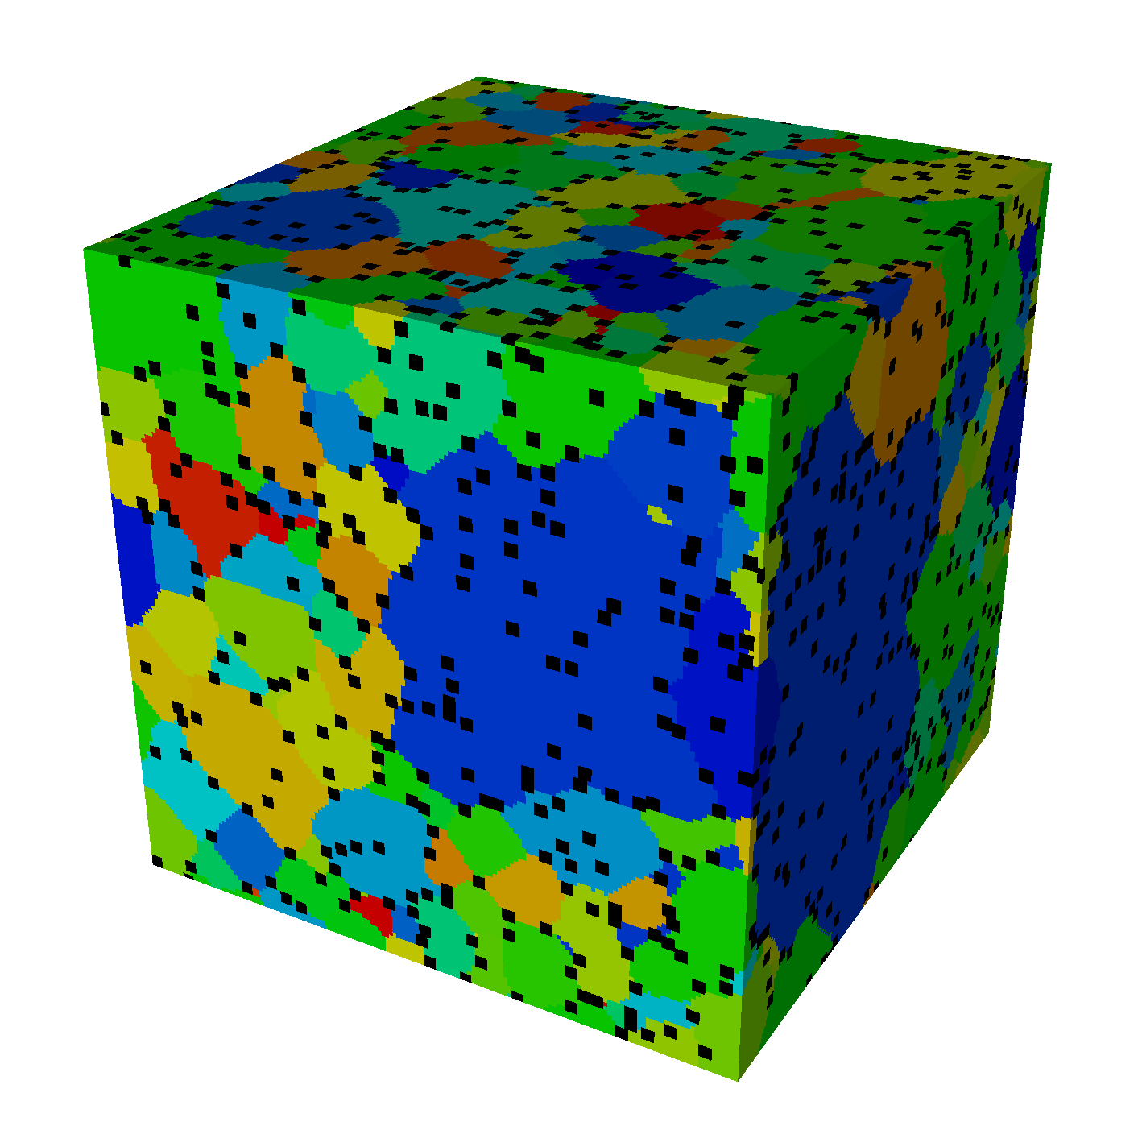
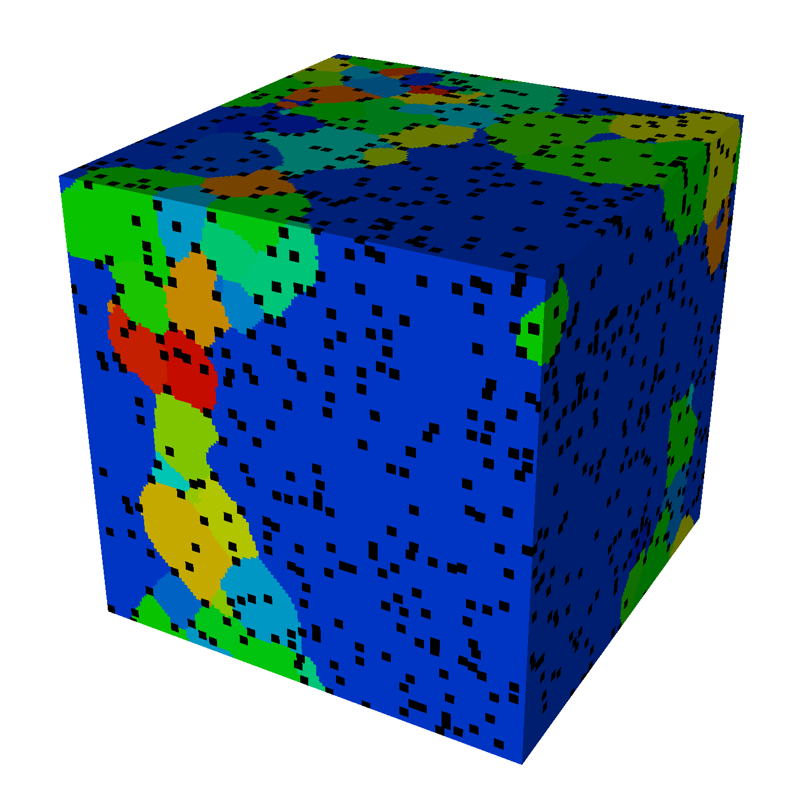
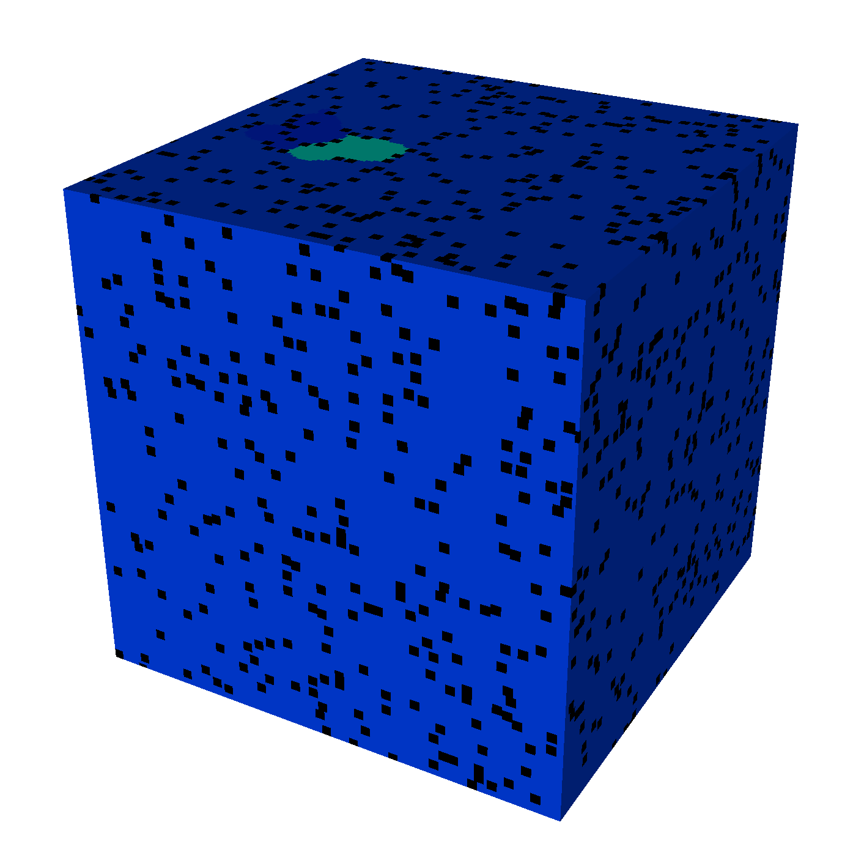
Results: Microstructural evolution
AGG occurs
The abnormal grain size far exceeds the Zener pinned grain size
This growth mode would not occur in the absence of particles.
A static particle dispersion inhibits normal grain growth but causes abnormal grain growth!
f = 0.1, initial
10000MCS
20000MCS
30000MCS
“Particle-Assisted Abnormal Grain Growth”, E.A. Holm, T.D. Hoffmann, A.D. Rollett, and C.G. Roberts (2015), in S. Fæster et al. (eds.): Proceedings 36th Risø Intl. Symp. Materials Sci.
Notes:
Pictures are at 10000 (initial), 40000, 70000, and 100000 MCS

Slide 25
Results: Growth kinetics and frequency
The system initially grows to its Zener pinned grain size.
AGG incubation time is long and variable; all of these runs eventually grow abnormally (by 10⁶ MCS).
AGG is rare: In this system, about 1 in 22,000 grains grows abnormally.
The abnormal grain consumes all others, so we see only one event per system.
Particle fraction = 10%
Initial grain radius = 10
Particle radius = 3
avg grain size
time (MCS)
“Particle-Assisted Abnormal Grain Growth”, E.A. Holm, T.D. Hoffmann, A.D. Rollett, and C.G. Roberts (2015), in S. Fæster et al. (eds.): Proceedings 36th Risø Intl. Symp. Materials Sci.

Slide 26
The causes of abnormal grain growth
What permits a particular grain to grow abnormally?
  Energy advantage (i.e. greater driving force for growth)
    Elastic or plastic strain energy
    Surface energy
  Mobility advantage (i.e. grows faster than competitors)
    Intrinsic – boundary structure
    Extrinsic – solutes, particles
Abnormal growth can occur only when the growth advantage can persist as the grain grows into new neighborhoods.
Abnormal grain growth requires a growth advantage and a persistence mechanism.
Notes:
Top down:
Fe-3Si goss grain in transformer steel - textured
PLD n-Ni film - untextured
Subgrains in Al, growing in a texture gradient
Al-Cu near ppt solvus
Cu film (nanocrystalline)
n-Ni film, abnormal grain with included defects

Slide 27
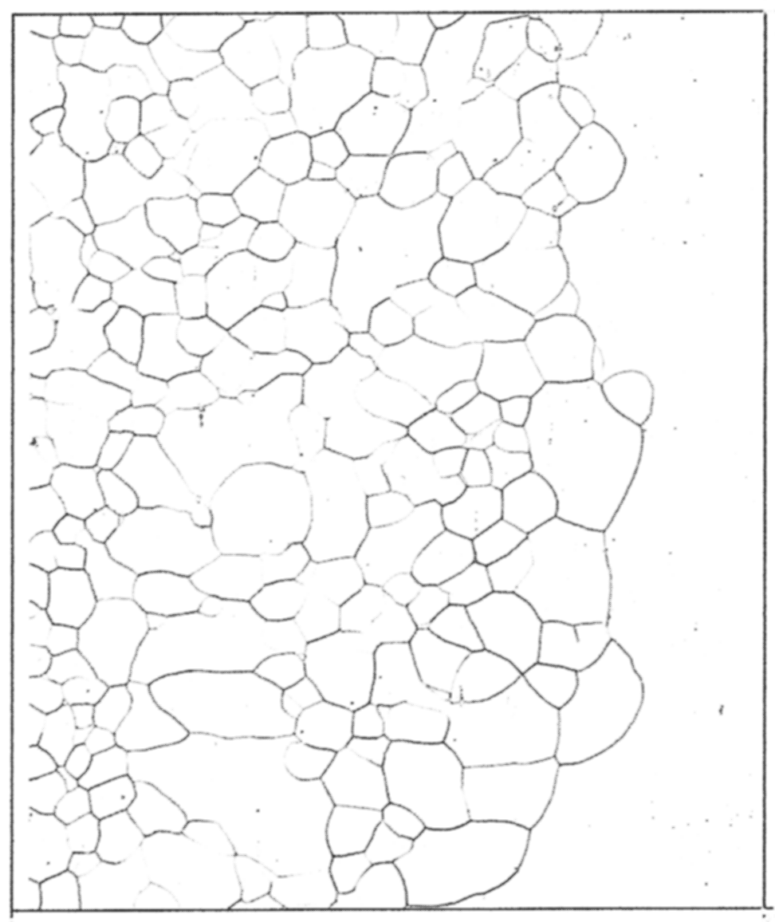
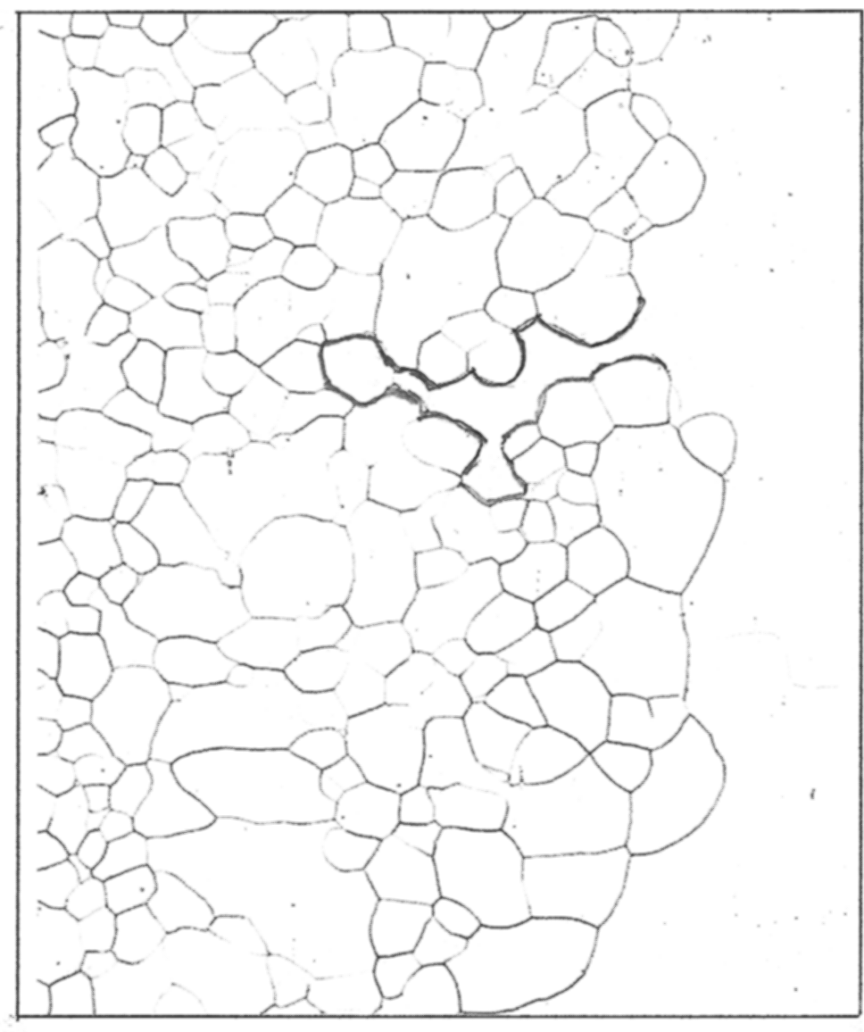
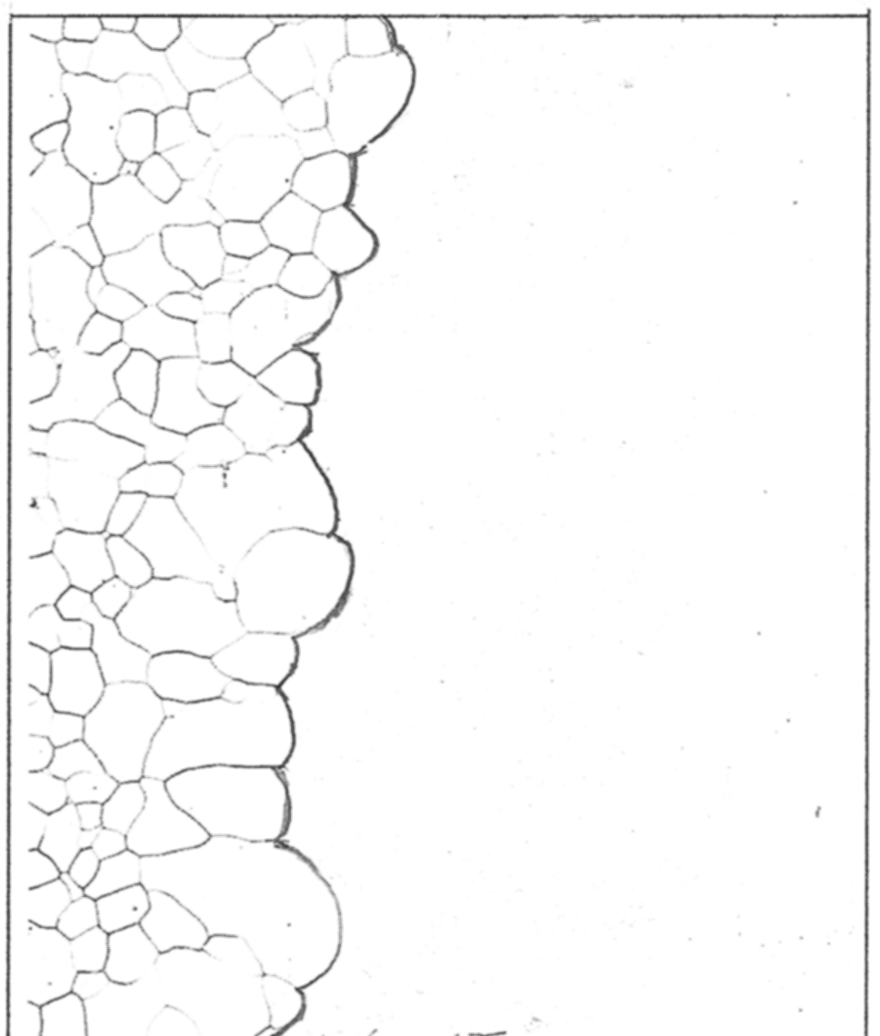
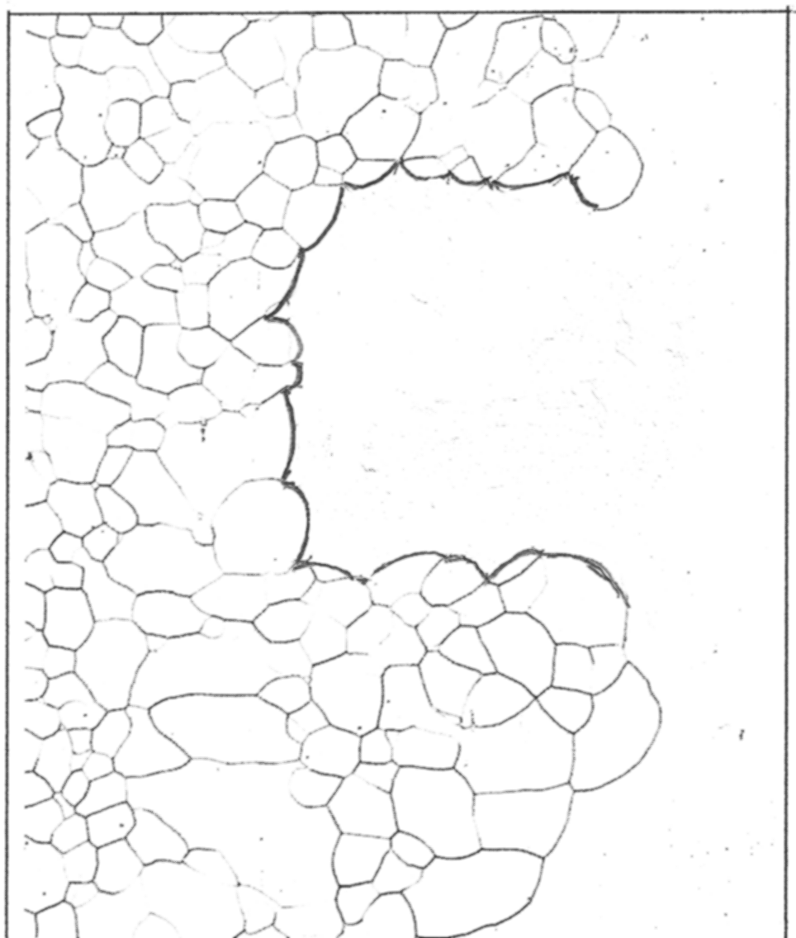
Model for particle-mediated AGG
All grains – but not all grain boundaries – are initially pinned; however, thermal fluctuations of the boundaries can occur.
A grain boundary that fluctuates off of its pinning particles can move freely, consuming other unpinned boundaries and destabilizing pinned boundaries.
  Mobility advantage.
If the free boundary belongs to a grain that is inclined to grow, it will grow at the expense of its pinned neighboring grains.
As the growing grain increases in size, it accesses ever more avenues for growth.
  Persistence mechanism.
Static interface
Lateral migration
Penetration
New static interface position
[courtesy Prof. Bevis Hutchinson]

Slide 28
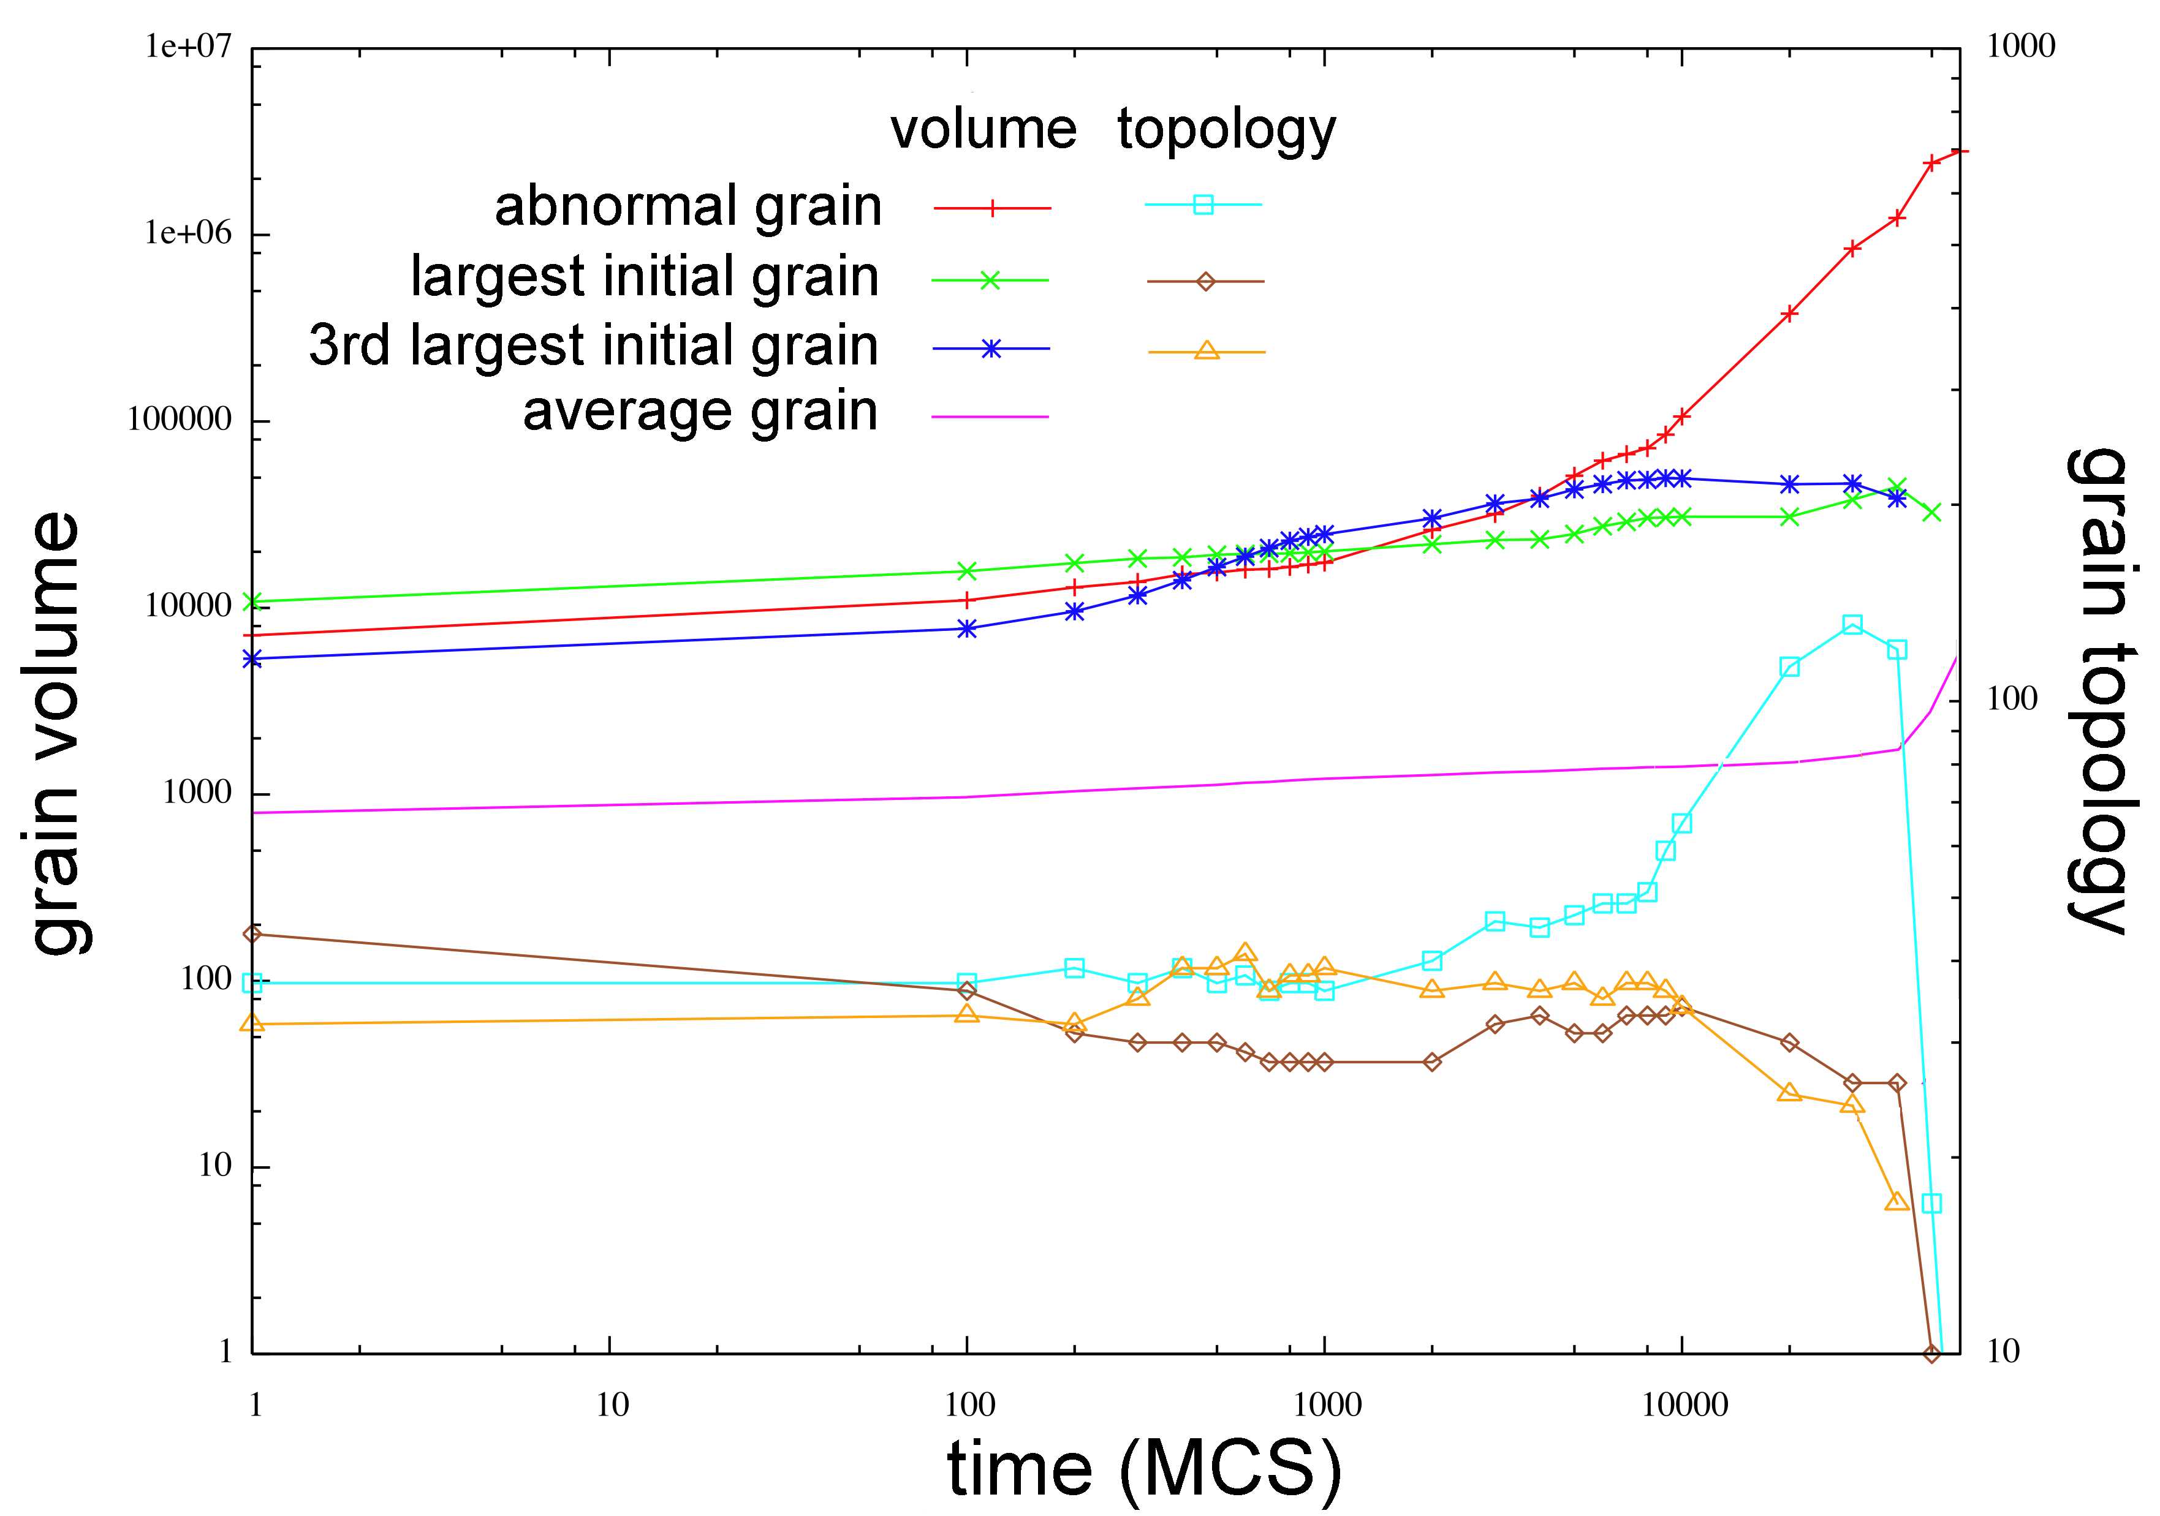
Effect of initial grain size on
particle-mediated AGG
For particle-assisted AGG, the the abnormal grains should begin as grains with a high driving force for growth, i.e. large grains.
Simulations confirm that the abnormal grains are usually among the largest initial grains.
Note: In normal GG, even a large size advantage does not guarantee AGG.
In this particular microstructure, the abnormal grain begins as the second largest grain, in both size and number of neighbors.
“Particle-Assisted Abnormal Grain Growth”, E.A. Holm, T.D. Hoffmann, A.D. Rollett, and C.G. Roberts (2015), in S. Fæster et al. (eds.): Proceedings 36th Risø Intl. Symp. Materials Sci.

Slide 29
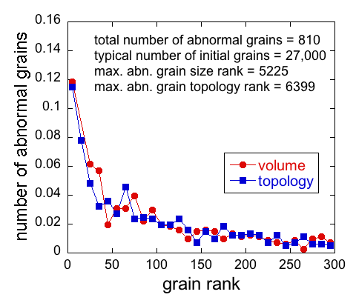
Which grains become abnormal?
Abnormal grains are typically among the largest – in volume and number of neighbors.
There is a substantial spread:
  We cannot predict which grain grows abnormally.
  We cannot even predict which group of grains likely contains the incipient abnormal grain
Abnormal grain growth depends on more than individual grain characteristics: The neighborhood is critical as well.

Slide 30
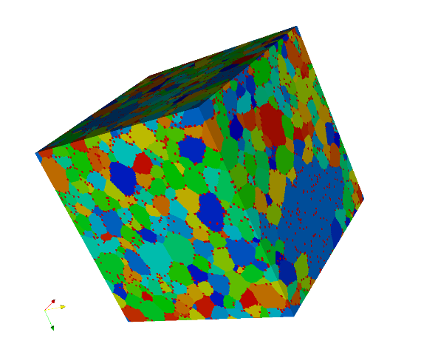
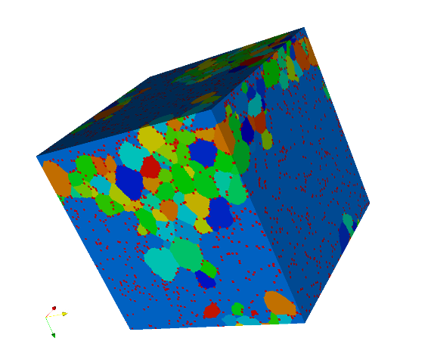
System scaling
This system scales with the area fraction of the particles on the boundaries, which is given by fR₀
We have examined f = 0.1, R₀ = 10
In extending the simulations to f = 0.05, R₀ = 20, the system grew to a pinned state then stopped.
However, after 29.10⁶ MCS abnormal grain growth occurred.
Because the initiating event is fluctuational, the incubation time scales exponentially with grain size.
We expect particle-stimulated AGG to increase as grain size decreases, consistent with experimental observations.
Notes:
F = 0.05, Ro = 20

Slide 31
GB Complexions and AGG
A notable achievement by Dillon, Harmer et al. has been to delineate several types or “complexions” of grain boundary according to impurity content and structure. J. Amer. Ceram. 89 3885 (2006).
Note that it is commonly accepted that segregation of impurities to GBs, in metals, results in solute drag, i.e. lower effective mobility. For many solutes, increases in recrystallization temperature are apparent above a few parts per million.
Counter to (metallurgical) intuition, for sufficiently high loading, boundaries in certain ceramics can be significantly more mobile than in the pure material.
A “complexion” denotes a definite grain boundary structure (e.g., 1, 2 or 3 layers of impurity atoms) that is in equilibrium with the adjoining material. It is not the same as wetting, which simply means penetration of a boundary by the impurity with no limit on volume fraction.
Just as in the model, if a small fraction (1%?) of GBs are highly mobile then AGG ensues. The crucial feature of the situation is, however, that the abnormal growth of a given grain cannot be sustained unless the complexion transition propagates from one grain boundary to (a reasonable fraction) of its adjoining boundaries. Frazier et al. (2015), 'Abnormal grain growth in the Potts model incorporating grain boundary complexion transitions that increase the mobility of individual boundaries', Acta Mater., 96 390.

Slide 32
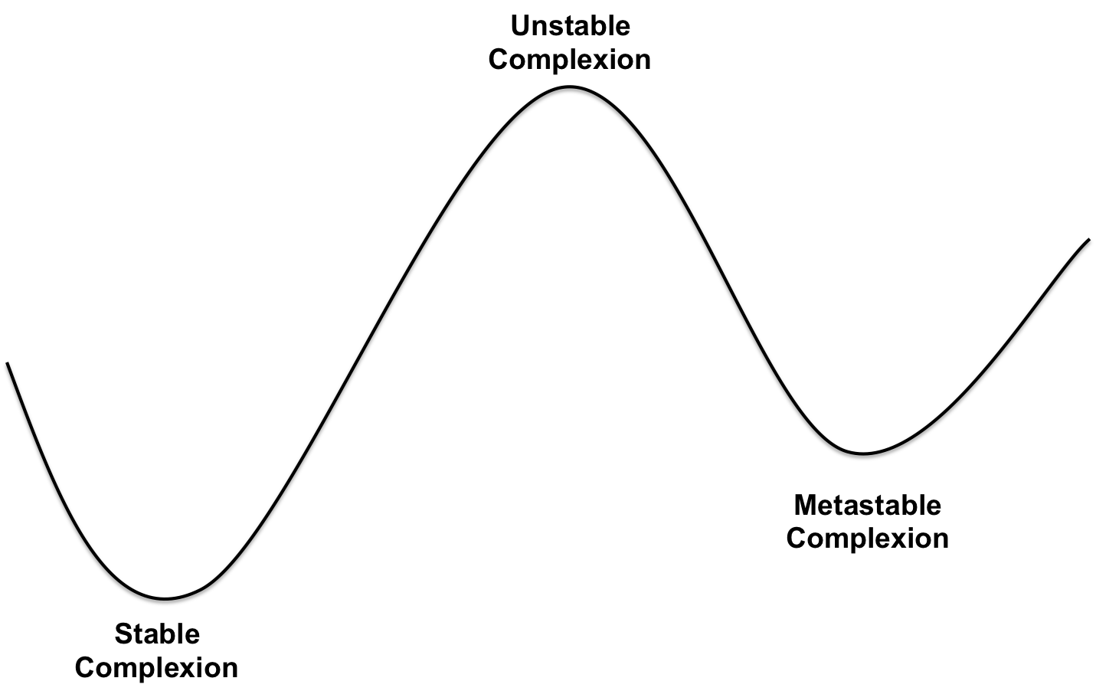
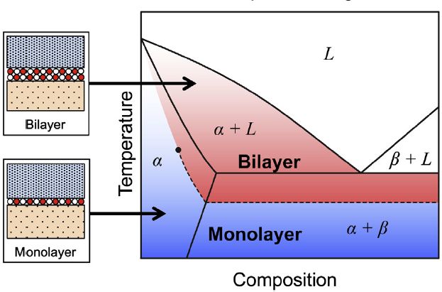
Grain Boundary Complexions
Complexion transitions occur when temperature and composition change such that one complexion becomes metastable with respect to another.
This can change some grain boundary properties drastically, especially mobility and energy
Cantwell et al. Acta Mater. (2014) 62 1

Slide 33
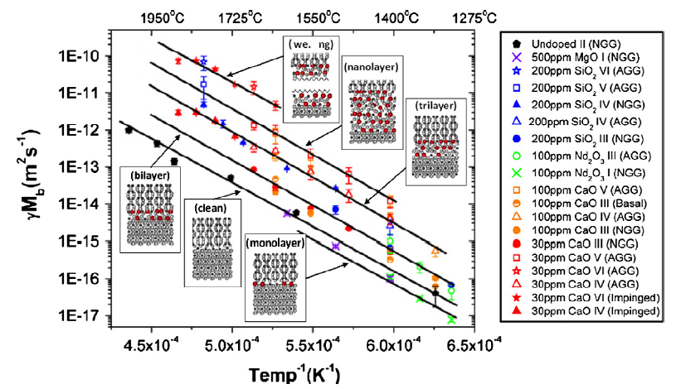
Complexion Transitions and AGG
Grain Boundary Mobility Increases as Complexions Get Closer to Complete Wetting, but the Slope with Respect to Temperature Remains the Same! Why?
Dillon & Harmer, J. Amer. Ceram. Soc. 2008 91 2304
S.J. Dillon, M. Tang, W.C. Carter, M.P. Harmer, “Complexion: A new concept for kinetic engineering in materials science,” Acta Mater. 55 6208-6218 (2007).

Slide 34
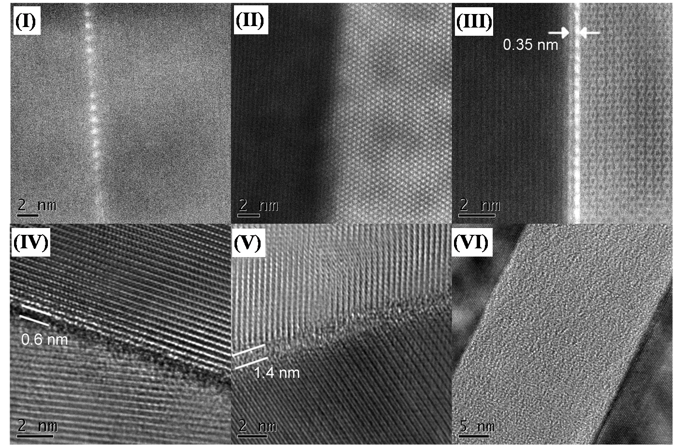
Aberration-Corrected Electron Microscopy
Courtesy: M.P. Harmer

Slide 35
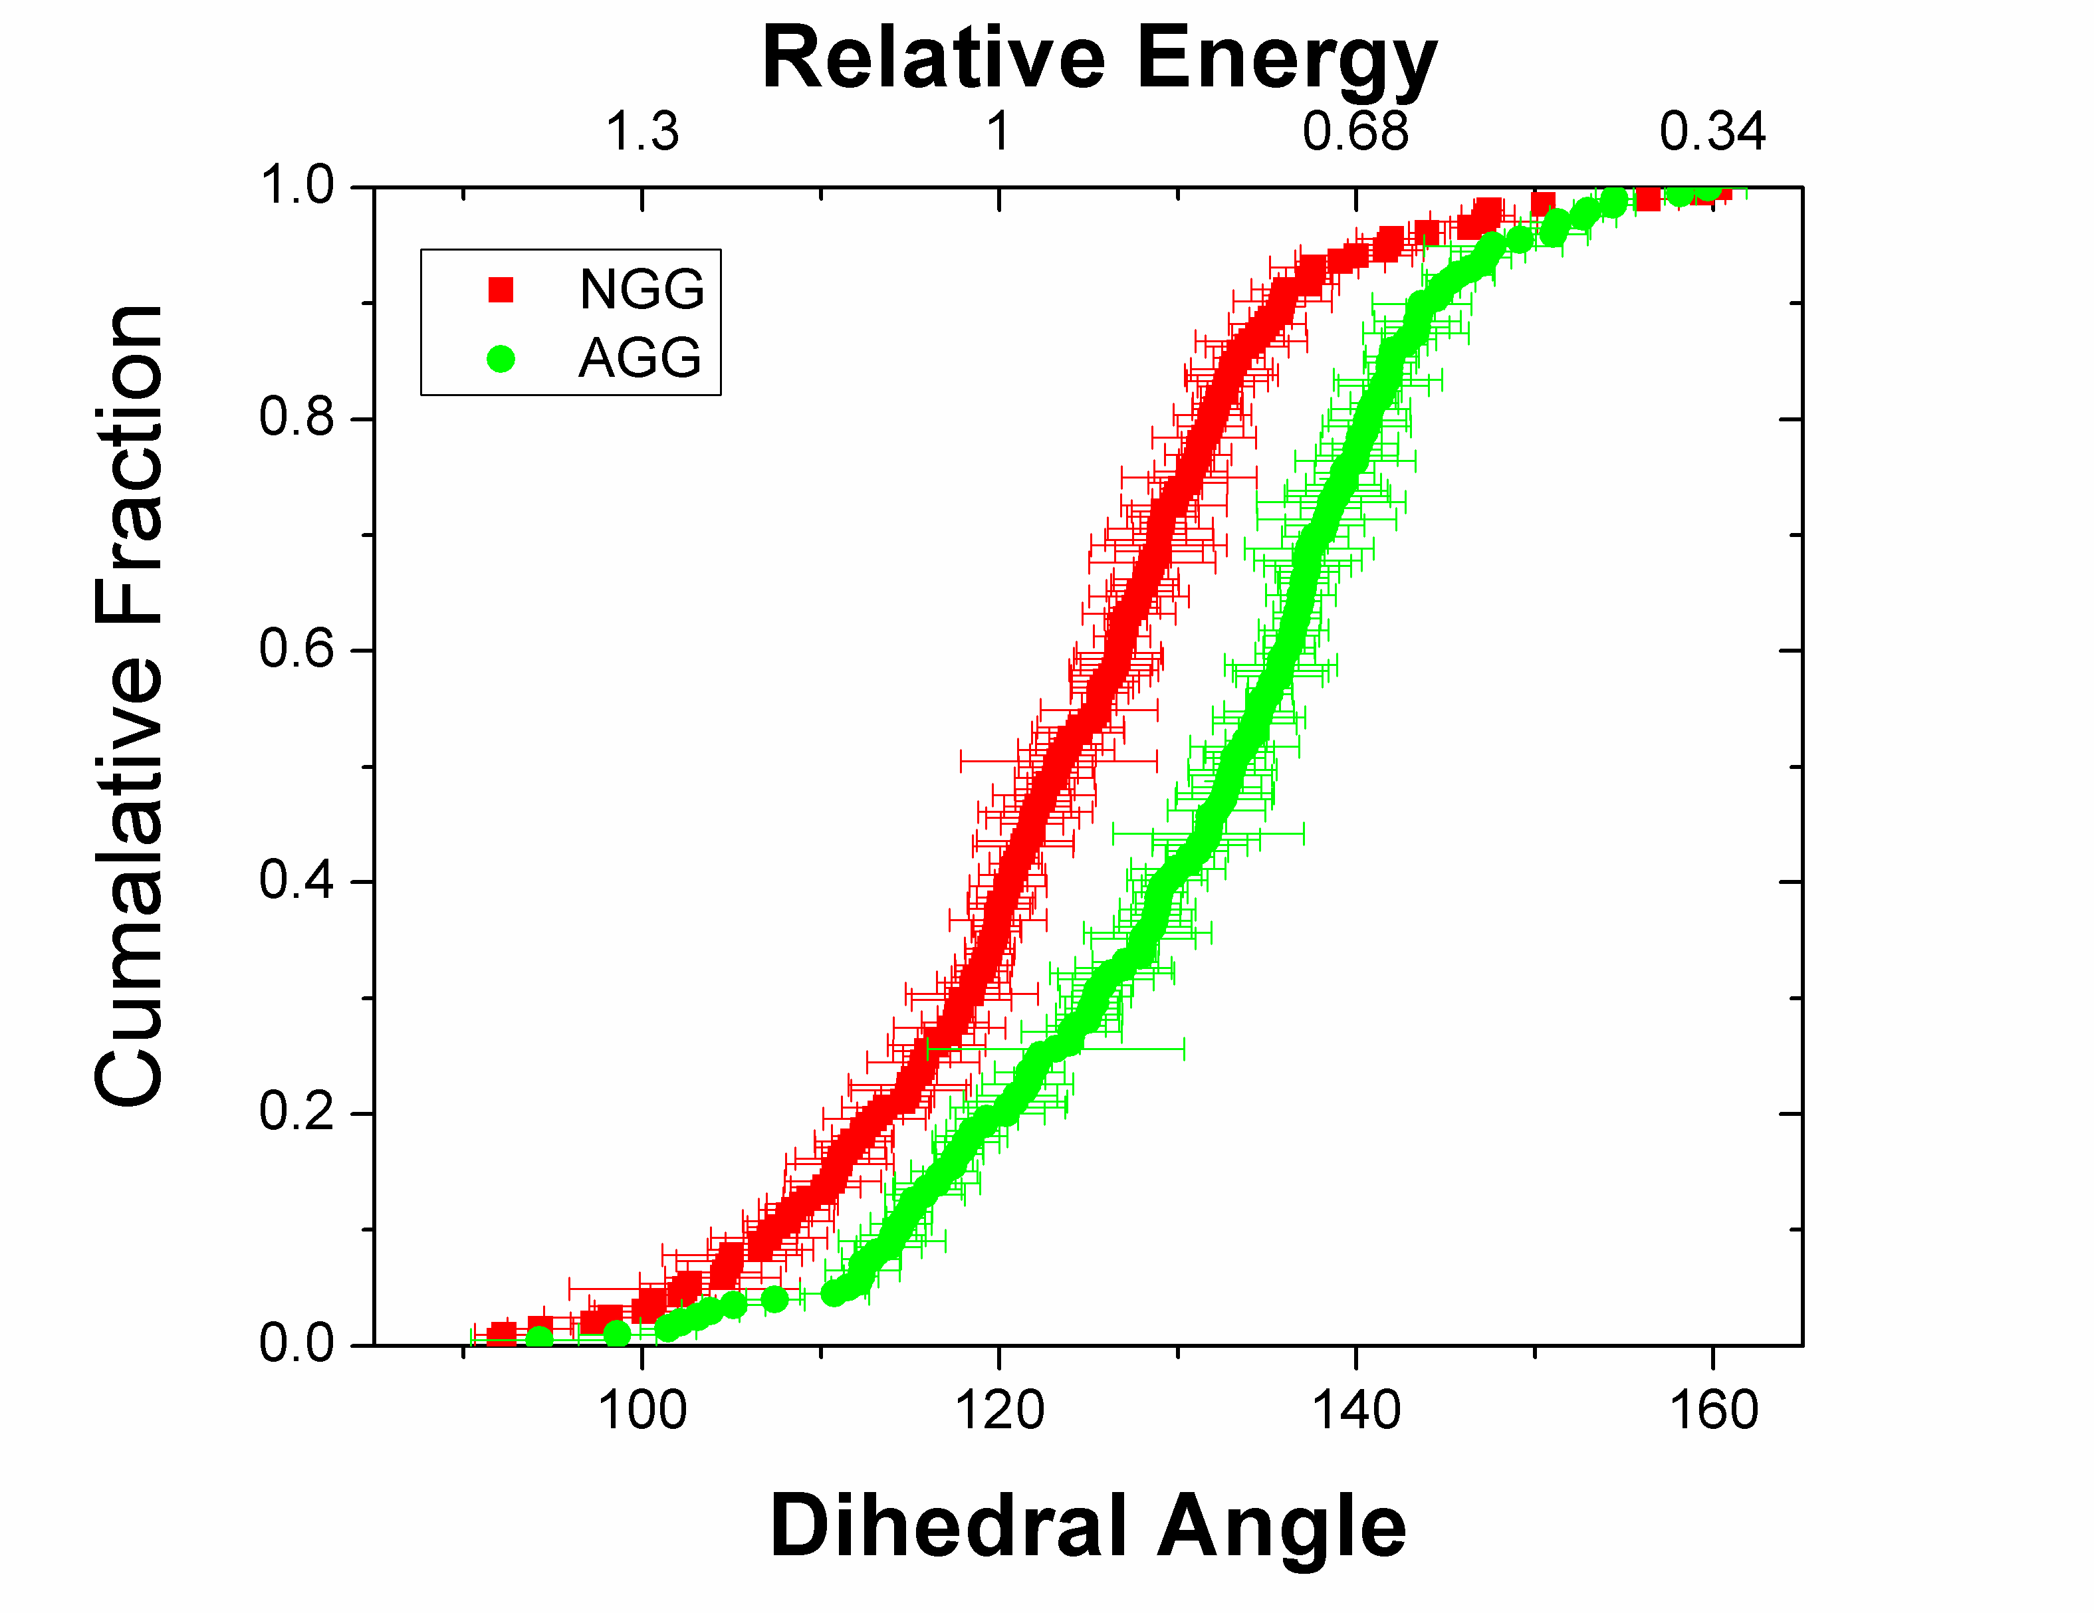
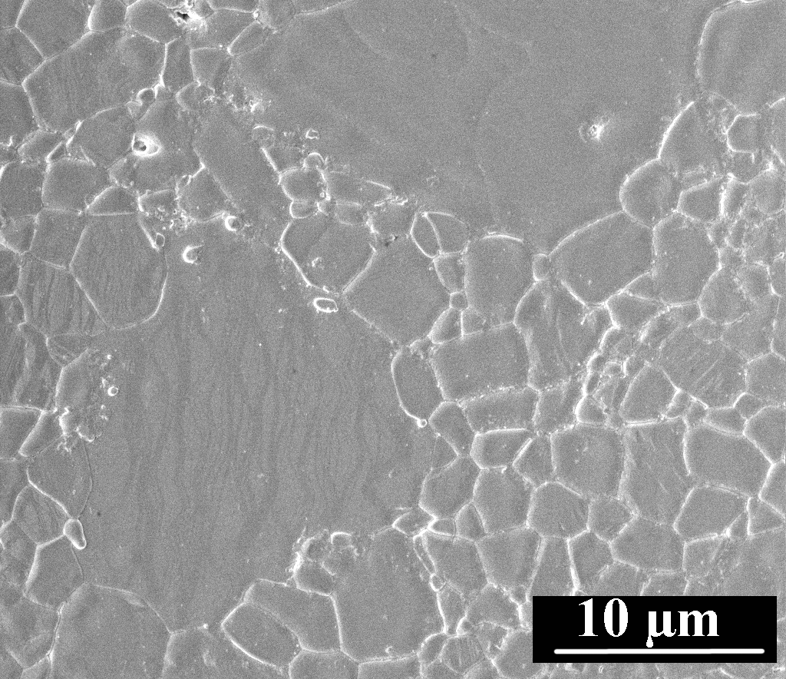
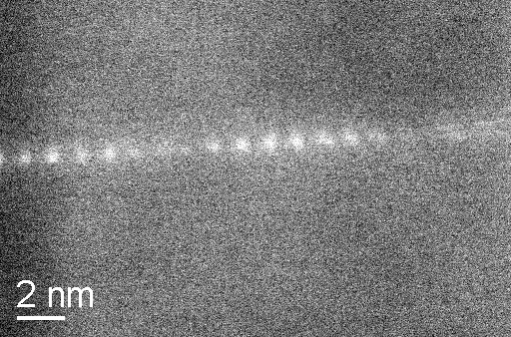
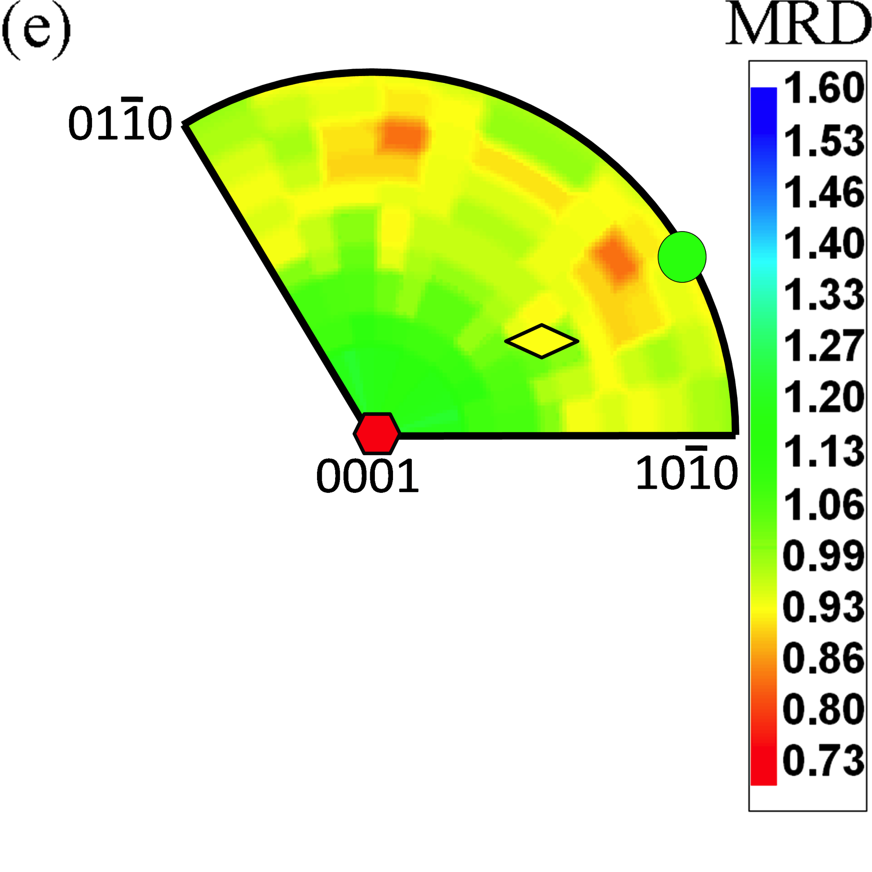

Complexion: Energy and Mobility Changes
Alumina doped with 100 ppm Nd
Cumulative Fraction
Grain boundary composition, structure, energy, mobility, and distribution linked.
Controlling complexion transitions offers possibility of microstructure control
Complexion III: bilayer segregation, higher mobility
Complexion I: mono layer segregation, low mobility
Dillon et al. Acta Mater. 55 (2007) 6208-18.
Dillon et al. Int. J. Mat. Res., 101 (2010) 50-56. Dillon et al. J. Am. Ceram. Soc., 93 (2010) 1796-802.
Notes:
•In my opinion, one of the most unforeseen and exciting achievements was the discovery of grain boundary complexions. This effort was led by Martin Harmer and Shen Dillon, at Lehigh.
•In very simple terms, we have found that compositional changes at grain boundaries can lead to very different properties (such as mobility)
•In a sample of this type, with a bimodal grain size distribution, if one separately characterizes the boundaries surrounding the large and small grains, they have different energies, populations, and atomic level structures.
•The interpretation is that one group of these boundaries has changed it complexion and, with it, the mobility has also changed.
•By controlling these complexion transitions, it is possible to control microstructural evolution.
•If this is a general phenomenon, then it has tremendous potential for engineering optimum microstructures.

Slide 36



Doped Yttria - EBSD
Normal Grain Growth (NGG) Abnormal Grain Growth (AGG)
0 hours 6 hours
100 ppm Calcia-doped yttria at 1700°C for 0 and 6 hours in reducing atmosphere
Fabricated by S. Ma at Lehigh University
Notes:
Difference in scales and clearly the difference in texture
These samples were doped and sintered at the same temperature but at different times
This could be because specifc boundaries underwent the complexion transition and grew forming the abnormal grains.
Texture like this also occurs, most often in metallic systems, as a result of surface energy, where the (111) is most stable and will thus be the predominate plane on the surface.

Slide 37

Grain Growth Kinetic Types
S.J. Dillon, M. Tang, W.C. Carter, M.P. Harmer, “Complexion: A new concept for kinetic engineering in materials science,” Acta Mater. 55 6208-6218 (2007).

Slide 38





Complexion Transitions and AGG
High energy GBs transition more easily, hence we observe AGG more against the single crystal that has a high energy 0001 surface (red color)
Implication: many grain boundaries changed complexion AFTER coming into contact with abnormal grains
a-plane
low γ
c-plane
high γ
a-plane
low γ
c-plane
high γ
single crystals
single crystals
Surface dihedral angles
Yttirum-doped alumina:
Bojarski et al., Mater. Sci. Forum (2013) 753 87
Bojarski et al. Metall. and Mater. Trans. A. (2012) 43 3532
Notes:
1. Comparing the experiment with contact with a high E interface versus the low E interface, GBs in contact with the high E were more likely (higher fraction) to transition. 2. Grain boundaries near or adjacent to abnormal grains have transitioned more often than remote GBs.

Slide 39



Propagation
Consider the problem of how the transitioned, high mobility boundaries have to propagate.

Slide 40
Boundary-Based Approach to Modeling AGG with Complexion Transitions
Over the course of the simulation, transition randomly selected grain boundaries to a high mobility “complexion”.
Grain boundaries are “special”, as opposed to entire grains.
How easily can such a process result in AGG?
Grains with a volume 10x the average (~2.66x average radius) regarded as abnormal.
Frazier, W. E., Rohrer, G. S., & Rollett, A. D. (2015), 'Abnormal grain growth in the Potts model incorporating grain boundary complexion transitions that increase the mobility of individual boundaries', Acta Mater 96 390.

Slide 41

3 Different Transitions Across TLs
Independent
“N0” Transition
Single Adjacency
“N1” Transition
Double
Adjacency
“N2” Transition

Slide 42


Grain Growth with Independent (N0) + Adjacency (N1) Transitions
Frazier, W. E., Rohrer, G. S., & Rollett, A. D. (2015), 'Abnormal grain growth in the Potts model incorporating grain boundary complexion transitions that increase the mobility of individual boundaries', Acta Mater 96 390.

Slide 43



Subgrain Coarsening
Deformed metals, especially those with high stacking fault energy, will form a subgrain network inside each grain.
The misorientation across the average subgrain boundary increases steadily with strain.
Therefore, the likelihood of finding a subgrain with high angle, highly mobile boundaries increases with strain.
Such a subgrain has the potential to grow abnormally, which can give rise to a new grain – “intragrain nucleation”.
2D simulation, theory: Holm, E. A., et al. (2003). "On abnormal subgrain growth and the origin of recrystallization nuclei." Acta materialia 51: 2701-2716.
Complication: “intergrain nucleation” can occur via “strain induced boundary migration”.
Low misorientation
High
misorientation

Slide 44
Anisotropy Dependence?
•
Parametric simulations show that:
isotropic γ + isotropic M ⇒ normal growth
anisotropic γ + isotropic M ⇒ normal growth
isotropic γ + anisotropic M ⇒ abnormal growth
anisotropic γ + anisotropic M ⇒ abnormal growth
•
Low densities of highly mobile boundaries are necessary for abnormal growth:
Few high-M boundaries
Many high-M boundaries
Holm et al. (2003) Acta mater. 51 2701-2716.

Slide 45
Mean field theory for AGG in 2D
Hillert originally suggested that any grain with size twice that of the mean,
R > 2<R>, would be able to escape and grow abnormally.
Simulations showed that this was not the case and Thompson et al. demonstrated this theoretically by re-analyzing the basic mean field theory; Acta metall. 35: 887-890 (1987).
Rollett et al. (1989) Acta metall. 37 2127, showed that a mobility advantage for the boundary of a grain would allow it to grow abnormally to a multiple of the matrix grain size. Rollett & Mullins (1997) Scripta mater. 36 975, extended von Neumann-Mullins to include energy and mobility (Humphreys used mean-field in his 1997 Acta paper)
The issue with this approach is, how can an individual grain sustain a mobility advantage while growing through a matrix of multiple orientations?
1st Answer: subgrain structures can sustain a mobility advantage where a particular outlier subgrain always has a high misorientation, high mobility, perimeter; (AGG) Holm et al. Acta mater. (2003) 51: 2701. (Applied to the nucleation of recrystallization) Wang et al. (2011), Acta mater. 59 3872.
2nd Answer: changes in the composition of boundaries (to form different “complexions”) generates perimeters around abnormal grains with sustained high mobility; Frazier et al. (2015) Acta Mater 96 390.

Slide 46
Philosophy of Approach
This development is based on: Rollett, A. D. and W. W. Mullins (1996). “On the growth of abnormal grains.” Scripta metall. et mater. 36(9): 975-980.
Analysis confined to 2D because it is possible to integrate the curvature around the perimeter of a grain and relate it to the rate of change of area; not possible in 3D.

Slide 47
Relative growth rate - summary
Plot of relative growth rate versus relative size for µ = 2 with four different values for the ratio of grain boundary energies, Γ = 0.7, 1.0 (solid line), 1.1 and 1.3. Note that only the curve for Γ = 1.3 shows both upper and lower roots (G = 0) but that the other three cases also have upper roots that increase with decreasing Γ. The results predict abnormal grain growth (Γ > 0) over a range of relative size that decreases with increasing boundary energy ratio and decreasing boundary mobility ratio.
Rollett and Mullins (1996) Scripta metall. et mater. 36 975.

Slide 48
AGG Analysis: Assumptions
The theory makes a number of simplifying assumptions.
Students are assumed to be familiar with the Herring equation.
Only 2D grain growth is treated, although it is reasonable to expect that theory applies in 3D also.
Grain boundary properties are assumed to be constant (uniform) everywhere except for the boundaries between certain special grains (type A) and grains in the matrix (type B).
The special grains share the same energy and mobility on their boundaries.
The special grains are isolated (no A-A boundaries).
Rollett and Mullins (1996) Scripta metall. et mater. 36 975.

Slide 49
Microstructure
turning angle=ζ
Each A grain is surrounded by B grains.
We are interested in whether the A grain grows faster than the B grains during growth.
4-sided example should shrink.
Figure 1.
Rollett and Mullins (1996) Scripta metall. et mater. 36 975.

Slide 50
Parameters
Γ:=γ_{AB}/γ_{BB} in which the γ's are the boundary energies on the AB and BB boundaries, respectively.
µ:= M_{AB}/M_{BB} in which the M’s are the boundary mobilities.
A:= area of a grain; n:= number of sides of a grain.
S:= arc length; β:=angle made by directed tangent to line relative to a fixed reference direction.
Define a function a, of the energy ratio:

Slide 51
Turning angle at a vertex
Fig. 1 shows an irregular 4-sided A grain surrounded by B grains. The vertices are assumed to be in equilibrium. If torque terms are neglected, the turning angle ζ of the tangent to the AB boundary at a vertex is then given by
Note the limiting case of wetting of the matrix grain boundaries by the A grain occurs at Γ=1/2 or ζ=π.
Rollett and Mullins (1996) Scripta metall. et mater. 36 975.

Slide 52
dA/dt vs. curvature
We now derive a relationship between the rate of change of area of the “A” grain, its number of sides, and the equilibrium angles at each vertex. The curvature rule for a two dimensional grain may be written:
where v is the outward velocity in the normal direction, and dβ/ds is the curvature.
Rollett and Mullins (1996) Scripta metall. et mater. 36 975.

Slide 53
Integrate around the grain
If Eq. 2 is integrated around the “A” grain with n sides of fixed M_{AB} and γ_{ΑΒ}, the left hand side just gives the rate of change of area A of the grain and on the right, the integral of dβ/ds gives 2π−nζ, since there is a discontinuity of the AB tangent angle of ζ at each of the n vertices as illustrated in Fig. 1.
Rollett and Mullins (1996) Scripta metall. et mater. 36 975.

Slide 54
The “n-6” rule
The previous equation shows that the rate of area change is constant; if all boundaries are equivalent, as they are for a “B” grain surrounded by “B” grains in the matrix, then Γ=1, a=1 and the equation reduces to the “n-6” rule for the B matrix grains:
Rollett and Mullins (1996) Scripta metall. et mater. 36 975.

Slide 55
Grow or Shrink?
The equation shows that the A grain will grow if n>ν=6/a and shrink if the reverse is true. Fig. 2 shows a plot of v as a function of Γ.
Rollett and Mullins (1996) Scripta metall. et mater. 36 975.

Slide 56
Grow or Shrink? Contd.
If n>ν the A grain grows and if n<ν it shrinks. Note if Γ<1/√3, the A grain grows for any number of sides n≥3, which corresponds to the wetting criterion.
We now turn to the comparison of the ultimate size of the A grain to that of the B grains. For this purpose, following Thompson et al.† and Rollett et al.*, we study the time dependence of the ratio ρ=R_{A}/<R_{B}> where the R's are area-equivalent radii.
† Thompson, C., H. Frost, et al. (1987). “The relative rates of secondary and normal grain growth.” Acta metall. 35 887-890.
* Rollett, A. D., D. J. Srolovitz, et al. (1989). “Simulation and Theory of Abnormal Grain Growth-
Variable Grain Boundary Energies and Mobilities.” Acta Metall. 37 2127.

Slide 57
Growth of A grains
Using the rule for differentiating a quotient we have
where simply means that is averaged over (isolated) A grains of the same R_{A} but otherwise possibly of different shape and n, and similarly for .
Rollett and Mullins (1996) Scripta metall. et mater. 36 975.

Slide 58
Growth of A grains, contd.
To evaluate the first derivative in the brackets of the previous equation, we combine Eq. 3 and the expression A=πR_{A}² to get
For <n|R_{A}>, the average number of sides of A grains with a fixed R_{A}, we use the expression
<n|R_{A}> = 3r + 3
which is linear in the size of the A grain and gives the limit 3 as R_{A} becomes very small; it approximates the number of circular B grains that would fit on the circumference of the A grain
Rollett and Mullins (1996) Scripta metall. et mater. 36 975.

Slide 59
Growth of A grains, contd.
Combining these equations:
Now we need something to predict the coarsening rate in the matrix (the “B” grains), for which we turn to Hillert’s classical grain growth theory.
Rollett and Mullins (1996) Scripta metall. et mater. 36 975.

Slide 60
Hillert’s theory
Assume that the presence of A grains does perturb the B matrix; the theory may be obtained by combining two ingredients: the “n-6” rule, expressed in area equivalent radius form and averaged over all B grains of radius R_{B}:
and the linear relation sides(size):
Rollett and Mullins (1996) Scripta metall. et mater. 36 975.

Slide 61
Hillert’s theory, contd.
Abbruzzese et al.† found that this relationship is experimentally supported. It also satisfies the Euler* requirement that <n>=6. Combining Eqs. 11 and 12 with standard coarsening theory, one obtains the Hillert result
† Abbruzzese, G., I. Heckelmann, et al. (1991). “Topological foundation and kinetics of texture controlled grain growth.” Textures and Microstructures 14-18: 659-666.
*Courant, R. and H. E. Robbins (1941). What is Mathematics, Oxford University Press.

Slide 62
Abnormal Growth: main result
Combining equations gives the following:
The sign of G is the same as that of
Rollett and Mullins (1996) Scripta metall. et mater. 36 975.

Slide 63
Finding a limiting (abnormal) size
Think of the result as a quadratic equation and consider which way the relative size is changing: for there to be a fixed relative size (ρ), there must be a “restoring force”.
Thus, for a stable ρ to exist, corresponding to a fixed ratio of the A to B grain size as growth proceeds, there must be a positive root ρ of the quadratic equation G=0 at which
∂G/∂ρ<0, so that the sign of is positive
The mathematical condition for real roots of G=0 to exist is
Rollett and Mullins (1996) Scripta metall. et mater. 36 975.

Slide 64
The positive root: max. size
Physically μ must also be positive. If the previous condition is not satisfied, G<0 for all ρ (the Eq. above shows G<0 for large ρ) so that under these conditions the “A” grain would shrink and disappear. If the condition above is satisfied, it is easily shown that the upper root, given by
is then the stable one. If
1/2<Γ≤1/√3 (3>a≥2),
then G>0 for any (positive) ρ<ρ₊ so that any A grain in this range will grow toward the stable ρ₊.
Rollett and Mullins (1996) Scripta metall. et mater. 36 975.

Slide 65
Minimum size for abnormal growth
If, however, Γ>1/√3 (a<2), the initial value of ρ must lie in the range ρ₋ <ρ < ρ₊ for growth toward ρ₊ to occur, where ρ₋ is given by
if ρ<ρ₋, G<0 so shrinkage and disappearance of the A grain would occur. In the special case that the condition above is an equality, which represents a double-root curve in the (μ, Γ) plane (e.g. μ=Γ=a=1 as discussed by Thompson et al.), then . In this case G is never positive so grain A would again ultimately disappear.
Rollett and Mullins (1996) Scripta metall. et mater. 36 975.

Slide 66
Asymptotes
Note also that one only expects the relative size to approach the asymptote rather slowly under experimental conditions. If the range of ρ over which G>0 is small then fluctuations in the growth rate, due for example, to fluctuations in the number of neighbors, may cause to become negative for long enough to cause A to disappear. Note also that one only expects the relative size to approach the asymptote rather slowly under experimental conditions.
Rollett and Mullins (1996) Scripta metall. et mater. 36 975.

Slide 67
Details
The case of a<2 (Γ>1/√3) is illustrated in the following figure which shows a plot of G as a function of ρ for μ=2 and several values of Γ. There are two positive roots of G=0. The effect of decreasing Γ is to expand the range over which G is positive. The meaning of G>0 or >0 is that the average growth rate of the A grain will exceed that of the mean size of the matrix so that the expected value of ρ will increase until it reaches the stable upper root of G=0. Note that this analysis addresses only the average value of dρ/dt. If the range of ρ over which G>0 is small then fluctuations in the growth rate, due for example, to fluctuations in the number of neighbors, may cause to become negative for long enough to cause A to disappear.
Rollett and Mullins (1996) Scripta metall. et mater. 36 975.

Slide 68
Relative growth rate - plot
Figure 3. Plot of relative growth rate versus relative size for µ=2 with four different values for the ratio of grain boundary energies, Γ=0.7, 1.0 (solid line), 1.1 and 1.3. Note that only the curve for Γ=1.3 shows both upper and lower roots (ρ=0) but that the other three cases also have upper roots that increase with decreasing Γ. The results predict abnormal grain growth (G>0) over a range of relative size that decreases with increasing boundary energy ratio.
Rollett and Mullins (1996) Scripta metall. et mater. 36 975.

Slide 69
Contours in the (µ,Γ) plane
The next figure shows the (μ,Γ) plane with regions of ρ₊ (stable root) delineated: no real roots exist in the upper left triangle whereas two roots exist in the lower right triangle (Γ>1/√3). Over the range 0.5<Γ≤1/√3, only one positive root exists (ρ₋ is negative), and for Γ≤0.5, wetting occurs. Several contours of constant relative size are shown; these were calculated by setting G=0 in Eq. 14a, and solving for µ with fixed values of ρ. Also shown is the curve (thick line) along which the upper and lower roots are equal; this was calculated from Eq. 16 with an equality. Each contour of constant ρ touches this line at a point for which ρ₊=ρ₋; for µ and Γ less than this point, the contour describes the branch for ρ₊; conversely, for µ and Γ larger than this point, the contour describes the branch for ρ₋. In the region of two positive roots, each µ,Γ pair is intersected by two contours; the difference between ρ₊ and ρ₋ defines the range of relative size over which abnormal growth is likely to occur. [Eq. numbers refer to the Scripta metall. Paper]
Rollett and Mullins (1996) Scripta metall. et mater. 36 975.

Slide 70
Contours in the (µ,Γ) plane: plot
Figure 4. The μ, Γ plane with regions of stable ρ delineated. For Γ<0.5, wetting occurs; for 0.5≤Γ≤1/√3, only one positive root exists; below the double root curve (dotted line) and for Γ>1/√3 two positive roots exist. Contours of constant ρ₊ (solid curves) and ρ₋ (dashed curves) have been drawn; the difference between the ρ₊ and ρ₋ values at any point in the two root region defines the range of relative sizes over which abnormal growth can occur.
Rollett and Mullins (1996) Scripta metall. et mater. 36 975.

Slide 71
Abn. Gr. Gr.: Conclusions
Abnormal growth is promoted by high mobility of the abnormal grain relative to the matrix.
Abnormal growth is constrained by high energy of the abnormal grain.
A combination of high mobility and high energy could occur in a sub-grain structure with a few misoriented subgrains.
Complex dependence of abnormal growth revealed by contours in the (µ,Γ) plane.

Slide 72
Extending AGG to nucleation of primary recrystallization
Since deformed metals develop dislocation cell structures with accumulating strain, it is reasonable to ask what happens during annealing.
Polygonization is the process by which dislocation cells evolve into subgrain structures. Cahn [Cahn, R. W. (1950), Proceedings of the Physical Society of London A, 63, 323-336] postulated many years ago that this process could continue with certain individual subgrains growing abnormally and thereby acting as "nuclei" for primary recrystallization.
Wang et al. extended the simulation of AGG in subgrain structures by combining its results (in terms of the frequency of generation of abnormal grains) with constitutive information about subgrain misorientations available in the literature and showed that the dependence of recrystallized grain size on prior strain was in reasonable agreement with the literature.
It is important to note that primary recrystallized grain size is, to first order, only dependent on the prior strain and not sensitive to annealing temperature. This confirms that the process of recrystallization is determined by the prior strain history, even if the rate (kinetics) of recrystallization depend on temperature via the rate sensitivity of grain mobility.
Wang et al. (2011), Acta mater. 59 3872.

Slide 73


Grain Boundary Network at Increasing Strain
Original Grain Structure
The prior grain structure stretches out, becomes elongated.
The subgrain structure, by contrast, remains approximately equi-axed and changes size according to the flow stress.
High angle boundaries also develop within the (prior) grains at higher strains.
10% Thickness reduction
40% Thickness reduction
HAGB (>= 15º)
LAGB (< 15º)
60% Thickness reduction
RD
Notes:
This cartoon neglects some real characters of deformed materials, but it illustrates how the microstructure will evolve at different strain levels. During deformation at low temperatures i.e. during cold work (typically less than 150ﾊ｡C, for Al alloys), work expended on the crystal lattice distorts the lattice by introduction of defects and consequently microstructural changes occur. These include･elongated grains, with accompanying increase in grain surface per unit volume (micrographs below)･increase in dislocation density･increase in entanglement of dislocations･re-orientation of grains relative to the direction of applied stressFor alloys which do not strain harden, the stored energy per unit volume due to plastic strain ε for deformation at a stress σ is ε′σ′ 0.05 because only about 5% of the work done in deformation is actually stored in the metal. The rest is dissipated as heat.

Slide 74


Holm Theory
Mobility anisotropy is changed by varying critical angle (θ*) defining a jump in mobility.
Holm et al. (2003) Acta mater. 51 2701
Notes:
Before I show my own results, I would like to talk a little about Holm’s theory in order to compare my findings with hers. This work was published in 2003 in acta. This theory is about 2D monte carlo simulation of subgrain growth on a single phase, strain-free subgrain structures with experimentally validated microstructure, texture, boundary character, and boundary properties. They found boundary mobility anisotropy is the major factor influencing abnormal growth probability. And this anistorpy is varied by changing critical angle defining a jump in mobility.

Slide 75
MDF Comparison
Cut-off
highly Mobile boundaries
Note: Misorientation calculation is based on only nearest neighbors in a 3D voxelized structure.
Notes:
Fit equation for number fractions. Looks similar to Holm’s curve.

Slide 76
3D Simulation Results
Cut-off
0.03
Synthetic Brass Textures
Synthetic S Textures
0.025
Average
highly Mobile boundaries
0.02
0.015
0.01
0.005
0
10
11
12
13
14
15
Random
Grain Orientation Deviation (θ)
Average over 2 textures is based on the similar MDFs for synthetic Brass/S textures.

Slide 77
Abnormal growth Modeling
2.5
2
y = 28.024x - 1.1803
1.5
1
0.5
0
0.05
0.06
0.07
0.08
0.09
0.1
0.11
0.12
Application conditions:
Strong texture
One single component
C₁ and C₂ are constants, 28.0 and 1.18 respectively.
Wang et al. (2011), Acta mater. 59 3872.
Notes:
Prototype of 3D modeling

Slide 78
Relation between GOD & Mean Misorientation
<θ>
<θ>=1.1849θ+0.9333
These 2 constants are system dependent.
θ
Wang et al. (2011), Acta mater. 59 3872.

Slide 79
Model by Wang et al.
M.A. Miodownik, P. Smereka, E.A. Holm and D.J. Srolovitz, Proc. Roy. Soc. Lond. A457 1807 (2001)
Notes:
C=8.8857

Slide 80
Application to Nucleation
Where k is a constant, ~ 1.50º for incidental subgrain boundaries (IDBs) and ~7.21º for geometrically necessary boundaries (GNBs).
is Von Mises strain.
Based on data: 90% thickness reduction and GNBs.
D.A. Hughes et al. Phys. Rev Lett. 81 4664 (1998)
Wang et al. (2011), Acta mater. 59 3872.

Slide 81

Grain Size (after Recrystallization) Model via AsGG
Subgrain size model
Wang et al. (2011). "Modeling the recrystallized grain size in single phase materials." Acta mater. 59 3872-3882.
Nucleation model
Based on the subgrain size (a constant) calculated from the flow stress model
1050 Model 1: 672 K (Def. T), 5/s (strain rate)
1050 Model 2: 561 K (Def. T), 50/s (strain rate)
5XXX Model: 623 K (Def. T), 50/s (strain rate)
AA 5XXX: 1.1% Mg, 97% Al, other alloying elements and impurities.
AA1050: Commercial purity aluminum.
AA5052: J.J. Nah et al. Scripta Materialia 58 (2008) 500-503
AA1050: J.P. Suni, H. Weiland, R.T. Shuey. Materials Science Forum 2002; 408 - 412: 359.
D.A. Hughes et al. Phys. Rev Lett. 81 4664 (1998)
Notes:
81
Last but not least, we need to validate our model using expl. data. So we combined the probability model with the subgrain size function, which was obtained from literature. The integrated model is a red dotted line in this plot. Exptl data are obtained from 4 different sources. AA5012 data fit the curve very well. The remarkable thing is that hot-rolled AA5005 for this study also fall into the prediction line.
However, AA2012 does not mainly due to another recrystallization nucleation mechanism in 2-phase materials, which is particle stimulated nucleation.

Slide 82
Questions (1)
If a given grain has a perimeter that has a higher mobility than the boundaries in the surrounding (matrix) grains, what effect does this have on the probability of AGG?
If a given grain has a perimeter that has a higher energy than the boundaries in the surrounding (matrix) grains, what effect does this have on the probability of AGG?
What contradictory effects can impurities have in promoting AGG?
What is the main effect of second phase particles on grain boundary migration?
What is the main effect of second phase particles on grain growth kinetics?
What effect do pores have on grain growth?
In what way are pores different from (most) second phase particles?

Slide 83
Questions (2)
What is “relative size” in the context of AGG?
What does an analysis of relative size reveal in terms of mobility and energy ratios?
What impact does abnormal growth in subgrain networks have on primary recrystallization?
Why is the dependence of average GB misorientation on plastic strain important?
Why is the subgrain size as a function of flow stress important?
How does abnormal subgrain growth help to explain the fact that recrystallized grain size depends on prior strain (and deformation conditions such as deformation temperature and strain rate) but not on annealing temperature?

Slide 84
Summary
The kinetics of abnormal grain growth can be described with a mean field theory that considers the behavior of an exceptional grain. Upper and lower limits to relative size are found, so we expect bimodal grain size distributions.
Abnormal grain growth in a limited range of orientations (subgrains) occurs when a small minority of grains have misorientations large enough to give their perimeters high mobility.
AGG can also occur if the boundaries of a grain undergo a transition to high mobility, e.g. impurity segregation leading to a transition in the GB structure.
AGG demonstrated to occur in the presence of particle pinning, provided that the grain size is smaller (but not too much smaller) than the Smith-Zener limit. If a higher than random fraction of particles is present on the boundaries, then this raises the probability of AGG.

Slide 85
Supplemental Slides

Slide 86
Waspaloy: Experimental
Waspaloy is a high strength, nickel base, precipitation-hardening alloy.
Waspaloy Composition:
Al B C Nb Co Cr Fe Mo Mn Ni Ti Zr
1.34 0.01 0.04 0.06 13.5 19.8 0.79 4.25 0.04 Bal. 2.98 0.05
Processing History:
Effect of High Temperature:
γ’ dissolves
Only [MC] type carbides are present.
Complex alloy is essentially reduced to 2 phases:
Matrix + Carbides
As-received Condition
Cast
Hot Work
Anneal
Temperature
Quench
Time
Roberts, PhD thesis CMU (2007)
Sims and Hagel, The Superalloys, Wiley: New York (1972), p. 577.
Jackman, Canada and Sczerzenie, Superalloys 1980, TMS: Warrendale, p. 365
Annealing Temperature = 1100°C (above the γ’ solvus)
Notes:
Now onto the alloy. The material of choice was Waspaloy.
Here is the composition (trace elements excluded).
The ternary PD shows that the major constituents (Ni-Cr-Co) lie in the austenitic region, better known as the gamma phase in nickel alloys.
IN addition, previous work has examined the stability of carbides. The graph suggests that only [MC] type carbides are stable at 1100C.
The processing history is…
The use of a high temperature simplifies the problem…. 1) 2) 3)
In addition, the simulation model is simplified such that only 2 phases must be accounted for: matrix and inert particles.

Slide 87
Particle/Boundary Stereological Relationship
The number fraction of particles on grain boundaries was measured and predicted for the (1) initial and (2) annealed conditions (i.e. 1100°C/1h).
Assumptions:
(1) N_{S} = N_{A}
(2) spherical particle
(3) uniform spatial distribution
Predicted:
Observed:
Definitions:
(N_{A})_{b} = # of particles on boundaries
N_{A} = # of particles
r = particle radius
L_{A} = grain boundary trace per unit area
The fraction on boundaries decreased in agreement with theoretical calculations; however, both experimental conditions showed higher fractions than predicted from random intersections.
History | Expected | Observed
As-received | 0.23 | 0.61
1100°C/1h | 0.07 | 0.19
Roberts, PhD thesis CMU (2007)
Larger than expected fractions on boundaries may explain why the limiting grain size is commonly less than the Smith-Zener limit.
Notes:
Given that we are interested in the boundary migration, a method was proposed to quantify the number fraction of particles on boundaries.
Only useful to radial plane since axial plane is far from a random spatial distribution.

Slide 88


Abnormal Grain Growth in Waspaloy
Abnormal
Grain
To obtain a pinned microstructure, the material was annealed for an extended period of time; however, abnormal grain growth (AGG) occurred at long annealing times (1100°C/2wk).
What is the cause of AGG in this material?
Texture? The orientation and misorientation were random, implying that texture does not initiate or control AGG.
Particles?
Size Advantage?
Roberts, PhD thesis CMU (2007)
Notes:
Recalling our previous discussion, I will now focus on the sample annealed for 2 weeks. Originally, we were focused on obtaining a pinned microstructure, but the outcome was different.

Slide 89


Comparison of Expt. w/ Simulation
Experiment and simulation show qualitative agreement of the observed growth trends.
Expt.
Note:
The nickel alloy increased its mean grain size by a factor of ~2.5 while the simulations exhibited factors greater than 3.
Potts model
Roberts, PhD thesis CMU (2007)

Slide 90
Comparison of Expt. w/ Simulation
A transition from NGG to AGG was observed in both the simulations and experiment.
Initiation of AGG was caused by grain size advantage and/or non-random particle distributions on grain boundaries. More specifically, if the grain size is smaller than the Smith-Zener limit, but the structure is pinned by the larger-than-random density of particles on boundaries (to match expts.), then it is possible for a large grain to escape and become “abnormal”.
Simulation: isotropic GB properties; temperature = 1.5; particles size = 27 voxels; volume fraction of particles = 6%, 70% of particles were located on boundaries; image taken at 100,000 MCS.
Roberts, PhD thesis CMU (2007)
Notes:
In the end, the MC model successfully simulates abnormal grain growth as was observed in the nickel alloy!!
Both analyses (exp & sim) reach an identical conclusion: AGG is not texture-induced.

Slide 91
Software
Materials people have, collectively, invested substantially in software development.
CMU philosophy: unless there exists an obvious opportunity for commercialization, it is better to make software freely available.
CMU makes its tools for serial and parallel algorithms for Monte Carlo, phase field, and level set models of grain growth, as well as particle dissolution. We have already made many of our 3D microstructure analysis tools available on the web.
CMU software is distributed over a number of websites.
  http://code.google.com/p/mbuilder/ : Microstructure Builder
  http://matforge.org/cmu/ : MMSP package
  http://latir.materials.cmu.edu/websvn
  http://mimp.materials.cmu.edu/research/downloads.html
  http://neon.materials.cmu.edu/rollett/texture_subroutines

Slide 92

MMSP is a library of functions that manipulate parallel uniform grids
Written in C++ using MPI
Open-source, extensible
Parallelism mostly hidden
Most serial algorithms written in C or C++ can be quickly parallelized
Primarily intended for numerical modeling
Grid data subdivided across an array of 18 processors

Slide 93
An MMSP grid is a distributed array
Distributed:
Each MPI process “owns” its own segment of the array, and “shares” ghost buffers
This permits the creation of very large grids which can be accessed at the same time by many processors on any system with MPI installed (either shared or distributed memory architectures).
ghost buffers (grey); original domain (white)
process 0
process 1
process 2

Slide 94
An MMSP grid is a templated array
Templated:
An MMSP grid can
store any type of data.
An MMSP grid is N-dimensional, where N is any positive,
non-negative integer.
This permits tremendous versatility in the data structure used to represent information at each point in the domain, and also enables dimension-independant coding
Supported data types:
Any POD data type: int, float, double, etc.
Any STL container: std::vector, std::map, std::list, std::string, std::complex, etc.
MMSP built-in data types, such as arrays, matrices, sparse vectors, sparse matrices, tensors, etc.
Advanced users can create their own data types as well.

Slide 95
When to use MMSP
. . . when the required computations are data-intensive (large domains) so that data parallelism makes sense
. . . when the workload is evenly distributed across the domain (or approximately so)
. . . when you have access to a large computing system (with either shared or distributed memory) and on which MPI has been installed
. . . when your computation requires a complicated data type (such as vector, sparse vector, or sparse tensor data) at every node in your grid
Other options exist, such as global arrays:
http://www.emsl.pnl.gov/docs/global/
MMSP is not compatible with some excellent software utilities
(such as PETSC; http://www.mcs.anl.gov/petsc/petsc-as/ )

Slide 96
Adapting MMSP for AGG
Use the Potts model (Q-state Ising) for simplicity and efficiency
Moderately large domains run in minutes on a single CPU
Run isotropic grain growth until small, compact grain structure developed
Use microstructure from previous run as input;
declare a small (~10) grains as abnormal grains;
assign their perimeters as having low energy and high mobility
allow the system to evolve
Measure the results
Eventually, repeat in phase field to permit dependence of energy, mobility on boundary normal (e.g. to capture the faceted growth observed in yttria)

Slide 97




Synthetic Textures (One Component)
L/HAGBs Transition
highly Mobile boundaries
5º
8º
12º
15º
HAGBs(< 15º)
LAGBs (< 15º)
Note: Misorientation calculation is based on only nearest neighbors in a 3D voxelized structure.
Notes:
Note: Misorientation calculation is based on only nearest neighbors in a 3D voxelized structure.
The new pictures are very nice! Also fascinating how the HAGBs seem to be clustered.

Slide 98












AsGG - Brass Component
8º GROD of Brass
The number of abnormally
large
grains
(ALG)
increases
as
deviation
increases.
Initial
4×10⁷
5×10⁷
Final
12º GROD of Brass
Initial
1×10⁷
2×10⁷
Final
15º GROD of Brass
Initial
1×10⁷
2×10⁷
Final
Time
AGG has occurred when a minority of grains grow much larger than the majority (“matrix”).
An “abnormal grain” is defined as one that is > 8X initial average volume.
Notes:
98
Here there are some Monte Carlo simulation snapshots showing that as deviation increases, the number of abnormally large grains increases.

Slide 99













AsGG - S Component
8º GROD of S
The number of abnormally
large
grains
(ALG)
increases
as
deviation
increases.
Initial
4×10⁷
5×10⁷
Final
12º GROD of S
Initial
1×10⁷
2×10⁷
Final
15º GROD of S
AGG has occurred when a minority of grains grow much larger than the majority (“matrix”).
An “abnormal grain” is defined as one that is > 8X initial average volume.
Initial
1×10⁷
2×10⁷
Final
Notes:
99
The same phenomenon is observed for S texture.
If we only look at grain boundaries, we can see only those highly mobile boundaries have advantage to migrate faster than the rest of them.

Slide 100










SIBM
grain1
5º
5º
grain2
1. Nucleation at HAGB after 20% thickness reduction in aluminum. New grain A,B are growing between deformed grain C,D.
Initial
2×10⁵ Steps
5×10⁶ Steps
9 ×10⁶ Steps
2. EBSD Map showing SIBM in Al-0.1 wt% Mg, cold rolled 20% and annealed at 300°C. HAGBs are black and LAGBs are grey.
ND
RD
Ideal Components: Brass Bunge Angles: 35,45,0 S : 123,27,221
1. Beck PA, Sperry PR.. J. Applied Physics. (1950); 21:150-152
2. P.J. and Humphreys, F.G. (2003), Acta Mater. 51.
Notes:
If 2 texture components are involved, then the interface btw them will play an important role, especially for low strain levels. For example, for 5 GROD, only those subgrains along the high angle boundaries bulge into the other region. This phenomenon is similar to what observed in 50s by Sperry and Beck based on high purity Al after 20% reduction in thickness.
There is no stress field in this digital microstructure, but the resultant grain boundary configuration is similar.

Slide 101
Subgrain Coarsening - Map
GOD 1
Random
SIBM
+Normal
Normal
Normal
+Abnormal
15º
SIBM
+Abnormal
Abnormal
Normal
+Abnormal
8º
SIBM
+Abnormal
SIBM
+Normal
SIBM
GOD 2
0º
8º
15º
Random
Note: based on studies of Brass and S texture components. An ALG is a (sub)-grain which is 8 times greater in volume than the average at 10⁶ MCS.
Notes:
Due to the in homogeneity of a deformed structure, GOS varies from region to region.
This is the map illustrating growth mechanism as GOD varies in a digital material. If both of block have GOD less than 8 degree, then SIBM is the mechanism. If the GOD is between 8 and 15, then Abnormal growth is the major mechanism. For random texture, we will see normal growth. Even though this is a simplified model, it can shed some light on the growth mechanism during annealing.

Slide 102

Summary of Simulation
Both AsGG and SIBM was successfully simulated using 3D Monte Carlo method. The 3D digital materials model physical textures with variable orientation spread, which is correlated with the mean misorientation.
Which recrystallization nucleation mechanism operates depends on the orientation spread. For example, when both grains have orientation spreads (GROD values) smaller than 5°, SIBM is dominant.
Notes:
102
Of course, different nucleation mechanisms take place simultaneously in practice depending on the deformation conditions. This diagram summarizes which mechanisms are dominant in different situations.

Slide 103
Recrystallized Grain Size based AsGG
Mean Misorientation
<θ> vs. Strain
Hughes et al.
Probability of AsGG Model
P_{AsGG} vs. <θ>
our Potts model
Subgrain Size Model
vs. Strain
Literature data
Probability of Nucleation Model
P_{nucleation} vs. Strain
Recrystallized Grain Size Model
Grain Size vs. Strain
We need a functional form for P_{AsGG} vs. <θ>:
Model 1: Regression analysis of the probability of AsGG against θ (GROD).
Model 2: Regression analysis of the probability of AsGG against 15/<θ>.
Model 3: Exponential function found by plotting the scaled probability of AsGG against 1/θ.
Notes:
Where k is a constant, ~ 1.50º for incidental subgrain boundaries (IDBs) and ~7.21º for geometrically necessary boundaries (GNBs).
ε_{vM} is von Mises strain.

Slide 104

Mean Misorientation Validation
Sample1
Sample3
Hughes’s equation is valid!
Sample2
AA5005 data: 90% thickness reduction and GNBs.
Hughes’s Observation:
Where k is a constant, ~ 1.50º for incidental subgrain boundaries (IDBs) and ~7.21º for geometrically necessary boundaries (GNBs).
ε_{vM} is von Mises strain.
TEM micrograph showing the arrangement
of dislocation boundaries developing in pure Ni
deformed to a rolling reduction of 20%.
D.A. Hughes et al. Phys. Rev Lett. 81 4664 (1998)
D.A. Hughes et al. / Scripta Mater. 48 (2003) 147–153
Notes:
Incidental subgrain boundaries represent the random local accumulation of statistical dislocations involved in the deformation of the crystal. GNBs are dislocations required to accommodate the gradients of plastic strain induced by the deformation.

Slide 105
Subgrain Size Models
Shear Stress Model
Flow Stress Model
Zener-Hollomon Parameter
K=10 ,r=1
Steps:
von Mises strain is converted to shear strain.
Shear stress is found from the shear stress-strain curve.
Insert shear stress into the subgrain size equation.
Plot subgrain size as a function of v.M strain.
Assumption: The strain rate and deformation temperature for 5XXX (5000 series) alloy are based on typical industry process parameters.
AA5005 data
T. Sheppard, M.A. Zaidi, P.A. Hollinshead, N. Raghunathan. Structural Evolution During The Rolling of Alumimium Alloys. In: Chia E, H., McQueen HJ, editors. Microstructural Control in Aluminium Alloys: Deformation, Recovery and Recrystallization New York, USA, 1985. p.19.
Timothy J. Ginter, Farghalli A. Mohamed, Journal of Materials Science 17 (1982) 2007-2012
D.A. Hughes et al. Phys. Rev Lett. 81 4664 (1998)
Notes:
Subgrain size goes down with strain. Beyond 0.5, subgrain size remain relatively constant.

Slide 106
Subgrain Size Models
Flow Stress Model
Zener-Hollomon Parameter
Subgrain size obtained from standard relationship between flow stress and subgrain size.
Assumption: The strain rate and deformation temperature for 5XXX (5000 series) alloy are based on typical industry process parameters.
T. Sheppard, M.A. Zaidi, P.A. Hollinshead, N. Raghunathan. Structural Evolution During The Rolling of Alumimium Alloys. In: Chia E, H., McQueen HJ, editors. Microstructural Control in Aluminium Alloys: Deformation, Recovery and Recrystallization New York, USA, 1985. p.19.
Notes:
Subgrain size goes down with strain. Beyond 0.5, subgrain size remain relatively constant.

Slide 107

Grain Size (after Recrystallization) Model via AsGG
Subgrain size model
log-scale grain size
Nucleation model
Based on the subgrain size (a constant) calculated from the flow stress model
1050 Model 1: 672 K (Def. T), 5/s (strain rate)
1050 Model 2: 561 K (Def. T), 50/s (strain rate)
5XXX Model: 623 K (Def. T), 50/s (strain rate)
AA 5XXX: 1.1% Mg, 97% Al, other alloying elements and impurities.
AA1050: Commercial purity aluminum.
AA5052: J.J. Nah et al. Scripta Materialia 58 (2008) 500-503
AA1050: J.P. Suni, H. Weiland, R.T. Shuey. Materials Science Forum 2002; 408 - 412: 359.
D.A. Hughes et al. Phys. Rev Lett. 81 4664 (1998)
Notes:
107
Last but not least, we need to validate our model using expl. data. So we combined the probability model with the subgrain size function, which was obtained from literature. The integrated model is a red dotted line in this plot. Exptl data are obtained from 4 different sources. AA5012 data fit the curve very well. The remarkable thing is that hot-rolled AA5005 for this study also fall into the prediction line.
However, AA2012 does not mainly due to another recrystallization nucleation mechanism in 2-phase materials, which is particle stimulated nucleation.

