Slide 1
Crystallographic orientation representations
-- Euler Angles
-- Axis-Angle
-- Rodrigues-Frank Vectors
-- Unit Quaternions
Tugce Ozturk, Anthony Rollett
27-750 Texture, Microstructure & Anisotropy
April 12, 2016

Slide 2
Lecture Objectives
Brief review on the challenges of describing crystallographic orientations
Review of previously studied orientation representations: rotation matrices and Euler angles
Introduction of Rodrigues-Frank vectors
Introduction of unit quaternions
Useful math for using quaternions as rotation operators
Conversions between Euler angles, axis-angle pairs, RF vectors, and quaternions

Slide 3
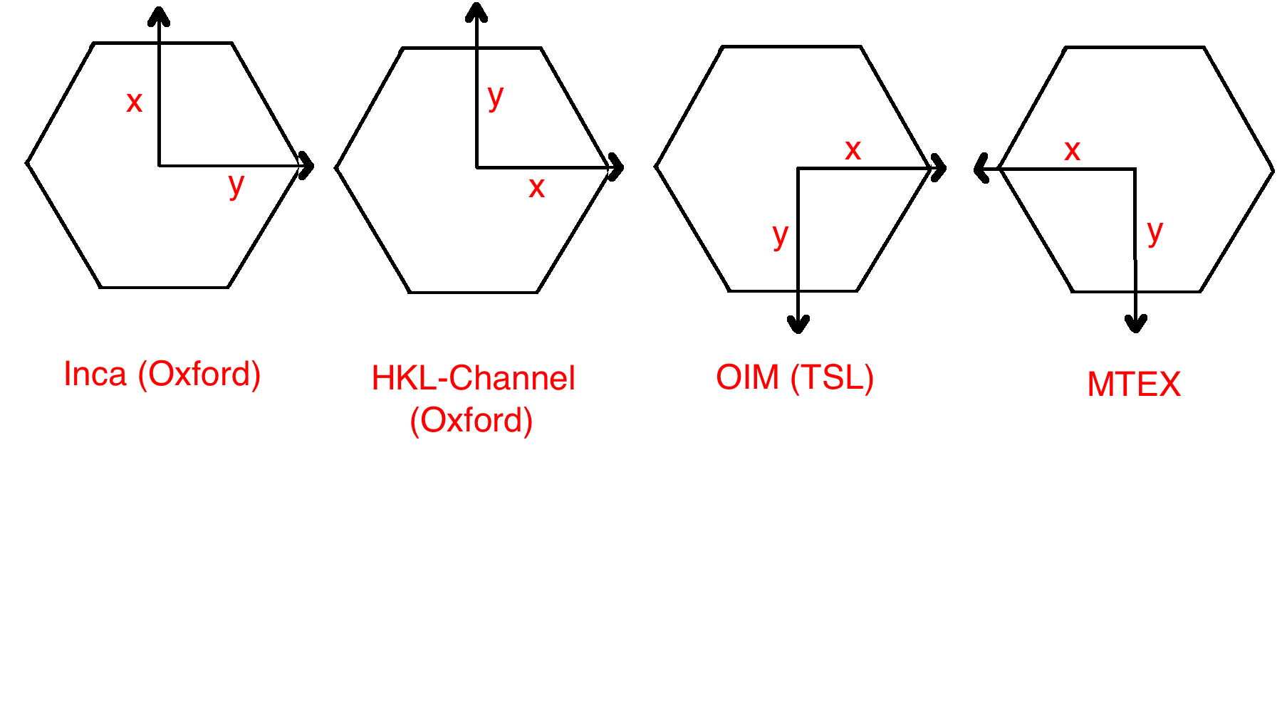
Why can it get challenging to work with crystallographic orientations?
Orientation is specified based on reference frames
Sample coordinates Crystal coordinates Lab coordinates
Different choices of axes to convert crystal frames
Hexagonal frame into orthonormal frame
X= Y= Z= or X= Y= Z=
Personal experiences?

Slide 4
Descriptors of orientation
Orientation matrix
Misorientation matrix
Miller indices
Euler angles
Axis/angle pair
Rodrigues Vectors
Unit Quaternions
Pole Figure
Inverse PF
Euler space ODF and mODF
Axis/angle space ODF and mODF
Rodrigues space ODF and mODF
Quaternion space (4D) ODF and mODF
Computational efficiency

Slide 5
Crystal Orientation: Rotation (direction cosine) Matrices
Crystallographic orientation is the position of crystal system with respect to the specimen coordinate system.
A single rotation can be described by a rotation axis and an angular offset about the axis.
Passive rotation: Rotation of axes, sample coordinate into crystal coordinate.
Active rotation: Rotation of the object, crystal coordinate into sample coordinate.
3x3 rotation matrices, R, left-multiply column vectors
Properties:
R⁻¹ = R^{T} and det (R) = 1
Rows and columns are unit vectors, and the cross product of two rows or columns gives the third.
vs.
Notes:
Rotation matrices bridge the relative state of vectors to coordinate systems, before and after rotation.
On the board, show a rotation, and show why R multiplies column vectors

Slide 6
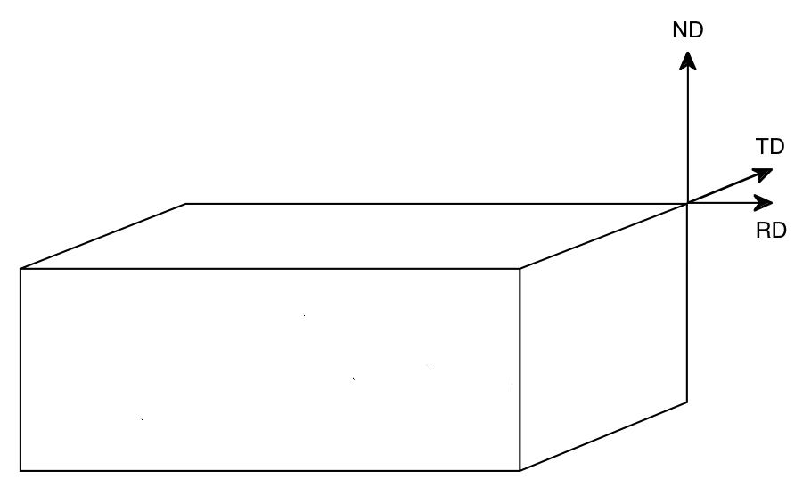
Crystal Orientation: Miller Indices Notation
Three orthogonal directions chosen as the reference frame
All directions can then be described as linear combinations of the three unit direction vectors.
Most straightforward in orthonormal systems, e.g. cubic, as indices for plane and direction are identical.
In many cases we use the metallurgical names Rolling Direction (RD) // x, Transverse Direction (TD) // y, and Normal Direction (ND) // z.
We then identify a plane normal parallel to 3rd axis (ND) and a crystal direction parallel to the 1st axis (RD), written as (hkl)[uvw].
≡Z
(hkl)
∕ ∕ Z
≡Y
≡X
[uvw]
∕ ∕ X

Slide 7
Crystal Orientation: Euler Angles
Euler showed three sequential rotations about different axes can describe orientations (18th century)
Passive rotation (SCoord into CCoord)
There are 12 different possible axis-angle sequences.
The “standard” sequence varies from field to field.
Multiple conventions
Proper Euler angles (z-x-z, x-y-x, y-z-y, z-y-z, x-z-x, y-x-y)
Tait–Bryan angles (x-y-z, y-z-x, z-x-y, x-z-y, z-y-x, y-x-z)
We use the Bunge convention.
First angle φ₁ about ND
Second angle Φ about new RD
Third angle φ₂ about newest ND
Sample symmetry effects the size of Euler space
Most general, triclinic crystal system, no sample symmetry → 0 ≤ φ₁, φ₂ ≤ 360 0 ≤ Φ ≤ 180
Cubic crystal system, rolled sample (orthonormal sample symmetry) → 0 ≤ φ₁, φ₂ Φ ≤ 90
Notes:
Proper euler: first and third axes same
Tait-bryan all axes
Sample symmetry reduces theta1

Slide 8
Rotation matrices from Miller indices
[uvw]≡RD
TD
ND≡(hkl)
Rows are the direction cosines for [100], [010], and [001] in the sample coordinate system, columns are the direction cosines (i.e. hkl or uvw) for the RD, TD and ND in the crystal coordinate system.
[100] direction
[010] direction
[001] direction
Challenge: With Miller indices, we define the closest family (can be degrees away)
7
7

Slide 9
Rotation matrices from Bunge Euler angles
Combine the 3 rotations via matrix multiplication; 1st on the right, last on the left:
[uvw]
(hkl)
A = Z₂XZ₁ =

Slide 10
Miller indices from Bunge Euler angles
Compare the indices matrix from slide 6 with the Euler angle matrix from slide 8.
n, n’ = factors to make integers towards the closest family

Slide 11
Bunge Euler angles from rotation matrices
Notes: The range of inverse cosine (ACOS) is 0-π, which is sufficient for Φ; from this, sin(Φ) can be obtained; The range of inverse tangent is 0-2π, (must use the ATAN2 function) which is required for calculating φ₁ and φ₂.

Slide 12
Bunge Euler angles from miller indices
Caution: when one uses the inverse trig functions, the range of result is limited to 0°≤cos⁻¹θ≤180°, or -90°≤sin⁻¹θ≤90°. Thus it is not possible to access the full 0-360° range of the angles. It is more reliable to go from Miller indices to an orientation matrix, and then calculate the Euler angles. Extra credit: show that the following surmise is correct. If a plane, hkl, is chosen in the lower hemisphere, l<0, show that the Euler angles are incorrect.

Slide 13
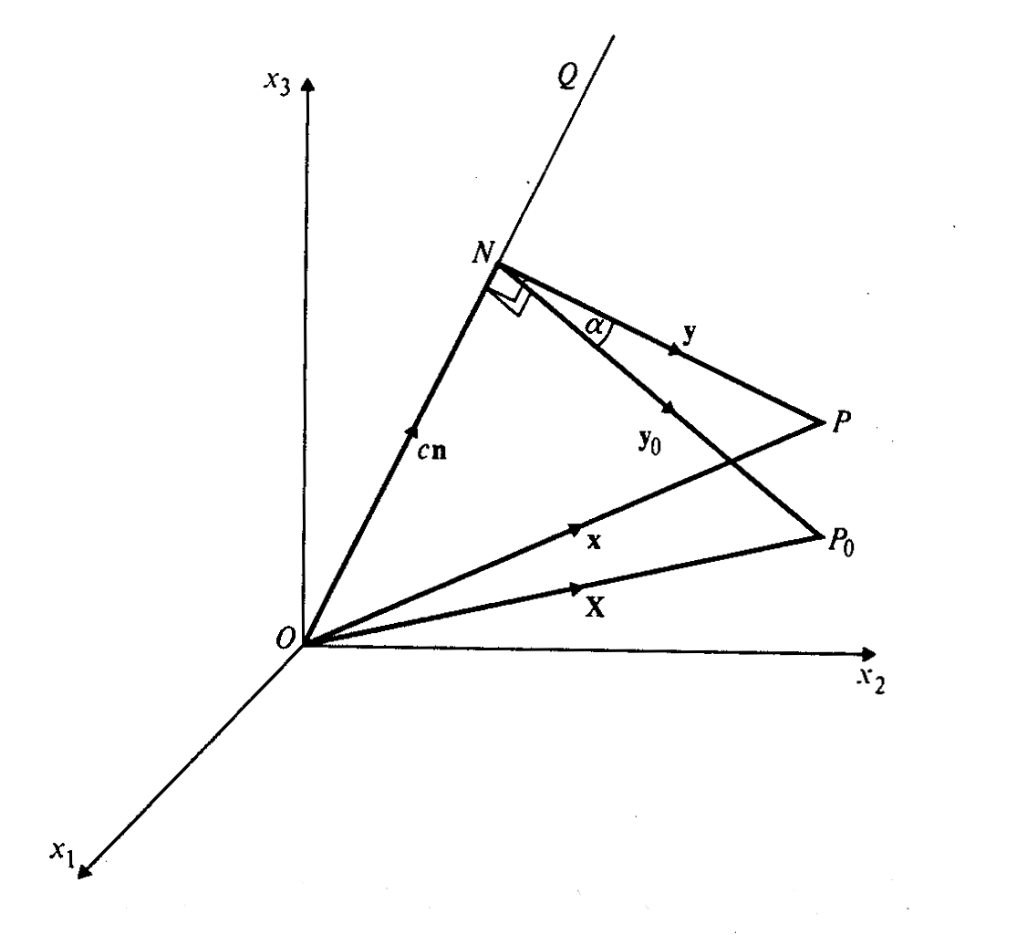
Crystal Orientation: Axis-angle Pair
Axis-angle pair is defined such that the crystal frame and the sample frame is overlapped by a single rotation, θ, along a common axis [u v w].
Commonly written as ( ,θ) or (n,ω)
Active rotation
The rotation can be converted to a matrix (passive rotation)
Common in misorientation representation
- Difference of misorientation vs. rotation difference is the choice of reference axis
Easy conversion into Rodrigues-Frank vectors

Slide 14
Rotation matrices from Axis-angle
For( ,θ) or (n,ω)
This form of the rotation matrix is a passive rotation, appropriate to axis transformations

Slide 15
Axis-Angle from Rotation matrices
Rotation axis, n:
Note the order (very important) of the coefficients in each subtraction; again, if the matrix represents an active rotation, then the sign is inverted.
Rotation angle, θ:
therefore, cos θ = 0.5 (trace(a) – 1).
Notes:
- In numerical calculations, it can happen that tr(a)-1 is either slightly greater than 1 or slightly less than -1. Provided that there is no logical error, it is reasonable to truncate the value to +1 or -1 and then apply ACOS.
- Note that if you try to construct a rotation of greater than 180° (which is perfectly possible using the formulas given), what will happen when you extract the axis-angle is that the angle will still be in the range 0-180° but you will recover the negative of the axis that you started with. This is a limitation of the rotation matrix (which the quaternion does not share).

Slide 16
Crystal Orientation: Rodrigues-Frank Vectors
Rodrigues vectors were popularized by Frank [“Orientation mapping.” Metall. Trans. 19A: 403-408 (1988)], hence the term Rodrigues-Frank space
Easily converted from axis-angle
Most useful for representation of misorientations, also useful for orientations
The RF representation from axis angle
scales r by the tangent of α/2
R(r, α )
Note semi-angle

Slide 17
Rodrigues-Frank Space
Population of vectors
Smallest R results from the smallest θ, and it lies closest to the origin of the RF space
Lines in RF space represent rotation about fixed axis
Further, when the RF space is divided into subvolumes, the misorientations that lie on the boundary of the subvolume are geometrically special, by having a low index axis of misorientation.
As the Rodrigues vector is so closely linked to the rotation axis, which is meaningful for the crystallography of grain boundaries, the RF representation of misorientations is very common.
Cubic crystal symmetry no sample symmetry
Cubic
orthorhombic
Cubic
cubic
16
Notes:
In cubic crystals have a symmetry operator for 90° about <100>, which is associated with a RF vector of length tan(45°)=1; based on the cut plane being at a distance of tan(θ/4) from the origin (2 slides back), this sets the limit of R₁=tan(22.5°)=√2-1.
This defines a plane perpendicular to the R₁ axis.

Slide 18
R-F Vector from Rotation matrices
Simple formula, due to Morawiec:
Trace of a matrix:
tr(a) = a₁₁ + a₂₂ + a₃₃

Slide 19
R-F Vector from Bunge Euler angles and Bunge Euler from R-F vectors
tan(α/2) = √{(1/[cos(Φ/2) cos{(φ₁ + φ₂)/2}]² – 1}
ρ₁ = tan(Φ/2) [cos{(φ₁ - φ₂)/2}/cos{(φ₁ + φ₂)/2}]
ρ₂ = tan(Φ/2) [sin{(φ₁ - φ₂)/2}/[cos{(φ₁ + φ₂)/2}]
ρ₃ = tan{(φ₁ + φ₂)/2}
P. Neumann (1991). “Representation of orientations of symmetrical objects by Rodrigues vectors.” Textures and Microstructures 14-18: 53-58.
Conversion from Rodrigues to Bunge Euler angles:
sum = atan(R₃) ; diff = atan ( R₂/R₁ ) φ₁ = sum + diff; Φ = 2. * atan(R2 * cos(sum) / sin(diff) ); φ₂ = sum - diff

Slide 20
Rotation matrix from R-F vectors
Due to Morawiec:
Example for the 12 entry:
NB. Morawiec’s Eq. on p.22 has a minus sign in front of the last term; this will give an active rotation matrix, rather than the passive rotation matrix seen here.

Slide 21
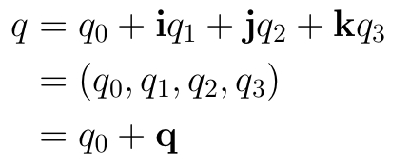
Crystal Orientation: Unit Quaternions
What is a quaternion?
A quaternion (1843 by Hamilton) is an ordered set of four real numbers q₀, q₁, q₂, and q₄.
Here, i, j, k are the familiar unit vectors that correspond to the x-, y-, and z-axes, resp.
Scalar part
Vector part
[1] Quaternion multiplication is non-commutative (pq≠qp)
[2] An extension to 2D complex numbers
[3] Of the 4 components, one is a ‘real’ scalar number, and the other 3 form a vector in imaginary ijk space!

Slide 22
Quaternions as rotations
A quaternion can represent a rotation by an angle θ around a unit axis n= (x y z):
Checking the magnitude of the quaternion,
Unit!

Slide 23
Unit Quaternion from Rotation Matrices
Formulae, due to Morawiec:
Note: passive rotation/ axis transformation (axis changes sign for for active rotation)
Note the coordination of choice of sign!

Slide 24
Rotation Matrices from Unit Quaternions
For
Orientation matrix:
g=
Quaternions are
Computationally efficient – multiplication requires fewer computations
Axis-angle and R-F into quaternion conversion is simple
Notes:
Here if there is time do the euler quaternion multiplication

Slide 25
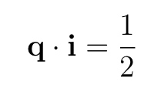
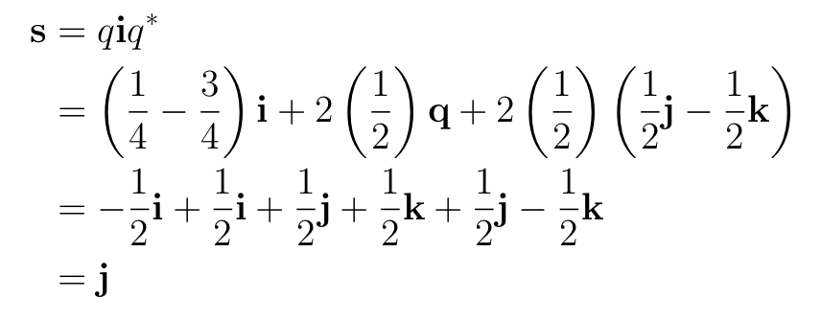
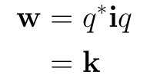
Rotation of a vector by a quaternion
Passive rotation
Active rotation
Rotation axis:
Consider rotating the vector i by an angle of α = 2π/3 about the <111> direction.
k
j
For an active rotation:
i
For a passive rotation:

Slide 26
References
Frank, F. (1988). “Orientation mapping,” Metallurgical Transactions 19A: 403-408.
P. Neumann (1991). “Representation of orientations of symmetrical objects by Rodrigues vectors.” Textures and Microstructures 14-18: 53-58.
Takahashi Y, Miyazawa K, Mori M, Ishida Y. (1986). “Quaternion representation of the orientation relationship and its application to grain boundary problems.” JIMIS-4, pp. 345-52. Minakami, Japan: Trans. Japan Inst. Metals. (1st reference to quaternions to describe grain boundaries).
A. Sutton and R. Balluffi (1996), Interfaces in Crystalline Materials, Oxford.
V. Randle & O. Engler (2010). Texture Analysis: Macrotexture, Microtexture & Orientation Mapping. Amsterdam, Holland, Gordon & Breach.
S. Altmann (2005 - reissue by Dover), Rotations, Quaternions and Double Groups, Oxford.
A. Morawiec (2003), Orientations and Rotations, Springer (Europe).
“On a New Species of Imaginary Quantities Connected with a Theory of Quaternions”, by William Rowan Hamilton, Proceedings of the Royal Irish Academy, 2 (1844), 424–434.
“Des lois géométriques qui régissent les déplacements d’un système solide dans l’espace et de la variation des coordonnées provenant de ces déplacements considérées indépendamment des causes qui peuvent les produire”, M. Olinde Rodrigues, Journal des Mathématiques Pures et Appliquées, 5 380-440.

Slide 27
Properties of Quaternions
Magnitude of a quaternion:
Conjugate of a quaternion:
Addition of quaternions:
Product of two arbitrary quaternions
Scalar part
Vector part
Using more compact notation: again, note the + in front of the vector product
On a New Species of Imaginary Quantities Connected with a Theory of Quaternions, by William Rowan Hamilton, Proceedings of the Royal Irish Academy, 2 (1844), 424–434.

Slide 28
Cubic Crystal Symmetry Operators
The numerical values of these symmetry operators can be found at: http://pajarito.materials.cmu.edu/rollett/texture_subroutines: quat.cubic.symm etc.

Slide 29
Combining Rotations as RF vectors
Two Rodrigues vectors combine to form a third, ρ_{C}, as follows, where ρ_{B} follows after ρ_{A}. Note that this is not the parallelogram law for vectors! ρ_{C} = (ρ_{A}, ρ_{B}) = {ρ_{A} + ρ_{B} - ρ_{A} x ρ_{B}}/{1 - ρ_{A}•ρ_{B}}
addition
vector product
scalar product

