Slide 1


(Normal) Grain Growth and Size Distributions
27-750
Texture, Microstructure & Anisotropy
A.D. Rollett
Some slides from a 2014 lecture by S.P. Donegan
Updated 19th Apr. 2016

Slide 2
References
Recrystallization & Related Annealing Phenomena, Humphreys & Hatherly, Elsevier, 2nd Ed., 2004.
C. Herring in The Physics of Powder Metallurgy. (McGraw Hill, New York, 1951) pp. 143-79
von Neumann, J. (1952). discussion of article by C.S. Smith. Metal Interfaces, Cleveland, Amer. Soc. Testing of Materials.
Mullins, W. W. (1956). "Two-dimensional motion of idealized grain boundaries." Journal of Applied Physics 27 900-904.
Palmer et al., Scripta metall. 30, 633-637 (1994).
Other papers noted in individual slides.

Slide 3
Outline
Re-cap of Herring relations at triple lines
The “n-6 rule”
Integration of turning angle around a grain
Test of the n-6 rule
Stability of 2D networks
Grain growth, self-similarity
Grain growth, basic theory
Grain growth exponent
Coarsening theory, Hillert model
Grain size distributions, probability plots, upper tails
Full equation for migration rate of a boundary

Slide 4
Interfacial Energies
Practical Applications: Rain-X for windshields. Alters the water/glass:glass/vapor ratio so that the contact angle is increased. Water droplets “bead up” on the surface.
“streaky” “clear”

Slide 5
Impact on Materials
Surface grooving where grain boundaries intersect free surfaces leads to surface roughness, possibly break-up of thin films.
Excess free energy of interfaces (virtually all circumstances) implies a driving force for reduction in total surface area, e.g. grain growth (but not recrystallization).
Interfacial Excess Free Energy:= γ, or σ

Slide 6
Force Balance
Consider only interfacial energy: vector sum of the forces must be zero to satisfy equilibrium.
These equations can be rearranged to give the Young equations (sine law):

Slide 7
Dihedral Angles from Energies
If the energies of the 3 boundaries are known, it is simple to compute the dihedral angles.
Example for one angle shown: others obtained by permutation.

Slide 8
Herring’s Relations
C. Herring in The Physics of Powder Metallurgy. (McGraw Hill, New York, 1951) pp. 143-79

Slide 9
Why Triple Junctions?
For isotropic g.b. energy, 4-fold junctions split into two 3-fold junctions with a reduction in free energy:
90°
120°

Slide 10
The “n-6 Rule”
The “n-6 rule” is the rule previously shown pictorially that predicts the growth or shrinkage of grains (in 2D only) based solely on their number of sides/edges. For n>6, grain grows; for n<6, grain shrinks.
Originally derived for gas bubbles by von Neumann (1948) and written up as a discussion on a paper by Cyril Stanley Smith (W.W. Mullins’ advisor).
von Neumann, J. (1952). discussion of article by C.S. Smith. Metal Interfaces, Cleveland, Amer. Soc. Testing of Materials.

Slide 11
Curvature and Sides on a Grain
Shrinkage/growth depends on which way the grain boundaries migrate, which in turn depends on their curvature.
velocity = mobility * driving force;
driving force = g.b. stiffness * curvature
v = Mf = M (γ+ γ”) κ
We can integrate the curvature around the perimeter of a grain in order to obtain the net change in area of the grain.
Mullins, W. W. (1956), 'Two-dimensional motion of idealized grain boundaries', Journal of Applied Physics, 27, 900-904.

Slide 12
Integrating inclination angle to obtain curvature
Curvature = rate of change of tangent, φ, with arc length, s:
κ = dφ/ds
Integrate around the perimeter (isolated grain with no triple junctions), k = M γ :

Slide 13
Integrating around a GB: n-6 rule
Consider a plane curve r(θ,t)
red = r(θ,t)
blue = polar vector
green = (directed) tangent
k = Mσ

Slide 14
Effect of TJs on curvature
Each TJ in effect subtracts a finite angle from the total turning angle to complete the perimeter of a grain:
3
1
φ₁−φ₃
2

Slide 15
n-6 rule
Consider a network of r_{N}(θ,t) curves where all vertices terminate at angles of 2π/3; number the sides and vertices of a given curve in the following manner:

Slide 16
Isotropic Case
In the isotropic case with all three dihedral angles equal to 120°, the turning angle (change in inclination angle) is 60°.
For the average grain with <n>=6,
the sum of the turning angles = <n>60°=6*60° =360°.
Therefore all the change in direction of the perimeter of an n=6 grain is accommodated by the dihedral angles at the TJs, which means no curvature for each side and thus no change in area.

Slide 17
Isotropy, n<6, n>6
If the number of TJs is less than 6, then not all the change in angle is accommodated by the TJs and the GBs linking the TJs must be curved such that their centers of curvature lie inside the grain, i.e. shrinkage
If n>6, converse occurs and centers of curvature lie outside the grain, i.e. growth.
Final result: dA/dt = πk/6(n-6) , k= M γ
Known as the von Neumann-Mullins Law.
von Neumann, J. (1952). discussion of article by C.S. Smith. Metal Interfaces, Cleveland, Amer. Soc. Testing of Materials.
Mullins, W. W. (1956). "Two-dimensional motion of idealized grain boundaries." Journal of Applied Physics 27 900-904.

Slide 18
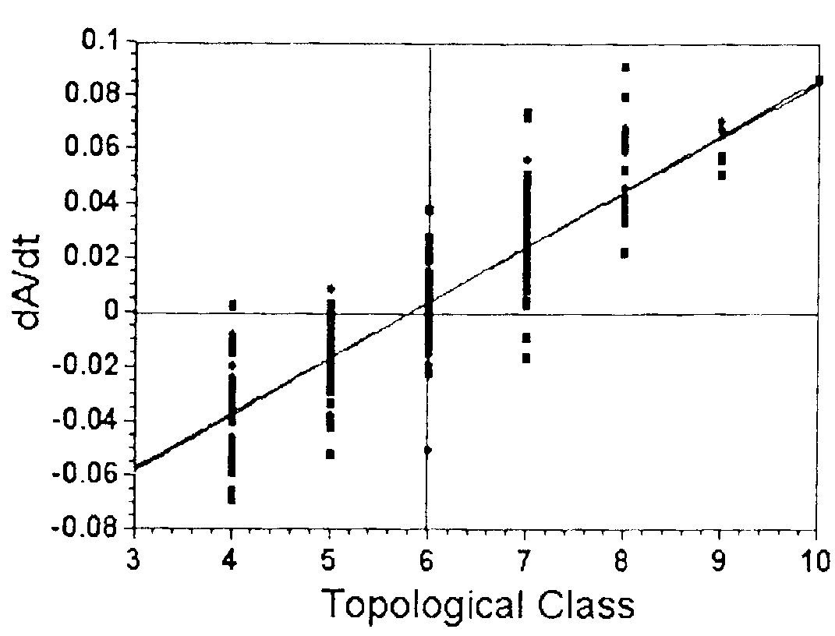
Test of the n-6 Rule
Grain growth experiments in a thin film of 2D polycrystalline succinonitrile (bcc organic, much used for solidification studies) were analyzed by Palmer et al.
Averaging the rate of change of area in each size class produced an excellent fit to the (n-6) rule.
Palmer et al., Scripta metall. 30, 633-637 (1994).
Note the scatter in dA/dt within each topological class; this indicates that the local neighborhood of each grain has an effect on its growth.

Slide 19
Stability of 2D Networks
Note that a precisely hexagonal network of grain boundaries is metastable (not stable as stated in the caption). Any perturbation will set up a net driving force for a grain smaller than the average to shrink.
Humphreys

Slide 20
Grain Growth
One interesting feature of grain growth is that, in a given material subjected to annealing at the same temperature, the only difference between the various microstructures is the average grain size. Or, expressed another way, the microstructures (limited to the description of the boundary network) are self-similar and cannot be distinguished from one another unless the magnification is known. This characteristic of grain growth has been shown by Mullins (1986) to be related to the kinetics of grain growth. The kinetics of grain growth can be deduced in a very simple manner based on the available driving force.
Curvature is present in essentially all grain boundary networks and statistical self-similarity in structure is observed both in experiment and simulation. This latter observation is extremely useful because it permits an assumption to be made that the average curvature in a network is inversely proportional to the grain size. In other words, provided that self-similarity and isotropy hold, the driving force for grain boundary migration is inversely proportional to grain size.
Mullins, W. (1986). "The statistical self-similarity hypothesis in grain growth and particle coarsening." Journal of Applied Physics 59 1341.

Slide 21
Grain Growth Kinetics
The rate of change of the mean size, d<r>/dt, must be related to the migration rate of boundaries in the system. Thus we have a mechanism for grain coarsening (grain growth) and a quantitative relationship to a single measure of the microstructure. This allows us to write the following equations.
v = α M γ / r = d<r>/dt
One can then integrate and obtain
<r>² - <r_{t=0}>²= α M γ t
In this, the constant α is geometrical factor of order unity (to be discussed later). In Hillert’s theory, α = 0.25. From simulations,
α ~ 0.50, which is the expected value from this simple theory.
Burke, J. E. (1949). "Some Factors Affecting the Rate of Grain Growth in Metals." Trans. AIME 180: 73-91.

Slide 22
Grain Growth Exponent
Humphreys

Slide 23
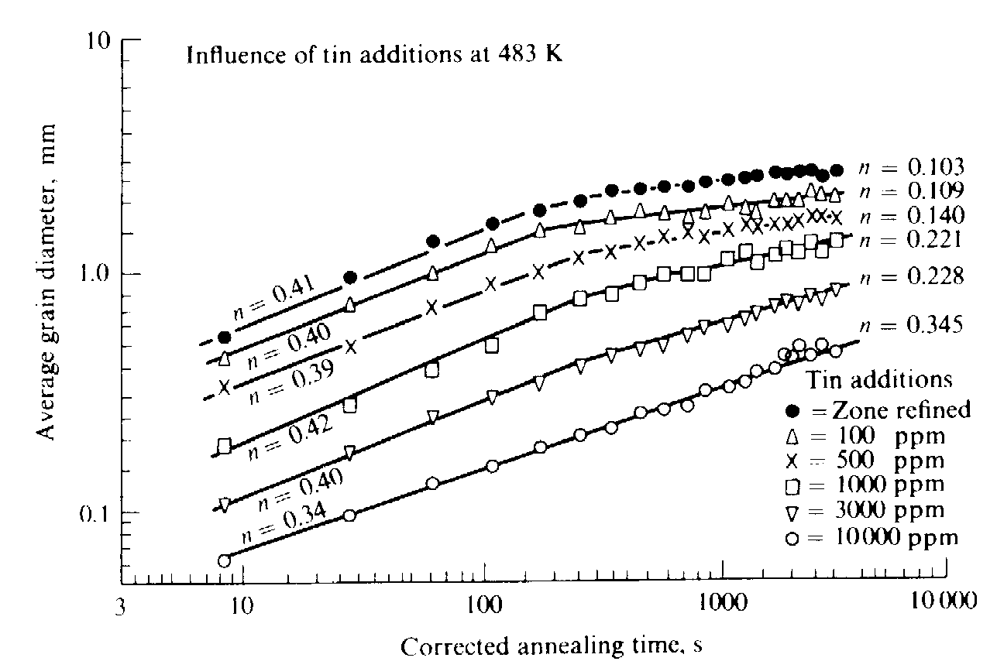
Experimental grain growth data
Data from
Grey & Higgins
(1973) for
zone-refined Pb
with Sn
additions,
showing deviations
from the
ideal grain
growth law (n<0.5).
In general, the grain growth exponent (in terms of radius) is often appreciably less than the theoretical value of 0.5

Slide 24
Self-Similarity
Note the implicit assumption that grain sizes follow a log-normal distribution; elsewhere we note that this is only true close to the mean size.
Humphreys

Slide 25
Why grain size distributions?
Grain size has a measurable effect on material properties
σ_{y} = yield stress
C = constant
D = ‘grain size’
Hall-Petch:
.
ε = strain rate
n = creep exponent
D = ‘grain size’
Creep:
Real grain sizes exhibit dispersion, which leads to a grain size distribution
So why only one ‘grain size’ in the phenomenological relationships?

Slide 26
Why grain size distributions?
Answer: no one likes to deal with statistics
Another answer: it’s hard
Kurzydlowski attempted to incorporate grain dispersion into Hall-Petch by defining a constant size of grains (CSG) polycrystal
Berbenni extended Kurzydlowski by defining a size-dependant constitutive equation for elasto-viscoplastic behavior
Both these approaches assume log-normal distributions of grains; but are grain size distributions really log-normal?

Slide 27
Log-normal distribution
The log-normal distribution describes a random variable whose natural logarithm follows the normal distribution. The cumulative distribution function (CDF) of a log-normal distribution is:
The probability density function (PDF) of a log-normal distribution is:

Slide 28
PDFs and CDFs
The PDF of a random variable defines the probability of that variable taking a particular value (think ‘bell curve’ e.g. normal distribution)
The integral of a PDF along its domain must equal 1 (i.e., if discrete, all probabilities sum to 1)
The CDF of a random variable defines the probability that a value of the variable will be found <= x (think ‘s-curve’)
The CDF can be defined as the integral of the PDF up to x

Slide 29
Grain Growth Theory
The main objective in grain growth theory is to be able to describe both the coarsening rate and the grain size distribution with (mathematical) functions.
What is the answer? Unfortunately only a partial answer exists and it is not obvious that a unique answer is available, especially if realistic (anisotropic) boundary properties are included.
Hillert adapted particle coarsening theory by Lifshitz-Slyozov and Wagner.
Lifshitz, I. M. and V. V. Slyozov (1961). "The Kinetics of Precipitation from Supersaturated Solid Solutions", Journal Of Physics And Chemistry Of Solids 19 35-50. Wagner, C. (1961). "Theorie Der Alterung Von Niederschlagen Durch Umlosen (Ostwald-Reifung)", Zeitschrift Fur Elektrochemie 65 581-591.
Hillert, M. (1965) Acta metall. 13 227-238.

Slide 30
Theoretical approaches: Hillert
Now determine the average number of sides:

Slide 31
Theoretical approaches: Hillert
Finally, after some calculus, arrive at the growth equation:
u = R/R_{cr}
γ = 2αMσ(dt/dR_{cr}²)
τ = lnR_{cr}²
M Hillert, Acta Metall., vol. 13 pp. 227-238 (1965)

Slide 32
Theoretical approaches: Hillert
The goal is now to arrive at a PDF for the limiting grain size distribution. After some (more) calculus (β is the dimension, 2 or 3):
Is it a PDF?
YES!
M Hillert, Acta Metall., vol. 13 pp. 227-238 (1965)

Slide 33
Theoretical approaches: Hillert
Coarsening rate in more detail:
<r>² - <r_{t=0}>² = 0.25 k t = 0.25 Mγ t
Grain size distribution (2D), f:
Here, ρ = r/<r>, also known as the reduced grain size.

Slide 34
Hillert Normal Grain Growth Theory
Grain size distribution (3D), f:
Here, ρ = r/<r>.
General formula (as before), where β is the dimension (2 or 3):

Slide 35
Grain Size Distributions
Humphreys
a) Comparison of theoretical distributions due to Hillert (dotted line), Louat (dashed) and the log-normal (solid) distribution. The histogram is taken from the 2D computer simulations of Anderson, Srolovitz et al.
b) Histogram showing the same computer simulation results compared with experimental distributions for Al (solid line) by Beck and MgO (dashed) by Aboav and Langdon.

Slide 36
More Theory: Mullins
Mullins derived a more general form for the limiting grain size distribution that can extend up to ∞ (as opposed to just 2)
The distribution requires a function of the number of sides of a grain (s(x)) and a function G(x) that is conceptually describes whether grains of a particular size will grow or shrink:
x = R/<R>
d = dimensionality
P = PDF
NB: the integration need not be taken to ∞!
W.W. Mullins, Acta Mater., vol. 46 pp. 6219-6226 (1998)

Slide 37
Theoretical approaches: Mullins
Inverting G(x) yields an expression for the PDF:
Not all G(x) necessarily yield a true PDF!
If s(x) is defined (in 2D) as a linear function of the number of sides, then Mullins is degenerate to Hillert!
There is no (closed-form) analytical solution in 3D since we lack a well-defined n-6 rule in higher dimensions
W.W. Mullins, Acta Mater., vol. 46 pp. 6219-6226 (1998)

Slide 38
Are they log-normal?
Answer: not really… (they fail the standard tests)
They are not really close to real grain size distributions (or simulations) either!
So where do we go from here?
Plotted with ggplot2 in the R package

Slide 39
Visualizing grain size
Histograms provide a way to visualize the PDF
A histogram discretizes the data by separating it into bins (x axis). The y axis is then the total number of data points that fall in each bin

Slide 40
Visualizing grain size
Empirical CDFs (eCDF) provide a way to visualize the CDF
The eCDF is a step function that jumps by 1/x for each of the x data points
red = actual data
blue = sampled from ideal normal

Slide 41
Visualizing grain size
Probability plots compare empirical data to a theoretical distribution
Probability plots may have different types of axes (quantiles or probabilities)
The shape of the curve on a probability plot determines the shape of the underlying distribution

Slide 42
Sampling
Actual problem: how does one sample data points from a given PDF?
One answer: inverse transform sampling
Inverse transform sampling requires knowing the quantile function, which is the inverse of the CDF:
Unfortunately, not all CDFs can be expressed in terms of elementary functions, and thus cannot be inverted (not even the normal distribution); this is the case for the general Mullins, but not for the Hillert

Slide 43
Numerical CDFs

Slide 44
Numerical CDFs

Slide 45
Numerical CDFs
Construct a numerical CDF by computing the cumulative sum of the areas:
A grain size can now be sampled by finding a random (real) number, Q, on the interval [0,1], and comparing it to the set P:

Slide 46
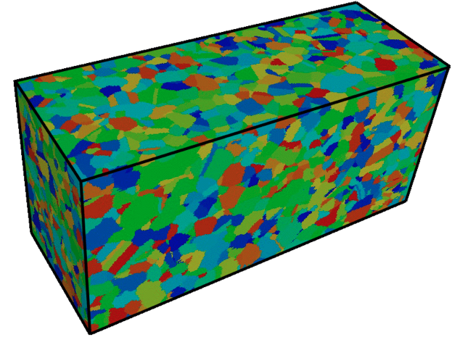
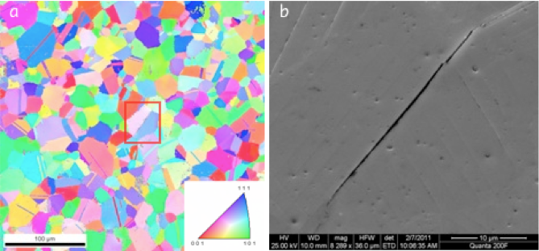
Extreme value theory
In some material systems, large grains (“as-large-as”, or ALA) play an important role in failure, since they often serve as the nucleation site for fatigue cracks

Slide 47
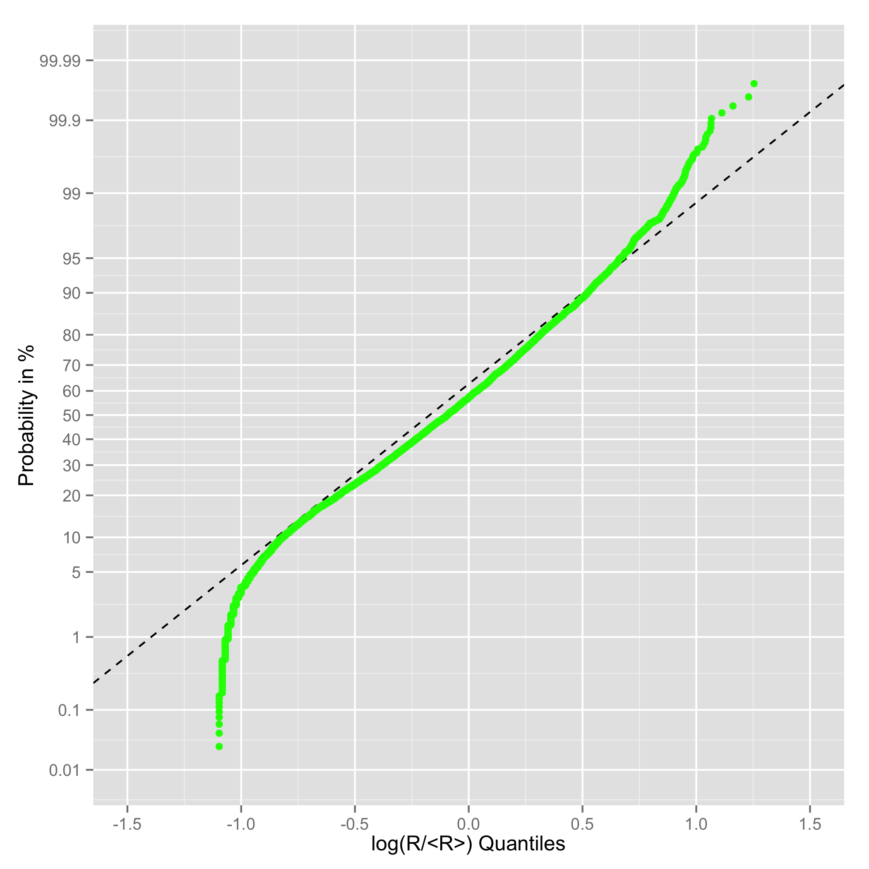
Extreme value theory
IN100

Slide 48
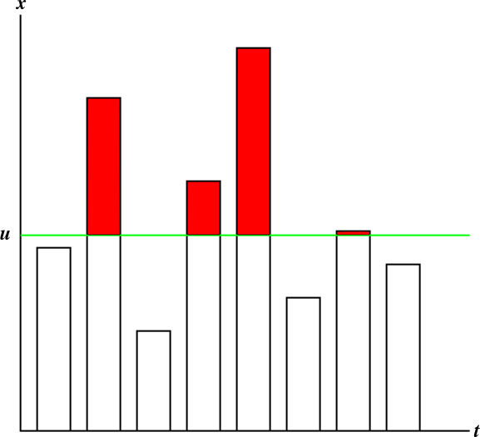
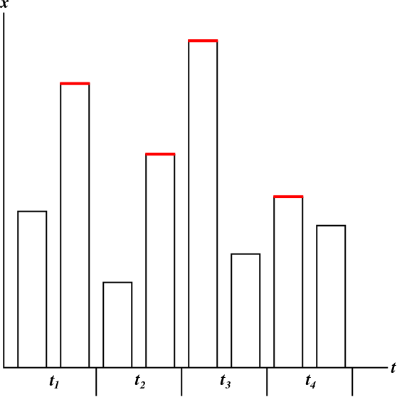
Extreme value theory
Fisher-Tippett-Gnedenko Theorem: The maximum of a random variable converges in distribution to either the Gumbel, Fréchet, or Weibull distribution.
Pickands-Balkema-de Haan Theorem: For some unknown distribution of a random variable, the distribution of values beyond some threshold, u, converges in distribution to the generalized Pareto distribution (GPD).

Slide 49
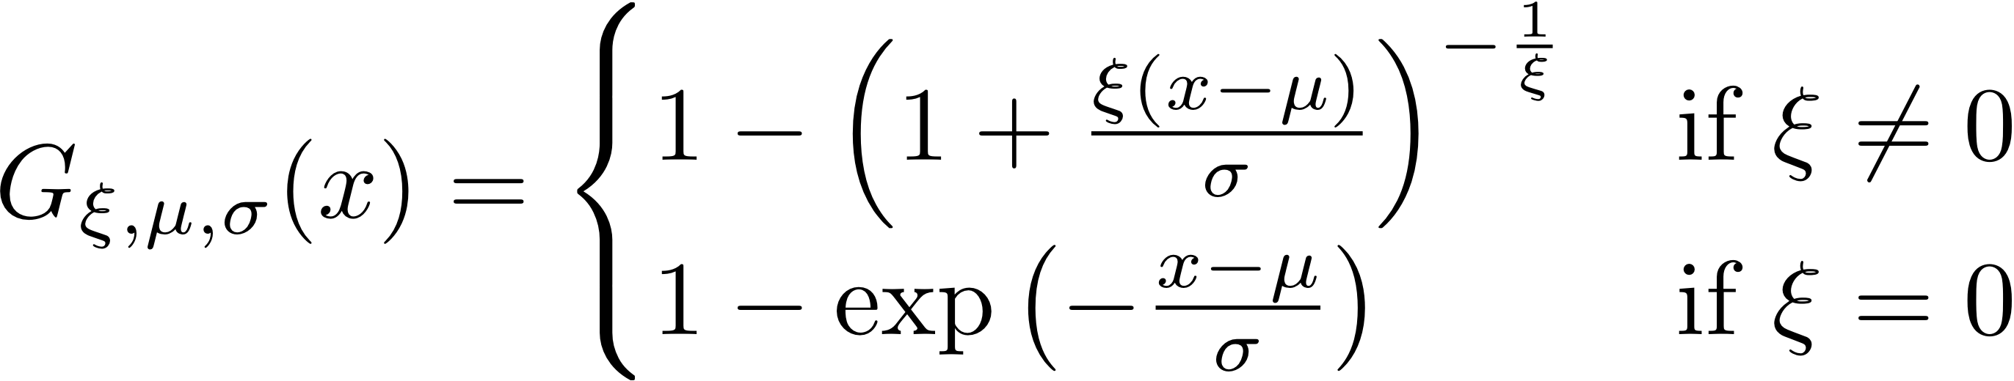
Extreme value theory
density
ξ = shape parameter
σ = scale parameter
μ = location parameter
ξ+
x

Slide 50
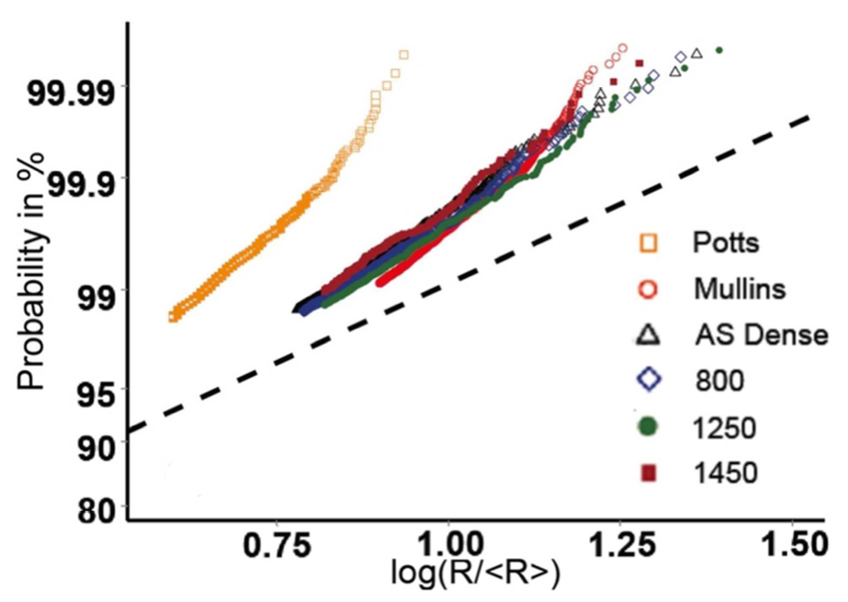
Extreme value theory
The tails of different grain size distributions can be quantitatively compared (given suitable normalization)

Slide 51
Extreme value theory
The shapes of the upper tails of grain size distributions appears correlated to grain growth kinetics: upper tails become longer (more akin to log-normal) as the microstructure stagnates
Analytical approaches to plane curve evolution indicate that the limiting (self-similar) size distribution is uniquely determined by the initial tail distribution
“Analytical approaches” means application of mean curvature flow to a collection of disjoint plane curves

Slide 52
Questions (1)
What is the relationship between interfacial energies and contact angle, e.g. for droplets of liquid on a solid surface?
Why do grain boundaries develop surface grooves if the material is annealed at sufficiently high temperature?
What is the “n-6 rule”? Under what circumstances is it valid?
What terms enter the equation for the migration rate (velocity) of a grain boundary?

Slide 53
Questions (2)
What do you obtain by integrating the rate of change of the tangent to the grain boundary around the perimeter of a grain?
What does a triple point do to the tangent (or turning angle)?
What can one say about the expected growth rate of grains with less than or greater than 6 sides?
What is observed experimentally about the relationship between growth/shrinkage rate and topological class (i.e. number of sides)?

Slide 54
Questions (3)
What is the self-similarity principle in grain growth?
What simple derivation due to Burke shows that the average radius is expected to vary as √(time)?
Is the square root dependence actually observed?
What is the most basic grain growth theory that describes kinetics and predicts the grain size distribution?

Slide 55
Questions (4)
What grain size distributions are actually observed experimentally (and in simulations)?
What is the full description of the migration rate of grain boundaries?

Slide 56
Summary (1)
Force balance at triple junctions leads to the Herring equations. These include both surface tension and torque terms.
If the interfacial energy does not depend on inclination, the torque terms are zero and Herring equations reduce to the Young equations, also known as the sine law.
In 2D, the curvature of a grain boundary can be integrated to obtain the ‘n-6’ or 'von Neumann-Mullins' rule that predicts the growth (shrinkage) of a grain.
Normal grain growth is associated with self-similarity of the evolving structures which in turn requires the area to be linear in time.

Slide 57
Summary (2)
Hillert extended LSW particle coarsening theory to predict a stable grain size distribution and coarsening rate.
The capillarity vector allows the force balance at a triple junction to be expressed more compactly and elegantly.
It is important to remember that the Herring equations become inequalities if the inclination dependence (torque terms) are too strong.

Slide 58
Supplemental Slides

Slide 59
Development of Hillert Theory
Where does the solution come from?
The most basic aspect of any particle coarsening theory is that it must satisfy the continuity requirement, which simply says that the (time) rate of change of the number of particles of a given size is the difference between the numbers leaving and entering that size class.
The number entering is the number fraction (density), f, in the class below times the rate of increase, v. Similarly for the size class above.
∂f/∂t = ∂/∂r(fv)

Slide 60
Grain Growth Theory (1)
Expanding the continuity requirement gives the following:
Assuming that a time-invariant (quasi-stationary) solution is possible, and transforming the equation into terms of the relative size, ρ:
Clearly, all that is needed is an equation for the distribution, f, and the velocity of grains, v.

Slide 61
Grain Growth Theory (2)
General theories also must satisfy volume conservation:
In this case, the assumption of self-similarity allows us to assume a solution for the distribution function in terms of ρ only (and not time).

Slide 62
Grain Growth Theory (3)
A critical part of the Hillert theory is the link between the n-6 rule and the assumed relationship between the rate of change, v=dr/dt.
N-6 rule: dr/dt = Mγ(π/3r)(n-6)
Hillert: dr/dt = Mγ /2{1/<r>-1/r}
= Mγ /2<r> {ρ - 1}
Note that Hillert’s (critical) assumption means that there is a linear relationship between size and the number of sides:
n = 6{1 +0.5 (r/<r> - 1)} =3 {1 + ρ}

Slide 63
Anisotropic grain boundary energy
If the energies are not isotropic, the dihedral angles vary with the nature of the g.b.s making up each TJ.
Changes in dihedral angle affect the turning angle.
See: Rollett and Mullins (1996). “On the growth of abnormal grains.” Scripta metall. et mater. 36(9): 975-980. An explanation of this theory is given in the second section of this set of slides.

Slide 64
v = Mf, revisited
If the g.b. energy is inclination dependent, then equation is modified: grain boundary energy term includes the second derivative. The sum is known as the interface stiffness. Derivative evaluated along directions of principal curvature.
• Care required: curvatures have sign; the sign of the velocity depends on the convention for the boundary normal.

Slide 65
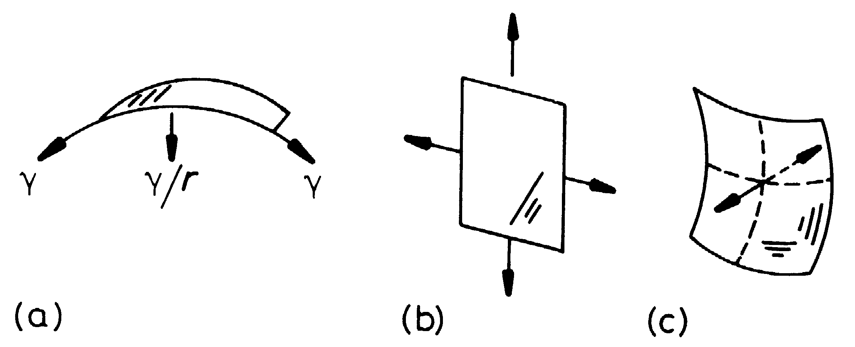
Sign of Curvature
Porter & Easterling, fig. 3.20,
p. 130
(a) singly curved; (b) zero curvature, zero force; (c) equal principal curvatures, opposite signs, zero (net) force.

Slide 66
Application to G.B. Properties
In principle, one can measure many different triple junctions to characterize crystallography, dihedral angles and curvature.
From these measurements one can extract the relative properties of the grain boundaries.
The method for extracting relative GB energy was described in the lecture notes on that topic.

Slide 67
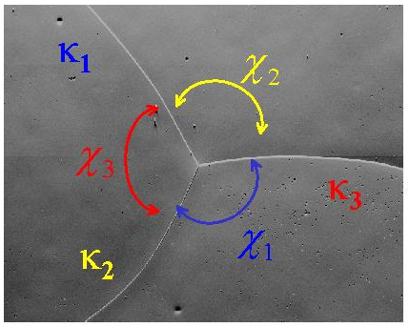
Energy Extraction
(sinχ₂) σ₁ - (sinχ₁) σ₂ = 0
(sinχ₃) σ₂ - (sinχ₂) σ₃ = 0
σ₁
σ₂
σ₃
:
σ_{n}
sinχ₂ -sinχ₁ 0 0 …0
0 sinχ₃ -sinχ₂ 0 ...0
* * 0 0 ...0
: : : : :
0 0 * * 0
= 0
Measurements at
many TJs; bin the
dihedral angles by g.b. type; average the sinχ;
each TJ gives a pair of equations
Adams, B. L., Ta'asan, S., Kinderlehrer, D., Livshits, I., Mason, D. E., Wu, C. T., Mullins, W. W., Rohrer, G. S., Rollett, A. D., & Saylor, D. M. 1999, 'Extracting grain boundary and surface energy from measurement of triple junction geometry', Interface Science, 7, 3-4, 321-338.

Slide 68
Mobility Extraction
(σ₁κ₁sinχ₁)m₁ + (σ₂κ₂sinχ₂)m₂ + (σ₃κ₃sinχ₃)m₃ = 0
m₁
m₂
m₃
:
m_{n}
σ₁κ₁sinχ₁ σ₂κ₂sinχ₂ σ₃κ₃sinχ₃ 0 0 …0
0 * * * 0 ...0
* 0 * * 0 ...0
: : : : : :
0 0 * * * 0
= 0

Slide 69
Expanded Young Equations
Project the force balance along each grain boundary normal in turn, so as to eliminate one tangent term at a time:

Slide 70
Example of importance of interface stiffness
The Monte Carlo model is commonly used for simulating grain growth and recrystallization.
It is based on a discrete lattice of points in which a boundary is the dividing line between points of differing orientation. In effect, boundary energy is a broken bond model.
This means that certain orientations (inclinations) of boundaries will have low energies because fewer broken bonds per unit length are needed.
This has been analyzed by Karma, Srolovitz and others, e.g. Lobkovsky et al. (2004), 'Grain shape, grain boundary mobility and the Herring relation', Acta mater. 52 285-292.

Slide 71
Broken bond model, 2D
[10]
We can estimate the boundary energy by counting the lengths of steps and ledges.

Slide 72
Interface stiffness
At the singular point, the second derivative goes strongly positive, thereby compensating for the low density of defects at that orientation that otherwise controls the mobility!

