Slide 1


Grain Boundary Properties:
Energy
27-750
Texture, Microstructure & Anisotropy
A.D. Rollett
With thanks to:
G.S. Rohrer, D. Saylor,
C.S. Kim, K. Barmak, W. Frazier, others …
Updated 3rd April, 2016

Slide 2
References
Interfaces in Crystalline Materials, Sutton & Balluffi, Oxford U.P., 1998. Very complete compendium on interfaces.
Interfaces in Materials, J. Howe, Wiley, 1999. Useful general text at the upper undergraduate/graduate level.
Grain Boundary Migration in Metals, G. Gottstein and L. Shvindlerman, CRC Press, 1999. The most complete review on grain boundary migration and mobility. 2nd edition: ISBN: 9781420054354.
Materials Interfaces: Atomic-Level Structure & Properties, D. Wolf & S. Yip, Chapman & Hall, 1992.
See also publication lists by G.S. Rohrer and others for papers on grain boundary characterization and energy by researchers connected with the Mesoscale Interface Mapping Project (“MIMP”).

Slide 3
Outline
Motivation, examples of anisotropic grain boundary properties
Grain boundary energy
  Overview of GB energy
  Low angle boundaries
  Measurement methods
  Herring relations, Young’s Law
  Extraction of GB energy from dihedral angles
  Surface Grooves
  High angle boundaries
  Boundary plane vs. CSL
  Simulation of grain growth
  Capillarity Vector

Slide 4
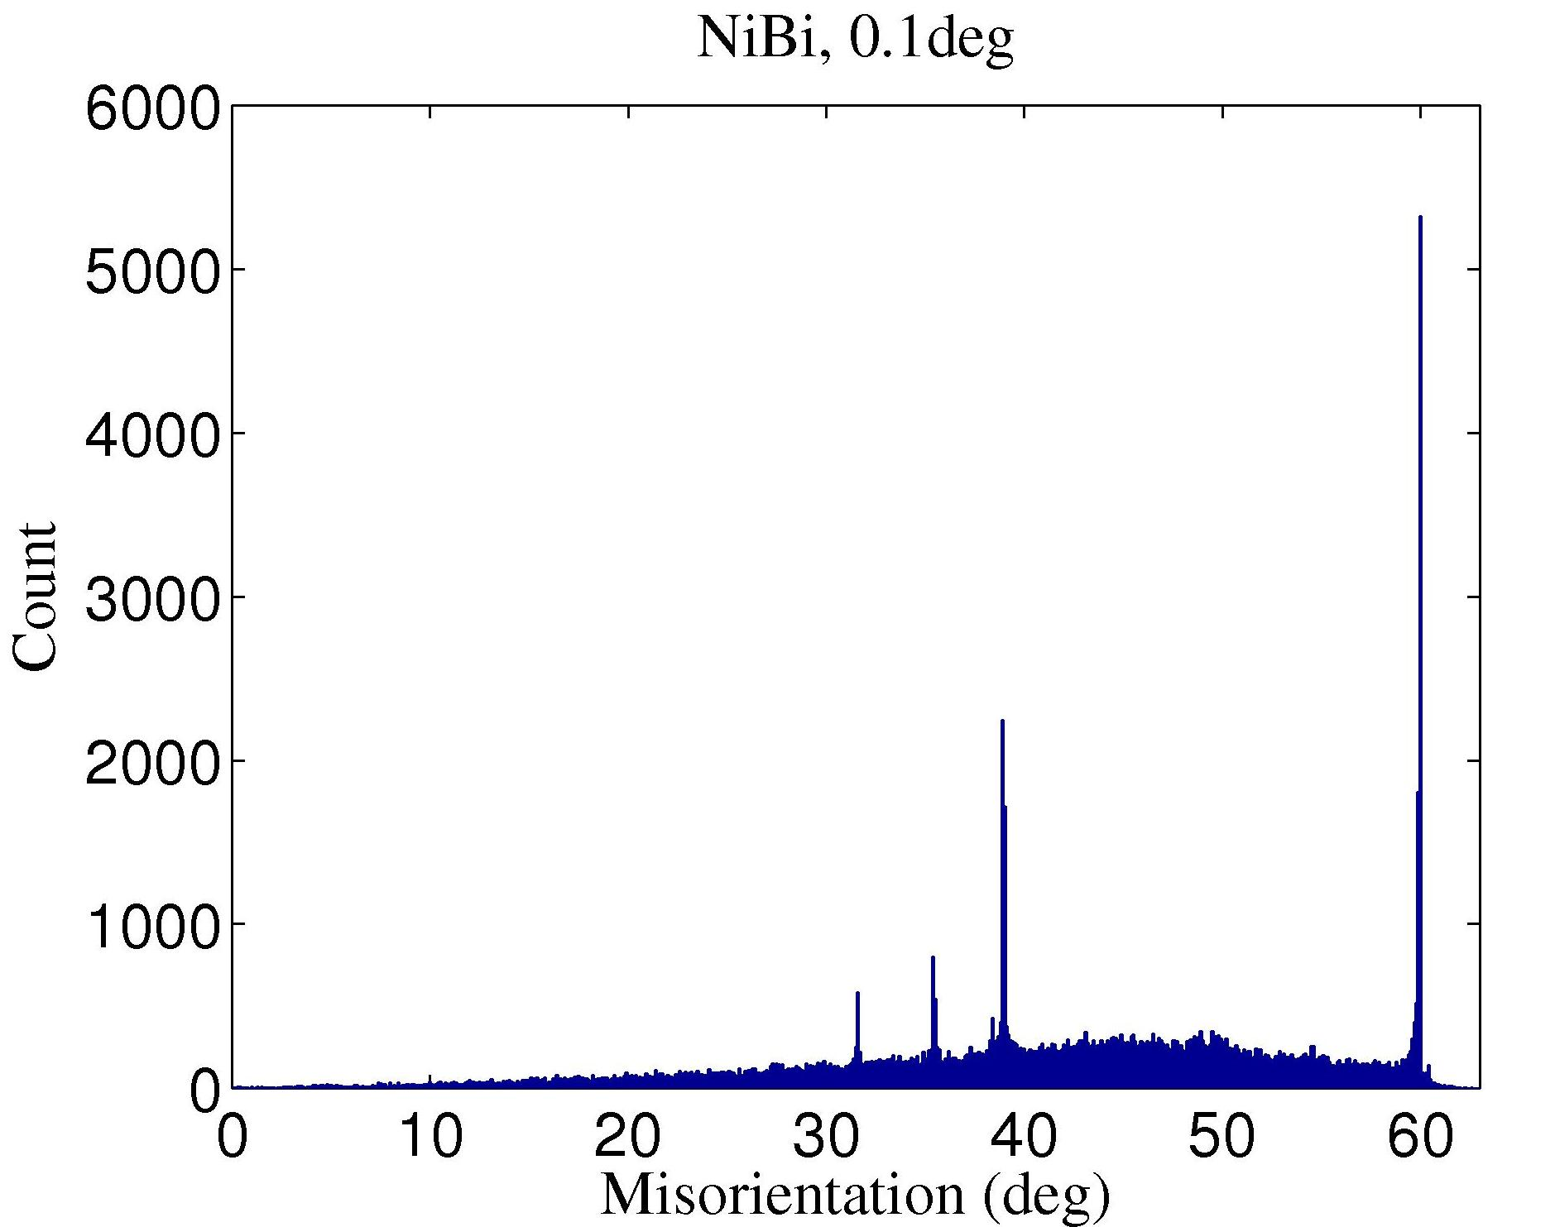
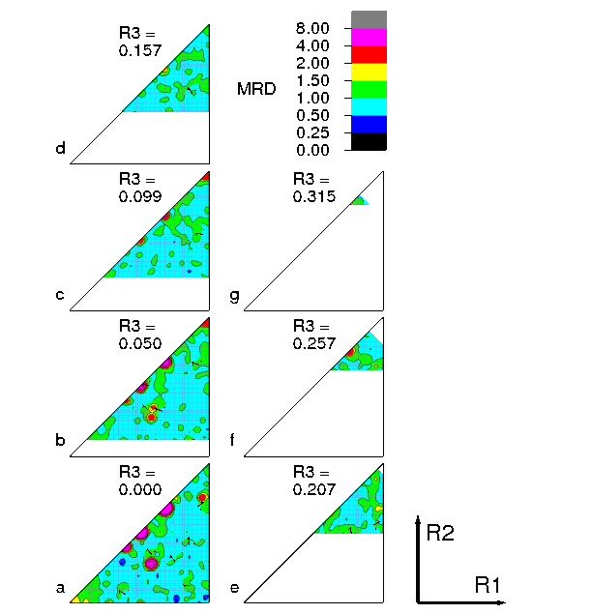
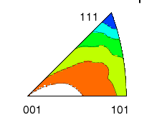
1 / 2 / 3 / 5 -parameter GB Character Distribution
1-parameter
Misorientation
angle only.
“Mackenzie plot”
5-parameter
Grain Boundary Character Distribution – “GBCD”.
Each misorientation type expands to a stereogram that shows variation in frequency of GB normals.
http://mimp.materials.cmu.edu
2-parameter
Grain Boundary Plane Distribution – “GBPD”.
Shows variation in frequency of
GB normals only, averaged over misorientation.
Σ3
3-parameter
Misorientation
Distribution
“MDF”
Rodrigues-Frank space
↵
Σ9
Ni
surface
energy
[Foiles]
Origin
Example: Bi-doped Ni

Slide 5
Why learn about grain boundary properties?
Many aspects of materials processing, properties and performance are affected by grain boundary properties.
Examples include:
- stress corrosion cracking in Pb battery electrodes, Ni-alloy nuclear fuel containment, steam generator tubes, aerospace aluminum alloys
- creep strength in high service temperature alloys
- weld cracking (under investigation)
- electromigration resistance (interconnects)
Grain growth and recrystallization, e.g. grain size control in ceramics
Precipitation of second phases at grain boundaries depends on interface energy (& structure).

Slide 6
Properties, phenomena of interest
1. Energy (interfacial excess free energy → grain growth, coarsening, wetting, precipitation)
2. Mobility (normal motion in response to differences in stored energy → grain growth, recrystallization)
3. Sliding (tangential motion → creep)
4. Cracking resistance (intergranular fracture)
5. Segregation of impurities (embrittlement, formation of second phases), especially where they lead to complexion transitions.

Slide 7
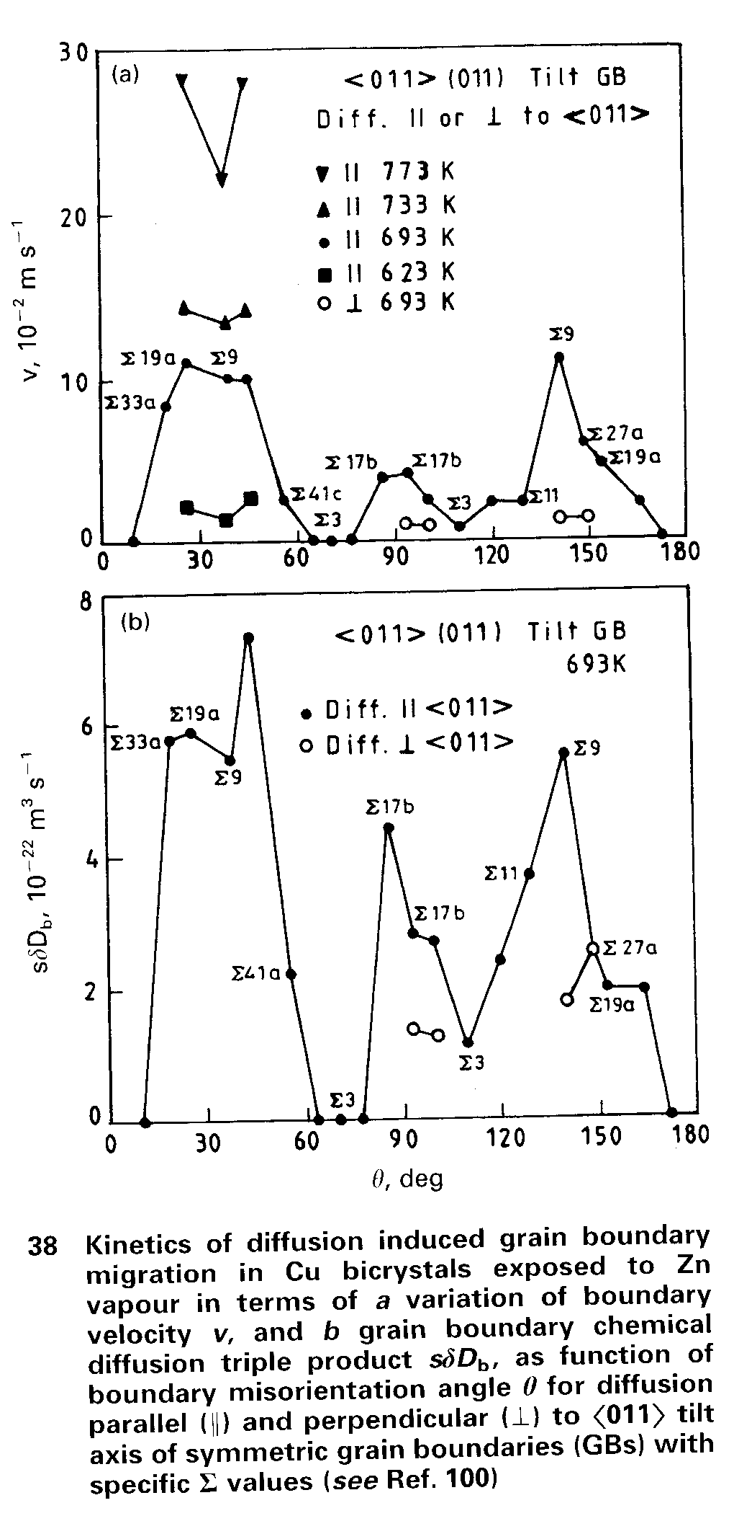
Grain Boundary Diffusion
Especially for high symmetry boundaries, there is a very strong anisotropy of diffusion coefficients as a function of boundary type. This example is for Zn diffusing into a series of <110> symmetric tilt boundaries in copper. Since this was an experiment on diffusion induced grain boundary migration (DIGM), see the figure above, the upper graph shows the migration velocity. The lower graph shows grain boundary diffusion coefficients.
Note the low diffusion rates along low energy boundaries, especially Σ3.
Schmelze et al., Acta mater. 40 997 (1992)

Slide 8
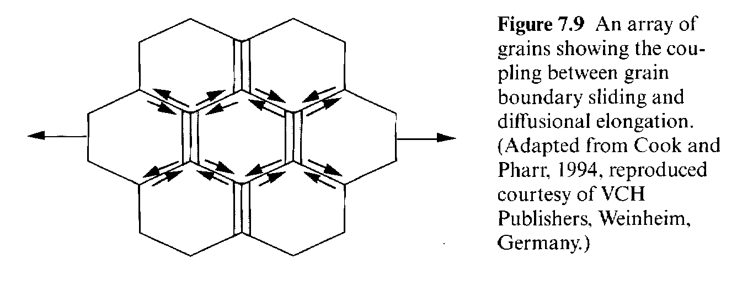
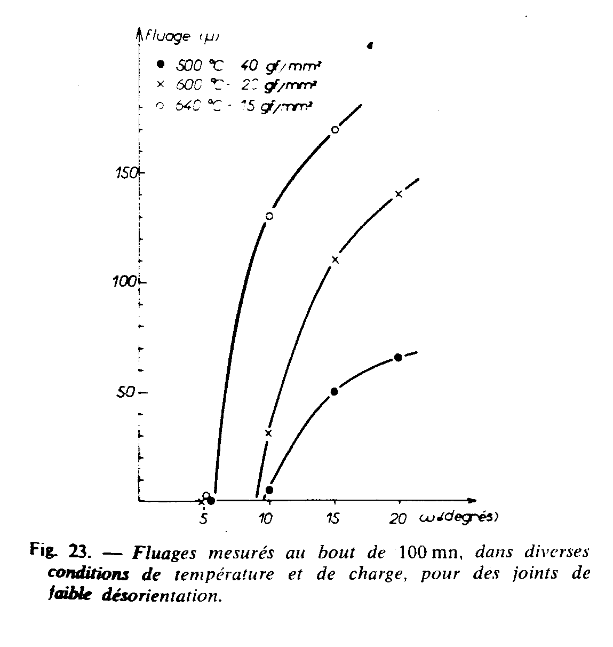
Grain Boundary Sliding
640°C
Grain boundary sliding should be very structure dependent. Reasonable therefore that Biscondi’s results show that the rate at which boundaries slide is highly dependent on misorientation; in fact there is a threshold effect with no sliding below a certain misorientation at a given temperature.
600°C
500°C
Biscondi, M. and C. Goux (1968), "Fluage intergranulaire de bicristaux orientés d'aluminium”, Mémoires Scientifiques Revue de Métallurgie 55 167-179.

Slide 9
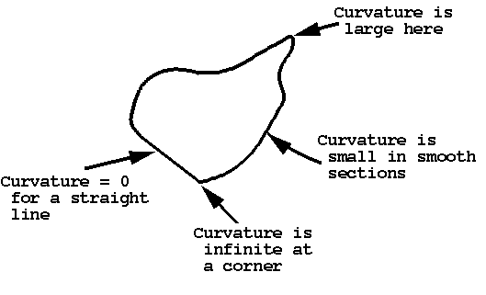
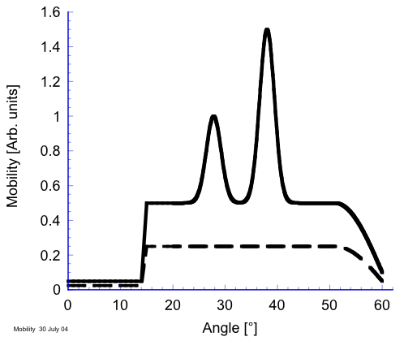
Mobility: Overview
V = M γ κ
Highest mobility observed for <111> tilt boundaries. At low temperatures, the peaks occur at a few CSL types - Σ7, especially.
This behavior is inverse to that deduced from classical theory (Turnbull, Gleiter).
For stored energy driving force, strong tilt-twist anisotropy observed.
No simple theory available.
Grain boundary mobilities and energies (anisotropy thereof) are essential for accurate modeling of evolution.
<111> Tilts
general boundaries
“Bridging Simulations and Experiments in Microstructure Evolution”, Demirel et al., Phys. Rev. Lett., 90, 016106 (2003)
Grain Boundary Migration in Metals, G. Gottstein and L. Shvindlerman, CRC Press, 1999 (+ 2nd ed.).

Slide 10
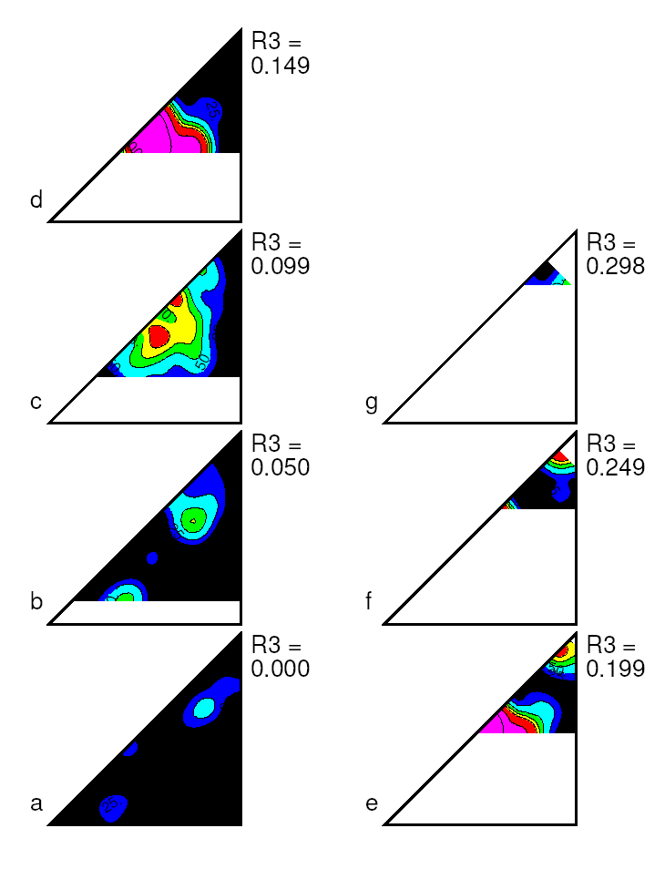
Mobility vs. Boundary Type
Al+.03Zr - individual recrystallizing grains
R₂
“Classical” peak at 38°<111>, Σ7
R₁
<111> tilts
Σ7
general
At 350ºC, only boundaries close to 38°<111>, or Σ7 are mobile
Taheri et al. (2005) Z. Metall. 96 1166
Notes:
The dependence of mobility on boundary type was plotted in Rodrigues space. To the left is a schematic diagram of where the boundary types and CSL boundaries are located in each section of the plot on an R3=0 section. This section corresponds to the bottom left section of the plotted data. It is seen that there are practically no <001> boundaries. Looking to the other sections, <111> boundaries can be found on the bottom left corner of each colored section in each triangle while <110> boundaries occur along the hypoteneuse of the R3=0 section. Looking at the top left section of the plotted data, it is evident that there is a strong sigma 7 mobility maxima.

Slide 11
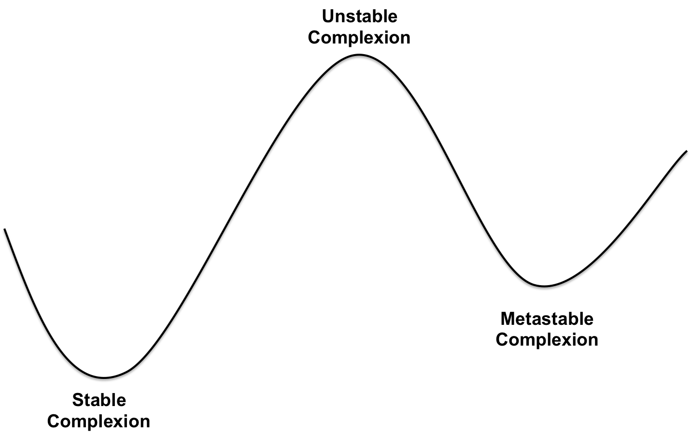
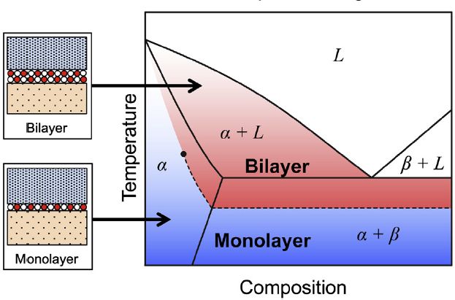
Grain Boundary Complexions
A Complexion Transitions is a change in grain boundary structure from one atomic structure (e.g. no impurities) to another (e.g. a bi-layer structure).
Complexion transitions occur when temperature and composition change such that one complexion becomes metastable with respect to another.
This often changes grain boundary properties, both energy and mobility
P.R. Cantwell et al. Acta Mater. (2014) 62 1.

Slide 12
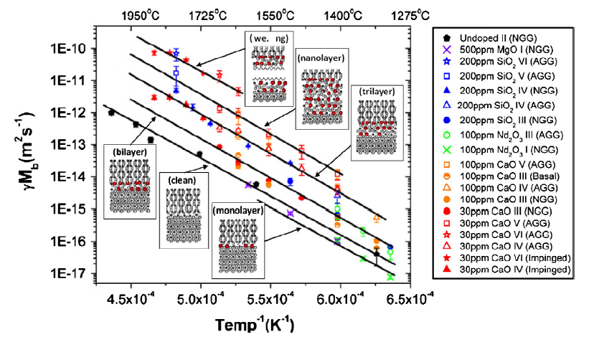
Complexion Transitions and AGG
Example: complexions in alumina with various dopants
Grain boundary mobility increases as complexions get closer to complete wetting, but the slope with respect to temperature remains the same! Why?
S.J. Dillon et al. J. Amer. Ceram. Soc. (2008) 91 2304.

Slide 13
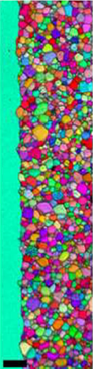

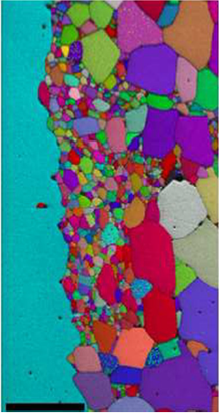
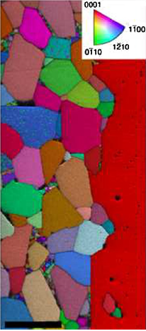
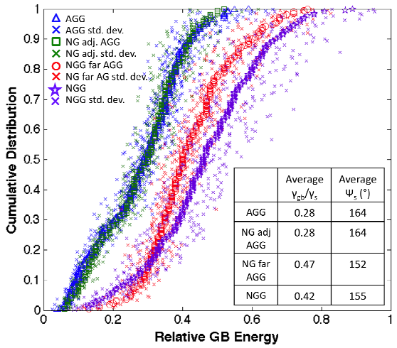
Complexion Transitions and AGG
Implication: many grain boundaries changed complexion AFTER coming into contact with abnormal grains!
S.A. Bojarski et al., Mater. Sci. Forum (2013) 753 87
S.A. Bojarski et al. Metall. and Mater. Trans. A (2012) 43 3532

Slide 14
Grain Boundary Energy: Definition
Grain boundary energy is defined as the excess free energy associated with the presence of a grain boundary, with the perfect lattice as the reference point.
A thought experiment provides a means of quantifying GB energy, γ. Take a patch of boundary with area A, and increase its area by dA. The grain boundary energy is the proportionality constant between the increment in total system energy and the increment in area. This we write as:
γ = dG/dA
The physical reason for the existence of a (positive) GB energy is misfit between atoms across the boundary. The deviation of atom positions from the perfect lattice leads to a higher energy state. Wolf established that GB energy is correlated with excess volume in an interface. There is no simple method, however, for predicting the excess volume based on a knowledge of the grain boundary crystallography.

Slide 15
Grain boundary energy, γ: overview
Grain boundary energies can be extracted from 3D images by measurement of dihedral angles at triple lines and by exploiting the Herring equations at triple junctions.
The population of grain boundaries are inversely correlated with grain boundary energy.
Apart from a few deep cusps, the relative grain boundary energy varies over a small range, ~ 40%.
The grain boundary energy scales with the excess volume; unfortunately no model exists to connect excess volume with crystallographic type.
The average of the two surface energies has been demonstrated to be highly correlated with the grain boundary energy in MgO.
For metals, population statistics suggest that a few deep cusps in energy exist for both CSL-related and non-CSL boundary types (e.g. in fcc, Σ3, Σ11), based on both experiments and simulation.
Theoretical values of grain boundary energy have been computed by a group at Sandia Labs (Olmsted, Foiles, Holm) using molecular statics, and GB mobilities using molecular dynamics.
Olmsted et al. (2009) “… Grain boundary energies" Acta mater. 57 3694;
Rohrer, et al. (2010) “Comparing … energies.” Acta mater. 58 5063; Holm et al., Acta mater. 59 5250

Slide 16
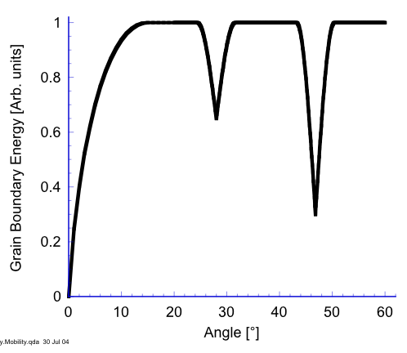
G.B. Properties Overview: Energy
Low angle boundaries can be treated as dislocation structures, as analyzed by Read & Shockley (1951).
Grain boundary energy can be constructed as the average of the two surface energies -
γ_{GB} = γ(hkl_{A})+γ(hkl_{B}).
For example, in fcc metals, low energy boundaries are found with {111} terminating surfaces.
In most fcc metals, certain CSL types are much more common than expected from a random texture.
Does mobility scale with g.b. energy, based on a dependence on acceptor/donor sites? Answer: this supposition is not valid.
Read-Shockley
one {111}
two {111}
planes (Σ3 …)
Shockley W., Read W.T., “Quantitative Predictions From Dislocation Models Of Crystal Grain Boundaries.” Phys. Rev. (1949) 75 692.

Slide 17
Grain Boundary Energy
First categorization of boundary type is into low-angle versus high-angle boundaries. Typical value in cubic materials is 15° for the misorientation angle.
Typical values of average grain boundary energies vary from 0.32 J.m⁻² for Al to 0.87 for Ni J.m⁻² (related to bond strength, which is related to melting point).
Read-Shockley model describes the energy variation with angle for low-angle boundaries successfully in many experimental cases, based on a dislocation structure.

Slide 18
Read-Shockley model
Read-Shockley applies to Low Angle Grain Boundaries (LAGB)
Start with a symmetric tilt boundary composed of a wall of infinitely straight, parallel edge dislocations (e.g. based on a 100, 111 or 110 rotation axis with the planes symmetrically disposed).
Dislocation density (L⁻¹) given by:
1/D = 2sin(θ/2)/b ≈ θ/b for small angles.

Slide 19
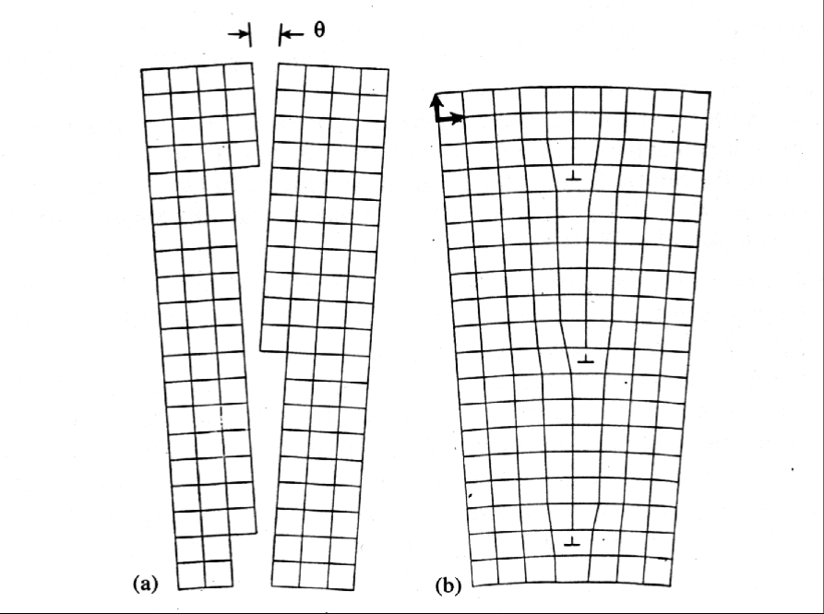
Tilt boundary
b
D
Each dislocation accommodates the mismatch between the two lattices; for a <112> or <111> misorientation axis in the boundary plane, only one type of dislocation (a single Burgers vector) is required.

Slide 20
Read-Shockley model, contd.
For an infinite array of edge dislocations the long-range stress field depends on the spacing. Therefore given the dislocation density and the core energy of the dislocations, the energy of the wall (boundary) is estimated (r₀ sets the core energy of the dislocation):
γ_{gb} = E₀ θ (A₀ - lnθ), where
E₀ = µb/4π(1-ν); A₀ = 1 + ln(b/2πr₀)
Note that differentiation of the Eq above leads to a maximum energy when exp(θ) = (A₀ - 1), or,
θ = b/2πr₀, which shows that the choice of the cut-off radius, r₀, determines the maximum in the energy.

Slide 21
Read-Shockley model, contd.
If the non-linear form for the dislocation spacing is used, we obtain a sine-law variation (U_{core}= core energy):
γ_{gb} = sin|θ| {U_{core}/b - µb²/4π(1-ν) ln(sin|θ|)}
Note: this form of energy variation may also be applied to CSL-vicinal boundaries.

Slide 22
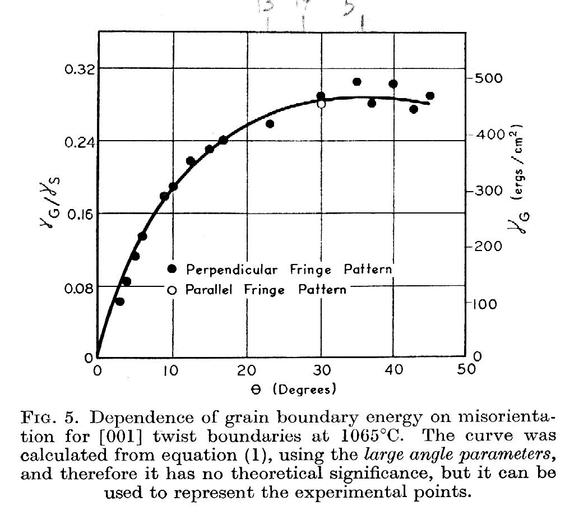
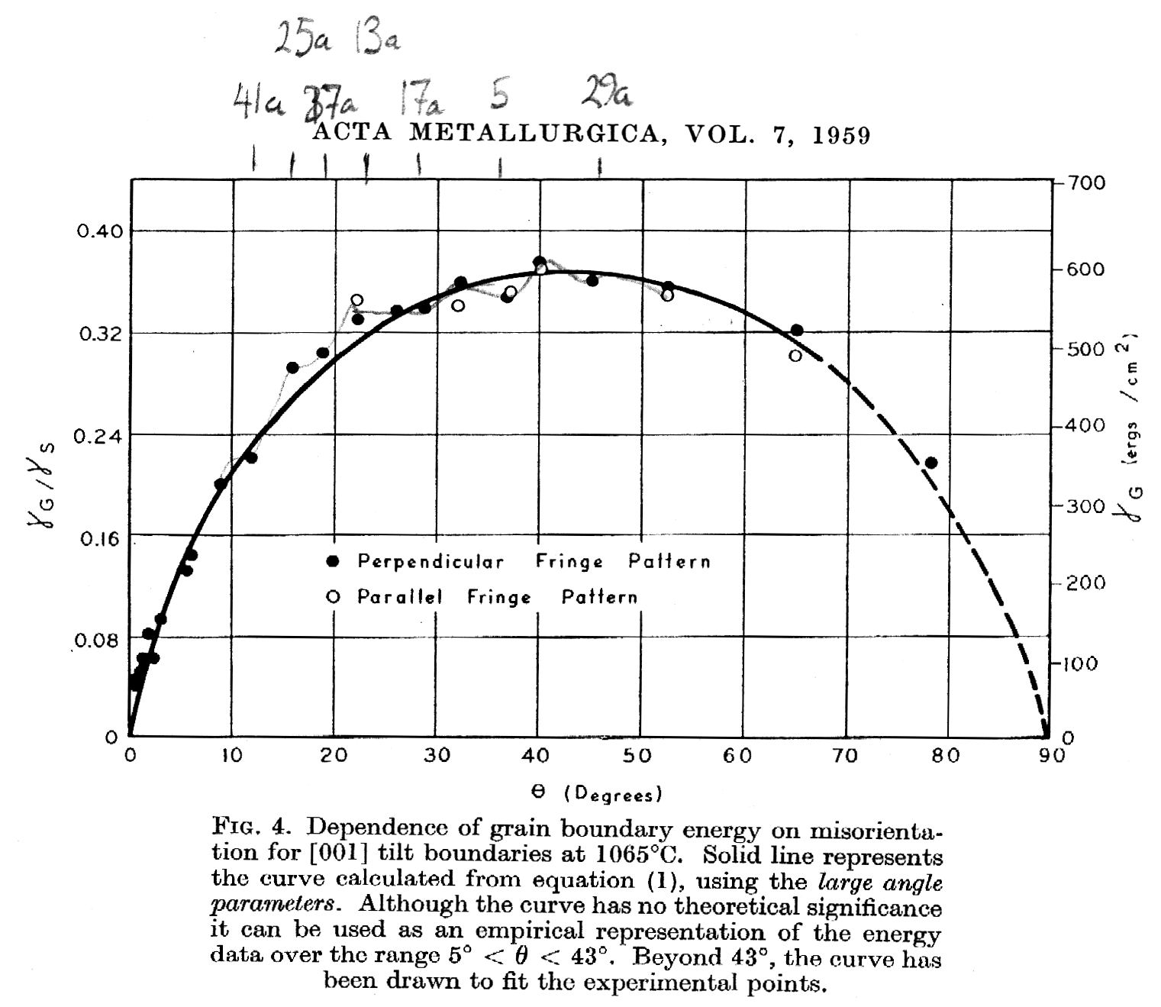
LAGB experimental results
Experimental results on copper. Note the lack of evidence of deep minima (cusps) in energy at CSL boundary types in the <001> tilt or twist boundaries. Also note that the sine curve appears to apply over the entire angular range, not just up to 15°.
Disordered Structure
Dislocation Structure
Gjostein & Rhines, Acta metall. 7, 319 (1959)

Slide 23
Physical Meaning of
5 Macroscopic Grain Boundary Parameters
θ
g_{A}
g_{B}
Lattice Misorientation, ∆g (rotation, 3 parameters)
Boundary Plane Normal, n (unit vector, 2 parameters)
Grain Boundaries have 5 Macroscopic Degrees of Freedom

Slide 24
Measurement of GB Energy
We need to be able to measure grain boundary energy.
In general, we do not need to know the absolute value of the energy but only how it varies with boundary type, i.e. with the crystallographic nature of the boundary.
For measurement of the anisotropy of the energy, then, we rely on local equilibrium at junctions between boundaries. This can be thought of as a force balance at the junctions.
For not too extreme anisotropies, the junctions always occur as triple lines.

Slide 25
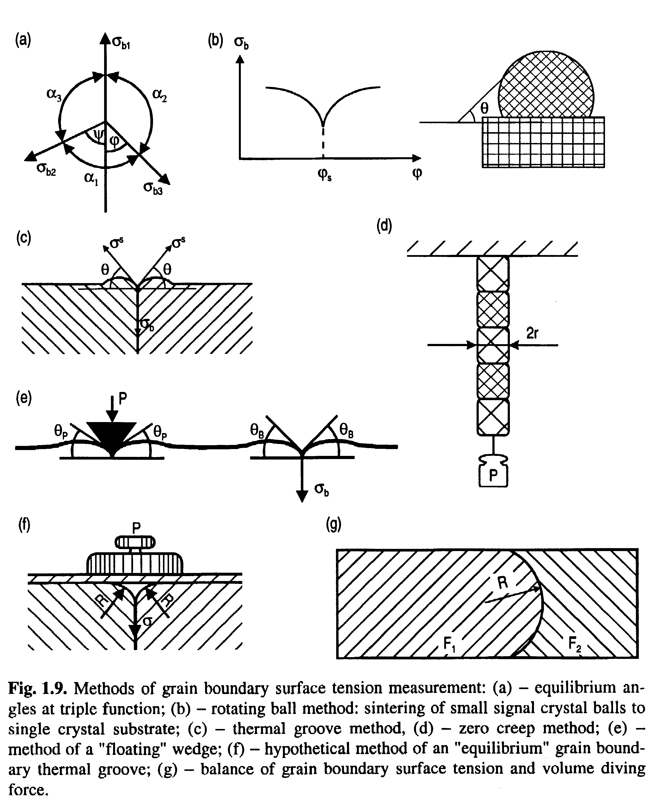
Experimental Methods for g.b. energy measurement
G. Gottstein & L. Shvindlerman, Grain Boundary Migration in Metals, CRC (1999)
Method (a), with dihedral angles at triple lines, is most generally useful; method (b), with surface grooving also used.

Slide 26
Herring Equations
We can demonstrate the effect of interfacial energies at the (triple) junctions of boundaries.
Equal g.b. energies on 3 GBs implies equal dihedral angles:
1
γ₁=γ₂=γ₃
2
3
120°

Slide 27
Definition of Dihedral Angle
Dihedral angle, χ:= angle between the tangents to an adjacent pair of boundaries (unsigned). In a triple junction, the dihedral angle is assigned to the opposing boundary.
1
γ₁=γ₂=γ₃
2
3
120°
χ₁ : dihedral
angle for g.b.1

Slide 28
Dihedral Angles
An material with uniform grain boundary energy should have dihedral angles equal to 120°.
Likely in real materials? No! Low angle boundaries (crystalline materials) always have a dislocation structure and therefore a monotonic increase in energy with misorientation angle (Read-Shockley model).
The inset figure is taken from Barmak et al. Progr. Matls. Sci. 58 987 (2013) and shows the distribution of dihedral angles measured in a 0.1 µm thick film of Al, along with a calculated distribution based on an GB energy function from a similar film (with two different assumptions about the distribution of misorientations). Note that the measured dihedral angles have a wider distribution than the calculated ones.

Slide 29
Unequal energies
If the interfacial energies are not equal, then the dihedral angles change. A low g.b. energy on boundary 1 increases the corresponding dihedral angle.
1
γ₁<γ₂=γ₃
2
3
χ₁>120°

Slide 30
Unequal Energies, contd.
A high g.b. energy on boundary 1 decreases the corresponding dihedral angle.
Note that the dihedral angles depend on all the energies.
1
γ₁>γ₂=γ₃
2
3
See Fisher & Fullman JAP
22 1350 (1951) for application to analysis of annealing twin formation.
χ₁< 120°

Slide 31
Wetting
For a large enough ratio, wetting can occur, i.e. replacement of one boundary by the other two at the TJ.
γ₁>γ₂=γ₃
Balance vertical
forces ⇒
γ₁ = 2γ₂cos(χ₁/2)
Wetting ⇒
γ₁ ≥ 2 γ₂
γ₁
1
γ₂cosχ₁/2
γ₃cosχ₁/2
2
3
χ₁< 120°

Slide 32
Triple Junction Quantities
Notes:
Diagram of a labeling convention for grain boundary character, showing dihedral angles, χ, inclination angles, φ, boundary tangent vectors, b, boundary normals, n, and grain orientations, g. The triple junction line is perpendicular to the plane of the diagram.

Slide 33
Triple Junction Quantities
Grain boundary tangent (at a TJ): b
Grain boundary normal (at a TJ): n
Grain boundary inclination, measured anti-clockwise with respect to a(n arbitrarily chosen) reference direction (at a TJ): φ
Grain boundary dihedral angle: χ
Grain orientation:g

Slide 34
Force Balance Equations/
Herring Equations
The Herring equations [(1951). Surface tension as a motivation for sintering. The Physics of Powder Metallurgy. New York, McGraw-Hill Book Co.: 143-179] are force balance equations at a TJ. They rely on a local equilibrium in terms of free energy.
A virtual displacement, δr, of the TJ (L in the figure) results in no change in free energy.
See also: Adams et al., Interface Science 7 321 (1999); Kinderlehrer D and Liu C, Mathematical Models and Methods in Applied Sciences, (2001) 11 713-729; Kinderlehrer, et al. (2004) “Mesoscale simulation of grain growth”, in Continuum Scale Simulation of Engineering Materials, (Raabe, D. et al., eds),Wiley-VCH Verlag, Weinheim, Chap. 16, 361-372

Slide 35
Derivation of Herring Equs.
A virtual displacement, δr, of the TJ results in
no change in free energy.
See also: Adams et al., Interface Science 7 321 (1999); Kinderlehrer, D and Liu, C Mathematical Models and Methods in Applied Sciences (2001) 11 713; Kinderlehrer et al. (2004) Mesoscale simulation of grain growth, in Continuum Scale Simulation of Engineering Materials, (Raabe, D. et al., eds), Wiley-VCH Verlag, Weinheim, Chapt. 16, p361.

Slide 36
Force Balance
Consider only interfacial energy: vector sum of the forces must be zero to satisfy equilibrium. Each “b” is a tangent (unit) vector.
These equations can be rearranged to give the Young equations (sine law):

Slide 37
Analysis of Thermal Grooves to obtain GB Energy
See, for example: Gjostein, N. A. and F. N. Rhines (1959). "Absolute interfacial energies of [001] tilt and twist grain boundaries in copper." Acta metall. 7 319
W
2W
γ_{S2}
Surface 1
Ψ_{s}
Surface 2
Surface
γ_{S1}
d
β
Grain Boundary
Crystal 1
Crystal 2
?
γ_{Gb}
It is often reasonable to assume a constant surface energy, γ_{S}, and examine the variation in GB energy, γ_{Gb}, as it affects the thermal groove angles

Slide 38
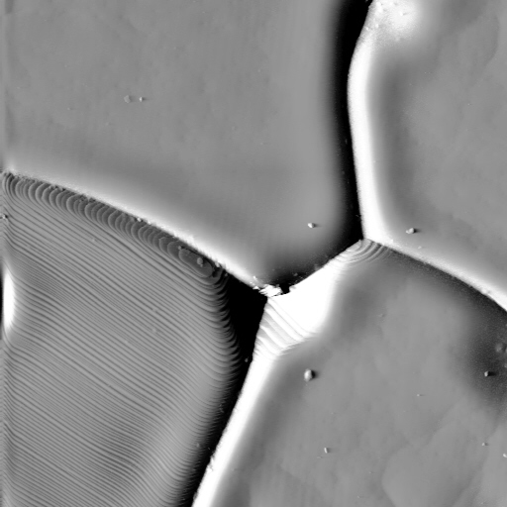

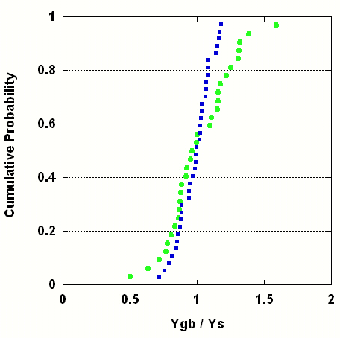
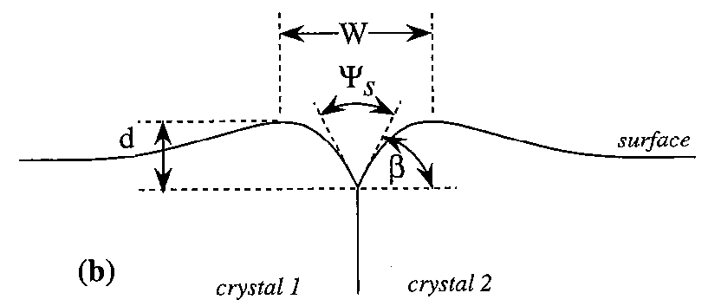
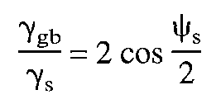
Grain Boundary Energy Distribution is Affected by Alloying
Δγ = 1.09
1 μm
Δγ = 0.46
Ca solute increases the range of the γ_{GB}/γ_{S} ratio. The variation of the relative energy in doped MgO is higher (broader distribution) than in the case of undoped material.
76
Notes:
This anisotropy was confirmed by thermal groove measurements, which showed that the doped sample had a wider distribution of thermal groove widths and, therefore a wider distribution of energies. The diagram in lower right shows how we apply Young’s Eq, i.e. same local eq. at TJs to the balance between surfaces and GB energy. Image in upper right is an AFM of thermally grooved GBs.

Slide 39
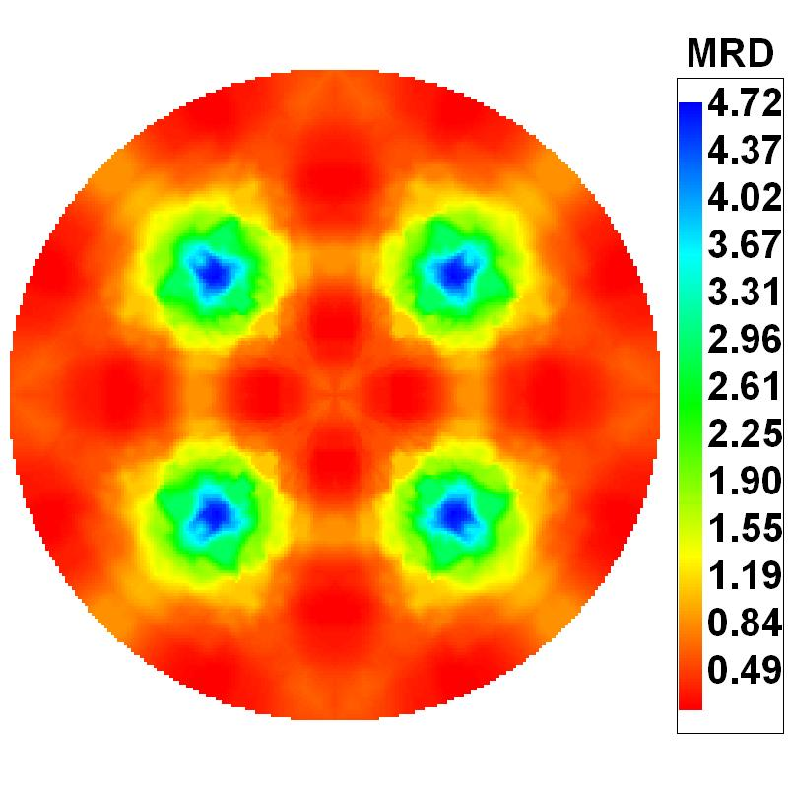
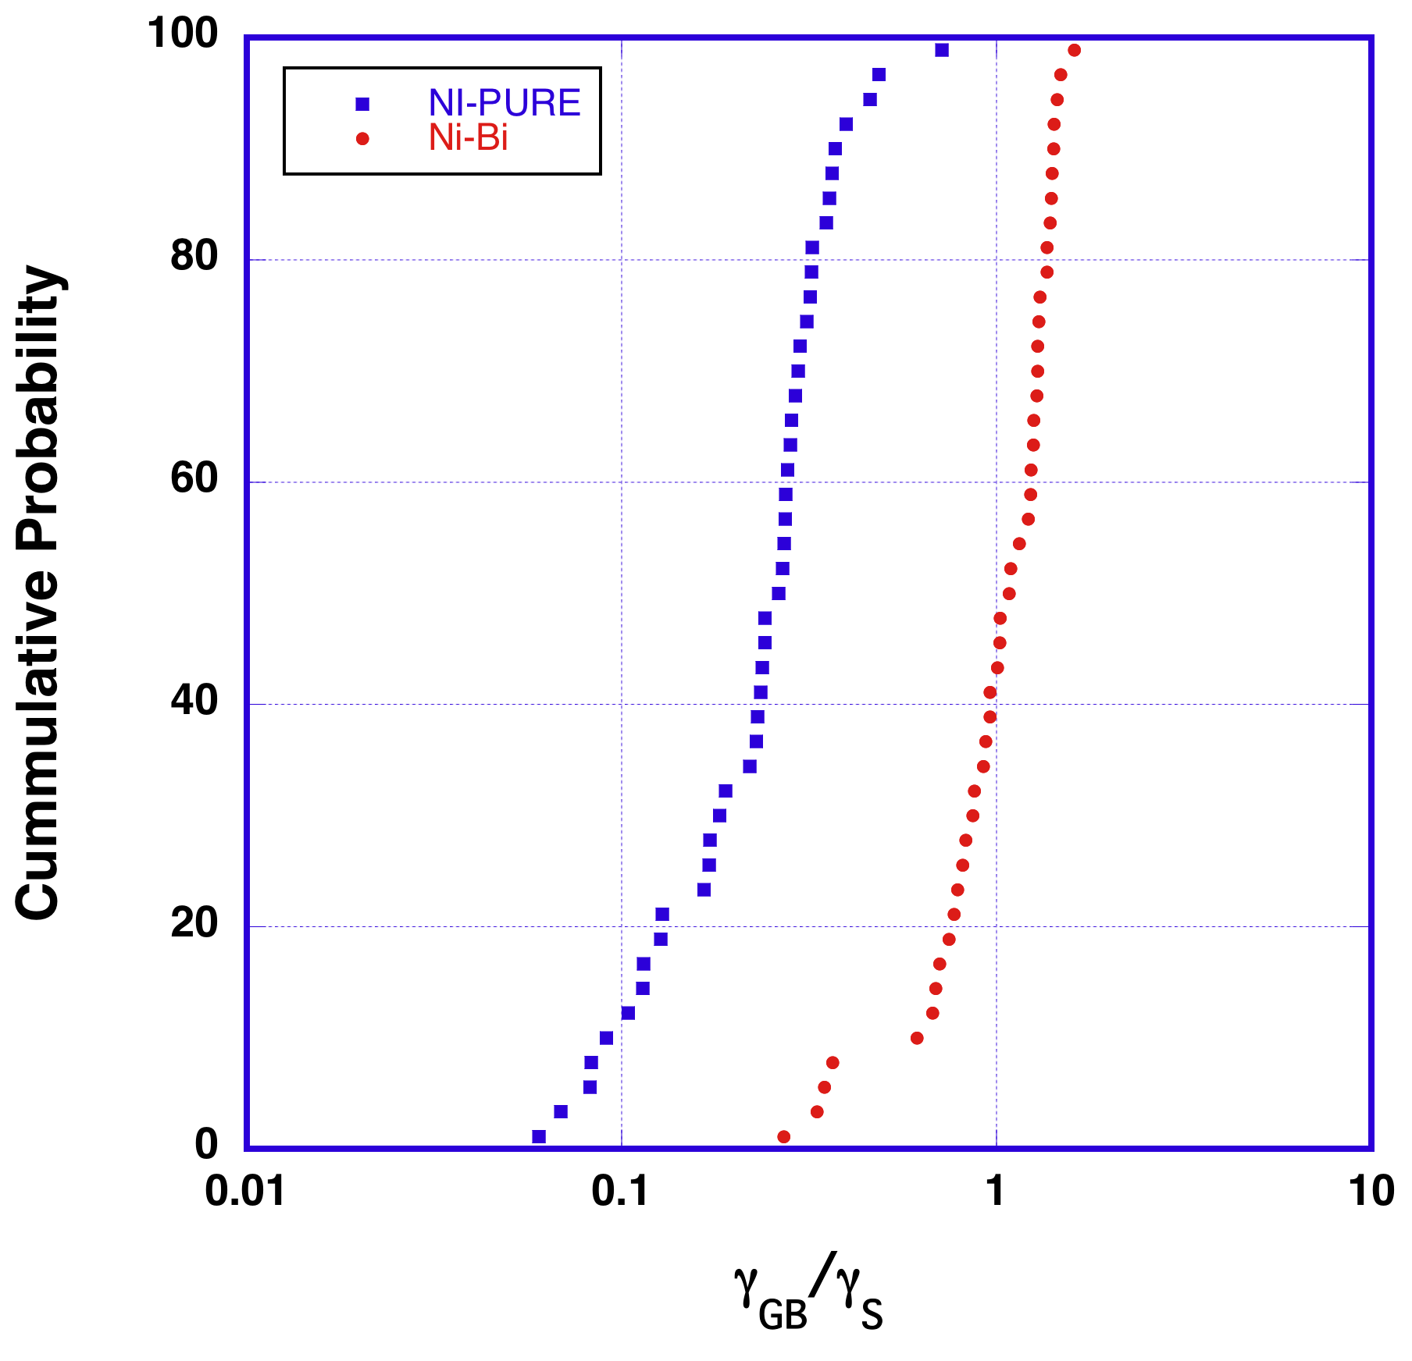
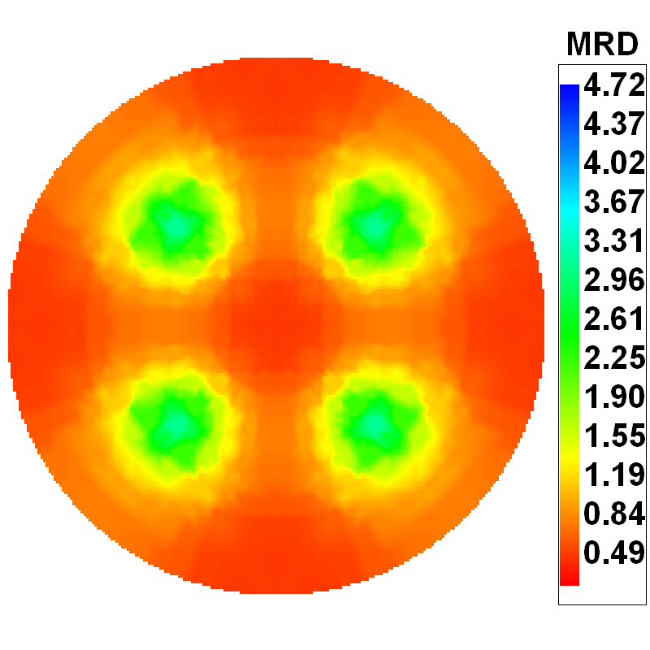
Bi impurities in Ni have the opposite effect
Pure Ni, grain size: 20μm
Bi-doped Ni, grain size: 21μm
Range of γ_{GB}/γ_{S} (on log scale) is smaller for Bi-doped Ni than for pure Ni, indicating smaller anisotropy of γ_{GB}/γ_{S}. This correlates with the plane distribution.
77
Notes:
The opposite trend was found in Bi-doped Ni. In this case, Bi suppressed the grain boundary anisotropy and a narrower range of energies was found.
Very curious: Cu-Bi exhibits the opposite effect – the doped case is WIDER than the undoped. So, it is NOT possible to assume that segregation decreases or increases the anisotropy of GB energy.

Slide 40
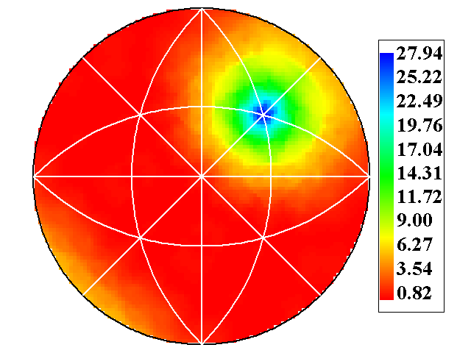
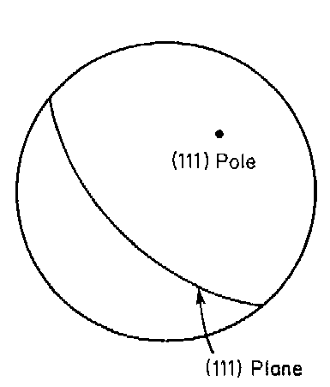
Separation of ∆g and n
Plotting the boundary plane requires a full hemisphere which projects as a circle. Each projection describes the variation at fixed misorientation. Any (numerically) convenient discretization of misorientation and boundary plane space can be used.
Distribution of normals for boundaries with Σ3 misorientation (commercial purity Al)
Misorientation axis, e.g. 111,
also the twist type location

Slide 41
Tilt versus Twist Boundaries
Isolated/occluded grain (one grain enclosed within another) illustrates variation in boundary plane for constant misorientation. The normal is // misorientation axis for a twist boundary whereas for a tilt boundary, the normal is ⊥ to the misorientation axis. Many variations are possible for any given boundary.
Misorientation axis
Twist boundaries
Tilt boundaries
g_{B}
g_{A}

Slide 42
Inclination Dependence
Interfacial energy can depend on inclination, i.e. which crystallographic plane is involved.
Example? The coherent twin boundary is obviously low energy as compared to the incoherent twin boundary (e.g. Cu, Ag). The misorientation (60° about <111>) is the same, so inclination is the only difference.

Slide 43
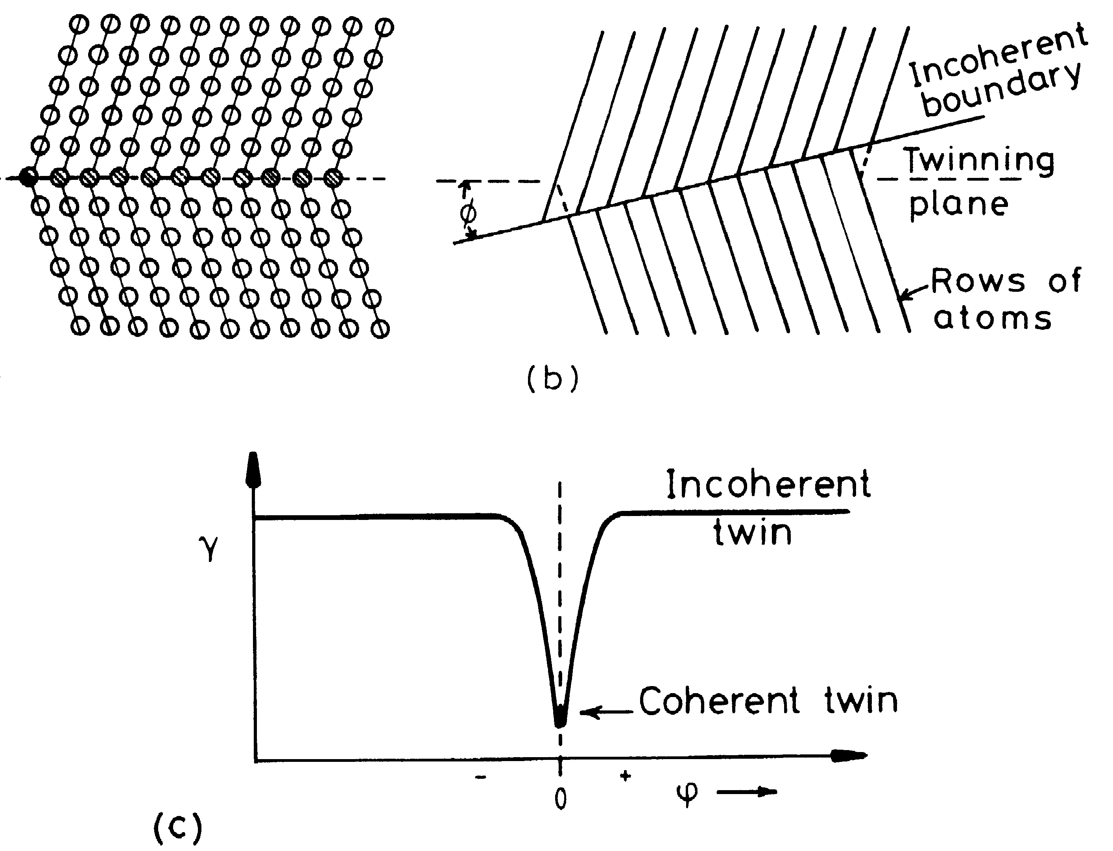
Twin: coherent vs. incoherent
Porter & Easterling fig. 3.12/p123

Slide 44
The torque term
Change in inclination causes a change in its energy,
tending to twist it (either back or forwards)
dφ
1

Slide 45
Inclination Dependence, contd.
For local equilibrium at a TJ, what matters is the rate of change of energy with inclination, i.e. the torque on the boundary.
Recall that the virtual displacement twists each boundary, i.e. changes its inclination.
Re-express the force balance as (σ≡γ):
surface
tension
terms
torque terms

Slide 46
Herring’s Relations
C. Herring in The Physics of Powder Metallurgy. (McGraw Hill, New York, 1951) pp. 143-79
NB: the torque terms can be just as large as the surface tensions

Slide 47
Torque effects
The effect of inclination seems esoteric: should one be concerned about it?
Yes! Twin boundaries are only one example where inclination has an obvious effect. Other types of grain boundary (to be explored later) also have low energies at unique misorientations.
Torque effects can result in inequalities* instead of equalities for dihedral angles.
* B.L. Adams, et al. (1999). “Extracting Grain Boundary and Surface Energy from Measurement of Triple Junction Geometry.” Interface Science 7: 321-337.

Slide 48
Aluminum foil, cross section
surface
Torque term literally twists the boundary away from being perpendicular to the surface

Slide 49
Why Triple Junctions?
For isotropic g.b. energy, 4-fold junctions split into two 3-fold junctions with a reduction in free energy:
90°
120°

Slide 50
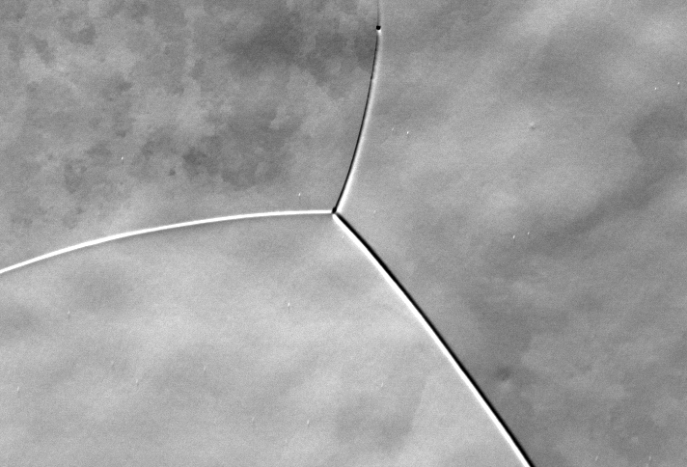
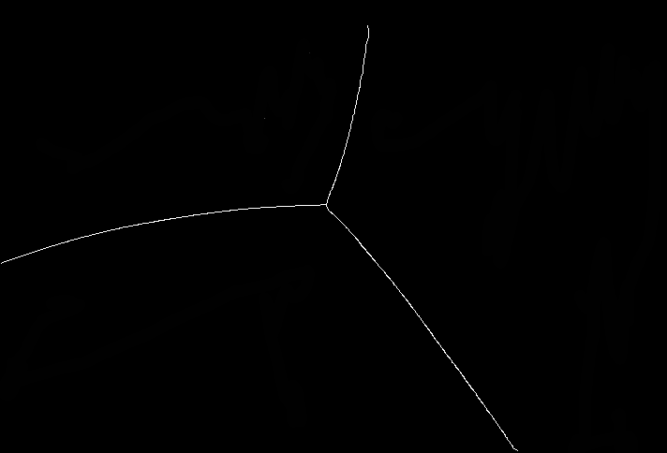
How to Measure Dihedral
Angles and Curvatures: 2D microstructures
Image Processing
(1)
(2) Fit conic sections to each grain boundary:
Q(x,y)=Ax²+ Bxy+ Cy²+ Dx+ Ey+F = 0
Assume a quadratic curve is adequate to describe the shape of a grain boundary.
"Measuring relative grain boundary energies and mobilities in an aluminum foil from triple junction geometry", C.-C. Yang, W. W. Mullins and A. D. Rollett, Scripta Materialia 44: 2735-2740 (2001).

Slide 51
Measuring Dihedral Angles and Curvatures
(3) Calculate the tangent angle and curvature at a triple junction from the fitted conic function, Q(x,y):
Q(x,y)=Ax²+ Bxy
+ Cy²+ Dx+
Ey+F=0

Slide 52
Application to G.B. Properties
In principle, one can measure many different triple junctions to characterize crystallography, dihedral angles and curvature.
From these measurements one can extract the relative properties of the grain boundaries.

Slide 53
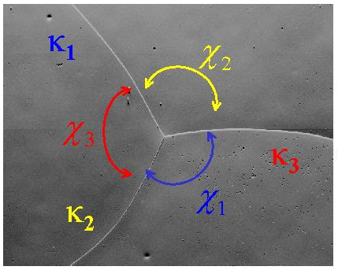
Energy Extraction
(sinχ₂) σ₁ - (sinχ₁) σ₂ = 0
(sinχ₃) σ₂ - (sinχ₂) σ₃ = 0
σ₁
σ₂
σ₃
:
σ_{n}
sinχ₂ -sinχ₁ 0 0 …0
0 sinχ₃ -sinχ₂ 0 ...0
* * 0 0 ...0
: : : : :
0 0 * * 0
= 0
Measurements at
many TJs; bin the
dihedral angles by g.b. type; average the sinχ;
each TJ gives a pair of equations
D. Kinderlehrer et al. , Proc. of the Twelfth International Conference on Textures of Materials (ICOTOM), Montréal, Canada, (1999) p1643.
K. Barmak et al., "Grain boundary energy and grain growth in Al films: Comparison of experiments and simulations", Scripta Mater., 54 (2006) 1059-1063: following slides …

Slide 54
Determination of Grain Boundary Energy
via a Statistical Multiscale Analysis Method
Assume:
  Equilibrium at the triple junction (TJ)
  Grain boundary energy to be independent of grain boundary inclination
Sort boundaries according to misorientation angle (θ) – use 2º bins
Symmetry constraint: θ ≤ 62.8º
Type | Misorientation Angle
1 | 1.1-4
2 | 4.1-6
3 | 6.1-8
4 | 8.1-10
5 | 10.1-15
6 | 15.1-18
7 | 18.1-26
8 | 26.1-34
9 | 34.1-42
10 | 42.1-46
11 | 46.1-50
12 | 50.1-54
13 | 54.1-60
θ − misorientation angle
χ − dihedral angle
K. Barmak, et al.
Example: {001}^{c} [001]^{s} textured Al foil

Slide 55
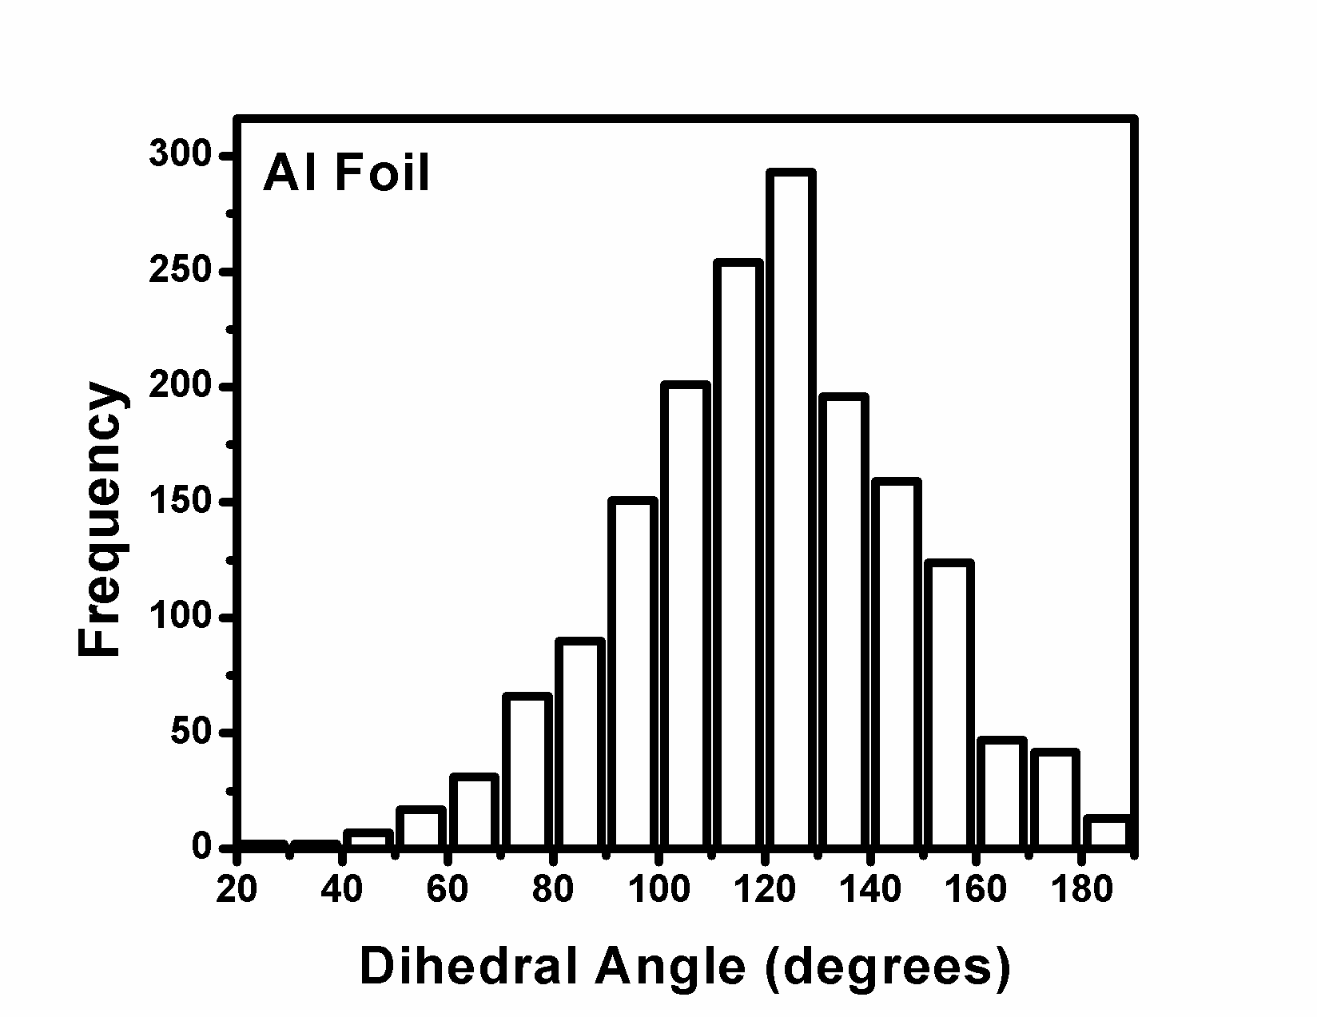
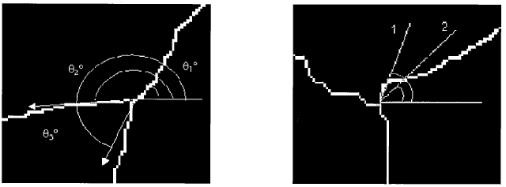
Equilibrium at Triple Junctions
Herring’s Eq.
Young’s Eq.
b_{j} - boundary tangent
n_{j} - boundary normal
χ - dihedral angle
σ - grain boundary energy
Example: {001}^{c} [001]^{s} textured Al foil
Since the crystals have strong {111} fiber texture, we assume ;
- all grain boundaries are pure {111} tilt
boundaries
- the tilt angle is the same as the
misorientation angle
For example use Linefollow (Mahadevan et al.)
K. Barmak, et al.

Slide 56
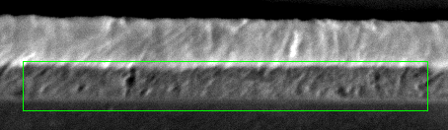
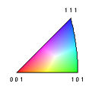
Cross-Sections Using OIM
[001]_{sample} inverse pole figure map, raw data
3 μm
SEM image
[001]_{sample} inverse pole figure map, cropped cleaned data
- remove Cu (~0.1 mm)
- clean up using a grain dilation method (min. pixel 10)
[010] sample
Al film
[010]_{sample} inverse pole figure map, cropped cleaned data
scanned cross-section
[001] sample
→ Nearly columnar grain structure
more examples
This film: {111}_{crystal}// [010]_{sample} textured Al foil
K. Barmak, et al.
3 μm

Slide 57
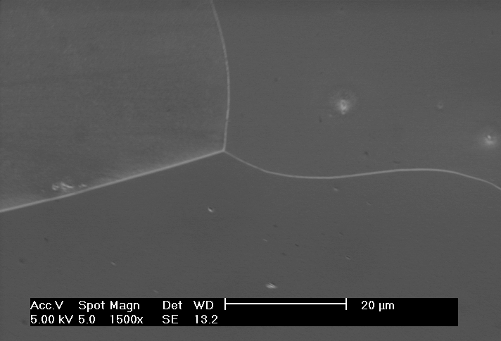
Grain Boundary Energy Calculation : Method
Type 1
Type 1 - Type 2 = Type 2 - Type 1
Type 2 - Type 3 = Type 3 - Type 2
Type 1 - Type 3 = Type 3 - Type 1
χ₂
Type 3
Type 2
Pair boundaries and put into urns of pairs
Linear, homogeneous equations
Young’s Equation
K. Barmak, et al.

Slide 58
Grain Boundary Energy Calculation : Method
N×(N-1)/2 equations
N unknowns
i=1,….,N(N-1)/2
N(N-1)/2
=
N
N
N(N-1)/2
K. Barmak, et al.

Slide 59
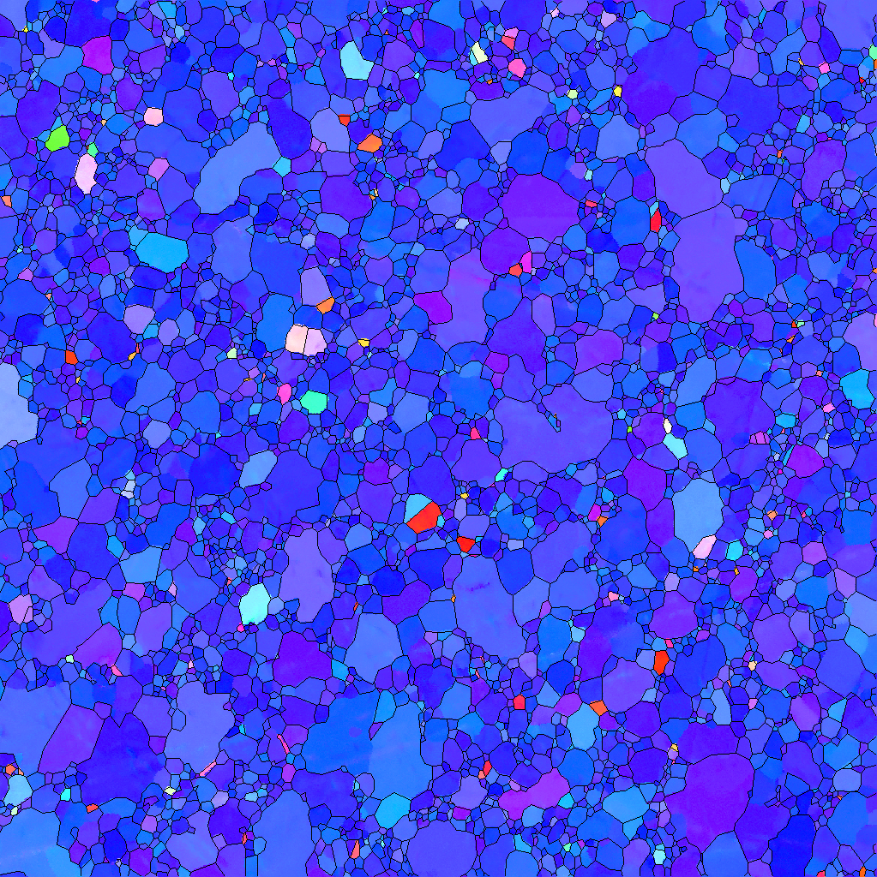

Grain Boundary Energy Calculation : Summary
Assuming columnar grain structure
and pure <111> tilt boundaries
# of total TJs : 8694
# of {111} TJs : 7367 (10° resolution)
22101 (=7367×3) boundaries
calculation of dihedral angles
- reconstructed boundary line segments from
TSL software
2° binning
(0°-1°, 1° -3°, 3° -5°, …,59° -61°,61° -62°)
32×31/2=496 pairs
no data at low angle boundaries (<7°)
This film: {111}_{crystal}// [001]_{sample} textured Al foil
i=1,….,N(N-1)/2
Kaczmarz iteration method
B.L. Adams, D. Kinderlehrer, W.W. Mullins,
A.D. Rollett, and Shlomo Ta’asan,
Scripta Mater. 38, 531 (1998)
Reconstructed boundaries
K. Barmak, et al.

Slide 60
<111> Tilt Boundaries: Results
1
2
.
1
0
.
Relative Boundary Energy
0
8
.
Σ7
0
6
Σ13
.
1
0
2
0
3
0
4
0
5
0
6
0
M
i
s
o
r
i
e
n
t
a
t
i
o
n
A
n
g
l
e
,
o
Cusps at tilt angles of 28 and 38 degrees, corresponding to CSL type boundaries Σ13 and Σ7, respectively.
K. Barmak, et al.

Slide 61
Energy of High Angle Boundaries
No universal theory exists to describe the energy of HAGBs.
Based on a disordered atomic structure for general high angle boundaries, we expect that the g.b. energy should be at a maximum and approximately constant.
Abundant experimental evidence for special boundaries at (a small number) of certain orientations for which the atomic fit is better than in general high angle g.b’s.
Each special point (in misorientation space) expected to have a cusp in energy, similar to zero-boundary case but with non-zero energy at the bottom of the cusp.
Atomistic simulations suggest that g.b. energy is (positively) correlated with free volume at the interface. However, no simple way exists to predict the free volume based on the crystallographic type, so this does not help much.

Slide 62
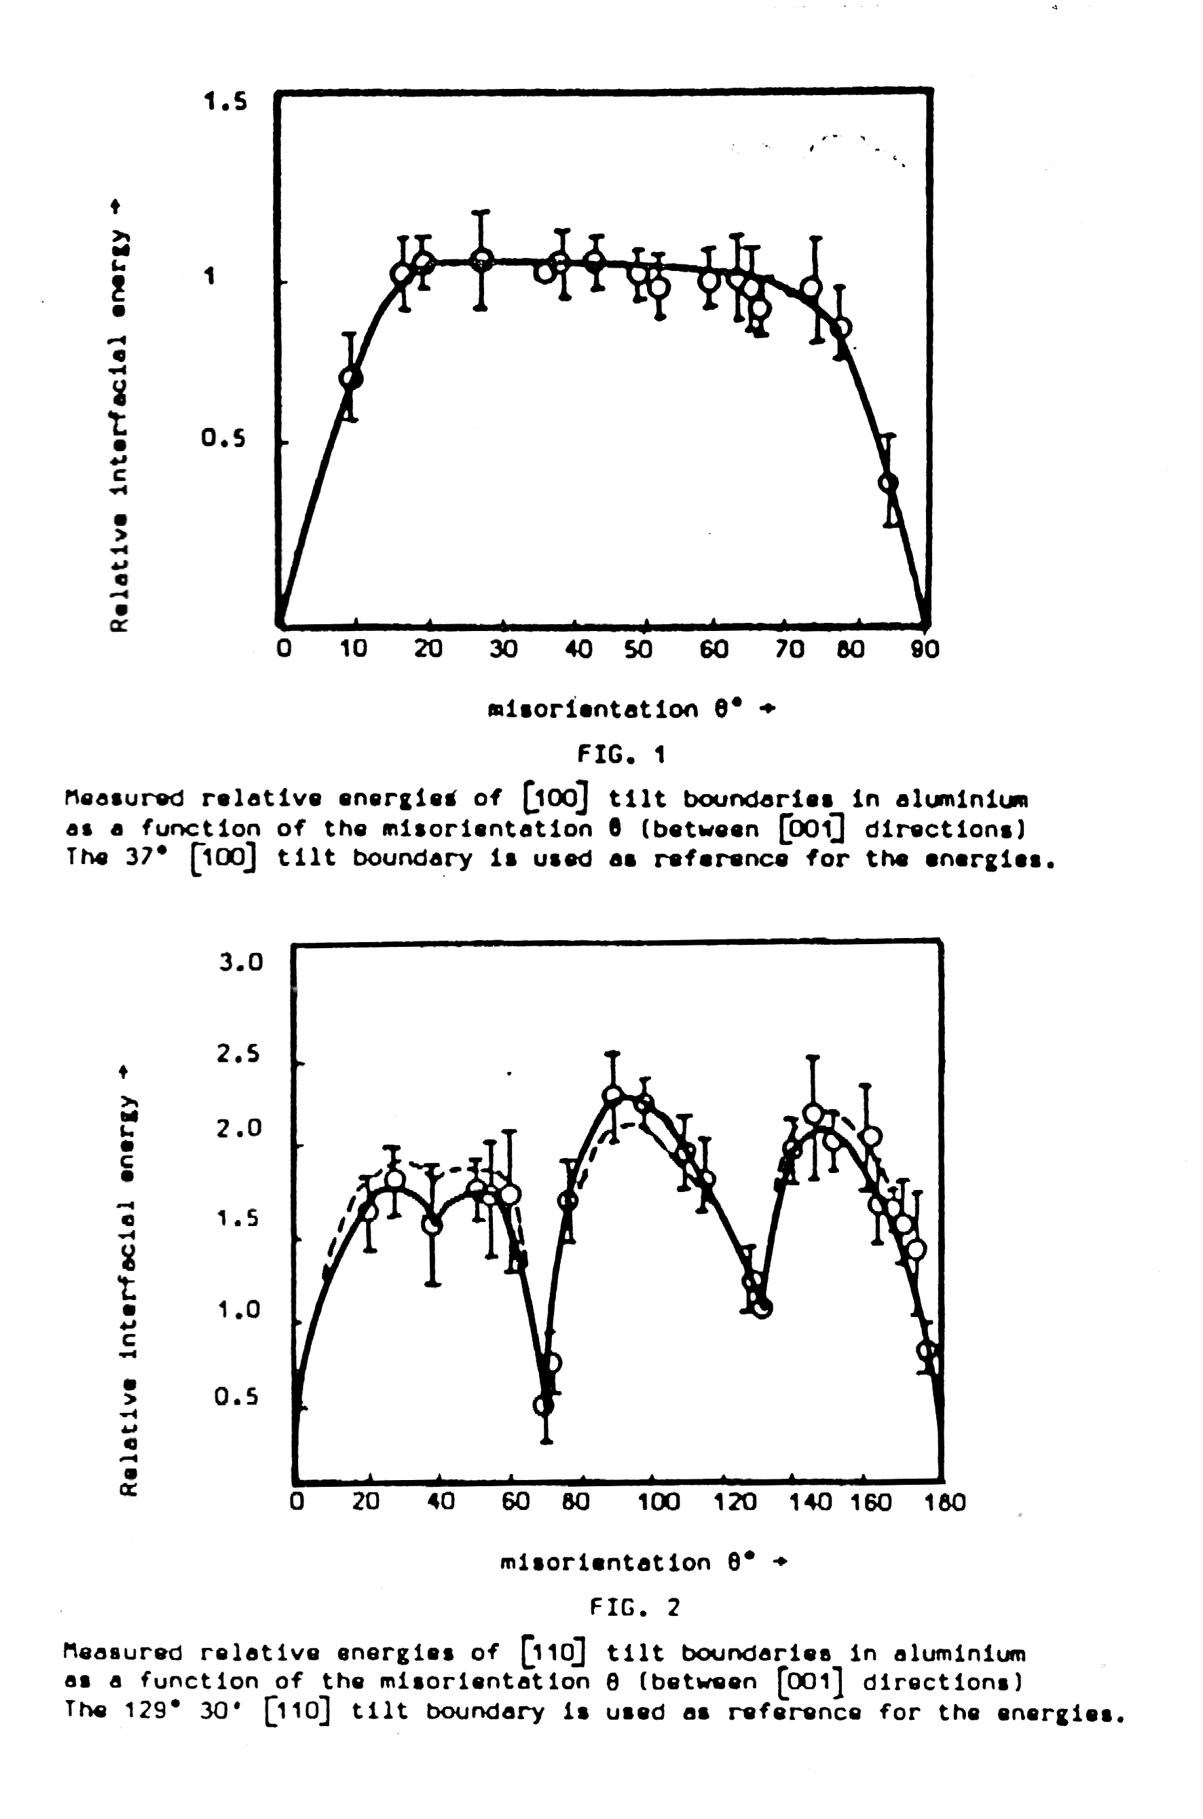
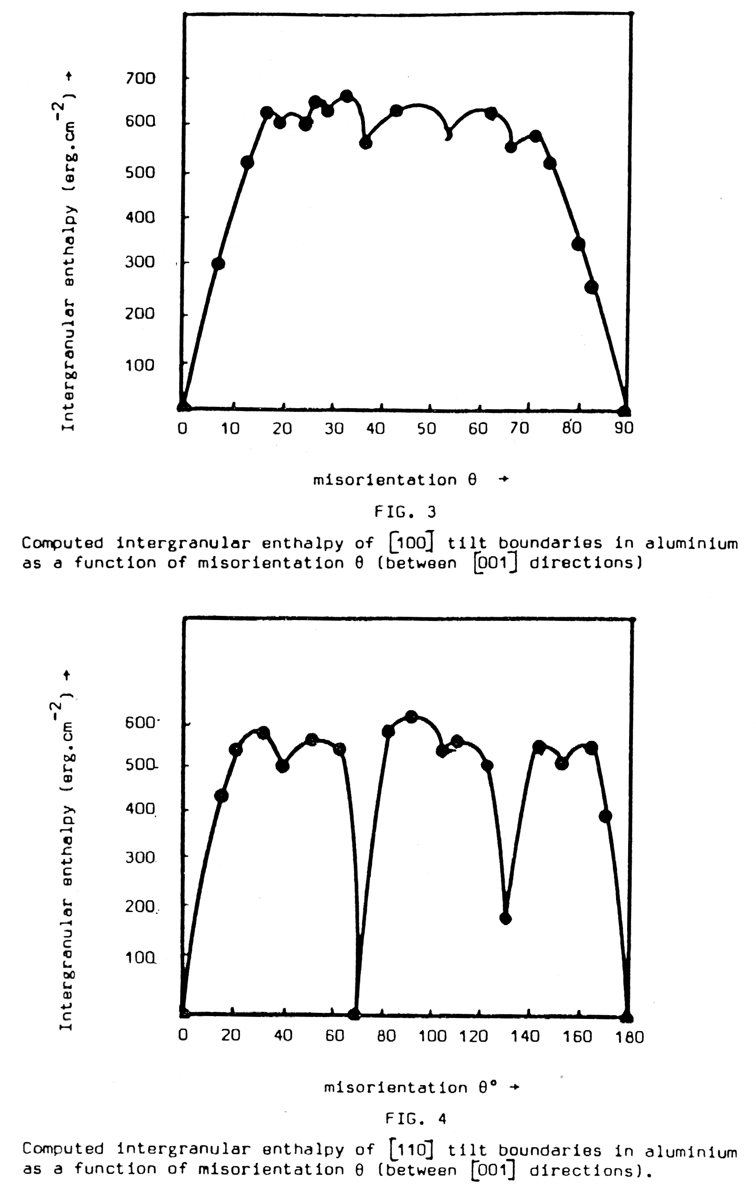
Exptl. vs. Computed E_{gb}
<100>
Tilts
Note the presence of local minima in the <110> series, but not in the <100> series of tilt boundaries.
Σ11 with (311) plane
<110>
Tilts
Σ3, 111 plane: CoherentTwin
Hasson & Goux, Scripta metall. 5 889

Slide 63
Atomistic Calculations
Olmsted, Foiles and Holm computed grain boundary energies for a set of 388 grain boundaries using molecular statics and embedded-atom interatomic potentials that represent nickel and aluminum [“Survey of computed grain boundary properties in face-centered cubic metals: I. Grain boundary energy,”Acta Materialia 57 (2009) 3694–3703].

Slide 64
Atomistic Calculations, contd.
It is important to understand that each result i.e. an energy value for a particular grain boundary type, was the minimum value from a large number of trial configurations of that boundary.
Olmsted et al., Acta Materialia 57 (2009) 3694

Slide 65
Atomistic Calculations, contd.
There are several key results. One is that, for any given CSL value, there is a wide range of energies, especially for 41 different Σ3 GBs. Also note that {111} twist boundaries are particularly low in energy, as expected from the argument about low energy surfaces giving low energy GBs. One outlier is the low energy Σ11 symmetric tilt with {113} normals. The excess free volume provides a weak correlation with energy, as previously noted.
Acta Materialia 57 (2009) 3694

Slide 66
Atomistic Calculations, contd.
When the GB energies calculated in this manner for Al and Ni are compared, there is a very strong correlation. It appears that the proportionality factor is is very similar to the Voigt average shear modulus, which is the last entry in Table 1. This suggests (without proof!) that the properties of dislocations may be relevant to GB energy. This last point remains to be substantiated.
Acta Materialia 57 (2009) 3694

Slide 67
Surface Energies vs.
Grain Boundary Energy
A recently revived, but still surprising to materials scientists, is that the grain boundary energy is largely determined by the energy of the two surfaces that make up the boundary (and that the twist angle is not significant).
This is has been demonstrated to be highly accurate in the case of MgO, which is an ionic ceramic with a rock-salt structure. In this case, {100} has the lowest surface energy, so boundaries with a {100} plane are expected to be low energy.
The next slide, taken from the PhD thesis work of David Saylor, shows a comparison of the GB energy computed as the average of the two surface energies, compared to the frequency of boundaries of the corresponding type. As predicted, the frequency is lowest for the highest energy boundaries, and vice versa.

Slide 68
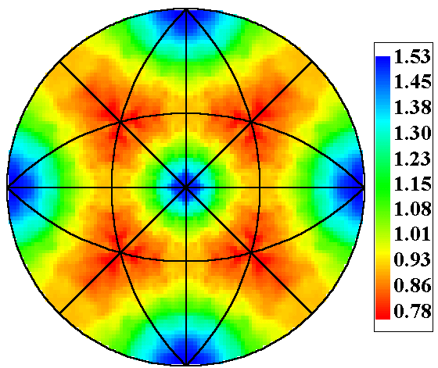
2-Parameter Distributions: Boundary Normal only
• Index n’ in the crystal reference frame:
n = g_{i}n' and n = g_{i+1}n'
(2 parameter description)
i
j
i+1
λ(n)
(MRD)
i+2
l’_{ij}
3
r_{ij2}
2
j
r_{ij1}
n’_{ij}
1
These are Grain Boundary Plane Distributions (GBPD)

Slide 69
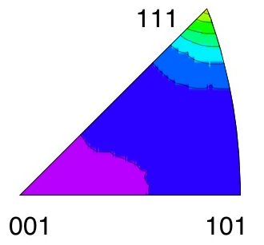
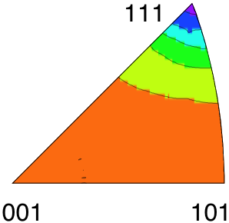

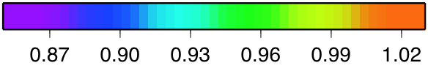
Distribution of GB planes and energies in the crystal reference frame for Nickel
(a)
(b)
Population, MRD
Energy, a.u.
(111) planes have the highest population and the lowest relative energy (computed from dihedral angles)
Li et al., Acta Mater. 57 (2009) 4304
Notes:
Results for the Ni sample are illustrated here.
We can also look at specific misorientations

Slide 70
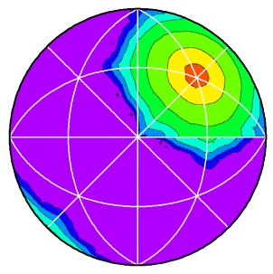
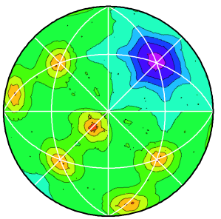


Distribution of GB planes and energies in the bicrystal reference frame
High purity Ni
Σ3 – Grain Boundary, Population and Energy
(a)
(b)
Sidebar
Simulations of grain growth with anisotropic grain boundaries shows that the GBCD develops as a consequence of energy but not mobility;
Gruber et al. (2005) Scripta mater. 53 351
[010]
[100]
ln(λ(n|60°/[111]), MRD)
γ(n|60°/[111]), a.u.
Boundary populations are inversely correlated with energy, although there are local variations
Li et al., Acta Mater. 57 (2009) 4304
Notes:
Example of data, including reconstructed energy
Twin is well known feature, and its energy is a minimum; nevertheless the GBED map shows additional fine structure away from the global minimum that is NOT reflected in the GBCD.

Slide 71
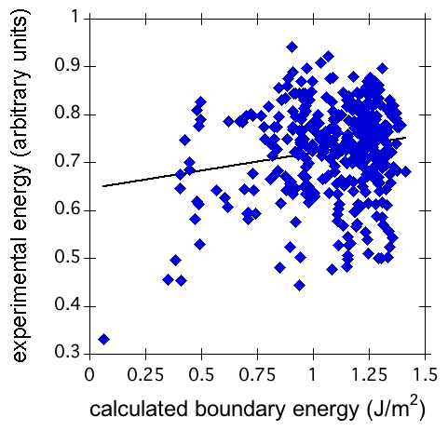
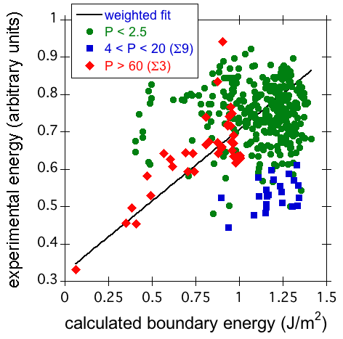
Theoretical versus Experimental GB Energies
Recent experimental [Acta mater. 57 (2010) 4304; Acta mater. 59 (2011) 5250] and computational studies [Acta Mater. 57 (2009) 3694] have produced two large grain boundary energy data sets for Ni. Using these results, we perform the first large-scale comparison between measured and computed grain boundary energies. While the overall correlation between experimental and computed energies is minimal, there is excellent agreement for the data in which we have the most confidence, particularly the experimentally prevalent Σ3 and Σ9 boundary types. Other CSL boundaries are infrequently observed in the experimental system and show little correlation with computed boundary energies. Because they do not depend on observation frequency, computed grain boundary energies are more reliable than the experimental energies for low population boundary types. Conversely, experiments can characterize high population boundaries that are not included in the computational study.
Unweighted fit
Weighted fit
“Validating computed grain boundary energies in fcc metals using the grain boundary character distribution”, Holm et al. Acta mater. (2011) 59 5250

Slide 72



Theoretical versus Experimental GB Energies
[1] Li, et al. (2010) Acta mater. 57 4304; [2] Rohrer, et al. (2010) Acta mater. 58 5063
Regression for Σ9 boundaries ➔
Regression for Σ3 boundaries; outliers circled
⬅
GB populations obtained from serial sectioning of fine grain (~5 µm) grain size pure Ni. GB energies calculated from dihedral angles at triple junctions. [1]
For high population Σ3 and mid population Σ9 boundaries, the inverse correlation between GBCD and GBED (solid lines) is stronger than the direct correlation between experimental and calculated GBEDs. However, the low population boundaries remain poorly correlated, due to high experimental uncertainty. [2]

Slide 73





Grain Boundary Distribution in MgO: [100]
λ(Δg, n)
^
n
[100]
λ(n|5°/[100])
^
n
^
n
λ(n|15°/[100])
^
n
^
n
λ(n|25°/[100])
^
n
^
n
λ(n|35°/[100])
^
n
Every peak in λ(Δg,n) is related to a boundary with a {100} plane
Saylor DM, Morawiec A, Rohrer GS. Distribution and Energies of Grain Boundaries as a Function of Five Degrees of Freedom. Journal of The American Ceramic Society (2002) 85 3081.
Notes:
For any point on the plots, we have to define the BP normal in terms of its crystallographic direction
The problem is that, we can express it in terms of either of the two crystals, for example … blue = 100, red does not, we have to pick one
We see that there are always peaks in the distribution for <100> BP normals, as it turns out that the other peaks occur when the BP normal is <100> in terms of the other crystal that we are not plotting
So, we start with one peak at each of the <100> poles when the <100> planes are reasonably close to each other, as the misorientation angle increases these planes move away from each other, and when the <100> planes of the two crystals are far enough from each other the peak splits
Not counting the low angle boundaries, every peak in the movie corresponds to a GB that has one of the two possible crystallographic BP normal directions is near <100>

Slide 74



Examples of 2-Parameter Distributions
Grain Boundary Population (Δg averaged)
Measured Surface Energies
MgO
Saylor & Rohrer, Inter. Sci. 9 (2001) 35.
SrTiO₃
Sano et al., J. Amer. Ceram. Soc., 86 (2003) 1933.

Slide 75
Grain boundary energy and population
For all grain boundaries in MgO
3.0
2.5
2.0
ln(λ+1)
1.5
1.0
0.5
0.0
0.70
0.78
0.86
0.94
1.02
γ_{gb} (a.u)
Population and Energy are inversely correlated
Saylor DM, Morawiec A, Rohrer GS. Distribution and Energies of Grain Boundaries as a Function of Five Degrees of Freedom. Journal of The American Ceramic Society (2002) 85 3081.

Slide 76




Grain boundary energy and population
[100] misorientations in MgO
Grain boundary energy
γ(n|ω/[100])
ω= 10°
ω= 30°
MRD
MRD
Grain boundary distribution
λ(n|ω/[100])
ω=10°
ω= 30°
Population and Energy are inversely correlated
Saylor, Morawiec, Rohrer, Acta Mater. 51 (2003) 3675

Slide 77
Boundary energy and population in Al
Σ=
9
11
3
3
11
9
0.8
30
Symmetric [110] tilt boundaries
25
0.6
λ(Δg, n), MRD
20
Energy, a.u.
0.4
15
10
Energies:
0.2
5
G.C. Hasson and C. Goux Scripta Met. 5 (1971) 889.
0
0
0
30
60
90
120
150
180
Al boundary populations:
Saylor et al. Acta mater., 52, 3649-3655 (2004).
Misorientation angle, deg.

Slide 78


Σ5 (37°/[100]) tilt boundaries in MgO
λ
(043)
(010)
(001)
(034)
(034)
(001)
(012)
(021)
(021)
(031)
(013)
(013)
(012)
0.91
(031)
0.55
0.90
0.50
0.45
γ_{gb} (a.u)
λ (MRD)
γ
0.89
0.40
0.88
0.35
0.87
0.30
0
30
60
90
120
150
180
θ₀₁₀ (°)
The energy-population correlation is not one-to-one

Slide 79
Computer Simulation of
Grain Growth
From the PhD thesis project of Jason Gruber.
MgO-like grain boundary properties were incorporated into a finite element model of grain growth, i.e. minima in energy for any boundary with a {100} plane on either side.
Simulated grain growth leads to the development of a g.b. population that mimics the experimental observations very closely.
The result demonstrates that it is reasonable to expect that an anisotropic GB energy will lead to a stable population of GB types (GBCD).

Slide 80


Moving Finite Element Method
A.P. Kuprat: SIAM J. Sci. Comput. 22 (2000) 535. Gradient Weighted Moving Finite Elements (LANL); PhD by Jason Gruber
Elements move with a velocity that is proportional to the mean curvature
Initial mesh: 2,578 grains, random grain orientations (16 x 2,578 = 41,248)
Energy anisotropy modeled after that observed for magnesia: minima on {100}.

Slide 81






GWMFE Results
MRD
• Input energy modeled after MgO
• Steady state population develops that correlates (inversely) with energy.
1.6
5 10
4
t=3
t=5
t=0
t=10
t=15
t=1
1.4
4 10
4
λ(n)
λ (MRD)
4
1.2
number of grains
λ(111)
3 10
λ(100)
λ(100)/λ(111)
4
1
Grains
2 10
0.8
1 10
4
0
5
10
15
20
25
time step
“Effect of anisotropic grain boundary properties on grain boundary plane distributions during grain growth”, J. Gruber et al., Scripta Mater. 53 351 (2005).

Slide 82
Population versus Energy
Simulated data:
Moving finite elements
Experimental data: MgO
3
(a)
1
(b)
2
0
1
ln(λ)
-1
0
ln(λ)
-1
-2
-2
-3
-3
0.7
0.75
0.8
0.85
0.9
0.95
1
1.05
1
1.05
1.1
1.15
1.2
1.25
γ_{gb} (a.u.)
γ_{gb} (a.u.)
Energy and population are strongly correlated in both experimental results and simulated results.
Is there a universal relationship?
Notes:
The relationship between the energy and the distribution the results from the simulation is also similar to the experiment.
One of the most important issues we intend to investigate is how this scales with properties and how universal it is.

Slide 83
Capillarity Vector, ξ
The capillarity vector is a convenient quantity to use in force balances at junctions of surfaces.
It is derived from the variation in (excess free) energy of a surface.
In effect, the capillarity vector combines both the surface tension (so-called) and the torque terms into a single quantity
Hoffman, D. W. & Cahn, J. W., “A vector thermodynamics for anisotropic surfaces. I. Fundamentals and application to plane surface junctions.” Surface Science 31 368-388 (1972).
Cahn, J. W. and D. W. Hoffman, "A vector thermodynamics for anisotropic surfaces. II. curved and faceted surfaces." Acta metall. 22 1205-1214 (1974).

Slide 84
Equilibrium at TJ
The utility of the capillarity (or “xi”) vector, ξ, can be illustrated by re-writing Herring’s equations as follows, where l₁₂₃ is the triple line (tangent) vector.
(ξ₁ + ξ₂ + ξ₃) x l₁₂₃ = 0
Note that the cross product with the TJ tangent implies resolution of forces perpendicular to the TJ.
Used by the MIMP group to calculate the GB energy function for MgO. The numerical procedure is very similar to that outlined for dihedral angles, except now the vector sum of the capillarity vectors is minimized (Eq. above) at each point along the triple lines.
Morawiec A. “Method to calculate the grain boundary energy distribution over the space of macroscopic boundary parameters from the geometry of triple junctions”, Acta mater. (2000) 48 3525.
Also, Saylor D.M., Morawiec A., Rohrer G.S. “Distribution and Energies of Grain Boundaries as a Function of Five Degrees of Freedom” J. American Ceramic Soc. (2002) 85 3081.

Slide 85
Capillarity vector definition
Following Hoffman & Cahn, define a unit surface normal vector to the surface, , and a scalar field, rγ( ), where r is a radius from the origin. Typically, the normal is defined with respect to crystal axes.

Slide 86






Capillarity vector: derivations
Definition:
From which, Eq (1)
Giving,
Compare with the
rule for products:
gives: (2), and, (3)
Combining total derivative of (2), with (3):
Eq (4):
Another useful result is the force, f, on an edge defined by a unit vector, l:

Slide 87

Capillarity vector: components
The physical consequence of Eq (2) is that the component of ξ that is normal to the associated surface, ξ_{n}, is equal to the surface energy, γ.
Can also define a tangential component of the vector, ξ_{t}, that is parallel to the surface:
where the tangent vector is associated with the maximum rate of change of energy.
With suitable manipulations, the Herring expression can be recovered.

Slide 88
G.B. Energy: Metals: Summary
For low angle boundaries, use the Read-Shockley model with a logarithmic dependence: well established both experimentally and theoretically.
For high angle boundaries, use a constant value unless (for fcc metals only) near a CSL structure related to the annealing twin (i.e. Σ3, Σ9, Σ27, Σ81 etc.) with high fraction of coincident sites and plane suitable for good atomic fit.
In ionic solids, the grain boundary energy may be simply the average of the two surface energies (modified for low angle boundaries). This approach appears to be valid for metals also, although there are a few CSL types with special properties, e.g. highly mobile Σ7 boundaries in fcc metals.

Slide 89
Summary
Although the CSL theory is a useful introduction to what makes certain boundaries have special properties, grain boundary energy appears to be more closely related to the two surfaces comprising the boundary. This holds over a wide range of substances and means the g.b. energy is more closely related to surface energy than was previously understood. In fcc metals, however, certain CSL types are found in substantial fractions.

Slide 90
Questions: 1
From the review of general properties:
What are the general features of the variation of GB mobility with GB type?
How does GB sliding vary with misorientation?
For <110> tilt boundaries in an fcc metal, how do you expect the GB diffusivity to vary with misorientation angle?

Slide 91
Questions: 2
From the section on the Read-Shockley model
What is the functional form associated with Read-Shockley?
What is the physical basis for the R-S model?
If the misorientation axis is not, say <110>, is the single family of straight and parallel dislocations a reasonable picture of GB structure?
How do we typically partition between LAGB and HAGB?

Slide 92
Questions: 3
From the section on energy measurement:
What does local equilibrium at a triple junction (line) mean?
How does help us measure variations in GB energy with crystallographic type?
What are Young’s equations?
What are standard ways to measure GB energy?
Where does the “torque term” come from?
What are Herring’s equations?
What is a way to parameterize a curve (in 2D)?
How do we use the information about dihedral angles to calculate GB energy?
What variation in GB energy was observed for <111> tilt GBs in Al?

Slide 93
Questions: 4
From the section on High Angle GBs:
What is a general rule for predicting HAGB energy?
How do GB energies relate to surface energies?
What is the evidence about <100> tilt GBs in MgO that tells us that surface energy dominates over, say, expecting a minimum GB energy for a symmetric tilt boundary?
What does the evidence for <110> tilt boundaries in Al suggest?
What correlation is generally observed for GB population and energy?
Which GBs generally exhibit low energy in fcc metals?

Slide 94
Questions: 5
Which GBs might be expected to exhibit low energy in bcc metals?
What was the main result found by Gruber in his computer simulations?
How is the capillarity vector constructed from a knowledge of the GB energy and the torque term?
What is the practical value of the capillarity vector?

Slide 95
Supplemental Slides

Slide 96
Young Equns, with Torques
Contrast the capillarity vector expression with the expanded Young eqns.:

Slide 97
Expanded Young Equations
Project the force balance along each grain boundary normal in turn, so as to eliminate one tangent term at a time:

