Slide 1


Analysis of EBSD Data
27-750
Texture, Microstructure & Anisotropy
B. El-Dasher*, A.D. Rollett, M.H. Alvi†,
G.S. Rohrer, P.N. Kalu¹, T. Bennett²,
N. Bozzolo³ and F. Wagner⁴
*formerly at Lawrence Livermore Natl. Lab.; †Intel; ¹FAMU/FSU; ²Jamaica; ³CEMEF, Sophia Antipolis, France; ⁴LEM³, Metz, France;
Last revised: 30th March ‘16

Slide 2
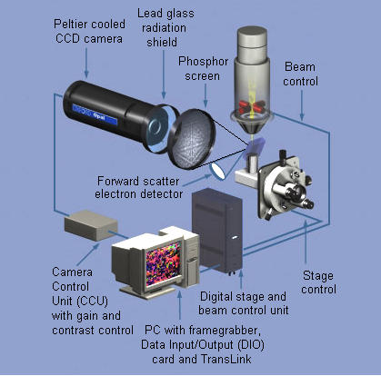
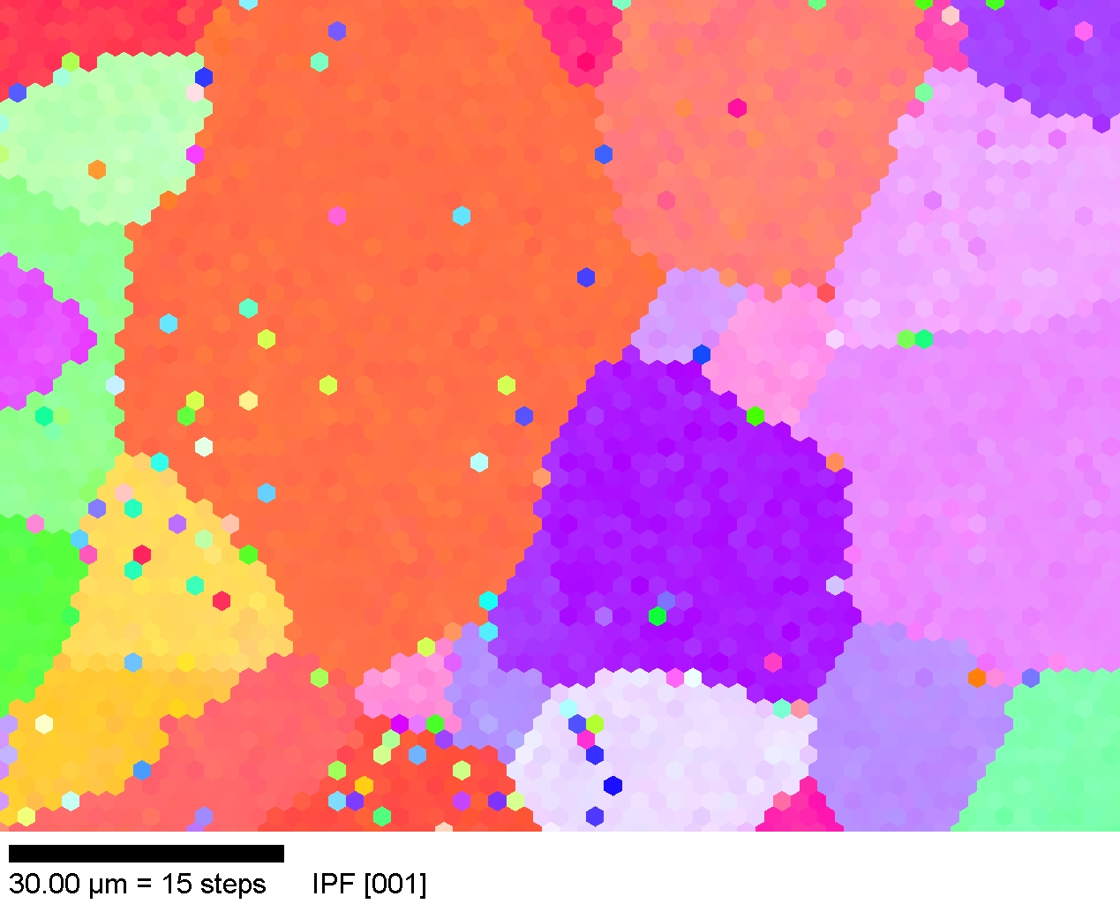
Electron Back-Scatter Diffraction (EBSD/OIM)
Schematic diagram of a typical EBSD system (Oxford INCA)
Provides (2D regular grid) maps of crystal orientation from polished cross-sections
Adams, B., K. Kunze and S. I. Wright (1993) Metall. Mater. Trans. 24A: 819

Slide 3
Overview
Understanding the program:
  Important menus
  Definition of Grains in OIM
  Partitioning datasets
Cleaning up the data:
  Types
  Examples of Neighbor correlation
  Importance of reporting clean-up in reports
Orientation:
  System Definition
  Distribution Functions (ODFs)
  Plotting ODFs

Slide 4
Overview
Misorientation:
  Definitions - Orientation vs. Misorientation
  Distribution Functions (MDFs)
  Plotting MDFs
Other tools:
  Plotting Distributions
  Interactive tools
Frames of Reference:
  Spatial versus Euler frames
  Different suppliers of software
  Issues with Hexagonal materials
Important: the menus change as the software packages are updated. Although this lecture is illustrated from (older versions of) the TSL software, similar functions area available in other EBSD analysis software. Mtex also provides a number of the analysis functions.

Slide 5
Questions & Answers
How are Orientation Distributions computed?
  The discrete orientations provide the input data to which the coefficients of the generalized spherical harmonic functions are fitted.
What is the difference between a discrete plot and a contour plot and when should I use them?
  The discrete plots provide individual points in pole figures, inverse pole figures, ODs etc. Contour plots are always based on the fitted generalized spherical harmonic functions.
What is meant by the various different measures of orientation spread within a grain, and what are they useful for?
  The names given to the functions vary across the packages. There is a pixel-based measure that computes the average of the misorientation between a given point/pixel and its first nearest neighbor points (generally, 8 NN in a square lattice); there is also an average over all points in a given grain (e.g. Grain Average Misorientation). This is sensitive to only local orientation gradients. There is also a pixel-based measure that gives the misorientation between the given point and the average orientation for the grain; likewise there is an average quantity for the whole grain. This pair of measures are sensitive to long range orientation gradients (found, e.g., in shear bands, kink bands etc.).

Slide 6
Questions & Answers
Why do I have to worry about reference frames?
  Orientations are given in reference to a frame that is different from the frame in which the coordinates of the image; see the notes for details. Different softwares have different alignments, and hexagonal materials are a particular problem because of different conventions for the alignment of the orthonormal frame used for calculation versus the crystallographic frame of reference.
What is “clean-up”?
  “Clean-up” is a generic term for the various steps used to remove unreliable or non-indexed points from the map and replace them with (in general) more reliable orientations from neighboring pixels. Generally speaking, the methods are analogous to “erosion” and “dilation” used in image processing.
How is the grain structure determined (slide 9)?
  The procedure that is typically used is known as a “burn algorithm” in percolation analysis. One starts at an arbitrary pixel location and uses it as the starting point of a grain; add any nearest neighbor pixel to the grain that has a misorientation with the first point less than some user-chosen threshold. Repeat until no more points can be added according to the threshold. The largest threshold typically used is 15°, i.e. the limit for low-angle boundaries in cubic materials.

Slide 7
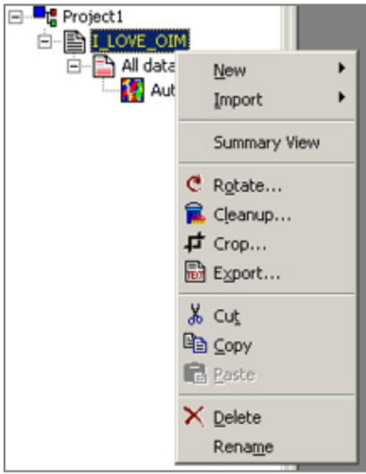
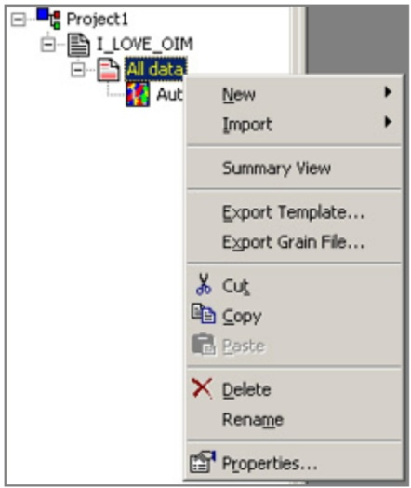
Navigating the menus
There are two menus that access virtually everything:
Check the scan stats
Creates new partitions
Rotate the orientations of each point about sample frame
Imports data as partitions
Access to routines that cleanup the dataset
Cut out scan sections
Use this to export text .ang files
Check the partition stats & definition
Access to menu for:
- Maps
- Texture calculation
- Texture plots
Change the partition properties:
Decide which points to include
Define a “grain”
Export grain ID data associated with each point

Slide 8
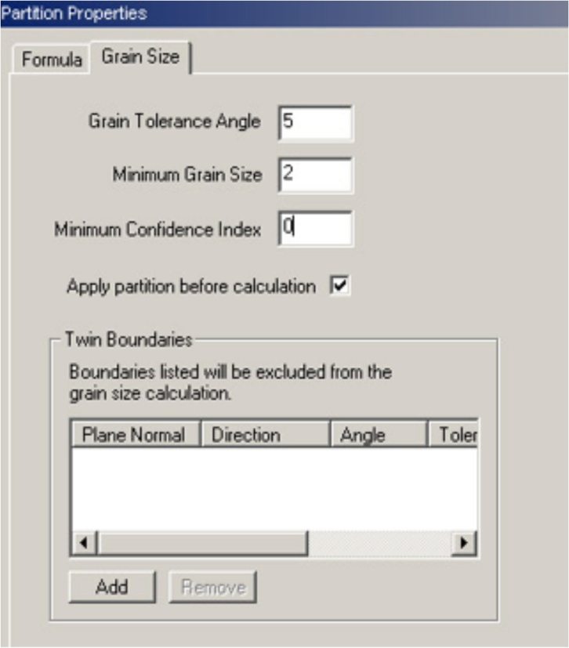
Grain Definitions
OIM defines a set of points to constitute a grain if:
- A path exists between any two points (in the set) such that it does not traverse a misorientation angle more than a specified tolerance
- The number of points is greater than a specified number
Points with a CI less than specified are excluded from statistics
Note: Points that are excluded are given a grain ID of 0 (zero) in exported files

Slide 9
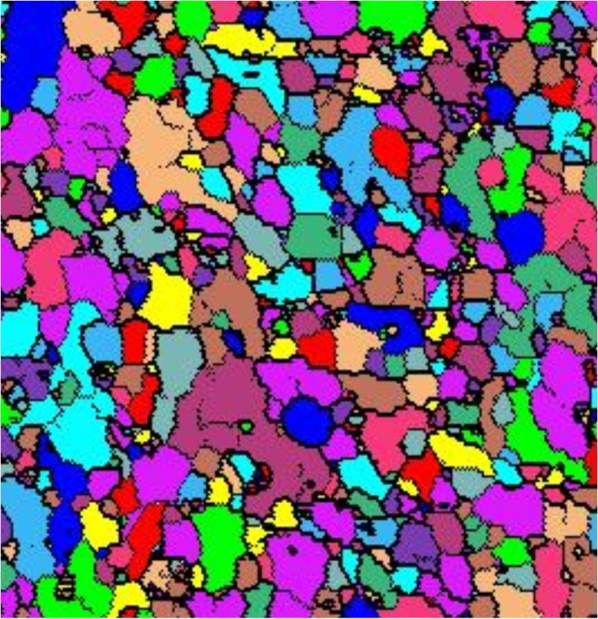
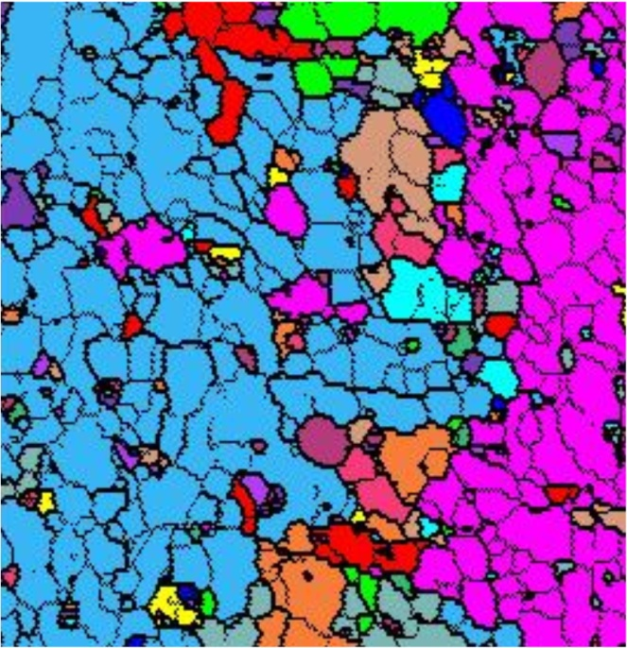
Grain Definitions
3 degrees
15 degrees
Note that each color represents 1 grain
Examples of definitions

Slide 10
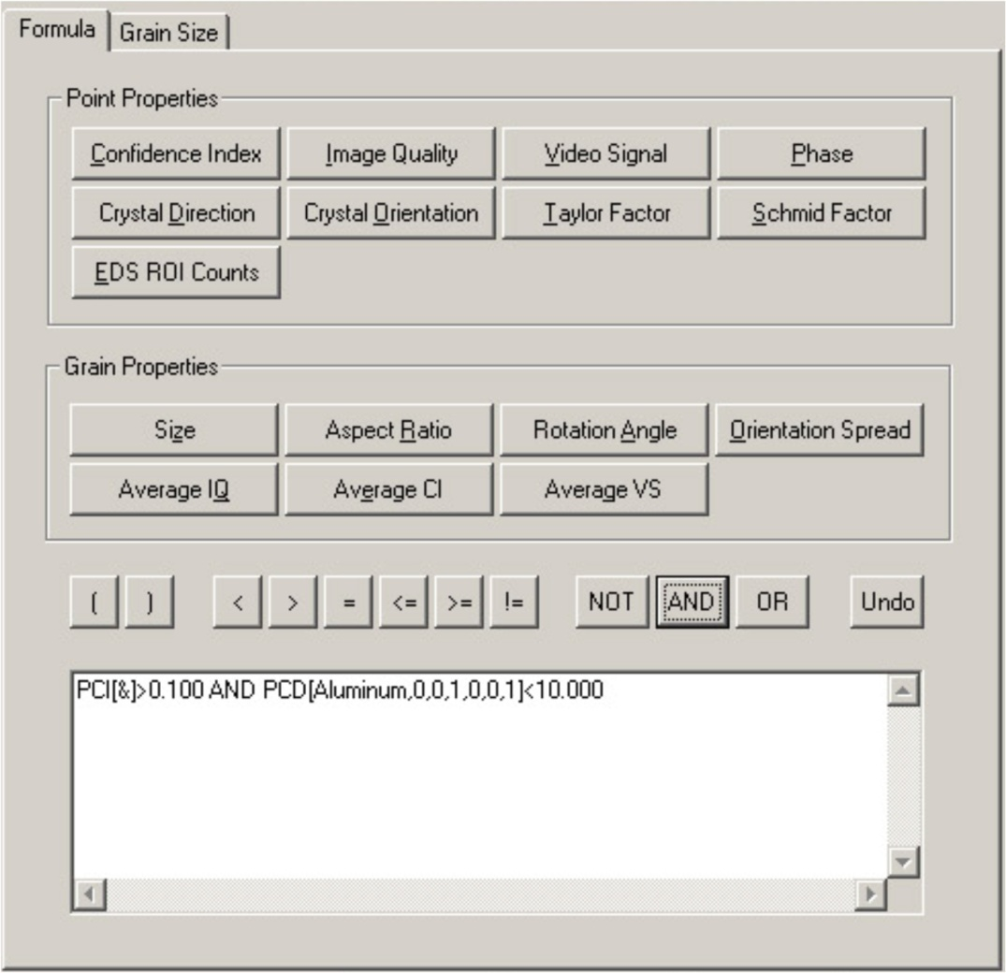
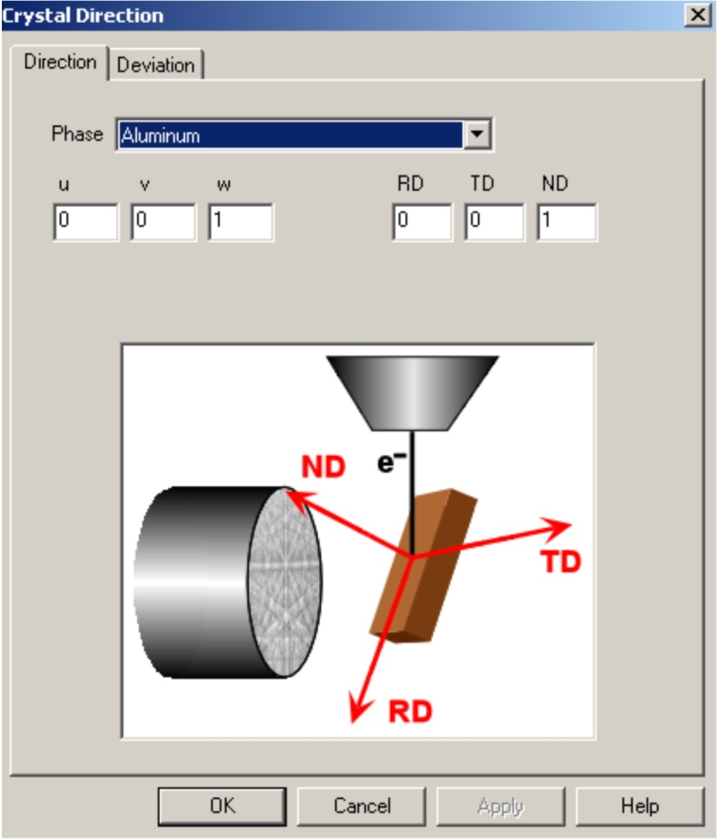
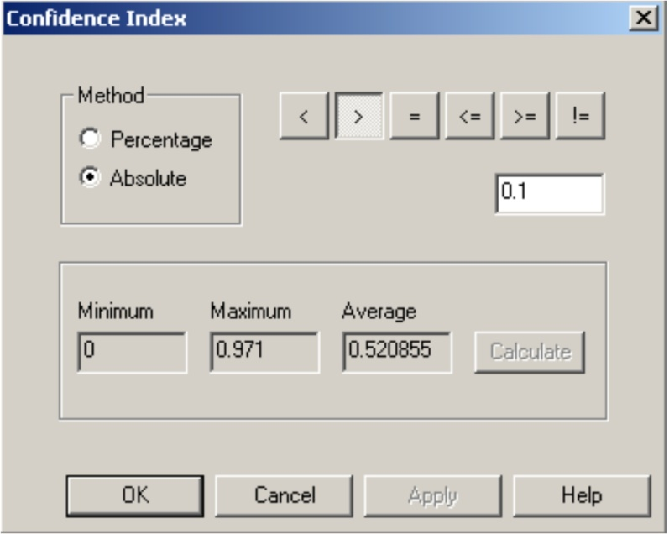
Partitioning Datasets
Choose which points to include in analysis by setting up selection formula
Use to select by individual point attributes
Use to select by grain attributes
Selection formula is explicitly written here

Slide 11
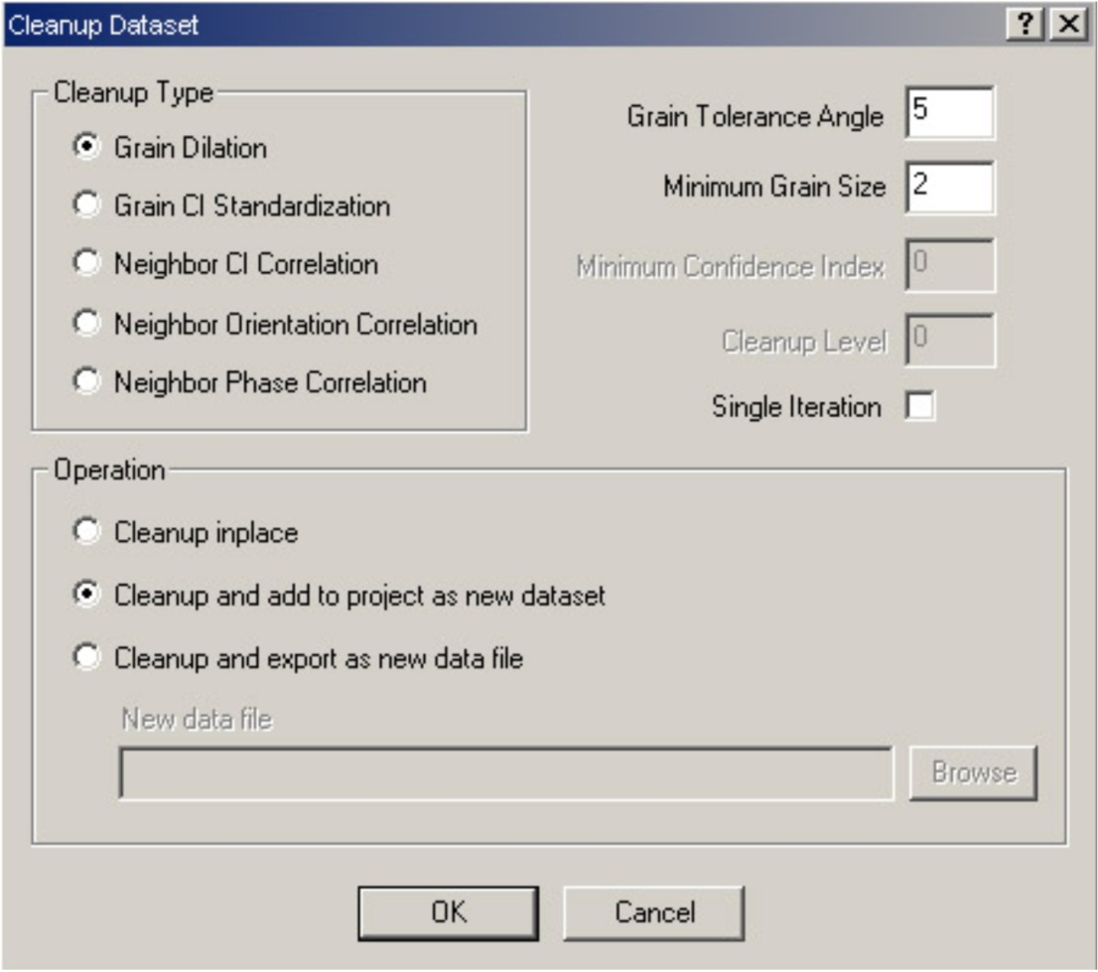
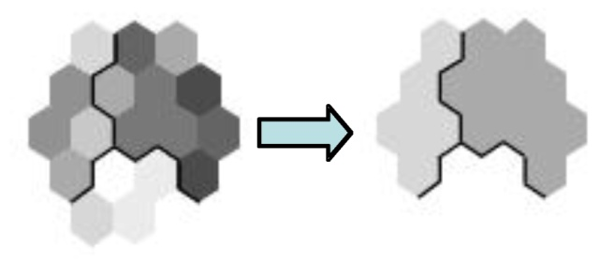
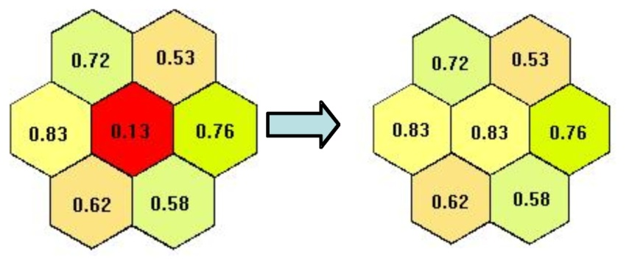
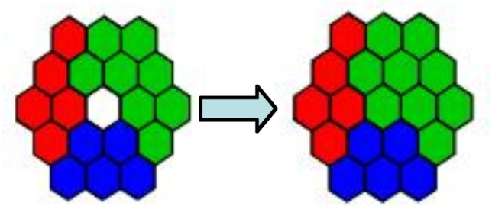
Data Cleanup
Neighbor Orient. Correlation
Performed on all points in the dataset
For cleanup level n:
Condition 1: Orientation of 6-n nearest neighbors is different than current point (misorientation angle > chosen)
Condition 2: Orientation of 6-n nearest neighbors is the same as each other
If both conditions are met, the point’s orientation is chosen to be a neighbor’s at random
Repeat low cleanup levels (n=3 max) until no more points change for best results
Neighbor Phase Correlation
- Same as Grain Dilation but instead of using the grain with most number of neighboring points, the phase with the most number of neighboring points is used
Grain CI Standardization:
Changes the CI of all points within a grain to be that of the highest within each grain
Most useful if a minimum CI criterion is used in analyzing data (prevents low CI points within a grain from being lost)
Neighbor CI Correlation
Performed only on points with CI less than a given minimum
The orientation and CI of the neighbor with highest CI is assigned to these points
Use when majority of points are high CI, and only a few bad points exist
Grain Dilation:
Acts only on points that do not belong to any grain as defined
A point becomes part of the grain with the most number of surrounding points
Takes the orientation and CI of the neighboring point with highest CI
Use to remove bad points due to pits or at G.Bs
Output Options:
Overwrite current dataset
Create “cleaned up” dataset as a new dataset
Write the “cleaned up” dataset directly to file

Slide 12
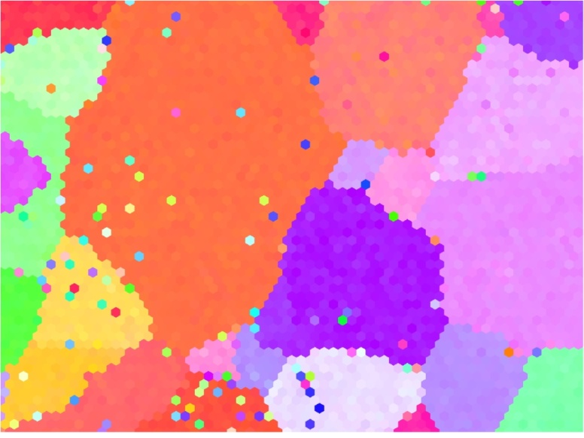
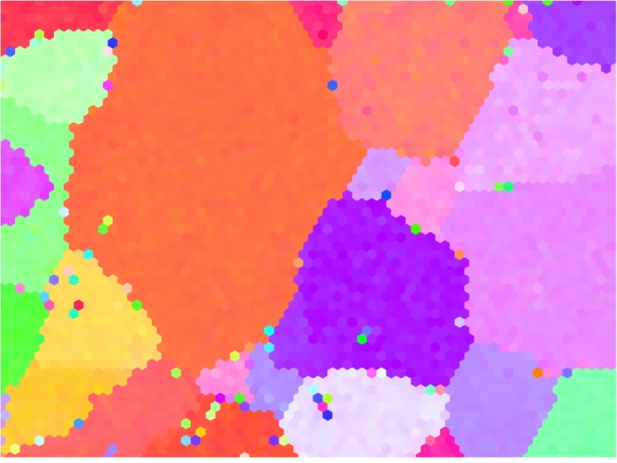
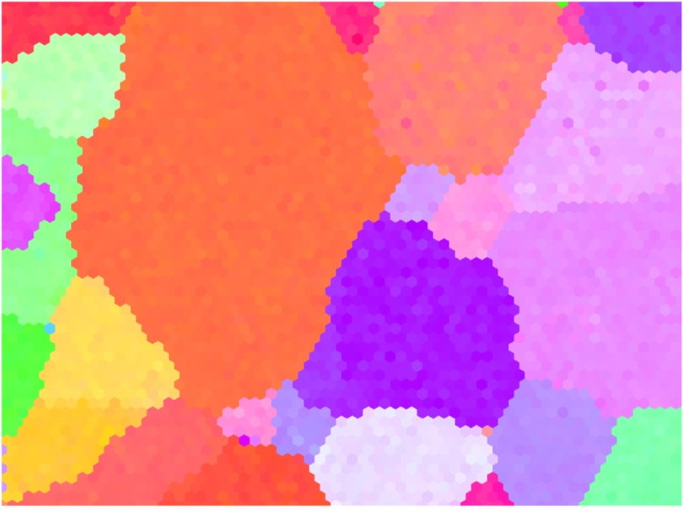
Neighbor Correlation Example
No Cleanup
Level 0
Note that Higher cleanup levels are iterative (i.e. Level 3= Levels 0,1,2,3)
Level 3

Slide 13
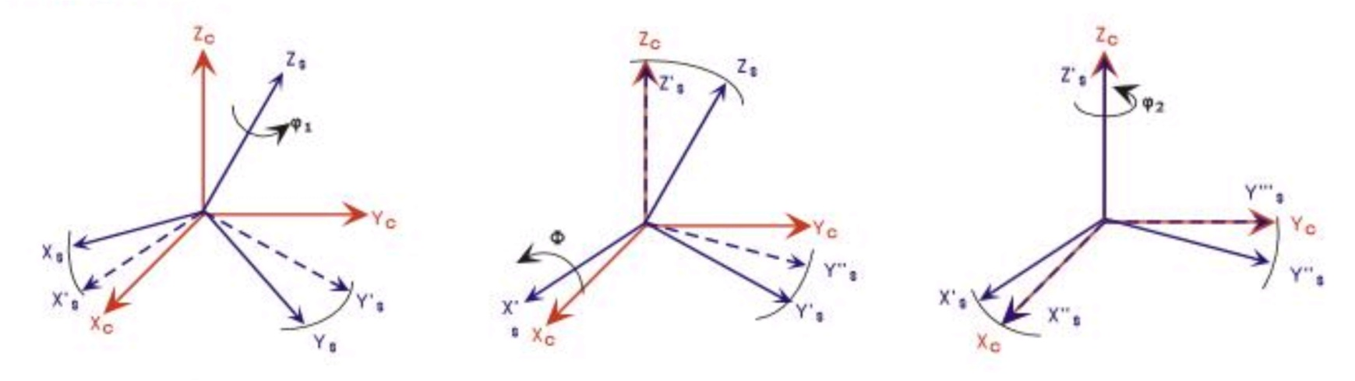
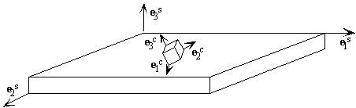
Definition of Orientation
e₂^{s}
e₁^{s}
ϕ₁
Φ
ϕ₂
NB: a more comprehensive discussion of reference frames is given later
By definition an orientation is always relative. The OIM uses the sample surface to define the orthogonal reference frame.
Quantities are transformed from sample frame to crystal frame

Slide 14
Reference Frames
This next set of slides is devoted to explaining, as best we can, how to relate features observed in EBSD images/maps to the Euler angles.
In general, the Euler frame is not aligned with the x-y axes used to measure locations in the maps.
The TSL (OIM™) and Channel (HKL) softwares both rotate the image 180° relative to the original physical sample.
Both TSL (OIM™) and Channel (HKL) softwares use different reference frames for measuring spatial location versus the the Euler angles, which is, of course, extremely confusing.

Slide 15
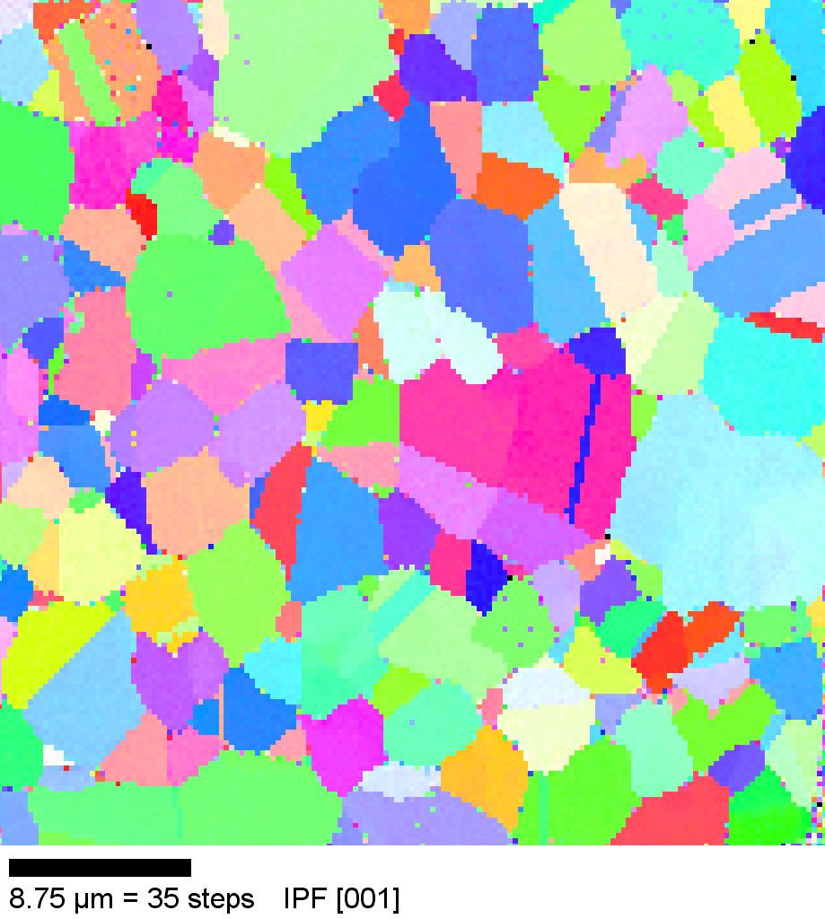
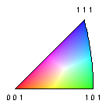
Z_{spatial} points in to the plane
Z_{Euler} points out of the plane
TSL / OIM Reference Frames
TD = y_{Euler} = 010_{sample}
x_{spatial}
The purple line indicates a direction, associated with, say, a scratch, or trace of a grain boundary on the specimen.
+
RD = x_{Euler}
=100_{sample}
Physical specimen:
Mounted in the SEM, the tilt axis
is parallel to “x_{spatial}”
y_{spatial}
Image:
Note the 180° rotation.
ND
= z_{Euler}
Sample Reference Frame for Orientations/Euler Angles
-TD
= -y_{Euler}
-RD
= -x_{Euler}
“+” denotes the Origin
Crystal Reference Frame:
Remember that, to obtain directions and tensor quantities in the crystal frame for each grain (starting from coordinates expressed in the Euler frame), one must use the Euler angles to obtain a transformation matrix (or equivalent).
+
y_{spatial}
x_{spatial}
Z_{spatial}
Reference Frame for Spatial Coordinates
Notes:
15
NB: this alignment is not the same as that determined by Sukbin Lee

Slide 16
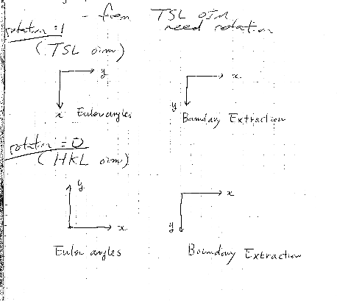
TSL / OIM Reference Frames for Images
Conversion from spatial to Euler and vice versa (TSL only)
From Herb Miller’s notes:
The axes for the TSL Euler frame are consistent with the RD-TD-ND system in the TSL Technical Manual, but only with respect to maps/images, not the physical specimens.
The axes for the HKL system are consistent with the information provided by users in Metz. Here, x is in common, but the two y-axes point in opposite directions.
Note that the transformation is a 180° rotation about the line x=y
Notes: the image, as presented by the TSL software, has the vertical axis inverted in relation to the physical sample, i.e. a 180° rotation.

Slide 17
TSL / OIM Reference Frames:
Coordinates in Physical Frame, Conversion to Image
• The previous slides make the point that a transformation is required to align spatial coordinates with the Euler frame.
• However, there is also a 180° rotation between the physical specimen and the image. Therefore to align physical markings on a specimen with traces and crystals in an image, it is necessary to take either the physical data and rotate it by 180°, or to rotate the crystallographic information.
ND
= z_{Euler}
Sample Reference Frame for Orientations
-TD
= -y_{sample}
• How to measure lines etc. on a physical specimen?
• Answer: use the spatial frame as shown on the diagram to the left (which is NOT the normal, mathematical arrangement of axes) and your measured coordinates will be correct in the images, provided you plot them according to the IMAGE spatial frame. The purple line, for example, will appear on the image (e.g. an IPF map) as turned by 180° in the x-y plane.
-RD
= -x_{Euler}
+
y_{spatial}
x_{spatial}
Z_{spatial}

Slide 18
Cartesian Reference Frame for Physical Measurement
• How to measure lines etc. on a physical specimen using the standard Cartesian frame with x pointing right, and y pointing up?
• Answer: use the Cartesian frame as shown on the diagram to the left (which IS the normal, mathematical arrangement of axes and is NOT the frame used for point coordinates that you find in a .ANG file). Apply the transformation of axes (passive rotation) as specified by the transformation matrix shown and then your measured coordinates will be in the same frame as your Euler angles. This transformation is a +90° rotation about z_{sample}. In this case, the z-axis points out of the plane of the page.
x_{Euler}
y_{Cartesian}
y_{Euler}
x_{Cartesian}

Slide 19
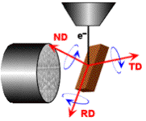
TSL / OIM Reference Frames: Labels in the TSL system
The diagram is reproduced from the TSL Technical Manual (v5 and older); the designation of RD, TD and ND is only correct for Euler angles in reference to the plotted maps/images, not the physical specimen
= x_{spatial}
= y_{Euler}
= y_{spatial}
= x_{Euler}
• What do the labels “RD”, “TD” and “ND” mean in the TSL literature?
• The labels should be understood to mean that RD is the x-axis, TD is the y-axis and ND the z-axis, all for Euler angles (but not spatial coordinates).
• The labels on the Pole Figures are consistent with the maps/images (but NOT the physical specimen).
• The labels on the diagram are consistent with the maps/images, but NOT the physical specimen, as drawn.
• The frame in which the spatial coordinates are specified in the datasets is different from the Euler frame (RD-TD-ND) – see the preceding diagrams for information and for how to transform your spatial coordinates into the same frame as the Euler angles, using a 180° rotation about the line x=y.

Slide 20
TSL versus HKL Reference Frames
The two spatial frames are the same, exactly as noted by Changsoo Kim and Herb Miller previously. The figures show images (as opposed to physical specimen).
The Euler angle references frames differ by a rotation of +90° (add 90° to the first Euler angle) going from the TSL to the HKL frames (in terms of an axis transformation, or passive rotation). Vice versa, to pass from the HKL to the TSL frame, one needs a rotation of -90° (subtract 90° from the first Euler angle).
The position of the “sample” axes is critical. The names “RD” and “TD” do not necessarily correspond to the physical “rolling direction” and “transverse direction” because these depend on how the sample was mounted in the microscope.
TD
=010_{sample}
= y_{Euler}
RD
=100_{sample} = x_{Euler}
TD
=010_{sample}= y_{Euler}
x_{spatial}
x_{spatial}
Z (x)
+
+
Z (x)
RD
=100_{sample}
= x_{Euler}
y_{spatial}
y_{spatial}
HKL
TSL

Slide 21
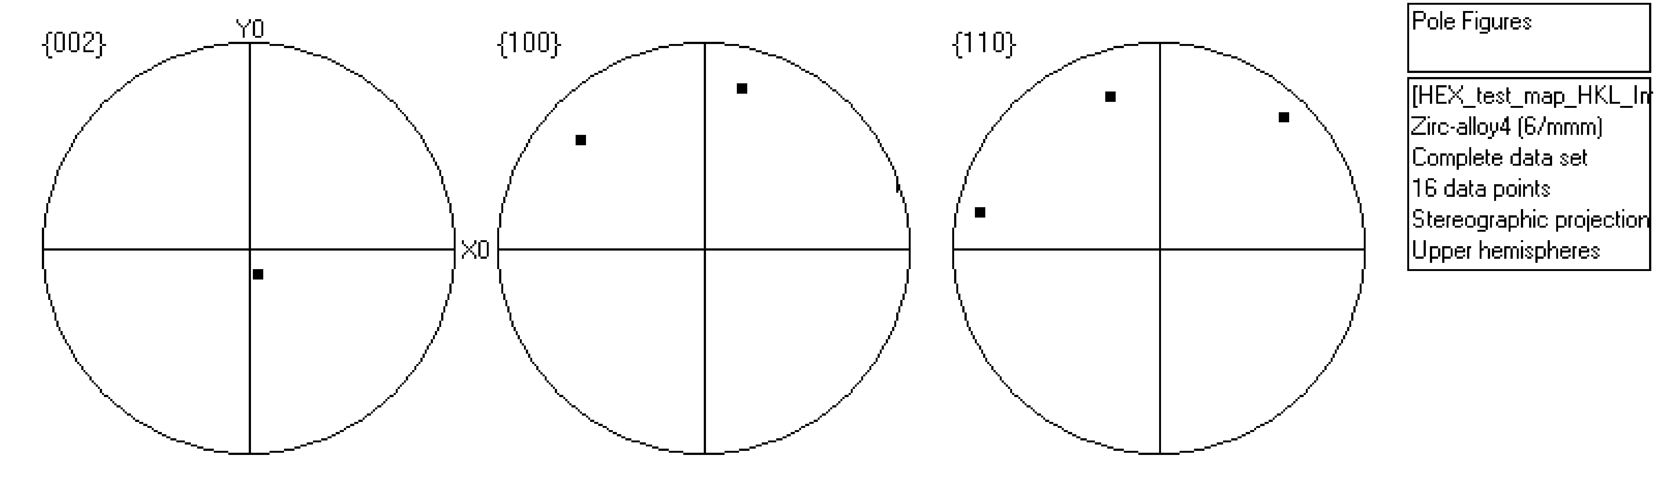
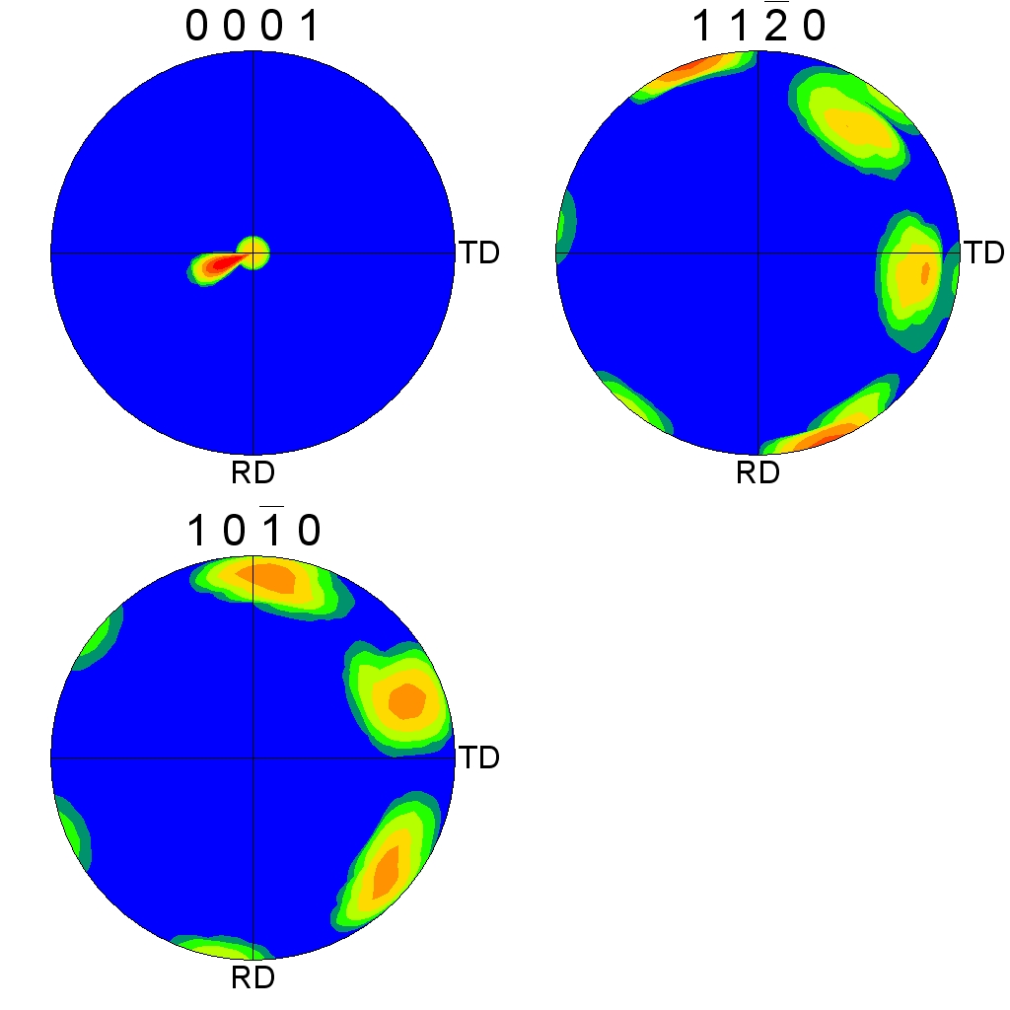
Test of Euler Angle Reference Frames
φ₁
Hexagonal crystal symmetry (no sample symmetry)
Φ
Euler angles: 17.2°, 14.3°, 0.57°
HKL
Φ
A simple test of the frames used for the Euler angles is to have the softwares plot pole figures for a single orientation with small positive values of the 3 angles. This reveals the position of the crystal x-axis via the sense of rotation imposed by the second Euler angle, Φ.
Clearly, one has to add 90° to φ₁ to pass from HKL coordinates to TSL coordinates.
Note that the CMU TSL is using the x//1120 convention (“X convention”), whereas the Metz Channel/HKL software is using the y//1120 convention (“Y convention”).
φ₁
TSL

Slide 22
The Axis Alignment Issue for Hexagonal
The issue with hexagonal materials is the alignment of the Cartesian coordinate system used for calculations with the crystal coordinate system (the Bravais lattice).
In one convention (e.g. popLA, TSL), the x-axis, i.e. [1,0,0], is aligned with the crystal a₁ axis, i.e. the [2,-1,-1,0] direction. In this case, the y-axis is aligned with the [0,1,-1,0] direction.
In the other convention, (e.g. HKL, Univ. Metz software), the x-axis, i.e. [1,0,0], is aligned with the crystal [1,0,-1,0] direction. In this case, the y-axis is aligned with the [-1,2,-1,0] direction.
See next page for diagrams.
This is important because texture analysis can lead to an ambiguity as to the alignment of [2,-1,-1,0] versus [1,0,-1,0], with apparent 30° shifts in the data.
Caution: it appears that the axis alignment is a choice that must be made when installing TSL software so determination of which convention is in use must be made on a case-by-case basis. It is fixed to the y-convention in the HKL software.
The main clue that something is wrong in a conversion is that either the 2110 & 1010 pole figures are transposed, or that a peak in the inverse pole figure that should be present at 2110 has shifted over to 1010.

Slide 23
Hexagonal Materials: Diagram of Axes
a₃ //
y // [010]_{Cartesian}
a₂ //
x // [100]_{Cartesian}
y // [010]_{Cartesian}
x // [100]_{Cartesian}
a₁ //

Slide 24
Euler Angles
To add to the confusion, all of the different Euler angle conventions can, and are used for hexagonal materials.
Recall that Bunge Euler angles make the second rotation about the x-axis, whereas Roe, Matthies and Kocks angles rotate about the y-axis.
Generally speaking there is no problem provided that one stays within a single software analysis system for which the indexing is self-consistent. There are, however, known issues with calculation of inverse pole figures in the popLA package.

Slide 25
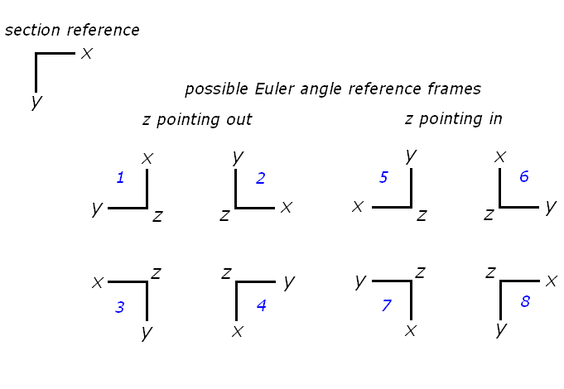
HKL frames
Xpix
Z1
Ypix
top
Ypix
X1
Xpix
Y1
CS1 = raw data format
bottom
CS0 is modified by the user to align axes however they please. The CTF format always exports in CS0 arrangement.
first acquired pixel
(Xpix=1,Ypix=1)
Euler angle reference frame
"Virtual chamber" of HKL software, which is used to define the specimen orientation in the microscope chamber
(= how to align frame_0 with frame_1); picture is drawn as if the observer was the camera. Note that the maps are turned by 180° with respect to this picture.
- original Euler angles are given in frame_1 (also called CS1)
The ctf format is designed to export Euler angle into frame_0 (CS0), which is correct, provided that the specimen orientation is correctly defined.
25

Slide 26
HKL software
keeping CS0 (sample frame) aligned with CS1(microscope frame)
relying on what the virtual chamber is showing :
Xpix
Z1
Ypix
top
Ypix
X1
Xpix
Y1
CS1 as shown in the virtual chamber
bottom
CS1
first acquired pixel (X_{spatial}=1,Y_{spatial}=1)
= top left pixel of the resulting map
but this alignment is not consistent with the axes of the PF plots…
or with previous experience with data sets from the HKL software

Slide 27
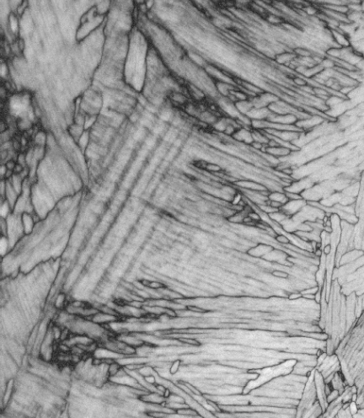
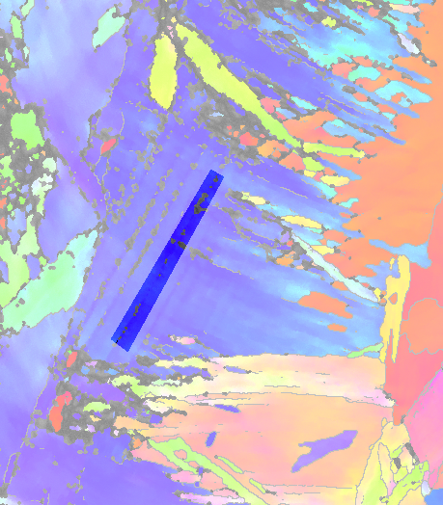
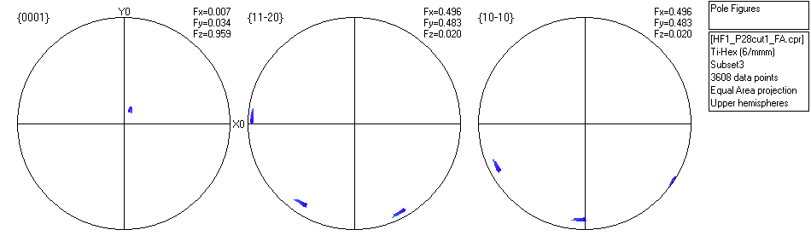
Beta-transformed Ti (from Nathalie Gey, LETAM – now LEM3)
(Z0 pointing out)
Traces of {10-10} planes
X_{spatial}
EBSD map
Euler frame
Y_{spatial}
Xpix, Ypix = spatial frame
X0,Y0,Z0 = euler angle frame, supposed to be aligned with X1,Y1,Z1 (µscope frame)
Spatial frame
Note that a rotation of the PF axes by 180° around Z to recover the frame numbered 3 on the PF plots, would also be consistent with the trace being perpendicular to <10-10>…

Slide 28
Notes on HKL Frames
There is a discrepancy in the HKL software between how the frame CS1 (and CS0) is represented in the virtual chamber and how the PF axes are placed
The difference is a rotation by 180° around the Z direction (frame numbered 2 versus frame 3)
It is not possible to determine which one is correct from the two previous slides
Nevertheless, the test maps acquired with LETAM's HKL system and with MRSEC's TSL one did show that the frame number 2 was the correct one

Slide 29
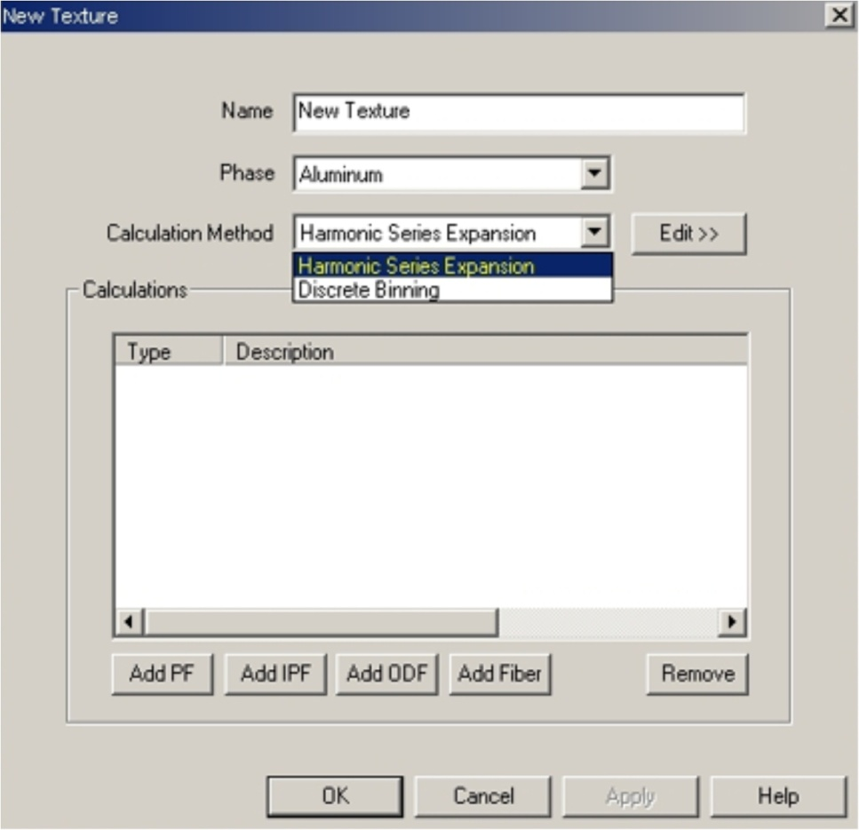
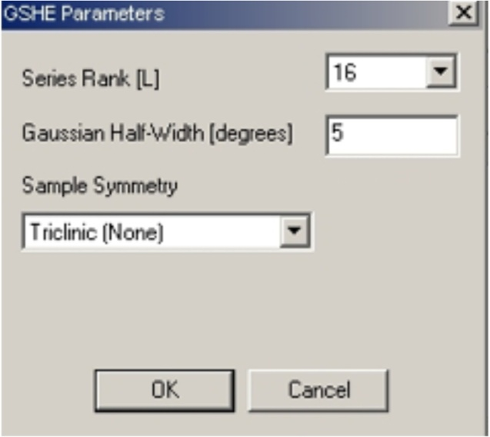
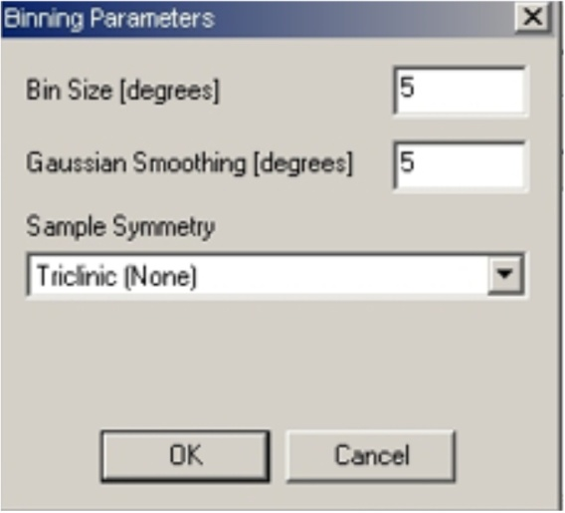
Orientation Distribution Functions
Discrete ODF:
Bin size defines the volume of each element in orientation space (5ºx5ºx5º)
Fast calculation
Suitable for most texture strengths but not weak textures if the number of grains is small (consider the number of data points per cell required to achieve reasonably low noise)
Continuous ODF:
Generalized Spherical Harmonic Functions: Rank defines the “resolution” of the function
Equivalent to a Fourier transform
Calculation time rises steeply with rank number (32 is an effective maximum)
Time intensive
Mostly appropriate for weaker textures
Some smoothing is inherent
The ODF displays how the measured orientations are distributed in orientation space
Two types of distributions can be calculated:

Slide 30

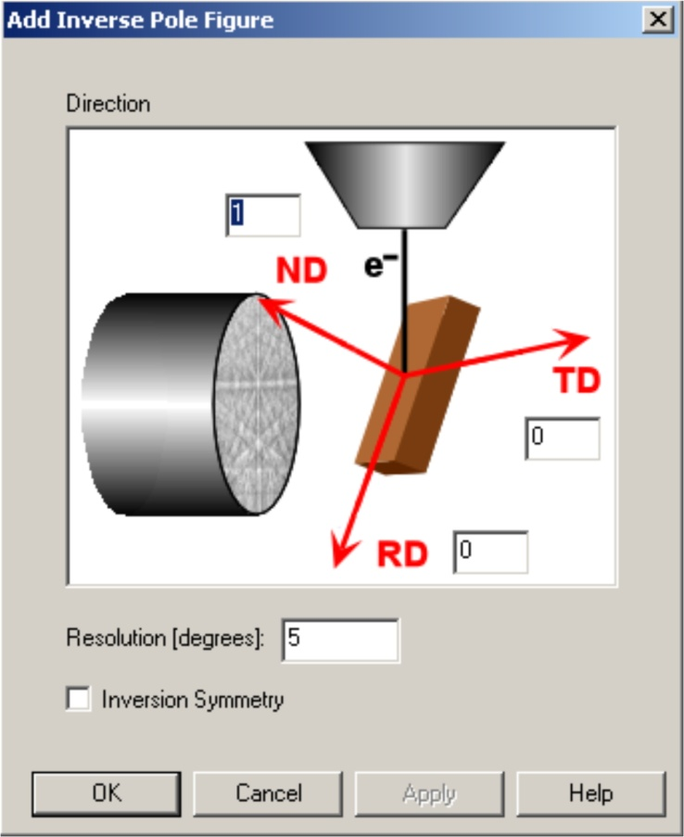
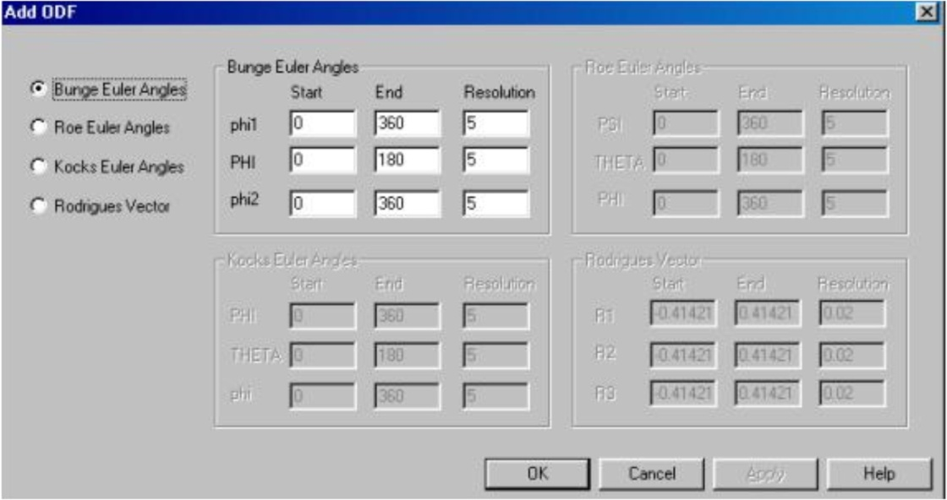
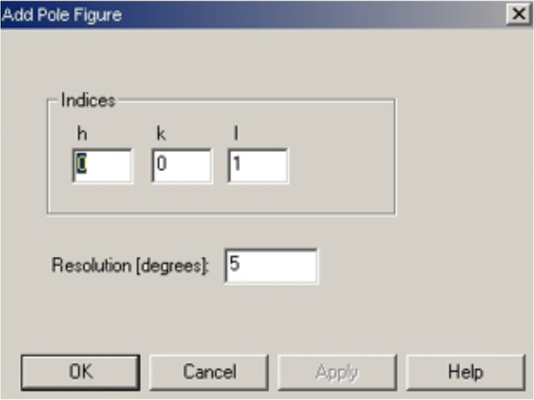
Plotting Orientation Distributions
One must select the types of data visualization desired
Euler space plot shows the distribution of intensity as a function of the Euler angles
Used to visualize pockets of texture as well as “fiber” textures
Resolution defines how many slices are possible in the plot
Pole figures show the distribution of specific crystal planes w.r.t. sample reference frame
For the generation of more than one PF, they need to be added one at a time.
Inverse Pole Figures are used to illustrate which crystal plane normals are parallel to sample directions (generally RD, TD & ND)
The indices entered represent which sample reference frame plane is being considered: 100, 010 and 001 are typical choices
Multiple planes also need to be entered one at a time

Slide 31
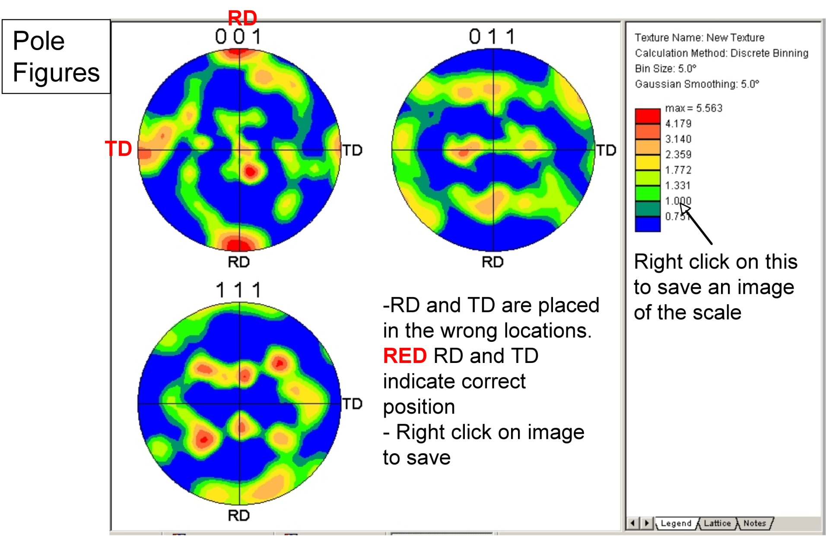
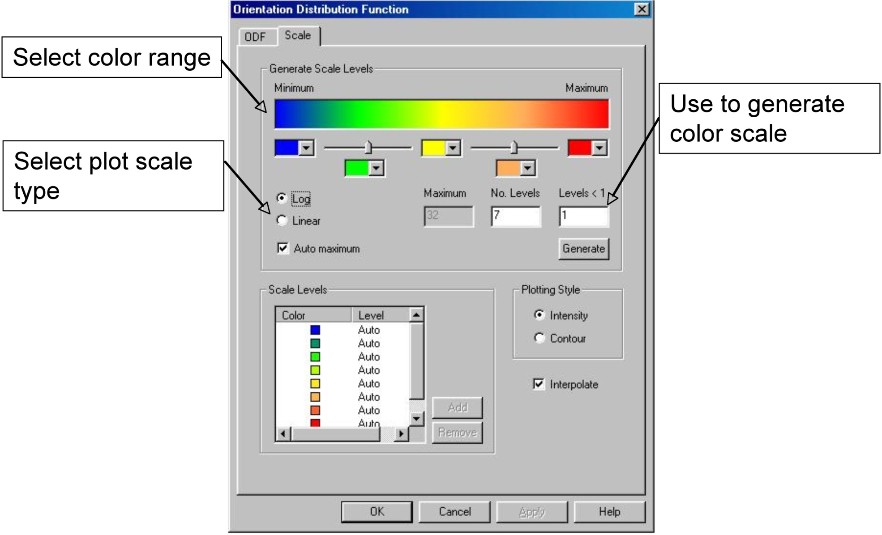
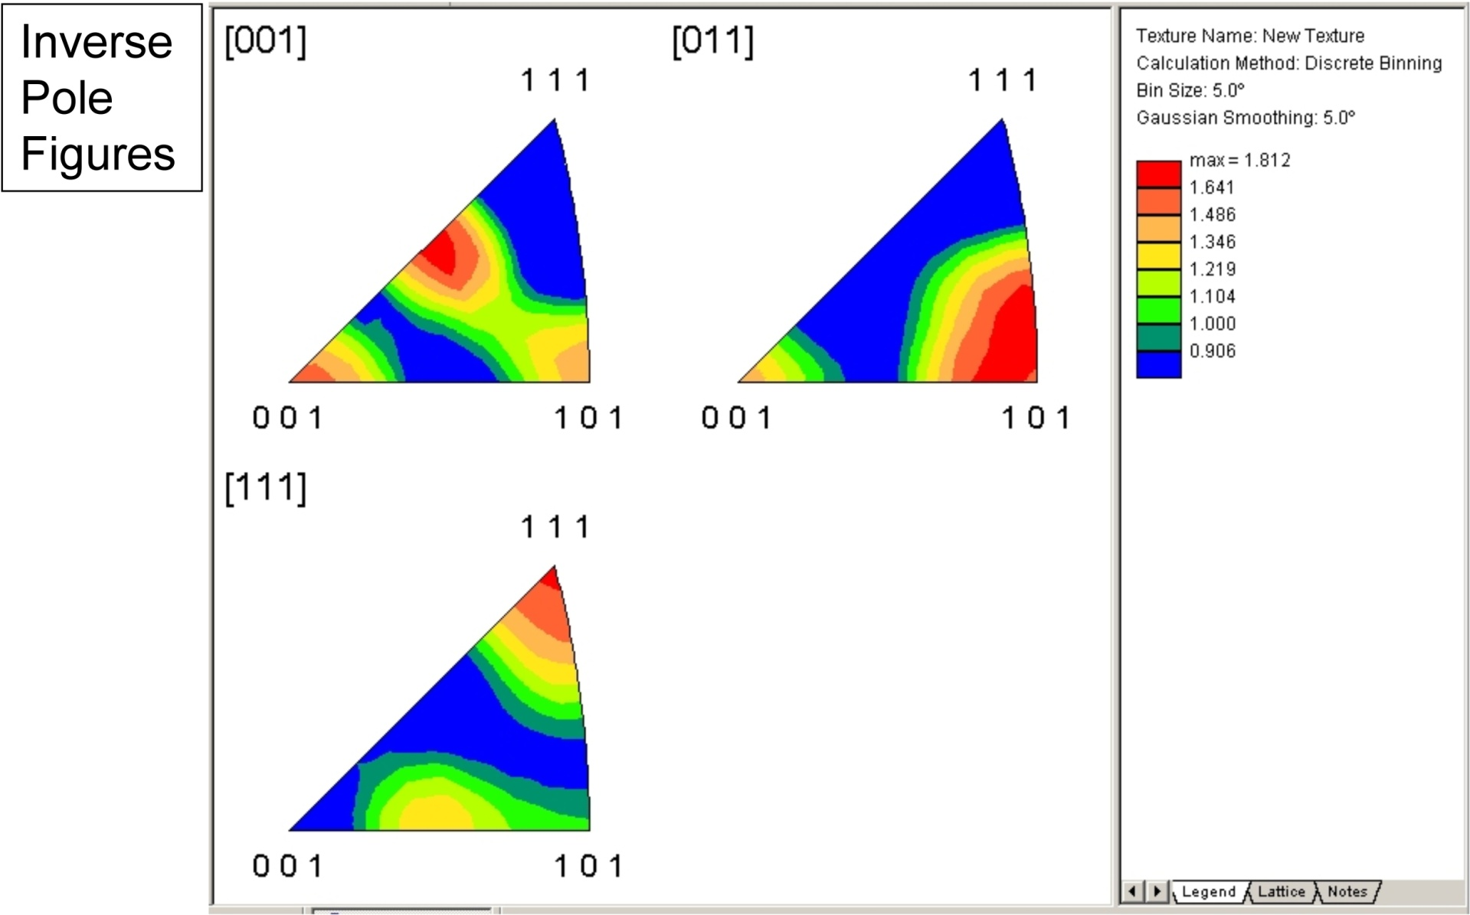
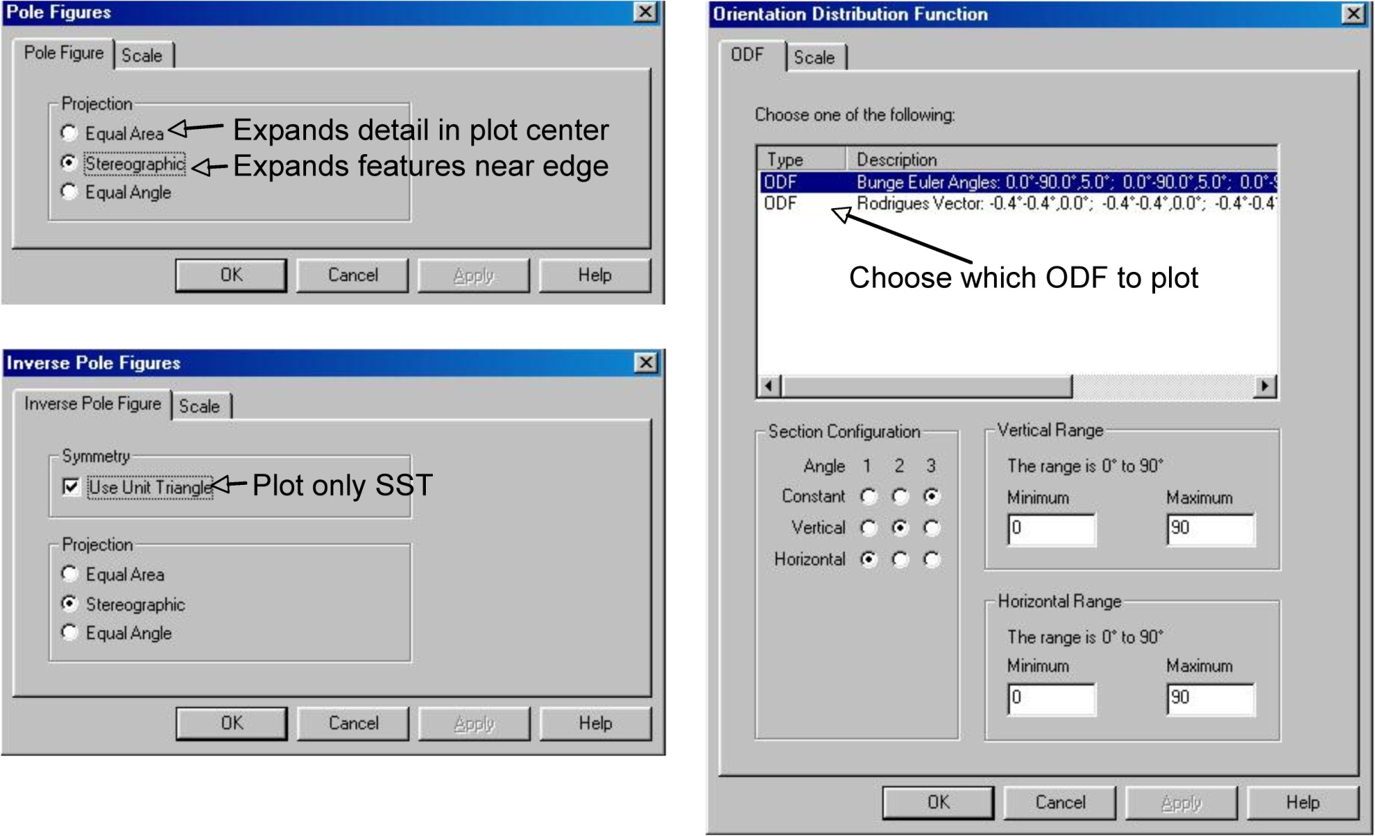
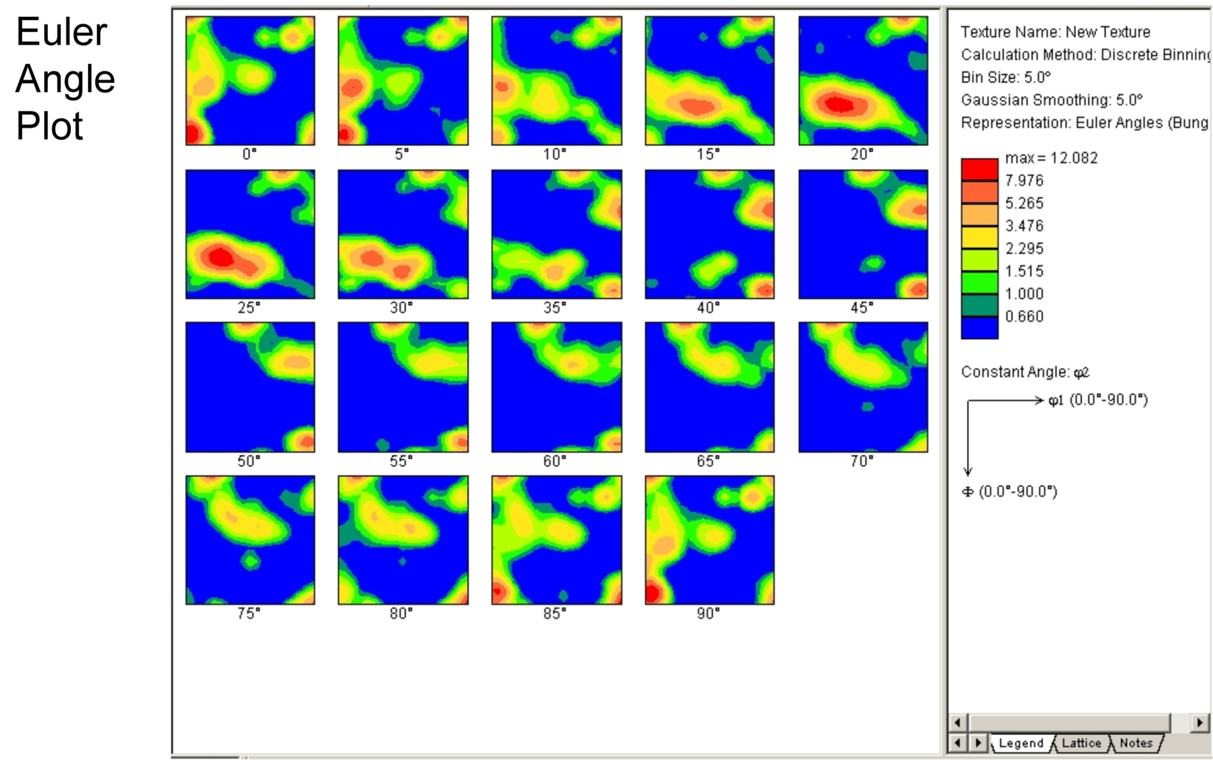
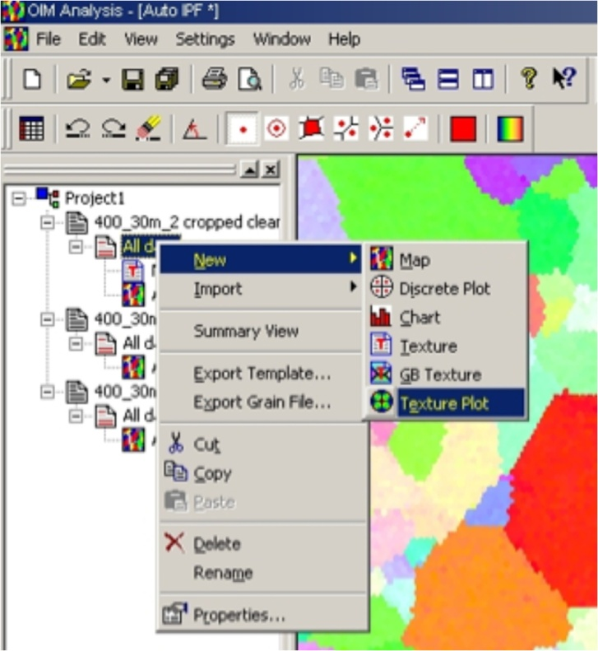
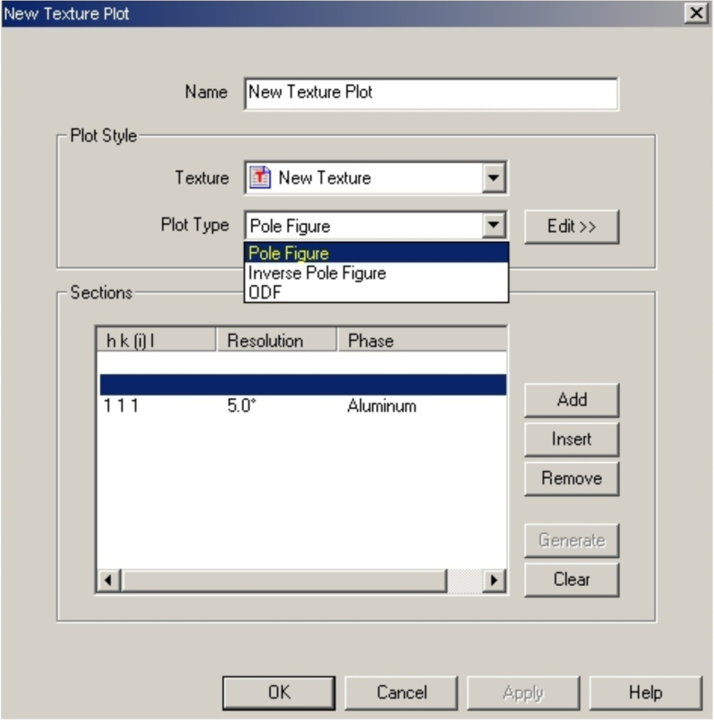
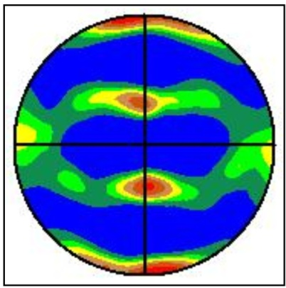
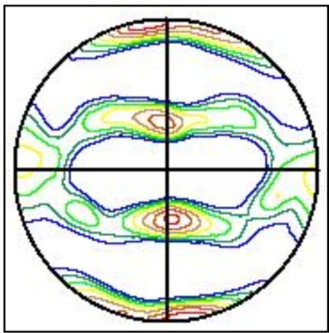
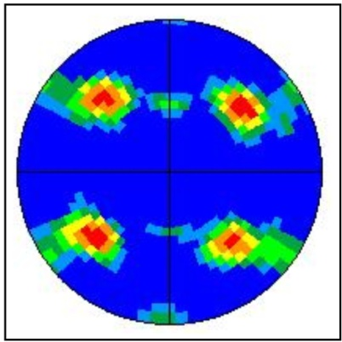
Types of ODF/Pole Figure/ Inverse PF Plots
Choose texture and desired plot type
Use to add multiple plots to the same image
NB: a more comprehensive discussion of reference frames is given later

Slide 32
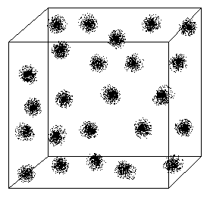
Preparation of the data for analysis
Courtesy of N. Bozzolo
The Average Orientation of the pixels in a grain
is given by this equation:
Very simple, n’est-ce pas?
However, there is a problem...
As a consequence of the crystal symmetry, there are several equivalent orientations.
This example illustrates the point:
i=1,24
RD
{111}
10 000 orientations near to the Brass component:
represented
by a {111} pole figure
and, in the complete Euler space to show the 24 equivalents resulting from application of cubic crystal symmetry
Cho J H, Rollett A D and Oh K H (2005) Determination of a mean orientation in electron backscatter diffraction measurements, Metall. Mater. Trans. 36A 3427-38
Notes:
Calcule d’orientation moyenne comprit le moyenne arithmétique de chaque coéfficient de quaternion. Mais chaque orientation mesuré a 23 autres réprésentations équivalentes reliées par les opérations de symmétrie. Une exemple de 10,000 orientations proche à Brass nous montre l’effet, a gauche dans une figure de pôle, à droit , dans l’espace d’Euler où on voit 24 nuages d’orientations, un pour chaque opération de symmétrie. Pour calculer, on fait la moyenne avec un seul nuage.

Slide 33
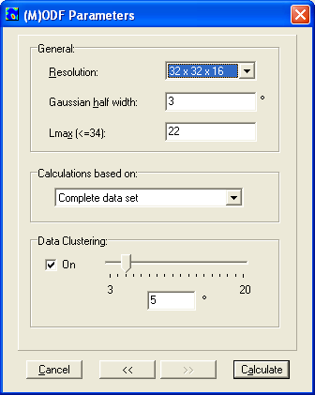
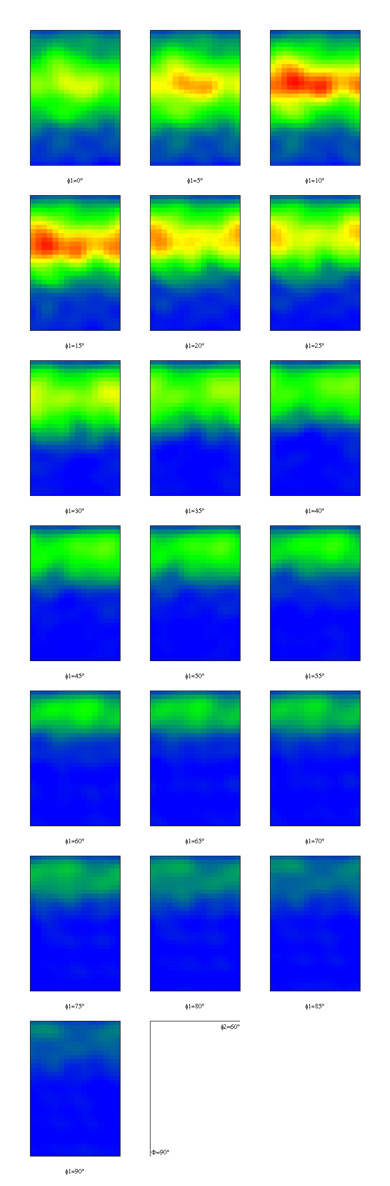
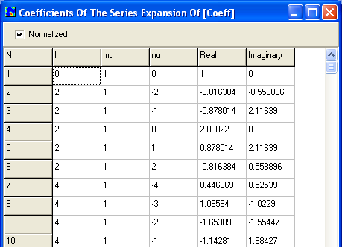
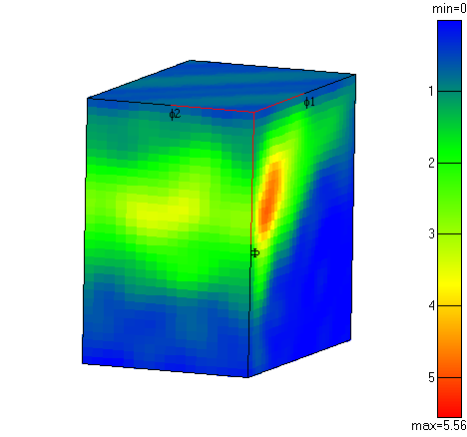
Parameters for texture analysis: example of Zr alloy
...
ϕ₁=0°
ϕ₁=5°
ϕ₁=10°
ϕ₁=15°
...
max = 5.56
Courtesy of N. Bozzolo, CEMEF
Notes:
Ici on voit une representation avec lequelle nous faisons les comparaisons. Il y a beaucoup de données et le choix des paramètres nous donne une certaine representation. En bas gauche, une vue tri-dimensionelle; en haut droit, les coupes dans l’espace d’Euler. En bas droit, la liste des coefficients, un pour chaque fonction harmonique (comme les orbiteaux d’électrones). En général, le valeur de chaque coéfficient décroit avec l’ordre d’harmonique. En effet, on groupe ou “bin” les donnés dans les boîtes, calculer les coéfficients, et goûter/sampler/échantilloner l’espace avec la résolution specifié en haut.

Slide 34


Parameters for texture analysis
Courtesy of N. Bozzolo
Resolution 32x32x16
Gaussian 3°
L_{max} 22
Bin Size 5°
max = 5.56
Effect of the binning resolution
Effect of the width of the Gaussian
16x16x8
3°
22
5°
32x32x16
8°
22
5°
max = 5.37
max = 4.44
Notes:
En bas gauche, l’effet de croisance en résolution d'affichage. L’image devient plus grossière parce qu’on « goût » l’espace moins souvent. Aussi le maximum décroit un peu.
En bas droit, l’effet de enlargir la largeur de gausienne, qui produit une plus douce variation avec un plus petit maximum d’intensité.

Slide 35




Effect of the maximum rank in the series expansion, L_{max}
Resolution 32x32x16
Gaussian 3°
L_{max} 22
Bin Size 5°
Courtesy of N. Bozzolo
L_{max} = 34
L_{max} = 22
L_{max} = 16
L_{max} = 8
L_{max} = 5
max = 6.36
max = 5.56
max = 5.17
max = 4.04
max = 2.43
Clearly, taking the fitting to higher order (angular frequency) provides better resolution of the texture
Notes:
Maintenant, nous montrons l’effet de variation du rang de développement L_{max}. Plus haut rang donne une representation plus détaillée (gauche) avec un maximum plus haut. Rang en bas donne moin détailles et un maximum plus faible.

Slide 36




Direct Method
Courtesy of N. Bozzolo
max = 5.56
In effect the harmonic method gives some ”smoothing" . Without this, a coarse binning of, say, 10°, produces a very “lumpy” result because the Gaussian applied around each point is not sufficiently wide to give a continuous distribution.
Same, with 10° binning :
ϕ₁=5°
max = 31 !
Notes:
Si on n’utilise pas la méthode harmonique et on fait un simple boîtement ou binning des données dans l’espace d’Euler, le résultat est typiquement buité, sauf un très grand quantité de données (et grains, discuté ailleurs). La méthode, en effet, effectue un lissage. Donc, en bas, voyez l’effet d’un binning plus grossier que la résolution pour representation; on peut voir chaque boîte! Telle une concentration des données produit un maximum de 31.

Slide 37
Statistical Aspects
ϕ₀= 4°
Texture = distribution of orientations
→ Problem of sampling!
8.2 at {0 30 25}
9.0 at {-5 30 40}
15.5 at {-5 35 50}
Triclinic sample symmetry
ϕ₀= 8°
0.7
Number of grains measured
Width of the Gaussian ( and/or L_{max})
Influence of the sample symmetry
1.4
7.1 at {0 35 25}
6.9 at {-5 35 35}
7.3 at {345 35 50}
2.0
80000 grains
16000 grains
2000 grains
2.8
4.0
5.6
8.0
11.3
ϕ₀= 8°
16.0
Orthorhombic sample symmetry
6.6
at
{0 35 30}
6.7
at
{0 35 30}
5.8
at
{5 30 15}
Zirconium, equiaxed
Sections thru the OD at constant ϕ₁ (L_{max} = 34)
Gaussian, ϕ₀= 4°
Courtesy of N. Bozzolo
7.6
at
{0 35 30}
7.9 at {0 35 30}
8.3
at
{15 30 30}
Notes:
Donc, combien de grains à mesurer? Faites attention! Il ne s’agit pas du nombre de points! Un balayage sur les mêmes grains avec 1,000, 10,000, 100,000, million etc points ne fait qu’un negligible différence. Le truc est, que les orientations sont semblable, voisins dans chaque grain, et, en conséquence, les données sont aussi localisées dans l’espace d’orientation.
Donc, chaque colonne montre l’effet de décroissane en nombre de grains. Avec nul symmétrie d’échantillon et une petite largeur de Gausienne, premier rang, l’image est bruité dans tous les trois. Avec un plus grande largeur de Gausienne, second rang, l’images sont acceptable sauf la dernière. Avec symétrie d'échantillon orthorhombique et la même grande largeur, l’images sont assez lisses mais le texture est fausse pour le troisième cas. Pour une plus petite largeur, 80000 grains suffit mais il y a une problème avec le moindre nombre.

Slide 38






Statistical Aspects
Courtesy of N. Bozzolo
Homogeneity/heterogeneity of the specimen...
Not just the number of grains must be considered but also their spatial distribution:
Single EBSD map (1 mm²)
Multiple maps, different locations ( total =1 mm²)
equiaxed Ti
{10.0}
RD
(00.1)
TD
ND
0.7
4.0
1.4
5.6
2.0
8.0
2.8
11.3
asymmetry of intensity
Notes:
Malheureusement, l‘échantillonagement ne s’agit pas seulement de nombre de grains! Si le distribution spatial grains est hétérogene, on peuet obtenir un dissymétrie de texture qui est évident dans les figures de pole. L’exemple ci-dessus de Titane nous montre cette effet. On a besoin de mesurer plusieurs balayages en quelques parts d’échantillon pour obtenir un bon résultat. Qu’est-ce que veut dire “bon résultat”? C’est le texture qui est représentative de matériau en tout. Notez que la surface des exemples est égal en les deux.

Slide 39


Texture – Microstructure Coupling
Example : partial texture of populations of grains identified by a grain size criterion
(zirconium at the end of recrystallization )
ϕ
= 0
°
1
0
0.7
7.41
1.4
Φ
2.0
2.8
4.0
D > 2D (=11 µm)
D < D/2 (=2.75 µm)
5.6
3496 grains
14255 grains
8.0
11.3
17.9% surf.
1.7% surf.
90
ϕ
16.0
0
60
2
partial texture of the largest grains
Global texture
Partial texture of the smallest grains
Important for texture evolution during grain growth: the large grains grow at the expense of the small grains. Since the large grains have a different texture, the overall texture also changes during growth.
Notes:
Seconde exemple de couplage entre texture et microstructure. Si on partage les grains dans parties avec grains grands et grains petits, et puis évaluer la texture, on peut facilement voir que la texture est toute différente entre les deux parties. Dans cet exemple de zirconium en fin de recristallisation, les grains grands montre un texture dominé par la composante (0,35,30) mais les grains petits sont situé entre (0,35,0) et (0,35,60), essentiallement une fibre.

Slide 40
Definition of Misorientation
Misorientation is an orientation defined with another crystal orientation frame as reference instead of the sample reference frame
Thus a misorientation is the axis transformation from one point (crystal orientation) in the dataset to another point
z
g_{B}
y
x,y,z are sample reference axes
g_{A} is orientation of data point A (reference orientation) w.r.t sample reference
g_{B} is orientation of data point B w.r.t. sample reference
g_{A}⁻¹
x
Misorientation = g_{B}g_{A}⁻¹

Slide 41


Misorientation Distribution Functions
Again the function can be either discrete or continuous
Correlated MDF:
Misorientations are calculated only between neighbors
If the misorientation is greater than the grain definition angle, the data point is included
This effectively only plots the misorientations between neighboring points across a G.B.
Uncorrelated MDF:
Misorientations are calculated between all pairs of orientations in dataset
This is the “texture derived” MDF as it effectively is calculated from the ODF
Only effectively used if the sample has weak texture
Texture Reduced:
Requires both Correlated and Uncorrelated MDFs to be calculated for the same plot type
This MDF is simply the Correlated / Uncorrelated values
May be used to amplify any features in the correlated MDF
Calculating MDFs is very similar to calculating ODFs

Slide 42



Plotting MDFs
Select the Texture dataset
Select the plot type (axis/angle ; Rodrigues; Euler)
Use to generate plot sections
Again, you need to choose what data you want to see

Slide 43


Sections through Misorientation Space

Slide 44







Charts
Increasing bin #
Charts are easy to use in order to obtain statistical information

Slide 45
Kernel Average Misorientation (KAM)
∆g = {O_{c}}g_{B}g_{A}⁻¹{O_{c}}
• For each point (orange box), compute the misorientation (θ, angle only, purple arrows) for each nearest neighbor (26 in 3D).
• For all values < chosen threshold (ψ, say, = 5°) compute an average value.
• Use of a threshold eliminates any contribution from high angle boundaries.
High values indicate orientation gradients, obviously, which are closely related to GND.
• Averaged over a grain gives Grain Ave. Misorientation (GAM)
neighbor
neighbor
neighbor
neighbor
Why is KAM important? Nucleation of recrystallization, e.g.

Slide 46
Intra-Granular Misorientation (IGM)
∆g = {O_{c}}g_{B}g_{A}⁻¹{O_{c}}
• For all points in a given grain compute an average value, g_{GrainAverage}.
• For each point, compute the misorientation (θ, angle only) with the average orientation.
• High values indicate large differences from the grain averaged orientation.
• Variation from dark (large IGM) to light (small IGM) shows the idea.
• Sometimes called the Grain Reference Deviation (GRD).
• When averaged over the grain, one obtains the Grain Orientation Spread (GOS).
Why is IGM important? Long range orientation gradients, for example

Slide 47



GOS and GAM
n = no. nearest neighbors
N = number of pixels
GAM
Nearest neighbor pixel pairs
⇒ short range orientation gradients
GOS
All pixel pairs
⇒ long range orientation gradients
M.H. Alvi

Slide 48




GOS and GAM
Recrystallized
Recrystallized
Unrecrystallized
Unrecrystallized
GOS
GAM
Overlapping peaks for deformed and recrystallized regions
M.H. Alvi

Slide 49




Partitioned scan: threshold GOS = 3°
Deformed
Grains
Recrystallized
Grains
“Cube texture in hot rolled Aluminum Alloy 1050 (AA1050) - nucleation and growth behavior”, M. H. Alvi, S. W. Cheong, J. P. Suni, H. Weiland, A. D. Rollett, Acta materialia, 56 3098-3108 (2008).

Slide 50

As-deformed Fe-1%Si
Intergranular variations in GOS greater in 8% temper-rolled material.
Maps shaded according to GOS.
AGG is a local phenomenon.
AGG occurs more readily in 8% material because of greater local intergranular orientation gradients.
Grains that grow abnormally already exist in the as-deformed material.
Density of abnormally large grains will be higher in the 8% material.
Presence of several same-stored-energy regions in 1.5% material leads to lower density of abnormally large grains.
"Strain-Induced Selective Growth in 1.5 % Temper-Rolled Fe similar to 1 % Si", Tricia A. Bennett, Peter N. Kalu; Anthony D. Rollett, Microscopy and Microanalysis, 17(3) 362-367 (2011)

Slide 51













Orientation Spread, Fe-1%Si
1.5% and 8% temper-rolled Fe-1%Si, annealed in air at 787C for various times.
1.5% temper-rolled
8% temper-rolled
60 min.
0.5 min.
15 min.
15 min.
180 min.
30 min.
30 min.
5 min.
T.A. Bennett
Overall, GOS decreases with annealing time.

Slide 52


Pure Nb: Longitudinal Section Etched
3mm from top of cavity
Inner surface of cavity
Secondary electron image
Backscattered electron image
EBSD Grid
R. Crooks

Slide 53


Nb: EBSD IPF Map
R. Crooks
Crystal directions normal to
sheet surface
Color changes within grain
show distortion of crystal
95% hit rate, 560,200 data points, 1 μm spatial resolution

Slide 54



Nb: EBSD GOS Map
Strain in isolated grains
GOS: The average orientation is first calculated for each grain. The spread is then the average deviation between the orientation of each point in the grain and the grain average.
1 μm spatial resolution
As-received sheet
R. Crooks

Slide 55


Nb: EBSD KAM Map
0
250
500
Stored Strain Energy
very high at 500 μm
from inner surface
750
R. Crooks
1 μm spatial resolution

Slide 56


Nb: EBSD IPF Map 500 μm deep
750 x 500, 0.3 μm spatial resolution
R. Crooks

Slide 57


Nb: EBSD GOS Map 500 μm deep
0.3 μm spatial resolution
R. Crooks

Slide 58


Nb: EBSD KAM Map 500 μm deep
Stored Strain Energy
KAM 3rd neighbor x 0.3 μm spatial resolution
R. Crooks

Slide 59


Nb: EBSD GROD Map 500 μm deep
Severely deformed, >15° in 50 μm
Deviation from grain minimum KAM
R. Crooks
0.3 μm spatial resolution

Slide 60

Nb: Backscattered electron image
Channeling contrast of
Polished and etched
surface resembles
EBSD map
In as-deep-drawn
condition, severe strain
located in pockets
through-thickness.
Greater strain at 300
and 500 μm
than at surface.
R. Crooks

Slide 61



Reconstructed Boundaries
The software includes an analysis of grain boundaries that outputs the information as a (long) list of line segment data.
use of the GB segment analysis is an essential preliminary step before performing the stereological 5-parameter analysis of GBCD.
The data must be on a hexagonal/triangular grid. If you have a map on a square grid, you must convert it to a hexagonal grid. Use the software called OIMTools to do this (freely available fortran program).
Data MUST be on hexagonal grid
Clean up the data to desired level
Choose boundary deviation limit
Generate a map with reconstructed boundaries selected
Export g.b. data into text file
This type of data is required for stereological analysis of 5-parameter grain boundary character

Slide 62
Geometrically Necessary Dislocations (GND)
Orientation gradients in (crystalline) metals and ceramics can be accommodated in various ways.
1. Elastic distortions of the lattice
2. Arrays of dislocations
3. Grain boundaries (high angle)
4. Disclinations
Ceramics rarely exhibit orientation gradients because they are difficult to deform plastically (high Peierls stress).
Elastic distortions are likely to be extremely small in metals because of the low resistance to dislocation motion, generally speaking.
Dislocation arrays are how orientation gradients are produced within grains. This dislocation content is known as the Geometrically Necessary Dislocation density (GND) and represents a lower bound on the dislocation density. Statistically stored dislocations are considered to be unobservable at the scale of EBSD. GND is created during the plastic deformation of metals.
High angle grain boundaries with atomically disordered interface structures also accommodate orientation gradients (in the sense of a sharp interface limit).
Disclinations are an alternative approach to accommodating orientation gradients. They are more controversial because there are very few direct observations of disclinations, by contrast to lattice dislocations.

Slide 63
GND, contd.
We now address the analysis of GND.
There is a tensor known as the dislocation tensor or Nye’s tensor, α.
Here, ε^{e} is the elastic strain tensor and g is the lattice orientation expressed as an orientation matrix in the usual fashion. In the absence of long-range elastic stress fields, Nye’s original formulation of the dislocation tensor is obtained:
The dislocation tensor can thus be directly calculated from the observable, i.e. the gradient of the orientation field. We can also write: α = curl(g)
J.F. Nye, “Some geometrical relations in dislocated crystals” Acta Metall., 1, 153 (1953).
El-Dasher et al., 2003. “Viewpoint: experimental recovery of geometrically necessary dislocation density in polycrystals” Scripta mater. 48, 141.

Slide 64
Nye tensor to GND content
Nye’s original work also shows a precise connection between the dislocation tensor and the local dislocation network, formally expressed as:
Here, ρ is the dislocation density of the k^{th} dislocation type, b is the associated Burgers vector and z is the corresponding line direction. There are 1 through K dislocations types.
It is typical to make the line direction discrete, i.e. either edge (perpendicular to the Burgers vector) or screw type (parallel to b). In fcc metals with 6 distinct <110> Burgers vectors, this gives 18 dislocation types because each <110> edge can exist on two different slip planes.
The analytical challenge is, therefore, the undetermined nature of the equation because there are more free variables on the RHS than (derived) observables on the LHS. Generally speaking, numerical methods such as simplex must be resorted to, combined with a constraint such as minimization of the total dislocation line length.

Slide 65
Disclination analysis
Analyzing orientation gradients in terms of disclinations has been known for many years.
Disclinations can be thought of as wedges on a continuum basis. Isolated disclinations have divergent strain fields but disclination dipoles are similar (but not the same as) arrays of edge dislocations.
Disclination analysis has been developed by a number of people such as Romanov; most recently Fressengeas and Capolungo.

Slide 66
Disclinations, analysis
To make a start, consider the gradient of the displacement field, formally the distortion tensor and equivalent to strain.
Consider the incompatible elastic distortion of the lattice that arises to maintain lattice continuity. The curl of this tensor provides the same Nye tensor as before.
There is a similar equation for the disclination density, θ, based on the curl of the elastic curvature, κ_{e}:
The tricky part is how to obtain the elastic curvature from the observable, i.e. the orientation field, g. Here, ω_{e} is the rotation vector, obtained from the misorientation rotation matrix, ∆g.

Slide 67
Disclinations, analysis, contd.
It is useful to note that one can always compute the Nye tensor and fit a dislocation density to this value at each point. The curl of the curvature tensor, κ_{e}, which is the disclination vector, is assumed to be zero for this. If this field is non-zero, then a disclination field is present. This disclination field can be regarded as a quantification of the rotation defects present in the material.
Recent papers on this topic include these:
- M. Upadhyay, L. Capolungo, V. Taupin, C. Fressengeas, “Grain boundary and triple junction energies in crystalline media: A disclination based approach”, International Journal of Solids and Structures 48 (2011) 3176–3193
- C. Fressengeas, V. Taupin, M. Upadhyay, L. Capolungo, “Tangential continuity of elastic/plastic curvature and strain at interfaces”, International Journal of Solids and Structures 49 (2012) 2660–2667

