Slide 1


Stereology
27-750
Texture, Microstructure & Anisotropy
A.D. Rollett
Last revised: 24th March 2016

Slide 2
Outline
Objectives
Motivation
Quantities,
  definitions
  measurable
  Derivable
Problems that use
Stereology, Topology
Volume fractions
Surface area per unit volume
Facet areas
Oriented objects
Particle spacings
  Mean Free Path
  Nearest Neighbor Distance
Zener Pinning
Grain Size
Sections through objects
  Size Distributions

Slide 3
Objectives
To instruct in methods of measuring characteristics of microstructure: grain size, shape, orientation; phase structure; grain boundary length, curvature etc.
To describe methods of obtaining 3D information from 2D planar cross-sections: stereology.
To illustrate the principles used in extracting grain boundary properties (e.g. energy) from geometry+crystallography of grain boundaries: microstructural analysis.
Objectives Notation Equations Delesse S_{V}-P_{L} L_{A}-P_{L} Topology Grain_Size Distributions

Slide 4
Objectives, contd.
[Stereology] To show how to obtain useful microstructural quantities from plane sections through microstructures.
[Image Analysis] To show how one can analyze images to obtain data required for stereological analysis.
[Property Measurement] To illustrate the value of stereological methods for obtaining relative interfacial energies from measurements of relative frequency of faceted particles.
Note that true 3D data is available from serial sectioning, tomography, and 3D microscopy (using diffraction). All these methods are time consuming and therefore it is always useful to be able to infer 3D information from standard 2D sections.
Objectives Notation Equations Delesse S_{V}-P_{L} L_{A}-P_{L} Topology Grain_Size Distributions

Slide 5
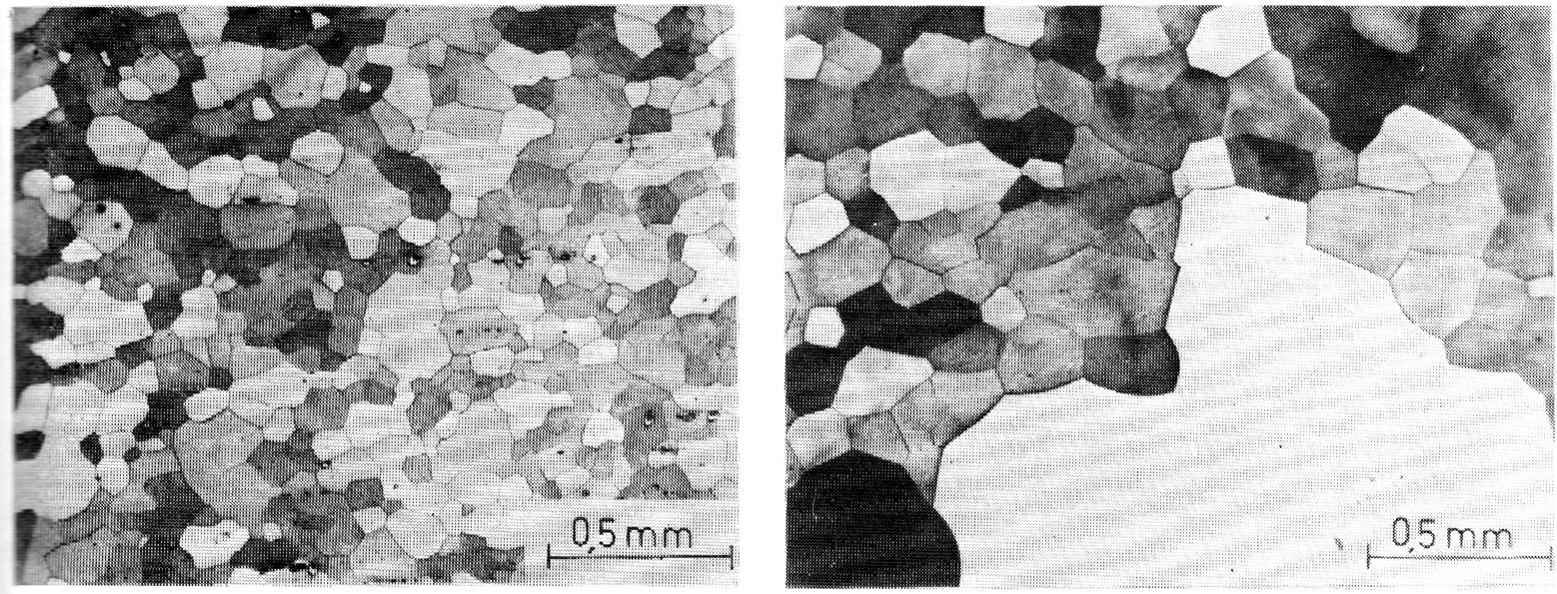
Motivation: grain size
Secondary recrystallization in Fe-3Si at 1100°C
How can we obtain the average grain size (as, say, the caliper diameter in 3D) from measurements from the micrograph?
Grain size becomes heterogeneous, anisotropic: how to measure?
Objectives Notation Equations Delesse S_{V}-P_{L} L_{A}-P_{L} Topology Grain_Size Distributions

Slide 6
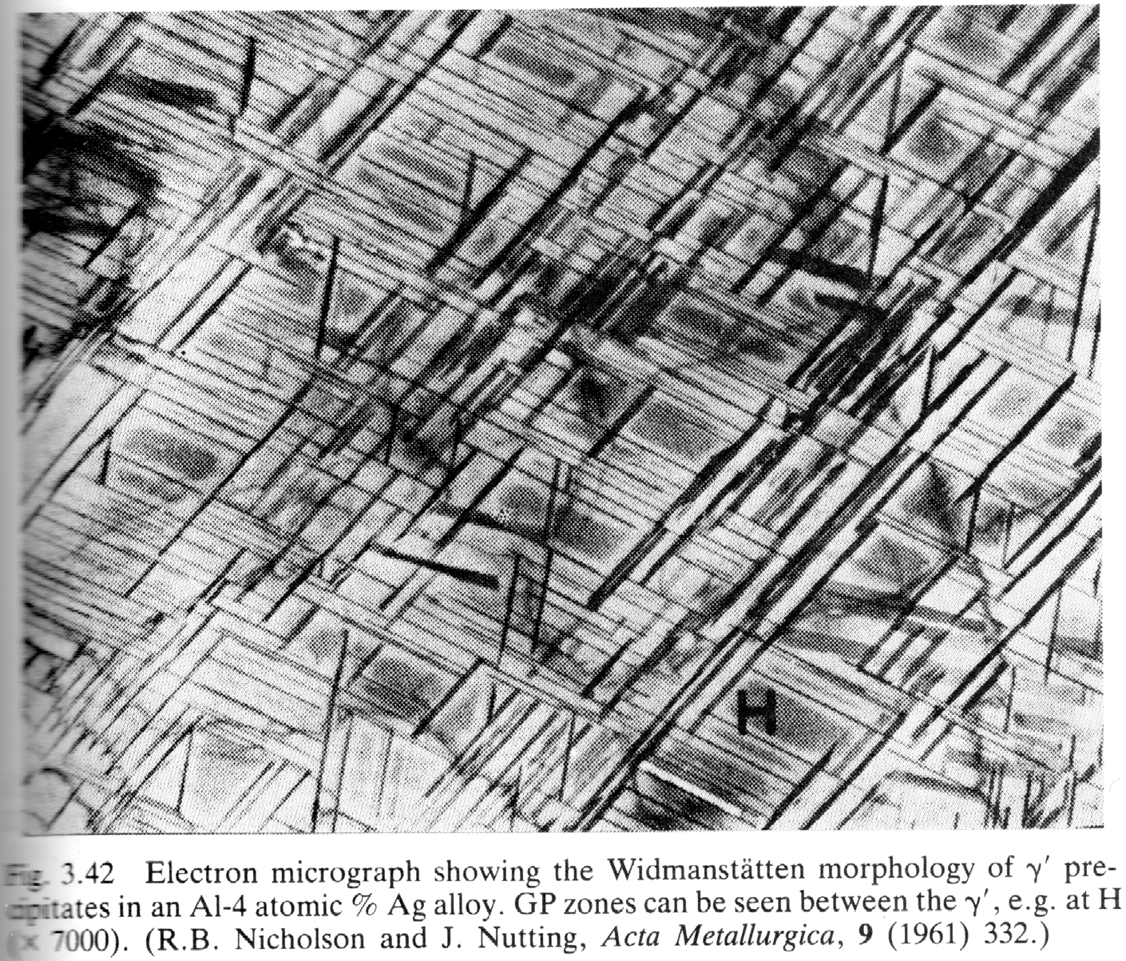
Motivation: precipitate sizes, frequency, shape, alignment
Gamma-prime precipitates in Al-4a/oAg.
Precipitates aligned on {111} planes, elongated: how can we characterize the distribution of directions, lengths?
Given crystal directions, can we extract the habit plane?
[Porter & Easterling]
Objectives Notation Equations Delesse S_{V}-P_{L} L_{A}-P_{L} Topology Grain_Size Distributions

Slide 7
Stereology: References
These slides are based on: Quantitative Stereology, E.E. Underwood, Addison-Wesley, 1970.
- equation numbers given where appropriate.
Practical Stereology, John Russ, Plenum (1986, IDBN 0-306-42460-6).
A very useful, open source software package for image analysis: ImageJ, http://rsb.info.nih.gov/ij/.
A more comprehensive commercial image analysis software is FoveaPro, http://www.reindeergraphics.com.
Also useful, and more rigorous: M.G. Kendall & P.A.P. Moran, Geometrical Probability, Griffin (1963).
More modern textbook, more mathematical in approach: Statistical Analysis of Microstructures in Materials Science, J. Ohser and F. Mücklich, Wiley, (2000, ISBN 0-471-97486-2).
Stereometric Metallography, S.A. Saltykov, Moscow: Metallurgizdat, 1958.
Many practical (biological) examples of stereological measurement can be found in Unbiased Stereology, C.V. Howard & M.G. Reed, Springer (1998, ISBN 0-387-91516-8).
Random Heterogeneous Materials: Microstructure and Macroscopic Properties, S. Torquato, Springer Verlag (2001, ISBN 0-387-95167-9).
D. Sahagian and A. Proussevitch (1998) 3D particle size distributions from 2D observations: Stereology for natural applications, J Volcanol Geotherm Res, 84(3-4), 173-196.
A. Brahme, M.H. Alvi, D. Saylor, J. Fridy, A.D. Rollett (2006) 3D reconstruction of microstructure in a commercial purity aluminum, Scripta mater. 55(1):75-80.
A.D. Rollett, R. Campman, D. Saylor (2006), Three dimensional microstructures: Statistical analysis of second phase particles in AA7075-T651, Materials Science Forum 519-521: 1-10 Part 1-2, Proceedings of the International Conference on Aluminium Alloys (ICAA-10), Vancouver, Canada.
A.D. Rollett, S.-B. Lee, R. Campman and G.S. Rohrer, “Three-Dimensional Characterization of Microstructure by Electron Back-Scatter Diffraction,” Annual Reviews in Materials Science, 37: 627-658 (2007).
M.A. Przystupa (1997) Estimation of true size distribution of partially aligned same-shape ellipsoidal particles, Scripta Mater., 37(11), 1701-1707.
D. M. Saylor, J. Fridy, B El-Dasher, K. Jung, and A. D. Rollett (2004) Statistically Representative Three-Dimensional Microstructures Based on Orthogonal Observation Sections, Metall. Trans. A, 35A, 1969-1979.
Objectives Notation Equations Delesse S_{V}-P_{L} L_{A}-P_{L} Topology Grain_Size Distributions

Slide 8
Problems
What is Stereology useful for?
Problem solving:
  How to measure grain size (in 3D)?
  How to measure volume fractions, size distributions of a second phase
  How to measure the amount of interfacial area in a material (important for porous materials, e.g.)
  How to measure crystal facets (e.g. in minerals)
  How to predict strength (particle pinning of dislocations)
  How to predict limiting grain size (boundary pinning by particles)
  How to construct or synthesize digital microstructures from 2D data, i.e. how to re-construct a detailed arrangement of grains or particles based on cross-sections.
Objectives Notation Equations Delesse S_{V}-P_{L} L_{A}-P_{L} Topology Grain_Size Distributions

Slide 9
Measurable Quantities
N := number (e.g. of points, intersections)
P := points
L := line length
Blue ⇒ easily measured directly from images
A := area
S := surface or interface area
V := volume
Red ⇒ not easily measured directly
Objectives Notation Equations Delesse S_{V}-P_{L} L_{A}-P_{L} Topology Grain_Size Distributions

Slide 10
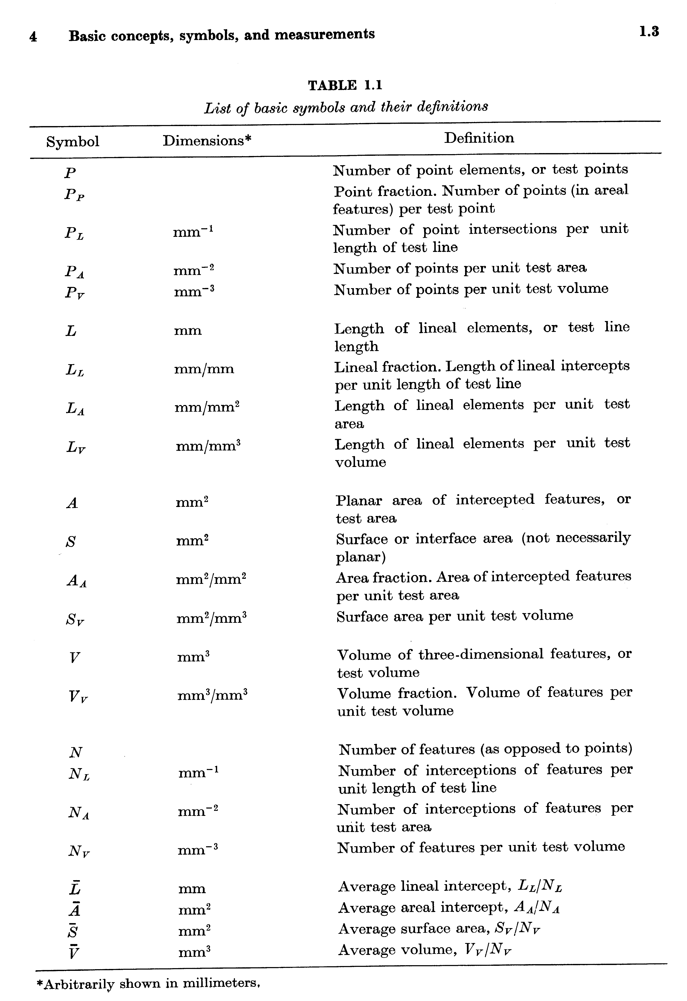
Definitions
Subscripts:
P := per test point
L := per unit of line
A := per unit area
V := per unit volume
T := total
overbar:= average
<x> = average of x
E.g. P_{A} :=
Points per unit area
[Underwood]
Objectives Notation Equations Delesse S_{V}-P_{L} L_{A}-P_{L} Topology Grain_Size Distributions

Slide 11
Other Quantities
∆ := nearest neighbor spacing, center-to-center (e.g. between particles)
λ := mean free path (uninterrupted distance between particles); this is important in calculating the critical resolved shear stress for dislocation motion, for example.
(N_{A})_{b} is the number of particles per unit area in contact with (grain) boundaries
N_{S} is the number of particles (objects) per unit area of a surface; this is an important quantity in particle pinning of grain boundaries, for example.

Slide 12
Quantities measurable in a section
Or, what data can we readily extract from a micrograph?
We can measure how many points fall in one phase versus another phase, P_{P} (points per test point) or P_{A} (points per unit area). Similarly, we can measure area e.g. by counting points on a regular grid, so that each point represents a constant, known area, A_{A}.
We can measure lines in terms of line length per unit area (of section), L_{A}. Or we can measure how much of each test line falls, say, into a given phase, L_{L}.
We can use lines to measure the presence of boundaries by counting the number of intercepts per line length, P_{L}.
We can measure the angle between a line and a reference direction; for a grain boundary, this is an inclination.
Objectives Notation Equations Delesse S_{V}-P_{L} L_{A}-P_{L} Topology Grain_Size Distributions

Slide 13
Relationships between Quantities
V_{V} = A_{A} = L_{L} = P_{P} mm⁰
S_{V} = (4/π)L_{A} = 2P_{L} mm⁻¹
L_{V} = 2P_{A} mm⁻²
P_{V} = 0.5L_{V}S_{V} = 2P_{A}P_{L} mm⁻³ (2.1-4).
These are exact relationships, provided that measurements are made with statistical uniformity (randomly). Obviously experimental data is subject to error.
Objectives Notation Equations Delesse S_{V}-P_{L} L_{A}-P_{L} Topology Grain_Size Distributions

Slide 14
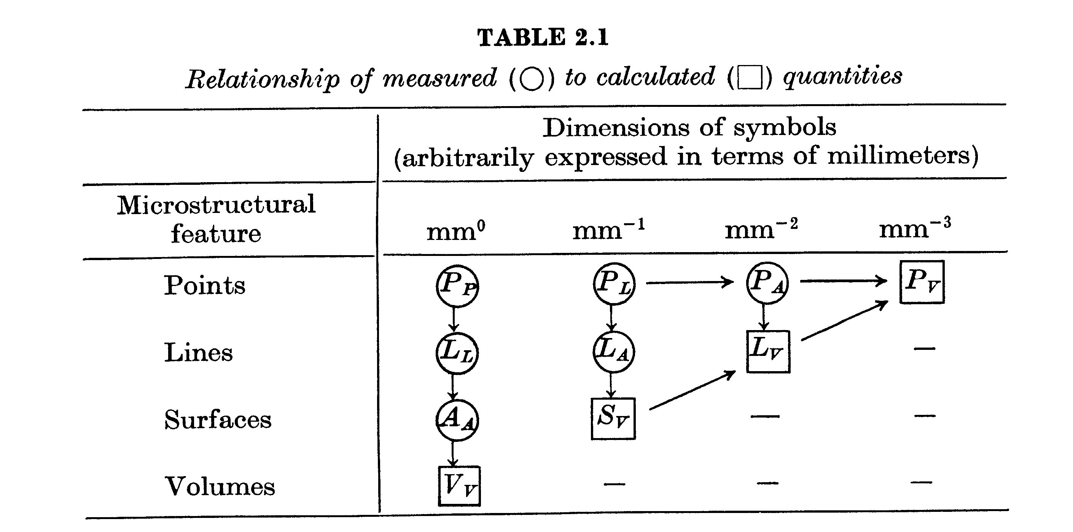
Measured vs. Derived Quantities
Remember that it is very difficult to obtain true 3D measurements (squares) and so we must find stereological methods to estimate the 3D quantities (squares) from 2D measurements (circles).
Objectives Notation Equations Delesse S_{V}-P_{L} L_{A}-P_{L} Topology Grain_Size Distributions

Slide 15
Volume Fraction
Typical method of measurement is to identify phases by contrast (gray level, color) and either use pixel counting (point counting) or line intercepts.
Volume fractions, surface area (per unit volume), diameters and curvatures are readily obtained.
Objectives Notation Equations Delesse S_{V}-P_{L} L_{A}-P_{L} Topology Grain_Size Distributions

Slide 16
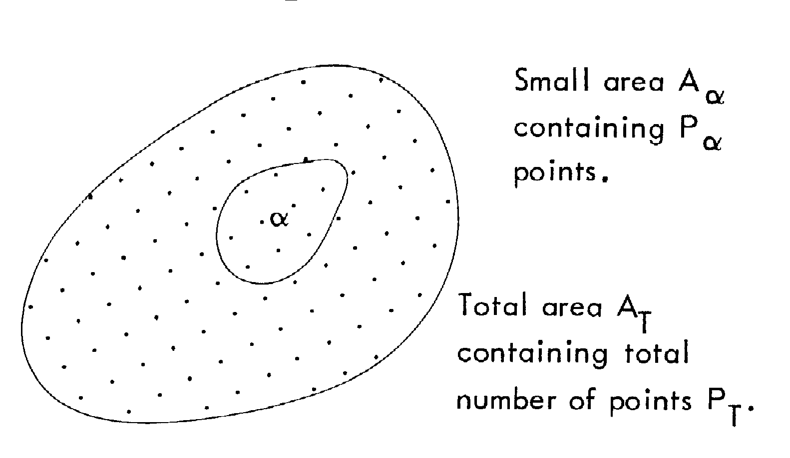
Point Counting
Issues:
- Objects that lie partially in the test area should be counted with a factor of 0.5.
- Systematic point counts give the lowest coefficients of deviation (errors):
coefficient of deviation/variation (CV) = standard deviation (σ) divided by the mean (<x>), CV=σ(x)/<x>.
Objectives Notation Equations Delesse S_{V}-P_{L} L_{A}-P_{L} Topology Grain_Size Distributions

Slide 17
Delesse’s Principle: Measuring volume fractions of a second phase
The French geologist Delesse pointed out (1848) that A_{A}=V_{V} (2.11).
Rosiwal pointed out (1898) the equivalence of point and area fractions, P_{P} = A_{A} (2.25).
Relationship for the surface area per unit volume derived from considering lines piercing a body: by averaging over all inclinations of the line
Objectives Notation Equations Delesse S_{V}-P_{L} L_{A}-P_{L} Topology Grain_Size Distributions

Slide 18
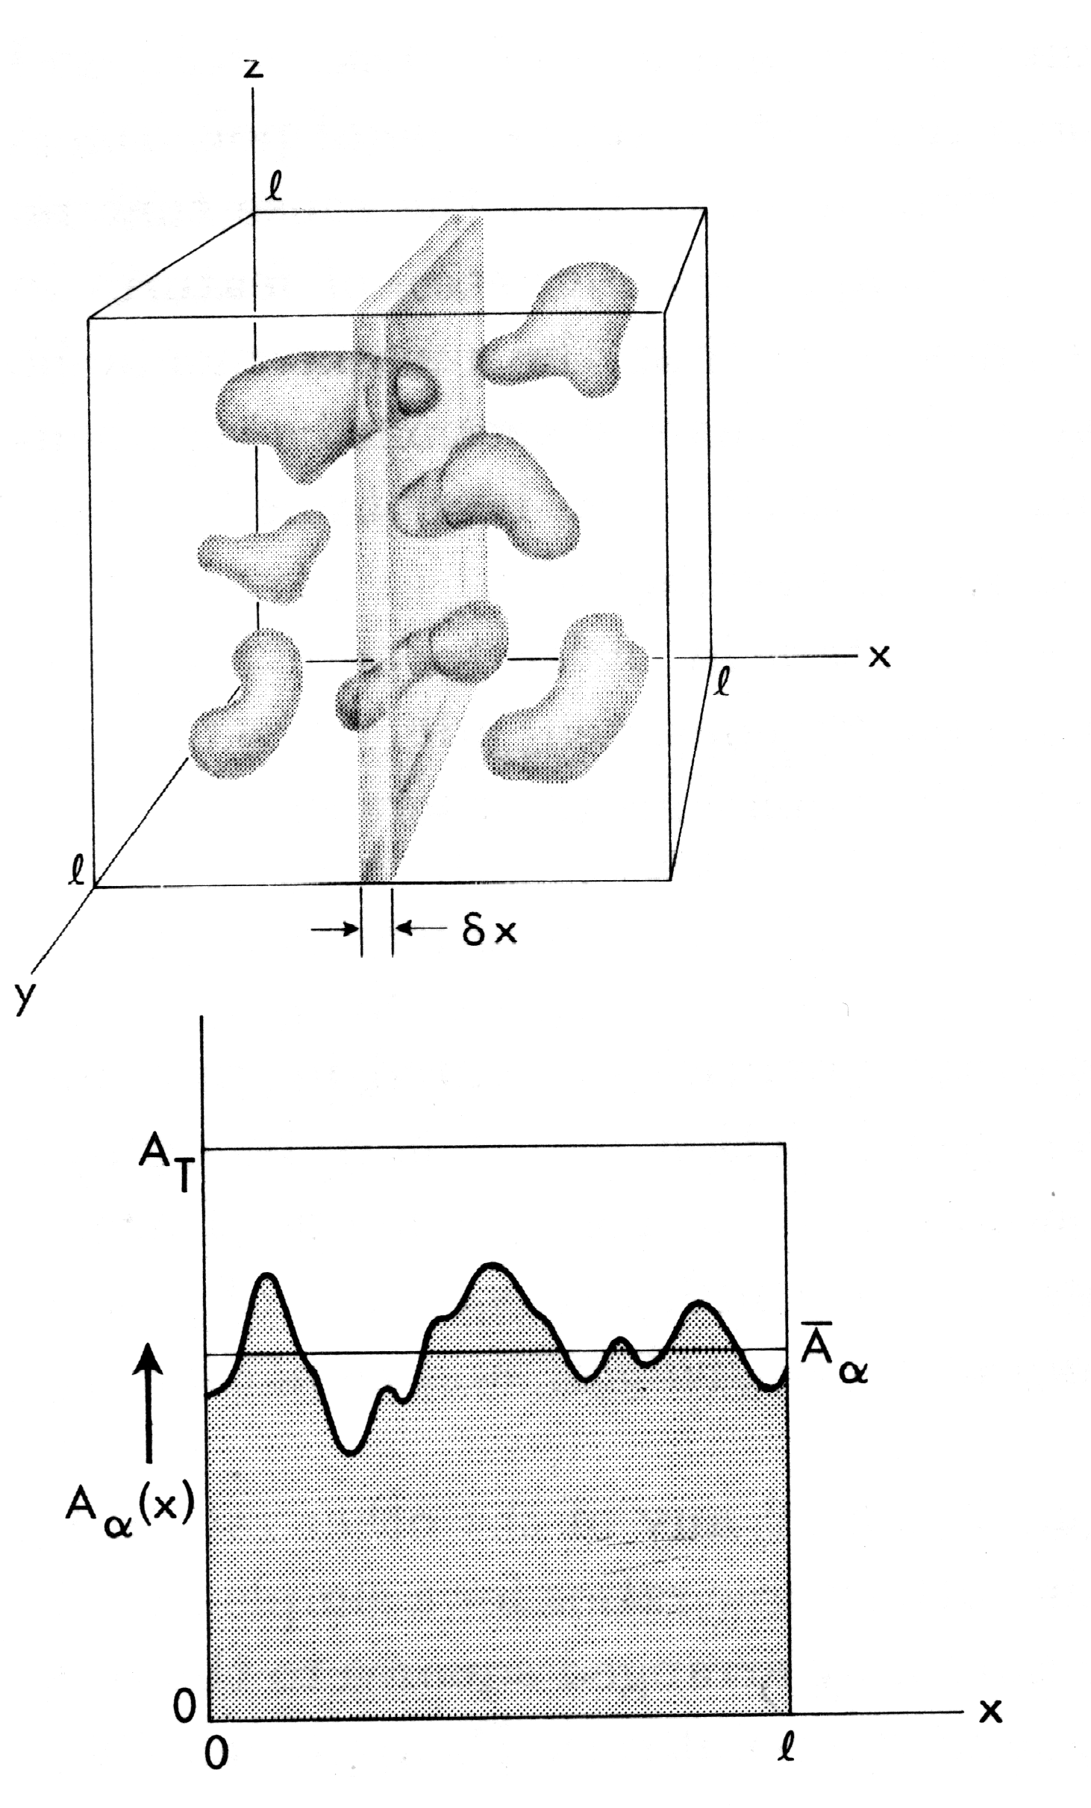
Derivation: Delesse’s formula
Basic idea:
Integrate area
fractions over
the volume
Objectives Notation Equations Delesse S_{V}-P_{L} L_{A}-P_{L} Topology Grain_Size Distributions

Slide 19
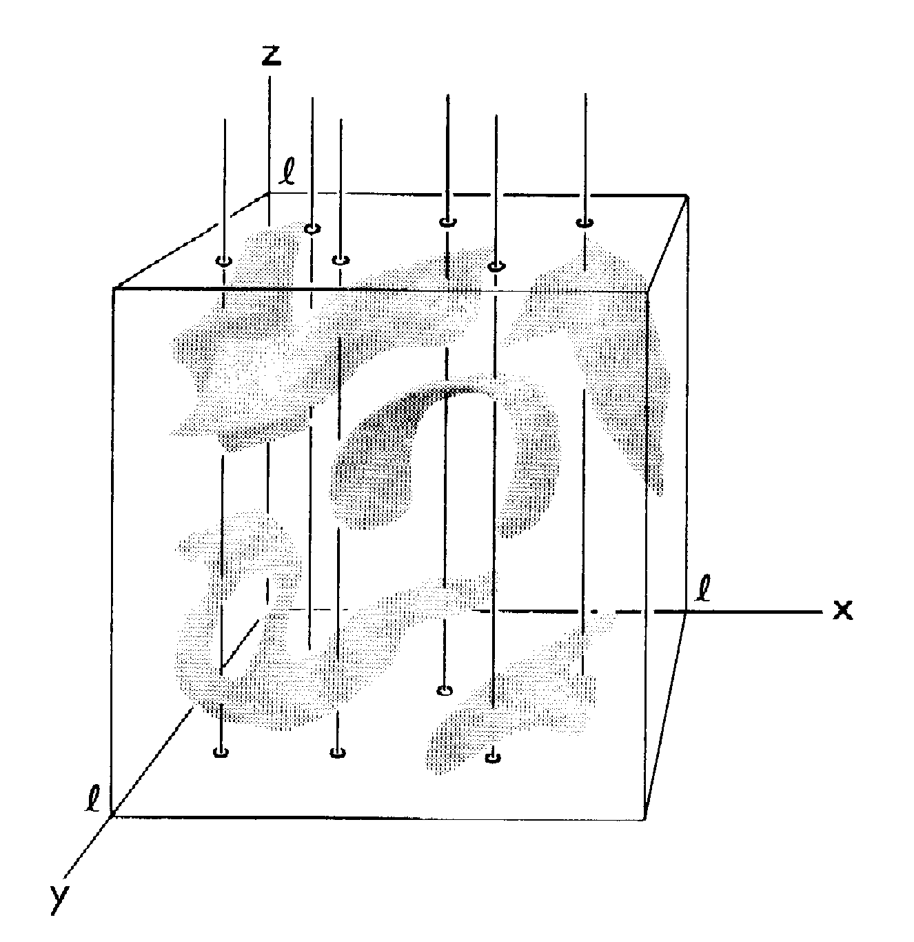
Surface Area (per unit volume)
S_{V} = 2P_{L} (2.2).
Derivation based on random intersection of lines with (internal) surfaces. Probability of intersection depends on inclination angle, θ, between the test line and the normal of the surface. Averaging θ gives factor of 2.
Objectives Notation Equations Delesse S_{V}-P_{L} L_{A}-P_{L} Topology Grain_Size Distributions

Slide 20
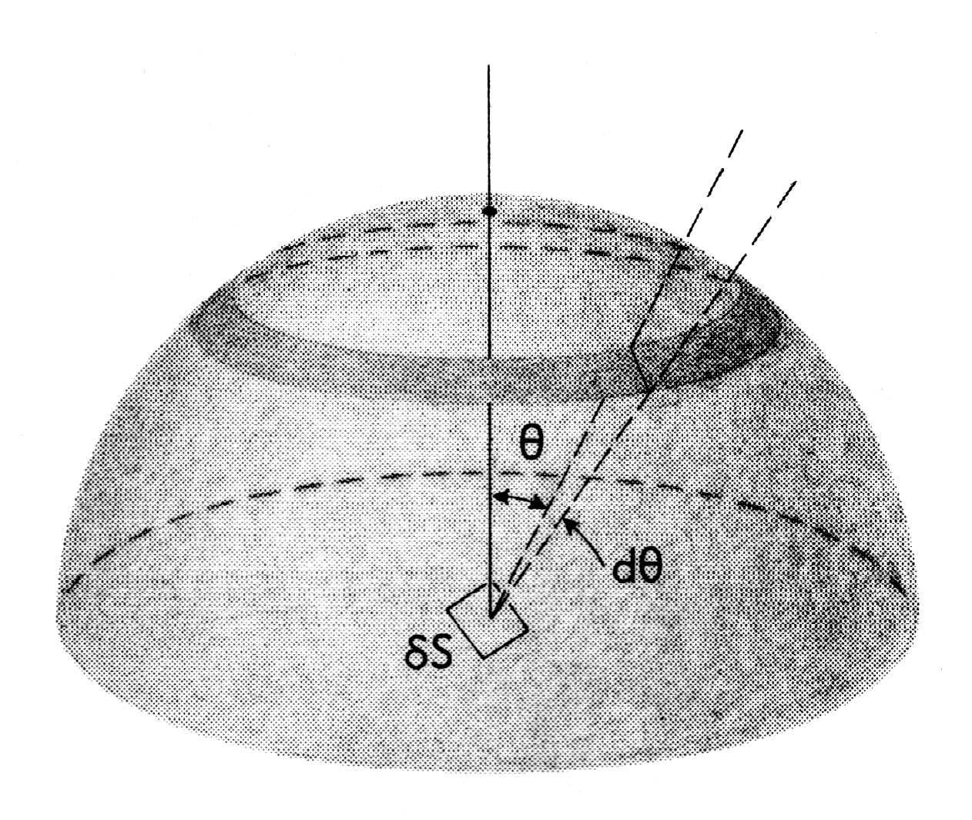
S_{V} = 2P_{L}
Derivation based on
uniform distribution
of elementary areas.
Consider the dA to be
distributed over the surface of a sphere. The sphere represents the effect of randomly (uniformly) distributed surfaces.
Projected area = dA cosθ.
Probability that a line will intersect with a given patch of area on the sphere is proportional to projected area on the plane.
This is useful for obtaining information on the full 5 parameter grain boundary character distribution (a later lecture).
Objectives Notation Equations Delesse S_{V}-P_{L} L_{A}-P_{L} Topology Grain_Size Distributions

Slide 21
S_{V} = 2P_{L}
Objectives Notation Equations Delesse S_{V}-P_{L} L_{A}-P_{L} Topology Grain_Size Distributions

Slide 22
Length of Line per Unit Area, L_{A} versus Intersection Points Density, P_{L}
Set up the problem with a set of test lines (vertical, arbitrarily) and a line to be sampled. The sample line can lie at any angle: what will we measure?
ref: p38/39 in Underwood
This was first considered by Buffon, Essai d’arithmetique morale, Supplément à l’Histoire Naturelle, 4, (1777) and the method has been used to estimate the value of π. Consequently, this procedure is also known as Buffon’s Needle.
Objectives Notation Equations Delesse S_{V}-P_{L} L_{A}-P_{L} Topology Grain_Size Distributions

Slide 23


L_{A} = π/2 P_{L}, contd.
∆x, or d
The number of points of intersection with the test grid depends on the angle between the sample line and the grid. Larger θ value means more intersections. The projected length = l sin θ = l P_{L} ∆x.
l
l cos θ
θ
l sin θ
• Line length in area, L_{A}; consider an arbitrary area of x by x :
Therefore to find the relationship between P_{L} and L_{A} for the general case where we do not know ∆x, we must average over all values of the angle θ.
Objectives Notation Equations Delesse S_{V}-P_{L} L_{A}-P_{L} Topology Grain_Size Distributions

Slide 24
L_{A} = π/2 P_{L}, contd.
Probability of intersection with test line given by average over all values of θ:
θ
• Density of intersection points, P_{L},
to Line Density per unit area, L_{A}, is
given by this probability. Note that a simple experiment estimates π (but beware of errors!).
Objectives Notation Equations Delesse S_{V}-P_{L} L_{A}-P_{L} Topology Grain_Size Distributions

Slide 25
Buffon’s Needle Experiment
In fact, to perform an actual experiment by dropping a needle onto paper requires care. One must always perform a very large number of trials in order to obtain an accurate value. The best approach is to use ruled paper with parallel lines at a spacing, d, and a needle of length, l, less than (or equal to) the line spacing, l ≤ d. Then one may use the following formula. (A more complicated formula is needed for long needles.) The total number of dropped needles is N and the number that cross (intersect with) a line is n.
See: http://www.ms.uky.edu/~mai/java/stat/buff.html
Also http://mathworld.wolfram.com/BuffonsNeedleProblem.html
Objectives Notation Equations Delesse S_{V}-P_{L} L_{A}-P_{L} Topology Grain_Size Distributions

Slide 26
S_{V} = (4/π)L_{A}
If we can measure the line length per unit area directly, then there is an equivalent relationship to the surface area per unit volume.
This relationship is immediately obtained from the previous equations:
S_{V}/2 = P_{L} and P_{L} = (2/π)L_{A}.
In the OIM software, for example, grain boundaries can be automatically recognized and their lengths counted to give an estimate of L_{A}. From this, the grain boundary area per unit volume can be estimated (as S_{V}).
Objectives Notation Equations Delesse S_{V}-P_{L} L_{A}-P_{L} Topology Grain_Size Distributions

Slide 27
Outline
Objectives
Motivation
Quantities,
  definitions
  measurable
  Derivable
Problems that use
Stereology, Topology
Volume fractions
Surface area per unit volume
Facet areas
Oriented objects
Particle spacings
  Mean Free Path
  Nearest Neighbor Distance
Zener Pinning
Grain Size
Sections through objects
  Size Distributions

Slide 28
Line length per unit volume, L_{V} vs. Points per unit area, P_{A}
Equation 2.3 states that L_{V} = 2P_{A}.
Practical application: estimating dislocation density from intersections with a plane.
Derivation based on similar argument to that for surface:volume ratio. Probability of intersection of a line with a section plane depends on the inclination of the line with respect to (w.r.t.) the plane:
therefore we average a term in cos(θ).
Objectives Notation Equations Delesse S_{V}-P_{L} L_{A}-P_{L} Topology Grain_Size Distributions

Slide 29
Oriented structures: 2D
For highly oriented structures, it is sensible to define specific directions (axes) aligned with the preferred directions (e.g. twinned structures) and measure L_{A} w.r.t. the axes.
For less highly oriented structures, orientation distributions should be used (just as for pole figures!):
Objectives Notation Equations Delesse S_{V}-P_{L} L_{A}-P_{L} Topology Grain_Size Distributions

Slide 30
Distribution of Lines on Plane
The diagram in the top left shows a set of lines, obviously not uniformly distributed.
The lower right diagram shows the corresponding distribution.
Clearly the distribution has smoothed the exptl. data.
What function can we fit to this data?
θ
In this case,
a function of the form
r = a+sin(θ) is reasonable
Objectives Notation Equations Delesse S_{V}-P_{L} L_{A}-P_{L} Topology Grain_Size Distributions

Slide 31
Generalizations
Now that we have seen what a circular distribution looks like, we can make connections to more complicated distributions.
1-parameter distributions: the distribution of line directions in a plane is exactly equivalent to the density of points along the circumference of a (unit radius) circle.
So how can we generalize this to two parameters?
Answer: consider the distribution or density of points on a (unit radius) sphere. Here we want to characterize/measure the density of points per unit area.
How does this connect with what we have learned about texture?
Answer: since the direction in which a specified crystal plane normal points (relative to specimen axes) can be described as the intersection point with a unit sphere, the distribution of points on a sphere is exactly a pole figure!
Objectives Notation Equations Delesse S_{V}-P_{L} L_{A}-P_{L} Topology Grain_Size Distributions

Slide 32
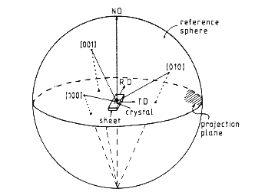
Oriented structures: 3D
Again, for less highly oriented structures, orientation
distributions should be used
(just as for pole figures): note
the incorporation of the normalization factor on the RHS of (Eq. 3.32).
See also Ch. 12 of Bunge’s book; in this case, surface spherical harmonics are useful (trigonometric functions of φ and θ). See, e.g. http://imaging.indyrad.iupui.edu/projects/SPHARM/SPHARM-docs/C01_Introduction.html for a Matlab package.
Objectives Notation Equations Delesse S_{V}-P_{L} L_{A}-P_{L} Topology Grain_Size Distributions

Slide 33
Orientation distributions
Given that we now understand how to describe a 2-parameter distribution on a sphere, how can we connect this to orientation distributions and crystals?
The question is, how can we generalize this to three parameters?
Answer: consider the distribution or density of points on a (unit radius) sphere with another direction associated with the first one. Again, we want to characterize/measure the density of points per unit area but now there is a third parameter involved. The analogy that can be made is that of determining the position and the heading of a boat on the globe. One needs latitude, longitude and a heading angle in order to do it. As we shall see, the functions required to describe such distributions are correspondingly more complicated (generalized spherical harmonics).
Objectives Notation Equations Delesse S_{V}-P_{L} L_{A}-P_{L} Topology Grain_Size Distributions

Slide 34
Outline
Objectives
Motivation
Quantities,
  definitions
  measurable
  Derivable
Problems that use
Stereology, Topology
Volume fractions
Surface area per unit volume
Facet areas
Oriented objects
Particle spacings
  Mean Free Path
  Nearest Neighbor Distance
Zener Pinning
Grain Size
Sections through objects
  Size Distributions

Slide 35
Second Phase Particles
Now we consider second phase particles
Although the derivations are general, we mostly deal with small volume fractions of convex, (nearly) spherical particles
Quantities of interest:
  intercept length, P_{L} or N_{L}
  particle spacing, ∆
  mean free path, λ (or uninterrupted distance between particles)

Slide 36
S_{V} and 2nd phase particles
Convex particles:= any two points on particle surface can be connected by a wholly internal line.
Sometimes it is easier to count the number of particles intercepted along a line, N_{L}; then the number of surface points is double the particle number. Also applies to non-convex particles if interceptions counted.
S_{v} = 4N_{L} (2.32)
Objectives Notation Equations Delesse S_{V}-P_{L} L_{A}-P_{L} Topology Grain_Size Distributions

Slide 37
S:V and Mean Intercept Length
Mean intercept length in 3 dimensions, <L₃>, from intercepts of particles of a (dispersed) alpha phase:
<L₃> = 1/N Σ_{i} (L₃)_{i} (2.33)
Can also be obtained as:
<L₃> = L_{L} / N_{L} (2.34)
Substituting:
<L₃> = 4V_{V} / S_{V} , (2.35)
where fractions refer to the (dispersed) alpha phase only.
Objectives Notation Equations Delesse S_{V}-P_{L} L_{A}-P_{L} Topology Grain_Size Distributions

Slide 38
S:V example: sphere
For a sphere, the volume:surface ratio (=V_{V}/S_{V}) is D[iameter]/6.
Thus <L₃>_{sphere} = 2D/3.
In general we can invert the relationship to obtain the surface:volume ratio, if we know (or measure) the mean intercept:
<S/V>_{alpha} = 4/<L₃> (2.38)
Objectives Notation Equations Delesse S_{V}-P_{L} L_{A}-P_{L} Topology Grain_Size Distributions

Slide 39
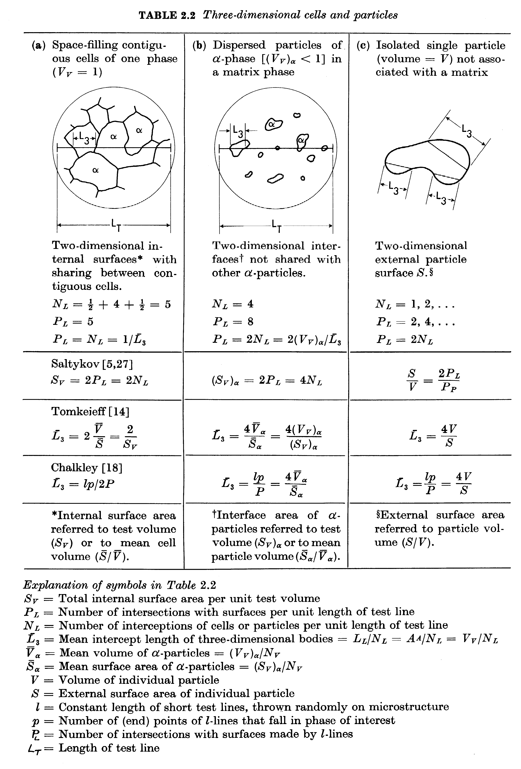
Table 2.2
<L₃>:= mean intercept length, 3D objects
<V>:= mean volume
l := length (constant) of test lines superimposed on structure
p:= number of (end) points of l-lines in phase of interest
L_{T}:= test line length
[Underwood]
Objectives Notation Equations Delesse S_{V}-P_{L} L_{A}-P_{L} Topology Grain_Size Distributions

Slide 40
Grain size measurement: intercepts
From Table 2.2 [Underwood], column (a), illustrates how to make a measurement of the mean intercept length, based on the number of grains per unit length of test line.
<L₃> = 1/N_{L}
Important: use many test lines that are randomly oriented w.r.t. the structure.
Assuming spherical† grains, <L₃> = 4r/3, [Underwood, Table 4.1], there are 5 intersections and if we take the total test line length, L_{T}= 25µm, then L_{T}N_{L}= 5, so N_{L}= 1/5 µm⁻¹
∴ d = 2r = 6<L₃>/4 = 6/N_{L}4 = 6*5/4 = 7.5µm.
† Ask yourself what a better assumption about grain shape might be!
Objectives Notation Equations Delesse S_{V}-P_{L} L_{A}-P_{L} Topology Grain_Size Distributions

Slide 41
Particles and Grains
“Where the rubber meets the road”, in stereology, that is! By which we mean that particles and pores are very important in materials processing therefore we need to know how to work with them.
Mean free distance, λ:= uninterrupted interparticle distance through the matrix averaged over all pairs of particles (which is not the same as the interparticle distance for nearest neighbors).
(4.7)
Number of interceptions with particles is same as
number of interceptions with the matrix. Thus lineal
fraction of occupied by matrix is λN_{L}, equal to the
volume fraction, 1-V_{V-alpha}.
Objectives Notation Equations Delesse S_{V}-P_{L} L_{A}-P_{L} Topology Grain_Size Distributions

Slide 42
Mean Random Spacing
The number of interceptions with particles per unit test length = N_{L} = P_{L}/2. The reciprocal of this quantity is the mean random spacing, σ, which is the mean uninterrupted center-to-center length between all possible pairs of particles (also known as the mean free path). Thus, the particle mean intercept length, <L₃>:
<L₃> = σ − λ [mm] (4.8)
Objectives Notation Equations Delesse S_{V}-P_{L} L_{A}-P_{L} Topology Grain_Size Distributions

Slide 43
Particle Relationships
Application: particle coarsening in a 2-phase material; strengthening of solid against dislocation flow.
Eqs. 4.9-4.11, with
L_{A}=πP_{L}/2=πN_{L}= πS_{V}/4
dimension: length
units (e.g.): mm
This allows one to use measurements (L_{A}) on a micrograph to deduce particle mean free paths in 3D
Objectives Notation Equations Delesse S_{V}-P_{L} L_{A}-P_{L} Topology Grain_Size Distributions

Slide 44
Mean free path, λ, versus
Nearest neighbor spacing, ∆
It is useful (and therefore important) to keep the difference between mean free path and nearest neighbor spacing separate and distinct.
Mean free path is how far, on average, you travel from one particle until you encounter another one.
Nearest neighbor spacing is how far apart, on average, two nearest neighbors are from each other. Matters for diffusion distances, e.g.
They appear at first glance to be the same thing but they are not!
They are related to one another, as we shall see in the next few slides.
This matters, e.g., when considering dislocations moving past obstacles, which may be effectively rigid lines (weak obstacles) or flexible (strong obstacles).
Objectives Notation Equations Delesse S_{V}-P_{L} L_{A}-P_{L} Topology Grain_Size Distributions

Slide 45
Nearest-Neighbor Distances, ∆
For distances between nearest neighbors, see “Stochastic problems in physics and astronomy”, S. Chandrasekhar, Rev. Mod. Physics, 15, 83 (1943).
Note how the nearest-neighbor distances, ∆, grow more slowly than the mean free path, λ.
r := particle radius
2D: ∆₂ = 0.5 / √P_{A} (4.18a)
3D: ∆₃ = 0.554 (P_{V})^{-1/3} (4.18)
Based on λ~1/N_{L} , ∆₃ ≈ 0.554 (πr² λ)^{1/3}
for small V_{V}, ∆₂ ≈ 0.500 (π/2 rλ)^{1/2}
Objectives Notation Equations Delesse S_{V}-P_{L} L_{A}-P_{L} Topology Grain_Size Distributions

Slide 46
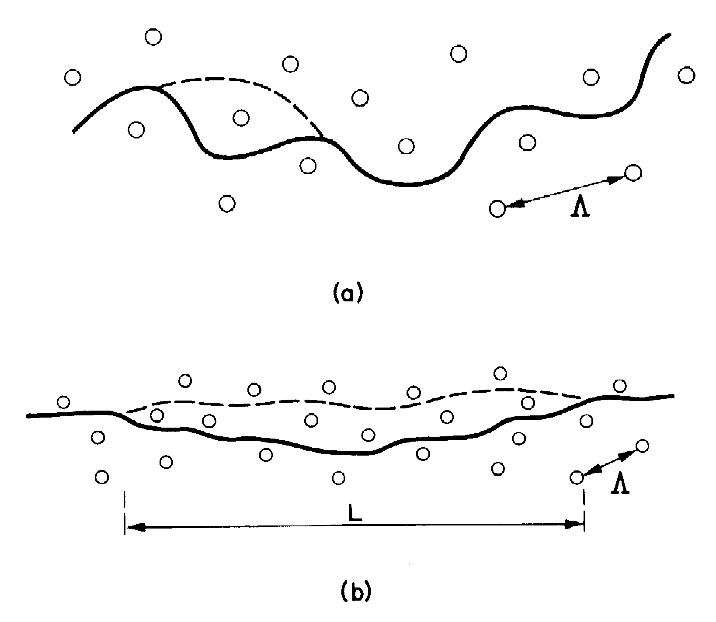
Application of ∆₂ to Dislocation Motion
Percolation of dislocation lines through arrays of 2D point obstacles.
Caution! “Spacing” has many interpretations: select the correct one!
In general, if the obstacles are weak (lower figure) and the dislocations are nearly straight then the relevant spacing is the mean free path, λ. Conversely, if the obstacles are strong (upper figure) and the dislocations bend then the relevant spacing is the (smaller) nearest neighbor spacing, ∆₂.
Hull & Bacon;
fig. 10.17
Objectives Notation Equations Delesse S_{V}-P_{L} L_{A}-P_{L} Topology Grain_Size Distributions

Slide 47
Particle Pinning - Summary
Strong obstacles + flexible entities: nearest neighbor spacing, ∆, applies.
Weak obstacles + inflexible entities: mean free path, λ, applies.
This applies to dislocations or grain boundaries or domain walls or diffusion distances.
Note the same dependence on particle size, r, but very different dependence on volume fraction, f !
Objectives Notation Equations Delesse S_{V}-P_{L} L_{A}-P_{L} Topology Grain_Size Distributions

Slide 48
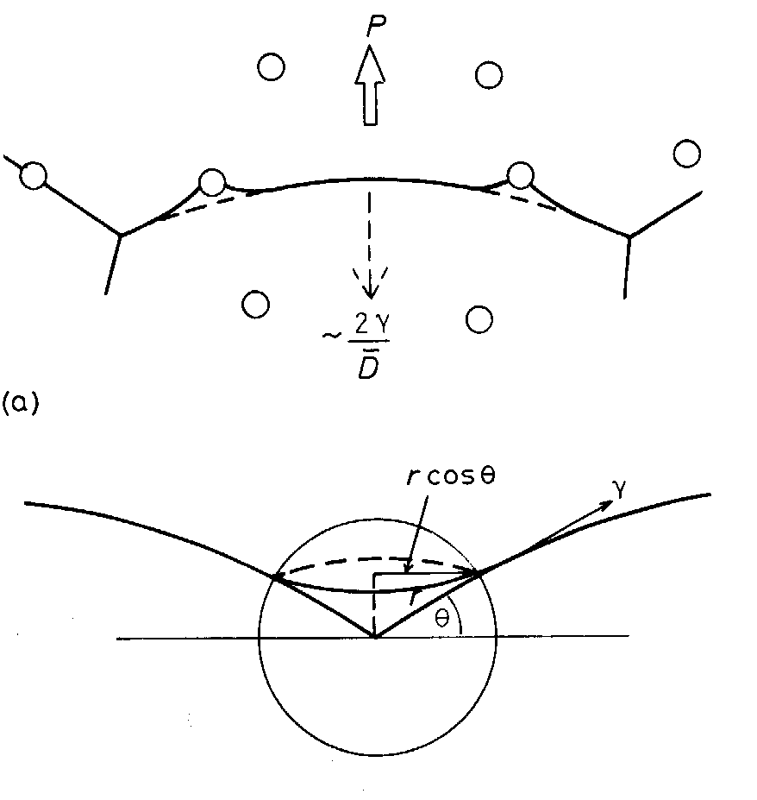
Smith-Zener Pinning of Boundaries
Limiting Grain Size:
Limiting Assumptions:
Zener, C. (1948). communication to C.S. Smith. Trans. AIME. 175: 15.
Srolovitz, D. J., M. P. Anderson, et al. (1984), Acta metall. 32: 1429-1438.
E. Nes, N. Ryum and O. Hunderi, Acta Metall., 33 (1985), 11

Slide 49
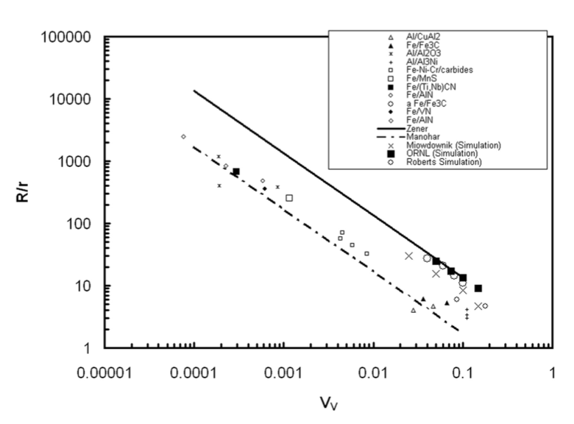
Smith-Zener Pinning
The literature indicates that the theoretical limiting grain size (solid line) is significantly higher than both the experimental trend line (dot-dash line) and recent simulation results. The volume fraction dependence, however, corresponds to an interaction of boundaries with particles based on mean free path, λ, m=1, not nearest neighbor distances, ∆, m=0.33 (in 3D).
C.G. Roberts, Ph.D. thesis, Carnegie Mellon University, 2007.
B. Radhakrishnan, Supercomputing 2003.
Miodownik, M., E. Holm, et al. (2000), Scripta Materialia 42: 1173-1177.
P.A. Manohar, M.Ferry and T. Chandra, ISIJ Intl., 38 (1998), 913.

Slide 50
Particles on boundaries, in cross-section
From discussion with C. Roberts, 16 Aug 06
An interesting question is to compare the number of particles on boundaries, as a fraction of the total particles in view in a cross-section. We can use the analysis provided by Underwood to arrive at an estimate. If, for example, boundaries have pinned out during grain growth, one might expect the measured fraction on boundaries to be higher than this estimate based on random intersection.
- (N_{A})_{b} is the number of particles per unit area in contact with boundaries.
- L_{A} is the line length per unit area of (grain) boundary.
- The other quantities have their usual meanings.
See: "Particle-Associated Misorientation Distribution in a Nickel-Base Superalloy". Roberts C.G., Semiatin S.L., Rollett A.D., Scripta materialia 56 899-902 (2007).

Slide 51
Outline
Objectives
Motivation
Quantities,
  definitions
  measurable
  Derivable
Problems that use
Stereology, Topology
Volume fractions
Surface area per unit volume
Facet areas
Oriented objects
Particle spacings
  Mean Free Path
  Nearest Neighbor Distance
Zener Pinning
Grain Size
Sections through objects
  Size Distributions

Slide 52
Grain Size Measurement
Measurement of grain size is a classic problem in stereology. There are two different approaches (for 2D images), which rarely yield the same answer.
Method A: measure areas of grains; calculate grain size based on an assumed shape (that determines the size:projected_area ratio.)
Method B: measure linear intercepts of grains; calculate grain size based on an assumed shape (that, in this case, determines the ratio of size to projected length).
Underwood recommends the latter approach because the mean intercept length, <L₃> is closely related to the surface area per volume, <L₃>=2/S_{V}.
Grain size number based on the E112 ASTM standard.
The problem of plane sections (stereology).
The problem of grain shape.
See: http://www.metallography.com/grain.htm
Useful references: Quantitative Stereology, E.E. Underwood, Addison-Wesley, 1970; Practical Stereology by John C. Russ.
Objectives Notation Equations Delesse S_{V}-P_{L} L_{A}-P_{L} Topology Grain_Size Distributions

Slide 53
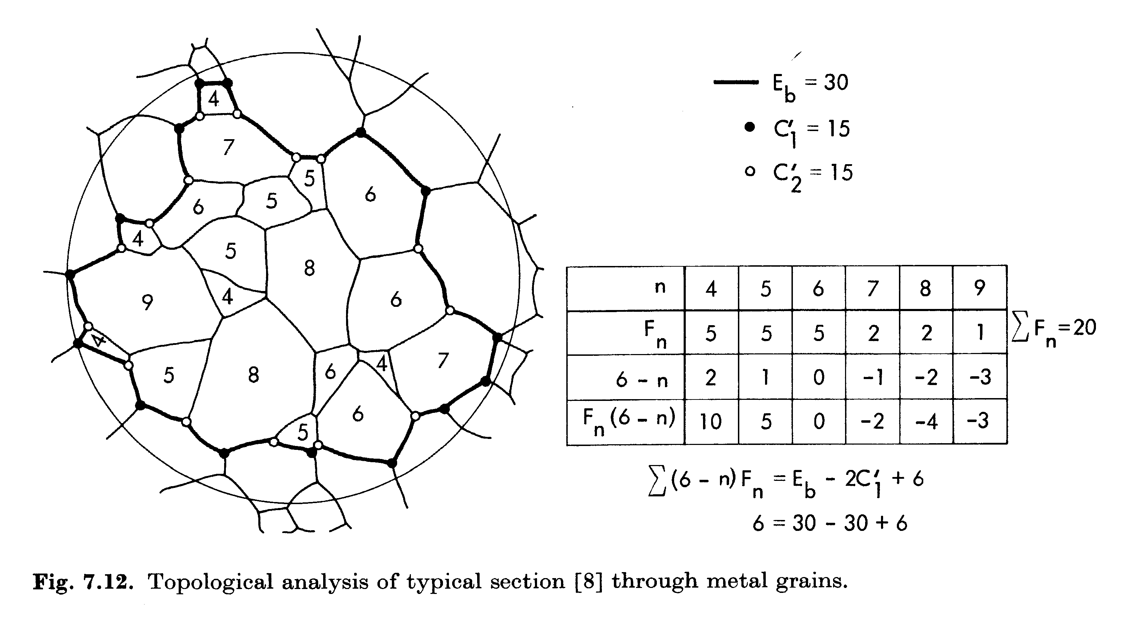
Method A: typical section
[Underwood]
Correction terms (E_{b}, C₁’,C₂’) allow finite sections to be interpreted.
C₁’:=number of incomplete corners against 1 polygon;
C₂’:= same for 2 polygons
Objectives Notation Equations Delesse S_{V}-P_{L} L_{A}-P_{L} Topology Grain_Size Distributions

Slide 54
Method A: area based
[Underwood]
Fig. 7.12
Grain count method:
<A>=1/N_{A}
Number of whole grains= 20
Number of edge grains= 21
Effective total = N_{whole}+N_{edge}/2
= 30.5
Total area= 0.5 mm²
Thus, N_{A}= 61 mm⁻²; <A>=16,400 µm²
Assume spherical* grains, <A> mean intercept area= 2/3πr²
∴ d = 2√(3<A>/2π)= 177 µm.
*Do you think this is a reasonable assumption?!
[Underwood]
Objectives Notation Equations Delesse S_{V}-P_{L} L_{A}-P_{L} Topology Grain_Size Distributions

Slide 55
Method B: linear intercept
From Table 2.2 [Underwood], column (a), illustrates how to make a measurement of the mean intercept length, based on the number of grains per unit length of test line.
<L₃> = 1/N_{L}
Important: use many test lines that are randomly oriented w.r.t. the structure.
Assuming spherical† grains, <L₃> = 4r/3, [Underwood, Table 4.1], if we take the total line length (diameter of test area), L_{T}= 798µm, and draw a line that intersects 7 boundaries, then N_{L}= 1/114 µm⁻¹
∴ d = 6<L₃>/4 = 6/N_{L}4 = 6*114/4 = 171 µm.
Clearly the two measures of grain size are similar but not necessarily the same.
† Ask yourself what a better assumption about grain shape might be!
Objectives Notation Equations Delesse S_{V}-P_{L} L_{A}-P_{L} Topology Grain_Size Distributions

Slide 56
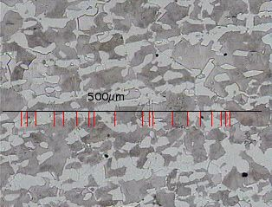
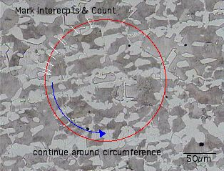
More about the Line Intercept Technique
One can either count the number of intercepts per unit length along a straight line (which is sensitive to the orientation of the line)
Or, one can count intercepts around a circle (eliminates any anisotropy in the microstructure) and divide by the perimeter length of the circle to obtain P_{L}.
Grain size = <L₃> = P_{L}⁻¹
Note some elementary image analysis: increasing the contrast on the original images made it much easier to perceive the two separate phases.
http://callisto.my.mtu.edu/my3200/lab1/steel.html

Slide 57

Alternative Representation:
ASTM Grain Size Number
ASTM has defined a standard, E112, for grain size measurement.
ASTM has a grain size parameter, G, which can be calculated based on either area or linear measurements.
This ASTM grain size number, G, is commonly employed within industry and earlier research efforts (before computer technologies were available).
Higher grain size number means smaller grain size.
American Standards and Test Methods, Designation E112, (1996).

Slide 58
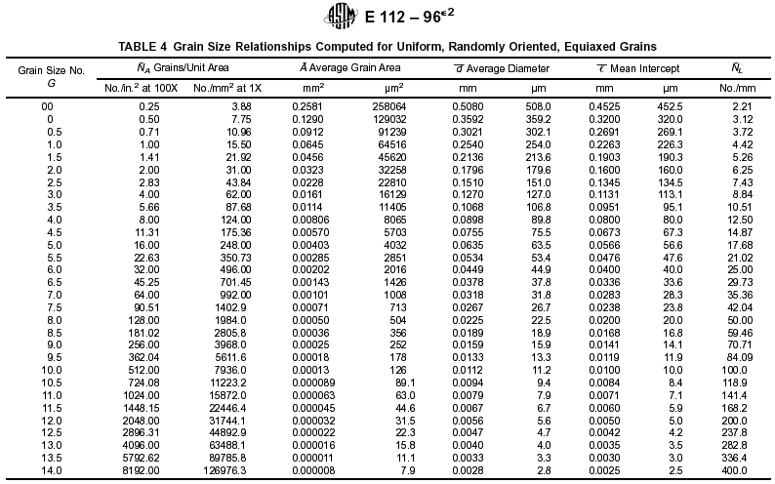

Slide 59
Outline
Objectives
Motivation
Quantities,
  definitions
  measurable
  Derivable
Problems that use
Stereology, Topology
Volume fractions
Surface area per unit volume
Facet areas
Oriented objects
Particle spacings
  Mean Free Path
  Nearest Neighbor Distance
Zener Pinning
Grain Size
Sections through objects
  Size Distributions

Slide 60
3D Size Derived from 2D Sections
Purpose: how can we relate measurements in plane sections to what we know of the geometry of regularly shaped objects with a distribution of sizes?
In general, the mean intercept length is not equal to the grain diameter, for example! Also, the proportionality factors depend on the (assumed) shape.
Example: for monodisperse spherical particles (all the same size) distributed (randomly) in space, sectioning through them and measuring the size distribution will show a spread in apparent size.
Objectives Notation Equations Delesse S_{V}-P_{L} L_{A}-P_{L} Topology Grain_Size Distributions

Slide 61
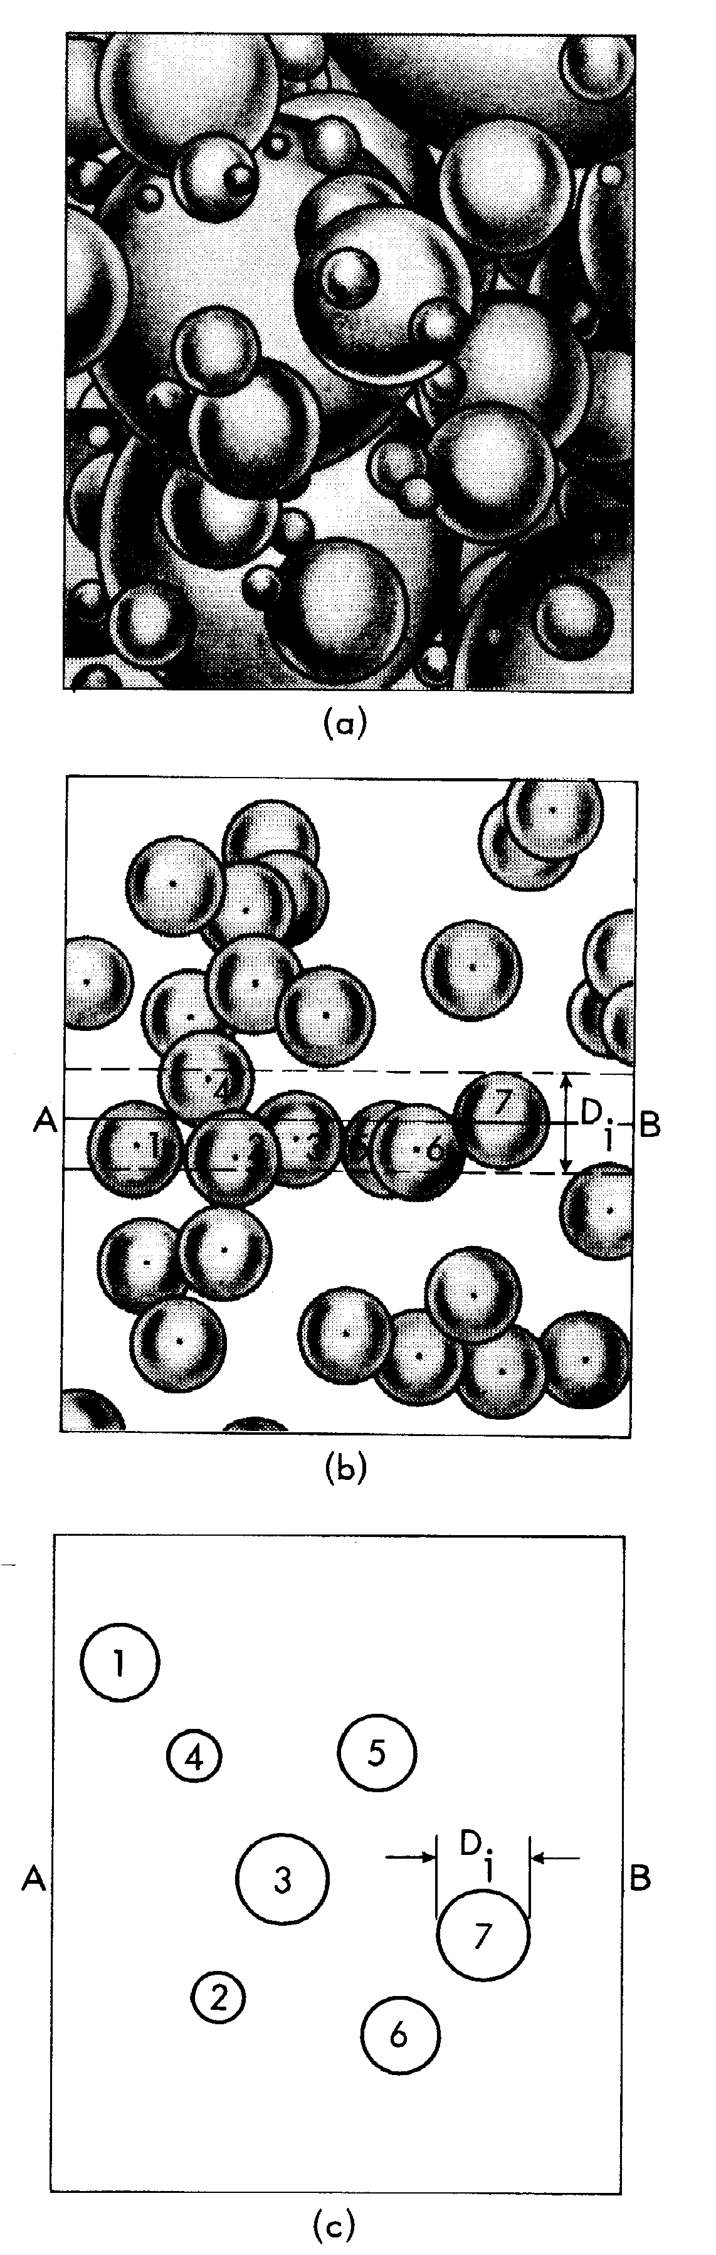
Sections through dispersions of spherical objects
Even mono-disperse spheres
exhibit a variety of diameters
in cross section.
Only if you know that the
second phase is monodisperse
may you measure diameter
from maximum cross-section!
Objectives Notation Equations Delesse S_{V}-P_{L} L_{A}-P_{L} Topology Grain_Size Distributions

Slide 62
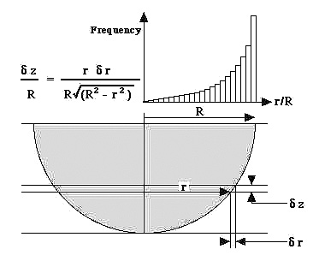
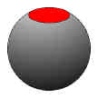
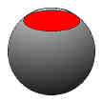
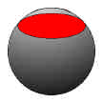
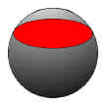
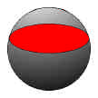
Sectioning
Spheres
[Russ & DeHoff, Ch. 12]
The radius, r, of a circle sectioned at a distance h from the center is
r = √(R²-h²).
Since the sectioning planes intersect a sphere at a random location relative to its size, R, we can assume that the probability of observing a circle between a given intercept radius, r, and r+dr, is equal to the relative thickness, dz/R, of the corresponding slice.
The result is a distribution of intercept sizes that varies between zero and the actual sphere size.

Slide 63
Circle Sampling: example
• Numbers for each plot indicate the number of samples taken
• A random number was generated in the range 0..1
• Value of radius of “sampled circle” taken to be RAN()/√(1-RAN²)
• Values binned in 16 bins - note how noisy random sampling often is, which means that a large number of samples must be taken to obtain an accurate distribution
This analysis leads to the Saltykov method for reconstructing a 3D distribution of particles sizes from 2D data. See later slides.

Slide 64
Distributions of Sizes
Measurement of an average quantity is reasonably straightforward in stereology.
Deduction of a 3D size distribution from the projection of that distribution on a section plane is much less straightforward (and still controversial in certain respects).
Example: it is useful to be able to measure particle size and grain size distributions from plane sections (without resorting to serial sectioning).
Assumptions about particle shape must be made.
Objectives Notation Equations Delesse S_{V}-P_{L} L_{A}-P_{L} Topology Grain_Size Distributions

Slide 65
True dimension(s) from measurements: examples
Measure the number of objects per unit area, N_{A}. Also measure the mean number of intercepts per unit length, N_{L}.
Assume that the objects are spheres: then their radius,
r = 8N_{L}/3πN_{A}.
Alternatively, assume that the objects are truncated octahedra, or tetrakaidcahedra: then their edge length,
a, = L₃/1.69 = 0.945 N_{L}/N_{A}.
Volume of truncated octahedron
= 11.314a³ = 9.548 (N_{L}/N_{A})³.
Equivalent spherical radius, based on V_{sphere} = 4π/3 r³ and equating volumes:
r_{sphere} = 1.316 N_{L}/N_{A}.
Objectives Notation Equations Delesse S_{V}-P_{L} L_{A}-P_{L} Topology Grain_Size Distributions

Slide 66
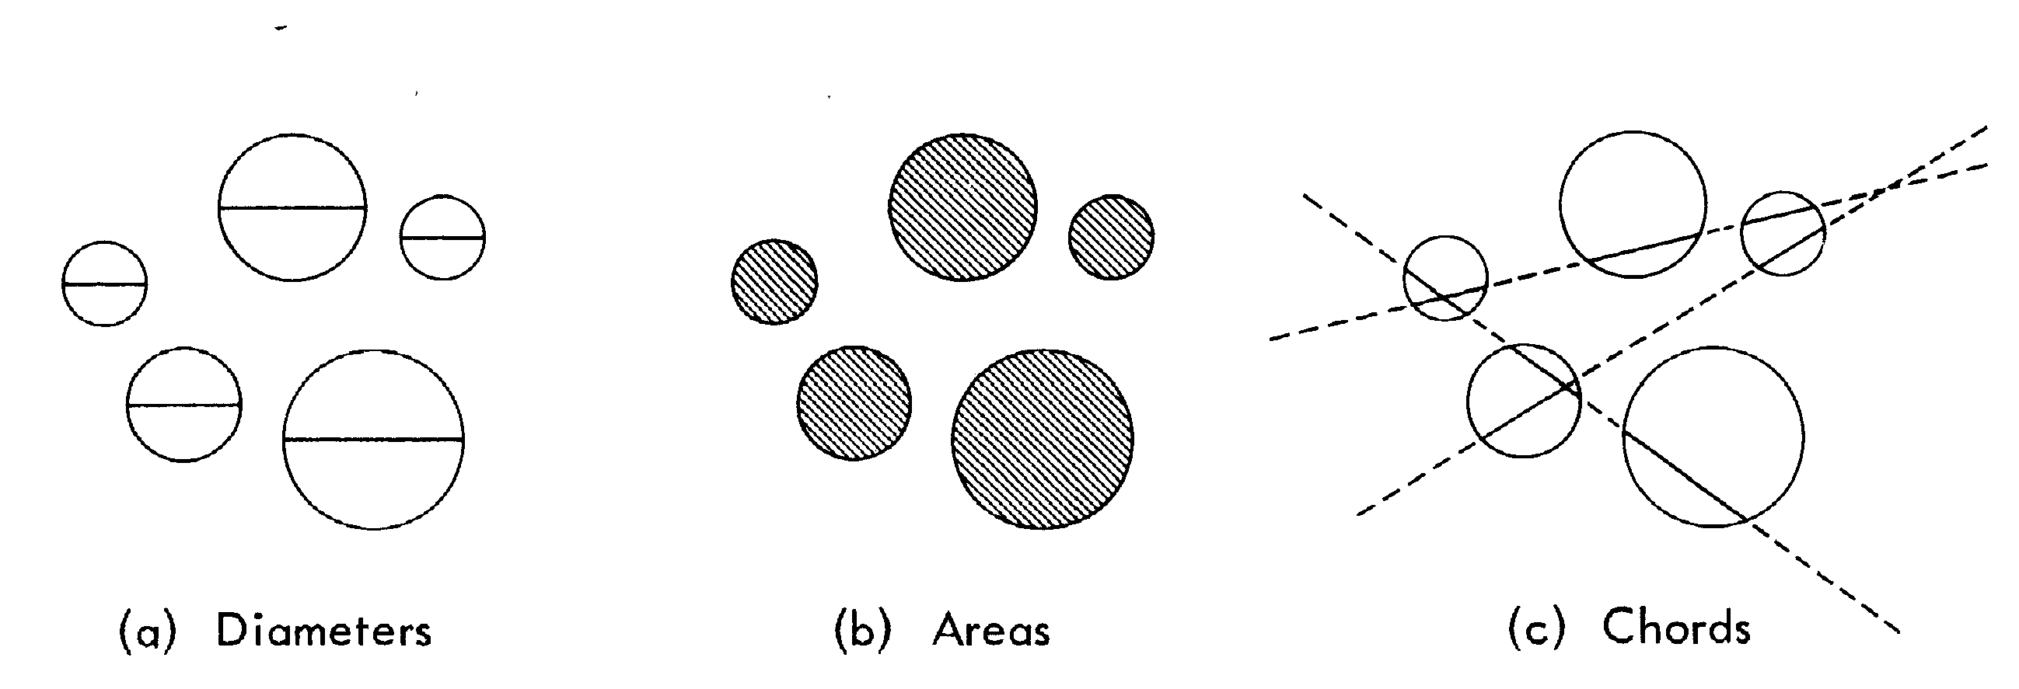
Measurements on Sections
• Areas are convenient if automated pixel counting available
• Either areas or diameters are a type of planar sampling involving measurement of circles (or some other basic shape)
• Chords are convenient for use of random test lines, which is a type of linear sampling: n_{L} := number of chords per unit length
Objectives Notation Equations Delesse S_{V}-P_{L} L_{A}-P_{L} Topology Grain_Size Distributions

Slide 67
Extraction of Size Distribution
Whenever you section a distribution of particles of a finite size, the section plane is unlikely to cut at the maximum diameter (of, say, spherical particles).
Therefore the observed sizes are always an underestimate of the actual sizes.
Any method for estimating size distributions in effect starts with the largest size class and, based on some assumption about the shape and distribution of the particles, reduces the volume fraction of the next smallest size class by an amount that is proportional to the fraction of the current size class.

Slide 68
Size distributions from measurement
Distribution of cross sections very different from 3D size distribution, as illustrated with monosize spheres.
Measurement of chord lengths is most reliable, i.e. experimental frequency of n_{L}(l) versus l.
See articles by Lord & Willis; Cahn & Fullman; book by Saltykov
<D> := mean diameter;
σ(D):= standard deviation
N_{V} := number of particles (grains) per unit volume.
Objectives Notation Equations Delesse S_{V}-P_{L} L_{A}-P_{L} Topology Grain_Size Distributions

Slide 69
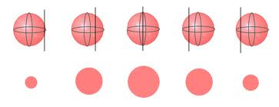
Chord lengths
http://131.111.17.74/issue51/features/buckley/index.html
It happens that making random intersections of a test line (L_{L}) with a sphere leads to a rather simple probability distribution (in contrast to planar intercepts and diameters). In the graph, the value of the intercept length is normalized by the sphere diameter (effectively the largest observed length).

Slide 70
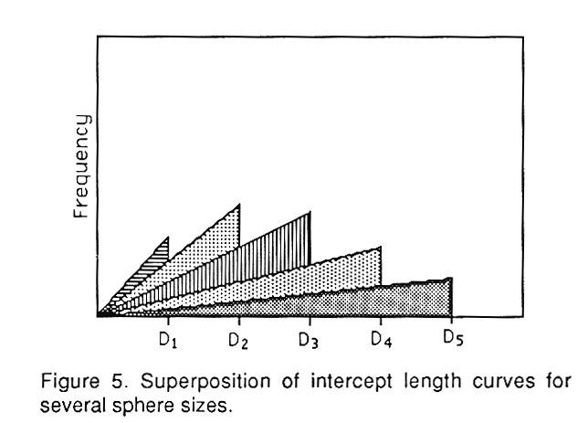
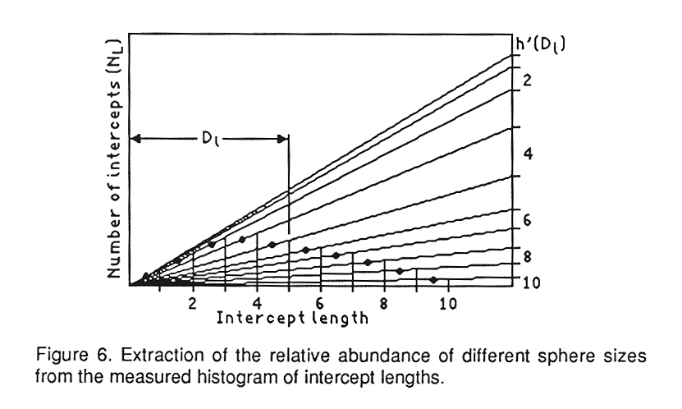
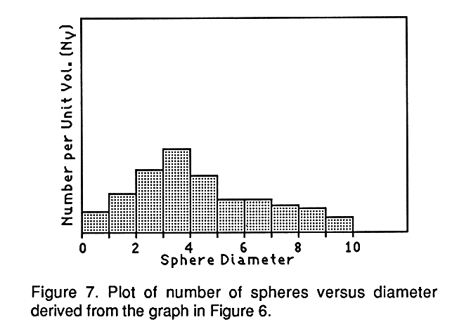
Multiple sphere sizes
A consequence of the linear probability distribution is a particularly simple superposition for different sphere sizes, fig. 5 above.
This also means that the sphere size distribution can be obtained purely graphically, fig. 6: one starts with the vertical intercept (RH axis) for the smallest size and subtracts off the intercept for the next largest size. Each intercept on the right-hand axis represents the value of the 3D sphere diameter density.
Examples shown from Russ's Practical Stereology and is explained in more detail in Underwood's book. Note that in order to obtain the number of spheres, N_{V} , the vertical line on the RHS of the graph must be drawn at an intercept length = 2/π in the same units as the length measurement.

Slide 71
Number per unit volume
Current size class
Next largest size class
Lord & Willis also described a numerical procedure, based on measurement of number of chords of a given length, which accomplishes the same procedure as the graphical procedure. One simply starts with the smallest size value and proceeds to progressively larger sizes. For the last bin (largest size), no subtraction is performed.
∆l := size interval
a_{j} := median of class intervals (can use average of the size, l, in the j^{th} interval)
ASTM Bulletin 177 (1951) 56.
Objectives Notation Equations Delesse S_{V}-P_{L} L_{A}-P_{L} Topology Grain_Size Distributions

Slide 72
Number per unit volume:
Cahn & Fullman
Cahn & Fullman:
Trans AIME 206 (1956) 610.
D:= diameter = l
numerical differentiation of n_{L}(l) required.
Can be applied to systems other than spheres.
Objectives Notation Equations Delesse S_{V}-P_{L} L_{A}-P_{L} Topology Grain_Size Distributions

Slide 73
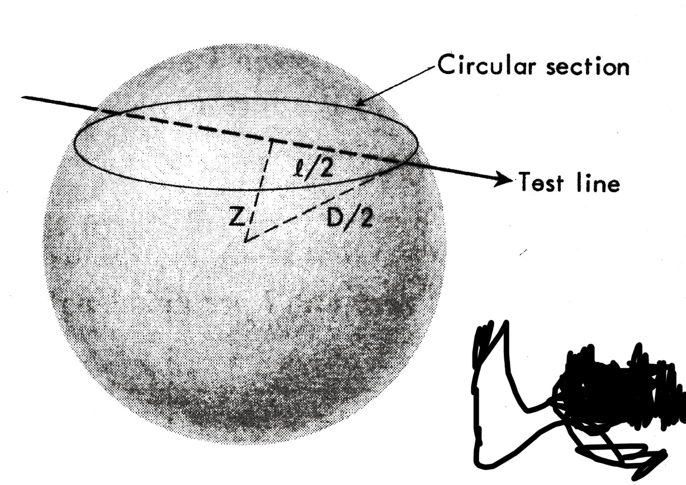
Projections of Lines: Spektor
Spektor developed a method of extracting a distribution of sizes of spheres from chord length data (very similar result to Lord & Willis).
Z = √([D/2]² - [l /2]²)
Consider a cylindrical volume of length L, and radius Z centered on the test line. Volume is πZ²L and the intercepted chord lengths vary between l and D.
Objectives Notation Equations Delesse S_{V}-P_{L} L_{A}-P_{L} Topology Grain_Size Distributions

Slide 74
Projections of Lines, contd.
Number of chords per unit length of line:
n_{L} = πZ²N_{V} = π/4 (D² - l²)N_{V}.
where N_{V} is the no. of spheres per unit vol.
For a dispersion of spheres, sum up:
Objectives Notation Equations Delesse S_{V}-P_{L} L_{A}-P_{L} Topology Grain_Size Distributions

Slide 75
Projections of Lines, contd.
The terms on the RHS can be related to the total surface area, S_{V}, and the total no of particles per unit volume, N_{V}, respectively:
Differentiating this expression gives:
Objectives Notation Equations Delesse S_{V}-P_{L} L_{A}-P_{L} Topology Grain_Size Distributions

Slide 76
Projections of Lines, contd.
The first two terms cancel out; also we note that d(n_{L})_{l}^{Dmax} = - d(n_{L})₀^{l}, so that we obtain:
Objectives Notation Equations Delesse S_{V}-P_{L} L_{A}-P_{L} Topology Grain_Size Distributions

Slide 77
Projections of Lines, contd.
In order to relate a distribution of the number of spheres per unit volume to the distribution of chord lengths, we can take differences: n_{L} is a number of chords over an interval of lengths, ∆l is the length interval (essentially the Lord & Willis result).
Objectives Notation Equations Delesse S_{V}-P_{L} L_{A}-P_{L} Topology Grain_Size Distributions

Slide 78
Artificial Digital Particle Placement
To test the system of particle analysis and generation of a 3D digital microstructure of particles, an artificial 3D microstructure was generated using a Cellular Automaton on a 400x200x100 regular grid (equi-axed voxels or pixels). Particles were injected along lines to mimic the stringered distributions observed in 7075. The ellipsoid axes were constrained to be aligned with the domain axes (no rotations).
This microstructure was then sectioned, as if it were a real material, the sections were analyzed, and a 3D particle set reconstructed.
The main analytical tool employed in this technique is the (anisotropic) pair correlation function = pcf (to be explained in a later lecture).
The length units for this calculation are pixels or voxels.
See: “Three-Dimensional Characterization of Microstructure by Electron Back-Scatter Diffraction”, A.D. Rollett, S.-B. Lee, R. Campman, G.S. Rohrer, Annual Review of Materials Research, 37: 627-658 (2007).

Slide 79
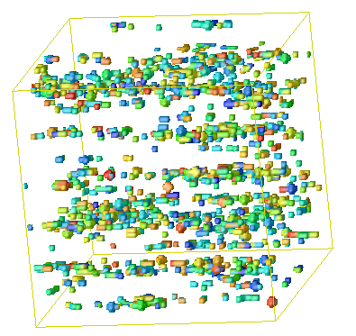
Simulation Domain with Particles
Particles distributed randomly along lines to reproduce the effect of stringers.
Series of slices through the domain used to calculate pcfs, just as for the experimental data.
Averaged pcfs used with simulated annealing to match the measured pair correlation functions.

Slide 80
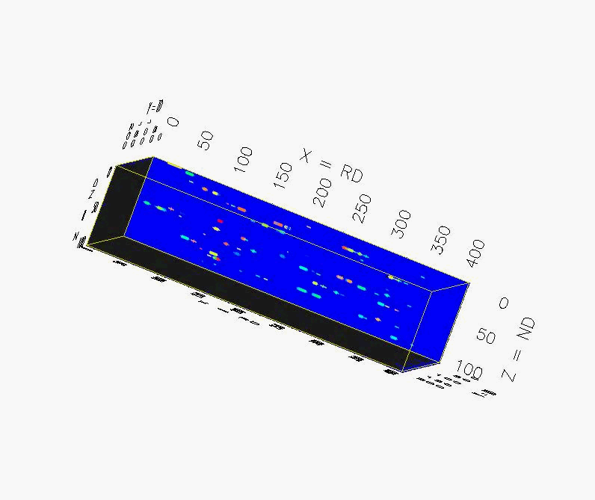
Sections through 3D Image

Slide 81
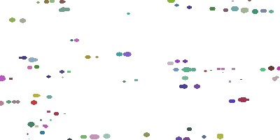
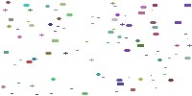
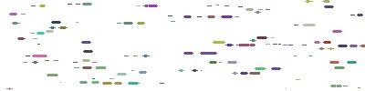
Generated Particle Structure: Sections
Ellipsoids were inserted into the domain with a constant aspect ratio of a:b:c = 3:2:1. The target correlation length was 0.07x400 = 28, with 10 particles per colony
Rolling plane (Z) - Transverse (X) - Longitudinal (Y)

Slide 82
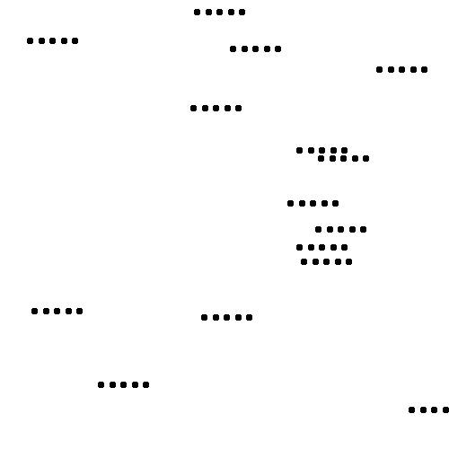
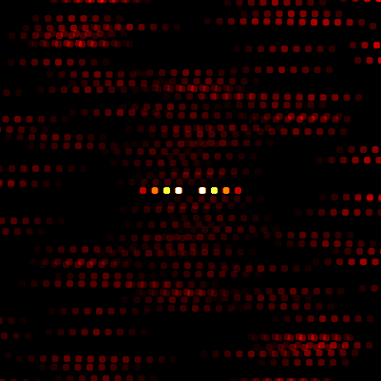
Pair Correlation Function: example
      The PCF is the probability of finding neighboring particle at a certain distance & direction relative to the any particle.
n
PCF(x,y)=∑ P_{i}(x,y)/N_{i}(x,y)
i=1
Output (401X401)
Center of image to end of red dot is 53 pixels
Input (500X500)
Center of 1 dot to end of 5th dot is 53 pixels
See also: Tewari, A.M Gokhale, J.E Spowart, D.B Miracle, Quantitative characterization of spatial clustering in three-dimensional microstructures using two-point correlation functions, Acta Materialia, Volume 52, Issue 2, 19 January 2004, Pages 307-319; also chemwiki.ucdavis.edu/Physical_Chemistry/Statistical_Mechanics/Advanced_Statistical_Mechanics/Distribution_Function_Theory/The_pair_correlation_function

Slide 83
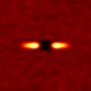
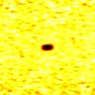
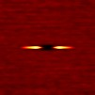
Generated Particle Structure: PCFs
Pair Correlation Functions were calculated on a 50x50 grid. The x-direction correlation length was ~29 pixels (half-length of the streak), in good agreement with the input.
Rolling plane (Z) - Transverse (X) - Longitudinal (Y)

Slide 84
2D section size distributions
A comparison of the shapes of ellipses shows reasonable agreement between the fitted set of ellipsoids and initial cross-section statistics (size distributions)
Cross-plot
Initial vs. Final section distributions

Slide 85
Comparison of 3D Particle Shape, Size
Comparison of the semi-axis size distributions between the set of 5765 ellipsoids in the generated structure and the 1,000 ellipsoids generated from the 2D section statistics shows reasonable agreement, with some “leakage” to larger sizes.
Much larger data sets clearly needed to test the reconstruction of ellipsoidal particles

Slide 86
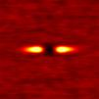
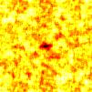
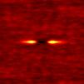
Comparison of PCFs for Original and Reconstructed Particle Distribution
From CA
Reconstructed
Rolling plane (Z) - Transverse (X) - Longitudinal (Y)

Slide 87
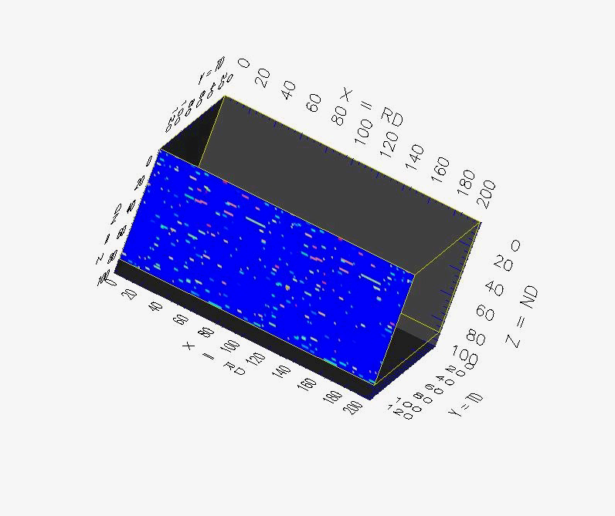
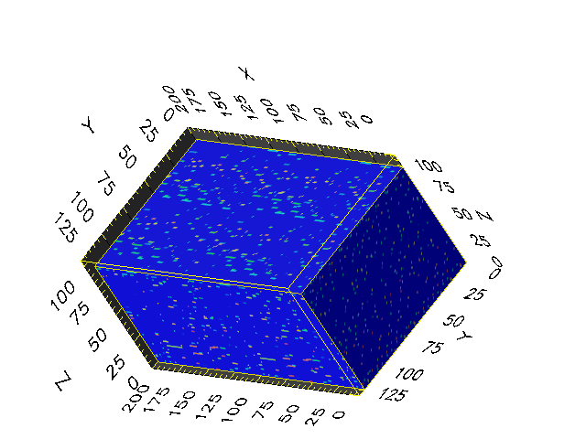
Reconstructed 3D particle distribution

Slide 88
Geometric Relationships
For each regular shape, whether sphere or tetrakaidecahedron, there is a set of analytical expressions that relate the dimensions of the object in 3D to its geometry in cross section.
The following tables reproduced from Underwood summarize the available formulae.
Note the difference between projected quantities and mean intercept quantities. Example: for spheres, the projected area is the equatorial area, πr², whereas the mean intercept area is only 2/3 πr².
First slide is for bodies of revolution; second slide is for polyhedral shapes.
Objectives Notation Equations Delesse S_{V}-P_{L} L_{A}-P_{L} Topology Grain_Size Distributions

Slide 89
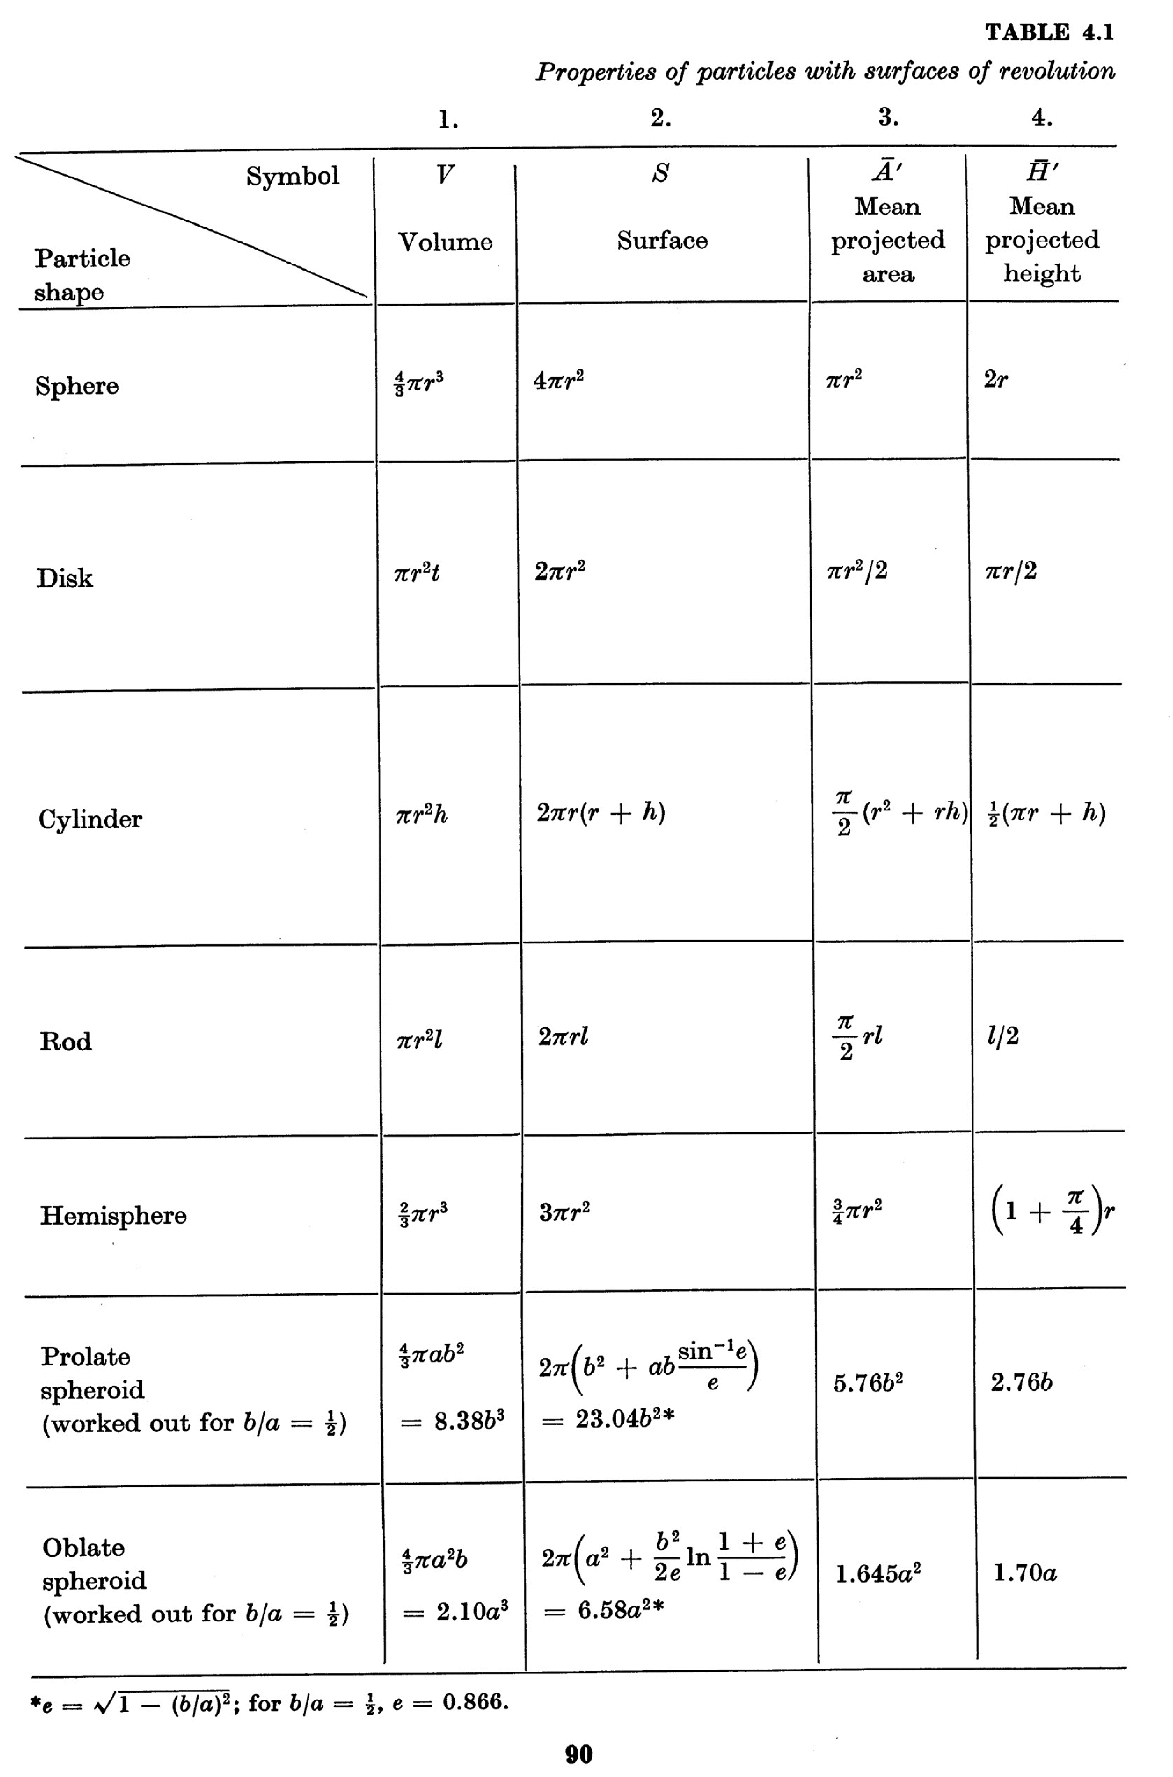
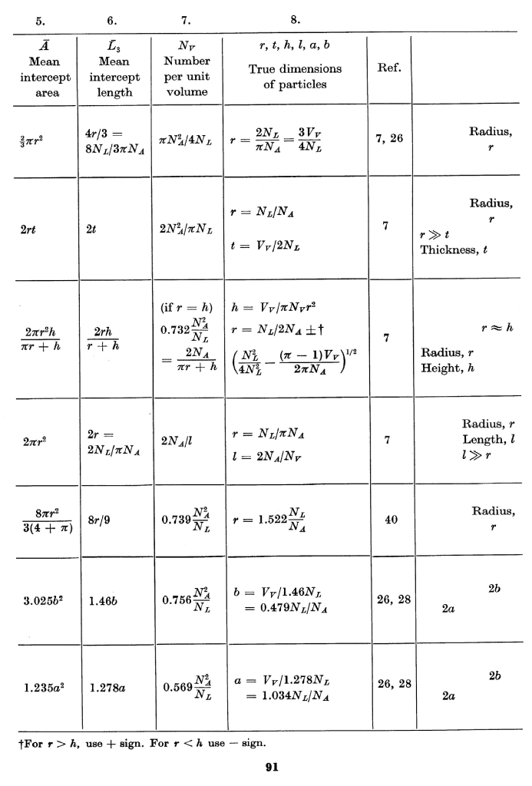
Objectives Notation Equations Delesse S_{V}-P_{L} L_{A}-P_{L} Topology Grain_Size Distributions

Slide 90
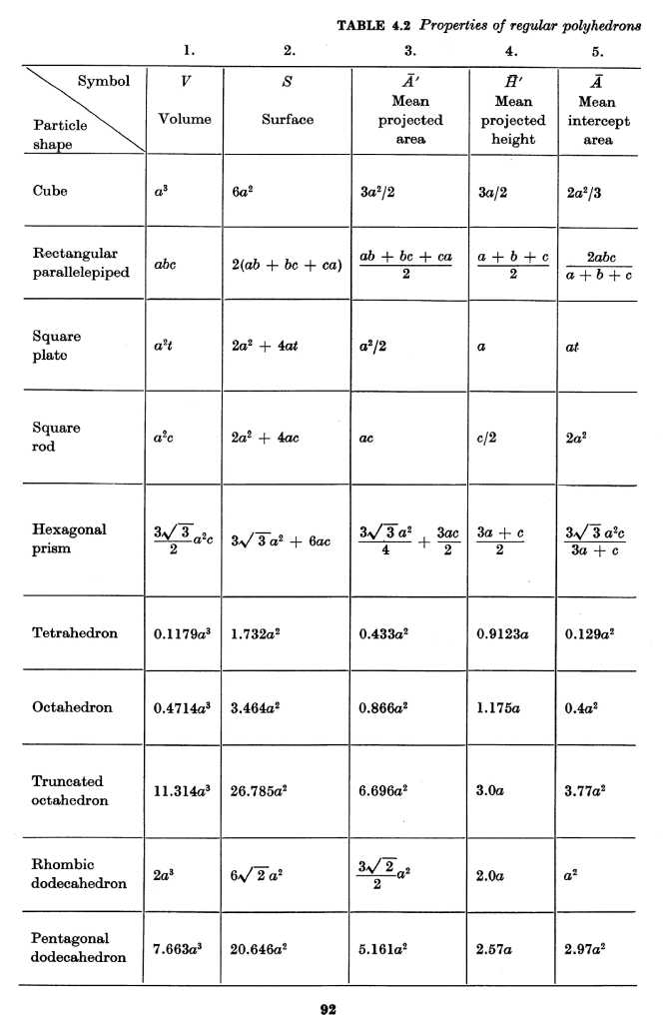
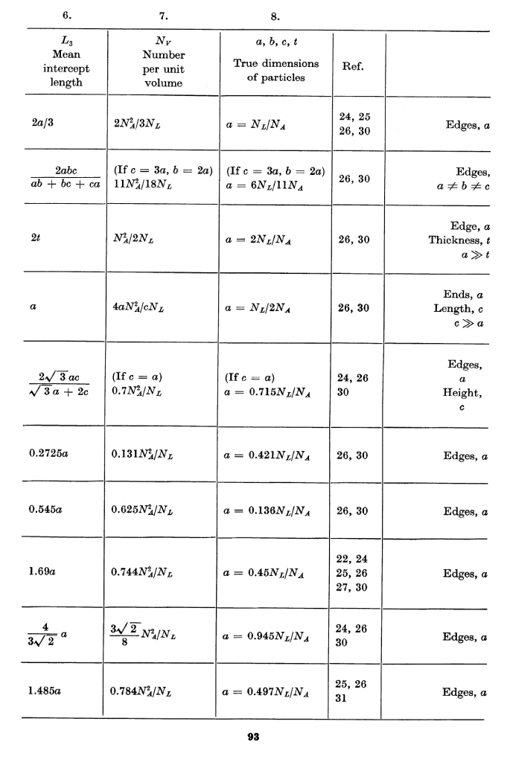
Objectives Notation Equations Delesse S_{V}-P_{L} L_{A}-P_{L} Topology Grain_Size Distributions

Slide 91
Questions
Which set of quantities are equal to each other? The point/line/area/volume fractions.
How does Buffon’s needle relate to the measurement of π? The intersection of a test line with a grid of parallel lines is related via 2L_{A} = π P_{L}.
Under what circumstances do we need to consider projected quantities rather than intercepts? Projected areas, e.g., are appropriate when viewing a sample in transmission (e.g. TEM) and the feature is, say, blocking the illumination, as opposed to being viewed in cross-section.
In general, do size distributions measured in 2D show larger or smaller means than their true 3D means? Since 2D sections cut objects in all possible locations, the observed mean sizes are invariably smaller than the true sizes.
Why are intercepts of grain boundaries with a circle sometimes used for measuring grain size? Using a circle ensures that any bias in the grain morphology does not affect the results (of grain size measurement).
Why are nearest neighbor distances smaller than the mean free path for a given volume fraction and size of particle? In qualitative terms, a nearest neighbor distance is based on finding the nearest neighbor object (particle) regardless of direction, whereas a mean free path is measured in a straight line and so is unlikely to pass through the nearest neighbor (but rather a next-nearest neighbor). See also the Eqs.

Slide 92
Summary
Provided that certain assumptions about the way in which a section plane samples the 3D microstructure are valid, statistically based relationships exist between experimental measures of points, lines and areas and various corresponding 3D quantities.

Slide 93
Supplemental Slides
Following slides contain useful information of various kinds.
Definitions of statistical terms
Measurement of area and circumference of spheres that are instantiated on a regular grid (voxelized).
Verification of Stereological Relationships for (voxelized) objects on regular grids

Slide 94
1. Statistics: definitions
Population: a well defined set of individual elements or measurements (e.g. areas of grains in a micrograph).
Parameter: a numerical quantity that is defined for the population (e.g. mean grain area).
Sampling Units: non-overlapping sets of elements. The union of all sampling units is equal to the population.
Sample: a collection of sampling units taken from the population.
Estimate: a numerical approximation of a population parameter calculated from a particular sample (e.g. mean grain area calculated from a subset of the areas).
Estimator: a well-defined numerical method that describes how to calculate an estimate from a sample.
Uniform random sample: a sample taken so that all sampling units within the population possess the same probability of falling within the sample.
Objectives Notation Equations Delesse S_{V}-P_{L} L_{A}-P_{L} Topology Grain_Size Distributions

Slide 95
Statistics: quantitative definitions
Population mean of a quantity R:
Population variance, or mean square deviation:
Population standard deviation:
Coefficient of variation:
Estimates:
sample mean:
Variance of sampling distribution:
Quantities in turquoise apply to the entire population;
Estimates from samples are in red.
Objectives Notation Equations Delesse S_{V}-P_{L} L_{A}-P_{L} Topology Grain_Size Distributions

Slide 96
Quantitative definitions, contd.
Standard Error of the sampling distribution (SE) and the Coefficient of Error (CE):
Sample Variance, s, the square root of which is the sample standard deviation:
Estimates of the coefficient of variation and the standard error:
Note the sample size dependence of these estimates of the population quantities.
Objectives Notation Equations Delesse S_{V}-P_{L} L_{A}-P_{L} Topology Grain_Size Distributions

Slide 97
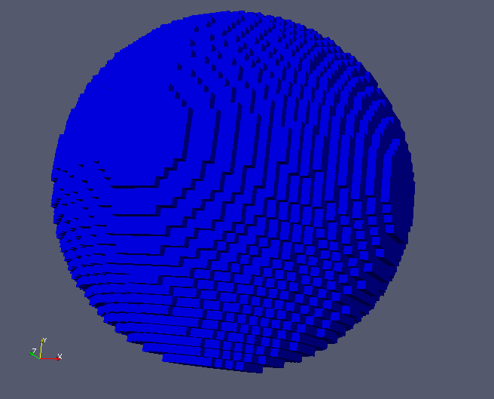
2. Sampling of Voxelized Sphere
This exercise attempts to measure how accurately the surface area and circumference of a sphere can be measured on a rectilinear grid (i.e. the sphere has been voxelized) using a simple ledge counting method.
From the PhD thesis work by C.G. Roberts
The figure above reveals the steps on the surface of a sphere with a radius equal to 50 pixels.

Slide 98

Surface Area of Voxelized Sphere
The surface area was measured and normalized by the analytical value (4πr²).
A constant ratio of 1.5 is obtained for radii greater than or equal to 3.

Slide 99

Circumference of Voxelized Sphere
A two-dimensional cross section was removed from the equatorial plane of the sphere and the circumference was measured and normalized by the analytical value (2πr).
Contrary to the surface area results, the ratio begins at a larger value for small radii and reaches an asymptotic value of 1.27 for radii greater than 30 pixels.

Slide 100
3. Verification of Stereological Relationships
Definition:
Stereology is the interpretation of three-dimensional structures based on two-dimensional observations. The relationships between lower and higher dimensionality are primarily mathematical in nature.
Practicality:
A majority of experimental investigations involve destructive evaluation of the specimen wherein the researcher measures the parameter of interest on a cross-sectional area; therefore, stereology provides the link between the planar and volumetric quantities.

Slide 101
Quick Statistics Review
Population Mean = μ
Population Standard Deviation = σ
Sample Mean =
Sample Standard Deviation = s
Population
Sample
Usually the population mean and error are unknown, but we would like to be able to estimate it using our sample subset.
The sample mean and standard deviation are the best estimates for the population mean and standard deviation.
How good is the fit between the sample and population mean? In this case, we need to find the difference between and . This is known as the “standard error” and is given as:
Notes:
A sample is a collection of random variables which are independent and have the same distribution as the population.
The sample average is an unbiased estimate of mu!!!!

Slide 102


L_{A} Algorithm Verification
Using 1st nearest neighbors only (up, down, left, right)
Particle-Matrix Trace = 3 boxes * (4 x 41) + 1 box * (4 * 100) = 892
Cross-sectional Area = 500 x 500
41 x 41 pixels
100 x 100 pixels
Comparing this to the program output….
500 pixels
Algorithm produces correct result
500 pixels

Slide 103



S_{V} Algorithm Verification
Two cubes inserted into a 100 x 100 x 100 box.
Small Cube: a=3
SA = 6 faces * 9 pixels = 54 pixels
Large Cube: a=50
SA = 6 faces * 2500 pixels = 15000
Output from Fortran…
Algorithm produces correct result

Slide 104
Particle Fractions
Estimation of volume fraction from cross-sectional areas is typically accomplished by using the following equation:
Since our images are a square grid, the point counting method is the easiest to implement for each dimensionality.
INPUT V_{V} | V_{V} | A_{A} | L_{L}
0.001 | 0.001026 | 0.00097 ± 4x10⁻⁵ | 0.00091 ± 4x10⁻⁵
0.01 | 0.010017 | 0.00991 ± 1.3x10⁻⁴ | 0.00851 ± 1.4x10⁻⁴
0.1 | 0.100008 | 0.10030 ± 4.4x10⁻⁴ | 0.06422 ± 4.1x10⁻⁴
Notes:
Must use the standard error of the sample.

Slide 105

Particle Fractions, contd.
20 microstructures were generated and monosized (a=3) particles were randomly inserted into each 100³ domain.
For any linear or area-based measurements: 10 sections were randomly selected from the x, y, and z planes (total of 30) and the area and linear fractions were measured.
600
measurements
At low volume fractions, the agreement among all three parameters is very close; however, the L_{L} parameter deviates significantly from the A_{A} and V_{V} values are larger particle fractions.
Recommendation: Use the area fraction (A_{A}) as a replacement for any equation or expression containing the linear fraction term.
Notes:
The middle form is most practical → experimental measurements are performed on 2D cross-sections.
The error between the area and volume fractions is very small for the observed ranges (0.001<VF<0.1)

Slide 106
Stereology: Grains vs. Particles
Space-filling structures Dispersed Phase
When we analyze the grain characteristics in typical metal alloys, we will use the left-hand relationships; for particle statistics (V_{V}<<1), the right-hand equation is valid.
It is apparent that a factor of 2 is the difference between the two approaches, which can be attributed to the sharing of grain boundary area between 2 grains.
E.E. Underwood, Quantitative Stereology, Addison-Wesley, MA (1970).
J.C. Russ, Practical Stereology, Plenum Press, New York (1986).

Slide 107

Stereology: L_{A} and S_{V}
Since most experimental studies involve two-dimensional statistical analyses, one inevitably will need to apply stereology to obtain a 3D parameter. Quantities highlighted with circles are easily measured on 2D planes.
We are interested in finding out how accurate the highlighted relationship is using computer generated three-dimensional structures.

Slide 108

Stereology: L_{A} and S_{V}
Using the same particles microstructures, the two quantities S_{V} and L_{A} were measured.
At larger volume fractions, the stereological prediction appears to under-estimate the true surface area per unit volume.
Particle Shape Effect??
INPUT V_{V} | V_{V} | S_{V} (3D) | S_{V} = (4/π)L_{A}
0.001 | 0.00101 | 0.00216 | 0.00176 ± 7x10⁻⁵
0.01 | 0.01001 | 0.02129 | 0.01789 ± 2.4x10⁻⁴
0.1 | 0.10002 | 0.205722 | 0.175084 ± 7.6x10⁻⁴
Is approximately constant

Slide 109
Mean Intercept Length
Another quantity of interest is the mean intercept length since it is an integral part of the relationship:
For particles ONLY
Measured Intercept -- Based on our previous results on particle fractions, the mean intercept length can be obtained using:
Predicted Intercept – Knowledge of the 3D quantity, S_{V}, enables us to predict the mean intercept and compare it to the measured quantity.
But be very careful about how λ is defined.
For dispersed particles….
OR

Slide 110
Mean Intercept Length, contd.
How well does the 3D and 2D mean intercept measurements compare?
The constant ratio of S_{V}/V_{V} creates a situation where the relationship would imply that the mean intercept length must be a constant also.
The artificial condition of monosized particles may be responsible for this behavior.
V_{V} | Measured | Predicted
0.001 | 3.25 ± 1.96 | 2
0.01 | 2.75 ± 0.83 | 2
0.1 | 2.74 ± 0.20 | 2.1

Slide 111
Conclusions
The area fraction measurements provide an accurate estimate of the three-dimensional volume fraction for V_{V} ≤ 0.1 while the line fraction significantly underestimates the true 3D quantity.
Line trace per unit area under-estimates the surface area per unit volume for volume fractions above 1 percent.
The predicted mean intercept length cannot be used as a substitute for the measurement of the mean intercept length.

