Slide 1


Stereology applied to GBCD
Texture, Microstructure & Anisotropy
A.D. Rollett
Last revised: 19th Mar. ‘14

Slide 2
Objectives
To instruct in methods of measuring characteristics of microstructure: grain size, shape, orientation; phase structure; grain boundary length, curvature etc.
To describe methods of obtaining 3D information from 2D cross-sections: stereology.
To show how to obtain useful microstructural quantities from plane sections through microstructures.
In particular, to show how to apply stereology to the problem of measuring 5-parameter Grain Boundary Character Distributions (GBCD) without having to perform serial sectioning.
Objectives Notation Equations Delesse S_{V}-P_{L} L_{A}-P_{L} Topology Grain_Size Distributions

Slide 3
Stereology: References
These slides are partly based on: Quantitative Stereology, E.E. Underwood, Addison-Wesley, 1970.
- equation numbers given where appropriate.
Also useful: M.G. Kendall & P.A.P. Moran, Geometrical Probability, Griffin (1963).
Kim C S and Rohrer G S Geometric and crystallographic characterization of WC surfaces and grain boundaries in WC-Co composites. Interface Science, 12 19-27 (2004).
C.-S. Kim, Y. Hu, G.S. Rohrer, V. Randle, "Five-Parameter Grain Boundary Distribution in Grain Boundary Engineered Brass," Scripta Materialia, 52 (2005) 633-637.
Miller HM, Saylor DM, Dasher BSE, Rollett AD, Rohrer GS. Crystallographic Distribution of Internal Interfaces in Spinel Polycrystals. Materials Science Forum 467-470:783 (2004).
Rohrer GS, Saylor DM, El Dasher B, Adams BL, Rollett AD, Wynblatt P. The distribution of internal interfaces in polycrystals. Z. Metall. 2004; 95:197.
Saylor DM, El Dasher B, Pang Y, Miller HM, Wynblatt P, Rollett AD, Rohrer GS. Habits of grains in dense polycrystalline solids. Journal of The American Ceramic Society 2004; 87:724.
Saylor DM, El Dasher BS, Rollett AD, Rohrer GS. Distribution of grain boundaries in aluminum as a function of five macroscopic parameters. Acta mater. 2004; 52:3649.
Saylor DM, El-Dasher BS, Adams BL, Rohrer GS. Measuring the Five Parameter Grain Boundary Distribution From Observations of Planar Sections. Metall. Mater. Trans. 2004; 35A:1981.
Saylor DM, Morawiec A, Rohrer GS. Distribution and Energies of Grain Boundaries as a Function of Five Degrees of Freedom. Journal of The American Ceramic Society 2002; 85:3081.
Saylor DM, Morawiec A, Rohrer GS. Distribution of Grain Boundaries in Magnesia as a Function of Five Macroscopic Parameters. Acta mater. 2003; 51:3663.
Saylor DM, Rohrer GS. Determining Crystal Habits from Observations of Planar Sections. Journal of The American Ceramic Society 2002; 85:2799.
Objectives Notation Equations Delesse S_{V}-P_{L} L_{A}-P_{L} Topology Grain_Size Distributions

Slide 4
Questions
What is the connection between lines/traces observed on planar cross-sections of 3D interfaces and surface area?
How does Buffon’s Needle measure π?
What is the definition of Stereology?
What are some examples of measureable quantities and derived quantities in stereology?
What is an accumulator diagram/stereogram?
When we observe the trace of a boundary/interface in a cross-section, what can we infer about the true normal to that interface?
How do we use the trace, once converted to crystal coordinates, in an accumulator stereogram?
What is the standard discretization of the (hemi-)spherical accumulator stereogram?
Why do we divide up the declination (co-latitude) angle in increments of cos(θ)?
What is the key difference between analyzing surface normals and grain boundaries (to get the GBCD)?
Given a 3D microstructure (i.e. image as an orientation map), what is the best way to proceed to extract grain boundary normals (and misorientations)?
What units do we (typically) use for GBCD and Misorientation Distributions?

Slide 5
Measurable Quantities
N := number (e.g. of points, intersections)
P := points
L := line length
Blue ⇒ easily measured directly from images
A := area
S := surface or interface area
V := volume
Red ⇒ not easily measured directly
Objectives Notation Equations Delesse S_{V}-P_{L} L_{A}-P_{L} Topology Grain_Size Distributions

Slide 6
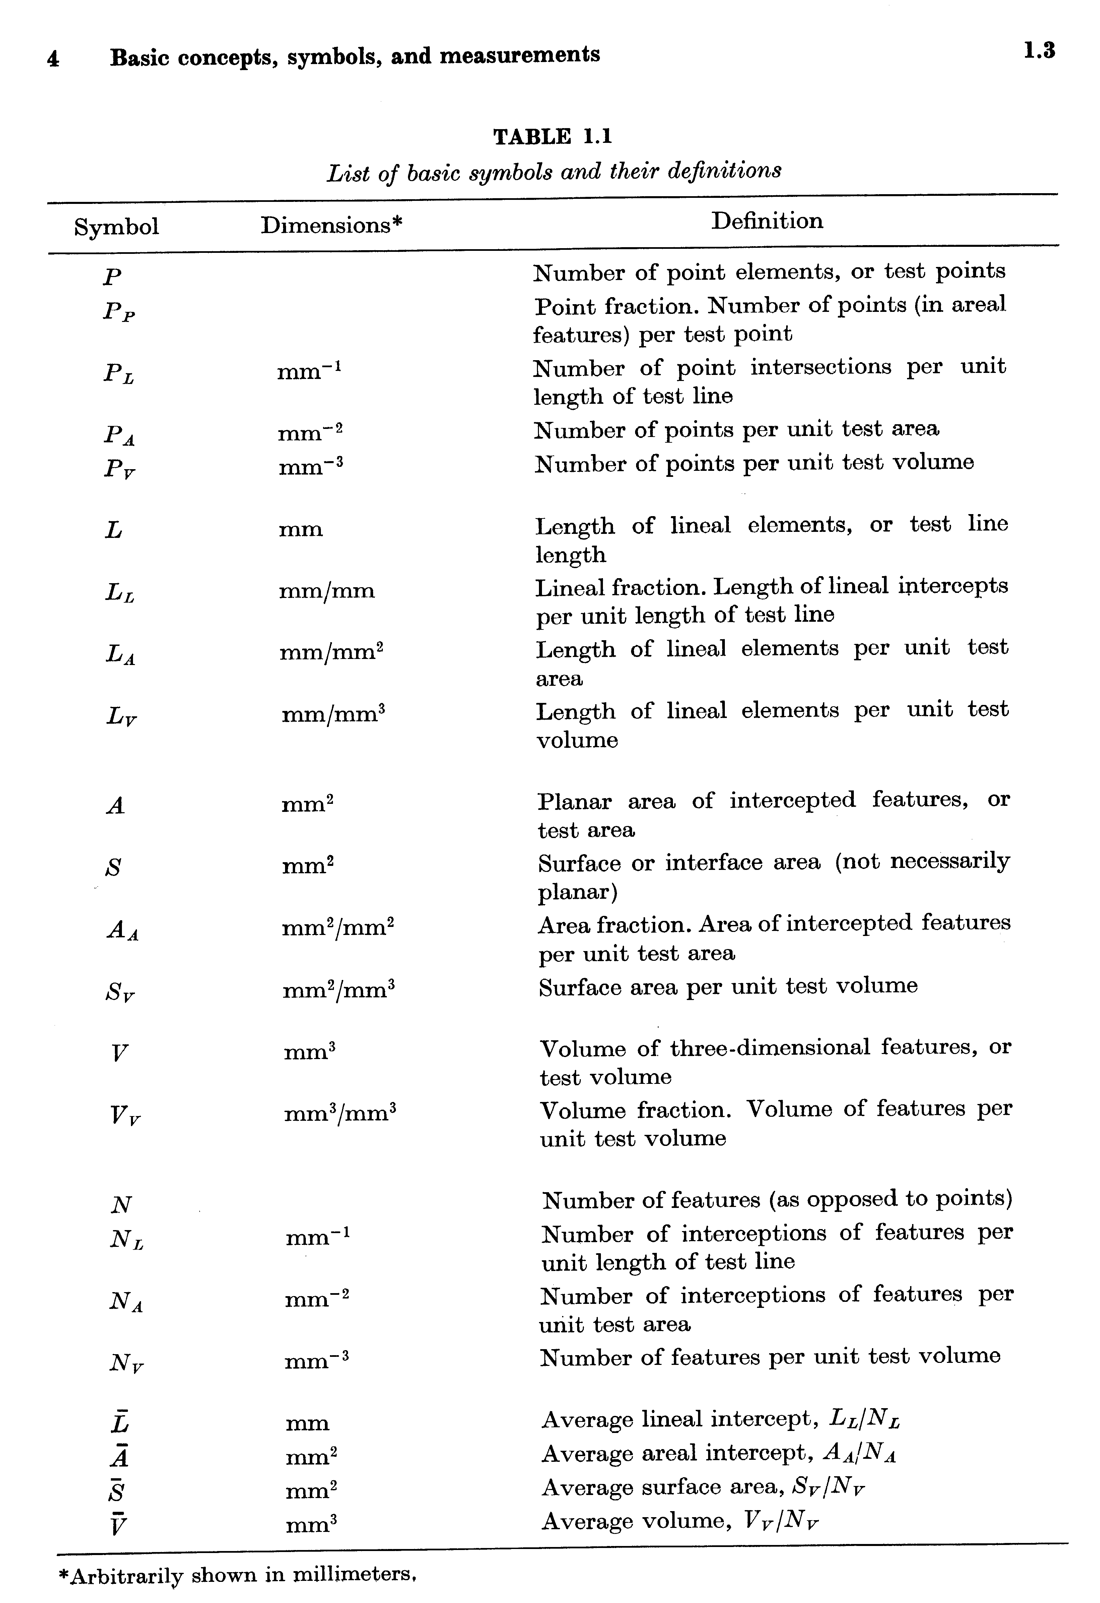
Definitions
Subscripts:
P := per test point
L := per unit of line
A := per unit area
V := per unit volume
T := total
overbar:= average
<x> = average of x
E.g. P_{A} :=
Points per unit area
[Underwood]
Objectives Notation Equations Delesse S_{V}-P_{L} L_{A}-P_{L} Topology Grain_Size Distributions

Slide 7
Relationships between Quantities
V_{V} = A_{A} = L_{L} = P_{P} mm⁰
S_{V} = (4/π)L_{A} = 2P_{L} mm⁻¹
L_{V} = 2P_{A} mm⁻²
P_{V} = 0.5L_{V}S_{V} = 2P_{A}P_{L} mm⁻³ (2.1-4).
These are exact relationships, provided that measurements are made with statistical uniformity (randomly). Obviously experimental data is subject to error.
Notation and Eq. numbers from Underwood, 1971
Objectives Notation Equations Delesse S_{V}-P_{L} L_{A}-P_{L} Topology Grain_Size Distributions

Slide 8
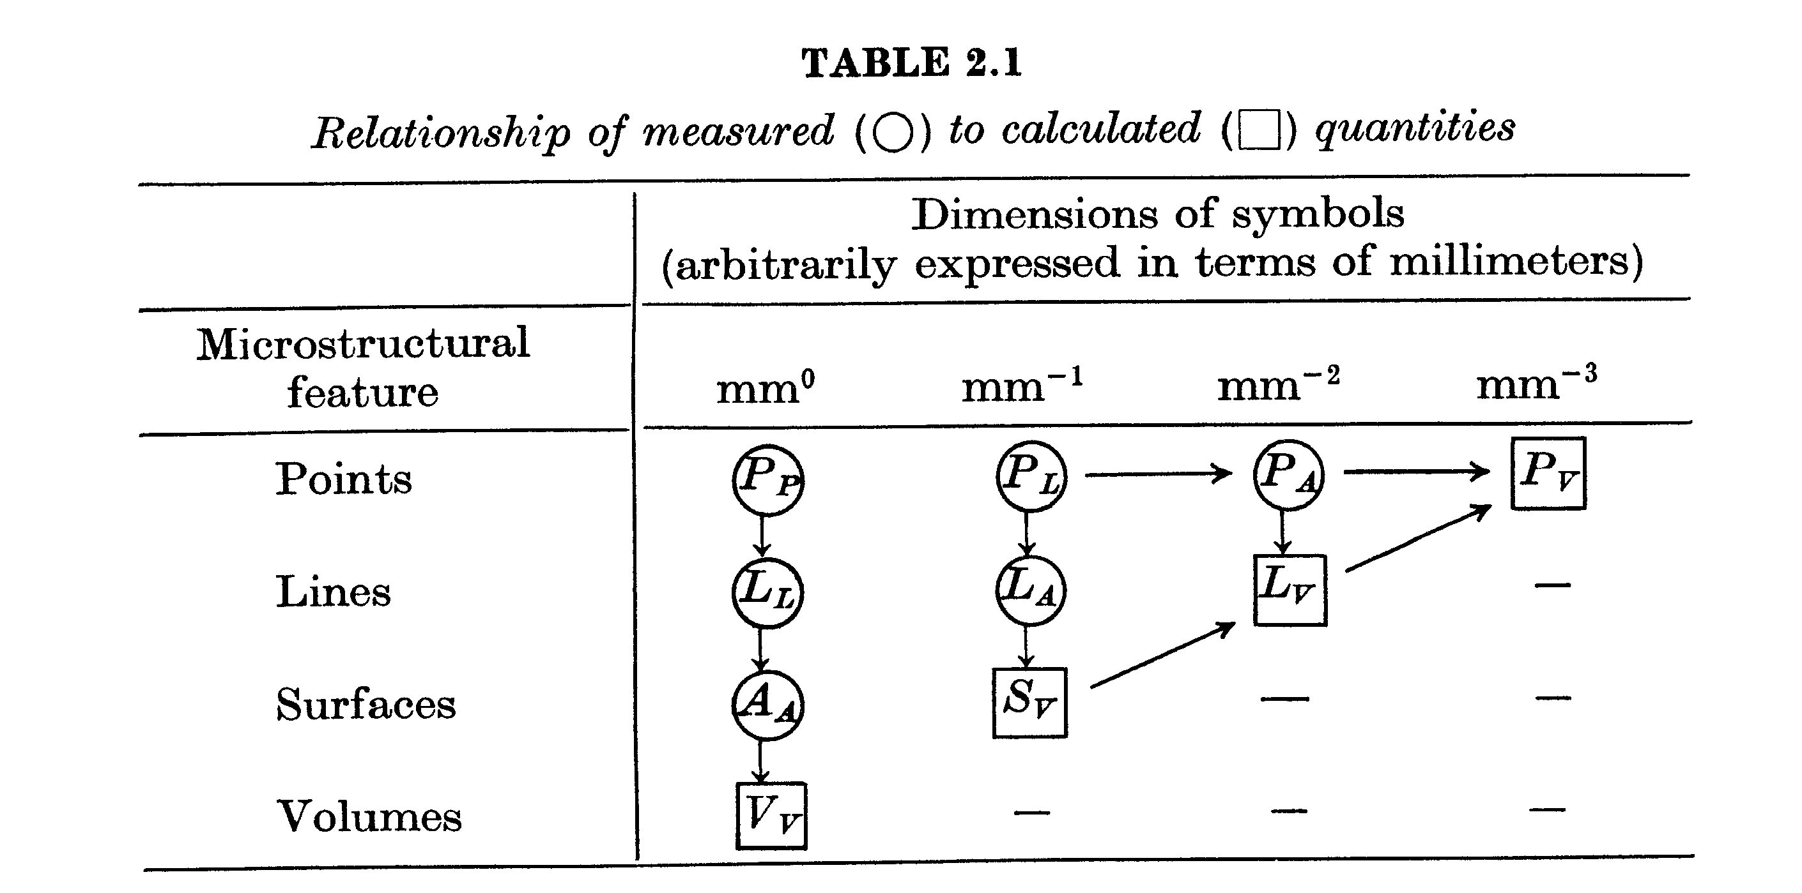
Measured vs. Derived Quantities
Relationships between Quantities
Remember that it is not easy to obtain true 3D measurements (squares) and so we must find stereological methods to estimate the 3D quantities (squares) from 2D measurements (circles).
Objectives Notation Equations Delesse S_{V}-P_{L} L_{A}-P_{L} Topology Grain_Size Distributions

Slide 9
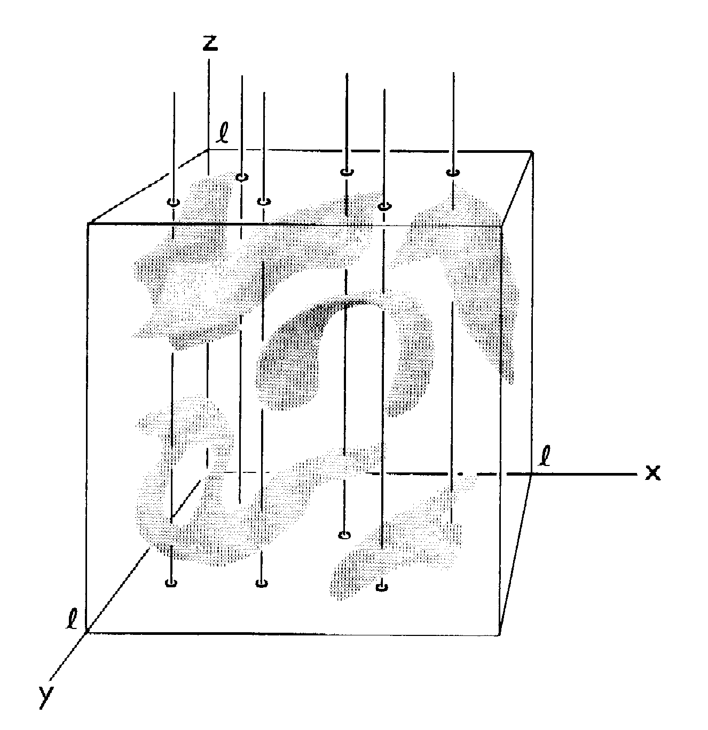
Surface Area (per unit volume)
S_{V} = 2P_{L} (2.2).
Derivation based on random intersection of lines with (internal) surfaces. Probability of intersection depends on inclination angle, θ. Averaging θ gives factor of 2.
Clearly, the area of grain boundary per unit volume is measured by S_{V}.
Objectives Notation Equations Delesse S_{V}-P_{L} L_{A}-P_{L} Topology Grain_Size Distributions

Slide 10
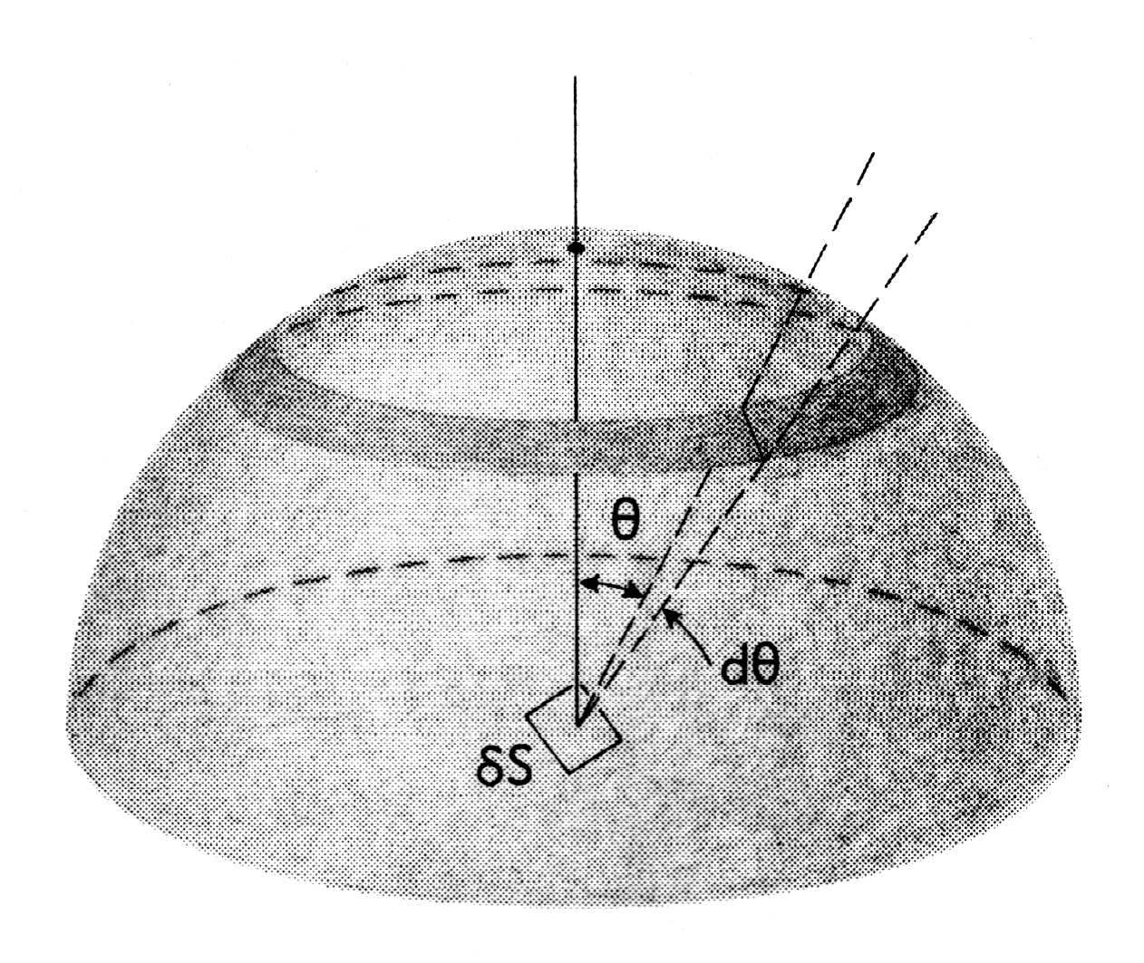
S_{V} = 2P_{L}
Derivation based on
uniform distribution
of elementary areas.
Consider the dA to be
distributed over the surface of a sphere. The sphere represents the effect of randomly (uniformly) distributed surfaces.
Projected area = dA cosθ.
Probability that a vertical line will intersect with a given patch of area on the sphere is proportional to projected area of that patch onto the horizontal plane.
Therefore we integrate both the projected area and the total area of the hemisphere, and take the ratio of the two quantities
Objectives Notation Equations Delesse S_{V}-P_{L} L_{A}-P_{L} Topology Grain_Size Distributions

Slide 11
S_{V} = 2P_{L}
Objectives Notation Equations Delesse S_{V}-P_{L} L_{A}-P_{L} Topology Grain_Size Distributions

Slide 12
Length of Line per Unit Area, L_{A} versus Intersection Points Density, P_{L}
Set up the problem with a set of test lines (vertical, arbitrarily) and a line to be sampled. The sample line can lie at any angle: what will we measure?
ref: p38/39 in Underwood
This was first considered by Buffon, Essai d’arithmetique morale, Supplément à l’Histoire Naturelle, 4, (1777) and the method has been used to estimate the value of π. Consequently, this procedure is also known as Buffon’s Needle.
Objectives Notation Equations Delesse S_{V}-P_{L} L_{A}-P_{L} Topology Grain_Size Distributions

Slide 13


L_{A} = π/2 P_{L}, contd.
∆x, or d
The number of points of intersection with the test grid depends on the angle between the sample line and the grid. Larger θ value means more intersections. The projected length = l sin θ = l P_{L} ∆x.
l
l cos θ
θ
l sin θ
• Line length in area, L_{A}; consider an arbitrary area of x by x :
Therefore to find the relationship between P_{L} and L_{A} for the general case where we do not know ∆x, we must average over all values of the angle θ.
Objectives Notation Equations Delesse S_{V}-P_{L} L_{A}-P_{L} Topology Grain_Size Distributions

Slide 14
L_{A} = π/2 P_{L}, contd.
Probability of intersection with test line given by average over all values of θ:
θ
• Density of intersection points, P_{L},
to Line Density per unit area, L_{A}, is
given by this probability. Note that a simple experiment estimates π (but beware of errors!).
Objectives Notation Equations Delesse S_{V}-P_{L} L_{A}-P_{L} Topology Grain_Size Distributions

Slide 15
Buffon’s Needle Experiment
In fact, to perform an actual experiment by dropping a needle onto paper requires care. One must always perform a very large number of trials in order to obtain an accurate value. The best approach is to use ruled paper with parallel lines at a spacing, d, and a needle of length, l, less than (or equal to) the line spacing, l ≤ d. Then one may use the following formula. (A more complicated formula is needed for long needles.) The total number of dropped needles is N and the number that cross (intersect with) a line is n.
See: http://www.ms.uky.edu/~mai/java/stat/buff.html
Also http://mathworld.wolfram.com/BuffonsNeedleProblem.html
Objectives Notation Equations Delesse S_{V}-P_{L} L_{A}-P_{L} Topology Grain_Size Distributions

Slide 16
S_{V} = (4/π)L_{A}
If we can measure the line length per unit area, L_{A}, directly, then there is an equivalent relationship to the surface area per unit volume, S_{V}.
This relationship is immediately obtained from the previous equation and a further derivation (not given here) known as Buffon’s Needle:
S_{V} / 2 = P_{L} and P_{L} = (2/π) L_{A},
which together give:
S_{V} = (4/π) L_{A}.
Careful! This simple analysis leads to an elegant experiment which consists of dropping a needle on ruled paper and counting intersections. This is, however, an inefficient way of estimating π.
In the OIM software, for example, grain boundaries can be automatically recognized based on misorientation and their lengths counted to give an estimate of L_{A}. From this, the grain boundary area per unit volume can be estimated (as S_{V}).
Objectives Notation Equations Delesse S_{V}-P_{L} L_{A}-P_{L} Topology Grain_Size Distributions

Slide 17
Example Problem:
Tungsten Carbide
Example Problem (Changsoo Kim, Prof. G. Rohrer): consider a composite structure (WC in Co) that contains faceted particles. The particles are not joined together although they may touch at certain points. You would like to know how much interfacial area per unit volume the particles have (from which you can obtain the area per particle). Given data on the line length per unit area in sections, you can immediately obtain the surface area per unit volume, provided that the sections intersect the facets randomly.

Slide 18
Faceted particles, contd.
An interesting extension of this problem is as follows. What if each facet belongs to one of a set of crystallographic facet types, and we would like to know how much area each facet type has?
What can we measure, assuming that we have EBSD/OIM maps? In addition to the line lengths of grain boundary, we can also measure the orientation of each line. If the facets are limited to a all number of types, say {100}, {111} and {110}, then it is possible to assign each line to one type (except for a few ambiguous positions). This is true because the grain boundary “line” that you see in a micrograph must be a tangent to the boundary plane, which means that it must be perpendicular to the boundary normal. In crystallographic terms, it must lie in the zone of the plane normal.

Slide 19
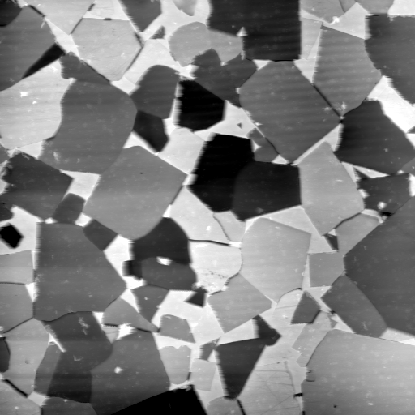
Determining Average 3-D Shape for WC
Problem : Crystals are three-dimensional, micrographs are two-dimensional
Serial sectioning :
- labor intensive, time consuming
involves inaccuracies in measuring each slice especially in hard materials
3DXDM :
- needs specific equipment,
i.e. a synchrotron!
Do these WC crystals
have a common, crystallographic shape?
60 x 60 μm²

Slide 20
Measurement from Two-Dimensional Sections
We know that each habit plane is in the zone of the observed surface trace
Assumption : Fully faceted isolated crystalline inclusions dispersed in a second phase
For every line segment observed, there is a set of possible planes that contains a correct habit plane together with a set of incorrect planes that are sampled randomly. Therefore, after many sets of planes are observed and transformed into the crystal reference frame, the frequency with which the true habit planes are observed will greatly exceed the frequency with which non-habit planes are observed.
[Changsoo Kim, 2004]
Notation: l_{ij}: trace of j^{th} facet of the i^{th} particle
n_{ijk}: normal, perpendicular to trace.

Slide 21
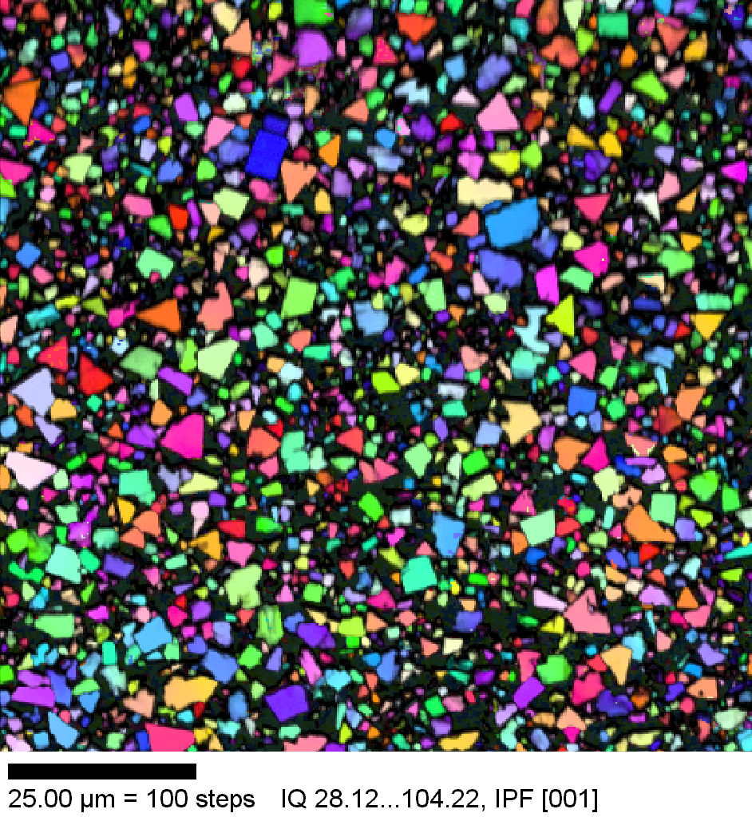
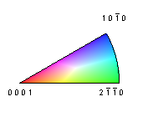
Transform Observations to Crystal Frame
Transformation (orientation) matrix from (Bunge) Euler angles:
c : cosine, s : sine
Vector components in
crystal reference frame
100x100 μm²
Vector components in
laboratory reference frame
[Changsoo Kim, 2004]

Slide 22
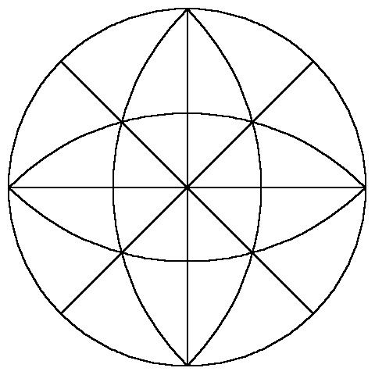
Basic Idea
transform to crystal reference frame
Trace Pole
Observed surface trace
Poles of possible planes
Draw the zone of the Trace Pole:
X
2
3
X
X
1
X
2
X
1
4
4
3
The normal to a given facet type is always perpendicular to its trace:
X
Therefore, if we repeat this procedure for many WC grains, high intensities (peaks) will occur at the positions of the habit plane normals
[Changsoo Kim, 2004]

Slide 23
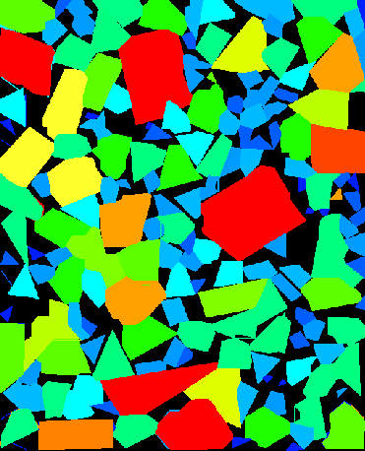
Crystallography
t_{sample}
Step 1: identify a reference direction.
Step 2: identify a tangent to a grain boundary for a specified segment length of boundary.
Step 3: measure the angle between the g.b. tangent and the reference direction.
Step 4: convert the direction, t_{sample}, in sample coordinates to a direction, t_{crystal}, in crystal coordinates, using the crystal orientation, g.
Steps 2-4: repeat for all boundaries
Step 5: classify/sort each boundary segment according to the type of grain boundary.
WC in Co, courtesy of Changsoo Kim
θ
t_{crystal} = g • t_{sample}

Slide 24
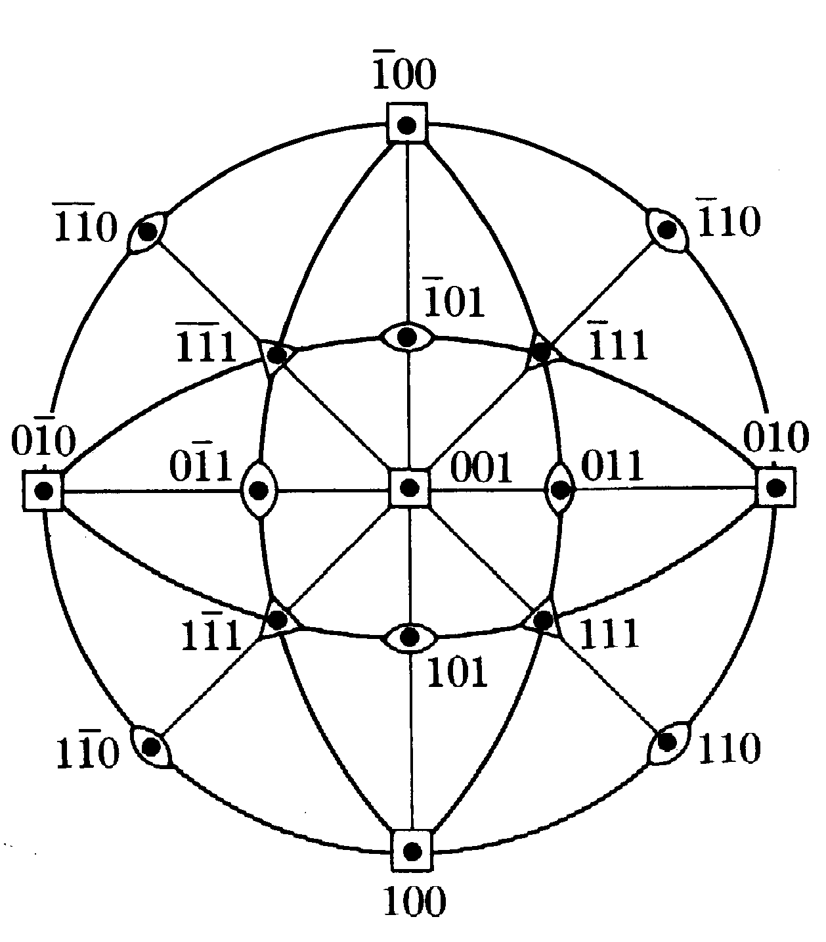
Faceted particles, facet analysis
The set of measured tangents, {t_{crystal}} can be plotted
on a stereographic
projection
Red poles must lie on {110} facets
Discussion:
where would
you expect to
find poles for lines
associated with {111} facets?
Blue poles must lie on {100} facets

Slide 25
Faceted particles, area analysis
The results depicted in the previous slide suggest (assuming equal line lengths for each sample) that the ratio of values is:
L_{A/110}: L_{A/100} = 6:4
⇒ S_{V/110}: S_{V/100} = 6:4
From these results, it is possible to deduce ratios of interfacial energies.

Slide 26
Habit Probability Function
When this probability is plotted as a function of the normal, n’, (in the crystal frame) maxima will occur at the habit planes.
The probability that a plane is observed is proportional to sinθ_{k} and to the line length |l_{ij}|. Planes parallel to the section plane are not observed whereas planes perpendicular to the section have the maximum probability of being observed.
3D reconstruction :
The dot product of any l_{ij} with each habit plane vanishes for the habit plane that created the surface trace. Since the total length of a set of randomly distributed lines intersecting an area is proportional to that area, the ratios of the line lengths associated with each plane is an estimate of the relative surface areas.
[Changsoo Kim, 2004]

Slide 27
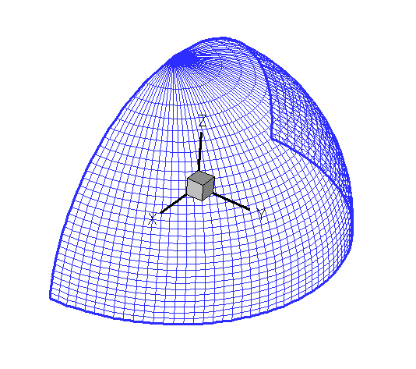
Numerical Analysis
Discretization
→ Grid discretization in increments of φ and (cosθ) gives equal area for each cell
½ of the total grid
Procedure: compute a series of points along the zone of each trace pole and bin them in the crystal frame.
Probability function, normalized to give units of:
Multiples of Random Distribution (MRD)
[Changsoo Kim, 2004]

Slide 28
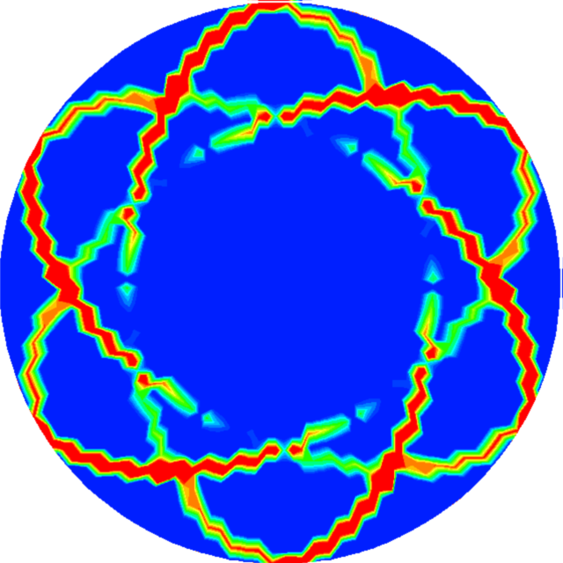
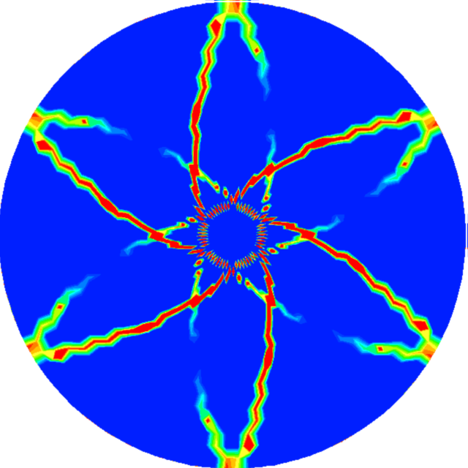
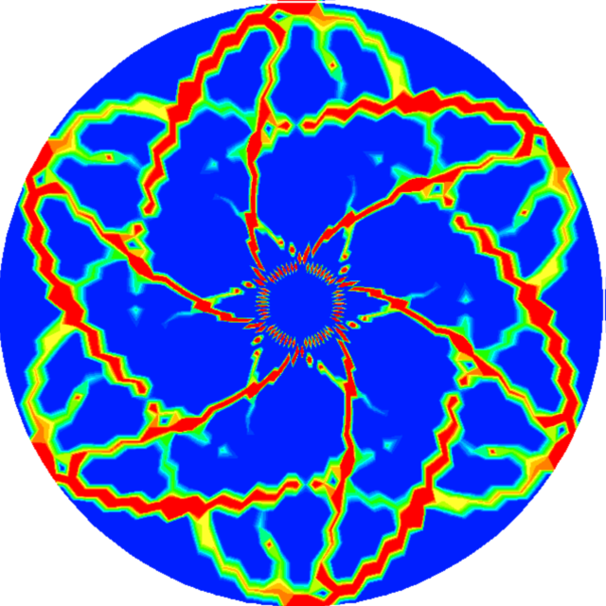
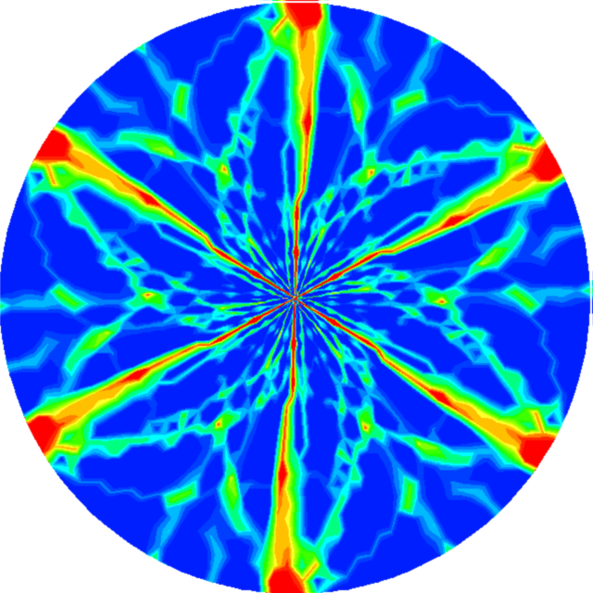
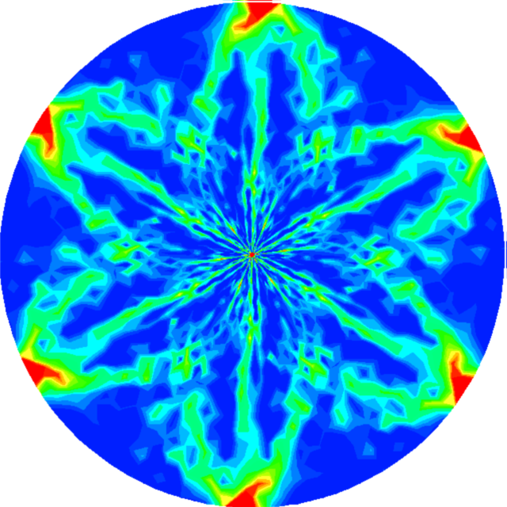
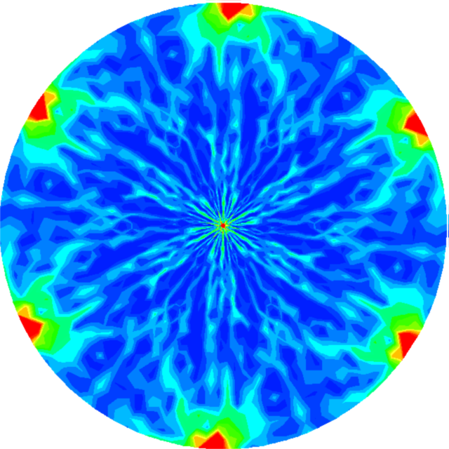
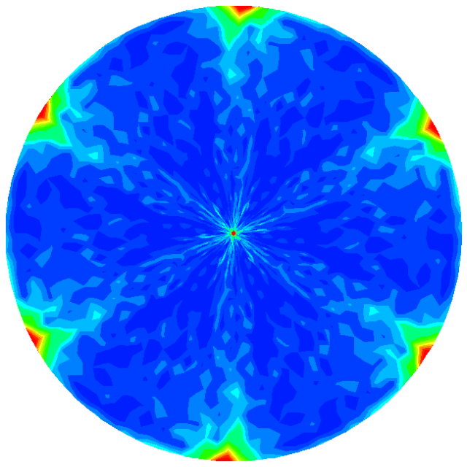
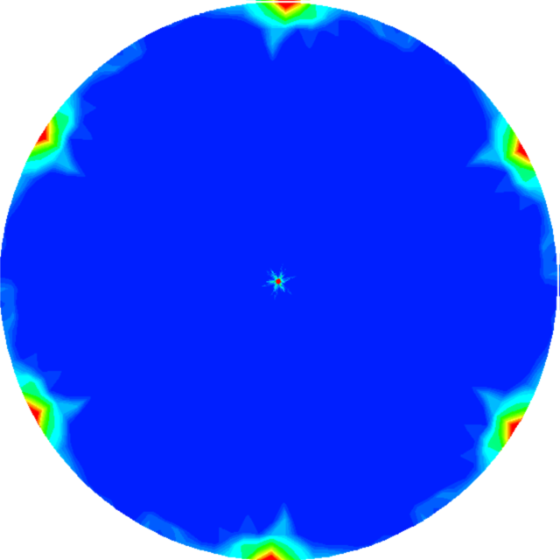
+
=
1 line segment of 1 grain
another line segment
of 1 grain
2 line segments of 1 grain
another grain
+
+ …. =
→
15 grains
→
→
30 grains
50 grains
200 grains
[Changsoo Kim, 2004]

Slide 29
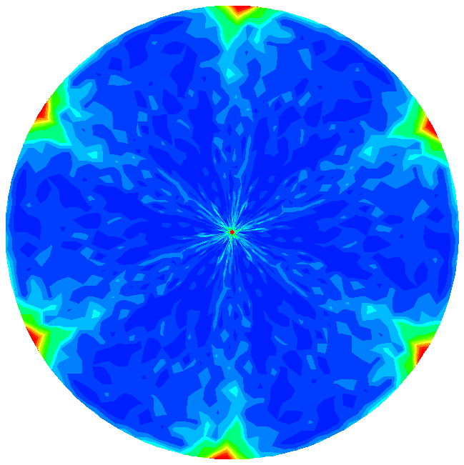
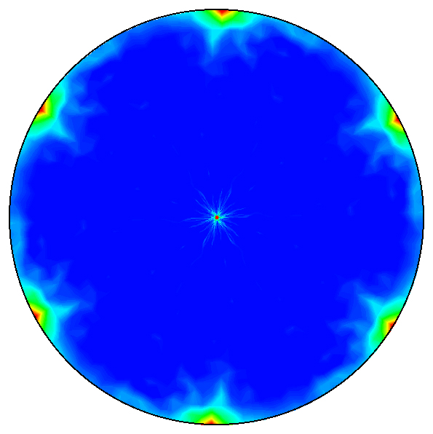
Results
~50 WC grains
~200 WC grains
(0001)
(0001)
High MRD values occur at the same positions of 50 and 200 WC grain tracings
→ Only 200 grains are needed to determine habit planes because of the small number of facets
There are two habit planes, basal plane (0001) and prism plane
[Changsoo Kim, 2004]

Slide 30
Five parameter grain boundary
character distribution (GBCD)
i
j
l’_{ij}
3
i+1
r_{ij2}
2
j
r_{ij1}
n’_{ij}
i+2
1
Three parameters for the misorientation: Δg_{i,i+1}
Two parameters for the orientation: n_{ij}
Grain boundary character distribution: λ(Δg, n),
a normalized area measured in MRD

Slide 31
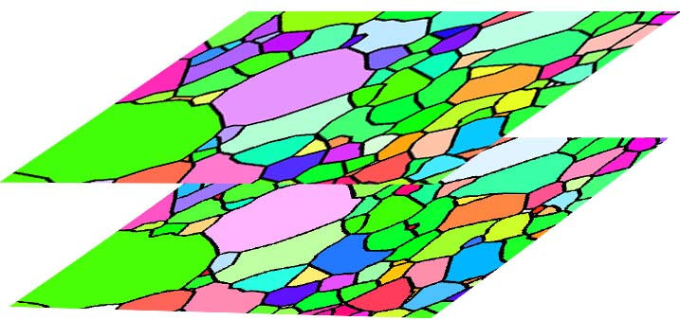
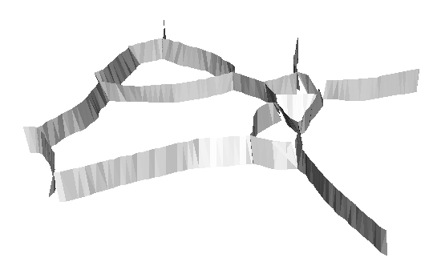
Direct Measurement of the Five Parameters
Record high resolution EBSP maps on two adjacent layers.
Assume triangular planes connect boundary segments on the two layers.
n
∆g and n can be specified for each triangular segment
n
n
Saylor, Morawiec, Rohrer, Acta Mater. 51 (2003) 3663

Slide 32
Stereology for Measuring Δg and n
The probability that the correct plane is in the zone is 1.
The probability that all planes are sampled is < 1.
Poles of possible planes
The grain boundary surface trace is the zone axis of the possible boundary planes.
transform to the misorientation reference frame
Δg
Trace pole
NB each trace contributes two poles, zones, one for each side of the boundary
D.M. Saylor, B.L. Adams, and G.S. Rohrer, "Measuring the Five Parameter Grain Boundary Distribution From Observations of Planar Sections," Metallurgical and Materials Transactions, 35A (2004) 1981-1989.

Slide 33
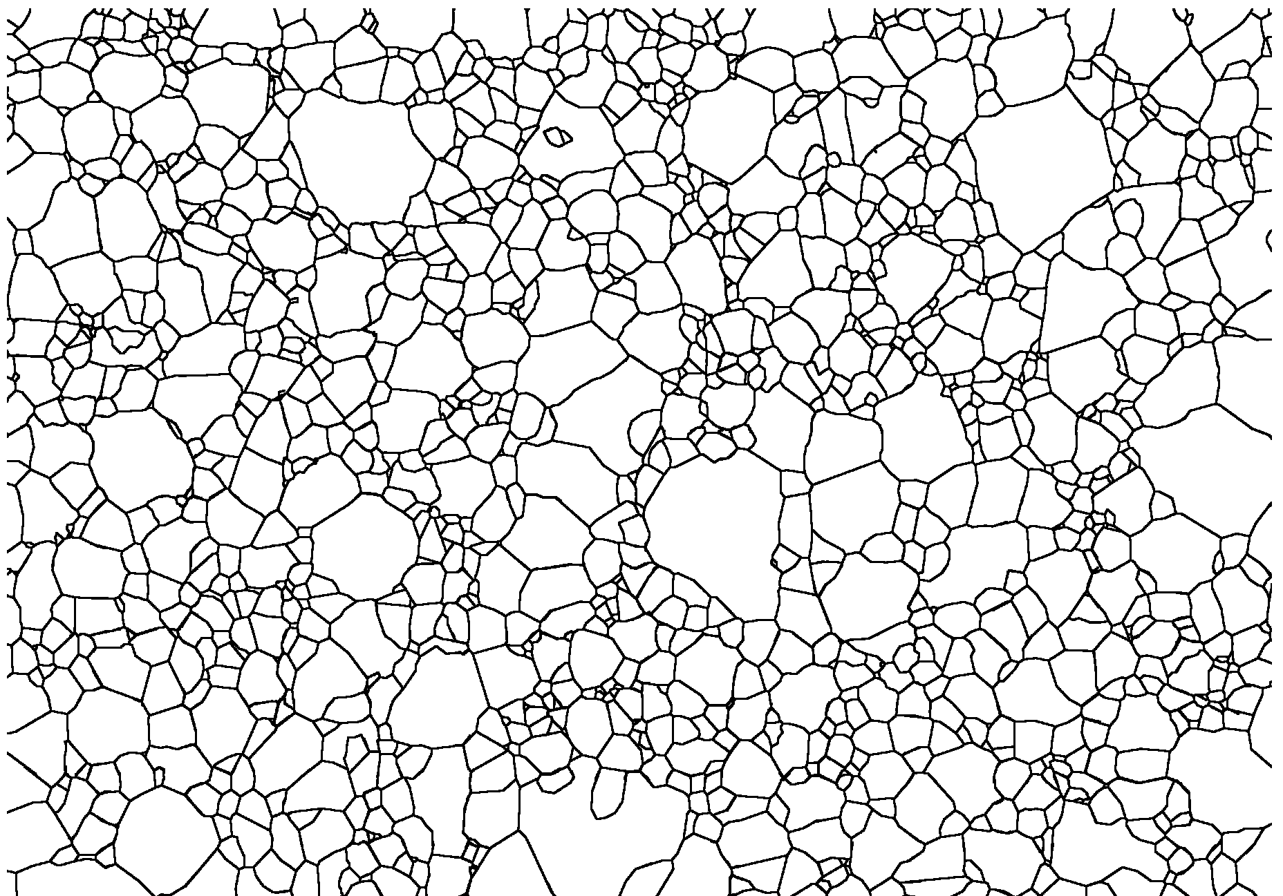
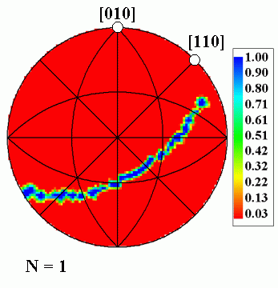
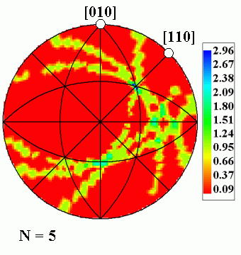
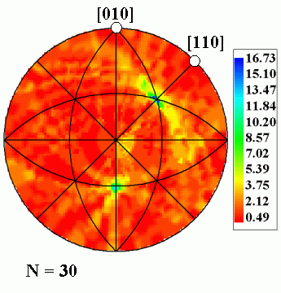
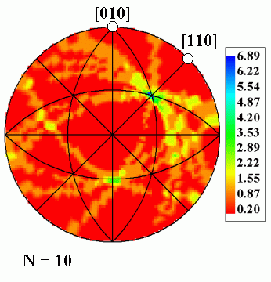
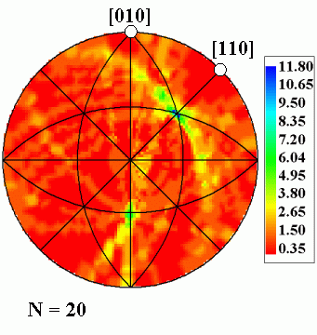
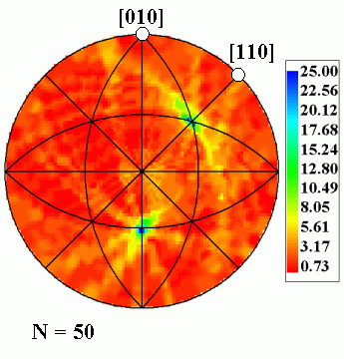
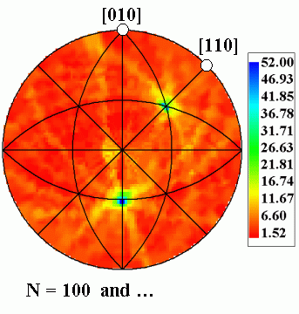
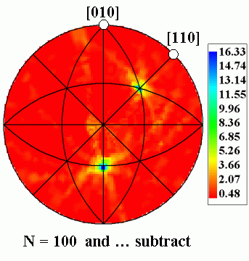
Illustration of Boundary Stereology
Grain boundary traces in sample reference frame
All planes in the zone of trace, in the misorientation frame (at a fixed Δg)
The background of accumulated false signals must then be subtracted.
• The result is a representation of the true distribution of grain boundary planes at each misorientation.
• A continuous distribution requires roughly 2000 traces for each Δg

Slide 34
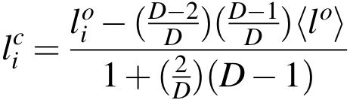
Background Subtraction
Each tangent accumulated contributes intensity both to correct cells (with maxima) and to incorrect cells.
The closer that two cells are to each other, the higher the probability of “leakage” of intensity. Therefore the calculation of the correction is based on this.
The correct line length in the i^{th} cell is l_{i}^{c} and the observed line length is l_{i}º. The discretization is specified by D cells over the angular range of the accumulator (stereogram).

Slide 35
Background Subtraction: detail
Recall the basic approach for the accumulator diagram:
X
2
3
X
X
1
X
2
X
1
4
4
3
X
Take the “correct” location of intensity at 111; the density of arcs decreases steadily as one moves away from this location. This is the basis for the non-uniform background correction.

Slide 36
Background Subtraction: detail
The basis for the correction given by Saylor et al. is simplified to two parts.
A correction is applied for the background in all cells.
A second correction is applied for the nearest neighbor cells to each cell.
In more detail:
The first correction uses the average of the intensities in all the cells except the one of interest, and the set of nearest neighbor (NN) cells.
The second correction uses the average of the intensities in just the NN cells, because these levels are higher than those of the far cells.
Despite the rather approximate nature of this correction, it appears to function quite well.

Slide 37
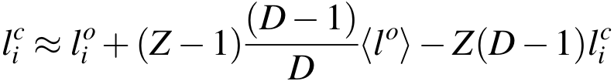
Background Subtraction: detail
The correction given by Saylor et al. is based on fractions of each line that do not belong to the point of interest.
Out of D cells along each line (zone of a trace) D-1 out of D cells are background. The first order correction is therefore to subtract (D-1)/D multiplied by the average intensity, from the intensity in the cell of interest (the i^{th} cell).
This is then further corrected for the higher background in the NN cells by removing a fraction Z (=2/D) of this amount and replacing it with a larger quantity, Z(D-1) multiplied by the intensity in the cell of interest (l_{i}^{c}).

Slide 38
Texture effects, limitations
If the (orientation) texture of the material is too strong, the method as described will not work.
Texture effects can be mitigated by taking sections with different normals, e.g. slices perpendicular to the RD, TD, ND.
No theory is available for how to quantify this issue (e.g. how many sections are required?).

Slide 39
Examples of 2-Parameter GBCD
Important limitation of the stereological approach: it assumes that the (orientation) texture of the material is negligible.
The next several slides show examples of 2-parameter and 5-parameter distributions from various materials.
The 2-parameter distributions are equivalent to posing the question “how does the boundary population vary with plane/normal, regardless of misorientation?”
Intensities are given in terms of multiples of a random (uniform) intensity (MRD/MUD).
Grain boundary populations are computed for only the boundary normal (and the misorientation is “averaged out”). These can be compared with surface energies.

Slide 40
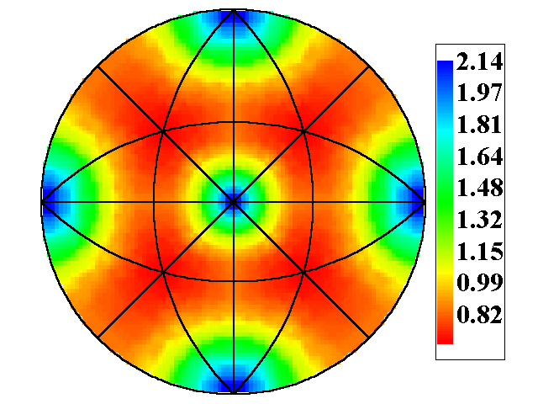
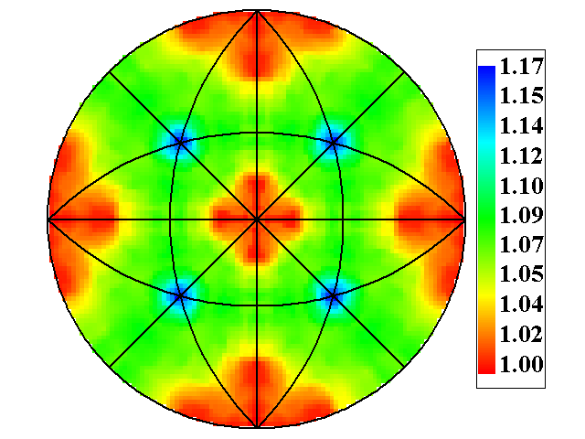
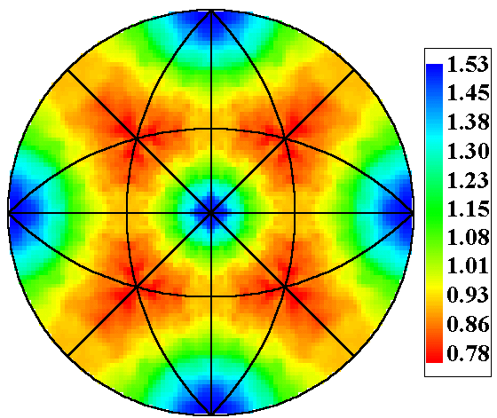
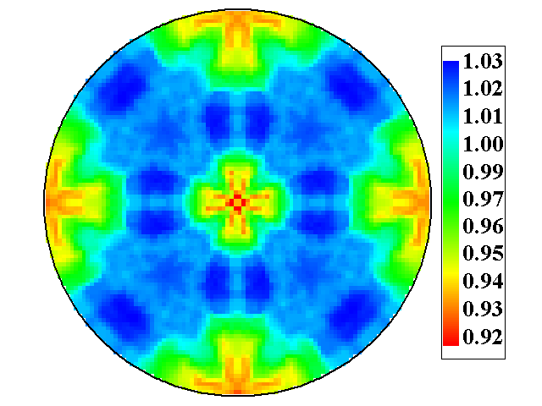
Examples of Two Parameter Distributions
Grain Boundary Population (Δg averaged)
Measured Surface Energies
MgO
Saylor & Rohrer, Inter. Sci. 9 (2001) 35.
SrTiO₃
Sano et al., J. Amer. Ceram. Soc., 86 (2003) 1933.

Slide 41
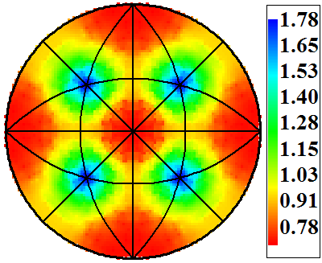
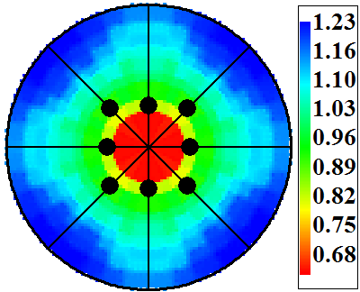
Examples of Two Parameter Distributions
Grain Boundary Population (Δg averaged)
Surface Energies/habit planes
MgAl₂O₄
TiO₂
Ramamoorthy et al., Phys. Rev. B 49 (1994)16721.

Slide 42
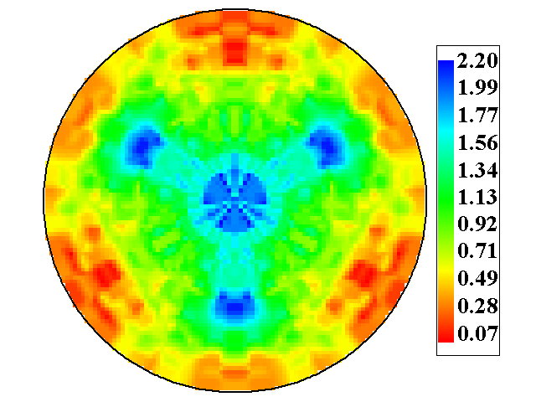
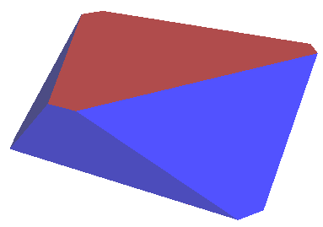
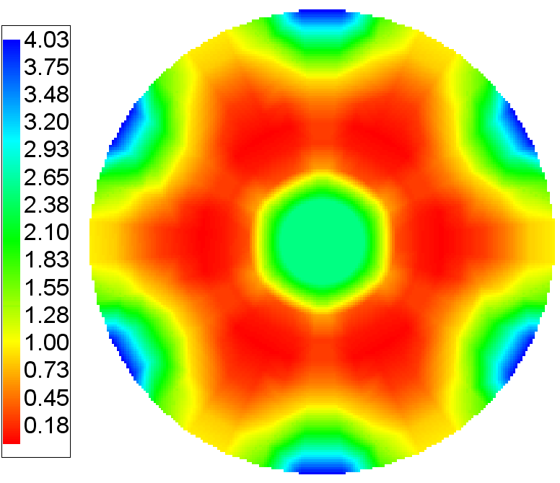
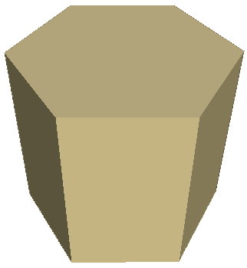
Examples of Two Parameter Distributions
Grain Boundary Population (Δg averaged)
Surface Energies/habits
Al₂O₃
1.00<γ
1.00
0.95
WC
Kitayama and Glaeser, JACerS, 85 (2002) 611.

Slide 43
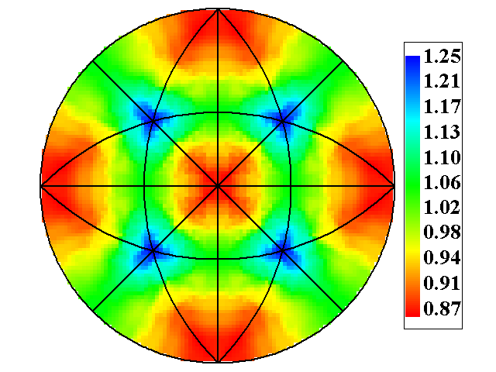
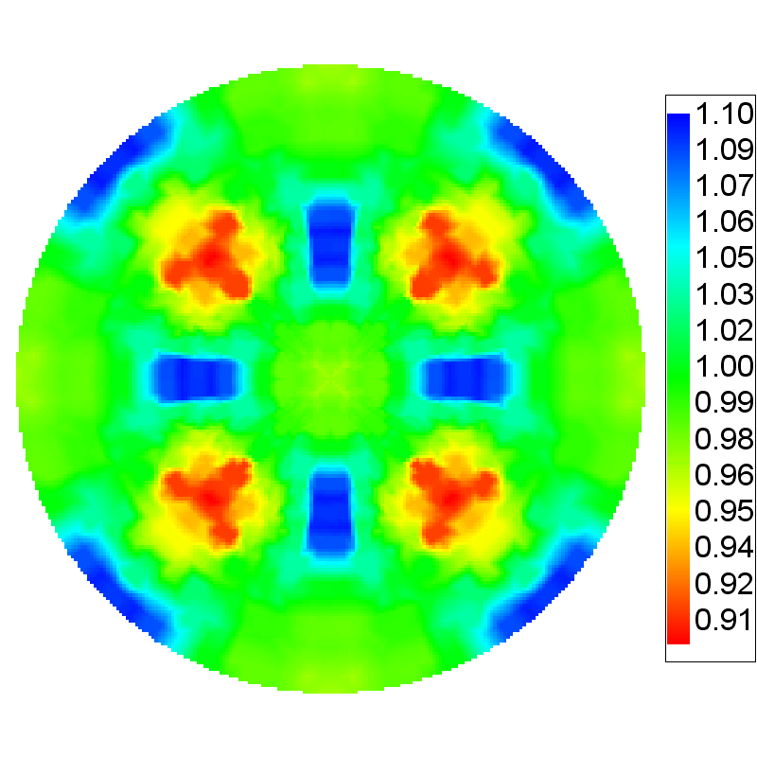
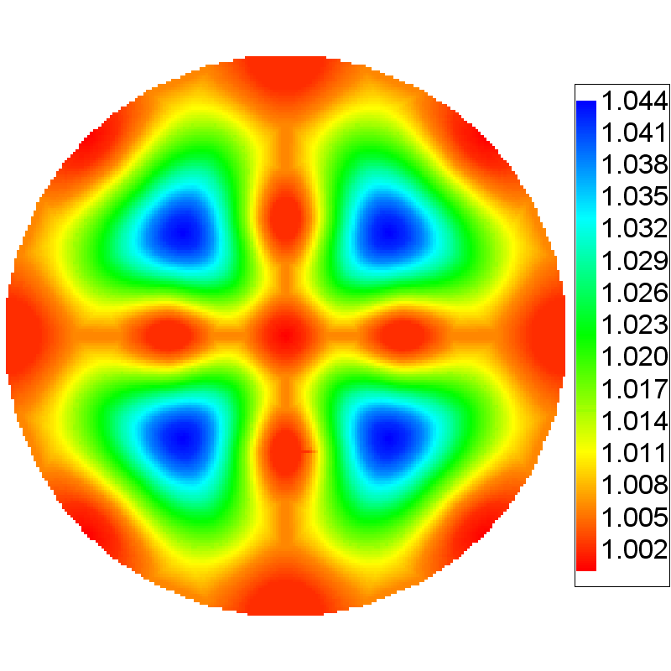
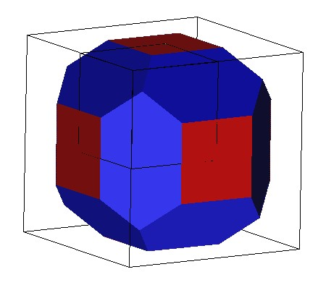
Examples of Two Parameter Distributions
Grain Boundary Population (Δg averaged)
Measured Surface Energies
Al
>1.0
1.0
0.98
0.95
Saylor et al. (2004) Acta mater. 52 3649-3655
Nelson et al. Phil. Mag. 11 (1965) 91.
Fe-Si
Bennett et al. (2004) Recrystallization and Grain Growth, 467-470: 727-732
Gale et al. Phil. Mag. 25 (1972) 947.

Slide 44
Examples of 5-parameter GBCDs
Next, we consider how the population varies when the misorientation is taken into account
Each stereogram corresponds to an individual misorientation: as a consequence, the crystal symmetry is (in general) absent because the misorientation axis is located in a particular asymmetric zone in the stereogram.
It is interesting to compare the populations to those that would be predicted by the CSL approach.
Note that the pure twist boundary is represented by normals parallel to (coincident with) the misorientation axis. Pure tilt boundaries lie on the zone of the misorientation axis.
The misorientation axis is always placed in the 100-110-111 triangle.

Slide 45
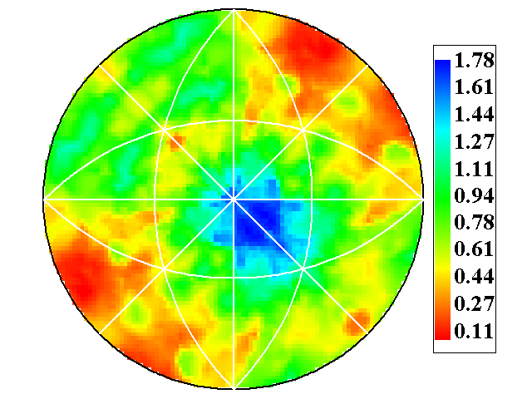
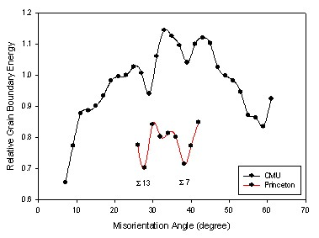


Grain Boundary Distribution in Al: [111] axes
Misorientation axis always in this SST
λ(n)
λ(Δg, n)
λ(n|40°/[110])
MRD
(221)
(114)
(a)
(b)
40°≈Σ9
Σ7
MRD
MRD
(c)
38°=Σ7
(d)
60°=Σ3
<111> tilt boundaries analyzed in an Al thin film, annealed at 400°C.
λ(n|38°/[111])
λ(n|60°/[111])
(111) Twist boundaries are the dominant feature in λ(∆g,n)

Slide 46




λ(n) for low Σ CSL misorientations: SrTiO₃
MRD
MRD
(031)
(211)
(012)
Σ3
Σ5
MRD
MRD
(221)
(321)
(114)
Σ7
Σ9
Except for the coherent twin, high lattice coincidence and high planar coincidence do not explain the variations in the grain boundary population.

Slide 47

Distribution of planes at a single misorientation
Twin in TiO₂
66° around [100]
or, 180° around <101>
λ(n|66°[100])
[100]
(011)

Slide 48



Distribution of planes at a single misorientations: WC
MRD
(10
1
0)
(11
2
0)
(0001)
Plane orientations for grain boundaries with a 30° misorientation about [0001]
MRD
(10
1
0)
Plane orientations for grain boundaries with a 90° misorientation about

Slide 49


Cubic close packed metals with low stacking fault energies
λ(n)
λ(n)
α-brass
MRD
Ni
MRD
Preference for the (111) plane is stronger than in Al, but this is mainly a consequence of the high frequency of annealing twins in low to medium stacking-fault energy fcc metals.

Slide 50





Influence of GBCD on Properties: Experiment
Grain Boundary Engineered α-Brass
all planes, λ(n)
planes at Σ9: λ(n|39°/[110])
MRD
MRD
[110]
Difference
(SR5-SR1)
ΔMRD
Strain-recrystallization cycle 1
MRD
Σ9 2.8% of total area
MRD
The engineering of the GBCD leads to a 40% increase in ductility: V. Randle, Phil. Mag. A (2001) 81 2553.
Strain-recrystallization cycle 5
Σ9 3.8% of total area
The increase in ductility can be linked to increased dislocation transmission at grain boundaries.
14
Notes:
14. These grain boundary plane distributions, from a grain boundary engineered brass, are the results of a collaboration with Val Randle's group in Wales.
When we compare the GBPD after a single strain-recrystallization cycle to the distribution after five such cycles, we see an increase in the number of {111} planes.
The same is true if we look as a specific boundary and, if we subtract these two distributions, the enhancement in the relative area of {111} planes is obvious.
The GBE process enhances the ductility of this material by 40% while not greatly affecting the grain size or texture. This demonstrates substantial changes in properties can be correlated to the GBCD.
An initial comparison of these distribution suggest that the boundaries in the second distribution are better for transmitting slip from grain to grain and this might explain the increase in the microstructure’s ductility.
These results have led us to pose three new avenues for continued research.

Slide 51




Effect of GB Engineering on GBCD
λ(n), averaged over all misorientations (Δg)
MRD
MRD
α-brass
7.79
1.39
3.94
1.03
Can processes that are not permitted to reach steady state be predicted from steady state behavior (grain boundary engineering)?
0.08
0.67
all boundaries
twins removed
Al
MRD
1.25
With the exception of the twins, GBE brass is similar to Al
1.06
0.86

Slide 52



Experiment: compare the GBCD and GBED for pure (undoped) and doped materials
MRD
Undoped MgO, grain size: 24μm
Ca-doped MgO, grain size: 24μm
Larger GB frequency range of Ca-doped MgO suggests a larger GB energy anisotropy than for undoped MgO
75
Notes:
We have also monitored the changes in the distribution of interfaces in doped systems
This example shows the grain boundary plane distribution for undoped and Ca-doped MgO,
They have very different anisotropies and, by implication, different ranges of energy anisotropy

Slide 53





Grain Boundary Energy Distribution is Affected by Composition
Δγ = 1.09
1 μm
Δγ = 0.46
Ca solute increases the range of the γ_{gb}/ γ_{s} ratio.
The variation of the relative energy in undoped MgO is lower
(narrower distribution) than in the case of doped material.
76
Notes:
This anisotropy was confirmed by thermal groove measurements, which showed that the doped sample had a wider distribution of thermal groove widths and, therefore a wider distribution of energies. The diagram in lower right shows how we apply Young’s Eq, i.e. same local eq. at TJs to the balance between surfaces and GB energy. Image in upper right is an AFM of thermally grooved GBs.

Slide 54



Bi impurities in Ni have the opposite effect
Pure Ni, grain size: 20μm
Bi-doped Ni, grain size: 21μm
Range of γ_{GB}/γ_{S} (on log scale) is smaller for Bi-doped Ni than for pure Ni, indicating smaller anisotropy of γ_{GB}/γ_{S}. This correlates with the plane distribution
77
Notes:
The opposite trend was found in Bi-doped Ni. In this case, Bi suppressed the grain boundary anisotropy and a narrower range of energies was found.
Very curious: Cu-Bi exhibits the opposite effect – the doped case is WIDER than the undoped. So, it is NOT possible to assume that segregation decreases or increases the anisotropy of GB energy.

Slide 55
Conclusions
• Statistical stereology can be used to reconstruct a most probable distribution of boundary normals, based on their traces on a single section plane.
• Thus, the full 5-parameter Grain Boundary Character Distribution can be obtained stereologically from plane sections, provided that the texture is weak.
• The tendency for grain boundaries to terminate on planes of low index and low energy is widespread in materials with a variety of symmetries and cohesive forces.
• The observations reduce the apparent complexity of interfacial networks and suggest that the mechanisms of solid state grain growth may be analogous to conventional crystal growth.

Slide 56
Questions
What is an accumulator diagram?
Why do we transform grain boundary traces from the sample frame to the crystal frame?
What is stereology?
Which quantities can be measured directly from cross-sections?
What is the stereological relationship between line length (e.g. of grain boundaries) measured in cross-section to surface area per unit volume?
How does frequency of grain boundary type relate to surface energy?

Slide 57
Questions - 2
What is the significance, if any of the CSL concept in terms of grain boundary populations?
Which CSL types are actually observed in large numbers (and in which materials)?
How does grain boundary frequency relate to grain boundary energy?
What is “Buffon’s Needle”?
How does stereology help us to measure the Grain Boundary Character Distribution?
What are typical 1-, 3-, 5- and 2-parameter plots of GB character?

Slide 58
Supplemental Slides
Details about how to construct the zone to an individual pole in a stereogram that represents a (hemi-)spherical space.
Details about how texture affects the stereological approach to determining GBCD.

Slide 59
Boundary Tangents
A more detailed approach is as follows.
Measure the (local) boundary tangent: the normal must lie in its zone.
g_{B}
n_{s}^{(A)}
B
A
t_{s}^{(A)}
x₁
g_{A}
x₂

Slide 60
G.B. tangent: disorientation
Select the pair of symmetry operators that identifies the disorientation, i.e. minimum angle and the axis in the SST.

Slide 61

Tangent → Boundary space
Next we apply the same symmetry operator to the tangent so that we can plot it on the same axes as the disorientation axis.
We transform the zone of the tangent into a great circle.
Boundary planes lie on zone
of the boundary tangent: in this example
the tangent happens to be coincident with
the disorientation axis.
Disorientation axis

Slide 62
Tangent Zone
The tangent transforms thus:
t_{A} = O_{A}g_{A}t_{S}^{(A)}
This puts the tangent into the boundary plane (A) space.
To be able to plot the great circle that represent its great circle, consider spherical angles for the tangent, {χ_{t},φ_{t}}, and for the zone (on which the normal must lie), {χ_{n},φ_{n}}.

Slide 63
Spherical angles
“chi” := declination
“phi” := azimuth
Pole of tangent has
coordinates (χ_{t},φ_{t})
φ
χ
Zone of tangent (χ_{n},φ_{n})

Slide 64
Tangent Zone, parameterized
The scalar product of the (unit) vectors representing the tangent and its zone must be zero:
To use this formula, choose an azimuth angle, φ_{t}, and calculate the declination angle, χ_{n}, that goes with it.

Slide 65
Effect of Texture:
Distribution of misorientation axes in the sample frame
To make a start on the issue of how texture affects stereological measurement of GBCD, consider the distribution of misorientation axes.
In a uniformly textured material, the misorientation axes are also uniformly (randomly) distributed in sample space.
In a strongly textured material, this is no longer true, and this perturbs the stereology of the GBCD measurement.
For example, for a strong fiber texture, e.g. <111>//ND, the misorientation axes are also parallel to the common axis. Therefore the misorientation axes are also //ND. This means that, although all types of tilt and twist boundaries may be present in the material (for an equi-axed grain morphology), all the grain boundaries that one can sample with a section perpendicular to the ND will be much more likely to be tilt boundaries than twist boundaries. This then biases the sampling of the boundaries. In effect, the only boundaries that can be detected are those along the zone of the 111 pole that represents the misorientation axis (see diagram on the right).
Misorientation axis, e.g. 111

Slide 66


GBCD in annealed Ni
This Ni sample had a high density of annealing twins, hence an enormous peak for 111/60° twist boundaries (the coherent twin). Two different contour sets shown, with lower values on the left, and higher on the right, because of the variation in frequency of different misorientations.

Slide 67


Misorientation axes: Ni example
Now we show the distributions of misorientation axes in sample axes, again with lower contour values on the left. Note that for the 111/60° case, the result resembles a pole figure, which of course it is (of selected 111 poles, in this case). The distributions for the 111/60° and the 110/60° cases are surprisingly non-uniform. However, no strong concentration of the misorientation axes exists in a single sample direction.

Slide 68
Zones of specimen normals in crystal axes (at each boundary)
An alternate approach is to consider where the specimen normal lies with respect to the crystal axes, at each grain boundary (and on both sides of the boundary). Rather than drawing/plotting the normal itself, it is better to draw the zone of the normal because this will give information on how uniformly, or otherwise, we are sampling different types of boundaries.
Note that the crystal frame is chosen so as to fix the misorientation axis in a particular location, just as for the grain boundary character distributions.
n_{A}
Zone of B
∆g
Zone of A
n_{B}

Slide 69


Zones of specimen normals:
Ni example
Again, two different scales to add visualization with lower values on the left. Note that the 111 cases are all quite flat (uniform). The 110/60° case, however, is far from flat, and two of the 3 peaks coincide with the peaks in the GBCD.

