Slide 1


Grain Boundary Engineering
&
Coincident Site Lattice
(CSL) Theory
Texture, Microstructure & Anisotropy
A.D. Rollett
Last revised: 18th Mar. ‘14

Slide 2
Objectives
The objectives of this lecture are:
Develop an understanding of grain boundary engineering
Explain the theory of Coincident Site Lattices (CSLs) and how it applies to grain boundaries
Show how microstructures are analyzed for CSL content

Slide 3
References
Interfaces in Crystalline Materials, Sutton & Balluffi, Oxford U.P., 1998. Very complete compendium on interfaces.
Interfaces in Materials, J. Howe, Wiley, 1999. Useful general text at the upper undergraduate/graduate level.
Crystal Defects and Crystalline Interfaces, W. Bollmann, (1970). New York, Springer Verlag.
Grain Boundary Migration in Metals, G. Gottstein and L. Shvindlerman, CRC Press, 1999. The most complete review on grain boundary migration and mobility.
Materials Interfaces: Atomic-Level Structure & Properties, D. Wolf & S. Yip, Chapman & Hall, 1992.
Bollmann, W. (1982), Crystal lattices, interfaces, matrices. Published by the author, Geneva.
Grimmer, H., Disorientations and coincidence rotations for cubic lattices. Acta Crystall. A30 (1974) 685–688.
Grimmer, H., Bollmann, W., Warrington, D. H., Coincidence- site lattices and complete pattern-shift lattices in cubic crystals. Acta Cryst. A30 (1974) 197 – 207.
Bonnet, R., et al. (1981). Determination of near-Coincident Cells Hexagonal Crystals - Related DSC Lattices. Acta Crystall. A37 184-189.
Ikuhara, Y. and P. Pirouz (1996). Orientation relationship in large mismatched bicrystals and coincidence of reciprocal lattice points (CRLP). In: Intergranular and Interphase Boundaries in Materials, Pt 1. 207 121-124.

Slide 4
Outline
Slides from Integran with examples of Grain Boundary Engineered materials
CSL theory
Brandon’s criterion for classification of grain boundaries by CSL type
Technical information on comparative properties of GBE and non-GBE materials

Slide 5
Reading
Pages 3-25 of Sutton & Balluffi
Pages 307-346 of Howe.

Slide 6
Grain Boundary Engineering
Grain Boundary Engineering (GBE) is the practice of obtaining microstructures with a high fraction of boundaries with desirable properties.
In general, desirable properties are associated with boundaries that have simple, low energy structures.
Such low energy structures are, in turn, associated with CSL boundaries.
GBE generally consists of repeated cycles of deformation and annealing, chosen so as to generate large fractions of “special boundaries” and avoid development of strong recrystallization textures.
GBE is largely confined at present to fcc metallic systems such as stainless steel, nickel alloys, Pb, Cu.
Note that detailed information on exactly which CSL boundaries have useful properties is lacking, as is information on how the typical processing routes actually produce high fractions of CSL boundaries.

Slide 7

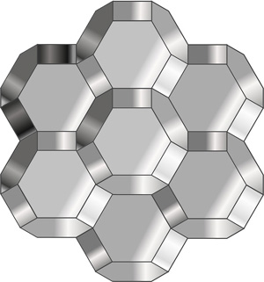
Courtesy of:
Metallurgical Nano-Technology
Grain boundary engineering (GBE™)
is the methodology by which the local grain boundary structure is characterized and material processing variables adjusted to create an optimized grain boundary microstructure for improved material performance.
Nanocrystalline materials are those in which the average crystal size is reduced 1000-fold from the micron-range in conventional materials to the nanometer size range (3-100nm). This can be cost -effectively achieved by proprietary electrodeposition techniques (NanoPlate™).

Slide 8

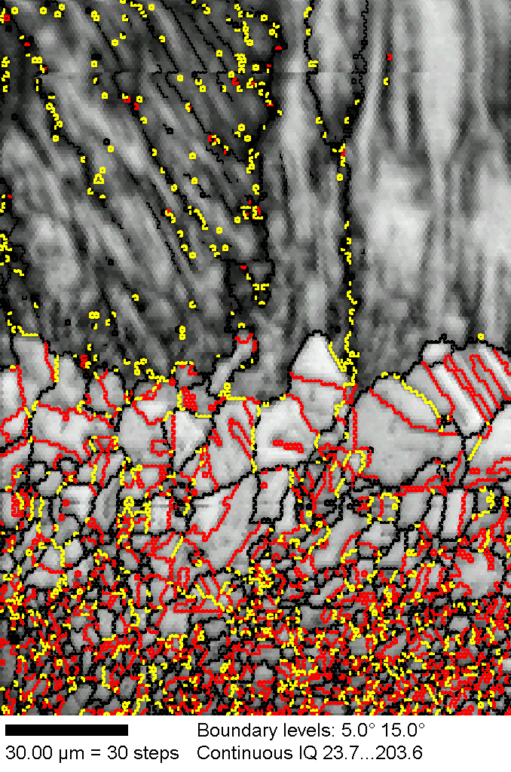
GBE Technology
Grain boundary engineering (GBE™) is the methodology by which the local grain boundary structure is characterized and material processing variables adjusted to create an optimized grain boundary microstructure for improved material performance.
Base Material
GBE Surface Treatment
Patent-Protected Thermo-Mechanical Metallurgical Process
Applied during component forming/fabrication processes.
Can also be applied as a surface treatment (0.1 to 1mm) to finished or semi-finished structures.
Increases Population of ‘Special’ Grain Boundaries
Reduces Average Grain Size
Enhances Microstructural Uniformity
Fully Randomizes Crystallographic Texture
Alloy 625
Special GB’s (red; yellow)
General GB’s (black)
Integran’s GBE technology has also been applied to mitigate stress corrosion cracking susceptibility of Ni-base alloys, extend the service-life of lead-acid battery grids, and improve the fatigue and creep performance of aerospace superalloys.

Slide 9
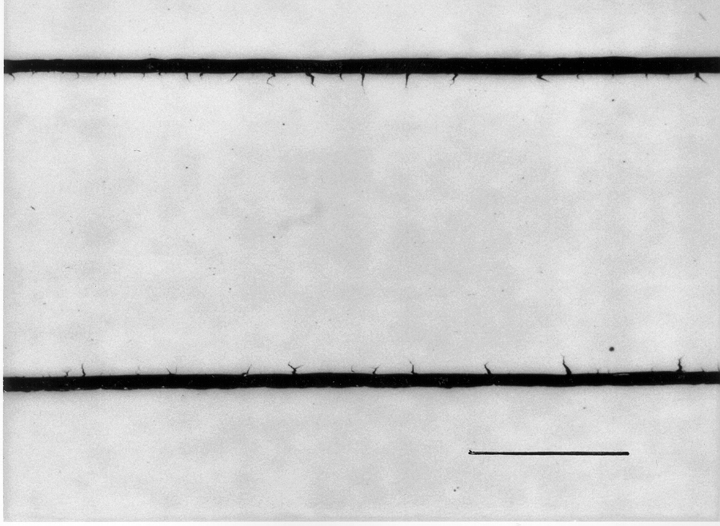
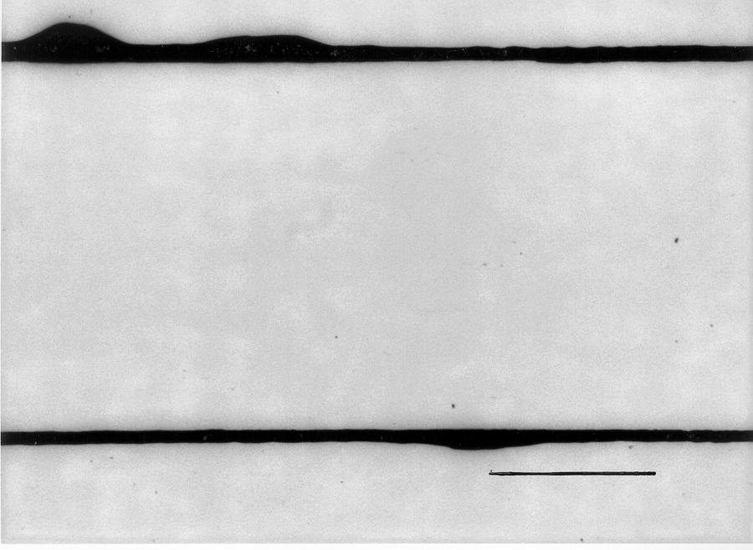

Nuclear Steam Generator Tubing
Alloy 690 nuclear steam generator tubing can be further optimized for SCC-resistance by GBE mill processing technology. Alloy 690 is replacing 600 in many nuclear power plants because of its enhanced resistance to SCC.
Conventional
0.02 in.
  Cross sections of sample gauge lengths following interrupted environmental CERT tests.
  Test Conditions: 60h; 10% NaOH; 600F; +0.100 mV vs. OCP; Ni Ref. Electrode; 5X10⁻⁷ in/sec.
0.02”
0.02”
See also: Alexandreanu, B., B. Capell, et al. (2001). "Combined effect of special grain boundaries and grain boundary carbides on IGSCC of Ni-16Cr-9Fe-xC alloys." Materials Science and Engineering A 300(1-2): 94.

Slide 10
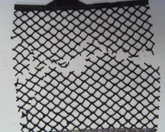
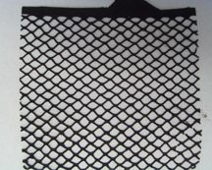
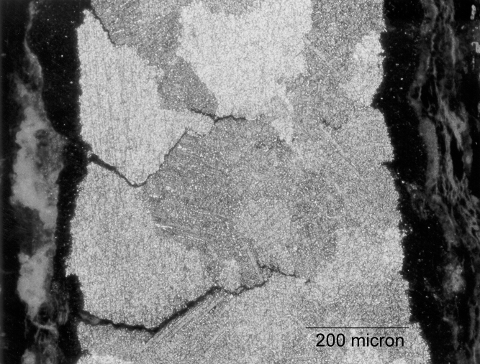
Lead-Acid Batteries
Integran’s innovative GBE® grid processing technology is designed to extend the service life of conventional SLI and industrial batteries (US Patent No. 6,342,110 B1).
The cycle - life of lead-acid batteries (e.g., automotive) is compromised by intergranular degradation processes (corrosion, cracking).
Conventional (fsp<15%) after 2 weeks of cycling.
GBE (fsp=55%) after 4 weeks of cycling.
Palumbo, G. et al. (1998). "Applications for grain boundary engineered materials." Journal of Minerals, Metallurgy and Materials (JOM) 50 40-43.
Conventional lead-acid battery grid (Pb-1wt%Sb) following 4 years of service.

Slide 11
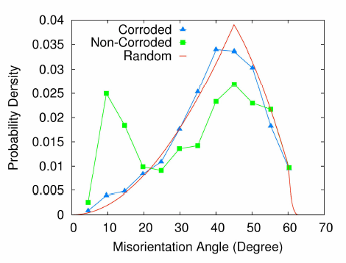
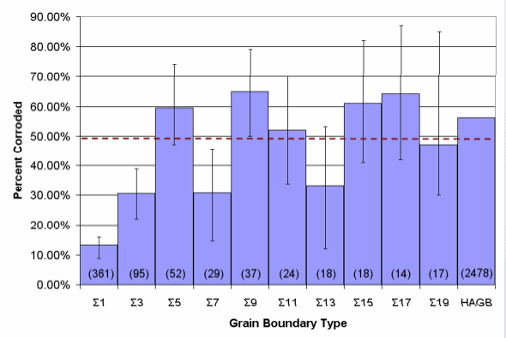
Corrosion of Aluminum 2124
Results from experiment involving intergranular corrosion of aluminum alloy 2124. Low angle boundaries are measurably more resistant than high angle boundaries. Some evidence for resistance of Σ3 and Σ7 boundaries (possibly also Σ13). Research by Lisa Chan, CMU.

Slide 12
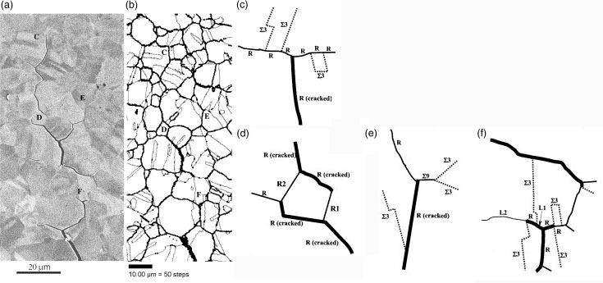
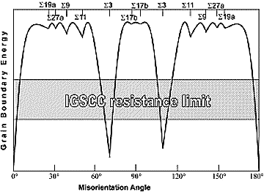
Corrosion in Ni
Alloy 600 (Ni-base alloy)
Several Σ3 boundaries with larger deviations from ideal misorientation cracked.
Gertsman et al., Acta Mater., 49 (9): 1589-1598 (2001).
Notes:
Austenitic stainless alloy, Ni: 72, Cr:14-17, Fe:6-10, Cu:0.50, C:0.15, Mg: 1, S: 0.015, Si: 0.50

Slide 13
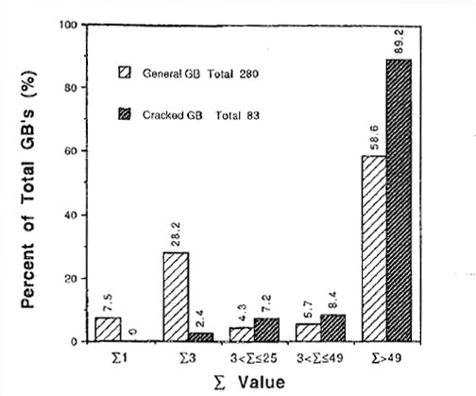
Σ3 Boundaries
Ni₃Al
Cracked Σ3 boundaries were found to deviate more than 5°from the trace of the {111} plane.
Lin et al., Acta Metall. Mater., 41 (2): 553-562 (1993).
13

Slide 14
Fatigue
R
o
o
m
T
e
m
p
e
r
a
t
u
r
e
F
a
t
i
g
u
e
P
e
r
f
o
r
m
a
n
c
e
o
f
S
e
l
e
c
t
e
d
N
i
c
k
e
l
B
a
s
e
d
A
l
l
o
y
s
1
2
0
0
0
0
0
C
o
n
v
e
n
t
i
o
n
a
l
1
0
0
0
0
0
0
G
B
E
Cycles to Failure
8
0
0
0
0
0
6
0
0
0
0
0
4
0
0
0
0
0
2
0
0
0
0
0
0
A
l
l
o
y
6
2
5
/
6
0
k
s
i
A
l
l
o
y
7
3
8
/
4
0
k
s
i
V
5
7
/
4
0
k
s
i
M
a
t
e
r
i
a
l
/
S
t
r
e
s
s

Slide 15
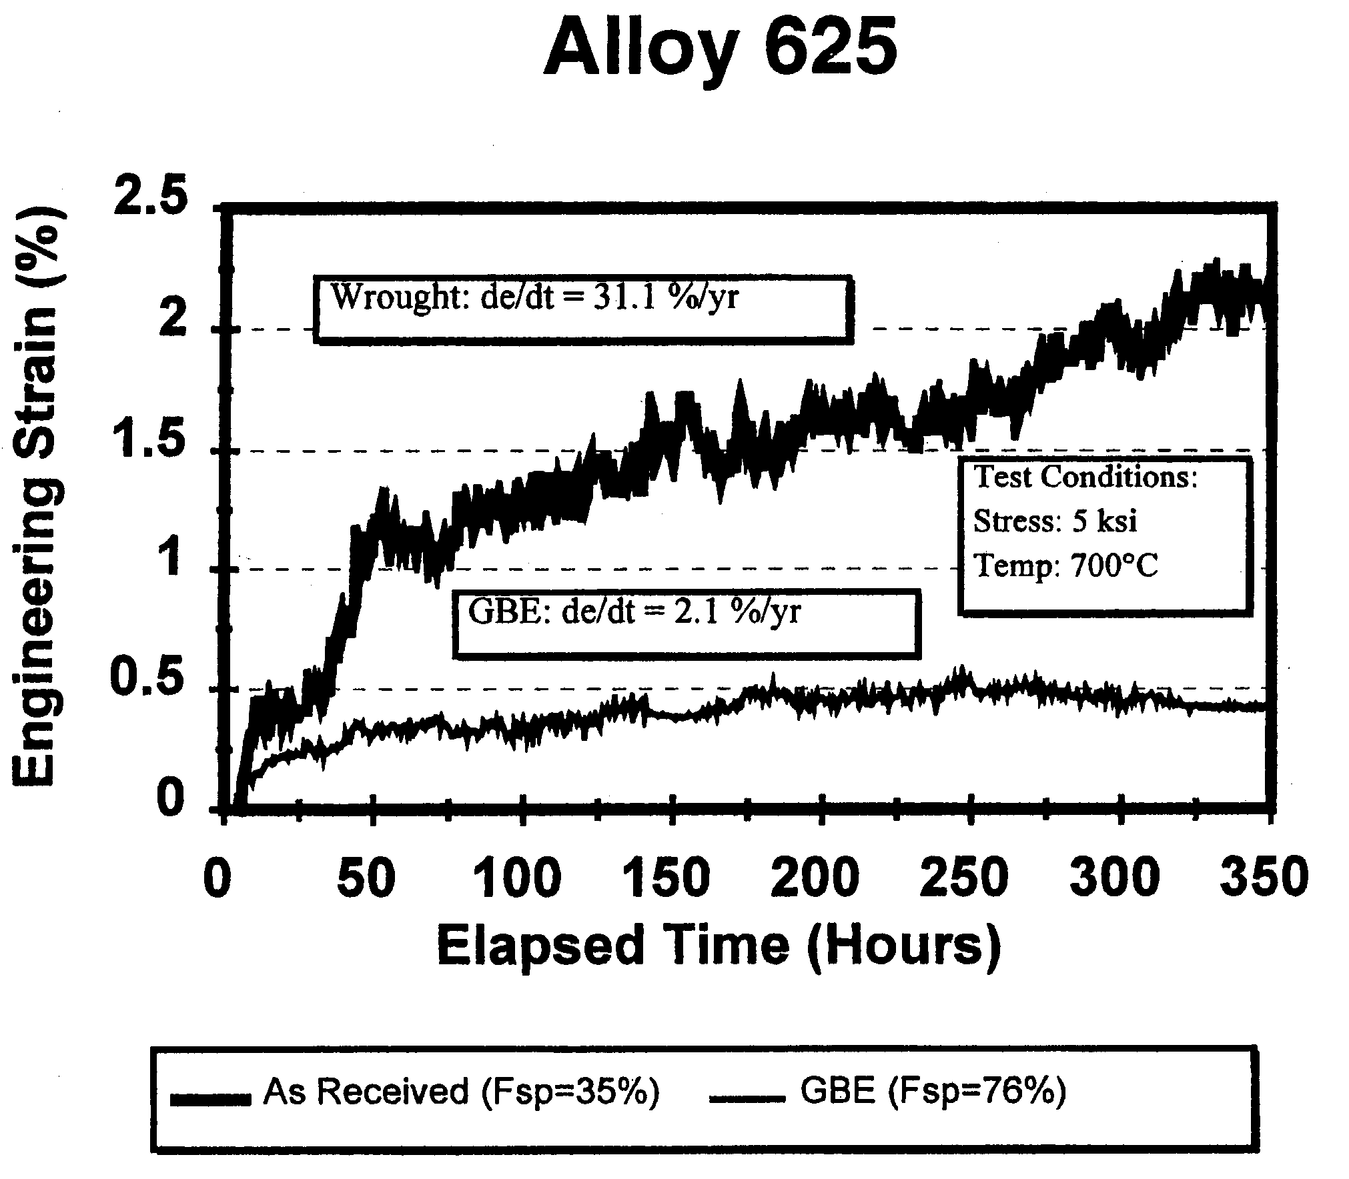
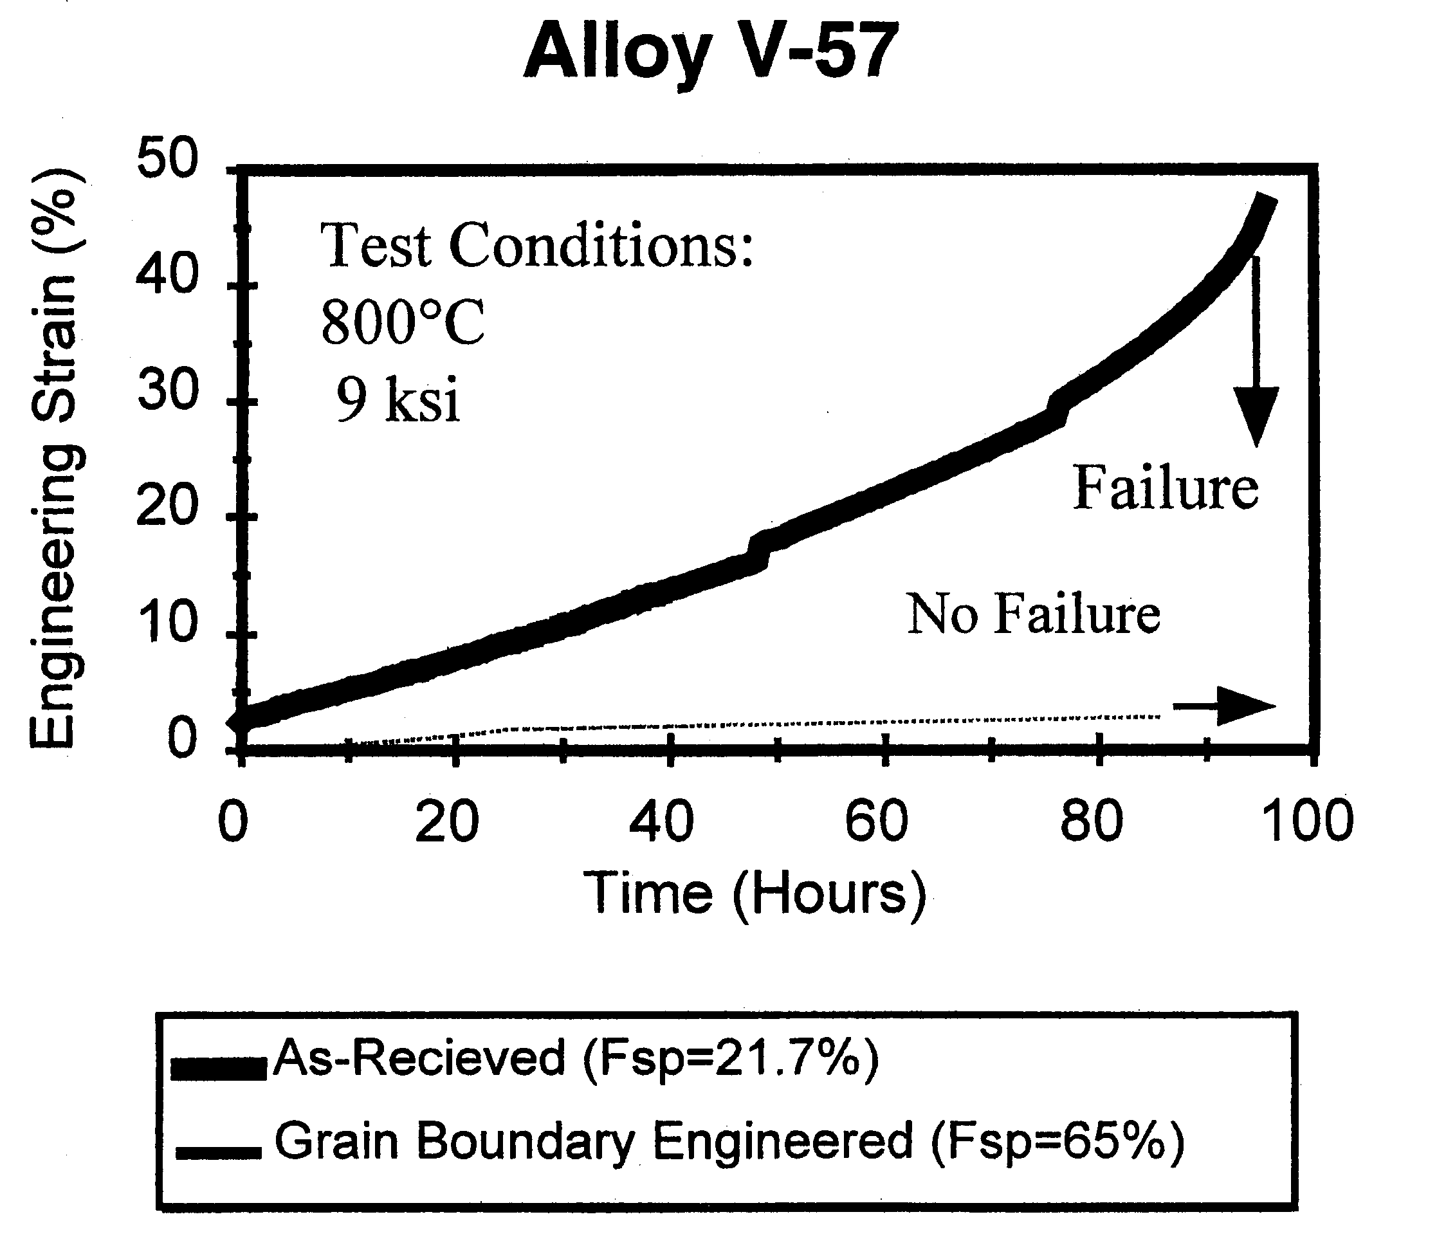
Creep
Thaveeprungsriporn, V. and G. S. Was (1997). "The role of coincidence-site-lattice boundaries in creep of Ni-16Cr-9Fe at 360 degrees C." Metallurgical And Materials Transactions A 28(10): 2101; Alexandreanu, B. et al. (2003). "The effect of grain boundary character distribution on the high temperature deformation behavior of Ni-16Cr-9Fe alloys." Acta materialia 51 3831.
Alloy V57
Alloy 625
Conventional
GBE

Slide 16
Special Grain Boundaries
There are some boundaries that have special properties, e.g. low energy.
In most known cases (but not all!), these boundaries are also special with respect to their crystallography.
When a finite fraction of lattice sites coincide between the two lattices, then one can define a coincident site lattice (CSL).
A boundary that contains a high density of lattice points in a CSL is expected to have low energy because of good atomic fit.
Note that the boundary plane matters, in addition to the misorientation; this means, in effect, that only pure tilt or pure twist boundaries are likely to have a high density of CSL lattice points.
Relevant website: http://www.tf.uni-kiel.de/matwis/amat/def_en/kap_7/illustr/a7_1_1.html (a page from a general set of pages on defects in crystals: http://www.tf.uni-kiel.de/matwis/amat/def_en/index.html ).

Slide 17
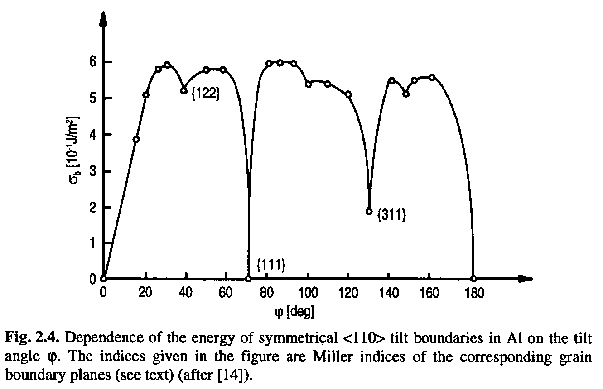
Grain Boundary properties
Σ3 ≡ 60°<111>
For example,
fcc <110> tilt boundaries show pronounced minima in energy
However, some caution needed because the <100> series do not show these minima.
Σ11 ≡ 50°<110>
Figure taken from Gottstein & Shvindlerman, based on Goux, C. (1974). “Structure des joints de grains: consideration cristallographiques et methodes de calcul des structures.” Canadian Metallurgical Quarterly 13: 9-31.]

Slide 18
Kronberg & Wilson
Kronberg & Wilson in 1947 considered coincidence patterns for atoms in the boundary planes (as opposed to the coincidence of lattice sites). Their atomic coincidence patterns for 22° and 38° rotations on the 111 plane correspond to the Σ13b and Σ7 CSL boundary types. Note the significance of coincidence in the plane of the boundary.
Friedel also explored CSL-like structures in a study of twins.
Kronberg, M. L. and F. H. Wilson (1949), “Secondary recrystallization in copper”, Trans. Met. Soc. AIME, 185, 501-514 (1947).
Friedel, G. (1926). Lecons de Cristallographie (2nd ed.). Blanchard, Paris.

Slide 19
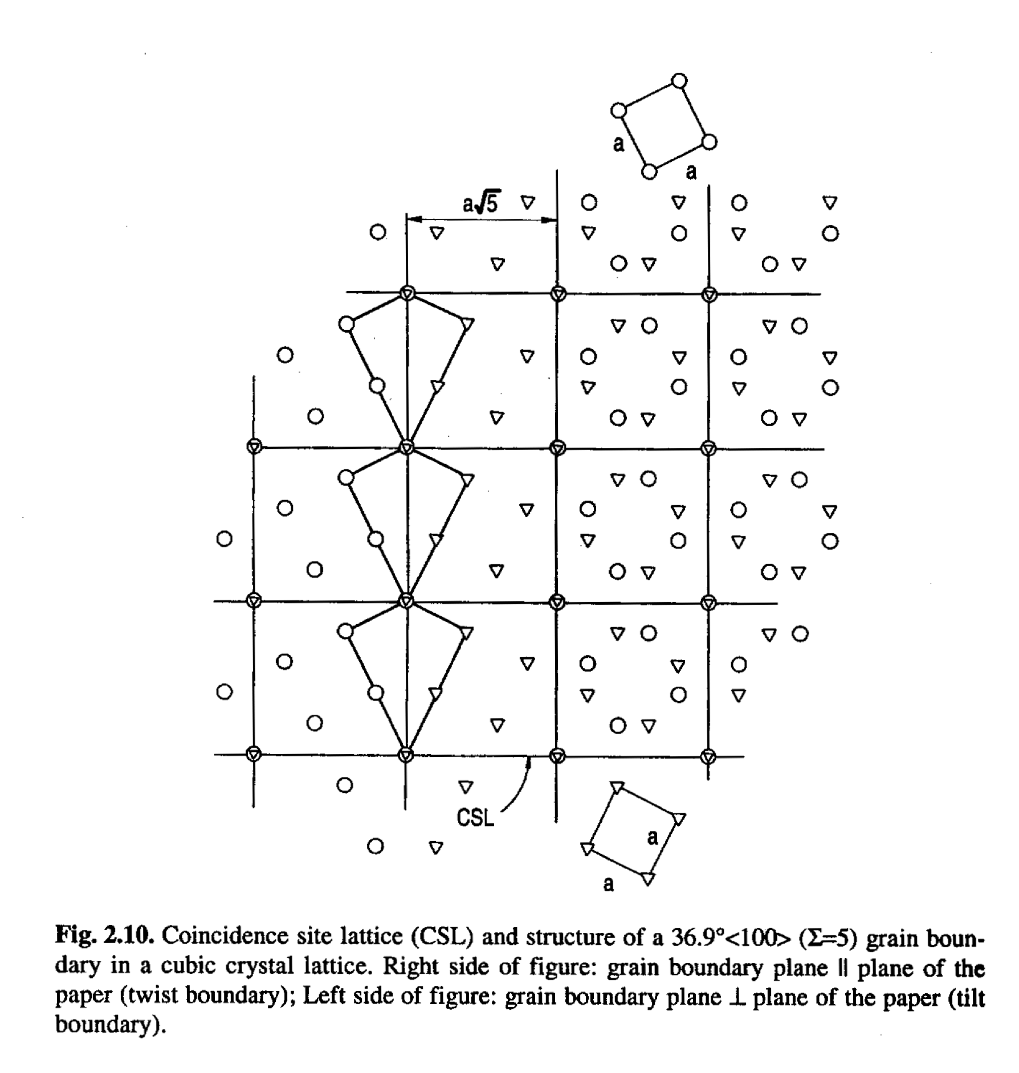
Sigma=5, 36.9° <100>
[Sutton & Balluffi]

Slide 20
CSL = geometrical concept
The CSL is a geometrical construction based on the geometry of the lattice.
Lattices cannot actually overlap!
If a (fixed) fraction of lattice sites are coincident, then the expectation is that the boundary structure will be more regular than a general boundary.
Atomic positions are not accounted for in CSLs.
It is possible to compute the density of coincident sites in the plane of the boundary - this goes beyond The basic CSL concept, which has to do only with the lattice misorientation.

Slide 21
CSL construction
The rotation of the second lattice is limited to those values that bring a (lattice) point into coincidence with a different point in the first lattice.
The geometry is such that the rotated point (in the rotated lattice 2) and the superimposed point (in the fixed lattice 1) are related by a mirror plane in the unrotated state.

Slide 22
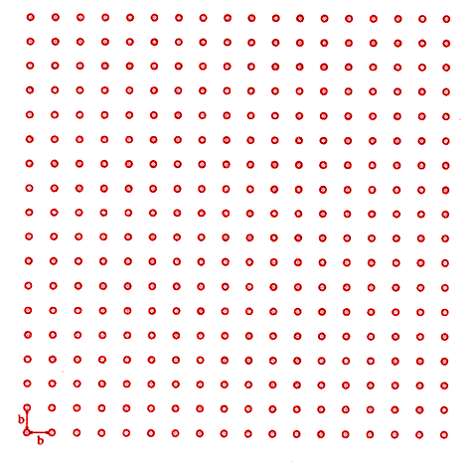
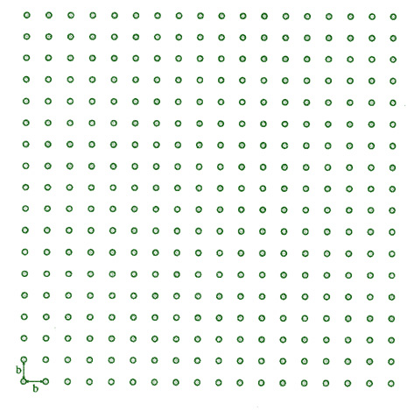
Rotation to Coincidence
Red and Green lattices coincide
Points to be brought into coincidence

Slide 23
rotating to the Σ5 relationship

Slide 24
rotating to the Σ5 relationship

Slide 25
rotating to the Σ5 relationship

Slide 26
rotating to the Σ5 relationship

Slide 27
rotating to the Σ5 relationship

Slide 28
rotating to the Σ5 relationship

Slide 29
rotating to the Σ5 relationship

Slide 30
rotating to the Σ5 relationship

Slide 31
rotating to the Σ5 relationship

Slide 32
Σ5 relationship
Red and Green lattices coincide after rotation of
2 tan⁻¹ (1/3) = 36.9°

Slide 33
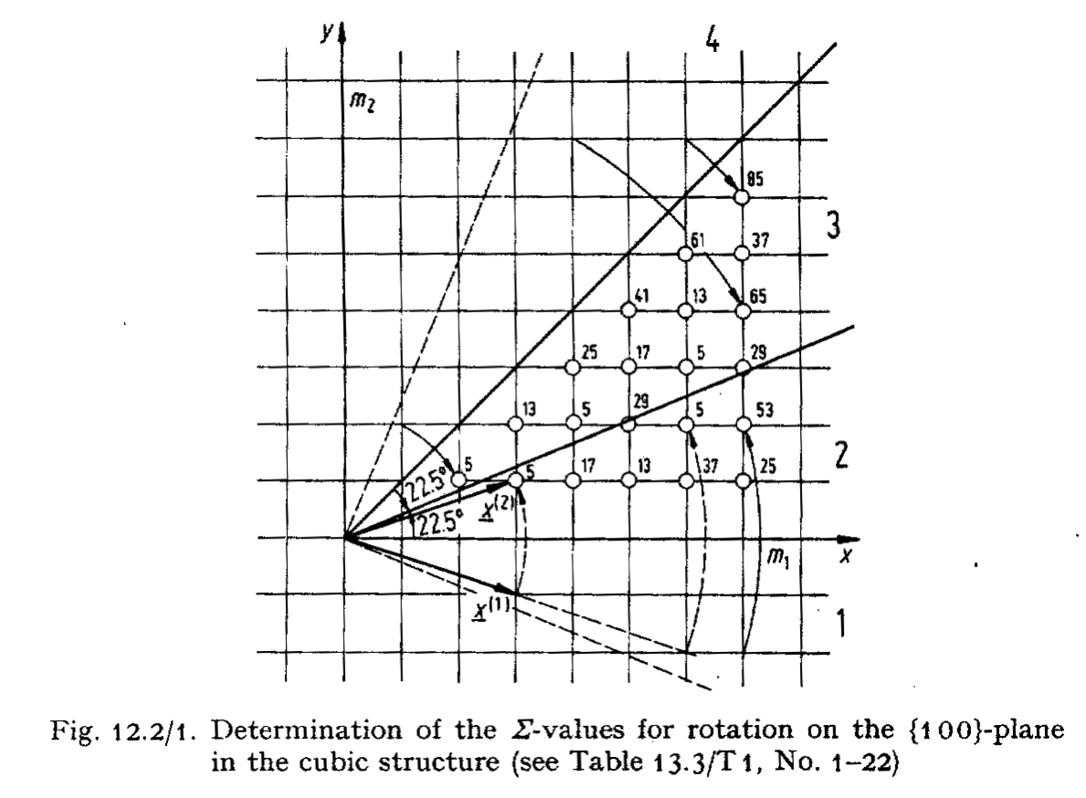
Rotation to achieve coincidence
Rotate lattice 1 until a lattice point in lattice 1 coincides with a lattice point in lattice 2.
Clear that a higher density of points observed for low index axis.
[Bollmann, W. (1970). Crystal Defects and Crystalline Interfaces. New York, Springer Verlag.]

Slide 34
CSL rotation angle
The angle of rotation can be determined from the lattice geometry. The discrete nature of the lattice means that the angle is always determined as follows.
θ = 2 tan⁻¹ (y/x),
where (x,y) are the coordinates of the superimposed point (in 1); x is measured parallel to the mirror plane.
y
x

Slide 35
CSL <-> Rodrigues
You can immediately relate the angle to a Rodrigues vector because the tangent of the semi-angle of rotation must be rational (a fraction, y/x); thus the magnitude of the corresponding Rodrigues vector must also be rational!
Example: for the Σ5 relationship, x=3 and y=1; thus θ = 2 tan⁻¹ (y/x) = 2 tan⁻¹ (1/3) = 36.9° and the rotation axis is [1,0,0], so the complete Rodrigues vector = [1/3, 0, 0].

Slide 36
The Sigma value (Σ)
Define a quantity, Σ', as the ratio between the area enclosed by a unit cell of the coincidence sites, and the standard unit cell. For the cubic case that whenever an even number is obtained for Σ', there is a coincidence lattice site in the center of the cell which then means that the true area ratio, Σ, is half of the apparent quantity. Therefore Σ is always odd in the cubic system.

Slide 37
Generating function
Start with a square lattice. Assign the coordinates of the coincident points as (n,m)*: the new unit cell for the coincidence site lattice is square, each side is √(m²+n²) long. Thus the area of the cell is m²+n². Correct for m²+n² even: there is another lattice point in the center of the cell thereby dividing the area by two.
* n and m are identical to x and y discussed in previous slides

Slide 38
Range of m,n
Restrict the range of m and n such that m<n.
If n=m then all points coincide, and m>n does not produce any new lattices.
Example of Σ5: m=1, n=3, area =(3²+1²) = 10; two lattice points per cell, therefore volume ratio = 1:5; rotation angle =2 tan⁻¹1/3 = 36.9°.
m
n

Slide 39
Generating function, contd.
Generating function: we call the calculation of the area a generating function.
Sigma denotes the ratio of the volume of coincidence site lattice to the regular lattice

Slide 40
Generating function: Rodrigues
A rational Rodrigues vector can be generated by the following expression, where {m,n,h,k,l} are all integers, m<n.
ρ = m/n [h,k,l]
The rotation angle is then:
tan θ/2 = m/n √(h²+k²+l²)

Slide 41
Sigma Values
A further useful relationship for CSLs is that for sigma. Consider the rotation in the (100) plane:
tan{θ/2} = m/n
area of CSL cell = m²+n²
= n² (1 + (m/n)²) = n² (1 + tan²{θ/2})
Extending this to the general case, we can write:
Σ = n² (1 + tan²{θ/2}) =
n² (1 + {m/n √(h²+k²+l²)}²) = n² + m²(h²+k²+l²)
Note that although using these formulas and inserting low order integers generates most of the low order CSLs, one must go to values of n~5 to obtain a complete list.
[Ranganathan, S. (1966). “On the geometry of coincidence-site lattices.” Acta Crystallographica 21 197-199; see also the Morawiec book, pp 142-149 for discussion of cubic and lower symmetry cases]

Slide 42

Quaternions
Recall that all CSL relationships can be thought of as twin relationships, which means that (in a centrosymmetric lattice) they can be constructed as 180° rotations about some axis.
Rotations of 180° have a very simple representation as a quaternion (by contrast to Rodrigues vectors) because
cos(θ/2)=cos(90°)=0 and sin(90°)=1. Therefore for a rotation axis of [x,y,z] the unit quaternion = {x,y,z,0}.
Take the Σ5 as an example. The rotation axis is [310], therefore the quaternion representation is 1/√10{3,1,0,0}.
Check that this is indeed the expected value by applying symmetry to the ∆g and indeed one finds that this is equivalent to {1/3,0,0} as a Rodrigues vector or 38.9°[100].
One can further check that a vector of type [310] is mapped onto its negative by using the quaternion to transform/rotate it. If we choose [-1,3,0] as being orthogonal to the [310] access, we can use the standard formula. PTO…

Slide 43
Quaternions, contd.
Note that q₀ = 0 in these cases (of 180° rotations) and q²=1, so that simplifies the formula considerably:
s = -v + 2(v•q) q
= -v + 2(v•[310]) [310]
Pick [-1,3,0] as an example:
= -v + 2([-1,3,0]•[3,1,0]) [3,1,0]
= -v + 2([-3+3+0]) [3,1,0]
= [+1,-3,0]
Note that any value of the z coefficient will also satisfy the relationship.
Note that any combination of b=-3a in [a,b,c] (i.e. that has integer coordinates to be a point in the lattice, and is perpendicular to the axis) will also work. This helps to make the point that there is an infinite set of points that coincide, each of which satisfies the required relationship. That infinite set of coincident points is the Coincident Site Lattice.

Slide 44
Table of CSL values in axis/angle, Euler angles, Rodrigues vectors
and quaternions
Note: in order to compare a measured misorientation with one of these values, it is necessary to compute the values to high precision (because most are fractions based on integers).
Note: integer fractions are quoted for most of the Rodrigues vectors. The entries in decimals also correspond to integer values and will be updated at a later time.

Slide 45
CSL + boundary plane
Good atomic fit at an interface is expected for boundaries that intersect a high density of (coincident site) lattice points.
How to determine these planes for a given CSL type?
The coincident lattice is aligned such that one of its axes is parallel to the misorientation axis. Therefore there are two obvious choices of boundary plane to maximize the density of CSL lattice points:
(a) a pure twist boundary with a normal // misorientation axis is one example, e.g. (100) for any <100>-based CSL;
(b) a symmetric tilt boundary that lies perpendicular to the axis and that bisects the rotation should also contain a high density of points. Example: for Σ5, 36.9° about <001>, x=3, y=1, and so the (310) plane corresponds to the Σ5 symmetric tilt boundary plane [i.e. (n,m,0)].

Slide 46
CSL boundaries and RF space
The coordinates of nearly all the low-sigma CSLs are distributed along low index directions, i.e. <100>, <110> and <111>. Thus nearly all the CSL boundary types are located on the edges of the space and are therefore easily located.
There are some CSLs on the 210, 331 and 221 directions, which are shown in the interior of the space.

Slide 47
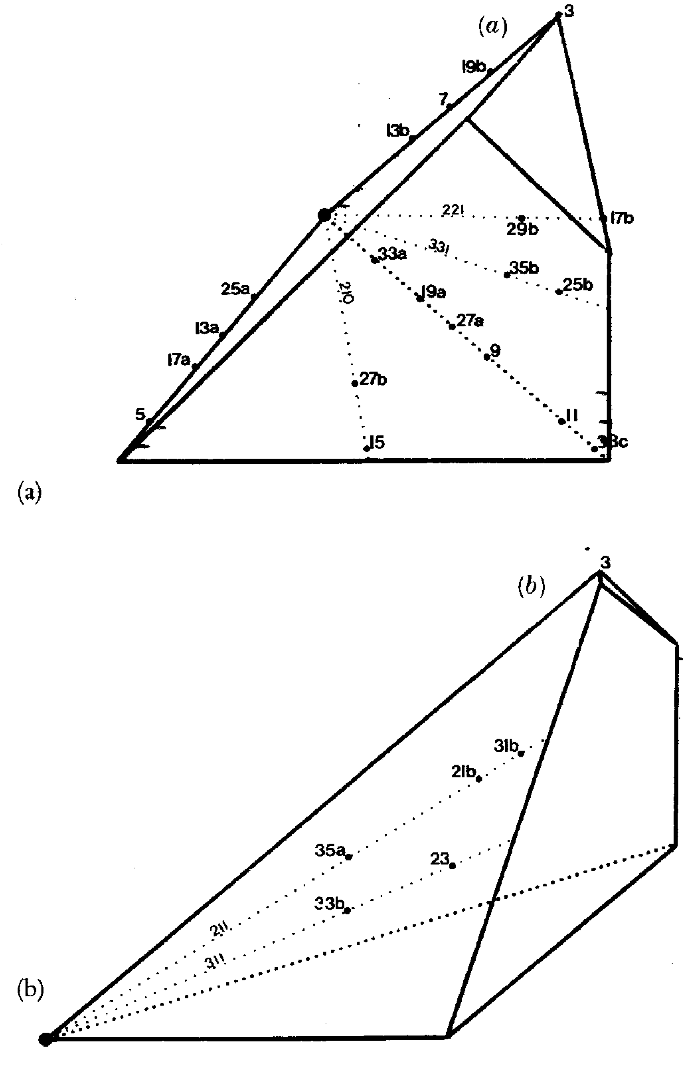
RF pyramid and CSL locations
R₁+R₂+R₃=1
l
=111
l
=100
(√2-1,√2-1)
(√2-1,0)
l
=110

Slide 48
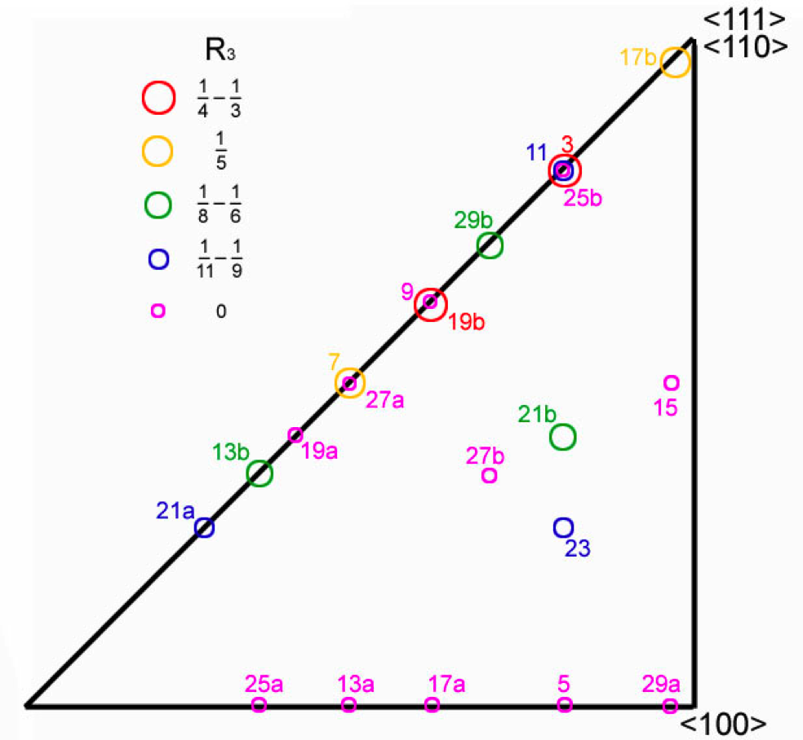
Plan View:
Projection on R₃= 0
<110>,
<111>
33c
<111> line
lies over the <110> line
<100>

Slide 49
Fractions of CSL Boundaries in a Randomly Oriented Microstructure
It is interesting is to ask what fraction of boundaries correspond to each sigma value in a randomly oriented polycrystal?
The method to calculate such (area) fractions is exactly the same as for volume fractions in an Orientation Distribution.
The Brandon Criterion establishes the “capture radius” for each sigma value (which decreases with increasing sigma value).
All points (in a discretized MD) are assigned to a given CSL type if they fall within the capture radius.

Slide 50
CSL % for Random Texture
Garbacz et al., Scr. Mater., 23 (8): 1369-1374 (1989).
Gertsman et al., Acta Metall. Mater., 42 (6): 1785-1804 (1994).
Morawiec et. al., Acta Metall. Mater., 41 (10): 2825-2832 (1993).
Pan et al., Scr. Metall. Mater., 30 (8): 1055-1060 (1994).
Generate MD from a random texture; analyze for fraction near each CSL type (method to be discussed later).
Notes:
50

Slide 51
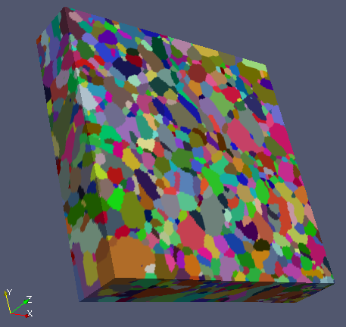
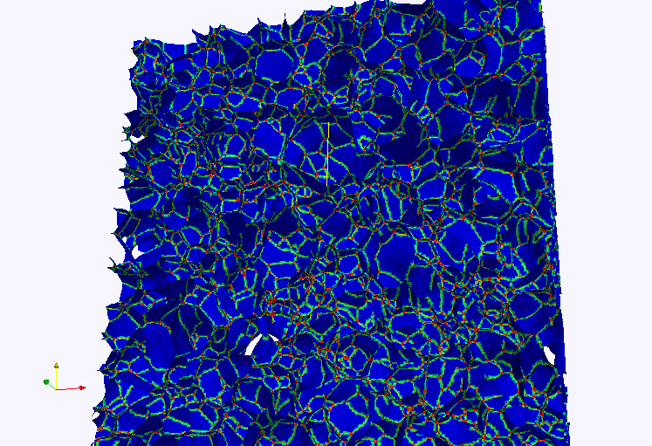
Grain Boundaries from High Energy Diffraction Microscopy
Measurements made at the Advanced Photon Source:
see Hefferan et al. (2009). CMC 14 209-219.
Pure Nickel: 42 layers, 4 micron spacing, 0.16 mm³
Pure Ni sample, 42 layers
3,496 grains; ~ 23,598 GBs

Slide 52
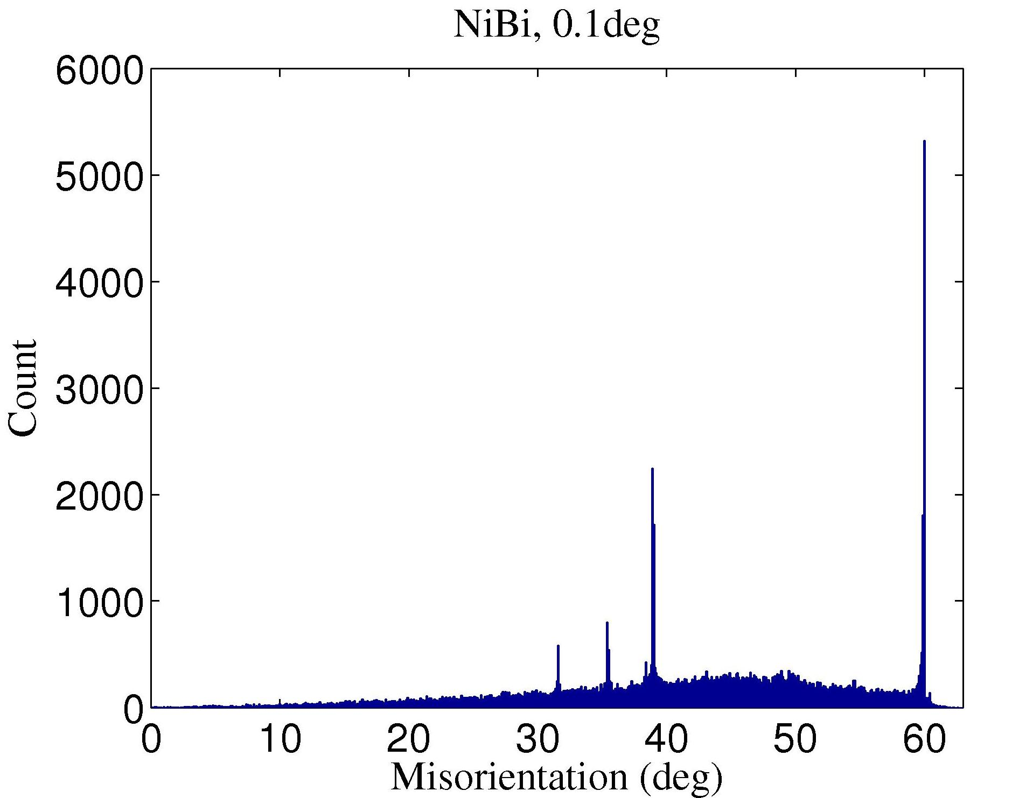
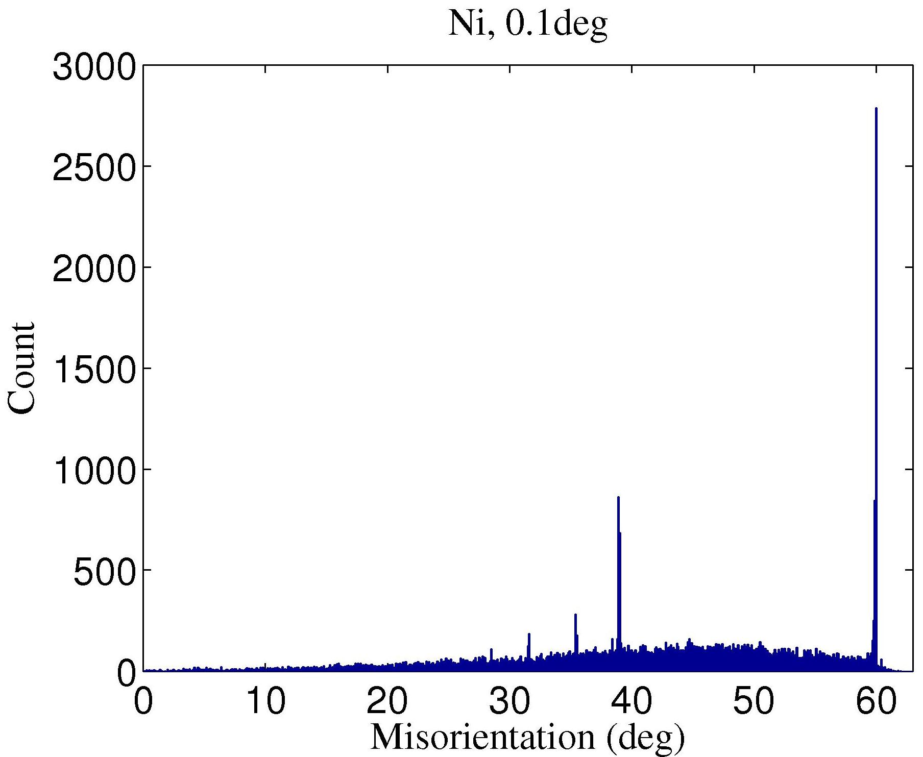
Statistics extraction from large data sets
Neighbor misorientation angle distribution
Hefferan et al. (2009). CMC 14 209-219.

Slide 53
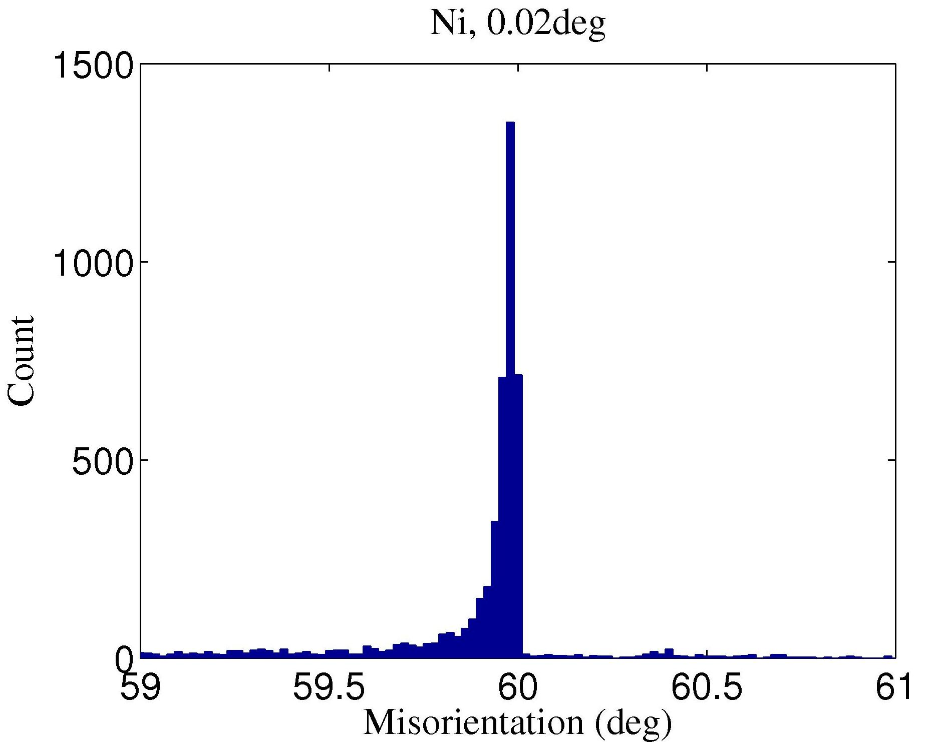
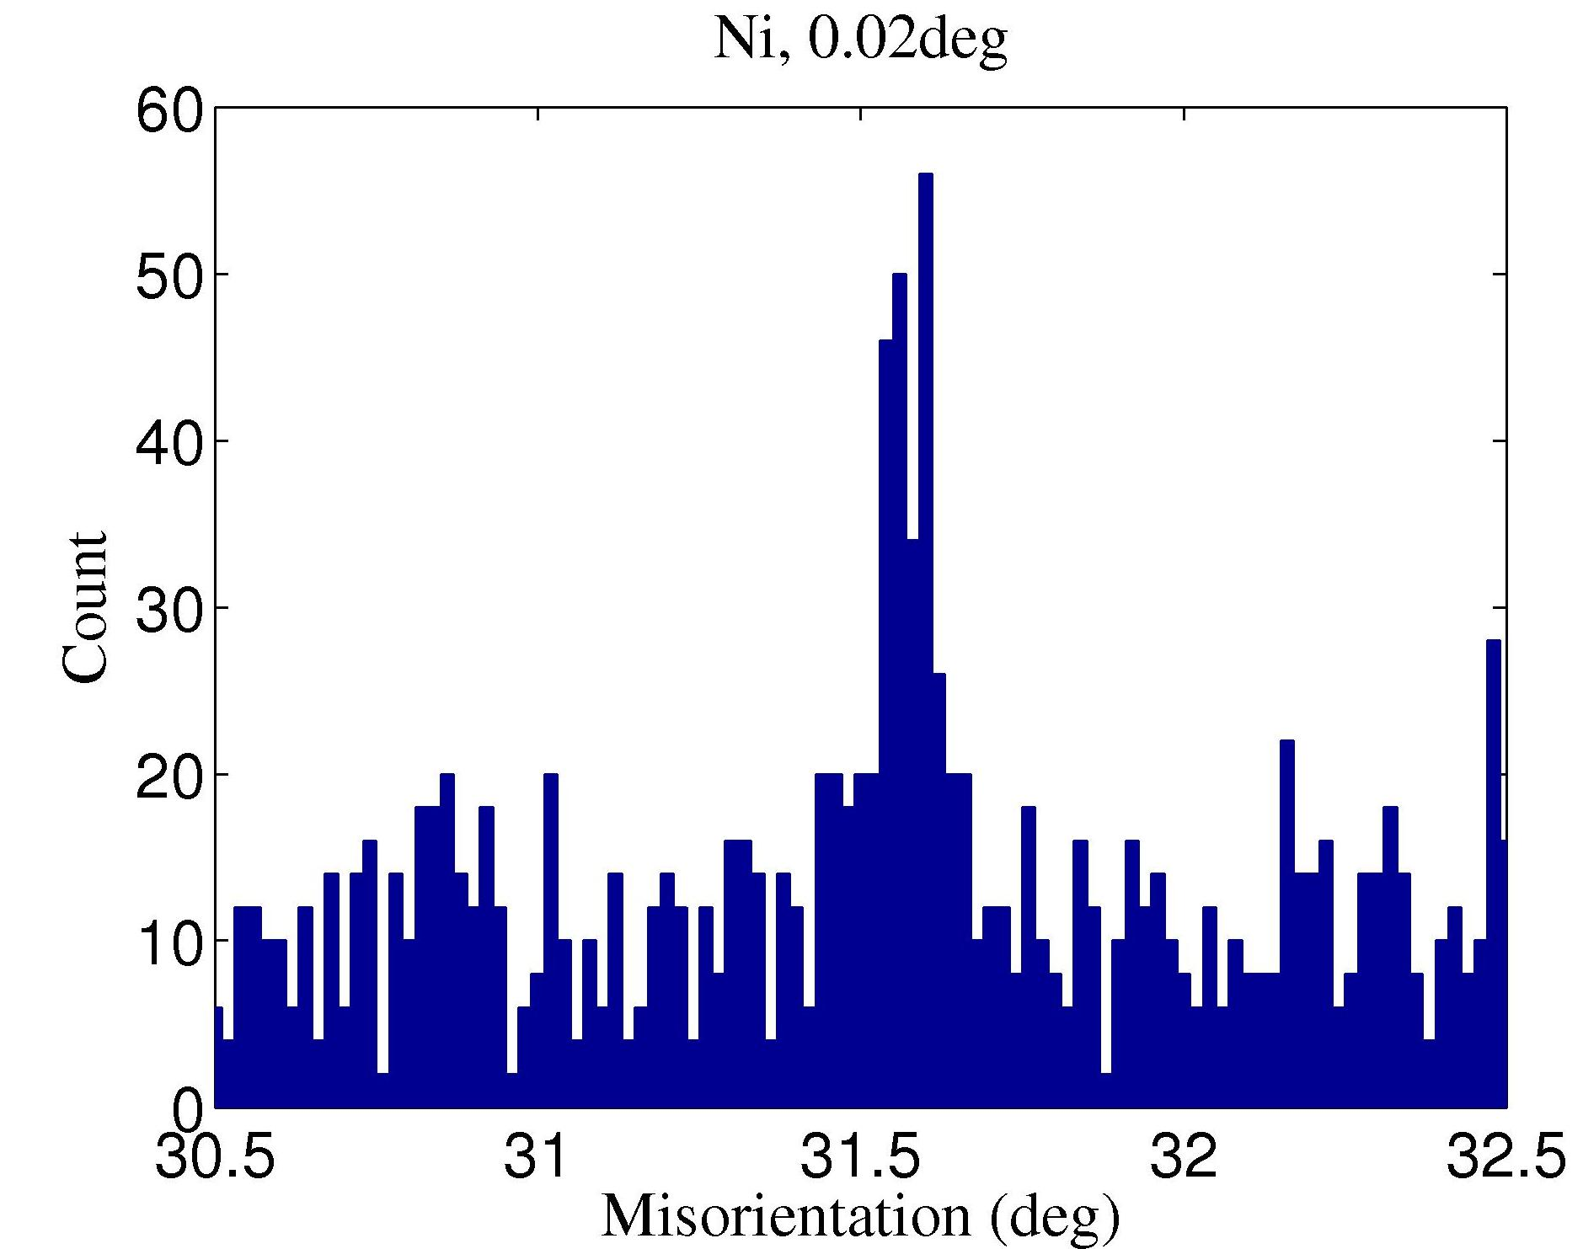
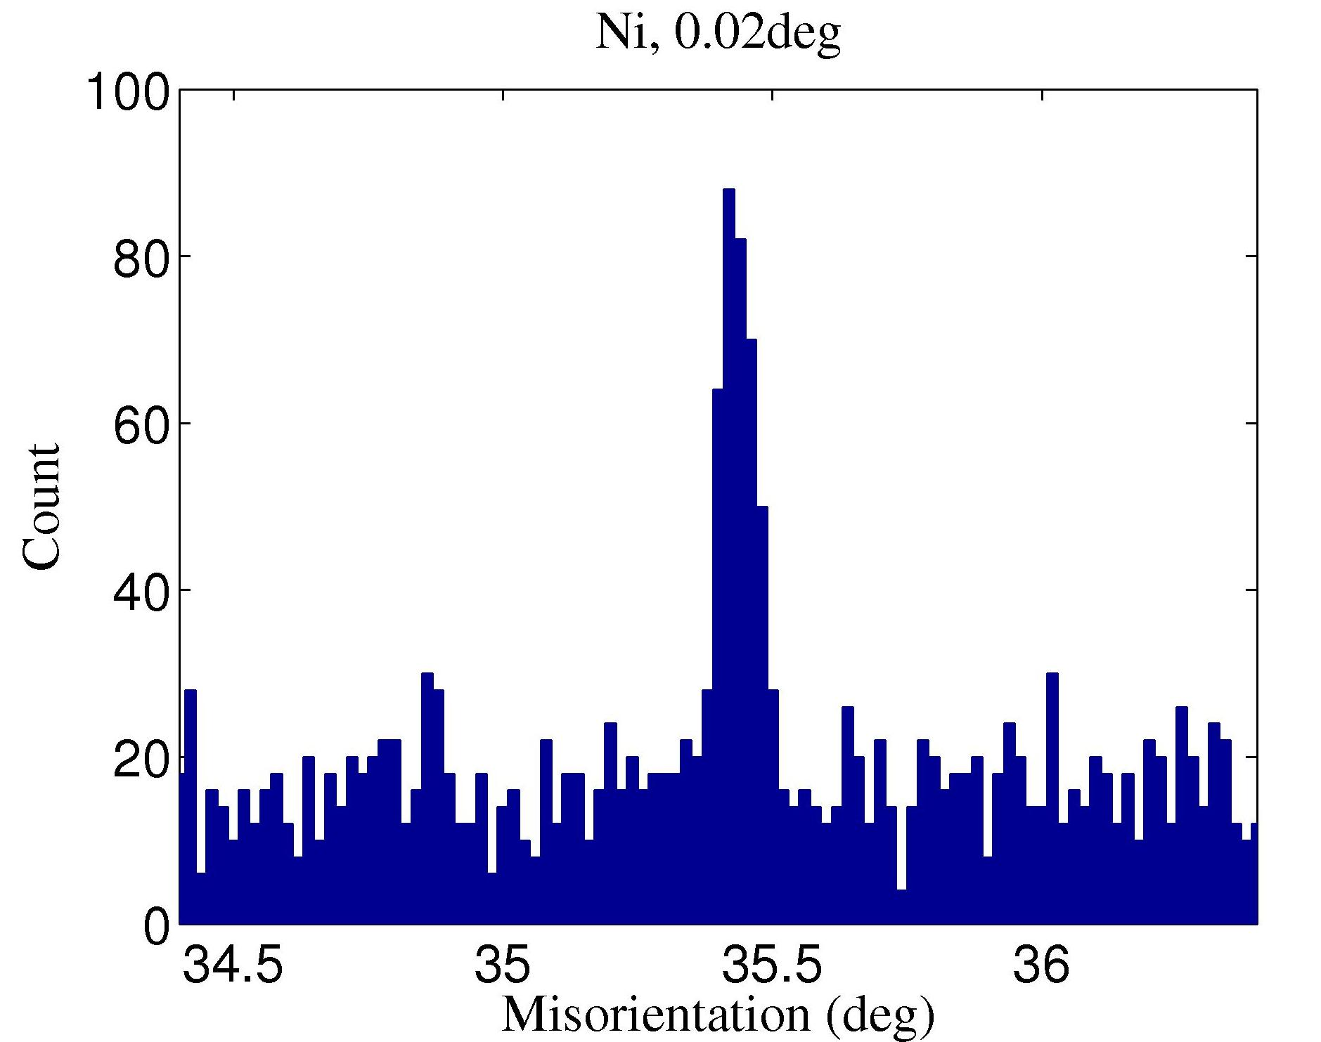
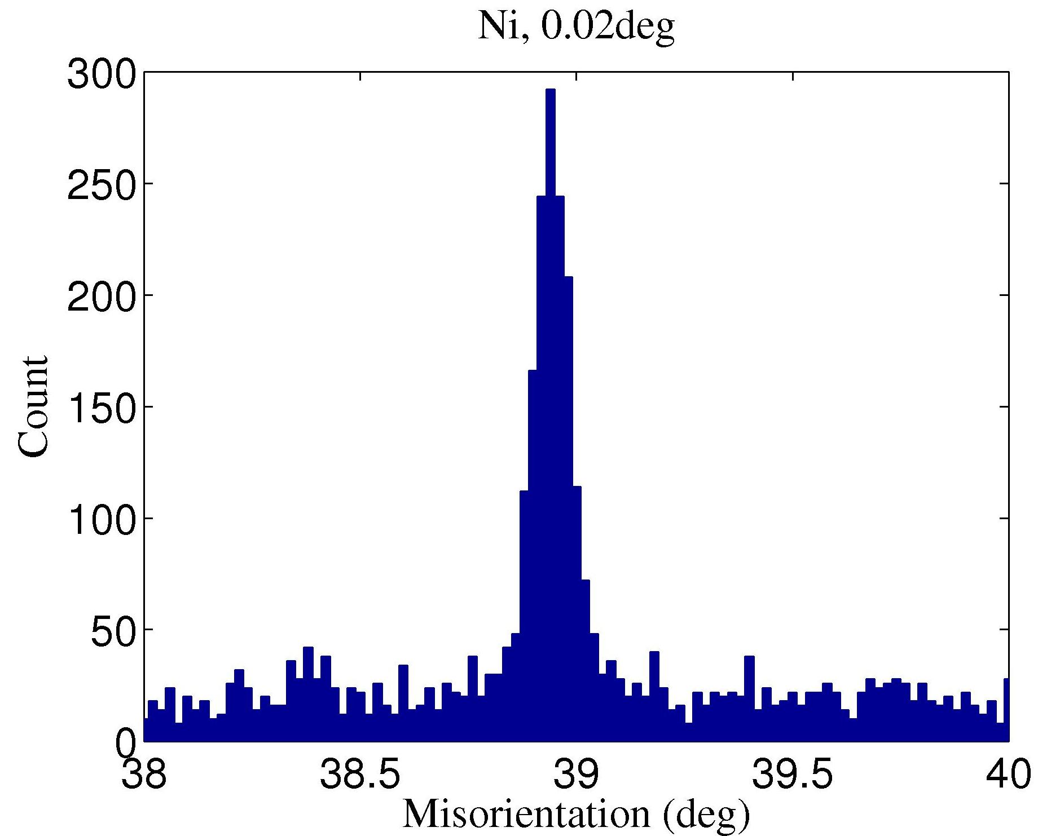
Statistics extraction from large data sets
Neighbor misorientation angle distribution
Σ27a
Σ3
Σ27b
Σ7
Conclusion:
The misorientations of grain boundaries in these nickel samples are concentrated on a small number of CSL types, i.e. sigma = 3,7,9,11,27
Hefferan et al. (2009). CMC 14 209-219.

Slide 54

Brandon Criterion
David Brandon [ 1966: "The structure of high-angle grain boundaries”, Acta metallurgica 14: 1479-1484] originated a criterion for proximity to a CSL structure.
v_{m} = v₀Σ^{-1/2}
where the proportionality constant, v₀, is generally taken to be 15°, based on the low-to-high angle transition.
Larger sigma values imply larger unit cells in the boundary, fewer coincident points, larger dislocation densities for the same deviation from the exact CSL misorientation. Thus one has to closer to the exact CSL position in order for a given boundary to be counted as belonging to that CSL type.
Closeness to a misorientation type is defined by the angle associated with the rotation between the misorientation in question, ∆g, and the CSL misorientation, ∆g_{CSL}.
cos(θ_{m}) = {trace(∆g ∆g^{T}_{CSL})-1}/2

Slide 55
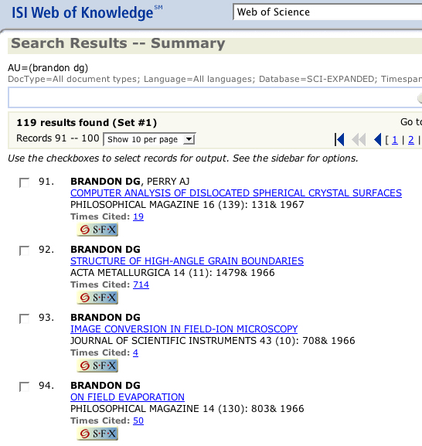
Impact of the Brandon Criterion

Slide 56
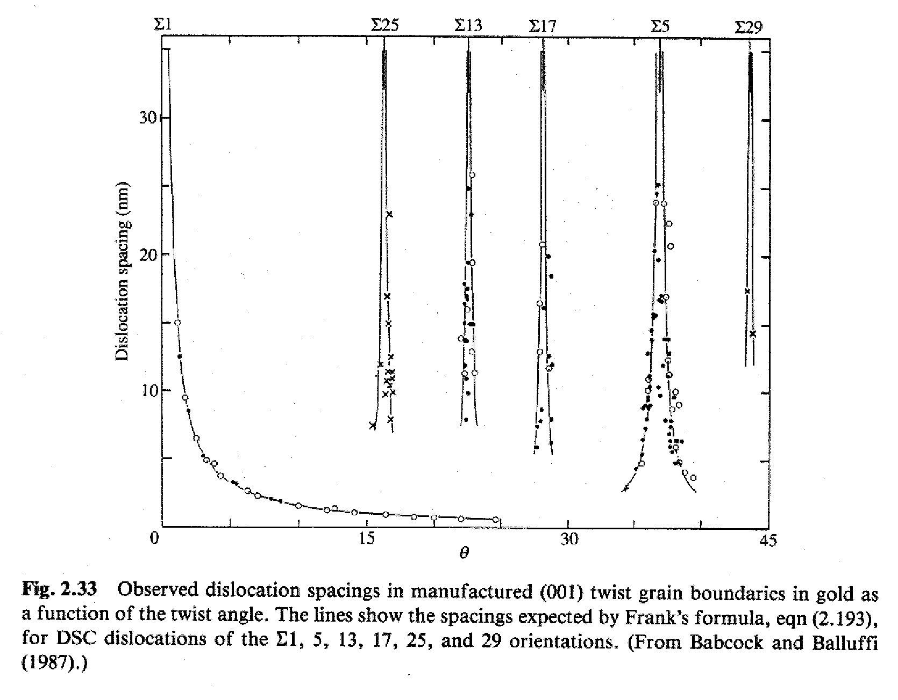
Brandon Criterion, contd.
Thus, if:
θ_{m} < v₀Σ_{m}^{-1/2} < 15°m^{-1/2}
then we accept the
boundary as belonging
to the CSL of type Σ=m.
The justification is
based on the existence
of a dislocation structure for vicinal interfaces to CSL structures, just as for low angle boundaries [see fig. 2.33 from Sutton & Balluffi]. Typical cutoff at Σ=29.

Slide 57
How near to a CSL?
A reasonable way to measure distance from a special boundary type and an arbitrarily specified boundary is to calculate a minimum rotation angle (“orientation distance”) in exactly the same way as for the disorientation. In terms of Rodrigues vectors, we write the following for the composition of two rotations, ρ₁ρ_{2,} which represents ρ₁ followed by ρ₂:

Slide 58
Composition of Rodrigues vectors
To use this, we simply assign the components of a CSL boundary type to one of the Rodrigues vectors (strictly speaking, the inverse rotation, although the negative rotation is always equivalent to the positive one.
As always, one must use the crystal symmetry operators in order to find the smallest available angle. Unless both the CSL value and the misorientation have been placed in the fundamental zone, then one will obtain the wrong result.

Slide 59
Angle from CSL
One can then extract the angle, θ, from the length of the resultant vector (Chapter 3), where ρ is the Rodrigues vector description of the boundary in question and |ρ| is the rotation angle associated with the vector:
θ₀ = |ρ • ρ_{000/0°}| = |ρ • ρ_{Σ1}|, ρ_{Σ1}=(0,0,0)
θ₁ = |ρ • ρ_{111/60°}| = |ρ • ρ_{Σ3}|, ρ_{Σ3}=(1/3,1/3,1/3)
θ₃ = |ρ • ρ_{111/38.21°}| , ρ_{Σ7}=(0.2,0.2,0.2)

Slide 60
Deviation from a CSL
The deviation of a given misorientation from an exact misorientation type, such as a CSL type, is found by forming the product of the misorientation to be tested, and the inverse of the reference type.
Given a ∆g = (O_{B}g_{B})(O_{A}g_{A})⁻¹, and a reference type, ∆g_{CSL}, then form the product
∆g’ = ∆g (∆g_{CSL})⁻¹.
As stated before, it is necessary to apply all the relevant (crystal) symmetry operators (including the switching symmetry) to the ∆g in order to ensure that the variant that is closest to the reference type is included in the comparison. This means that the result must be chosen that produces the minimum angle and that places the misorientation axis in the fundamental zone.
Given the product “mis-misorientation”, one usually only considers the magnitude (rotation angle) extracted from it.
All these operations can be performed with matrices, Rodrigues vectors, or (unit) quaternions. Most serious software uses quaternions.

Slide 61
Algorithm for Disorientation: 1
To find the disorientation*, as just an angle, associated with a grain boundary but not identifying which symmetry operator was required for each crystal:
  Make a list of all crystal symmetry operators;
  Loop over switching symmetry (2 passes), which computes both ∆g_{AB} and ∆g_{BA} ;
  Loop over O_{A} (24 different operators, for cubic xtal symmetry);
  Calculate ∆g = g_{B} (O_{A}g_{A})⁻¹ or (O_{A}g_{A}) g_{B}⁻¹ and extract the angle (e.g. as arc-cosine of [trace(∆g)-1]/2), depending on the first loop;
  If (misorientation) angle is lower than the previous result then retain the result (as the current candidate for the disorientation);
  End of loops: the misorientation that satisfied the tests is the disorientation because it possesses the minimum rotation angle. The misorientation axis can be placed in a single standard stereographic triangle by making all the indices positive that are associated with the minimum angle, and re-ordering so as to make h≤k≤l, for example.
*Disorientation:= combination of minimum angle and axis located in the fundamental zone

Slide 62
Algorithm for Disorientation: 2
To find the disorientation* associated with a grain boundary and identify which symmetry operator on each crystal provided the disorientation (useful for analyzing 5-parameter grain boundary character:
  List all relevant symmetry operators;
  Compute both ∆g_{AB} and ∆g_{BA} (for switching symmetry); first loop over switching symmetry (2 passes);
  Second loop over O_{A} ;
  Third loop over O_{B} to calculate ∆g = (O_{B}g_{B})(g_{A}O_{A})⁻¹ or (O_{A}g_{A})(g_{B}O_{B})⁻¹ , depending on the first loop;
  If (misorientation) rotation axis associated with ∆g lies within the fundamental zone (e.g. 100-110-111 SST for cubic), then proceed to the next test (treat the first such finding as a special case, i.e. retain the result and do not apply the next test);
  If (misorientation) angle is lower than the previous result then retain the result (as the current candidate for the disorientation);
  End of loops: the misorientation that satisfied the tests is the disorientation because it lies within the fundamental zone and possesses the minimum rotation angle.
  For any subsequent calculations, e.g. of boundary normal, ensure that you use the same symmetry operator in each grain as was found to yield the disorientation.
*Disorientation:= combination of minimum angle and axis located in the fundamental zone

Slide 63
Example: Effect of GBCD on Pb Electrodes in Lead-Acid Batteries
Palumbo et al. [Palumbo, G., E. M. Lehockey, and P. Lin (1998). “Applications for grain boundary engineered materials.” JOM 50(2): 40-43.] have shown that the crystallographic nature of grain boundaries in Pb have a strong effect on the resistance of Pb electrodes (in the form of lattice-work grids) to failure via intergranular corrosion and creep-cracking. More specifically, Pb that has been processed to have a high fraction of special boundaries, i.e. coincidence site lattice boundaries with low sigma numbers, exhibit significantly longer lifetimes.

Slide 64
Pb electrodes, contd.
The figure (next slide) illustrates the difference in performance for Pb-Ca-Sn-Ag lead-acid positive battery grids following 40 charge-discharge cycles. The image on the left is the as-cast material with 7% special boundaries (3 ≤ Σ ≤ 29); the image on the right is the grain boundary engineered material with 67.6% special boundaries. The small amount of Ca added to Pb is a hardening agent (from the eutectic at 0.07% Ca).

Slide 65
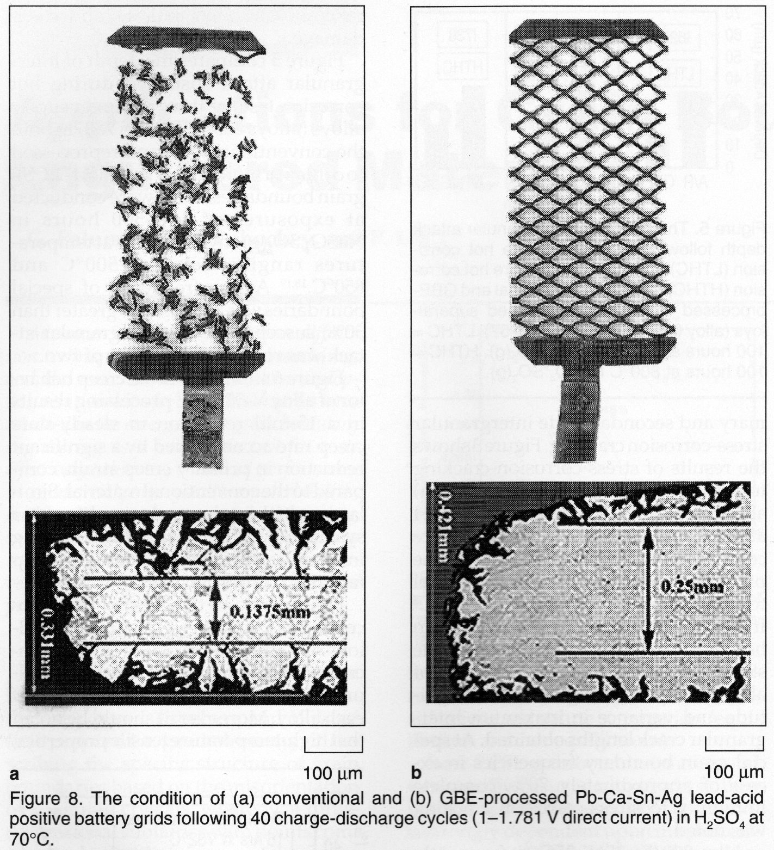

Slide 66
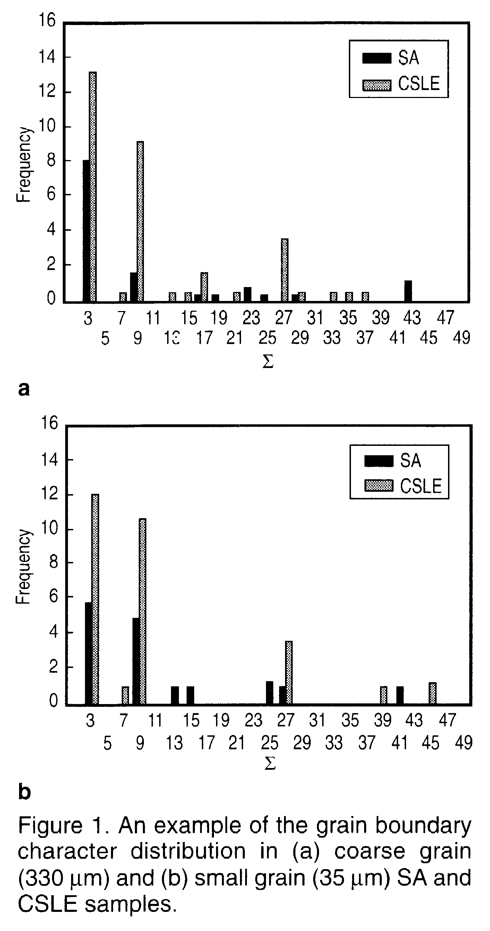
Example: creep resistance in Inconel 600: Ni-16Cr-9Fe
Creep resistance of Ni-alloys is strongly enhanced by maximizing the fraction of special boundaries.
Solution annealed (SA) vs. CSL-enhanced (CSLE): note higher frequencies of low-Σ boundaries.
Was, G. S., V. Thaveepringsriporn, et al. (1998). “Grain boundary misorientation effects on creep and cracking in Ni-based alloys.” JOM 50(2): 44-49.

Slide 67
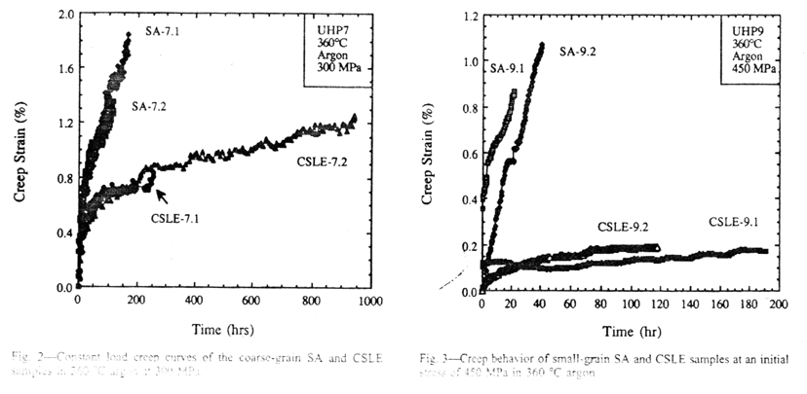
Creep Resistance
Grain Boundary Engineered
Standard Material
Constant load creep curves show dramatic improvement in creep resistance from samples with normal boundaries, and [grain boundary engineered] GBE samples with a high fraction of CSL boundaries.

Slide 68
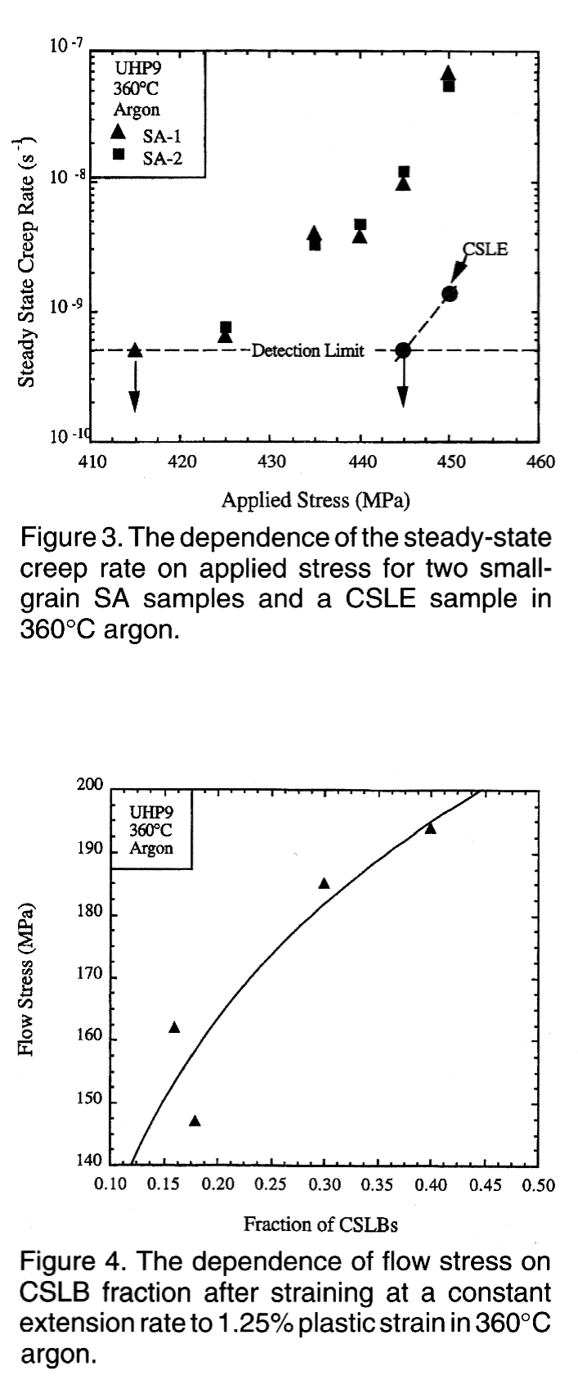
Creep Rates
Creep resistance thought to be enhanced by resistance of CSL boundaries to recovery of extrinsic dislocations. Lack of recovery in CSLs means higher back stresses opposing creep stress, therefore lower strain rate.

Slide 69
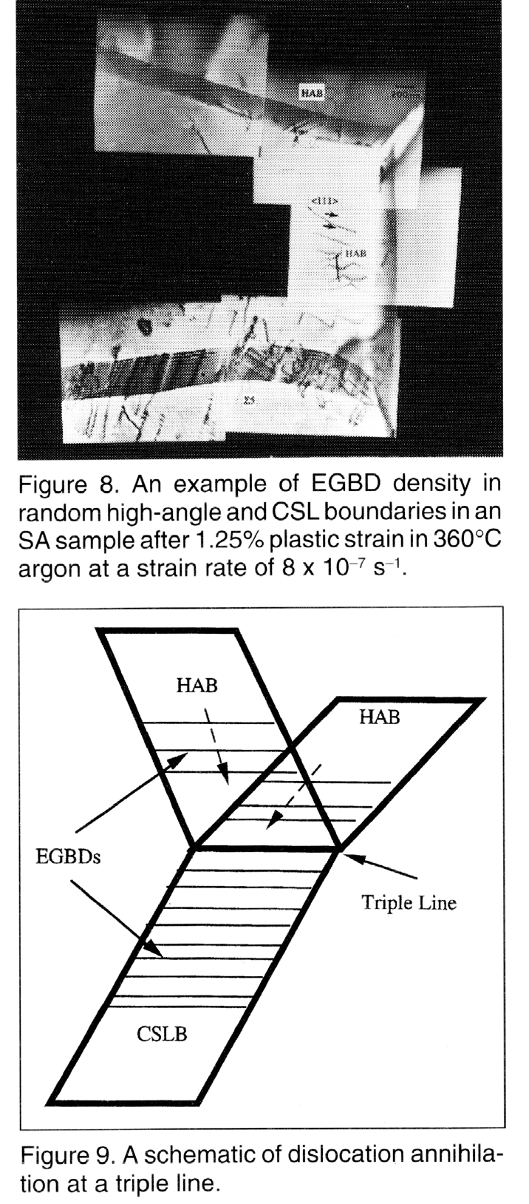
Mechanism
Dislocations (extrinsic grain boundary dislocations) accumulate in CSL boundaries giving rise to back stresses that oppose creep.
V. Thaveepringsriporn and Was, G. S. (1997). “The role of CSL boundaries in creep of Ni-16Cr-9Fe at 360°C.” Metall. Trans. 28A: 2101.

Slide 70
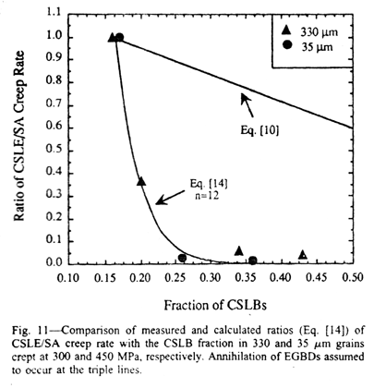
Creep of Ni: model
The creep rate as a function of grain size and boundary type was modeled (after Sangal & Tangri) assuming that dislocation annihilation is much slower in CSL boundaries than in general boundaries.

Slide 71
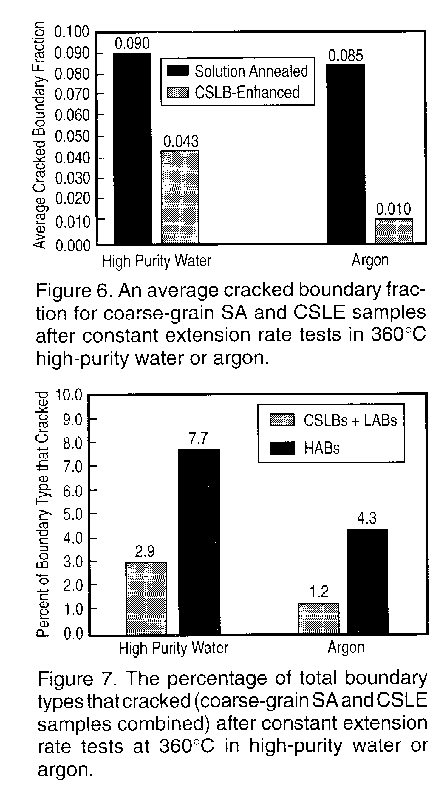
Grain Boundary
Cracking
Cracking at grain boundaries in corrosion testing post-creep shows strong sensitivity to boundary type: CSL boundaries are less prone to corrosion attack.
V. Thaveepringsriporn and Was, G. S. (1997). “The role of CSL boundaries in creep of Ni-16Cr-9Fe at 360°C.” Metall. Trans. 28A: 2101.

Slide 72
Grain Boundary Properties
Based on these remarks on grain boundary structure, one might expect that CSL boundaries (especially in the pure twist or tilt boundary alignment) would have low energy because of good atomic fit.
Some observations support this, e.g. deposition of small particles on a single crystal shows that low-sigma CSL boundaries are favored.
“Grain boundary engineering” relies on simply maximizing the (area) fraction of CSL boundaries. This is typically made quantitative by adopting Brandon’s criterion and counting the fraction of boundaries that are associated with Σ≤29.
Observations of grain boundary character MgO [Saylor & Rohrer] suggest otherwise: the low surface energy plane tends to dominate the grain boundary distribution, and is associated with low boundary energy in all crystalline materials.
It turns out that fcc metals are the exception because of their exceptionally low coherent twin boundary energy, which, in Ni & Cu (for example) is about 5% of the high angle GB energy. This promotes the formation of annealing twins, which in turn result in related CSL types being present such as Σ9, Σ27.

Slide 73
Summary
The Coincident Site Lattice is a useful concept for identifying boundaries with low misfit (thus, low energy) in fcc metals.
Brandon’s criterion: Standard analysis of orientation distance leads to a criterion for how close a given grain boundary is to a particular CSL type. Brandon’s criterion provides a numerical measure that is based on the concept of interfacial dislocations that accommodate small departures from an exact CSL relationship.
Grain Boundary Engineering relies upon CSL analysis.
Macroscopic Degrees of Freedom: In general, five parameters needed to describe crystallographic grain boundary character. This is apparent in the combination of CSL misorientation relationship and twist or tilt boundary plane (to maximize CSL point density in the boundary plane).
Caution: the CSL theory applies to lattice sites, not atom positions. Evidence suggests strongly that in all except fcc metals, the properties are related to the two surfaces that make up the boundary, not the CSL structure. The existence of low energy boundaries for e.g., Σ3 and Σ11 boundaries is “coincidence”.

Slide 74
Supplemental Slides
Information on CSL relationships in hcp metals, courtesy of Nathalie Bozzolo, CEMEF, France.

Slide 75
CSL list for HCP
Bozzolo et al. (2010). "Misorientations induced by deformation twinning in titanium." J. Appl. Crystallography 43 596-602

Slide 76
CSLs for HCP in RF space
Note the two different conventions for alignment of the orthonormal coordinate system (used for calculations) with the crystallographic axes. Typically Channel (HKL) systems use the Y-convention whereas EDAX (TSL/OIM) systems use the X-convention.
Certain CSL relationships correspond to deformation twins observed in Ti and Zr.
Bozzolo et al. (2010). "Misorientations induced by deformation twinning in titanium." J. Appl. Crystallography 43 596-602

