Slide 1


Polycrystal Plasticity -
Multiple Slip
27-750
Texture, Microstructure & Anisotropy
A.D. Rollett,
  Lecture notes originally by:
  H. Garmestani (GaTech),
  G. Branco (FAMU/FSU)
Last revised: 4th Mar. 2016

Slide 2
Objective
The objective of this lecture is to show how plastic deformation in polycrystals requires multiple slip in each grain. This is commonly referred to as the “Taylor model” in the literature.
Further, to show how to calculate the distribution of slips in each grain of a polycrystal (principles of operation of Los Alamos polycrystal plasticity, LApp; also the Viscoplastic Selfconsistent code, VPSC; also “crystal plasticity” simulations in general).
Requirements:
Dislocation controlled plastic strain
Mechanics of Materials, or, micro-mechanics
Continuum Mechanics

Slide 3
Questions
What is the key aspects of the Taylor model?
What is the difference between single slip and multiple slip in terms of boundary conditions?
What is “deviatoric stress” and why does it have 5 components?
How does the von Mises criterion for ductility relate to the 5 components of deviatoric stress and strain?
How does the Bishop-Hill theory work? What is the input and output to the algorithm? What is meant by the “maximum work” principle?
What is the Taylor factor (both definition and physical meaning)?
Why is the rate-sensitive formulation for multiple slip useful above and beyond what the Bishop-Hill approach gives?
What is it that causes/controls texture development?
On what quantities is lattice reorientation based (during multiple slip)?
How can we compute the macroscopic strain due to any given slip system?
How can we compute the resolved shear stress on a given slip system, starting with the macroscopic stress (tensor)?
What does Bishop & Hill state of stress mean (what is the physical meaning)? [Each B&H stress state (one of the 28) corresponds to a corner of the single xtal yield surface that activates either 6 or 8 slip systems simultaneously]

Slide 4
References
Key Papers:
1. Taylor G (1938) "Plastic strain in metals", J. Inst. Metals (U.K.) 62 307 ;
2. Bishop J and Hill R (1951), Phil. Mag. 42 1298;
3. Van Houtte P (1988), Textures and Microstructures 8 & 9 313-350;
4. Lebensohn RA and Tome CN (1993) "A Self-Consistent Anisotropic Approach for the Simulation of Plastic-Deformation and Texture Development of Polycrystals - Application to Zirconium Alloys" Acta Metall. Mater. 41 2611-2624.
Kocks, Tomé & Wenk: Texture & Anisotropy (Cambridge); chapter 8, 1996. Detailed analysis of plastic deformation and texture development.
Reid: Deformation Geometry for Materials Scientists, 1973. Older text with many nice worked examples. Be careful of his examples of calculation of Taylor factor because, like Bunge & others, he does not use von Mises equivalent stress/strain to obtain a scalar value from a multiaxial stress/strain state.
Hosford: The Mechanics of Crystals and Textured Polycrystals, Oxford, 1993. Written from the perspective of a mechanical metallurgist with decades of experimental and analytical experience in the area.
Khan & Huang: Continuum Theory of Plasticity, Wiley-Interscience, 1995. Written from the perspective of continuum mechanics.
De Souza Neto, Peric & Owen: Computational Methods for Plasticity, 2008 (Wiley). Written from the perspective of continuum mechanics.
Gurtin: An Introduction to Continuum Mechanics, ISBN 0123097509, Academic Press, 1981.

Slide 5
Background, Concepts

Slide 6
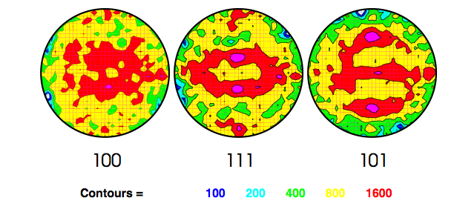
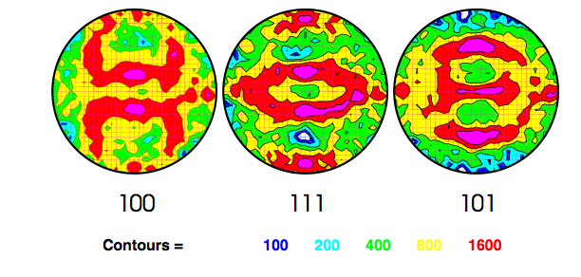
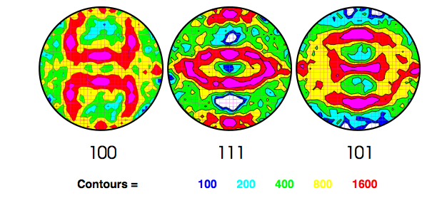
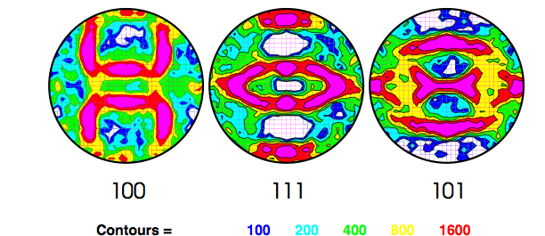
Output of Lapp*
Increasing strain
Figure shows pole figures for a simulation of the development of rolling texture in an fcc metal.
Top = 0.25 von Mises equivalent strain; 0.50, 0.75, 1.50 (bottom).
Note the increasing texture strength as the strain level increases.
*LApp = Los Alamos polycrystal plasticity (code)

Slide 7
Development
The Theory depends upon:
The physics of single crystal plastic deformation;
relations between macroscopic and microscopic quantities ( strain, stress ...);
The mathematical representation and models
Initially proposed by Sachs (1928), Cox and Sopwith (1937), and Taylor in 1938. Elaborated by Bishop and Hill (1951), Kocks (1970), Asaro & Needleman (1985), Canova (1984).
Self-Consistent model by Kröner (1958, 1961), extended by Budiansky and Wu (1962).
Further developments by Hill (1965a,b) and Lin (1966, 1974, 1984) and others.
Read Taylor (1938) “Plastic strain in metals.” J. Inst. Metals (U.K.) 62, 307;
available as: Taylor_1938.pdf

Slide 8
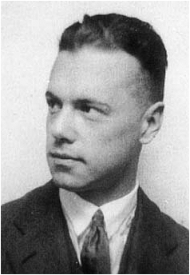
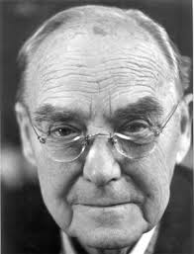
Sachs versus Taylor
Sachs Model (previous lecture on single crystal):
All single-crystal grains with aggregate or polycrystal experience the same state of stress;
Equilibrium condition across the grain boundaries satisfied;
Compatibility conditions between the grains violated, thus, finite strains will lead to gaps and overlaps between grains;
Generally most successful for single crystal deformation with stress boundary conditions on each grain.
Taylor Model (this lecture):
All single-crystal grains within the aggregate experience the same state of deformation (strain);
Equilibrium condition across the grain boundaries violated, because the vertex stress states required to activate multiple slip in each grain vary from grain to grain;
Compatibility conditions between the grains satisfied;
Generally most successful for polycrystals with strain boundary conditions on each grain.

Slide 9
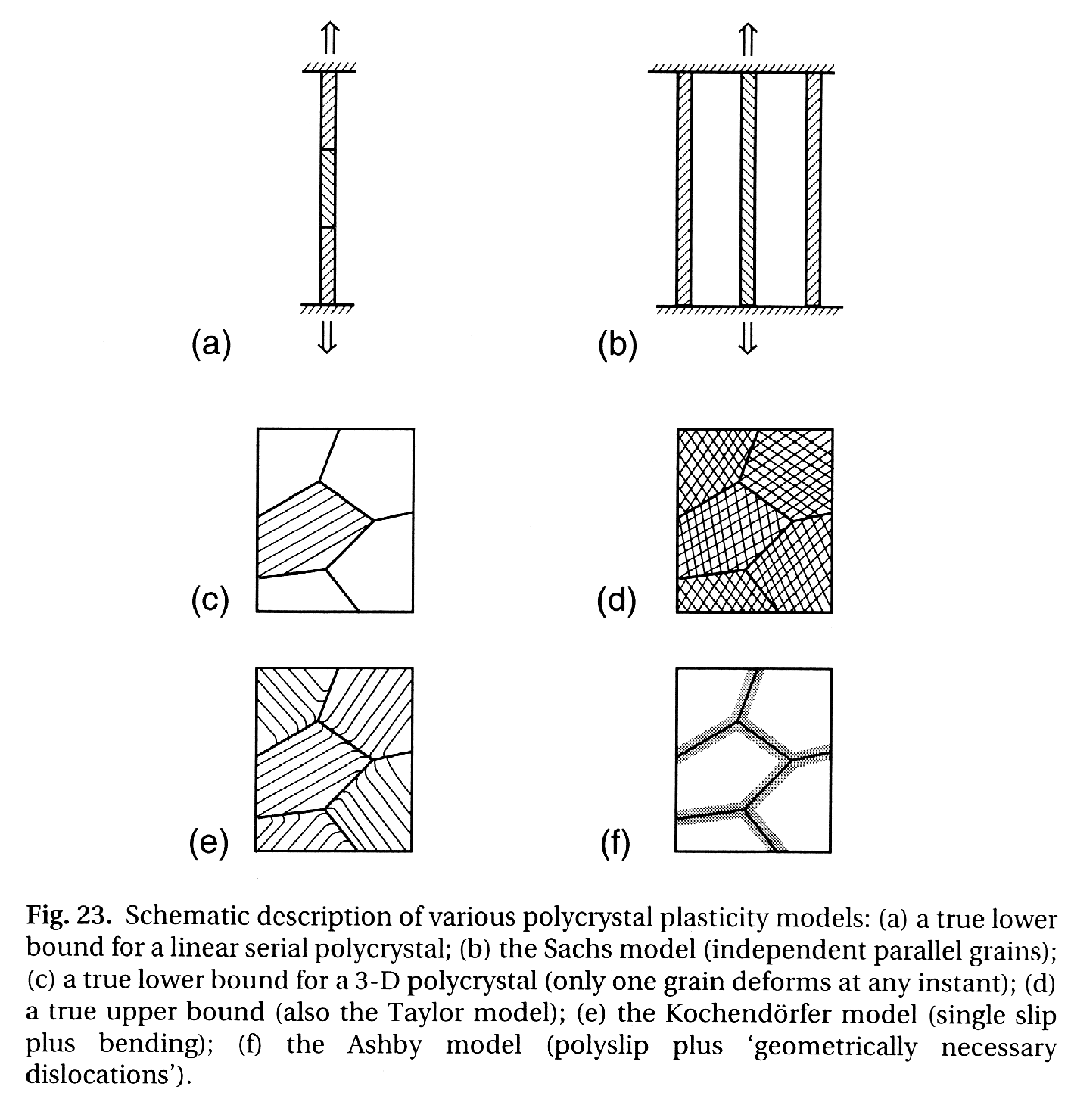
Sachs versus Taylor: 2
Diagrams illustrate the difference between the Sachs iso-stress assumption of single slip in each grain (a, c and e) versus the Taylor assumption of iso-strain with multiple slip in each grain (b, d).
iso-stress
iso-strain

Slide 10
Sachs versus Taylor: 3
Single versus Multiple Slip
External Stress or External Strain
Small arrows indicate variable stress state in each grain
Small arrows indicate identical stress state in each grain
Multiple slip (with 5 or more systems) in each grain satisfies the externally imposed strain, D
Increasing strain
Each grain deforms according to which single slip system is active (based on Schmid factor)
D = E^{T} dγ

Slide 11
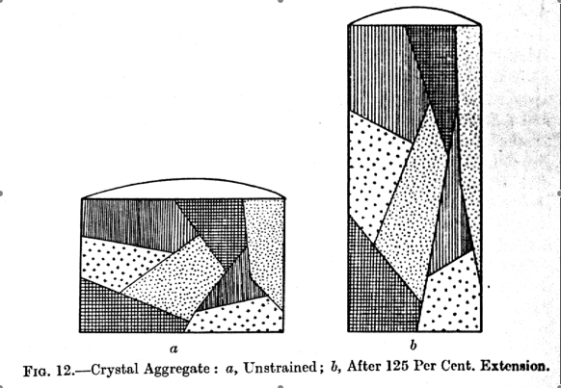
Taylor model: uniform strain
An essential assumption of the Taylor model is that each grain conforms to the macroscopic strain imposed on the polycrystal

Slide 12
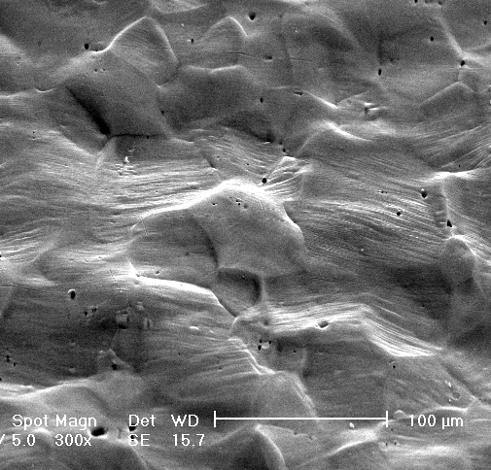
Example of Slip Lines at Surface
(plane strain stretched Al 6022)
T-Sample at 15% strain
Note how each grain exhibits varying degrees of slip line markings.
Although any given grain has one dominant slip line (trace of a slip plane), more than one is generally present.
Taken from CMU PhD research of Yoon-Suk Choi (Pusan U) on surface roughness development in Al 6022
PD // TD
PSD // RD

Slide 13
Notation: 1
Strain, local: E^{local}; global: E^{global}
Slip direction (unit vector): b or s
Slip plane (unit) normal: n
Slip, or Schmid tensor, m_{ij} = b_{i}n_{j} =P_{ij}
Stress (tensor or vector): σ
Shear stress (usually on a slip system): τ
Shear strain (usually on a slip system): γ
Stress deviator (tensor): S
Rate sensitivity exponent: n
Slip system index: s or α
Note that when an index (e.g. of a Slip system, b^{(s)}n^{(s)}) is enclosed in parentheses, it means that the summation convention does not apply even if the index is repeated in the equation.

Slide 14
Notation: 2
Coordinates: current: x; reference X
Velocity of a point: v.
Displacement: u
Hardening coefficient: h (dσ = h dγ )
Strain, ε
  measures the change in shape
Work increment: dW
  do not confuse with lattice spin!
Infinitesimal rotation tensor: Ω
Elastic Stiffness Tensor (4th rank): C
  Load, e.g. on a tensile sample: P
    do not confuse with slip tensor!

Slide 15
Notation: 3
Plastic spin: W
  measures the rotation rate; more than one kind of spin is used:
  “Rigid body” spin of the whole polycrystal: W
  “grain spin” of the grain axes (e.g. in torsion): W^{g}
  “lattice spin” from slip/twinning (skew symmetric part of the strain): W^{c}.
Rotation (small): ω

Slide 16
Notation: 4
Deformation gradient: F
  Measures the total change in shape (rotations included).
Velocity gradient: L
  Tensor, measures the rate of change of the deformation gradient
Time: t
Slip geometry matrix: E (do not confuse with strain)
Strain rate: D
  symmetric tensor; D = symm(L)

Slide 17
Basic Equations
Sachs model: iso-stress:
Identify the index, s, of the active system(s) from k available systems from the maximum Schmid factor: max_{s}(b^{(s)} σ n^{(s)} ).
If strain is accumulated compute the slip (shear strain) from the macroscopic applied strain. If more than one system is active (e.g. primary+conjugate) divide the shear strains equally.
Taylor model: iso-strain (Bishop & Hill variant for fcc/bcc only):
Identify the index, r, active (multi-slip) stress state (from list of 28) from the maximum inner product between the vertex stress state and the applied strain: max_{r}(σ^{(r)}dε).
Each possible vertex stress state activates 6 or 8 slip systems; either make an arbitrary choice of 5 to satisfy the external slip or, more typically compute the solution to the "rate-sensitive slip equation", below, i.e. the stress that satisfies the imposed strain rate. The slip rate on the s^{th} system is given by the exponentiated expression. Lattice spin is computed from the skew-symmetric version of the same expression.
Notes:
max_s (g_{im} b_i^{(s)} \sigma_{mn} g_{jn} n_j^{(s)})

Slide 18
Dislocations, Slip Systems, Crystallography
This section is provided to remind students about the basic geometry of slip via dislocation glide. Full details can, of course, be found in standard textbooks.

Slide 19
Dislocations and Plastic Flow
At room temperature the dominant mechanism of plastic deformation is dislocation motion through the crystal lattice.
Dislocation glide occurs on certain crystal planes (slip planes) in certain crystallographic directions (// Burgers vector).
A slip system is a combination of a slip direction and slip plane normal.
A second-rank tensor (m_{ij} = b_{i}n_{j} ) can associated with each slip system, formed from the outer product of slip direction and normal. The resolved shear stress on a slip system is then given by the inner product of the Schmid and the stress tensors: τ = m_{ij} σ_{ij}.
The crystal structure of metals is not altered by the plastic flow because slip is a simple shear mode of deformation. Moreover no volume change is associated with slip, therefore the hydrostatic stress has no effect on plasticity (in the absence of voids and/or dilatational strain). This explains the use of deviatoric stress in calculations.

Slide 20
Crystallography of Slip
Slip occurs most readily in specific directions on certain crystallographic planes.
Slip plane – is the plane of greatest atomic density.
Slip direction – is the close-packed direction within the slip plane.
Slip system – is the combination of preferred slip planes and slip directions (on those specific planes) along which dislocation motion occurs. Slip systems are dependent on the crystal structure.

Slide 21
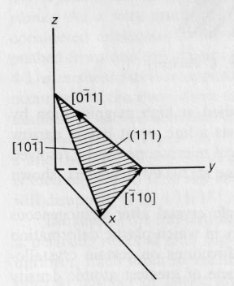
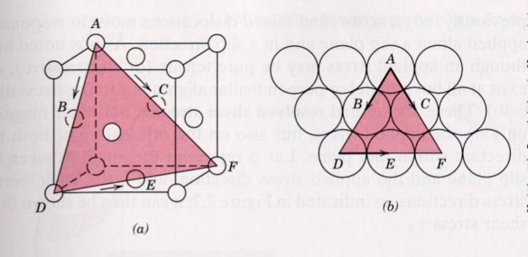
Crystallography of Slip in fcc
Example: Determine the slip system for the (111) plane in a fcc crystal and sketch the result.
The slip direction in fcc is <110>
The proof that a slip direction [uvw] lies in the slip plane (hkl) is given by calculating the scalar product:
hu + kv + lw =0

Slide 22
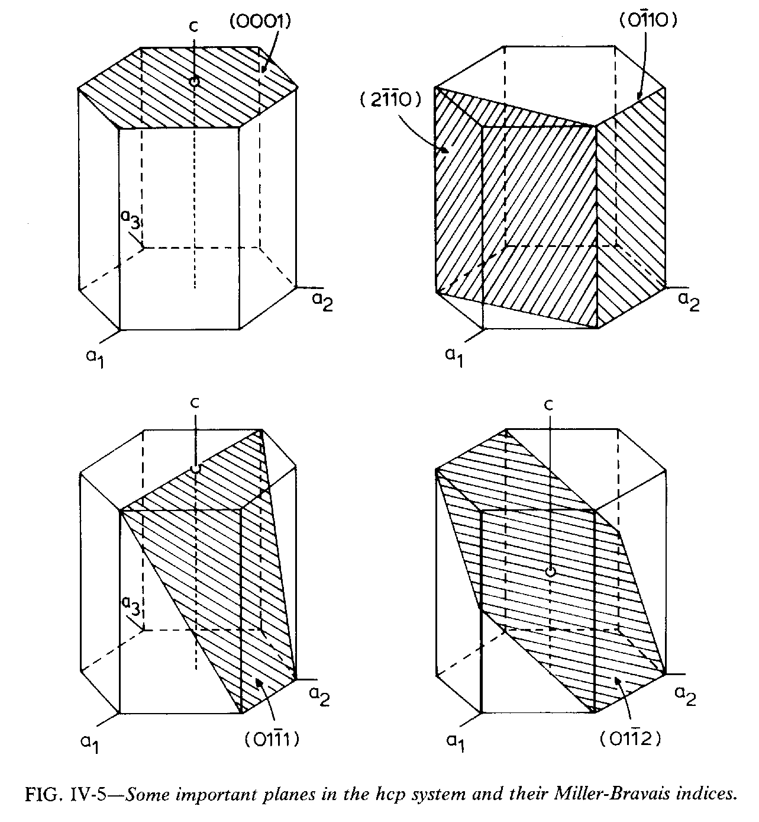
Slip Systems in Hexagonal Metals
Basal
(0002) <2 -1 -1 0>
Prism
{0 -1 1 0}<2 -1 -1 0>
Also:
(2 -1 -1 0)
Pyramidal (c+a)
(1 0 -1 1) <1 -2 1 3>
Pyramidal (a)
(1 0 -1 1) <1 -2 1 0>
Pyramidal
(1 0 -1 2)
Berquist & Burke: Zr alloys

Slide 23
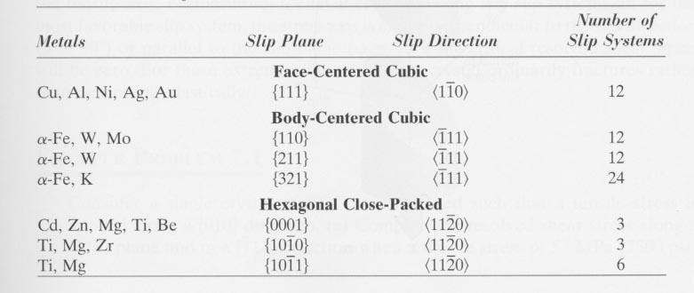
Slip Systems in fcc, bcc, hexagonal
The slip systems for FCC, BCC and hexagonal crystals are:
Also: Pyramidal (c+a) (1 0 -1 1) <1 -2 1 3>
For this lecture we will focus on FCC crystals only
Note:
In the case of FCC crystals we can see in the table that there are 12 slip systems. However if forward and reverse systems are treated as independent, there are then 24 slip systems.

Slide 24
Schmid / Sachs / Single Slip
This section is included as a reminder of how to analyze single slip. Since it assumes stress boundary conditions the analysis is straightforward. More detail is provided in the lecture that explicitly addresses this topic.

Slide 25
Schmid Law
Initial yield stress varies from sample to sample depending on, among several factors, the relation between the crystal lattice to the loading axis (i.e. orientation, written as g).
The applied stress resolved along the slip direction on the slip plane (to give a shear stress) initiates and controls the extent of plastic deformation.
Yield begins on a given slip system when the shear stress on this system reaches a critical value, called the critical resolved shear stress (crss), independent of the tensile stress or any other normal stress on the lattice plane (in less symmetric lattices, however, there may be some dependence on the hydrostatic stress).
The magnitude of the yield stress depends on the density and arrangement of obstacles to dislocation flow, such as precipitates (not discussed here).

Slide 26
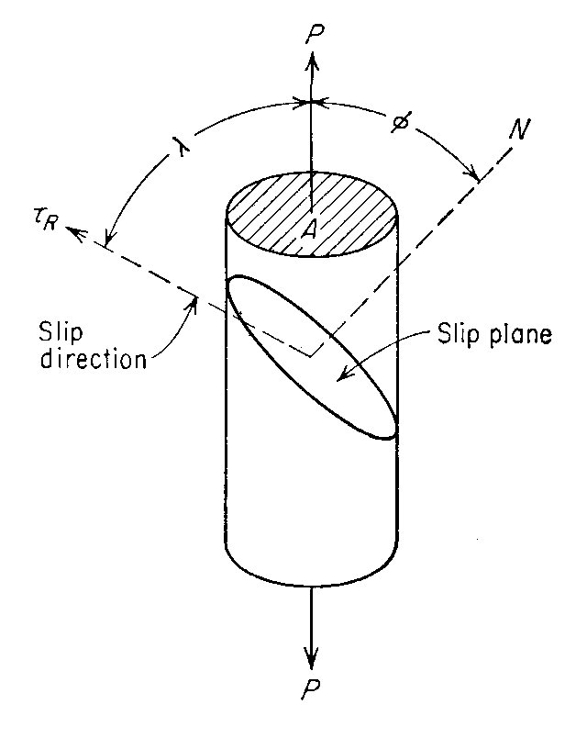
Minimum Work, Single Slip (Sachs)
Under stress boundary conditions, single slip occurs
Uniaxial Tension or Compression (where “m” is the slip tensor):
= n
The (dislocation) slip is given by (where “m” is the Schmid factor):
= b,
or, s
P is a unit vector in the loading direction
This slide, and the next one, are a re-cap of the lecture on single slip

Slide 27
Minimum Work, Single Slip
Applying the Minimum Work Principle, it follows that
Note: τ(γ) describes the dependence of the critical resolved shear stress (crss) on strain (or slip curve), based on the idea that the crss increases with increasing strain. The Schmid factor, m, has a maximum value of 0.5 (both angles = 45°).
If finite strain is imposed, the shear strain (slip) increment is given by the macroscopic strain divided by the Schmid factor,
dγ = dε ÷ m. After each increment, the Schmid factor must be recalculated because the lattice orientation has changed (in relation to the tensile stress axis)

Slide 28
Elastic vs. Plastic Deformation
Selection of Slip Systems for Rigid-Plastic Models
Assumption – For fully plastic deformation, the elastic deformation rate is usually small when compared to the plastic deformation rate and thus it can be neglected.
Reasons:
Perfect plastic materials - equivalent stress = initial yield stress
The elastic strain is limited to the ratio of stress to elastic modulus
For most metals, the initial yield stress is 2 to 4 orders of magnitude less than the elastic modulus –
ratio is << 1

Slide 29



Macro Strain – Micro Slip
Selection of Slip Systems for Rigid-Plastic Models
Once the elastic deformation rate is considered, it is reasonable to model the material behavior using the rigid-plastic model. The plastic strain rate is given by the sum of the slipping rates multiplied by their Schmid tensors:
where
forward and reverse considered independent
n is ≤ to 12 systems (or 24 systems – )
Note:
D can expressed by six components ( Symmetric Tensor)
Because of the incompressibility condition – tr(D) = D_{ii} = 0, only five out of the six components are independent.

Slide 30
Von Mises criterion
Selection of Slip Systems for Rigid Plasticity Models
As a consequence of the condition
the number of possible active slip systems (in cubic metals) is greater than the number of independent components of the tensor strain rate D^{p}, from the mathematical point of view (under-determined system), so any combination of five slip systems that satisfy the incompressibility condition can allow the prescribed deformation to take place. The requirement that at least five independent systems are required for plastic deformation is known as the von Mises Criterion. If less than 5 independent slip systems are available, the ductility is predicted to be low in the material. The reason is that each grain will not be able to deform with the body and gaps will open up, i.e. it will crack. Caution: even if a material has 5 or more independent systems, it may still be brittle (e.g. Iridium).

Slide 31
Selection of Active Slip Systems:
Taylor’s Minimum Work Principle

Slide 32
Minimum Work Principle
Proposed by Taylor in (1938).
The objective is to determine the combination of shears or slips that will occur when a prescribed strain is produced.
States that, of all possible combinations of the 12 shears that can produce the assigned strain, only that combination for which the energy dissipation is the least is operative.
The defect in the approach is that it says nothing about the activity or resolved stress on other, non-active systems (This last point was addressed by Bishop and Hill in 1951).
Mathematical statement:
Bishop J and Hill R (1951) Phil. Mag. 42 414; ibid. 1298

Slide 33
Minimum Work Principle
Minimum Work Principle
Here,
- are the actually activated slips that produce D.
- is any set of slips that satisfy tr(D)=D_{ii} = 0, but are operated by the corresponding stress satisfying the loading/unloading criteria.
- is the (current) critical resolved shear stress (crss) for the material (applies on any of the α^{th} activated slip systems).
- is the current shear strength of (= resolved shear stress on) the α^{th} geometrically possible slip system that may not be compatible with the externally applied stress.

Slide 34
Minimum Work Principle
Recall that in the Taylor model all the slip systems are assumed to harden at the same rate, which means that
and then,
Note that we now have only 12 operative slip systems once
the forward and reverse shear strengths (crss) are considered to be the same in absolute value.

Slide 35
Minimum Work Principle
Thus Taylor’s minimum work criterion can be summarized as in the following: Of the possible 12 slip systems, only that combination for which the sum of the absolute values of shears is the least is the combination that is actually operative.
The uniformity of the crss (same on all systems) means that the minimum work principle is equivalent to a minimum microscopic shear principle.

Slide 36
Stress > CRSS?
The obvious question is, if we can find a set of microscopic shear rates that satisfy the imposed strain, how can we be sure that the shear stress on the other, inactive systems is not greater than the critical resolved shear stress?
This is not the same question as that of equivalence between the minimum (microscopic) work principle and the maximum (macroscopic) work approach described later in this lecture.

Slide 37


Stress > CRSS?
The work increment is the (inner) product of the stress and strain tensors, and must be the same, regardless of whether it is calculated from the macroscopic quantities or the microscopic quantities:
For the actual set of shears in the material, we can write (omitting the “*”),
where the crss is outside the sum because it is constant.
[Reid: pp 154-156; also Bishop & Hill 1951]

Slide 38


Stress > CRSS?
Now we know that the shear stresses on the hypothetical (denoted by “*”) set of systems must be less than or equal to the crss, τ_{c}, for all systems, so:
This means that we can write:

Slide 39

Stress > CRSS?
However the LHS of this equation is equal to the work increment for any possible combination of slips, δw=σ_{ij}δε_{ij} which is equal to τ_{c} Σ_{α}δγ_{α}, leaving us with:
So dividing both sides by τ_{c} allows us to write:
Q.E.D.

Slide 40
Multiple Slip
This section analyzes the geometry of multiple slip, all in the crystal frame. This sets the scene for the treatment of the problem in terms of simultaneous equations.

Slide 41
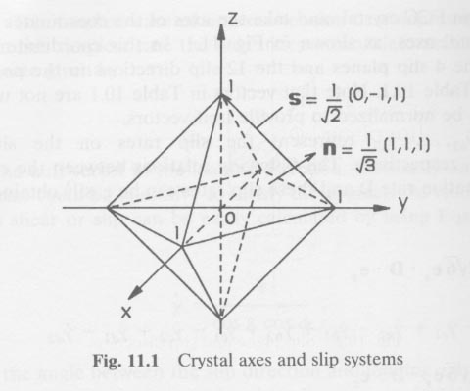
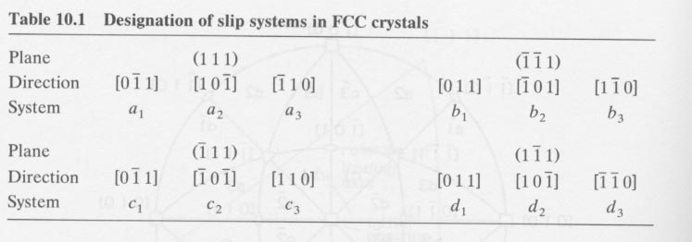
Multiple Slip
Deformation rate is multi-axial
General case – D
Only five independent (deviatoric)
components
Crystal - FCC
Slip rates - , , ....,
on the slip systems a₁, a₂, a₃ ..., respectively.
Note correction to system b2
Khan & Huang

Slide 42
Multiple Slip
Using
the following set of relations can be obtained
Note: e_{x}, e_{y}, e_{z} are unit vectors parallel to the axes

Slide 43
Multiple Slip

Slide 44
Multiple Slip
To verify these relations, consider the contribution of shear on system c₃ as an example:
Slip system - c₃;
Given :
Unit vector in the slip direction –
Unit normal vector to the slip plane –
The contribution of the c₃ system is given by:
Khan & Huang

Slide 45
Multiple Slip
From the set of equations, one can obtain 6 relations between the components of D and the 12 shear rates on the 12 slip systems. By taking account of the incompressibility condition, this reduces to only 5 independent relations that can be obtained from the equations.
So, the main task is to determine which combination of 5 independent shear rates, out of 12 possible rates, should be chosen as the solution of a prescribed deformation rate D.
This set of shear rates must satisfy Taylor’s minimum shear principle.
Note : There are 792 sets or ¹²C₅ combinations, of 5 shears, but only 384 are independent. Taylor’s minimum shear principle does not ensure that there is a unique solution (a unique set of 5 shears).

Slide 46
Multiple Slip: Strain
Suppose that we have 5 slip systems that are providing the external slip, D.
Let’s make a vector, D_{i}, of the (external) strain tensor components and write down a set of equations for the components in terms of the microscopic shear rates, dγ_{α}.
Set D₂ = dε₂₂, D₃ = dε₃₃, D₆ = dε₁₂,
D₅ = dε₁₃, and D₄ = dε₂₃.
D_2& = [m_{22}^{(1) } & m_{22}^{(2)} & m_{22}^{(3)} & m_{22}^{(4)} & m_{22}^{(5)} ] \cdot [ d\gamma_1& \\ d\gamma_2& \\ d\gamma_3& \\ d\gamma_4& \\ d\gamma_5& ]

Slide 47
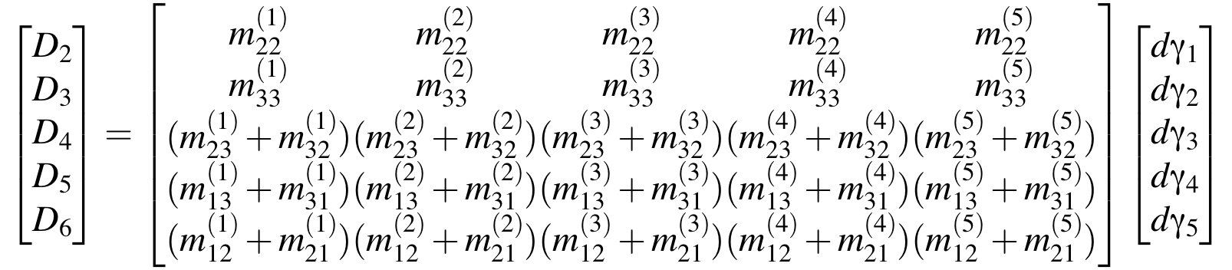
Multiple Slip: Strain
This notation can obviously be simplified and all five components included by writing it in tabular or matrix form (where the slip system indices are preserved as superscripts in the 5x5 matrix). This is similar to the "basis", b_{p}, described by Van Houtte (1988).
or, D = E^{T} dγ
\begin{bmatrix} D_2& \\ D_3& \\ D_4& \\ D_5& \\ D_6& \end{bmatrix} = \begin{bmatrix} m_{22}^{(1) } & m_{22}^{(2)} & m_{22}^{(3)} & m_{22}^{(4)} & m_{22}^{(5)} \\ m_{33}^{(1)} & m_{33}^{(2)} & m_{33}^{(3)} & m_{33}^{(4)} & m_{33}^{(5)} \\ (m_{23}^{(1)}+m_{32}^{(1)}) & (m_{23}^{(2)}+m_{32}^{(2)}) & (m_{23}^{(3)}+m_{32}^{(3)}) & (m_{23}^{(4)}+m_{32}^{(4)}) & (m_{23}^{(5)}+m_{32}^{(5)}) \\ (m_{13}^{(1)}+m_{31}^{(1)}) & (m_{13}^{(2)}+m_{31}^{(2)}) & (m_{13}^{(3)}+m_{31}^{(3)}) & (m_{13}^{(4)}+m_{31}^{(4)}) & (m_{13}^{(5)}+m_{31}^{(5)}) \\ (m_{12}^{(1)}+m_{21}^{(1)}) & (m_{12}^{(2)}+m_{21}^{(2)}) & (m_{12}^{(3)}+m_{21}^{(3)}) & (m_{12}^{(4)}+m_{21}^{(4)}) & (m_{12}^{(5)} +m_{21}^{(5)})\end{bmatrix} \begin{bmatrix} d\gamma_1& \\ d\gamma_2& \\ d\gamma_3& \\ d\gamma_4& \\ d\gamma_5& \end{bmatrix}

Slide 48
Multiple Slip: Stress
We can perform the equivalent analysis for stress: just as we can form an external strain component as the sum over the contributions from the individual slip rates, so too we can form the resolved shear stress as the sum over all the contributions from the external stress components (note the inversion of the relationship):
Or,

Slide 49
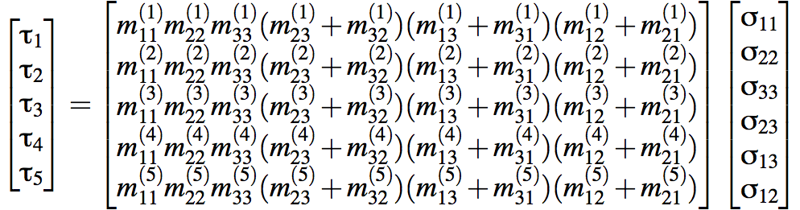
Multiple Slip: Stress
Putting into 5x6 matrix form, as for the strain components, yields:
or, τ = E σ

Slide 50
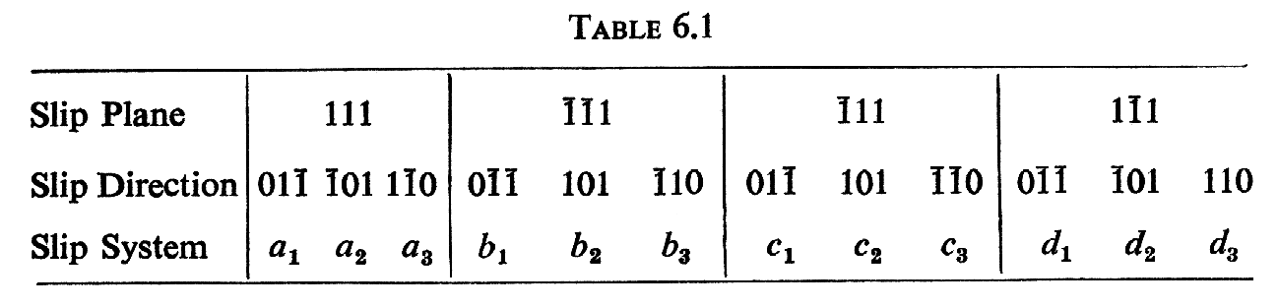
Definitions of Stress states, slip systems
Now define a set of six deviatoric stress terms, since we know that the hydrostatic component is irrelevant, of which we will actually use only 5:
A:= (σ₂₂ - σ₃₃) F:= σ₂₃
B:= (σ₃₃ - σ₁₁) G:= σ₁₃
C:= (σ₁₁ - σ₂₂) H:= σ₁₂
Slip systems (as before):
Note: these systems have the negatives of the slip directions compared to those shown in the lecture on Single Slip (taken from Khan’s book), except for b2.
[Reid]
Kocks: UQ -UK UP -PK -PQ PU -QU -QP -QK -KP -KU KQ

Slide 51
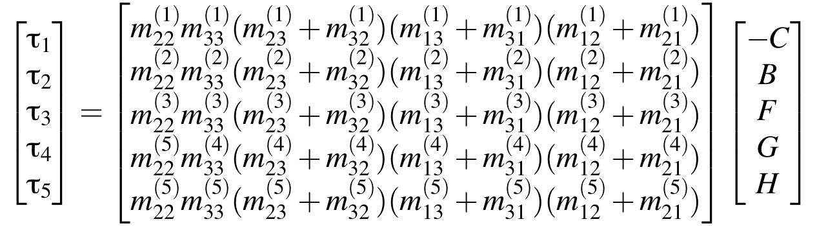
Multiple Slip: Stress
Equivalent 5x5 matrix form for the stresses:
Note that it is feasible to invert the matrix, provided that its determinant is non-zero, which it will only be true if the 5 slip systems chosen are linearly independent.
σ = E⁻¹ τ

Slide 52
Multiple Slip: Stress/Strain Comparison
The last matrix equation is in the same form as for the strain components.
We can test for the availability of a solution by calculating the determinant of the “E” matrix, as in:
τ = E σ
or, D = E^{T} dγ
A non-zero determinant of E means that a solution is available.
Even more important, the direct form of the stress equation means that, if we assume a fixed critical resolved shear stress, then we can compute all the possible multislip stress states, based on the set of linearly independent combinations of slip:
σ = E⁻¹ τ
It must be the case that, of the 96 sets of 5 independent slip systems, the stress states computed from them collapse down to only the 28 (+ and -) found by Bishop & Hill.
The Taylor approach can be used to find a solution for a set of active slip systems that satisfies the minimum (microscopic) work criterion. The most effective approach is to use the simplex method because the multiple possible solutions mean that the problem is mathematically underdetermined. A complete description is found in the 1988 review paper by Van Houtte [Textures and Microstructures 8 & 9 313-350].
The simplex method is also useful for analyzing geometrically necessary dislocation (GND) content, see El-Dasher et al. [Scripta mater. 48 141 (2003)].

Slide 53
Bishop and Hill model
This section describes the alternate approach of Bishop and Hill. This enumerates the corners (vertices) of the single crystal yield surface that permit multiple slip with 6 or 8 systems.

Slide 54
Maximum Work Principle
Bishop and Hill introduced a maximum work principle, which in turn was based on Hill's work on plasticity*. The papers are available as 1951-PhilMag-Bishop_Hill-paper1.pdf and 1951-PhilMag-Bishop_Hill-paper2.pdf.
This states that, among the available (multiaxial) stress states that activate a minimum of 5 slip systems, the operative stress state is that which maximizes the work done.
In equation form, δw = σ_{ij}dε_{ij} ≥σ∗_{ij}dε_{ij} , where the operative stress state is unprimed.
For cubic materials, it turns out that the list of discrete multiaxial stress states is quite short (28 entries). Therefore the Bishop-Hill approach is much more convenient from a numerical perspective.
The algebra is non-trivial, but the maximum work principle is equivalent to Taylor’s minimum shear (microscopic work) principle.
In geometrical terms, the maximum work principle is equivalent to seeking the stress state that is most nearly parallel (in direction) to the strain rate direction.
*Hill, R. (1950). The Mathematical Theory of Plasticity, Clarendon Press, Oxford.

Slide 55
Yield surfaces: introduction
Before discussing the B-H approach, it is helpful to understand the concept of a yield surface.
The best way to learn about yield surfaces is think of them as a graphical construction.
A yield surface is the boundary between elastic and plastic flow.
Example: tensile stress
σ=0
elastic
plastic
σ
σ= σ_{yield}

Slide 56
2D yield surfaces
Yield surfaces can be defined in two dimensions.
Consider a combination of (independent) yield on two different axes.
plastic
The material
is elastic if
σ₁ < σ_{1y}
and
σ₂ < σ_{2y}
σ₂
σ= σ_{2y}
plastic
elastic
0
σ₁
σ= σ_{1y}

Slide 57
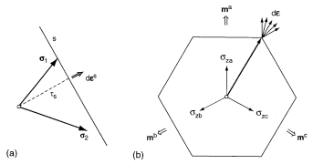
Crystallographic slip: a single system
Now that we understand the concept of a yield surface we can apply it to crystallographic slip.
The result of slip
on a single system
is strain in a single
direction, which
appears as a straight
line on the Y.S.
The strain direction that
results from this system
is necessarily perpendicular to the yield surface
[Kocks]

Slide 58
A single slip system
Yield criterion for single slip:
b_{i}σ_{ij}n_{j} ≥ τ_{crss}
In 2D this becomes (σ₁≡σ₁₁:
b₁σ₁n₁+ b₂σ₂n₂ ≥ τ_{crss}
σ₂
The second
equation defines
a straight line
connecting the
intercepts
plastic
τ_{crss}/b₂n₂
elastic
0
σ₁
τ_{crss}/b₁n₁

Slide 59
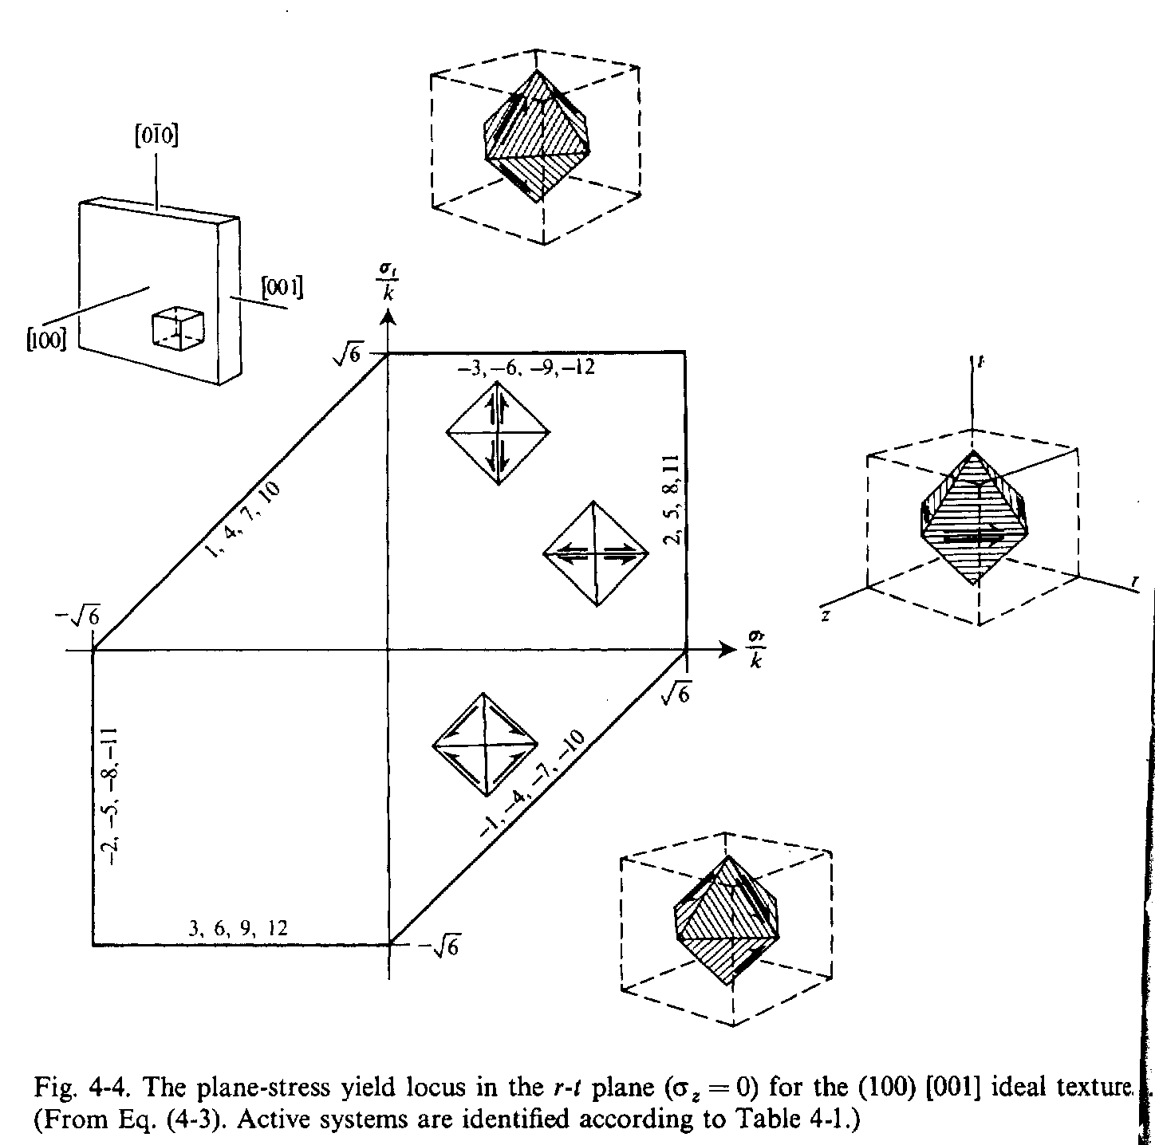
Single crystal Y.S.
8-fold vertex
When we examine yield surfaces for specific orientations, we find that multiple slip systems meet at vertices.
Cube component:
(001)[100]
The 8-fold vertex identified is one of the 28 Bishop & Hill stress states (next slides)
Backofen Deformation Processing

Slide 60
Definitions of Stress states, slip systems (repeat)
A set of six deviatoric stress terms can be defined. As previously remarked we know that the hydrostatic component is irrelevant because dislocation glide does not result in any volume change. Therefore we will use only 5 out of the 6:
A:= (σ₂₂ - σ₃₃) F:= σ₂₃
B:= (σ₃₃ - σ₁₁) G:= σ₁₃
C:= (σ₁₁ - σ₂₂) H:= σ₁₂
Slip systems (as before):
Note: these systems have the negatives of the slip directions compared to those shown in the lecture on Single Slip (taken from Khan’s book), except for b2.
[Reid]
Kocks: UQ -UK UP -PK -PQ PU -QU -QP -QK -KP -KU KQ

Slide 61
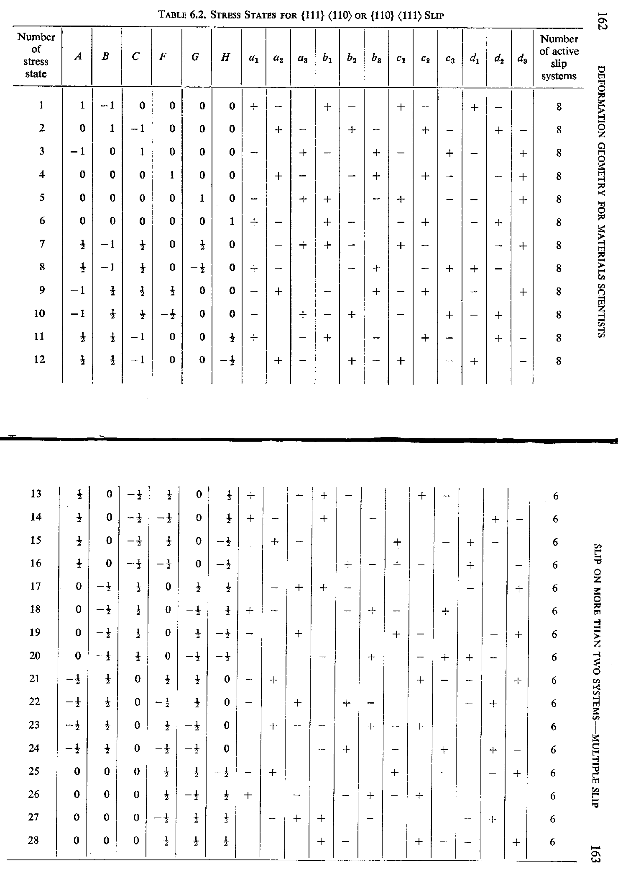
Multi-slip stress states
Each entry is in multiples of √6 multiplied by the critical resolved shear stress, √6τ_{crss}
Example:
the 18th multi-slip stress state:
A=F= 0
B=G= -0.5
C=H= 0.5
[Reid]
Notes:
12 8-fold systems; 5C8 = 56, therefore 12*56 = 672
16 6 –fold systems; 5C6 = 6; therefore 16*6 = 96. Clearly many redundant combos in each case.

Slide 62
Work Increment
The work increment is easily expanded as:
Simplifying by noting the symmetric property of stress and strain:
Then we apply the fact that the hydrostatic component of the strain is zero (incompressibility), and apply our notation for the deviatoric components of the stress tensor (next slide).

Slide 63
Applying Maximum Work
For each of 56 (with positive and negative copies of each stress state), find the one that maximizes dW:
Reminder: the strain (increment) tensor must be in grain (crystallographic) coordinates (see next page); also make sure that its von Mises equivalent strain = 1.

Slide 64

Sample vs. Crystal Axes
For a general orientation, one must pay attention to the product of the axis transformation that puts the strain increment in crystal coordinates. Although one should, in general, symmetrize the new strain tensor expressed in crystal axes, it is sensible to leave the new components as is and form the work increment as follows (using the tensor transformation rule):
Be careful with the indices and the fact that the above formula does not correspond to matrix multiplication (but one can use the particular formula for 2nd rank tensors, i.e. T’ = g T g^{T}
Note that the shear terms (with F, G & H) do not have the factor of two. Many worked examples choose symmetric orientations in order to avoid this issue!

Slide 65
Taylor Factor
This section explains what the Taylor is and how to obtain it, with a worked example.

Slide 66
Taylor factor
From this analysis emerges the fact that the same ratio couples the magnitudes of the (sum of the) microscopic shear rates and the macroscopic strain, and the macroscopic stress and the critical resolved shear stress. This ratio is known as the Taylor factor, in honor of the discoverer. For simple uniaxial tests with only one non-zero component of the external stress/strain, we can write the Taylor factor as a ratio of stresses of of strains. If the strain state is multiaxial, however, a decision must be made about how to measure the magnitude of the strain, and we follow the practice of Canova, Kocks et al. by choosing the von Mises equivalent strain (defined in the next two slides).
In the general case, the crss values can vary from one system to another. Therefore it is easier to use the strain increment based definition.

Slide 67
Taylor factor, multiaxial stress
For multiaxial stress states, one may use the effective stress, e.g. the von Mises stress (defined in terms of the stress deviator tensor, S = σ - ( σ_{ii} / 3 ), and also known as effective stress). Note that the equation below provides the most self-consistent approach for calculating the Taylor factor for multi-axial deformation.

Slide 68
Taylor factor, multiaxial strain
Similarly for the strain increment (where dε_{p} is the plastic strain increment which has zero trace,
i.e. dε_{ii}=0).
***
Compare with single slip: Schmid factor = cosφcosλ = τ/σ
*** This version of the formula applies only to the symmetric form of dε

Slide 69
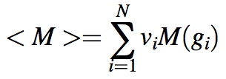
Polycrystals
Given a set of grains (orientations) comprising a polycrystal, one can calculate the Taylor factor, M, for each one as a function of its orientation, g, weighted by its volume fraction, v, and make a volume-weighted average, <M>.
Note that exactly the same average can be made for the lower-bound or Sachs model by averaging the
inverse Schmid factors (1/m).

Slide 70
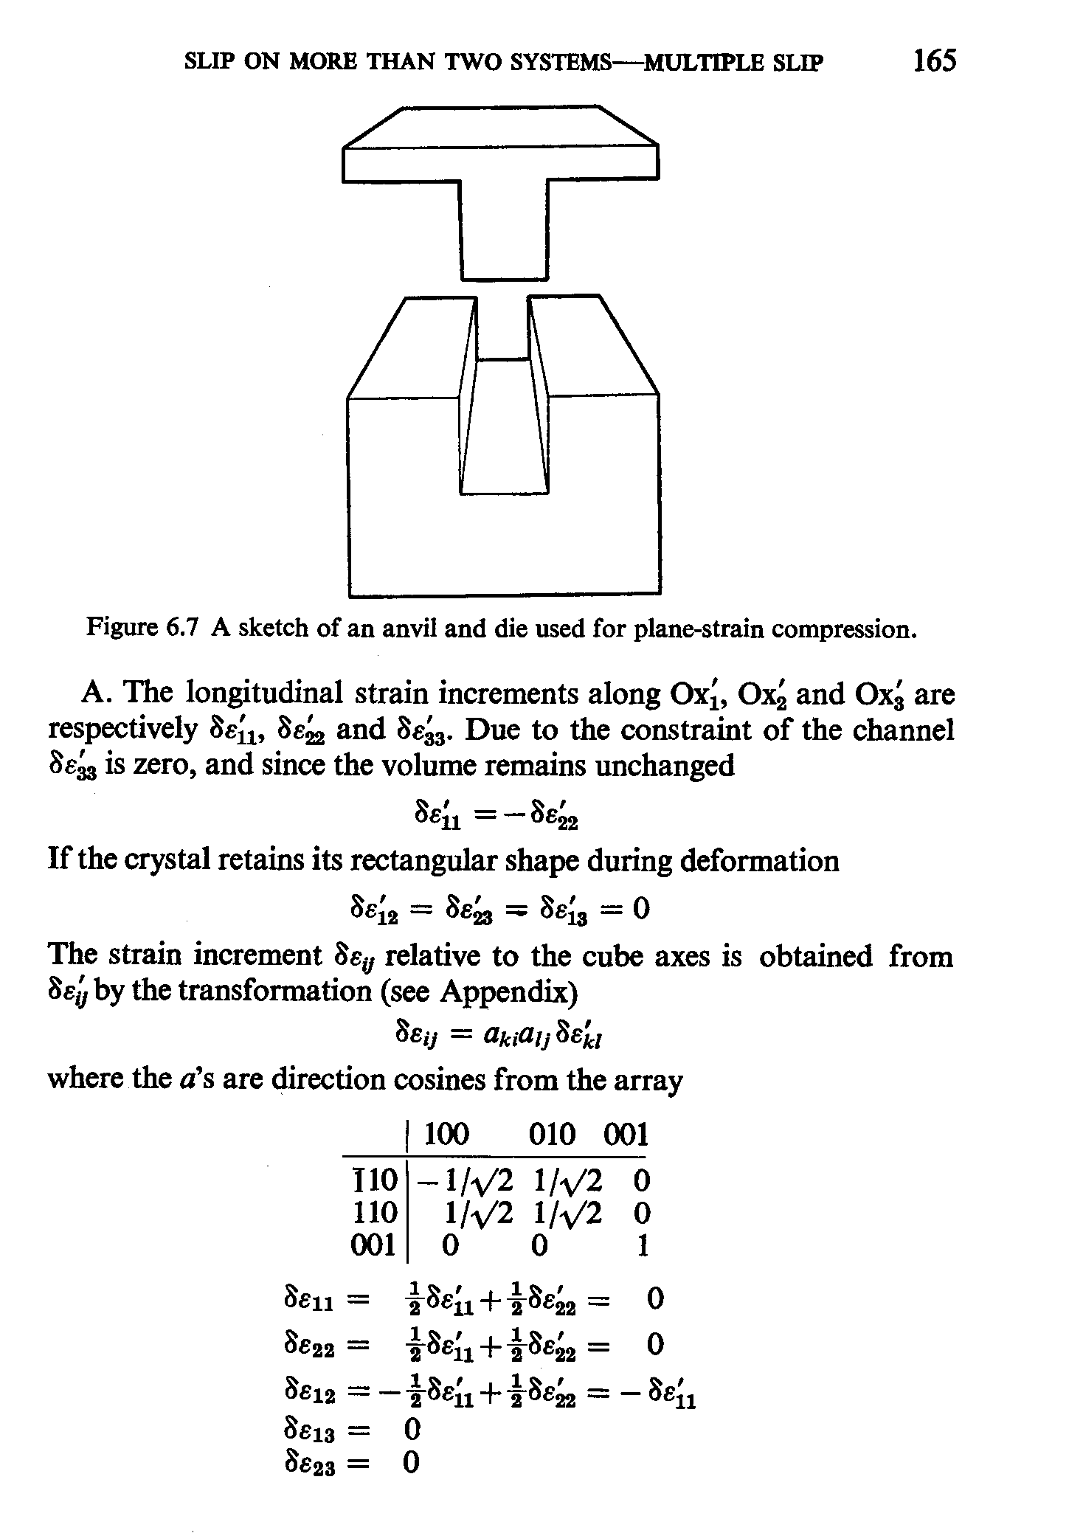
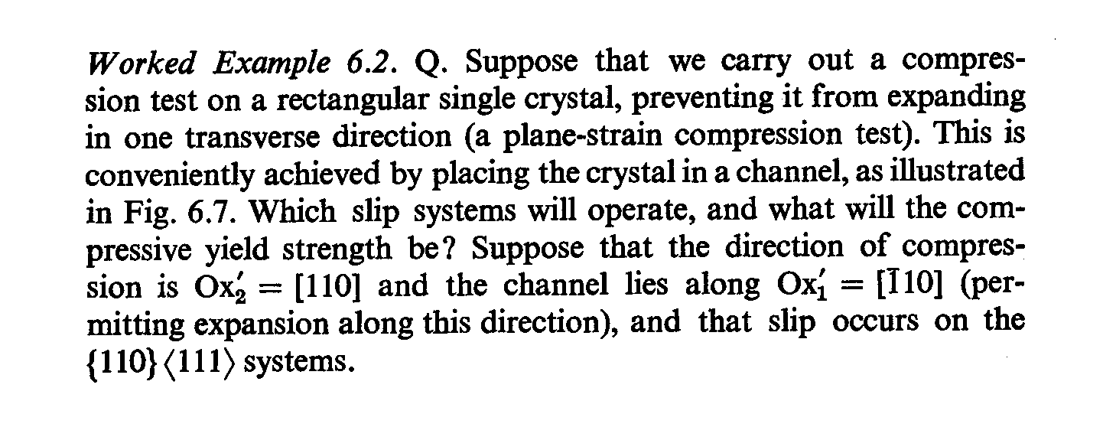
Multi-slip:
Worked Example
Objective is to find the multislip stress state and slip distribution for a crystal undergoing plane strain compression.
Quantities in the sample frame have primes (‘) whereas quantities in the crystal frame are unprimed; the “a” coefficients form an orientation matrix (“g”).
[Reid]

Slide 71
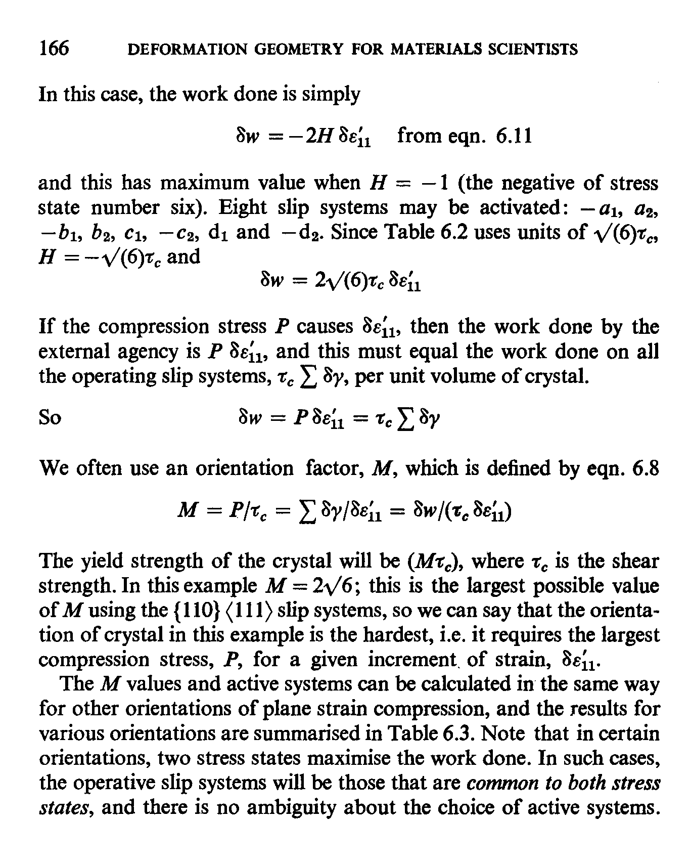
Multi-slip:
Worked Example
This worked example for a bcc multislip case shows you how to apply the maximum work principle to a practical problem.
Important note: Reid chooses to divide the work increment by the value of δε₁₁. This gives a different answer than that obtained with the von Mises equivalent strain (e.g. in LApp). Instead of 2√6 as given here,
the answer is √3√6 = √18.
In this example from Reid, “orientation factor” = Taylor factor = M

Slide 72
Bishop-Hill Method: pseudo-code
How to calculate the Taylor factor using the Bishop-Hill model?
  Identify the orientation of the crystal, g;
  Transform the strain into crystal coordinates;
  Calculate the work increment (product of one of the discrete multislip stress states with the transformed strain tensor) for each one of the 28 discrete stress states that allow multiple slip;
  The operative stress state is the one that is associated with the largest magnitude (absolute value) of work increment, dW;
  The Taylor factor is then equal to the maximum work increment divided by the von Mises equivalent strain.
Note: given that the magnitude (in the sense of the von Mises equivalent) is constant for both the strain increment and each of the multi-axial stress states, why does the Taylor factor vary with orientation?! The answer is that it is the dot product of the stress and strain that matters, and that, as you vary the orientation, so the geometric relationship between the strain direction and the set of multislip stress states varies.

Slide 73
Multiple Slip - Slip System Selection
So, now you have figured out what the stress state is in a grain that will allow it to deform. What about the slip rates on each slip system?!
The problem is that neither Taylor nor Bishop & Hill say anything about which of the many possible solutions is the correct one!
For any given orientation and required strain, there is a range of possible solutions: in effect, different combinations of 5 out of 6 or 8 slip systems that are loaded to the critical resolved shear stress can be active and used to solve the equations that relate microscopic slip to macroscopic strain.
Modern approaches use the physically realistic strain rate sensitivity on each system to “round the corners” of the single crystal yield surface. This will be discussed in later slides in the section on Grain Reorientation.
Even in the rate-insensitive limit discussed here, it is possible to make a random choice out of the available solutions.
The review of Taylor’s work that follows shows the “ambiguity problem” as this is known, through the variation in possible re-orientation of an fcc crystal undergoing tensile deformation (shown on a later slide).
Bishop J and Hill R (1951) Phil. Mag. 42 414; ibid. 1298

Slide 74
Taylor’s Rigid Plastic Model for Polycrystals: Hardening and Reorientation of the Lattice
This was the first model to describe, successfully, the stress-strain relation as well as the texture development of polycrystalline metals in terms of the single crystal constitutive behavior, for the case of uniaxial tension.
Taylor used this model to solve the problem of a polycrystalline FCC material, under uniaxial, axisymmetric tension and show that the polycrystal hardening behavior could be understood in terms of the hardening of a single type of slip system. In other words, the hardening rule (a.k.a. constitutive description) applies at the level of the individual slip system.

Slide 75
Taylor model basis
If large plastic strains are accumulated in a body then it is unlikely that any single grain (volume element) will have deformed much differently from the average (as previously discussed). The reason for this is that any accumulated differences lead to either a gap or an overlap between adjacent grains. Overlaps are exceedingly unlikely because most plastic solids are essentially incompressible. Gaps are simply not observed in ductile materials, though they are admittedly common in marginally ductile materials. This then is the "compatibility-first" justification, i.e. that the elastic energy cost for large deviations in strain between a given grain and its matrix are very large.

Slide 76
Uniform strain assumption
dE^{local} = dE^{global},
where the global strain is simply the average strain and the local strain is simply that of the grain or other subvolume under consideration. This model means that stress equilibrium cannot be satisfied at grain boundaries because the stress state in each grain is generally not the same as in its neighbors. It is assumed that reaction stresses are set up near the boundaries of each grain to account for the variation in stress state from grain to grain.

Slide 77
Taylor Model for Polycrystals
In this model, it is assumed that:
The elastic deformation is small when compared to the plastic strain.
Each grain of the single crystal is subjected to the same homogeneous deformation imposed on the aggregate,
Infinitesimal -
deformation
Large -

Slide 78
Taylor Model: Hardening Alternatives
The simplest assumption of all (rarely used in polycrystal plasticity) is that all slip systems in all grains harden at the same rate, h.
The most common assumption (often used in polycrystal plasticity) is that all slip systems in each grain harden at the same rate. In this case, each grain hardens at a different rate: the higher the Taylor factor, the higher the hardening rate (because the larger amount of microscopic slip). The sum i is over all the active slip systems.

Slide 79
Taylor Model: Hardening Alternatives, contd.
The next level of complexity is to allow each slip system to harden as a function of the slip on all the slip systems, where the hardening coefficient may be different for each system. This allows for different hardening rates as a function of how each slip system interacts with each other system (e.g. co-planar, non-co-planar etc.). Note that, to obtain the crss for the j^{th} system (in the i^{th} grain) one must sum up over all the slip system activities.

Slide 80
Taylor Model: Work Increment
Regardless of the hardening model, the work done in each strain increment is the same, whether evaluated externally, or from the shear strains. The average over the stresses in each grain is equivalent to making an average of the Taylor factors (and multiplying by the CRSS.

Slide 81
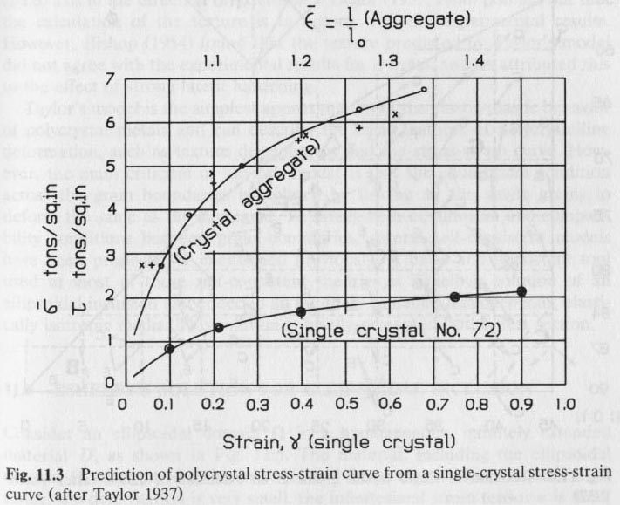
Taylor Model: Comparison to Polycrystal
The stress-strain curve obtained for the aggregate by Taylor in his work is shown in the figure. Although a comparison of single crystal (under multislip conditions) and a polycrystal is shown, it is generally considered that the good agreement indicated by the lines was somewhat fortuitous!
Note:
Circles - computed data
Crosses – experimental data
The ratio between the two curves is the average Taylor factor, which in this case is ~3.1

Slide 82
Taylor’s Rigid Plastic Model for Polycrystals
Another important conclusion based on this calculation, is that the overall stress-strain curve of the polycrystal is given by the expression
Where,
τ(γ) is the critical resolved shear stress (CRSS as a function of the shear strain) for a single crystal, assumed to have a single value;
<M> is an average value of the Taylor factor of all the grains (which changes with strain).
By Taylor’s calculation, for FCC polycrystal metals,

Slide 83
Updating the Lattice Orientation
This section analyzes one approach to computing the change in lattice orientation that results from slip. The number of slip systems is not restricted to any particular value.

Slide 84
Taylor Model: Grain Reorientation
For texture development it is necessary to obtain the total spin for the aggregate. Note that the since all the grains are assumed to be subjected to the same displacement (or velocity field) as the aggregate, the total rotation experienced by each grain will be the same as that of the aggregate. The q introduced here can be thought of as the skew-symmetric counterpart to the Schmid tensor.
Note: “W” denotes spin here, not work done
For uniaxial tension
Then,
Note:

Slide 85
Taylor model: Reorientation: 1
Review of effect of slip system activity:
Symmetric part of the distortion tensor resulting from slip:
Anti-symmetric part of Deformation Strain Rate Tensor (used for calculating lattice rotations, sum over active slip systems):

Slide 86
Taylor model: Reorientation: 2
Strain rate from slip (add up contributions from all active slip systems):
Rotation rate from slip, W^{C}, (add up contributions from all active slip systems):

Slide 87
Taylor model: Reorientation: 3
Rotation rate of crystal axes (W*), where we account for the rotation rate of the grain itself, W^{g}:
Rate sensitive formulation for slip rate in each crystal (solve as implicit equation for stress):
Crystal axes grain slip
= τ^{(s)}

Slide 88
Taylor model: Reorientation: 4
The shear strain rate on each system is also given by the power-law relation (once the stress is determined):
= τ^{(s)}
= τ^{(s)}

Slide 89
Iteration to determine stress state in each grain
An iterative procedure is required to find the solution for the stress state, σ^{c}, in each grain (at each step). Note that the strain rate (as a tensor) is imposed on each grain, i.e. boundary conditions based on strain. Once a solution is found, then individual slipping rates (shear rates) can be calculated for each of the s slip systems. The use of a rate sensitive formulation for yield avoids the necessity of ad hoc assumptions to resolve the ambiguity of slip system selection.
Within the LApp code, the relevant subroutines are SSS and NEWTON

Slide 90
Update orientation: 1
General formula for rotation matrix:
In the small angle limit (cosθ ~ 1, sinθ ~ θ):

Slide 91
Update orientation: 2
In tensor form (small rotation approx.):
R = I + W*
General relations:
ω = 1/2 curl u = 1/2 curl{x-X}
- u := displacement
Ω:= infinitesimal
rotation tensor

Slide 92
Update orientation: 3
To rotate an orientation:
g^{new} = R·g^{old}
= (I + W*)·g^{old},
or, if no “rigid body” spin (W^{g} = 0),
Note: more complex algorithm required for relaxed constraints.

Slide 93
Combining small rotations
It is useful to demonstrate that a set of small rotations can be combined through addition of the skew-symmetric parts, given that rotations combine by (e.g.) matrix multiplication.
This consideration reinforces the importance of using small strain increments in simulation of texture development.

Slide 94
Small Rotation Approximation
Neglect this second
order term for
small rotations

Slide 95
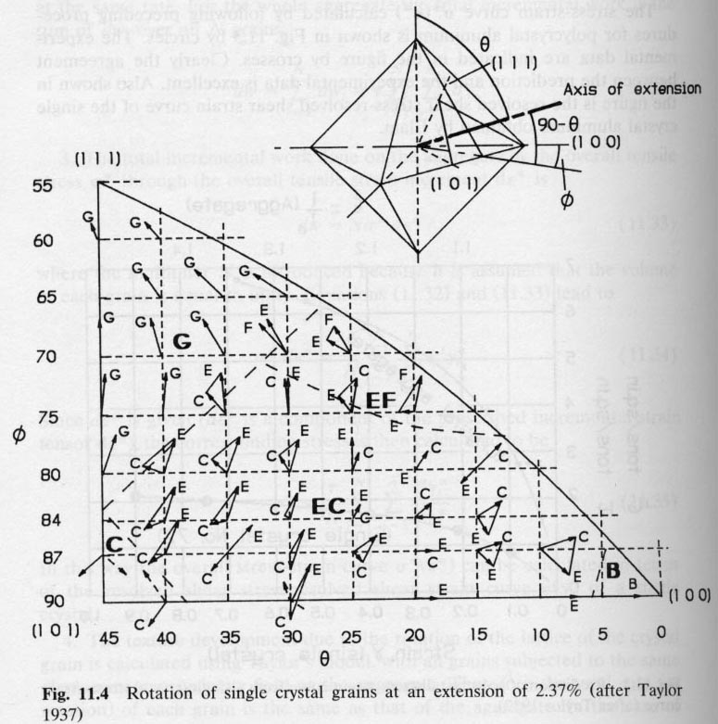
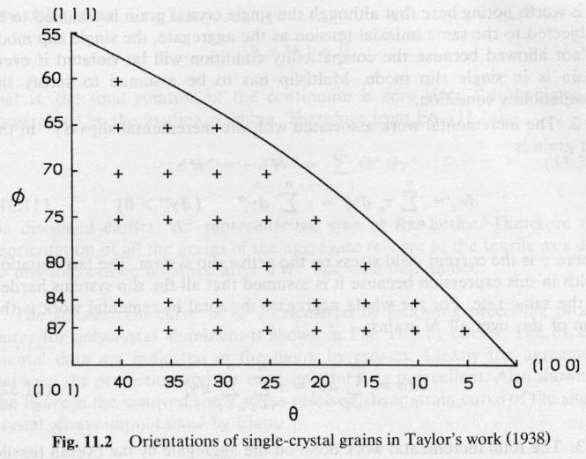
Taylor Model: Reorientation in Tension
Note that these results have been tested in considerable experimental detail by Winther et al. at Risø; although Taylor’s results are correct in general terms, significant deviations are also observed*.
Texture development = mix of <111> and <100> fibers
Initial configuration
Each area within the triangle represents a different operative vertex on the single crystal yield surface
Final configuration, after 2.37% of extension
*Winther G., 2008, Slip systems, lattice rotations and dislocation boundaries, Materials Sci Eng. A 483, 40-6

Slide 96
Final Texture
It is not particularly clear from the previous figure but the Taylor theory (iso-strain) for uniaxial tension in fcc materials predicts that the tensile axis will move towards either the 111 or 100 corner. This means that the final texture is predicted to be a mix of <111> and <100> fibers. This is, in fact, what is observed experimentally.
Contrast this result for the Taylor theory (iso-strain) with that of the single slip situation (previous lecture, iso-stress) in which the tensile axis ends up parallel to 112. Note that this requires two slip systems to be active, the primary and the conjugate. Thus the predicted iso-stress texture is a <112> fiber, which is not what is observed.

Slide 97
Taylor factor: multi-axial stress and strain states
The development given so far needs to be generalized for arbitrary stress and strain states.
Write the deviatoric stress as the product of a tensor with unit magnitude (in terms of von Mises equivalent stress) and the (scalar) critical resolved shear stress, τ_{crss}, where the tensor defines the multiaxial stress state associated with a particular strain direction, D.
S = M(D) τ_{crss}.
Then we can find the (scalar) Taylor factor, M, by taking the inner product of the stress deviator and the strain rate tensor:
S:D = M(D):D τ_{crss} = M τ_{crss}.
See p 336 of [Kocks] and the lecture on the Relaxed Constraints Model.

Slide 98
Summary
Multiple slip is very different from single slip.
Multiaxial stress states are required to activate multiple slip.
For cubic metals, there is a finite list of such multiaxial stress states (56).
Minimum (microscopic) slip (Taylor) is equivalent to maximum work (Bishop-Hill).
Solution of stress state still leaves the “ambiguity problem” associated with the distribution of (microscopic) slips; this is generally solved by using a rate-sensitive solution.

Slide 99
Supplemental Slides

Slide 100
Self-Consistent Model
Following slides contain information about a more sophisticated model for crystal plasticity, called the self-consistent model.
It is based on a finding a mean-field approximation to the environment of each individual grain.
This provides the basis for the popular code VPSC made available by Tomé and Lebensohn (Lebensohn, R. A. and C. N. Tome (1993). "A Self-Consistent Anisotropic Approach for the Simulation of Plastic-Deformation and Texture Development of Polycrystals - Application to Zirconium Alloys." Acta Metallurgica et Materialia 41 2611-2624).

Slide 101
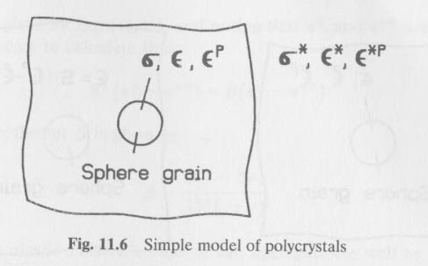
Kröner, Budiansky and Wu’s Model
Taylor’s Model
- compatibility across grain boundary
- violation of the equilibrium between the grains
Budiansky and Wu’s Model
- Self-consistent model
- Ensures both compatibility and equilibrium
conditions on grain boundaries
- Based on the Eshelby inclusion model

Slide 102
Kröner, Budiansky and Wu’s Model
The model:
Khan & Huang
Sphere (single crystal grain) embedded in a homogeneous polycrystal matrix.
The grain and the matrix are elastically isotropic.
Can be described by an elastic stiffness tensor C, which has an inverse C⁻¹.
The matrix is considered to be infinitely extended.
The overall quantities and are considered to be the average values of the local quantities and over all randomly distributed single crystal grains.

Slide 103
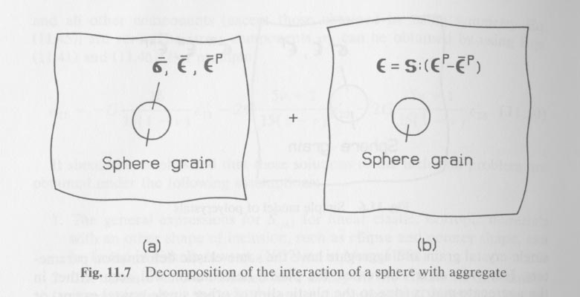
Kröner, Budiansky and Wu’s Model
The initial problem can be solved by the following approach
1 – split the proposed scheme into two other as follows
Khan & Huang

Slide 104
Kröner, Budiansky and Wu’s Model
1.a – The aggregate and grain are subject to the overall quantities and . In this case the total strain is given by the sum of the elastic and plastic strains:
Khan & Huang

Slide 105
Kröner, Budiansky and Wu’s Model
1.b – The sphere
has a stress-free transformation strain, ε’, which originates in the difference in plastic response of the individual grain from the matrix as a whole.
has the same elastic property as the aggregate
is very small when compared with the aggregate (the aggregate is considered to extend to infinity)
Notes:
Consider the “stress-free transformation strain” to be the same as an EIGENSTRAIN. Where this comes from is the difference in plastic behavior between the grain itself and the matrix.

Slide 106
Kröner, Budiansky and Wu’s Model
The strain inside the sphere due to the elastic interaction between the grain and the aggregate caused by is given by
Where,
S is the Eshelby tensor (not a compliance tensor) for a sphere inclusion in an isotropic elastic matrix

Slide 107
Kröner, Budiansky and Wu’s Model
Then the actual strain inside the sphere is given by the sum of the two representations (1a and 1b) as follows
Given that,
where
It leads to

Slide 108
Kröner, Budiansky and Wu’s Model
From the previous equation, it follows that the stress inside the sphere is given by

Slide 109
Kröner, Budiansky and Wu’s Model
In incremental form
where

Slide 110
Equations
Slide 31: \tau = m_{11} \sigma_{11} + m_{22} \sigma_{22} + m_{33} \sigma_{33} + ( m_{12} + m_{21}) \sigma_{12} \\+ (m_{13} + m_{31}) \sigma_{13} +(m_{23} + m_{32}) \sigma_{23}
SLIDE 34:
\begin{bmatrix} \tau_1& \\ \tau_2& \\ \tau_3& \\ \tau_4& \\ \tau_5& \end{bmatrix}= \begin{bmatrix} m_{11}^{(1) } & m_{22}^{(1) } & m_{33}^{(1)} & (m_{23}^{(1)}+m_{32}^{(1)}) & (m_{13}^{(1)}+m_{31}^{(1)}) & (m_{12}^{(1)}+m_{21}^{(1)})
\\ m_{11}^{(2)} & m_{22}^{(2)} & m_{33}^{(2)} & (m_{23}^{(2)}+m_{32}^{(2)}) & (m_{13}^{(2)}+m_{31}^{(2)}) & (m_{12}^{(2)}+m_{21}^{(2)}) \\ m_{11}^{(3)} & m_{22}^{(3)} & m_{33}^{(3)} & (m_{23}^{(3)}+m_{32}^{(3)}) & (m_{13}^{(3)}+m_{31}^{(3)}) & (m_{12}^{(3)}+m_{21}^{(3)}) \\
m_{11}^{(4)} & m_{22}^{(4)} & m_{33}^{(4)} & (m_{23}^{(4)}+m_{32}^{(4)}) & (m_{13}^{(4)}+m_{31}^{(4)}) & (m_{12}^{(4)}+m_{21}^{(4)}) \\
m_{11}^{(5)} & m_{22}^{(5)} & m_{33}^{(5)} & (m_{23}^{(5)}+m_{32}^{(5)}) & (m_{13}^{(5)}+m_{31}^{(5)}) & (m_{12}^{(5)}+m_{21}^{(5)}) \end{bmatrix}
\begin{bmatrix} \sigma_{11} \\ \sigma_{22} \\ \sigma_{33} \\ \sigma_{23} \\ \sigma_{13} \\ \sigma_{12} \end{bmatrix}
\begin{bmatrix} \tau_1& \\ \tau_2& \\ \tau_3& \\ \tau_4& \\ \tau_5& \end{bmatrix}= \begin{bmatrix} m_{22}^{(1) } & m_{33}^{(1)} & (m_{23}^{(1)}+m_{32}^{(1)}) & (m_{13}^{(1)}+m_{31}^{(1)}) & (m_{12}^{(1)}+m_{21}^{(1)}) \\ m_{22}^{(2)} & m_{33}^{(2)} & (m_{23}^{(2)}+m_{32}^{(2)}) & (m_{13}^{(2)}+m_{31}^{(2)}) & (m_{12}^{(2)}+m_{21}^{(2)}) \\ m_{22}^{(3)} & m_{33}^{(3)} & (m_{23}^{(1)}+m_{32}^{(3)}) & (m_{13}^{(3)}+m_{31}^{(3)}) & (m_{12}^{(3)}+m_{21}^{(3)}) \\
m_{22}^{(5)} & m_{33}^{(4)} & (m_{23}^{(1)}+m_{32}^{(4)}) & (m_{13}^{(4)}+m_{31}^{(4)}) & (m_{12}^{(4)}+m_{21}^{(4)}) \\
m_{22}^{(5)} & m_{33}^{(5)} & (m_{23}^{(5)}+m_{32}^{(5)}) & (m_{13}^{(5)}+m_{31}^{(5)}) & (m_{12}^{(5)}+m_{21}^{(5)}) \end{bmatrix}
\begin{bmatrix} -C \\ B \\ F \\ G \\ H \end{bmatrix}
\begin{bmatrix} -C \\ B \\ F \\ G \\ H \end{bmatrix} = \begin{bmatrix} m_{22}^{(1) } & m_{22}^{(2)} & m_{22}^{(3)} & m_{22}^{(4)} & m_{22}^{(5)} \\ m_{33}^{(1)} & m_{33}^{(2)} & m_{33}^{(3)} & m_{33}^{(4)} & m_{33}^{(5)} \\ (m_{23}^{(1)}+m_{32}^{(1)}) & (m_{23}^{(2)}+m_{32}^{(2)}) & (m_{23}^{(3)}+m_{32}^{(3)}) & (m_{23}^{(4)}+m_{32}^{(4)}) & (m_{23}^{(5)}+m_{32}^{(5)}) \\ (m_{13}^{(1)}+m_{31}^{(1)}) & (m_{13}^{(2)}+m_{31}^{(2)}) & (m_{13}^{(3)}+m_{31}^{(3)}) & (m_{13}^{(4)}+m_{31}^{(4)}) & (m_{13}^{(5)}+m_{31}^{(5)}) \\ (m_{12}^{(1)}+m_{21}^{(1)}) & (m_{12}^{(2)}+m_{21}^{(2)}) & (m_{12}^{(3)}+m_{21}^{(3)}) & (m_{12}^{(4)}+m_{21}^{(4)}) & (m_{12}^{(5)} +m_{21}^{(5)})\end{bmatrix} \begin{bmatrix} \tau_1& \\ \tau_2& \\ \tau_3& \\ \tau_4& \\ \tau_5& \end{bmatrix}
SLIDE 37
\delta w = \sigma_{11} d\epsilon_{11} + \sigma_{22} d\epsilon_{22} +\sigma_{33} d\epsilon_{33} + 2 \sigma_{12} d\epsilon_{12} + 2 \sigma_{13} d\epsilon_{13} +
2 \sigma_{23} d\epsilon_{23}
SLIDE 53: \Omega_{ij}^{(\alpha)} = \frac{1}{2} (b_i&^{(\alpha)} n_j&^{(\alpha)} - b_j&^{(\alpha)} n_i&^{(\alpha)} )

