Slide 1


27-750
Texture, Microstructure & Anisotropy
Lecture 1:
Introduction
Prof. A. D. Rollett
Updated 11th January, 2016

Slide 2
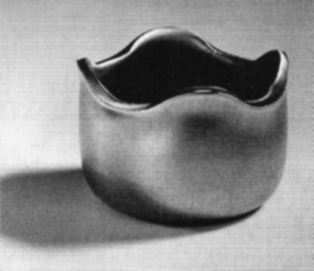
Anisotropy Example:
Drawn Aluminum Cup with Ears
Figure shows example of a cup that has been deep drawn. The plastic anisotropy of the aluminum sheet resulted in non-uniform deformation and “ears.”
Randle, Engler, p.340

Slide 3
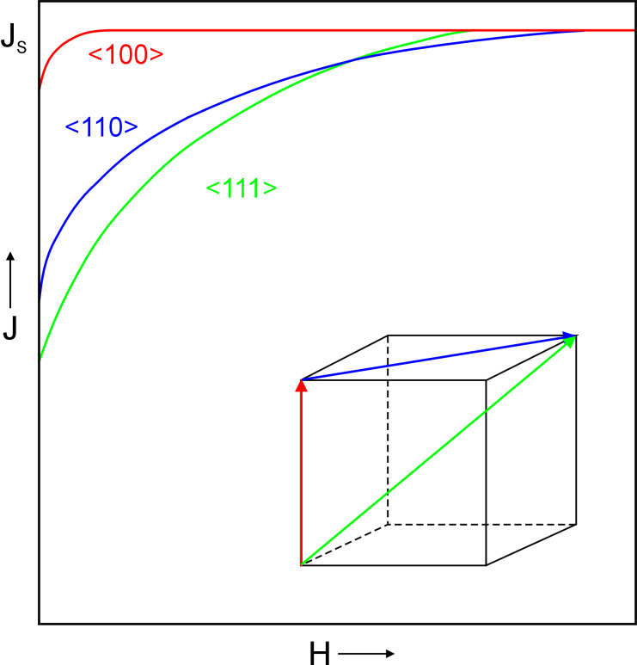
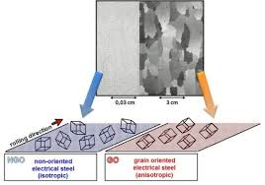
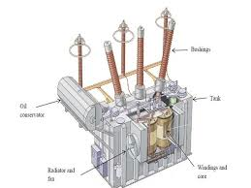
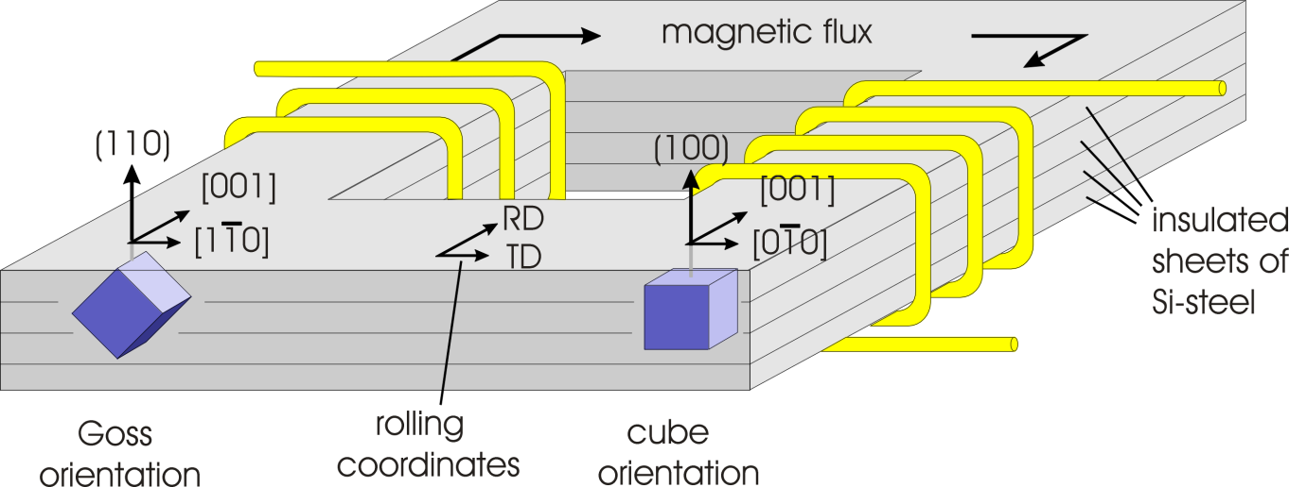
Transformer Steel
Dierk-raabe.com
S. Zaefferer, MPIE
Shanghaimetal.com

Slide 4
Books, Links
Course Textbook: U.F. Kocks, C. Tomé, and H.-R. Wenk, Eds. (1998). Texture and Anisotropy, Cambridge University Press, Cambridge, UK, ISBN 0-521-79420-X. This is now available as a paperback. Relevant chapters: 1, 2, 3, 4, 5, 6, 7, 8. Note that there is more detail in each chapter than we will have time to cover.
V. Randle and O. Engler, Texture Analysis: Macrotexture, Microtexture & Orientation Mapping (2000), Gordon & Breach
B.D. Cullity,(1978) Elements of X-ray Diffraction.
H.-J. Bunge, (1982) Texture Analysis in Materials Science.
A. Morawiec, Orientations and Rotations (2003), Springer.
Recent review of Texture & Anisotropy: Wenk, H. R. and P. Van Houtte (2004). “Texture and anisotropy” Reports On Progress In Physics 67 1367-1428.
Old, but still useful overview: I.L. Dillamore and W.T. Roberts (1965) “Preferred orientation in wrought and annealed metals”, Metall. Rev., 10, 271-380.
http://aluminium.matter.org.uk/content/html/eng/default.asp?catid=100&pageid=1039432491
http://code.google.com/p/mtex/

Slide 5
Course Objectives
The objective of this course is to provide you with the tools to understand and quantify various kinds of texture and to solve problems that involve texture and anisotropy.
A secondary objective is to acquaint students with various useful tools for analysis such as MTEX (in Matlab), popLA, the R package for statistics, VPSC.
Despite the crystalline nature of most useful and interesting polycrystalline materials, crystal alignment and the associated anisotropy is often ignored. Yet, most properties are sensitive to the anisotropy of the crystals that comprise the material. Therefore microstructure should include crystallographic orientation (“texture”).
Very few departments teach a course on this topic.

Slide 6
Lecture List (abbreviated)
1. Introduction
2. Texture components, Euler angles
3. X-ray diffraction
4. Symmetry (crystal, sample)
5. Euler angles, variants
6. Calculation of ODs from pole figure data, popLA
7. Orientation distributions
8. Microscopy, SEM, electron diffraction
9. Texture in bulk materials
10. EBSD/OIM
11. Misorientation at boundaries
12. Continuous functions for ODs
13. Stereology
14. Grain growth, normal & abnormal
15. Graphical representation of ODs
16. Volume fractions, Fiber textures
17. Select statistical methods
18. Rodrigues vectors, quaternions
19. CSL boundaries
20. GB properties
21. 5-parameter descriptions of GBs
22. Herring’s relations
23. Elastic, plastic anisotropy
24. Taylor/Bishop-Hill model
25. Yield Surfaces
26. Orientation Relationships (“OR”) between phases

Slide 7
What is microstructure?
Microstructure originally meant the structure inside a material that could be observed with the aid of a microscope.
In contrast to the crystals that make up materials, which can be approximated as collections of atoms in specific packing arrangements (crystal structure), microstructure is the ensemble of defects in the material.
What defects are we interested in? Interfaces (both grain boundaries and interphase boundaries), dislocations (and other line defects), and point defects.
Since the invention of prefixes for units, the micrometer (1 µm) happens to correspond to the wavelength of light. Light, obviously is used to form images in a light/optical microscope. Thus microstructure has come to be accepted as those elements of structure with length scale of order 1 µm.
Since we commonly examine materials in the microscope, we generally observe grains as crystallites in polycrystals, separated by grain boundaries.

Slide 8
Texture: Quantitative Description
Three (3) parameters needed to describe the orientation [of a crystal relative to the embedding body or its environment] because it is a 3D rotation.
Most common description: 3 [rotation] Euler angles
Other descriptions include: (orthogonal) rotation matrix (or axis transformation matrix), Rodrigues-Frank vector, unit quaternion.
A common misunderstanding: although 2 parameters are sufficient to describe the position of a vector, a 3D object such as a crystal requires 3 parameters to describe its (angular) position
Most experimental methods [X-ray pole figures included] do not measure all 3 angles, so orientation distribution must be calculated. An orientation distribution is just a probability distribution: it tells you how likely you are to find a crystal that has the orientation specified by the coordinates (Euler angles) of the point
Measurement of diffraction patterns from individual locations (Laue, EBSD) do provide a complete orientation i.e. all three Euler angles.

Slide 9
Euler Angles, Animated
e’₃=
e₃=Z_{sample}=ND
3rd position (final)
[001]
2nd position
[010]
z_{crystal}=e₃’’’
=
φ₁
1st position
y_{crystal}=e₂’’’
e”₃
e”₂
φ₂
e’₂
e₂=Y_{sample}=TD
Crystal
RD
x_{crystal}=e₁’’’
[100]
Φ
TD
e’₁
=e”₁
e₁=X_{sample}=RD
Sample Axes

Slide 10
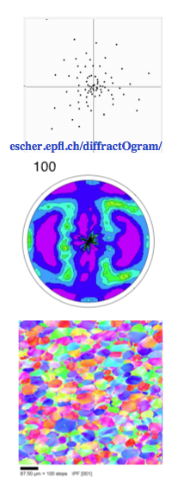
Texture Measurement
The best method of quantifying texture is to measure the crystallographic orientation of a statistically representative set of grains in the material.
Historically, this was a tedious exercise with Laue X-ray diffractograms that was only possible on single crystals or very coarse polycrystals.
The standard characterization method for texture (crystallographic preferred orientation) in an average sense is to measure x-ray pole figures.
A more modern technique is that of Orientation Imaging Microscopy (OIM), which is readily available in the SEM (and much used here at CMU). This Electron Back Scatter Diffraction (EBSD) technique produces a map of orientation measured on a regular grid of points (pixels).
Now synchrotron x-rays can measure 3D orientation maps non-destructively

Slide 11
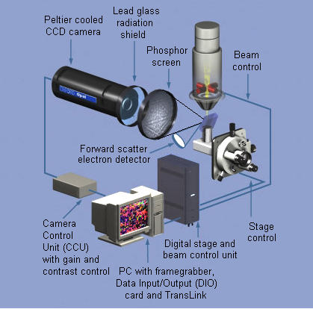
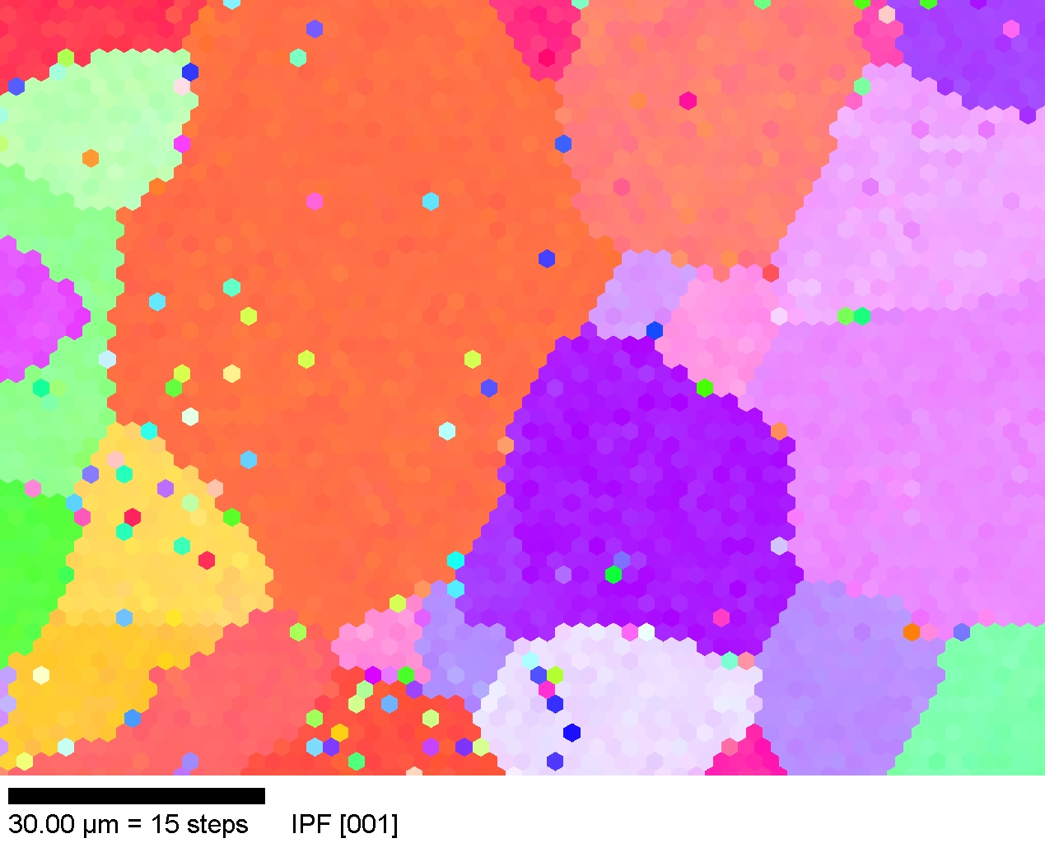
Electron Back-Scatter Diffraction (EBSD/OIM)
Schematic diagram of a typical EBSD system (Oxford INCA)
Provides (2D regular grid) maps of crystal orientation from polished cross-sections
Adams, B., K. Kunze and S. I. Wright (1993) Metall. Mater. Trans. 24A: 819

Slide 12
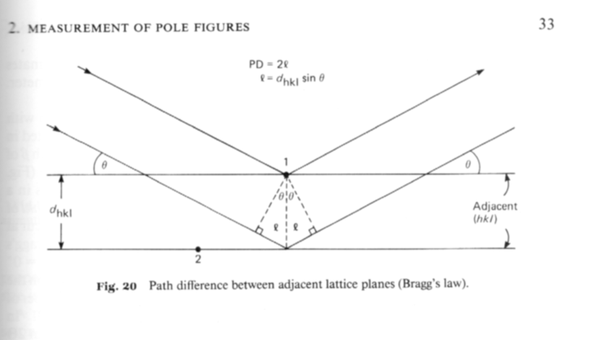
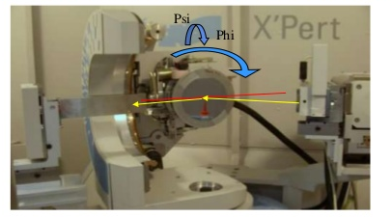
PF apparatus
From Wenk’s chapter on texture measurement in the Kocks-Tomé-Wenk book.
Fig. 20: showing path difference between adjacent planes leading to destructive or constructive interference. The path length condition for constructive interference is the basis for the Bragg equation:
2 d sinθ = n λ
Fig. 21: pole figure goniometer for use with x-ray sources. Also shown is a photo of an X’Pert system (such as used at CMU).
[Kocks]
[Cernacescu, Panalytical]

Slide 13
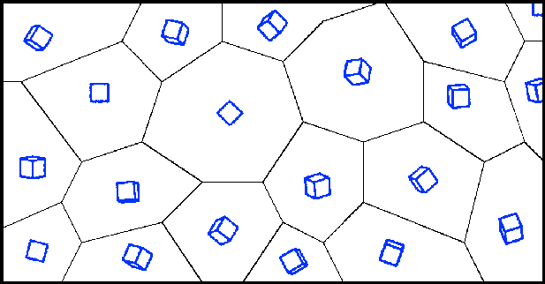
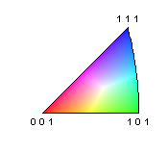
Grain Orientation
Polycrystal with no texture,
i.e. no crystallographic preferred orientation
Think of each crystallite as a separate lattice orientation, represented by a cube
110
100
102
102
103
221
100
123
110
111
221
111
112
122
100
Colors are often used in images to denote the orientation: in “inverse pole figure maps”, the color is based on the crystal direction that is parallel to a sample direction (often the surface normal); in the absence of texture, all colors are present

Slide 14
Grain Orientation Texture
Polycrystal with orientation texture
[111]
Axial texture: in this example (often observed in rolled sheets of bcc metals), most grains have a <111> // sample normal
Grain colors correlate with orientation; here the strong color indicates a strong texture

Slide 15
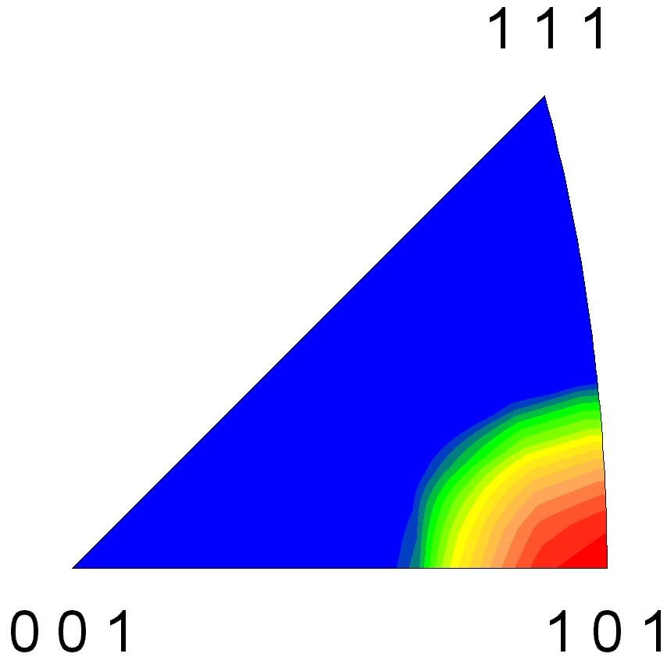
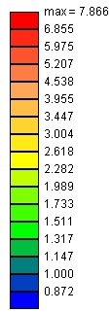
Grain Orientation Distribution
Axial texture is easily represented on an inverse pole figure
MRD
Strong axial <110> texture
8.0
4.0
2.0
1.0
Data from a Si-Fe alloy that has a strong Goss texture component, which means crystals aligned with <100>//RD and <011>//ND
Notes:
Stopped here on Mon, 23 Aug 10.

Slide 16
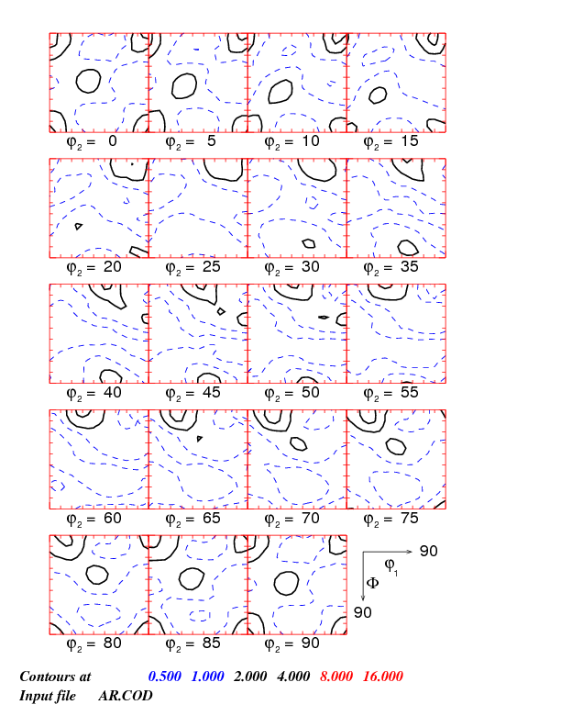
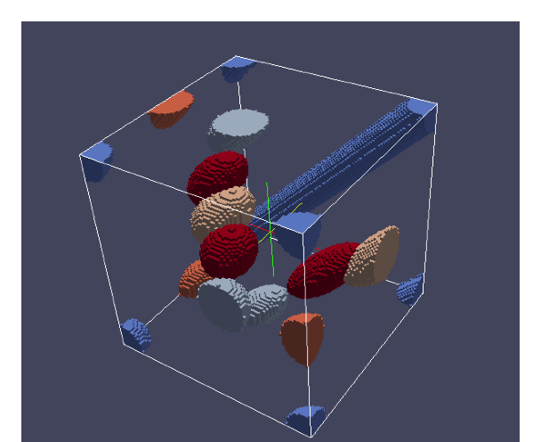
ODF: 3-D vs. sections
ODF gives the density of grains having a particular orientation.
ODF
Orientation Distribution Function f (g)
Cube {100}<001> (0, 0, 0)
Goss
{110}<001>
(0, 45, 0)
Brass
{110}<-112>
(35, 45, 0)
Φ
φ₁
g = {φ₁, Φ, φ₂}
φ₂
Slide from Lin Hu [2011]

Slide 17
Geometry of {hkl}<uvw>
Sample to Crystal (primed)
Miller index
notation of
texture component
specifies direction
cosines of crystal
directions // to
sample axes. Form the second axis from the cross-product of the 3rd and 1st axes.
^
^
e’₃
e₃ // (hkl)
[001]
[010]
^
e’₂
^
^
e₂ // t
^
e₁ // [uvw]
^
t = hkl x uvw
e’₁
[100]

Slide 18
Form matrix from Miller Indices
Basic idea: we can construct the complete rotation matrix from two known, easy to determine columns of the matrix. Knowing that we have columns rather than rows is a consequence of the sense of rotation, which is equivalent to the direction in which the axis transformation is carried out.

Slide 19
Matrix with Bunge Angles
A = Z₂XZ₁ =
[uvw]
(hkl)

Slide 20
Matrix, Miller Indices
The general Rotation Matrix, a, can be represented as in the following:
Here the Rows are the direction cosines for the 3 crystal axes, [100], [010], and [001] expressed in the sample coordinate system (pole figure).
[100]_{xtal} direction
[010]_{xtal} direction
[001]_{xtal} direction

Slide 21
What is a Grain Boundary?
Grain boundaries control the process of recrystallization. This suggests that it is worth knowing something about the structure and properties of boundaries.
Regular atomic packing disrupted at the boundary by the change in lattice directions.
In most crystalline solids, a grain boundary is very thin (one/two atoms).
Disorder (broken bonds) unavoidable for geometrical reasons; therefore large excess free energy. This interfacial energy is analogous to the surface tension in a soap bubble (and many investigations on grain growth have been made with soap froths).

Slide 22
Crystal orientations at a g.b.
g_{B}
TJ_{ACB}
g_{D}
∆g=g_{B}g_{A}⁻¹
g_{C}
g_{A}
TJ_{ABC}
Here, “g” represents a crystal orientation, e.g. as a rotation matrix.
Also, “TJ” means triple junction; ∆g represents misorientation i.e. difference in orientation across a grain boundary (also a rotation).

Slide 23
Grain Boundary Structure
High angle boundaries: can be thought of as two crystallographic planes joined together (with or w/o a twist of the lattices).
Low angle boundaries are arrays (walls) of dislocations: this is particularly simple to understand for pure tilt boundaries [to be explained]. From this comes the Read-Shockley model for grain boundary energy (as a function of misorientation).
Grain boundary energy increases monotonically with misorientation as a consequence of increasing dislocation density.
Transition: in the range 10-15°, the dislocation structure changes to a high angle boundary structure.
The grain boundary mobility increases abruptly at this transition in structure.

Slide 24
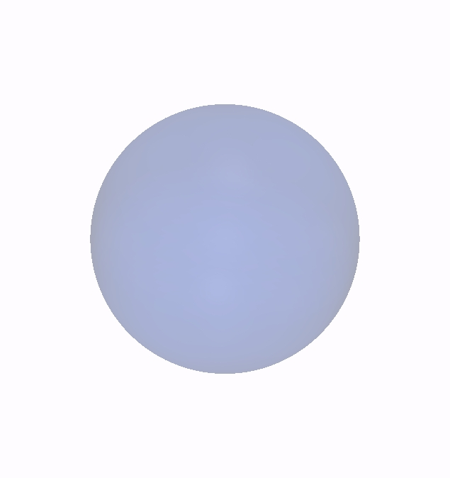
Rodrigues vectors
Any rotation may therefore be characterized by an axis r and a rotation angle α about this axis
R(r, α )
“axis-angle” representation
The RF representation instead scales r by the tangent of α/2
BEWARE: Rodrigues vectors do NOT obey the parallelogram rule (because rotations are NOT commutative!) See slide 16…
Note semi-angle

Slide 25
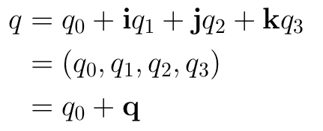

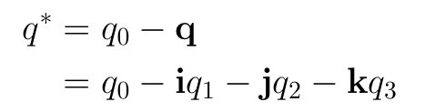
Quaternions: Yet another representation of rotations
What is a quaternion?
A quaternion is first of all an ordered set of four real numbers q₀, q₁, q₂, and q₄.
Here, i, j, k are the familiar unit vectors that correspond to the x-, y-, and z-axes, resp.
Scalar part
Vector part
Addition of two quaternions and multiplication of a quaternion by a real number are as would be expected of normal four-component vectors.
Magnitude of a quaternion:
Conjugate of a quaternion:

Slide 26
Tensor Transformation Rule
There are quantities known as tensors. In order for a quantity to “qualify” as a tensor it has to obey the axis transformation rule.
The idea is that a tensor quantity represents something physical that is the same regardless of which frame of reference (i.e. set of axes) one uses to describe it. Examples are electric current (vector), stress (2nd rank tensor), elastic modulus (4th rank tensor).
The transformation rule defines relationships between transformed (quantities with a prime) and untransformed tensors (no prime) of various ranks.
The Einstein convention applies, i.e. a repeated index represents a summation over that index. In the 1st example below, “V” means a vector and the index “j” is repeated (on the RHS) and therefore one performs a sum on that index.
Vector: V’_{i} = a_{ij}V_{j}
2nd rank T’_{ij} = a_{ik}a_{jl}T_{kl}
3rd rank T’_{ijk} = a_{il}a_{jm}a_{kn}T_{lmn}
4th rank T’_{ijkl} = a_{im}a_{jn}a_{ko}a_{lp}T_{mnop}
This rule is a critical piece of information, which you must know how to use.

Slide 27
Axis Transformations for Texture
We now define how we use axis transformation to deal with problems involving texture (crystal orientation).
The standard definition of crystal orientation is with an orientation matrix, g, which is exactly equivalent to the “a” on the previous slide. We associate a unit vector, ê, with each axis in both the crystal and the sample reference frames. The orientation matrix is then calculated as follows.
g_{ij} = ê_{crystal} • ê_{sample}
Given any quantity expressed in sample coordinates, it can be transformed (converted, if you like) to crystal coordinates by using the version of the tensor transformation rule that is appropriate to the rank of the tensor concerned (previous slide).
To transform in the opposite direction (crystal to sample), one uses the same transformation but reverses the sense of rotation. This sounds complicated but it’s actually simple because one uses the transpose, g^{T}. That we can do this is because of the properties of rotations, which can be described by orthogonal matrices.

Slide 28
Axis Transformation: Examples
As a practical illustration, consider where the color in the inverse pole figure map comes from.
What we want is to know which crystal axis is parallel to the surface normal of a sample. By convention, we assume a perfectly flat surface and set the sample z-axis perpendicular to the surface (with the x- and y-axes in the plane).
This means that we need to transform a vector, V=[0,0,1], where the numbers are the x, y & z coefficients of the vector. (Vectors are 1st rank tensors).
Using a Matlab routine called EulerToMatrix_ADR.m, we can obtain an orientation matrix from a set of three Euler angles (to be explained at a later date), specified as [0.,54.5,45.].
Orientation Matrix: =
--1--> --2--> --3-->
--1--> 0.70711 0.41062 0.57567
--2--> -0.70711 0.41062 0.57567
--3--> 0 -0.81412 0.58070
By performing matrix multiplication of this matrix with the vector (treat it as a column vector), V = [0, 0, 1], we obtain the new, transformed vector, V’ = [0.576, 0.576, 0.581] .
In relation to the color maps already shown, this transformed vector is very close to [111], which means that we would color that grain blue.

Slide 29
Stereology
Stereology provides us with relationships between quantities that are measurable on a plane section, and 3D quantities that we may need.
Two quantities that are (relatively) easily measured are the number of points per unit length along a line, P_{L}, and the number of points per unit area, P_{A}. This nomenclature can be extended to volumes (V) and surfaces (S).
Quantities per unit volume have to be calculated (table).
In this course, we will describe a few key results from stereology, mainly motivated by the need to be able to measure grain size. No derivations of the equations will be carried out.

Slide 30
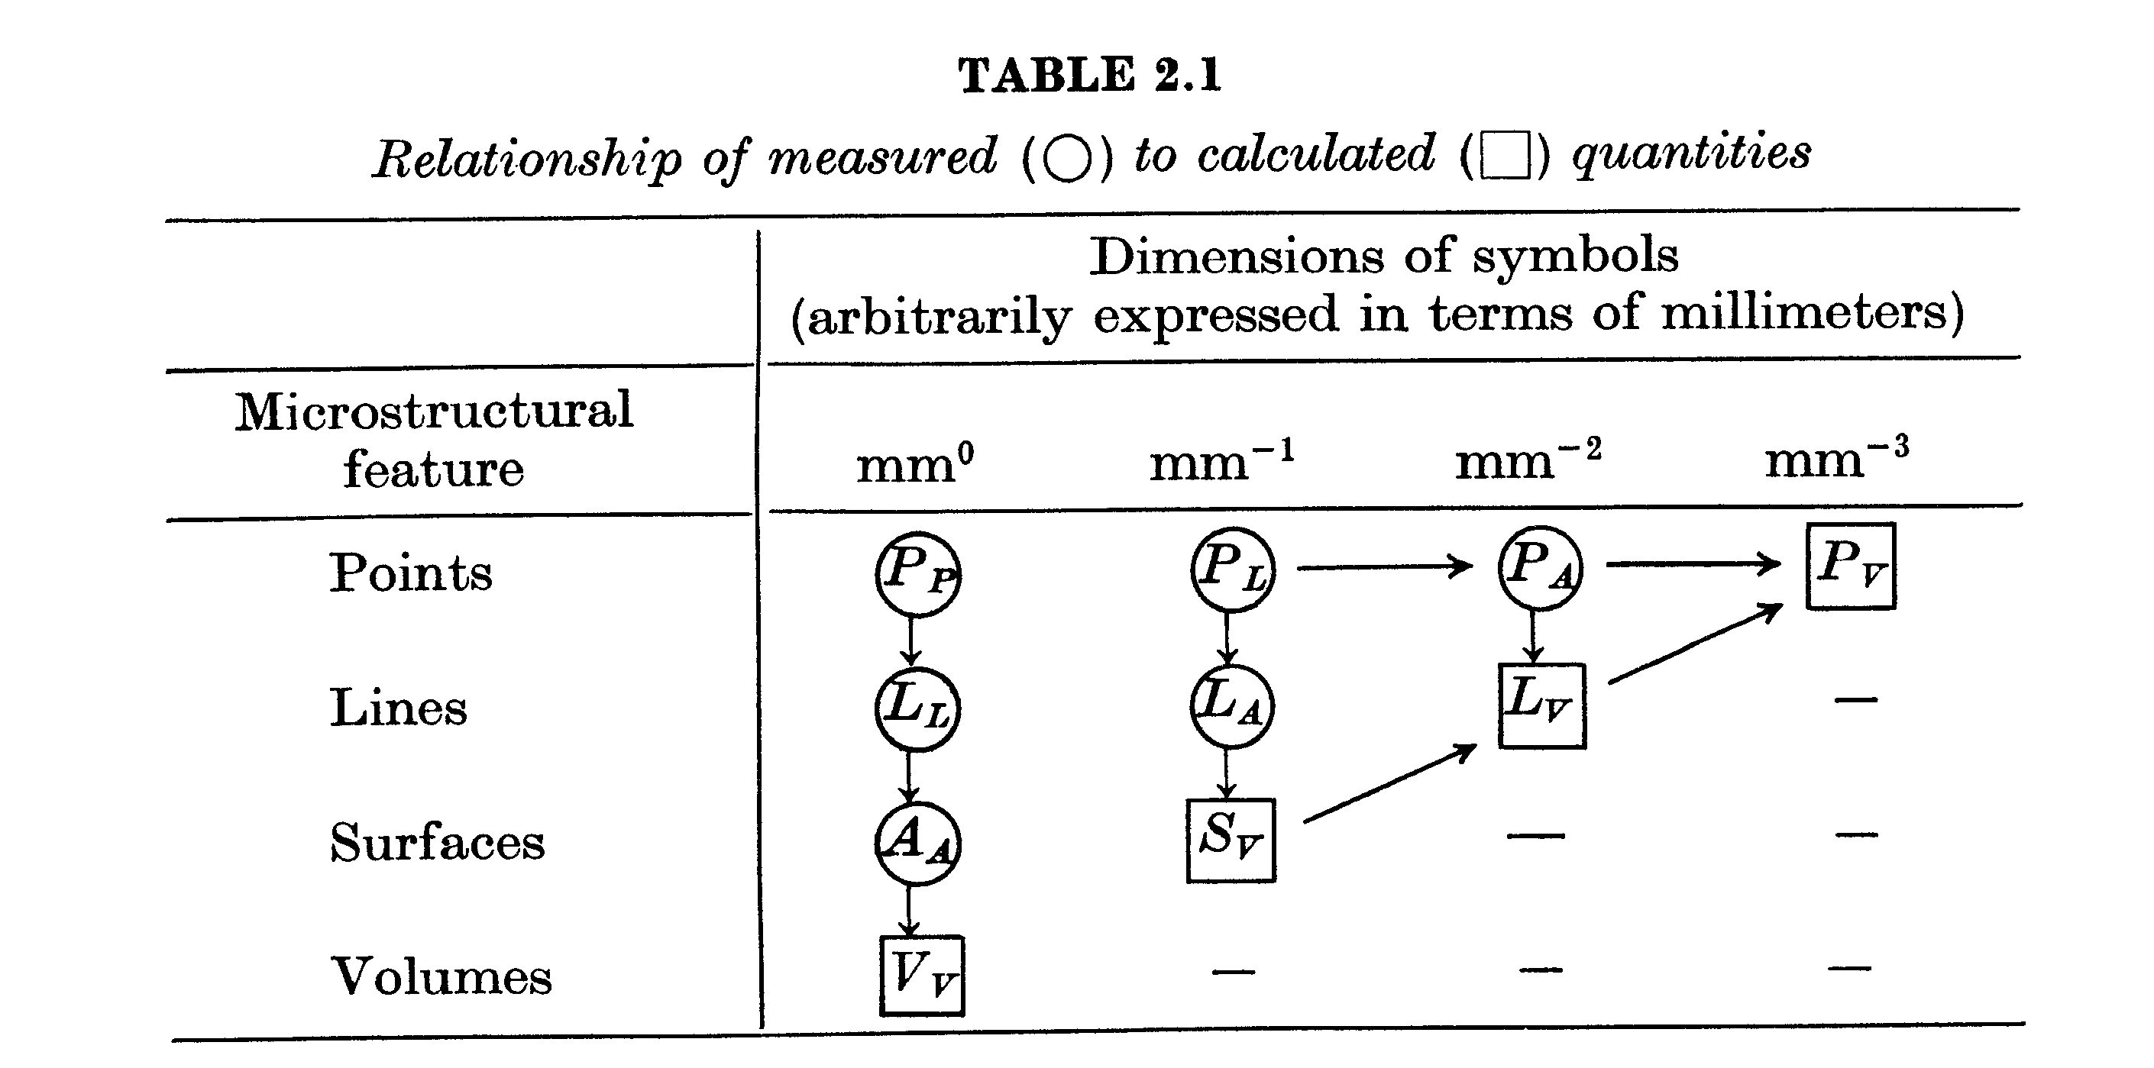
Basic relationships in stereology
Underwood, Quantitative Stereology, 1971, Addison-Wesley

Slide 31
Statistics: R package: 1
Step 1: install the R package
Step 2: visit http://www.r-tutor.com/
Many steps: advance through each page on this website to learn how to work with quantities in R
Pages of particular interest for data:
  http://www.r-tutor.com/r-introduction/matrix
  http://www.r-tutor.com/r-introduction/data-frame
  http://www.r-tutor.com/r-introduction/data-frame/data-import

Slide 32
Statistics: R package: 2
Pages of particular interest for basic statistics:
  http://www.r-tutor.com/elementary-statistics/quantitative-data
Read in ReducedDiameter_StagDerrJih_Cu_A-O.csv using read.csv; this is a set of values of individual grain sizes from measurements on thin films (see Donegan et al. Acta mater. 2013). Use barm=read.csv with header=F (there is no header line).
First convert the data to a row using, e.g., nbarm=barm($V1); then plot with hist(nbarm). Amuse yourself by playing with the colors!
Process the data by following the steps that you find at www.r-tutor.com to bin the data (the “cut” function) and produce a histogram of the frequency distribution with (arbitrarily) 30 bins.

Slide 33
Statistics: R package: 3
Now make a relative frequency histogram
Here’s a quick way to do it:
  > barm.table = hist(nbarm, breaks = 30, plot=F)
  > barm.table$counts = barm.table$counts/sum(barm.table$counts)
  > plot(barm.table)
  > plot(barm.table, col = colors)
Now follow the r-tutor method

Slide 34
Statistics: R package: 4
Now let’s make a probability density function
Remember what how PDF is defined?!
Easy way: hist(nbarm.relative, freq= F, col = colors, main = "Prob. Density of Barmak Grain Sizes")

Slide 35
Statistics: R package: 5
Now let’s make a cumulative distribution function (CDF)
Quick way:
  > barm.cdf = ecdf(nbarm)
  > plot(barm.cdf, col = "blue" , lwd = 3)
And, of course, there is lots more to figure out, e.g., how to investigate whether distributions are normal, log-normal etc.

Slide 36
Statistics: R package: 6
Now we need to think about 2-D and 3-D distributions, because that’s what we have to deal with in texture, and in many other applications.
For a simple, quick approach, visit http://www.r-bloggers.com/5-ways-to-do-2d-histograms-in-r/
Try generating some random points as suggested and use the hist2d function, for which you will have to install the gplots package.
  x <- rnorm(mean=1.5, 5000)
  > y <- rnorm(mean=1.8, 5000)
  > df = data.frame(x,y)
  > summary(df)
  x y
  Min. :-2.0417 Min. :-1.724
  1st Qu.: 0.7981 1st Qu.: 1.141
  Median : 1.4693 Median : 1.818
  Mean : 1.4787 Mean : 1.819
  3rd Qu.: 2.1545 3rd Qu.: 2.491
  Max. : 4.6917 Max. : 5.367
  > library(ggplot2)
  > p = ggplot(df, aes(x,y))
  > h3 = p + stat_bin2d()
  > qplot(x,y,data=df, geom = 'bin2d')
  # Color housekeeping
  library(RColorBrewer)
  rf <- colorRampPalette(rev(brewer.pal(11,'Spectral')))
  r <- rf(32)
  # Add colouring and change bins
  h3 <- p + stat_bin2d(bins=25) + scale_fill_gradientn(colours=r)
  h3

Slide 37
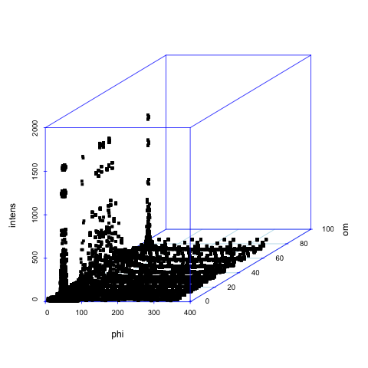
3d scatterplot
http://www.r-bloggers.com/3d-scatter-plot-using-r/
  pf = read.table('SmallIN100.dat', header=F)
  d2<-data.frame(phi=c(pf[,1]), om=c(pf[,2]), intens=c(pf[,3]))
  attach(d2)
  scatterplot3d(phi, om,intens, angle = 30, col.axis="blue", col.grid="lightblue", pch = 15, cex.symbols=0.7)

Slide 38
Last thoughts
http://www.r-bloggers.com/creating-3d-geographical-plots-in-r-using-rgl/
Making true 3D contour plots is more involved …
Pole figure data, for example, are usually a set of diffraction intensities at regular angular intervals in latitude and longitude.
Plotting them is complicated by the need for spherical projections (later in the course).
Data from EBSD is scattered data and has to be binned in 3D orientation space before it can be plotted.
Any texture data has to be appropriately normalized but this procedure does not give PDFs.

Slide 39
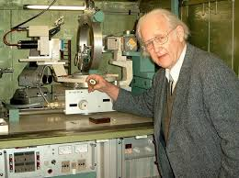
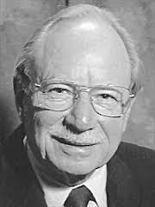
People
The development of the field is greatly indebted to Hans J. Bunge who passed away in 2006.
His textbook (translated from the German original), Texture Analysis in Materials Science, is a very useful reference and many of his suggestions are only just now being developed into useful tools
The textbook that we use here, Texture & Anisotropy, was largely written by Fred Kocks (one of my advisors).

Slide 40
Summary
Objectives of the course have been described.
Examples of ‘typical’ microstructures described.
Methods for measuring grain size described: first method is based on linear intercepts. Second method is based on average area on the cross section.

Slide 41
Supplemental Slides
The following slides provide supplemental information, e.g. to explain what stereology is.

