Slide 1
27-750, Advanced Characterization and Microstructural Analysis: Texture and its Effect on Anisotropic Properties
Tony (A.D.) Rollett, Carnegie Mellon Univ.
Last revised: 12th Jan. 2014

Slide 2
Microstructure-Properties Relationships
Processing
Performance
Design
Microstructure
Properties

Slide 3
Course Objective
Many courses deal with microstructure-properties relationships, so what is special about this course?!
Despite the crystalline nature of most useful and interesting materials, crystal alignment and the associated anisotropy is ignored. Yet, most properties are sensitive to anisotropy. Therefore microstructure should include crystallographic orientation (“texture”).
The objective of this course is to provide you with the tools to understand and quantify various kinds of texture and to solve problems that involve texture and anisotropy.

Slide 4
Questions
Examples of questions that you should be able to answer with the knowledge and skills provided by this course:
What is a “fiber texture”?
Why is a <111>//ND texture ideal for deep drawing?
Why is obtaining a <111> fiber texture difficult in FCC metals, but straightforward in BCC?
Why are intensity values generally much higher in the Orientation Distribution than in the corresponding pole figures?
How is it possible to recover the full 5-parameter distribution of grain boundary character from a plane section and yet one can only measure 4 out of 5 parameters for an individual boundary in that plane section?
What do the units “Multiples of a Random/Uniform Distribution” mean? Why are distributions scaled differently in texture than in statistics?
Why was solving the problem of calculating an orientation distribution from pole figures a fundamental advance in texture analysis? Hint: think about the parameterization of rotations.
Why do we need 3 (and only 3) parameters to describe a rotation?
How do Miller indices, orthogonal matrices, Rodrigues parameters and quaternions relate to each other?
What is epitaxy? What is apotaxy (not apoplexy!)?
Why do textures develop during plastic deformation?

Slide 5
Encyclopedia Britannica, texture
Texture refers to the physical makeup of rock--namely, the size, shape, and arrangement (packing and orientation) of the discrete grains or particles of a sedimentary rock. Two main natural textural groupings exist for sedimentary rocks: clastic (or fragmental) and nonclastic (essentially crystalline). Noncarbonate chemical sedimentary...

Slide 6
Websters’ Dictionary, fabric
Main Entry: fab·ric
Pronunciation: 'fa-brik
Function: noun
Etymology: Middle French fabrique, from Latin fabrica workshop, structure
Date: 15th century
1 a : STRUCTURE, BUILDING b : underlying structure : FRAMEWORK <the fabric of society>
2 : an act of constructing : ERECTION; specifically : the construction and maintenance of a church building
3 a : structural plan or style of construction b : TEXTURE, QUALITY -- used chiefly of textiles c : the arrangement of physical components (as of soil) in relation to each
other
4 a : CLOTH 1a b : a material that resembles cloth
5 : the appearance or pattern produced by the shapes and arrangement of the crystal grains in a rock

Slide 7
Websters’ Dictionary, anisotropy
Main Entry: an·iso·trop·ic
Pronunciation: "a-"nI-s&-'trä-pik
Function: adjective
Date: 1879: exhibiting properties with different values when measured in different directions <an anisotropic crystal>
- an·iso·trop·i·cal·ly /-pi-k(&-)lE/ adverb
- an·isot·ro·py /-(")nI-'sä-tr&-pE/ also an·isot·ro·pism /-"pi-z&m/ noun

Slide 8
People
The development of the field is greatly indebted to Hans J. Bunge who passed away in 2006.
His textbook (translated from the German original), Texture Analysis in Materials Science, is a very useful reference and many of his suggestions are only just now being developed into useful tools

Slide 9
Microstructure
Conventional Approach: grain structure, phase structure (qualitative, image based), emphasizes interfaces and boundaries between phases.
Quantitative (conventional): grain size, aspect ratio(s), particle size, phase connectivity.
Modern Quantitative: (probability) distributions of orientation of crystal axes (relative to a reference frame) of crystals or boundaries between crystals. Properties calculated from distributions and/or microstructures with orientation included.

Slide 10
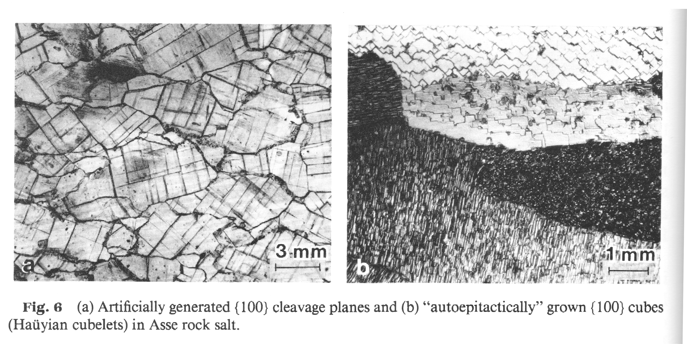
Microstructure with Crystal Directions
Note cleavage planes within each grain: a natural indicator of crystallographic directions in a geological material.

Slide 11
Why study texture?
Many examples exist of materials engineered to have a specific texture in order to optimize performance (single crystal turbine blades, transformer steel, magnetic thin films…).
Control of texture achievable through control of processing but many challenges remain.

Slide 12
Texture examples
Example 1. Transformer Steel
Example 2. Anisotropic particles (whiskers) of hydroxy-apatite (HA) in polyethylene (PE)
Example 3. Earing in Deep Drawing of Cups: see slides on forming of Beer Cans
Example 4. Anisotropy of Fatigue Properties in Aerospace Al
Example 5. Effect of Grain Boundary Character on Pb Electrodes in Lead-Acid Batteries: see slides on grain boundaries and grain boundary engineering (GBE)

Slide 13
Example 1: Transformer Steel
1935 : Goss first published his work on high permeability silicon steels.
The most commonly used material as the soft magnetic material for transformer laminations is a highly oriented albeit polycrystalline 3%Si steel; in other words, the material is almost a single crystal.
"Goss orientation" has a <110> direction normal to the sheet and a <001> parallel to the rolling direction.
Aligns the softest magnetic direction with the direction of magnetization. Thus transformers made from the textured sheet exhibit lower electrical losses.
Processing relies on a secondary recrystallization step in which all grains in a fine, primary recrystallized structure are pinned by second phase particles while the Goss grains grow to consume the entire volume.
Not clearly understood what differences in grain boundary character at the perimeter of the growing Goss grains provides them with the ability to grow at the expense of the general population.

Slide 14
Example 2: HA particles in PE
The figure shows (a) Spherical hydroxyapatite particles (b) Whisker hydroxyapatite particles (c) Size and frequency of the hydroxyapatite particles.
Y. Zhang, K.E. Tanner, N. Gurav, and L. Di Silvio: In vitro osteoblastic response to 30 vol% hydroxyapatite polyethylene composite. J Biomed Mater Res A. 2007 May;81(2):409-17.

Slide 15
Eg 2, contd.: HA particles in PE
The figure shows (a) An XRD orientation comparison of whisker hydroxyapatite particles and random powder (b) An XRD orientation comparison of spherical hydroxyapatite particles and random powder [Zhang et al.]. Texture is inferred from the difference between the measured powder pattern and the pattern expected for a randomly oriented material (from the powder diffraction file). This is typical in the literature as a purely qualitative measure of texture.

Slide 16
Texture in HA in bone: refs
X-ray Pole Figure Analysis of Apatite Crystals and Collagen Molecules in Bone - all 3 versions, N Sasaki - Calcified Tissue International, 1997 - Springer
… figure analysis of mineral nanoparticle orientation in individual trabecula of human vertebral bone - all 6 versions, D Jaschouz, O Paris, P Roschger, HS Hwang, P … - Journal of Applied Crystallography, 2003 - dx.doi.org
Crystal alignment of carbonated apatite in bone and calcified tendon: results from quantitative … - all 4 versions, HR Wenk, F Heidelbach - Bone, 1999 - Elsevier
Pole figures of the orientation of apatite in bones - all 3 versions, JP Nightingale, D Lewis - Nature, 1971 - nature.com, Pole Figures of the Orientation of Apatite in Bones. ... THE orientation of the apatite and collagen in bone was first considered in this work because of its ...
Orientation of apatite in single osteon samples as studied by pole figures, A Ascenzi, E Bonucci, P Generali, A Ripamonti, N … - Calcified Tissue International, 1979 - Springer
Bone Marrow Is a Reservoir of Repopulating Mesangial Cells during Glomerular Remodeling - all 4 versions, T Ito, A Suzuki, E Imai, M Okabe, M Hori - Journal of the American Society of Nephrology, 2001 - jasn.org
Quantitative texture analysis of small domains with synchrotron radiation X-rays, F Heidelbach, C Riekel, HR Wenk - logo, 1999 - dx.doi.org

Slide 17
Connections
Crystals are anisotropic.
A collection of crystals (a polycrystal) is therefore anisotropic unless all possible orientations are present.
Almost any processing of a material changes and biases the crystal orientations, leading to texture development.
Anisotropy can be taken advantage of; therefore it makes sense to engineer (control, design) the texture of a material.

Slide 18
Books, Links
Course Textbook: U.F. Kocks, C. Tomé, and H.-R. Wenk, Eds. (1998). Texture and Anisotropy, Cambridge University Press, Cambridge, UK, ISBN 0-521-79420-X. This is now available as a paperback. Relevant chapters: 1, 2, 3, 4, 5, 6, 7, 8. Note that there is more detail in each chapter than we will have time to cover.
V. Randle and O. Engler, Texture Analysis: Macrotexture, Microtexture & Orientation Mapping (2000), Gordon & Breach
B.D. Cullity,(1978) Elements of X-ray Diffraction.
H.-J. Bunge, (1982) Texture Analysis in Materials Science.
A. Morawiec, Orientations and Rotations (2003), Springer.
Recent review of Texture & Anisotropy: Wenk, H. R. and P. Van Houtte (2004). “Texture and anisotropy” Reports On Progress In Physics 67 1367-1428.
Old, but still useful overview: I.L. Dillamore and W.T. Roberts (1965) “Preferred orientation in wrought and annealed metals”, Metall. Rev., 10, 271-380.
http://aluminium.matter.org.uk/content/html/eng/default.asp?catid=100&pageid=1039432491
http://code.google.com/p/mtex/

Slide 19
Secondary References
Nye, J. F. (1957). Physical Properties of Crystals.
Ohser, J. and F. Mücklich (2000), Statistical Analysis of Microstructures in Materials Science
Reid, C. N. (1973). Deformation Geometry for Materials Scientists
Hosford, W. (1993). The Mechanics of Crystals and Textured Polycrystals, Oxford Engineering Science Series.
Khan, A.S. & S. Huang (1995). Continuum Theory of Plasticity, Wiley.
Sutton, A. P. and R. W. Balluffi (1995). Interfaces in Crystalline Materials
Gottstein, G. and L. S. Shvindlerman (1999). Grain Boundary Migration in Metals
Howe, J.M. (2000). Interfaces in Materials
Underwood, E. E., Quantitative Stereology, (1970)
http://www.msm.cam.ac.uk/phase-trans/texture.html
http://labotex.com/

Slide 20
Topics, Activities in Course: 1
First major topic will be a discussion of orientations and how to represent them quantitatively with Miller indices, matrices, Rodrigues vectors and quaternions.
The next major topic will be x-ray pole figures and their analysis
Every student will obtain his/her own data set
We will first perform a standard analysis using popLA to generate an orientation distribution; then each student will measure their own pole figures and analyze the results
The emphasis will be on development of practical skills followed up by discussion of the underlying concepts
The objective will be to have students be competent and comfortable with pole figure analysis
Each student will report on their analyses as their project presentation at the end of the course.

Slide 21
Topics, Activities: 2
The next major topic will be the analysis of orientation distributions
This will involve understanding the relationships between the different methods of describing orientations, especially Euler angles and Miller indices
We will explore the mathematical aspects of orientation space and the impact of crystal symmetry and sample symmetry
The objective will be to develop students’ quantitative skills with orientation information so that they understand the physical meaning of orientation and texture

Slide 22
Topics, Activities: 3
The next major topic will be to investigate orientation imaging microscopy (OIM) based on automated indexing of electron back scatter diffraction (EBSD) patterns in the scanning electron microscope (SEM)
As with x-ray pole figures, students will first analyze a standard data set and then will make their own scan (if they are not already using EBSD) for further analysis
The objective will be to understand the differences between sampling discrete orientations in a limited area (EBSD) and measurement of the average orientation (distribution) over a large area

Slide 23
Topics, Activities: 4
The next major topic is grain boundaries, whose crystallography can be easily characterized by electron microscopy
We will discuss the physical characteristics of grain boundaries, e.g. energy, mobility, together with the additional complications for symmetry and descriptions (Rodrigues vectors, quaternions)
The objective is for students to become familiar with both the properties of grain boundaries and the methods for quantitative characterization

Slide 24
Topics, Activities: 5
The next major topic is microstructure-property relationships using texture information
Students will explore percolation analysis using electrical conductivity in superconductors as an example of a case where the crystal properties are (strongly) anisotropic and the grain boundaries are also anisotropic.
This exercise will teach students how to develop a computer model on a discrete grid. Programming will be required, although any of the following languages may be used: C, C++, Fortran, VisualBasic.

Slide 25
Topics, Activities: 6
The next major topic is microstructural measurement and stereology. Stereology is the science of obtaining 3D information about microstructure from 2D sections.
Even something as seemingly straightforward as grain size is interesting because we lack quantitative models for the size distribution. GSDs are approximately log-normal, but not exactly.
Stereology is necessary because characterization is most readily available on plane cross sections. Therefore for most microstructures, we need tools to infer the true 3D image from the 2D slices through the material
The objective is to equip students to understand and use stereological tools, e.g. reconstruction of particle size distributions from cross sections, or, use of Microstructure Builder

Slide 26
Topics, Activities: 7
The next major topic is elastic and plastic anisotropy
Plastic deformation in metals (and ceramics at high temperatures, and some polymers) is governed by the motion of line defects - dislocations. The crystallographically restricted slip directions (Burgers vector) and slip planes mean that any degree of texture results in an anisotropic response, e.g. a multi-axial strain from an imposed unixial stress
The objective is to equip students to understand and use polycrystal analysis + modeling, e.g. LApp

Slide 27
Lecture List (abbreviated)
1. Introduction
2. Texture components, Euler angles
3. X-ray diffraction
4. Calculation of ODs from pole figure data, popLA
5. Orientation distributions
6. Microscopy, SEM, electron diffraction
7. Texture in bulk materials
8. EBSD/OIM
9. Misorientation at boundaries
10. Continuous functions for ODs
11. Stereology
12. Graphical representation of ODs
13. Symmetry (crystal, sample)
14. Euler angles, variants
15. Volume fractions, Fiber textures
16. Grain boundaries
17. Rodrigues vectors, quaternions
18. CSL boundaries
19. GB properties
20. 5-parameter descriptions of GBs
21. Herring’s relations
22. Elastic, plastic anisotropy
23. Taylor/Bishop-Hill model
24. Yield Surfaces

Slide 28
Learning Approach
Overall Concept
Phenomenology
Cause-and-Effect
Required Math+Physics+Chemistry
Measurement Technique, data
Analysis
Interpretation

Slide 29
Anisotropy-Texture
Overall Concept: materials behave anisotropically and, regarding texture as part of microstructure, this is another microstructure-property relationship
Phenomenology: anisotropy is correlated with non-random grain alignment.
Cause-and-Effect: the cause of anisotropic behavior is the crystallographic preferred orientation (texture) of the grains in a polycrystal.
4. Required Math: Crystal orientation is described by a (3D) rotation; therefore texture requires distributions of rotations to be described.
Measurement Technique, data: see next page
6. Analysis: 3D distributions have to be reconstructed from 2D projections
7. Interpretation: Although pole figures often provide easily recognized patterns, orientation distributions provide quantitative information.

Slide 30
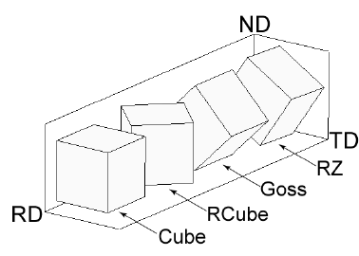
Crystal Orientations – Euler angles
Euler Angles to represent a crystal orientation with respect to samples axes
Sample Axes
<100>
ND
<100>
100
Crystal Axes
{011}
010
{001}
RD
a
Component | RD | ND
Cube | <100> | {001}
Goss | <100> | {011}
Brass | <112> | {110}
Copper | <111> | {112}
001
TD
Rotation 1 (φ₁): rotate sample axes about ND
Rotation 2 (Φ): rotate sample axes about rotated RD
Rotation 3 (φ₂): rotate sample axes about rotated ND
C. N. Tomé and R. A. Lebensohn, Crystal Plasticity, presentation at Pohang University of Science and Technology, Korea, 2009

Slide 31
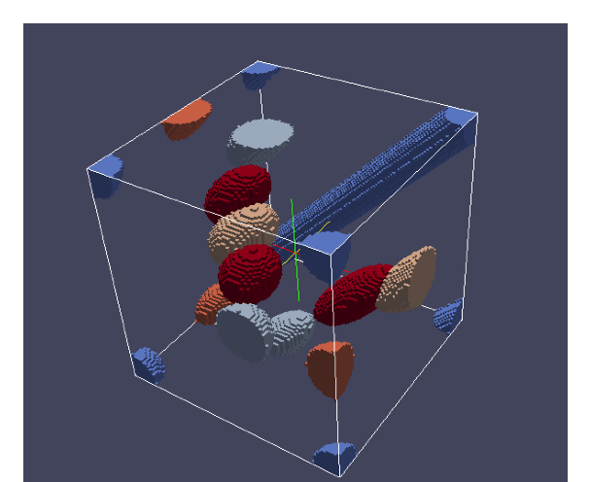
Crystal Orientations – Orientation Space
<100>
Cube {100}<001> (0, 0, 0)
<100>
Goss
{110}<001>
(0, 45, 0)
{011}
Brass
{110}<-112>
(35, 45, 0)
010
{001}
a
Component | Euler Angles (°)
Cube | (0, 0, 0)
Goss | (0, 45, 0)
Brass | (35, 45, 0)
Copper | (90, 45, 45)
001
Rotation 1 (φ₁): rotate sample axes about ND
Rotation 2 (Φ): rotate sample axes about rotated RD
Rotation 3 (φ₂): rotate sample axes about rotated ND
Φ
φ₁
φ₂
Orientation Space
[1] C. N. Tome and R. A. Lebensohn, crystal plasticity, presentation at Pohang University of Science and Technology, Korea, 2009

Slide 32
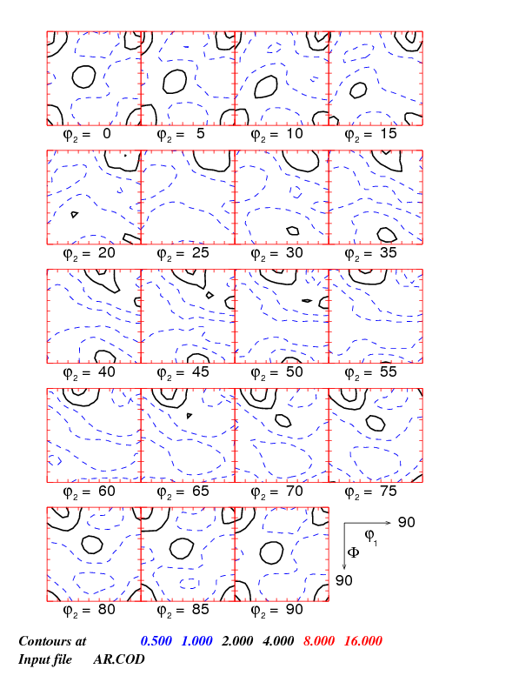
Crystal Orientations – ODF
ODF gives the density of grains having a particular orientation.
ODF
Orientation Distribution Function f (g)
Cube {100}<001> (0, 0, 0)
Goss
{110}<001>
(0, 45, 0)
Brass
{110}<-112>
(35, 45, 0)
Φ
φ₁
g = {φ₁, Φ, φ₂}
φ₂

Slide 33
{111} Pole Figure for Rolled Cu
A {111} pole figure of rolled copper, showing the typical distribution of intensity for moderate to large strains. The rolling plane normal (ND) is perpendicular to the plane of the figure and the rolling (RD) and transverse (TD) directions are vertical and horizontal, respectively, in the plane of the figure. The contours indicate the diffracted intensity in units of Multiples of a Random Density (MRD). High frequencies of <111> directions are found close to the RD, for example, and also inclined 20° away from the ND towards the RD [Hirsch, J. and K. Lücke. Mechanism of Deformation and Development of Rolling Textures in Polycrystalline FCC Metals 1. Description of Rolling Texture Development in Homogeneous CuZn Alloys. Acta Metallurgica, 36 (11): 2863-2882, 1988].

Slide 34
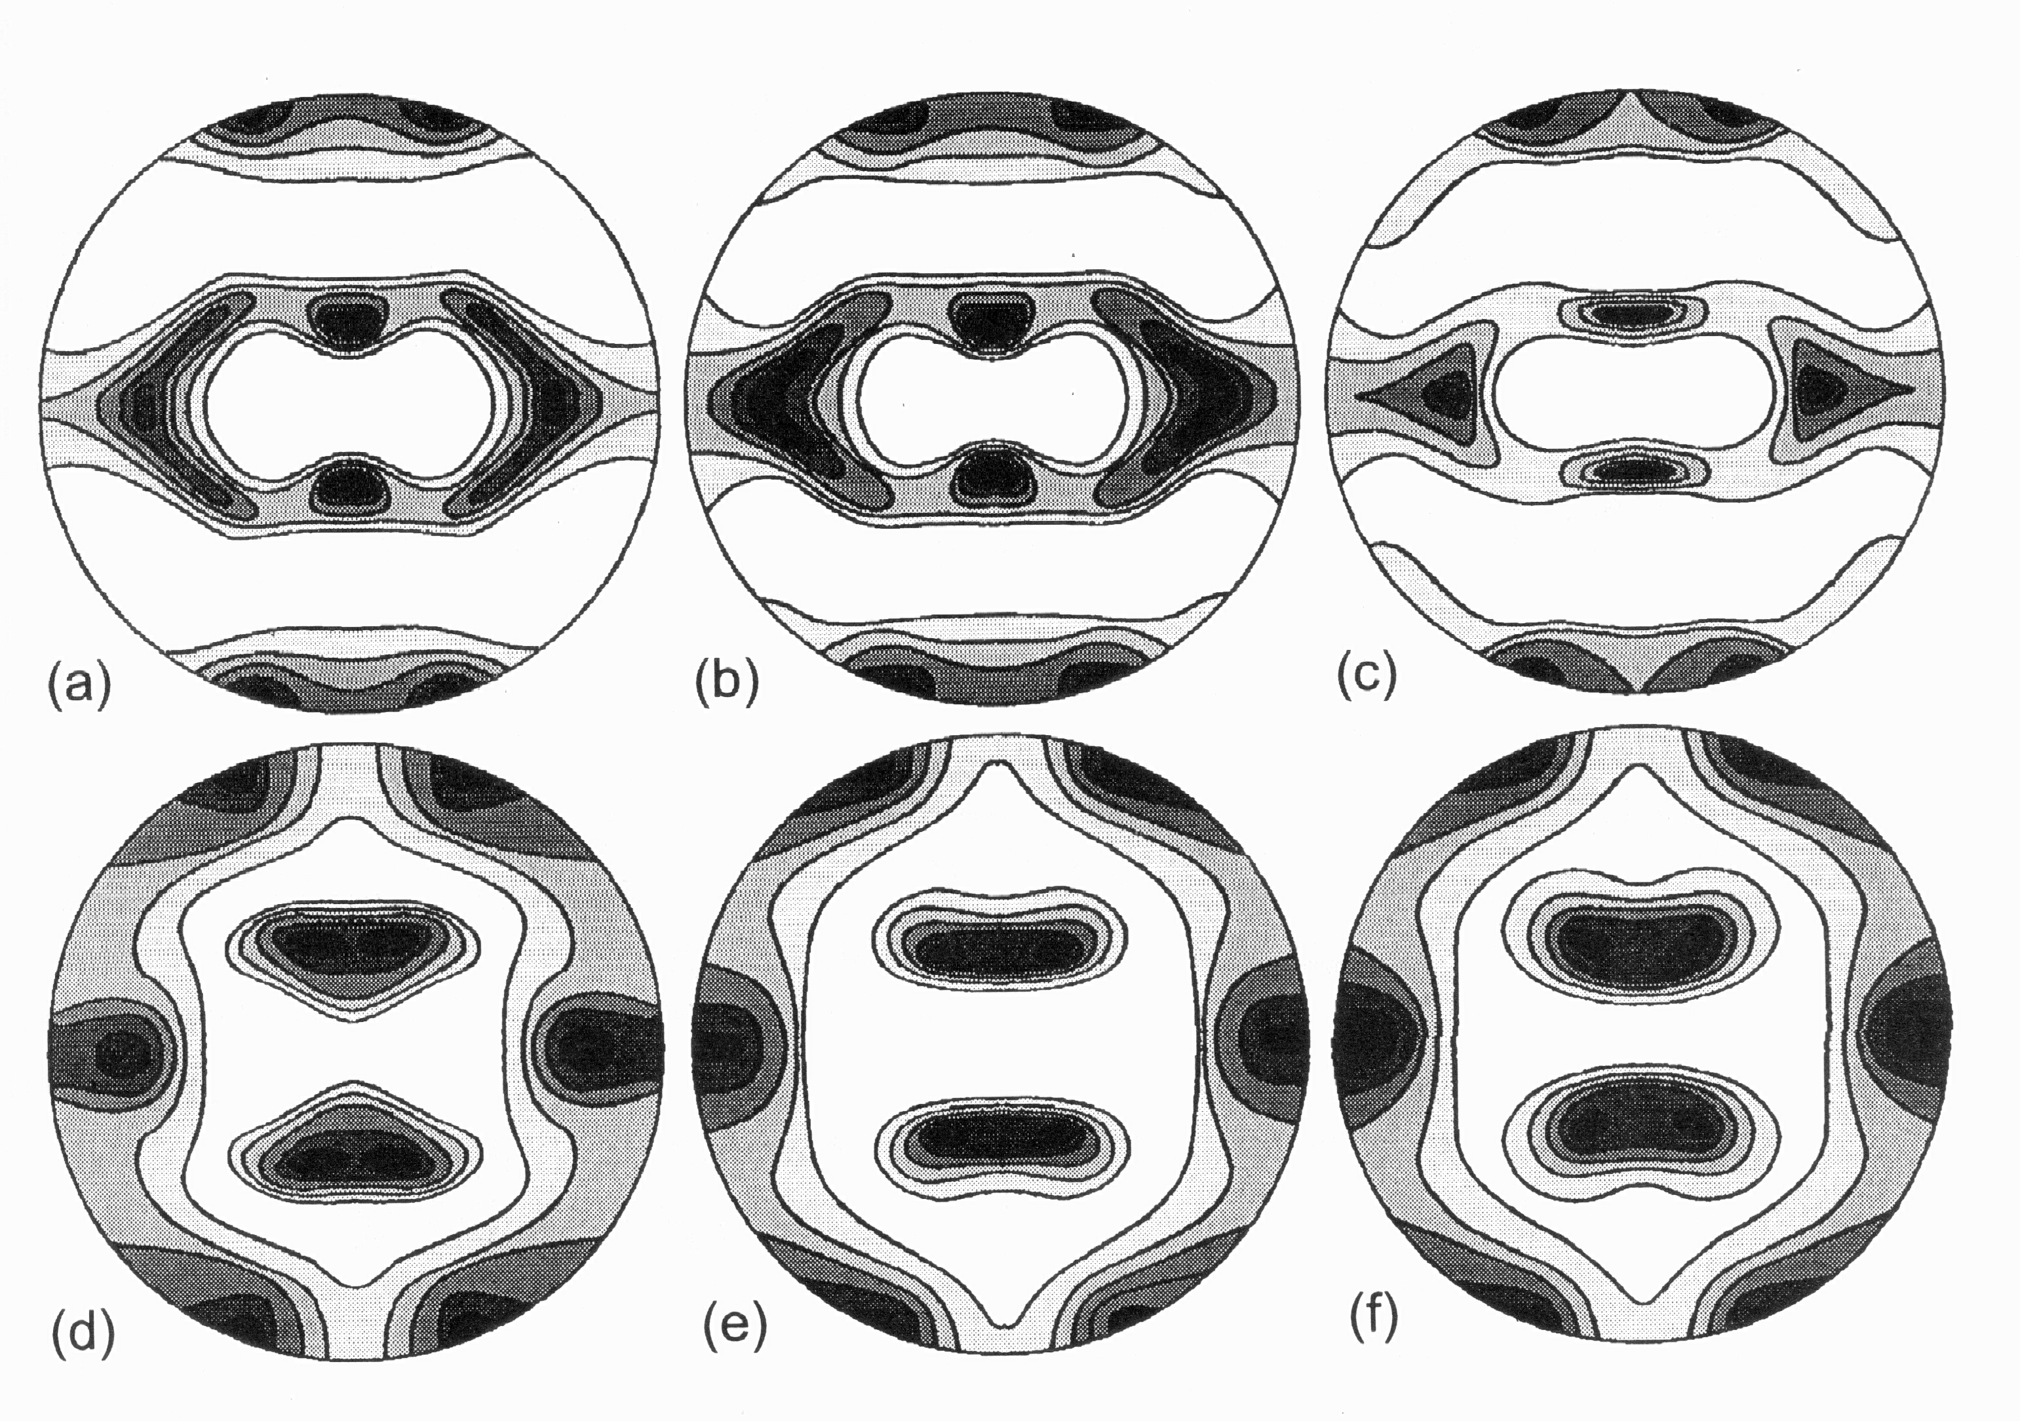
Effect of Alloying: Cu-Zn (brass); the texture transition
Copper
Brass
Check contour levels: 1, 2, 3 …?
Zn content: (a) 0%, (b) 2.5%, (c) 5%, (d) 10%, (e) 20% and (f) 30% [Stephens 1968]

Slide 35
Texture: Quantitative Description
Three (3) parameters needed to describe the orientation [of a crystal relative to the embedding body or its environment] because it is a 3D rotation.
Most common description: 3 [rotation] Euler angles
Other descriptions include: (orthogonal) rotation matrix (or axis transformation matrix), Rodrigues-Frank vector, unit quaternion.
A common misunderstanding: although 2 parameters are sufficient to describe the position of a vector, a 3D object such as a crystal requires 3 parameters to describe its (angular) position
Most experimental methods [X-ray pole figures included] do not measure all 3 angles, so orientation distribution must be calculated. An orientation distribution is just a probability distribution: it tells you how likely you are to find a crystal that has the orientation specified by the coordinates (Euler angles) of the point

Slide 36
Euler Angles, Animated
e’₃=
e₃=Z_{sample}=ND
3rd position (final)
[001]
2nd position
[010]
z_{crystal}=e₃’’’ =
φ₁
1st position
y_{crystal}=e₂’’’
e”₃
e”₂
φ₂
e’₂
e₂=Y_{sample}=TD
Crystal
RD
x_{crystal}=e₁’’’
[100]
Φ
TD
e’₁
=e”₁
e₁=X_{sample}=RD
Sample Axes

Slide 37
Sections through an OD
φ₂ = 5°
φ₂ = 15°
φ₂ = 0°
φ₂ = 10°
Φ
φ₁
φ₂
This example of the texture of rolled copper, taken from Bunge’s book, uses the Bunge definition of the Euler angles so that each possible orientation is defined by (φ₁, Φ, φ₂)

Slide 38
Transformations of Axes
A 3D object such as a crystal requires 3 parameters to describe its (angular) position.
The 3 parameters can be one of a great variety of types, including Euler angles (best known in Materials Science), unit quaternions (popular in robotics), Rodrigues vectors (useful for grain boundaries), or rotation matrices.
Most often in materials science, we prefer to describe properties and field quantities (stress, strain, current, heat flux …) in terms of a convenient local frame.
Since some quantities are most easily described in, say, a frame associated with a specimen (e.g. rolling-transverse-normal) and others (such as single crystal properties) are associated with the local crystal frame, we need a method to transform quantities from one frame to another.
There is a standard procedure known as “transformation of axes” that we will use. Later on we will see that it is implicit in the Tensor Transformation Rule. Mathematicians know this as a “passive rotation”. It is complementary to the “active rotation” commonly used in solid mechanics.
Vector and Tensor Analysis, Borisenko & Tarapov, translated by R. Silverman,Dover 1979.

Slide 39
Scalars, Vectors, Tensors: Notation
General case: three dimensions
Vector: needs 3 numbers or coefficients to quantify its x, y and z components.
Two notations for vectors: “vector-tensor notation” where bold-face implies higher-than-scalar nature; “component notation” where a suffix(-es) show how many coefficients are needed.
Vector: either b or b_{i},i∈{1,2,3}, or, i∈{x,y,z}.
2nd rank tensor: either T or T_{ij}, i,j∈{1,2,3}
Advantage of vector-tensor notation is that the equations work (or, are valid) in any reference frame. By contrast, when component notation is used, the actual values of the coefficients depend on which reference frame is used.
If you see subscripts attached to a quantity, it is (almost always) a tensor and the Einstein summation convention is assumed. The Einstein summation convention says that a repeated index (on the RHS) implies summation over that index (typically 1,2, and 3 in 3D). If the same, non-repeated index is found on both sides of an equation, then no summation is performed.

Slide 40
Changing the Coordinate System
Many different choices are possible for the orthonormal base vectors and origin of the Cartesian coordinate system. A vector is an example of an entity which is independent of the choice of coordinate system. Its direction and magnitude must not change (and are, in fact, invariants), although its components will change with this choice.
Why would we want to do something like this? For example, although the properties are conveniently expressed in a crystal reference frame, experiments often place the crystals in a non-symmetric position with respect to an experimental frame. Therefore we need some way of converting the coefficients of the property into the experimental frame.
Changing the coordinate system is also known as axis transformation.

Slide 41
Motivation for Axis Transformation
One motivation for axis transformations is the need to solve problems where the specimen shape (and the stimulus direction) does not align with the crystal axes. Consider what happens when you apply a force parallel to the sides of this specimen …
[100]
The direction parallel to the long edge does not line up with any simple, low index crystal direction. Therefore we have to find a way to transform the properties that we know for the material into the frame of the problem (or vice versa).
Applied stress
[110]
Image of Pt surface from www.cup.uni-muenchen.de/pc/wintterlin/IMGs/pt10p3.jpg

Slide 42
New Axes
Consider a new orthonormal system consisting of right-handed base vectors: These all have the same origin, o, associated with the original axes:
The vector v is clearly expressed equally well in either coordinate system: Note - same physical vector but different values of the components.
We need to find a relationship between the two sets of components for the vector.

Slide 43
Direction cosines
α₁ = u = cosθ₁
α₂ = v = cosθ₂
α₃ = w = cosθ₃
θ₃
θ₂
Each direction cosine is the length of the unit vector, a, projected onto each axis in turn. The second direction cosine, α₂ is shown.
α₂
θ₁

Slide 44
Rotation of axes in the x-y plane
y
y’
v
General rule for determining the coefficients of a transformation matrix, using dot-products:
x’
θ
x
x, y = old axes; x’,y’ = new axes
Passive Rotation/ Transformation of Axes

Slide 45
Example: rotation angle = 30°
y’
v
x’
θ
x, y = old axes; x’,y’ = new axes
Passive Rotation/ Transformation of Axes

Slide 46
Tensor: definition, contd.
In order for a quantity to “qualify” as a tensor it has to obey the axis transformation rule, as discussed in the previous slides.
The transformation rule defines relationships between transformed and untransformed tensors of various ranks. Vector: V’_{i} = a_{ij}V_{j} 2nd rank T’_{ij} = a_{ik}a_{jl}T_{kl} 3rd rank T’_{ijk} = a_{il}a_{jm}a_{kn}T_{lmn} 4th rank T’_{ijkl} = a_{im}a_{jn}a_{ko}a_{lp}T_{mnop}
This rule is a critical piece of information, which you must know how to use.

Slide 47
3D Axis Transformation
e = old (sample) axes; e’ = new (crystal) axes
Sample to Crystal (primed)
^
^
e’₃
e₃
^
e’₂
^
e₂
^
^
e₁
e’₁
Obj/notation AxisTransformation Matrix EulerAngles Components

Slide 48
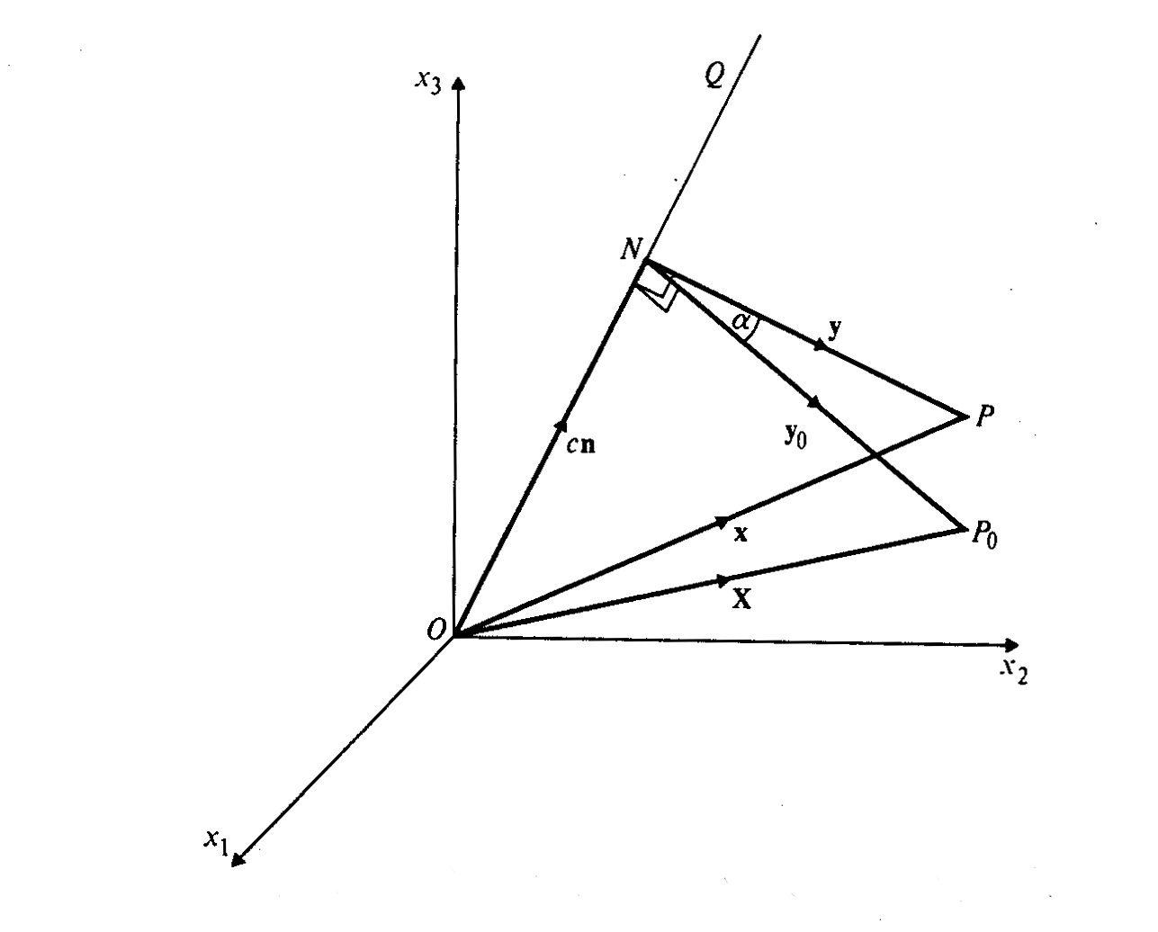
Rodrigues-Frank vector definition
We write the axis-angle representation as: where the rotation axis = OQ/|OQ|
The Rodrigues vector is defined as:
The vector is parallel to the rotation axis, and the rotation angle is α, and the magnitude of the vector is scaled by the tangent of the semi-angle.

Slide 49
Quaternion: definition
q = q(q₁,q₂,q₃,q₄)
For a unit quaternion, representing a rotation, we have: q(r sinθ/2, cosθ/2) q(u sinθ/2, v sinθ/2, w sinθ/2, cosθ/2)
Here, the rotation axis is r=[u,v,w], as a unit vector, and the rotation angle is θ.
Alternative notation puts cosine term in 1st position, q(q₀,q₁,q₂,q₃) : q = (cosθ/2, u sinθ/2, v sinθ/2, w sinθ/2).

Slide 50
Summary
Microstructure contains far more than qualitative descriptions (images) of cross-sections of materials.
Most properties are anisotropic which means that it is critically important for quantitative characterization to include orientation information (texture).
Many properties can be modeled with simple relationships, although numerical implementations are (almost) always necessary.

Slide 51
Supplemental Slides

Slide 52
Websters’ Dictionary, texture
Pronunciation: 'teks-ch&r
Function: noun
Etymology: Latin textura, from textus, past participle of texere to weave -- more at TECHNICAL
Date: 1578
1 a : something composed of closely interwoven elements; specifically : a woven cloth b : the structure formed by the threads of a fabric
2 a : essential part : SUBSTANCE b : identifying quality : CHARACTER
3 a : the disposition or manner of union of the particles of a body or substance b : the visual or tactile surface characteristics and appearance of something <the texture of
an oil painting>
4 a : a composite of the elements of prose or poetry <all these words... meet violently to form a texture impressive and exciting -- John Berryman> b : a pattern of
musical sound created by tones or lines played or sung together
5 a : basic scheme or structure b : overall structure

Slide 53
What do we need to learn?
1. How to measure texture:
Method 1: x-ray pole figures
Method 2: electron back scatter diffraction (EBSD)
Method 3: transmission electron microscopy (TEM)
Stereology: sections through 3D materials
2. What causes texture to develop in materials, and how does it depend on material type and the processing history?
Deformation of bulk metals: rolling vs. torsion etc.
Annealing: grain growth, recrystallization
Thin films

Slide 54
What do we need to learn? (contd.)
3. How to describe texture quantitatively, how to plot textures, and how to understand texture:
Method 1: pole figures
Method 2: orientation distributions (OD)
Symmetry: crystal symmetry, sample symmetry
Components
Fibers
How to obtain ODs from pole figures
4. How does anisotropy depend on texture?
Elastic anisotropy
Plastic anisotropy; yield surfaces
Corrosion (grain boundaries)

Slide 55
What do we need to learn? (contd.)
5. Grain Boundaries
Grain boundary atomic structure: low angle vs. high angle boundaries
Special grain boundaries: Coincident Site Lattice boundaries (CSL)
How to describe grain boundary crystallography: axis-angle, Rodrigues vectors
How to measure grain boundaries
6. Underlying Concepts
Different descriptions of rotations: Miller indices, Euler angles, matrices, axis-angle pairs, Rodrigues vectors, quaternions
How to work with distributions
Spherical harmonics (series expansions)
Discretization of distributions
Volume fractions

Slide 56
Learning Approach: 1
What is the result that we want? For a solved problem, we quote the equation or concept.
How do we find solutions for the differential equations, and what are they?
What are the variables?
How do we visualize the solution - what graphs are appropriate?
How do we set up the differential equations?
How do we determine the boundary conditions?
What do worked solutions corresponding to physical situations look like?

Slide 57
How to Measure Texture
X-ray diffraction; pole figures; measures average texture at a surface (µms penetration); projection (2 angles).
Neutron diffraction; type of data depends on neutron source; measures average texture in bulk (cms penetration in most materials) ; projection (2 angles).
Electron [back scatter] diffraction; easiest [to automate] in scanning electron microscopy (SEM); local texture; complete orientation (3 angles).
Optical microscopy: optical activity (plane of polarization); limited information (one angle)

Slide 58
X-ray Pole Figures
X-ray pole figures are the most common source of texture information; cheapest, easiest to perform.
Pole figure:= variation in diffracted intensity with respect to direction in the specimen.
Representation:= map in projection of diffracted intensity.
Each PF is equivalent to a geographic map of a hemisphere (North pole in the center).
Map of crystal directions w.r.t. sample reference frame.

Slide 59
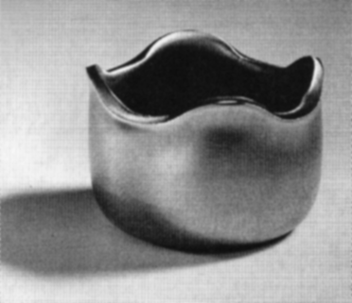
Anisotropy Example 2: Drawn Aluminum Cup with Ears
Figure shows example of a cup that has been deep drawn. The plastic anisotropy of the aluminum sheet resulted in non-uniform deformation and “ears.”
Randle, Engler, p.340

Slide 60
Challenges in Microstructure
Annealing textures: where does the cube texture come from in annealed fcc metals? Goss texture in bcc metals?
Processing: how can we produce large crystals of ceramics by abnormal grain growth?
Plastic deformation: how can we explain the “break-up” of grains during deformation?
Simulation, numerical representation: how can we generate faithful 3D representations of microstructure?
Constitutive relations: what are the properties of defects such as grain boundaries?

Slide 61
Notation: vectors, matrices
Vector-Matrix: v is a vector, A is a matrix (always a square matrix in this course).
Index notation: explicit indexes (Einstein convention): v_{i} is a vector, A_{jk} is a matrix (maybe tensor, though not necessarily).
Scalar (dot) product: c = a•b = a_{i}b_{i}; zero dot product means vectors are perpendicular. For two unit vectors, the dot product is equal to the cosine of the angle between them.
Vector (cross) product: c = c_{i} = a x b = a ∧ b = ε_{ijk} a_{j}b_{k}; generates a vector that is perpendicular to the first two. Two vectors that are perpendicular have a zero length cross product. The cross product defines a rotation axis that carries one vector into another. The magnitude of the cross product is the product of the magnitudes (lengths) of the vectors multiplied by the sine of the angle between them.
Permutation or alternating tensor, ε_{ijk}, is +1 for ijk=123, 231, 312, and -1 for ijk= 132, 213 and 321.
Obj/notation AxisTransformation Matrix EulerAngles Components

Slide 62
An axis system
Consider a right-handed set of axes defined by a set of three unit basis vectors, e.
Right-handed means that the scalar triple product, e₁xe₂•e₃ = +1
o

Slide 63
Direction cosines
α₁ = u = cosθ₁
α₂ = v = cosθ₂
α₃ = w = cosθ₃
x₃
a
θ₃
θ₂
x₂
θ₁
x₁

Slide 64
New Axes
Consider a new orthonormal system consisting of right-handed base vectors with the same origin, o, associated with the basis vectors. The vector is clearly expressed equally well in either coordinate system: Note - same vector, different values of the components. We need to find a relationship between the two sets of components for the vector.

Slide 65
Direction Cosines: definition
The two systems are related by the nine direction cosines, a_{ij}, which fix the cosine of the angle between the i^{th} primed and the j^{th} unprimed base vectors: Equivalently, a_{ij} represent the components of in according to the expression

Slide 66
Rotation of axes in the x-y plane
y
y’
v
x’
θ
x
x, y = old axes; x’,y’ = new axes
Passive Rotation/ Transformation of Axes

Slide 67
Example: rotation angle = 30°
y’
y
v
x’
θ
x
x, y = old axes; x’,y’ = new axes
Passive Rotation/ Transformation of Axes

Slide 68
Rotation Matrices
Since an orthogonal matrix merely rotates a vector but does not change its length, the determinant is one, det(a)=1.
Moreover, each row and each column is a unit vector, so these six relations apply, resulting in only 3 independent parameters:

Slide 69
Scalars, Vectors, Tensors
Scalar:= quantity that requires only one number, e.g. density, mass, specific heat.
Vector:= quantity that has direction as well as magnitude, e.g. velocity, current, magnetization; requires 3 numbers or coefficients (in 3D).
Tensor:= quantity that requires higher order descriptions but is the same, no matter what coordinate system is used to describe it, e.g. stress, strain, elastic modulus; requires 9 (or more, depending on rank) numbers or coefficients.

Slide 70
Scalars, Vectors, Tensors: NOTATION
General case: three dimensions
Vector: needs 3 numbers or coefficients to quantify its x, y and z components.
Two notations for vectors: “vector-tensor notation” where bold-face implies higher-than-scalar nature; “component notation” where a suffix(-es) show how many coefficients are needed.
Vector: either b or b_{i},i ∈ {1,2,3}, or, i ∈ {x,y,z}.
2nd rank tensor: either T or T_{ij}, i,j ∈ {1,2,3}
Advantage of vector-tensor notation is that the equations work in any reference frame. By contrast, when component notation is used, the actual values of the coefficients depend on which reference frame is used.
If you see subscripts attached to a quantity, it is (almost always) a tensor and the Einstein summation convention is assumed. The Einstein summation convention says that a repeated index (on the RHS) implies summation over that index (typically 1,2, and 3 in 3D).

