Slide 1


Grain Boundaries,
Misorientation Distributions, Rodrigues space, Symmetry
27-750
Texture, Microstructure & Anisotropy,
A.D. Rollett
Last revised: 20th June 2024

Slide 2
Objectives
Identify the Grain Boundary as an important element of microstructure and focus on the lattice misorientation associated with interfaces.
Define the Misorientation Distribution (MD) or Misorientation Distribution Function (MDF) and describe typical features of misorientation distributions and their representations.
Describe the crystallography of grain boundaries, using the Rodrigues-Frank vector [Frank, F. (1988), “Orientation mapping.” Metallurgical Transactions 19A 403-408].
Describe the effect of symmetry on the Rodrigues space; also the shape of the space (i.e., the fundamental zone) required to describe a unique set of grain boundary types in Rodrigues space, axis-angle space and Euler space.
Demonstrate how to obtain the misorientation and apply symmetry to get the disorientation in the FZ. Explain the importance of active vs passive rotations and how swapping the order in which g_{A} and g_{B}^{T} can lead to the misorientation axis being in the sample frame instead of the local crystal frame.
The discussion provided here is entirely in terms of cubic crystal symmetry. Obviously, the details change for different classes of crystal symmetry.
Overall objective of the discussion of grain boundaries is to illustrate the power of gathering data on a statistical basis, which complements the more traditional approach of studying high symmetry boundaries in the transmission electron microscope.

Slide 3
Reading
Pages 3-25 of book by Sutton & Balluffi
Pages 307-346 of book by Howe
Frank, F. (1988), “Orientation mapping.” Metallurgical Transactions 19A 403-408
P. Neumann, “Representation of orientations of symmetrical objects by Rodrigues vectors”, Textures and Microstructures 14-18 53-58 (1991).
Zhao, J. and B. L. Adams (1988). "Definition of an asymmetric domain for intercrystalline misorientation in cubic materials in the space of Euler angles." Acta Crystallographica A44 326-336
Book by Adam Morawiec

Slide 4
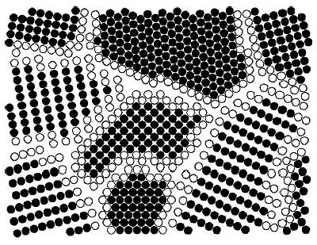
Grain Boundaries
Where crystals or grains join together, the crystal lattice cannot be perfect and therefore a grain boundary exists. At the atomistic scale, each boundary is obvious as a discontinuity in the atomic packing.
In most crystalline solids, a grain boundary is very thin (one/two atoms).
Disorder (broken bonds) unavoidable for geometrical reasons; therefore large excess free energy (0.1 - 1 J.m⁻²).
http://jolisfukyu.tokai-sc.jaea.go.jp/fukyu/tayu/ACT02E/06/0603.htm

Slide 5
Axis Transformations at a Grain Boundary
z
g_{B}
In terms of orientations:
transform back from frame A
to the reference position.
Then transform to frame B.
Compound (“compose”)
the two transformations to arrive at the net transformation between the two grains.
y
g_{A}⁻¹
reference
position:
(001)[100]
x
Net transformation = g_{B}g_{A}⁻¹
NB: these are passive rotations

Slide 6
Misorientation
Definition of misorientation†: given two orientations (grains, crystals), the misorientation is the transformation required to transform tensor quantities (vectors, stress, strain) from one set of crystal axes to the other set [passive rotation].
Alternate [active rotation*]: given two orientations (grains, crystals), the misorientation is the rotation required to rotate one set of crystal axes into coincidence with the other crystal (based on a fixed reference frame).
* For the active rotation description, the natural choice of reference frame is the set of sample axes. Expressing the misorientation in terms of sample axes, however, will mean that the associated misorientation axis is unrelated to directions in either crystal. In order for the misorientation axis to relate to crystal directions, one must adopt one of the crystals as the reference frame. Confused?! Study the slides and examples that follow!
† In some texts, the word disorientation (as opposed to misorientation) means the smallest physically possible rotation that will connect two orientations. The idea that there is any choice of rotation angle arises because of crystal symmetry: by re-labeling axes (in either crystal), the net rotation changes.

Slide 7
Why are grain boundaries interesting, important?
Grain boundaries vary a great deal in their characteristics (energy, mobility, chemistry).
Many properties of a material - and also processes of microstructural evolution - depend on the nature of the grain boundaries.
Materials can be made to have good or bad corrosion properties, mechanical properties (creep) depending on the type of grain boundaries present.
Some grain boundaries exhibit good atomic fit and are therefore resistant to sliding, show low diffusion rates, low energy, etc.

Slide 8
Degrees of (Geometric) Freedom
Grain boundaries have 5 degrees of freedom in terms of their macroscopic geometry: either 3 parameters to specify a rotation between the lattices plus 2 parameters to specify the boundary plane; or 2 parameters for each boundary plane on each side of the boundary (total of 4) plus a twist angle (1 parameter) between the lattices.
In addition to the macroscopic degrees of freedom, grain boundaries have 3 degrees of microscopic freedom (not considered here). The lattices can be translated in the plane of the boundary, and they can move towards/away from each other along the boundary normal.
If the orientation of a boundary with respect to sample axes matters (e.g. because of an applied stress, or magnetic field), then an additional 2 parameters must be specified.
Recommended description of a grain boundary (GB): determine the disorientation for the GB, then specify the boundary plane normal in relation to that disorientation. This means identifying the symmetry operators on each side of the GB that reduce the raw misorientation to the FZ and applying the same operators to the normal on each side. This allows the tilt-twist character to be identified.

Slide 9
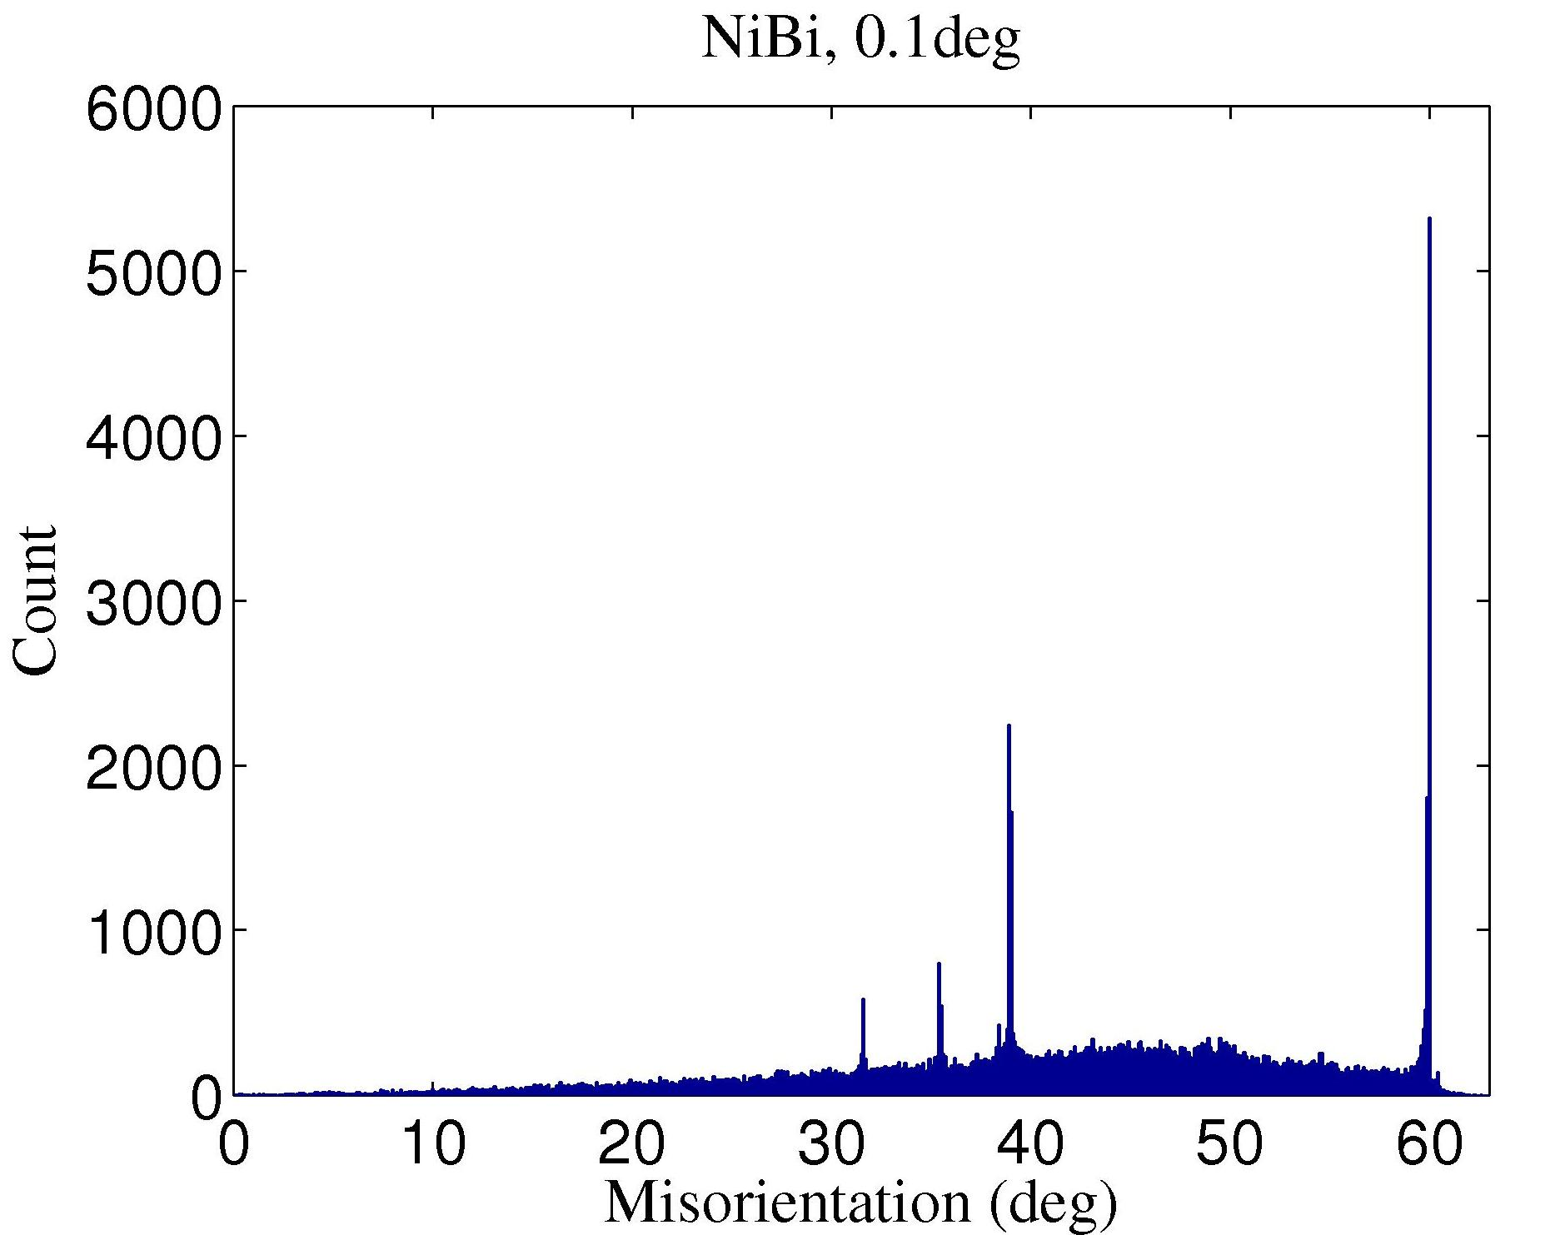
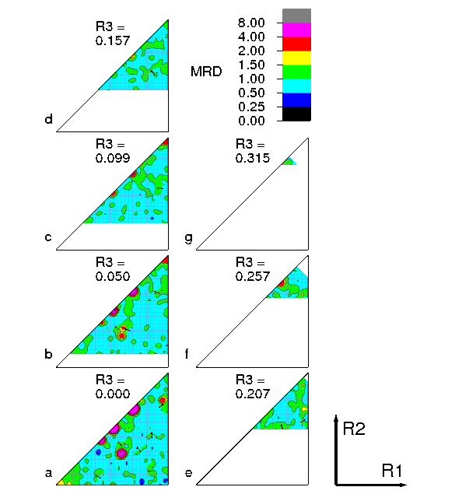
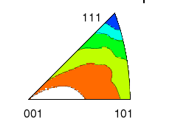
1 / 2 / 3 / 5 -parameter GB Character Distributions
http://mimp.materials.cmu.edu
1-parameter
Misorientation
angle only.
“Mackenzie plot”
5-parameter
Grain Boundary Character Distribution – “GBCD”.
Each misorientation type expands to a stereogram that shows variation in frequency of GB normals.
2-parameter
Grain Boundary Plane Distribution – “GBPD”.
Shows variation in frequency of
GB normals only, averaged over misorientation.
Σ3
3-parameter
Misorientation
Distribution
“MDF”
Rodrigues-Frank space
↵
Σ9
Ni
surface
energy
[Foiles]
Origin
Example: Bi-doped Ni

Slide 10
Boundary Type
There are several ways of describing grain boundaries.
A traditional method (in materials science) uses the tilt-twist description.
A twist boundary is one in which one crystal has been twisted about an axis perpendicular to the boundary plane, relative to the other crystal.
A tilt boundary is one in which one crystal has been twisted about an axis that lies in the boundary plane, relative to the other crystal.
More general boundaries have a combination of tilt and twist.
The approach specifies all five degrees of freedom.
Contrast with more recent (EBSD inspired) method that describes only the misorientation between the two crystals.
The Grain Boundary Character Distribution, GBCD, method, developed at CMU, uses misorientation+normal to characterize grain boundaries.

Slide 11
Tilt versus Twist Boundary Types
Tilt boundary is a rotation about an axis in the boundary plane. Thus the misorientation axis is perpendicular to the GB normal.
Twist boundary is a rotation about an axis perpendicular to the plane. Thus the misorientation axis is parallel to the GB normal.
Grain A
Grain B
Tilt Boundary
Grain Boundary
Grain A
Grain B
Twist Boundary
NB: the tilt or twist angle is not necessarily the same as the minimum misorientation angle (although for low angle boundaries, it typically is so).

Slide 12
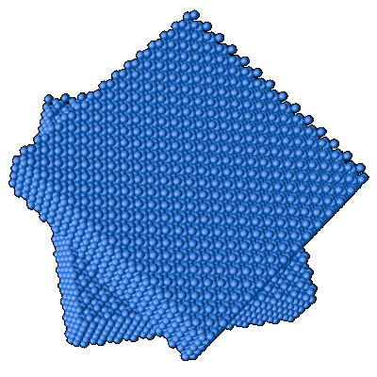
How to construct a grain boundary
There are many ways to put together a grain boundary.
There is always a common crystallographic axis between the two grains: one can therefore think of turning one piece of crystal relative to the other about this common axis. This is the misorientation concept. A further decision is required in order to determine the boundary plane.
Alternatively, one can think of cutting a particular facet on each of the two grains, and then rotating one of them to match up with the other. This leads to the tilt/twist concept.
The choice of the particular facet
defines the GB normal, and the
rotation defines the misorientation.
Note: the misorientation axis is,
in general, unrelated to the boundary
plane.
http://www.lce.hut.fi/research/eas/nanosystems/proj_gb/

Slide 13
Differences in Orientation
Preparation for the math of misorientations: the difference in orientation between two grains is a transformation, just as an orientation is the transformation that describes a texture component.
Convention: we use different methods (axis-angle , or Rodrigues vectors) to describe GB misorientation than we do for texture. This is because the rotation axis is often important in terms of its crystallographic alignment (by contrast to orientations, where it is generally of minor interest).
Note that we could use Euler angles for everything, – see for example Zhao, J. and B. L. Adams (1988). "Definition of an asymmetric domain for intercrystalline misorientation in cubic materials in the space of Euler angles." Acta Crystallographica A44: 326-336.

Slide 14
Alternate Diagram
g_{B}
TJ_{ACB}
g_{D}
g_{B}g_{A}⁻¹
g_{C}
g_{A}
TJ_{ABC}

Slide 15
Switching Symmetry
g_{B}
∆g=g_{B}g_{A}⁻¹≡ g_{A}g_{B}⁻¹
g_{A}
Switching symmetry:
A to B is indistinguishable
from B to A because there is no difference in grain
boundary structure

Slide 16
Switching Symmetry: Details
What do we mean by switching symmetry?
The idea is that going from grain A to grain B makes no difference to the physical nature of the boundary. Therefore we consider the two descriptions to be physically equivalent.
The mathematical descriptions are different, however. Therefore we have to describe the set of equivalent misorientations as the union of the forward and backward sets.
Also, collapsing the descriptions into a fundamental zone with only one unique descriptor of each misorientation requires care with the shape and symmetry elements used. We call the unique descriptor the “disorientation”.

Slide 17
Representations of Misorientation
What is different from Texture Components?
Miller indices not useful (except for describing the misorientation axis).
Euler angles can be used but untypical.
Reference frame is usually the crystal lattice (in one grain), not the sample frame.
Application of symmetry is different (no sample symmetry!)

Slide 18
Grain Boundaries vs. Texture
Why use the crystal lattice as a frame? Grain boundary structure is closely related to the rotation axis, i.e. the common crystallographic axis between the two grains.
The crystal symmetry applies to both sides of the grain boundary; in order to put the misorientation into the fundamental zone (or asymmetric unit) two sets of 24 operators (for cubic symmetry) with the switching symmetry must be used. However only one set of 24 symmetry operators are needed to find the minimum rotation angle.

Slide 19
Disorientation
Thanks to the cubic crystal symmetry, no two cubic lattices can be different by more than ~62.8° (see papers by Mackenzie).
Combining two orientations can lead to a rotation angle as high as 180°: applying crystal symmetry operators decreases the required rotation angle.
Disorientation:= (is defined as) the minimum rotation angle between two lattices with the misorientation axis located in the Standard Stereographic Triangle. Alternatively, the disorientation is the misorientation described in a particular fundamental zone.

Slide 20
Grain Boundary Representation
Axis-angle representation: axis is the common crystal axis (but it is also possible to describe the axis in the sample frame); angle is the rotation angle, θ.
3x3 Rotation matrix, ∆g=g_{B}g_{A}^{T}.
Rodrigues vector: 3 component vector whose direction is the axis direction and whose length = tan(θ /2).

Slide 21
How to Choose the
Misorientation Angle: matrix
If the rotation angle is the only criterion, then only one set of 24 operators (cubic) need be applied: sample versus crystal frame is indifferent because the angle (from the trace of a rotation matrix) is invariant under axis transformation.
Note: taking absolute value of the misorientation angle accounts for switching symmetry

Slide 22
How to Choose the
Misorientation Angle: quaternions
This algorithm is valid only for cubic-cubic misorientations and for obtaining only the angle (not the axis).
Arrange q₄ ≥ q₃ ≥ q₂ ≥ q₁ ≥ 0.
Choose the maximum value of the fourth component, q₄’, from three variants as follows:
[i] (q₁,q₂,q₃,q₄)
[ii] (q₁-q₂, q₁+q₂, q₃-q₄, q₃+q₄)/√2
[iii] (q₁-q₂+q₃-q₄, q₁+q₂-q₃-q₄, -q₁+q₂+q₃-q₄, q₁+q₂+q₃+q₄)/2
Reference: Sutton & Balluffi, section 1.3.3.4; see also H. Grimmer, Acta Cryst., A30, 685 (1974) for more detail.

Slide 23
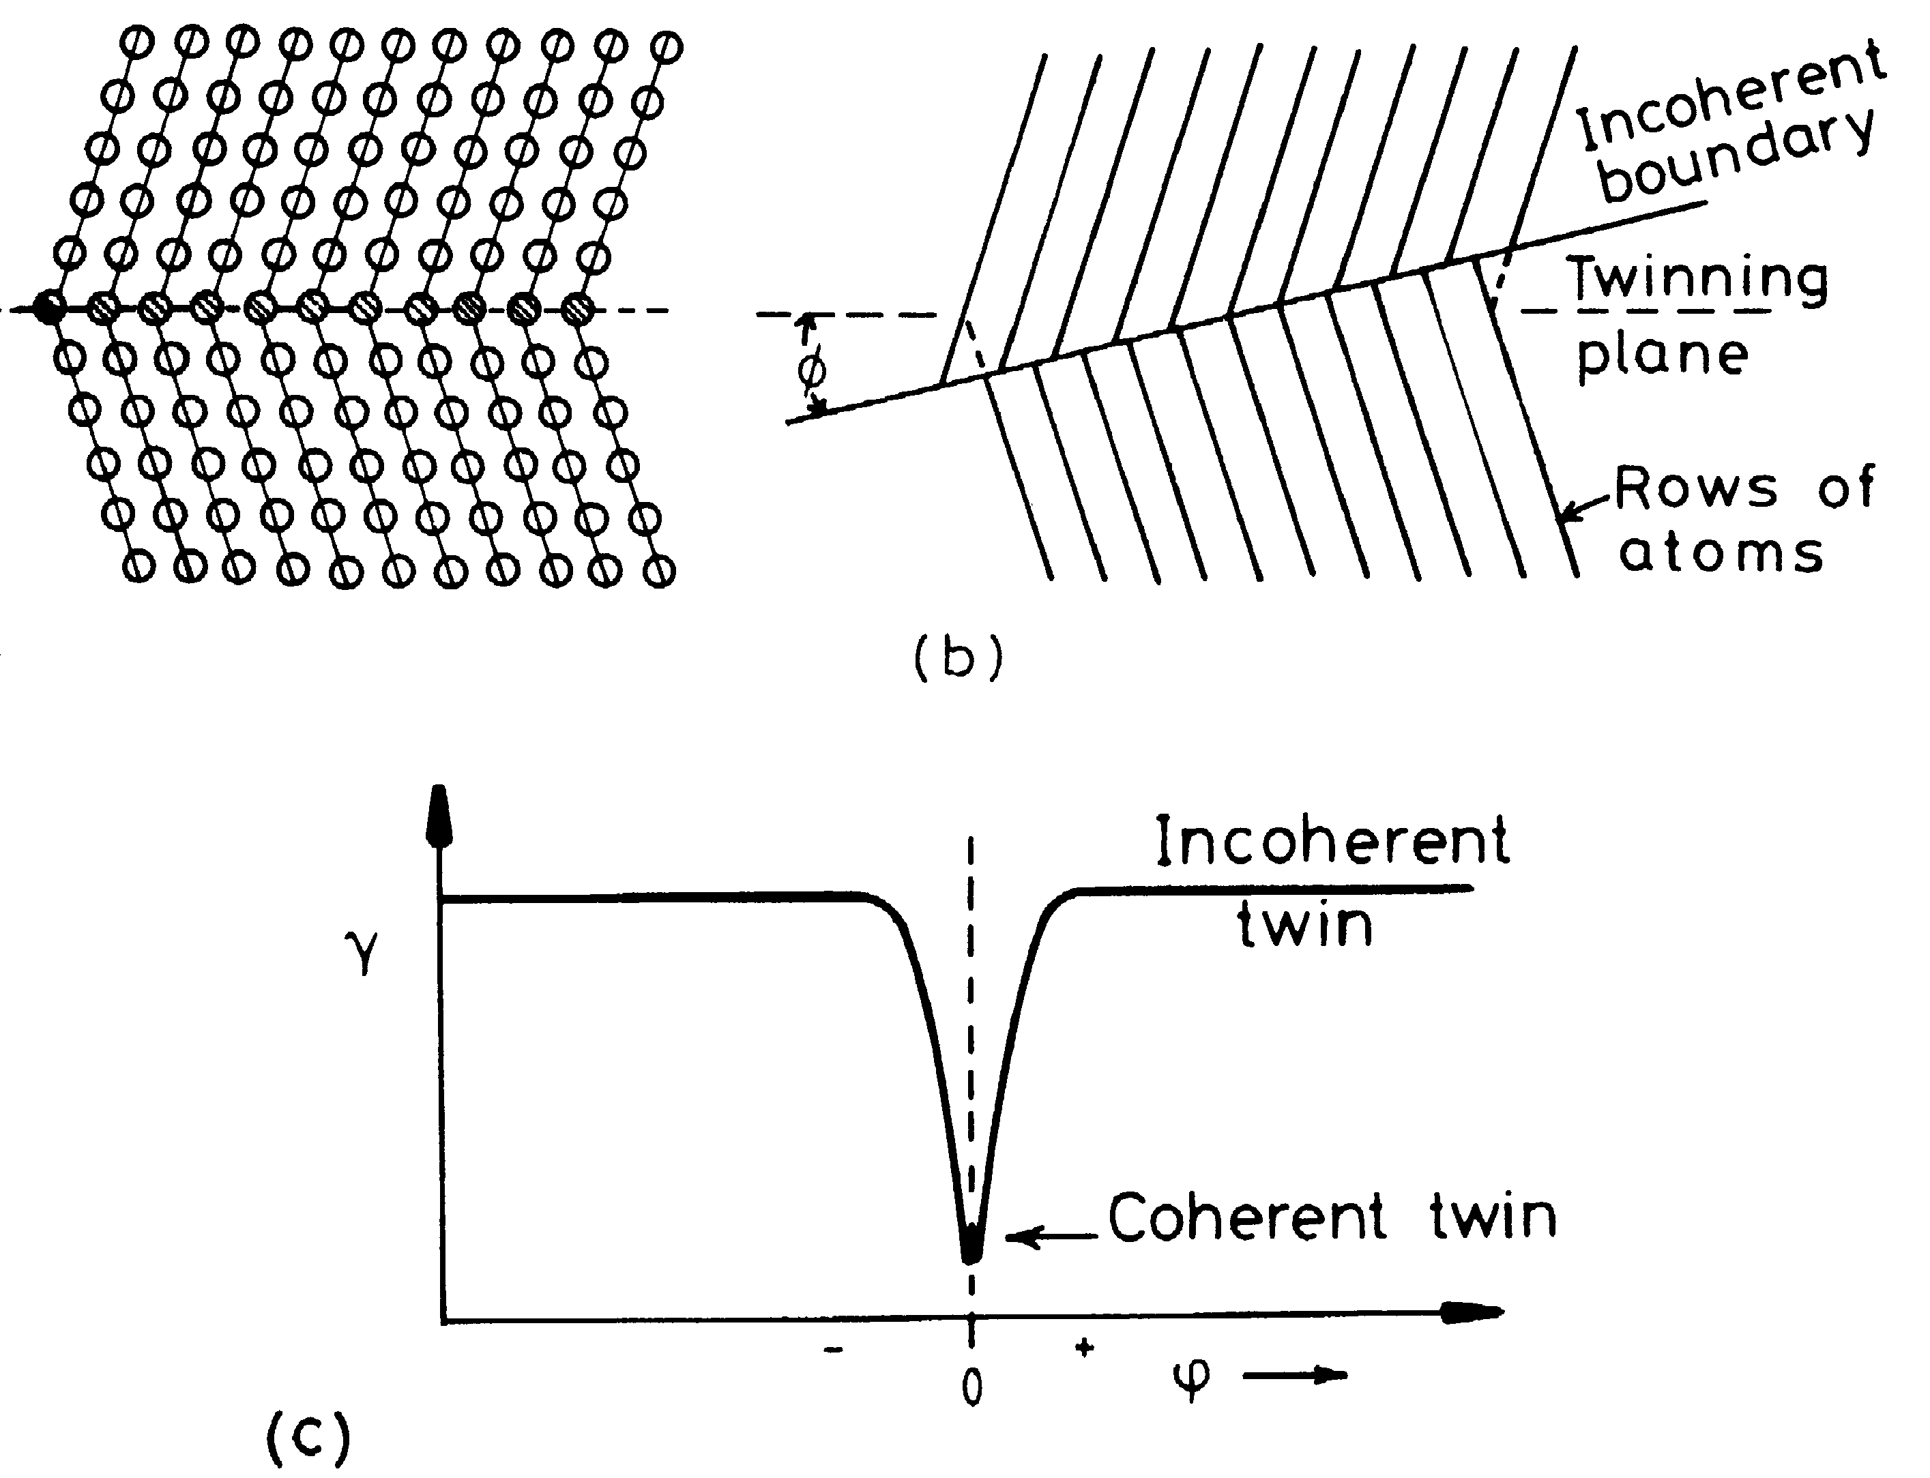
Crystal vs Sample Frame
Components of
the rotation axis
are always
(1/√3,1/√3,1/√3) in
the crystal frame:
in the sample frame
the components
depend on the
orientations of
the grains.
z
g_{B}
y
g_{A}⁻¹
reference
position:
(001)[100]
θ=60°
x

Slide 24
Worked Example
In this example, we take a pair of orientations that were chosen to have a 60°<111> misorientation between them (rotation axis expressed in crystal coordinates). In fact the pair of orientations are the two sample symmetry related Copper components, which are twin related.
We calculate the 3x3 Rotation matrix for each orientation, g_{A} and g_{B}, and then form the misorientation matrix, ∆g=g_{B}g_{A}⁻¹.
From the misorientation matrix, we calculate the angle,
= cos⁻¹(trace(∆g)-1)/2), and the rotation axis.
In order to find the smallest possible misorientation angle, we have to apply crystal symmetry operators, O, to the misorientation matrix, O∆g, and recalculate the angle and axis.
First, let’s examine the result … .

Slide 25
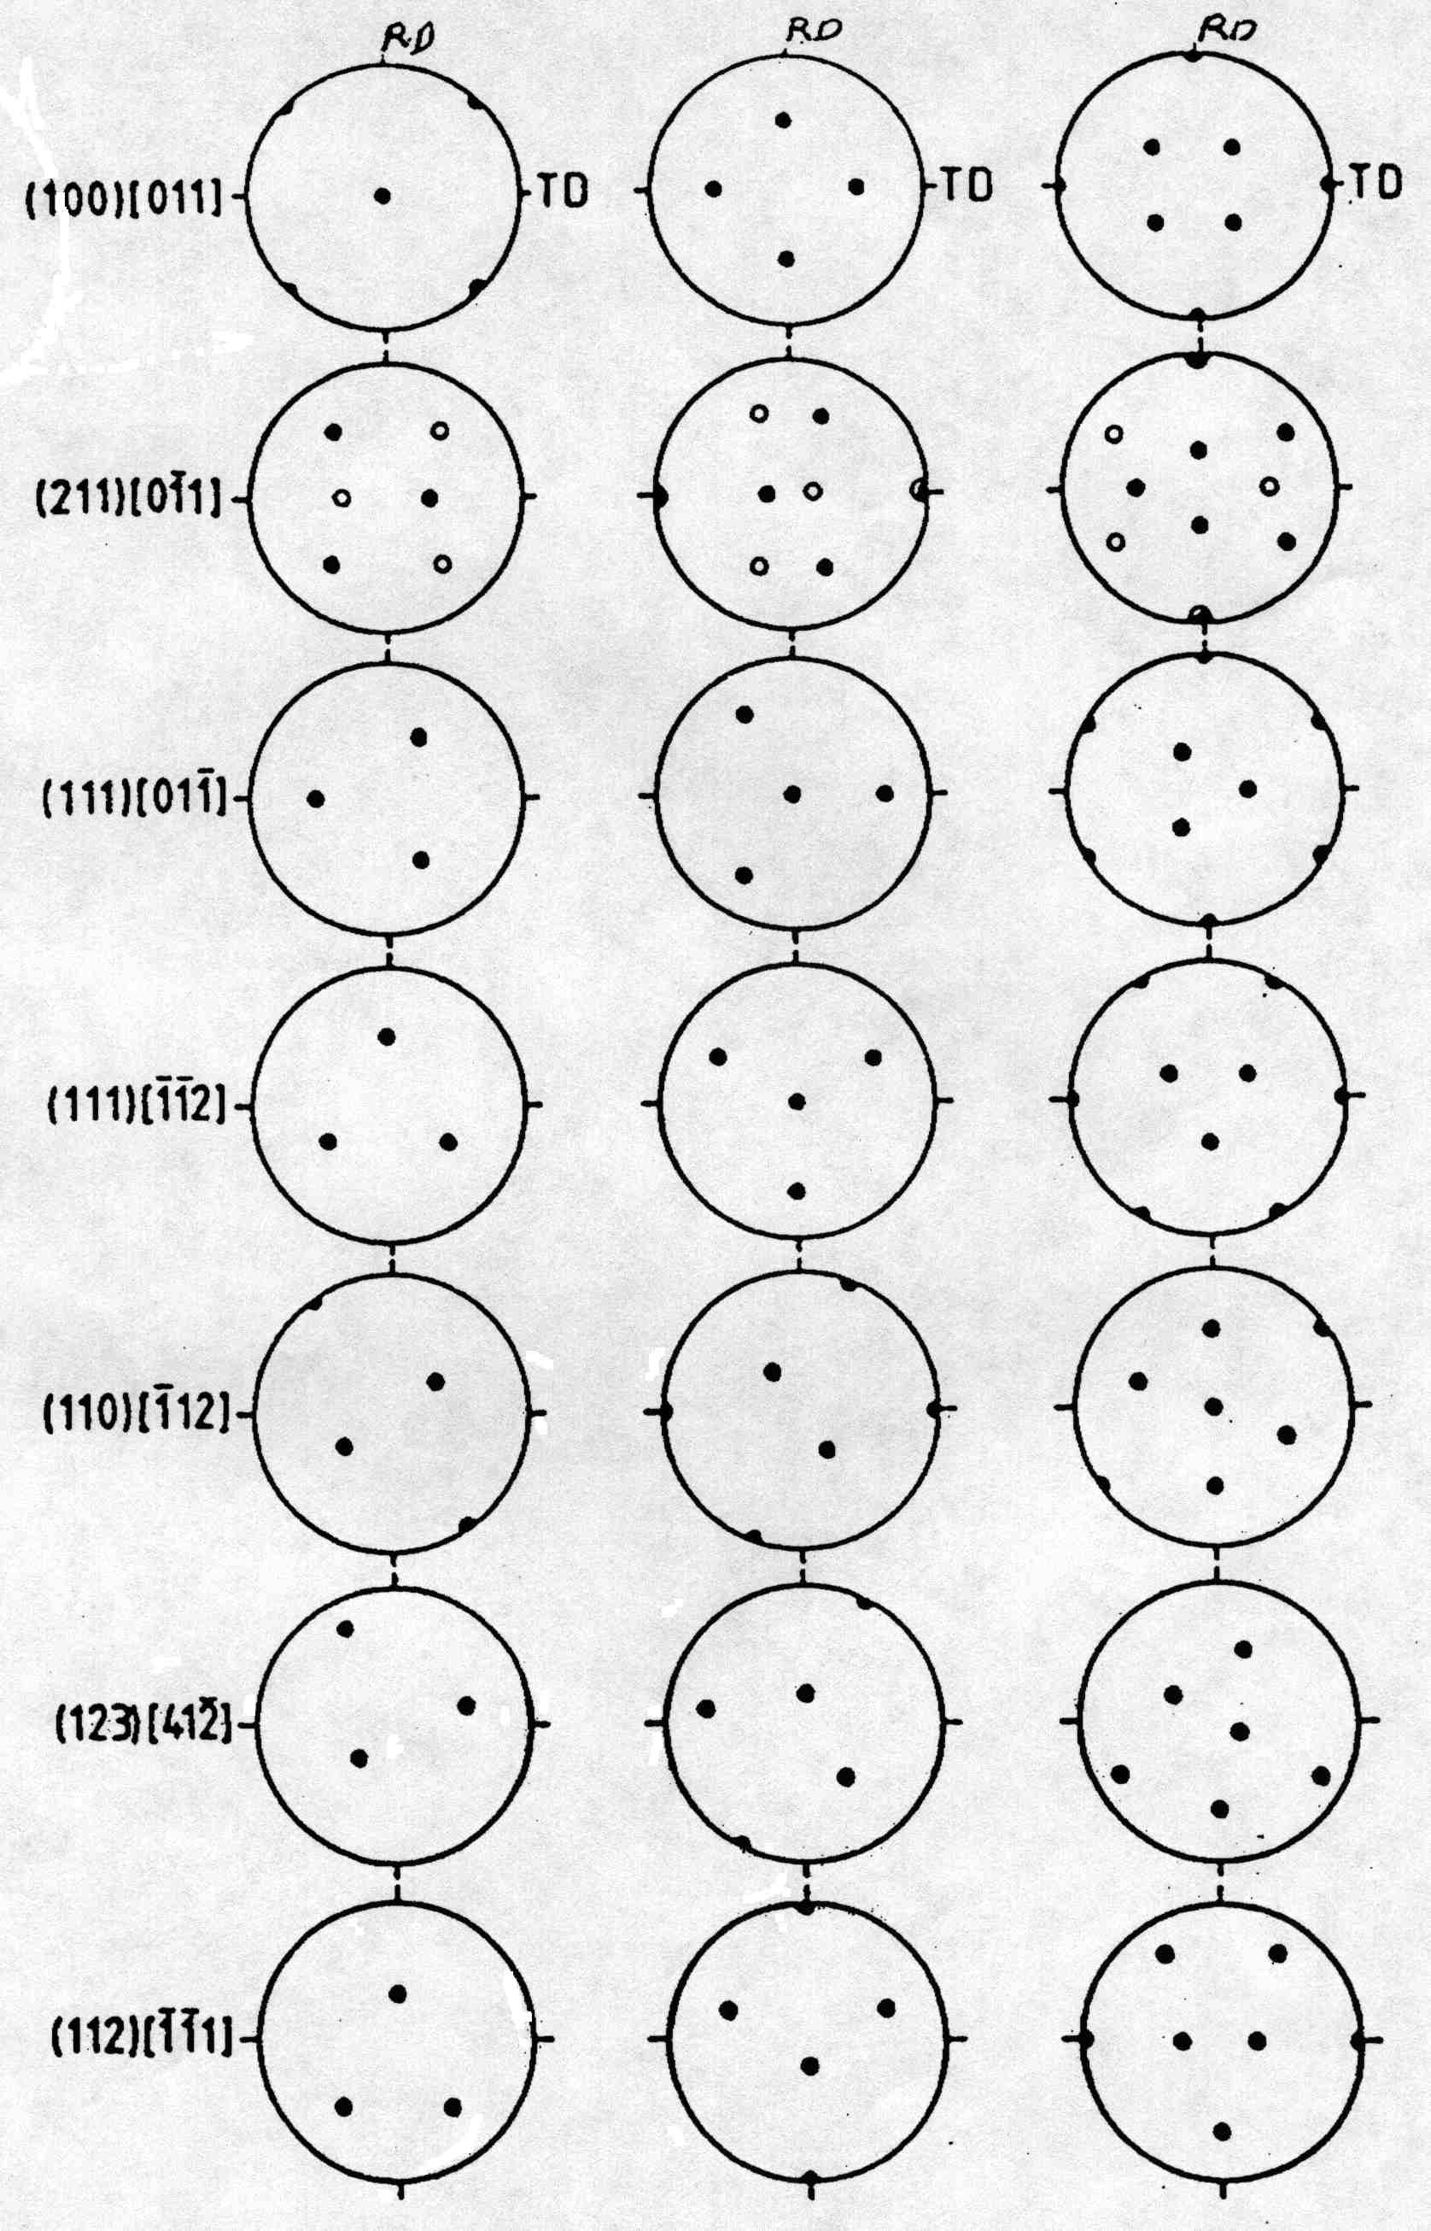
Worked Example
angles.. 90. 35.2599983 45.
angles.. 270. 35.2599983 45.
1st Grain: Euler angles: 90. 35.2599983 45.
2nd Grain: Euler angles: 270. 35.2599983 45.
1st matrix:
[ -0.577 0.707 0.408 ]
[ -0.577 -0.707 0.408 ]
[ 0.577 0.000 0.817 ]
2nd matrix:
[ 0.577 -0.707 0.408 ]
[ 0.577 0.707 0.408 ]
[ -0.577 0.000 0.817 ]
Product matrix for gA X gB^-1:
[ -0.667 0.333 0.667 ]
[ 0.333 -0.667 0.667 ]
[ 0.667 0.667 0.333 ]
MISORI: angle= 60. axis= 1 1 -1
{100} pole figures
+
Note that the misorientation axis is // 1 1 -1, which is also the sample-1 (X) axis

Slide 26
Detail Output
Symmetry operator number 5
Product matrix for gA X gB^-1:
[ -0.667 -0.667 -0.333 ]
[ 0.333 -0.667 0.667 ]
[ -0.667 0.333 0.667 ]
Trace = -0.666738987
angle = 146.446442
Symmetry operator number 6
Product matrix for gA X gB^-1:
[ 0.667 0.667 0.333 ]
[ 0.333 -0.667 0.667 ]
[ 0.667 -0.333 -0.667 ]
Trace = -0.666738987
angle = 146.446442
Symmetry operator number 7
Product matrix for gA X gB^-1:
[ 0.667 -0.333 -0.667 ]
[ 0.333 -0.667 0.667 ]
[ -0.667 -0.667 -0.333 ]
Trace = -0.333477974
angle = 131.815872
Symmetry operator number 8
Product matrix for gA X gB^-1:
[ 0.667 -0.333 -0.667 ]
[ -0.333 0.667 -0.667 ]
[ 0.667 0.667 0.333 ]
Trace = 1.66695571
angle = 70.5199966
Symmetry operator number 9
Product matrix for gA X gB^-1:
[ 0.333 -0.667 0.667 ]
[ 0.667 -0.333 -0.667 ]
[ 0.667 0.667 0.333 ]
Trace = 0.333477855
angle = 109.46682
Symmetry operator number 10
Product matrix for gA X gB^-1:
[ -0.333 0.667 -0.667 ]
[ -0.667 0.333 0.667 ]
[ 0.667 0.667 0.333 ]
Trace = 0.333477855
angle = 109.46682
Symmetry operator number 11
Product matrix for gA X gB^-1:
[ -0.333 0.667 -0.667 ]
[ 0.667 0.667 0.333 ]
[ 0.667 -0.333 -0.667 ]
Trace = -0.333261013
angle = 131.807526
Symmetry operator number 12
Product matrix for gA X gB^-1:
[ 0.667 0.667 0.333 ]
[ 0.667 -0.333 -0.667 ]
[ -0.333 0.667 -0.667 ]
Trace = -0.333261073
angle = 131.807526
Symmetry operator number 13
Product matrix for gA X gB^-1:
[ -0.333 0.667 -0.667 ]
[ -0.667 -0.667 -0.333 ]
[ -0.667 0.333 0.667 ]
Trace = -0.333261013
angle = 131.807526
Symmetry operator number 14
Product matrix for gA X gB^-1:
[ -0.667 -0.667 -0.333 ]
[ -0.667 0.333 0.667 ]
[ -0.333 0.667 -0.667 ]
Trace = -1.
angle = 180.
Symmetry operator number 15
Product matrix for gA X gB^-1:
[ 0.333 -0.667 0.667 ]
[ -0.667 -0.667 -0.333 ]
[ 0.667 -0.333 -0.667 ]
Trace = -1.
angle = 180.
Symmetry operator number 16
Product matrix for gA X gB^-1:
[ -0.667 -0.667 -0.333 ]
[ 0.667 -0.333 -0.667 ]
[ 0.333 -0.667 0.667 ]
Trace = -0.333260953
angle = 131.807526
Symmetry operator number 17
Product matrix for gA X gB^-1:
[ 0.333 -0.667 0.667 ]
[ 0.667 0.667 0.333 ]
[ -0.667 0.333 0.667 ]
Trace = 1.66652203
angle = 70.533165
Symmetry operator number 18
Product matrix for gA X gB^-1:
[ 0.667 0.667 0.333 ]
[ -0.667 0.333 0.667 ]
[ 0.333 -0.667 0.667 ]
Trace = 1.66652203
angle = 70.533165
Symmetry operator number 19
Product matrix for gA X gB^-1:
[ 0.333 -0.667 0.667 ]
[ -0.667 0.333 0.667 ]
[ -0.667 -0.667 -0.333 ]
Trace = 0.333044171
angle = 109.480003
Symmetry operator number 20
Product matrix for gA X gB^-1:
[ 0.667 -0.333 -0.667 ]
[ 0.667 0.667 0.333 ]
[ 0.333 -0.667 0.667 ]
Trace = 2.
angle = 60.
Symmetry operator number 21
Product matrix for gA X gB^-1:
[ 0.667 0.667 0.333 ]
[ -0.333 0.667 -0.667 ]
[ -0.667 0.333 0.667 ]
Trace = 2.
angle = 60.
Symmetry operator number 22
Product matrix for gA X gB^-1:
[ 0.667 -0.333 -0.667 ]
[ -0.667 -0.667 -0.333 ]
[ -0.333 0.667 -0.667 ]
Trace = -0.666522205
angle = 146.435211
Symmetry operator number 23
Product matrix for gA X gB^-1:
[ -0.667 -0.667 -0.333 ]
[ -0.333 0.667 -0.667 ]
[ 0.667 -0.333 -0.667 ]
Trace = -0.666522026
angle = 146.435196
Symmetry operator number 24
Product matrix for gA X gB^-1:
[ -0.333 0.667 -0.667 ]
[ 0.667 -0.333 -0.667 ]
[ -0.667 -0.667 -0.333 ]
Trace = -0.999999881
angle = 179.980209
MISORI: angle= 60. axis= 1 1
MISORI: angle= 60. axis= 1 1 -1-1
1st matrix:
[ -0.691 0.596 0.408 ]
[ -0.446 -0.797 0.408 ]
[ 0.569 0.100 0.817 ]
2nd matrix:
[ 0.691 -0.596 0.408 ]
[ 0.446 0.797 0.408 ]
[ -0.569 -0.100 0.817 ]
Symmetry operator number 1
Product matrix for gA X gB^-1:
[ -0.667 0.333 0.667 ]
[ 0.333 -0.667 0.667 ]
[ 0.667 0.667 0.333 ]
Trace = -1.
angle = 180.
Symmetry operator number 2
Product matrix for gA X gB^-1:
[ -0.667 0.333 0.667 ]
[ -0.667 -0.667 -0.333 ]
[ 0.333 -0.667 0.667 ]
Trace = -0.666738808
angle = 146.446426
Symmetry operator number 3
Product matrix for gA X gB^-1:
[ -0.667 0.333 0.667 ]
[ -0.333 0.667 -0.667 ]
[ -0.667 -0.667 -0.333 ]
Trace = -0.333477736
angle = 131.815857
Symmetry operator number 4
Product matrix for gA X gB^-1:
[ -0.667 0.333 0.667 ]
[ 0.667 0.667 0.333 ]
[ -0.333 0.667 -0.667 ]
Trace = -0.666738927
angle = 146.446442
This set of tables shows each successive result as a different symmetry operator is applied to ∆g. Note how the angle and the axis varies in each case!

Slide 27
Basics
Passive Rotations
Materials Science
g describes an axis transformation from sample to crystal axes
Active Rotations
Solid mechanics
g describes a rotation of a crystal from ref. position to its orientation.
Passive Rotations (Axis Transformations) Active (Vector) Rotations

Slide 28
Objective
To make clear how it is possible to express a misorientation in more than (physically) equivalent fashion.
To allow researchers to apply symmetry correctly; mistakes are easy to make!
It is essential to know how a rotation/orientation/texture component is expressed in order to know how to apply symmetry operations.

Slide 29
Matrices
g = Z₂XZ₁ =
g = g_{φ1/001}g_{Φ100}g_{φ2/001} =
Passive Rotations (Axis Transformations) Active (Vector) Rotations

Slide 30
Worked example: active rotations
So what happens when we express orientations as active rotations in the sample reference frame?
The result is similar (same minimum rotation angle) but the axis is different!
The rotation axis is the sample [100] axis, which happens to be parallel to a crystal <111> direction.
{100} pole figures
60° rotation
about RD

Slide 31
Active rotations example
∆g=g_{B}⁻¹g_{A}
Symmetry operator number 1
Product matrix for gB X gA^-1:
[ -1.000 0.000 0.000 ]
[ 0.000 -1.000 0.000 ]
[ 0.000 0.000 1.000 ]
Trace = -1.
angle = 180.
Symmetry operator number 2
Product matrix for gB X gA^-1:
[ -0.333 0.000 0.943 ]
[ 0.816 -0.500 0.289 ]
[ 0.471 0.866 0.167 ]
Trace = -0.666738927
angle = 146.446442
Symmetry operator number 3
Product matrix for gB X gA^-1:
[ 0.333 0.817 0.471 ]
[ 0.817 0.000 -0.577 ]
[ -0.471 0.577 -0.667 ]
Trace = -0.333477914
angle = 131.815872
…………..
angles.. 90. 35.2599983 45.
angles.. 270. 35.2599983 45.
1st Grain: Euler angles: 90. 35.2599983 45.
2nd Grain: Euler angles: 270. 35.2599983 45.
1st matrix:
[ -0.577 0.707 0.408 ]
[ -0.577 -0.707 0.408 ]
[ 0.577 0.000 0.817 ]
2nd matrix:
[ 0.577 -0.707 0.408 ]
[ 0.577 0.707 0.408 ]
[ -0.577 0.000 0.817 ]
MISORInv: angle= 60. axis= 1 0 0
Note that the misorientation axis is still // 1 1 -1, but now the calculation identifies 1 0 0 as the axis, which is the sample-1 (X) axis.

Slide 32
Active rotations
What is stranger, at first sight, is that, as you rotate the two orientations together in the sample frame, the misorientation axis moves with them, if expressed in the reference frame (active rotations).
On the other hand, if one uses passive rotations, so that the result is in crystal coordinates, then the misorientation axis remains unchanged.

Slide 33
Active rotations example
∆g=g_{B}⁻¹g_{A}
Symmetry operator number 1
Product matrix for gB X gA^-1:
[ -1.000 0.000 0.000 ]
[ 0.000 -1.000 0.000 ]
[ 0.000 0.000 1.000 ]
Trace = -1.
angle = 180.
Symmetry operator number 2
Product matrix for gB X gA^-1:
[ -0.478 0.004 0.878 ]
[ 0.820 -0.355 0.448 ]
[ 0.314 0.935 0.167 ]
Trace = -0.666738808
angle = 146.446426
Symmetry operator number 3
Product matrix for gB X gA^-1:
[ 0.044 0.824 0.564 ]
[ 0.824 0.289 -0.487 ]
[ -0.564 0.487 -0.667 ]
Trace = -0.333477765
angle = 131.815857
…………..
Add 10° to the first Euler angle so that both crystals move together:
angles.. 100. 35.2599983 45.
angles.. 280. 35.2599983 45.
1st Grain: Euler angles: 90. 35.2599983 45.
2nd Grain: Euler angles: 270. 35.2599983 45.
1st matrix:
[ -0.577 0.707 0.408 ]
[ -0.577 -0.707 0.408 ]
[ 0.577 0.000 0.817 ]
2nd matrix:
[ 0.577 -0.707 0.408 ]
[ 0.577 0.707 0.408 ]
[ -0.577 0.000 0.817 ]
MISORInv: angle= 60. axis= 6 1 0
Note the change in the misorientation axis from 100 to 610 because it is expressed in the sample frame!

Slide 34
Texture+Symmetry
Symmetry Operators:
O_{sample} ≡ O_{s}
O_{crystal} ≡ O_{c}
Note that the crystal symmetry post-multiplies, and the sample symmetry pre-multiplies.
Note the reversal in order of application of symmetry operators!
Passive Rotations (Axis Transformations) Active (Vector) Rotations

Slide 35
Groups:
Sample+Crystal Symmetry
O_{c}∈O(432);
proper rotations of the cubic point group.
O_{s}∈O(222);
proper rotations of the orthorhombic point group.
Think of applying the symmetry operator in the appropriate frame: thus for active rotations, apply symmetry to the crystal before you rotate it.
Passive Rotations (Axis Transformations) Active (Vector) Rotations

Slide 36
Misorientations
Misorientations:
∆g=g_{B}g_{A}⁻¹;
transform from crystal axes of grain A back to the reference axes, and then transform to the axes of grain B.
Misorientations:
∆g=g_{B}g_{A}⁻¹;
the net rotation from A to B is: rotate first back from the position of grain A and then rotate to the position of grain B.
Passive Rotations (Axis Transformations) Active (Vector) Rotations

Slide 37
Notation
In some texts, misorientation formed from axis transformations is written with a tilde.
Standard A->B transformation is expressed in crystal axes.
You must verify from the context which type of misorientation is discussed in a text!
Standard A->B rotation is expressed in sample axes.
Passive Rotations (Axis Transformations) Active (Vector) Rotations

Slide 38
Misorientation+Symmetry
∆g=
(O_{c} g_{B})(O_{c} g_{A})⁻¹
= O_{c}g_{B}g_{A}⁻¹O_{c}⁻¹.
Note the presence of symmetry operators pre- & post-multiplying the basic misorientation
∆g=g_{B}g_{A}⁻¹;
(g_{B}O_{c})(g_{A}O_{c})⁻¹
= g_{B}O_{c}O_{c}⁻¹g_{A}⁻¹
= g_{B} O_{c} g_{A}⁻¹.
Note the reduction to a single symmetry operator because the symmetry operators belong to the same group!
Passive Rotations (Axis Transformations) Active (Vector) Rotations

Slide 39
Switching Symmetry, v2
If we write down the set of possible misorientations, recognizing the equivalence of forward and backward rotations, we get:
{∆g}={∆g_{AB}}U{∆g_{BA}} =
{(O_{c} g_{B})(O_{c} g_{A})⁻¹}U(O_{c} g_{A})(O_{c} g_{B})⁻¹}
= {O_{c}g_{B}g_{A}⁻¹O_{c}⁻¹}U{O_{c}g_{A}g_{B}⁻¹O_{c}}.
Equivalently in the sample frame:
{∆g}={g_{B}g_{A}⁻¹}U{g_{A}g_{B}⁻¹}=
{(g_{B}O_{c})(g_{A}O_{c})⁻¹}U
{(g_{A}O_{c})(g_{B}O_{c})⁻¹}
= {g_{B}O_{c}O_{c}⁻¹g_{A}⁻¹}U{g_{A}O_{c}O_{c}⁻¹g_{B}⁻¹}
= {g_{B}O_{c}g_{A}⁻¹}U{g_{A}O_{c}g_{B}⁻¹}.
Passive Rotations (Axis Transformations) Active (Vector) Rotations

Slide 40
Symmetry: how many equivalent representations of misorientation?
Axis transformations:
24 independent operators present on either side of the misorientation. Two equivalents from switching symmetry.
Number of equivalents=
24x24x2=1152.
Active rotations:
Only 24 independent operators present “inside” the misorientation. 2 from switching symmetry.
Number of equivalents=
24x2=48.
Passive Rotations (Axis Transformations) Active (Vector) Rotations

Slide 41
Passive <-> Active
Just as is the case for rotations, and texture components,
g_{passive}(θ,n) = g^{T}_{active}(θ,n),
so too for misorientations,

Slide 42
Disorientation Choice?
Disorientation to be chosen to make the description of misorientation unique and thus within the Fundamental Zone (FZ, irreducible zone, etc.).
The FZ is a unit spherical triangle for cubic and hexagonal crystal symmetries (different extent, obviously).
Must work in the crystal frame so that the rotation axis is described in a crystallographic frame.
For lower symmetry systems, be careful of the transformation required from a Cartesian frame to the Bravais lattice frame (and vice versa).
Active rotations: write the misorientation as follows so as to express in crystal frame:
∆g=(g_{B}O_{c}) ⁻¹(g_{A}O_{c}) =O_{c}g_{B}⁻¹g_{A}O_{c}⁻¹.

Slide 43
Disorientation Choice, contd.
Rotation angle to be minimized, and,
place the axis in the standard stereographic triangle.
Use the full list of (for cubic symmetry) 1,152 equivalent representations to find minimum angle, and:
u ≥ v ≥ w ≥ 0,
where [uvw] is the rotation axis associated with the rotation.
Algorithm: see next slide

Slide 44
Apply the Disorientation to One of the Orientations
What happens when one applies the disorientation to either of the original orientations? Does one recover a new orientation that is symmetrically equivalent to the other orientation?
∆g = O_{c}g_{B}g_{A}⁻¹O_{c}
Now insert the original (first) orientation, g_{A}, on the RHS:
∆g·g_{A} = O_{c}g_{B}[g_{A}⁻¹O_{c}g_{A}]; note that the combination in brackets does not collapse to the identity unless the symmetry operator in between happens to be the identity.
The only other circumstance that allows the second orientation to be recovered is when the latter aligns with the chosen symmetry operator, e.g., [uvw]{111} in the γ-fiber, such that the combination becomes commutative:
∆g·g_{A} = O_{c}g_{B}[g_{A}⁻¹O_{c}g_{A}] = O_{c}g_{B}[g_{A}⁻¹g_{A}O_{c}] = O_{c}g_{B}[I O_{c}] = O_{c}g_{B}O_{c}. Then one has to use the commutativity a second time to show that this result is symmetrically equivalent to the original g_{B}.
Unless the disorientation happens to be calculated with the identity for the first orientation, g_{A}, the action of the disorientation on that original orientation does not give a new orientation that is symmetrically equivalent to the grain on the other side, g_{B}. Or vice versa if switching symmetry applies.

Slide 45
Pseudo-code for Disorientation
! Work in crystal (local) frame
Calculate misorientation as g_{B}g_{A}⁻¹
For each ith crystal symmetry operator, calculate O_{i}g_{B}g_{A}⁻¹
For each jth crystal symmetry operator, calculate O_{i}g_{B}g_{A}⁻¹O_{j}
Test the axis for whether it lies in the FZ; repeat for inverse rotation
If if does, test angle for whether it is lower than the previous minimum
If new min. angle found, retain the result (with indices i & j)
endif
endif
enddo
enddo
Note that it is essential to test the axis in the outer loop and the angle in the inner loop, because it is often the case that the same (minimum ) angle will be found for multiple rotation axes.
The “inverse rotation” can be easily obtained by negating the fourth (cosine) component of the quaternion.

Slide 46
Misorientation Distributions
Commonly, you will see “MDF” for misorientation distribution function, which implies that a mathematical function (such as a series expansion based on generalized spherical harmonics) has been fit to the data.
Given that misorientations are almost always reduced to the FZ, i.e., disorientations, the term should probably be DDF (disorientation distribution function)!

Slide 47
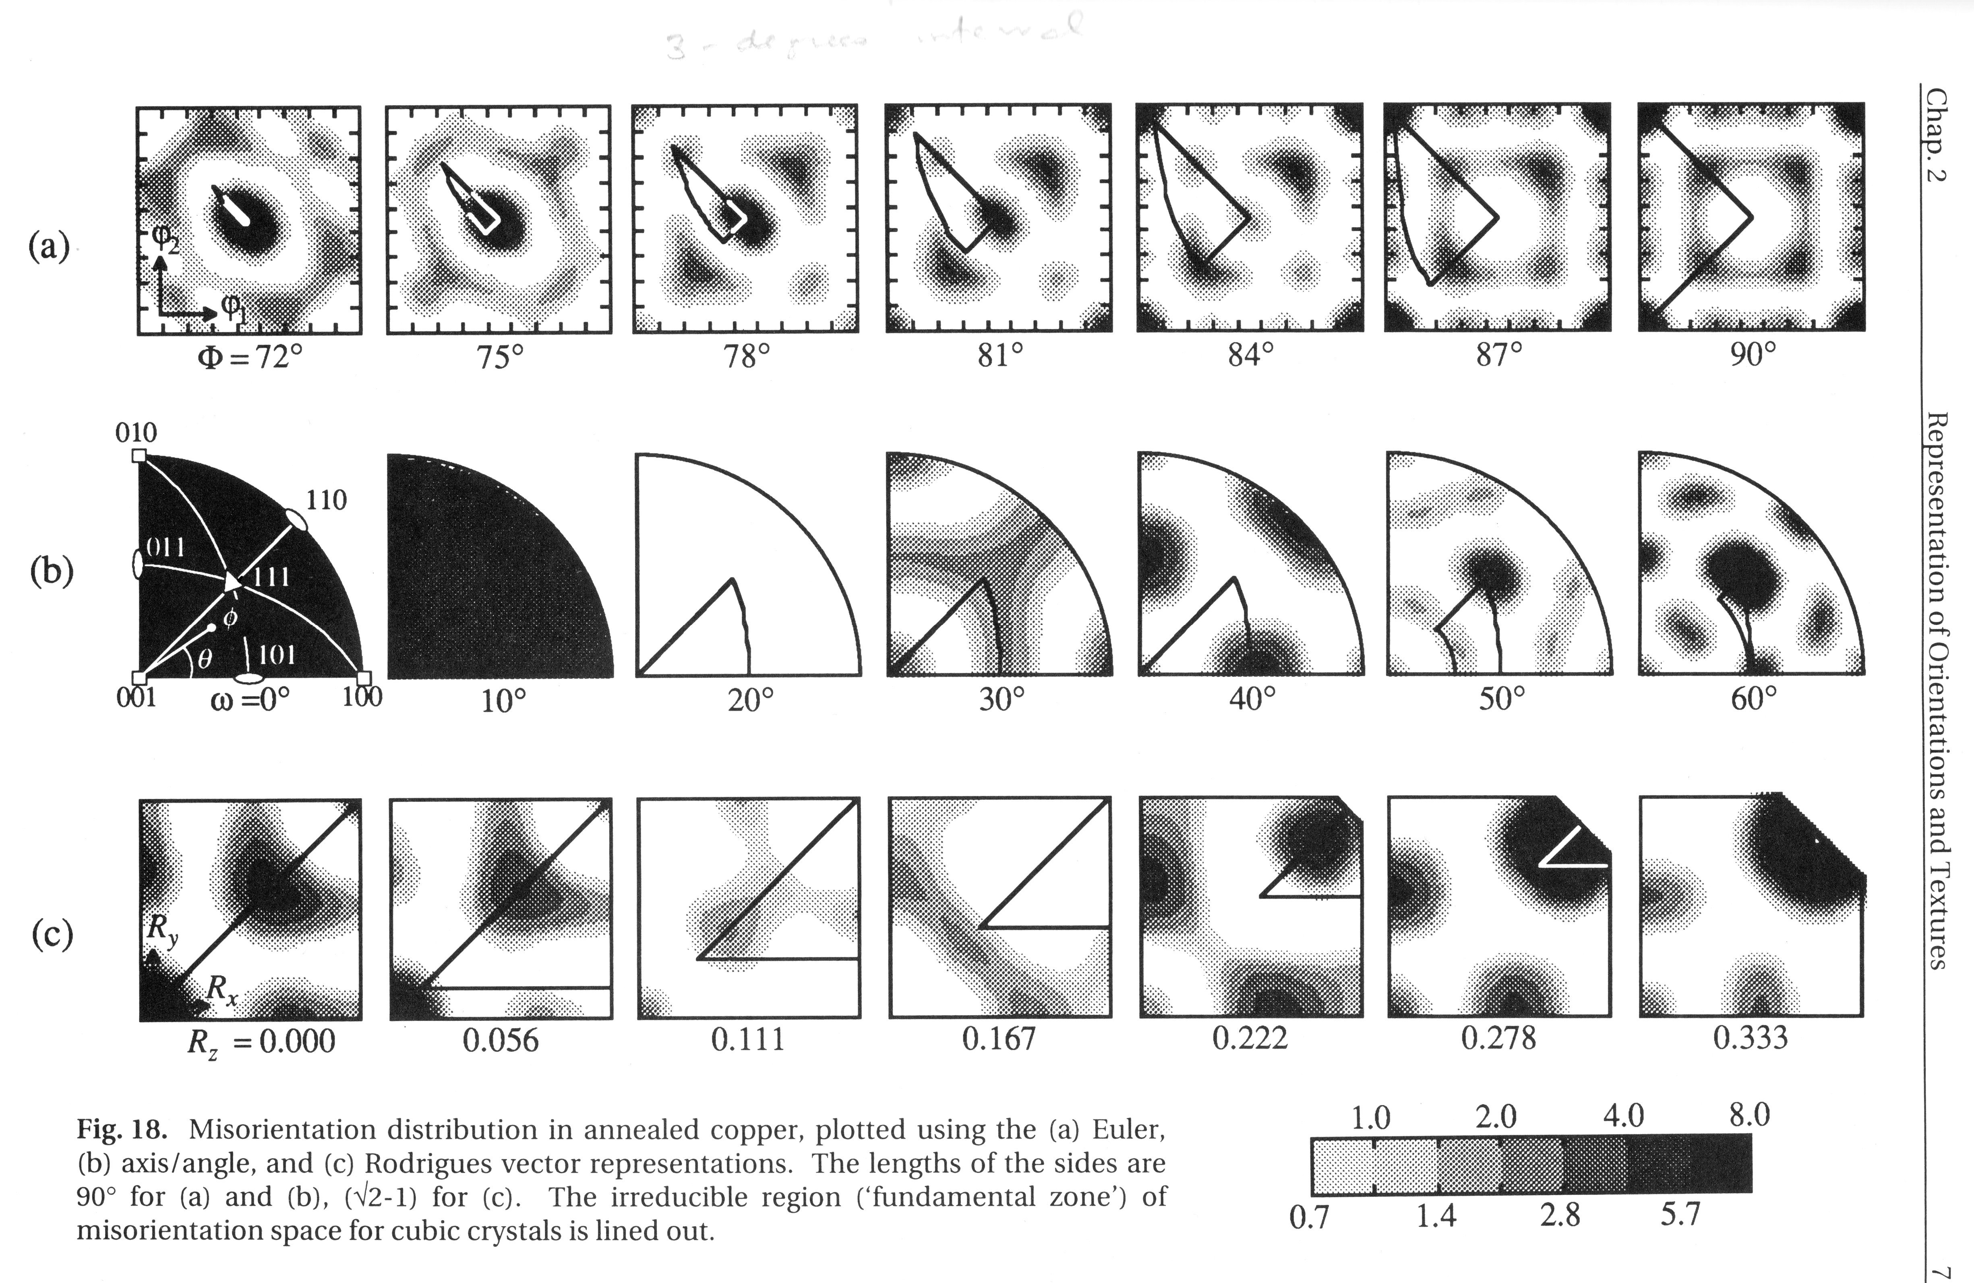
MD for Annealed Copper
2 peaks: 60°<111>, and
38°<110>
Kocks, Ch.2

Slide 48
Misorientation Distributions
The concept of a Misorientation Distribution (MD, MODF or MDF) is analogous to an Orientation Distribution (OD or ODF).
Relative frequency in the space used to parameterize misorientation, e.g. 3 components of Rodrigues vector, f(R₁,R₂,R₃), or 3 Euler angles f(φ₁,Φ,φ₂)
or axis-angle f(θ, n).
Probability density (but normalized to units of Multiples of a Uniform Density) of finding a given misorientation in a certain range of misorientation, d∆g (specified by all 3 parameters), is given by f(d∆g).
As before, when the word “function” is included in a name, this implies that a continuous mathematical function is available, such as obtained from a series expansion (with generalized spherical harmonics).

Slide 49
Area Fractions
Grain Boundaries are planar defects therefore we should look for a distribution of area (or area per unit volume, S_{V}).
Later we will define the Grain Boundary Character Distribution (GBCD) as the relative frequency of boundaries of a given crystallographic type.
Fraction of area within a certain region of misorientation space, ∆Ω, is given by the MDF, f, where Ω₀ is the complete space:

Slide 50
Normalization of MDF
If boundaries are randomly distributed then MDF has the same value everywhere, i.e. 1 (since a normalization is required).
Normalize by integrating over the space of the 3 parameters (exactly as for ODF, except that the range of the parameters is different, in general). Thus the MDF is not a true probability density function in the statistical sense.
If Euler angles used, the same equation applies (but one must adjust the normalization constant for the size of the space that is actually used):

Slide 51
Estimation of MDF from ODF
The EBSD softwares often refer to a “texture-based MDF”.
One can always estimate the misorientations present in a material based on the texture. If grains are inserted at random, then the probability of finding a given boundary/misorientation type is the sum of all the possible combinations of orientations that give rise to that misorientation.
Therefore, one can estimate the MDF, based on an assumption of randomly placed orientations, drawn from the ODF, thus:
This texture-derived estimate is exactly the texture-based MDF mentioned above. It can be used to normalize the MDF obtained by characterizing grain boundaries in an EBSD map. Note that texture can strongly affect the MD, e.g., Heidelbach et al., below.
F. Heidelbach, H. R. Wenk, S. R. Chen, J. Pospiech, and S. I. Wright, "Orientation and misorientation characteristics of annealed, rolled and recrystallized copper" Materials Science and Engineering A 215, 39-49 (1996)

Slide 52
Differences in Orientation
Preparation for the math of misorientations: the difference in orientation between two grains is a rotation just as is the rotation that describes a texture component.
Careful! The application of symmetry is different from orientations because crystal symmetry applies to both sides of the relationship (but not sample symmetry),
Convention: we use different methods (Rodrigues vectors, or axis-angle) to describe g.b. misorientation than for texture (but we could use Euler angles for everything, for example).

Slide 53
Example: Twin Boundary in fcc
The energy of the coherent twin GB is exceptionally low because of the the perfect atomic fit between the two surfaces.
<111> rotation axis,
common to both crystals
θ=60°
CSL: Σ3
Axis/Angle: 60°<111>
Rodrigues: [1/3, 1/3, 1/3]
Quaternion: [1/2, 1/2, 1/2, 1/2]
MATRIX REPRESENTATION:
[ 0.667 0.667 -0.667 ]
[ -0.333 0.667 0.667 ]
[ 0.333 -0.333 0.667 ]
Porter & Easterling fig. 3.12/p123
There is also a minimum g.b. energy “twin” in bcc metals, which is 60°<111> with a {112} normal

Slide 54
Coherent vs. Incoherent Twin
The word “coherent” refers to coherency or matching of atoms across an interface. When two close-packed 111 planes (in fcc materials) are placed in contact, there are two positions (relative rotations, with in-plane adjustments) that provide exact atom matching. One results in no boundary at all, and the other has a 60° misorientation about the interface normal. This latter is the “coherent twin”.
Any interface with the same misorientation but a different normal than 111 is an incoherent twin boundary because the atoms do not fit together exactly.
Fcc metals with medium to low stacking energy commonly exhibit high fractions of coherent twin boundaries or “annealing twins”.
The word “twin” is also used for deformation twins. In the most general sense, it refers to pairs of orientations related by a mirror; centro-symmetry allows a proper rotation to accomplish the same relationship. We return to this topic when we discuss Coincident Site Lattice (CSL) misorientations.
This will be addressed in more detail elsewhere.
For atomistic calculations of g.b. energy, see: Olmsted, D. L., S. M. Foiles et al. (2009), "Survey of computed grain boundary properties in face-centered cubic metals: I. Grain boundary energy." Acta materialia 57: 3694-3703.

Slide 55
Grain Boundary Representation
Axis-angle representation: axis is the common crystal axis (but could also describe the axis in the sample frame); angle is the rotation angle, θ.
3x3 Rotation matrix, ∆g=g_{B}g_{A}⁻¹.
Rodrigues vector: 3 component vector whose direction is the misorientation axis direction and whose length is equal to the tangent of 1/2 of the rotation angle, θ :
R = tan(θ/2)v,
v is a unit vector representing the rotation axis.

Slide 56
Misorientation +Symmetry
The crystal symmetry pre-multiplies the orientation matrix
∆g =
(O_{c} g_{B})(O_{c} g_{A})⁻¹
= O_{c}g_{B}g_{A}⁻¹O_{c}⁻¹ = O_{c}g_{B}g_{A}⁻¹O_{c}.
Note the presence of symmetry operators pre- & post-multiplying the misorientation; no inverse is needed for a symmetry operator (member of a finite group).

Slide 57
Symmetry: how many equivalent representations of misorientation?
Axis transformations:
24 independent operators (for cubic) present on either side of the misorientation. Two equivalents from switching symmetry, i.e. the fact that there is no (physical) difference between passing from grain A to grain B, versus passing from grain B to grain A.
Number of equivalents = 24x24x2=1152.

Slide 58
Rodrigues vector, contd.
Many of the boundary types that correspond to a high fraction of coincident lattice sites (i.e. low sigma values in the CSL model) occur on the edges of the Rodrigues space.
CSL boundaries have simple values, i.e. components are reciprocals of integers:
e.g., twin in fcc = (1/3,1/3,1/3) ≡ 60° <111> ≡ Σ3.
The “sigma number” is the reciprocal of the fraction of common (coincident) sites between the lattices of the two grains.
RF space is also useful for texture representation.
CSL theory of grain boundaries will be explained in a later lecture: for now, think of a CSL type as a particular (mathematically singular) misorientation for which good atomic fit may be expected (and therefore special properties). A list of values for CSL types up to Σ=29 is provided in the supplemental slides.
How does one compute how near a GB is to a CSL boundary type? The answer is to first make sure that both are in the same FZ, then compute the misorientation between them, in exactly the same way as for a pair of orientations. This is described in more detail in the lecture on CSLs.

Slide 59
Examples of symmetry operators in various parameterizations
Diad on z
or C_{2z}, or L₀₀₁²:
Triad about [111], or
120°-<111>, or, L₁₁₁³:
Note how infinity is a common value in the Rodrigues vectors that describe 180° rotations (2-fold diad axes). This makes Rodrigues vectors awkward to use from a numerical perspective and is one reason why (unit) quaternions are used.

Slide 60
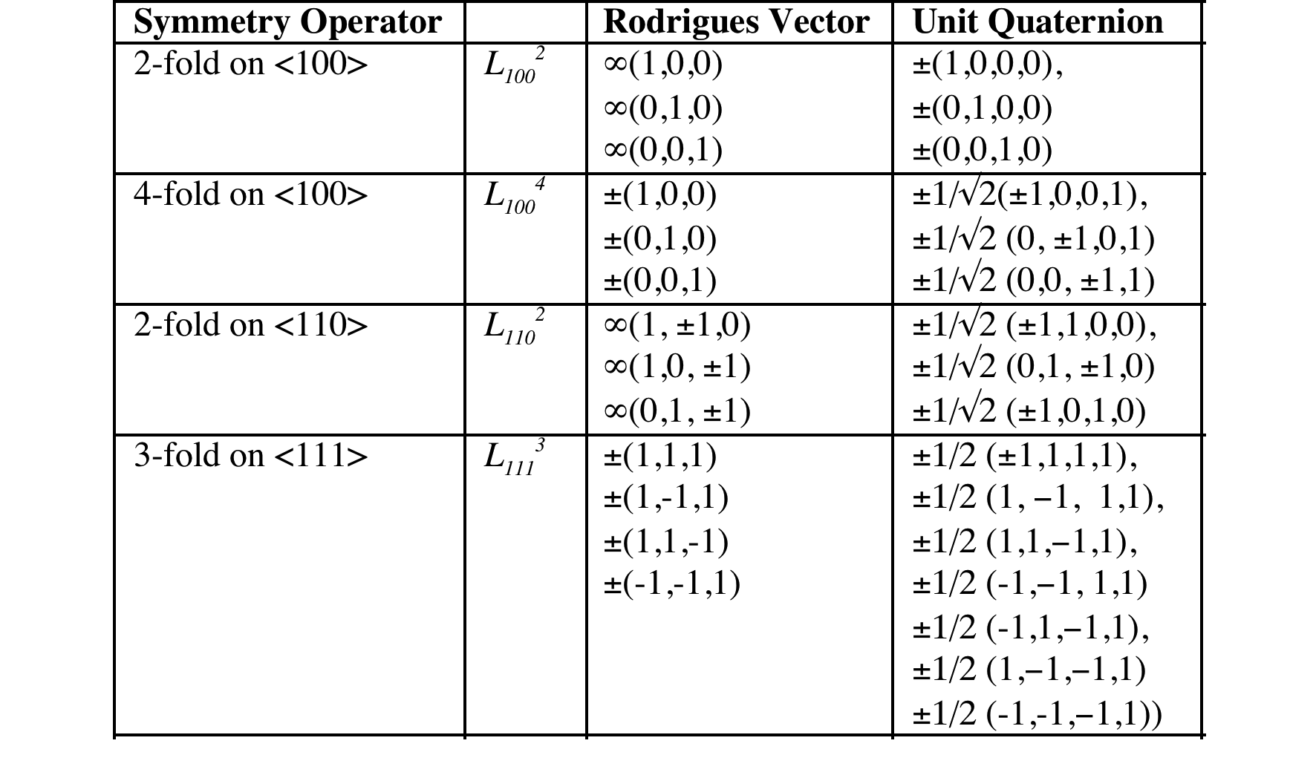
Cubic Crystal Symmetry Operators
The numerical values of these symmetry operators can be found at:
http://pajarito.materials.cmu.edu/texture_subroutines: quat.cubic.symm etc.

Slide 61
Symmetry in Rodrigues space
Demonstration of symmetry elements as planes
Illustration of action of a symmetry element
-90° about [100] which is the Rodrigues vector [-1,0,0].
Order of application of elements to active rotations.
In this case, it is useful to demonstrate that any vector on the plane ρ₁ = √2-1 is mapped
onto the plane ρ₁ = -1(√2-1).

Slide 62
Example: 90° <100>
Consider the vector [√2−1, ρ₂, ρ₃] acted on by the operator [-1,0,0], i.e. -90° about [100]:
ρ_{C} = (ρ_{A}, ρ_{B}) = {ρ_{A} + ρ_{B} - ρ_{A} x ρ_{B}}/{1 - ρ_{A}•ρ_{B}}
Cross product
term
Scalar product
term
Any point outside the plane defined by R₁ = (√2−1) will be equivalent to a point inside the plane R₁ = -(√2−1). Thus this pair of planes define edges of the fundamental zone.

Slide 63
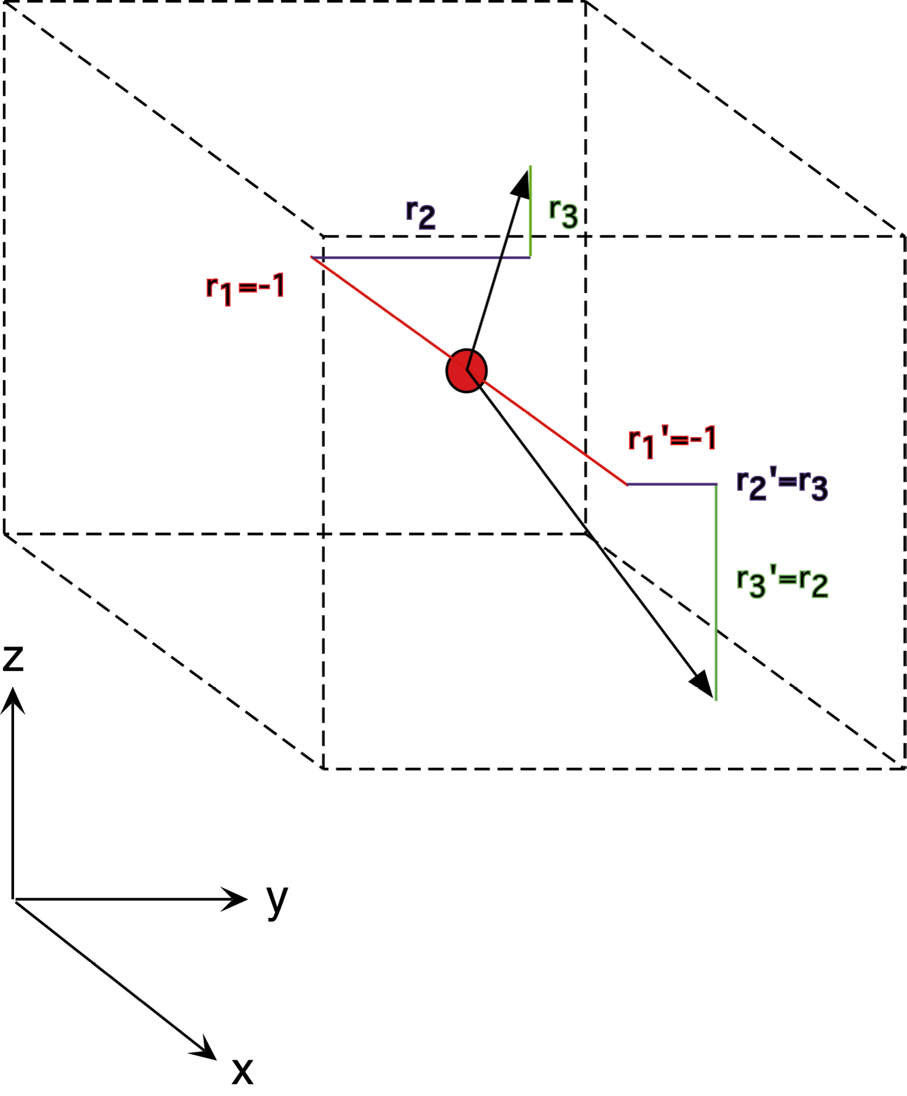
Action of 90° about [100]
Inspection of the result shows that any point on the plane ρ₁ = √2-1 is mapped onto a new, symmetry-related point lying on the plane ρ₁ = -1*(√2-1), regardless of the values of the other two parameters of the Rodrigues vector.
The re-appearance of a point as it passes through a symmetry element at a different surface of the fundamental zone has been likened to the umklapp process for electrons.

Slide 64
Symmetry planes in RF space
The effect of any symmetry operator in Rodrigues space is to insert a dividing plane in the space. If R (= tan(θ/2)v) is the vector that represents the symmetry operator (v is a unit vector), then the dividing plane is y + tan(±θ/4)v, where y is an arbitrary vector perpendicular to v.
This arises from the geometrical properties of the space (exercise for the reader: prove this property of the Rodrigues-Frank vector).

Slide 65
Fundamental Zone, FZ
By setting limits on all the components (and confining the axis associated with an RF vector to the SST) we have implicitly defined a Fundamental Zone.
The Fundamental Zone is simply the set of (mis-)orientations for which there is one unique representation for any possible misorientation. This unique representation is sometimes termed the disorientation.
Note: the standard 90x90x90 region in Euler space for orientations contains 3 copies of the FZ for cubic-orthorhombic symmetry. The 90x90x90 region in Euler space for misorientations contains 48 copies of the FZ for cubic-cubic symmetry. Just as with orientations, so for misorientations, we can apply group theory to compute the size of the (mis-)orientation space needed for a FZ.

Slide 66
Size, Shape of the Fundamental Zone
We can use some basic information about crystal symmetry to set limits on the size of the FZ.
Clearly in cubic crystals we cannot rotate by more than 45° about a <100> axis before we encounter equivalent rotations by going in the opposite direction; this sets the limit of
R₁=tan(22.5°)=√2-1.
This defines a plane perpendicular to the R₁ axis.

Slide 67
Size, Shape of the Fundamental Zone
Similarly, we cannot rotate by more than 60° about <111>, which sets a limit of (1/3,1/3,1/3) along the <111> axis, or
√{R₁²+R₂²+R₃²}=tan(30°)=1/√3. Note that this is the limit on the length of the Rodrigues vector // 111. In general, the limit is expressed as the equation of a plane, R₁+R₂+R₃=1.
Symmetry operators can be defined in Rodrigues space, just as for matrices or Euler angles. However, we typically use unit quaternions for operations with rotations because some of the symmetry operators, when expressed as Rodrigues vectors, contain infinity as a coefficient, which is highly inconvenient numerically!
The FZ for grain boundaries in cubic materials has the shape of a truncated pyramid.

Slide 68
Delimiting planes
For the combination of O(222) for orthorhombic sample symmetry and O(432) for cubic crystal symmetry, the limits on the Rodrigues parameters are given by the planes that delimit the fundamental zone.
These include (for cubic crystal symmetry with O(432)):
- six octagonal facets orthogonal to the <100> directions, at a distance of tan(π/8) (=√2-1) from the origin, and
- eight triangular facets orthogonal to the <111> directions at a distance of
tan(π/6) (=√3⁻¹) from the origin.
The sample symmetry operators appear as planes that intersect the origin, with normals parallel to the associated rotation axis. A slightly odd feature of RF-space (not well explained in the books) is that each 2-fold operator (diad) excludes ½ the space. If one were to literally divide the space by two perpendicular to each direction, then one would be left with only an octant, which would contain only 1/8 the volume of the original. However, one has to recall that combining any pair of diads (from O(222)) leads the same result and adding a third diad makes no difference. Strictly speaking, one should keep the all-positive octant and the all-negative octant. It is convenient for representation to keep two adjacent octants, as shown by Neumann (next slide). This “trick” has the effect of making the y-axis look different from x and z, but this is a visual convenience.

Slide 69
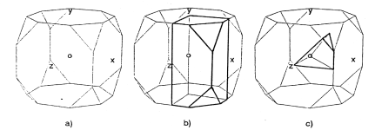
Symmetry planes in RF space
4-fold axis on <100>
3-fold axis on <111>
Cubic crystal symmetry,
no sample symmetry
Cubic-orthorhombic
Cubic-cubic symmetry
Neumann, P. (1991). "Representation of orientations of symmetrical objects by Rodrigues vectors." Textures and Microstructures 14-18: 53-58

Slide 70
Truncated pyramid for cubic-cubic misorientations
R1+R2+R3=1
l
=111
l
=100
(√2-1,√2-1))
(√2-1,0)
l
=110
The fundamental zone for grain boundaries between cubic crystals is a truncated pyramid.

Slide 71
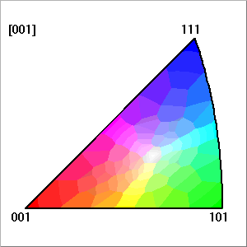
Range of Values of RF vector components for grain boundaries in cubic materials
Q. If we use Rodrigues vectors, what range of values do we need to represent grain boundaries?
A. Since we are working with a rotation axis that is based on a crystal direction then it is logical to confine the axis to the standard stereographic triangle (SST).
Colored triangle copied from TSLTM software

Slide 72
Shape of RF Space for cubic-cubic
z, ρ₃
origin
y, ρ₂
x=y=z, ρ₁=ρ₂=ρ₃, [111]
x, ρ₁, [100]
x=y, ρ₁=ρ₂
[110]
Distance (radius) from origin represents the misorientation angle (tan(θ/2))
Each colored line represents a low-index rotation axis, as in the colored triangle.

Slide 73
Range of RF vector components
ρ₁ corresponds to the component //[100];
ρ₂ corresponds to the component //[010];
ρ₃ corresponds to the component //[001];
ρ₁ > ρ₂ > ρ₃ > 0
0 ≤ ρ₁ ≤ (√2-1)
ρ₂ ≤ ρ₁
ρ₃ ≤ ρ₂
ρ₁ + ρ₂ + ρ₃ ≤ 1
45° rotation about <100>
60° rotation about <111>

Slide 74
Alternate Notation: (R₁ R₂ R₃)
R₁ corresponds to the component //[100];
R₂ corresponds to the component //[010];
R₃ corresponds to the component //[001];
R₁ > R₂ > R₃ > 0
0 ≤ R₁ ≤ (√2-1)
R₂ ≤ R₁
R₃ ≤ R₂
R₁ + R₂ + R₃ ≤ 1

Slide 75
Sections through RF-space
For graphical representation, the R-F space is typically sectioned parallel to the 100-110 plane.
Each triangular section has R₃=constant.
Most of the special CSL relationships lie on the 100, 110, 111 lines.
base of pyramid

Slide 76
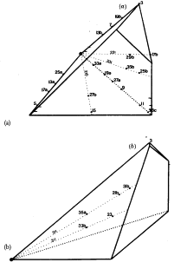
RF-space
<111>
ρ₁ + ρ₂ + ρ₃ ≤ 1
<110>
Exercise: show that the largest possible misorientation angle corresponds to the point marked by o. Based on the geometry of the fundamental zone, calculate the angle (as an inverse tangent). Hint: the answer is in Frank’s 1988 paper on Rodrigues vectors.
<111>
<100>, ρ₁
<110>
<100>, ρ₁
[Randle]

Slide 77
Density of points in RF space
The variation in the volume element with magnitude of the RF vector (i.e., with misorientation angle) is such that the density of points decreases slowly with distance from the origin.
For a random distribution, low angle boundaries are rare, so in a one-parameter distribution based on misorientation angle, the frequency increases rapidly with angle up to the maximum at 45°. Think of integrating the volume in successive spherical layers (layers of an onion). The outer layers have larger volumes than the inner layers.
Mackenzie, J. K. (1958). “Second paper on statistics associated with the random orientation of cubes.” Biometrica 45: 229-240.

Slide 78
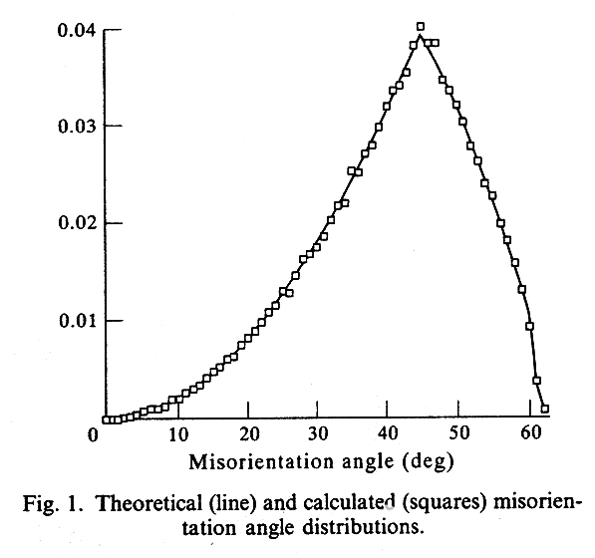
Mackenzie Distribution for cubic-cubic
Frequency distribution with respect to disorientation angle for randomly distributed grain boundaries.
This result can be easily obtained by generating sets of random orientations and applying crystal symmetry to find the minimum rotation angle for each set, then binning, normalizing (to unit area) and plotting.
Note: this is a true probability density function
Morawiec A, Szpunar JA, Hinz DC (1993) Acta metall. mater. 41 2825.
The peak at 45° is associated with the 45° rotation limit on the <100> axis - again, think of integrating over a spherical shell associated with each value of the misorientation angle.

Slide 79
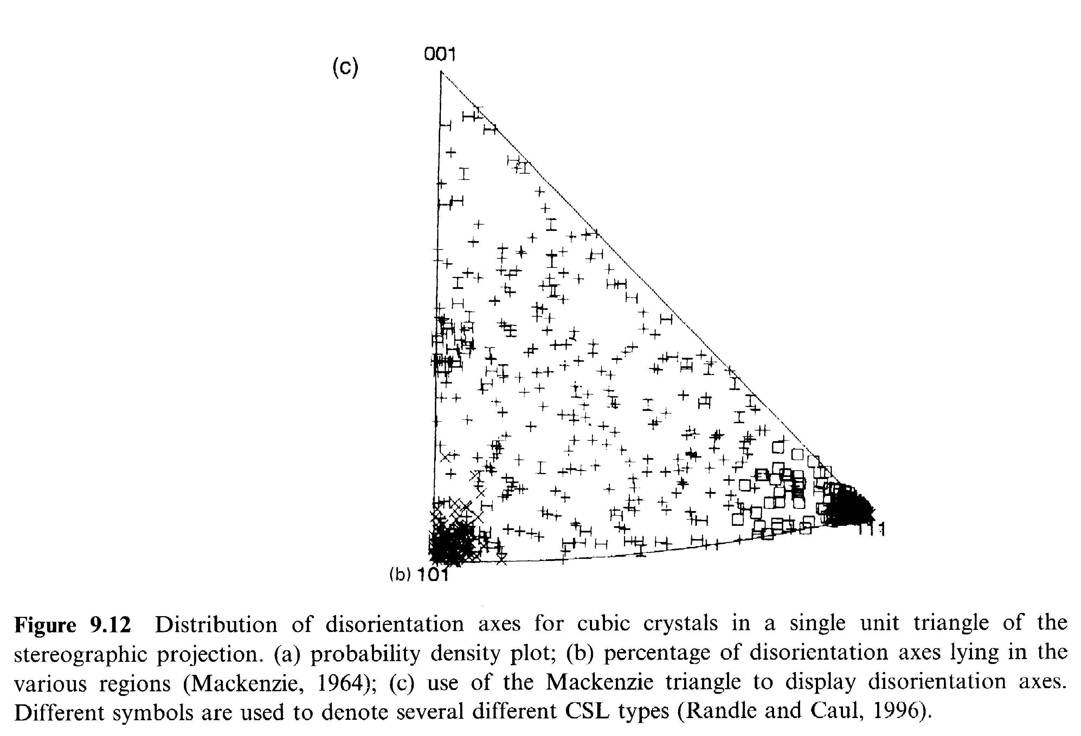
Experimental Example
Note the bias to certain misorientation axes within the SST, i.e. a high density of points close to <101> and <111>.
[Randle]

Slide 80
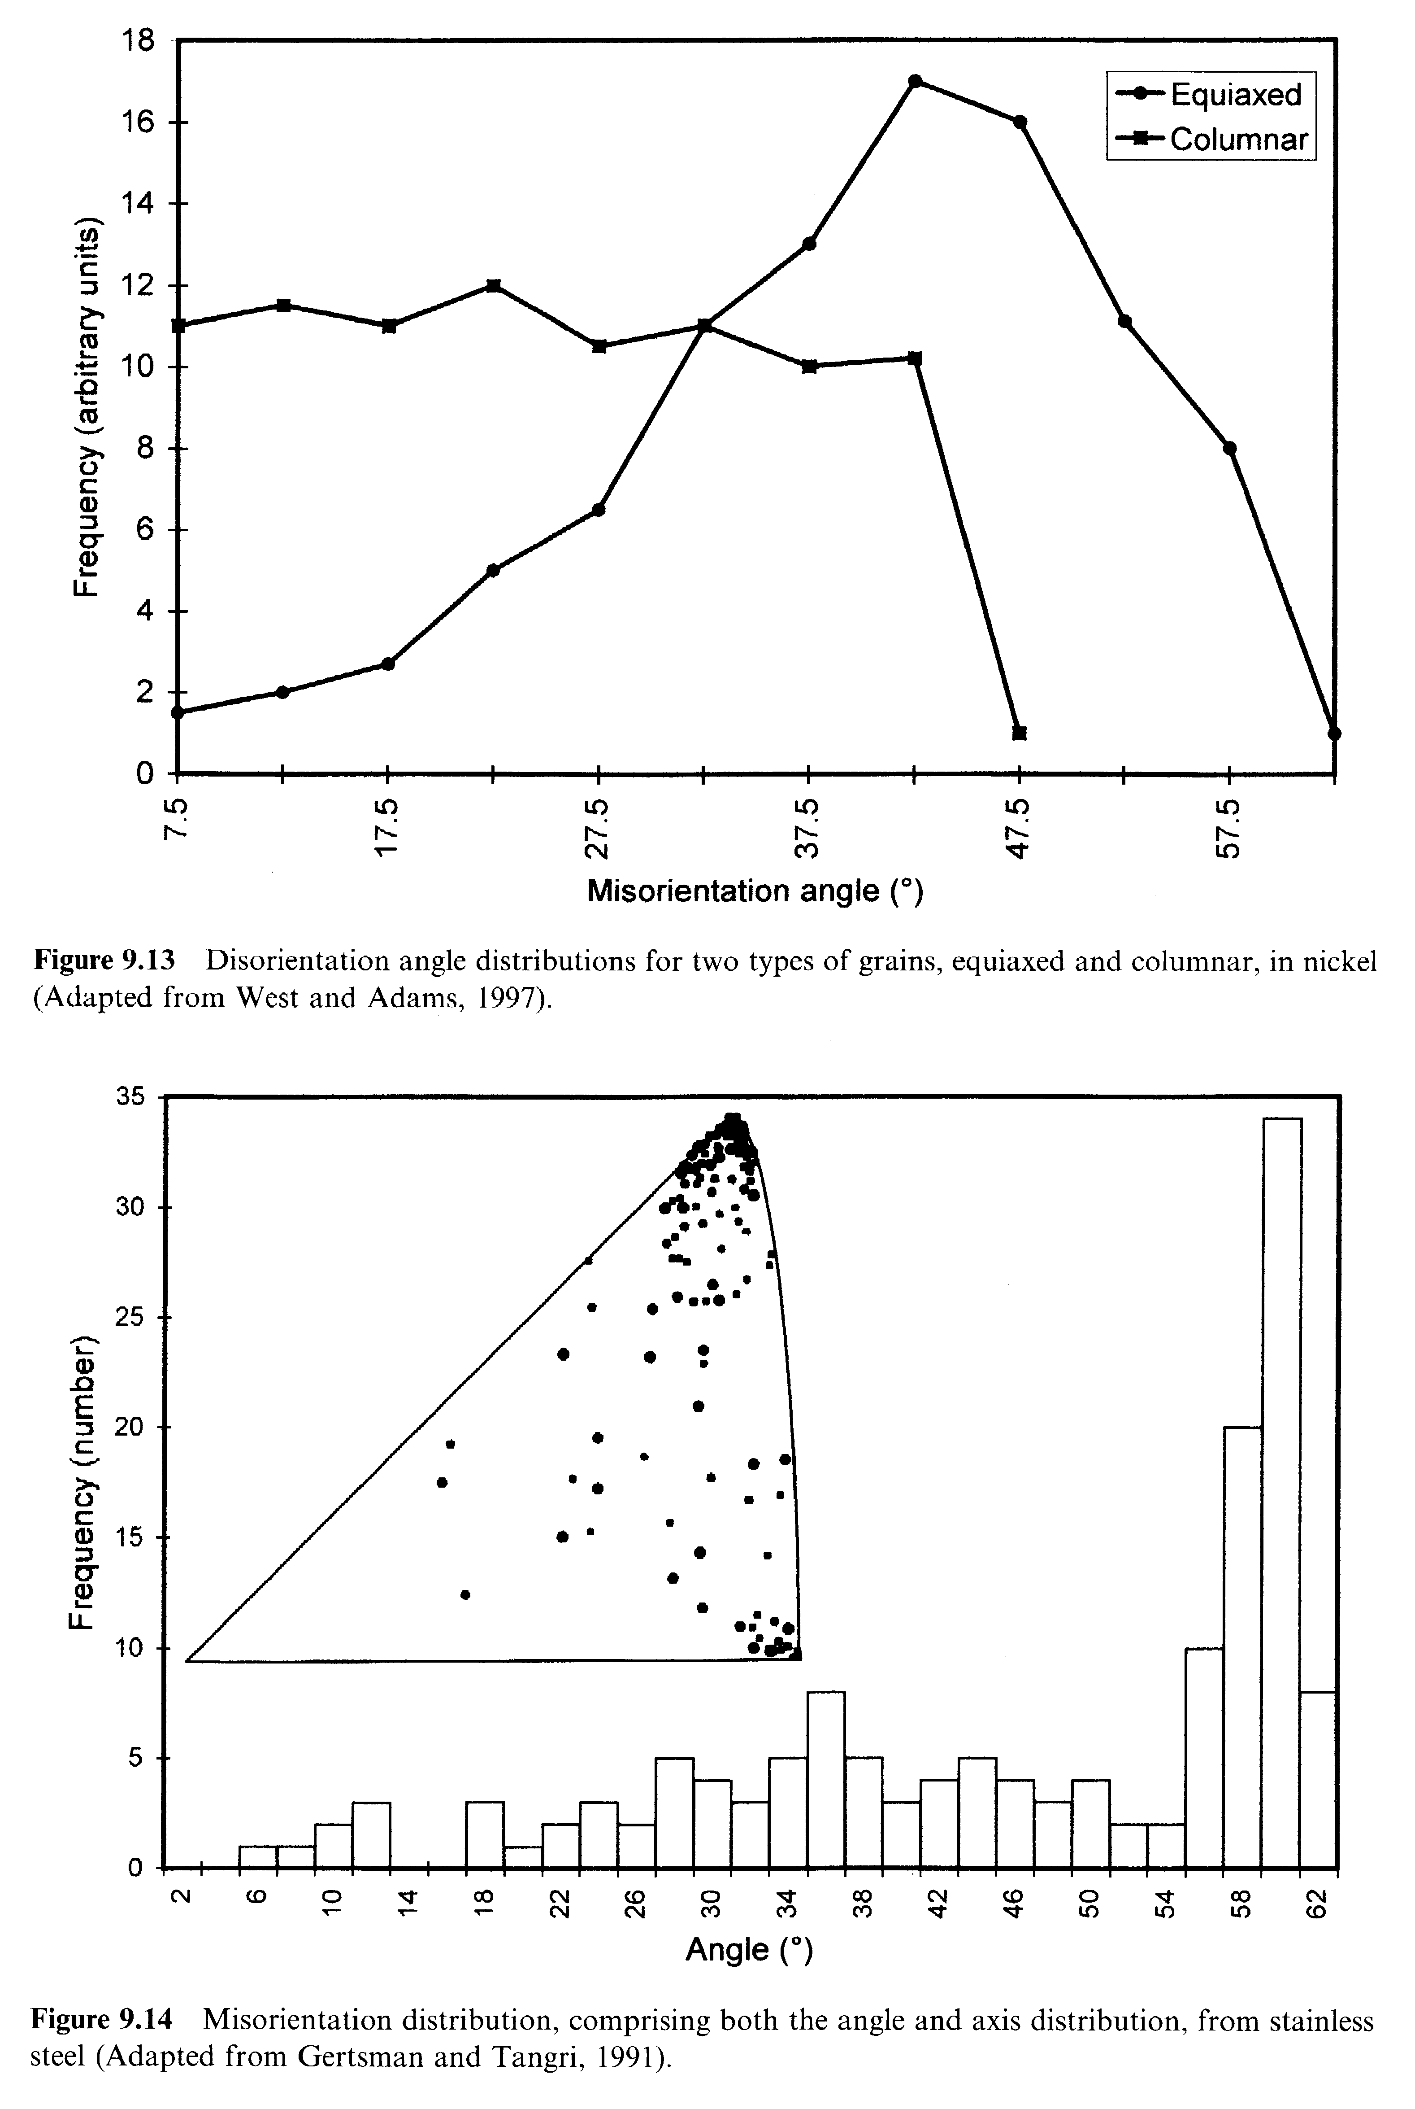
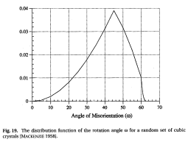
Experimental Distributions by Angle
<100> fiber texture, columnar casting
Random,
equi-axed
casting
Fiber textures with a uniform distribution about the fiber axis give rise to uniform densities in the MD because they are one-parameter distributions. The cut-off angle depends on symmetry: thus 45° for 100 and 60° for 111.
Random:
[Randle]

Slide 81
Ideal Fiber Textures > MDF
For a perfect <100> fiber texture, all grains are aligned with a <100> direction // a particular sample direction (e.g., surface normal in a thin film sample). This limits the Euler angles to a variation in only, say, the 1st angle. Symmetry means that any value >45° is equivalent to one in the 0-45° range. The MDF from such a texture is then a “top-hat” function with value equal to 1/45 or 2.2222e-2.
Similarly for a perfect <111> fiber texture, all grains are aligned with a <111> direction // a particular sample direction (e.g., surface normal in a thin film sample). This limits the Euler angles to a variation in only, say, the 1st angle. Symmetry (3-fold on 111) means that any value >60° is equivalent to one in the 0-60° range. The MDF from such a texture is then a “top-hat” function with value equal to 1/60 or 1.66666e-2.

Slide 82
Choices for MDF Plots
Euler angles: use subset of 90x90x90 region, starting at Φ=72°.
Axis-angle plots, using SST (or 001-100-010 quadrant) and sections at constant misorientation angle.
Rodrigues vectors, using either square sections, or triangular sections through the fundamental zone.

Slide 83
MDF for Annealed Copper
2 peaks: 60°<111>, and
38°<110>
Kocks, Ch.2

Slide 84
Summary
Grain boundaries require 3 parameters to describe the lattice relationship because it is a rotation (misorientation).
Misorientation is calculated from the product (or composition) of one orientation and the inverse of the other.
Almost invariably, misorientations between two crystals are described in terms of the local, crystal frame so that the misorientation axis is in crystal coordinates.
To find the minimum misorientation angle, one need only apply one set of 24 symmetry operators for cubic crystals. However, to find the full disorientation between two cubic crystals, one must apply the symmetry operators twice (24x24) and reverse the order of the two crystals (switching symmetry). In general, one chooses a particular unit (spherical) triangle (or quadrant, or whatever is appropriate to the crystal symmetry) and selects the rotation axis to lie within that triangle.
The result of applying all the available symmetry is termed the disorientation.

Slide 85
Summary
Differences between orientation and misorientation? There are some differences: misorientation always involves two orientations and therefore (in principle) two sets of symmetry operators (as well as switching symmetry for grain boundaries).
{∆g} = (O_{c} g_{B})(O_{c} g_{A})⁻¹ = O_{c}g_{B}g_{A}⁻¹O_{c}⁻¹.
Orientation involves only one orientation, although one can think of it as being calculated in the same way as misorientation, just with one of the orientations set to be the identity (matrix), I.
So, leaving out sample symmetry and starting with the same formula, the set of equivalent orientations for grain B is:
{g_{B}} = (O_{c} g_{B})(O_{c} I)⁻¹ = O_{c}g_{B}I = O_{c}g_{B}.

Slide 86
Summary, contd.
Misorientation distributions are defined in a similar way to orientation distributions, except that, for grain boundaries, they refer to area fractions rather than volume fractions. The same parameters can be used for misorientations as for orientations (but the fundamental zone (FZ) is different.
In addition to the misorientation, boundaries require an additional two parameters to describe the plane, for a total of 5 parameters.
Rodrigues vectors are particularly useful for representing grain boundary crystallography; axis-angle and (unit) quaternions also useful.

Slide 87
Questions
What is a grain boundary?
What is misorientation, and how does it related to grain boundaries?
How can we quantify or parameterize misorientation?
What is the misorientation distribution?
How do we apply symmetry to misorientations, and how does that affect the fundamental zone for misorientations?
What are typical 1D and 3D representations of MDs?

Slide 88
Questions: 2
What is a Rodrigues vector and how does it relate to an axis-angle description of a grain boundary misorientation?
What is the relationship between misorientation-with-normal and the tilt-twist approach to describing grain boundaries?
How do we mean by 5-parameter descriptions of grain boundaries?
What are examples of symmetry operators described by Rodrigues vectors?
How is symmetry revealed in Rodrifuges-Frank space?
What are the limits on the FZ in RF space for cubic-cubic misorientations?

Slide 89
References
A. Sutton and R. Balluffi (1996), Interfaces in Crystalline Materials, Oxford.
J. Howe (1997), Interfaces in Materials, Wiley.
Morawiec, A. (2003), Orientations and Rotations, Berlin: Springer.
Olaf Engler, Stefan Zaefferer and Valerie Randle (2024). Introduction to texture analysis: macrotexture, microtexture, and orientation mapping. CRC Press.
Frank, F. (1988), “Orientation mapping.” Metallurgical Transactions 19A: 403-408.
Neumann, P. (1991), “Representation of orientations of symmetrical objects by Rodrigues vectors”, Textures and Microstructures 14-18: 53-8
Mackenzie, J. K. (1958), Second paper on statistics associated with the random orientation of cubes Biometrica 45 229-40.
Adam J. Schwartz and Mukul Kumar, Electron Backscatter Diffraction in Materials Science, 2nd Ed., Springer, 2009.
Shoemake, K. (1985) Animating rotation with quaternion curves. In: Siggraph'85: Association for Computing Machinery (ACM)) pp 245-54.
mtex - Quantitative Texture Analysis Software; Texture Analysis with MTEX - Free and Open Source Software Toolbox, F. Bachmann, R. Hielscher, H. Schaeben: Solid State Phenomena (2010) 160 63-68
J. K. Mason and C. A. Schuh (2009), "The generalized Mackenzie distribution: Disorientation angle distributions for arbitrary textures" Acta materialia 57 4186-4197.

Slide 90
Supplemental Slides

Slide 91
Conversions for Axis
Matrix representation, a, to axis, [uvw]=v:
Rodrigues
vector:
Quaternion:
N.B. the axis is assumed to be from an axis transformation

Slide 92
Maximum rotation: cubics
The vertices of the triangular facets have coordinates (√2-1, √2-1, 3-2√2) (and their permutations), which lie at a distance √(23-16√2) from the origin. This is equivalent to a rotation angle of 62.7994…°, which represents the greatest possible rotation angle, either for a grain rotated from the reference configuration (i.e. orientation), or between two grains (i.e. disorientation).

Slide 93
How to Choose the
Misorientation Angle: quaternions
This algorithm is valid only for cubic-cubic misorientations and for obtaining only the angle (not the axis).
Arrange q₄ ≥ q₃ ≥ q₂ ≥ q₁ ≥ 0.
Choose the maximum value of the fourth component, q₄’, from three variants as follows:
[i] (q₁,q₂,q₃,q₄)
[ii] (q₁-q₂, q₁+q₂, q₃-q₄, q₃+q₄)/√2
[iii] (q₁-q₂+q₃-q₄, q₁+q₂-q₃-q₄, -q₁+q₂+q₃-q₄, q₁+q₂+q₃+q₄)/2
Reference: Sutton & Balluffi, section 1.3.3.4; see also H. Grimmer, Acta Cryst., A30, 685 (1974) for more detail.

Slide 94
Various Symmetry Combinations
Fundamental zones in Rodrigues space:
(a) no sample symmetry with cubic crystal symmetry;
(b) orthorhombic sample symmetry (divide the space by 4 because of the 4 symmetry operators in 222), see next slide for details;
(c) cubic-cubic symmetry for disorientations.
[after Neumann, 1991]

Slide 95
Effect of 2-fold Diads - schematic
Z-diad
Green indicates region not excluded by the symmetry operator; when combining two operators, only the union of the green regions is kept.
Y-diad
z
X-diad
y
Y-diad + X-diad
or
Z-diad + X-diad
or
Y-diad + Z-diad
ANY combination of two diads leads to the same result.
x

Slide 96
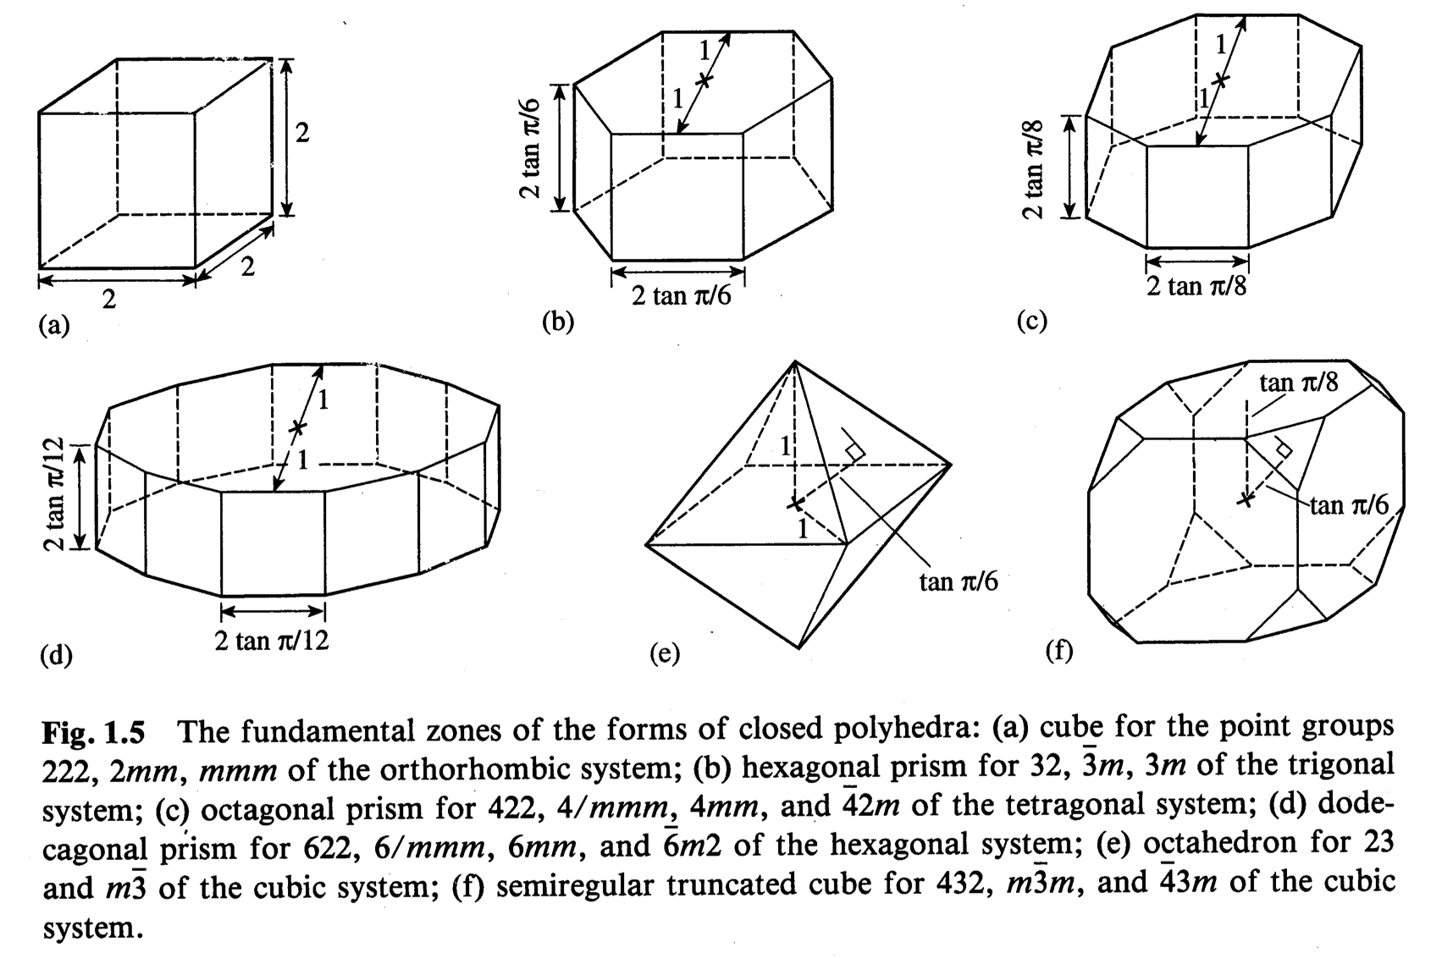
Fundamental Zones for Orientations
[Sutton & Balluffi]

Slide 97
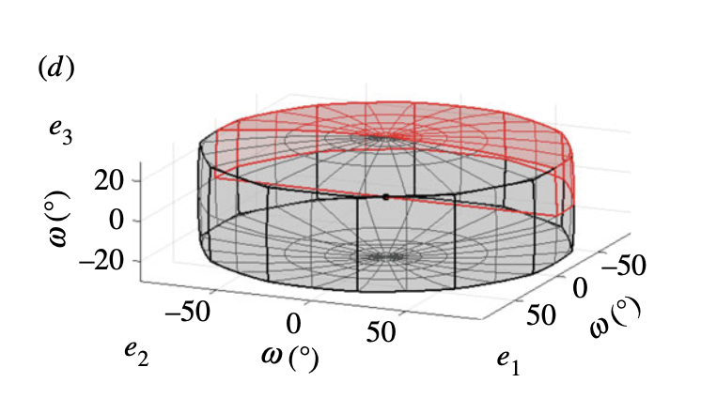
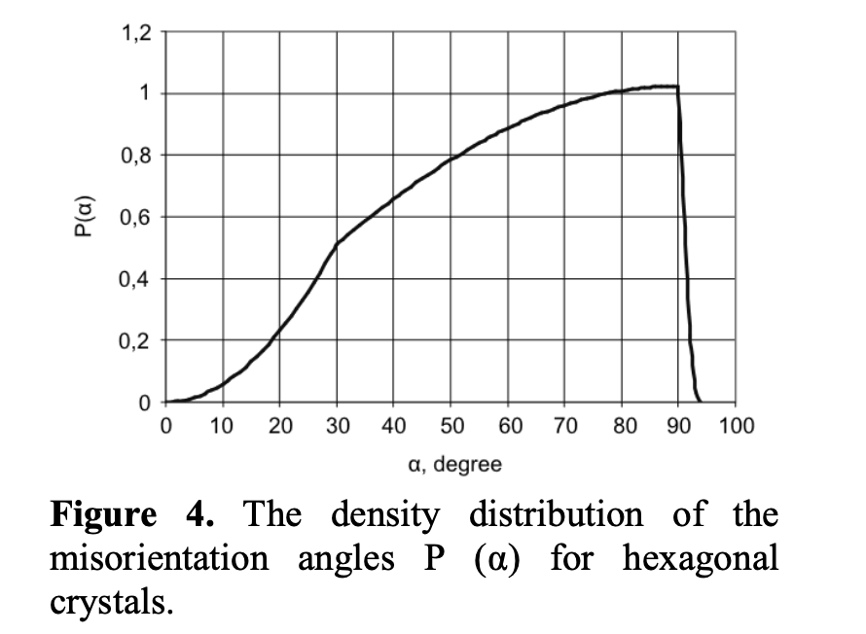
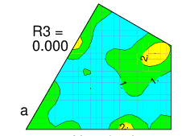
Maximum rotation angles
hexagonal
6-fold axis on c (hexagonal): maximum angle = 93°50’ (e.g., Krakow et al. 2017; Skrytnyy & Yaltzev 2016).
3-fold axis on c (trigonal systems):
The coordinates of the point of interest (projection onto R3=0 shown as a red dot) are: {1,tan(30°),tan(30°)}={1,1/√3,1/√3}. Distance from the origin =√[1+1/3+1/3]. Corresponding maximum rotation angle
= 2*arctangent(√1.6667)
= 2*52.239°=104.475°
trigonal

Slide 98
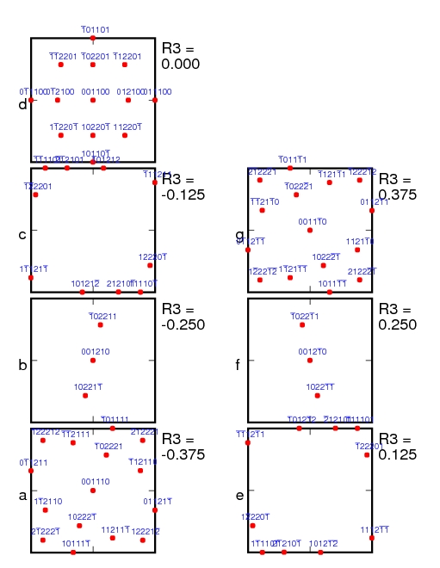
Rolling Texture Components for fcc in RF Space
Goss
Cube
Goss
Copper
Brass
Brass
Note how many of the standard components are located, either in the R₃=0 plane, or at the top/bottom of the space.
Note that the Cube appears only once, Goss appears twice, and Copper and Brass appear 4 times.
Copper
Copper
Brass
Brass
Copper

Slide 99
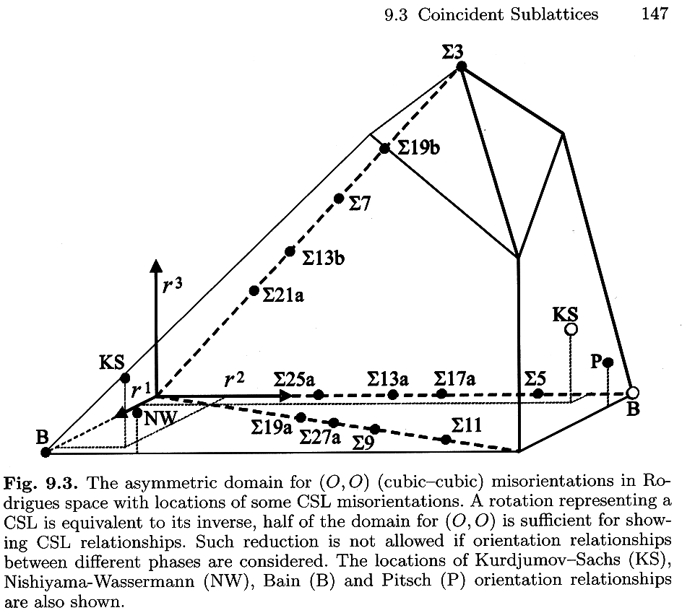
Another view of RF Space
This gives another view of the Rodrigues space for disorientations in cubic materials, with low-sigma value CSL locations noted.
In this case, the <100> misorientations are located along the r² line.
This also includes the locations of the most common Orientation Relationships found in phase transformations.
[Morawiec]

Slide 100
Table of CSL values in axis/angle, Euler angles, Rodrigues vectors
and quaternions
Sigma-9 values for Rodrigues vector and quaternion corrected 10th May 2007

Slide 101
Rodrigues vector normalization
The volume element, or Haar measure, in Rodrigues space is given by the following formula
[ρ = tan(θ/2)]:
Can also write in terms of an azimuth, χ, and declination , ζ, angles:
And finally in terms
of R₁, R₂, R₃:
ρ = √{R₁² + R₂² + R₃²} = tanθ/2; χ = cos⁻¹R₃;
ζ = tan⁻¹R₂/R₁; dn = sinχdχdζ; ρ² = R₁² + R₂² + R₃²

Slide 102
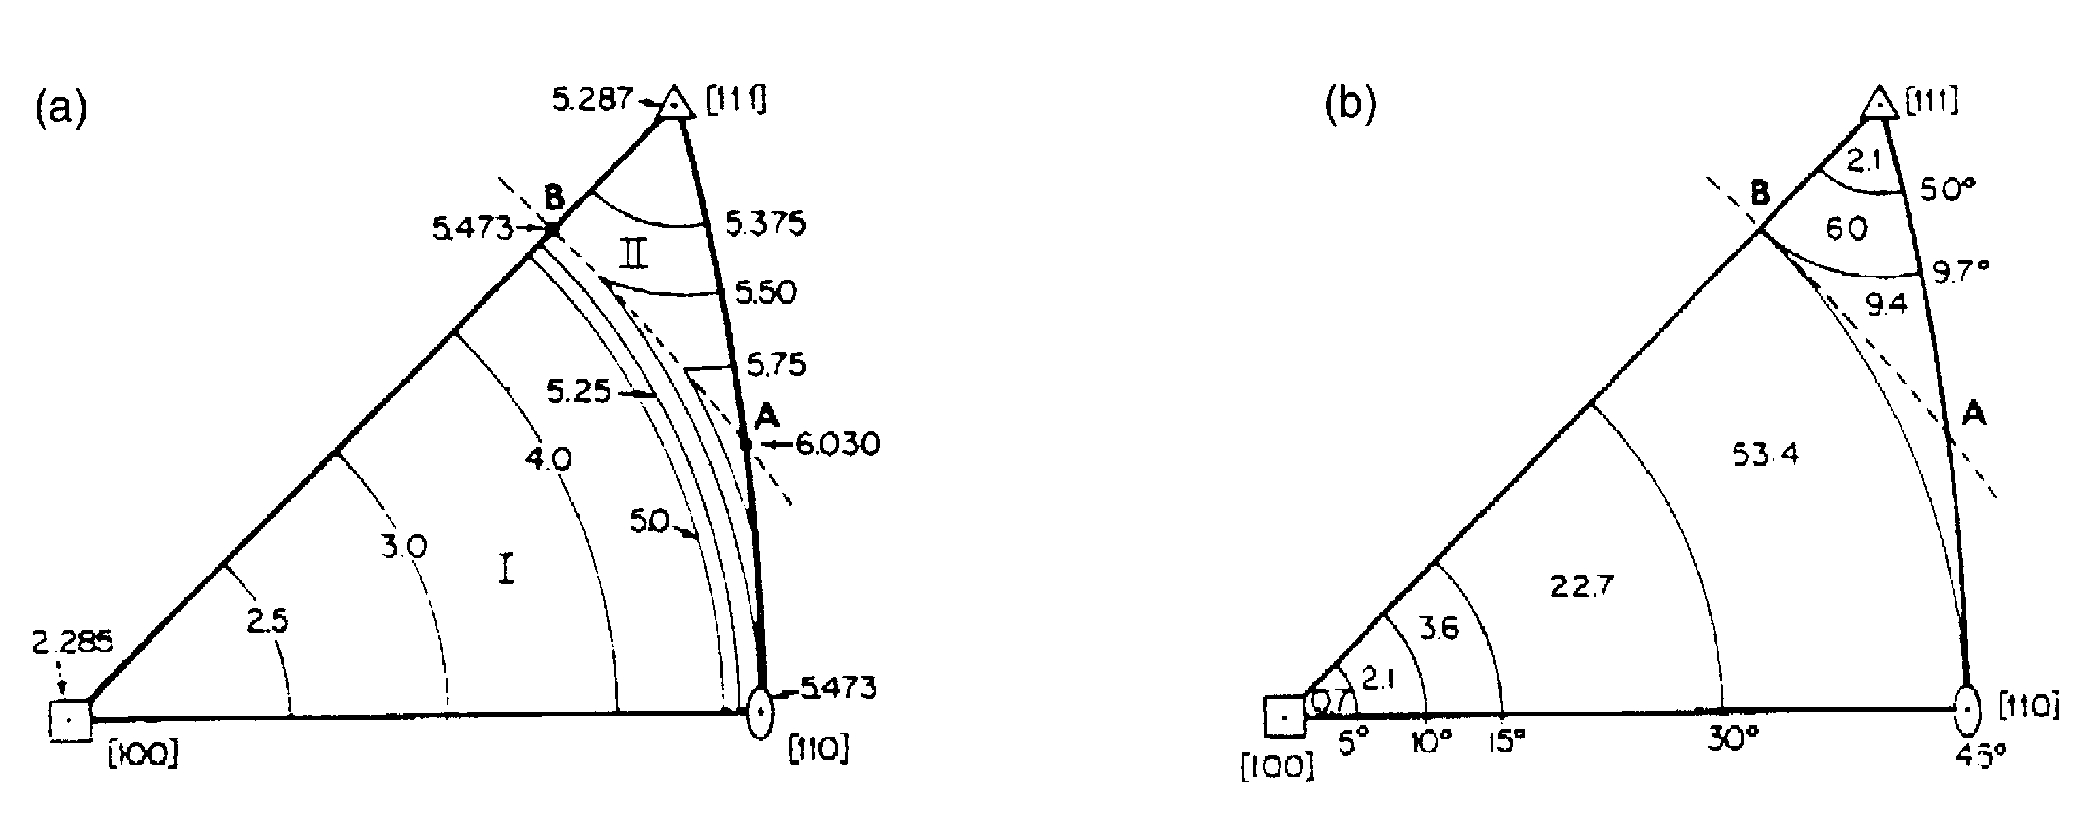
Density in the SST
Density or % in area
J.K. Mackenzie 1958

Slide 103
ID of symmetry operator(s)
For calculations (numerical) on grain boundary character, it is critical to retain the identity of each symmetry operator use to place a given grain boundary in the FZ.
That is, given O_{c} ∈O(432)=O_{i}{O₁,O₂,…,O₂₄}
one must retain the value of index “i” for subsequent use, e.g. in determining tilt/twist character.

Slide 104
Successive misorientations
There are problems where one needs to calculate the effect of two successive misorientations, taking into account variants. By “variants” we mean that the second misorientation (twin) can occur on any of the systems related by crystal symmetry. For example, if twinning occurs on more than one system, then the second twin can be physically contained within the first twin but still make a boundary with the original matrix. So, the problem is, how do we calculate the matrix-twin₂ misorientation, taking account of crystal symmetry and the possibility of (crystal) symmetry-related variants?
Matrix-twin₁
Matrix-twin₂
Matrix
twin₁
g’
g
twin₂
g’’
twin₁
g’
Matrix
twin₁-twin₂
g

Slide 105
Successive Twins
The key to this problem is to recognize that (a) the order of the two twins/misorientations does not matter, and (b) that one must insert an additional (crystal) symmetry element between the two twins/misorientations. In effect one treats each twin/misorientation (T) as a rotation (or orientation). The same procedure can be used for phase transformations, although one must be careful about the difference between going from phase 1 to phase 2, versus 2 to 1. We obtain a set of physically equivalent orientations, {g”}, starting from a matrix orientation, g, thus:
{g”} = (O_{c} T₂) O_{c}(O_{c} T₁)g = O_{c}T₂ O_{c} T₁ g.
Note the presence of symmetry operators pre-multiplying, as well the additional symmetry operator in between the two misorientations. This additional symmetry operator is applied in a manner that is equivalent to sample symmetry.
Curiously, the order in which the twins/misorientations are applied does not make any difference, for the three types of twins considered here (for Ti). The overall misorientation for matrix→twin₁→twin₂ is the same as matrix→twin₂→twin₁. The reason for this not very obvious result is the fact that the rotation axes coincide with mirror planes in the crystal symmetry. Accordingly, this is not a general result.
Thanks to Nathalie Bozzolo (Univ. Metz) for pointing out this problem.
For a (much) more detailed analysis of twin chains, see papers by Cayron.

Slide 106
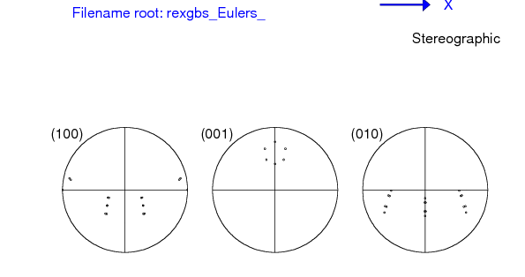
Successive twins: simple example
First let’s illustrate how this works with the first misorientation as 60° about 100, and the second as 15°, also about 100. We use hexagonal crystal symmetry so that we can view the 0001 pole figure and easily interpret the results. What we expect to see is that the second misorientation (twin, if you like) “decorates” the first twin, by producing additional, small changes in position relative to the first one. In this example, the two symmetry operators that are normally used to apply crystal symmetry to calculate disorientation have been omitted. If only the first misorientation of 60° had been applied, there would be only one pole in the 0001 pole figure ( at the center of the ring of six poles that you see).
{∆g} = T₂ O_{c} T₁

Slide 107
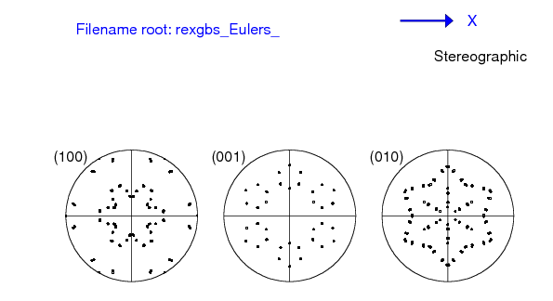
Successive twins: simple example
Now let’s add all the symmetry operators so that we see all the possible variants. Now there are six rings of six poles in the 0001 pole figure. Remember: pole figures of pairs of successive twins vary with the order in which the twins are applied, even though the misorientations remain the same.
{∆g} =
(O_{c} T₂) O_{c}(O_{c} T₁)
= O_{c}T₂ O_{c} T₁O_{c}
= O_{c}T₂ O_{c} T₁ O_{c}.

Slide 108

Successive twins: Zr, CT-TT2
This illustrates the result for a hexagonal system (Zr) with the two twins,
a) tensile twins (twin₂)
(TT2 type ; close to sigma11a ; 35.1°<10-10> )
b) inside compressive twins (twin₁)
(CT type; close to sigma7b ; 64.6°<10-10> )
The results are illustrated first as pole figures, in order to make sure that the calculations are performed correctly.

Slide 109

Successive twins: Zr, CT-TT2
Now we add all the symmetry operators so that we see the full effect. Note that the two twins share the same axis and that the two angles add up to almost exactly 100°, so there are many near coincidences in the pole positions.

Slide 110
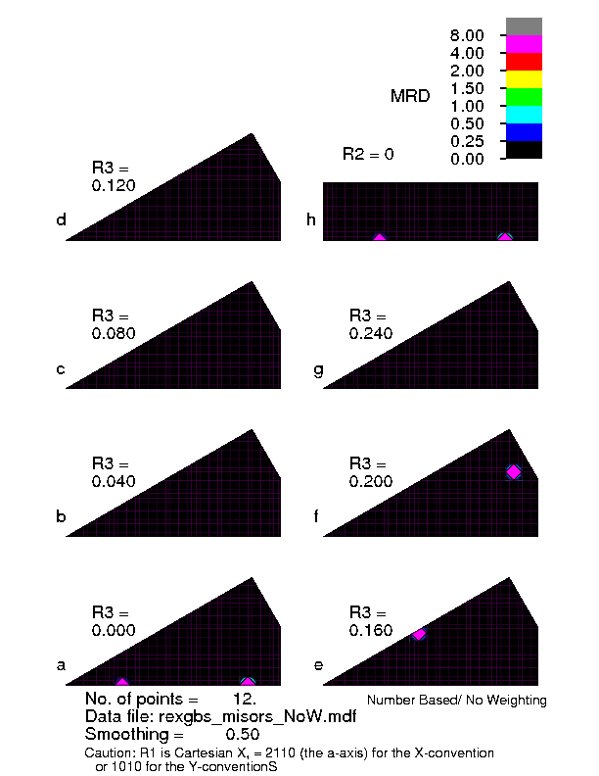
Successive twins: Zr, CT-TT2
Now we plot the misorientations that result from this pair.
These are the misorientations between the matrix and the second twin. The combination produces new misorientations, relative to the two twins.
Add chains of CT, TT1 …; add the second cut for R1=0

Slide 111
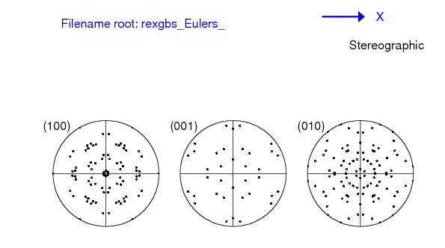
Successive twins: Zr, TT2-CT
The twin chain TT2 then CT produces a slightly different result in terms of pole figures. The misorientations, however, are the same.

Slide 112

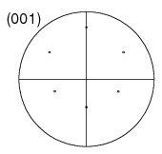
Order of twins, PFs, ∆g
We can understand the reason for the pole figures depending on the order of the twins, but not the misorientation as follows. Pole figures show us what is going on with respect to the sample frame. Given that two rotations do not commute, it is not surprising that the net result is different: see below for 60° about 100, followed by 15° about each of the equivalent 100 axes in the intermediate frame. The other figure shows 15° followed by 60°, again for all equivalent 100 axes in the intermediate frame.
1st rotation = 60° [100]
1st rotation = 15° [100]

Slide 113
Order of twins, PFs, ∆g, contd.
In order to understand why, in this particular case, the order of the twins does not matter, consider the fact that the twin/rotation axis is coincident with one of the 2-fold symmetry operators in the hexagonal point group.
The consequence of this is that, although the forward twin is obviously different from the negative twin, the set of twin variants produced by the twin is the same, regardless of whether rotates in the positive or negative sense.
In mathematical terms, this means the following (note the “=“, meaning that the sets are the same):
{O_{c} T₂} = {O_{c} T₂⁻¹}
Recall also the physical equivalence between the forward (positive) and the backward (negative) misorientation across a boundary:
∆g ≡ ∆g⁻¹

Slide 114
Order of twins, PFs, ∆g, contd.
∆g = O_{c}T₂ O_{c} T₁ O_{c} ≡ O_{c}T₁⁻¹ O_{c} T₂⁻¹O_{c}
What we want is the set of transformations that represent the boundary:
{∆g}={∆g₁₂}U{∆g₂₁}
Using the equality noted above:
{∆g} = {O_{c}T₂ O_{c} T₁ O_{c}} U {O_{c}T₁⁻¹ O_{c} T₂⁻¹O_{c}}
= {O_{c}T₂ O_{c} T₁ O_{c}} U {O_{c}T₁ O_{c} T₂ O_{c}}
This demonstrates (Q.E.D.) that the order of the twins does not matter, provided that the twins both coincide with a crystal symmetry element such that the forward and backward rotations (with all their variants) yield the same set of results.

Slide 115
Calculation with rexgbs
The results shown in many of the slides in this set were calculated with rexgbs.f. This is a program written in fortran-90 that computes the disorientation for a given input pair of orientations (or a single misorientation).
Crystal symmetry: as of Sep 08, cubic, hexagonal or orthorhombic are possible.
Input: the program can either read direct input from the terminal, or from texin, which is has to be a list of Euler angles in popLA .WTS format. There are 4 header lines and then each line has a triple of Euler angles [in degrees] and a weight [not needed for rexgbs]. Direct input can be in Euler angles (degrees or radians), (HKL)[UVW] pairs, Rodrigues vectors, quaternions, or axis-angle. In most cases, either a single misorientation can be entered, or a pair of orientations.

Slide 116
rexgbs output
Output: rexgbs_output.txt contains the standard output from the program (similar to what you see on the screen). Each combination of grains (orientations) leads to a unique disorientation, printed in terms of axis-angle and quaternion.
Output: rexgbs_misors.mdf contains the same output as above but listed as quaternions so that the disorientations can be plotted with RF_misor (latest is RF_misor_27Aug08.f).
Output: rexgbs_Eulers.wts contains the same information as above, except that it is formatted as a popLA .WTS file (4 header lines, then sets of 3 Euler angles with a weight of 1) so that it can be processed with wts2pop to examine and plot textures. The special feature of this output is that it includes all the variants of the final orientation, including the effect of an intermediate symmetry operator when requested. This permits twin chains to be treated, as discussed in the preceding slides.
Output: rexgbs_misors_forward.mdf contains the same information as the file above, but formatted such as to be suitable as input for RF_misor. As of Sep 08, this does not give different results from rexgbs_misors.mdf when plotted in the fundamental zone (of misorientations).

