Slide 1


Anisotropic Elasticity
27-731
Texture, Microstructure & Anisotropy
Dr. Jerard Gordon
(w/ A.D. Rollett & M. De Graef Notes)
Last revised: 15th March, 2020

Slide 2
Bibliography
R.E. Newnham, Properties of Materials: Anisotropy, Symmetry, Structure, Oxford University Press, 2004, 620.112 N55P.
Nye, J. F. (1957). Physical Properties of Crystals. Oxford, Clarendon Press.
Kocks, U. F., C. Tomé and R. Wenk (1998). Texture and Anisotropy, Cambridge University Press, Cambridge, UK. Chapter 7.
T. Courtney, Mechanical Behavior of Materials, McGraw-Hill, 0-07-013265-8, 620.11292 C86M.
Reid, C. N. (1973). Deformation Geometry for Materials Scientists. Oxford, UK, Pergamon.
Newey, C. and G. Weaver (1991). Materials Principles and Practice. Oxford, England, Butterworth-Heinemann.

Slide 3
Notation
F Stimulus (field)
R Response
P Property
j electric current
E electric field
D electric polarization
Strain (also, permutation tensor)
Stress (or conductivity)
Resistivity
d piezoelectric tensor
C elastic stiffness
S elastic compliance
a transformation matrix
W work done (energy)
dW work increment
I identity matrix
O symmetry operator (matrix)
Y Young’s modulus
Kronecker delta
e axis (unit) vector
T tensor
α direction cosine

Slide 4
Objective
The objective of this lecture is to provide a mathematical framework for the description of properties, especially when they vary with direction.
A basic property that occurs in almost applications is elasticity. Although elastic response is linear for all practical purposes, it is often anisotropic (composites, textured polycrystals etc.).
Why do we care about elastic anisotropy? In composites, especially fibre composites, it is easy to design in substantial anisotropy by varying the lay-up of the fibres.
Geologists are very familiar with elastic anisotropy and exploit it for understanding seismic results; see, e.g., https://en.wikipedia.org/wiki/Seismic_anisotropy .

Slide 5
In Class Questions
Why is plastic yielding a non-linear property, in contrast to elastic deformation?
What is the definition of a tensor?
Why is stress is 2nd-rank tensor?
Why is elastic stiffness a 4th-rank tensor?
What is “matrix notation” (in the context of elasticity)?
What are the relationships between tensor and matrix coefficients for stress? Strain? Stiffness? Compliance?
Why do we need factors of 2 and 4 in some of these conversion factors?
How do we use crystal symmetry to decrease the number of coefficients needed to describe stiffness and compliance?
How many independent coefficients are needed for stiffness (and compliance) in cubic crystals? In isotropic materials?
How do we express the directional dependence of Young’s modulus?
What is Zener’s anisotropy factor?

Slide 6
Anisotropy: Practical Applications
The practical applications of anisotropy of composites, especially fiber-reinforced composites are numerous.
The stiffness of fiber composites varies tremendously with direction. Torsional rigidity is very important in car bodies, boats, aeroplanes etc.
Even in monolithic polymers (e.g. drawn polyethylene) there exists large anisotropy because of the alignment of the long-chain molecules.

Slide 7
What is a Material Property?
When we “do something” to a material, the material will “react” in a particular way
More formally: when we apply a field, we obtain a response
We can “do something” to a material by applying a field, (F) then measuring its “reaction” or response (R)
  This is one of the most important and central problems in MSE:
  What is the response is for a given field?

Slide 8
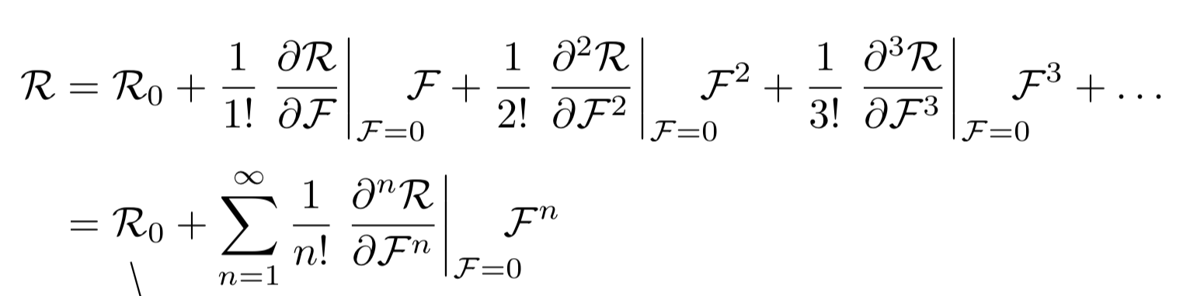
What is a Material Property?
  One of the most important problems in MSE: What is the response is for a given field?
  Response (R) is a functional of the applied field (F): R = R(F)
  By using a finite number of terms of its Taylor series, we can approximate the response (R) of a given material under an applied field (F)
“State” of the material at zero field
Response is proportional to field (Linear material property)
Response is NOT proportional to field (Non-linear material properties)
If the complete Taylor series is needed, then we use a more general “constitutive relation” to describe the response in terms of material properties (i.e. hysteresis)

Slide 9
Linear properties
Certain properties, such as elasticity in most cases, are linear which means that we can simplify even further to obtain
R = R₀ + PF
or if R₀ = 0,
R = PF.
e.g. elasticity: σ = C ε
In tension, C ≡ Young’s modulus, Y or E.
stiffness

Slide 10
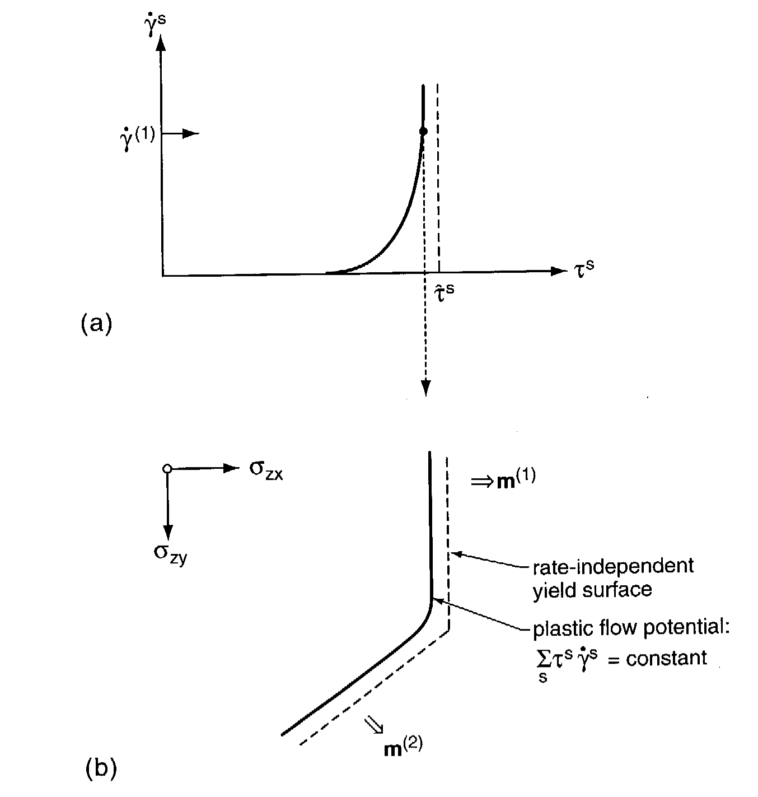
Non-Linear properties, example
Another important example of non-linear anisotropic properties is plasticity, i.e. the irreversible deformation of solids.
A typical description of the response at plastic yield
(what happens when you load a material to its yield stress)
is elastic-perfectly plastic. In other
words, the material responds
elastically until the yield stress is
reached, at which point the stress
remains constant (strain rate
unlimited).
• A more realistic description is a power-law with a large exponent, n~50. The stress is scaled by the crss, and be expressed as either shear stress-
shear strain rate [graph], or tensile stress-tensile strain [equation].
[Kocks]

Slide 11
General Anisotropic Properties
There is no a-priori reason for a property to be the same in all directions.
There is no a-priori reason for a response to be in the same direction as the applied field.
Linear and non-linear properties can be anisotropic; a constitutive relation can also be anisotropic.
Both single and poly-crystals can be anisotropic

Slide 12
General Anisotropic Properties
Many different properties of crystals can be described as tensors.
The rank of each tensor property depends, naturally, on the nature of the quantities related by the property.

Slide 13
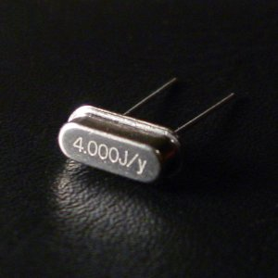
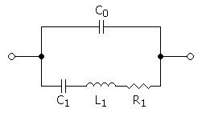
Application example: quartz oscillators
Piezoelectric quartz crystals are commonly used for frequency control in watches and clocks. Despite having small values of the piezoelectric coefficients, quartz has positive aspects of low losses and the availability of orientations with negligible temperature sensitivity. The property of piezoelectricity relates strain to electric field, or polarization to stress.
ε_{ij} = d_{ijk}E_{k}
PZT, lead zirconium titanate PbZr_{1-x}Ti_{x}O₃, is another commonly used piezoelectric material.
RLC circuit

Slide 14
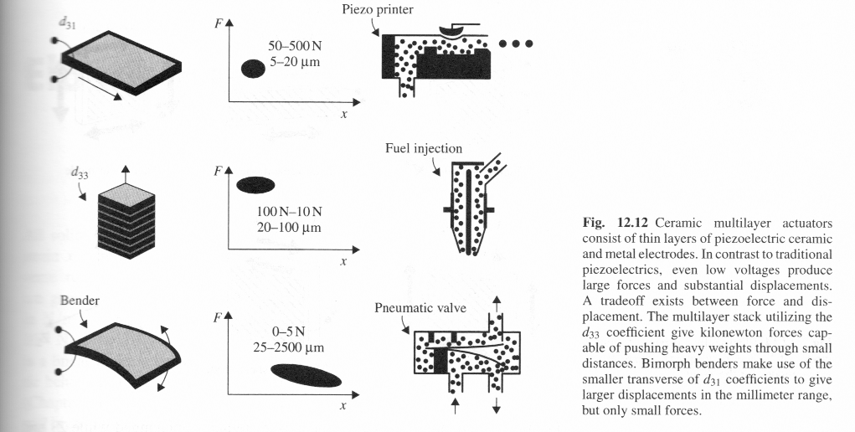
Piezoelectric Devices
Examinable
The property of piezoelectricity relates strain to electric field, or polarization to stress.
ε_{ij} = d_{ijk}E_{k}
PZT, lead zirconium titanate PbZr_{1-x}Ti_{x}O₃, is another commonly used piezoelectric material.
Note: Newnham consistently uses vector-matrix notation, rather than tensor notation. We will explain how this works later on.
[Newnham]

Slide 15
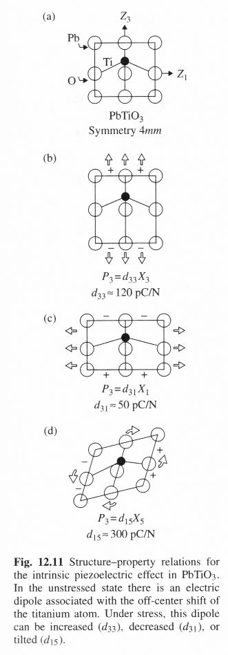
Piezoelectric Crystals
How is it that crystals can be piezoelectric?
The answer is that the bonding must be ionic to some degree (i.e. there is a net charge on the different elements) and the arrangement of the atoms must be non-centrosymmetric.
PZT is a standard piezoelectric material. It has Pb atoms at the cell corners (a~4Å), O on face centers, and a Ti or Zr atom near the body center. Below a certain temperature (Curie T), the cell transforms from cubic (high T) to tetragonal (low T). Applying stress distorts the cell, which changes the electric displacement in different ways (see figure).
Although we can understand the effect at the single crystal level, real devices (e.g. sonar transducers) are polycrystalline. The operation is much complicated than discussed here, and involves “poling” to maximize the response, which in turns involves motion of domain walls.
[Newnham]

Slide 16
Mathematical Descriptions
Mathematical descriptions of properties are available.
Mathematics, or a type of mathematics provides a quantitative framework. It is always necessary, however, to make a correspondence between mathematical variables and physical quantities.
In group theory one might say that there is a set of mathematical operations & parameters, and a set of physical quantities and processes: if the mathematics is a good description, then the two sets are isomorphous.
This lecture makes extensive use of tensors. A tensor is a quantity that can be transformed from one set of axes to another via the tensor transformation rule (next slide).

Slide 17
Tensor: definition, contd.
In order for a quantity to “qualify” as a tensor it has to obey the axis transformation rule, as discussed in the previous slides.
The transformation rule defines relationships between transformed and untransformed tensors of various ranks.
It says that any tensor quantity can be transformed from one reference frame to another; this transformation of axes is sometimes called a passive rotation.
Vector: V’_{i} = a_{ij}V_{j}
2nd rank T’_{ij} = a_{ik}a_{jl}T_{kl}
3rd rank T’_{ijk} = a_{il}a_{jm}a_{kn}T_{lmn}
4th rank T’_{ijkl} = a_{im}a_{jn}a_{ko}a_{lp}T_{mnop}
This rule is a critical piece of information, which you must know how to use.

Slide 18
Tensor: definition, contd.
We will denote tensors by subscripted variables, e.g.,
  𝜀_{ij} (rank-2)
  d_{pqr} (rank-3)
  C_{lmno}(rank-4)
The number of subscripts represents the rank of the tensor. Vectors = rank-1 tensors, scalars = rank-0 tensors.
Subscripts are known as dummy indices; it doesn’t matter which character you use . . . as long as you use it consistently.
Two (2) subscript “rules”:
  Conservation of subscripts
  Summation implied over each pair of subscripts on one side of an equation

Slide 19
Einstein Convention
The Einstein Convention, or summation rule for suffixes looks like this:
A_{i} = B_{ij} C_{j}
where “i” and “j” both are integer indexes whose range is {1,2,3}. So, to find each “i^{th}” component of A on the LHS, we sum up over the repeated index, “j”, on the RHS:
A₁ = B₁₁C₁ + B₁₂C₂ + B₁₃C₃
A₂ = B₂₁C₁ + B₂₂C₂ + B₂₃C₃
A₃ = B₃₁C₁ + B₃₂C₂ + B₃₃C₃

Slide 20
Examples of Materials Properties as Tensors
Table 1 shows a series of tensors that are of importance for material science. The tensors are grouped by rank, and are also labeled (in the last column) by E (equilibrium property) or T (transport property). The number following this letter indicates the maximum number of independent, nonzero elements in the tensor, taking into account symmetries imposed by thermodynamics.
The Field and Response columns contain the following symbols: ∆T = temperature difference, ∆S = entropy change, E_{i} = electric field components, H_{i} = magnetic field components, ε_{ij} = mechanical strain, D_{i} = electric displacement, B_{i} = magnetic induction, σ_{ij} = mechanical stress, ∆β_{ij} = change of the impermeability tensor, j_{i} = electrical current density, ∇_{j}T = temperature gradient, h_{i} = heat flux, ∇_{j}c = concentration gradient, m_{i} = mass flux, ρª_{i} = anti-symmetric part of resistivity tensor, ρ^{s}_{i} = symmetric part of resistivity tensor, ∆ρ_{ij} = change in the component ij of the resistivity tensor, l_{i} = direction cosines of wave direction in crystal, G = gyration constant,

Slide 21
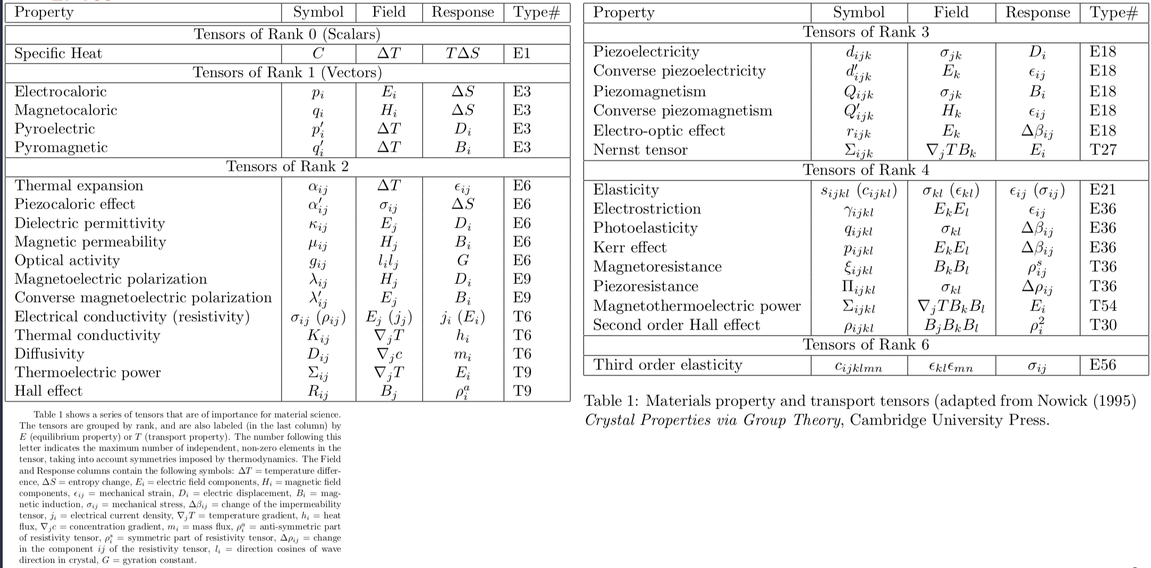
Examples of Materials Properties as Tensors
Courtesy of Prof. M. De Graef

Slide 22
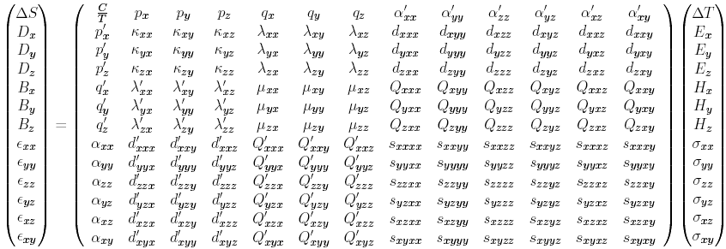
Principal Effects
Courtesy of Prof. M. De Graef
Electrocaloric = pyroelectric
Magnetocaloric = pyromagnetic
Thermal expansion = piezocaloric
Magnetoelectric and converse magnetoelectric
Piezoelectric and converse piezoelectric
Piezomagnetic and converse piezomagnetic

Slide 23
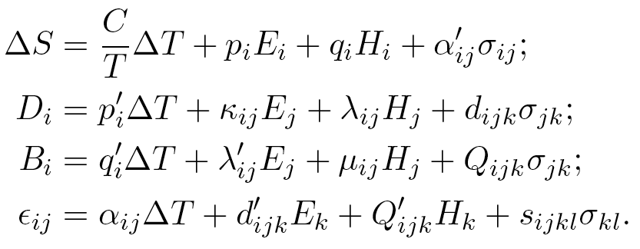
Principal Effects
Courtesy of Prof. M. De Graef
1st rank cross effects
2nd rank cross effects
3rd rank cross effects

Slide 24
Examples of Materials Properties as Tensors
A tensor of rank n has 3n components; but they are not all independent due to the presence of symmetry which reduces the number of independent components
Two types of symmetry to consider:
  Thermodynamic symmetry (from Helmholtz free energy)
  K_{ij} = K_{ji}
  True for tensors which connect conjugate variables (e.g. 𝜎-𝜀, H-B, etc. )
  Crystallographic symmetry (Group Symmetry)
    Neumann’s Principle: “The symmetry of any physical property of a crystal must include the symmetry elements of the point group of the crystal.”
Definition #1: We call a tensor “symmetric” if interchanging two subscripts does not change the value (𝜀_{ij} =𝜀_{ji})
Definition #2: We call a tensor is “antisymmetric” if the interchange of two subscripts causes a sign change (𝜀_{ij} = - 𝜀_{ji})
Note the minus (-) sign!

Slide 25
Elasticity
Elasticity: example of a property that requires tensors to describe it fully.
Even in cubic metals, a crystal is quite anisotropic. The [111] in many cubic metals is stiffer than the [100] direction.
Even in cubic materials, 3 numbers/coefficients/moduli are required to describe elastic properties; isotropic materials only require 2.
Familiarity with Miller indices, suffix notation, Einstein convention, Kronecker delta, permutation tensor, and tensors is assumed.

Slide 26
Elastic Anisotropy: 1
First we restate the linear elastic relations for the properties Compliance, written S, and Stiffness, written C (admittedly not very logical choice of notation), which connect stress, σ, and strain, ε. We write it first in vector-tensor notation with “:” signifying inner product (i.e. add up terms that have a common suffix or index in them):
σ = C:ε
ε = S:σ
In component form (with suffixes),
σ_{ij} = C_{ijkl}ε_{kl}
ε_{ij} = S_{ijkl}σ_{kl}

Slide 27
Elastic Anisotropy: 2
The definitions of the stress and strain tensors mean that they are both symmetric (second rank) tensors. Therefore we can see that
ε₂₃ = S₂₃₁₁σ₁₁
ε₃₂ = S₃₂₁₁σ₁₁ = ε₂₃
which means that,
S₂₃₁₁ = S₃₂₁₁
and in general,
S_{ijkl} = S_{jikl}
This reduces considerably the number of different coefficients needed

Slide 28
Elastic Anisotropy: 3
For 4th–order symmetric tensors, the 81 components (i.e. 3⁴) reduces to just 36 components since:
S_{ijkl} = S_{jikl} = S_{ijlk}= S_{jilk}
Becomes only:
S_{ij}
Also known as the 6x6 Stiffness (C) or Compliance (S) Matrix

Slide 29
Stiffness Matrix
Vector-matrix notation (two indices for the moduli, one index for stress or strain); note that this matrix is symmetric, therefore there are only 21 independent coefficients, even for triclinic crystals (see later slides).

Slide 30
Stiffness in sample coords.
Consider how to express the elastic properties of a single crystal in the sample coordinates. In this case we need to rotate the (4th rank) tensor stiffness from crystal coordinates to sample coordinates using the orientation (matrix), a :
c_{ijkl}' = a_{im}a_{jn}a_{ko}a_{lp}c_{mnop}
Note how the transformation matrix appears four times because we are transforming a 4th rank tensor!
The axis transformation matrix, a, is sometimes also written as λ, also as the orientation matrix g.

Slide 31
Young’s modulus from compliance
Young's modulus as a function of direction can be obtained from the compliance tensor as:
E=1/s'₁₁₁₁
Using compliances and a stress boundary condition (only σ₁₁≠0) is most straightforward. To obtain s'₁₁₁₁, we simply apply the same transformation rule,
s'_{ijkl} = a_{im} a_{jn} a_{ko} a_{lp}s_{mnop}

Slide 32
Matrix, Miller Indices
The general Rotation Matrix, a, can be represented as in the following:
Here the Rows are the direction cosines for the 3 crystal axes, [100], [010], and [001] expressed in the sample coordinate system (pole figure).
[100]_{xtal} direction
[010]_{xtal} direction
[001]_{xtal} direction

Slide 33
“Voigt” or “matrix” notation
It is useful to re-express the three quantities involved in a simpler format. The stress and strain tensors are vectorized, i.e. converted into a 1x6 notation and the elastic tensors are reduced to 6x6 matrices.

Slide 34
“matrix notation”, contd.
Similarly for strain:
The particular definition of shear strain used in the reduced notation happens to correspond to that used in mechanical engineering such that ε₄ is the change in angle between direction 2 and direction 3 due to deformation.

Slide 35
Work conjugacy, matrix inversion
The more important consideration is that the reason for the factors of two is so that work conjugacy is maintained.
dW = σ:dε = σ_{ij} : dε_{ij} = σ_{k} • dε_{k}
Also we can combine the expressions
σ = Cε and ε = Sσ to give:
σ = CSσ, which shows:
I = CS, or, C = S⁻¹

Slide 36
Tensor conversions: stiffness
Lastly we need a way to convert the tensor coefficients of stiffness and compliance to the matrix coefficients. For stiffness, it is very simple because one substitutes values according to the following table, such that [vector-matrix] C₁₁ = C₁₁₁₁ [tensor] for example.

Slide 37
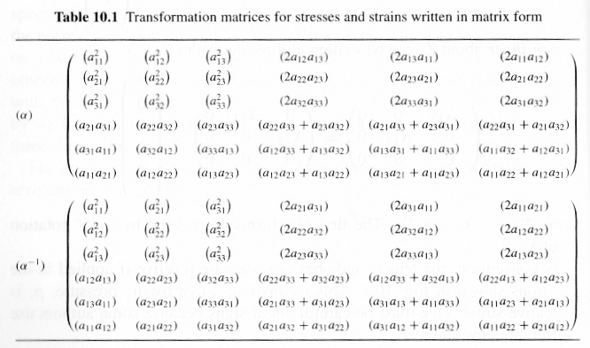
Axis Transformations
It is still possible to perform axis transformations, as allowed for by the Tensor Rule. The coefficients can be combined [Newnham] together into a 6 by 6 matrix that can be used for 2nd rank tensors such as stress and strain, below.
Stress (in vector notation) transforms as:
X’_{i} = α_{ij} X_{j}
Strain (in vector notation) transforms as:
x’_{i} = (α⁻¹_{ij})^{T} x_{j}
where superscript “T” signifies transpose of the matrix.

Slide 38
Tensor conversions: compliance
For compliance some factors of two are required and so the rule becomes:

Slide 39
Relationships between coefficients:
C in terms of S
Some additional useful relations between coefficients for cubic materials are as follows. Symmetrical relationships exist for compliances in terms of stiffnesses (next slide).
C₁₁ = (S₁₁+S₁₂)/{(S₁₁-S₁₂)(S₁₁+2S₁₂)}
C₁₂ = -S₁₂/{(S₁₁-S₁₂)(S₁₁+2S₁₂)}
C₄₄ = 1/S₄₄.

Slide 40
S in terms of C
The relationships for S in terms of C are symmetrical to those for stiffnesses in terms of compliances (a simple exercise in algebra).
S₁₁ = (C₁₁+C₁₂)/{(C₁₁-C₁₂)(C₁₁+2C₁₂)}
S₁₂ = -C₁₂/{(C₁₁-C₁₂)(C₁₁+2C₁₂)}
S₄₄ = 1/C₄₄
S₁₁ - S₁₂ = (C₁₁+2C₁₂)/{(C₁₁-C₁₂)(C₁₁+2C₁₂)}
S₁₁ - S₁₂ = 1/(C₁₁-C₁₂).

Slide 41
Neumann's Principle
A fundamental natural law: Neumann's Principle: the symmetry elements of any physical property of a crystal must include the symmetry elements of the point group of the crystal. The property may have additional symmetry elements to those of the crystal (point group) symmetry. There are 32 crystal classes for the point group symmetry.
F.E. Neumann 1885.

Slide 42
Neumann, extended
If a crystal has a defect structure such as a dislocation network that is arranged in a non-uniform way then the symmetry of certain properties may be reduced from the crystal symmetry. In principle, a finite elastic strain in one direction decreases the symmetry of a cubic crystal to tetragonal or less. Therefore the modified version of Neumann's Principle: the symmetry elements of any physical property of a crystal must include the symmetry elements that are common to the point group of the crystal and the defect structure contained within the crystal.

Slide 43
Effect of crystal symmetry
Consider an active rotation of the crystal, where O is the symmetry operator. Since the crystal is indistinguishable (looks the same) after applying the symmetry operator, the result before, R⁽¹⁾, and the result after, R⁽²⁾, must be identical:
The two results are indistinguishable and therefore equal. It is essential, however, to express the property and the operator in the same (crystal) reference frame.

Slide 44
Symmetry, properties, contd.
Expressed mathematically, we can rotate, e.g. a second rank property tensor thus:
P' = OPO^{T} = P , or, in coefficient notation,
P’_{ij} = O_{ik}O_{il}P_{kl}
where O is a symmetry operator.
Since the rotated (property) tensor, P’, must be the same as the original tensor, P, then we can equate coefficients:
P’_{ij} = P_{ij}
If we find, for example, that P’₂₁ = -P₂₁,then the only value of P₂₁ that satisfies this equality is P₂₁ = 0.
Remember that you must express the property with respect to a particular set of axes in order to use the coefficient form. In everything related to single crystals, always use the crystal axes as the reference frame!
Homework question: based on cubic crystal symmetry, work out why a second rank tensor property can only have one independent coefficient.

Slide 45
Effect of symmetry on stiffness matrix
Why do we need to look at the effect of symmetry? For a cubic material, only 3 independent coefficients are needed as opposed to the 81 coefficients in a 4th rank tensor. The reason for this is the symmetry of the material.
What does symmetry mean? Fundamentally, if you pick up a crystal, rotate [mirror] it and put it back down, then a symmetry operation [rotation, mirror] is such that you cannot tell that anything happened.
From a mathematical point of view, this means that the property (its coefficients) does not change. For example, if the symmetry operator changes the sign of a coefficient, then it must be equal to zero.

Slide 46
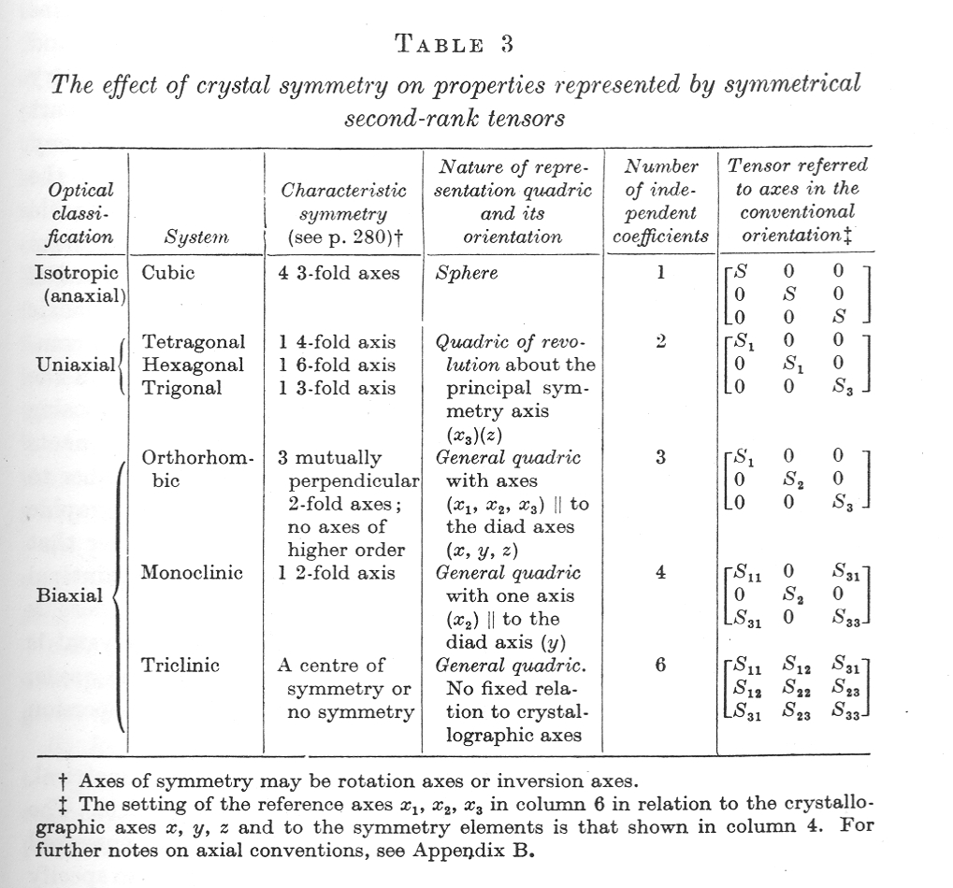
2nd Rank Tensor Properties & Symmetry
The table from Nye shows the number of independent, non-zero coefficients allowed in a 2nd rank tensor according to the crystal symmetry class.

Slide 47
Effect of symmetry on stiffness matrix
Examinable
Following Reid, p.66 et seq.:
Apply a -90° rotation about the crystal-z axis (axis 3)*,
C’_{ijkl} = O_{im}O_{jn}O_{ko}O_{lp}C_{mnop}:
C’ = C
*Reid describes this as +90°, but -90° reproduces his result (because he apparently considers positive to be clockwise).

Slide 48
Effect of symmetry, 2
Examinable
Using P’ = P, we can equate all the coefficients in the 6x6 matrix and find that:
C₁₁=C₂₂, C₁₃=C_{23,} C₄₄=C₃₅, C₁₆=-C_{26,}
C₁₄=C₁₅ = C₂₄ = C₂₅ = C₃₄ = C₃₅ = C₃₆ = C₄₅ = C₄₆ = C₅₆ = 0.

Slide 49
Effect of symmetry, 3
Thus by repeated applications of the symmetry operators, one can demonstrate (for cubic crystal symmetry) that one can reduce the 81 coefficients down to only 3 independent quantities. These become two in the case of isotropy.

Slide 50
General crystal symmetry shown above.
Courtesy of Prof. M. De Graef

Slide 51
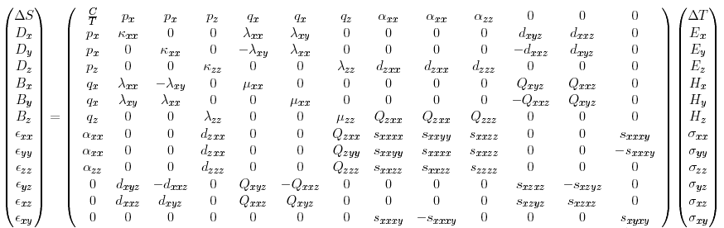
Point group 4
Courtesy of Prof. M. De Graef

Slide 52
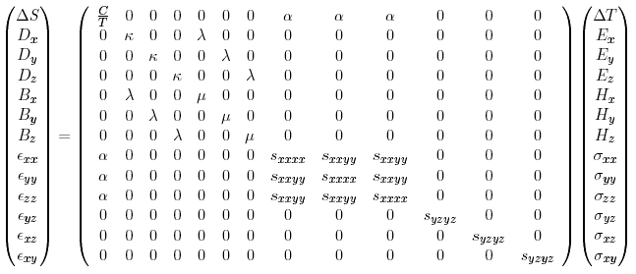
Point group m3m
Note how many fewer independent coefficients there are!
Note how the center of symmetry eliminates many of the properties, such as pyroelectricity
Courtesy of Prof. M. De Graef

Slide 53
Cubic crystals: anisotropy factor
If one applies the symmetry elements of the cubic system, it turns out that only three independent coefficients remain: C₁₁, C₁₂ and C₄₄, (similar set for compliance). From these three, a useful combination of the first two is
C' = (C₁₁ - C₁₂)/2
See Nye, Physical Properties of Crystals

Slide 54
Zener’s anisotropy factor
C' = (C₁₁ - C₁₂)/2 turns out to be the stiffness associated with a shear in a <110> direction on a plane. In certain martensitic transformations, this modulus can approach zero which corresponds to a structural instability.
Zener (Physics, Carnegie Tech. Inst.) proposed a measure of elastic anisotropy based on the ratio C₄₄/C'. This turns out to be a useful criterion for identifying materials that are elastically anisotropic, i.e., via the extent to which C₄₄/C' varies from unity.
Note that this provides a way to convert an anisotropic elastic stiffness into an isotropic one. One can, e.g., adjust C₁₂ until the Zener ratio=1. Some care is required, however, because one might want to match some average Young’s modulus, for example.

Slide 55
Rotated compliance (matrix)
Given an orientation a_{ij}, we transform the compliance tensor, using cubic point group symmetry, and find that:

Slide 56
Rotated compliance (matrix)
This can be further simplified with the aid of the standard relations between the direction cosines, a_{ik}a_{jk} = 1 for i=j; a_{ik}a_{jk} = 0 for i≠j, (a_{ik}a_{jk} = δ_{ij}) to read as follows.
By definition, the Young’s modulus in any direction is given by the reciprocal of the compliance, E = 1/S’₁₁.
By definition, the Young’s modulus along <100> is given by the reciprocal of the compliance for <100>:
E₁₀₀ = 1/S₁₁ = {(C₁₁-C₁₂)(C₁₁ + 2C₁₂)}/(C₁₁ + C₁₂).

Slide 57
Anisotropy in cubic materials
Thus the second term on the RHS is zero for <100> directions and, for C₄₄/C'>1, a maximum in <111> directions (conversely a minimum for C₄₄/C'<1).
The following table shows that
most cubic metals have positive
values of Zener's coefficient so
that <100> is soft and <111>
is hard, with the exceptions of V
and NaCl.
See the supplemental slides for
how to go between C values and
the Lamé constants used to
describe isotropic materials.

Slide 58
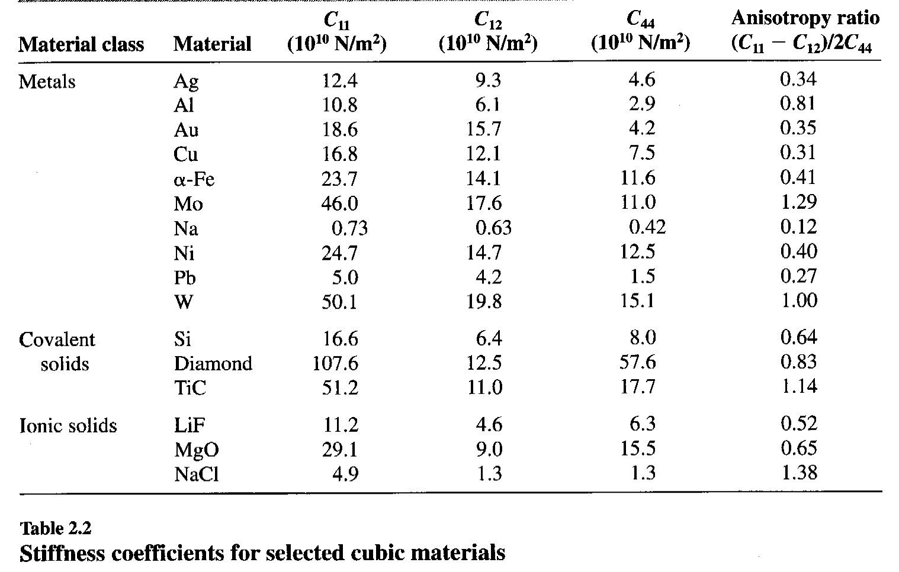
Stiffness coefficients, cubics
[Courtney]

Slide 59
Anisotropy in terms of moduli
Another way to write the above equation is to insert the values for the Young's modulus in the soft and hard directions, assuming that the <100> are the most compliant direction(s). (Courtney uses α, β, and γ in place of my α₁, α₂, and α₃.) The advantage of this formula is that moduli in specific directions can be used directly.

Slide 60
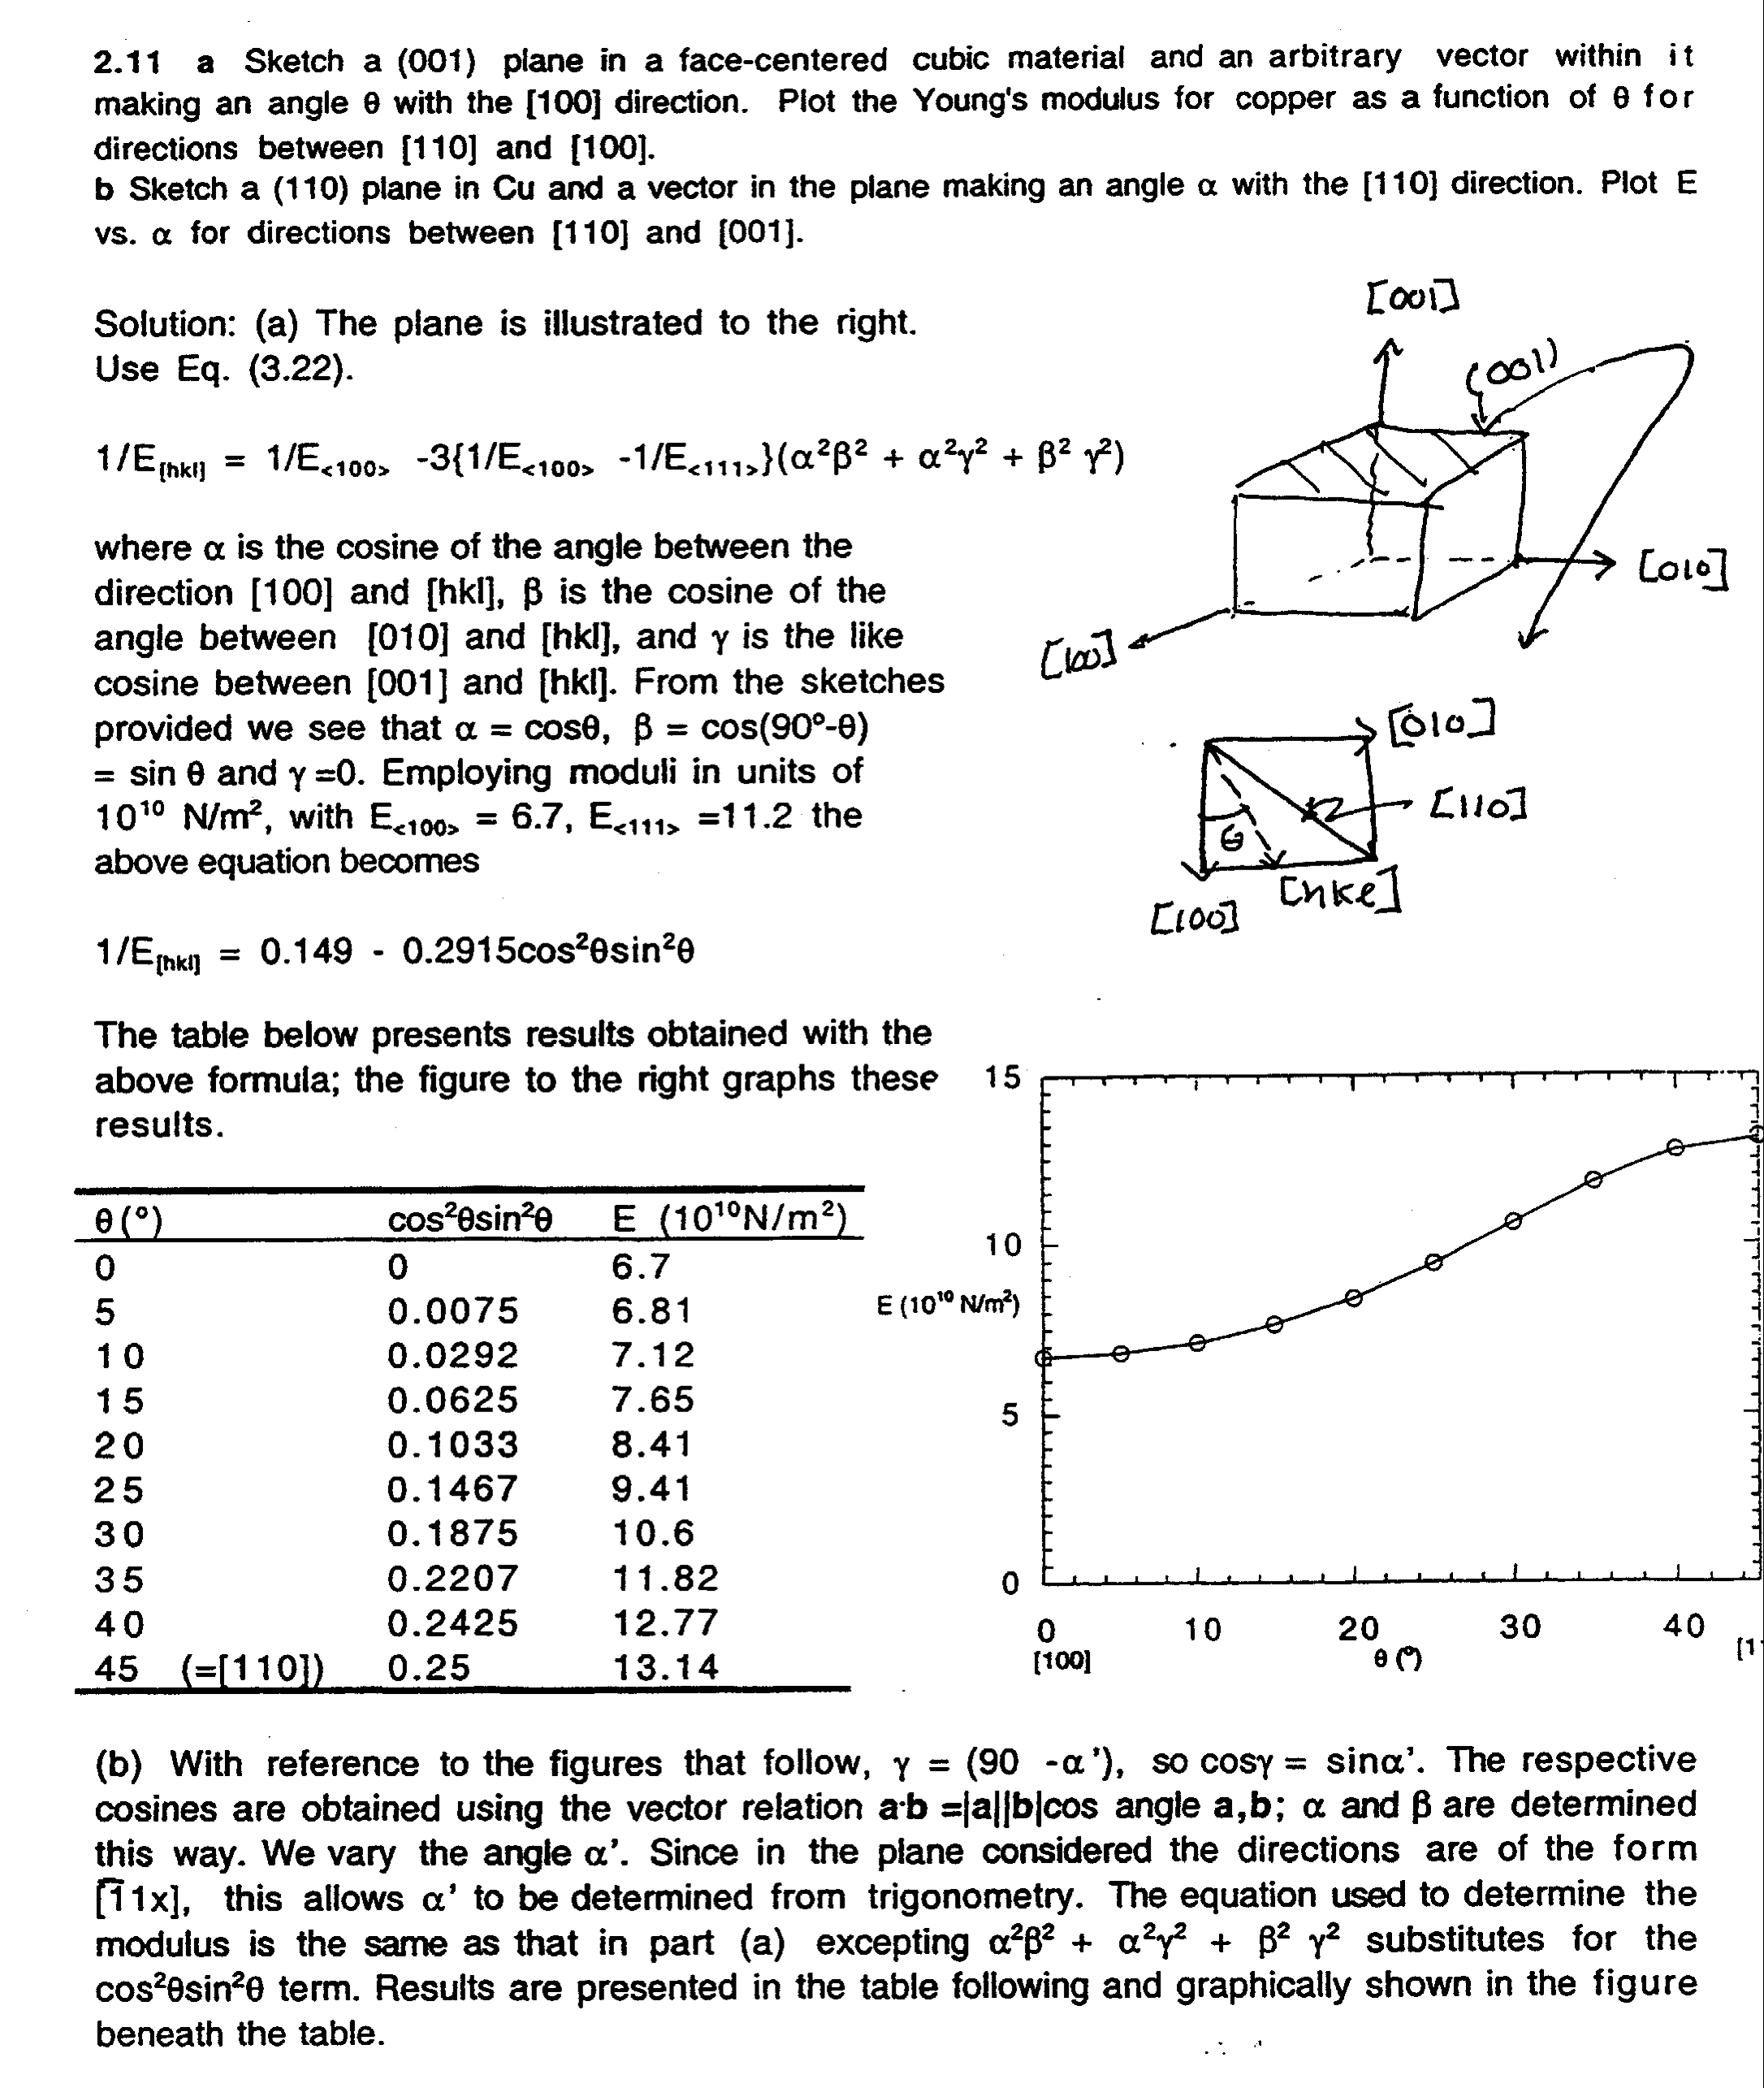
Example Problem
[Courtney]
Should be E_{<111>}= 18.89

Slide 61
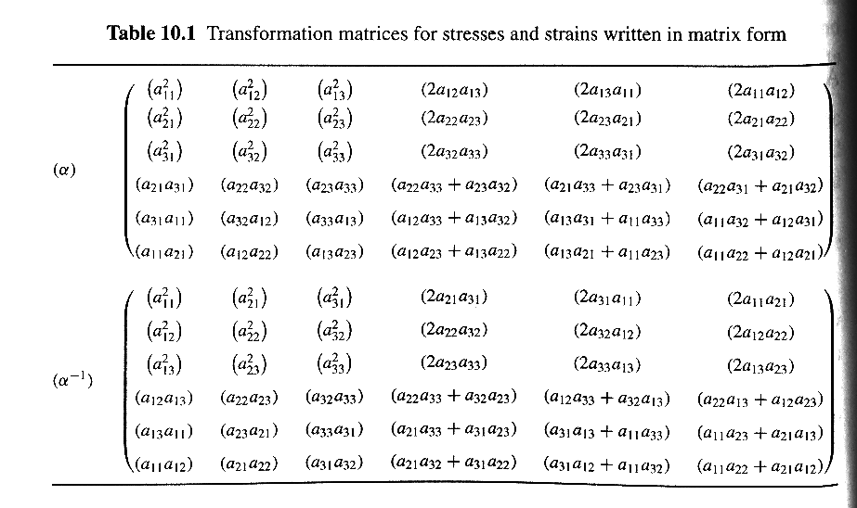
Transformations of Stress & Strain Vectors
It is useful to be able to transform the axes of stress tensors when written in Voigt notation or matrix/vector form (equation on the left). The table (right) is taken from Newnham’s book; the "a" coefficients are from the standard transformation matrix. In vector-matrix form, the transformations are:
R.E. Newnham, Properties of Materials: Anisotropy, Symmetry, Structure, Oxford University Press, 2004, 620.112 N55P

Slide 62
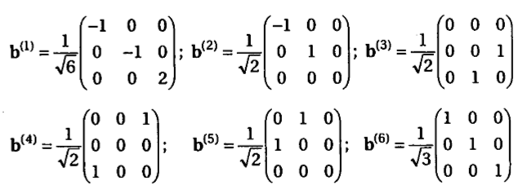
Alternate Vectorization
An alternate vectorization, discussed by Tomé on p287 of the Kocks et al. textbook, is to use the above set of eigentensors. For both stress and strain, one can matrix multiply each eigentensor into the stress/strain tensor in turn and obtain the coefficient of the corresponding stress/strain vector. Work conjugacy is still satisfied. The first two eigentensors represent shears in the {110} planes; the next three are simple shears on {110}<110> systems, and the last (6th) is the hydrostatic component. The same vectorization can be used for plastic anisotropy, except in this case, the sixth, hydrostatic component is (generally) ignored.

Slide 63
Homogeneity
Stimuli and responses of interest are, in general, not scalar quantities but tensors. Furthermore, some of the properties of interest, such as the plastic properties of a material, are far from linear at the scale of a polycrystal. Nonetheless, they can be treated as linear at a suitably local scale and then an averaging technique can be used to obtain the response of the polycrystal. The local or microscopic response is generally well understood but the validity of the averaging techniques is still controversial in many cases. Also, we will only discuss cases where a homogeneous response can be reasonably expected.
There are many problems in which a non-homogeneous response to a homogeneous stimulus is of critical importance. Stress-corrosion cracking, for example, is a wildly non-linear, non-homogeneous response to an approximately uniform stimulus which depends on the mechanical and electro-chemical properties of the material.

Slide 64
Homogeneity
How do we go from a single crystal to a poly-crystal ?
How do we average properties over a microstructure? What are the relevant parameters? Orientation, grain size, grain boundaries, ...
This is a very complex problem!
How do we “solve this”?

Slide 65
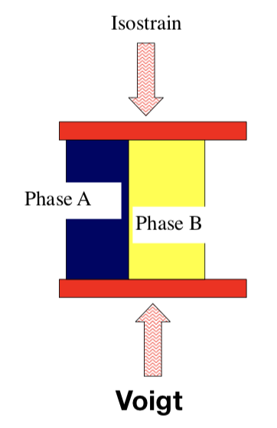
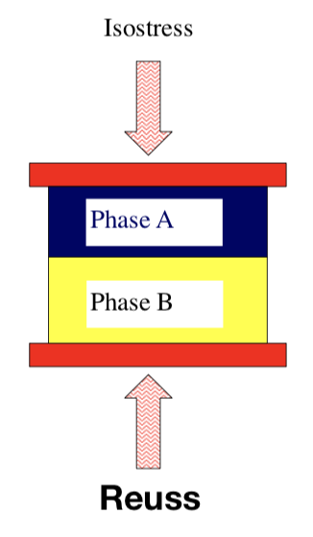
Homogeneity
Take the effective properties of a microstructure in the form of bounds
Bounds are typically estimates of the upper and lower limiting values of a given property for a given microstructure.
Many ways to derive such bounds at various levels of complexity:
  Simple: (i.e. Voigt-Reuss Bounds)
  More complex: Hashin-Shtrickman bounds; Self-consistent methods (i.e. elastic-plastic polycrystals VPSC/EPSC)

Slide 66
Summary
We have covered the following topics:
  Linear properties
  Non-linear properties
  Examples of properties
  Tensors, vectors, scalars, tensor transformation law.
  Elasticity, as example as of higher order property, also as example as how to apply (crystal) symmetry.

Slide 67
Q&A
How do we write the relationship between (tensor) stress and (tensor) strain? σ=C:ε. How about the other way around? ε=S:σ. What are “stiffness” and “compliance” in this context? The stiffness tensor is the collection of coefficients that connect all the different stress coefficients/components to all the different strain coefficients/components. How do we express this in Voigt or vector-matrix notation? The only difference is that the stress and strain are vectors and the stiffness and compliance are matrices. If indices are used then stress and strain each have two indices and the stiffness and compliance each have four.
What are the relationships between the coefficients of the (4th rank) stiffness tensor and the stiffness matrix (6x6)? See the notes for details but, e.g., {11,22,33}_{tensor} correspond to {1,2,3}_{matrix}. E.g. C₁₂(matrix)=C₁₁₂₂(tensor). What about the compliance tensor and matrix? Here, more care is required because certain coefficients have factors of 2 or 4.
What does work conjugacy mean? The energy stored in a body when elastic strains and stresses are present is calculated as the product of the stress and strain, which means that the work done makes the strain and stress conjugate (joined) variables. What does this mean for the relationships between (2nd rank) tensor stress and its vector form? What about strain? Answering these two together, we note that work conjugacy means that whatever notation is used to express stress and strain, the product of the two must be the same because of conservation of energy. This then explains why factors of two are used in the conversion to/from matrix to tensor representations of the shear components of strain (but not the normal strain components). These factors of two could have been applied to stress, but by convention we do this for strain.
How do we write the tensor transformation rule in vector-matrix notation? See the notes for details but the basic idea is that a 6x6 matrix (that can be applied to a stiffness or compliance tensor) is formed from the coefficients of the transformation matrix.
How do we apply crystal symmetry to elastic moduli (e.g. the stiffness tensor)? We apply a symmetry operator to the (stiffness) tensor and set the new and old versions of the tensor equal to each other, coefficient by coefficient. What net effect does it have on the stiffness matrix for cubic materials? Applying the cubic crystal symmetry to the stiffness tensor reduces most of the coefficients to zero and there are only 3 independent coefficients that remain.

Slide 68
Q&A, part 2
How do we convert from stiffness to compliance (and vice versa)? The detailed mathematics is out of scope for this course. It is sufficient to know that the two tensors combine to form a 4th rank identity tensor, from which one can obtain algebraic relationships as given in the notes. Be aware that these formulae depend on the crystal symmetry (as do the compliance & stiffness tensors themselves).
How do we apply symmetry (and transformations of axes in general) to the property of anisotropic elasticity? There are two answers. The first answer is that one can apply the tensor transformation rule, just as explained in previous lectures. Generate the transformation matrix with any the methods described (i.e. dot products between old and new axes, or using the combination of axis and angle). Then write out the transformation with 4 copies of the matrix taking care to specify the indices correctly. The alternative answer is to generate a 6x6 transformation matrix that can be used with vector-matrix (Voigt) notation for either the stress, strain (6x1) vectors or the modulus (6x6) matrix.
How do we show that symmetry reduces the number of independent coefficients in an anisotropic elasticity modulus tensor? Given a symmetry matrix, one proceeds just as in the previous examples i.e. apply symmetry and then equate individual coefficients to find the cases of either zero or equality(between different coefficients).
How do we calculate the (anisotropic) elastic (Young’s) modulus in an arbitrary direction? This looks ahead to the next lecture. The idea is to realize that a tensile test is such that there is only one non-zero coefficient in the stress tensor (or vector); the strain tensor, however, has to have more than one non-zero coefficient (because of the Poisson effect). Therefore one uses the relationship that strain = compliance x stress. By rotating the compliance tensor such that one axis (usually x) is parallel to the desired direction, one obtains the Young’s modulus in that direction as 1/S₁₁.

Slide 69
Supplemental Slides
The following slides contain some useful material for those who are not familiar with all the detailed mathematical methods of matrices, transformation of axes, tensors etc.

Slide 70
Matrix Multiplication
Take each row of the LH matrix in turn and multiply it into each column of the RH matrix.
In suffix notation, a_{ij} = b_{ik}c_{kj}

Slide 71
Properties of Rotation Matrix
The rotation matrix is an orthogonal matrix, meaning that any row is orthogonal to any other row (the dot products are zero). In physical terms, each row represents a unit vector that is the position of the corresponding (new) old axis in terms of the (old) new axes.
The same applies to columns: in suffix notation -
a_{ij}a_{kj} = δ_{ik}, a_{ji}a_{jk} = δ_{ik}
ad+be+cf = 0
bc+ef+mn = 0

Slide 72
Direction Cosines, contd.
That the set of direction cosines are not independent is evident from the following construction:
Thus, there are six relationships (i takes values from 1 to 3, and j takes values from 1 to 3) between the nine direction cosines, and therefore, as stated above, only three are independent, exactly as expected for a rotation.
Another way to look at a rotation: combine an axis (described by a unit vector with two parameters) and a rotation angle (one more parameter, for a total of 3).

Slide 73
Orthogonal Matrices
Note that the direction cosines can be arranged into a 3x3 matrix, Λ, and therefore the relation above is equivalent to the expression
where Λ ^{T} denotes the transpose of Λ. This relationship identifies Λ as an orthogonal matrix, which has the properties

Slide 74
Relationships
When both coordinate systems are right-handed, det(Λ)=+1 and Λ is a proper orthogonal matrix. The orthogonality of Λ also insures that, in addition to the relation above, the following holds:
Combining these relations leads to the following inter-relationships between components of vectors in the two coordinate systems:

Slide 75
Transformation Law
These relations are called the laws of transformation for the components of vectors. They are a consequence of, and equivalent to, the parallelogram law for addition of vectors. That such is the case is evident when one considers the scalar product expressed in two coordinate systems:

Slide 76
Invariants
Thus, the transformation law as expressed preserves the lengths and the angles between vectors. Any function of the components of vectors which remains unchanged upon changing the coordinate system is called an invariant of the vectors from which the components are obtained. The derivations illustrate the fact that the scalar product is an invariant of and . Other examples of invariants include the vector product of two vectors and the triple scalar product of three vectors. The reader should note that the transformation law for vectors also applies to the components of points when they are referred to a common origin.

Slide 77
Orthogonality
A rotation matrix, Λ, is an orthogonal matrix, however, because each row is mutually orthogonal to the other two.
Equally, each column is orthogonal to the other two, which is apparent from the fact that each row/column contains the direction cosines of the new/old axes in terms of the old/new axes and we are working with [mutually perpendicular] Cartesian axes.

Slide 78
Anisotropy
Anisotropy as a word simply means that something varies with direction.
Anisotropy is from the Greek: aniso = different, varying; tropos = direction.
Almost all crystalline materials are anisotropic; many materials are engineered to take advantage of their anisotropy (beer cans, turbine blades, microchips…)
Older texts use trigonometric functions to describe anisotropy but tensors offer a general description with which it is much easier to perform calculations.
For materials, what we know is that some properties are anisotropic. This means that several numbers, or coefficients, are needed to describe the property - one number is not sufficient.
Elasticity is an important example of a property that, when examined in single crystals, is often highly anisotropic. In fact, the lower the crystal symmetry, the greater the anisotropy is likely to be.
Nomenclature: in general, we need to use tensors to describe fields and properties. The simplest case of a tensor is a scalar which is all we need for isotropic properties. The next “level” of tensor is a vector, e.g. electric current.

Slide 79
Scalars, Vectors, Tensors
Scalar:= quantity that requires only one number, e.g. density, mass, specific heat. Equivalent to a zero-rank tensor.
Vector:= quantity that has direction as well as magnitude, e.g. velocity, current, magnetization; requires 3 numbers or coefficients (in 3D). Equivalent to a first-rank tensor.
Tensor:= quantity that requires higher order descriptions but is the same, no matter what coordinate system is used to describe it, e.g. stress, strain, elastic modulus; requires 9 (or more, depending on rank) numbers or coefficients.

Slide 80
Vector field, response
If we have a vector response, R, that we can write in component form, a vector field, F, that we can also write in component form, and a property, P, that we can write in matrix form (with nine coefficients) then the linearity of the property means that we can write the following (R₀ = 0):
R_{i} = P_{ij}F_{j}
A scalar (e.g. pressure) can be called a zero-rank tensor.
A vector (e.g. electric current) is also known as a first-rank tensor.

Slide 81
Linear anisotropic property
This means that each component of the response is linearly related to each component of the field and that the proportionality constant is the appropriate coefficient in the matrix. Example:
R₁ = P₁₃F₃,
which says that the first component of the response is linearly related to the third field component through the property coefficient P₁₃.
x₃
F₃
R₁
x₁

Slide 82
Example: electrical conductivity
An example of such a linear anisotropic (second order tensor, discussed in later slides) property is the electrical conductivity of a material:
    Field: Electric Field, E
    Response: Current Density, J
    Property: Conductivity, σ
    J_{i} = σ_{ij} E_{j}

Slide 83
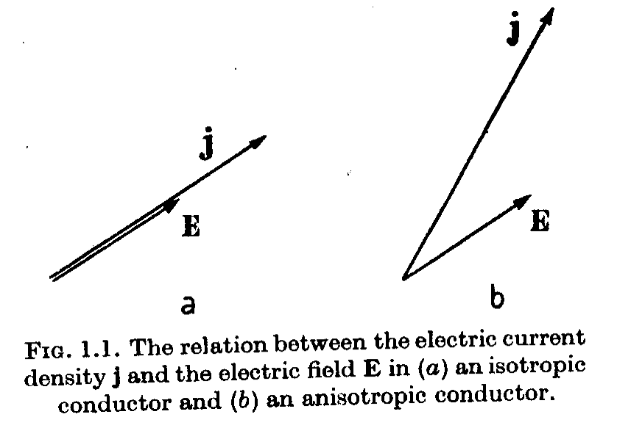
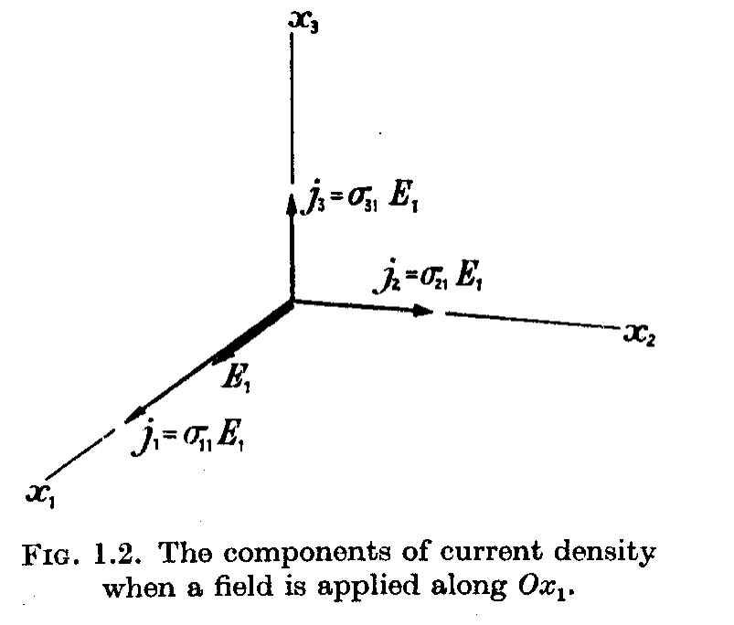
Anisotropic electrical conductivity
We can illustrate anisotropy with Nye’s example of electrical conductivity, σ:
O
Stimulus/ Field: E₁≠0, E₂=E₃=0
Response: j₁=σ₁₁E₁, j₂=σ₂₁E₁, j₃=σ₃₁E₁,

Slide 84
Changing the Coordinate System
Many different choices are possible for the orthonormal base vectors and origin of the Cartesian coordinate system. A vector is an example of an entity which is independent of the choice of coordinate system. Its direction and magnitude must not change (and are, in fact, invariants), although its components will change with this choice.
Why would we want to do something like this? For example, although the properties are conveniently expressed in a crystal reference frame, experiments often place the crystals in a non-symmetric position with respect to an experimental frame. Therefore we need some way of converting the coefficients of the property into the experimental frame.
Changing the coordinate system is also known as axis transformation.

Slide 85
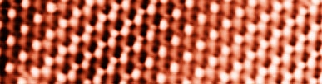
Motivation for Axis Transformation
One motivation for axis transformations is the need to solve problems where the specimen shape (and the stimulus direction) does not align with the crystal axes. Consider what happens when you apply a force parallel to the sides of this specimen …
[100]
The direction parallel to the long edge does not line up with any simple, low index crystal direction. Therefore we have to find a way to transform the properties that we know for the material into the frame of the problem (or vice versa).
Applied stress
[110]
Image of Pt surface from www.cup.uni-muenchen.de/pc/wintterlin/IMGs/pt10p3.jpg

Slide 86
New Axes
Consider a new orthonormal system consisting of right-handed base vectors:
These all have the same origin, o,
associated with
The vector v is clearly expressed equally well in either coordinate system:
Note - same physical vector but different values of the components.
We need to find a relationship between the two sets of components for the vector.

Slide 87
Anisotropy in Composites
The same methods developed here for describing the anisotropy of single crystals can be applied to composites.
Anisotropy is important in composites, not because of the intrinsic properties of the components but because of the arrangement of the components.
As an example, consider (a) a uniaxial composite (e.g. tennis racket handle) and (b) a flat panel cross-ply composite (e.g. wing surface).

Slide 88
Fiber Symmetry
z
y
x

Slide 89
Fiber Symmetry
We will use the same matrix notation for stress, strain, stiffness and compliance as for single crystals.
The compliance matrix, s, has 5 independent coefficients.

Slide 90
Relationships
For a uniaxial stress along the z (3) direction,
This stress causes strain in the transverse plane: e₁₁ = e₂₂ = s₁₂σ₃₃. Therefore we can calculate Poisson’s ratio as:
Similarly, stresses applied perpendicular to z give rise to different moduli and Poisson’s ratios.

Slide 91
Relationships, contd.
Similarly the torsional modulus is related to shears involving the z axis, i.e. yz or xz shears:
s₄₄ = s₅₅ = 1/G
Shear in the x-y plane (1-2 plane) is related to the other compliance coefficients:
s₆₆ = 2(s₁₁-s₁₂) = 1/G_{xy}

Slide 92
Plates: Orthotropic Symmetry
Again, we use the same matrix notation for stress, strain, stiffness and compliance as for single crystals.
The compliance matrix, s, has 9 independent coefficients.
This corresponds to othorhombic sample symmetry: see the following slide with Table from Nye’s book.

Slide 93
Plates: 0° and 90° plies
If the composite is a laminate composite with fibers laid in at 0° and 90° in equal thicknesses then the symmetry is higher because the x and y directions are equivalent.
The compliance matrix, s, has 6 independent coefficients.
This corresponds to (tetragonal) 4mm sample symmetry: see the following slide with Table from Nye’s book.

Slide 94
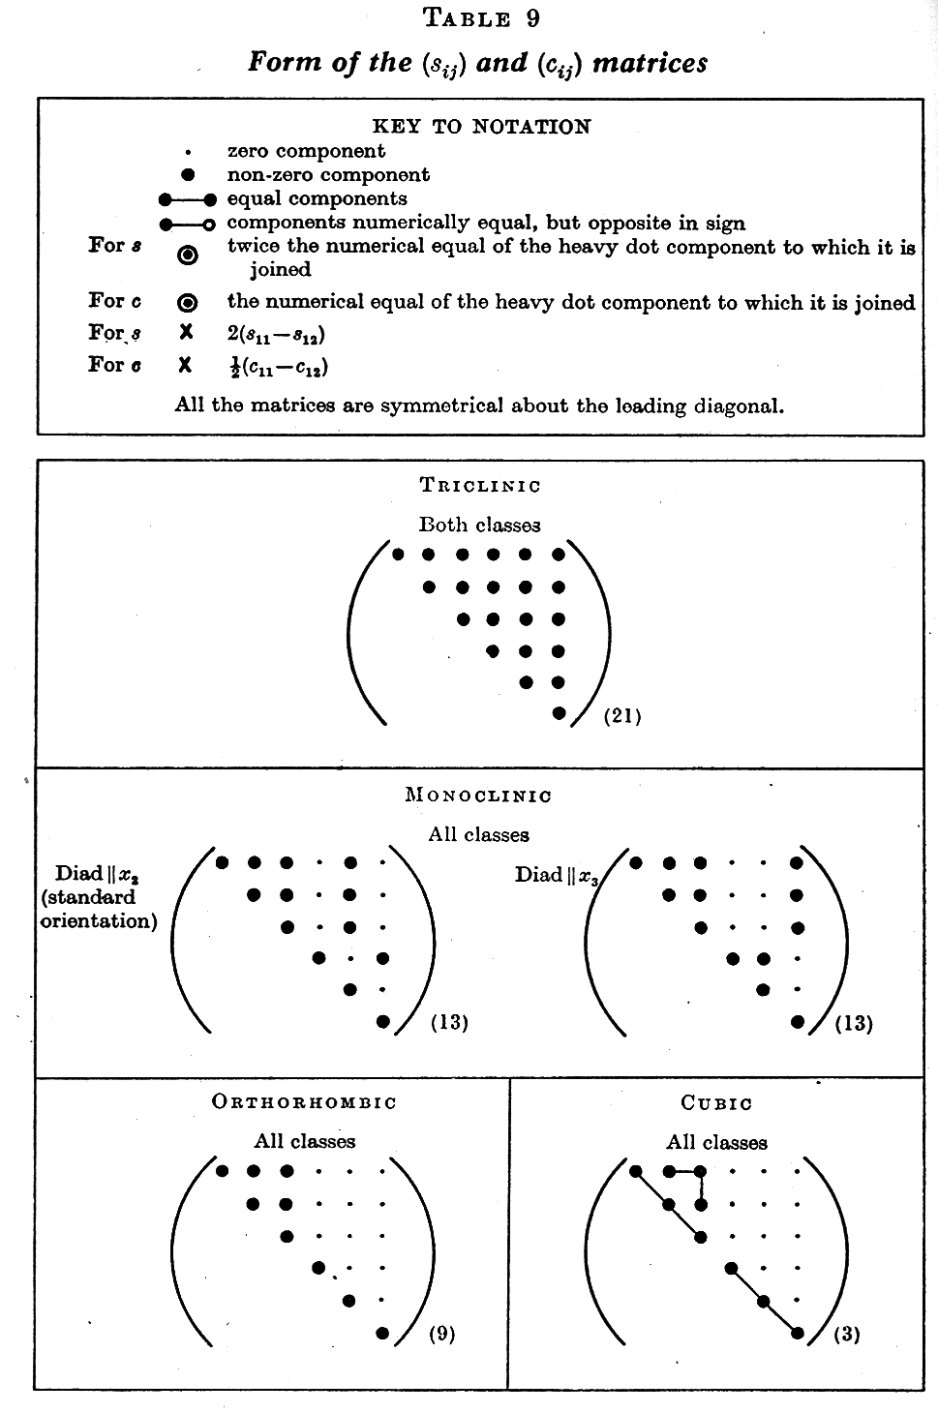
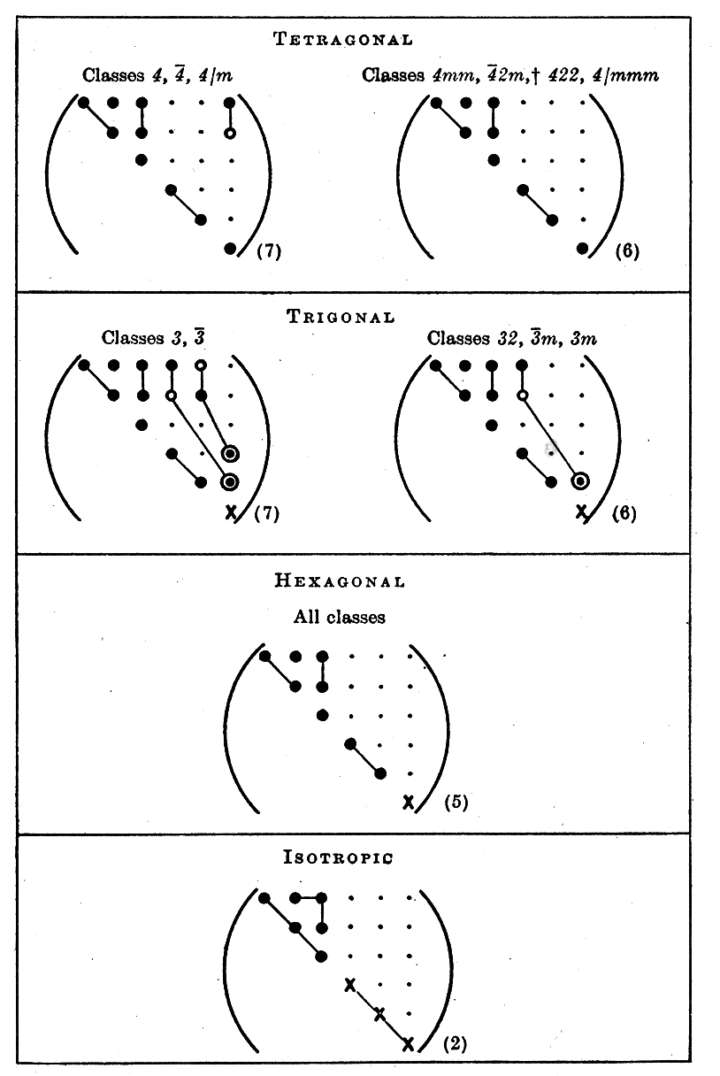
Effect of Symmetry on the Elasticity Tensors, S, C

Slide 95
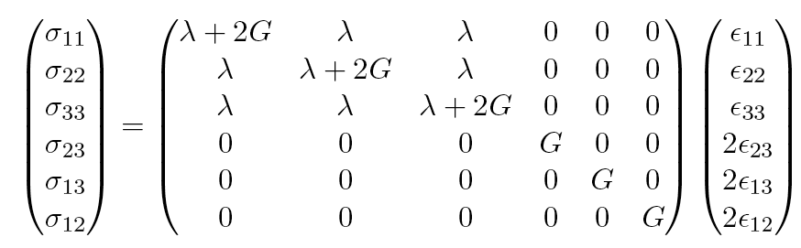
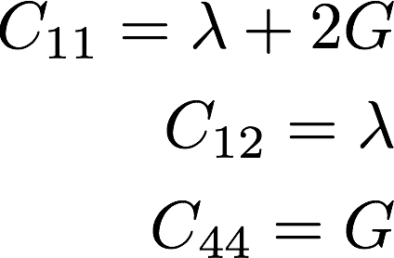
Lamé constants (isotropic elasticity)
For an elastically isotropic body, there are only 2 elastic moduli, known as the Lamé constants.
This means that, if you know the Lamé constants, then you can obtain the stiffness values thus:

Slide 96
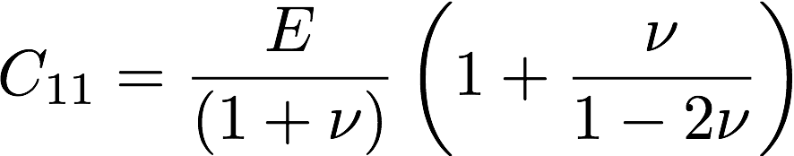
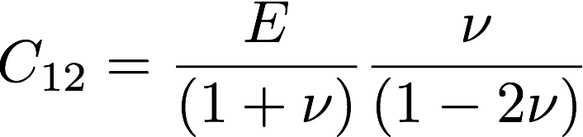
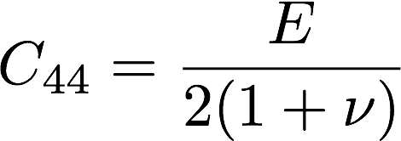
Stiffnesses in terms of E and ν
S₁₁ = (C₁₁+C₁₂)/{(C₁₁-C₁₂)(C₁₁+2C₁₂)}
S₁₁ = (λ+2G + λ) / {(λ+2G - λ)(λ+2G + 2λ)}
S₁₁ = (λ+G) / {G(2G + 3λ)}
S₁₂ = -C₁₂/{(C₁₁-C₁₂)(C₁₁+2C₁₂)}
S₁₂ = -λ / {2G (2G + 3λ)}
S₄₄ = 1 / G
Notes:
C_{11} = \frac{E}{(1 + \nu)} \left( 1 + \frac{\nu} { 1-2\nu} \right)
C_{12} = \frac{E}{( 1 + \nu) } \frac{ \nu } {( 1 - 2\nu) }

Slide 97
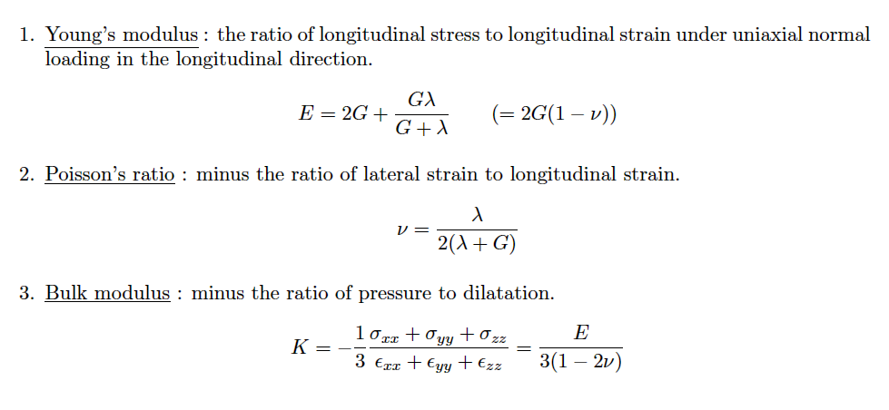
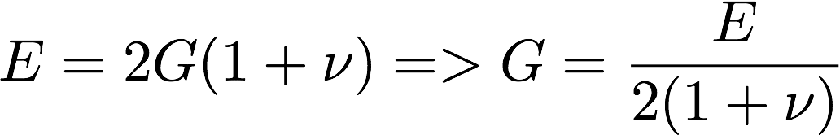
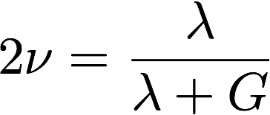
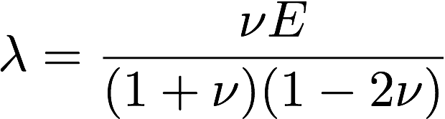
Young’s, Bulk moduli, Poisson’s ratio
ν = λ /2(G + λ) => 1-ν = {2(G + λ) - λ }/2(G + λ)
1-ν = {2G + λ) }/2(G + λ)
1-2ν = {2(G + λ) - 2λ }/2(G + λ) = G / (G + λ)
1-(1-2ν)/(1-2ν) = λ/G
2ν /(1-2ν) = λ/G
G 2ν /(1-2ν) = λ
λ = G 2ν /(1-2ν)
λ = E/ 2{1 + ν} * 2ν /(1-2ν)
λ =ν E/ {(1 + ν) (1-2ν)}
λ = E/(1 + ν) {ν /(1-2ν)}
E = 2{2G(G + λ) + Gλ}/2(G + λ)
E = 2{2G² + 3G λ}/2(G + λ)
E/ 1-2ν = 2G{2G + 3λ} / 2G = 2G + 3λ
E/ 1-2ν = 2G{2G + 3λ} / 2G = 2G + 3G {2ν /(1-2ν)}
E/ 1-2ν = 2G {1 + ν} /(1-2ν)
E = 2G {1 + ν} => G = E/ 2{1 + ν}
C₁₁ = E/ {1 + ν} + ν E/ {(1 + ν) (1-2ν)}
C₁₁ = E [1 + (ν / (1-2ν))] / {1 + ν}
Notes:
E₁₀₀ = {(λ+2G - λ)(λ+2G + 2λ)}/(λ+2G + λ)
E₁₀₀ = {(2G )(2G + 3λ)}/2(λ+G)
E₁₀₀ = G {2G + 3λ}/(λ+G)
E₁₀₀ = G {2G + 2λ}/(λ+G) + λ/(λ+G)
E₁₀₀ = 2G + Gλ/(λ+G). QED.

Slide 98
General Anisotropic Properties
Many different properties of crystals can be described as tensors.
The rank of each tensor property depends, naturally, on the nature of the quantities related by the property.

Slide 99
Examples of Materials Properties as Tensors
Table 1 shows a series of tensors that are of importance for material science. The tensors are grouped by rank, and are also labeled (in the last column) by E (equilibrium property) or T (transport property). The number following this letter indicates the maximum number of independent, nonzero elements in the tensor, taking into account symmetries imposed by thermodynamics.
The Field and Response columns contain the following symbols: ∆T = temperature difference, ∆S = entropy change, E_{i} = electric field components, H_{i} = magnetic field components, ε_{ij} = mechanical strain, D_{i} = electric displacement, B_{i} = magnetic induction, σ_{ij} = mechanical stress, ∆β_{ij} = change of the impermeability tensor, j_{i} = electrical current density, ∇_{j}T = temperature gradient, h_{i} = heat flux, ∇_{j}c = concentration gradient, m_{i} = mass flux, ρª_{i} = anti-symmetric part of resistivity tensor, ρ^{s}_{i} = symmetric part of resistivity tensor, ∆ρ_{ij} = change in the component ij of the resistivity tensor, l_{i} = direction cosines of wave direction in crystal, G = gyration constant,

Slide 100
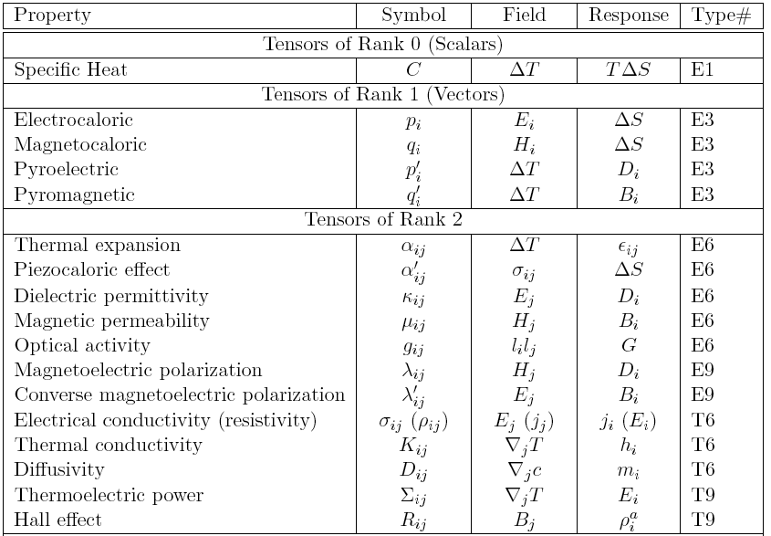

Slide 101
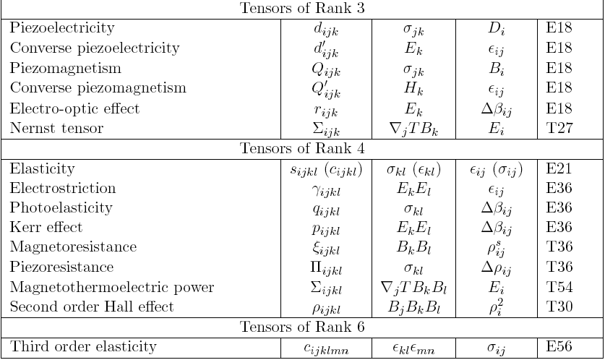
Courtesy of Prof. M. De Graef

Slide 102
Principal Effects
Courtesy of Prof. M. De Graef
Electrocaloric = pyroelectric
Magnetocaloric = pyromagnetic
Thermal expansion = piezocaloric
Magnetoelectric and converse magnetoelectric
Piezoelectric and converse piezoelectric
Piezomagnetic and converse piezomagnetic

Slide 103
Principal Effects
Courtesy of Prof. M. De Graef
1st rank cross effects
2nd rank cross effects
3rd rank cross effects

Slide 104
General crystal symmetry shown above.
Courtesy of Prof. M. De Graef

Slide 105
Point group 4
Courtesy of Prof. M. De Graef

Slide 106
Point group m3m
Note how many fewer independent coefficients there are!
Note how the center of symmetry eliminates many of the properties, such as pyroelectricity
Courtesy of Prof. M. De Graef

Slide 107
Homogeneity
Stimuli and responses of interest are, in general, not scalar quantities but tensors. Furthermore, some of the properties of interest, such as the plastic properties of a material, are far from linear at the scale of a polycrystal. Nonetheless, they can be treated as linear at a suitably local scale and then an averaging technique can be used to obtain the response of the polycrystal. The local or microscopic response is generally well understood but the validity of the averaging techniques is still controversial in many cases. Also, we will only discuss cases where a homogeneous response can be reasonably expected.
There are many problems in which a non-homogeneous response to a homogeneous stimulus is of critical importance. Stress-corrosion cracking, for example, is a wildly non-linear, non-homogeneous response to an approximately uniform stimulus which depends on the mechanical and electro-chemical properties of the material.

Slide 108
Use of MuPAD inside Matlab
Note that the 6x6 transformation matrix can be programmed inside Matlab just as a 3x3 can.
In order to apply a transformation (e.g. a symmetry operator) to a 6x6 stiffness or compliance matrix, the formula is the same as before, i.e.:
C’= O C O^{T}

Slide 109
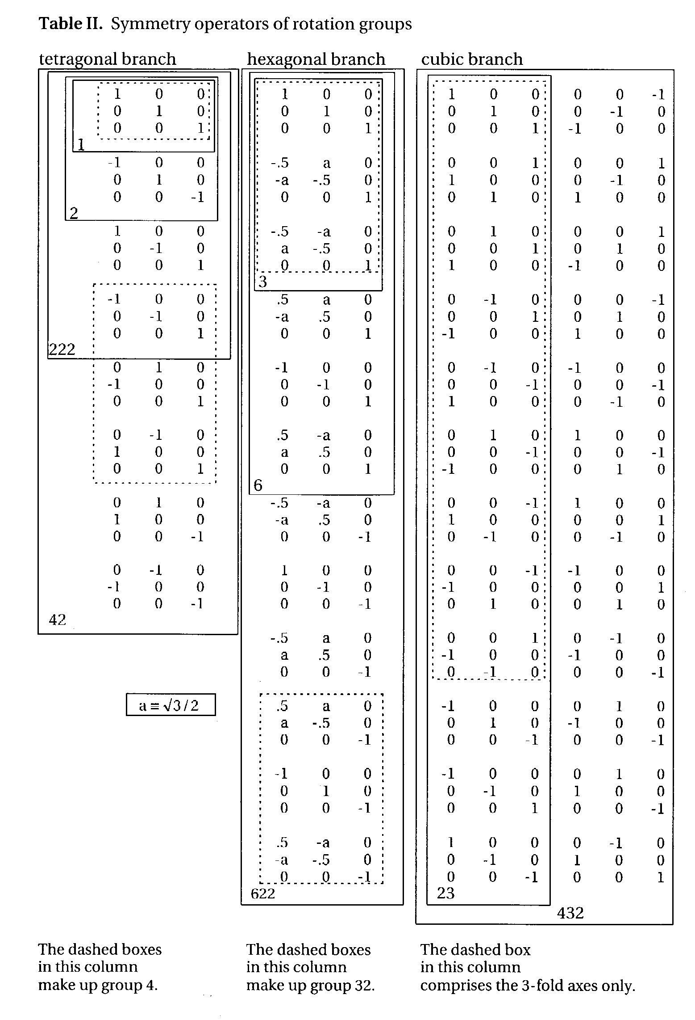
Matrix
representation of the
rotation point groups
-
What is a group? A group is a set of objects that form a closed set: if you combine any two of them together, the result is simply a different member of that same group of objects. Rotations in a given point group form closed sets - try it for yourself!
Note: the 3rd matrix in the 1st column (x-diad) is missing a “-” on the 33 element; this is corrected in this slide. Also, in the 2nd from the bottom, last column: the 33 element should be +1, not -1. In some versions of the book, in the last matrix (bottom right corner) the 33 element is incorrectly given as -1; here the +1 is correct.
Kocks, Tomé & Wenk:
Ch. 1 Table II
Notes:
Complicated slide with much data. Illustrates the different matrices used. Note that the coefficients for the 6-fold rotation axes do not have unit values.

