Slide 1


Texture Components and Euler Angles
27-731 (normally, 27-750)
Texture, Microstructure & Anisotropy
A.D. (Tony) Rollett
Last revised: 23rd Jan. 2022

Slide 2
Lecture Objectives
Show how to convert from a description of a crystal orientation based on Miller indices to matrices to Euler angles.
Give examples of standard named components and their associated Euler angles.
The overall aim is to be able to describe a texture component by a single point (in orientation space, which is parameterized with some set of coordinates such as Euler angles) instead of needing to draw the crystal embedded in a reference frame.
Homework exercises will be converting Miller indices to Euler angles.
Obj/notation AxisTransformation Matrix EulerAngles Components

Slide 3
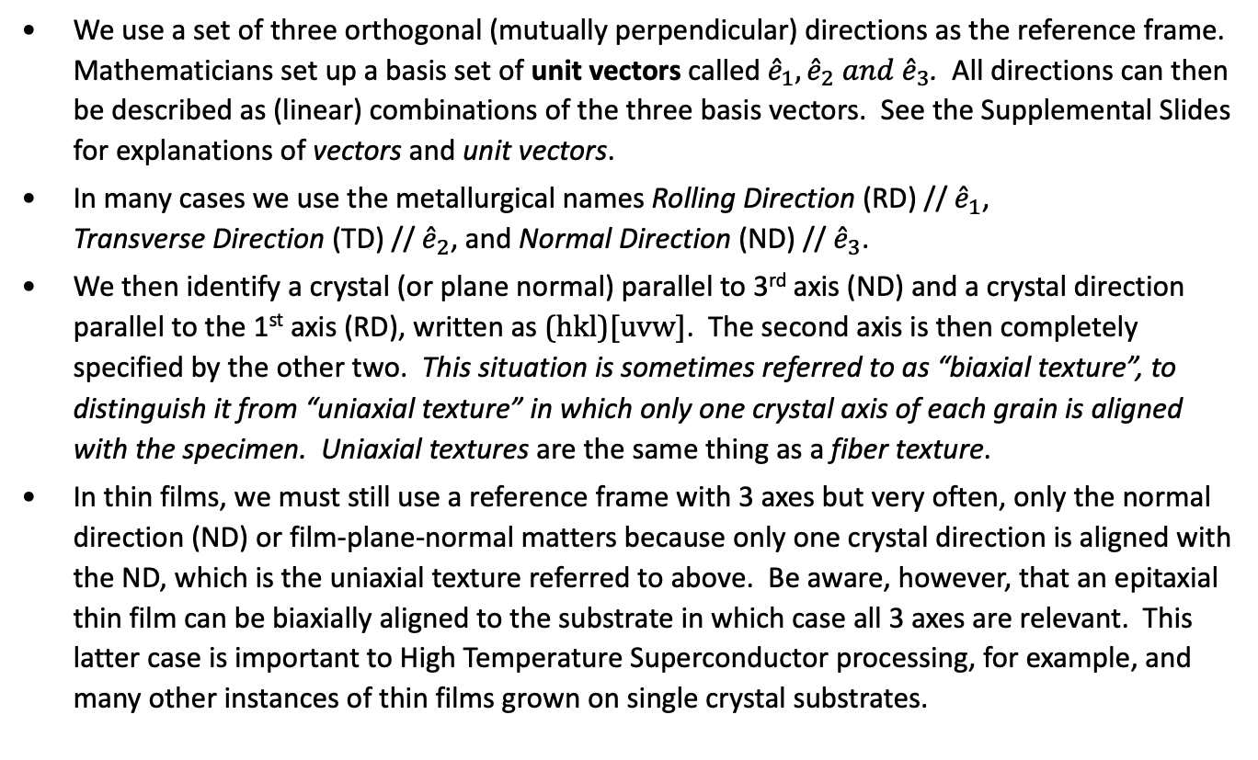
(hkl)[uvw], Miller Index Definition of a Crystal Orientation
We use a set of three orthogonal (mutually perpendicular) directions as the reference frame. Mathematicians set up a basis set of unit vectors called${\hat{e}}_{1},{\hat{e}}_{2} and {\hat{e}}_{3}$. All directions can then be described as (linear) combinations of the three basis vectors. See the Supplemental Slides for explanations of vectors and unit vectors.
In many cases we use the metallurgical names Rolling Direction (RD) // ${\hat{e}}_{1}$, Transverse Direction (TD) // ${\hat{e}}_{2}$, and Normal Direction (ND) // ${\hat{e}}_{3}$.
We then identify a crystal (or plane normal) parallel to 3rd axis (ND) and a crystal direction parallel to the 1st axis (RD), written as (hkl)[uvw]. The second axis is then completely specified by the other two. This situation is sometimes referred to as “biaxial texture”, to distinguish it from “uniaxial texture” in which only one crystal axis of each grain is aligned with the specimen. Uniaxial textures are the same thing as a fiber texture.
In thin films, we must still use a reference frame with 3 axes but very often, only the normal direction (ND) or film-plane-normal matters because only one crystal direction is aligned with the ND, which is the uniaxial texture referred to above. Be aware, however, that an epitaxial thin film can be biaxially aligned to the substrate in which case all 3 axes are relevant. This latter case is important to High Temperature Superconductor processing, for example, and many other instances of thin films grown on single crystal substrates.

Slide 4
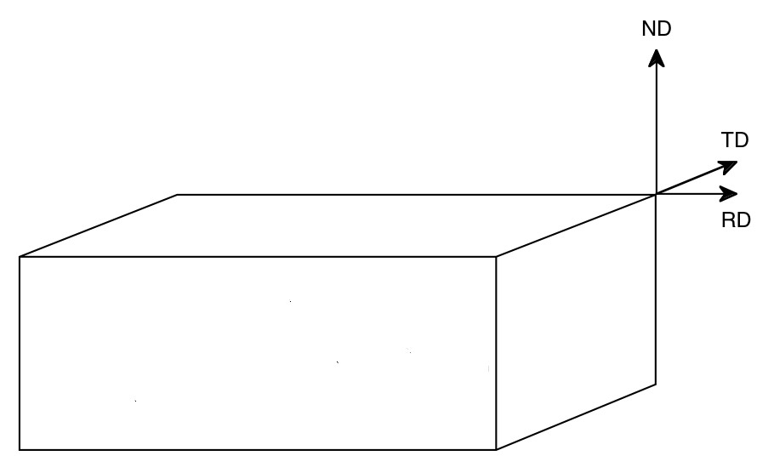
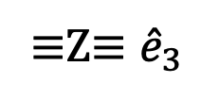
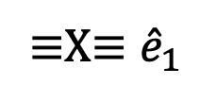
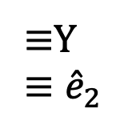
Orientation specification via
Miller indices: (hkl)[uvw]
We specify a texture component by the Miller indices of a plane normal that is parallel to sample Z, and Miller indices of a direction parallel to sample X.
≡Z≡ ${\hat{e}}_{3}$
(hkl)
∕ ∕ Z
≡Y
≡ ${\hat{e}}_{2}$
≡X≡ ${\hat{e}}_{1}$
[uvw]
∕ ∕ X
Obj/notation AxisTransformation Matrix EulerAngles Components

Slide 5
Active versus Passive Rotations
Before we discuss the details of how to calculate orientation matrices, it is a good idea to summarize the difference between “active” and “passive” rotations, as mathematicians know them.
Youtube: https://www.youtube.com/watch?v=EcLOT6Eqr5o
In materials science, we are mostly concerned with describing anisotropic properties of crystals and the aggregate anisotropy of polycrystalline materials, for which it is convenient to use tensors to describe those properties.
For tensor quantities, we commonly need their coefficients in either the sample frame or the crystal frame. For this we use “transformations of axes”, which are “passive rotations”, in the sense that the two frames share a common origin and differ by only a (proper) rotation. The tensor quantities do not rotate in real space, however.
In solid mechanics, however, it is more typical to need to describes the motions of objects. Certain motions are just rotations and one can think of rotating a vector, for example, about the origin, in which case one is describing an “active rotation”. Some object is rotated about the origin and moves through the frame.
When we deal with Miller indices, remember to divide by the magnitude of the vector so as to obtain a unit vector.
For all work in texture we will consistently use axis transformations, a.k.a. passive rotations.

Slide 6
Why do we need Axis Transformations?
The reason that we need axis transformations is because in order to compute the anisotropic properties of a polycrystal, we need to be able to transfer (single crystal) properties from the crystal frame to the sample frame. Equally, we need to transfer stresses, strains and other fields from the sample frame to the crystal frame.
In order for a quantity to “qualify” as a tensor it has to obey the axis transformation rule, as discussed in the previous slides.
The tensor transformation rule defines relationships between transformed and untransformed tensors of various ranks.
Vector: V’_{i} = a_{ij}V_{j}
2nd rank T’_{ij} = a_{ik}a_{jl}T_{kl}
3rd rank T’_{ijk} = a_{il}a_{jm}a_{kn}T_{lmn}
4th rank T’_{ijkl} = a_{im}a_{jn}a_{ko}a_{lp}T_{mnop}
and so on and so forth (without limit in the rank)
Here, "T" is a tensor and "a" is a (3x3, orthogonal) transformation matrix
Reference: Vector and Tensor Analysis, with Applications, A.I. Borisenko and I.E. Tarapov

Slide 7
Rotation of axes in the (2D) plane: x, y = old axes; x’,y’ = new axes
We transform the coefficients of, e.g., a vector, v, from one set of axes to another; note that the vector does not change position in real space
v
θ
N.B. Passive Rotation/ Transformation of Axes
Obj/notation AxisTransformation Matrix EulerAngles Components
Notes:
New coefficients in the new set of axes for the SAME vector

Slide 8
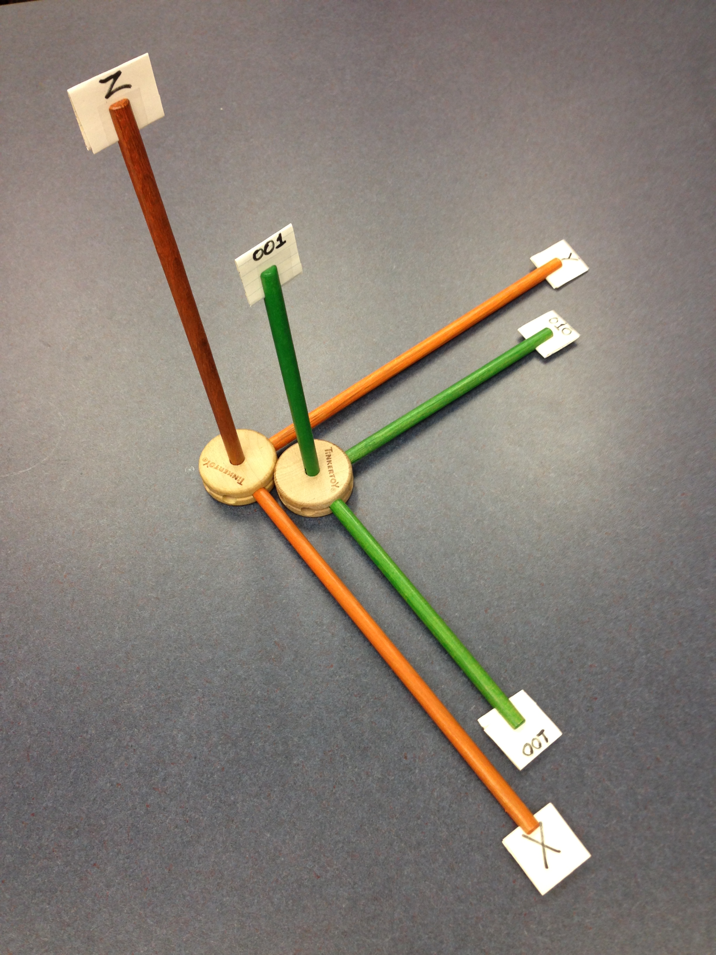
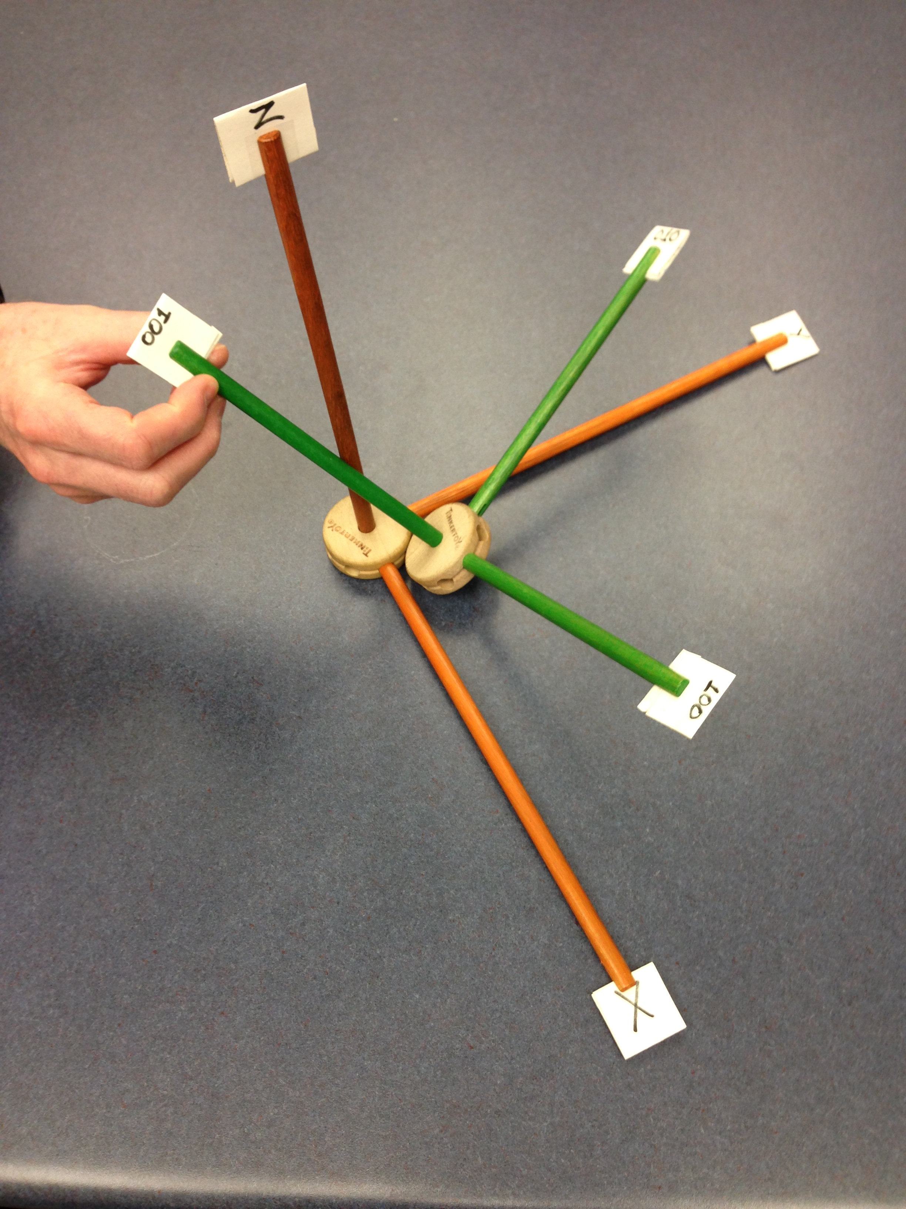
Reference Frames
Initial position, crystal frame (green, K_{B} in Bunge) aligned with reference (sample, K_{A} in Bunge) frame (orange)
New position, crystal frame (green) rotated with respect to the reference (sample) frame (orange)

Slide 9
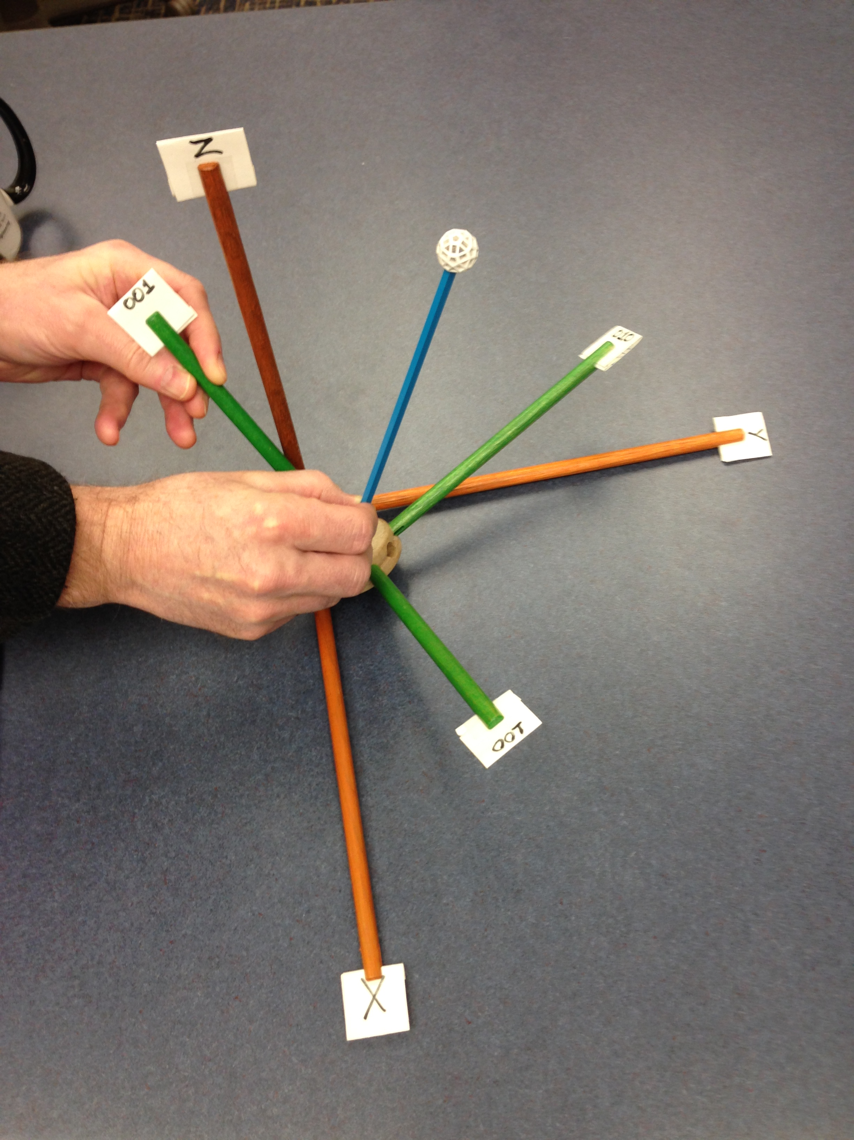
Vector Represented in Two Different Frames
New position, crystal frame (green, K_{B} in Bunge) rotated with respect to the reference (sample, K_{A} in Bunge) frame (orange)
Now we add a vector (the blue stick) that we wish to represent in two different frames (sample vs. crystal)

Slide 10
Definition of an Axis Transformation: ê = old axes; ê′= new axes
We transform the coefficients of, e.g., a vector, v, from one set (un-primed) of axes to another (primed); note that the vector does not change position in real space
v
From Sample to
Crystal (primed)
ê₃
ê’₃
ê’₂
ê₂
ê’₁
ê₁
Obj/notation AxisTransformation Matrix EulerAngles Components
Notes:
Physically, the vector does not change

Slide 11
Geometry of {hkl}<uvw>
Sample to Crystal (primed)
Miller index
notation of
texture component
specifies direction
cosines of crystal
directions // to
sample axes. Form the second axis from the cross-product of the 3rd and 1st axes.
^
^
e’₃
e₃ // (hkl)
[001]
[010]
^
e’₂
^
^
e₂ // t
^
e₁ // [uvw]
^
t = hkl x uvw
e’₁
[100]
Obj/notation AxisTransformation Matrix EulerAngles Components

Slide 12
Form matrix from Miller Indices
Basic idea: we can construct the complete rotation matrix from two known, easy to determine columns of the matrix. Knowing that we have columns rather than rows is a consequence of the sense of rotation, which is equivalent to the direction in which the axis transformation is carried out.
Obj/notation AxisTransformation Matrix EulerAngles Components

Slide 13
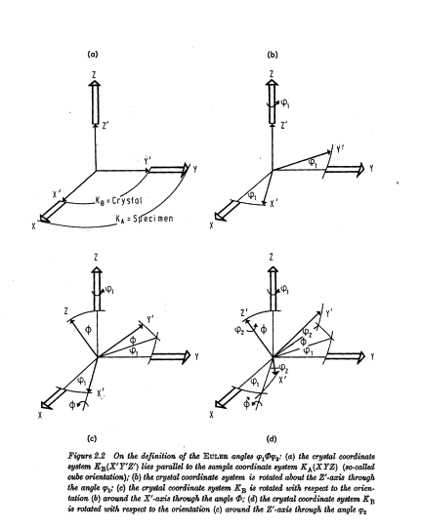
(Bunge) Euler Angle Definition
[Bunge]
The three reference axes are labeled as X, Y & Z; also commonly known as ND, RD, and TD.
The three crystal axes are labeled as X’, Y’ & Z’ ; also commonly known as [100], [010] & [001] in cubic crystals.
The reference (sample) frame is labeled as “K_{A}” in the figure, and the crystal frame as “K_{B}”.
Each diagram shows successive rotations, more properly thought of as transformations of axes.
Obj/notation AxisTransformation Matrix EulerAngles Components

Slide 14
Euler Angles, Animated
e’₃=
e₃=Z_{sample}=ND
3rd position (final)
[001]
2nd position
[010]
z_{crystal}=e₃’’’
=
φ₁
1st position
e”₃
y_{crystal}=e₂’’’
e”₂
φ₂
e’₂
e₂=Y_{sample}=TD
Crystal
RD
x_{crystal}=e₁’’’
[100]
Φ
TD
e’₁
=e”₁
e₁=X_{sample}=RD
Sample Axes
Obj/notation AxisTransformation Matrix EulerAngles Components

Slide 15
Named Texture Components
In metals, especially rolled fcc metals it is common to give proper names to particular texture components that commonly occur. Thus, you will encounter “cube”, “brass”, “copper”, “S” and the like. Each component has particular Euler angles, as we will now explain. Along with these names there are also names associated so-called fibers such as alpha and beta. A texture fiber is a continuous line (curve) of orientations through orientation space.
In rolled bcc metals, it is typical to refer to fibers only, such as the alpha fiber in which the orientations all have <110>//RD, and the gamma fiber for which <111>//ND. One exception to this is the “Goss” component, named after the person who identified the textures critical to transformer steels.
In hexagonal metals, the texture is mostly evident in the basal pole figure and so the names generally refer to the deviation of the <0001> with respect to a particular sample direction such as ND. This is described in more detail later.
In thin films of all kinds, unless an epitaxial texture is present, the texture is described in terms of which crystal direction is most commonly found parallel to the normal of the film plane, or <uvw>//ND.

Slide 16
Cube Texture (001)[100]: cube-on-face
Observed in recrystallization of fcc metals
The three crystal axes, <001>, are parallel to the three sample axes, i.e.,
ND≡Z, RD≡X, and TD≡Y directions.
[001]
[100]
[0-10]
Obj/notation AxisTransformation Matrix EulerAngles Components

Slide 17
Sharp Texture (Recrystallization)
Figure on the left shows the {001} pole figures (PFs) for this texture component: maxima correspond to {100} poles in the standard stereographic projection aligned with the sample axes. Note that this pole figure could not be measured experimentally unless transmission and reflection methods were to be combined because the reflections on the edge of the PF cannot be detected (see lecture on PF measurement).
Obj/notation AxisTransformation Matrix EulerAngles Components

Slide 18
Euler angles of Cube component
The Euler angles for this component are simple, and yet not so simple!
The crystal axes align exactly with the specimen axes, therefore all three Euler angles are exactly zero:
(φ₁, Φ, φ₂) = (0°, 0°, 0°).
Orientation Matrix:
Rodrigues vector: [0,0,0]
Unit quaternion: [0,0,0,1]
As an introduction to the effects of crystal symmetry: consider aligning [100]//TD, [010]//-RD, [001]//ND. This is evidently still the cube orientation, but the Euler angles are
(φ₁,Φ,φ₂) = (90°,0°,0°)!
This is a first illustration of the confusing (but real) situation where the same physical orientation has multiple mathematical/numerical descriptions. This leads eventually to the discussion of fundamental zones.
Obj/notation AxisTransformation Matrix EulerAngles Components

Slide 19
{110}<001>: the Goss Component
This type of texture is known as Goss Texture and occurs as a Recrystallization texture for FCC materials such as Brass, …
In this case the (011) plane is oriented towards the ND and the [001] inside the (011) plane is along the RD.
ND
(110)
[001]
TD
[100]
RD
Obj/notation AxisTransformation Matrix EulerAngles Components

Slide 20
{110}<001>: cube-on-edge
In the 011 pole figure, one of the poles is oriented parallel to the ND (center of the pole figure) but the other ones will be at 60° or 90° angles but tilted 45° from the RD! (Homework: draw the (111) pole figure by hand.)
TD
ND
(110)
[001]
TD
[100]
RD
RD
{110}

Slide 21
Euler angles of Goss component
The Euler angles for this component are simple, and yet other variants exist, just as for the cube component.
Only one rotation of 45° is needed to rotate the crystal from the reference position (i.e. the cube component) to (011)[100]; this happens to be accomplished with the 2nd Euler angle.
(φ₁,Φ,φ₂) = (0°,45°,0°).
Other variants will be shown when symmetry is discussed.
Matrix:
Rodrigues vector:
[ tan(22.5°), 0 , 0 ]
Unit quaternion (q₁, q₂, q₃, q₄):
[ sin(22.5°) , 0, 0, cos(22.5°)]
Note that, since there is only one non-zero Euler angle, the rotation axis is obvious by inspection, i.e. the x-axis. For more general cases, the rotation axis has to be calculated.
Obj/notation AxisTransformation Matrix EulerAngles Components

Slide 22
Brass component
This type of texture is known as Brass Texture and occurs as a rolling texture component for materials such as Brass, Silver, and Stainless steel.
Obj/notation AxisTransformation Matrix EulerAngles Components

Slide 23
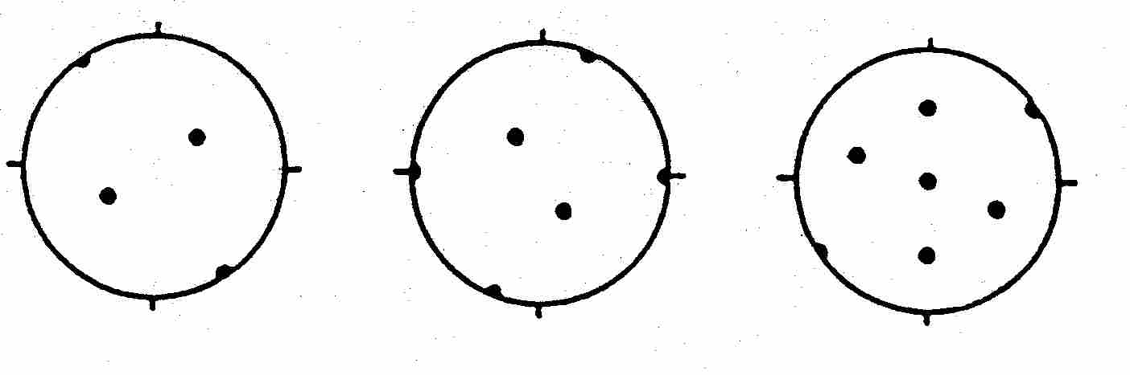
Brass component, contd.
The associated (110) pole figure is very similar to the Goss texture pole figure except that it is rotated about the ND. In this example, the crystal has been rotated in only one sense (anticlockwise).
(100)
(111)
(110)
Obj/notation AxisTransformation Matrix EulerAngles Components

Slide 24
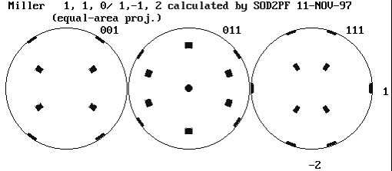
{110}<112> Brass component
- Think of rotating the Goss component around the ND. In this example, the crystal has been rotated in both clockwise and anti-clockwise (two variants).
- Example of the effect of (statistical) sample symmetry
TD
TD
RD
RD

Slide 25
Brass component: Euler angles
The brass component is convenient because we can think about performing two successive rotations:
1st about the ND, 2nd about the new position of the [100] axis.
1st rotation is 35° about the ND; 2nd rotation is 45° about the [100].
(φ₁,Φ,φ₂) = (35°,45°,0°).
Obj/notation AxisTransformation Matrix EulerAngles Components

Slide 26
Euler Angle Conventions
An inconvenient fact is that the definition of Euler angles that we have given so far is not unique.
Many other variants not only exist but have names and are in regular use! Euler angles are used in physics, aeronautics, robotics, to name but a few other fields. YouTube: https://www.youtube.com/watch?v=q0jgqeS_ACM
The differences between the conventions lie in the choice of the rotation axes (generally only the second axis) and the sense of rotation.
Some of the commonly used conventions are Bunge, Kocks, Roe and Canova* (in approximate order of decreasing popularity).
For the purposes of this course we will only use the Bunge convention. At this point in time, almost all codes assume this. Nevertheless, it is wise to check what is being used. The VPSC code, e.g., requires that the input list of orientations has a letter in column 1 on line 4 to define the convention; use “B” in this position to select the Bunge convention.
*You will find Canova angles inside the computer code LApp

Slide 27
Meaning of Bunge Euler angles
In the Bunge convention, the first two angles, φ₁ and Φ, tell you the position of the [001] crystal direction relative to the specimen axes.
Think of rotating the crystal about the ND (1st angle, φ₁); then rotate the crystal out of the plane (about the [100] axis, Φ);
Finally, the 3rd angle (φ₂) _{tells} you how much to rotate the crystal about [001].
Obj/notation AxisTransformation Matrix EulerAngles Components

Slide 28
Meaning of Roe Euler angles
In the Roe convention, the first two angles, Ψ and Θ, tell you the position of the [001] crystal direction relative to the specimen axes.
Then think of rotating the crystal about the ND or 001 or z-axis (1st angle, Ψ); then rotate the crystal out of the plane (about [010], or the y-axis, Θ);
Finally, the 3rd angle (Φ) tells you how much to rotate the crystal about [001].
Obj/notation AxisTransformation Matrix EulerAngles Components

Slide 29
Meaning of Kocks Euler angles
In the Kocks convention, which is almost the same as the Roe convention with the exception of the third angle, the first two angles, Ψ and Θ, tell you the position of the [001] crystal direction relative to the specimen axes.
Then think of rotating the crystal about the ND or 001 or z-axis (1st angle, Ψ); then rotate the crystal out of the plane (about [010], or the y-axis, Θ);
Finally, the 3rd angle (φ) tells you how much to rotate the crystal anti-clockwise about [001]. Here’s the difference between Roe and Kocks - the last angle is a negative or clockwise rotation about 001, instead of a positive or counter-clockwise rotation.
Obj/notation AxisTransformation Matrix EulerAngles Components

Slide 30
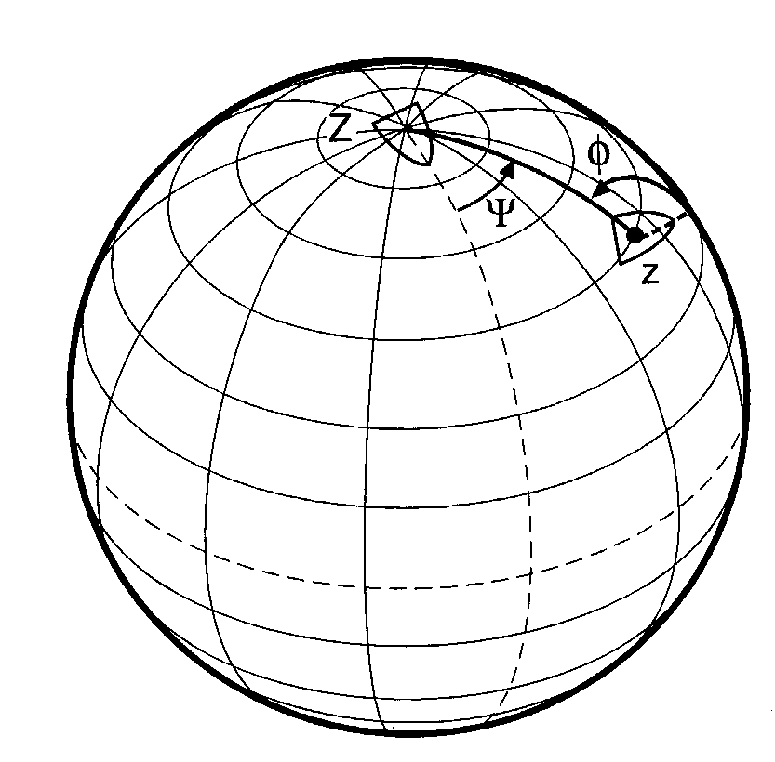
Kocks Euler Angles:
Ship Analogy
[Kocks, Tomé, Wenk]
Analogy: position and the heading of a boat with respect to the globe. Latitude (Θ) and longitude (ψ) describe the position of the boat; third angle describes the heading (φ) of the boat relative to the line of longitude that connects the boat to the North Pole.
Obj/notation AxisTransformation Matrix EulerAngles Components

Slide 31
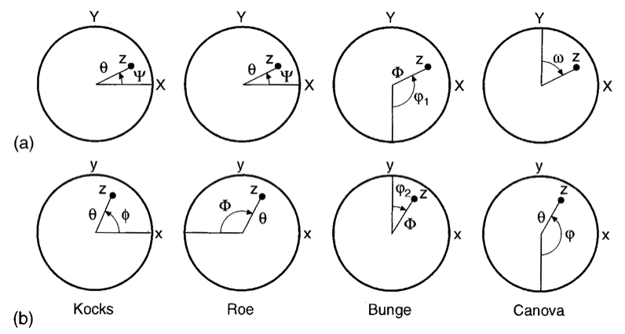
Euler Angle Definitions
[Kocks, Tomé, Wenk]
Bunge and Canova are inverse to one another
Kocks and Roe differ by sign of third angle
Bunge rotates about x’, Roe/Kocks about y’ (2nd angle)
Obj/notation AxisTransformation Matrix EulerAngles Components

Slide 32
Euler Angle Conversions
[Kocks, Tomé, Wenk]
Obj/notation AxisTransformation Matrix EulerAngles Components

Slide 33
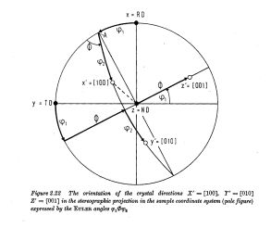
Complete orientations in the Pole Figure
φ₁
(φ₁,Φ,φ₂) ~
(30°,70°,40°).
Note the loss of
information
in a diffraction
experiment if each set of poles from a single component cannot be related to one another.
φ₂
Φ
φ₁
Φ
φ₂
[Bunge]
Obj/notation AxisTransformation Matrix EulerAngles Components

Slide 34
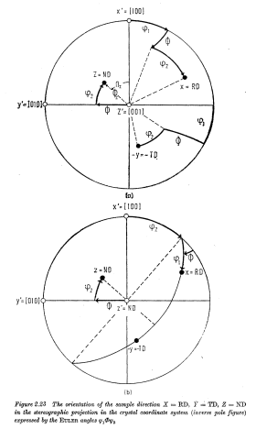
Complete orientations in the Inverse Pole Figure
Think of yourself as an observer standing on the crystal axes and measuring where the sample axes lie in relation to the crystal axes.
[Bunge]
Obj/notation AxisTransformation Matrix EulerAngles Components

Slide 35
Summary
Conversion between different forms of description of texture components described.
Physical picture of the meaning of Euler angles as rotations of a crystal given.
Miller indices are descriptive (and typical in physical metallurgy), but matrices are useful for computation, and Euler angles are useful for mapping out textures (to be discussed). Later, we will describe Rodrigues vectors and (unit) quaternions: the latter are the most useful representation for computations.

Slide 36
In-Class Exercises: 1
Draw three orthogonal axes to represent the reference frame. Draw a unit cube to represent a crystal such the that <100> directions are aligned with the {x,y,z} axes. Explain that there are several alternative labels for such sets of axes or frames-of-reference, such as {RD,TD,ND}. Distinguish between the use of {} to denote a family of plane normals and {} to denote a set of objects (which may, or may not, constitute a group). Explain that this alignment is called the “cube component”.
Starting with the reference frame, also called the sample frame, sketch the 3 successive rotations that correspond to the (Bunge) Euler angles, {φ₁, Φ, φ₂}. Label the axes of rotation for each one. Explain that it is permissible to describe this process in terms of rotations about the crystal z axis, then the x axis, then the z axis again.
Draw the sample frame, with labels, and then draw a unit cube with one edge parallel to the sample x axis and rotated by 45° about this axis. State that this is a graphical representation of the texture component known as “Goss”. Identify the Miller indices of the three crystal directions parallel to {RD, TD, ND} as {100,011,0-11}.

Slide 37
In-Class Exercises: 2
For the Goss component shown previously, explain that the Euler angles that parameterize this texture component are {0,45,0} (in degrees). Refer to the previous explanation of the definition of the Bunge Euler angles to do this.
For the same Goss component, draw the {110} pole figure. Hint: a simple way to do this is to find a diagram of the stereographic projection for cubic materials with 110 in the center of the figure; rotate it until a <100> direction is aligned pointing to the right. In all our work we will align the x axis of a Cartesian reference frame pointing to the right, just as in standard mathematical plots, and the y axis pointing up.
For the same Goss component, introduce the rotation matrix. Setting aside its properties as an orthogonal matrix for the time being, explain how one can construct it as a 2x2 45° rotation matrix, which can then be embedded in a 3x3 matrix to represent the 45° rotation about the x axis.

Slide 38
In-Class Exercises: 3
Introduce the Brass component by using the same 110 stereographic projection as before but rotating it so that, instead of having, say, 001//RD, now we have -112//RD. Show that the angle required to rotate from Goss to Brass is approximately 35°. Show that this rotation is about the center of the projection, i.e. 110.
Picking up from the previous exercise, show that the combination of the 45° rotation about x to arrive at the Goss component, combined with the 35° rotation about 110 means that we can describe the Brass component with Euler angles {35,45,0}.
Show, again with the aid of the projection, that the 3 crystal directions parallel to the sample frame are {-112, 1-11, 110}. Check that these form a right-handed set!
Draw the definition of the Roe Euler angles. Explain the differences between this definition and the Bunge definition.
Draw the definition of the Kocks convention for Euler angles. Explain the differences between this definition and the Bunge definition.
List the conversions between the different definitions of Euler angles.

Slide 39
In-Class Exercises: 4
Setting aside the precise definition of a pole figure for the time being, sketch a pole figure with the sample X pointing to the right, the Y up and the Z in the center. (Later on we will discuss the confusing practice of drawing pole figures with RD up and TD to the right.) Sketch the successive rotations that correspond to the 3 (Bunge) Euler angles.
Sketch an inverse pole figure with the crystal x (i.e. 100) pointing to the right, the y (010) up and the z (001) in the center. Sketch the successive rotations that correspond to the 3 (Bunge) Euler angles. You will find it easier to start with the last angle, φ₂, and work backwards.
Anticipating the next lecture, discuss how to use the information about hkl//Z and uvw//X to construct a set of 3 mutually orthogonal unit vectors as a preliminary to obtaining an orientation matrix.

Slide 40
Supplementary Slides
The following slides provide supplementary information on Miller indices, the dot (scalar) product and direction cosines.

Slide 41
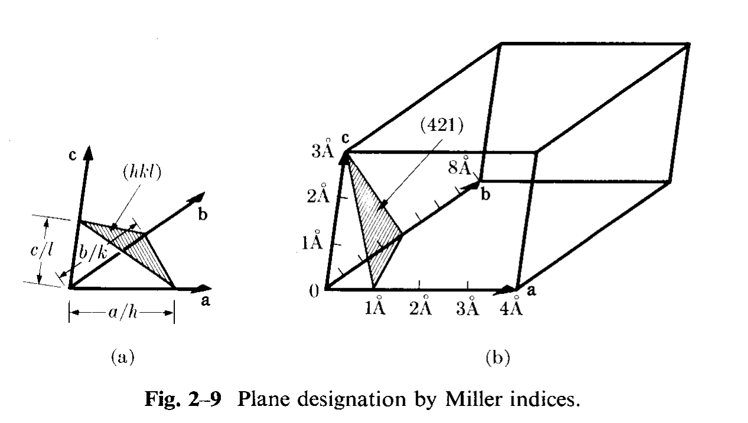
Miller Indices
Cubic system: directions, [uvw], are equivalent to, and parallel to plane normals with the same indices, (hkl).
Miller indices for a plane specify reciprocals of intercepts on each axis.

Slide 42
Miller <-> vectors
Miller indices [integer representation of direction cosines] can be converted to a unit vector, n, by dividing by the square root of the sum of the squares: {similar for [uvw]}. This is known as normalization.

Slide 43
Miller Index Definition of a Texture Component
The commonest method for specifying a texture component is the plane-direction.
Specify the crystallographic plane normal that is parallel to the specimen normal (e.g. the ND≡Z) and a crystallographic direction that is parallel to the long direction (e.g. the RD≡X).
(hkl) // ND, [uvw] // RD, or (hkl)[uvw]

Slide 44
Dot Product
Given two vectors, a and b, the dot product, a•b is a scalar quantity that is equal to the product of the magnitudes (lengths) of the vectors, multiplied by the cosine of the angle between them:
a•b = a b cosθ
If both vectors are unit vectors then the dot product is equal to the cosine of the angle.
In index form, a•b = a_{i} b_{i} .
Given a set of unit vectors defining an axis system, e_{x}, e_{y}, e_{z},a vector can be defined on that system by taking the dot product with each axis vector in turn, e.g.:
a_{x} = a• e_{x}

Slide 45
Direction Cosines
Definition of direction cosines: In analytic geometry, the direction cosines of a vector are the cosines of the angles between the vector and the three coordinate axes. Equivalently, they are the contributions of each component of the basis to a unit vector in that direction [en.wikipedia.org/wiki/Direction_cosine].
The components of a unit vector are equal to the cosines of the angle between the vector and each (orthogonal, Cartesian) reference axis.
We can use axis transformations to describe vectors in different reference frames (room, specimen, crystal, slip system….)

