Slide 1
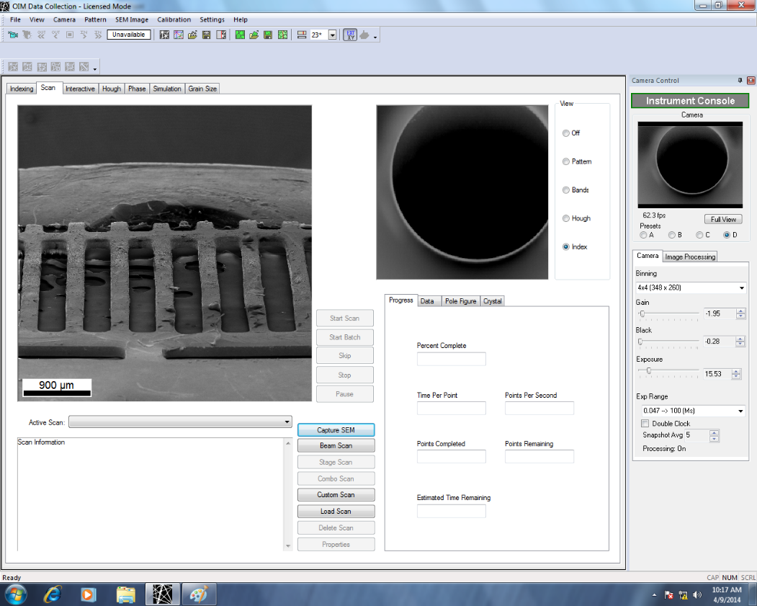
SEM view
Location of EBSD Camera
Bottom
Top view of a sample on a tilted sample holder (taken by my phone)
A hole for screw
Bottom
SEM View in the EBSD software
Top
Top
Bottom
The measured orientation map is consistent with the view of SEM images

