Slide 1
Nye’s dislocation density tensor
and its measurement
using EBSD orientation mapping
Benoît BEAUSIR & Claude FRESSENGEAS
Laboratoire d’Etude des Microstructures et de Mécanique des Matériaux (LEM3)
Université de Lorraine/CNRS
57045 Metz , France
LEM3, 4 octobre 2012

Slide 2
Acknowledgements
We gratefully acknowledge
- Chengfan F. Gu
Department of Materials Engineering, Monash University, Clayton, Australia
Nilesh P. Gurao
Department of Materials Engineering, Indian Institute of Science, Bangalore, India
Sabine Lay and Edgar F. Rauch
Laboratoire de Science et Ingénierie des Matériaux et des Procédés, Institut National Polytechnique/CNRS, Grenoble, France
Nicolas Bayona, Francis Wagner, Nathalie Bozzolo, J.J. Fundenberger
LEM3, Université de Lorraine/CNRS, Metz, France
who kindly provided orientation maps in copper, IF-steel, aluminum and
titanium, respectively.
LEM3, 4 octobre 2012

Slide 3
Motivation
Why should we try recovering Nye’s dislocation density tensor?
Nye’s tensor field reflects
Dislocation microstructures
Lattice curvature and strain due to dislocations
Internal stress fields, stored elastic energy
Nye’s tensor may be used to model
Path-dependent (“kinematic”) hardening
Size effects (sample size, particles size)
Interface incompatibility, dislocation pile-ups
Recrystallization (nucleation criterion and grain growth)
Anelastic relaxation …
LEM3, 4 octobre 2012

Slide 4
Outline
Nye’s dislocation density tensor
Lattice incompatibility
Aerial measure of incompatibility
Coarse graining
Dislocation/disclination densities from elastic curvature
Rotational compatibility: standard dislocation treatment
Rotational incompatibility: disclination density
Dislocation density measurement from EBSD orientation mapping
Measurement from a single planar map
Measurement from 3D data
Tantalum benchmark
Conclusions
LEM3, 4 octobre 2012

Slide 5
Nye’s dislocation density tensor
Nye’s dislocation density tensor
Lattice incompatibility
Aerial measure of incompatibility
Coarse graining
Dislocation/disclination densities from elastic curvature
Rotational compatibility: standard dislocation treatment
Rotational incompatibility: disclination density
Dislocation density measurement from EBSD orientation mapping
Measurement from a single planar map
Measurement from 3D data
Tantalum benchmark
Conclusions
LEM3, 4 octobre 2012

Slide 6
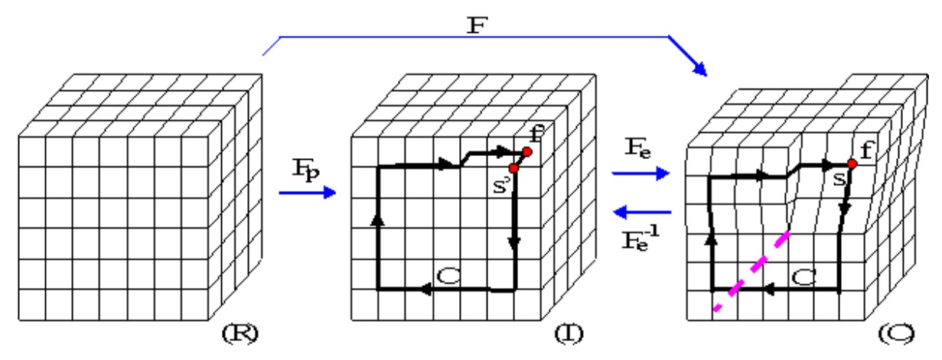
Lattice incompatibility
is a gradient tensor due to continuity of the deformed configuration ( ), but are not when dislocations are present (discontinuity of elastic/plastic displacement across a surface terminating at dislocation line).
Burgers vector : closure defect of a circuit in the presence of lattice incompatibility.
LEM3, 4 octobre 2012

Slide 7
Nye’s dislocation density tensor
Stokes theorem applied to the Burgers circuit C
Nye’s dislocation density tensor
Small distortion approximation
C
S
Nye, Acta Met. 1953
C
LEM3, 4 octobre 2012

Slide 8
Coarse graining
Loop at small resolution length scale
Averaging at a larger scale
Homogenized plastic distortion rate
The contribution to plastic distortion rate is due to statistical dislocations
Statistical dislocations contribute to the plastic distortion rate but not to lattice incompatibility/long range stresses
Scale dependence of Nye’s dislocation density tensor
LEM3, 4 octobre 2012

Slide 9
Dislocation/disclination densities
from elastic curvature
Nye’s dislocation density tensor
Lattice incompatibility
Aerial measure of incompatibility
Coarse graining
Dislocation/disclination densities from elastic curvature
Rotational compatibility: standard dislocation treatment
Rotational incompatibility: disclination density
Dislocation density measurement from EBSD orientation mapping
Measurement from a single planar map
Measurement from 3D data
Tantalum benchmark
Conclusions
LEM3, 4 octobre 2012
9

Slide 10
Integrability vs.nonintegrability
of elastic curvature
Standard treatment: rotational compatibility (Field Dislocation Mechanics)
Nye’s curvature tensor :
If is neglected
Rotational incompatibility: Field Dislocation and Disclination Mechanics
Kröner, Erg.Ang.Math. 1958
deWit, Nat. Bur. Stand. 1970
Fressengeas et al, IJSS 2011
LEM3, 4 octobre 2012

Slide 11
Dislocation/disclination density measurement from EBSD orientation maps
Nye’s dislocation density tensor
Lattice incompatibility
Aerial measure of incompatibility
Coarse graining
Dislocation/disclination densities from elastic curvature
Rotational compatibility: standard treatment
Rotational incompatibility: disclination density
Dislocation density measurement from EBSD orientation maps
Measurement from a single planar map
Measurement from 3D data
Tantalum benchmark
Conclusions
LEM3, 4 octobre 2012
11
11

Slide 12
Dislocation/disclination density measurement from EBSD orientation maps
Elastic curvature tensor from disorientation matrix
Two-dimensional orientation map, elastic strain overlooked
2
Pantleon, Scripta Mater. 2008
3
.
.
.
.
.
.
.
.
.
Beausir & Fressengeas, IJSS 2013
1
LEM3, 4 octobre 2012

Slide 13
Dislocation/disclination density measurement from EBSD orientation maps
Elastic curvature tensor from disorientation matrix
Two-dimensional orientation and elastic strain maps
2
Pantleon, Scripta Mater. 2008
3
.
.
.
.
.
.
.
.
.
Beausir & Fressengeas, IJSS 2013
1
LEM3, 4 octobre 2012
13

Slide 14
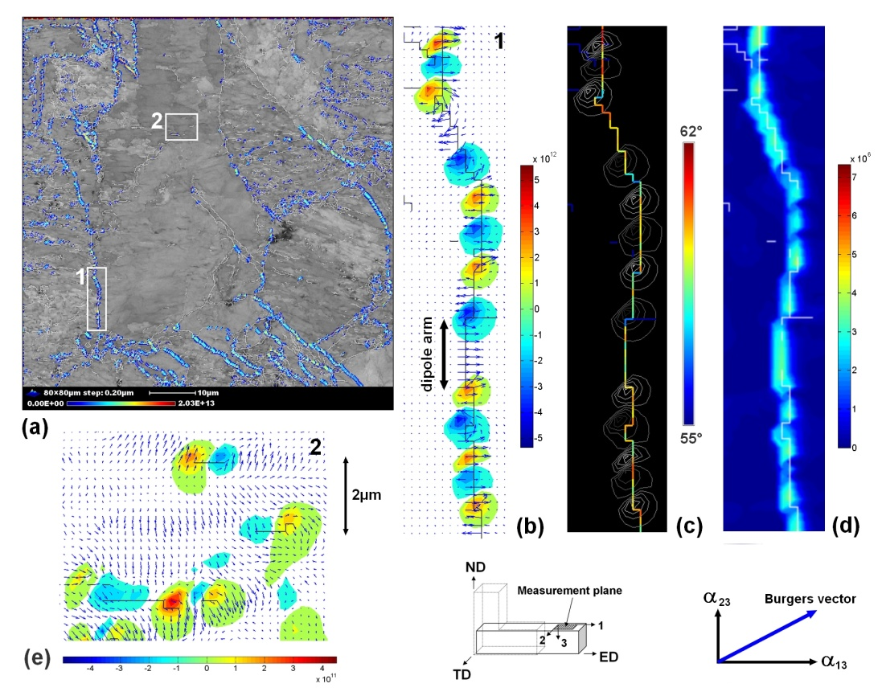
Dislocation/disclination density measurement from EBSD orientation maps
Pure copper ECAPed one pass, shear strain γ=2
Beausir & Fressengeas, IJSS 2013
LEM3, 4 octobre 2012

Slide 15
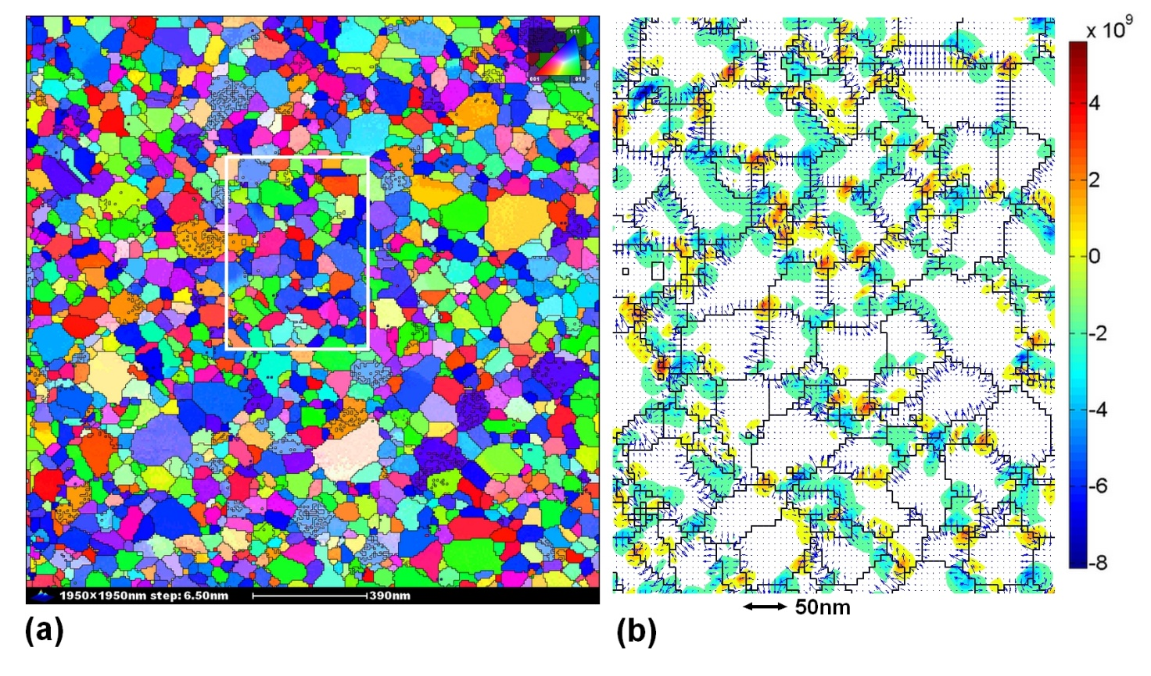
Dislocation/disclination density measurement from EBSD orientation maps
As deposited Al thin film
Beausir & Fressengeas, IJSS 2013
LEM3, 4 octobre 2012

Slide 16
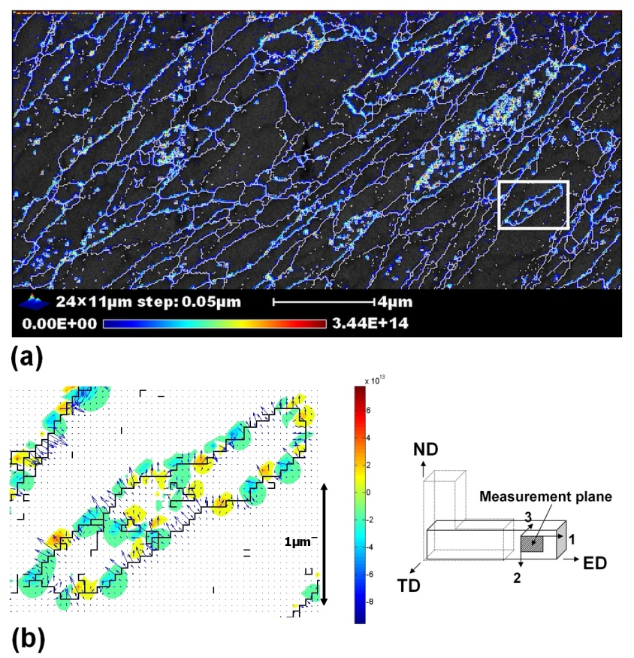
Dislocation/disclination density measurement from EBSD orientation maps
IF-steel ECAPed γ=6
Beausir & Fressengeas, IJSS 2013
LEM3, 4 octobre 2012

Slide 17
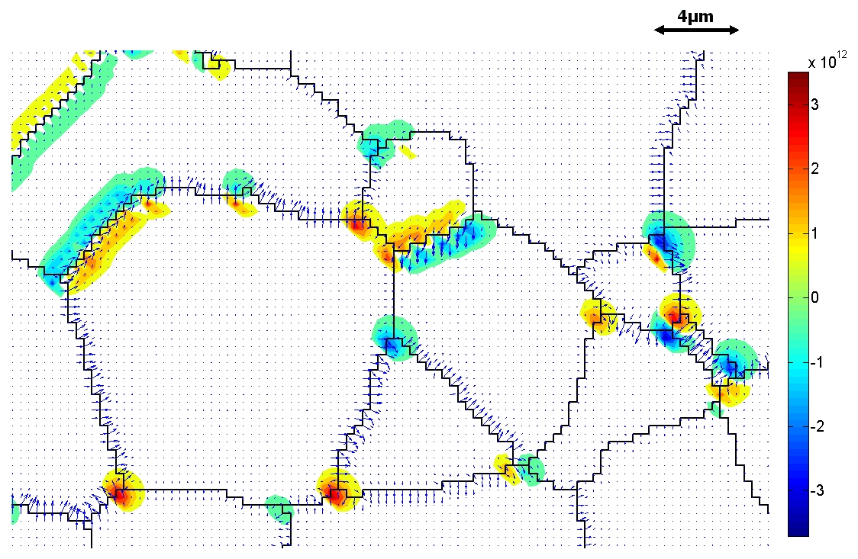
Dislocation/disclination density measurement from EBSD orientation maps
Recrystallized Titanium, 1% strain
Beausir & Fressengeas, IJSS 2013
LEM3, 4 octobre 2012

Slide 18
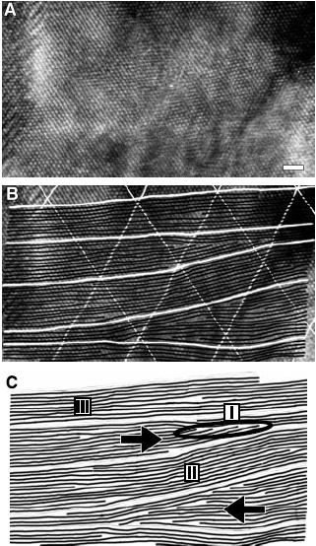
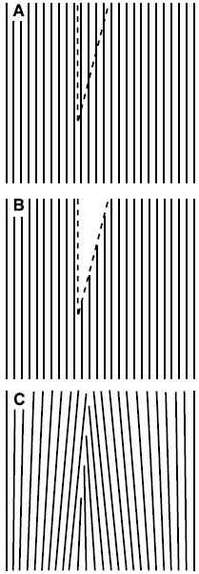
Disclination dipole from HRTEM
Murayama et al, Science 2002
LEM3, 4 octobre 2012

Slide 19
Conclusions
Nye’s dislocation density tensor
Lattice incompatibility
Aerial measure of incompatibility
Coarse graining
Dislocation/disclination densities from elastic curvature
Rotational compatibility: standard treatment
Rotational incompatibility: disclination density
Dislocation density measurement from EBSD orientation maps
Measurement from a single planar map
Measurement from 3D data
Tantalum benchmark
Conclusions
LEM3, 4 octobre 2012

Slide 20
Error estimates
Curvatures, dislocations
Error on disorientation: 0.5°, minimum GB disorientation: 5°
Error on spatial location: 1nm, minimum step size: 38nm
Disclinations
Nevertheless, fairly good spatial distribution….
LEM3, 4 octobre 2012

